Slide 1
Lecture 13
Cellular IoT & LPWAN Intro
CS397/497 – Wireless Protocols for IoT
Branden Ghena – Winter 2023
Materials in collaboration with Pat Pannuto (UCSD)

Slide 2
Today’s Goals
Understand how modern “Cellular for IoT” fit in to the existing cellular infrastructure, and what they do at a technical level to suit IoT needs
Apply knowledge from the course to understand LPWAN design
Overview of unlicensed-band LPWANs
  LoRaWAN

Slide 3
Outline
Cellular IoT
LPWAN Design
LoRaWAN

Slide 4
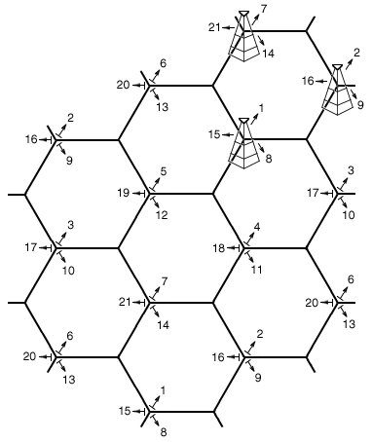
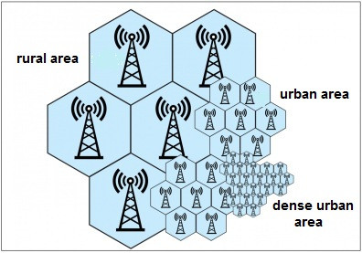
Reminder: the cell in cellular technologies
Place towers at corners of cells
  Directional antennas send three different frequency bands, one per cell
  Each cell gets three tower and three bands
Density of cells varies based on expected number of users
  Change cell size using Power Control

Slide 5
3GPP (aka: the actual answer for what stuff is really doing)
3rd Generation Partnership Project (3GPP)
Industry alliance for development of telecoms standards
  Established around 1998
  Makes “Releases” which are roughly analogous to IEEE standards/versions
    Release 8 (2008) LTE ~4G
    Release 15 (2018) NR (New Radio) ~5G
Focused on the practical
  ITU post-hoc defined “4G”, 3GPP defined LTE

Slide 6
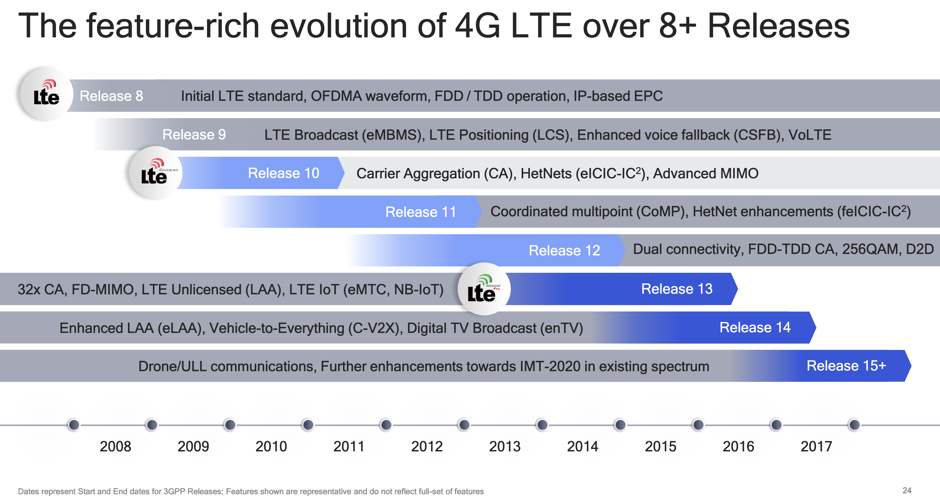
Mapping ”4G”, “LTE”, “LTE Advanced”, etc onto actual technologies
This Qualcomm presentation is great: https://www.qualcomm.com/media/documents/files/demystifying-3gpp-and-the-essential-role-of-qualcomm-in-leading-the-expansion-of-the-mobile-ecosystem.pdf

Slide 7
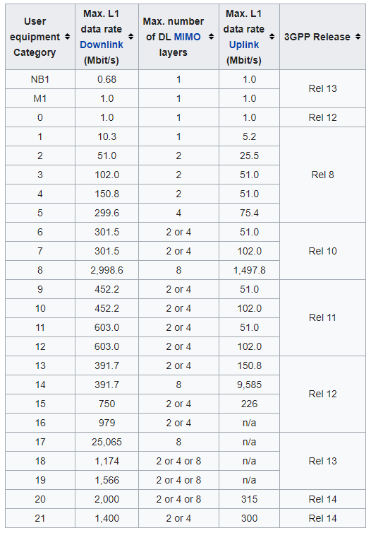
LTE Categories
Different equipment supports different “categories” of LTE
  Maximum MCS index supported
Examples
  iPhone 6 (2015): Cat 4
  Pixel 3 (2018): Cat 16
Notes:
MCS = Modulation Coding Scheme
https://mcsindex.com/ looks like all the tables for WiFi; not clear whether this is the same for cell

Slide 8
Additional low-end categories for IoT
LTE Cat 0
  Traditional LTE, but focused on the really low end
LTE-M (LTE Cat M1)
  375 kbps uplink, 300 kbps downlink (for the actually implemented mode)
  Reduced power and maximum bandwidth
  Increased range
NB-IoT (LTE Cat NB1)
  65 kbps uplink, 26 kbps downlink
  Reduced power and greatly reduced bandwidth
  Greatly increased range

Slide 9
Why do we need “special categories” for IoT on cell?
Pragmatic for the end device
  Lower power
  Allow for long-off periods
Pragmatic for network operators
  Allows for scale– network no longer needs to assume that devices could always be on in each cell

Slide 10
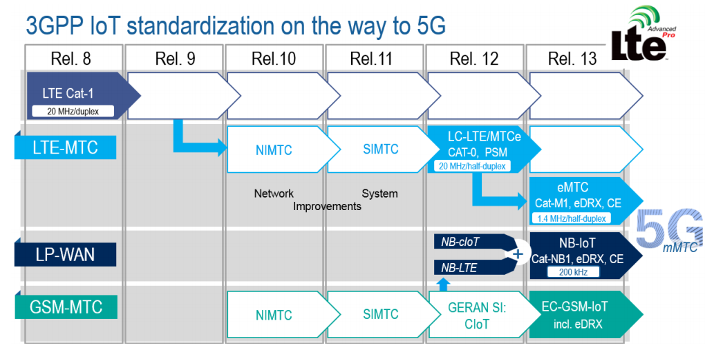
LTE-M and NB-IoT were developed in parallel

Slide 11
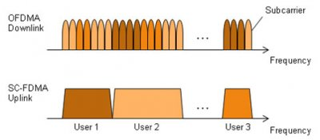
LTE-M and NB-IoT downlink and uplink
OFDMA downlink
  Put the more complicated hardware in the cell tower [simple FFT demodulator]
SC-FDMA (single carrier FDMA) uplink
  Blocks of subchannels combined into one signal
  Similar concept, but simpler for end devices to implement

Slide 12
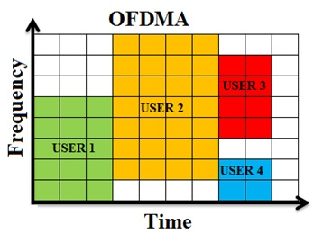
LTE resource allocation
Cellular uses OFDMA to schedule
  Time + Frequency -> “2D Scheduling”
Cellular uses single channels up to 20 MHz
  Further divides these into 100 Resource Blocks
Resource Block
  12 subcarriers for OFDM in frequency (15 kHz each)
  7 symbols in time (0.5 ms)
Devices are allocated frequency and time based on what they are sending
  Allocated in units of Resource Blocks
One “Resource Block”

Slide 13
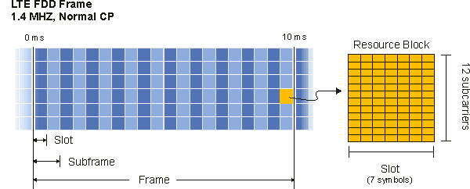
Resources used by LTE-M and NB-IoT
LTE-M uses up to 6 resource blocks
  1.4 MHz of bandwidth (1.080 MHz)
  Can co-exist with other normal LTE traffic, scheduled by cell tower
  Limited to only some capability of LTE (much less throughput)

Slide 14
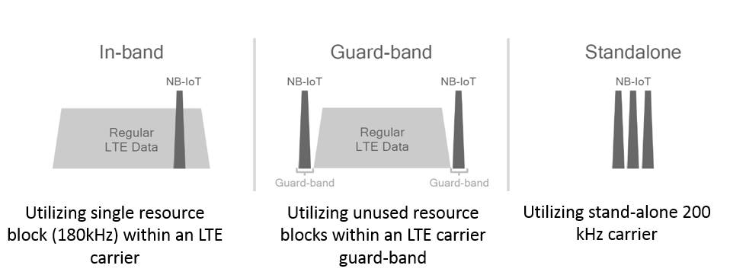
Resources used by LTE-M and NB-IoT
NB-IoT uses up to 1 resource block
  200 kHz of bandwidth (180 kHz)
  Multiple deployment options
    Guard-band in practice

Slide 15
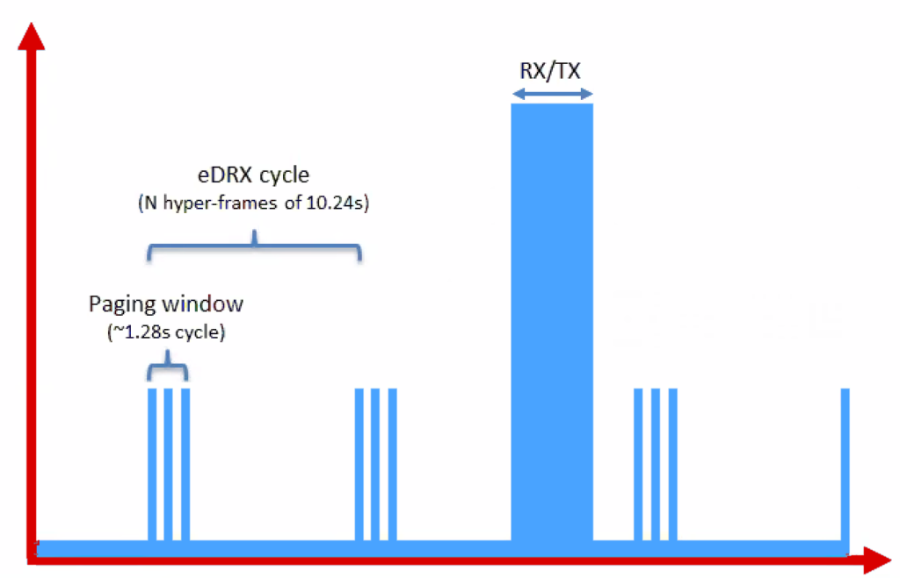
Reducing power for IoT devices
Reduce max Tx power to 20 dBm
  Increased receive sensitivity at tower will cover it
Extended Discontinuous Reception (eDRX)
  Allow devices to reduce paging period and still stay on network
  Cell tower will hold messages
What does this get to?
  “For a LTE-M1 device that transmits data once per day, and wakes up every 60 hyper frames to check for commands (this would be about every 10 minutes), a life of 4.7 years is achievable on 2 AA batteries.”
Graphics, quote from https://www.link-labs.com/blog/lte-e-drx-psm-explained-for-lte-m1

Slide 16
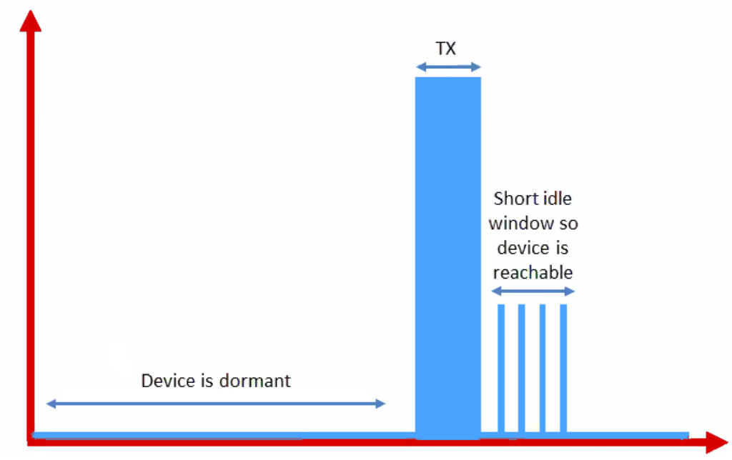
Further power reduction for simple devices
Power Saving Mode (PSM)
  For very simple, uplink-focused devices, allow them to turn off entirely but stay connected
  Minutes to days in duration
  Notify tower before sleeping, listen for packets after each transmission
Graphics from https://www.link-labs.com/blog/lte-e-drx-psm-explained-for-lte-m1

Slide 17
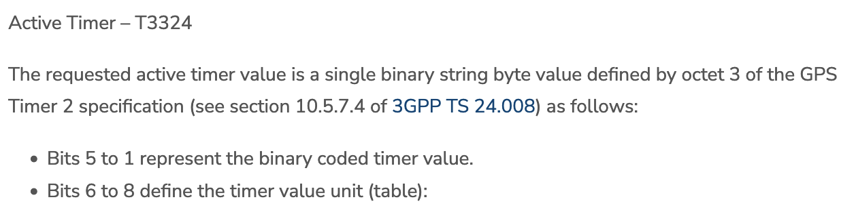
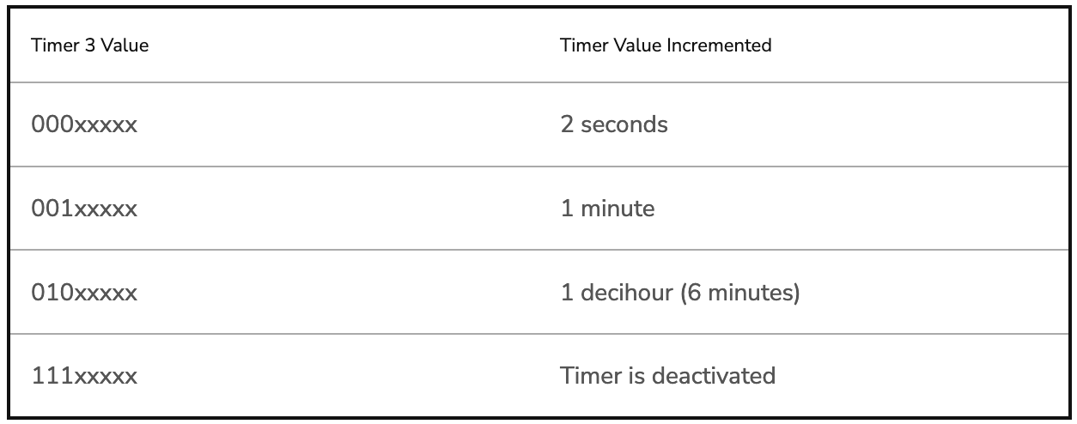
Some numbers from an actual telecom: Aeris
[n.b. Aeris has been a leader in cellular M2M since the 90’s]
PSM has two timers, devices request values, tower chooses actual:
  Extended Timer (“sleep” timer)
    3GPP max is 35,712,00s [413.33 days]
    Aeris timer range: Min 240m [4h]; Max 413 days
    “Aeris Fusion” timer range: Max: 12.9 days
  Active Timer (how long will the device stay in idle after communication?)
Numbers from https://aeriscom.zendesk.com/hc/en-us/articles/360049848254-Understanding-LTE-M-Power-Management-Modes
Notes:
Really hard to tell difference between Aeris and Aeris Fusion. I think Aeris Fusion is a new product that allows devices (same SIM?) to dynamically switch between an IoT profile and a full-fledge voice / high-bw data profile. My guess then is that Aeris network is all their own owned infra, and Fusion is them acting as an MVNO [thus limited to others for wakeup range]

Slide 18
Improved range for LTE-M and NB-IoT
LTE defines a Maximum Coupling Loss (MCL) a.k.a Link Budget
  Traditional cellular: 144 dB (~2.5 km)
  LTE-M: 160 dB (~5 km)
  NB-IoT: 164 dB (~10 km)
  Sigfox: ~155 dB
  LoRaWAN: ~143 dB
Note that many cellular bands are often on higher frequencies
  Example: 1900 GHz
  Coarsely, lower frequency is longer range, but it’s complicated

Slide 19
Coarsely, lower frequency -> longer range
This was the picture circa 2019
Why else might T-Mobile have really wanted to buy Sprint…

Slide 20
Cellular deployments
Originally unclear which would be dominant
  Verizon and AT&T focused on LTE-M
  T-Mobile focused on NB-IoT
  All rolled out services nationwide in the 2018-2019 timeframe
Networks expanded provide both capabilities
  LTE-M: AT&T, T-Mobile, Verizon, US Cellular
  NB-IoT: AT&T, T-Mobile, Verizon
Pricing models still very uncertain
  NB-IoT example: $5 per device per year up to 12 MB, 10 packets per hour
  Future adoption will greatly depend on these

Slide 21
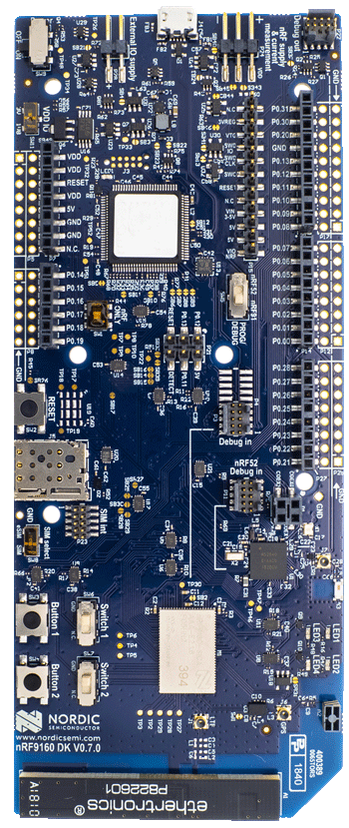
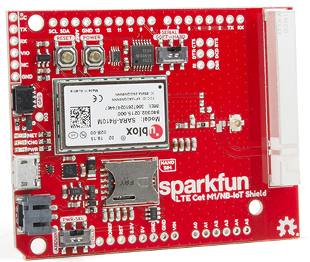
Microcontroller support
Devices need to be certified
  Hardware and software
  Tend to be modules or dual-core systems
Add a SIM card to connect to network

Slide 22
Break + Open Question
Cellular hardware almost always requires certified radio modules where you can’t change the code at all. Why?

Slide 23
Break + Open Question
Cellular hardware almost always requires certified radio modules where you can’t change the code at all. Why?
  Otherwise you could cheat at the protocols!!
  Or just generally not follow them fairly.
  Avoids “tragedy of the commons” by allowing specific trusted devices only

Slide 24
Outline
Cellular IoT
LPWAN Design
LoRaWAN

Slide 25
LTE-M and NB-IoT design constrained by fitting within existing cellular ecosystem
What might a fresh design look like?
Caveat: In ISM bands!
  So it’s an unlicensed, shared communication band

Slide 26
Design a wide-area network (ignore low-power for now)
What PHY choices would you make?

Slide 27
Design a wide-area network (ignore low-power for now)
What PHY choices would you make?
  Modulation
  Tx Power
  Carrier Frequency Band
  Data Throughput
  Channel Bandwidth

Slide 28
Design a wide-area network (ignore low-power for now)
What PHY choices would you make?
  Modulation
    Unclear. Can’t be too crazy for cheap devices.
  Tx Power
    High (much higher than 0 dBm)
  Carrier Frequency Band
    Low (something lower than 2.4 GHz, 915 MHz or lower?)
  Data Throughput
    Low (much lower than 1 Mbps)
  Channel Bandwidth
    Unclear. Likely smaller for lower frequency carrier.

Slide 29
Design a low-power wide-area network
Any particular MAC choices for lower power?

Slide 30
Design a low-power wide-area network
Any particular MAC choices for lower power?
  Diversity of devices in network
    High power gateway, low power devices in star topology
  Devices should be off whenever possible
    Listen-after send for downlink
  Remove requirements for synchronization
    No TDMA access control if it can be avoided
    Aloha, CSMA

Slide 31
Long-range CSMA is problematic
Long-range makes everything more challenging
  Kilometers of range mean kilometers between devices
Detection of channel use is less reliable
  Active research in clear channel assessment for LPWANs
Hidden terminal problem has a wider range
  Might make RTS/CTS more important
Result: CSMA doesn’t dominate LPWANs like it does WLANs

Slide 32
LPWANs overview (common qualities)
Unlicensed 915 MHz band (902-928 MHz)
Higher power transmissions: ~20 dBm (100 mW)
Low data rate 100 kbps or less
Range on the order of multiple kilometers
Simple Aloha access control

Slide 33
Outline
Cellular IoT
LPWAN Design
LoRaWAN

Slide 34
LoRaWAN
Open communication standard built with proprietary LoRa PHY
Low rate (1-20 kbps) and long range (~5 km)
  Shorter range than Sigfox but much higher bit rate
Most popular LPWAN protocol
  Target of academic research
  Industry involvement in hardware and deployments

Slide 35
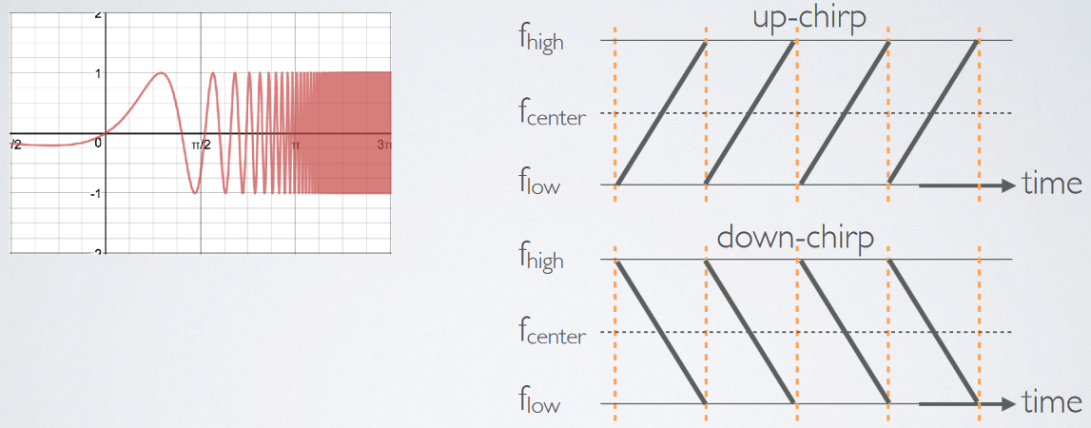
LoRa PHY uses a different modulation
Chirp Spread Spectrum (CSS)
  Modulation technique where frequency is varied linearly from lowest to highest within a channel

Slide 36
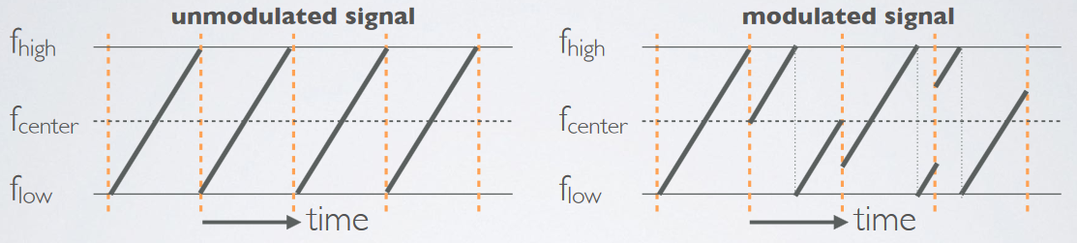
Chirp Spread Spectrum
Data is modulated in the starting and ending points of chirp
  Frequency increases linearly, modulo bounds of the channel

Slide 37
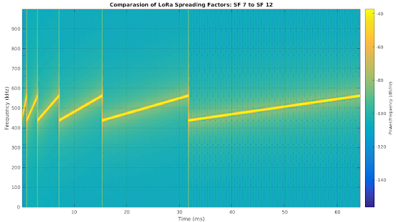
CSS has a Spreading Factor which determines bit rate
Spreading Factor is essentially the rate-of-change of frequency
  Slope of the line
  Lower values of spreading factor (steeper slope) are faster data rate
Important: different spreading factors are (mostly) orthogonal!
  Two can overlap in time, space, and channel without a collision

Slide 38
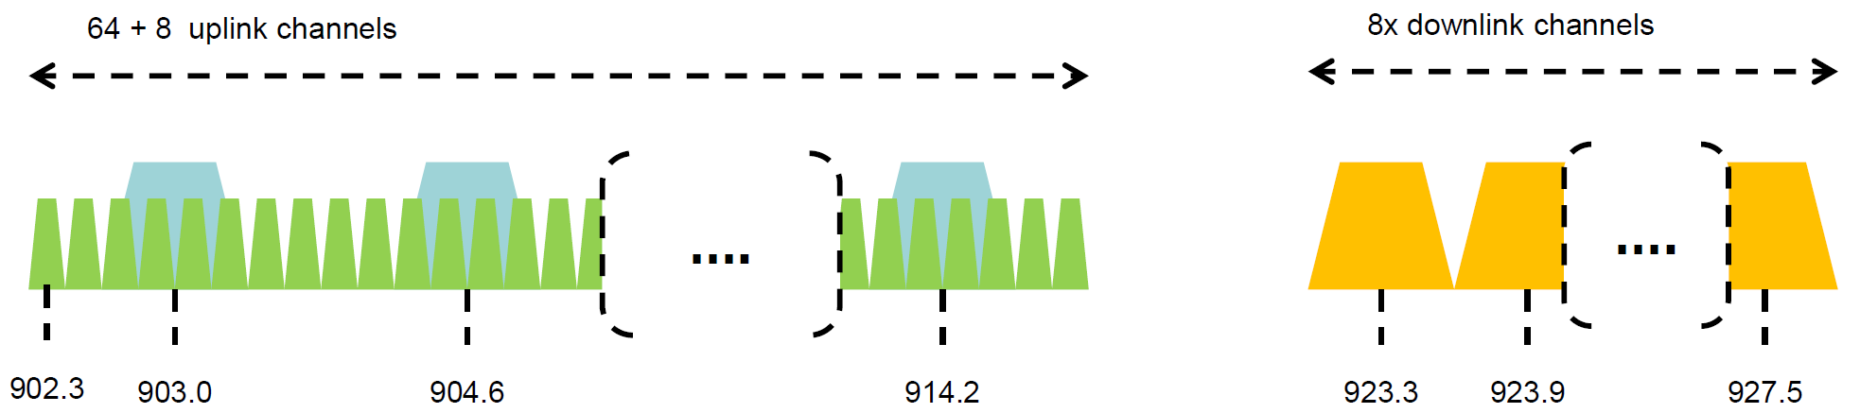
LoRaWAN channels
Sixty-four, 125 kHz uplink channels
  Frequency Hopping over the 64 uplink channels
  Plus eight, 500 kHz overlapping uplink channels (not well used in practice)
Eight, 500 kHz downlink channels

Slide 39
LoRaWAN gateways
No synchronization with end devices
Instead listen to entire bandwidth simultaneously
  Only 12 MHz total
  Recognize preambles and allocate a hardware to decode packet
    Normal gateways: 8 decoders
    Good gateways: 64 decoders

Slide 40
LoRaWAN data rates
Data Rate Index | Spreading Factor | Bit Rate
125 kHz Uplink Rates
0 | SF10, 125 kHz | 980 bps
1 | SF9, 125 kHz | 1760 bps
2 | SF8, 125 kHz | 3125 bps
3 | SF7, 125 kHz | 5470 bps
500 kHz Uplink Rates
4 | SF8, 500 kHz | 12500 bps
500 kHz Downlink Rates
8 | SF12, 500 kHz | 980 bps
9 | SF11, 500 kHz | 1760 bps
10 | SF10, 500 kHz | 3900 bps
11 | SF9, 500 kHz | 7000 bps
12 | SF8, 500 kHz | 12500 bps
13 | SF7, 500 kHz | 21900 bps
Data rate options depend on channel in use
  Unbalanced uplink and downlink
64-channel uplink
  1-5 kbps data rate
Allowable rates based on dwell time restriction
(400 ms)

Slide 41
LoRaWAN link budget
Typical TX power 20 dBm
  Up to 30 dBm for 64-channel hopping
  Up to 26 dBm for 8-channel hopping
Receive sensitivity -119 dBm
  Compare to -100 dBm for 802.15.4 and -95 dBm for BLE
Resulting range is about a kilometer in urban environments

Slide 42
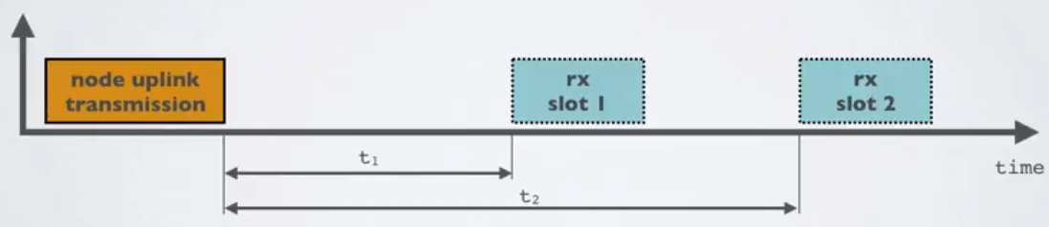
LoRaWAN MAC
Uplink: Aloha - transmit whenever
  Randomly split across 64 uplink channels (reduced odds of collision)
  Devices a different spreading factors also do not collide
  Packets are very long though: up to 400 ms in duration
Downlink: listen-after-send (class A device)
  Two windows for RX on different channels

Slide 43
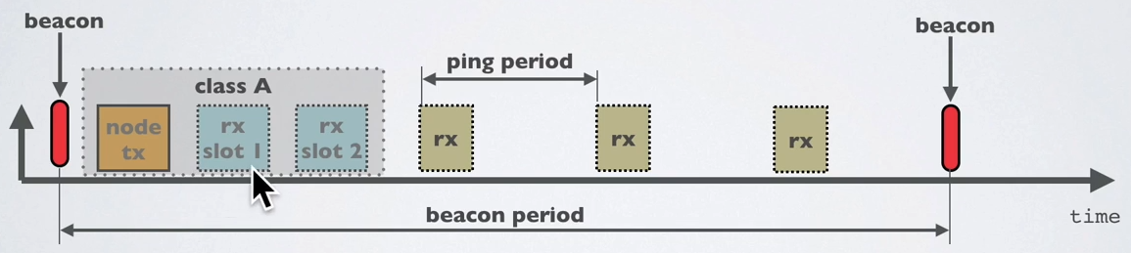
Optional downlink mechanisms
Periodic listening (class B device)
  Synchronized with periodic beacons
    TX still unsynchronized Aloha
  Mostly unused
Continuous listening (class C device)
  Always-on receivers

Slide 44
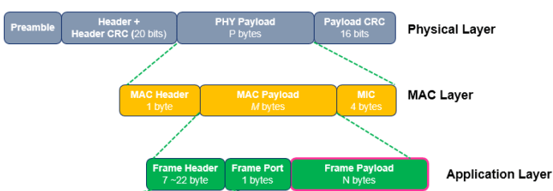
LoRaWAN packet format
Frame header includes device address
MAC Payload maximum size depends on data rate
  Again based on dwell time in the US
Data Rate Index | MAC Payload Size
0 | 19 bytes
1 | 61 bytes
2 | 133 bytes
3 | 250 bytes
4 | 250 bytes

Slide 45
LoRaWAN network details

Slide 46
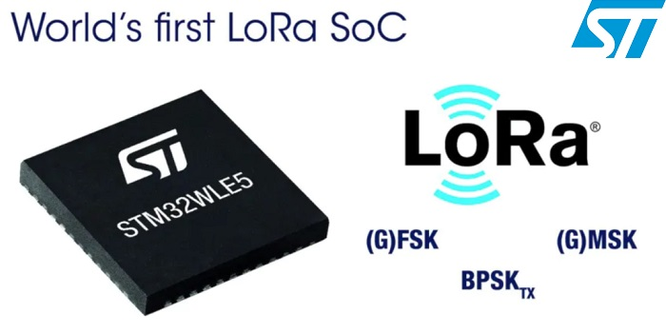
LoRaWAN hardware
Numerous hardware modules and development kits
  Almost all use Semtech radio chips (Semtech owns LoRa PHY)
Recent addition: STM32WLE5 LoRa SoC
  Cortex-M4 + LoRa radio (analogous to nRF52840)

Slide 47
LoRaWAN network providers
Somewhat-managed network providers
  The Things Network (predominantly in Europe)
    But available in the US too!
  Helium
    Any can buy and install their own gateway, which serves everyone
    Microtransactions to pay for communication

Slide 48
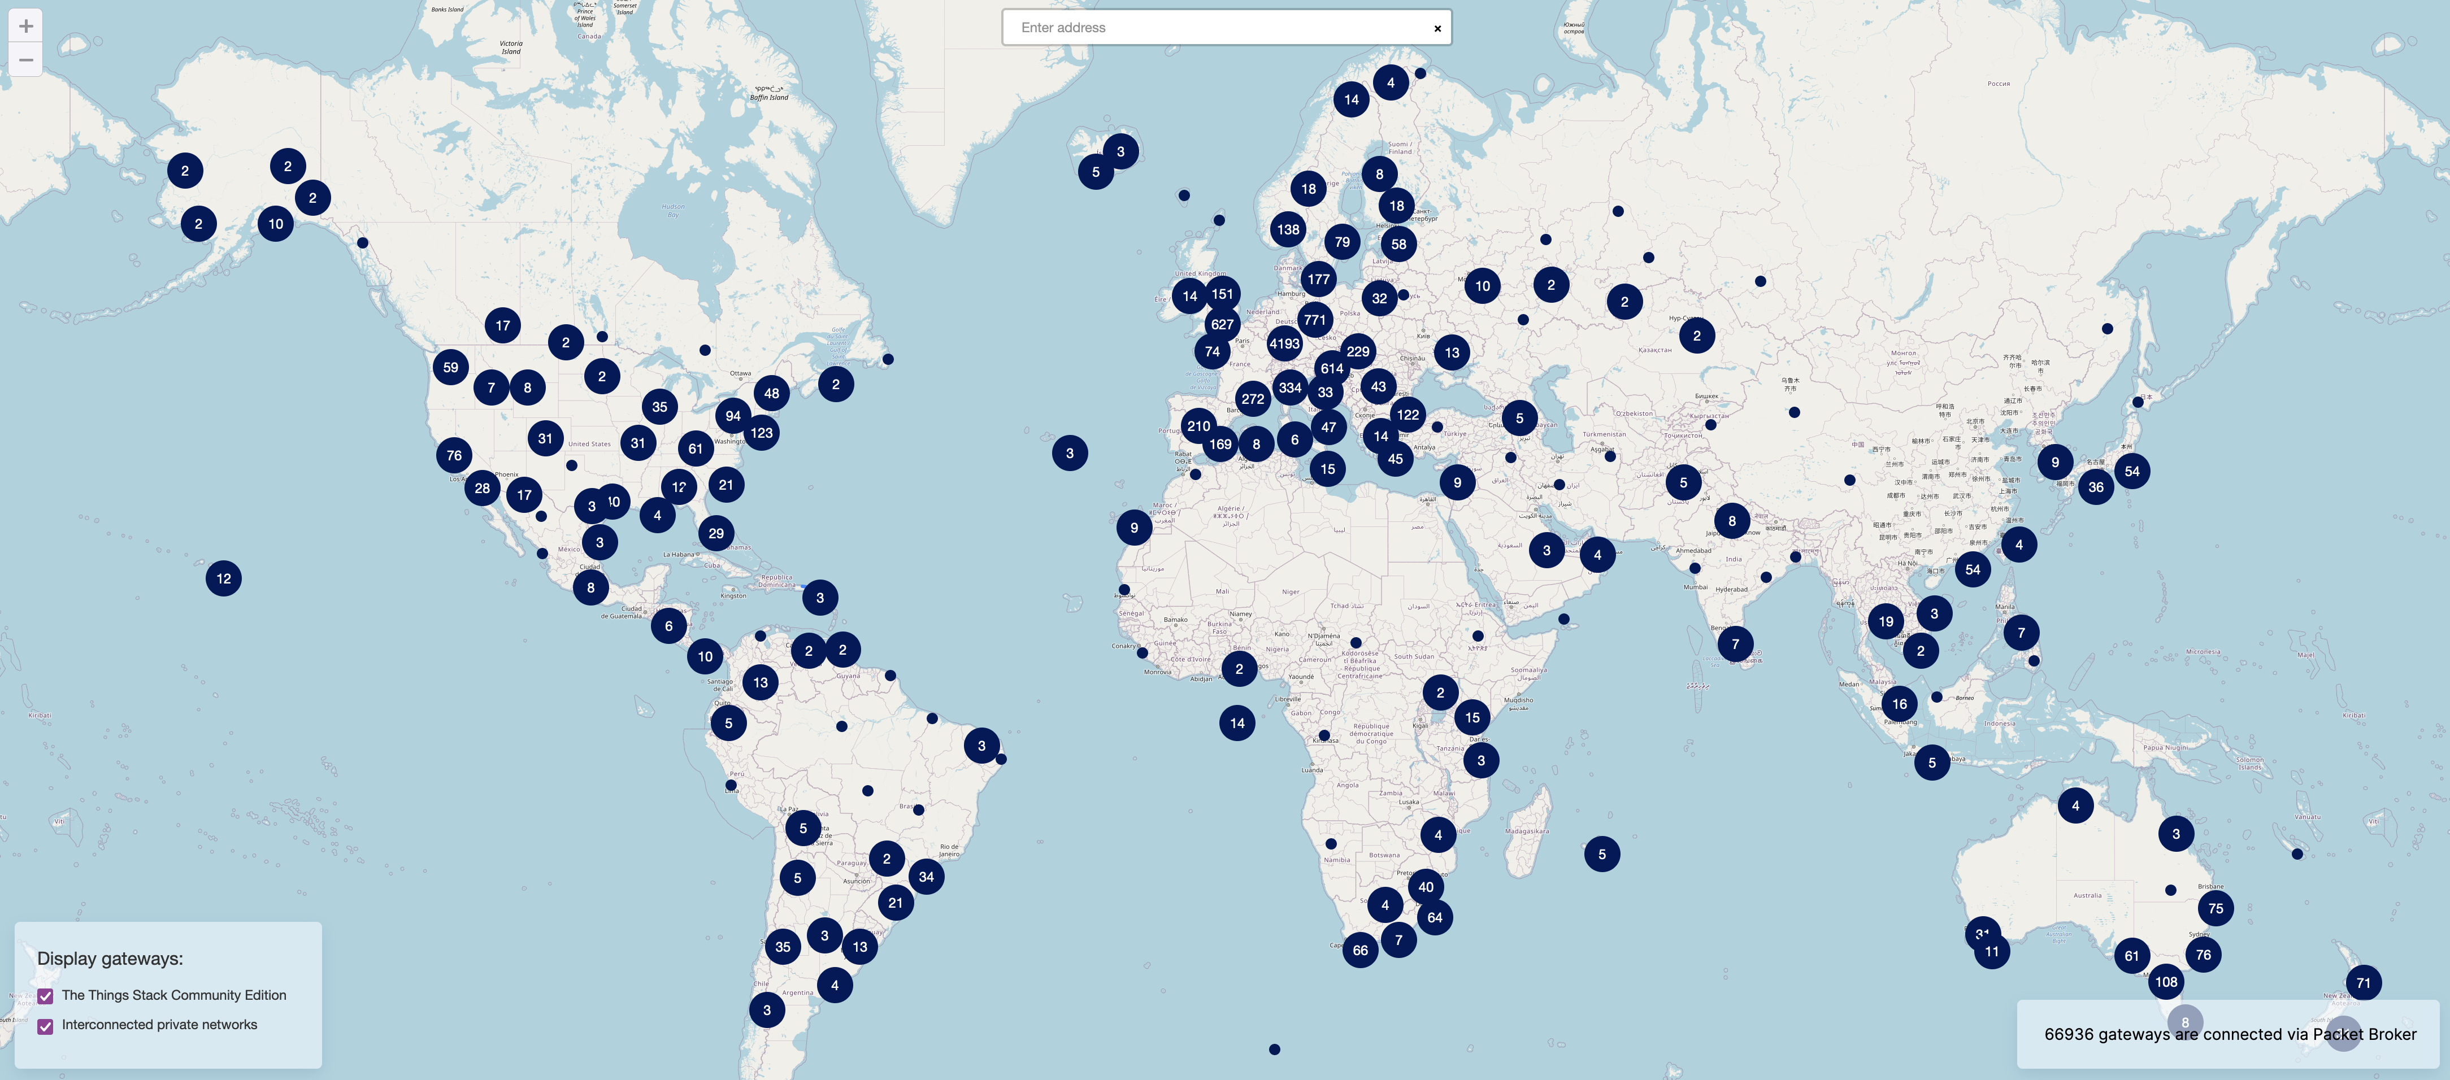
TTN Scale [Jan 2022]

Slide 49
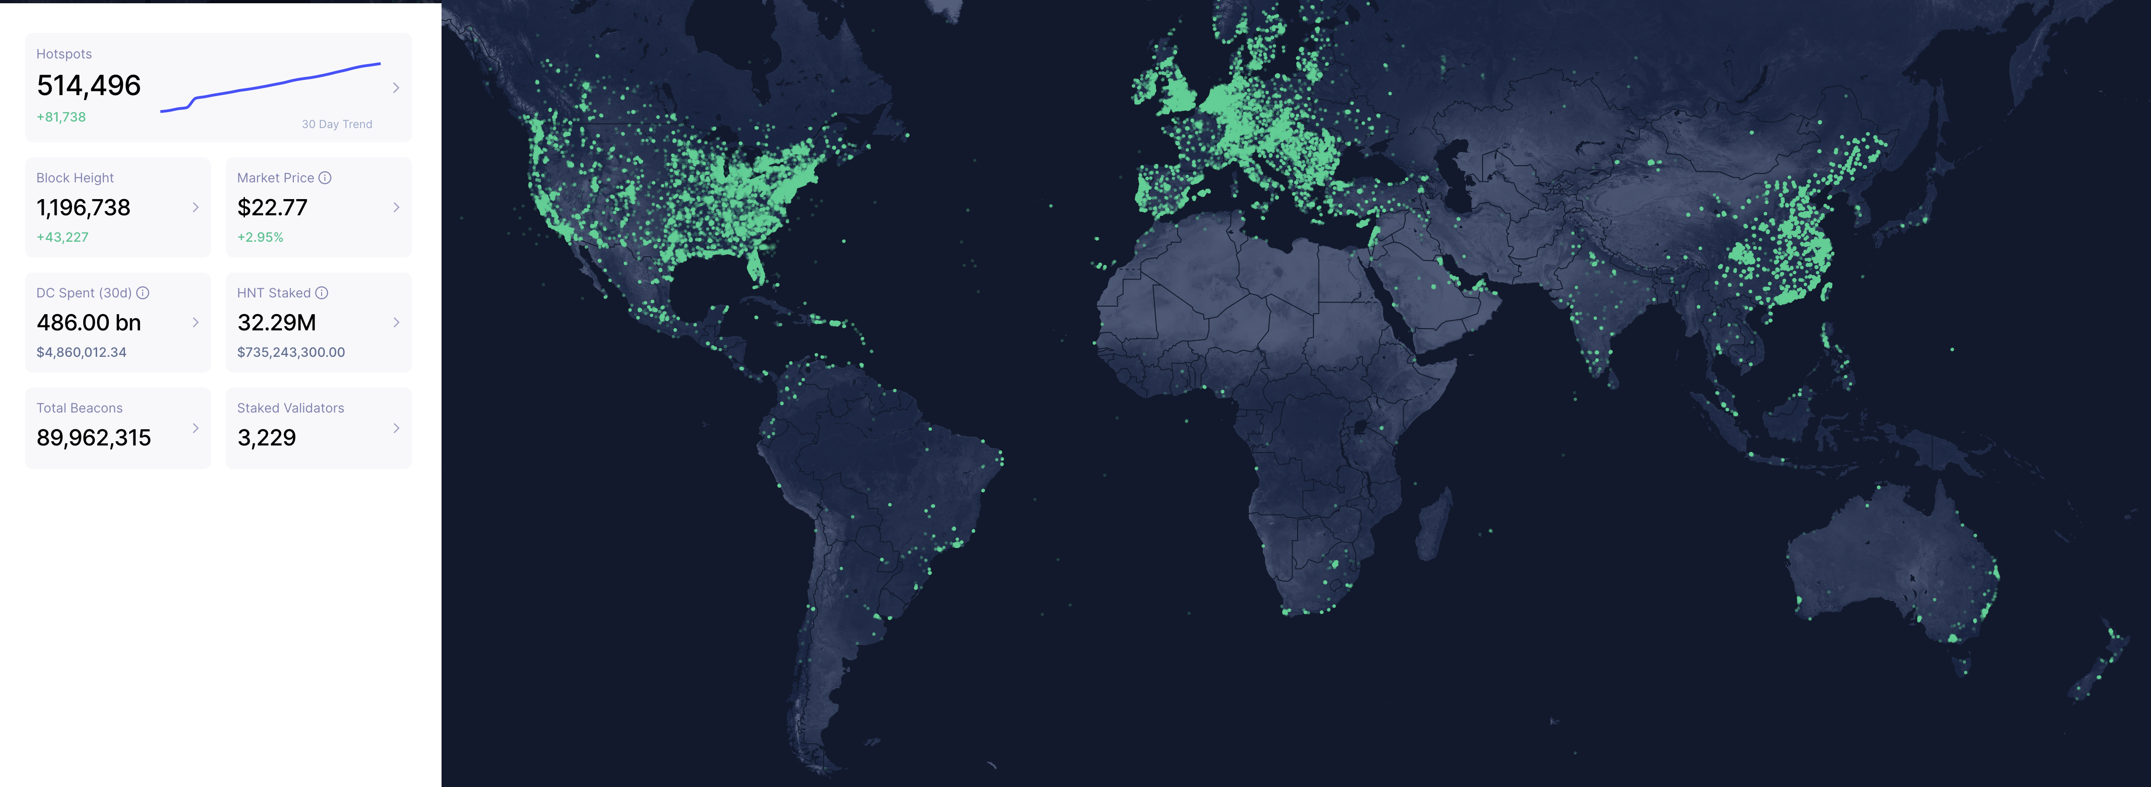
Helium Scale [Jan 2022]
May 2022: 800,000 hotspots, with +80K in last 30 days

Slide 50
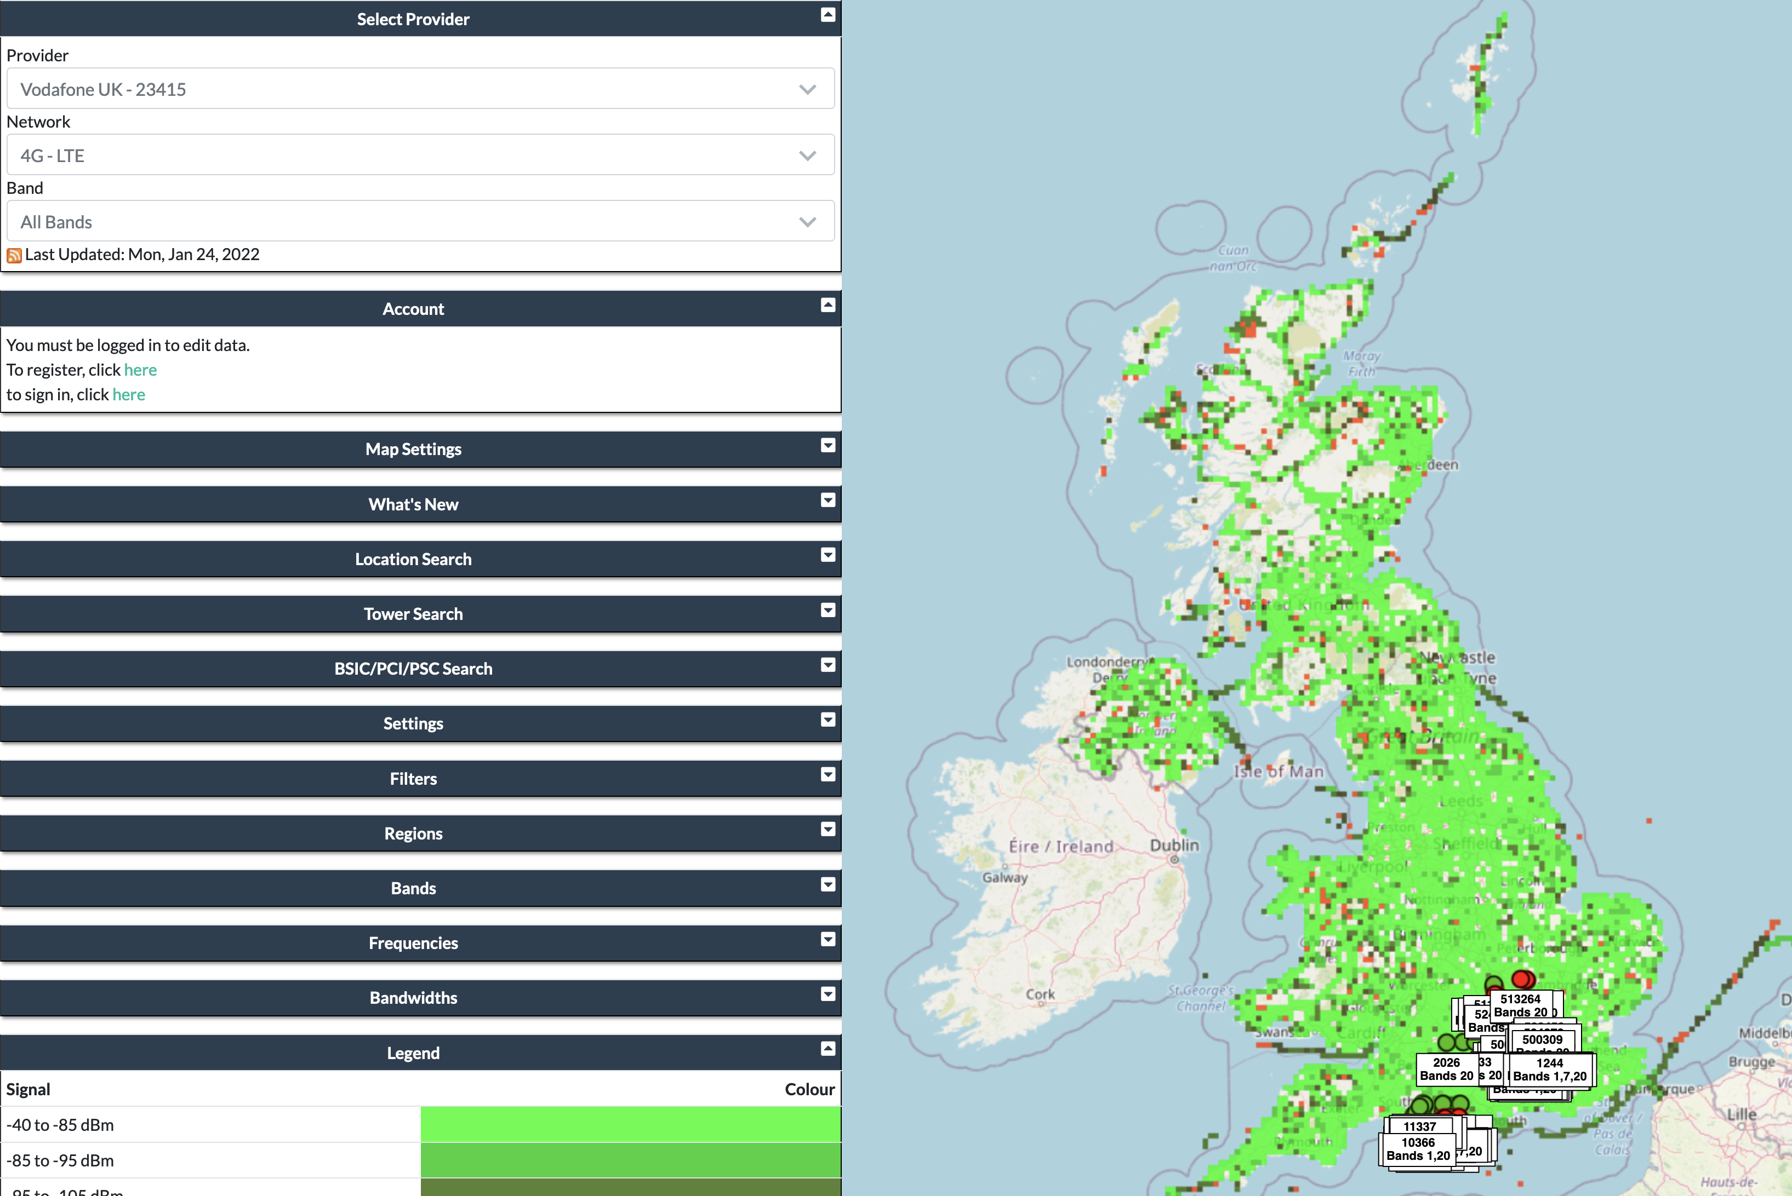
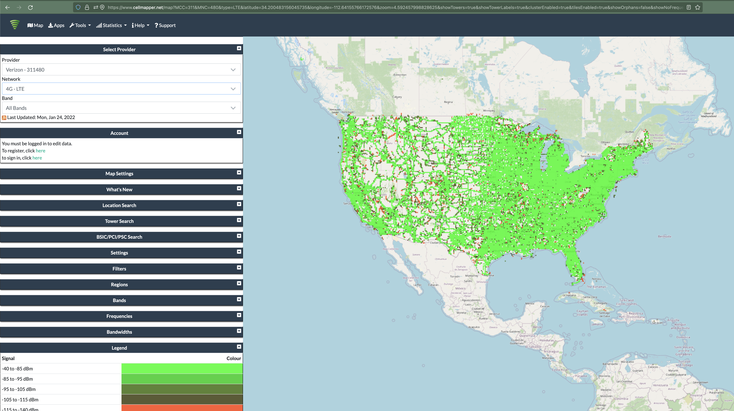
Quick reality check: Verizon?
And this is just crowd-sourced data…

Slide 51
LoRaWAN interested parties
MachineQ is a subsidiary of Comcast providing LoRaWAN networks
Long-term goal
  Indoor-to-outdoor LoRaWAN gateways combined with WiFi/Cellular
  Tune down power for 100-200 meter range
Current focus: IoT Platform-as-a-service
  Devices, network, analytics

Slide 52
Outline
Cellular IoT
LPWAN Design
LoRaWAN

