Slide 1
Lecture 11
WiFi MAC
CS397/497 – Wireless Protocols for IoT
Branden Ghena – Spring 2023
Materials in collaboration with Pat Pannuto (UCSD)

Slide 2
Administriva
Thread lab due on Friday
Matter homework finally posted
  Due next week Wednesday
WiFi homework coming out this weekend
  Let’s pretend it comes out on Friday
  I’ve got hardware today to give you after class

Slide 3
Today’s Goals
Introduce MAC layer concepts in 802.11
Understand what exists, what is actually used, and why
Explore two additional areas in 802.11
  Microcontroller use of WiFi
  Future of WiFi

Slide 4
Outline
802.11 Access Control
802.11 Frame format
802.11e Improvements to MAC
Microcontrollers and WiFi

Slide 5
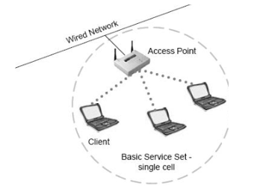
Basic WiFi network
Star topology network
Basic Service Set (BSS)
  Access point(s)
  Multiple connected clients
Service Set ID (SSID)
  Identifies network
  Broadcast by access point in beacons

Slide 6
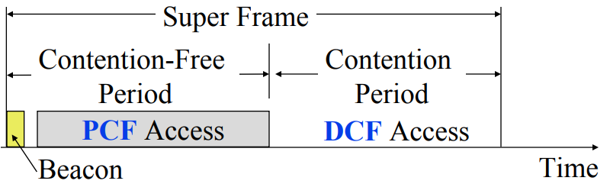
WiFi superframe structure
Beacon followed by contention-free period followed by contention
  Repeats periodically (default ~100 ms)
  802.15.4 adopted a similar superframe
This is more hypothetical than real

Slide 7
WiFi superframe in practice
Continuous contention access period
  Any device may send at any time
  PCF is unused in practice
Periodic beacons
  Which also use CSMA and therefore may be delayed
Contention
Based Access
Delayed Beacon
Beacon
Time

Slide 8
802.11 beacons
Transmitted periodically (~100 ms by default)
  Enable discovery of network
    Contain capabilities and SSID for the network (802.11b/g/n/ac/ax…)
  Assign contention-free slots if used
  Notify devices of waiting packets
    Traffic Indication Map (TIM) has a bitmap specifying which devices data is for
    Enables devices to sleep, skipping a number of beacons
  Handles broadcast/multicast messages
    Every N beacons includes a notation of available broadcast messages
    Messages are transmitted during next contention access period using normal CSMA
    Defines maximum sleep period for devices (must listen to these beacons)

Slide 9
Contention-free access
Known as Point Coordination Function (PCF)
  Allocates a contention-free period for specific devices
  Access Point decides when to grant based on requests
Drawbacks
  Latency depends on beacon intervals
  Mechanism for explicit Quality of Service is unclear
PCF is not used in practice

Slide 10
Contention-based access
Known as Distributed Coordination Function (DCF)
  Base communication method for WiFi (essentially always)
  All packets are immediately ACK’d by receiving device
  Uses CSMA/CA to determine when it can send
    With random backoff
  Problem: packets can be very long (up to 20 milliseconds)
  Solution: Network Allocation Vector (NAV)
    Packets include a notation of their duration
    Sensing the beginning of a packet allows backoff to skip the whole packet duration before continuing

Slide 11
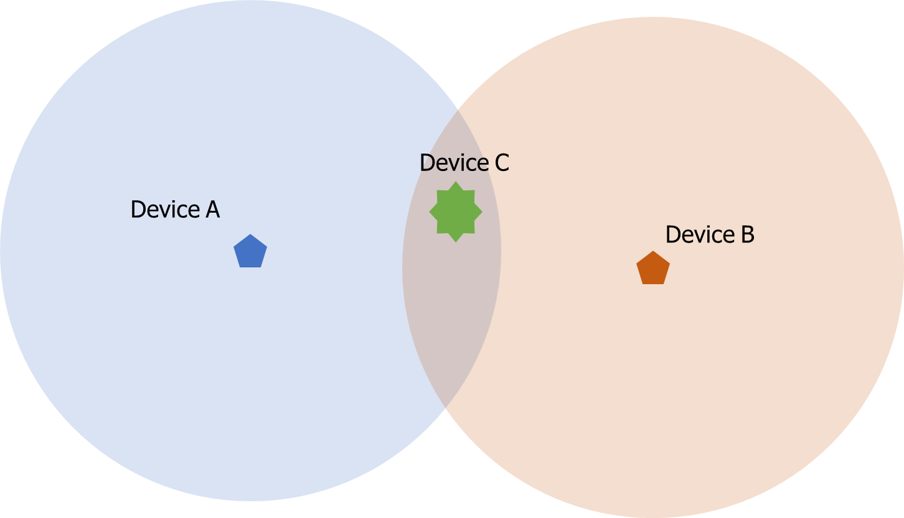
Reminder: hidden terminal problem
Two devices communicating with Access Point may not be able to hear each other
  CSMA fails and Access Point losses both messages
A solution: RTS/CTS (Request/Clear To Send)

Slide 12
Drawbacks of RTS/CTS
Four packets per data (RTS, CTS, Data, Ack)
  Could have just sent data instead of RTS
Significant portion of traffic are application-layer Acks
  Probably better to just have it fail and try again later
RTS/CTS only used for very large packets in practice
  *It’s mentioned still in 802.11n and 802.11ac, so not entirely unused

Slide 13
Backoff in WiFi
Listen for activity
  If free
    Wait for Inter Frame Spacing (IFS)
    If still free, transmit
  If busy
    Randomly select a number of backoff Slots
    Count down slots whenever medium is not busy
    If busy when backoff completes:
      Increase maximum backoff Slots
      Repeat
Slot time: basic time unit for protocol
  Total time of: switch from Rx to Tx, plus processing time, plus propagation delay

Slide 14
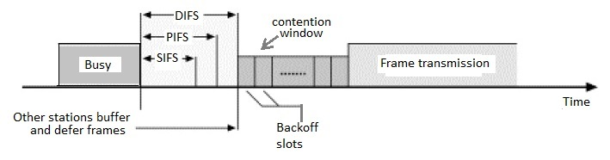
Prioritizing packets with varying IFS
Tiered Contention Multiple Access (TCMA)
  Idea: assign different inter-frame spacing based on traffic class
  Inherently prioritizes communication
Acknowledgements sent with Short IFS (SIFS)
  Will always transmit before new data clears CSMA check
New data sent with DCF IFS (DIFS)

Slide 15
Putting backoff together
Two variables
  Contention Window (CW) – maximum backoff amount
  Backoff Count (BO) – current remaining backoff
When attempting to send, if busy Backoff selected in [0, CW]
  Countdown Backoff slots whenever medium is not busy
  At 0, attempt to transmit if not busy
  If busy, double Window and select Backoff again
802.11g values:
  Slot time= 20 us, CWmin= 15 slots (300 us), CWmax= 1023 slots (20 ms)
  SIFS= 10 us, DIFS= 50 us

Slide 16
802.11 backoff example
A and B want to send and see the medium is busy
  Followed by an Acknowledgement after SIFS
Other Traffic
ACK
SIFS
DIFS
A
Arrival A
B
Arrival B
C

Slide 17
802.11 backoff example
Each chooses a random backoff [0, CW] (we’ll say CW is 32)
  Start counting down backoff slots
Other Traffic
ACK
SIFS
DIFS
A
Arrival A
Backoff = 10
B
Arrival B
Backoff = 8
C

Slide 18
802.11 backoff example
C wants to send, waits DIFS, and can send immediately
  No other traffic is going on
  A and B pause backoff for packet duration
Other Traffic
ACK
C Traffic
SIFS
DIFS
DIFS
A
Arrival A
Backoff = 10
B
Arrival B
Backoff = 8
C
Arrival C

Slide 19
802.11 backoff example
A and B used NAV to pause backoff for entire traffic plus ACK
  After DIFS, resume backoff count from its previous value
Other Traffic
ACK
C Traffic
ACK
SIFS
DIFS
DIFS
SIFS
DIFS
A
Arrival A
Backoff = 10
Backoff = 6
B
Arrival B
Backoff = 8
Backoff = 4
C
Arrival C

Slide 20
802.11 backoff example
B reaches zero backoff, finds channel empty, transmits
  A pauses its backoff again for duration plus ACK
Other Traffic
ACK
C Traffic
ACK
B Traffic
SIFS
DIFS
DIFS
SIFS
DIFS
A
Arrival A
Backoff = 10
Backoff = 6
B
Arrival B
Backoff = 8
Backoff = 4
C
Arrival C

Slide 21
Break + Hacking
If you wanted maximum data throughput on a WiFi radio, and you were willing to be non-standards-compliant, what would you do?

Slide 22
Break + Hacking
If you wanted maximum data throughput on a WiFi radio, and you were willing to be non-standards-compliant, what would you do?
  Never backoff at all. Just try during the next open period
    Always be “device C” in our previous example
  Use a shorter SIFS than other devices
    If you start transmitting sooner, you get to keep transmitting!
    Other devices will backoff on your transmission
  Tragedy of the Commons: this utterly fails if many radios follow it

Slide 23
Outline
802.11 Access Control
802.11 Frame format
802.11e Improvements to MAC
Microcontrollers and WiFi

Slide 24

802.11 frame
Frame control (various bits)
  Type of packet (Control, Management, Data)
  Subtype (Association, RTS, CTS, Ack, etc.)
  Indication of to/from “distribution system” (Internet rather than intranet)
Duration
  Specifies on-air time of full packet in microseconds
  Note: no actual length field 😱
Surprising, but smart!
Recall MCS vary — but everyone needs to be able to parse header (for duration, for NAV)
Length can be very large (e.g. in ac: 5.5 ms max duration is 4.5 MB length!); sent at full data rate

Slide 25
802.11 frame
Sequence control
  4-bit fragment number
  12-bit sequence number
Quality of Service control
  Identifies traffic category
High Throughput Control
  Configurations for selecting best data rate
Frame body
  Max size depends on PHY
    ~2000 for lower rates
    ~8000 for 802.11n
    ~11000 for 802.11ac
Frame check sequence
  32-bit CRC

Slide 26
Address field use cases
Source
AP
2
Repeater
2
Destination
Devices filter on Address 1
 | To DS | From DS | Address 1 | Address 2 | Address3 | Address4 | Use Case
1 | 0 | 0 | Destination Addr | Source Addr | BSS ID | - | Direct communication
2 | 0 | 1 | Destination Addr | BSS ID | Source Addr | - | Traffic from Internet
3 | 1 | 0 | BSS ID | Source Addr | Destination Addr | - | Traffic to Internet
4 | 1 | 1 | Receiver Addr | Transmitter Addr | Destination Addr | Source Addr | Repeater

Slide 27
Address field use cases
3
Source
3
AP
Repeater
Destination
Devices filter on Address 1
 | To DS | From DS | Address 1 | Address 2 | Address3 | Address4 | Use Case
1 | 0 | 0 | Destination Addr | Source Addr | BSS ID | - | Direct communication
2 | 0 | 1 | Destination Addr | BSS ID | Source Addr | - | Traffic from Internet
3 | 1 | 0 | BSS ID | Source Addr | Destination Addr | - | Traffic to Internet
4 | 1 | 1 | Receiver Addr | Transmitter Addr | Destination Addr | Source Addr | Repeater

Slide 28
Address field use cases
Source
AP
1
Repeater
Destination
Devices filter on Address 1
 | To DS | From DS | Address 1 | Address 2 | Address3 | Address4 | Use Case
1 | 0 | 0 | Destination Addr | Source Addr | BSS ID | - | Direct communication
2 | 0 | 1 | Destination Addr | BSS ID | Source Addr | - | Traffic from Internet
3 | 1 | 0 | BSS ID | Source Addr | Destination Addr | - | Traffic to Internet
4 | 1 | 1 | Receiver Addr | Transmitter Addr | Destination Addr | Source Addr | Repeater

Slide 29
Address field use cases
Source
4
AP
Repeater
4
Destination
Devices filter on Address 1
 | To DS | From DS | Address 1 | Address 2 | Address3 | Address4 | Use Case
1 | 0 | 0 | Destination Addr | Source Addr | BSS ID | - | Direct communication
2 | 0 | 1 | Destination Addr | BSS ID | Source Addr | - | Traffic from Internet
3 | 1 | 0 | BSS ID | Source Addr | Destination Addr | - | Traffic to Internet
4 | 1 | 1 | Receiver Addr | Transmitter Addr | Destination Addr | Source Addr | Repeater

Slide 30

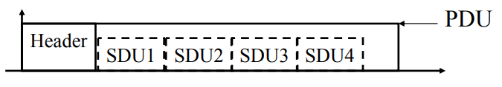
Sending frames in WiFi
Frame bursting
  Transmit multiple frames in a row
Frame fragmentation
  Split service data over multiple frames
Frame aggregation
  Multiple service data in a single frame
  Allows multiple packets to reach Access Point in a single transmission

Slide 31
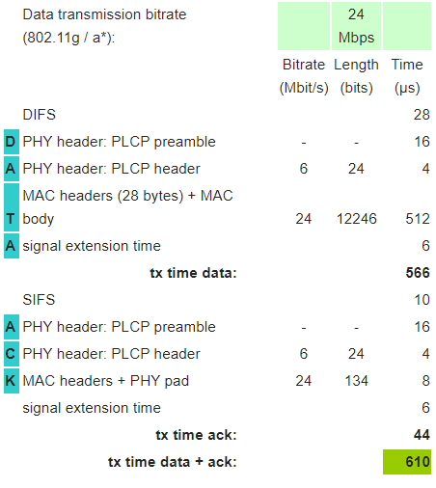
Calculating packet durations
Example duration for a 1500 byte 802.11g packet
  6 Mbps for header
  24 Mbps for payload
  566 μs for total packet
    Plus 10 μs for SIFS
    Plus 34 μs for ACK
https://sarwiki.informatik.hu-berlin.de/Packet_transmission_time_in_802.11

Slide 32
Implementation Drives Specification Sometimes
SIFS nominally defined by processing time
  Aside: Big challenge for SDRs
Convolutional decoders need(ed) 16 µs to finish processing
  For highest-rate MCS (ERP-OFDM)
  SIFS is 10 μs, so extension needed
Processing must finish before next packet starts
  To be able to decode NAV in header
Notes:
https://www.electronics-notes.com/articles/connectivity/wifi-ieee-802-11/802-11g.php

Slide 33
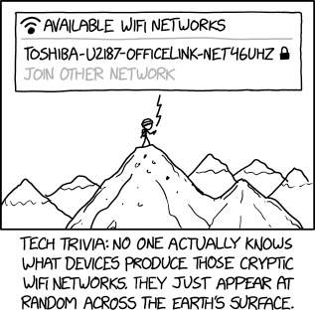
Break + xkcd
https://xkcd.com/2199/

Slide 34
Outline
802.11 Access Control
802.11 Frame format
802.11e Improvements to MAC
Microcontrollers and WiFi

Slide 35
802.11e improves MAC layer
Hybrid Coordination Function (HCF)
  Modifies contention-free access (still no one uses it)
  Modifies contention-based access: Enhanced Distributed Channel Access (EDCA)
Modifies Quality of Service based on application
  Example of breaking layering for an optimization
  Categories (lowest to highest priority):
    Background
    Best Effort
    Video
    Voice

Slide 36
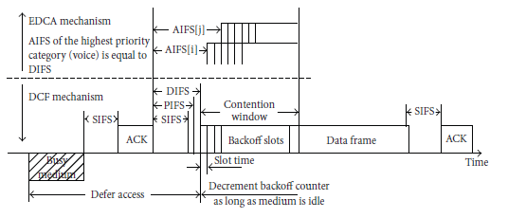
Different priority for different application category
Expand to more IFS lengths for different traffic categories
  Smallest AIFS (equal to DIFS) goes to Voice, Largest to Background
  Contention Window min and max also change for each category
    Selects a probability that most important category goes first

Slide 37
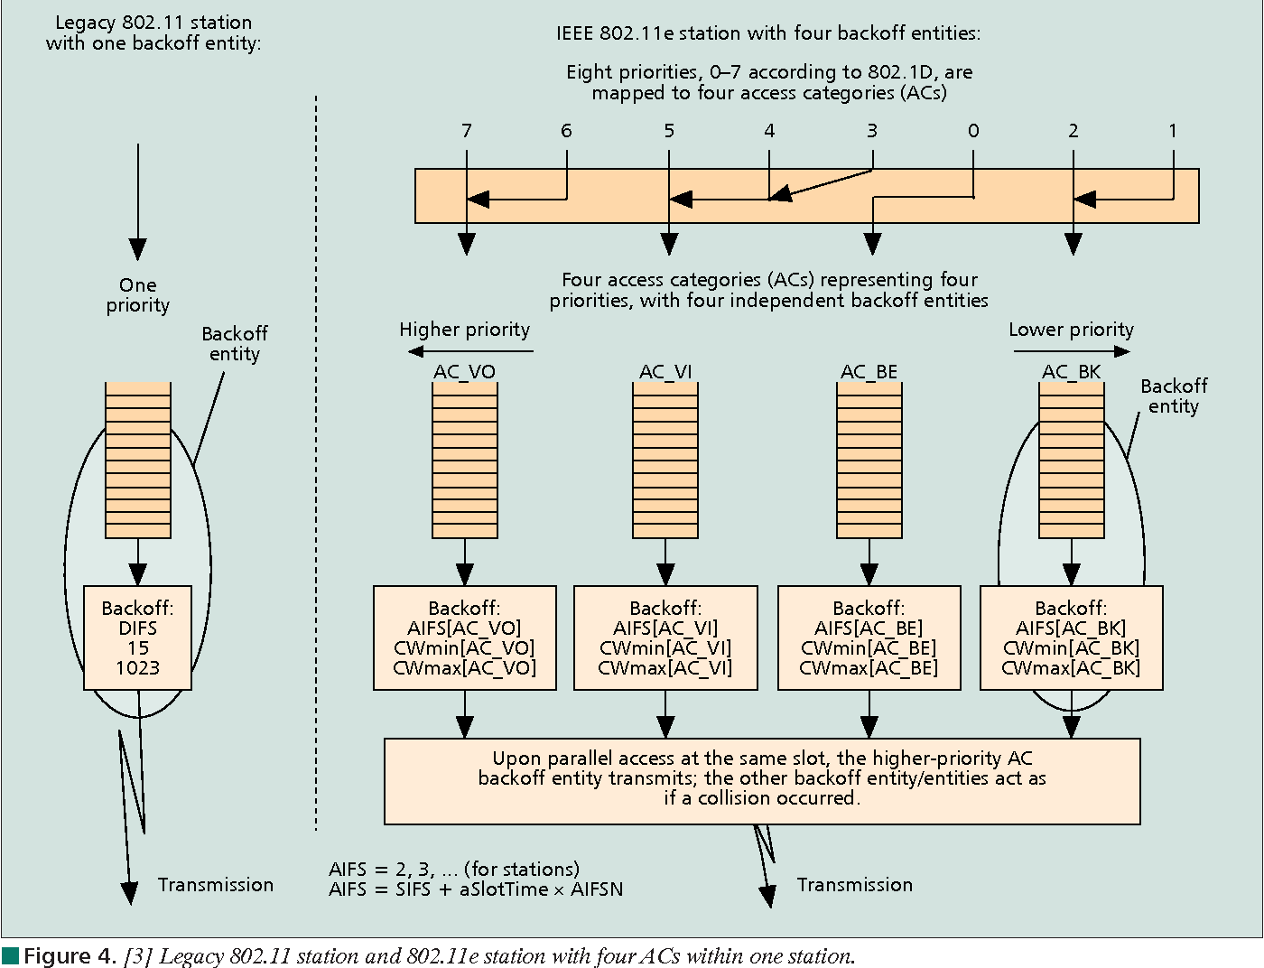
Multiple queues within a single device

Slide 38
802.11e also adds maximum durations
802.11e also defines duration a device can transmit for
  Based on PHY in use and Application category
  Background/Best Effort: one frame per contention win
  Example, up to 11 ms for Voice on 802.11ac
    Could be one really big frame at a low data rate
    Could be multiple frames in a row separated by SIFS

Slide 39
Outline
802.11 Access Control
802.11 Frame format
802.11e Improvements to MAC
Microcontrollers and WiFi

Slide 40
Why, why not, talk WiFi in a wireless for IoT class
Pros
  Ubiquitous
  High-performance
Cons
  Complex configuration
  And security requirements
    Device-Northwestern anyone?
  Expensive in energy and money

Slide 41
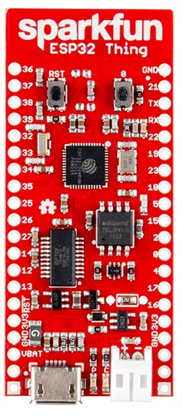
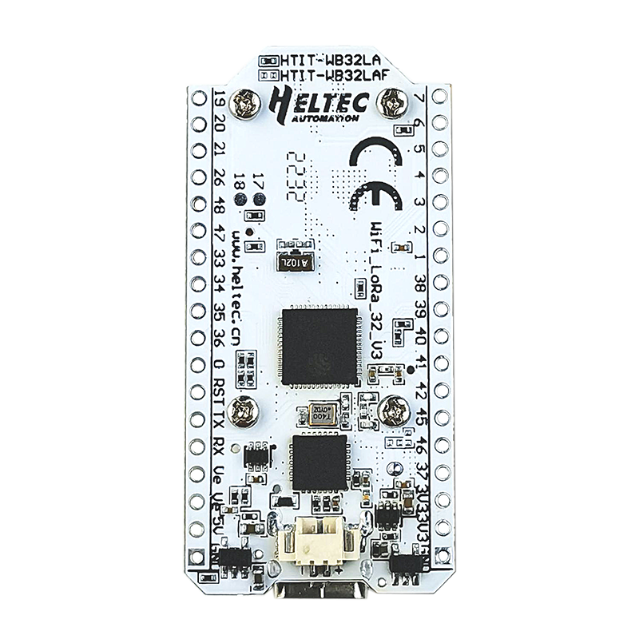
WiFi capability in microcontrollers
ESP32
  Microcontroller plus WiFi radio in single chip
  (Same idea as nRF52840)
Capabilities
  802.11b/g/n 2.4 GHz only
  20 MHz or 40 MHz channels
  Single antenna only (no MIMO)
  MCS0-7
    7 Mbps – 150 Mbps
  Tx power up to 20.5 dBm

Slide 42
Low power WiFi
Question: should a microcontroller stay connected or reconnect?
  Light sleep: stay connected always, only listening to beacons
  Deep sleep: reconnect to network each time data is ready
Answer for ESP32 depends on security and data interval
  Resecuring during connection takes lots of energy
    Crossover point is about 60 seconds
  Insecure transmissions have a crossover of 5-15 seconds
https://blog.voneicken.com/2018/lp-wifi-esp-comparison/#conclusions

Slide 43
Wrapup on WiFi
My takeaway: next time you buy a router, make it WiFi 6E
  Extra bandwidth with low contention means high speeds
  Although it won’t help until you upgrade devices too
However: additional WiFi speed won’t really help if it’s greater than your connection to your ISP
  1 Gbps link to router 😁
  10 Mbps link to Internet 😭
Still useful for local network communication

Slide 44
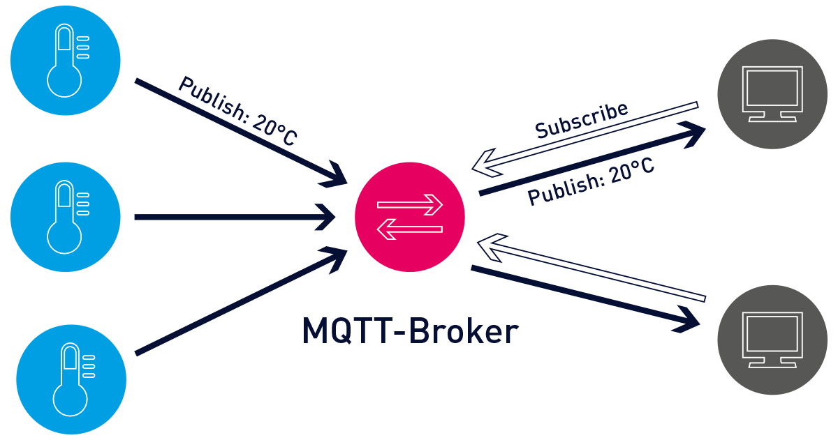
Bonus: MQTT – answer to the “where do you send data” question

Slide 45
Outline
802.11 Access Control
802.11 Frame format
802.11e Improvements to MAC
Microcontrollers and WiFi

