Slide 1
Lecture 06
802.15.4
CS397/497 – Wireless Protocols for IoT
Branden Ghena – Winter 2023
Materials in collaboration with Pat Pannuto (UCSD)

Slide 2
Administrivia
Hw: BLE Packets
  Due Wednesday
Check-in: how’s Lab: BLE going so far?
Lab: Thread
  Out either Friday or this weekend

Slide 3
Today’s Goals
Introduction to 802.15.4
Overview of physical layer details
Exploration of link layer
  Network topologies
  Communication structure
  Access control
  Packet structure

Slide 4
References
802.15.4 Specification [2006]
  “Part 15.4: Wireless Medium Access Control (MAC) and Physical Layer (PHY) Specifications for Low-Rate Wireless Personal Area Networks (WPANs)”
Other helpful references:
  Paper introducing the 802.15.4 draft
  NXP 802.15.4 Stack User Guide
  2005 presentation on 802.15.4

Slide 5
Outline
Overview
Physical Layer
Link Layer
Packet Structure

Slide 6
Comparison of networks
Data
Throughput
Range

Slide 7
Comparison of networks
WiFi
Cellular
Data
Throughput
Bluetooth
BLE
802.15.4
Range

Slide 8
Comparison of networks
WiFi
Cellular
Data
Throughput
Bluetooth
BLE
802.15.4
There are some missing qualities here.
Why be closer to the origin?
Range

Slide 9
Comparison of networks
WiFi
Cellular
Higher Power &
Higher Cost
Data
Throughput
Bluetooth
BLE
802.15.4
Lower Power &
Lower Cost
Range

Slide 10
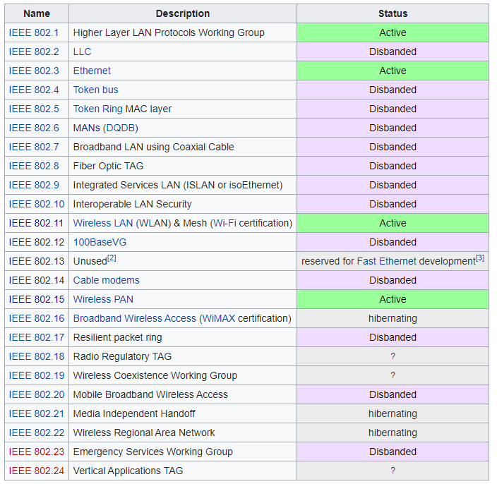
IEEE 802
Network standards for variable-sized packets
  Ethernet
  WiFi
  WPANs
E.g. not networks that send periodic constant-sized packets
Specifies PHY and Link layers
Another example standard:
  IEEE 754: Floating Point

Slide 11
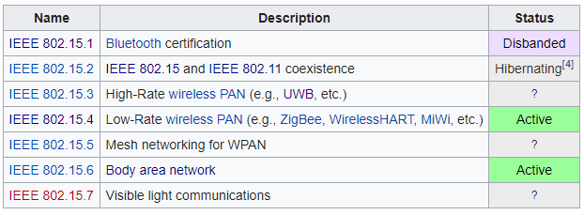
IEEE 802.15
Wireless Personal-Area Networks (WPAN)
  All the things within the workspace of a person
  Conceptually smaller domain that the Local Area Network
  Realistically about the same thing as a LAN
Formerly included a Bluetooth spec
  Bluetooth SIG took over governance

Slide 12
802.15.4 (LR-WPANs) Overview “Low-Rate Wireless Personal Area Networks”
Goals
  “The IEEE 802.15 TG4 was chartered to investigate a low data rate solution with multi-month to multi-year battery life and very low complexity.” [TG4]
Applications
  “Potential applications are sensors, interactive toys, smart badges, remote controls, and home automation.” [TG4]
  Ultimately home automation, industrial control/monitoring, vehicular sensing, agriculture; really most machine-to-machine (M2M) sensor applications
Other contemporary technologies
  WiFi 802.11b and Bluetooth Classic
    Too complex in specification and overachieving in capability

Slide 13
IEEE 802.15.4
Low-Rate Wireless PAN
  250 kbps, ~100 m range
  Radio hardware available with low-power and low-cost
Specification: 2003
  Also 2006, 2011, 2015, and 2020 revisions
    Mostly various added capabilities such as extra PHY layers
    Also define optional security, scheduling, and larger frame sizes
We’ll mostly work off of the 2006 version
  Thread is based on 2006 version
  Zigbee is based on the original 2003 version
  Roughly 200 pages of meaningful specification (100 of appendices)
    Compare to 3000 pages of Bluetooth/BLE

Slide 14
Outline
Overview
Physical Layer
Link Layer
Packet Structure

Slide 15
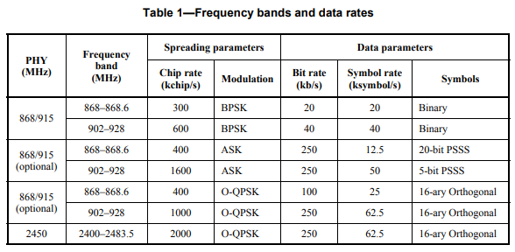
802.15.4 Physical Layers
Multiple options of physical layers are supported
  We’ll focus on 2.4 GHz (2400 MHz)

Slide 16
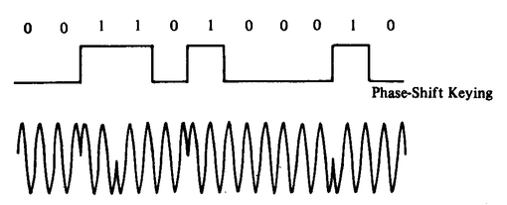
Physical Layer
O-QPSK modulation
  Offset Quadrature Phase-Shift Keying
  Twice the data rate of BPSK for same Bit-Error Rate
  Cost: most complicated design of receivers
    Which is pretty minimal with all the transistors we’ve got
    Plus the ability to reuse previous designs
  4 bits per symbol
Symbols versus bits
  A symbol is the unit of data transfer for a modulated signal
    Does not necessarily correspond 1:1 with bits
  The rate of symbols per second is a baudrate
  62.5 kBaud = 62500 symbols/second = 250000 bits/second = 250 kbps

Slide 17
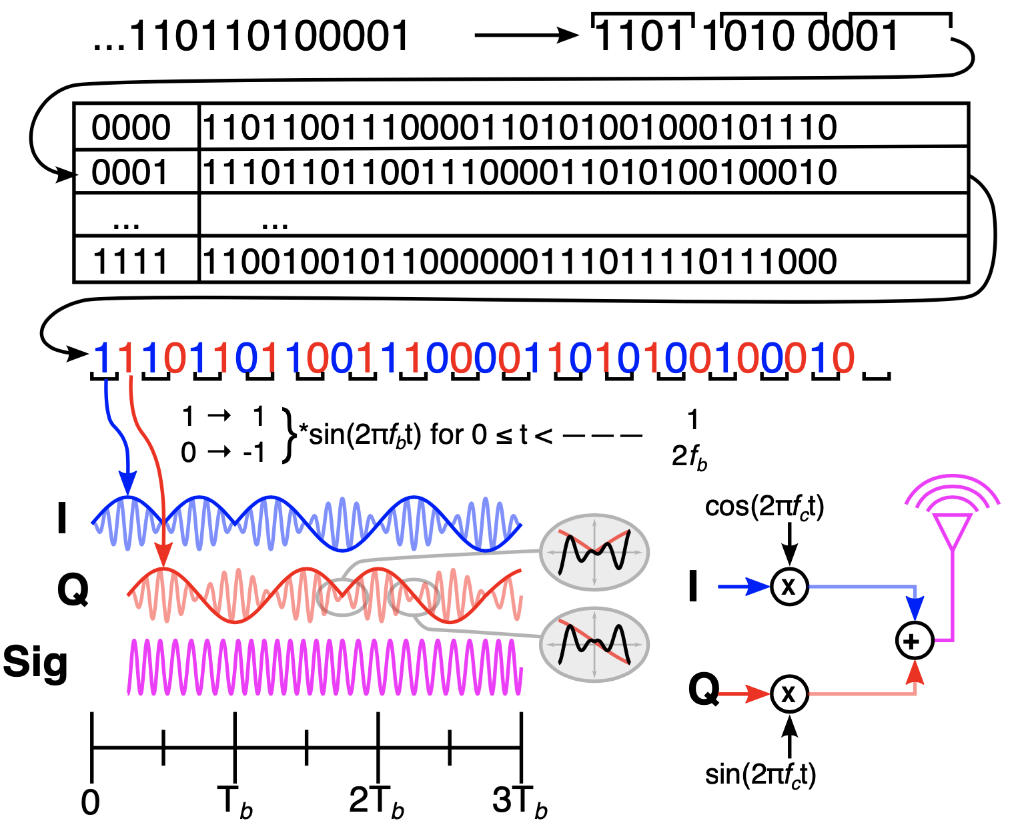


802.15.4 Modulation (@2.4 GHz f_{c})
O-QPSK with half-sine shaping is MSK!
Broken into 4-bit symbols
Each symbol maps to a 32-bit pseudo-noise code (PN-code) or sometimes pseudo-random sequence
Input bit stream
Each bit of the PN code is called a chip
I and Q half-sines are baseband, which are mixed with the carrier
Each chip encodes half a sine wine
I and Q carriers are combined to create the final on-air signal
Chips alternate in-phase and quadrature
Signal is MSK, which is a special, optimal case of FSK!
Quadrature component is offset π/2
Notes:
https://www.dsprelated.com/showarticle/1016.php – For reconvincing myself that yes, it really does boil down to MSK (a subset of FSK) on the air, which is insane.
https://arxiv.org/pdf/1611.03482.pdf – Also this for the same

Slide 18
802.15.4 Modulation (@2.4 GHz f_{c})
O-QPSK with half-sine shaping is MSK!
Broken into 4-bit symbols
Final detail:
This shows a f_{b} :: f_{c} ratio of 1 :: 10 so you can see the impact on the carrier. In reality, it’s closer to 1 :: 1200 (2,000 chips / s :: 2,400,000 Hz)
Each symbol maps to a 32-bit pseudo-noise code (PN-code) or sometimes pseudo-random sequence
Input bit stream
Each bit of the PN code is called a chip
I and Q half-sines are baseband, which are mixed with the carrier
Each chip encodes half a sine wine
I and Q carriers are combined to create the final on-air signal
Chips alternate in-phase and quadrature
Signal is MSK, which is a special, optimal case of FSK!
Quadrature component is offset π/2
Notes:
https://www.dsprelated.com/showarticle/1016.php – For reconvincing myself that yes, it really does boil down to MSK (a subset of FSK) on the air, which is insane.
https://arxiv.org/pdf/1611.03482.pdf – Also this for the same

Slide 19
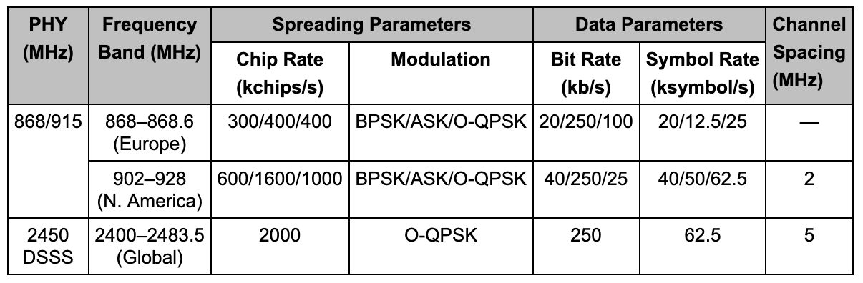
15.4 has multiple PHY layer choices
We focus on the 2.4 GHz one, that uses DSSS

Slide 20
802.15.4 actually sends way more data than symbols
For every 4 bits we want to send (one symbol)
  802.15.4 sends 32 bits of data instead
There’s a mapping from bit pattern to “chip pattern”
  One mapping that all 802.15.4 PHY layers must use
  This idea is called “Direct Sequence Spread Spectrum” (DSSS)

Slide 21
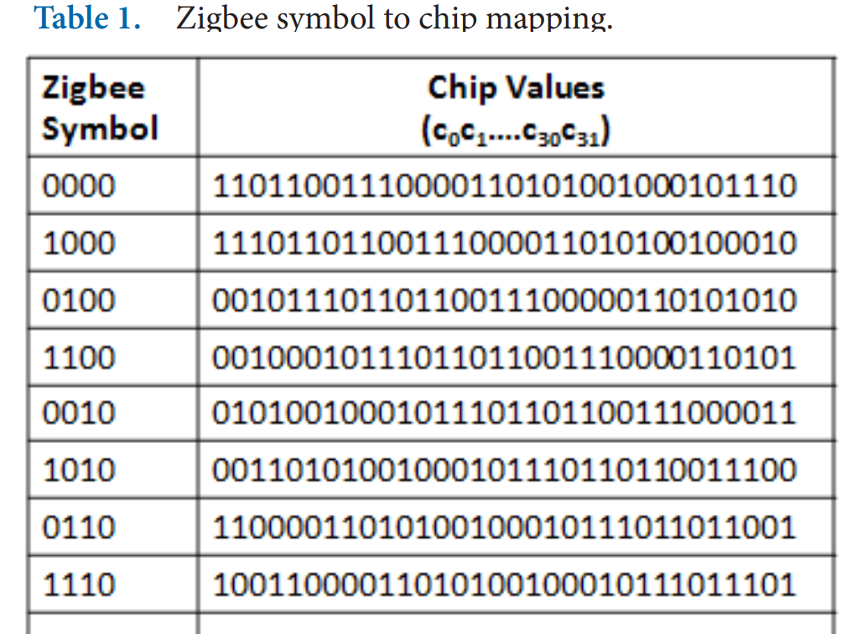
Direct Sequence Spread Spectrum (DSSS)
Increases the signal bandwidth of a transmission beyond information bandwidth
  Send sequences of chips, which are a translation of one symbol to a pattern of many bits
  Chips are transmitted much faster than symbols, essentially increasing the data rate
Enables better interference avoidance
  Received bits are correlated against codes to see which is most likely
  802.15.4 tolerates 13-15 bit flips (almost half!)
Notes:
n.b. 802.15.4 channels 5 MHz wide
BT Classic 1 MHz, BLE 2 MHz

Slide 22
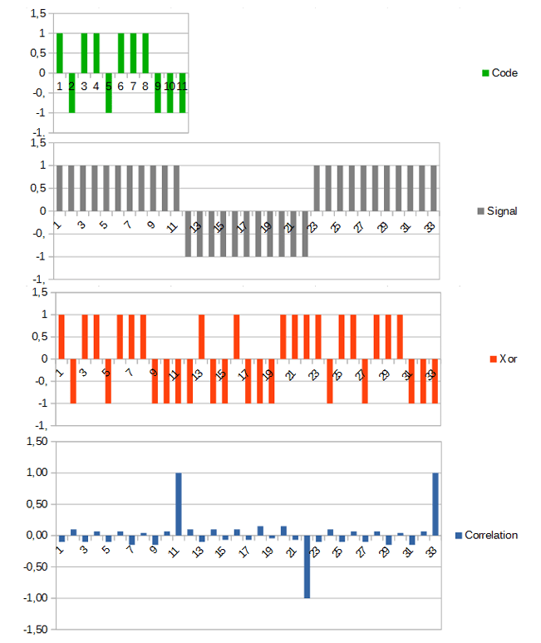
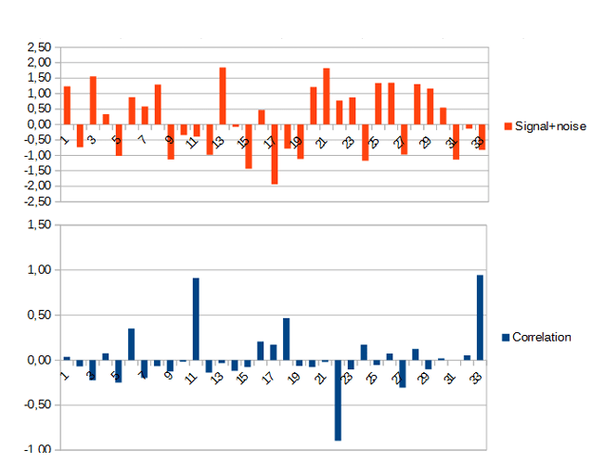
DSSS example
Data sent is 101
  Code is longer than data, so we replicate bits
  Data is recoverable, even with noise
https://circuitcellar.com/research-design-hub/dsss-in-a-nutshell/

Slide 23
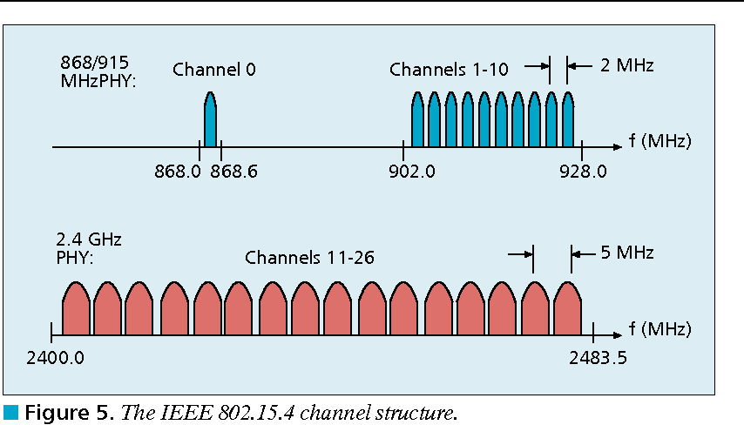
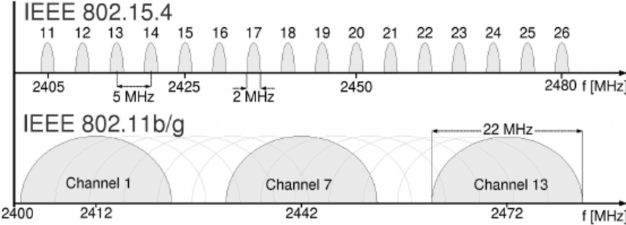
802.15.4 RF channels
27 channels across three bands
5 MHz channel separation at 2.4 GHz
  Compare to 2 MHz for BLE

Slide 24
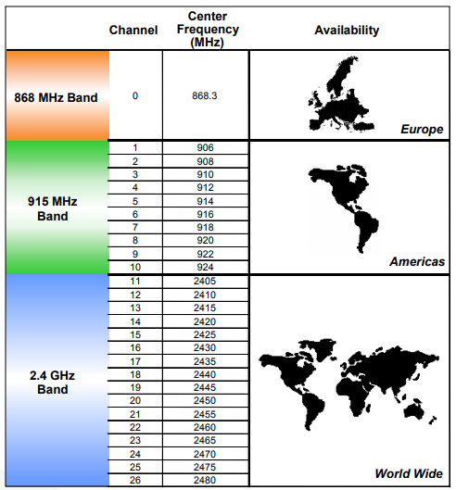
Regional bands
Different RF bands have different regional availability
Also have different rules
  915 MHz: 400 ms dwell time
  868 MHz: 1% duty cycle

Slide 25
Signal strength
Transmit power
  Typical: 0 dBm (remember: 0 dBm equals 1 mW)
Receiver sensitivity
  nRF52840 802.15.4: -100 dBm
    Compare to BLE sensitivity of -95 dBm
  Worst acceptable sensitivity (per spec): -85 dBm
  Circa-2006 radios (CC2420): -95 dBm
Which has longer range, 802.15.4 or BLE? Why?

Slide 26
Signal strength
Transmit power
  Typical: 0 dBm (remember: 0 dBm equals 1 mW)
Receiver sensitivity
  nRF52840 802.15.4: -100 dBm
    Compare to BLE sensitivity of -95 dBm
  Worst acceptable sensitivity (per spec): -85 dBm
  Circa-2006 radios (CC2420): -95 dBm
Which has longer range, 802.15.4 or BLE? Why?
  802.15.4 with +5 dBm more margin;
    lower bit rate plays into this, as does increased bandwidth

Slide 27
Outline
Overview
Physical Layer
Link Layer
Packet Structure

Slide 28
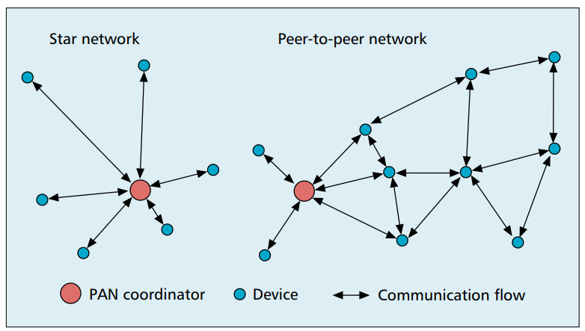
802.15.4 network topologies
Only specifies PHY and MAC, but has use cases in mind

Slide 29
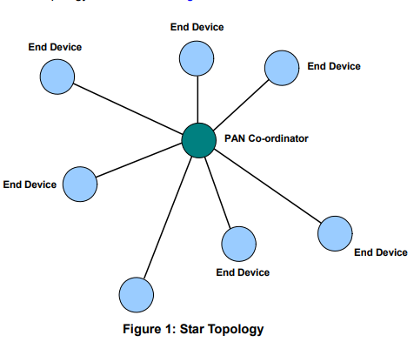
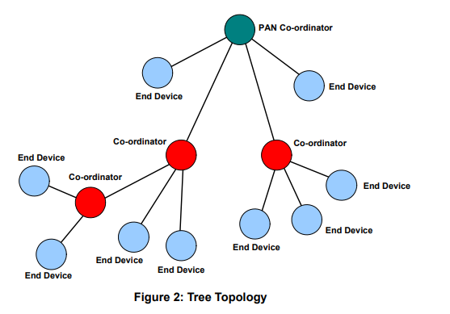
Star and Tree topologies
PAN Coordinator
  Receives and relays all messages
  Most capable and power-intensive
Coordinators (a.k.a. Routers)
  Control “clusters”
  Receives and relays to its children
  Communicates up to parent coordinator
End Devices
  Only communicate with single
  parent coordinator
  Least capable and power intensive

Slide 30
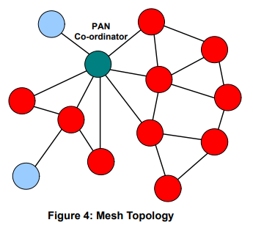
Break + Mesh networks
Most devices are capable of communicating with multiple neighbors
What are advantages of mesh?
What are disadvantages of mesh?

Slide 31
Break + Mesh networks
Most devices are capable of communicating with multiple neighbors
What are advantages of mesh?
  Devices can communicate over longer distances
  Device failures less likely to collapse the entire network
What are disadvantages of mesh?
  Some nodes have to spend more energy communicating
  Network protocol becomes more complicated to manage routing

Slide 32
Reminder: CSMA/CA – Carrier Sense Multiple Access with Collision Avoidance
First, wait a random amount (collision avoidance part)
Then, listen for a duration and determine if anyone is transmitting (carrier sense part)
  If idle, you can transmit
  If busy, repeat step 1 (often increasing maximum wait time)
Can be combined with notion of slotting
  Synchronize to slots (smaller than transmit times)
  Wait for a number of slots
  Listen for idle slots

Slide 33
Modes of operation
Beacon-enabled PAN
  Slotted CSMA/CA
  Structured communication patterns
  Optionally with some TDMA scheduled slots
Non-beacon-enabled PAN
  Unslotted CSMA/CA
  No particular structure for communication
    Could be defined by other specifications, like Thread or Zigbee

Slide 34
Beacon-enabled superframe structure
Beacon
Beacon
…
Contention Access Period
Inactive Period
Beacons occur periodically [15 ms – 245 seconds]
  Devices must listen to each beacon
Contention Access Period
  Slotted CSMA/CA synchronized by beacon start time
Inactive Period
  No communication occurring. Assumes sleepy devices

Slide 35
Guaranteed Time Slots (GTS)
Beacon
Beacon
…
Contention Access Period
Guaranteed Time Slots
Inactive Period
PAN Coordinator may create a Contention Free Period with Guaranteed Time Slots
  TDMA schedule assigned to specific devices
  Slots eat up part of the Contention Access Period
  No CSMA/CA within a guaranteed time slot

Slide 36
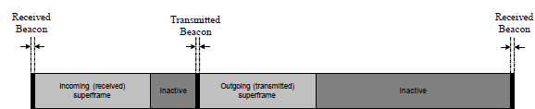
Handling tree-based topologies
All coordinators listen to beacon from PAN coordinator
  And can participate in that contention period
Send their own beacons to child devices during inactive period
  Children participate in that contention period

Slide 37
Non-beacon-enabled PAN
…
Contention Access Period
Same idea, just no beacons
  Which removes synchronization benefit (and slotted CSMA/CA)
  Also removes beacon listening cost
    Devices only need to check for activity before transmitting
  Still need an algorithm to determine when it should receive data
    All the time is a huge energy drain
    Algorithms can get complicated here

Slide 38
Non-beacon-enabled PAN
…
Contention Access Period
Same idea, just no beacons
  Which removes synchronization benefit (and slotted CSMA/CA)
  Also removes beacon listening cost
    Devices only need to check for activity before transmitting
  Still need an algorithm to determine when it should receive data
    All the time is a huge energy drain
    Algorithms can get complicated here
    Could BLE mechanism of listen-after-send apply?

Slide 39
Non-beacon-enabled PAN
…
Contention Access Period
Same idea, just no beacons
  Which removes synchronization benefit (and slotted CSMA/CA)
  Also removes beacon listening cost
    Devices only need to check for activity before transmitting
  Still need an algorithm to determine when it should receive data
    All the time is a huge energy drain
    Algorithms can get complicated here
    Could BLE mechanism of listen-after-send apply?
      Only if sending to a high-power device, not among equals

Slide 40
Receiving messages
Listen during entire contention period
  Can receive direct messages from any other device
  Can immediately respond to messages as well
Request messages from Coordinator
  Make all communication go through Coordinator
  Send a request-for-data packet to coordinator to get information
  Coordinator can include list of devices with pending data in beacon
More complicated listening algorithms are possible

Slide 41
Clear Channel Assessment (CCA)
The “listen” part of CSMA/CA
Variety of implementations are acceptable
  Energy above threshold
    Energy for 8 symbol durations above threshold (RSSI)
  Carrier sense
    Valid 802.15.4 carrier signal
  Energy AND/OR Carrier

Slide 42
Slotted CSMA/CA operation
Have data to send
Wait for next backoff slot (synchronized from beacon)
Wait for 0-7 backoff slots (slot is 20 symbol durations: 320 us)
Listen for two empty slots
  Idle: Transmit
  Occupied: wait 0-15 backoff slots and repeat
    Next time: 0-31 backoff slots and repeat
    Next time: 0-31 backoff slots and repeat (upper limit configurable)
    Next time: 0-31 backoff slots and repeat
    Next time: 0-31 backoff slots and repeat
    Timeout

Slide 43
Unslotted CSMA/CA operation
Have data to send
Wait for next backoff slot (synchronized from beacon)
Wait for 0-7 backoff slots (slot is 20 symbol durations: 320 us)
Listen for two empty slots
  Idle: Transmit
  Occupied: wait 0-15 backoff slots and repeat
    Next time: 0-31 backoff slots and repeat
    Next time: 0-31 backoff slots and repeat (upper limit configurable)
    Next time: 0-31 backoff slots and repeat
    Next time: 0-31 backoff slots and repeat
    Timeout

Slide 44
Break + Question
What are benefits/costs of using or not using beacons?
  Beacons
  No beacons

Slide 45
Break + Question
What are benefits/costs of using or not using beacons?
  Beacons
    Enable energy savings by designating period with radios off
    Enable structured communication like Guaranteed Slots
    Require some central coordinator within range of all devices
    Tradeoff in inactive period:
      communication latency vs beacon-listening costs
  No beacons
    Enable all devices to be identical (no coordinator needed)
    Require custom communication scheme
      Could be better or worse for various qualities… (always-on radios?)

Slide 46
Outline
Overview
Physical Layer
Link Layer
Packet Structure

Slide 47
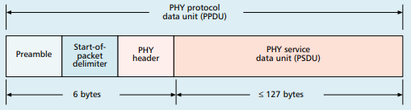
Base packet format
Synchronization
  Preamble: four bytes of zeros
  Start-of-Packet: 0xA7
PHY Header
  One field: length 0-127
  Why still 8 bits?

Slide 48
Base packet format
Synchronization
  Preamble: four bytes of zeros
  Start-of-Packet: 0xA7
PHY Header
  One field: length 0-127
  Why still 8 bits? Because computers depend on bytes

Slide 49
MAC frame format
Frame control
  Header
Sequence number
  8-bit monotonically increasing
Addressing fields
  PAN and addresses
  Varies based on frame type
Frame payload
  Depends on frame type
Frame check sequence
  16-bit CRC

Slide 50
Frame control
Frame type
  Type of payload included
  Beacon, Data, Control, Ack
Security enabled
  Packet is encrypted
  (extra 0-14 byte header)
Frame pending
  Fragmented packet
Acknowledgement required
PAN ID compression
  No PAN ID if intra-network
Addressing modes
  Which fields to expect
Why no length field?

Slide 51
Frame control
Frame type
  Type of payload included
  Beacon, Data, Control, Ack
Security enabled
  Packet is encrypted
  (extra 0-14 byte header)
Frame pending
  Fragmented packet
Acknowledgement required
PAN ID compression
  No PAN ID if intra-network
Addressing modes
  Which fields to expect
Why no length field?
Already in prior header

Slide 52
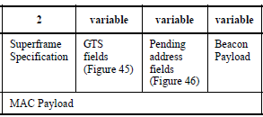
Frame types - Beacon
Beacon
  Information about the communication
  structure of this network
  Sent in response to requests from scanning devices
  Sent periodically at start of Superframes (if in use)
    Sent without CSMA/CA
MAC Header configuration
  Source address only, broadcast to everyone
Packet contents
  Superframe details, including Guaranteed Time Slots (if any)
  Pending addresses lists devices for which Coordinator has data

Slide 53
Frame types - Data
Data
  Data from higher-layer protocols
MAC Header configuration
  Source and/or Destination addresses as necessary
Packet Contents
  Whatever bytes are desired (122 bytes – address sizes)
  May be fragmented across packets

Slide 54
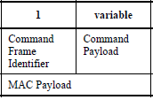
Frame types – MAC Command (i.e., control)
MAC Command
  Various commands for supporting link layer
    Join/leave network
    Change coordinator within network
    Request data from coordinator
    Request Guaranteed Time Slot
MAC Header configuration
  Source and/or Destination addresses as necessary

Slide 55
Frame types - Acknowledgement
Acknowledgement
  Acknowledges a Data or MAC Command packet
  Not beacons or other acknowledgements
    What happens if acknowledgement isn’t received?
MAC Header
  Repeats Sequence Number of acknowledged packet
  No Source or Destination addresses
Sent T_{IFS} after the packet it is acknowledging (immediately)

Slide 56
Frame types - Acknowledgement
Acknowledgement
  Acknowledges a Data or MAC Command packet
  Not beacons or other acknowledgements
    What happens if acknowledgement isn’t received?
      Packet will be transmitted again
MAC Header
  Repeats Sequence Number of acknowledged packet
  No Source or Destination addresses
Sent T_{IFS} after the packet it is acknowledging (immediately)

Slide 57
Analysis: maximum goodput
Assume best possible case for data transmission
  122 Bytes per packet
    At 250 kbps -> 3.904 ms
  Plus Inter-frame spacing of 40 symbols
    At 62.5 kBaud -> 0.640 ms
  122 Bytes / 4.544 ms -> 214 kbps
    Compare to BLE advertisements: 9.92 kbps
    Compare to BLE connections: 520 kbps

Slide 58
Outline
Overview
Physical Layer
Link Layer
Packet Structure

