Slide 1
Lecture 03 Data Link Layer + BLE Introduction
CS397/497 – Wireless Protocols for IoT
Branden Ghena – Winter 2023
Materials in collaboration with Pat Pannuto (UCSD)

Slide 2
Administrivia
Hw: Background
Goal: brush up on some embedded systems and networks background
Due by Wednesday end-of-day
Submit on Gradescope
Lab: Wireless
Goal: familiarize yourself with Wireshark
Install it, do some basic scanning, explore a little
Writeup:
Due Friday by end-of-day
Submit on Gradescope

Slide 3
Partnership survey
Labs (after this first one) will be in groups of exactly three
I’m trying to
Figure out what the groups are
Match up students who need groups
Please fill out the survey posted on Piazza:
https://forms.gle/wDvSngsSvJ2hWL56A

Slide 4
Today’s Goals
Overview of concerns for the Data link layer
Speak the “lingo” of wireless communication
Present technology aspects that we will return to in specific protocols
Describe Medium Access Control mechanisms
Introduction to Bluetooth Low Energy
What are the goals of the protocol?
What do the lower layers look like?

Slide 5
Bluetooth Low Energy Resources
Good walkthrough of BLE:
https://www.silabs.com/documents/public/user-guides/ug103-14-fundamentals-ble.pdf
[5.2 specification] [4.2 specification] (link to PDF download)
Also: [Supplement v9]
I used a mix of 5.2 and 4.2 for this
Will talk about BLE 5 differences as part of next lecture

Slide 6
Outline
Data Link Layer
BLE Background
BLE Layers
Physical Layer
Link Layer

Slide 7
Data Link Layer
Framing
Combine arbitrary bits into a “packet” of data
Logical link control
Manage transfer between transmitter and receiver
Error detection and correction
Media access
Controlling which device gets to transmit next
Inherently coupled to PHY and its decisions

Slide 8
Framing
Typical packet structure
Preamble - Existence of packet and synchronization of clocks
Header - Addresses, Type, Length
Data - Payload plus higher layer headers (e.g. IP packet)
Trailer - Padding, CRC
Wireless considerations
Control information for Physical Layer
Ensure robustness for header
Explicit multi-hop routing
Possibly different data rates for different parts of packet
Preamble | Destination Address | Source Address | Type and Length | Data | CRC

Slide 9
Error control: detection and recovery
Detection: only detect errors
Make sure corrupted packets get discarded
Cyclical Redundancy Checks
Detect single bit errors
Detect “burst” errors of several contiguous bits
Recovery: also try to recover from small bit errors
Forward error correction
Retransmissions
Far more important for wireless because the cost of transmission is higher

Slide 10
Medium Access Control
How does a network determine which transmitter gets to transmit?
Remember: the wireless medium is inherently broadcast
Two simultaneous transmitters may lose both packets

Slide 11
Analogy: wireless medium as acoustic
How do we determine who gets to speak?
Two simultaneous speakers also lose both “transmissions”
Task: in one minute you will have to recite the alphabet
We’ll jump by tables, one person per letter
You all fail if two people speak at the same time
I will ban any strategy that two tables use

Slide 12
Analogy: wireless medium as acoustic
How do we determine who gets to speak?
Two simultaneous speakers also lose both “transmissions”
Eye contact (or raise hand) -> out-of-band communication
Wait until it’s quiet for some time -> carrier sense multiple access
Strict turn order -> time division multiple access
Just speak and hope it works -> ALOHA
Everybody sing at different tones -> frequency division multiple access (stretching the metaphor)
Everyone speak in different languages -> code division multiple access
Others?

Slide 13
MAC protocol categorization
Medium Access Control Protocols
Contention-Based Protocols
Contention-Free Protocols
ALOHA
CSMA
FDMA
TDMA
Also, CDMA

Slide 14
ALOHA
ALOHAnet (1971)
University of Hawaii – Norman Abramson
First demonstration of wireless packet network
Rules
If you have data to send, send it
Two (or more) simultaneous transmissions will collide and be lost
Wait a duration of time for an acknowledgement
If transmission was lost, try sending again “later”
Want some kind of exponential backoff scheme here

Slide 15
Packet collisions
Each packet transmission has a window of vulnerability
Twice the on-air duration of a packet
Transmissions during the packet are bad
Transmissions before packet can also be bad
My transmission
Other transmission
My transmission
Other transmission

Slide 16
Slotted ALOHA
Split time into synchronized “slots”
Any device can transmit whenever it has data
But it must transmit at the start of a slot
And its transmission cannot be longer than a slot
Removes half of the possibilities for collisions!
At the cost of some synchronization method
My transmission
My transmission
Other transmission
Other transmission
time

Slide 17
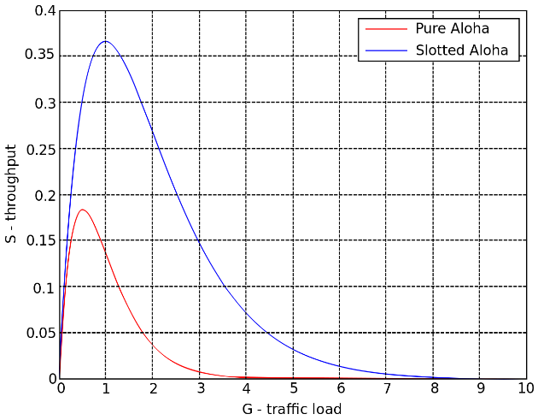
ALOHA throughput
It can be shown that traffic maxes out at
ALOHA: 18.4%
Slotted ALOHA: 36.8%
Assuming Poisson distribution of transmission attempts
Slotted throughput is double because the “before” collisions can no longer occur

Slide 18
Capture effect
Actually, two packets at once isn’t always a total loss
The louder packet can still sometimes be heard if loud enough
How much louder?
Ballpark 12-14 dB
When does this work?
Depends on the radio hardware
Louder packet first almost always works
Louder packet second sometimes works

Slide 19
MAC protocol categorization
Medium Access Control Protocols
Contention-Based Protocols
Contention-Free Protocols
ALOHA
CSMA
FDMA
TDMA
Also, CDMA

Slide 20
CSMA/CA – Carrier Sense Multiple Access with Collision Avoidance
First listen for a duration and determine if anyone is transmitting
If idle, you can transmit
If busy, wait and try again later
“listen before send”
Can be combined with notion of slotting
If current slot is idle, transmit in next slot
If current slot is busy, follow some algorithm to try again later

Slide 21
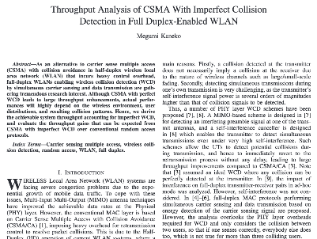
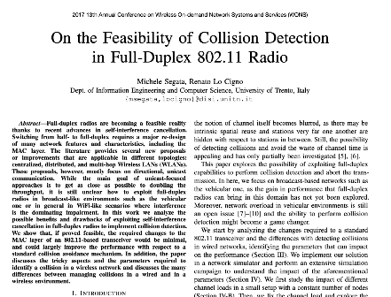
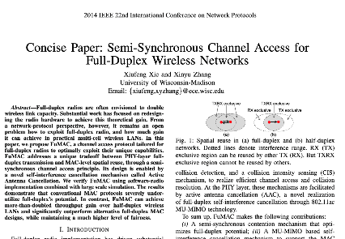
CSMA/CD – CSMA with Collision Detection
Detect collisions during your own transmission
Works great on wired mediums (Ethernet, I2C)
Very challenging for wireless systems
Transmit and receive are usually the same antenna
Receiving while transmitting would be drowned out by transmission
Remember: TX at 8 dBm and RX at -95 dBm
Area of active research!

Slide 22
Hidden terminal problem
Device C
Device A
Device B

Slide 23
CSMA with RTS/CTS
Hidden terminal problem means that two transmitters might never be able to detect each other’s transmissions
A partial solution
When channel is idle, transmitter sends a short Request To Send (RTS)
Receiver will send a Clear To Send (CTS) to only one node at a time
RTS collisions are faster and less wasteful than hidden terminal collisions
Downside: overhead is high for waiting for CTS when contention is low

Slide 24
MAC protocol categorization
Medium Access Control Protocols
Contention-Based Protocols
Contention-Free Protocols
ALOHA
CSMA
FDMA
TDMA
Also, CDMA

Slide 25
Contention-free access control protocols
Goal: split up communication such that devices will not conflict
Can be predetermined or reservation-based
Devices might request to join the schedule and be given a slot
Devices lose their slot if it goes unused for some amount of time
Reservations often occur during a dedicated CSMA contention slot
Assignment of schedules can be complicated
Really efficient at creating a high-throughput network
Assuming they are all following the same protocol
Otherwise, interference can be very problematic

Slide 26
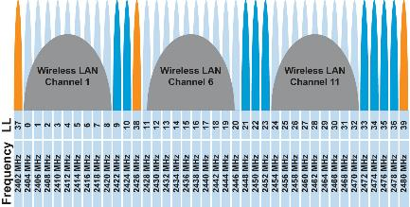
FDMA – Frequency Division Multiple Access
Split transmissions in frequency
Different carrier frequencies are independent
Fundamentally how RF spectrum is split
Technically, each device uses a separate, fixed frequency
Walkie-talkies
Conceptually, how RF channels work
WiFi networks pick different bands
802.15.4 picks a channel to communicate on

Slide 27
TDMA – Time Division Multiple Access
Split transmissions in time
Devices share the same channel
Splits time into fixed-length windows
Each device is assigned one or more windows
Can build a priority system here with uneven split among devices
Requires synchronization between devices
Often devices must listen periodically to resynchronize
Less efficient use of slots reduce synchronization
Large guard windows. E.g. 1.5 second slot for a 1 second transmission

Slide 28
Real-world protocol access control
ALOHA
BLE advertisements
Unlicensed LPWANs: Sigfox, LoRaWAN
CSMA
WiFi (slotted, CSMA/CA)
TDMA
BLE connections
Cellular LPWANs: LTE-M and NB-IoT

Slide 29
Break + Say hi to your neighbors
Things to share
Name
Major
One of the following
Favorite Candy
Favorite Pokemon
Favorite Emoji

Slide 30
Break + Say hi to your neighbors
Things to share
Name -Branden
Major -EE, CE, and CS
One of the following
Favorite Candy - Twix
Favorite Pokemon - Eevee
Favorite Emoji - 🍢

Slide 31
Outline
Data Link Layer
BLE Background
BLE Layers
Physical Layer
Link Layer

Slide 32
Basics of Bluetooth Low Energy (BLE)
Direct device-to-device communication
Usually: Computer to Thing
Smartphone to device, Laptop to device, etc.
Focus on making the “Thing” really low energy
Push energy-intensive requirements onto “Computer”
Devices (Computer or Thing) are servers with accessible fields
Not the traditional send-explicit-packets interface you might be expecting
Lower layers are still exchanging packets to make it work

Slide 33
A note on outdated notation
Master/Slave paradigm
Master is the “Computer” and is in charge of interaction
Slave is the “Device” and has little control over interaction parameters
Really common notation in EE side of the world.
Not intended to be harmful, but also literally inconsiderate.
Field is changing for the better. It’s going to take some time.
Central/Peripheral
Device/Peripheral
Controller/Peripheral
Master/Minion
Primary/Secondary

Slide 34
BLE development
Protocol development
Research product
Specification
Hardware support
Usefulness and iteration
Bluetooth Low Energy
Research in early 2000s: Bluetooth Low End Extension and Wibree
Specification in 2009: Bluetooth version 4.0
Hardware support in 2011/12: iPhone 4s, nRF51 series
4.1 and 4.2 (2014), 5.0 (2016, first in phones 2017, really 2019 though)

Slide 35
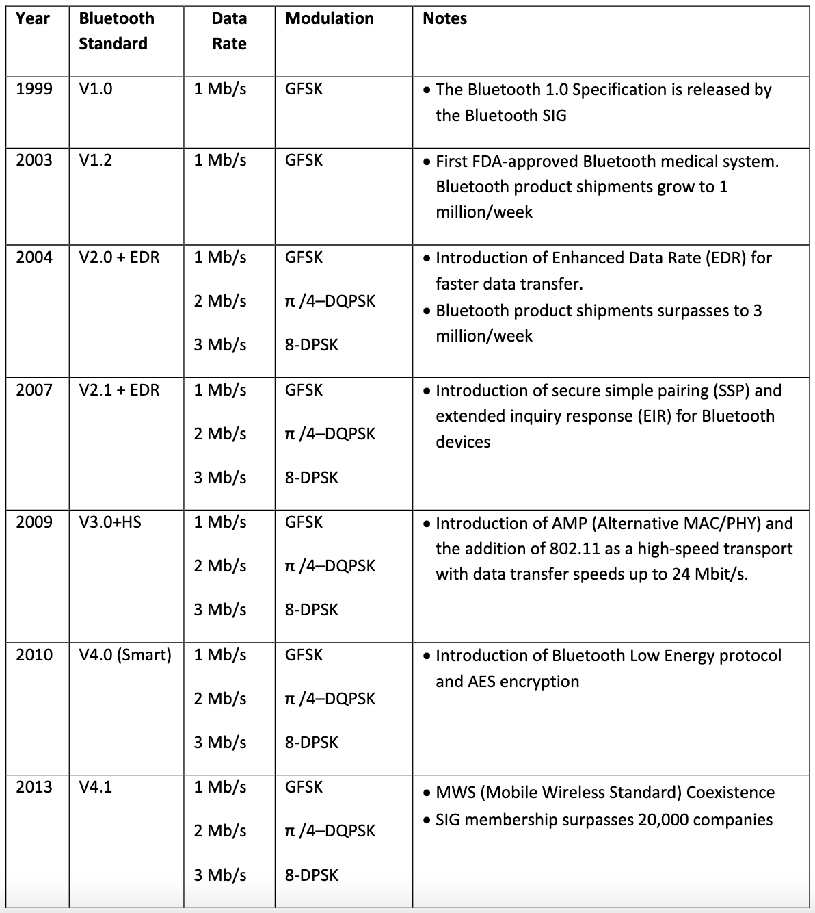
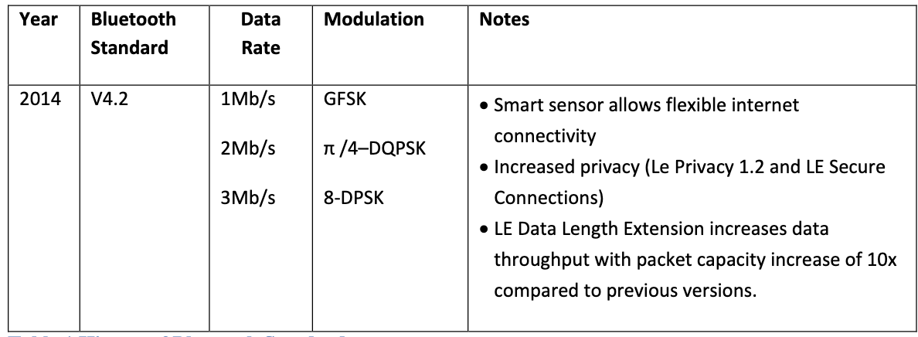
Bluetooth has a long history — the IoT is near-exclusively BLE (Bluetooth 4.0+) as opposed to Bluetooth Classic (<4.0)

Slide 36
Bluetooth Specification
Problem: a bit overwhelming…
5.2 spec: 3256 pages
We only care about Vol 6: Low Energy Controller
Part A: Physical Layer Specification
Part B: Link Layer Specification
CSS: Part A: Data Types Specification
So ~250 pages
Tip: be willing to just ignore things when skimming specs
5.2 spec covers BLE and Bluetooth Classic and a bunch of upper layer stuff that we never have to care about

Slide 37
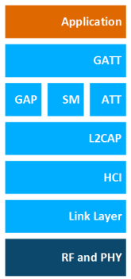
BLE Layers
GAP
Host – Configuration and Server
GAP – Generic Access Profile
Configure advertising
GATT – Generic ATTribute profile
Configure connections
HCI - Host Controller Interface (sigh)
Controller - Communication
Link Layer – send packets
RF and PHY – send bits
Host
Controller

Slide 38
BLE mechanisms
Advertising
Discovery
Advertisements – broadcast messages indicating device details
Ephemeral, uni-directional communication from Advertiser to Scanner(s)
ALOHA access control
Connections
Interaction
Bi-directional communication between Peripheral and Central
Maintained for some duration
TDMA access control

Slide 39
BLE network topology
Peripheral
Connection
Central & Scanner
Scanner
Connection
Peripheral
Advertisement
Advertisement
Advertisement
Advertisement
Advertiser
Advertiser
Advertiser

Slide 40
Multiple roles at the same time
Topology picture is a simplification of roles
A single device can have multiple roles simultaneously
Scanning and Advertising simultaneously
Peripheral and Scanner and Advertiser simultaneously
Peripheral and Scanner and Central and Advertiser simultaneously
Getting a bit out of hand though
Also possible:
One Peripheral can be connected to multiple Centrals
This is relatively new in BLE still, you’ll find old docs saying you can’t

Slide 41
Break + Check your understanding
Which roles is each device likely to have?
Keyboard
Laptop
Smartphone

Slide 42
Break + Check your understanding
Which roles is each device likely to have?
Keyboard
Advertiser and Peripheral
Laptop
Scanner and Central
Smartphone
Advertiser, Peripheral, Scanner, and Central

Slide 43
Outline
Data Link Layer
BLE Background
BLE Layers
Physical Layer
Link Layer

Slide 44
BLE frequency
2.4 GHz carrier, Forty 2-MHz channels, 1 Mbps data rate
37, 38, 39 for advertising
0-36 for connection (FHSS)
Why doesn’t BLE avoid WiFi altogether?

Slide 45
BLE frequency
2.4 GHz carrier, Forty 2-MHz channels, 1 Mbps data rate
37, 38, 39 for advertising
0-36 for connection (FHSS)
Why doesn’t BLE avoid WiFi altogether?
Can’t on 2.4 GHz
Wants 2.4 GHz for technology improvements

Slide 46
BLE modulation
Gaussian Frequency-Shift Keying (GFSK)
Improvement on base Frequency-shift Keying
Smoother transitions between bits -> reduces nearby interference

Slide 47
Gaussian FSK lessens spectral leakage at the expense of some loss in intersymbol discriminability
Notes:
Images from http://j3.rf-explorer.com/40-rfe/article/53-tutorial-how-to-use-rf-explorer-to-monitor-a-rfbee?start=4

Slide 48
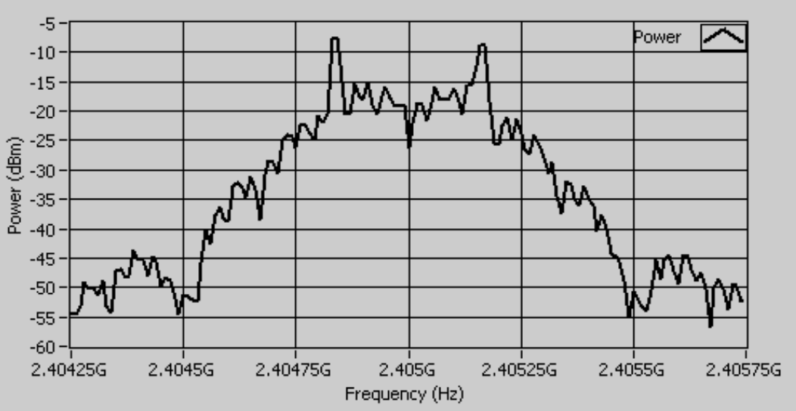
An example from `good case` BLE hardware
Notes:
Fig 8 in https://download.ni.com/evaluation/rf/intro_to_bluetooth_test.pdf

Slide 49
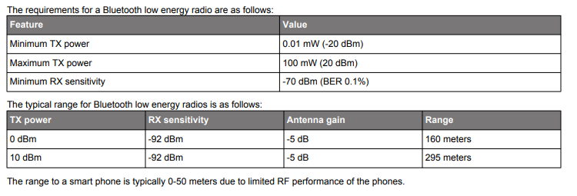
BLE signal strength
Remember nRF52840 capabilities
Transmit: up to 8 dBm
Receive sensitivity: -95 dBm

Slide 50
Outline
Data Link Layer
BLE Background
BLE Layers
Physical Layer
Link Layer

Slide 51
Packet structure
Same packet structure for both advertisements and connections
Fields are filled in little endian (the opposite of network byte order 😡)
Access address unique for each connection (randomly chosen)
In Advertising always set to 0x8E89BED6

Slide 52
Device addresses
Public and private address forms
Public
48 bits: 24-bits of company ID, 24-bits of company assigned number
Literally the same MAC address scheme as Ethernet and WiFi
Private
Top two MSbs specify type
46 bits of random
46 bits of hash of an identity key
Why have the two types?

Slide 53
Device addresses
Public and private address forms
Public
48 bits: 24-bits of company ID, 24-bits of company assigned number
Literally the same MAC address scheme as Ethernet and WiFi
Private
Top two MSbs specify type
46 bits of random
46 bits of hash of an identity key
Why have the two types? Privacy

Slide 54
Data whitening
Avoid long series of repetitive bits (all zeros or all ones)
Would cause RF noise to be more focused in one direction
Radio hardware desires output to have zero DC-bias (or close to that)
Great example of the PHY and MAC being interwoven in wireless
I always forget this exists, since hardware usually handles it automatically

Slide 55
Bit processing pipeline

Slide 56
Break + Question
With enough scanners, could you track BLE devices as they move?

Slide 57
Break + Question
With enough scanners, could you track BLE devices as they move?
Link Layer
Depends on how long they use a device address for
You can do a scan of BLE transmissions to find device addresses
Scans at multiple locations can detect when a device moves throughout an area
But if the device re-randomizes between two scanners, you can’t follow it anymore
Re-randomizing at a scanner could be detectable…
Or if the user has more than one device with unsynchronized rotation schedules

Slide 58
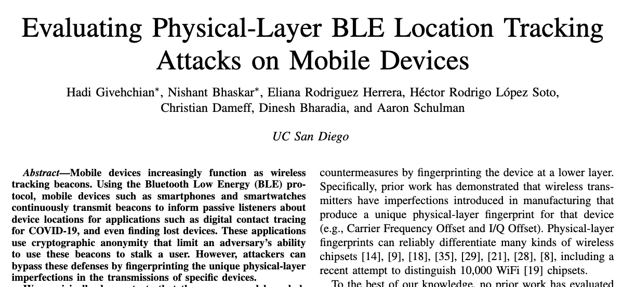
Break + Question
With enough scanners, could you track BLE devices as they move?
Physical Layer
Fingerprint unique physical-layer imperfections in signals
Looking at things like amplitude and timing
2022 paper out of UCSD explores this

Slide 59
Outline
Data Link Layer
BLE Background
BLE Layers
Physical Layer
Link Layer

