Slide 1
Lecture 01
Introduction
CS397/497 – Wireless Protocols for IoT
Branden Ghena – Winter 2023
Materials in collaboration with Pat Pannuto (UCSD)

Slide 2
Welcome to CS397/497!
Goal: get a feel for wireless communication and protocols
  How are they used?
  Why are they different and in what ways?
  Which applications are they most useful for?
~35 students (22 undergrad, 13 grad)
  Lots of different backgrounds and interests
This course is based on discussion and questions
  Expect to attend classes, ask questions, and interact with others
  You’re hopefully here because you want to be and want to learn

Slide 3
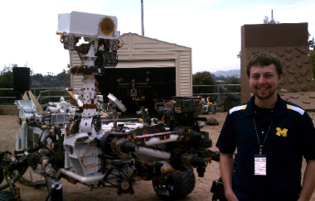
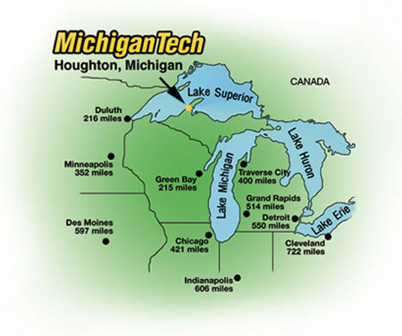
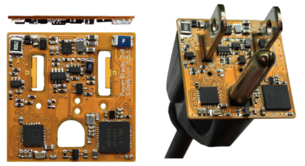
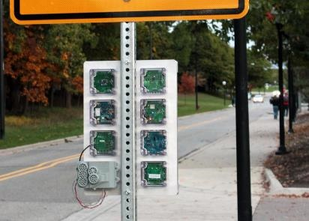





Branden Ghena (he/him)
Assistant Faculty of Instruction
Education
  Undergrad: Michigan Tech
  Master’s: University of Michigan
  PhD: University of California, Berkeley
Research
  Resource-constrained sensing systems
  Low-energy wireless networks
  Embedded operating systems
Teaching
  Computer Systems
    CS211: Fundamentals of Programming II
    CS213: Intro to Computer Systems
    CS343: Operating Systems
    CE346: Microprocessor System Design
    CS397: Wireless Protocols for the IoT
Things I love

Slide 4
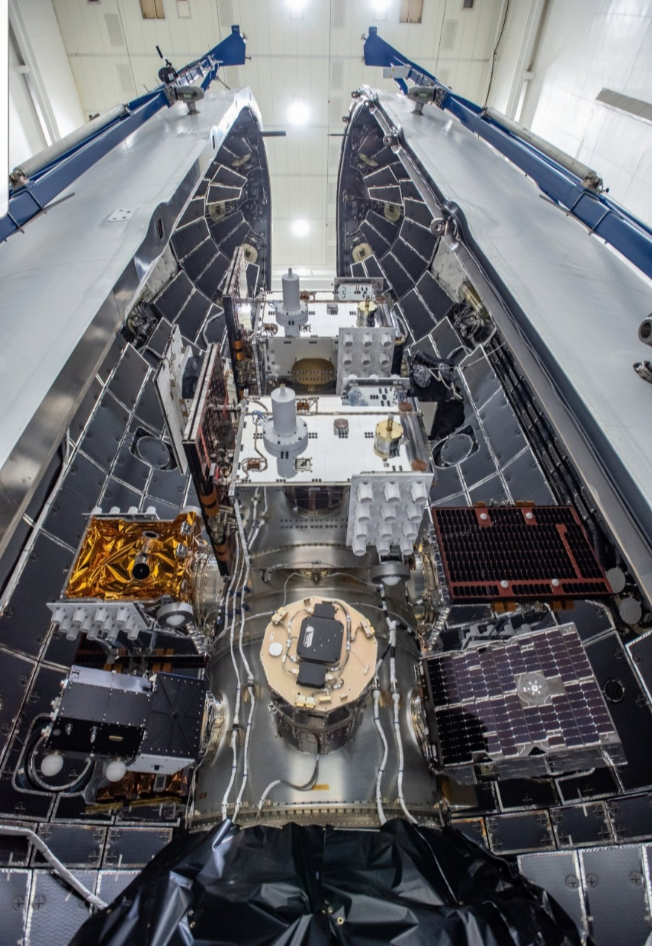
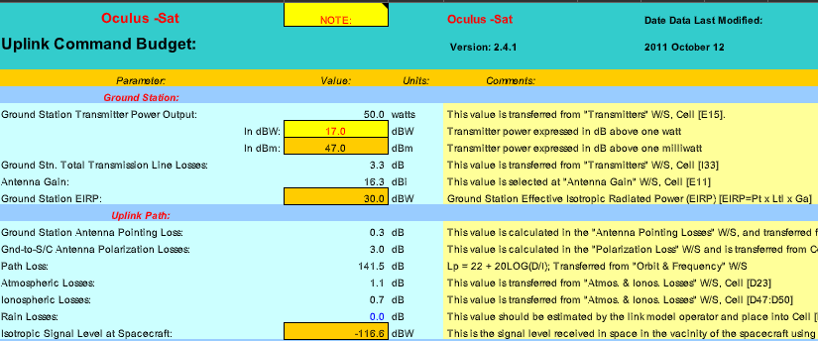
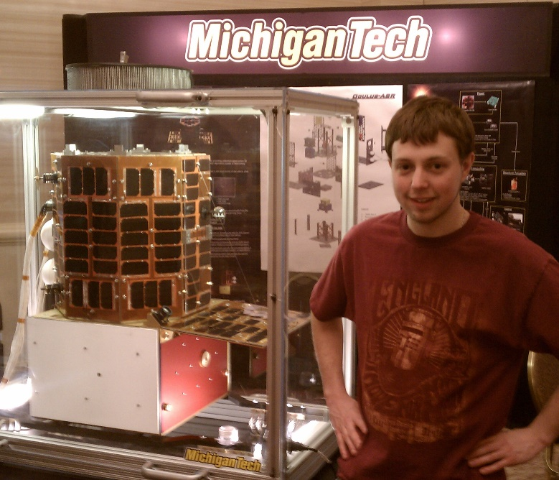
Undergraduate: satellite radios and computers
How the heck are you supposed to learn this stuff?

Slide 5

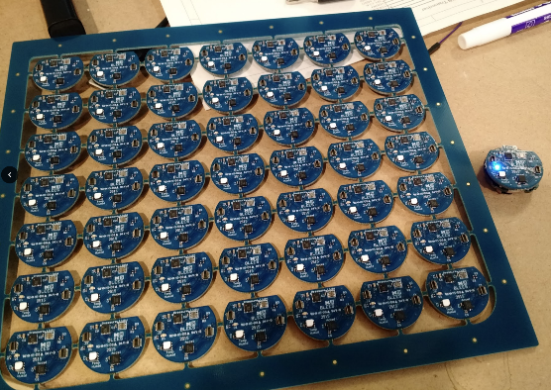
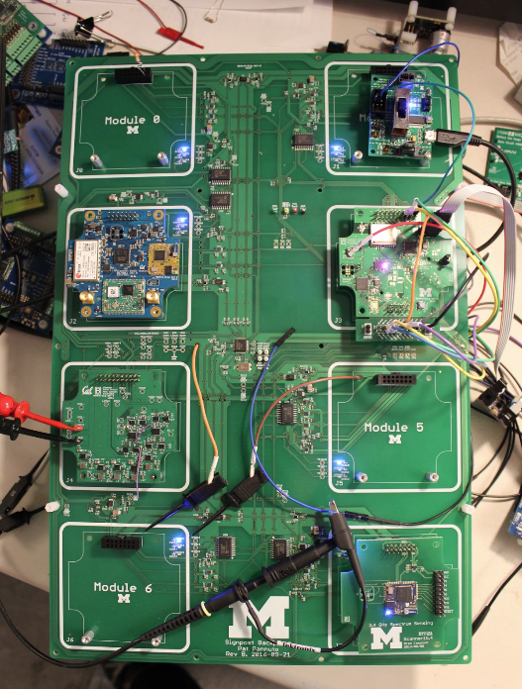
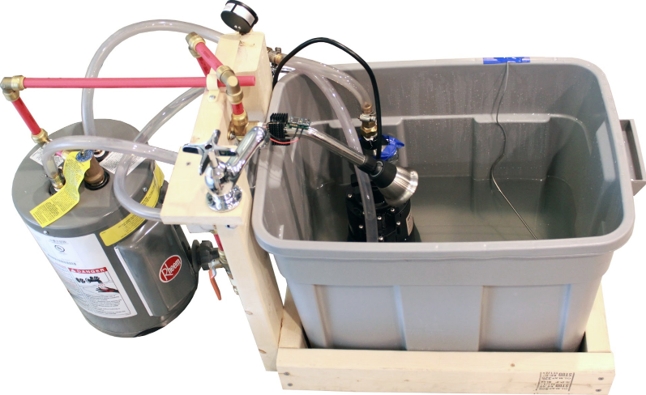
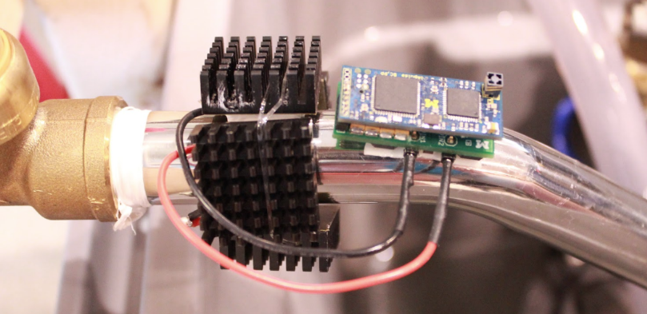
Grad school: resource-constrained embedded systems
Most interesting to me: the interfaces
  Hardware and software
  Applications and OS
  Communication
Again: learn by doing
  With significant assistance from my peers

Slide 6
Faculty: now I can choose what to teach!
Goal: provide classes that teach more advanced embedded systems topics
  Overlaps strongly with CS and ECE, but hopefully useful to other engineering and sciences domains too
Result: this course!
  Course goals: make students familiar with a number of different wireless protocols and their tradeoffs
    Practical hands-on experience with as many networks as possible
    Open-ended design for final, chance to delve deeply into materials

Slide 7
Today’s Goals
Introduction to the Internet of Things
Overview of the course
Introduction to wireless communication

Slide 8
Outline
Who and Why
Internet of Things
Embedded Systems
Course Overview
Overview of wireless networks

Slide 9
Perspective of this course
This class is about wireless protocols
  For a specific domain: the Internet of Things
So we’ll spend some amount of time discussing
the Internet of Things and embedded systems

Slide 10
Discussion: what is the Internet of Things?
Name a few Internet of Things devices
What are the qualities that designate those devices at “IoT”?

Slide 11
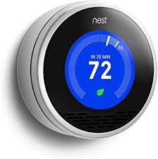
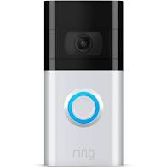


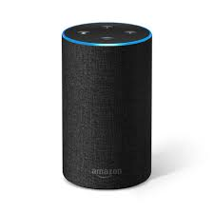
Discussion: what is the Internet of Things?
Name a few Internet of Things devices
What are the qualities that designate those devices at “IoT”?

Slide 12
Thought experiment on capabilities
What if a smart speaker was battery powered and meant to be kept in your pocket?
Would that still count as IoT?

Slide 13
Thought experiment on capabilities
What if a smart speaker was battery powered and meant to be kept in your pocket?
Would that still count as IoT?
  Feels to me like a personal device rather than infrastructure
  Something important about having many users

Slide 14
Thought experiment on capabilities
What if the Nest thermostat was powered by an entire desktop?
  8-core x86-64 processor, 32 GB RAM, 1 TB SSD
Would that still count as IoT?
Why don’t we see that in practice?

Slide 15
Thought experiment on capabilities
What if the Nest thermostat was powered by an entire desktop?
  8-core x86-64 processor, 32 GB RAM, 1 TB SSD
Would that still count as IoT?
Why don’t we see that in practice?
Cost

Slide 16
Thought experiment on energy
The origins of IoT are battery-powered sensing systems
  And energy-harvesting devices
Why do we put so much focus on systems with batteries?
  Why do they need batteries?

Slide 17
Thought experiment on energy
The origins of IoT are battery-powered sensing systems
  And energy-harvesting devices
Why do we put so much focus on systems with batteries?
  Why do they need batteries?
Deployability

Slide 18
Largest IoT challenges: power and communication
This class is about wireless technologies
  For resource-constrained systems, such as the IoT
We will focus on the tradeoffs between technologies
  How they balance differing constraints
    Power, spectrum, complexity, etc.
  And the technical foundations of these designs and differences

Slide 19
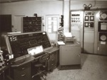
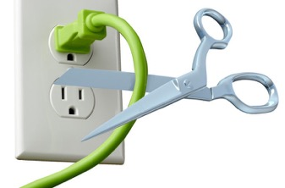
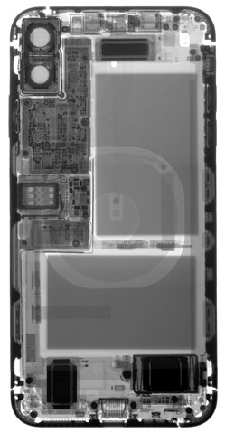
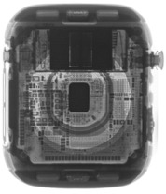
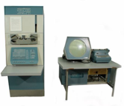


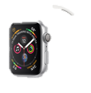

Energy is the defining constraint of emerging technologies
Mainframe
Computer
Workstation
By volume, the emerging computing classes are mostly energy storage
Volume is shrinking cubically
Laptop
Mini Computer
Battery
IoT/Wearable
Personal Computer
Smartphone
Notes:
Defining feature of modern computing classes is the amount of energy storage required to allow their operation
Clip art: http://www.ctecsolar.com/cut-cord-electric-company/
X-rays: iFixit teardowns

Slide 20
Branden’s take on the Internet of Things
Key features
  Computation
    Local to the device
    With some capability for arbitrary compute and storage
  Connectivity
    Almost certainly wireless
    Likely Internet, possibly local
  Interaction
    Sensing or Actuation
Secondary features
  Low energy
  (Relatively) Low cost

Slide 21
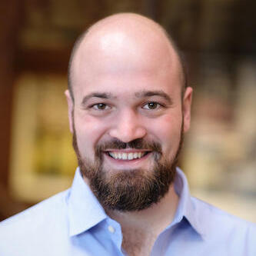
Pat Pannuto’s take on the Internet of Things
His early grad school essays described the “last inch” problem
  Now he often says “expanding the reach of digital world”
For him, it is about ‘networked’ ‘things’
  Which implicitly adds some computational capacity
    [Though not always? Backscatter sensors break this definition…]
Assistant Professor, UC San Diego
https://patpannuto.com/
He teaches a version of this course there, and we share materials back-and-forth!

Slide 22
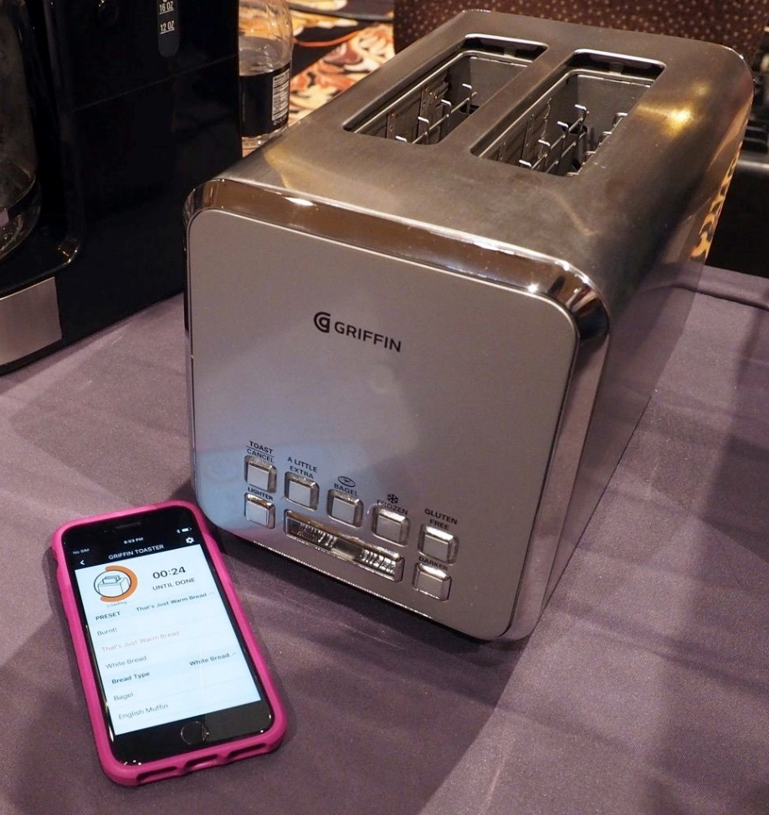
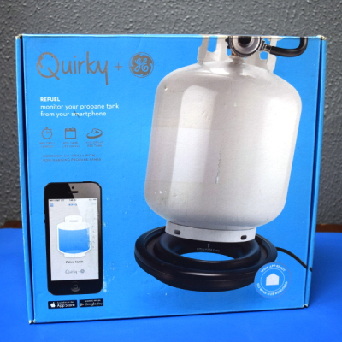
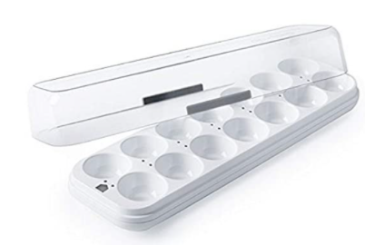
Warning: Internet of Crap

Slide 23
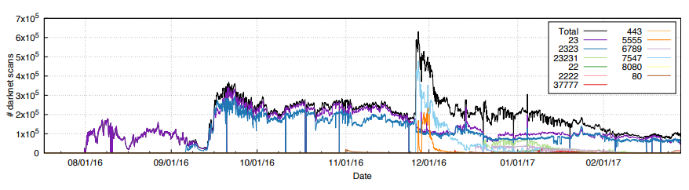
Internet of Insecure Crap
Mirai botnet (2016)
Takes control of up to 600,000 insecure connected devices
  IP-attached cameras, DVRs, routers, printers
Used to DoS websites

Slide 24
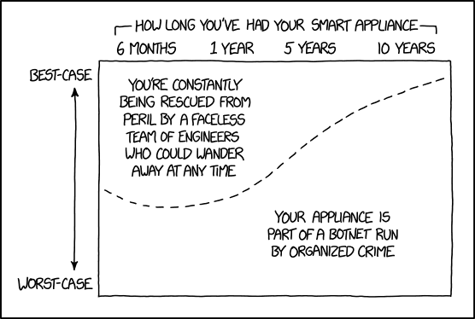
Break + xkcd
https://xkcd.com/1966/

Slide 25
Outline
Who and Why
Internet of Things
Embedded Systems
Course Overview
Overview of wireless networks

Slide 26
What are embedded systems
Embedded systems are devices containing computers that are used as a device rather than as a computer
  Computers are embedded into the device
Internet of Things devices are embedded devices
But there are embedded systems that are not IoT
  Smart vehicles and Robotics
  Personal devices (embedded systems inside laptops/smartphones)
Example: USB-C power brick has more compute than Apollo 11 did
https://forrestheller.com/Apollo-11-Computer-vs-USB-C-chargers.html

Slide 27
Microcontrollers drive most embedded systems
Microcontroller: entire computer in a single chip
  Processor
  Working memory: SRAM (like RAM)
  Nonvolatile memory: Flash (like SSD)
  Peripherals
    I/O pins
    Analog Inputs and Outputs
    Timers
    Wireless radios
    Cryptography accelerators
  Power management
    Buses
      UART
      I2C
      SPI
      USB

Slide 28
How is a microcontroller different?
A very constrained computer
  Simple processor
    16 or 32 bits (usually 32-bit these days)
    Processor speed in MHz
    Single core, pipelined processor
    No cache, or maybe a very small instruction cache
  Memory measured in kB
    Code executes right from read-only Flash (which is part of the address space)
  Often no OS support
    “bare-metal” programming

Slide 29
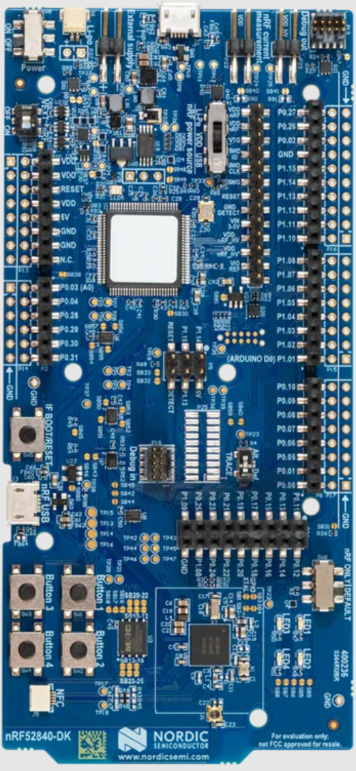
Nordic nRF52840DK - BLE & Thread
nRF52840 microcontroller dev kit
  Microcontroller is the bottom chip
  Everything else is just to program it, measure power, and connect to external things
nRF52840
  64 MHz, 32-bit ARM Cortex-M4F
  1 MB Flash, 256 KB RAM
  A bunch of peripherals
  Bluetooth Low Energy and 802.15.4 communication

Slide 30
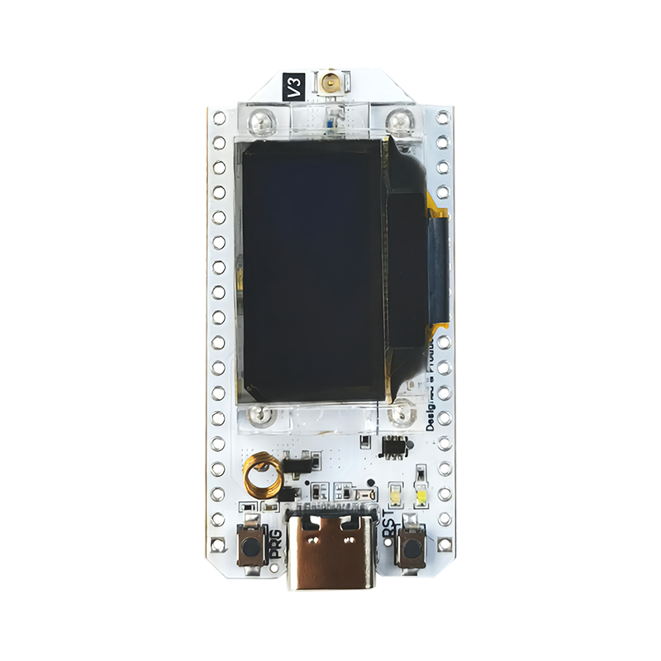
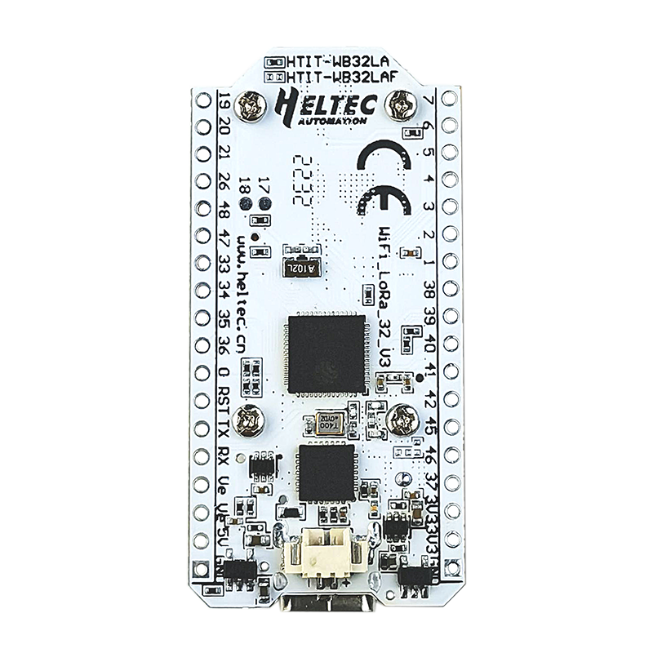
Heltec WiFi LoRa 32 v3 - WiFi & LoRa
ESP32 microcontroller
  240 MHz, 32-bit custom architecture
  384 kB Flash, 512 kB RAM
  A bunch of peripherals
  WiFi and Bluetooth Low Energy communication
SX1262
  LoRa transceiver (connected over SPI)
OLED display

Slide 31
Embedded systems are programmed in C
C++ also used
  Occasionally assembly
  Rarely other things (Rust, Lua, Python)
But even the few things C gives you aren’t necessarily available
  Heap space possibly nonexistent
    You have to choose some space in RAM to save as a heap
    And then include the algorithm for allocating that memory
  Printf may be nonexistent too
    There’s no STDIN/STDOUT/STDERR because there is no shell
    Might be able to do serial output though

Slide 32
How do I load code onto microcontrollers?
JTAG (Joint Test Action Group)
  Hardware built into the microcontroller for testing purposes
  Can arbitrarily read/write memory
  Can single step process too, at runtime!
    GDB can connect to it! (sort of)
  RTT (Real Time Transfer) makes printf work over JTAG
Serial bootloaders
  Software runs on the microcontroller at boot that waits a short time for someone to contact it and upload code
  Convenient, but sometimes flaky

Slide 33
Embedded software
There are a multitude of embedded software systems
  Every microcontroller vendor has their own
  Popular platforms like Arduino
Embedded OSes
  Contiki, Riot, Zephyr, Mynewt, FreeRTOS, Tock
nRF52840DK has support across all of these
WiFi LoRa 32 v3 should work with some
  Best support likely in Arduino

Slide 34
Outline
Who and Why
Internet of Things
Embedded Systems
Course Overview
Overview of wireless networks

Slide 35
Asking questions
Class and office hours are always an option!
  Office hours by demand. I promise to meet!!
Piazza: (similar to Campuswire)
  Post questions
  Answer each other’s questions
  Find lab partners
  Information from the course staff
  Post private info just to course staff
Please do not email me! Post to Piazza instead!
  I’ll be updating roster again a few times

Slide 36
Grading
50% Lab projects - hands-on semi-guided activities
  Likely 5 of these, divided equally
  Small groups of three students
25% Homeworks - pencil-on-paper practice
  Likely 4 of these, with the last worth double
  Individual work
25% Final design project - paper writeup
  One of these due during exam week
  Individual work

Slide 37
Labs
Practice interacting with and considering networks
Should all include real hardware and real wireless communication
  Wireshark
  Bluetooth
  Thread
  WiFi
  LoRaWAN
Note: WiFi/LoRa hardware shipping from China now, we’ll see how that goes and adjust if needed

Slide 38
Homeworks
Analysis, designing, calculating
  Background
  BLE packets
  Mesh
  Cellular (worth double)

Slide 39
Final design project
Design a communication plan for an application of your choice
Explain application and determine what its constraints are
  Cost, power, scale, data, reliability
Actually think through how it will work, citing real-world capabilities
  Research and cite data you find
  Explain and consider tradeoffs
This is the “final project” for the course
  Design rather than real hardware

Slide 40
On upper-level, special-topics courses
Something this class does not include is exams or quizzes
The point is to be here because you’re actually interested in the material
  So show up to lecture because it’s interesting to you and so you can discuss with your classmates
  But the class itself isn’t going to force you to learn anything
You can help guide the course
  It’s okay to derail lecture (sometimes) with interesting tangents
  I’m happy to add material on other topics if you ask

Slide 41
Break + Architecture of a lecture
Full
Administrivia
+ stretch break
Open
Question
Summary
+ Bonus
Attention
0
20
25
50
53
78
80
Time (minutes)

Slide 42
Outline
Who and Why
Internet of Things
Embedded Systems
Course Overview
Overview of wireless networks

Slide 43
Bluetooth Low Energy (BLE)
Bluetooth Classic was good for enabling device to device communication
  But not particularly fast or low energy
Bluetooth Low Energy was developed to improve this
  Focuses on low-energy interactions
  Much lower throughput that Bluetooth
Supported by hardware devices already in smartphones
  Humans can interact directly with nearby devices!!

Slide 44
802.15.4 & Thread
802.15.4 is a low-energy physical layer
  Radio chips have been widely available for 15-20 years
Significant amounts of sensor network research have focused on building layers on top of 802.15.4
  Access control layers
  Network layers
Thread is a selection of these possibilities to make a network
  Uses IPv6 networking!!

Slide 45
WiFi (802.11)
Ubiquitous wireless communication
  High energy requirements for high throughput communication
Now accessible through relatively low power radios
  ESP32 is dominant here
  Still significantly more effort than BLE or Thread
IoT devices can use the same WiFi that’s already available
  No need for additional infrastructure!!

Slide 46
LPWANs (Low-Power Wide-Area Networks)
How do we collect data from city-scale deployments?
  There’s an unmet need for long-range, but low-throughput networks
  Existing cellular technologies focus on human requirements
Still a brand new space (relatively)
  Unlicensed-band technologies in last 5 years: Sigfox and LoRaWAN
  Cellular technologies in last 2 years: LTE-M and NB-IoT
Focus on long-range, low-energy, low-throughput
  One gateway can cover an entire city!!

Slide 47
Extra topics
Matter
  Interoperability standard for the Internet of Things
  First public spec released in October 2022
Backscatter
  Insanely low-energy communication
  Enables energy-harvesting indoor devices
Localization
  How do we find all this stuff?
  And how do devices determine where they are relative to each other?
Other topics are possible if desired! (seriously!)
  Reach out and tell me what you want to learn about

Slide 48
Why use wireless?
There are no wires!
No need to install and maintain wires
  Reduces cost
  Simplifies deployment – place devices wherever makes sense
Supports mobile users
  Move around office, campus, city
  Move devices around home

Slide 49
What is hard about wireless?
There are no wires!
Wired networks are constant, reliable, and physically isolated
  Ethernet has the same throughput minute-to-minute
  Bits sent through Ethernet or USB are (usually) received
Wireless networks are variable, error-prone, and shared
  WiFi throughput changes based on location and walls
  Signals from nearby devices interfere with your signals
  Individual bits might flip or never be heard at all

Slide 50
Wireless is a shared medium
Wired communication has signals confined to a conductor
  Copper or fiber
  Guides energy to destination
  Protects signal from interference
Wireless communication is inherently broadcast
  Energy is distributed in space
  Signals must compete with other signals in same frequency band

Slide 51
Increasing network capacity is challenging
Wired networks just add more wires
  Buses are many signals in parallel to send more data
Wireless networks are harder
  Adding more links just increases interference
  Need to expand to different frequencies

Slide 52
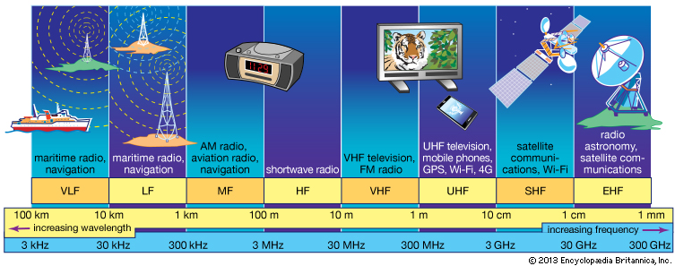
RF communication
IoT focus

Slide 53
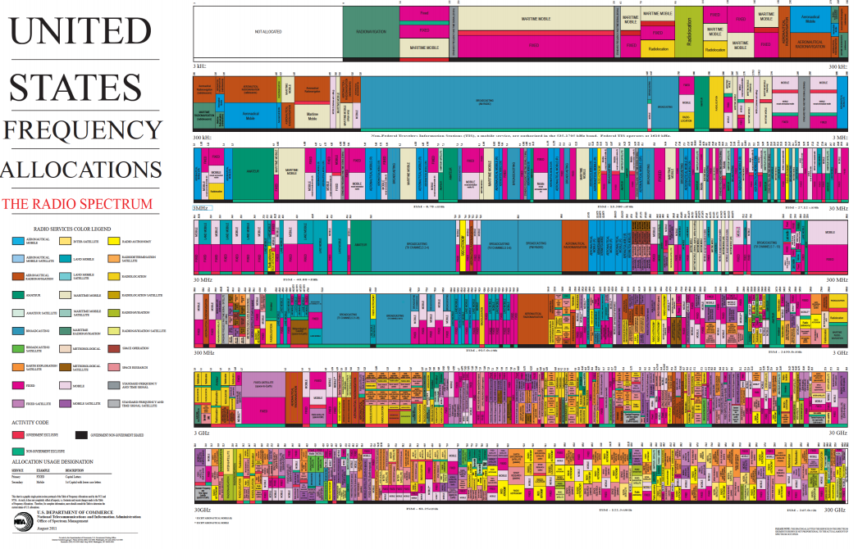
Wireless spectrum is allocated to specific uses

Slide 54
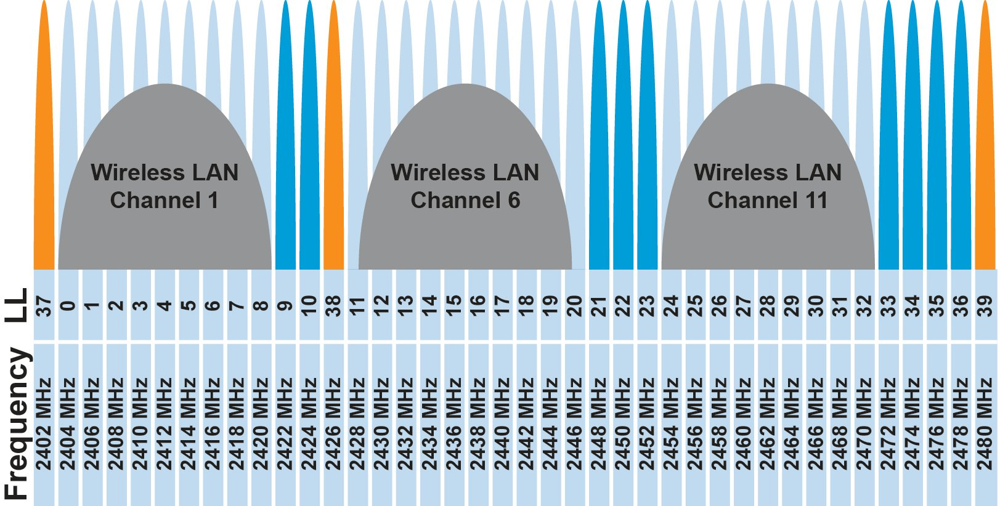
Unlicensed bands are where IoT thrives
902 MHz – 928 MHz
  LPWANs
2.4 GHz to 2.5 GHz
  WiFi, BLE, Thread
5 GHz
  Faster WiFi
Cellular uses licensed bands

Slide 55
Model of RF communication
Energy that radiates spherically from an antenna
Attenuation with distance
  Density of energy reduces over time, distance
  Signal strength reduced, errors go up
Two key features
  Error rates depend on distance
  Spatial reuse of frequencies

Slide 56
Outline
Who and Why
Internet of Things
Embedded Systems
Course Overview
Overview of wireless networks

