Slide 1
Lecture 16
Localization
CS397/497 – Wireless Protocols for IoT
Branden Ghena – Winter 2021

Slide 2
Today’s Goals
Discuss ideas in localization
  Uses wireless signals for the process
  Important for the Internet of Things
Describe background on GPS
Overview of indoor localization techniques
  Fingerprinting, Ultra-wideband, etc.

Slide 3
Outline
Localization Background
GPS
Indoor Localization
  Overview
  Fingerprinting
  Ultra-wideband
  Other techniques

Slide 4
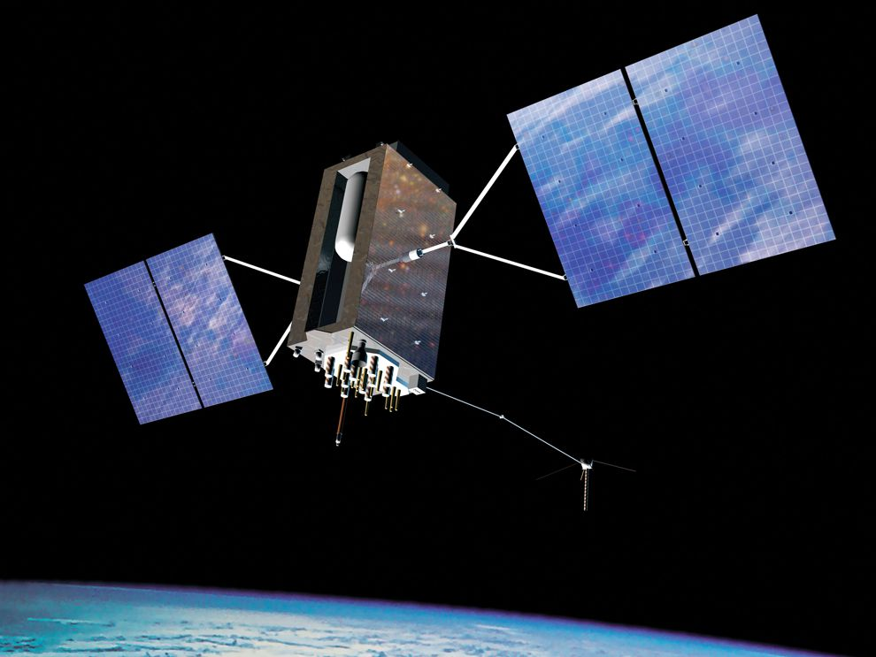
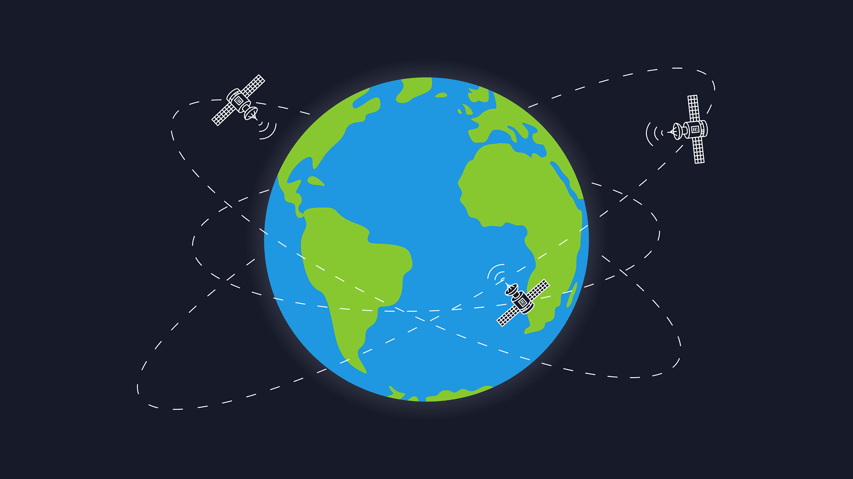
Background knowledge?
How does GPS work anyways?

Slide 5
Background knowledge?
How does GPS work anyways?
  Know the position of all satellites
  Receive signals from multiple satellites
  Determine distance from each satellite
  Trilateration

Slide 6
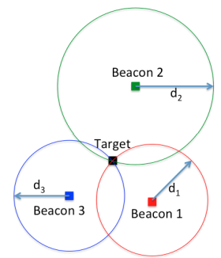
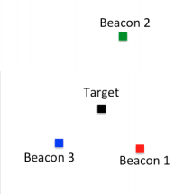
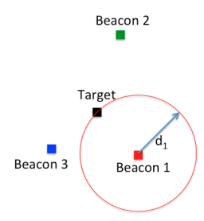
Trilateration
Determine distance from each beacon, then find position
  Apply trigonometry to solve triangle with beacons. Requires:
    3 lengths (or some angles and lengths…)
  Solve two triangles and get 3D position
Most common and accurate localization approach

Slide 7
Determining distance
Making trilateration work requires distance measurements
Techniques
  RSSI
  Time of Flight
  Time of Arrival

Slide 8
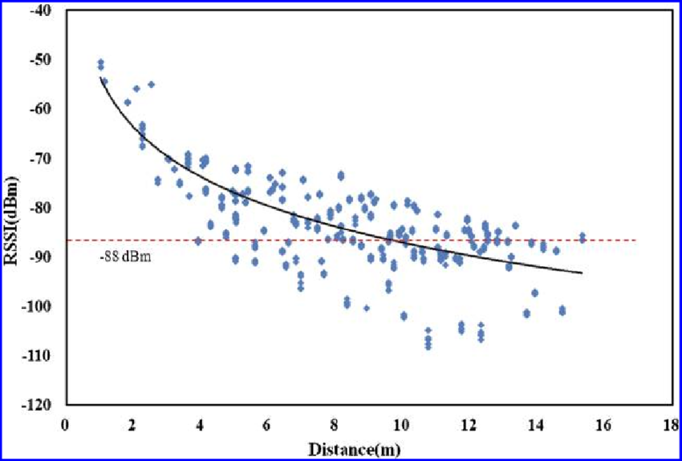
Reminder: problem with RSSI-based distance – not accurate
Pathloss is NOT only due to distance
RSSI is way worse at this than you hope it would be
Citation: literally everyone has made this figure at some point

Slide 9
Time of flight (also known as time of arrival, ToA)
Determine distance by knowing:
  Exact position of infrastructure
  Transmit time
  Receive time
  Signal velocity (i.e. speed of light)
Infrastructure transmits and device listens
  Can happen all the time, but devices only listen when they want a position
Requires time synchronization between infrastructure and device
  Synchronization must be good: 1 μs = 300 meters

Slide 10
Time difference of arrival (TDoA)
Device transmits and infrastructure receives transmission
  Multiple infrastructure nodes receive at different times based on distance
Determine distance by knowing
  Exact position of infrastructure
  Time of arrival at two different locations
  Signal velocity (i.e. speed of light)
Doesn’t require synchronization with infrastructure!
  Still requires synchronization between infrastructure nodes
  Does require device to transmit loud enough for infrastructure to hear it…

Slide 11
How many anchors are needed?
3 anchors gets a 2D location
4 anchors gets a 3D location
Shortcut: if the alignment is right, 3 anchors can do 3D
  3 anchors result in two possible points that satisfy equations
  One will be on the ground, the other somewhere mid-air or underground

Slide 12
Real-world complication: accuracy
No distance measurement will be perfect
Which means trilateration will not be perfect either
  Need to solve equations in a fuzzy manner looking for least error

Slide 13
Outline
Localization Background
GPS
Indoor Localization
  Overview
  Fingerprinting
  Ultra-wideband
  Other techniques

Slide 14
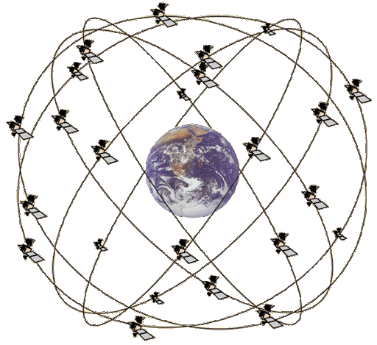
GPS overview
Trilateration using Time of Flight from at least 4 satellites
  Satellites in well-known orbits with VERY stable clocks
Satellites placed in Medium Earth Orbit (20,000 KM)
  Orbit earth twice per day
  Placed such that 4 are in view everywhere, always
  31 total in orbit as of November 2020
    Most recent launch November 5th 2020
Comparisons
  LEO 200-2000 km, ISS at 340 km
  GEO 35,000 km

Slide 15
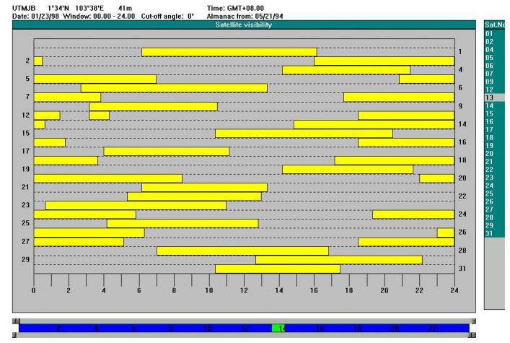
Satellite visibility overhead

Slide 16
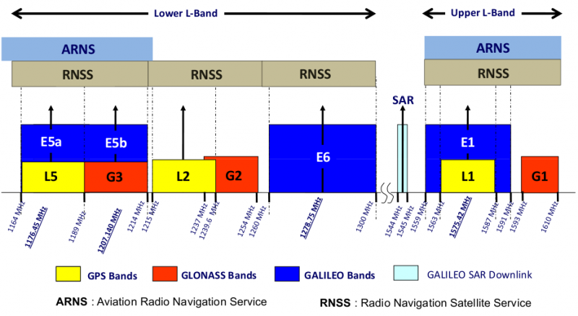
GPS PHY
GPS frequency
  1.2 GHz and 1.5 GHz
  10-15 MHz bandwidth
BPSK modulation
Signal has to travel 20,000 km, but most of that is through space
  Tx power 25 Watts (44 dBm)
  Rx sensitivity -140 dBm to -160 dBm (50 bps data rate)
  ~200 dBm total link budget

Slide 17
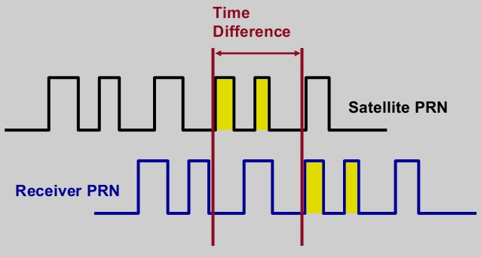
GPS transmissions
Each satellite sends a unique pseudo-random number sequence
  Sequence repeats in time (over minutes) and is well-known
  Position in signal is used to calculate time of flight

Slide 18
GPS requires signals from multiple satellites
4 satellites are needed to determine location and time
  3 for 2D location (assume on ground) and 1 for time offset
  Solve for both as a single equation
Steps to finding location
  Initialize time to whatever you heard from a satellite (~100 ms sync)
  Get time of arrival from four satellites
  Four variables
    x, y, z, and time offset

Slide 19
Additional GPS data
Receiver needs to know additional information
  Current time
  Position of each satellite
GPS transmission has this data layered on top (50 bps)
  Listening for (up to) 30 seconds gets time and this satellite’s position
    Known as ephemeris
    Valid for up to 4 hours
  Listening for 12.5 minutes gets all satellites’ positions
    Known as almanac
    Valid for up to two weeks
Cold-start for an embedded device takes significant time

Slide 20
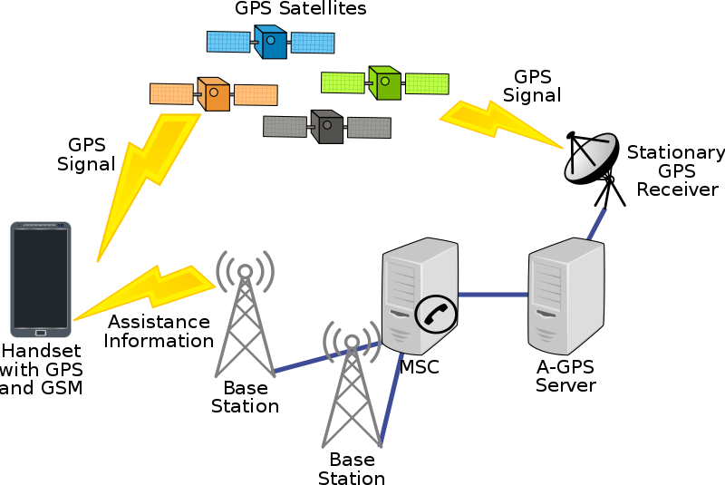
Assisted GPS
How is cell phone GPS so quick?
  Download almanac from the internet (only 1.8 kB)
Bootstrap location information
  Cell towers can give coarse position
  Enables device to know which satellites are overhead

Slide 21
Outline
Localization Background
GPS
Indoor Localization
  Overview
  Fingerprinting
  Ultra-wideband
  Other techniques

Slide 22
Clearing something up
The goal is NOT directing people through a building
Just because that’s what GPS is used for outdoors doesn’t mean we need that application indoors

Slide 23
Goal of indoor localization
The goal is positioning things within a building
  Where can I find X?
  X: where am I located?
  X and Y: are we near each other?
Robotic navigation is also important
  Although there are many approaches here

Slide 24
Localization classes
Absolute location
  X, Y, Z position based on already known infrastructure locations
    Like GPS does
  Installed localization hardware known as anchors
Relative location
  Position relative to some other device
    Technically absolute location is a version of this
  Might only need a few devices
  How far is the smartphone from the computer?

Slide 25
Localization knowledge
What kind of a result is actually useful?
  You are at {15, 27.5, 1}
  You are at Room 224
  Depends on the application
Additional systems on top of the localization method can translate between location representations

Slide 26
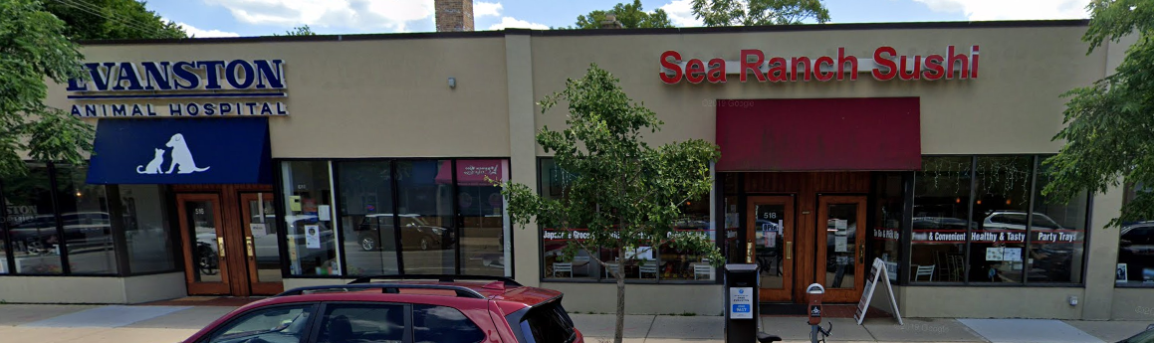
Barrier problem
“I’m here to pick up fish”
Walls are very contextually important, but difficult for localization systems to detect

Slide 27
Accuracy notation
“40 cm median accuracy”
  Majority of devices are 40 cm or better!
  What about the other half?
90th percentile error is often more important for real-world use
My least favorite aspect of localization
  Be wise to these tricks

Slide 28
Outline
Localization Background
GPS
Indoor Localization
  Overview
  Fingerprinting
  Ultra-wideband
  Other techniques

Slide 29
Mapping existing infrastructure
Can we repurpose existing infrastructure for localization?
  For example: WiFi access points
  Benefit: localization works with unmodified hardware
Mapping instead of trilateration
  Make a map of infrastructure and use that to locate device
  Coarse example: existence of WiFi network SSIDs
  Fine-grained example: signal strength to each Access Point
    Known as fingerprinting

Slide 30
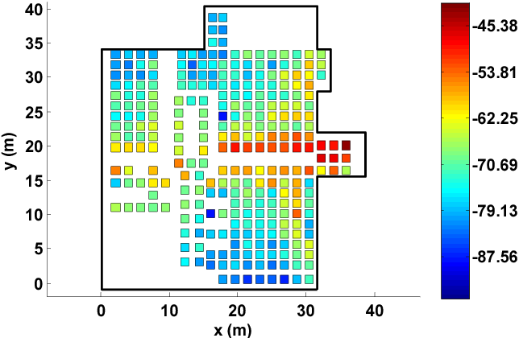
Fingerprinting overview
At setup time, for many locations throughout building
  Measure signal strength to Access Point
  Record measurement in a database with location
At run time, for the device that wants a location
  Measure signal strength to Access Point
  Look up measurement in database to get location

Slide 31
Fingerprinting improvements
Measurements can use several Access Points simultaneously
  Improves accuracy quite a bit
Doesn’t have to be WiFi based at all
  Cellular networks can do fingerprinting
  Deploy your own BLE beacons throughout environment
Apply techniques for minimizing error in signal strength
  Measurement won’t match record exactly
  But minimizing error should approach the same location

Slide 32
Fingerprinting challenges
Effort to create database in the first place
  Manually take measurements at every location
Environment is not stable
  Signal strength changes as chairs, doors, and people move
  Need ability to periodically re-measure
    Update database with most recent recording while in use
Measurements vary between devices
  Differ based on antennas, cases, how you hold it, etc.

Slide 33
Fingerprinting accuracy
State-of-the-art: median accuracy of 0.5-1.5 meters
  Not bad depending on the application!
  Likely places you in the right room, or at least nearby
  Long tail can be large, but more access points helps this
Barrier problem capability depends on walls
  Some materials attenuate signal strength more than others

Slide 34
Outline
Localization Background
GPS
Indoor Localization
  Overview
  Fingerprinting
  Ultra-wideband
  Other techniques

Slide 35
Improving accuracy
To get really good accuracy, let’s return to trilateration
Plan: Send an RF signal from one device and time how long it takes to reach another
  Brief transmissions rather than continuous like GPS
Problem: When does this signal arrive?
  Need to pick somewhere in rise as the “arrival time”

Slide 36
Multipath problem
Real-world signals bounce off of things in the environment
  Multiple, time-delayed versions of signal arrive at antenna
  Result smears out the arrival of energy in time
    More reflections mean more peak energy, but longer rise time
  This isn’t predictable. Depends on the exact environment configuration

Slide 37
Why does ultra-wideband yield better localization performance?
Wider bandwidth makes the RF pulse narrower in time
  Make it narrow enough, and multipath becomes entirely separate

Slide 38
Ultra-wideband localization system
Narrow ultra-wideband pulses makes arrival timing work
The rest is a copy of well-known techniques
  Deploy anchors in the environment with known positions
  Measure distance between anchors and device
    Time of Flight (if anchors transmit)
    Time Difference of Arrival (if devices transmit)
  Trilateration to find position

Slide 39
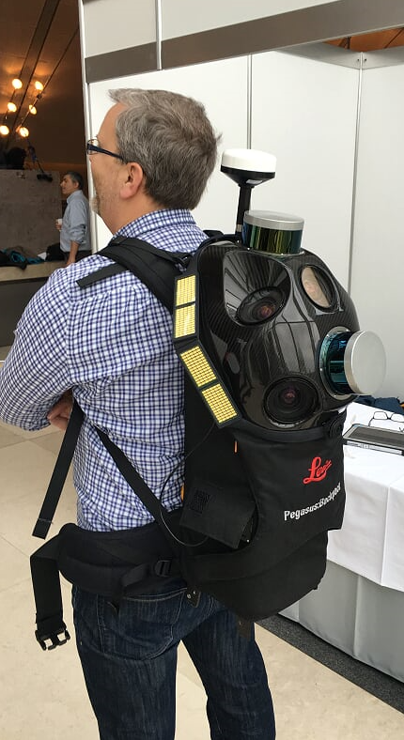
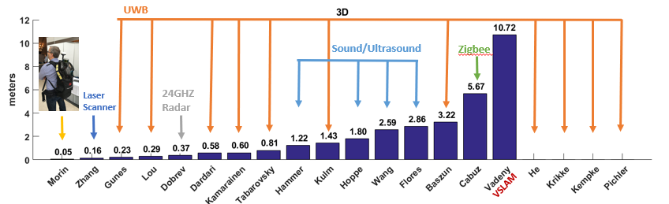
Localization state-of-the art
Microsoft indoor localization competition, 2016
  Teams are given a day to measure and deploy their systems in a space
  Provide {x, y, z} coordinates using up to 5 anchors in large open room

Slide 40
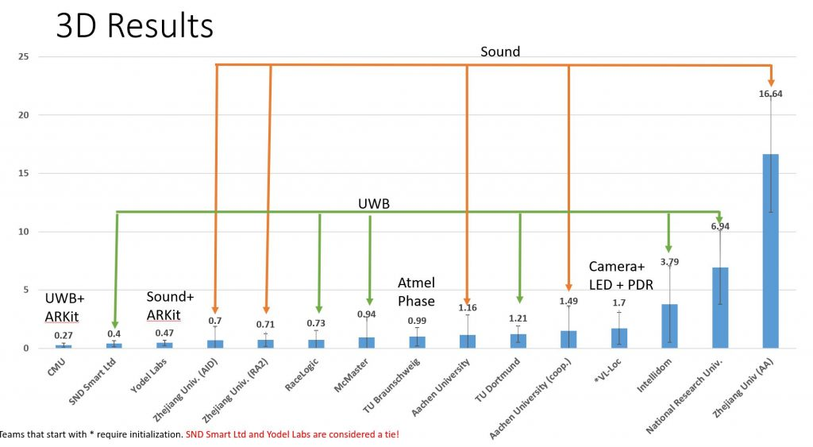
2019 results (Microsoft indoor localization competition)

Slide 41
Improvements to ultra-wideband
Improve results with multiple, diverse measurements
  Sources of diversity
    Send on multiple channels
    Send with multiple antennas
    Receive with multiple antennas
  Measure each combination of these and average to get better results
Combine with backscatter approaches
  Result is very slow (minutes to locate device) but very low power (<1μW)
  Most inventory doesn’t move!

Slide 42
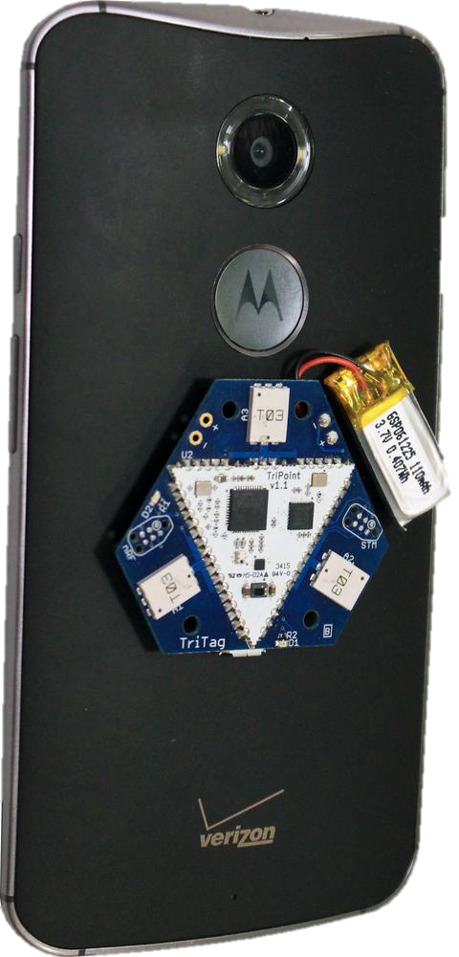
Bringing UWB to the real world
Ultra-wideband radios have been fairly specialized
  Needed to build special hardware to use them
iPhone 11 and 12 have UWB radios!!!
  Use cases are still a little unclear
  Opens a big area of development

Slide 43
Outline
Localization Background
GPS
Indoor Localization
  Overview
  Fingerprinting
  Ultra-wideband
  Other techniques

Slide 44
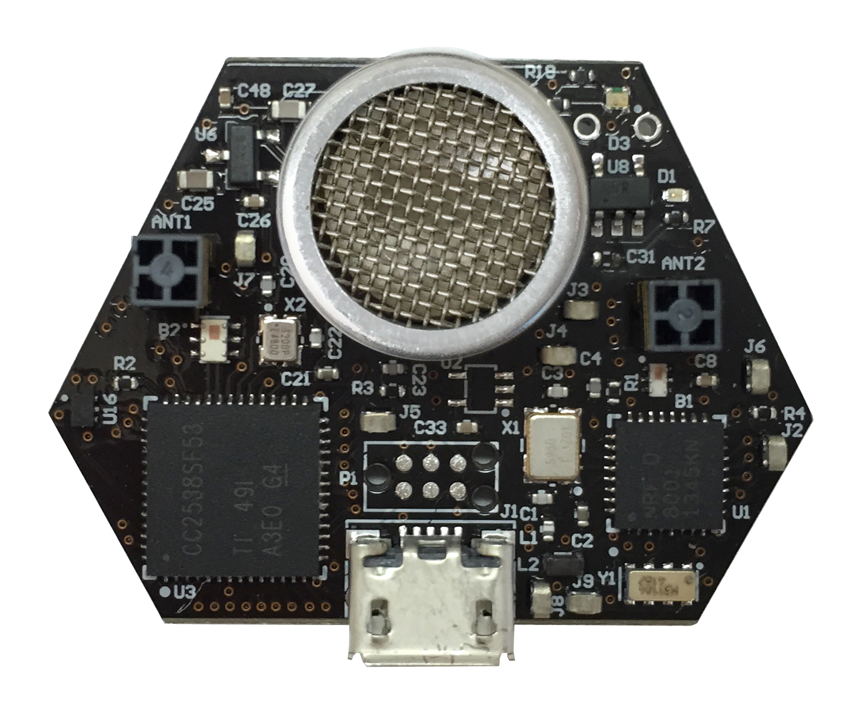
Ultrasound
Advantages
  Solves the barrier problem
    Human spaces already designed to contain sound
  Easier to get high-accuracy results
    Sound is ~1,000,000x slower than light
    Less synchronization is needed to get same accuracy
Disadvantages
  More energy to transmit
  Slower update rate (still sub-second)
  Limited range
  Pets can hear it…

Slide 45
Inertial navigation
If you know acceleration, you can get position, just integrate!
  With quite a bit of error
Accurate over short distances with filtering approaches
  Can be used to augment other systems
  Get a fix every few seconds from localization system
  Use inertial navigation to interpolate between measurements
IMUs (Inertial Measurement Units) available in all smartphones
  Accelerometer, Gyroscope, Magnetometer

Slide 46
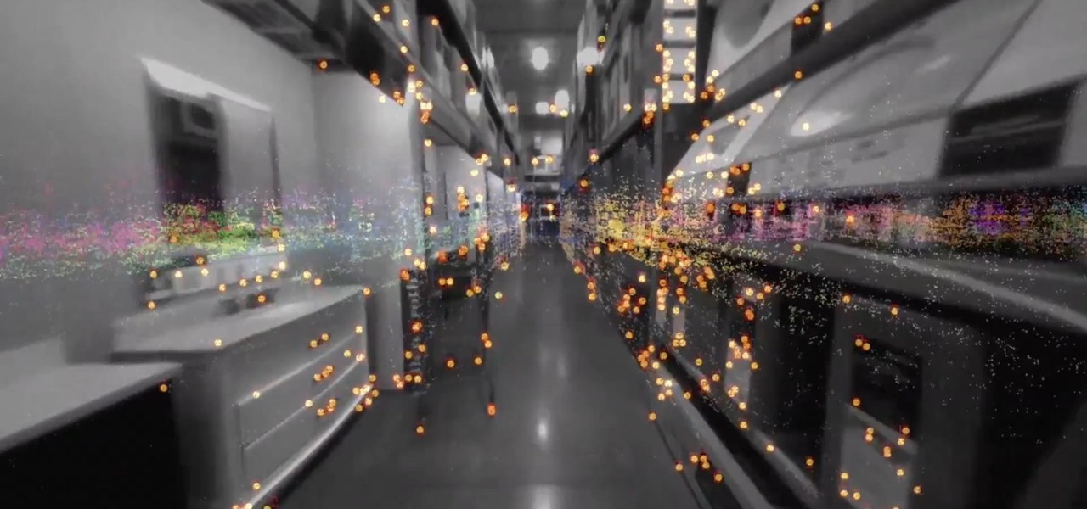
ARKit (and other AR techniques)
Leverage smartphone cameras for positioning
  Pictures of a user’s surroundings can be compared to floorplan
  Related to SLAM techniques (Simultaneous Localization And Mapping)
Can build an incredibly accurate system
  With a bit of bootstrapping
  Probably applies most to robotics use cases

Slide 47
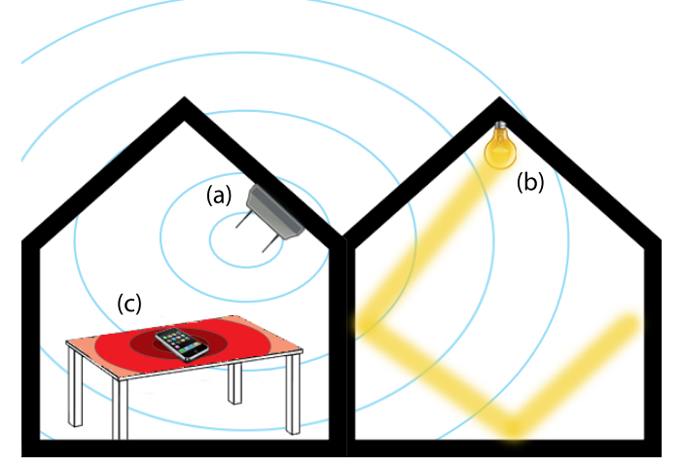
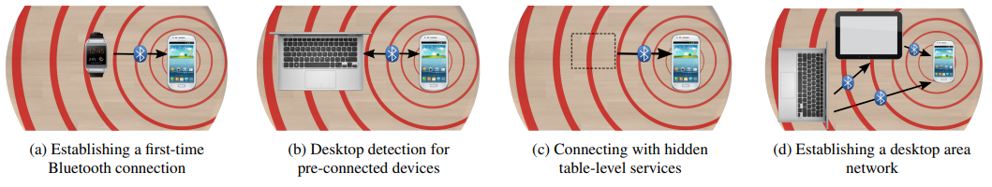
Vibrations
Determine shared context of a table
  Vibratory motors and IMUs are common
  Signaling demonstrates nearby devices

Slide 48
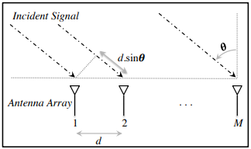
Angle of arrival (AoA)
Trilateration doesn’t only require distances, angles work
Antenna arrays can be used to determine the angle of an incoming signal
  Allows the use of normal RF communication (WiFi or BLE)
BLE 5.1 includes AoA localization

Slide 49
Outline
Localization Background
GPS
Indoor Localization
  Overview
  Fingerprinting
  Ultra-wideband
  Other techniques

