Slide 1
Lecture 11
WiFi PHY
CS397/497 – Wireless Protocols for IoT
Branden Ghena – Winter 2021

Slide 2
Today’s Goals
Discuss WiFi physical layers
  Get a feel for what choices are leading to more throughput
  Think a little about what the costs of that are

Slide 3
Outline
WiFi Overview
WiFi PHY
  802.11/802.11b
  802.11a/802.11g
  802.11n/802.11ac
  Real-World WiFi

Slide 4
What is WiFi?

Slide 5

What is WiFi?
(That title is a joke. Even my grandparents know what WiFi is.)
WiFi is the most successful wireless protocol.

Slide 6


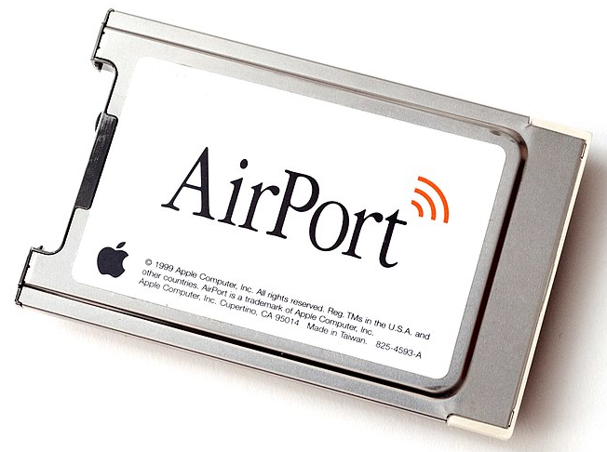
802.11 timeline
1985 – US FCC rules ISM band for unlicensed use
1990s – WaveLAN (NCR Corporation, Netherlands)
  Wireless ethernet for cashier systems
1997 – 802.11 specification
1999 – 802.11b and 802.11a amendments
1999 – WiFi Alliance formed for certification of devices
1999 – Apple iBook is the first consumer WiFi product

Slide 7
Major amendments
802.11b was very popular but is now usually unsupported
802.11a never saw major deployment
WiFi Alliance rebranded 802.11ac as “WiFi 5” and backported scheme
 | Protocol | Year | Frequency | PHY | Max Rate | Range
- | 802.11 | 1997 | 2.4 GHz | DSSS/FHSS | 2 Mbps | 20 m
1 | 802.11b | 1999 | 2.4 GHz | DSSS | 11 Mbps | 35 m
2 | 802.11a | 1999 | 5 GHz | OFDM | 54 Mbps | 35 m
3 | 802.11g | 2003 | 2.4 GHz | OFDM | 54 Mbps | 38 m
4 | 802.11n | 2009 | 2.4/5 GHz | OFDM + MIMO | 600 Mbps | 70 m
5 | 802.11ac | 2013 | 5 GHz | OFDM + MIMO | 3.4 Gbps | 35 m

Slide 8
Resources
Peter Steenkiste – Carnegie Mellon University
  https://www.cs.cmu.edu/~prs/wirelessS18/handouts/L11-AdHoc.pdf
  https://www.cs.cmu.edu/~prs/wirelessS18/handouts/L12-LAN.pdf
Raj Jain – Washington University in Saint Louis
  https://www.cse.wustl.edu/~jain/cse574-14/ftp/j_05lan.pdf
  https://www.cse.wustl.edu/~jain/cse574-14/ftp/j_06lan.pdf
Honestly
  https://en.wikipedia.org/wiki/IEEE_802.11

Slide 9
Outline
WiFi Overview
WiFi PHY
  802.11/802.11b
  802.11a/802.11g
  802.11n/802.11ac
  Real-World WiFi

Slide 10
WiFi Physical Layer
Details start to get pretty messy here for multiple reasons:
Different countries/regions have different standards
  Channels look a little different in different areas
WiFi has evolved over the last 20 years
  Different features are designed for different amendments
WiFi is focused on improving throughput
  Solutions that were initially “too complicated” no longer are

Slide 11
Goal: improve throughput
In twenty years, WiFi has gone from 2 Mbps to 3 Gbps
How does a network improve its throughput?

Slide 12
Goal: improve throughput
In twenty years, WiFi has gone from 2 Mbps to 3 Gbps
How does a network improve its throughput?
More capable modulation and/or bit transmission
  Techniques like OFDM and MIMO
More bandwidth
  Increased channel with at 2.4 Ghz and bigger 5 GHz channels

Slide 13
Walking through PHY changes by amendment
 | Protocol | Year | Frequency | PHY | Max Rate | Range
- | 802.11 | 1997 | 2.4 GHz | DSSS/FHSS | 2 Mbps | 20 m
1 | 802.11b | 1999 | 2.4 GHz | DSSS | 11 Mbps | 35 m
2 | 802.11a | 1999 | 5 GHz | OFDM | 54 Mbps | 35 m
3 | 802.11g | 2003 | 2.4 GHz | OFDM | 54 Mbps | 38 m
4 | 802.11n | 2009 | 2.4/5 GHz | OFDM + MIMO | 600 Mbps | 70 m
5 | 802.11ac | 2013 | 5 GHz | OFDM + MIMO | 3.4 Gbps | 35 m

Slide 14
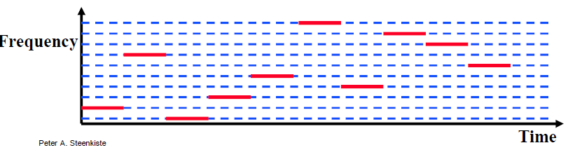
Original WiFi specification (1997)
Legacy WiFi
  Frequency Hopping Spread Spectrum (FHSS)
  GFSK (Gaussian Frequency-Shift Keying)
    Relatively simple radio design
  Frequency hopping over 80 channels (1 MHz each)
  Actually supports an Infrared PHY as well!!

Slide 15
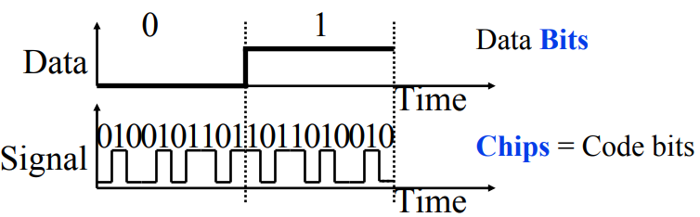
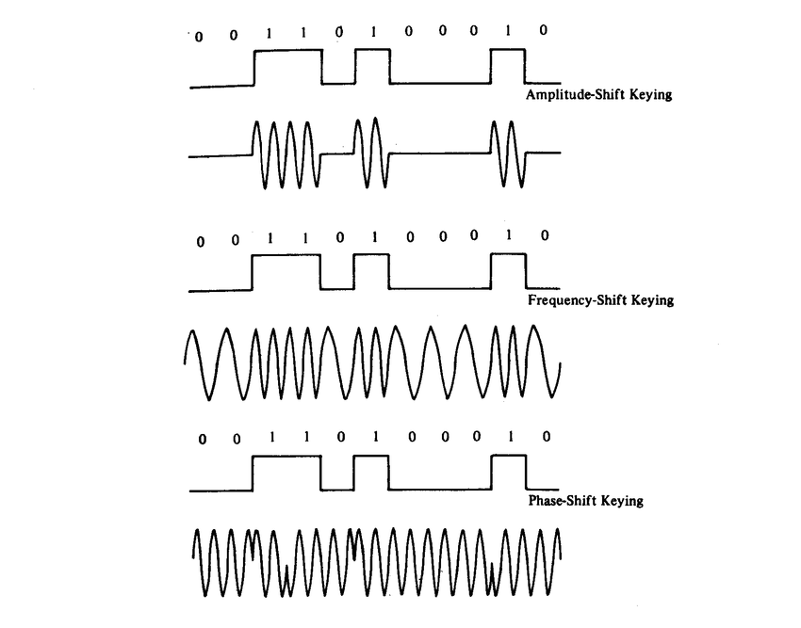
802.11b (1999)
802.11b
  Direct Sequence Spread Spectrum (DSSS)
  DBPSK and DQPSK (Differential Binary/Quadrature Phase-Shift Keying)
Translate data into “codes”
  Each data bit corresponds to several
  code bits (Chips)
  Chips are what is actually modulated
  over the air
  Data can be recovered by knowing
  the code patterns
Modulation
Phase-shift Keying (of the Chips)

Slide 16
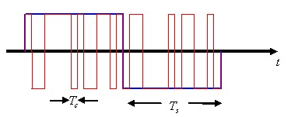
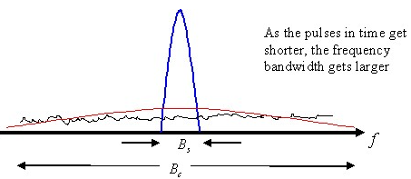
DSSS goals
DSSS increases bandwidth of a signal
  Beyond what is needed for the data
  Energy is smeared across the frequencies
More robust against interference
  Narrowband signals knock out only part
  of the signal
  Data can be recovered from partial code
Cost: using a lot of bandwidth for only a little data

Slide 17
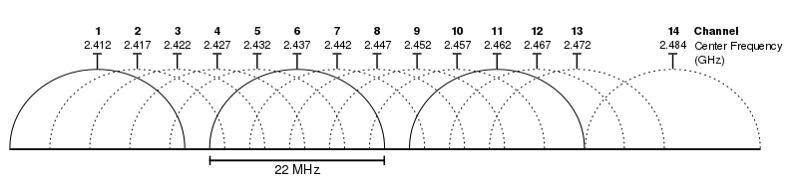
802.11b channels
14 channels total
  1-11 for US
  1-13 for most of the rest of the world
  1-14 for Japan (but 14 only for 802.11b
22 MHz channels
  5 MHz spacing -> significant channel overlap
  Channels 1, 6, and 11 can be used without overlap

Slide 18
Walking through PHY changes by amendment
 | Protocol | Year | Frequency | PHY | Max Rate | Range
- | 802.11 | 1997 | 2.4 GHz | DSSS/FHSS | 2 Mbps | 20 m
1 | 802.11b | 1999 | 2.4 GHz | DSSS | 11 Mbps | 35 m
2 | 802.11a | 1999 | 5 GHz | OFDM | 54 Mbps | 35 m
3 | 802.11g | 2003 | 2.4 GHz | OFDM | 54 Mbps | 38 m
4 | 802.11n | 2009 | 2.4/5 GHz | OFDM + MIMO | 600 Mbps | 70 m
5 | 802.11ac | 2013 | 5 GHz | OFDM + MIMO | 3.4 Gbps | 35 m

Slide 19
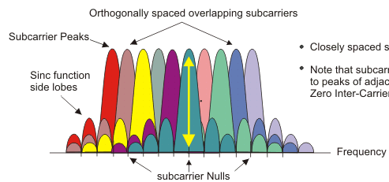
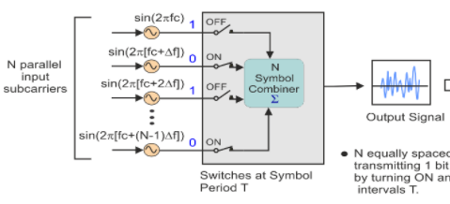
OFDM enables higher throughput
Replace DSSS with Orthogonal Frequency Division Multiplexing
OFDM idea
  Split band into a number of narrow subcarriers
  Subcarriers are spaced so that they don’t interfere
  Transmit on multiple subcarriers at once to increase throughput

Slide 20
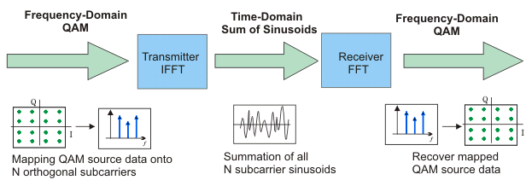
OFDM enables higher throughput at complexity cost
Receivers collect signal from entire channel
  And then can split it apart to gain the data on each subcarrier
Tradeoffs
  Benefits: more throughput, still robust against narrowband interference
  Costs: more complicated and sensitive radio design

Slide 21
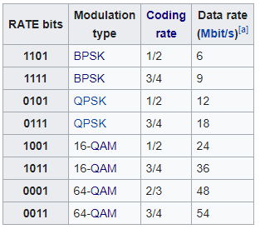
802.11a (1999)
Applied OFDM techniques on the 5 GHz band
  Enabled more data throughput 54 Mbps (compare to 11 Mbps for 802.11b)
Multiple rates available
  BPSK/QPSK/QAM over OFDM
  Quadrature Amplitude Modulation (QAM)
Never reached widespread adoption
  Regulatory hurdles in some regions
  More complicated hardware delayed it

Slide 22
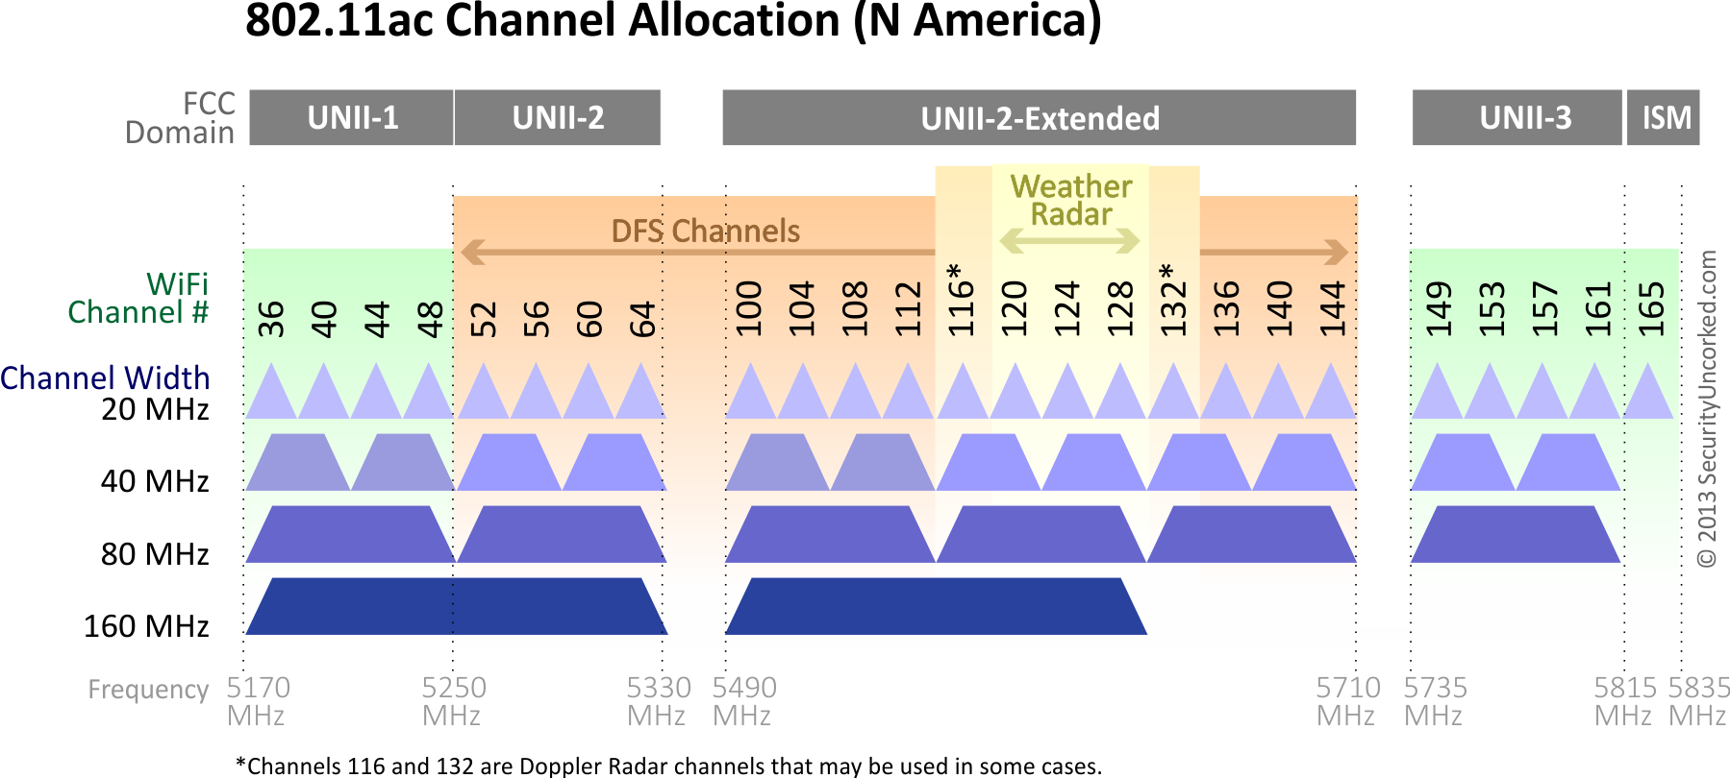
802.11a channels
802.11a did promote the use of 5 GHz band
  Several 20 MHz channels with no overlap
    Big increase from “three” channels of 2.4 GHz
  Various regional rules on a number of different channels
    Needs to avoid frequencies in use by existing radar deployments
    Orange channels aren’t used in the US at least, except for enterprise

Slide 23
802.11g (2003)
Applies OFDM to 2.4 GHz band
  Increases throughput from 11 Mbps to 54 Mbps
  Repeats rate choices of 802.11a but on more support 2.4 GHz band
Same 2.4 GHz channels as 802.11b, but 20 MHz bandwidth
  Still 1, 6, 11 in US
  1, 5, 9, 13 in other regions
Backwards compatible with 802.11b
  Capable of DSSS communication when required

Slide 24

Cost of supporting 802.11b
802.11g uses a completely different PHY layer than 802.11b
  DSSS -> OFDM
  Unintelligible to old receivers creating an interoperability problem
Interoperability mode: send part of message in old format
  DSSS header with OFDM payload
  Adds overhead and slows down the entire network
    Starting with 802.11n, routers don’t support 802.11b by default

Slide 25
Improved WiFi hardware is in high demand
Typically, standards lead hardware by several years
  BLE 5.2 is out, but 5.0 is just being adopted in phones
Development of 802.11g hardware started before finalization of standard
  Demand for increased performance was already high in 2003
Phenomena continues in modern WiFi and Cellular protocols
  Hardware supports some features as soon as it’s clear they’ll exist

Slide 26
Walking through PHY changes by amendment
 | Protocol | Year | Frequency | PHY | Max Rate | Range
- | 802.11 | 1997 | 2.4 GHz | DSSS/FHSS | 2 Mbps | 20 m
1 | 802.11b | 1999 | 2.4 GHz | DSSS | 11 Mbps | 35 m
2 | 802.11a | 1999 | 5 GHz | OFDM | 54 Mbps | 35 m
3 | 802.11g | 2003 | 2.4 GHz | OFDM | 54 Mbps | 38 m
4 | 802.11n | 2009 | 2.4/5 GHz | OFDM + MIMO | 600 Mbps | 70 m
5 | 802.11ac | 2013 | 5 GHz | OFDM + MIMO | 3.4 Gbps | 35 m

Slide 27
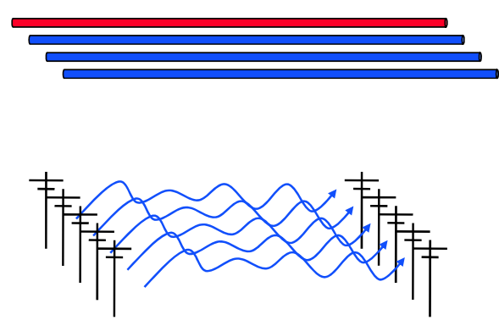
How do we increase throughput?
Wired world
  Add more wires in parallel
Wireless world
  Add more antennas?

Slide 28
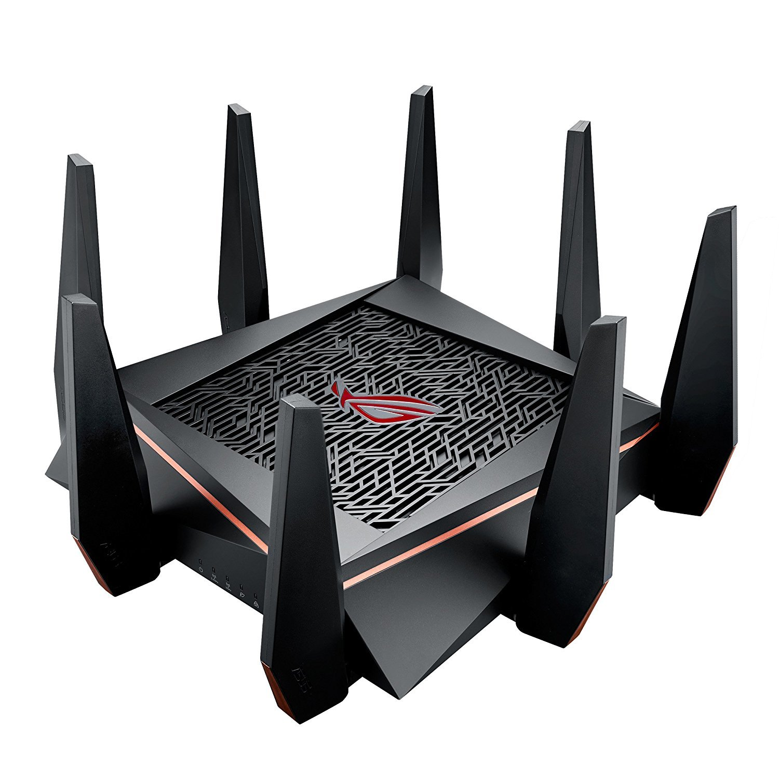
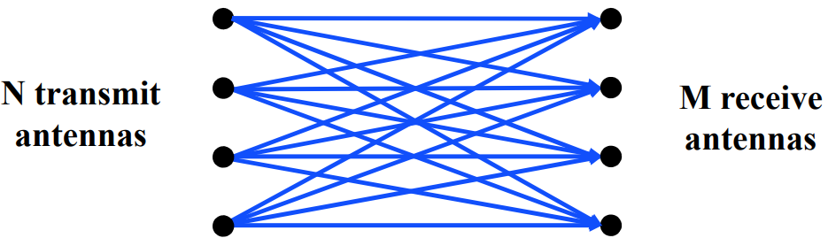
MIMO – Multiple In Multiple Out
N x M subchannels can be used to send data simultaneously
  Huge boost in data throughput
  Antenna diversity adds to reliability as well
The signals may interfere with each other
  But receiving all of them allows the data to be recovered
Beamforming
  Use interactions between array of antennas to focus energy on the receiver
  Way outside of the scope of this class

Slide 29
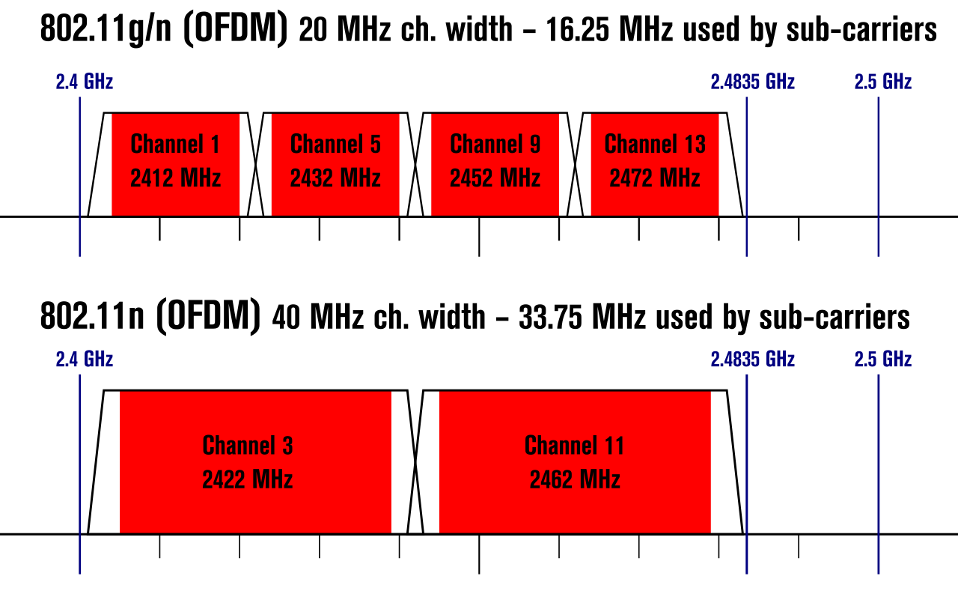
Expandable bandwidth
OFDM allows many subcarriers within a channel to be used at once
  Throughput scales with the amount of bandwidth available
  Allow larger 40 MHz channels to be used

Slide 30
802.11n (2009)
Supports OFDM and MIMO on 2.4 GHz and 5 GHz
Supports 20 MHz and 40 MHz channels
  Easier to create large channels in 5 GHz band
Backwards compatible with 802.11g (tries not to be with 802.11b)
Wildly successful
  Still the 2.4 GHz band protocol (802.11ac is 5 GHz only)
  A little less than half of the networks visible to me are still 802.11n
  The “building WiFi” is still 802.11g…

Slide 31
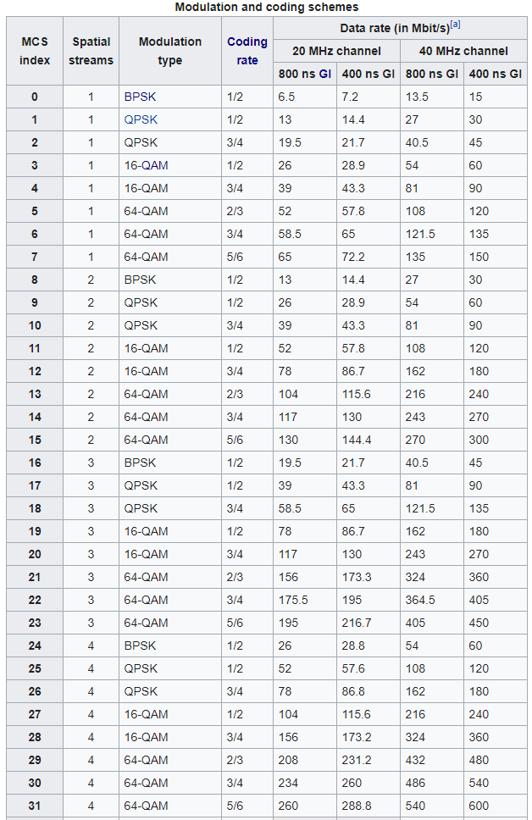
802.11n modulation and coding schemes
MCS – Modulation and Coding Scheme
GI – Guard Interval: delay between transmitted symbols

Slide 32
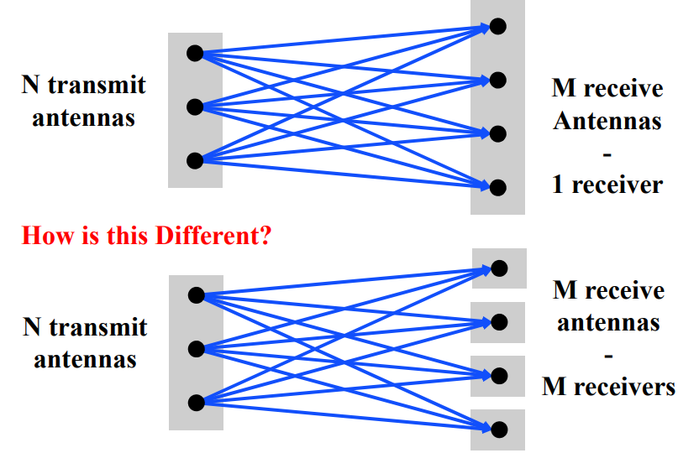
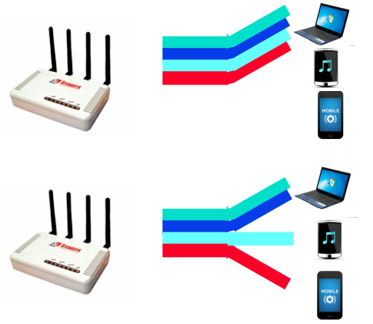
Multi-user Multiple In Multiple Out (MU-MIMO)
Multi-user MIMO uses the same techniques to send in parallel to multiple devices
  Devices cannot cancel out interference anymore
  Send slower, more reliable data streams to overcome this

Slide 33
802.11ac (2013)
Update for 5 GHz band only
  Supports Downlink MU-MIMO (from AP to device)
  Supports channels widths up to 160 MHz
  Engineering updates: up to 256-QAM
Routers apply 802.11ac to 5 GHz and 802.11n to 2.4 GHz

Slide 34
802.11ac channels

Slide 35
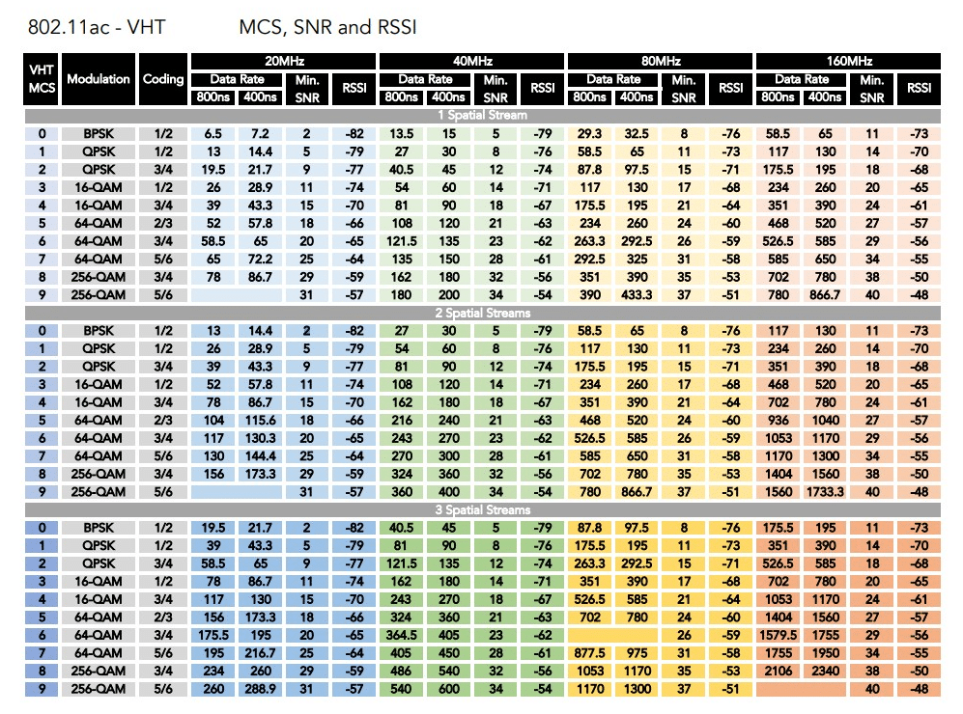
802.11ac modulation and coding schemes
4 spatial streams is also allowed, getting up to 3466 Mbps

Slide 36
Outline
WiFi Overview
WiFi PHY
  802.11/802.11b
  802.11a/802.11g
  802.11n/802.11ac
  Real-World WiFi

Slide 37
Goal: improve throughput
In twenty years, WiFi has gone from 2 Mbps to 3 Gbps
How does a network improve its throughput?
More capable modulation and/or bit transmission
  Techniques like OFDM and MIMO
    Original 2 Mbps -> 54 Mbps with OFDM -> 346 Mbps with MIMO (100x)
    Engineering improvements are baked into these steps too
More bandwidth
  Increased channel with at 2.4 Ghz and bigger 5 GHz channels
    346 Mbps with 20 MHz -> 3466 Mbps with 160 MHz (10x)

Slide 38
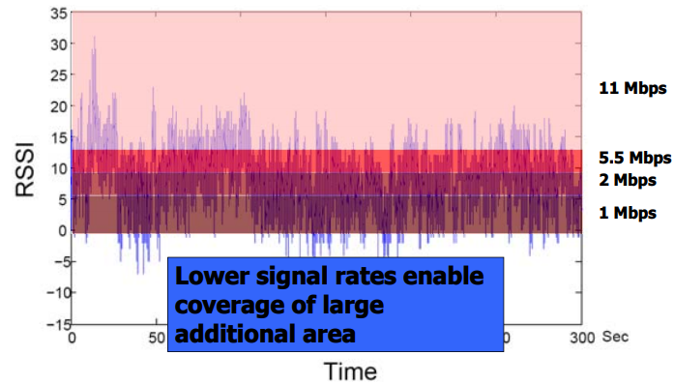
Bit rate adaptation
All modern WiFi standards support multiple bit rates (MCS)
Many factors can influence the choice of bit rate
  Capability of device: not all devices support all bit rates
  Range and packet reliability (interference)

Slide 39
Bit rate adaptation
Selecting the right rate at the right time is a complex problem
  And needs to be decided per-device
  Trial and Error
    Failures -> reduce rate
    Successes -> increase rate
  Signal strength
    Use channel state information to decide
  Context sensitive
    Mobile devices need lower rates

Slide 40
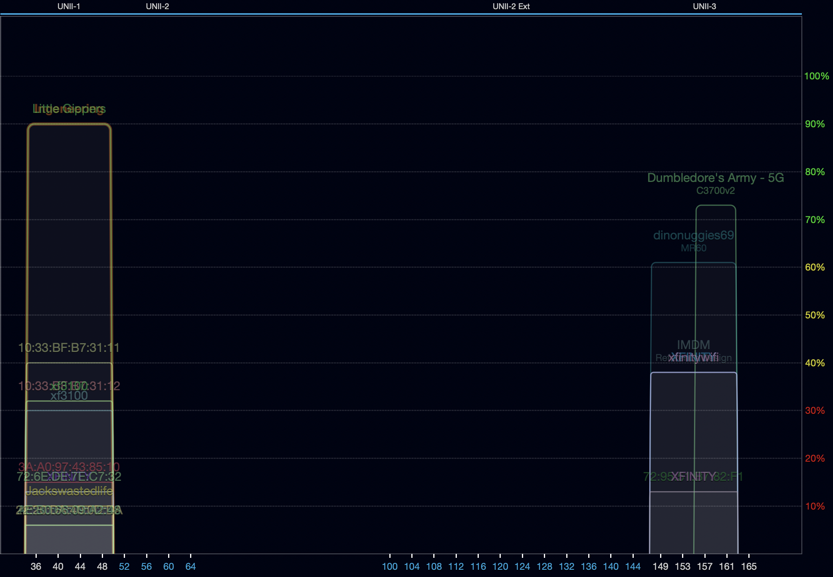
Real-world 802.11 channel use – 5 GHz
Devices use 80 MHz channels almost entirely
  One network using 40 MHz channel
No use of the more complicated bands
Why is no one using channel 165?

Slide 41
Real-world 802.11 channel use – 5 GHz
Devices use 80 MHz channels almost entirely
  One network using 40 MHz channel
No use of the more complicated bands
Why is no one using channel 165?
  That would be a 20 MHz channel
  And can’t be added on its own

Slide 42
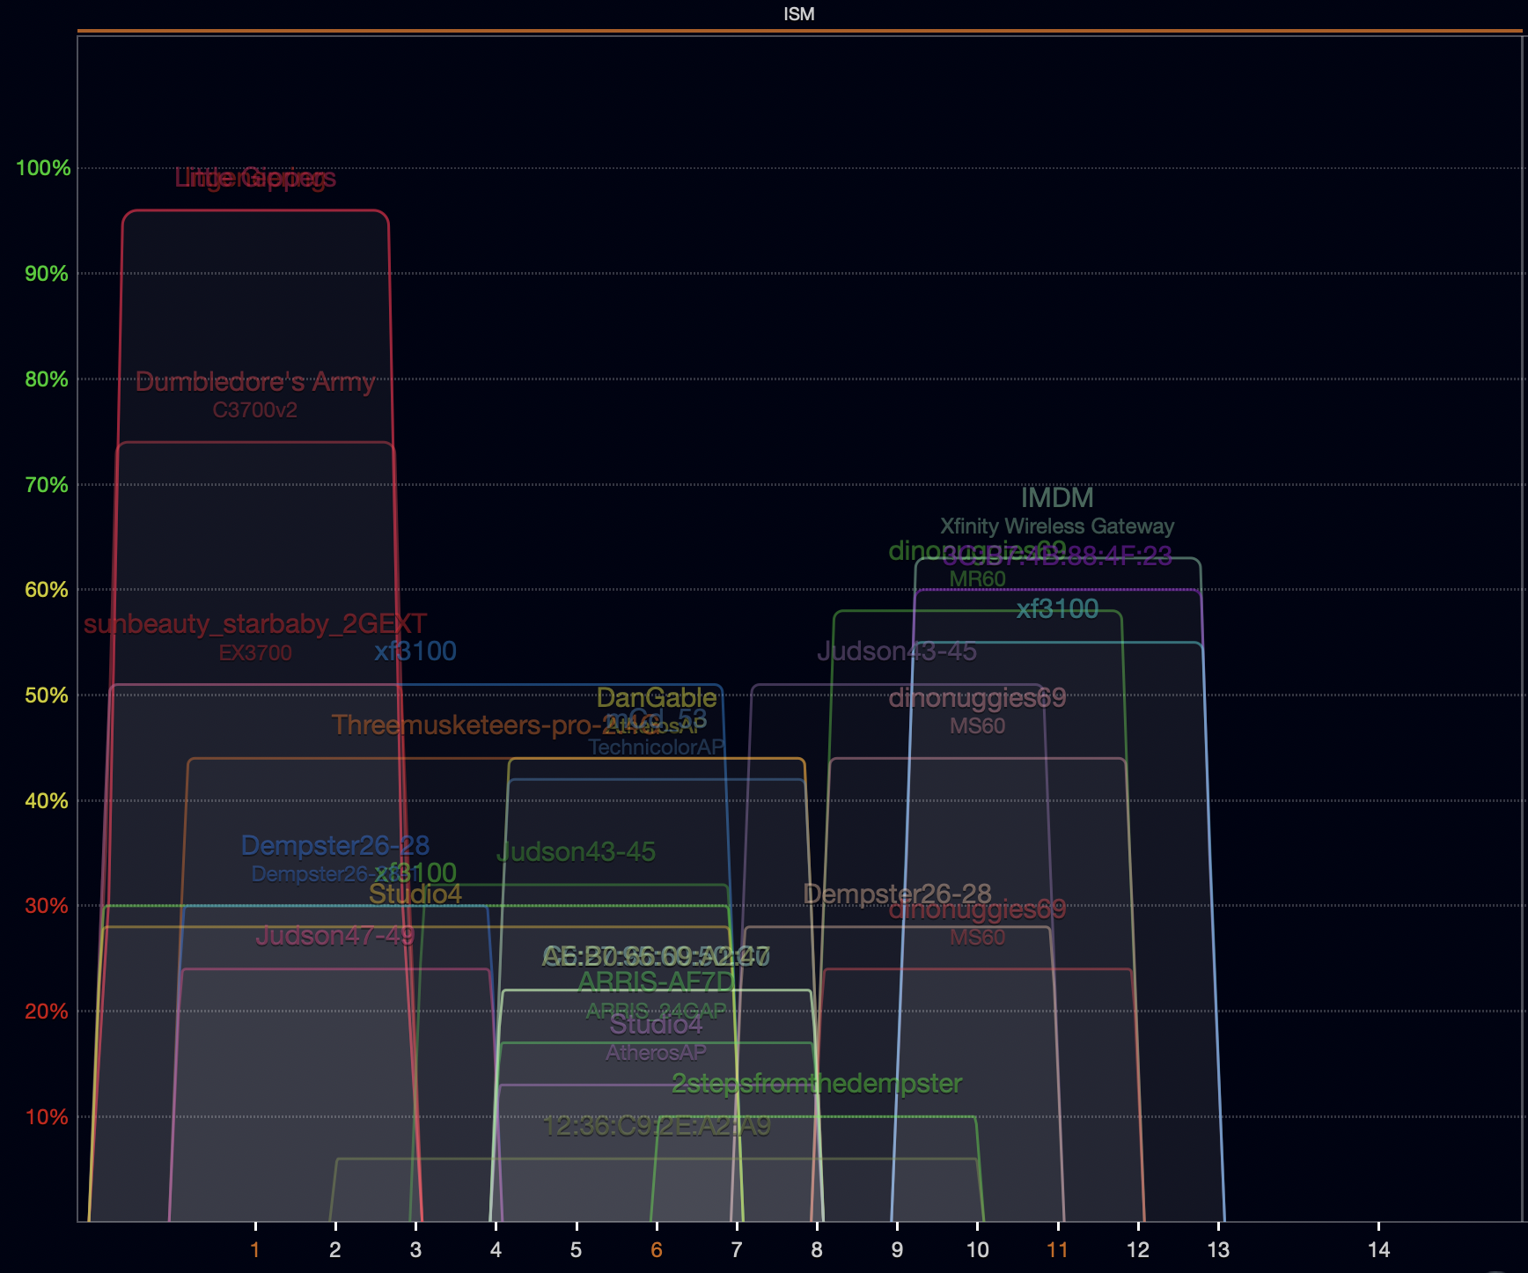
Real-world 802.11 channel use – 2.4 GHz
Most networks use
20 MHz channels
1, 6, or 11
  Just use 5 GHz for faster speeds
Several networks create 40 MHz allocations

Slide 43
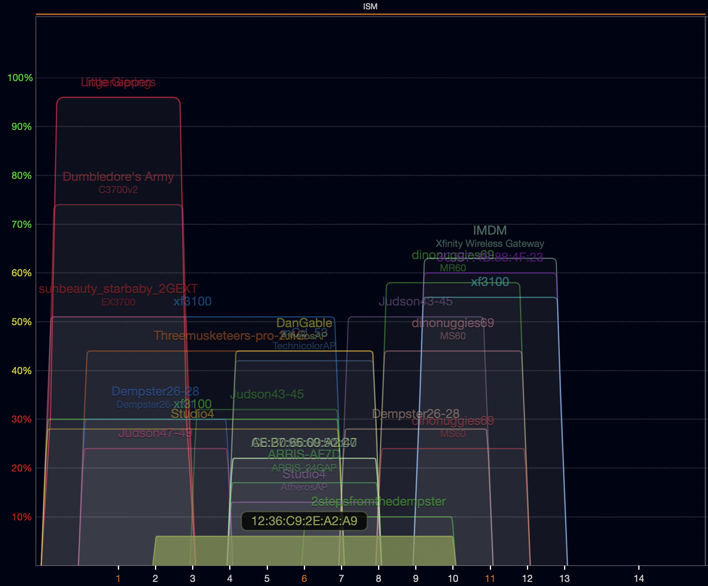
Real-world 802.11 channel use – some routers are weird
Some networks are weird
Why make a 40 MHz allocation centered on channel 6??!
Some 20 MHz networks use channels
2, 9, or 10

Slide 44
Outline
WiFi Overview
WiFi PHY
  802.11/802.11b
  802.11a/802.11g
  802.11n/802.11ac
  Real-World WiFi

