Slide 1
Lecture 07
Thread
CS397/497 – Wireless Protocols for IoT
Branden Ghena – Winter 2021
With some advice from Neal Jackson (UC Berkeley)

Slide 2
Today’s Goals
Explore 802.15.4 packet structure
Describe goals and capabilities of Thread networks
Understand addressing in Thread networks
Describe runtime behaviors like network joining

Slide 3
Outline
Packet Structure
Thread Overview
Thread Addressing
Runtime Behavior

Slide 4
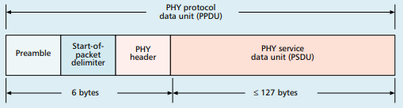
Base packet format
Synchronization
  Preamble: four bytes of 0x00
  Start-of-Packet: 0xA7
PHY Header
  One field: length 0-127
  Why still 8 bits?

Slide 5
Base packet format
Synchronization
  Preamble: four bytes of 0x00
  Start-of-Packet: 0xA7
PHY Header
  One field: length 0-127
  Why still 8 bits? Because computers depend on bytes

Slide 6
MAC frame format
Frame control
  Header
Sequence number
  8-bit monotonically increasing
Addressing fields
  PAN and addresses
  Varies based on frame type
Frame payload
  Depends on frame type
Frame check sequence
  16-bit CRC

Slide 7
Frame control
Frame type
  Type of payload included
Security enabled
  Packet is encrypted
  (extra 0-14 byte header)
Frame pending
  Fragmented packet
Acknowledgement required
PAN ID compression
  No PAN ID if intra-network
Addressing modes
  Which fields to expect
Why no length field?

Slide 8
Frame control
Frame type
  Type of payload included
Security enabled
  Packet is encrypted
  (extra 0-14 byte header)
Frame pending
  Fragmented packet
Acknowledgement required
PAN ID compression
  No PAN ID if intra-network
Addressing modes
  Which fields to expect
Why no length field?
Already in prior header

Slide 9
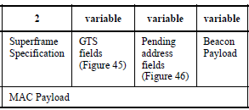
Frame types - Beacon
Beacon
  Information about the communication
  structure of this network
  Sent in response to requests from scanning devices
  Sent periodically at start of Superframes (if in use)
    Sent without CSMA/CA
MAC Header
  Source address only, broadcast to everyone
Packet contents
  Superframe details, including Guaranteed Time Slots (if any)
  Pending addresses lists devices for which Coordinator has data

Slide 10
Frame types - Data
Data
  Data from higher-layer protocols
MAC Header
  Source and/or Destination addresses as necessary
Packet Contents
  Whatever bytes are desired (122 bytes – address sizes)
  May be fragmented across packets

Slide 11
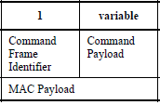
Frame types – MAC Command
MAC Command
  Various commands for supporting link layer
    Join/leave network
    Change coordinator within network
    Request data from coordinator
    Request Guaranteed Time Slot
MAC Header
  Source and/or Destination addresses as necessary

Slide 12
Frame types - Acknowledgement
Acknowledgement
  Acknowledges a Data or MAC Command packet
  Not beacons or other acknowledgements
    What happens if acknowledgement isn’t received?
MAC Header
  Repeats Sequence Number of acknowledged packet
  No Source or Destination addresses
Sent T_{IFS} after the packet it is acknowledging (immediately)

Slide 13
Frame types - Acknowledgement
Acknowledgement
  Acknowledges a Data or MAC Command packet
  Not beacons or other acknowledgements
    What happens if acknowledgement isn’t received?
      Packet will be transmitted again
MAC Header
  Repeats Sequence Number of acknowledged packet
  No Source or Destination addresses
Sent T_{IFS} after the packet it is acknowledging (immediately)

Slide 14
Analysis: maximum goodput
Assume best possible case for data transmission
  122 Bytes per packet
    At 250 kbps -> 3.904 ms
  Plus Inter-frame spacing of 40 symbols
    At 62.5 kBaud -> 0.640 ms
  122 Bytes / 4.544 ms -> 214 kbps
    Compare to BLE advertisements: 9.92 kbps
    Compare to BLE connections: 520 kbps

Slide 15
Outline
Packet Structure
Thread Overview
Thread Addressing
Runtime Behavior

Slide 16
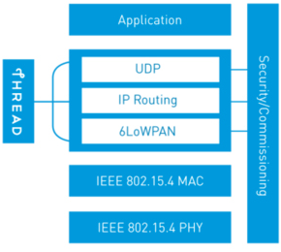
Thread overview
Build a networking layer on top of 15.4
  Reuses most of PHY and MAC
  Adds IP communication
  Handles addressing and mesh maintenance
Goals
  Simplicity – easy to install and operate
  Efficiency – years of operation on batteries
  Scalability – hundreds of devices in a network
  Security – authenticated and encrypted communication
  Reliability – mesh networking without single point of failure
Industry-focused, but based in academic research

Slide 17
References on Thread
Request for specification: https://www.threadgroup.org/ThreadSpec
  Frustratingly locked down 😡
Overview on capabilities: https://openthread.io/guides/thread-primer
  Excellent overview
  Lifting heavily for these slides

Slide 18
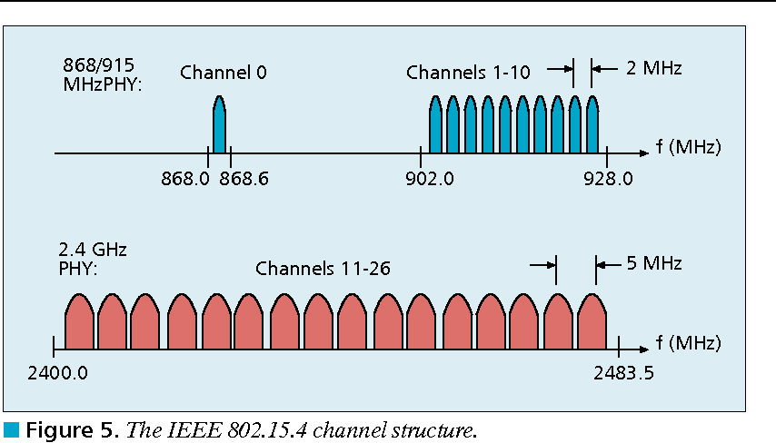
Changes to Physical Layer
Remove all non-2.4 GHz PHY options
Otherwise the same
  OQPSK
  16 channels, 5 MHz spacing
  Typical TX power 0 dBm
  Typical RX sensitivity -100 dBm

Slide 19
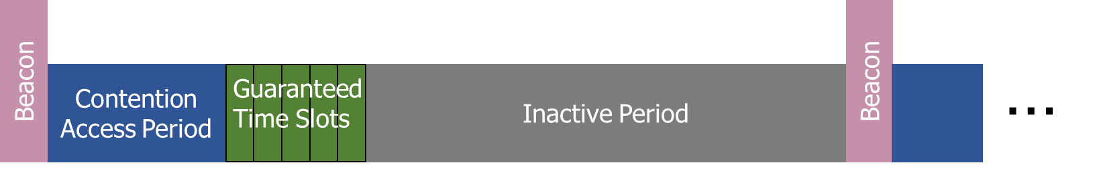
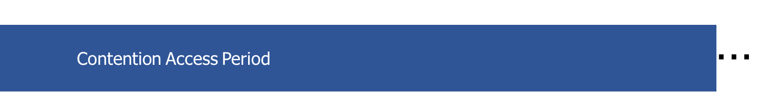
Changes to Link Layer and MAC
Non-beacon-enabled PAN only
  No superframe structure
  No periodic beacons
  No Guaranteed Time Slots
Throw out most existing MAC Commands
  Remove network joining/leaving
  Remove changing coordinators
  Remove Guaranteed Time Slot request
  Network joining will be handled at a higher layer

Slide 20
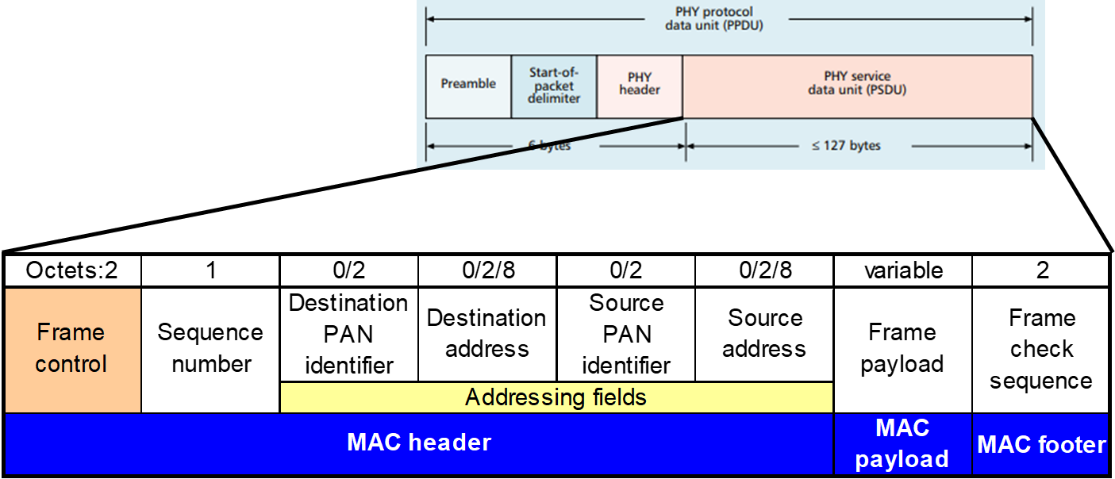
Changes to Link Layer and MAC
Keep unslotted CSMA/CA algorithm
Keep packet structure
Keep Frame Types
  Beacon
  MAC Command
    Beacon Request
    Data Request
  Data
  Acknowledgement

Slide 21
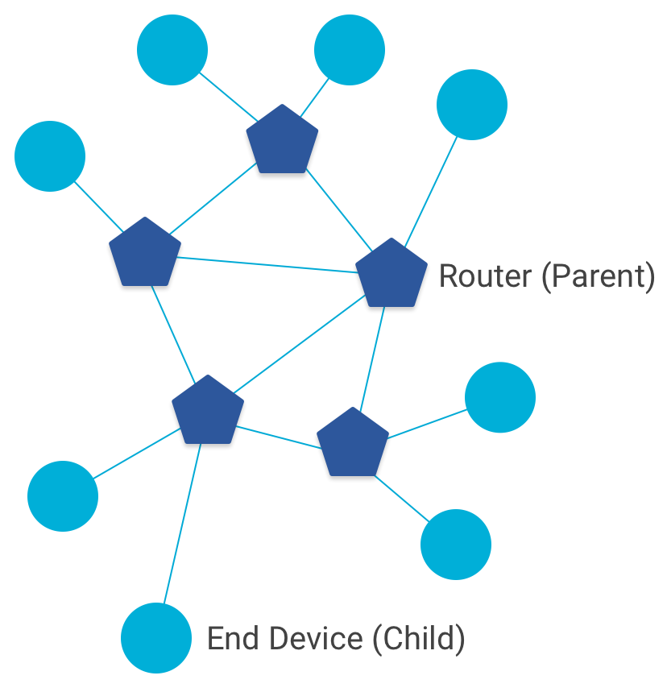
Combination of star and mesh topology
Routers (parent)
  Mesh communication with other routers
  Radio always on
  Forwards packets for network devices
  Enables other devices to join network
  32 routers per network
End devices (child)
  Communicates with one parent (router)
  Does not forward packets
  Can disable transceiver to save power
    Send packets periodically to avoid timeout
  511 end devices per router

Slide 22
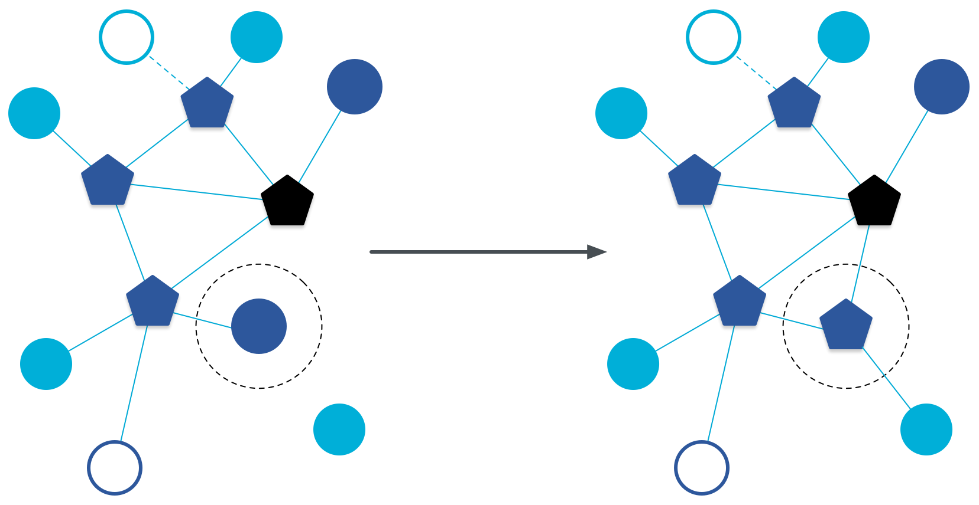
Router promotion
“Router Eligible End Device”
  A router without any children
  Can operate as an end device with one connection (lower power)
  Promotes to a router when a joining end device relies on it
    If there is room for an additional router (max 32, typical 16-23)

Slide 23
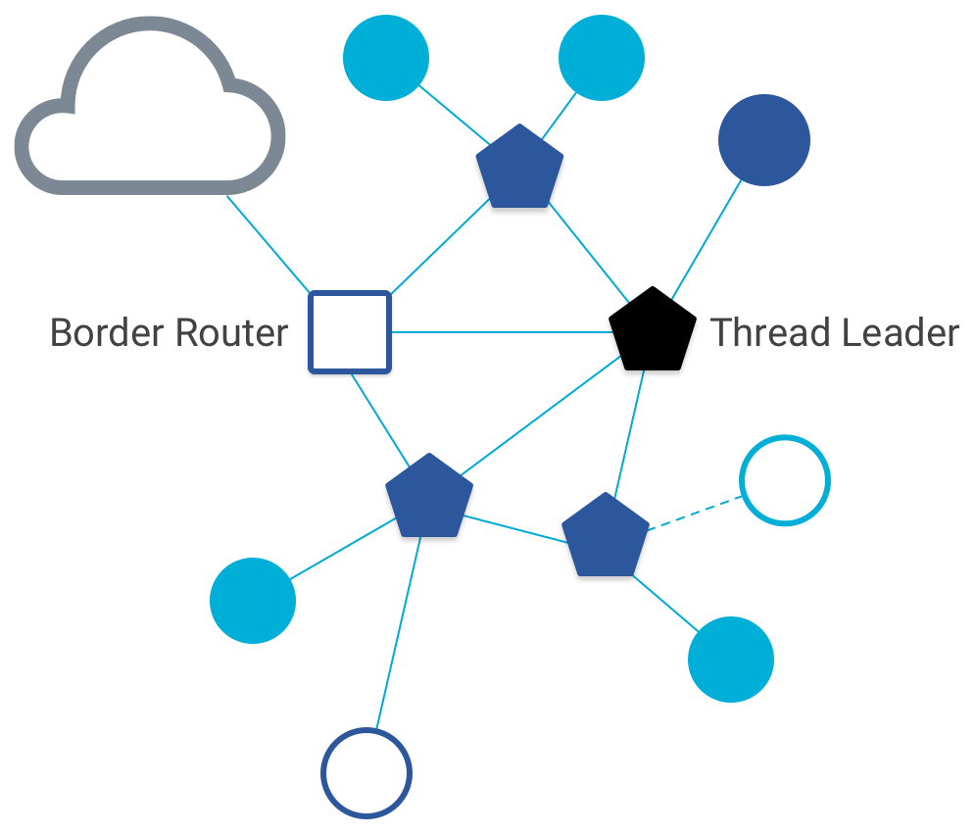
Other special roles
Thread leader
  Device in charge of making decisions
    Addresses, Joining details
  Automatically selected from routers
    One leader at any given time
    Additional leader is selected if the network partitions
Border router
  Router that also has connectivity to another network
    Commonly WiFi or Ethernet
  Provides external connectivity
  Multiple border routers may exist at once

Slide 24
Outline
Packet Structure
Thread Overview
Thread Addressing
Runtime Behavior

Slide 25
Thread uses IPv6 for communication
Why IP?
  If Wireless Sensor Networks represent a future of billions of connected devices distributed throughout the physical world
  Why shouldn’t they run standard protocols wherever possible?
  Why IPv6?
    Generalized, Flexible, Capable
Benefits
  Interoperability with normal computers and networks
  Reuse state of the art developed standards instead of remaking them
    Security, Naming, Discovery, Services
Costs
  Packet overhead can be high (will fix)
  Complexity for supporting protocols
Hui and Culler, “IP is Dead, Long Live IP for Wireless Sensor Networks”. 2008

Slide 26
Background: IPv6
Replacement to Internet Protocol v4
  (Something unrelated used version number 5)
Extended addressing for devices
  32-bits for IPv4 addresses -> 128-bits for IPv6 addresses
  Example: a39b:239e:ffff:29a2:0021:20f1:aaa2:2112
Supports multiple transmit models
  Broadcast: one-to-all
  Multicast: one-to-many
  Unicast: one-to-one
Various other improvements

Slide 27
Background: IPv6 address notation rules
Groups of zeros can be replaced with “::”
  Can only use “::” in one place in the address
Leading zeros in a 16-bit group can be omitted
  0000:0000:0000:0000:0000:0000:0000:0001 → ::1
  2345:1001:0023:1003:0000:0000:0000:0000 → 2345:1001:23:1003::
  aecb:0222:0000:0000:0000:0000:0000:0010 → aecb:222::10
Special addresses
  Localhost - ::1 (IPv4 version is 127.0.0.1)
  Link-Local Network - fe80:: (bottom 64-bits are ~device MAC address)
  Local Network – fc00:: and fd00::
  Global Addresses – 2000:: (various methods for allocating bottom bits)

Slide 28
Background: IPv6 datagram format
Priority: like “type of service” in IPv4.
Flow label: ambiguous
Next header: TCP, UDP
Hop limit = TTL
version
priority
flow label
payload length
next header
hop limit
source address
(128 bits)
destination address
(128 bits)
data
(variable length, typically a TCP or UDP segment)
how much overhead?
40 bytes of IPv6
20 more than IPv4
32 bits

Slide 29
6LoWPAN
Method for running IPv6 over 802.15.4 links
  IPv6 over Low-Power Wireless Personal Area Networks
  IETF Standard (RFC4944 + updates in RFC6282)
Directly out of the research world (Jonathan Hui + David Culler)
  Research Paper: IP is Dead, Long Live IP for Wireless Sensor Networks
  Thesis of work: sensor networks can and should use IPv6
Important goals
  Compress IPv6 headers
  Handle fragmentation of packets
  Enable sending packets through mesh

Slide 30
6LoWPAN header compression
40 bytes of IPv6 header are a lot for a 127-byte payload
Most important goals
  Communication with devices in the 15.4 network should be low-overhead
  Communication outside of the 15.4 network should still minimize overhead where possible
Assume a bunch of common parameters to save space
  A bunch of options are set to default values
  Payload length can be re-determined from packet length
  Source/Destination addresses can often be reassembled from link layer data
    Plus information about network address assignment known by routers
Border router “inflates” the packet before sending externally

Slide 31
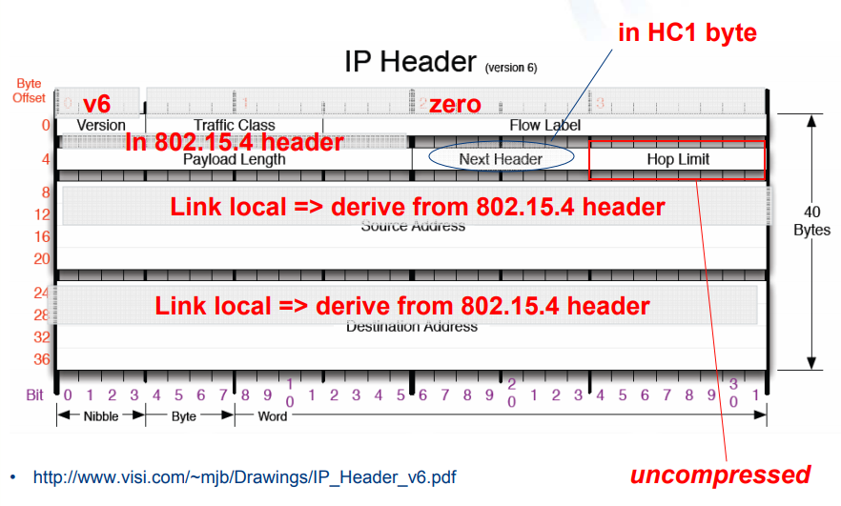
Example of compression
Note: Thread actually uses IPHC (not HC1) from rfc6282

Slide 32
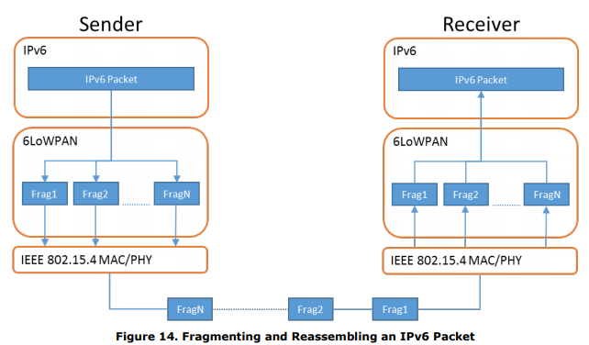
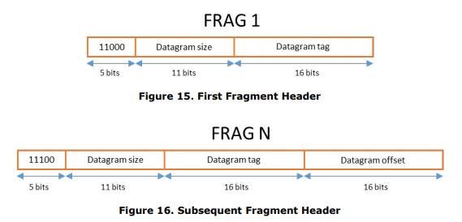
6LoWPAN fragmentation
Only the first packet of the fragments will hold the IPv6 header
  Tag, offset, and size are used to reconstruct

Slide 33

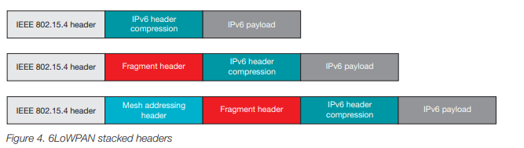
6LoWPAN mesh forwarding
Additional header with originator and final addresses
Which of these headers are used depends on the packet

Slide 34
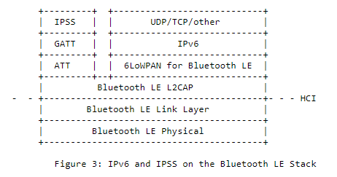
Sidebar: IPv6 over BLE
RFC7668 defines 6LoWPAN techniques for BLE connections

Slide 35
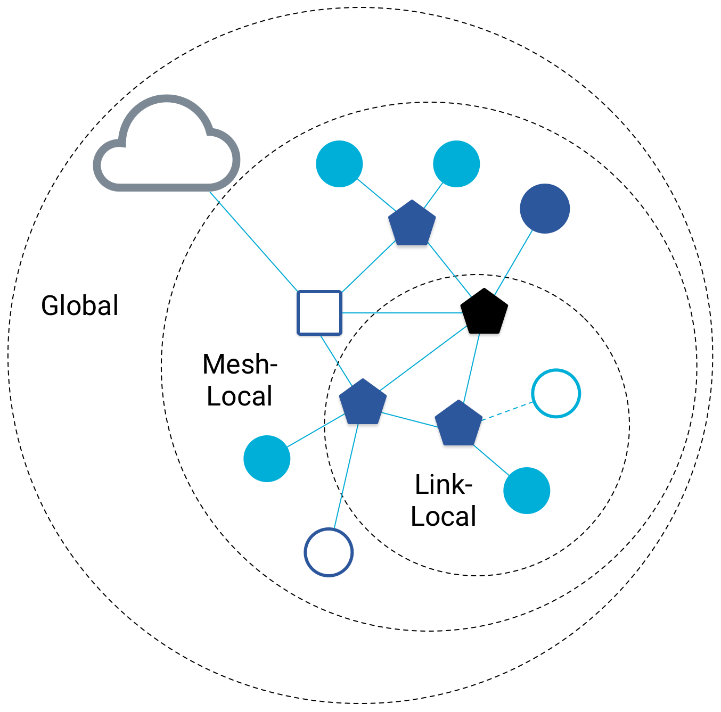
Benefit to IPv6: multiple address spaces per Thread device
Each device gets an IPv6 address for each way to contact it
  Global IP address
  Mesh-local IP address
  Link-local IP address
  Topology-based IP address
  Role-based IP address(es)

Slide 36
Traditional addresses in Thread
Link-Local Addresses
  FE80::/16
  Bottommost 64-bits are EUI-64 (MAC address with 0xFFFE in the middle)
  Permanent for a given device (no matter the network)
  Used for low-layer interactions with neighbors (discovery, routing info)
Mesh-Local Addresses
  FD00::/8 (FD00:: and FC00:: are for local networks)
  Remaining bits are randomly chosen as part of joining the network
  Permanent while connection is maintained to a network
  Used for application-layer interactions
Global Addresses
  2000::/3
  Public address for communicating with broader internet through Border Router
  Various methods for allocation (SLAAC, DHCP, Manual)

Slide 37
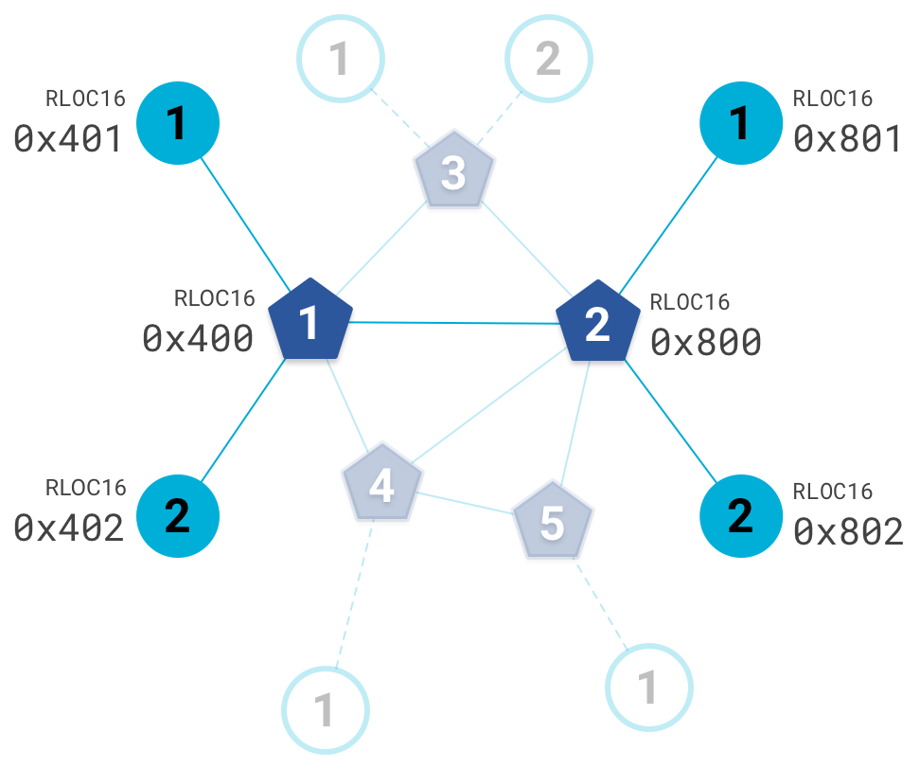
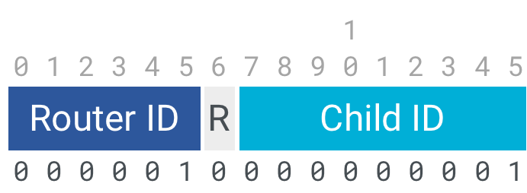
Topology-based addresses in Thread
FD00::00ff:fe00:RLOC16
  Same top bits as mesh-local
Routing Locator (RLOC)
  Router ID plus Child ID
Changes with network topology
  Used for routing packets

Slide 38
Role-based addresses in Thread
Multicast
  FF02::1 – link-local, all listening devices
  FF02::2 – link-local, all routers/router-eligible
  FF03::1 – mesh-local, all listening devices
  FF03::2 – mesh-local, all routers/router-eligible
Anycast
  FD00::00FF:FE00:FCxx
    00 – Thread Leader
    01-0F – DHCPv6 Agent
    30-37 – Commissioner
    etc.

Slide 39
Outline
Packet Structure
Thread Overview
Thread Addressing
Runtime Behavior

Slide 40
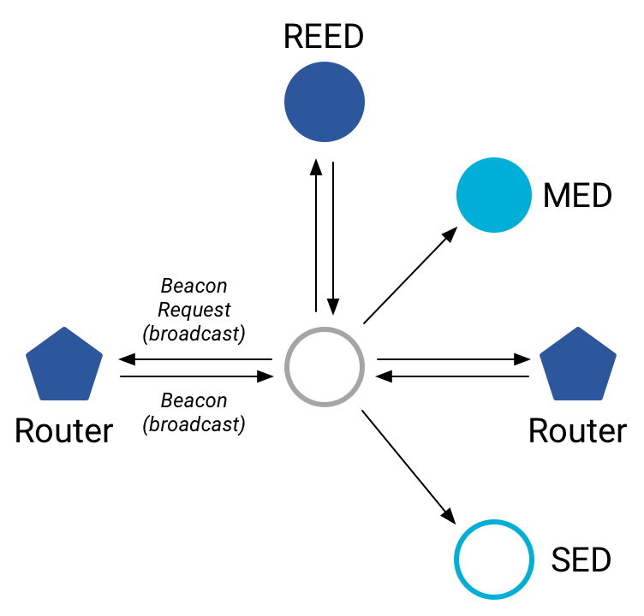
Discovering Thread networks
Beacon request MAC command
  Routers/Router-eligible devices respond
  Payload contains information about network
Thread network specification
  PAN ID – 16-bit ID
  XPAN ID – extended 64-bit ID
  Network Name – human-readable
Active scanning across channels can
quickly find all existing nearby networks

Slide 41
Creating a new network
Select a channel (possibly by scanning for availability)
Become a router
  Elect yourself as Thread Leader
  Respond to Beacon Requests from other devices
Further organization occurs through Mesh-Level Establishment protocol

Slide 42
Mesh-Level Establishment
Creating and configuring mesh links
  Payloads placed in UDP packets within IPv6 payloads
Commands for mesh
  Establish link
  Advertise link quality
  Connect to parent
TLVs (Type-Length-Value)
  Various data types that may be helpful within those packets
  Addresses, Link Quality, Routing Data, Timestamps
0 | Command Type | TLV | … | TLV
OR (secure version)
255 | Aux Header | Command Type | TLV | … | TLV | MIC

Slide 43
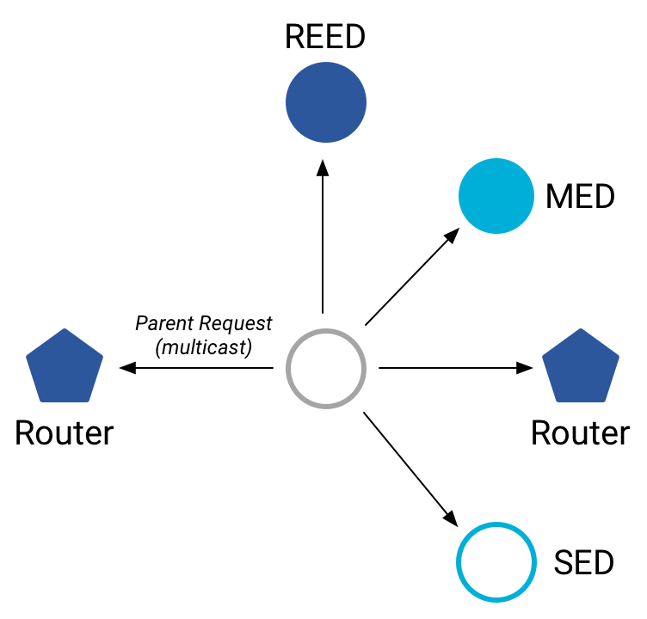
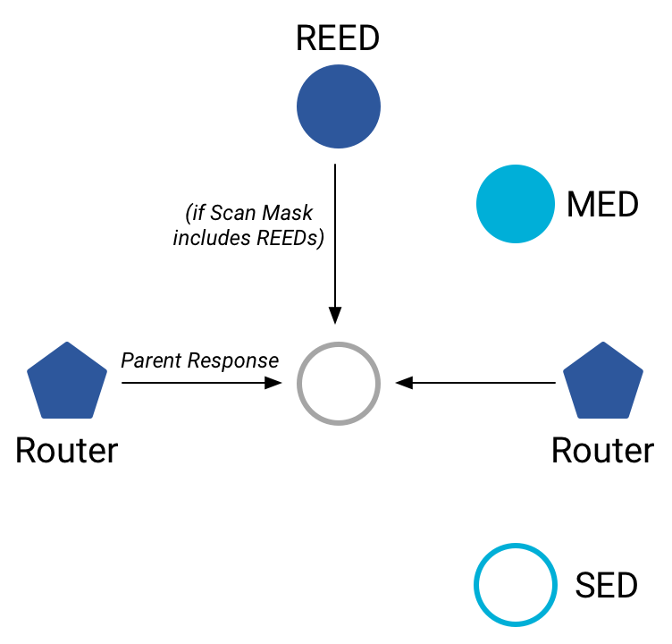
Joining an existing network
All devices join as a child of some existing router
Send a Parent Request (to all routers/router-eligible)
  Using the multicast, link-local address
Receive a Parent Response (from all routers/router-eligible separately)
  Contains information on link quality
Send a Child ID Request (to router with best link)
  Contains parameters about the new child device
Receive a Child ID Response (from that router)
  Contains address configurations

Slide 44
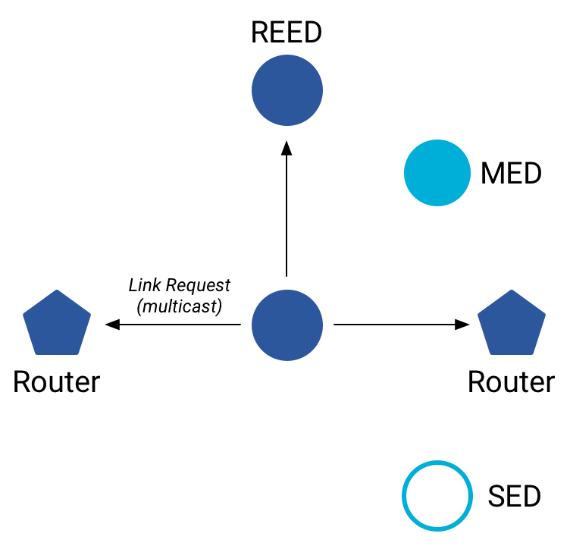
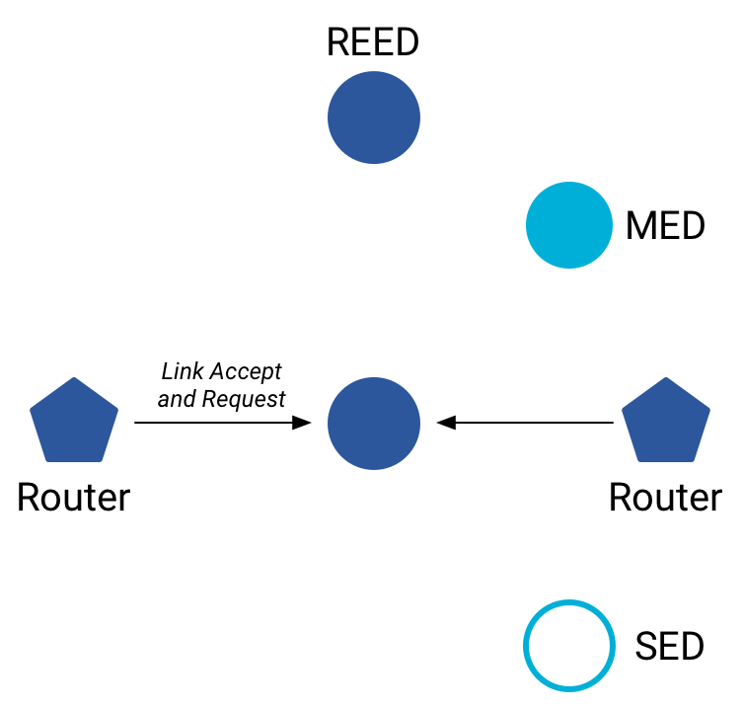
Becoming a router
Thread tries to maintain 16-23 routers (max 32)
  Goals: path diversity, extend connectivity
Send a Link Request (to all routers/router-eligible)
  Using the multicast, link-local address
Receive Link Accept and Request (from each router separately)
  Forms bi-directional link
Send a Link Accept (to each router individually)

Slide 45
Outline
Packet Structure
Thread Overview
Thread Addressing
Runtime Behavior

