Slide 1
Lecture 05
BLE Connections
CS397/497 – Wireless Protocols for IoT
Branden Ghena – Winter 2021

Slide 2
Today’s Goals
Explore how connections work
  What does the link layer look like?
  How do higher layers interact to share data?
Investigate network questions about connections
Overview of additions in BLE 5.0

Slide 3
Useful documentation
[5.2 specification] [4.2 specification] (link to PDF download)
https://www.novelbits.io/deep-dive-ble-packets-events/
Thinking about BLE connection data transfer rates
  https://punchthrough.com/maximizing-ble-throughput-on-ios-and-android/
  https://punchthrough.com/maximizing-ble-throughput-part-2-use-larger-att-mtu-2/
  https://punchthrough.com/maximizing-ble-throughput-part-3-data-length-extension-dle-2/

Slide 4
Outline
Connection Link Layer
Connection Investigations
GATT
BLE 5

Slide 5
Overview of connections
Connections are for bi-directional communication with higher throughput than advertisements
Simple view
  A peripheral is either advertising or in a connection
  A central is scanning and in one or more connections
  (Remember: actually false, devices can have many roles simultaneously)
While in a connection both devices act like servers
  Either device can read/write fields available on the other device

Slide 6
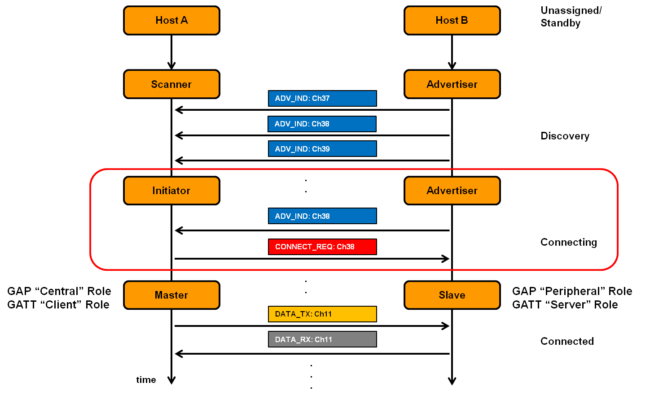
Connection timeline (in picture form)
Central
Peripheral

Slide 7
Connection timeline
Initiating a connection
  Peripheral is sending broadcast advertisements
  Central is scanning and receives an advertisement
  Central sends connection request
During a connection
  Central sends a packet each “connection interval”
  Peripheral immediately responds with a packet
  Multiple packets may be exchanged this way until done
  Repeat at next connection interval
Ending a connection
  Either device sends termination packet
  Timeout occurs on either device

Slide 8
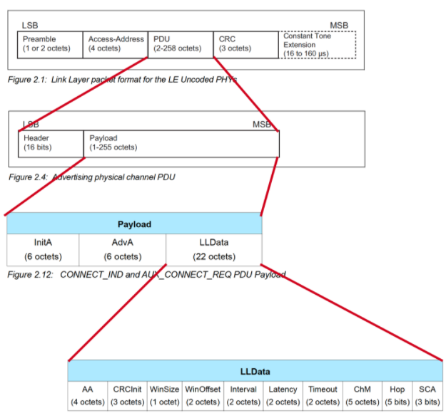
Connection request packet
Scanner waits until it sees an advertisement from a device it wants to connect to
  Requesting a connection (in higher layers) just starts this search process
Sends connection request payload in response to advertisement

Slide 9

Request parameters
Specifies parameters of the connection
  Peripheral must either agree or totally reject the connection
  Peripheral can later propose a change to the connection parameters
Interval is how frequently connection events occur
Timeout is how long since hearing from a device before the connection breaks
Channel Map and Hop have to do with FHSS pattern

Slide 10
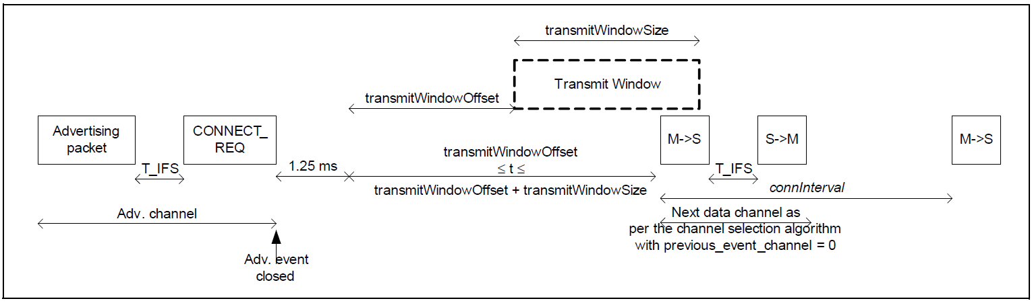
The Central schedules the first connection event
WinSize and WinOffset specify start of the first connection event
  Places an “anchor” point that defines the TDMA schedule for this device
  Interval specifies duration between connection events starting at “anchor”
  Allows Central to place this connection, avoiding others it has
    Before first response from peripheral, timeouts are faster
Central to Peripheral
Peripheral to Central
Central to Peripheral

Slide 11
Steady-state connection timing
Connection Interval
Central to Peripheral
Peripheral to Central
Central to Peripheral
Peripheral to Central
Central to Peripheral
Peripheral to Central
Central to Peripheral
Peripheral to Central
Central to Peripheral
Peripheral to Central
Hop to next data channel
Hop to next data channel
Optional packets
Some data can be exchanged at each interval
  Might just be acknowledgements
  Additional packets can be sent if there is a lot to transmit
  Each interval is on the next channel in the hopping sequence
Peripheral can skip a number of intervals to save energy
  Defined by the Latency connection request parameter

Slide 12
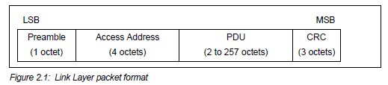
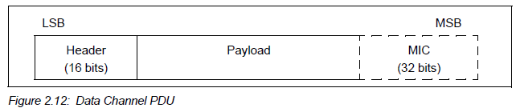
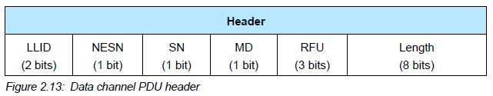
Connection packet layering
LLID – link layer ID
Empty data / Fragment
Data
Control
MD – more data (continues connection event)
Optional authentication
Sequence number nonsense

Slide 13
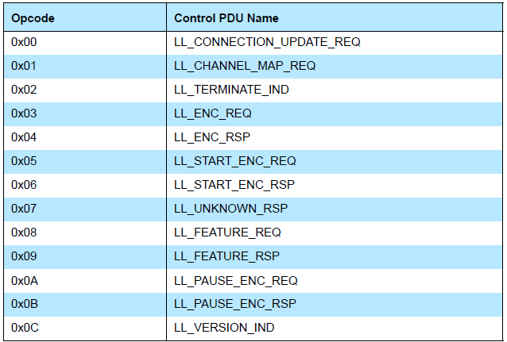
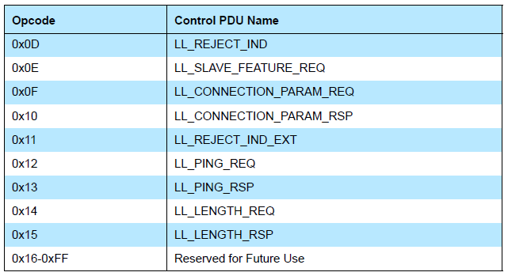
Control payloads
Examples:
Request update to connection parameters like interval (by peripheral)
Begin encrypting communication
Terminate a connection

Slide 14
Data payloads
SDU – Service Data Unit
Logical packet that may be split into several physical packets
Channel ID
Destination for data
ATTributes or Security
Can also make
custom endpoints
Length (16 bits) | Channel ID (16 bits) | L2CAP SDU Length* (16 bits) | Information Payload (0 to 249 octets)

Slide 15
Next steps in a connection
Control packets
  Version
    Bluetooth version, Company ID of Software Stack
  Features
    Various connection features supported by the device
    Encryption, Ping, Channel selection algorithms, Various 5.0 features
  Etc.
    Extended packet length, Various 5.0 features (change PHY)
    Various “procedures” for setting up changes in the connection
Data packets
  Attribute discovery
  Attribute reading

Slide 16
Ending connections
Termination control packet
Timeout parameter from connection parameters
  Human-based devices may just wander away from each other
  Or be shut off, or reprogrammed, etc.

Slide 17
Outline
Connection Link Layer
Connection Investigations
GATT
BLE 5

Slide 18
Questions about how a connection “network” works
How does TDMA MAC for connections work?
  Implies a schedule
  Implies synchronization
How many devices can be in a network?
How much throughput can a device have?

Slide 19
How is the TDMA schedule created/managed?
Only the central needs to know the schedule
  It controls interactions with the peripheral(s) it is connected to
Anchor point and connection interval determines the schedule for a specific device
Central to Peripheral
Peripheral to Central
Central to Peripheral

Slide 20
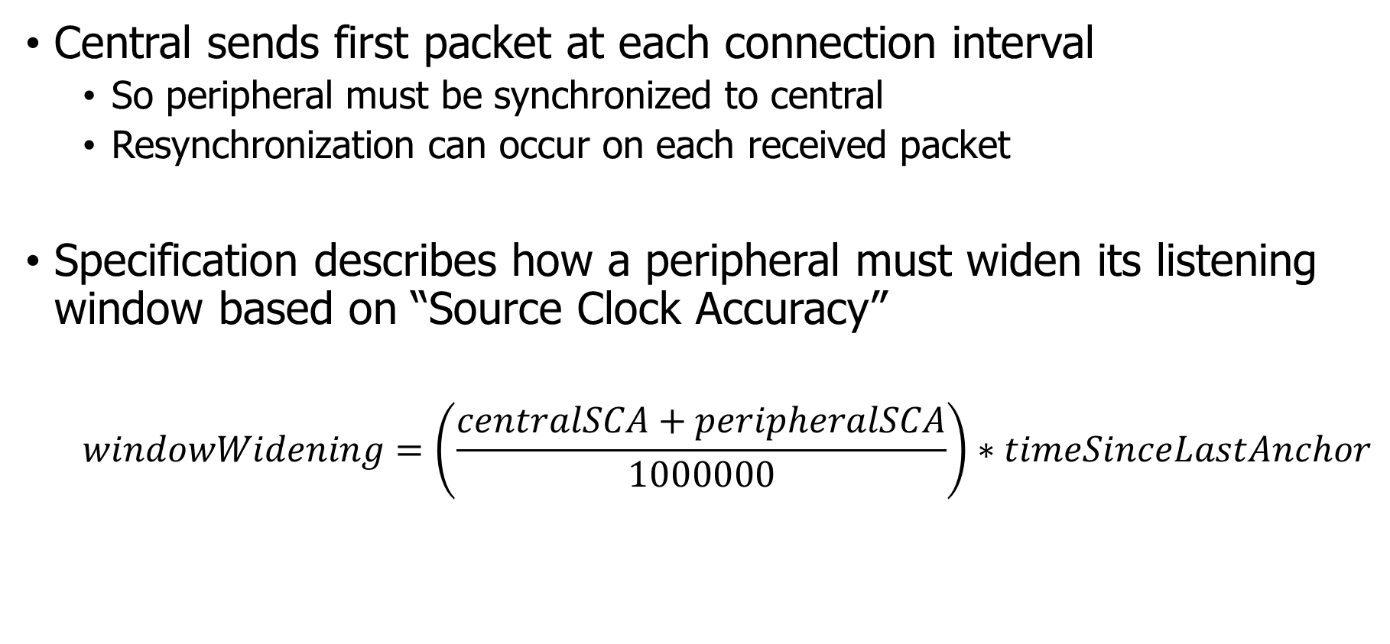
How is synchronization managed?
Central sends first packet at each connection interval
  So peripheral must be synchronized to central
  Resynchronization can occur on each received packet
Specification describes how a peripheral must widen its listening window based on “Source Clock Accuracy”
  $$windowWidening=\left(\frac{centralSCA+peripheralSCA}{1000000}\right)∗timeSinceLastAnchor$$

Slide 21
How many devices can be connected?
We can schedule with granularity of at least 1.25 ms (offset steps)
  That’s at least 800 devices per second
Intervals go up to 4 seconds, so multiply by four
  That’s 3200 devices per max interval
Plus central can skip intervals on occasion without dropping the connection
  And really the offset defines a window. More granularity is available
Answer: thousands of devices
  Although each is sending minimum-sized packets each interval

Slide 22
How many devices can be connected in the real world?
The limit is much much lower on real devices
  Example: Android sets a limit at around 4-15
  nRF52 s140 softdevice allows up to 20
Connection management is often done in firmware
  Softdevice for nRF, firmware on the radio chip in smartphones
Limited by memory and complexity

Slide 23
How much throughput can a device have?
1 Mbps?

Slide 24
How much throughput can a device have?
1 Mbps? Not even close. Packet overhead plus timing delays
Step 1: decrease connection interval as much as possible
  More connection events per second mean more data
  Range: 7.5 ms to 4.0 s
  Somewhat device-specific configuration
    Android allows 7.5 ms
    iOS allows 15 ms

Slide 25
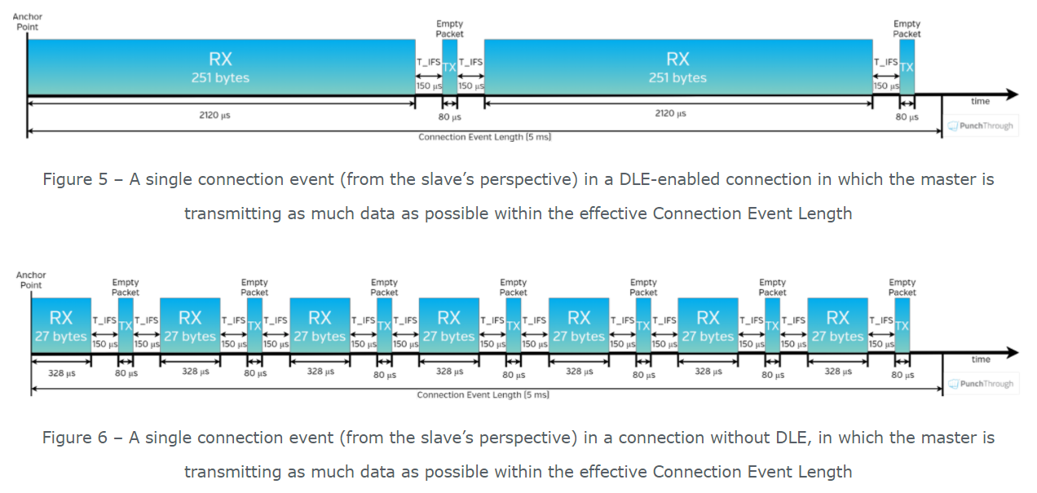
How much throughput can a device have?
Step 2, increase packet size

Slide 26
How much throughput can a device have?
488 bytes per connection event
  Maximum sized packets, discounting headers and timing delays
Connection event every 7.5 ms
Result: 520 kbps (65 kB per second)
  iOS result 260 kbps
  Original BLE 4.1 result on Android: 128 kbps
  Lower in practice due to lost packets

Slide 27
Outline
Connection Link Layer
Connection Investigations
GATT
BLE 5

Slide 28
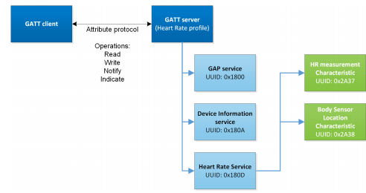
Overview of Generic Attribute Profile (GATT)

Slide 29
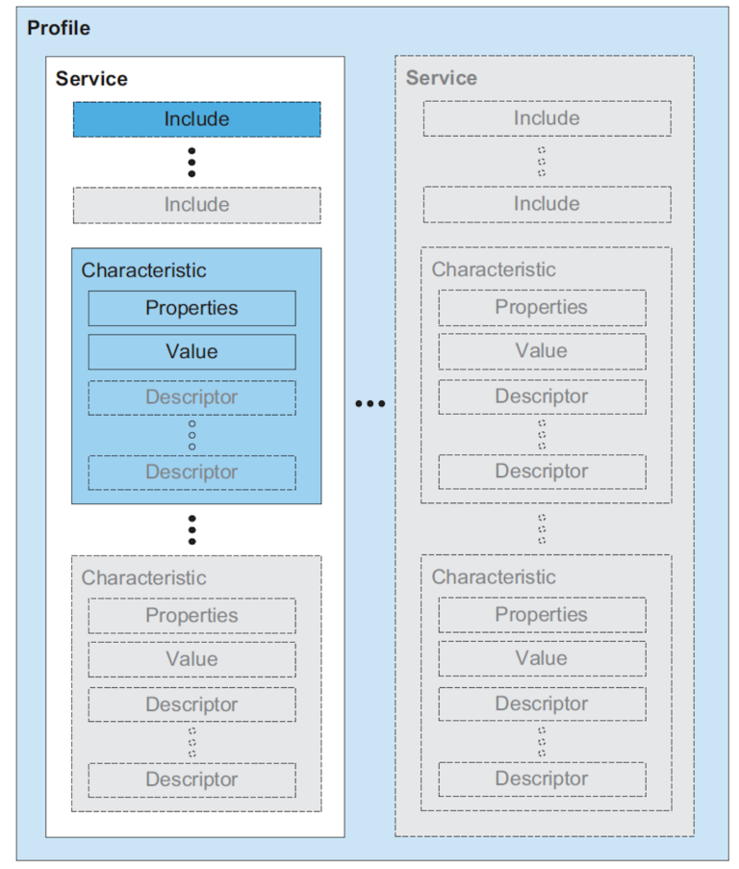
Attribute server keywords
Characteristic
  A field with properties and a value
  Descriptor: metadata about the characteristic
Service
  Collection of characteristics
Profile
  Collection of services

Slide 30
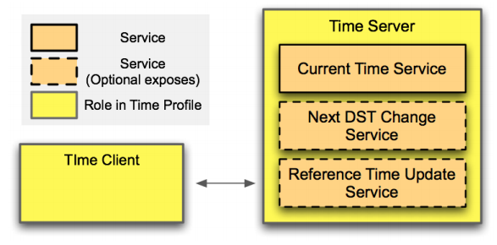
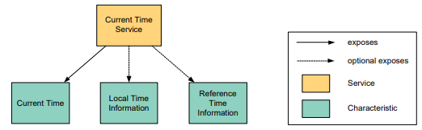
Example: Time Profile

Slide 31
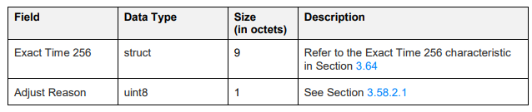
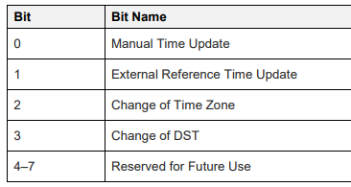
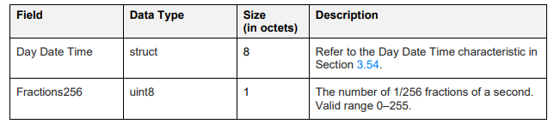
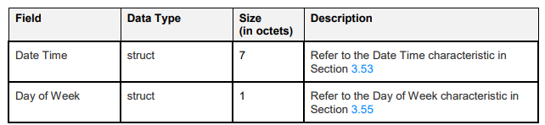
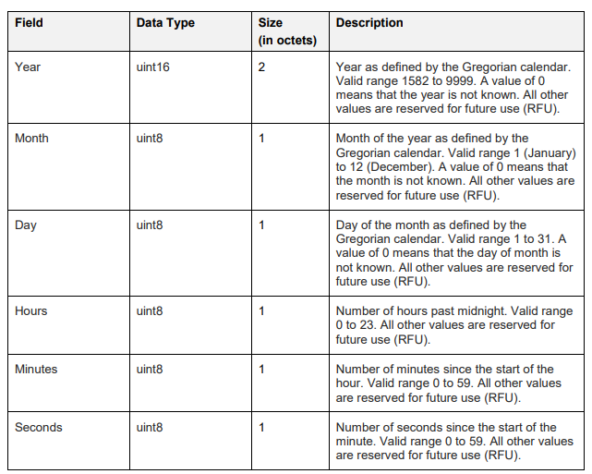
Current time characteristic
The Bluetooth SIG are just terrible, pedantic people

Slide 32
Documentation of GATT standards
https://www.bluetooth.com/specifications/gatt/
  Various profiles and services that have been standardized
GATT Specification Supplement
  Various characteristic definitions that have been standardized
Both incredibly specific and woefully inexhaustive

Slide 33
UUIDs and handles
Universally Unique Identifiers
  128-bit, mostly random with a few bits for versioning
  Example: 00000000-0000-1000-8000-00805F9B34FB
    This is the default BLE UUID for known services
    You can generate your own UUID for custom services
Handles
  Too long to pass around all the time, so pick 16 bits that mean that UUID
    Must be unique among services/characteristics on that device
  Taken from UUID: 0000xxxx-0000-1000-8000-00805F9B34FB
  Handle often sequentially incremented for each new characteristic within a service

Slide 34
Discovery
When a connection first occurs, each device can query the other for a list of services
  And can further query for a list of characteristics in that service
  Gets a list of handles/UUIDs
Standardized UUIDs can be interpreted immediately
  Custom services/characteristics need documentation from the manufacturer

Slide 35
Interacting with characteristics
Depends on their permissions
  Readable, Writable, Notify-able, etc.
Notify
  Automatically get a message sent whenever the characteristic value updates
  Note: have to enable this on both sides, it’s not the default behavior
Long characteristics are automatically fragmented across multiple packets and/or connection events
  L2CAP is in charge of this

Slide 36
Outline
Connection Link Layer
Connection Investigations
GATT
BLE 5

Slide 37
Changes in BLE 5
Major changes
  Multiple physical layers (optional implementation 😡)
  Advertising extensions
  Localization extensions (will discuss later with localization)
Minor changes
  Various quality of life improvements
  Examples:
    Advertise on channels in any order
    Better data channel hopping algorithm

Slide 38
Revised physical layers
2 Mbps PHY
  Transmit data faster
  Transmit more data in the same time
Coded PHY
  Forward Error Correction in the data stream
    1 bit -> 2 symbols or 8 symbols
  Makes bits more reliable -> longer distance
  500 kbps and 125 kbps modes
Connections can switch to these PHYs after creation
Advertisements can use these with extensions only

Slide 39
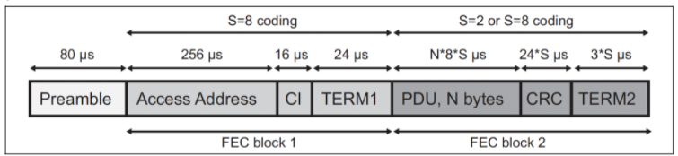
Coded PHY mixes physical and link layers
Different PHY settings at different times
  Make beginning headers extra-reliable
  Data might be slightly less reliable as a trade for faster speed
Packet sent with coded PHY

Slide 40
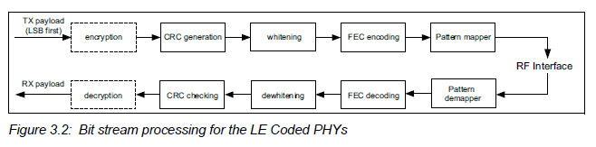
Revised processing path

Slide 41
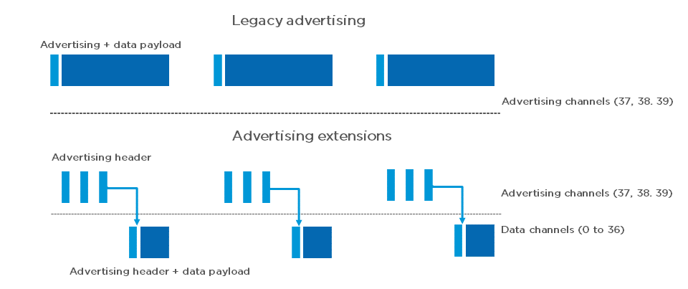
Extended advertising
Allow bigger payloads and/or different PHYs
  Uses Data Channels to do so. Why?
  Regular advertisements point to extended advertisements

Slide 42
Extended advertising
Allow bigger payloads and/or different PHYs
  Uses Data Channels to do so. Why? Packet collisions!
  Regular advertisements point to extended advertisements

Slide 43
Procedure for scanning extended advertisements
Scan on 3 primary channels for advertising packets.
If ADV_EXT_IND is scanned, record the secondary channel information (which channel and when etc.)
Scan the specific secondary channel at the given time.

Slide 44
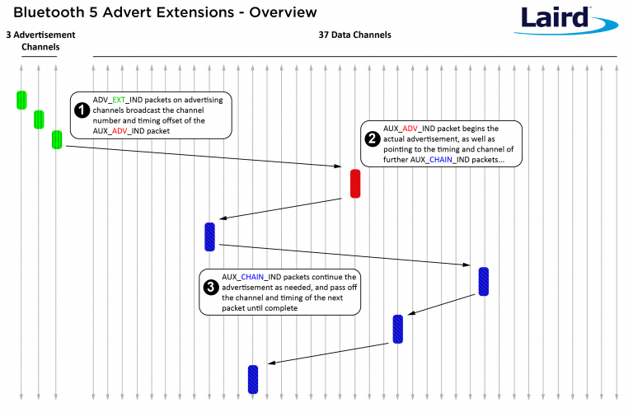
Extended advertisement train on data channels
Use case:
long advertisements that need to be fragmented

Slide 45
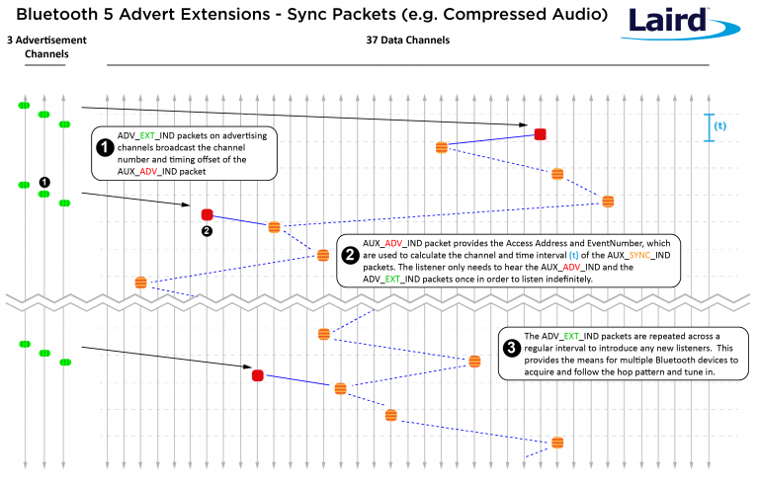
Periodic advertising on data channels
Use case:
publicly-available localized audio sources
TV in a bar
Commentary in a museum
Broadcast analogy of a connection
Downside:
how many of these can a gateway follow at a time?

Slide 46
Outline
Connection Link Layer
Connection Investigations
GATT
BLE 5

