Slide 1
Lecture 01 Introduction
CS397/497 – Wireless Protocols for IoT
Branden Ghena – Winter 2021

Slide 2
Today’s Goals
Overview of the course
Introduction to the Internet of Things
Introduction to wireless communication

Slide 3
Outline
Who and Why
Internet of Things
Course Overview
Overview of wireless networks

Slide 4
Welcome to CS397/497!
~16 students (9 undergrad, 7 grad)
Lots of different backgrounds and interests
This is going to be like a graduate course
No exams!
Occasional paper reading
Majority of your grade is the final project
This course is based on discussion and questions
Expect to attend course sessions, keep webcam on, and interact
You’re hopefully here because you want to be and want to learn

Slide 5
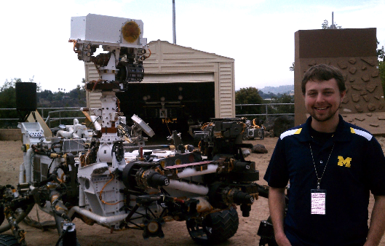
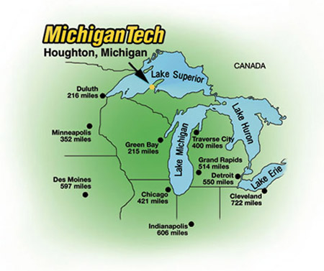
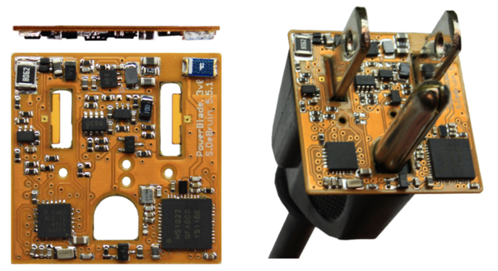
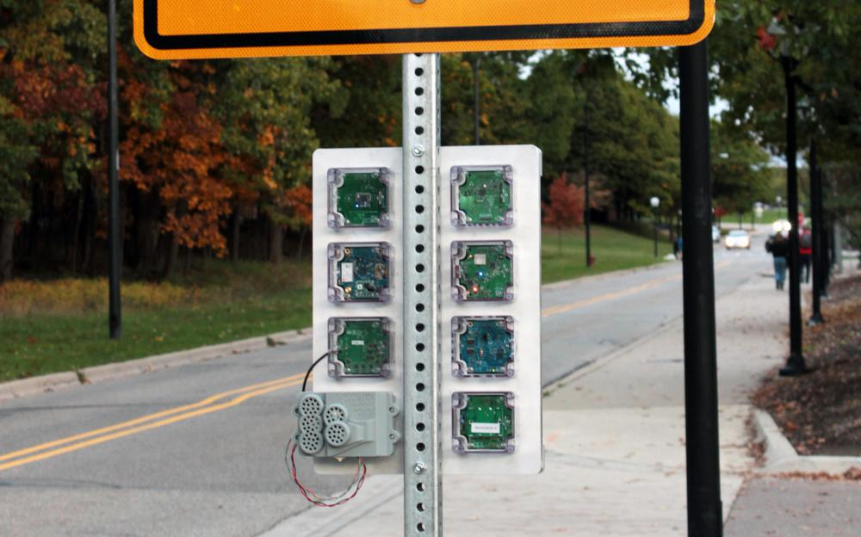
Branden Ghena (he/him)
Assistant Faculty of Instruction
Education
Undergrad: Michigan Tech
Master’s: University of Michigan
PhD: University of California, Berkeley
Research
Resource-constrained sensing systems
Low-energy wireless networks
Embedded operating systems
Teaching
Computer Systems
Intro to Computer Systems
Operating Systems
Microprocessor System Design
Things I love

Slide 6
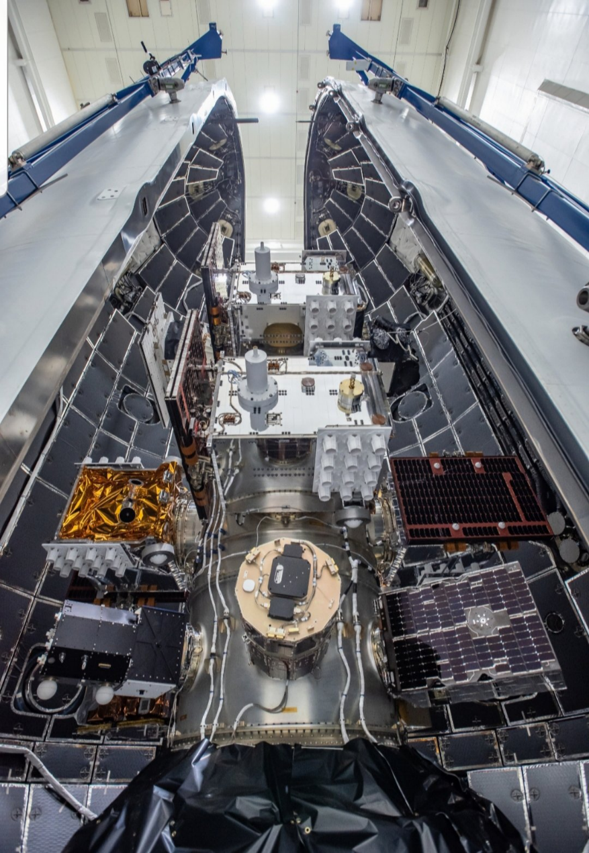
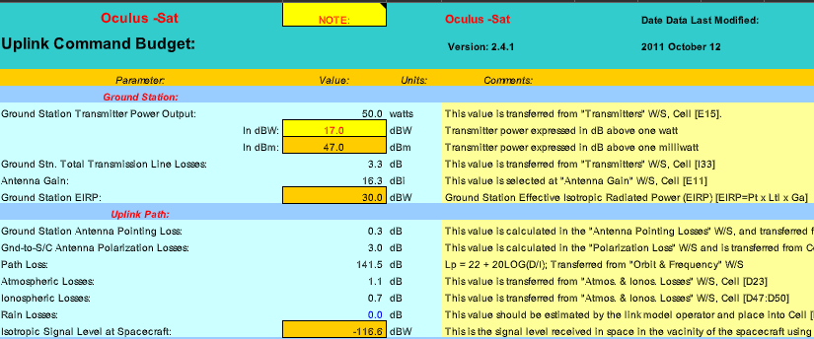
Undergraduate: satellite radios and computers
How the heck are you supposed to learn this stuff?

Slide 7
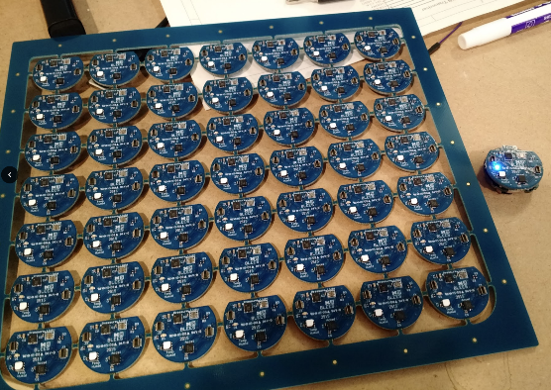
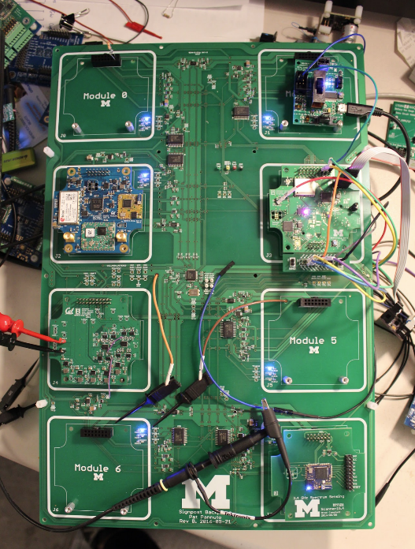
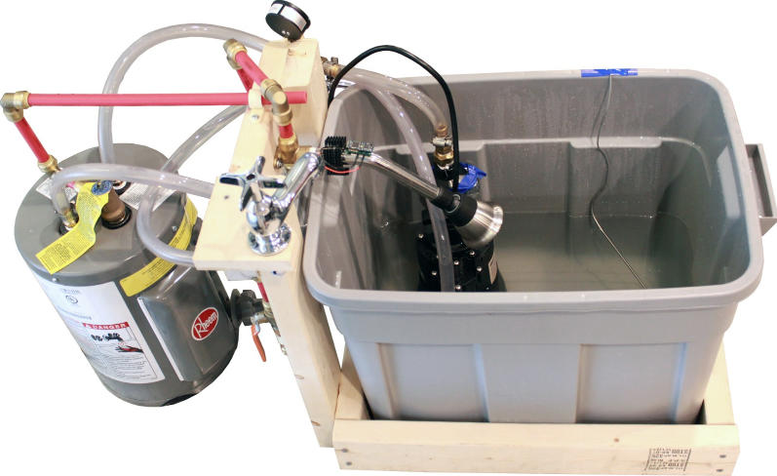
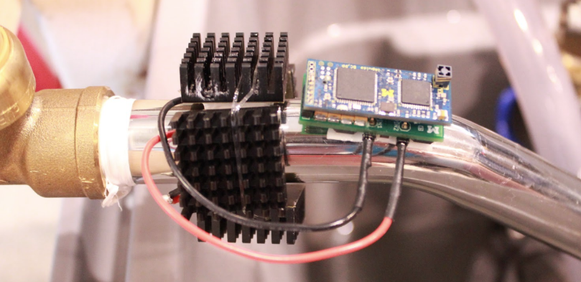
Grad school: resource-constrained embedded systems
Most interesting to me: the interfaces
Hardware and software
Applications and OS
Communication
Again: learn by doing
And with significant assistance from your peers

Slide 8
Faculty: now I can choose what to teach!
Goal: provide classes that teach more advanced embedded systems topics
Hopefully, generally useful to other nearby domains of CS and ECE too!
Result: this course!
Really would be much nicer in person, but 🤷‍♀️
Course goals: make students familiar with a number of different wireless protocols and their tradeoffs
Practical hands-on experience with some networks
Open-ended project where students can choose their specific focus

Slide 9
Outline
Who and Why
Internet of Things
Course Overview
Overview of wireless networks

Slide 10
Perspective of this course
This class is about wireless protocols
For a specific domain: the Internet of Things
So we’ll spend some amount of time discussing the Internet of Things and embedded systems
Including how to program embedded systems

Slide 11
Discussion: what is the Internet of Things?
Name a few Internet of Things devices
What are the qualities that designate those devices at “IoT”?

Slide 12
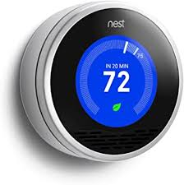
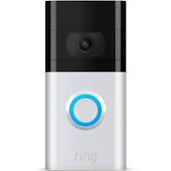
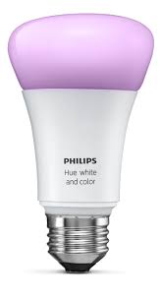
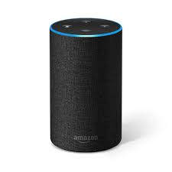
Discussion: what is the Internet of Things?
Name a few Internet of Things devices
What are the qualities that designate those devices at “IoT”?

Slide 13
Thought experiment on capabilities
What if the Nest thermostat was powered by an entire desktop?
8-core x86-64 processor, 32 GB RAM, 1 TB SSD
Would that still count as IoT?
Why don’t we see that in practice?

Slide 14
Thought experiment on capabilities
What if the Nest thermostat was powered by an entire desktop?
8-core x86-64 processor, 32 GB RAM, 1 TB SSD
Would that still count as IoT?
Why don’t we see that in practice?
Cost

Slide 15
Thought experiment on energy
IoT devices include a mix of batteries, wall power, (and energy-harvesting)
Why do we put so much focus on systems with batteries?
Why do they need batteries?

Slide 16
Thought experiment on energy
IoT devices include a mix of batteries, wall power, (and energy-harvesting)
Why do we put so much focus on systems with batteries?
Why do they need batteries?
Deployability

Slide 17
Branden’s take on the Internet of Things
Key features
Computation
Local to the device
With some capability for arbitrary compute and storage
Connectivity
Almost certainly wireless
Likely Internet, possibly local
Interaction
Sensing or Actuation
Secondary features
Low energy
(Relatively) Low cost

Slide 18
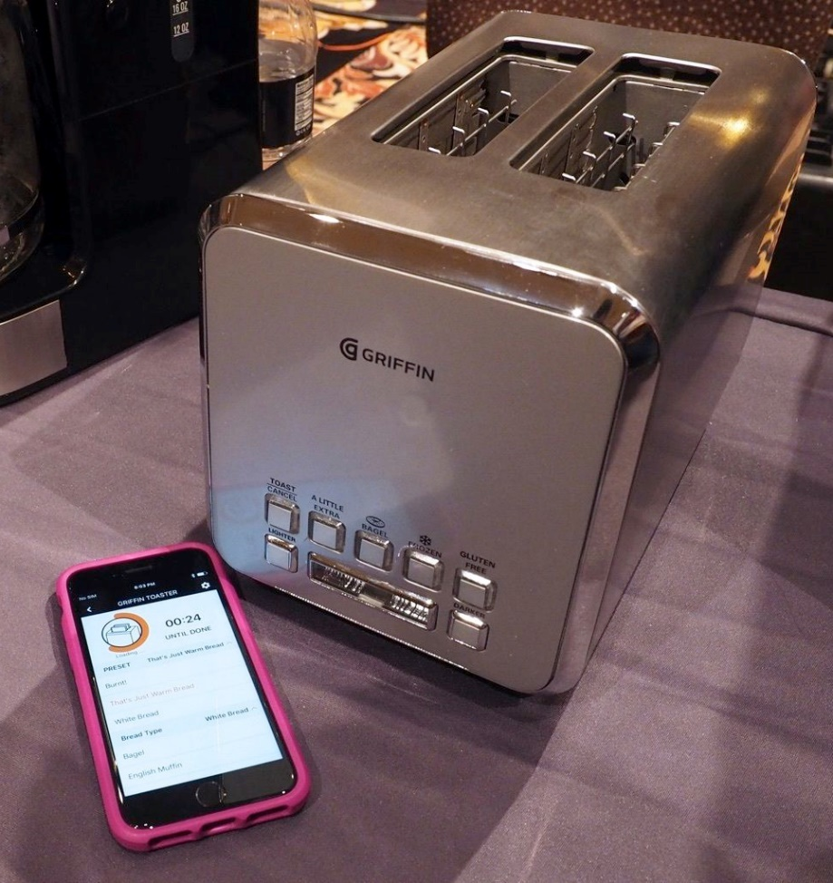
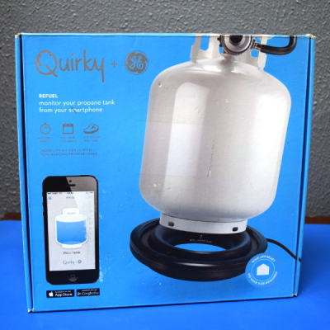
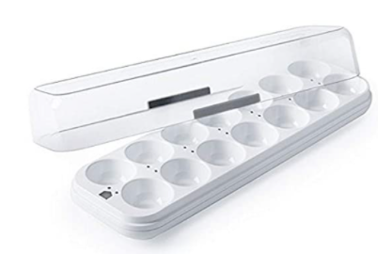
Warning: Internet of Crap

Slide 19
Internet of Insecure Crap
Mirai botnet (2016)
Takes control of up to 600,000 insecure connected devices
IP-attached cameras, DVRs, routers, printers
Used to DoS websites

Slide 20
Outline
Who and Why
Internet of Things
Course Overview
Overview of wireless networks

Slide 21
General course structure
Mondays and Wednesdays
Lecture and discussion about networks
Fridays
Labs and projects
A brief overview from me about what’s going on
Open work period while on zoom still
Closest I can get to a “lab” setting

Slide 22
Grading
35% Lab projects
65% Final project
Seriously, no exams or homework or participation points
The point of in-class material is to teach you and prepare you for projects
Come because you want to learn it

Slide 23
Labs
Semi-guided efforts of getting wireless communication working on real hardware
Get embedded software working
Bluetooth Low Energy advertisements
Bluetooth Low Energy connections
Thread network
In a perfect world we would also do something with WiFi and something LPWAN
Would need additional hardware
And extra time that we don’t have this quarter

Slide 24
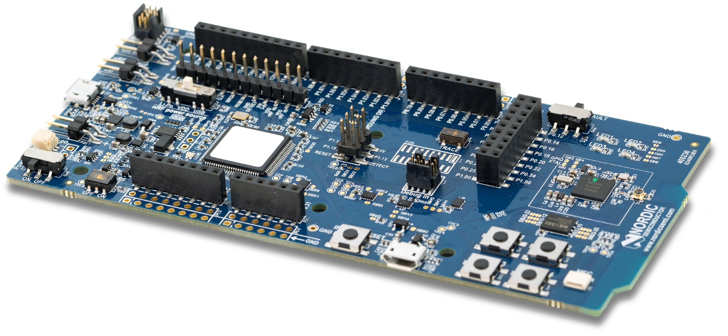
Lab hardware
nRF52840dk
Microcontroller with BLE and Thread support
JTAG support built into the board
Hopefully also useful for final projects for some portion of you!
Fill out campuswire survey!
I’ll start ordering stuff tomorrow

Slide 25
Lab grading
Around one page submission on canvas
“Prove to me that you did this lab”
Point me at public Github code. Include pictures of debug output/network visualization. Discuss what did/didn’t work.
NOT a formal lab writeup
Playing this pretty loose since it’s a small, experimental class
There’s always a chance something in labs won’t work

Slide 26
Project
Classic grad school “do a project”
Come up with something you’re interested in exploring that is linked to the topics of class
Definitely acceptable to overlap with research or other classes
Work in small groups of 2-3 students
This is your chance to decide what you’re actually interested in and to guide your own learning
Good ideas should be a lot of work too

Slide 27
Project proposals
Proposals due Monday, February 1st
3 weeks from today
Want to provide plenty of time to work on the project
Start thinking about project ideas and finding partners now
Preferably two-three people. One is possible. Four+ needs to be justified.
I am very happy to talk about ideas during office hours
Goal is that we’ll have talked about it at some point before you submit the proposal

Slide 28
Project ideas
Analyze and optimize a deployed network
Measure throughput, or energy, or latency, etc.
Determine how to improve network for application use case
Implement and evaluate a modified network protocol
Change something about the specification of an existing protocol
Measure the effect that it has on a deployment

Slide 29
Project ideas
Simulate a wireless network
Accurately predict throughput, energy, latency, etc.
Could be done in any language or platform (e.g. NS-3)
Visualize network performance
Provide tools for understanding and debugging performance
Real-time or historical snapshot

Slide 30
Hardware for projects
Mostly up to you to provide
Talk to me about your needs, and I might have ideas or things to lend out that will help
I’ve got lots of random stuff on hand, as does Josiah

Slide 31
Outline
Who and Why
Internet of Things
Course Overview
Overview of wireless networks

Slide 32
Schedule
Week | Monday | Wednesday | Friday
Jan 11-15 | Introduction | Slack (ComEd hates Branden) | MAC Protocols +Recorded Lab Embedded
Jan 18-22 | MLK Day | BLE Advertisements | Lab Advertisements
Jan 25-29 | BLE connections | Bluetooth Classic | Lab Connect
Feb 1-5 | 802.15.4 | Thread | Lab Thread
Feb 8-12 | Zigbee/Advanced | WiFi | slack
Feb 15-19 | WiFi 2 | LPWANs | Updates
Feb 22-26 | Cellular | Cellular 2 | slack
Mar 1-5 | Localization | Backscatter | Updates
Mar 8-12 | Wrapup + Extra | Presentations | Presentations 2

Slide 33
Bluetooth Low Energy
Bluetooth Classic was good for enabling device to device communication
But not particularly fast or low energy
Bluetooth Low Energy was developed to improve this
Focuses on low-energy interactions
Much lower throughput that Bluetooth
Supported by hardware devices already in smartphones
Humans can interact directly with nearby devices!!

Slide 34
802.15.4 & Thread
802.15.4 is a low-energy physical layer
Radio chips have been widely available for 15-20 years
Significant amounts of sensor network research have focused on building layers on top of 802.15.4
Access control layers
Network layers
Thread is a selection of these possibilities to make a network
Uses IPv6 networking!!

Slide 35
WiFi (802.11)
Ubiquitous wireless communication
High energy requirements for high throughput communication
Now accessible through relatively low power radios
ESP32, Electric Imp, and company
Still significantly more effort than BLE or Thread
IoT devices can use the same WiFi that’s already available
No need for additional infrastructure!!

Slide 36
LPWANs (Low-Power Wide-Area Networks)
How do we collect data from city-scale deployments?
There’s an unmet need for long-range, but low-throughput networks
Existing cellular technologies focus on human requirements
Still a brand new space (relatively)
Unlicensed-band technologies in last 5 years: Sigfox and LoRaWAN
Cellular technologies in last 2 years: LTE-M and NB-IoT
Focus on long-range, low-energy, low-throughput
One gateway can cover an entire city!!

Slide 37
Extras
Extremely active research areas
Backscatter
Insanely low-energy communication
Enables energy-harvesting indoor devices
Localization
How do we find all this stuff?
And how do devices determine where they are relative to each other?
Other topics are possible if desired. Tell me what focus you want.

Slide 38
Why use wireless?
There are no wires!
No need to install and maintain wires
Reduces cost
Simplifies deployment – place devices wherever makes sense
Supports mobile users
Move around office, campus, city
Move devices around home

Slide 39
What is hard about wireless?
There are no wires!
Wired networks are constant, reliable, and physically isolated
Ethernet has the same throughput minute-to-minute
Bits sent through Ethernet or USB are (usually) received
Wireless networks are variable, error-prone, and shared
WiFi throughput changes based on location and walls
Signals from nearby devices interfere with your signals
Individual bits might flip or never be heard at all

Slide 40
Wireless is a shared medium
Wired communication has signals confined to a conductor
Copper or fiber
Guides energy to destination
Protects signal from interference
Wireless communication is inherently broadcast
Energy is distributed in space
Signals must compete with other signals in same frequency band

Slide 41
Increasing network capacity is challenging
Wired networks just add more wires
Buses are many signals in parallel to send more data
Wireless networks are harder
Adding more links just increases interference
Need to expand to different frequencies

Slide 42
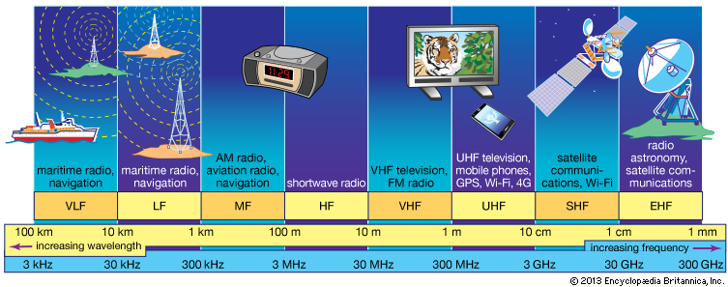
RF communication
IoT focus

Slide 43
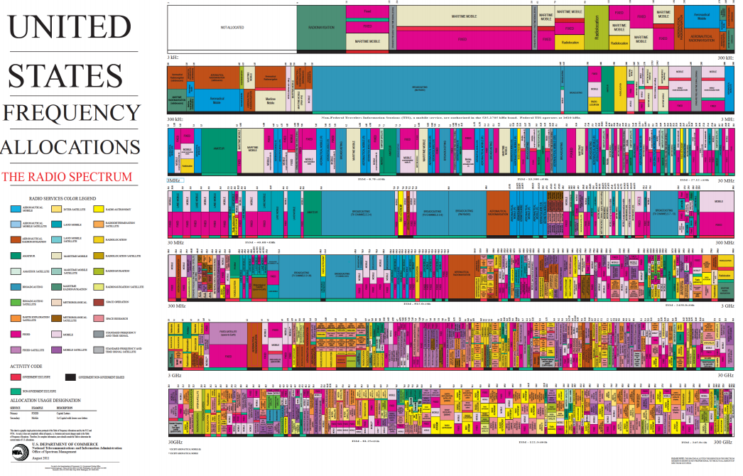
Wireless spectrum is allocated to specific uses

Slide 44
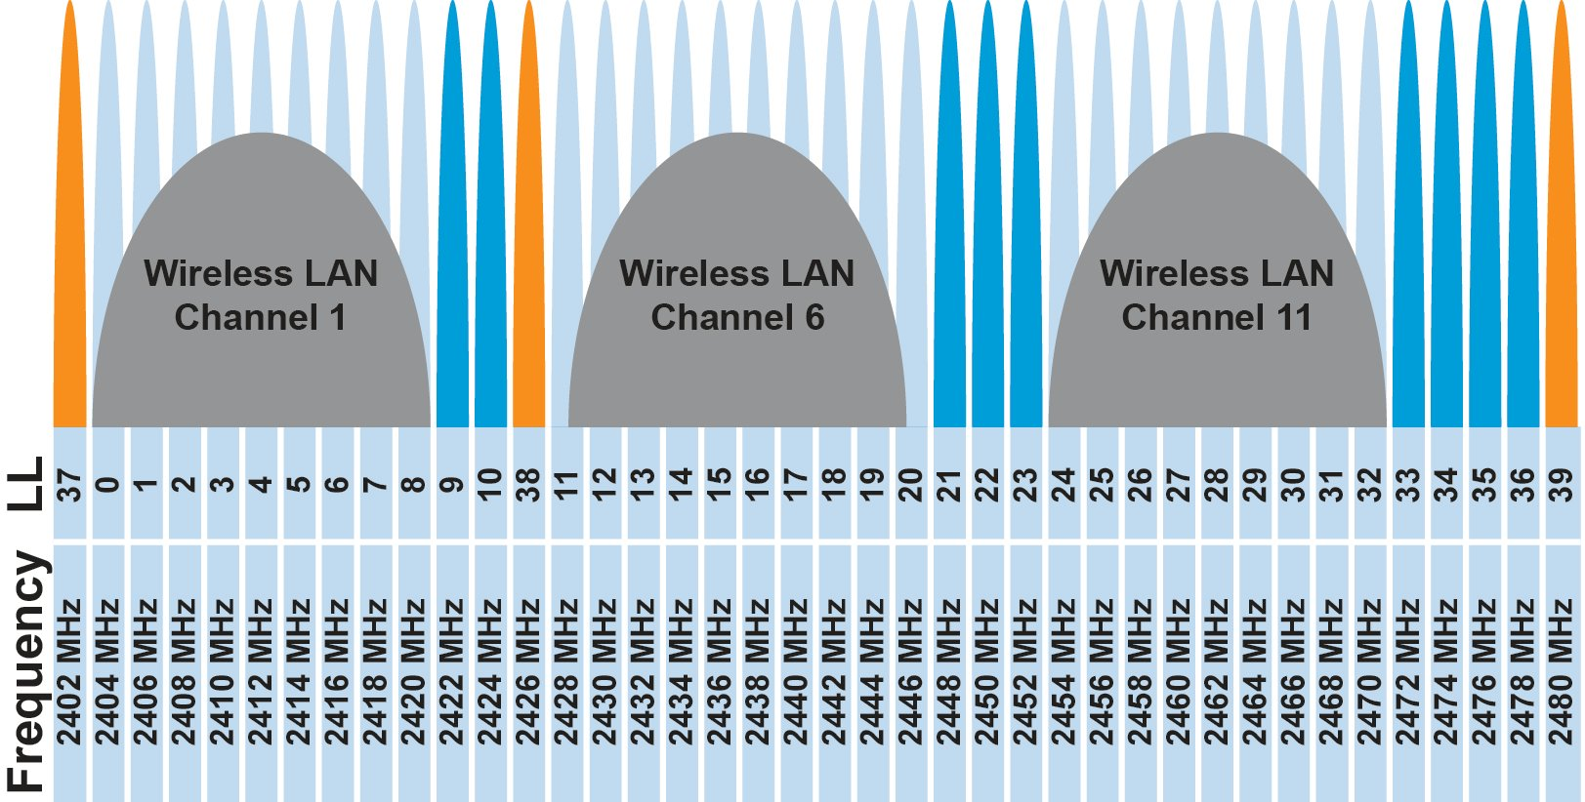
Unlicensed bands are where IoT thrives
902 MHz – 928 MHz
LPWANs
2.4 GHz to 2.5 GHz
WiFi, BLE, Thread
5 GHz
Faster WiFi
Cellular uses licensed bands

Slide 45
Model of RF communication
Energy that radiates spherically from an antenna
Attenuation with distance
Density of energy reduces over time, distance
Signal strength reduced, errors go up
Two key features
Error rates depend on distance
Spatial reuse of frequencies

Slide 46
Outline
Who and Why
Internet of Things
Course Overview
Overview of wireless networks

