Slide 1
Lecture 18
Backscatter & RFID
CS433 – Wireless Protocols for IoT
Branden Ghena – Spring 2026
Materials in collaboration with
Pat Pannuto (UCSD) and Brad Campbell (UVA)
Some slides borrowed from Ambuj Varshney (NUS)

Slide 2
Administrivia
Lab: LoRa
  Get checkoffs at office hours this week
  Evan’s office hours will still be held this Friday if late checkoffs are needed
Final Design Project
  Formal design review of an application
    Consider energy, costs, etc.
  Writeup due Tuesday of exam week
    No late days on this one. Submit it on time.
  Working on Cellular homework grading
    Common lost points: no inline citations

Slide 3
Quiz today
FYI

Slide 4
Today’s Goals
Describe backscatter communications
Understand one use of backscatter: RFID
Explore how backscatter techniques can be used for applications
    Sensor networks
    Localization

Slide 5
Outline
Backscatter
Backscatter Uses
  RFID
  Sensors (Backscatter LoRa)
  Localization
NFC

Slide 6
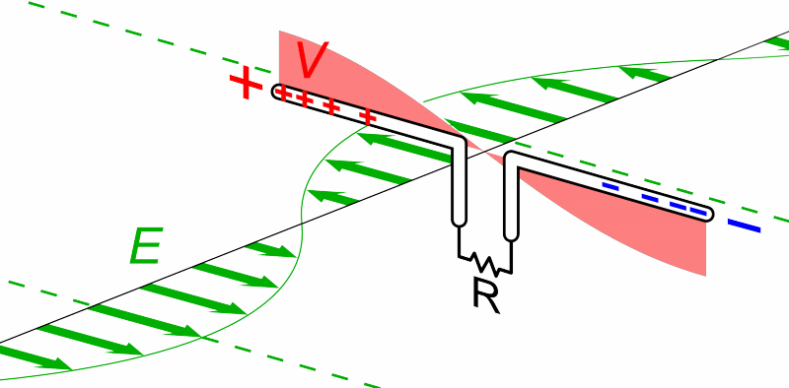
What does an antenna do?
Loosely: Converts between radio waves and electric signals
Animation by Chetvorno - Own work, CC0, https://commons.wikimedia.org/w/index.php?curid=40789783

Slide 7
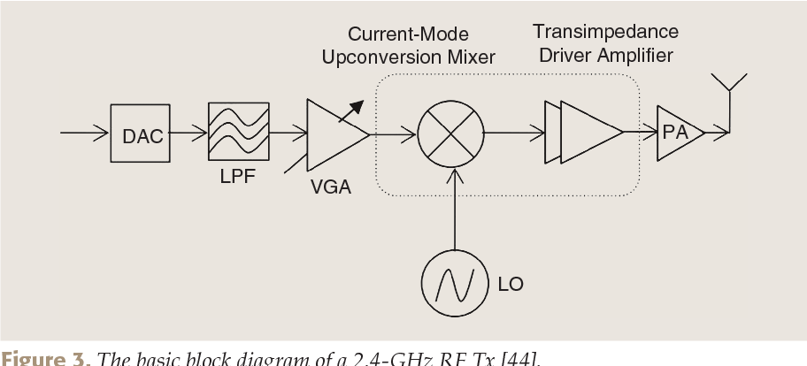
What generates electric waves?
RF front end
  can be done with high-speed digital components (e.g. fast DACs)

Slide 8
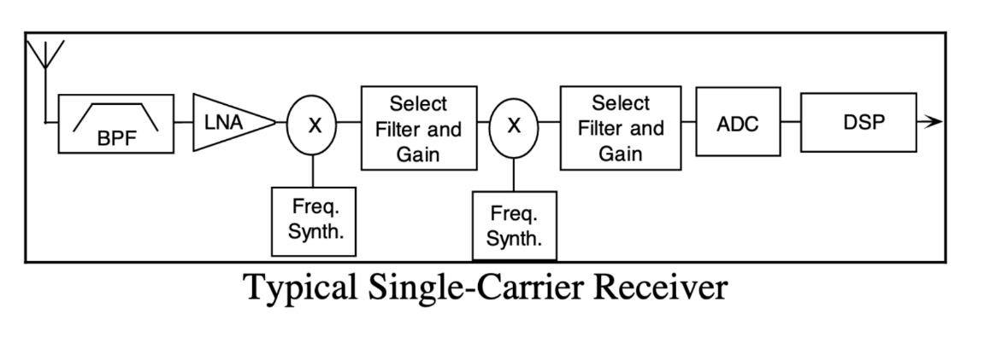
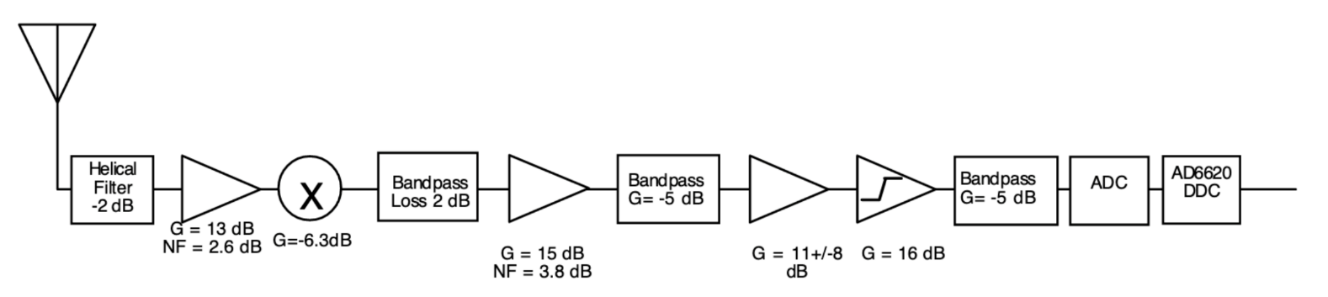
What receives electric waves?
Again, lots of stuff nowadays…
  Could be a high-speed ADC, more often with analog pieces in front:
Graphics from Analog Devices whitepaper: https://www.analog.com/media/en/technical-documentation/tech-articles/480501640radio101.pdf — significantly more detail here

Slide 9
Making ultra-low power radios
How do we make a radio that’s lower power?
What is the most costly part of the radio?
  Carrier-frequency generation is expensive
  Modulating bits is comparatively lower energy
Solution: do not generate carrier
  Instead, use existing RF signal transmitted nearby
  Common case: sent from nearby higher capability device
  Dream case: use ambient RF signals to communicate
  Bonus: could harvest energy from the signal being received
Two versions in practice: backscatter and inductive coupling

Slide 10
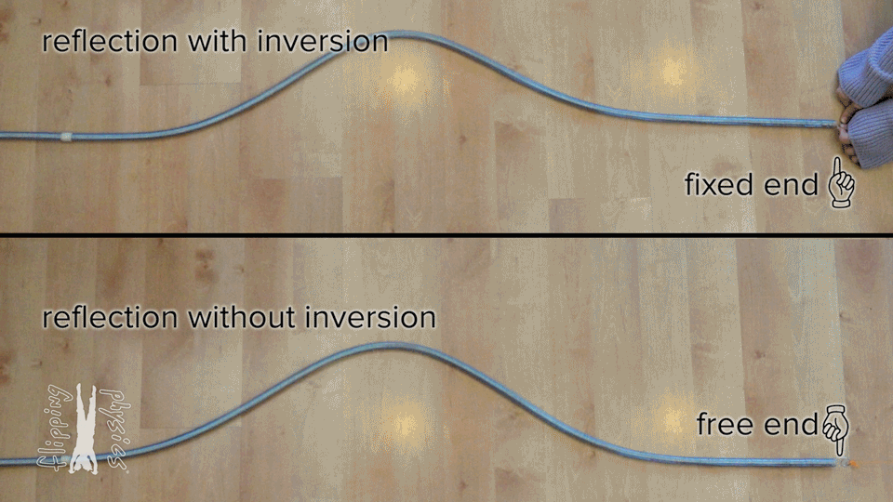
What happens if nothing ‘receives’ the wave?
From: https://www.flippingphysics.com/standing-waves.html

Slide 11
”Fixed end” and “Free end” in electronic transmission
~
Short Circuit = “Free End”
- Reflects wave
~
Open Circuit = “Fixed End”
- Inverts wave
~
Matched Load
- Absorbs wave (no reflection)

Slide 12
Backscatter theory of operation
Vary between absorbing or reflecting signal to modulate data
  Wireless transmissions at microwatts of power draw (10000x savings)
  Frequency bands: 400 MHz, 900 MHz, 2.4 GHz
  These are the really really cheap tags (~$0.15 each)
Ambient RF signal
Antenna
Reflected (backscatter) signal
RF Switch
Modulating Signal (Digital)
Backscatter tag
Reader/ Receiver

Slide 13
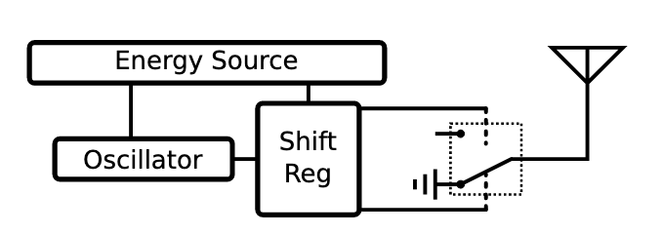
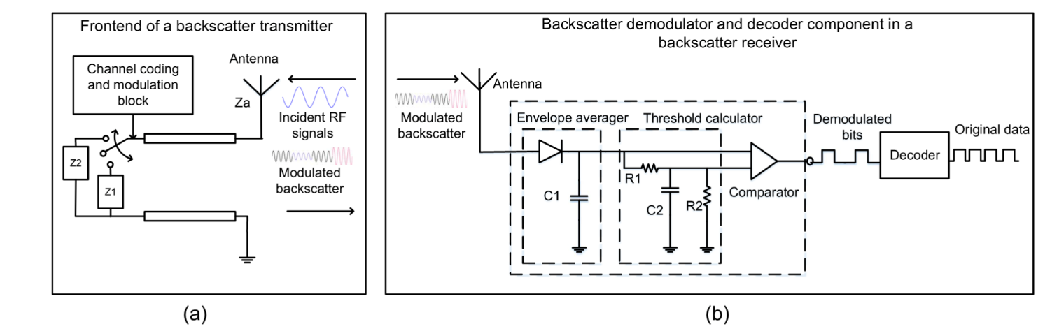
Backscatter radio designs
Simple versions just
‘reflect or don’t reflect’
Modern designs can do more advanced modulation as well
https://ieeexplore.ieee.org/stamp/stamp.jsp?arnumber=8368232

Slide 14
Break + Spycraft
How could a spy use backscatter for malicious, covert purposes?

Slide 15
Break + Spycraft
How could a spy use backscatter for malicious, covert purposes?
  Use microphone to change if antenna is grounded or not
  Transmit power at the backscatter tag and collect microphone data from the response

Slide 16
Backscatter is an old idea — history in spycraft!
1945: Leon Theremin* creates “The Thing” (aka Great Seal Bug)
  *Yes, same guy who invented the instrument
  Discovered when a British embassy radio operator heard recorded conversations (after hanging for 7 years in the ambassador’s office)

Slide 17
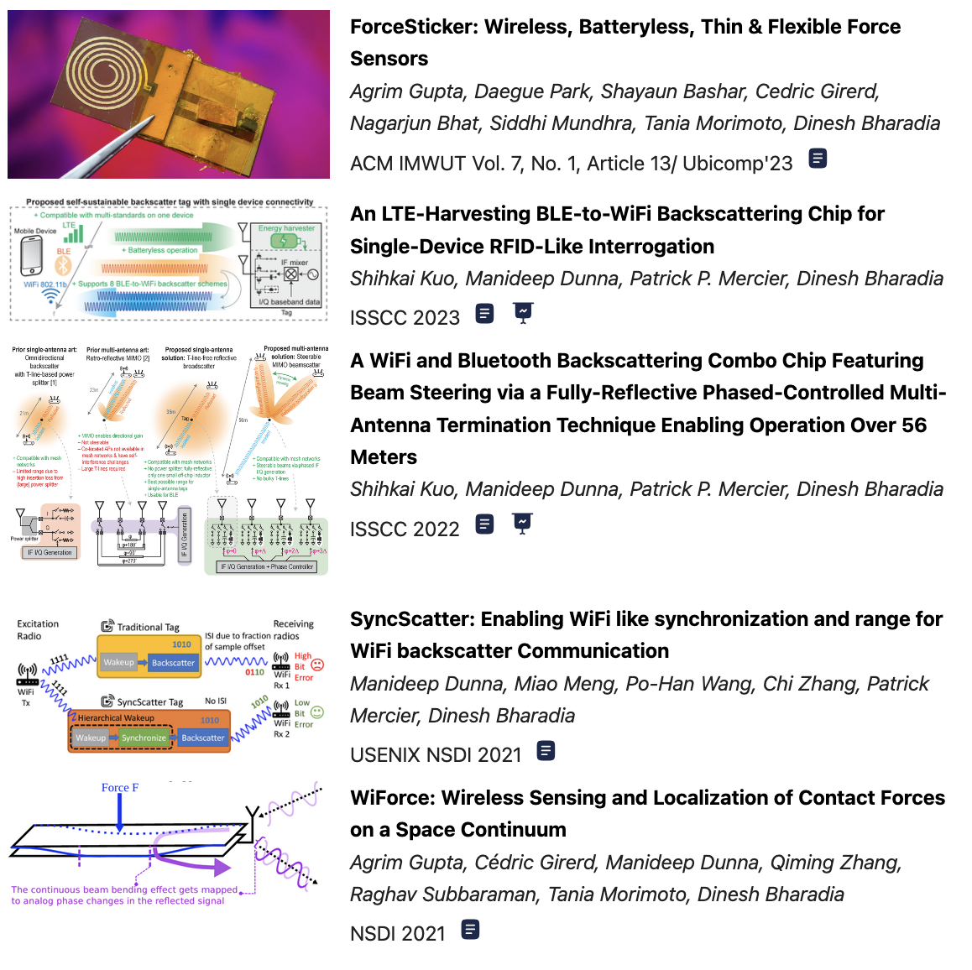
Lots of very active research in backscatter
Two broad paths…
  Passive sensing
    ”Detune” antennas predictably based on physical phenomenon
  Cross-technology communication
    Figure out how to speak “standard” WiFi, BLE, 15.4, etc. with backscattered signals

Slide 18
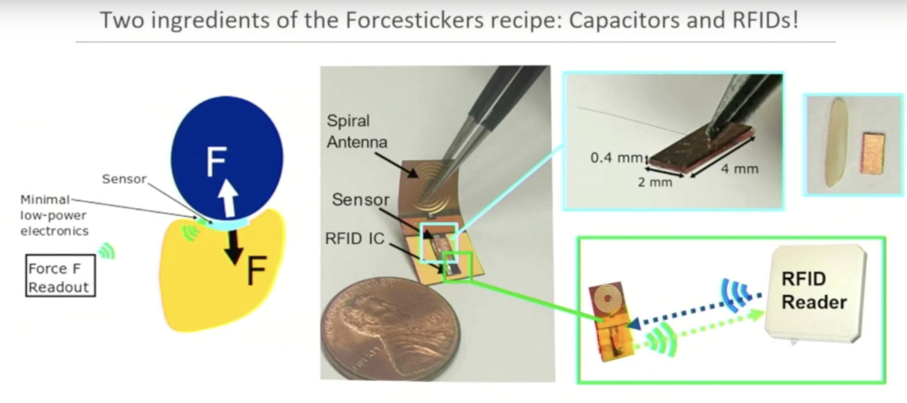
e.g., How much force is applied to a tag?
ForceSticker: Wireless, Batteryless, Thin & Flexible Force Sensors

Slide 19
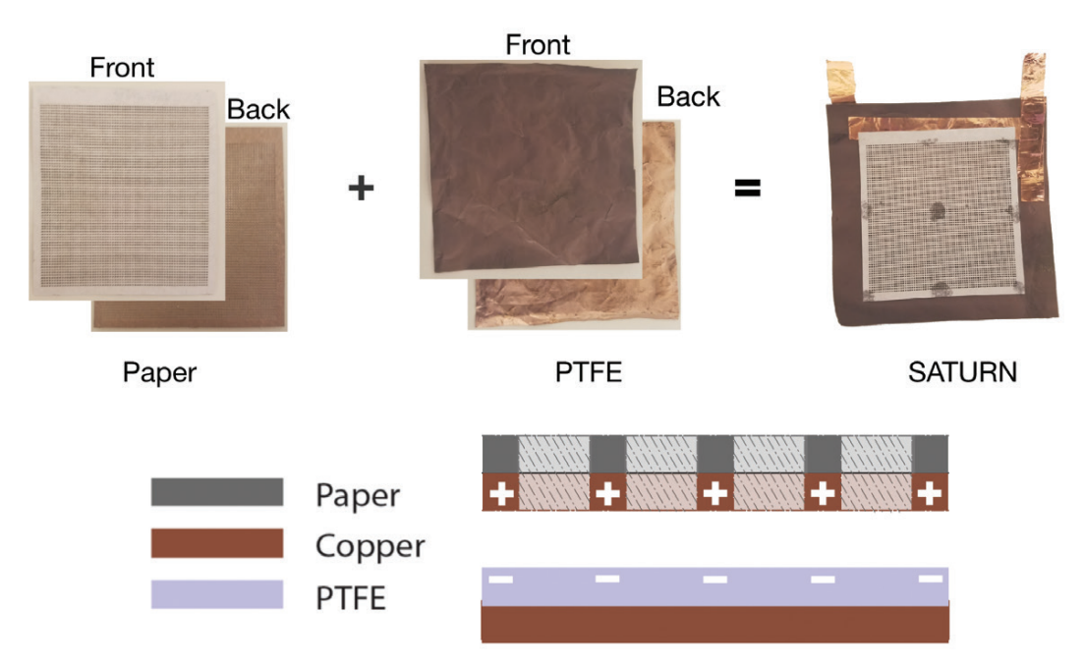
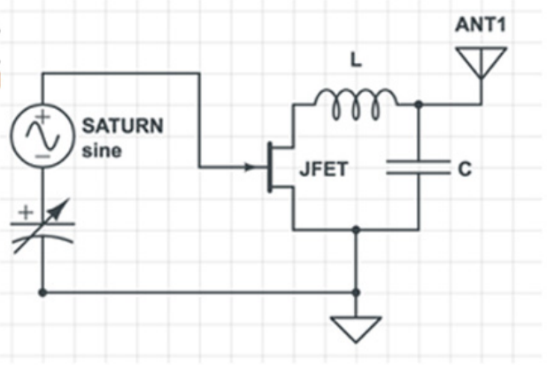
Simple sensors can trigger backscatter
Backscatter fed directly from a sensor
  SATURN is an energy-free microphone made of treated paper
  Use it to trigger transistor for backscattering
  Nivedita Arora (Northwestern ECE faculty)

Slide 20
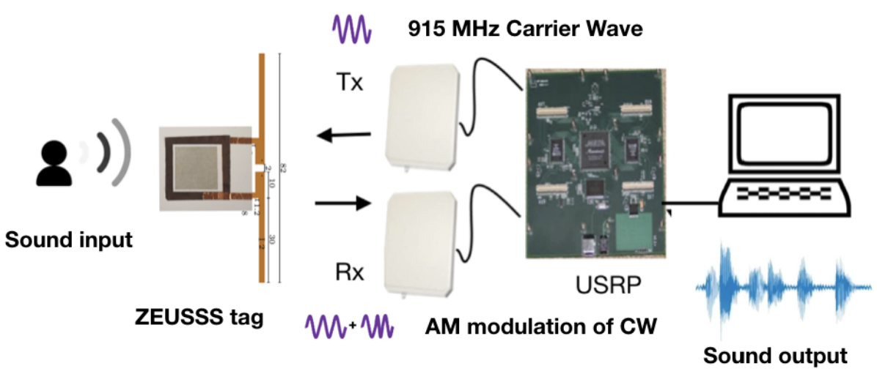
Complete transmission path for SATURN audio

Slide 21
Outline
Backscatter
Backscatter Uses
  RFID
  Sensors (Backscatter LoRa)
  Localization
NFC

Slide 22
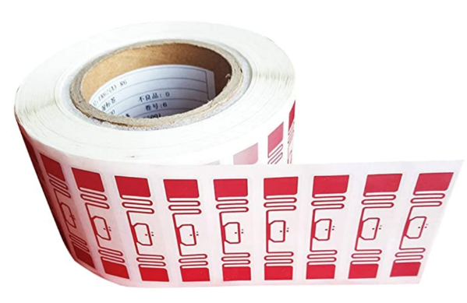
RFID is everywhere nowadays
Fundamental design principle is asymmetry
  Extremely simple, cheap tags
  Complex readers

Slide 23
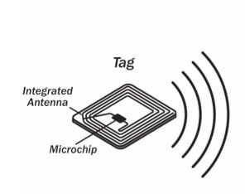
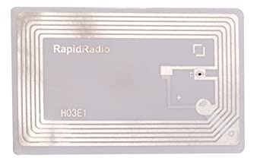
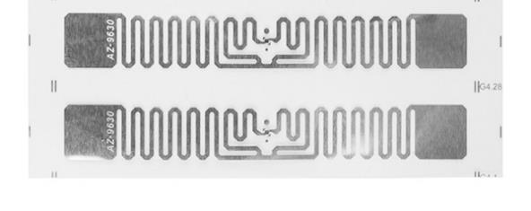
Radio Frequency ID
Cheap, low-power ubiquitous communication
  RFID tags on (or in) products
  NFC communication to/from smartphone
Requirements
  Need to transmit small amount of data (ID)
  Need to operate with little or no energy
    Most do not have batteries
  Short interaction time (fast enough bit rate)
  Range can be extremely limited
    Meters to centimeters (or millimeters)

Slide 24
A brief digression to be precise in terminology
RFID = Radio Frequency Identification = a communication standard
  A ton of standards through the ~early 90’s
  Most now EPC (Electronic Product Code) Gen2
There are actually three types of “RFID” device
  Passive Tags - harvest power from reader & reflect
  Semi-Passive Tags - on-board power, but reflect data
  Active Tags - on-board power that transmit data
Notes:
The point: Papers misuse “RFID” to mean backscatter, and misuse “passive tag” to mean anything that doesn’t actively emit RF.
Most things that do backscatter don’t do the energy harvesting bit
Many papers that do backscatter describe themselves as RFID, but don’t follow any RFID communication standard

Slide 25
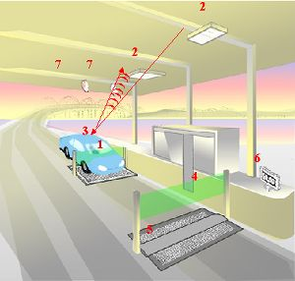
Car RFID systems
Usually two mounted antennas
  One broadcasts energy, activating the RFID device
  The other receives the reflected data
Devices are often battery powered for longer-range operation
  Semi-passive
  Don’t have to energize themselves with signal
  Batteries last a decade

Slide 26
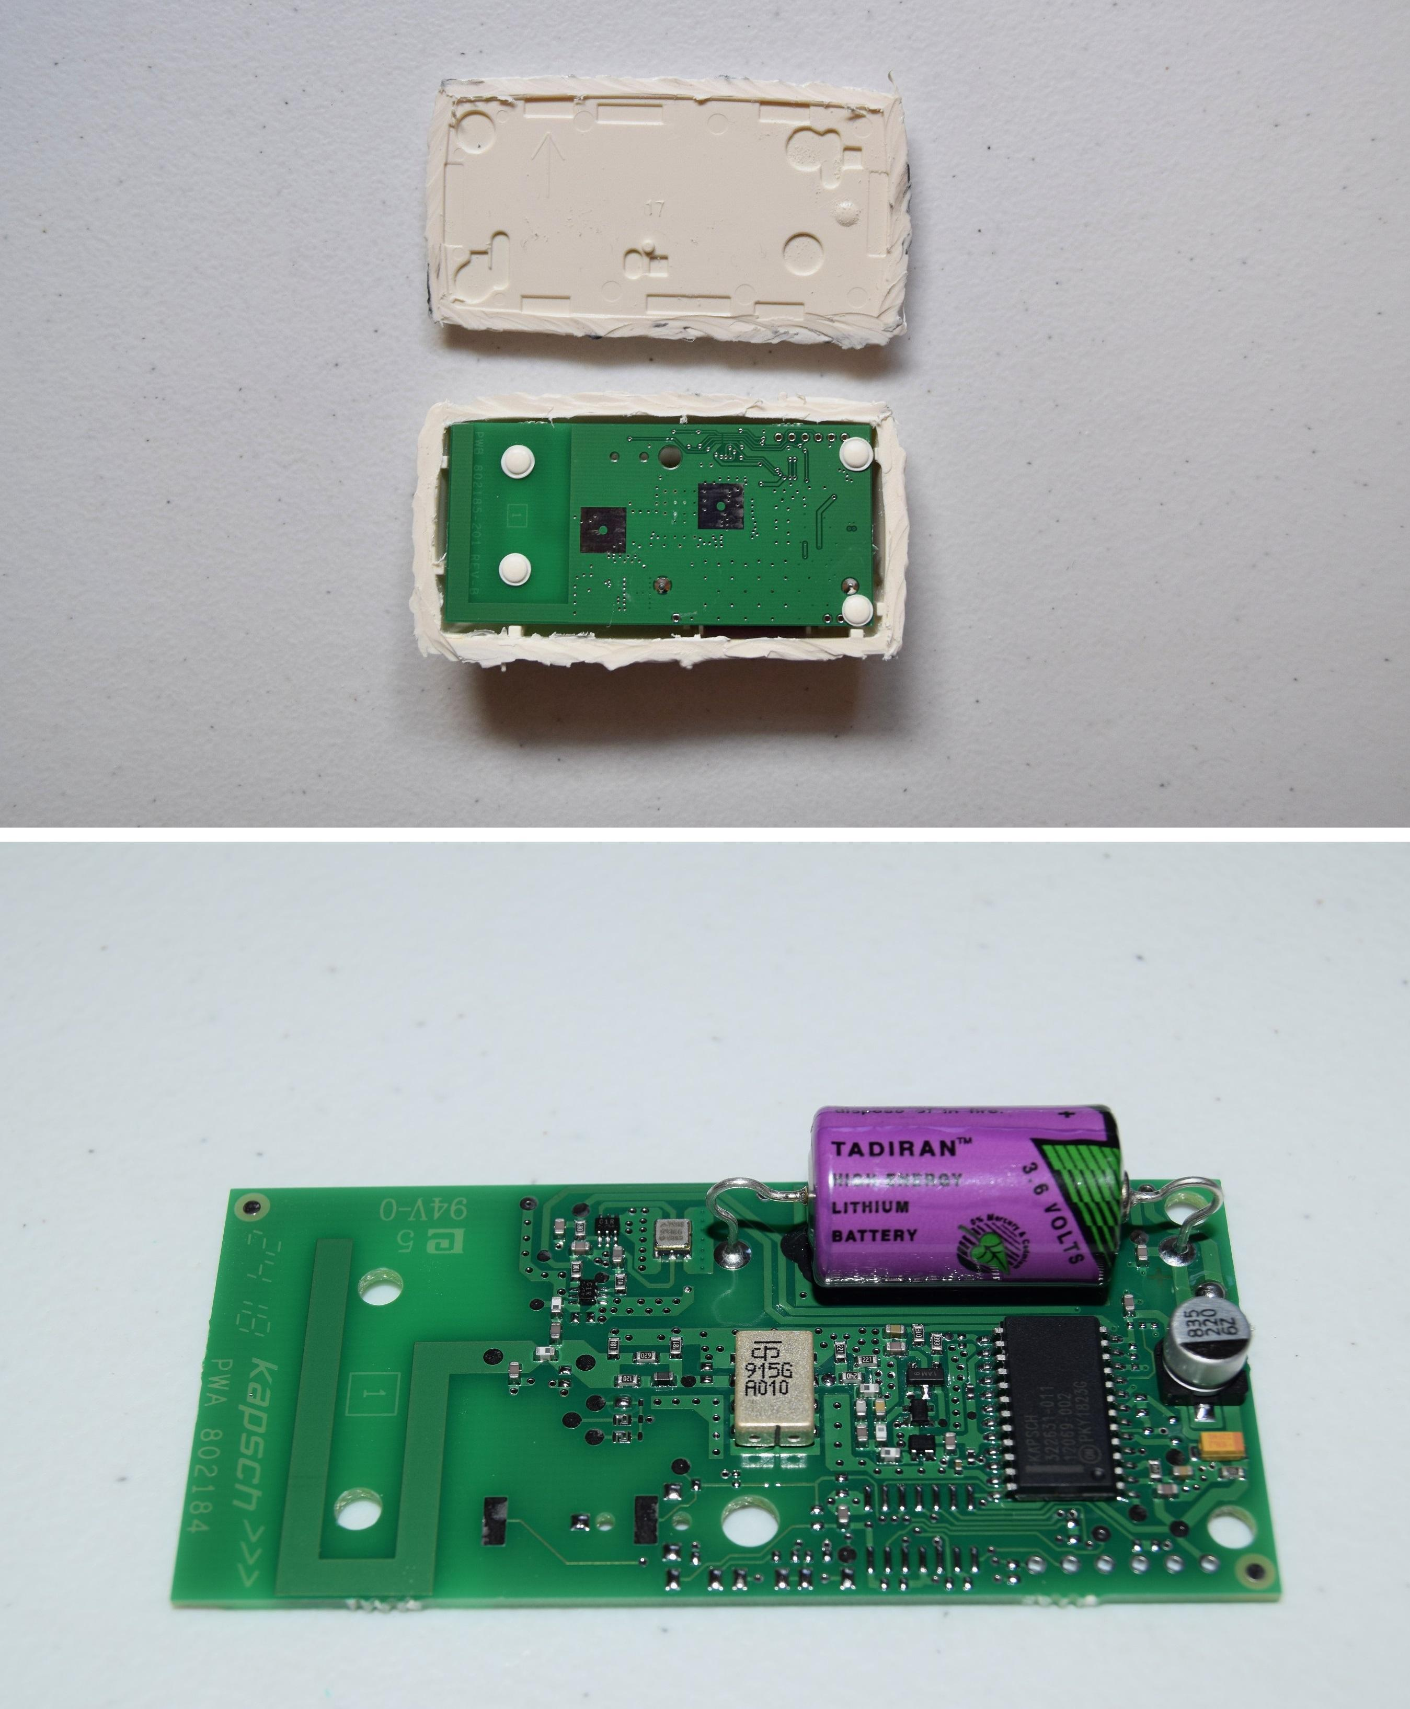
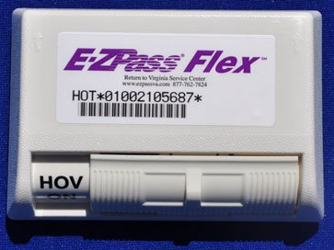
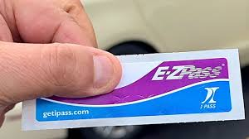
E-ZPass System
RFID for toll road payments
  Originally a battery-powered active system
  Recently switched to passive backscatter tags

Slide 27
Let’s look at RFID standards to get a sense of the numbers
Low Frequency (~300 kHz) — mostly legacy
  ~10cm read range (inductive coupling)
High Frequency (3~30 MHz; often 13.56 MHz)
  Passive: 4~7 m max (usually inductive coupling, I think)
  Semi-Passive: 10~30 m max
  Active: 30+ m
Ultra-High Frequency (300 MHz ~ 3 GHz)
  Passive: Up to 12 m (backscatter)
  Active: Up to 100 m

Slide 28
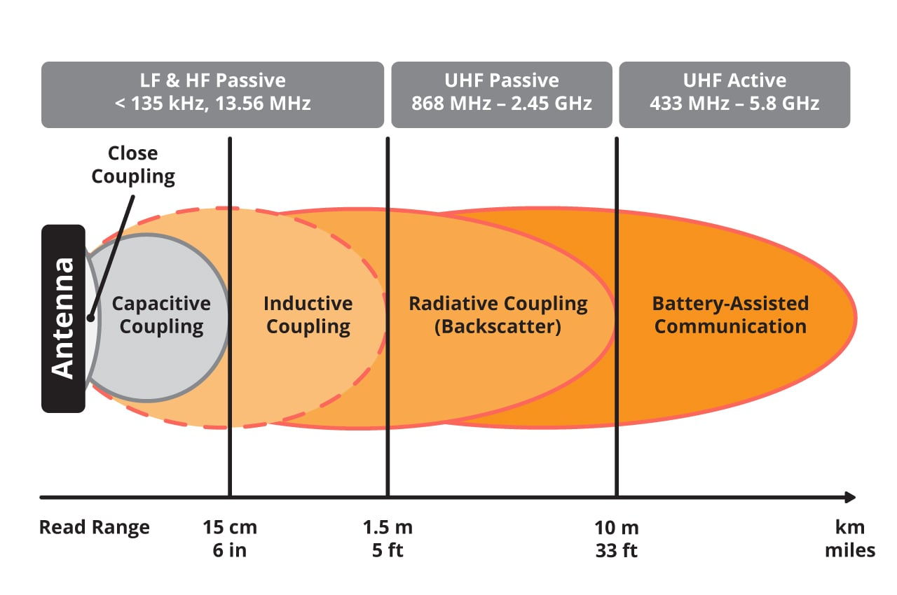
Ranges and typical frequency ranges of RFID systems

Slide 29
Inductive coupling versus RF communication
Inductive Coupling
Inductive Coupling
Reader
Reader
Tag
Tag
Electromagnetic waves propagate between two antennas
Includes backscatter techniques
Range depends on energy
Magnetic field induces a current in the tag
Change in current can be used to communicate
Very short range (<1 meter)

Slide 30
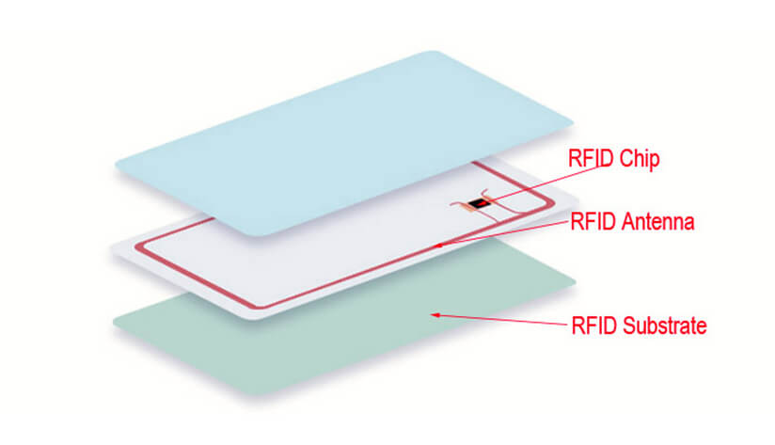
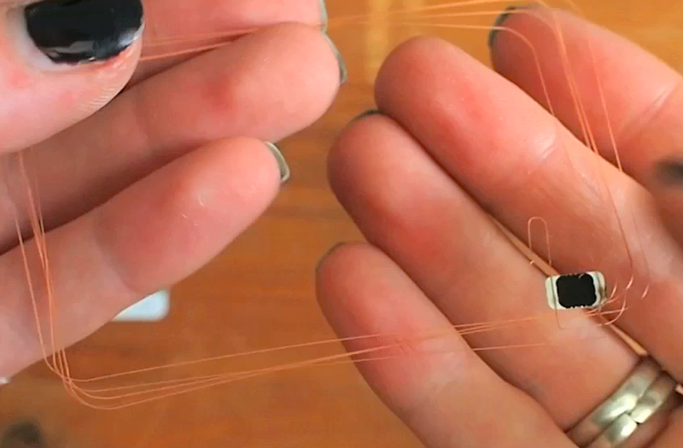
RFID Cards
Northwestern Wildcards are RFID cards with a chip inside
  Likely 13.56 MHz inductive coupling (not backscatter)

Slide 31
RFID challenges
Essentially free communication!
  Minimal cost (besides having a higher-capability device)
Difficult to reflect energy when it is already so low
  Essentially double the path loss (there and back)
Range is very limited (or transmit power needs to be high)
  Meters of range, maximum
  Centimeters for inductive coupling
  Alternatively, could decouple signal generation from reception

Slide 32
MAC layer for RFID tags
Cards are limited in capability so we can’t do anything fancy
  But tags are frequently co-located, so some solution is necessary
Option 1: Aloha with pseudo-random timing
  Reader sends out initialization, tags randomly respond back
Option 2: Adaptive binary tree
  Reader sends out initialization, along with first bit of ID
  All cards matching that ID respond
  Reader sends out a second bit of ID
  Repeat until CRC is valid, then go back and choose other branches

Slide 33
Electronic Product Code (EPC)
Format created by GS1
  Not-for-profit org that created and standardized barcodes
12-byte identifier for products for RFID use
Header | EPC Manager | Object Class | Serial Number
8 bits | 28 bits | 24 bits | 36 bits
(version number) | (Company ID) | (Product type SKU) | (Unique per instance of product)

Slide 34
Break + Security Consideration
What data should an ID card send?
  Is just sending ID bits sufficient? What problem could occur?

Slide 35
Break + Security Consideration
What data should an ID card send?
  Is just sending ID bits sufficient? What problem could occur?
  Simple identification, maybe. (e.g. products in a store)
  For authentication, no. Need to avoid replay attacks.
Include some kind of challenge and response
  Probably also encrypted
May also read/write from an arbitrary memory in the card
  Up to several hundred bits of storage

Slide 36
Outline
Backscatter
Backscatter Uses
  RFID
  Sensors (Backscatter LoRa)
  Localization
NFC

Slide 37
How does RFID, Backscatter, etc map back to the IoT?
Well, as always, “Power and Communication are the hard part”
  RFID works, but only in the presence of an RFID reader
  Recent research looks at eliminating that latter clause
Power: RF Harvesting for general purpose computation
  WISP
  Moo
Communication: Repurposing extant RF signals for other uses
  Ambient Backscatter
  Inter-Technology Backscatter

Slide 38
“Embedded” sensors
How do you change batteries in a device that’s inside a wall or inside someone’s body?

Slide 39
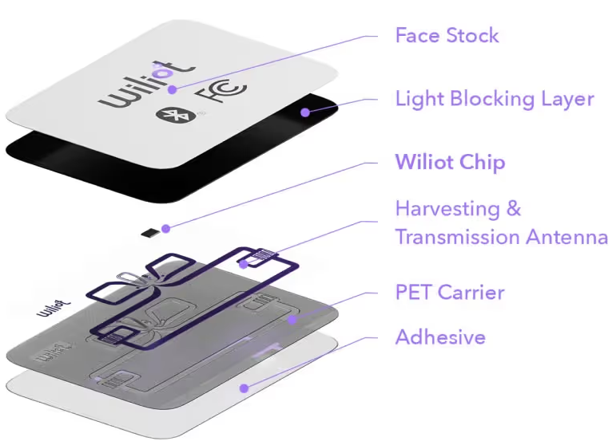
RF energy harvesting alone is useful
Wiliot IoT Pixels harvest RF energy for power
  Microcontroller, BLE radio, maybe even a sensor
  $0.10 each at high volume
Idea: powered transmitter sends
energy into area activating tags.
Standard BLE receiver captures data.
  (not a backscatter system)
Walmart partnership for pallet-level tracking
https://www.mobileworldlive.com/industry/walmart-wiliot-go-large-on-ambient-iot/

Slide 40
Backscatter for sensor networks
Conventional
Radio
Backscatter
Transmissions
Backscatter Tag
Backscatter allows transmissions at up to 10000x lower power than conventional radios
  Makes it very attractive for low-energy sensing devices

Slide 41
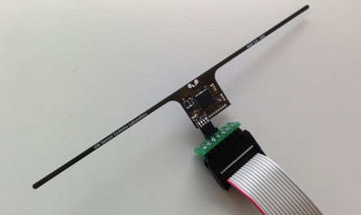
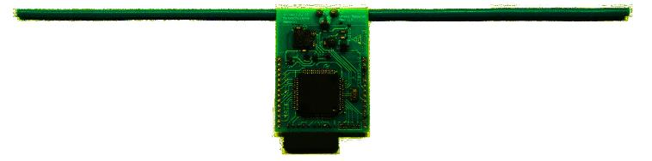
RFID sensors
First iterations were literally RFID sensors
  Limited by cost and range of RFID readers (only a few meters)
Moo 1.0
University of Massachusetts
WISP 5.0
University of Washington

Slide 42
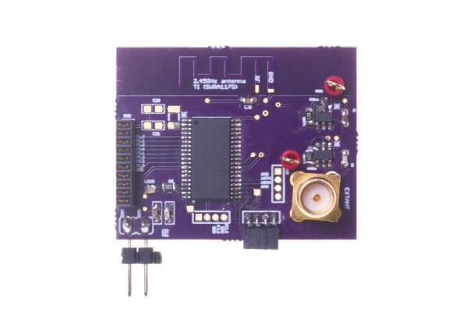
Backscatter + LPWAN = usable?
Idea:
  Backscatter is about low energy operation
  LPWANs are about long-range operation
  Can we combine them for low energy and medium-long range?
LoRea: long-range transmissions at μW
  (Next few slides stolen from Ambuj’s talks)
Varshney et al. ”LoRea: A Backscatter architecture that achieves a long communication range” SenSys 2017

Slide 43
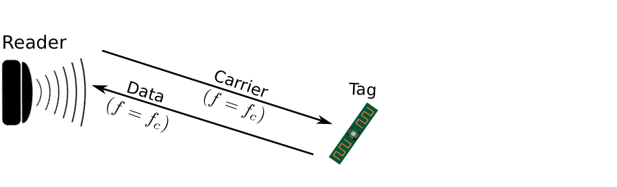
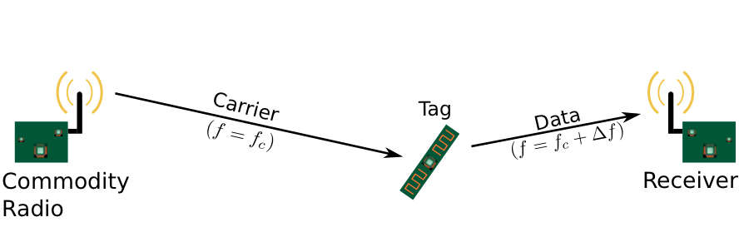
Design element #1: LoRea decouples the carrier signal generation and reception
Bi-static setup spatially separates carrier generation from the receiver
Use devices that surround us for providing the necessary carrier signal
Self-interference reduced due to path loss suffered by carrier signal
Monostatic configuration
Bi-static configuration
Notes:
+ If we look into a RFID reader's configuration, there is a single device that both receives the backscatter transmissions and generates the necessary carrier signal. This is called a monostatic configuration.
+ In LoRea, we decouple the task of carrier signal generation and the reception of the backscatter transmissions. We adopt a bistatic configuration as we show in the slide. We have a dedicated device for carrier signal generation and reception.
+The advantage of the bistatic configuration is two-fold: First, we can attenuate the carrier signal arriving at the receiver due to the path loss suffered due to the propagation of the wireless signal. This helps us reduce interference from stronger carrier signal to much weaker backscatter transmission. Second, it also enables us to use the devices that surround us, such as smartphones or wifi router, as sources for providing the necessary carrier signal to support backscatter transmissions. In fact, in lorea, we demonstrate the use of these devices to provide the carrier signal.’

Slide 44
Design element #2: LoRea backscatters at a frequency offset from the carrier signal
Backscatter is a mixing process
Transceivers attenuate interference at adjacent frequency channels
Frequency separation reduces interference from carrier to backscatter signal
No complex self-interference mechanisms required at reader
Notes:
+ The second design element that we incorporate in the design of LoRea is that we create separation in frequency between the carrier signal and the reflected transmissions. We transmit the backscattered signal at a particular offset from the carrier signal. This is unlike systems such as RFIDs that transmit at the same frequency as the carrier signal, requiring complex and expensive self-interference cancellation mechanisms.
+ To backscatter at an offset from the carrier signal, we take advantage of the property that the backscatter is a mixing process. If a carrier signal is incident on the backscatter tag, and if we toggle the antenna, i.e., change the antenna's state between absorption and reflection state at a frequency delta f, we can now create backscatter transmissions at a frequency offset of Fc+delta F due to the mixing property.
+ Most modern radio transceivers have bandpass filters present in adjacent frequency bands. They support these to enable co-existence on the shared wireless spectrum to suppress interference from adjacent traffic. We use these filters to our advantage; we place the carrier signal in the bandpass filter and significantly attenuate the carrier signal.
+ By incorporating the decoupling in space and frequency, we can reduce the interference to the weak backscatter transmissions from stronger carrier signal by up to 50-70 dB. We do not need to employ any complex self-interference cancellation mechanisms that are used on existing RFID readers. We use off-the-shelf commodity transceivers that just cost a few usd to carrier generation and the reception, thus significantly lowering the infrastructure's cost and complexity to support backscatter transmissions.

Slide 45
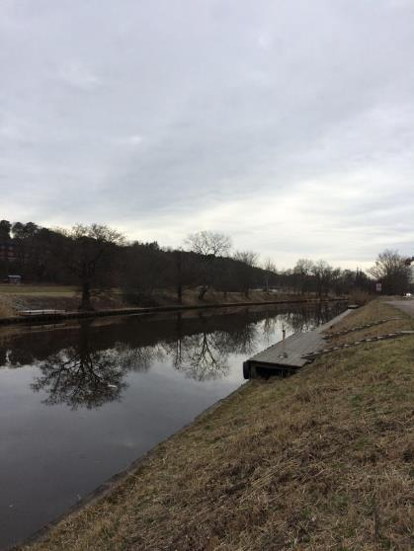
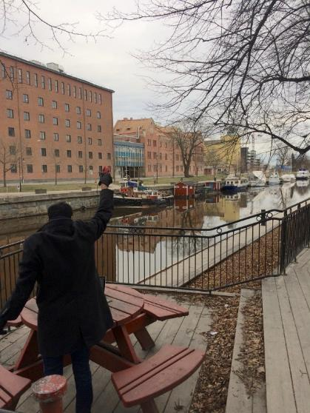
Ran out of space while performing experiments…
State-of-art few meters. System achieved kilometers, was difficult to anticipate
Initial experiments conducted near the university and a river in Uppsala
Experiment Setup
Receiving transmissions 1km away from the setup

Slide 46
LoRea outperforms state-of-the-art systems
System name | Communication range
LoRea – 868 MHz (SENSYS 2017) | 3400 m
LoRea – 2.4 GHz (SENSYS 2017) | 225 m
RFID | < 18 m
BackFi (SIGCOMM 2015) | 5 m
Passive WiFi (NSDI 2016) | 30 m
HitchHike (SENSYS 2016) | 54 m
Interscatter (SIGCOMM 2016) | 30 m
LoRa Backscatter (UBICOMP 2017) | 2800 m
Range reported are line of sight, with backscatter tag co-located with carrier source

Slide 47
Future research directions for backscatter sensor communication
Improve capabilities for “ambient” backscatter
  Reuse existing RF signals rather than relying on carrier generation
MAC layers for backscatter
  Need ability to communicate with very low power
  How do you manage access to the medium?
Real-world usable backscatter stacks and hardware
  Needs to be deployable and usable by non-experts

Slide 48
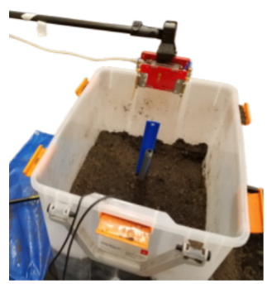
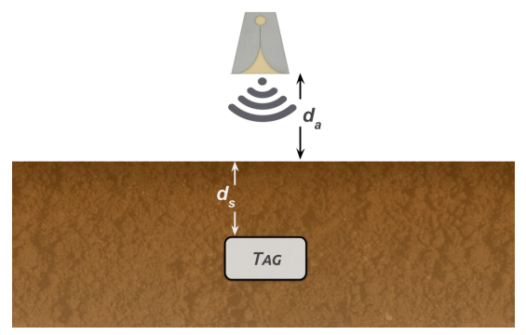
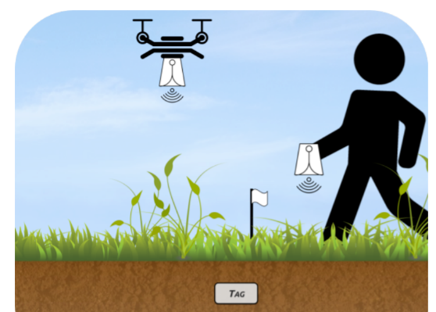
Backscatter as a sensor: soil moisture
Idea: bury backscatter tags in soil
  Measure round-trip-time for signal to reflect
  T_{s} (time signal travels through ground) changes
  based on the moisture in the soil
Josephson, Colleen, et al. "Low-cost In-ground Soil Moisture Sensing with Radar Backscatter Tags.“ COMPASS 2021

Slide 49
Break + Open Question
What would you use a backscatter sensor for?
  Requirement: sensing has to be extremely low power too

Slide 50
Outline
Backscatter
Backscatter Uses
  RFID
  Sensors (Backscatter LoRa)
  Localization
NFC

Slide 51

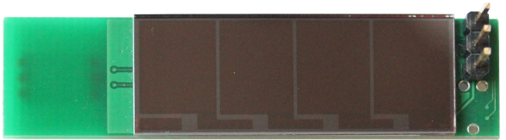
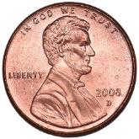
Slocalization: Ultra wideband backscatter localization
Notes:
Image (free use): https://www.google.com/imgres?imgurl=http%3A%2F%2Fwww.crismatec.com%2Fpython%2Fmo%2Finteriors-photography-modern-office-workspace-for-metaphore-design_office-decoration.jpg&imgrefurl=http%3A%2F%2Fwww.crismatec.com%2F1489389139%2Fmnc%2Fb3b60136b4fec2dd%2F&docid=rzPzabXuQo6qOM&tbnid=Ag7dvYLgrHLwIM%3A&vet=1&w=1800&h=1200&hl=en&safe=images&bih=803&biw=1440&ved=2ahUKEwiZ45vr19fdAhUBiIMKHfF8Dv0QxiAoBnoECAEQGg&iact=c&ictx=1

Slide 52
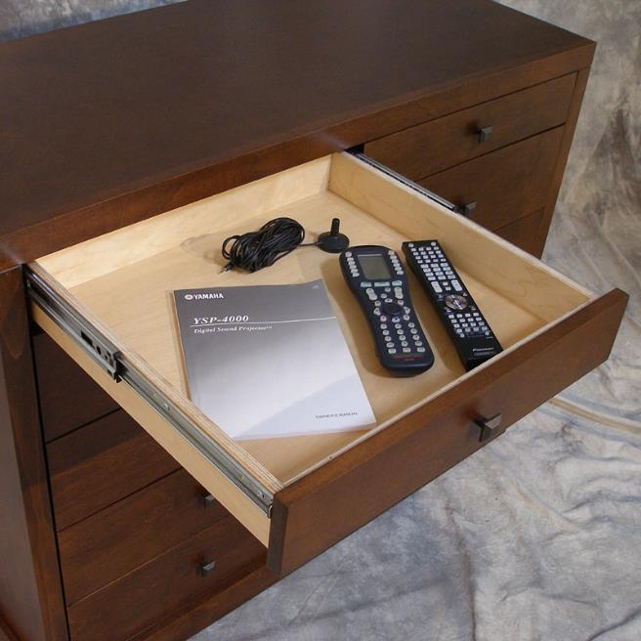
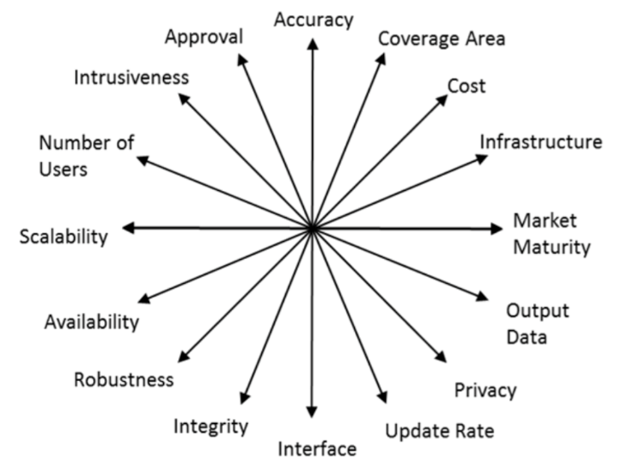
Why RF, why ultra wideband, why backscatter for ubiquitous localization?
Mautz, Rainer. "Indoor positioning technologies." (2012).

Slide 53
Why RF, why ultra wideband, why backscatter for ubiquitous localization?
Time Domain
Frequency Domain
5.31 GHz
5.33 GHz
Narrowband
5 GHz
6 GHz
Ultra-Wideband

Slide 54
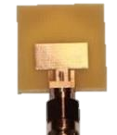
Reflections make time-of-flight estimation difficult and inaccurate

Slide 55
Ultra wideband can better disambiguate multipath and identify signal arrival time

Slide 56

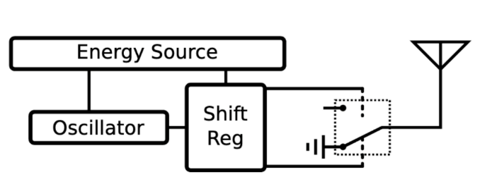
Design: localizing a UWB reflector tag
Sender
(mW - W)
Receiver
(mW - W)
Reflector
(nW)

Slide 57
There is a new tradeoff to introduce to enable wide-area ultra-low power, high-quality localization
Covers areas 30m+
  “through walls”
Decimeter accurate
<1 µW tag
  (COTS, can do order of magnitude or more better with VLSI)
(Nearly) unlimited number of concurrent tags
Cost: 1-15+ minutes per location fix
  A latency/energy tradeoff for localization
Slocalization: Sub-μW Ultra Wideband Backscatter Localization
Pat Pannuto, Kempke, Benjamin, and Prabal Dutta
Proceedings of the 17th ACM/IEEE International Conference on Information Processing in Sensor Networks (IPSN’18). Best Paper Finalist.

Slide 58
UWB Backscatter is passive reflection of a lot less energy than traditional communications
Sender
Reflector
Receiver
-100 dBm
-101 dBm
5m
5m
-41.3 dBm
-159 dBm
36 dBm
-56 dBm
900 MHz ISM
-9.5 dBm
-10.5 dBm
Notes:
NB: 900 Mhz -> wavelength = 299792458 / 900e6 = 0.33
20 * log10(.33 / (4 * pi * 5)) = -45.6
Over 100 dB (or over 1 billion times more power)

Slide 59
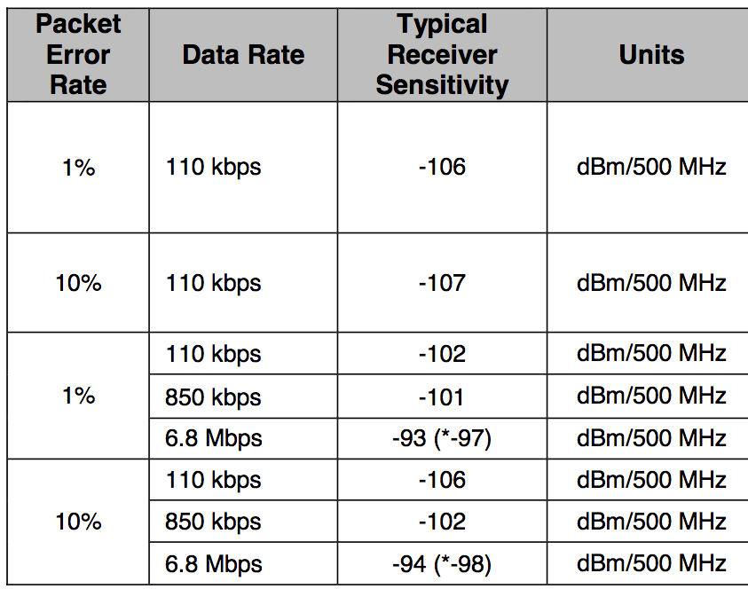
UWB Backscatter is passive reflection of a lot less energy
-100 dB
-101 dB
5m
5m
Typical receiver sensitivity
ranges from -94 to -106
-41.3 dB
-159 dBm
36 dB
-9.5 dB
-10.5 dB
-56 dBm
900 MHz ISM
Notes:
NB: 900 Mhz -> wavelength = 299792458 / 900e6 = 0.33
20 * log10(.33 / (4 * pi * 5)) = -45.6
Just 60 dB, only a million times off!

Slide 60

How do we recover a signal that is way below the noise floor?
Exploit tag stationarity and environmental stability
A
A
Notes:
Environment does not change

Slide 61
How do we recover a signal that is way below the noise floor?
Exploit tag stationarity and environmental stability
A
A

Slide 62
Ideally, the only change in the channel impulse response is the tag reflection
Subtracting the environment finds the tag

Slide 63
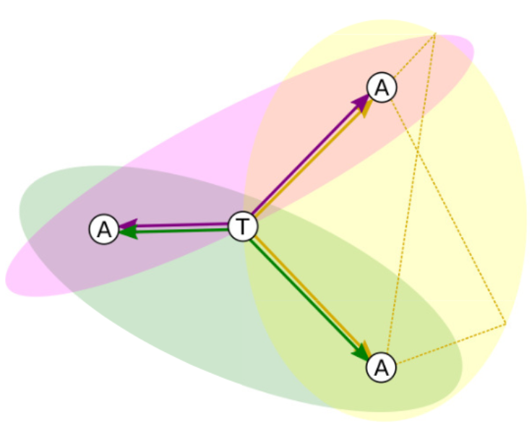
The goal is to estimate the time difference of arrival (TDoA) and trilaterate
TDoA
First peak is anchor—anchor path, then anchor—tag—anchor

Slide 64
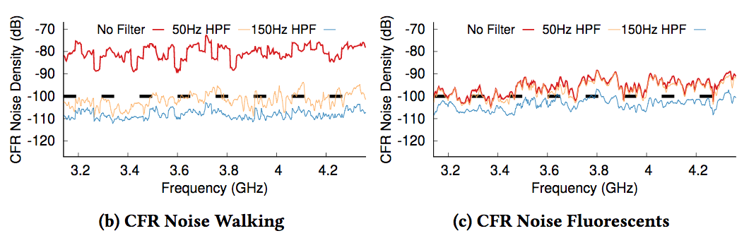
Extracting the tag signal in the real world has a few additional challenges
The environment is not actually static
  But noise is largely white & Gaussian
  And we can filter out the rest (sets floor for tag frequency, active power)
Finding tag phase offset currently requires brute force search

Slide 65
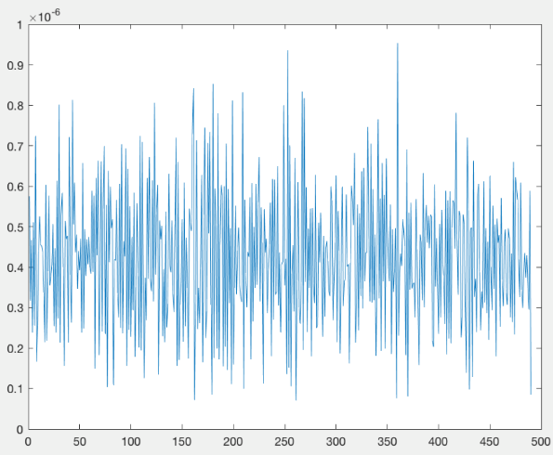
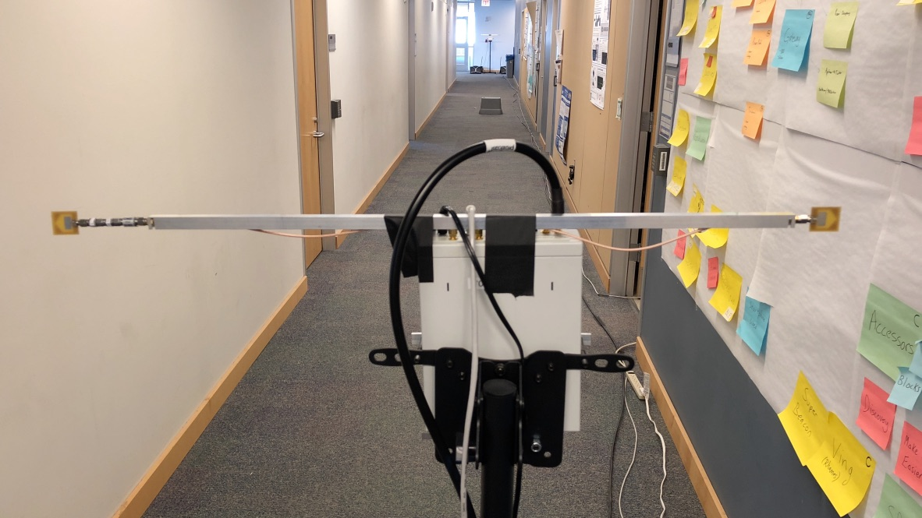
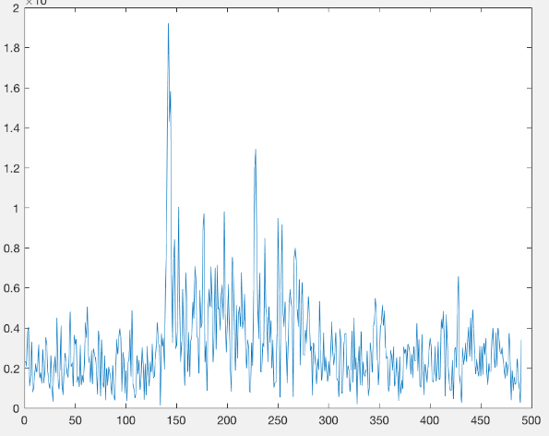
Does it really work?
After a few seconds
15 minutes can cover 30 meters
30 cm average error (3D Euclidean distance)
15m
15m
After a few minutes
65

Slide 66
Outline
Backscatter
Backscatter Uses
  RFID
  Sensors (Backscatter LoRa)
  Localization
NFC

Slide 67
Near Field Communication (NFC)
One type of RFID communication
  Inductive Coupling concept (13.56 MHz)
    Not actually backscatter at all
  But attached to a powered and capable device (smartphone)
  10-20 cm range max (usually <10)
Can act as a tag or as a reader
  Allows smartphone to power a tag if needed
  Alternatively, smartphone could act like a card and respond to a reader
  Two smartphones can communicate without power transfer
Data rate 100-400 kbps!
  nRF52840 capable of 100 kbps communication with attached antenna

Slide 68
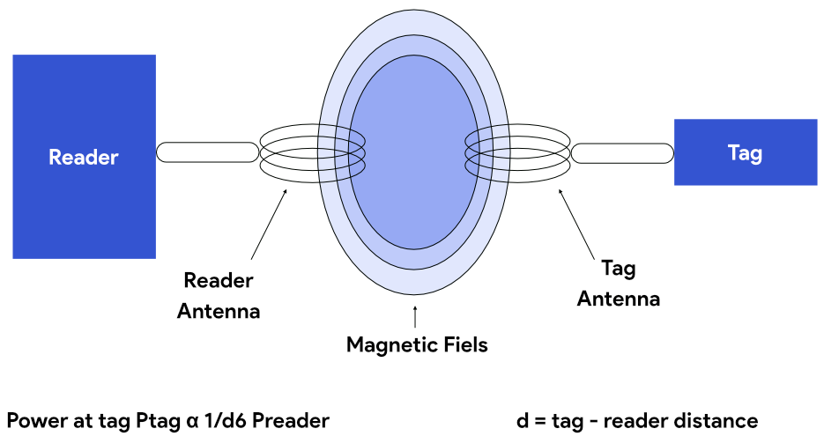
Inductive coupling theory of operation
A shared magnetic field is created between the two devices
  Change in current through one device induces current change through the other
  Device can vary load to transmit data
Very low frequency bands
(135 KHz, 13.56 MHz)
  Transmit through materials including skin
  Sensitive to metal

Slide 69
Long-range, low-data needs haven’t historically been met
WiFi
4G
Higher Power
& Higher Cost
3G
Data
Throughput
Bluetooth
2G
NFC
Low-Power
Wide-Area Networks
BLE
Zigbee
Lower Power
& Lower Cost
Range

Slide 70
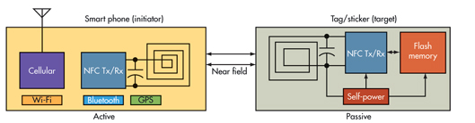
NFC Active and Passive Devices
Active NFC device is usually microcontroller-based like an NFC enabled smartphone. Can exchange information with other NFC devices.
It powers itself.
A passive device, such as an NFC tag, contains information that other devices can read but does not read any information itself. NFC tag does not have its own power source.

Slide 71
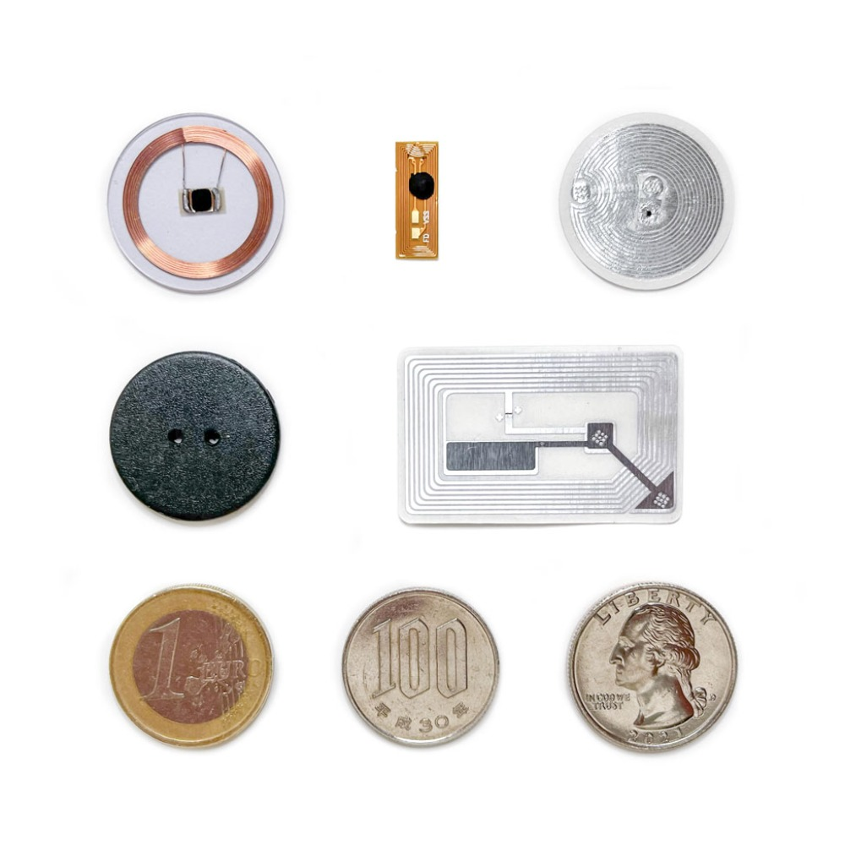
NFC Tags – Encoding data
NDEF (NFC Data Exchange Format) Structure
  Binary format for data
  Messages contains records
  Each record has header
NFC read returns the NDEF message

Slide 72
NFC Forum NDEF record types
Record Type Definitions
  RTD Technical - Specifies the format and rules for building standard record types used by NFC Forum application definitions and third parties that are based on the NDEF data format.
  Text - Provides an efficient way to store text strings in multiple languages by using the RTD mechanism and NDEF format. An example of using this specification is included in the Smart Poster RTD.
  URI - Provides an efficient way to store Uniform Resource Identifiers (URI) by using the RTD mechanism and NDEF format. An example of using this specification is included in the Smart Poster RTD.
  Smart Poster - Defines an NFC Forum Well Known Type to put URLs, SMSs or phone numbers on an NFC tag, or to transport them between devices. The Smart Poster RTD builds on the RTD mechanism and NDEF format and uses the URI RTD and Text RTD as building blocks.
  Generic Control - withdrawn
  Signature - Specifies the format used when signing single or multiple NDEF records. Defines the required and optional signature RTD fields, and also provides a list of suitable signature algorithms and certificate types that can be used to create the signature. Does not define or mandate a specific PKI or certification system, or define a new algorithm for use with the Signature RTD.
  PHDC - Addresses a need for an openly-defined standard for the exchange of personal health data between devices using Near Field Communication technology.
Derived types
  Android Application NDEF Record
  Application NDEF Record
  Contact NDEF Record
  Email NDEF Record
  File NDEF Record
  Geolocation NDEF Record
  Phone NDEF Record
  SMS NDEF Record
  Website NDEF Record
  WiFi NDEF Record

Slide 73
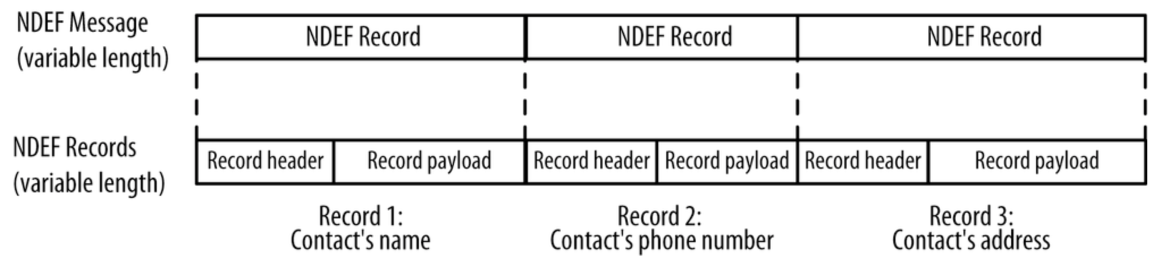

NDEF Format

Slide 74




Investigating NFC on your own
NFC tools app allows you to inspect NFC tags

Slide 75
Outline
Backscatter
Backscatter Uses
  RFID
  Sensors (Backscatter LoRa)
  Localization
NFC

Slide 76


Class Summary
Network Fundamentals
Bluetooth Low Energy
  Advertisements, Connections
802.15.4
  Thread, Zigbee, Mesh Routing
WiFi
Cellular
LPWANs
  LoRaWAN, Sigfox, Research and Challenges
Other
  Localization, Satellite Communication, Backscatter

Slide 77
Outline
Bonus: Wakeup Radios

Slide 78
Wakeup radios are another form of “RF-lite”
How do you make a radio really low power?
  Turn it off
Problem: how do you know when to turn the radio on?
Idea: can we design a simpler radio where the only purpose is determining whether a signal exists or not?

Slide 79


Concept: Can we design something (much?) lower power that can’t do general purpose data, but can signal wakeup?
Energy detectors
  Simple, but prone to false wakeups
Extremely simple signaling?
  Very often some form of on-off-keying (OOK)
  Seeing new life
    In mainstream networks, e.g. 802.11ba
    In sensor network research, e.g. Zippy
    Tuned energy harvesting frontends
    Manipulated standards for lower-BW signals

Slide 80






(Re)-emerging new ideas in wakeup design
Decoupling synchronization from communication
External synchronization sources?
  Ambient 60 Hz wave
  Sudden change in room lighting,
  or a noise
Synchronization and time-keeping burden is shifted to infrastructure

