Slide 1
Lecture 17
Satellite Communication
CS433 – Wireless Protocols for IoT
Branden Ghena – Spring 2025
Materials in collaboration with
Pat Pannuto (UCSD) and Brad Campbell (UVA)

Slide 2
Administrivia
Final Design Project
  Feel free to reach out over Piazza if you have any questions. I’m happy to discuss
  Be aware this is a hard deadline (no slip days or late submissions)
Return hardware
  When you’re done with the lab, I need your hardware back
  Options:
    Give it to me before or after lecture
    Leave it with me or Evan at office hours
    Return it to my office (Tech L368)
Quiz today

Slide 3
Today’s Goals
Understand the capabilities and restrictions of satellite communication
Explore real-world satellite communication
Discuss directions for cellular-to-satellite communication

Slide 4
Outline
Overview
Satellite Communication
  Voyager
Satellite Communications Providers
Cellular-to-Satellite Communication

Slide 5
Why use satellite communication?
True global connectivity
Cellular is dependent on someone actually building a cell tower near the area you want to communicate in
  Remote areas are out-of-luck (mountain, forest, ocean)
Satellites act as moving cell towers
  With enough of them, you could cover the globe

Slide 6
Satellite communication challenges
Distances involved
  Path loss
  Latency
Large deployment areas
  Shared bandwidth
  Handoffs
Deployment considerations
  Cost
  Coordination
Ignoring the difficulty of making the satellite itself

Slide 7
Satellite communication challenges
Distances involved
  Path loss
  Latency
Large deployment areas
  Shared bandwidth
  Handoffs
Deployment considerations
  Cost
  Coordination
Ignoring the difficulty of making the satellite itself

Slide 8
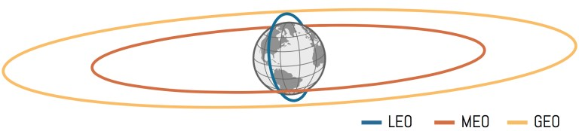
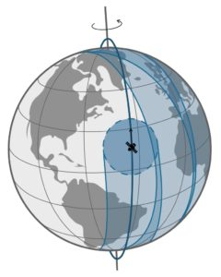
Satellite orbits - LEO
Low Earth Orbit (LEO)
  160-2000 km
  Includes all current human spaceflight (ISS at 400 km)
  Roughly 90 minutes per complete orbit
Polar orbit will eventually cover all of Earth
Group of satellites (constellation) can cover all of earth simultaneously if using enough satellites
https://aerospace.csis.org/aerospace101/earth-orbit-101/

Slide 9
Satellite orbits
Geostationary Orbit (GEO) (a.k.a. geosynchronous orbit)
  35768 km
  Exactly 24 hours per complete orbit
Result: fixed location in the sky over a position on Earth
  Very few satellites can cover all of Earth
  Or an operator can choose to only service a specific region
https://aerospace.csis.org/aerospace101/earth-orbit-101/

Slide 10
Satellite orbits
Medium-Earth Orbit (MEO)
  Between LEO and GEO
  Roughly 12 hours per complete orbit
GNSS satellites (GPS, Galileo, etc.) are here
  Smaller constellation and longer lifetime and LEO orbit
Radiation belts make this area more difficult to use
https://aerospace.csis.org/aerospace101/earth-orbit-101/

Slide 11
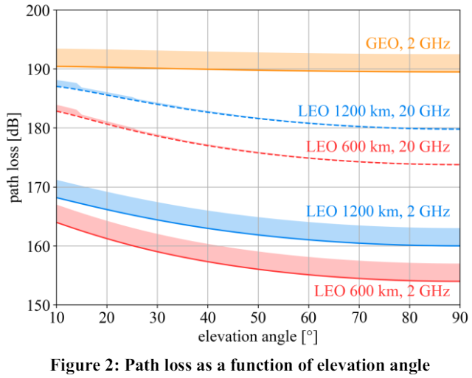
Path loss to orbit
Distance contributes significantly to signal strength loss. Frequency can hurt too
  Increased frequency
  leads to smaller antenna
  leads to less energy collected leads to weaker signal (somewhat)
Being at an angle on the horizon increases the total distance and the path loss
https://arxiv.org/pdf/2103.09156

Slide 12
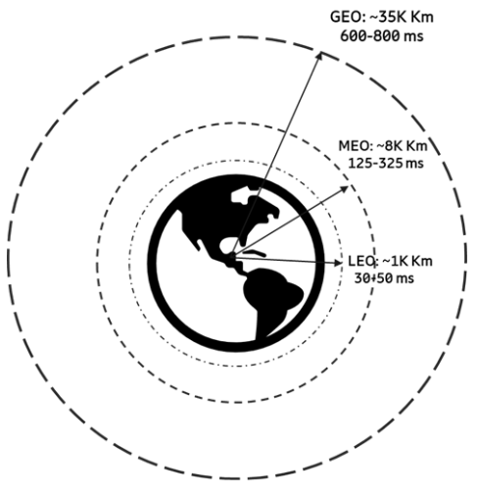
Latency to orbit
Even at speed of light, orbit distances contribute to communication delay
3GPP figure includes round-trip-time AND real-world delays through network
https://www.5gamericas.org/wp-content/uploads/2022/01/5G-Non-Terrestrial-Networks-2022-WP-Id.pdf

Slide 13
Satellite communication challenges
Distances involved
  Path loss
  Latency
Large deployment areas
  Shared bandwidth
  Handoffs
Deployment considerations
  Cost
  Coordination
Ignoring the difficulty of making the satellite itself

Slide 14
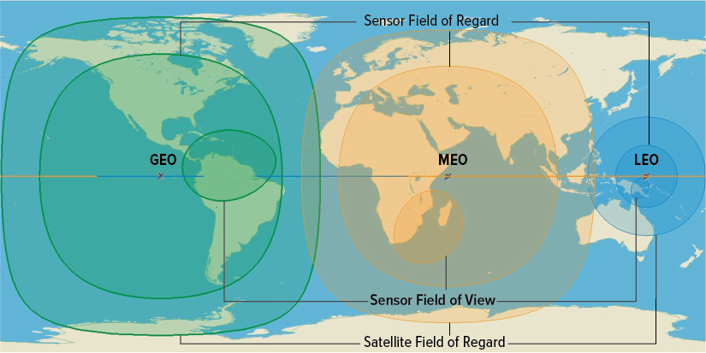
A single satellite provides considerable deployment area
Coverage areas can get quite wide here
  Biggest: all possible line-of-sight to satellite
  Middle: limited to ≥20º above horizon
  Smallest: example image sensing region

Slide 15
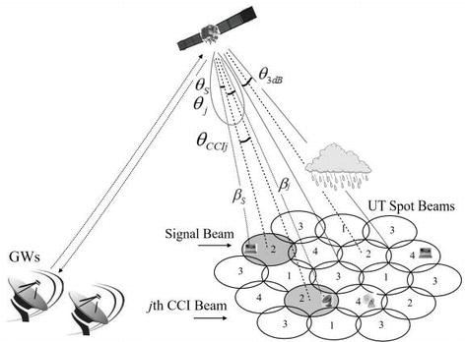
Huge coverage areas share bandwidth among many users
Same problem as LPWANs:
data throughput is shared across entire coverage area
Cellular solution can apply here
  Reduce coverage area and provide
  overlapping cells of coverage
  One satellite could support many cells
Limitation:
  Needs many channels to support cells
  Backhaul to downstation needs enough
  throughput for sum of all cells

Slide 16
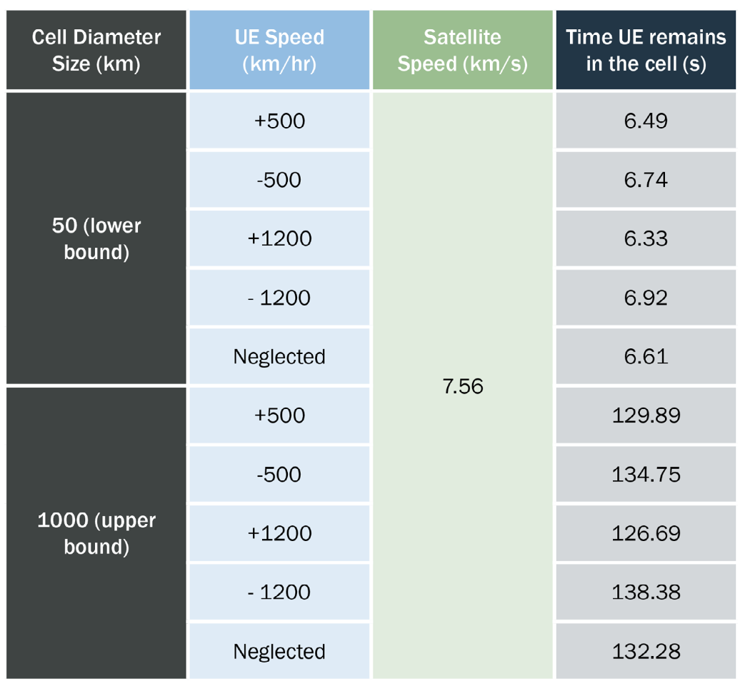
Moving satellites lead to many handoffs
In LEO, satellites are moving around 7 km/s (25,000 km/h)
  Comparatively, mobility of the user equipment is irrelevant
Depending on cell size, the device might leave the cell within seconds
  Smaller cells exacerbate this problem

Slide 17
Satellite communication challenges
Distances involved
  Path loss
  Latency
Large deployment areas
  Shared bandwidth
  Handoffs
Deployment considerations
  Cost
  Coordination
Ignoring the difficulty of making the satellite itself

Slide 18

Frequency allocations often must be world-wide
GEO satellites can focus on a region and provide a channel for that region
LEO constellations aiming for world-wide coverage must have a world-wide frequency allocation
International Telecommunication Union (ITU)
helps coordinate frequency allocations
  UN agency

Slide 19
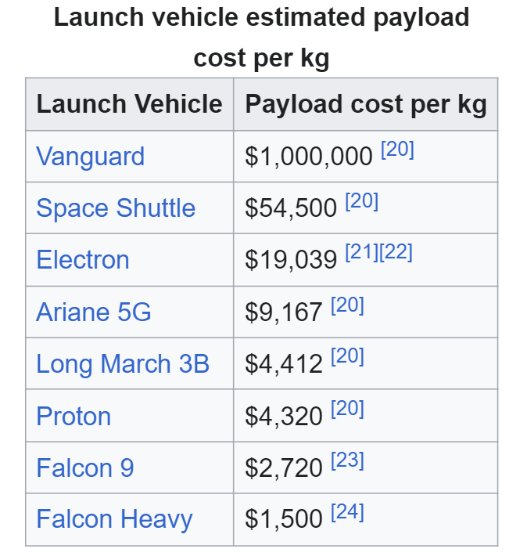
Getting hardware in orbit isn’t cheap
Costs have dropped significantly in recent years, but are still $1000 per kg
Mass references:
  Starlink v1.0: 260 kg
  Starlink v2.0: 1250 kg
  GPS: 1000-2000 kg

Slide 20
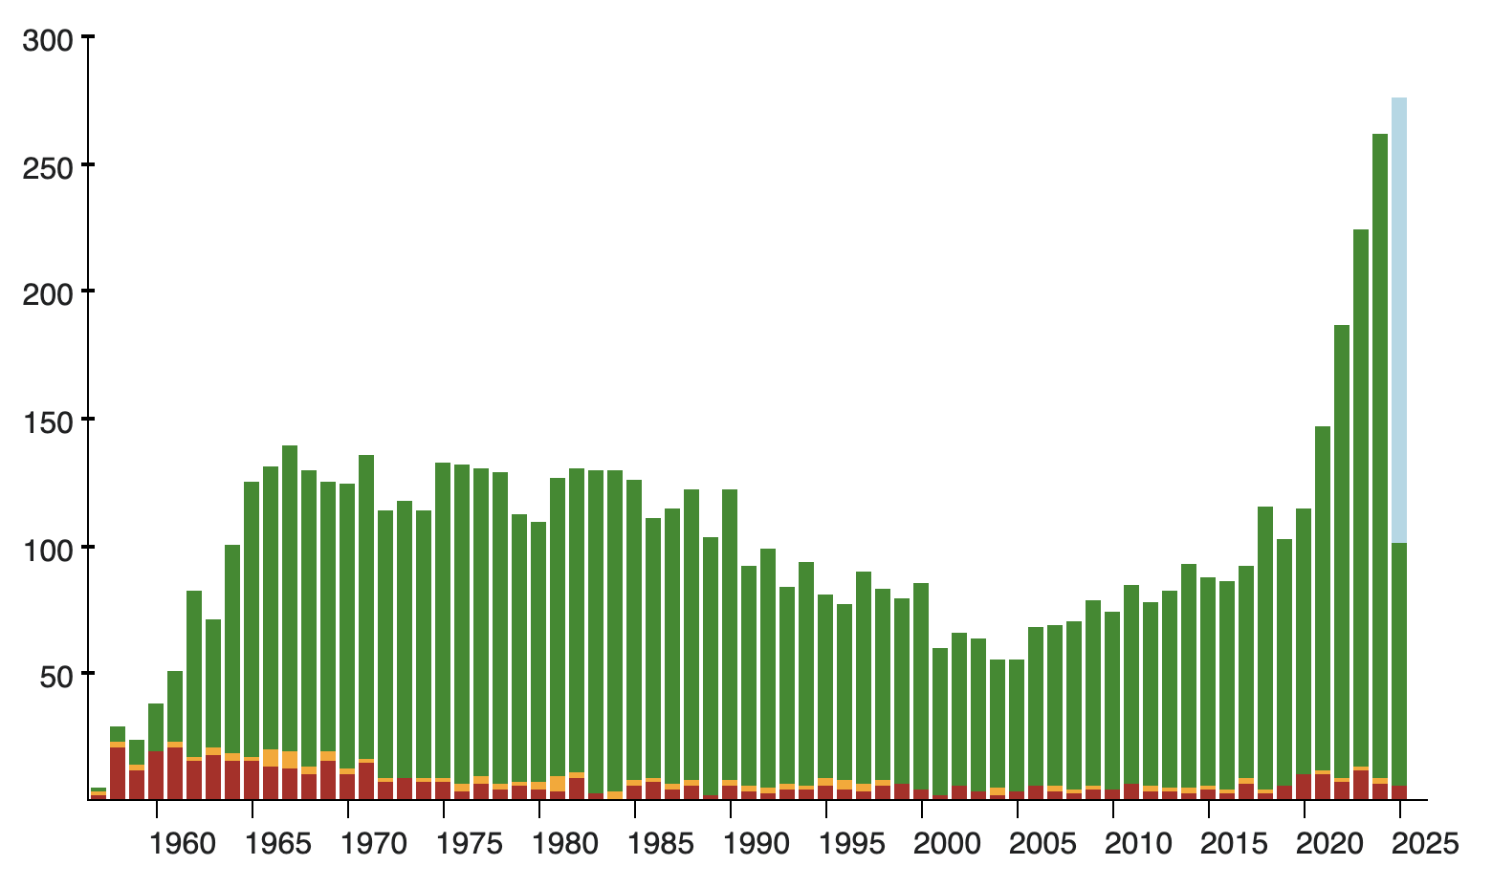
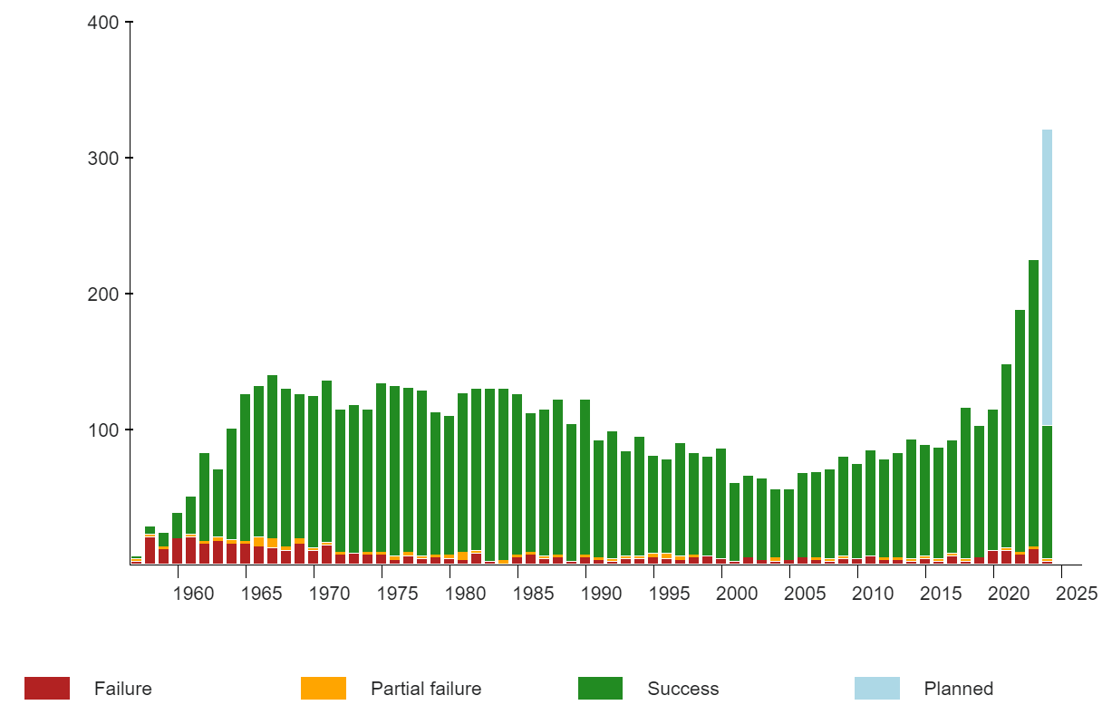
Actually getting a rocket to launch with has become easier
SpaceX (and other commercial rockets) have led a recent renaissance in number of rocket launches per year
2019: 104 launches
2024: 253 launches
2025: 300+ planned
This availability is
generating new interest in
satellite communications
https://en.wikipedia.org/wiki/Timeline_of_spaceflight#Orbital_launches_by_year

Slide 21
Break + Question
What do you do if a country doesn’t agree to let your satellite transmit on a certain frequency?

Slide 22
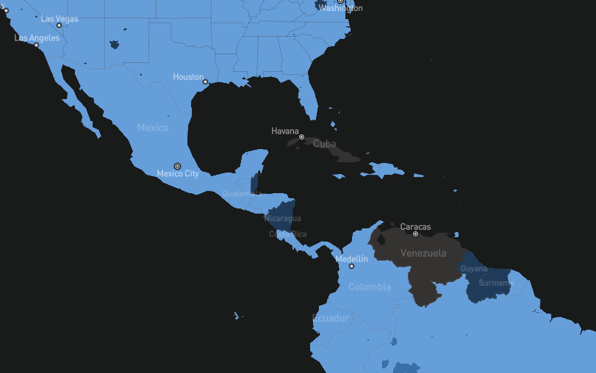
Break + Question
What do you do if a country doesn’t agree to let your satellite transmit on a certain frequency?
  Blackout over specific regions
  Satellites must already know their
  own locations to high accuracy,
  so this is possible

Slide 23
Outline
Overview
Satellite Communication
  Voyager
Satellite Communications Providers
Cellular-to-Satellite Communication

Slide 24
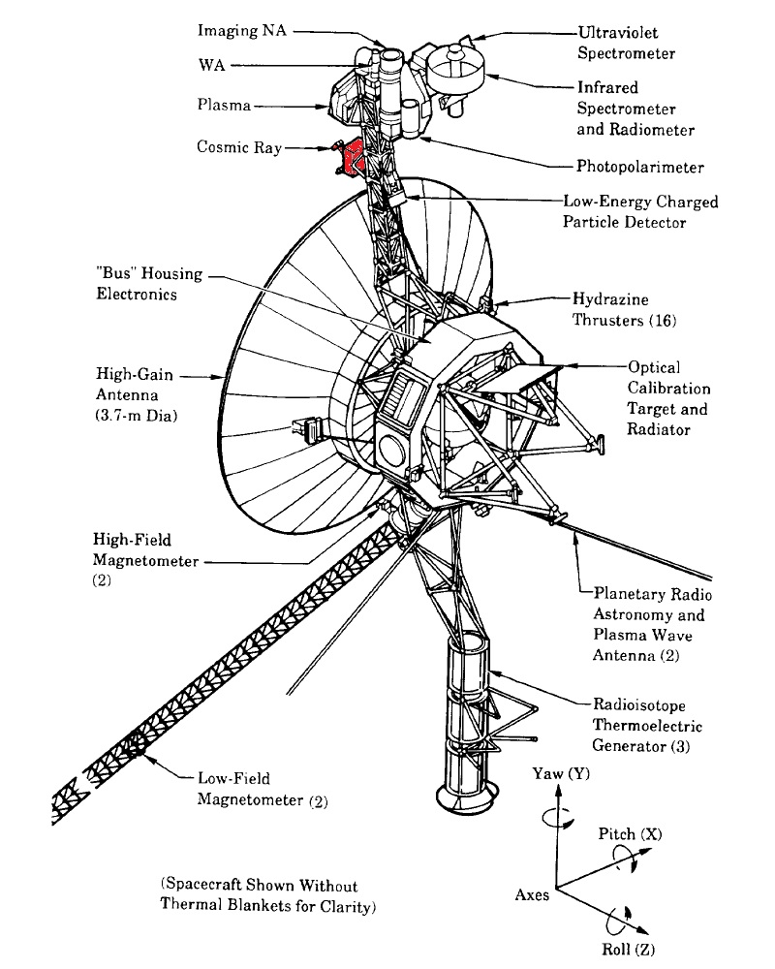
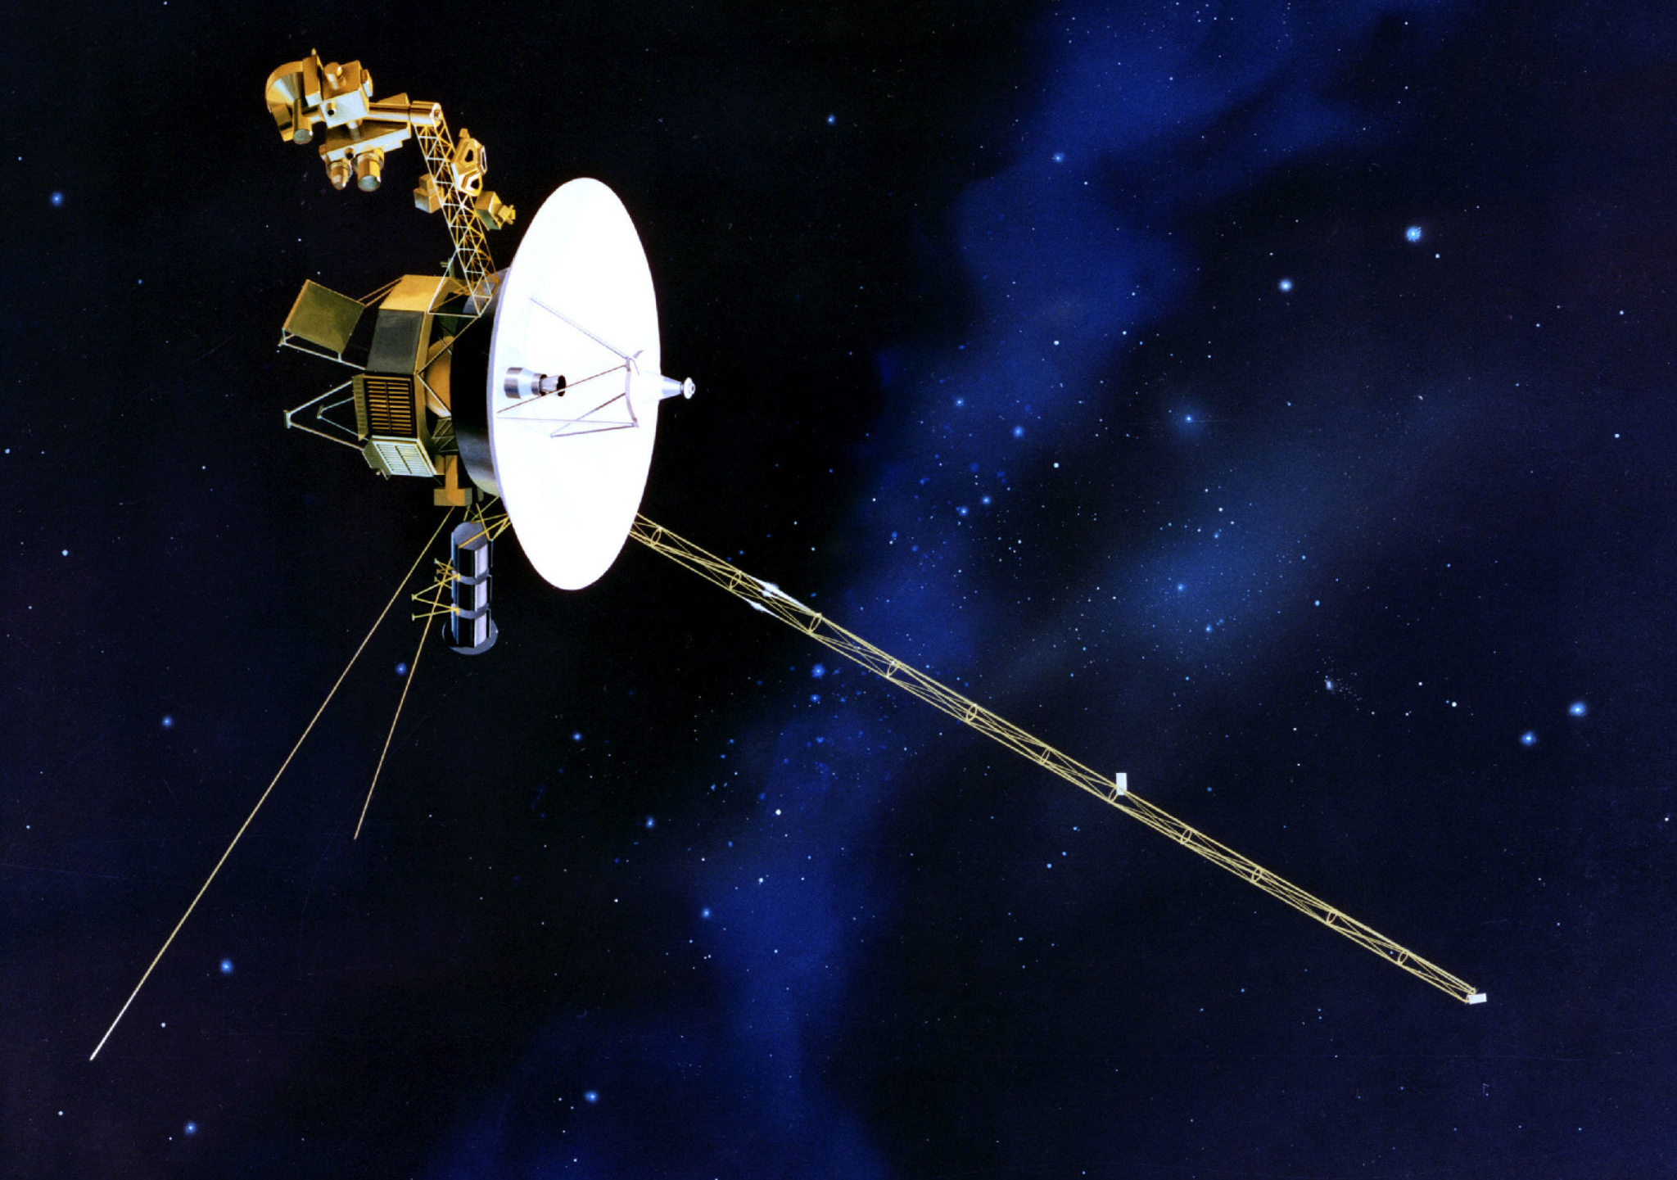
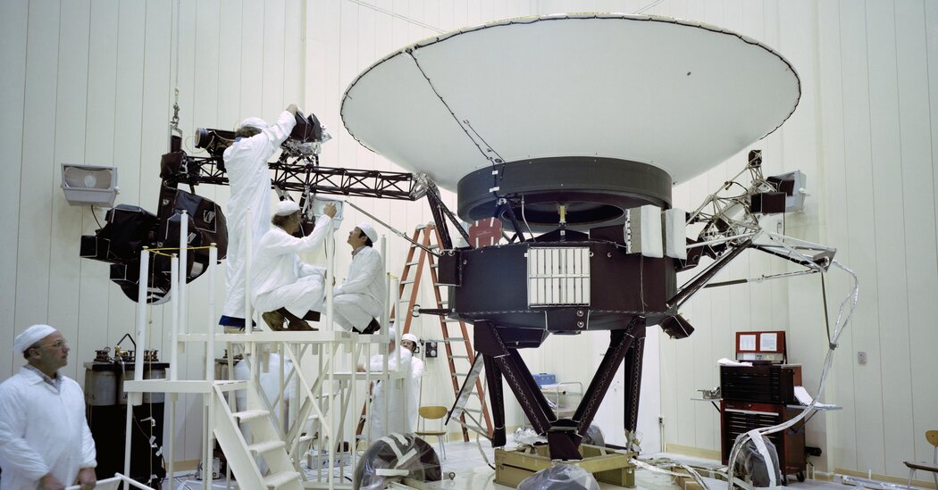
Voyager 1 and 2 (1977)

Slide 25
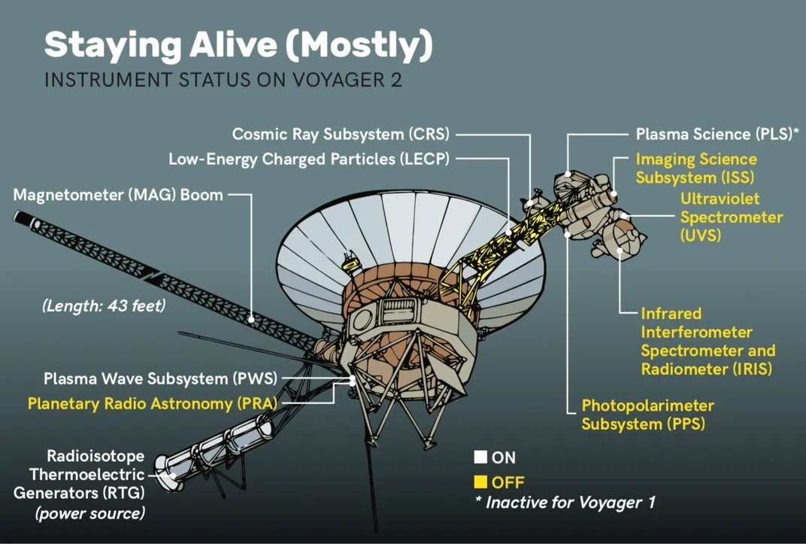
Voyager still functional
Voyager 2
Jupiter: 1979
Saturn: 1981
Uranus: 1985
Neptune: 1989
Edge of solar system: 2018
Still sending data!

Slide 26
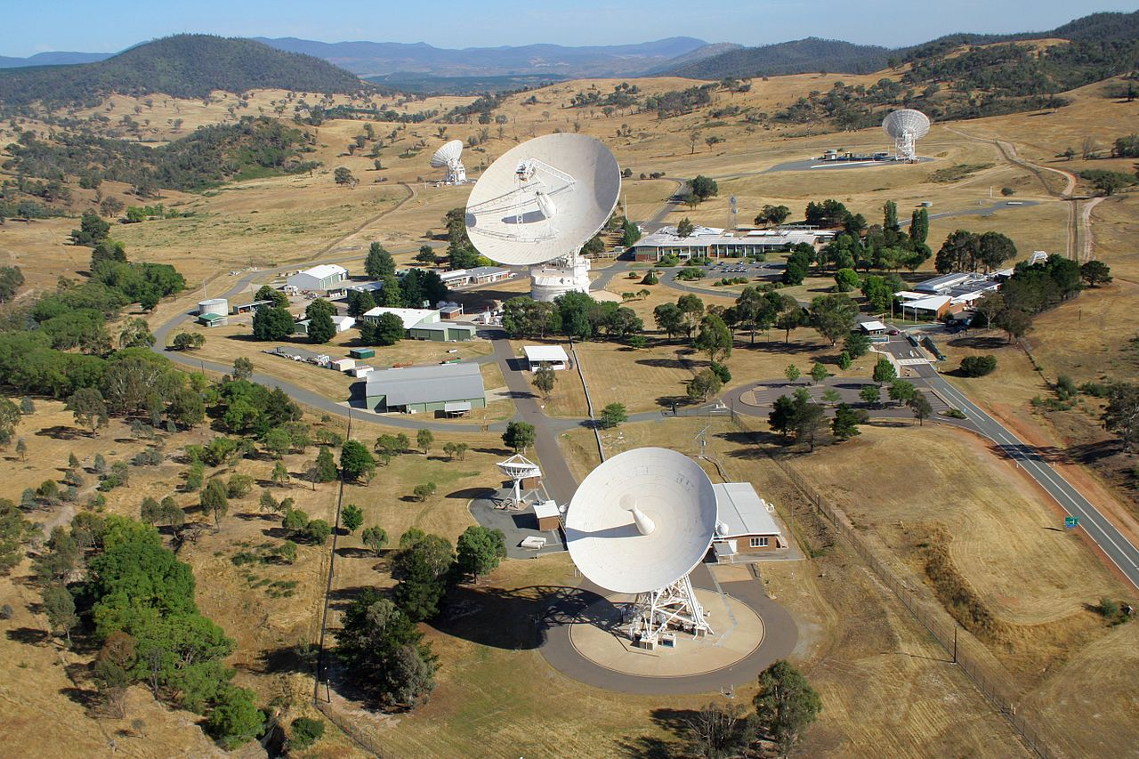
Deep Space Network Canberra complex

Slide 27
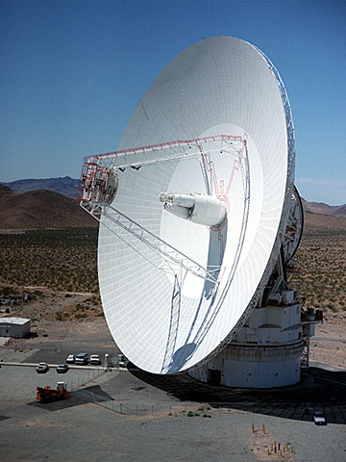
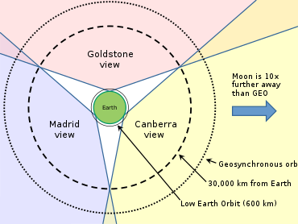
Deep Space Network
Receives data from NASA deep space missions
70-meter antenna (~70 dB gain)
Array of four 34-meter antennas

Slide 28
Voyager 2 path loss calculation
Frequency: 8.415 GHz communication (100 kHz bandwidth)
Distance: 20,800,000,000 km (May 2025)
Free Space Path Loss: 317 dB
Voyager 1 is further out: ~319 dB of Path Loss
In 2002, FSPL was 308 dB (see source below)
  So ~10 dB loss per 20 years
https://descanso.jpl.nasa.gov/DPSummary/Descanso4--Voyager_ed.pdf

Slide 29
Other factors
Voyager 2 Transmit:
  Transmission power: 41 dBm (12 Watts)
  Antenna gain: 48 dB
DSN Receiver:
  Antenna gain: 74 dB
Other factors:
  Pointing error: -0.3 dB
  Atmospheric loss: -0.04 dB
  Polarization loss: -0.08 dB
https://descanso.jpl.nasa.gov/DPSummary/Descanso4--Voyager_ed.pdf

Slide 30
Total received power from Voyager
Received power: 41 + 48 + 74 - ~1 -317 = -155 dBm
Compare to minimum receive sensitivity for IoT protocols:
  -95 dBm for BLE
  -119 dBm for LoRa
  -141 dBm for NB-IoT
Voyager transmits at 160 bps
https://descanso.jpl.nasa.gov/DPSummary/Descanso4--Voyager_ed.pdf

Slide 31
Voyager uplink math
Biggest difference: transmission power 72.55 dBm (18 kW)
Antennas and frequency are slightly different too
  DSN 62 dB gain, Voyager 34.6 dB gain
  FSPL (at 2.113 GHz): 305 dB
Received power: 72.55 + 62 + 34.6 - ~1 -305 = -137 dBm
  Almost 20 dB better than downlink
https://descanso.jpl.nasa.gov/DPSummary/Descanso4--Voyager_ed.pdf

Slide 32
Outline
Overview
Satellite Communication
  Voyager
Satellite Communications Providers
Cellular-to-Satellite Communication

Slide 33
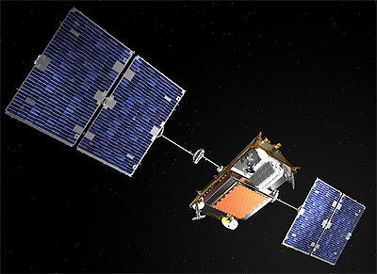
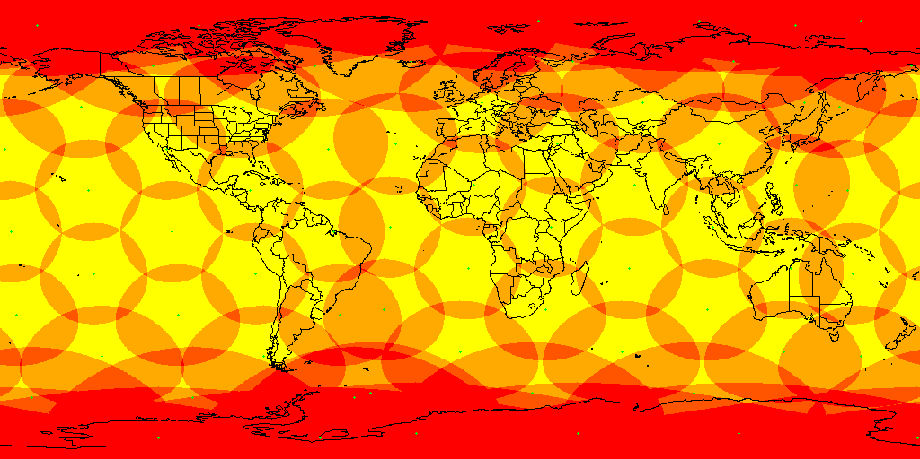
Iridium Constellation
Active since 1997
82 active satellites in LEO for global coverage
Each green dot is a satellite
Yellow is coverage
Red is overlapping coverage

Slide 34
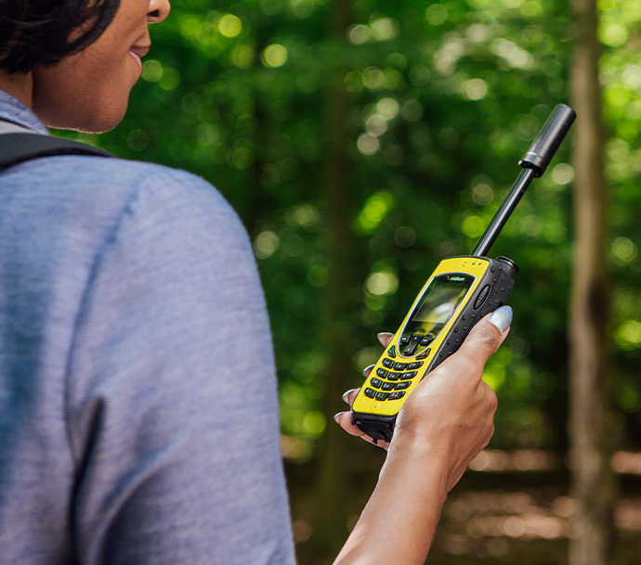
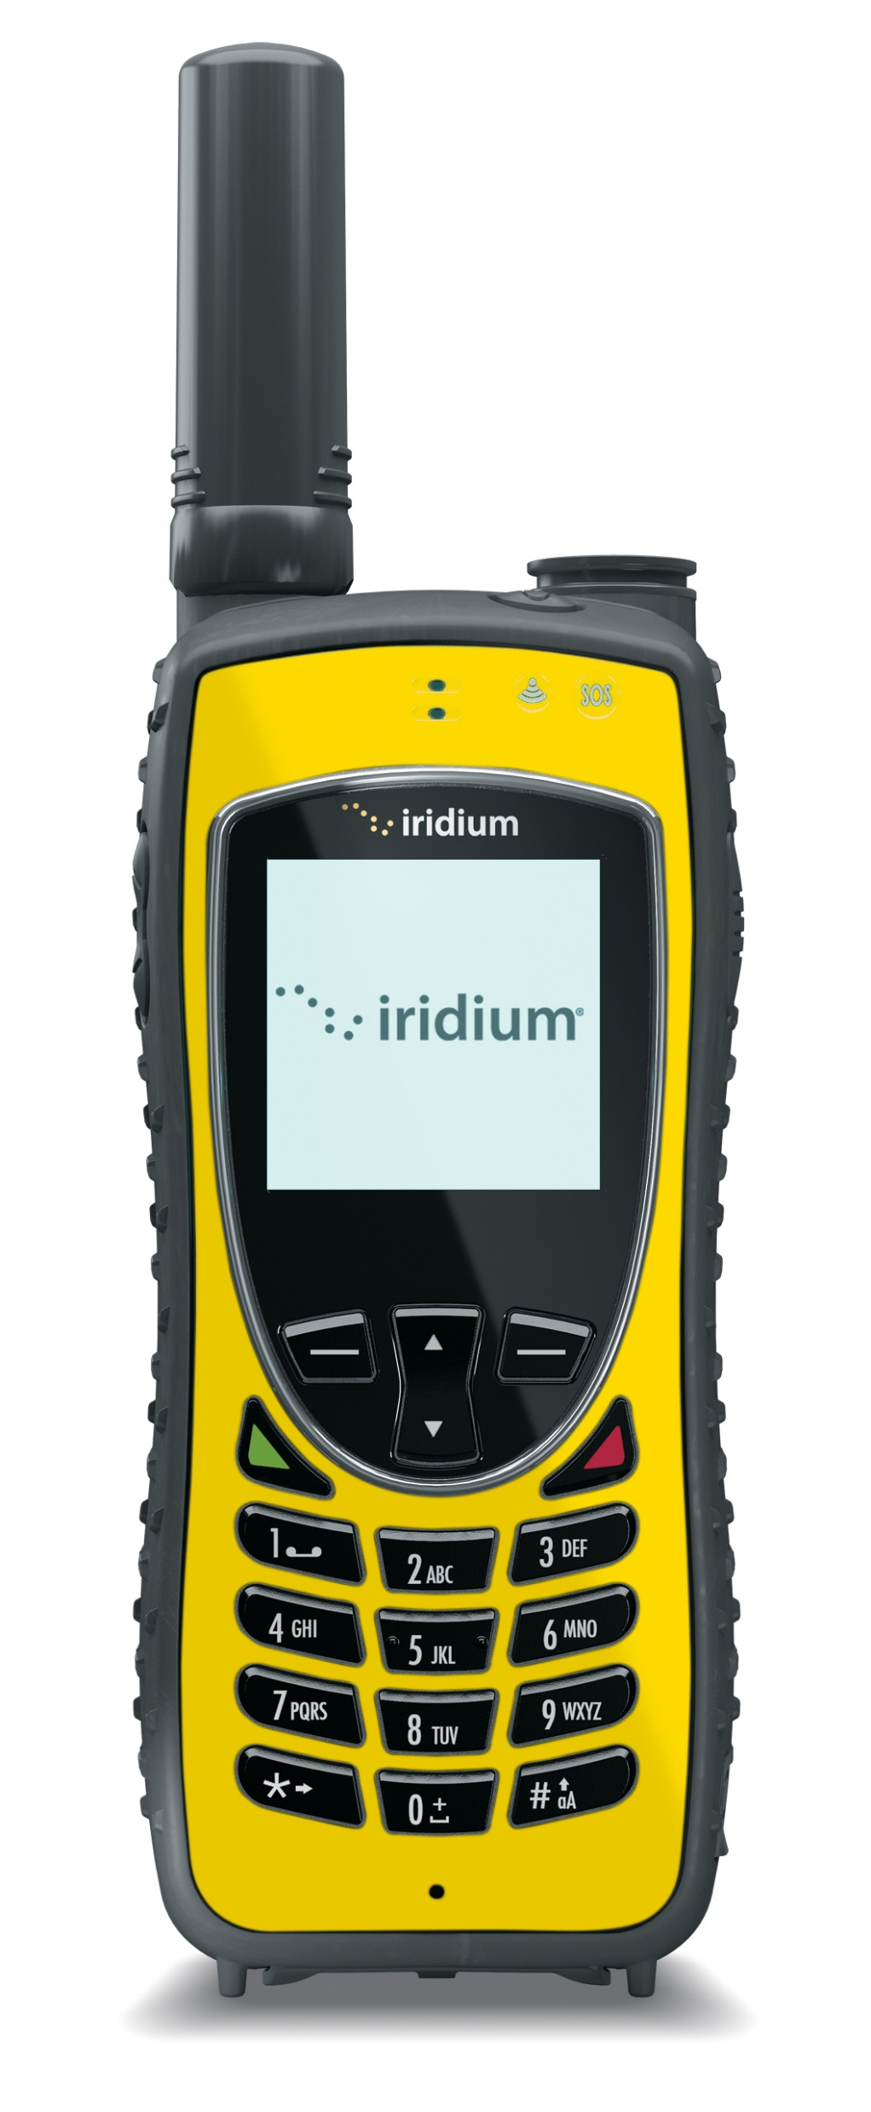
Iridium satellite phones
Initially marketed as general consumer phones
  Total failure leading to bankruptcy
Modern focus: highly reliable global niche
  Journalists, explorers, military
SMS and Voice service
  Up to 4 hours of talk time
Costs
  $1800 for phone
  Roughly $1 per minute for global voice coverage
  $400 gets you 3000 text messages

Slide 35
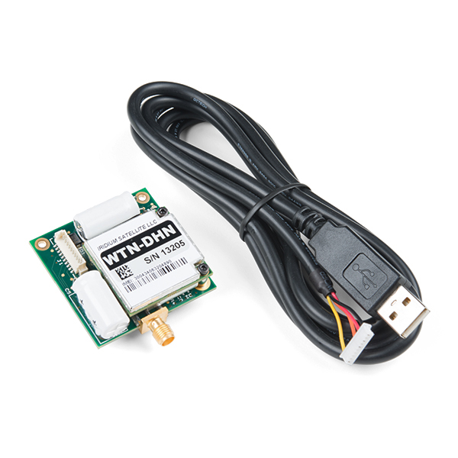
Using Iridium from a device
RockBLOCK radio module
  $268
  5V at 500 mA (max)
    Comparable to cellular modems
Communication
  340 byte uplink packets
  270 byte downlink packets
$15 per month active
plus ~$0.003 per byte
https://www.sparkfun.com/products/14498

Slide 36

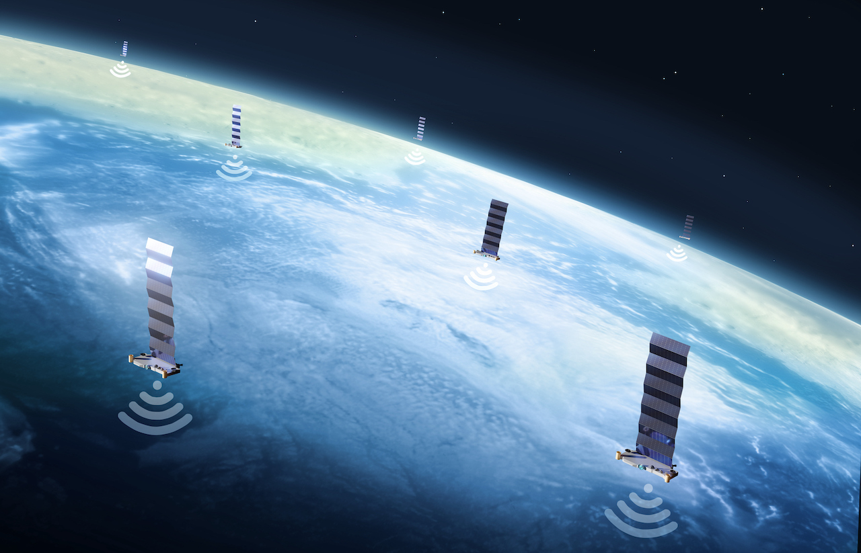
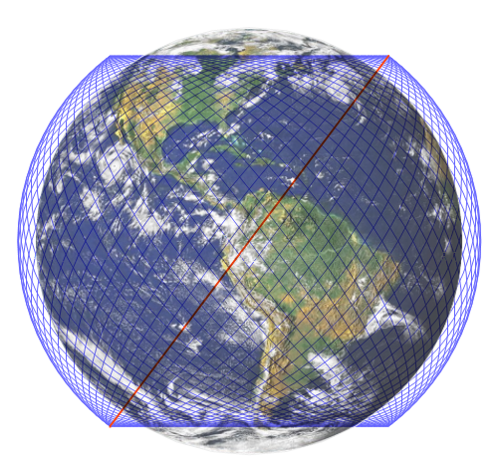
Starlink constellation
Over 7500 satellites (as of May 2025)
  12000-34000 planned
Service began in 2021

Slide 37
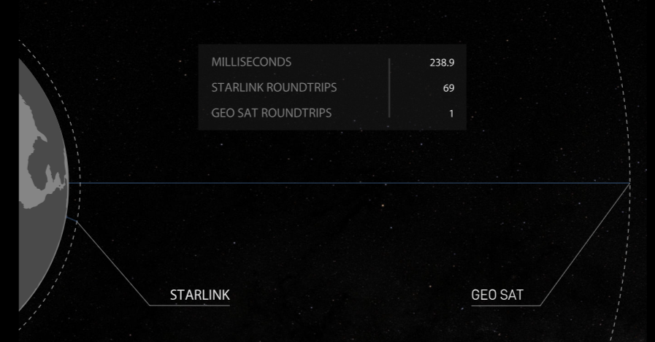
Starlink is deployed in LEO
LEO orbit allows much lower latency for communication than GEO
  ~60-70x faster
  Which enables voice/video operation
Downside is more frequent replacement of satellites
  Which is necessary for technology improvements anyways

Slide 38
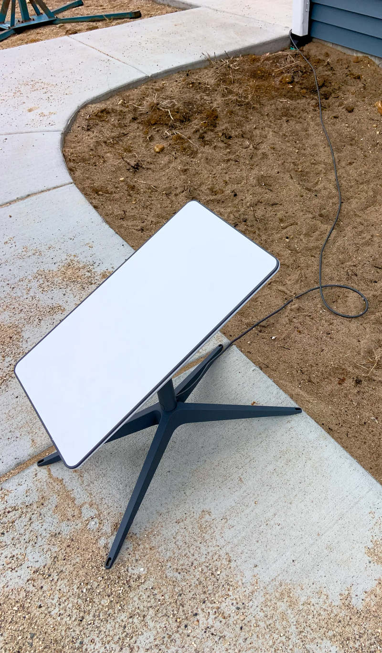
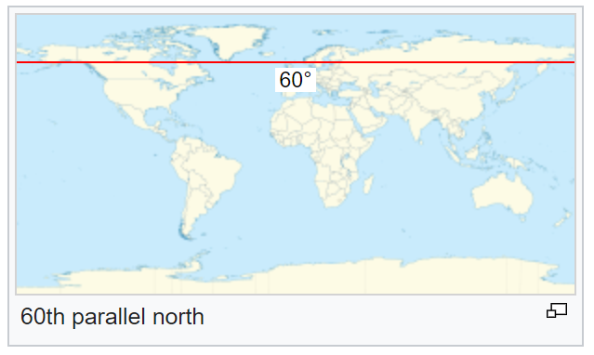
Starlink targets consumer connectivity
Broadband via satellite
  25-100 Mbps down, 5-10 Mbps up
  25-60 ms latency
Anywhere on Earth below 60° latitude
  But communications must be approved by individual countries (~40 so far)
Costs
  $600 for a hardware kit
  $120/month for continuous service

Slide 39
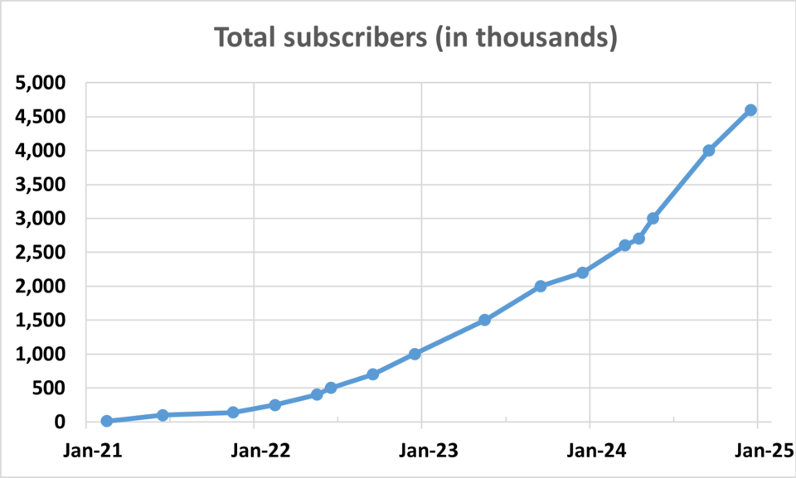
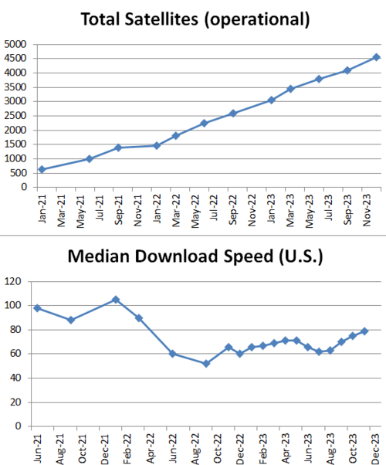
Starlink growth over two-year period
Growth in subscribers has been sustained by growth in satellite deployments
Roughly 1 satellite per 650 users
(May 2025)
  7500 satellites and 5 million users
Note: download speed chart cuts off in 2023…
https://en.wikipedia.org/wiki/Starlink

Slide 40
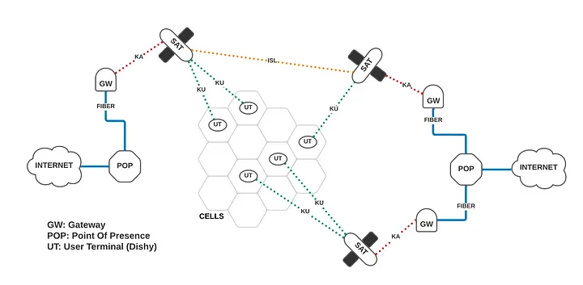
Starlink operation model
https://mikepuchol.com/modeling-starlink-capacity-843b2387f501

Slide 41
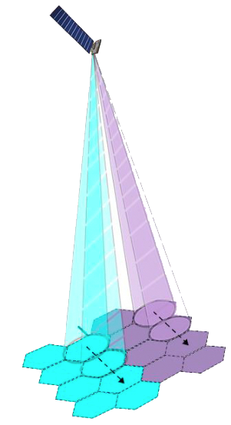
Starlink user communication
Starlink cells are 15 miles in diameter
Each satellite can communicate with 8 cells simultaneously (8 beams)
  Cells can be directed at any location in view of the satellite
  Can redirect cell locations quickly to time divide one beam into many cells per second
http://www.satmagazine.com/story.php?number=1026762698

Slide 42
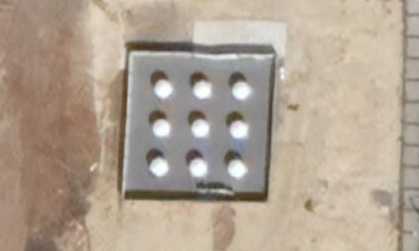
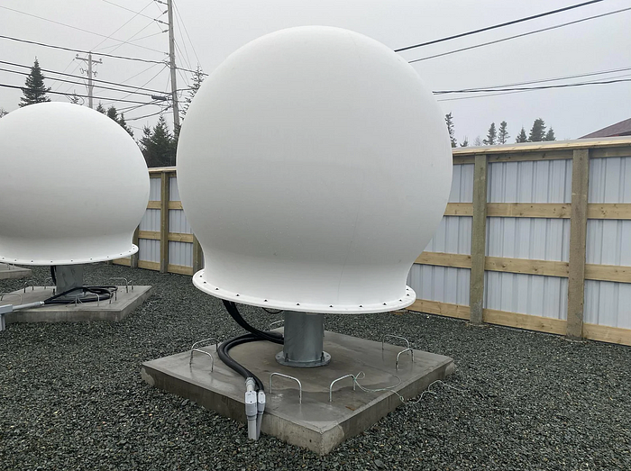
Starlink ground stations
Ground stations deployed worldwide
  Not entirely clear how many? 30-200
20 Gbps throughput from satellite to ground station (shared among all its cells)
Some regions (including eastern US) have a limitation on the band Starlink is using for downlink
  Starlink only gets to use 50% of it
https://www.pcmag.com/news/what-is-a-starlink-pop-how-ground-stations-improve-latency-capacity
https://starlinkinstallationpros.com/starlink-ground-station-backbone-of-satellite-internet/

Slide 43
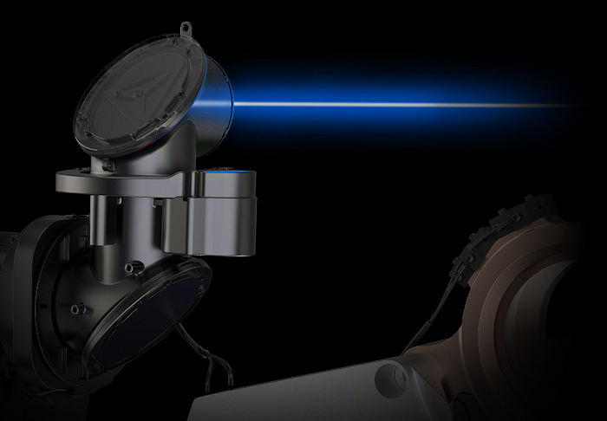
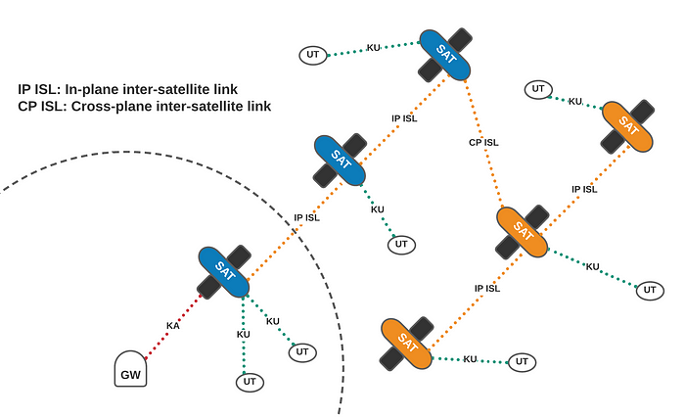
Starlink inter-satellite links
What if a ground station isn’t in view?
  Use mesh networks!!
Uses lasers to communicate with nearby satellites
  Position of each satellite is well-known

Slide 44
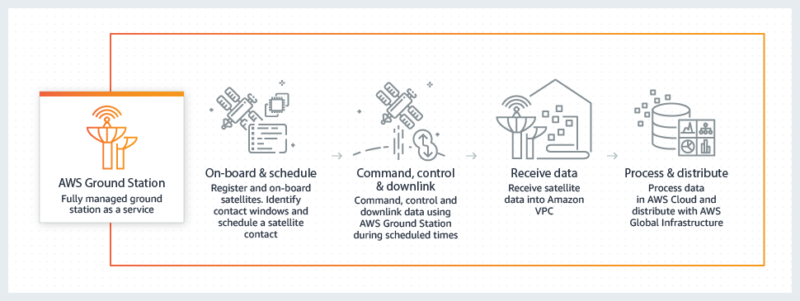
Amazon’s response: Project Kuiper
First prototype satellites in 2023
Service sometime in 2025?
  Planned constellation of 3000 satellites with launches in 2025
One advantage: AWS “ground station as a service” already exists

Slide 45
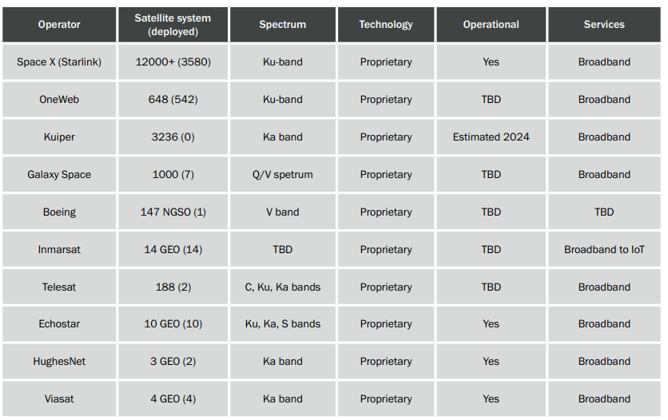
Satellite broadband providers (2023)
https://www.5gamericas.org/wp-content/uploads/2023/07/Update-on-5G-Non-terrestrial-Networks-Id.pdf

Slide 46
Break + Question
Is there a limit to how much stuff we can have in orbit?
What about old, defunct satellites?

Slide 47
Break + Question
Is there a limit to how much stuff we can have in orbit?
What about old, defunct satellites?
  Space Junk!! Major concern
  2022: FCC requires all satellites launched after 2024 to deorbit within five years of ending their mission
  For GEO, graveyard orbit: location to move your satellite to that no one wants to use anyways
    Need to move there before you run out of propellant

Slide 48
Outline
Overview
Satellite Communication
  Voyager
Satellite Communications Providers
Cellular-to-Satellite Communication

Slide 49
Goals of “Non-Terrestrial Networks”
Support connectivity in “remote, unserved, and underserved areas”
Target is remote regions: cities already have good cell coverage
  Supplemental Coverage from Space (SCS)
  Not intended to replace primary coverage
In the US:
  57 million people live in “rural” areas
  4 million km² results in ~10000 15-mile-diameter (24 km) cells
https://docs.fcc.gov/public/attachments/DOC-391794A1.pdf
http://www.satmagazine.com/story.php?number=1026762698

Slide 50
Apple Emergency SOS (2022)
Allows for calling emergency services over satellite communication
  Messages emergency contacts with your location as well
  Possibly additional functionality: call AAA for roadside assistance
Globalstar constellation
  24-satellite deployment in LEO (~1400 km)
  Frequencies: 1.6 GHz uplink, 2.4 GHz downlink (doesn’t overlap with WiFi)
Apple is guaranteed up to 85% of Globalstar bandwidth
Free for first few years (until November 2025?)
  No sense of how they’ll charge for it after that

Slide 51
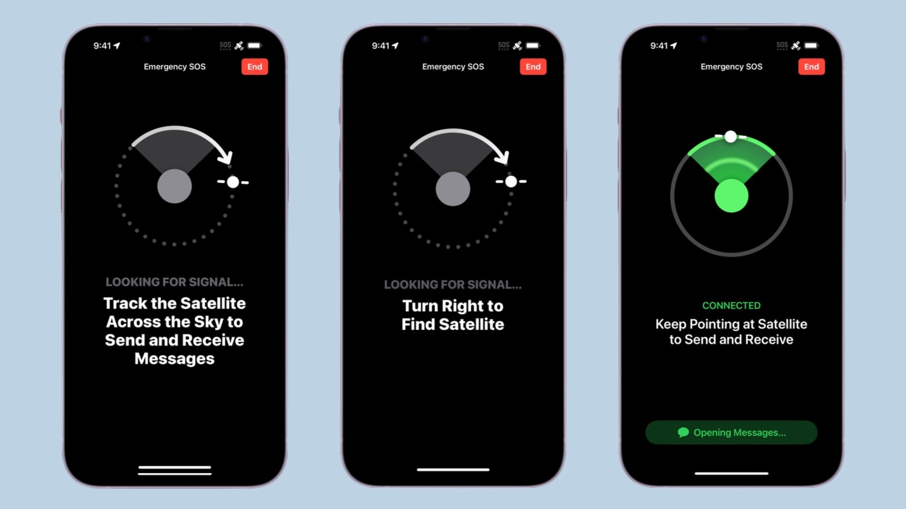
Emergency SOS pointing requirement
How do we handle distance?
  Have users accurately point directional antenna at satellite
  Combine with very slow data rates for better connectivity

Slide 52
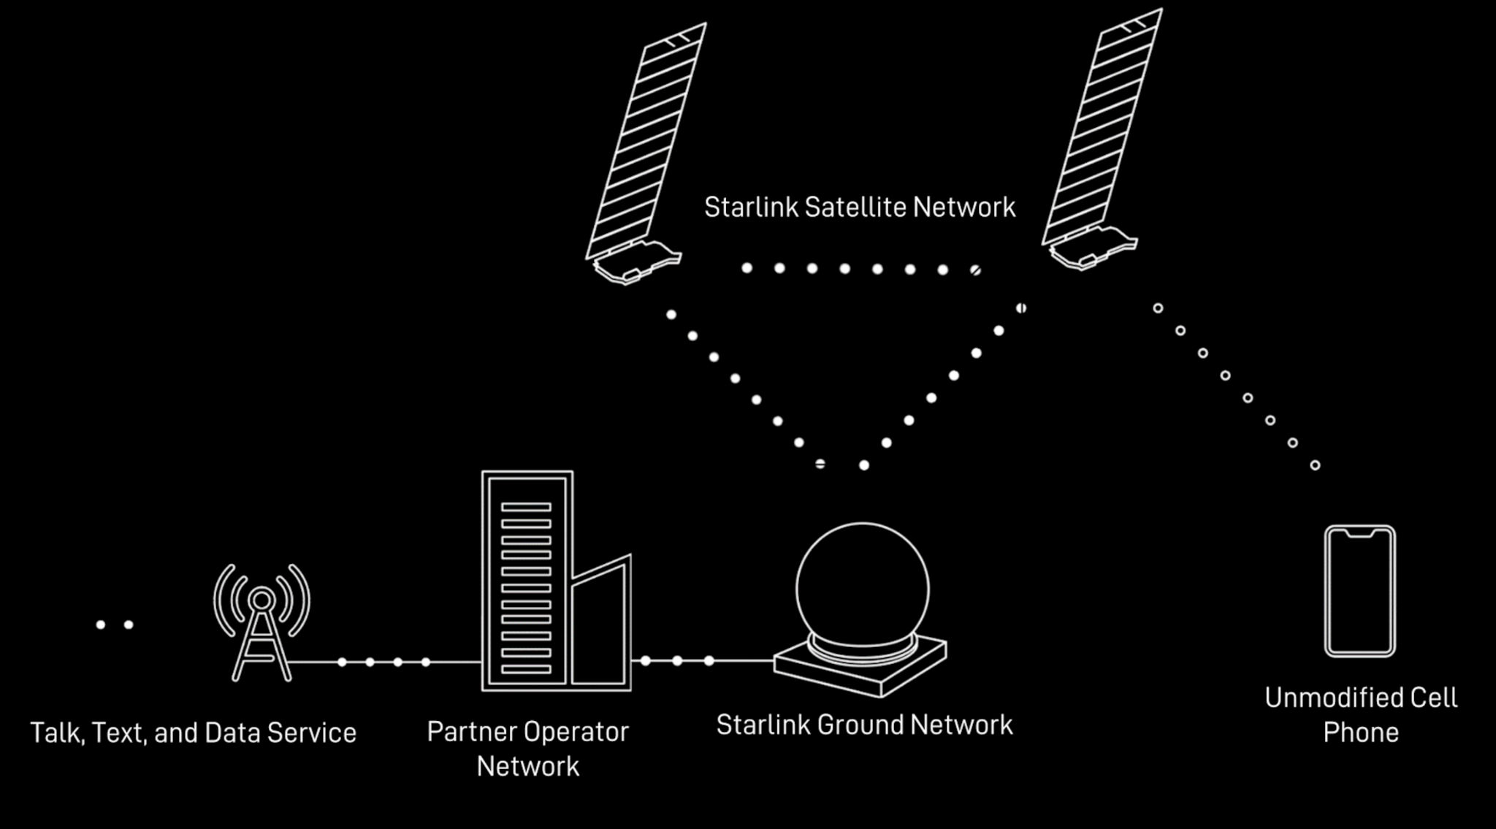
Satellite to cellular suddenly seems viable, but nascent
T-Mobile and SpaceX (2022)
  Partnership in 2022
  Direct-to-cell satellite launched in 2024
  SpaceX says:
    Text in 2024
    Voice/Data and IoT in 2025
    Beta program in 2025
Qualcomm and Iridium partnership (2023-2023)
  Announced in January, ended in November
  Qualcomm: going to focus on standards-based approaches
Verizon and AST SpaceMobile form partnership (May 2024)
“77 publicly announced partnerships over 43 countries” (March 2024)
https://insidetowers.com/partnerships-show-potential-of-satellite-to-cell-phone-market/

Slide 53
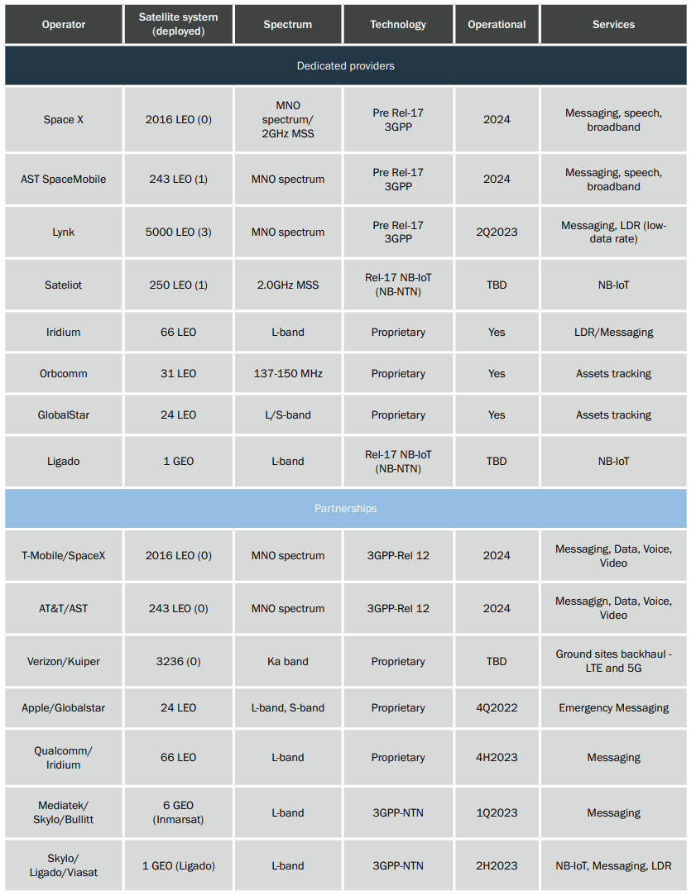
Planned and existing cellular/satellite partnerships (2023)
https://www.5gamericas.org/wp-content/uploads/2023/07/Update-on-5G-Non-terrestrial-Networks-Id.pdf

Slide 54
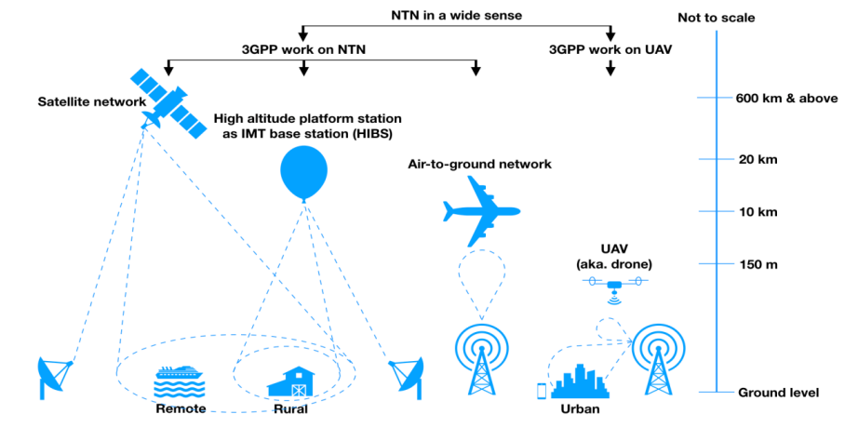
3GPP non-terrestrial networks
Satellites part of a broader Non-Terrestrial Networks (NTN) domain

Slide 55
3GPP 5G satellite requirements
Release 17 (2022) included requirements for NTN. Shall support:
  Service continuity between terrestrial and satellite networks
  Mobility across various access network types
  Low power IoT type of communication
    LTE-M and NB-IoT are rolled into general LTE support
Additional IoT focus
  Network can broadcast satellite parameters so devices understand coverage and timing for communication
  Assumes GNSS capability in IoT devices for timing and location
https://www.3gpp.org/technologies/ntn-overview
https://www.5gamericas.org/wp-content/uploads/2022/01/5G-Non-Terrestrial-Networks-2022-WP-Id.pdf

Slide 56
FCC gets involved (2023-2024)
Approves regulatory framework for “Supplemental Coverage from Space” (March 2024)
FCC attempting to fast-track new deployments
  But also restricting them from interfering with existing stuff
  Allocates some frequencies for SCS use, new ideas on a case-by-case basis
Communication classes
  Primary: existing “Mobile Satellite Services” like Globalstar and Iridium
  Secondary: new SCS services
    Must not disrupt existing MSS communications
https://docs.fcc.gov/public/attachments/FCC-23-22A1_Rcd.pdf
https://docs.fcc.gov/public/attachments/FCC-24-28A1.pdf
https://spacenews.com/taking-the-next-steps-for-satellite-to-smartphone-services/

Slide 57
Reality of satellite cellular coverage
Low throughput communication per device
  Needs to share bandwidth over a wide area
  Path loss involved means reducing bitrate to keep acceptable error rate
Targets rural areas without existing coverage
  Somewhat mitigates need to share bandwidth
  Some connectivity is better than none, right?
User-focused applications: text, maybe voice, no data
  Could get acceptable 1990s data, but the modern Internet doesn’t support that
  Initial focus on emergency services makes sense

Slide 58
IoT and space coverage could be mutually beneficial
Resulting non-terrestrial networks:
  Global coverage (including remote regions)
  Throughput too limited for primary human use
    But is going to exist for backup use
    Which means it might often go unused
Pretty great scenario for IoT communication
  Secondary quality-of-service (below emergency communications)
  Infrequent data uplink of relatively small packets
  Secondary monetary stream for service providers

Slide 59
Outline
Overview
Satellite Communication
  Voyager
Satellite Communications Providers
Cellular-to-Satellite Communication

Slide 60
Outline
Bonus: Oculus-ASR

Slide 61
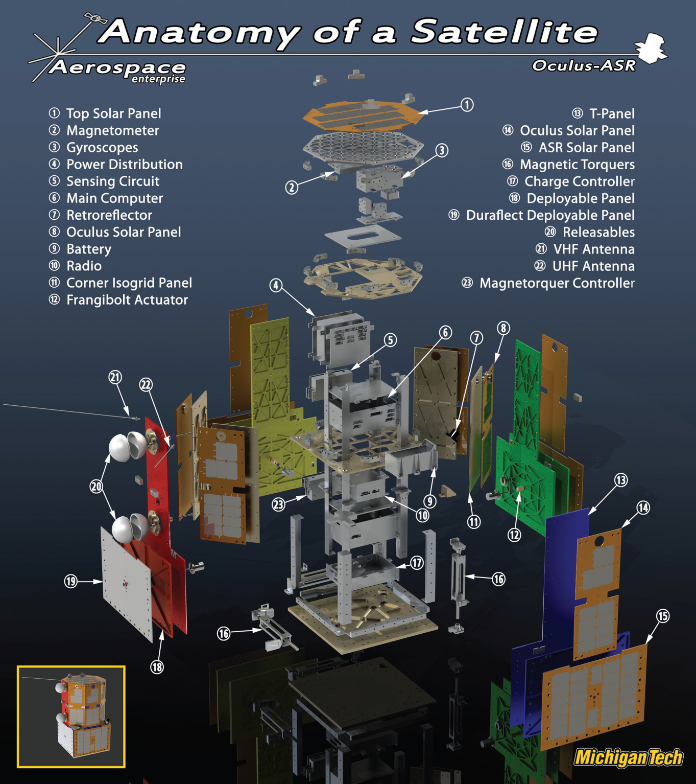
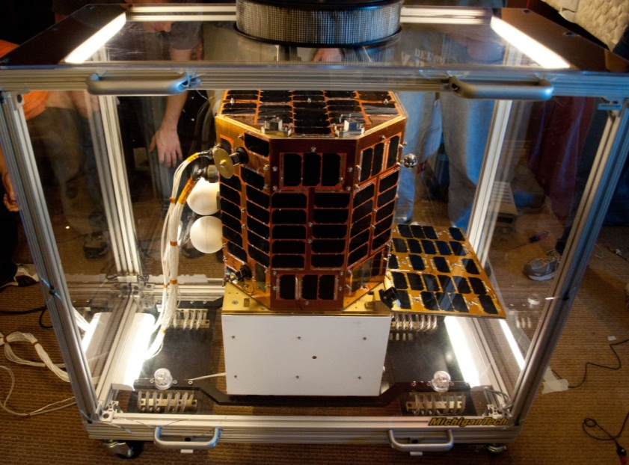

Oculus-ASR
Satellite I worked on from 2009-2013

Slide 62
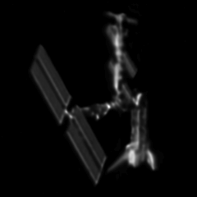
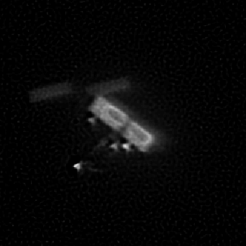
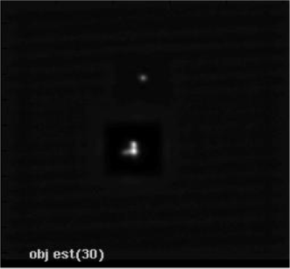
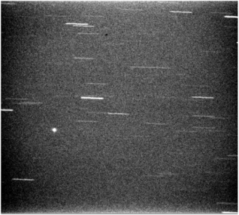
Oculus-ASR mission
Can we determine a satellite’s attitude and detect shape changes from the ground using only information gained from unresolved optical images?
Goal: Space Situational Awareness calibration
  In coordination with Air Force Research Lab (AFRL) and
  Air Force Maui Optical and Supercomputing Observatory (AMOS)

Slide 63
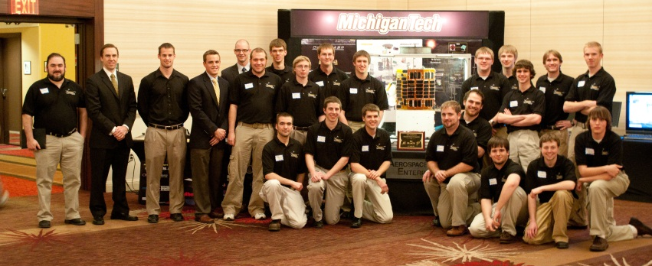
Winner of Nanosat-6: 2011

Slide 64
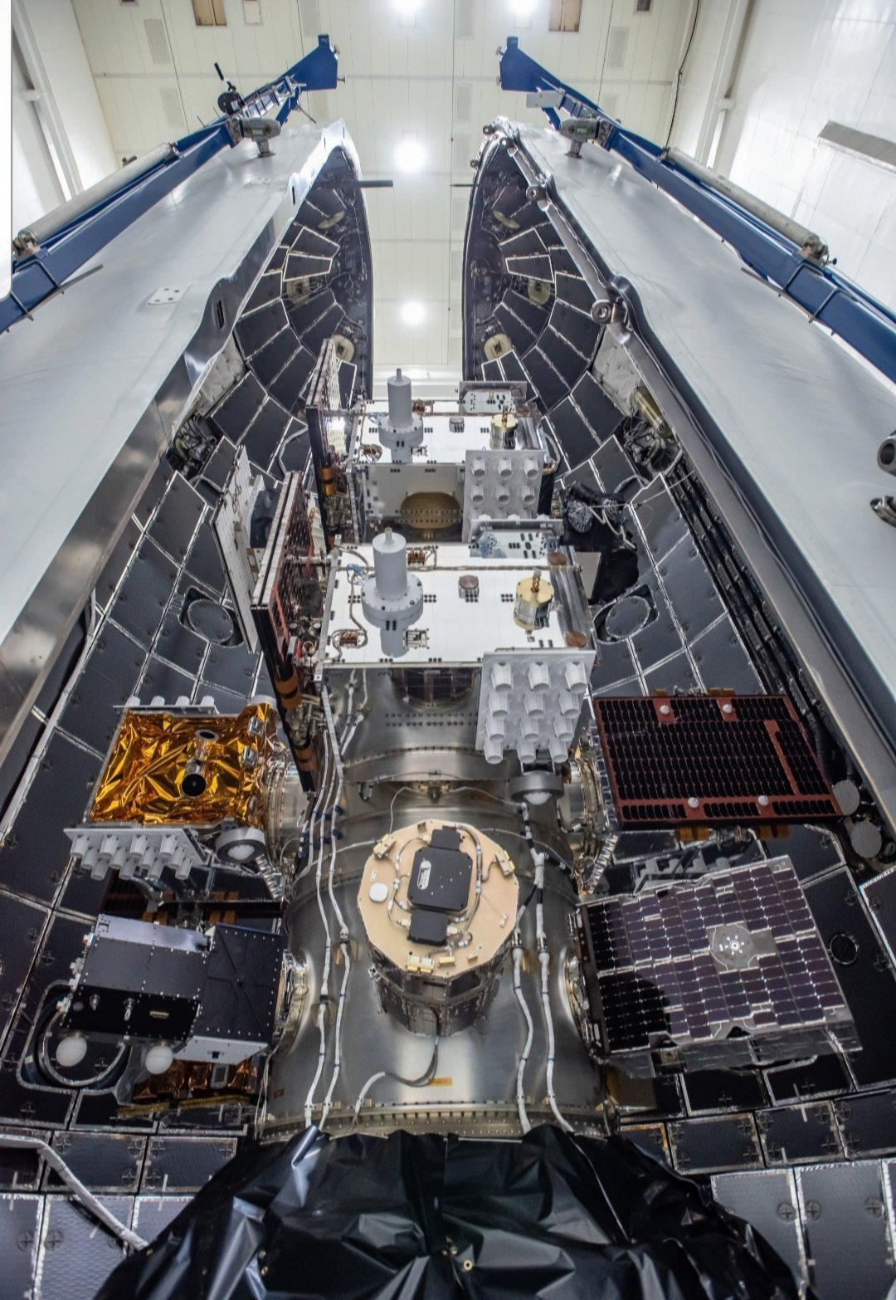

Launched in 2019
STP-2 mission
  Second Falcon Heavy launch

Slide 65


Oculus communication design
440 MHz downlink and 145 MHz uplink
  Amateur bands, coordinated with IARU and AMSAT
9600 bps GMSK modulation
Beacons data every 30 seconds

Slide 66
Oculus link budget
Transmit power: 34 dBm (3 W)
Path loss: 151 dB (at ~600 km)
Receiver antenna gain: 14 dB
Received power: -103 dB

Slide 67


Oculus packet data
108 byte beacon packets
Source: Command document I wrote as a Junior in undergrad

