Slide 1
Lecture 14
Unlicensed LPWANs
CS433 – Wireless Protocols for IoT
Branden Ghena – Spring 2025
Materials in collaboration with
Pat Pannuto (UCSD) and Brad Campbell (UVA)

Slide 2
Administrivia
WiFi Lab due today
Lab: LoRa on Friday
Cellular Homework due next week Thursday
  Last homework
  Counts as double points
  About half of you have made a reservation already
    No duplicates, No MVNOs
Final Project out now
Only other graded item: Quiz3 on Tuesday, June 3rd

Slide 3
Today’s Goals
Overview of unlicensed-band LPWAN approaches
  LoRaWAN
  Sigfox
  802.11ah
  TV Whitespaces

Slide 4
Resources
LoRaWAN
  LoRaWAN Specification version 1.1
  LoRaWAN Regional Parameters version 1.0.2
Sigfox
  Sigfox Technical Overview
  IETF Descriptions
    https://www.ietf.org/proceedings/97/slides/slides-97-lpwan-25-sigfox-system-description-00.pdf
    https://tools.ietf.org/html/draft-zuniga-lpwan-sigfox-system-description-04

Slide 5
Outline
Wide-Area Network Background
Unlicensed LPWANs
  LoRaWAN
  Sigfox
  802.11ah
  TV Whitespaces

Slide 6
Wide area networks
Communication at the region/city scale rather than the building/residence scale
  Throughout cities
  Agricultural deployments
  Industrial facilities
City-scale sensing is one very popular domain
  What might we want to sense throughout a city?

Slide 7
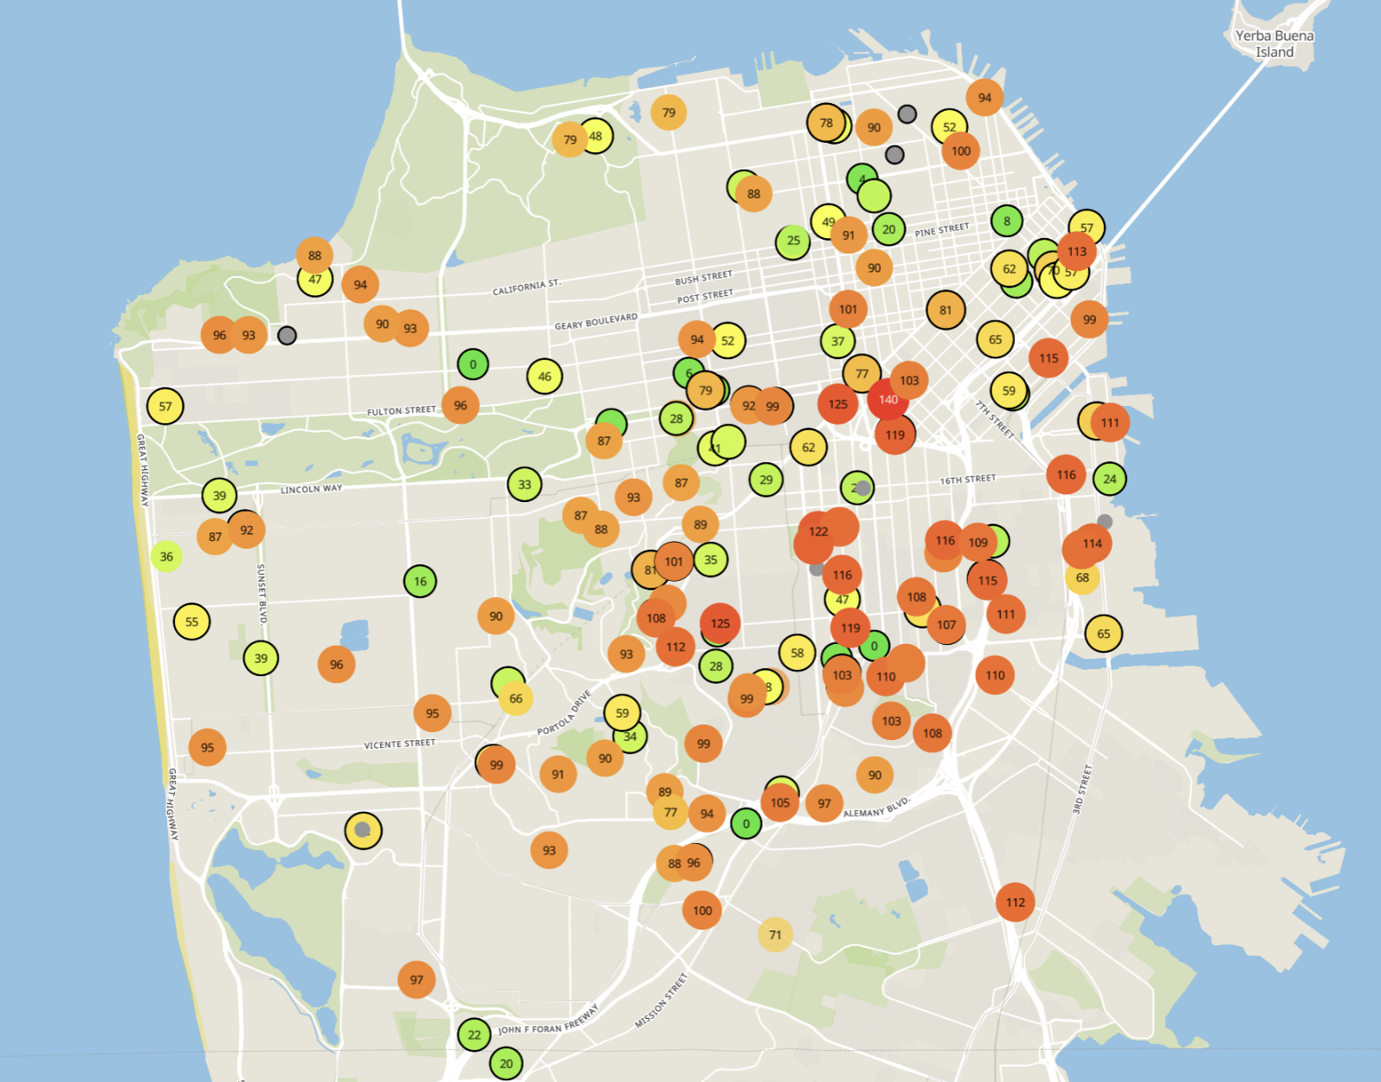
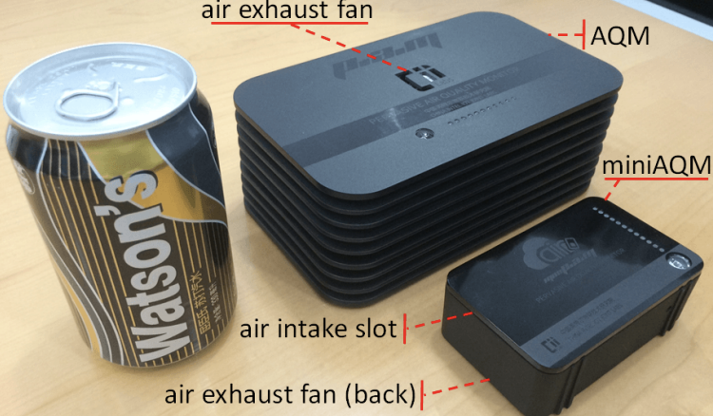
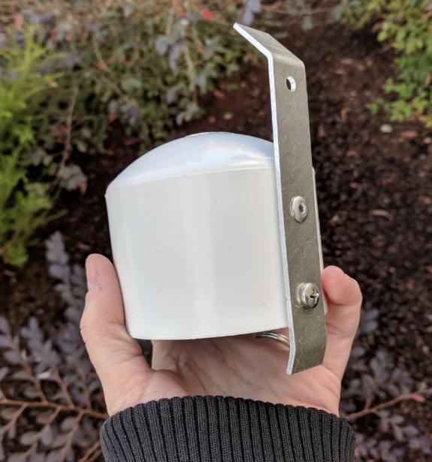
Example application: air quality monitoring
[1]
[2]
[2]
[1] Cheng et al. AirCloud: a cloud-based air-quality monitoring system for everyone. 2014. [2] Purple Air. 2019.

Slide 8

How do we collect data from a sensor?
Manually collect measurements
  Too much work
Connect it to WiFi (or Ethernet)
  Too many separate networks
Pay for cellular access
  Too expensive for many devices

Slide 9
How do we collect data from MANY sensors?
Manually collect measurements
  Too much work
Connect it to WiFi (or Ethernet)
  Too many separate networks
Pay for cellular access
  Too expensive for many devices

Slide 10
We need another network option
Requirements:
Wide area of coverage
  Deploy fewer gateways
Low power
  So we can deploy on batteries
Doesn’t need high throughput
  Sensor data is relatively small

Slide 11
Long-range, low-data needs haven’t historically been met
WiFi
Data
Throughput
Range

Slide 12
Long-range, low-data needs haven’t historically been met
WiFi
Data
Throughput
Bluetooth
BLE
Zigbee
Range

Slide 13
Long-range, low-data needs haven’t historically been met
WiFi
Higher Power
& Higher Cost
Data
Throughput
Bluetooth
BLE
Zigbee
Lower Power
& Lower Cost
Range

Slide 14
Long-range, low-data needs haven’t historically been met
WiFi
4G
Higher Power
& Higher Cost
3G
3G
Data
Throughput
2G
Bluetooth
2G
BLE
Zigbee
Lower Power
& Lower Cost
Range

Slide 15
Long-range, low-data needs haven’t historically been met
WiFi
4G
Higher Power
& Higher Cost
3G
Data
Throughput
Bluetooth
2G
Low-Power
Wide-Area Networks
BLE
Zigbee
Lower Power
& Lower Cost
Range

Slide 16
LPWANs overview (common qualities)
Unlicensed 915 MHz band (902-928 MHz in North America)
  EU: 863-870 MHz (notably less bandwidth)
  China: 779-787 MHz
Higher power transmissions: ~20 dBm (100 mW)
Low data rate 100 kbps or less
Range on the order of multiple kilometers
Simple Aloha access control

Slide 17
Outline
Wide-Area Network Background
Unlicensed LPWANs
  LoRaWAN
  Sigfox
  802.11ah
  TV Whitespaces

Slide 18
LoRaWAN
Open communication standard built with proprietary LoRa PHY
Low rate (1-20 kbps) and long range (~5 km)
  Shorter range than Sigfox but much higher bit rate
Most popular LPWAN protocol
  Target of academic research
  Industry involvement in hardware and deployments

Slide 19
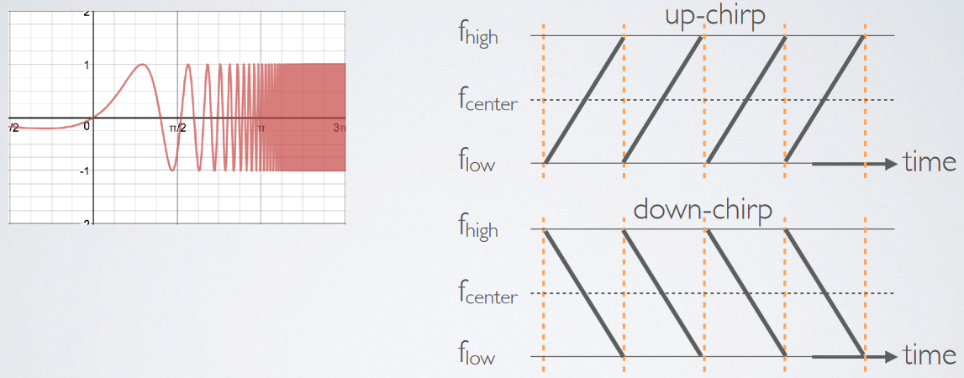
LoRa PHY uses a different modulation
Chirp Spread Spectrum (CSS)
  Modulation technique where frequency is varied linearly from lowest to highest within a channel

Slide 20
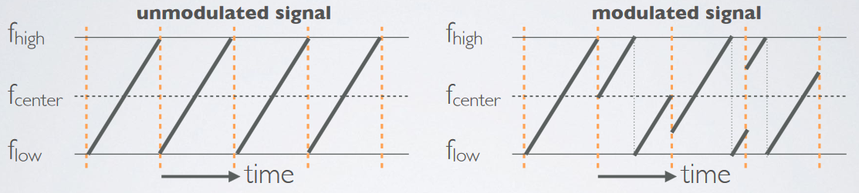
Chirp Spread Spectrum
Data is modulated in the starting and ending points of chirp
  Frequency increases linearly, modulo bounds of the channel

Slide 21
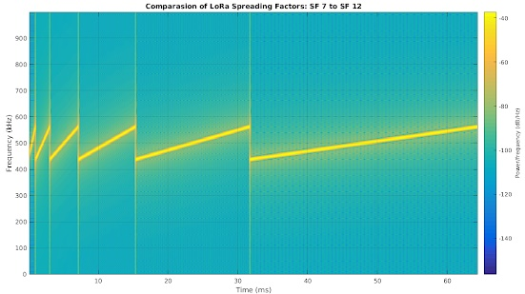
CSS has a Spreading Factor which determines bit rate
Spreading Factor is essentially the rate-of-change of frequency
  Slope of the line
  Lower values of spreading factor (steeper slope) are faster data rate
Important: different spreading factors are (mostly) orthogonal!
  Two can overlap in time, space, and channel without a collision

Slide 22
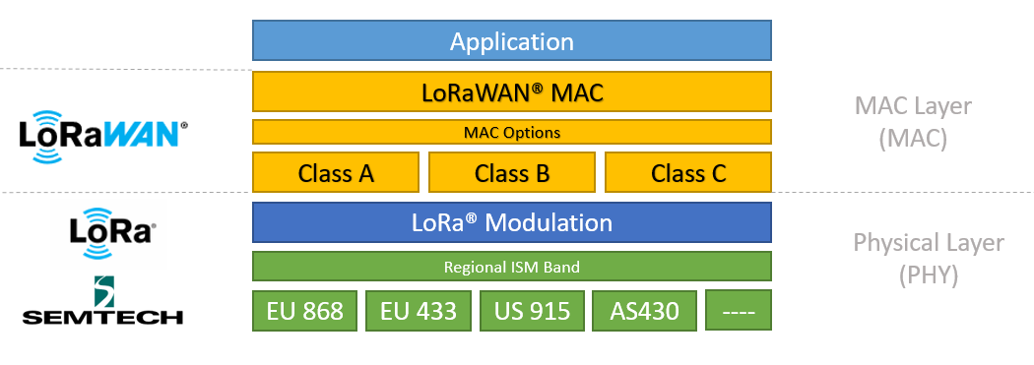
LoRa vs. LoRaWAN
LoRa: physical layer protocol
LoRaWAN: MAC and network layer
(In practice we often conflate LoRa and LoRaWAN.)
https://lora-developers.semtech.com/documentation/tech-papers-and-guides/lora-and-lorawan/

Slide 23
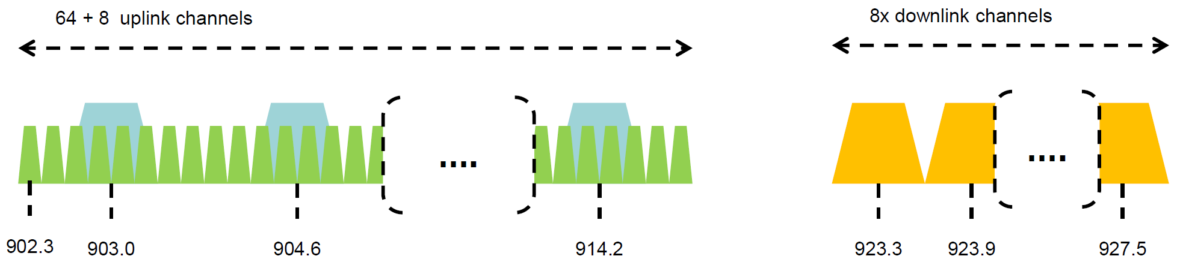
LoRaWAN channels (in the US)
Sixty-four, 125 kHz uplink channels
  Frequency Hopping over the 64 uplink channels
  Plus eight, 500 kHz overlapping uplink channels (not very used in practice)
Eight, 500 kHz downlink channels

Slide 24
LoRaWAN data rates
Data Rate Index | Spreading Factor | Bit Rate
125 kHz Uplink Rates
0 | SF10, 125 kHz | 980 bps
1 | SF9, 125 kHz | 1760 bps
2 | SF8, 125 kHz | 3125 bps
3 | SF7, 125 kHz | 5470 bps
500 kHz Uplink Rates
4 | SF8, 500 kHz | 12500 bps
500 kHz Downlink Rates
8 | SF12, 500 kHz | 980 bps
9 | SF11, 500 kHz | 1760 bps
10 | SF10, 500 kHz | 3900 bps
11 | SF9, 500 kHz | 7000 bps
12 | SF8, 500 kHz | 12500 bps
13 | SF7, 500 kHz | 21900 bps
Data rate options depend on channel in use
  Unbalanced uplink and downlink
64-channel uplink
  1-5 kbps data rate
Allowable rates based on US dwell time restriction
(400 ms)
  Different in different regions

Slide 25
LoRaWAN link budget
Typical TX power 20 dBm
  Up to 30 dBm for 64-channel hopping
  Up to 26 dBm for 8-channel hopping
Receive sensitivity -119 dBm
  Compare to -100 dBm for 802.15.4 and -95 dBm for BLE
Resulting range is about a kilometer in urban environments

Slide 26
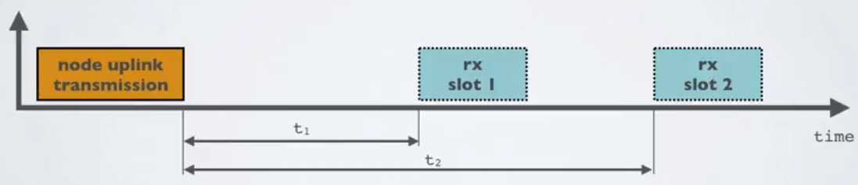
LoRaWAN MAC
Uplink: Aloha - transmit whenever
  Randomly split across 64 uplink channels (reduced odds of collision)
  Devices a different spreading factors also do not collide
  Packets are very long though: up to 400 ms in duration
Downlink: listen-after-send (class A device)
  Two windows for RX on different channels

Slide 27
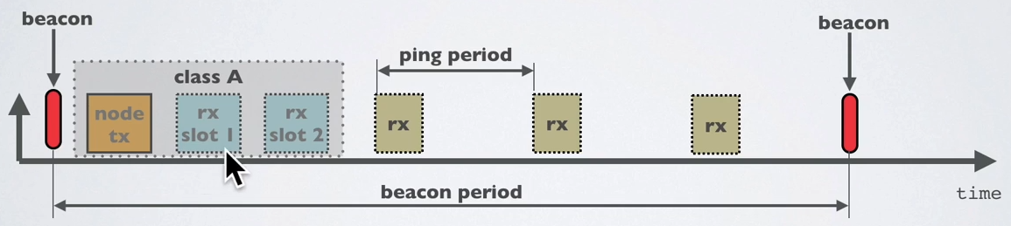
Optional downlink mechanisms
Periodic listening (class B device)
  Synchronized with periodic beacons
    TX still unsynchronized Aloha
  Mostly unused
Continuous listening (class C device)
  Always-on receivers

Slide 28
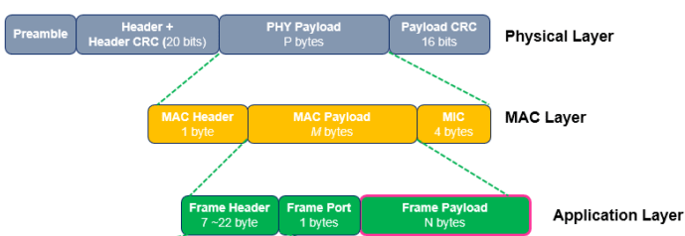
LoRaWAN packet format
Frame header includes device address
MAC Payload maximum size depends on data rate
  Again based on dwell time in the US
Data Rate Index | MAC Payload Size
0 | 19 bytes
1 | 61 bytes
2 | 133 bytes
3 | 250 bytes
4 | 250 bytes

Slide 29
LoRaWAN gateways
No synchronization with end devices
Instead listen to entire bandwidth simultaneously
  Only 12 MHz total
  Recognize preambles and allocate hardware to decode packet
  Number of simultaneously decoded packets depends on decoders
    Cheap gateways: 8 decoders
    Good gateways: 64 decoders

Slide 30
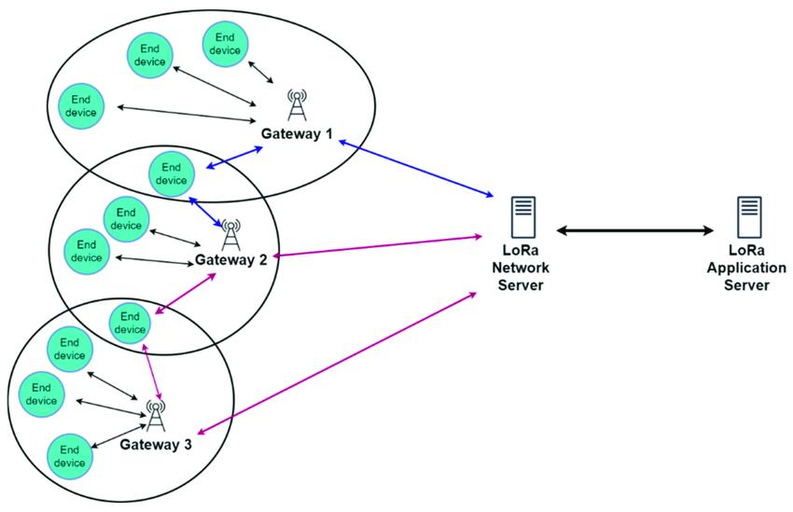
LoRaWAN star-of-stars topology
Each gateway is a star network
Many gateways connect to a LoRaWAN backend
https://www.researchgate.net/publication/360965985_LoRaWAN_Communication_Protocols_A_Comprehensive_Survey_under_an_Energy_Efficiency_Perspective

Slide 31
LoRaWAN network details

Slide 32
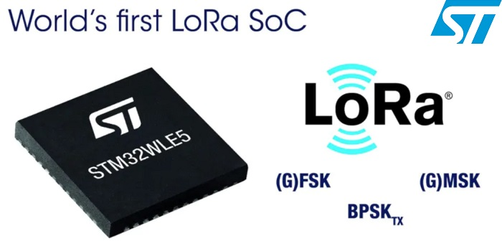
LoRaWAN hardware
Numerous hardware modules and development kits
  Almost all use Semtech radio chips (Semtech owns LoRa PHY)
Recent addition: STM32WLE5 LoRa SoC
  Cortex-M4 + LoRa radio (analogous to nRF52840)

Slide 33
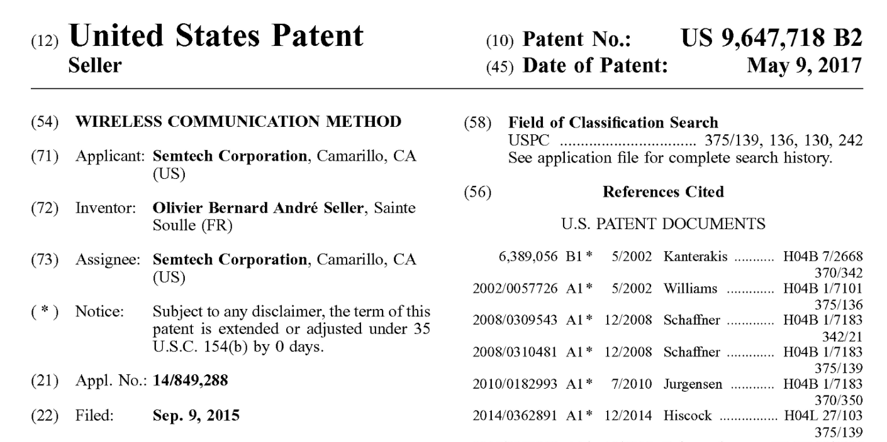
Note about LoRa hardware
LoRa PHY is patented
Hardware controlled by Semtech
  Good for interoperability
Openness? Innovation?
  Less good

Slide 34
Joining a LoRaWAN Network
Two modes:
  OTAA (Over the air activation): Dynamic join procedure that sets up security keys
  ABP (Activation By Personalization): Legacy approach with pre-shared security keys
OTAA Joining: two packets
  Join-request: from end device to the Network Server
  Join-accept: from Network Server to the end device

Slide 35
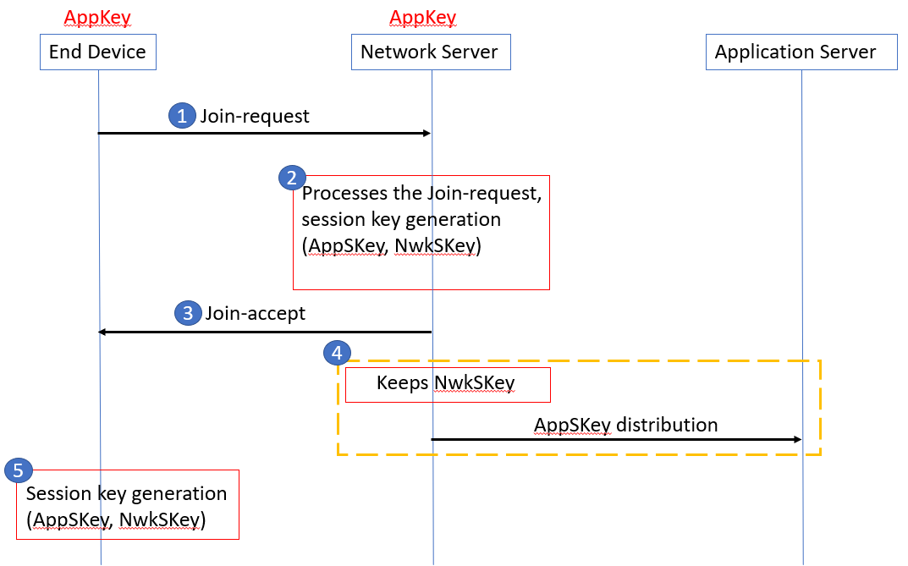
OTAA Join Procedure
Device knows three things:
AppEUI: Identifier for the application the device uses on the application server
DevEUI: Device ID
AppKey: AES-128 bit secret registered with the network server
Join Request
Device sends
(AppEUI, DevEUI, Nonce) and MIC using AppKey
Join Accept
Network server responds with AppNonce encrypted with AppKey
Device and network server compute the same AppSKey to encrypt all future payloads

Slide 36
LoRaWAN network providers
You can always manage your own network
  Buy a gateway and run whatever backend software you want
Somewhat-managed network providers
  The Things Network (predominantly in Europe)
    But available in the US too!
  Helium
    Anyone can buy and install their own gateway, which serves everyone
    Microtransactions to pay for communication

Slide 37
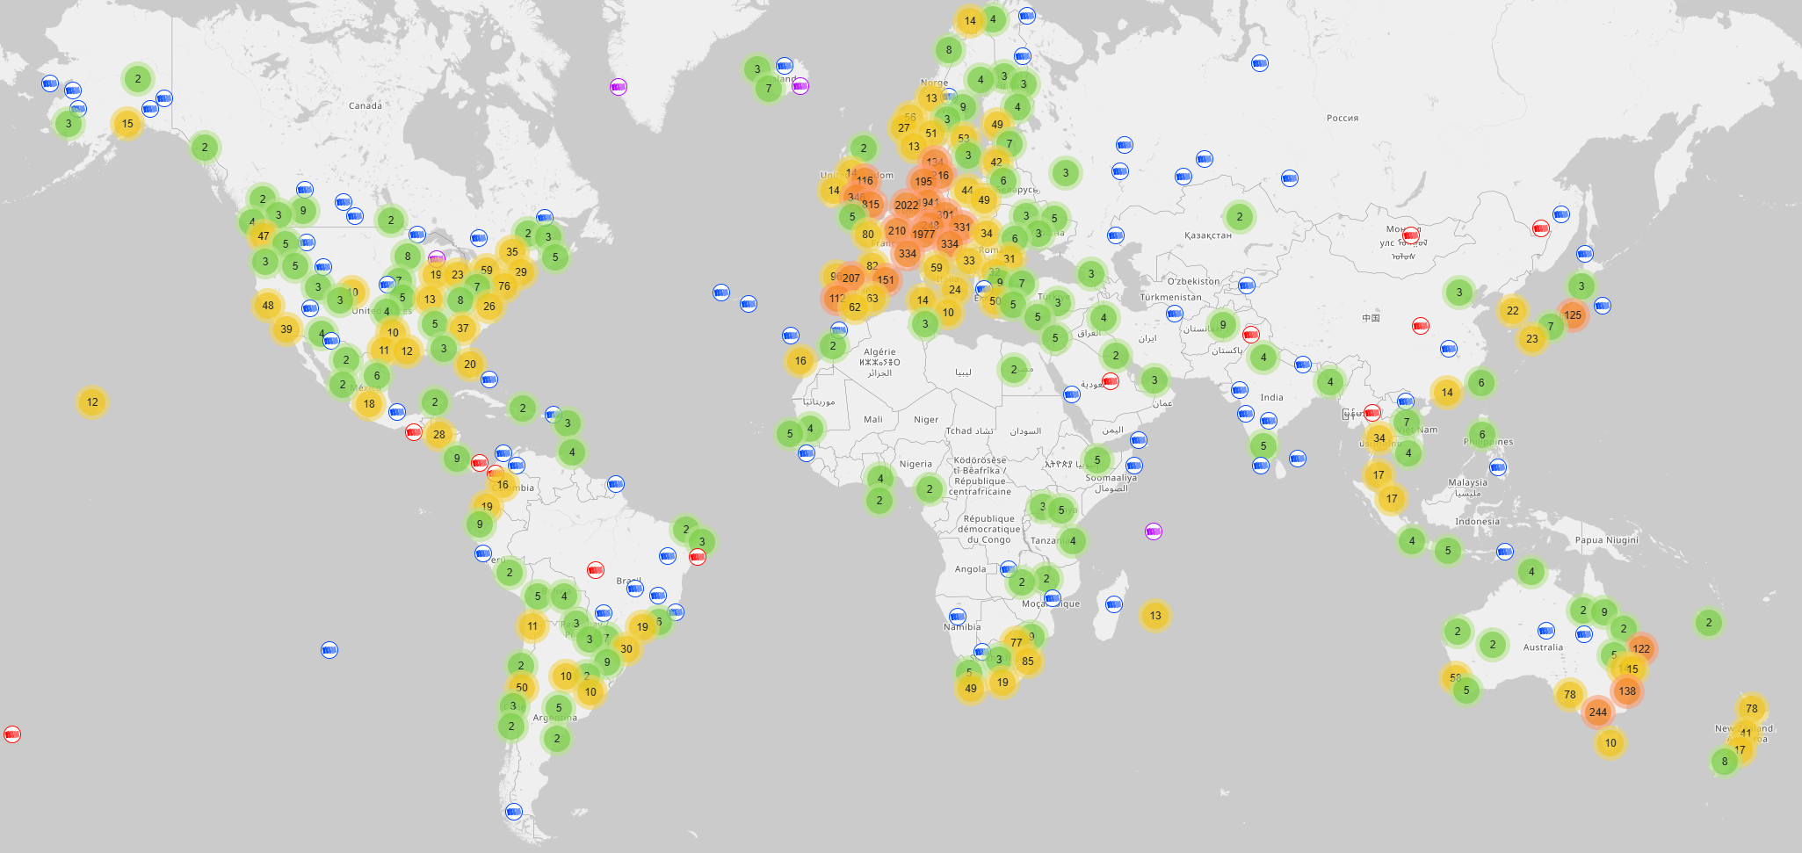
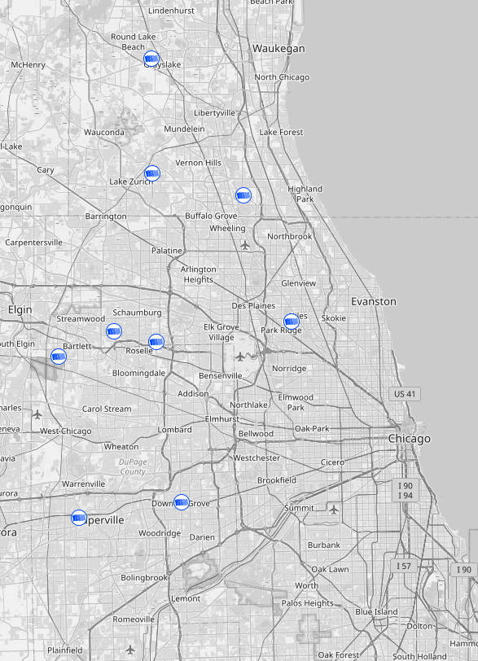
The Things Network gateways (Spring 2025)
21000 gateways active in last two weeks (May 2025)
Closest to Evanston is in Niles ~10 miles away

Slide 38
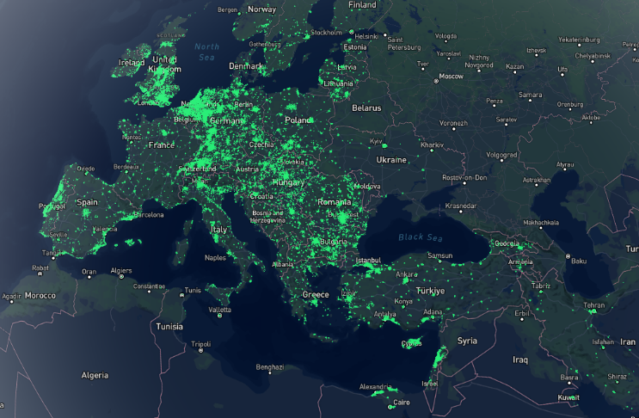
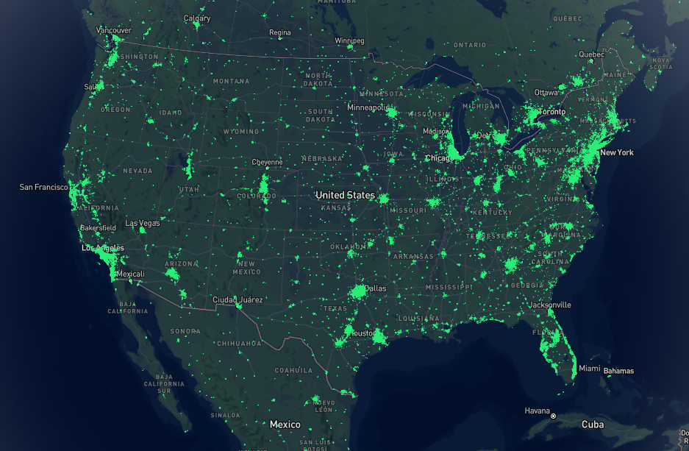
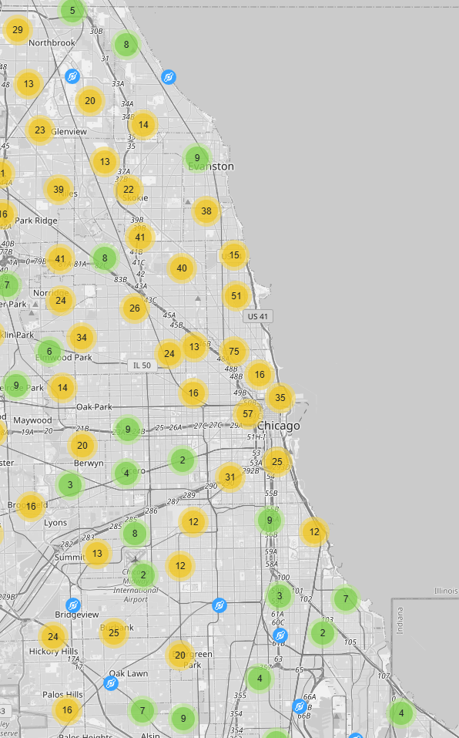
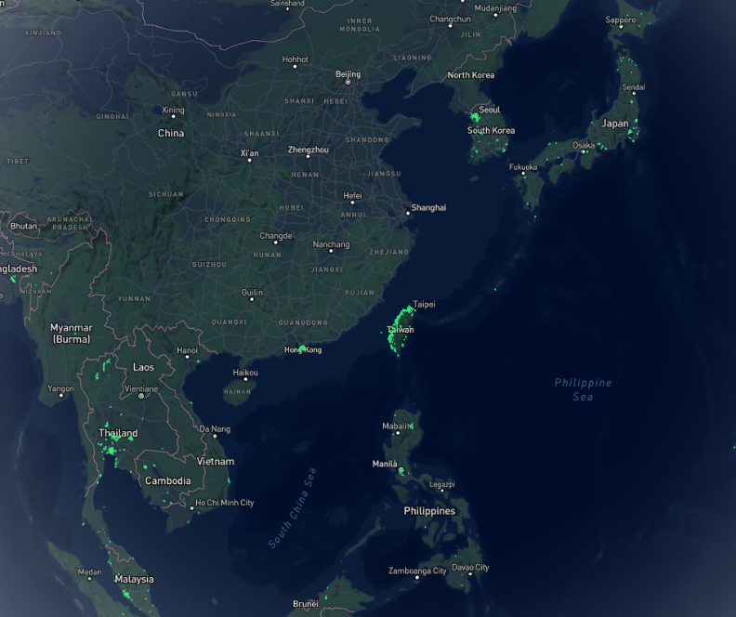
Helium gateways (Spring 2025)
May 2022: 800,000 hotspots, with +80K in last 30 days
Feb 2023: 980,000 hotspots, with +3K in last 30 days
May 2025: 285,000 hotspots… I think they pruned dead gateways, but also rewards seem to be reduced lately
Several gateways in Evanston, including one on far south side of campus

Slide 39
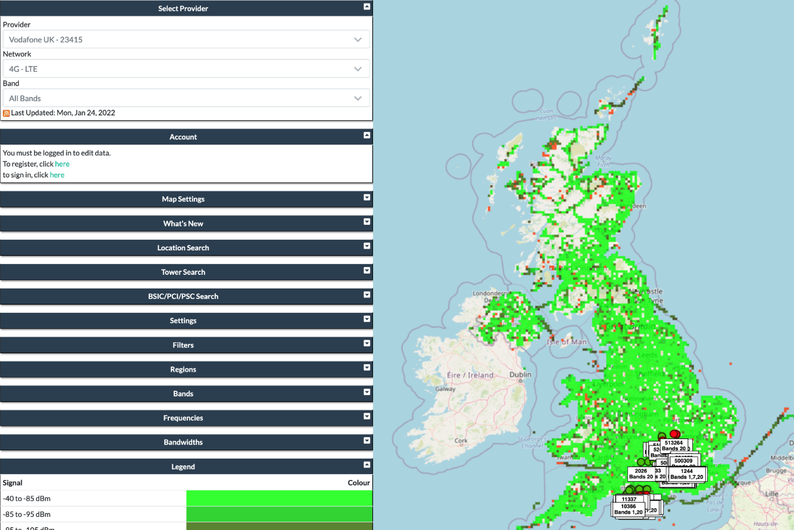
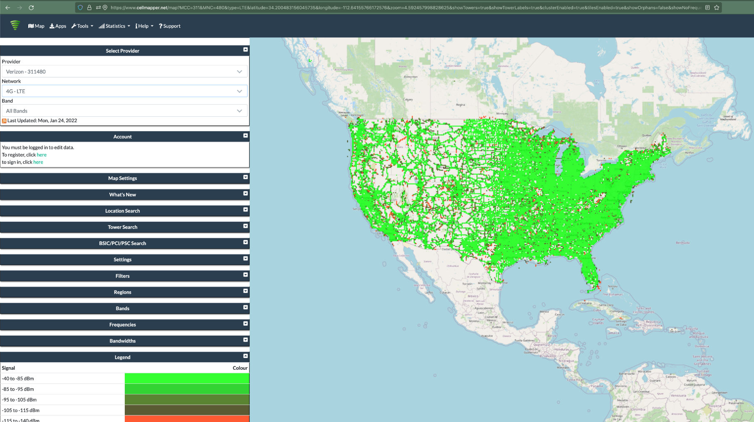
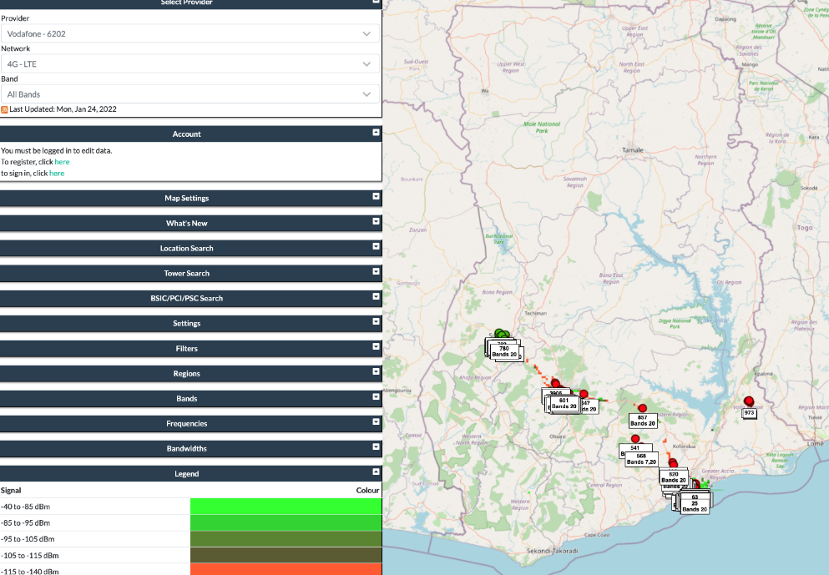
Quick reality check: Cellular?
~350,000 sites across ~150,000 towers
  In the just US

Slide 40
Break + Open Question
What kinds of use cases exist for LoRaWAN?
  What can you do with 1-5 kbps uplink, 1-22 kbps downlink?
  Multiplied by 64 channels uplink, 8 channels downlink

Slide 41
Break + Open Question
What kinds of use cases exist for LoRaWAN?
  What can you do with 1-5 kbps uplink, 1-22 kbps downlink?
  Multiplied by 64 channels uplink, 8 channels downlink
Outdoor small-sized sensing seems possibly achievable!
  With a low enough rate, it could support many devices
Code updates on devices could be tough

Slide 42
Outline
Wide-Area Network Background
Unlicensed LPWANs
  LoRaWAN
  Sigfox
  802.11ah
  TV Whitespaces

Slide 43


Sigfox
Very low-rate (600 bps), very long-range (10+ km) communication
Star-topology networks, with always-listening gateways
  Any number of low-power end devices
Uplink-focused communication
Applications: very low-rate metering

Slide 44
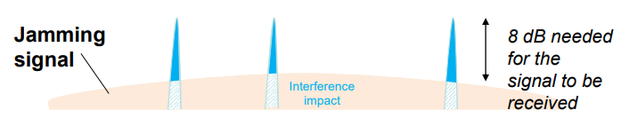
Sigfox PHY
Unlicensed-band communication
  Europe 868 MHz. US 902-928 MHz (915 MHz band)
Ultra-narrowband 600 Hz (100 Hz Europe) channel bandwidth
  Detection only needs to occur at very specific frequency
  Helps improve signal-to-noise ratio

Slide 45
Sigfox unbalanced uplink and downlink
Uplink
  600 Hz bandwidth, 600 bps, DBPSK
Downlink
  1.5 kHz bandwidth, 600 bps, GFSK
Particularly designed for Europe
  Uplink on 1% duty cycle channel, up to 14 dBm
  Downlink on 10% duty cycle channel, up to 27 dBm
Works fine in US too
  Gets more power (24 dBm up is typical, up to 32 dBm down) and more range

Slide 46
Sigfox link budget
Why transmit at 100-600 bps?
  For greatly increased link budget
Link budget: 150-160 dBm
  Assuming Tx at ~20 dBm
  Means Rx Sensitivity of -130 dBm (10 dBm better than LoRaWAN)
Resulting range: 10-15 km in urban environments
  Except that buildings lead to dead spots in range

Slide 47
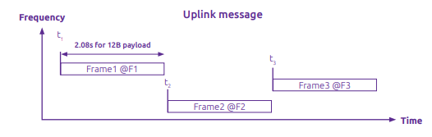
Sigfox MAC
Aloha-style access control (send whenever)
  No acknowledgements!
Send message three times for increased reliability
  Then listen for downlink at a set period later on a known frequency

Slide 48

Sigfox uplink packet
Up to 29 bytes total per packet
  Payload: up to 12 bytes 😱
Other fields
  Preamble + Frame Sync are really a 6 byte field for radio sync
  Authentication: 2-5 bytes
  Frame Check Sequence: 16-bit CRC

Slide 49
Aside: why faster bitrate in the US?
Packet size up to 29 bytes (232 bits)
  At 100 bps: 2.32 seconds on air
  At 600 bps: 0.387 seconds on air
Maximum dwell time for 915 MHz band: 400 ms

Slide 50

Sigfox downlink packet
Similar structure, 28 bytes total
  Payload: up to 8 bytes
Larger preamble + frame sync of 13 bytes
Error Correcting Code for increased reliability

Slide 51
Sigfox deployments
Proprietary network with managed deployment
  Like cellular networks
  Sigfox deploys networks and transports data
  140 uplink messages plus 4 downlink message per day
Connectionless communication
  Devices are registered with the networks
  Keys are provided in the software image
  Any deployed Sigfox gateway can collect transmitted data
    Enables mobile applications

Slide 52
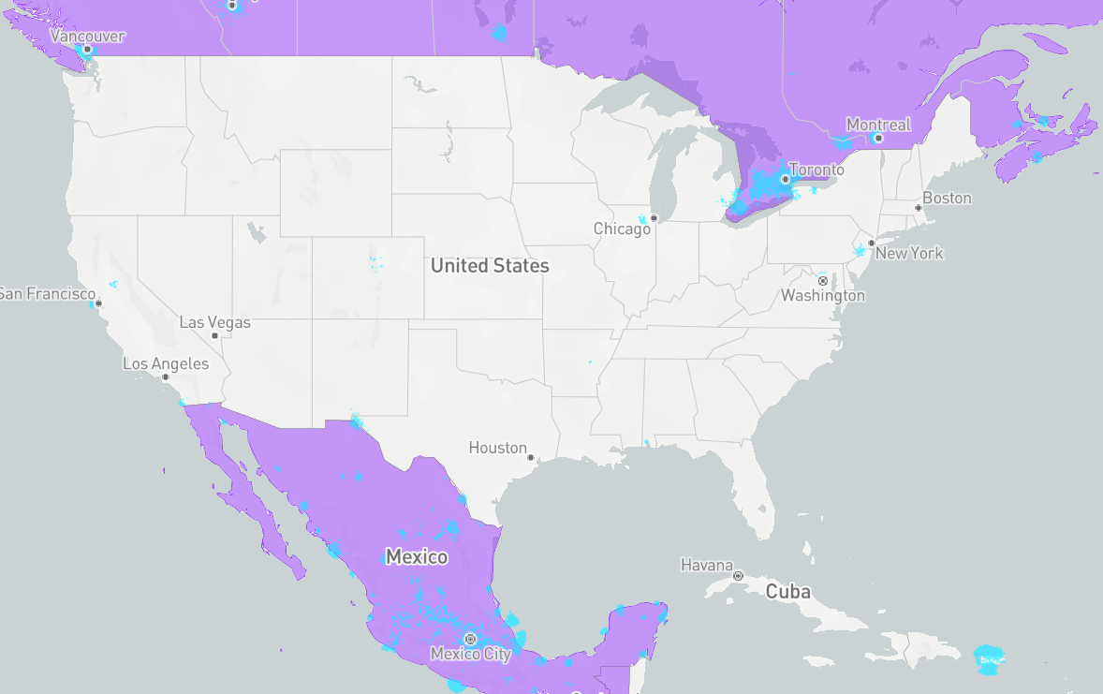
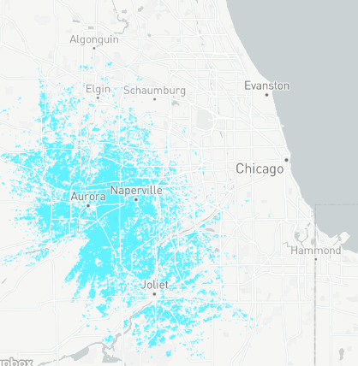
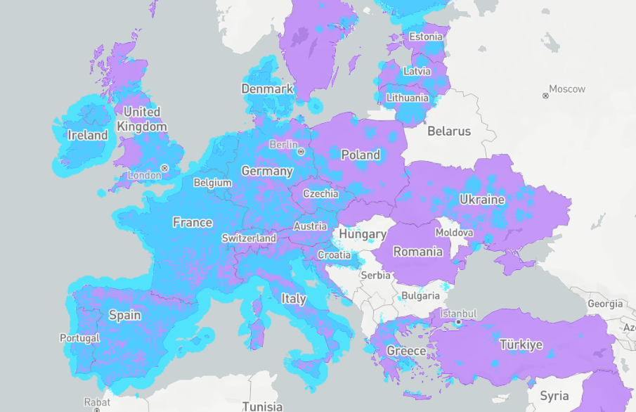
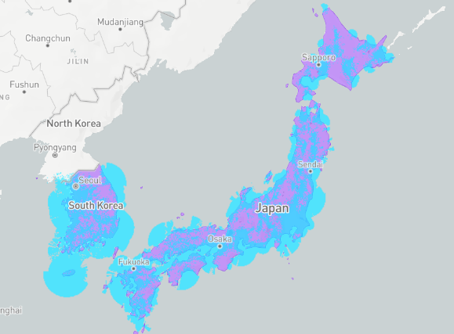
Sigfox coverage (Spring 2025)
Not focused on US coverage right now (coverage is blue)
  Much higher availability in Europe
  No longer planned rollout in US (purple)
January 2022
  Sigfox filed for bankruptcy
April 2022
  Sigfox purchased by UnaBiz
  Renamed: Sigfox “0G” Technology
December 2024
  Reports 14 million connected devices worldwide

Slide 53
Break + Open Question
What kinds of use cases exist for Sigfox?
  What can you do with 600 bps uplink, 600 bps downlink?
  Multiplied by ?hundreds? of channels (~400 in Europe)

Slide 54
Break + Open Question
What kinds of use cases exist for Sigfox?
  What can you do with 600 bps uplink, 600 bps downlink?
  Multiplied by ?hundreds? of channels (~400 in Europe)
Many devices that aren’t doing very much
  Simple status monitoring (water, electric, etc.)
    Not metering necessarily, but activity detection
    Did a breaker trip?, is water flowing?, etc.
Definitely no code updates

Slide 55
Outline
Wide-Area Network Background
Unlicensed LPWANs
  LoRaWAN
  Sigfox
  802.11ah
  TV Whitespaces

Slide 56
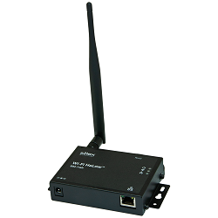
IEEE standard for LPWANs
802.11ah (HaLow) standard in 2016
  First real hardware in 2020
  Hardware and dev kits available (Heltec makes one)
  Unclear if there are real-world devices, but things are improving
Focus on the indoor-to-outdoor scenario
  Medium range (maximum 1 km, so expect 100s of meters)
915 MHz communication
  NOT interoperable with other 802.11 access points and devices
Theoretically up to 356 Mbps
  Practically, most devices are expected to implement 150 kbps to 8 Mbps

Slide 57
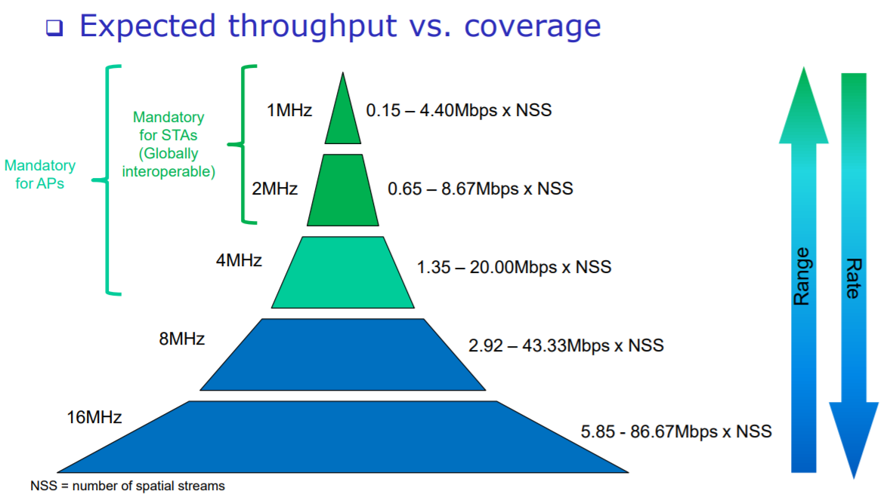
802.11ah allows multiple bandwidth allocations

Slide 58
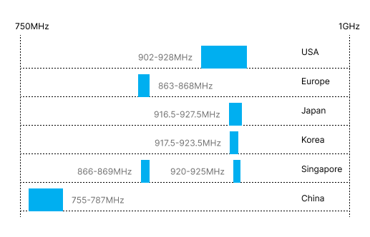
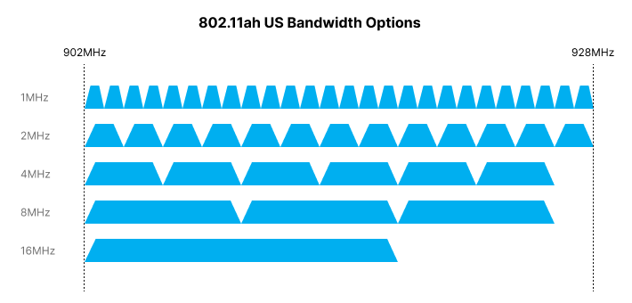
802.11ah frequency bands
Frequency and available bandwidth vary by region
  16 MHz allocation possible in US/China
  4 MHz max in Europe
Given range, probably want more smaller allocations to avoid contention
  Twenty-six 1 MHz bands up to 4 Mbps

Slide 59
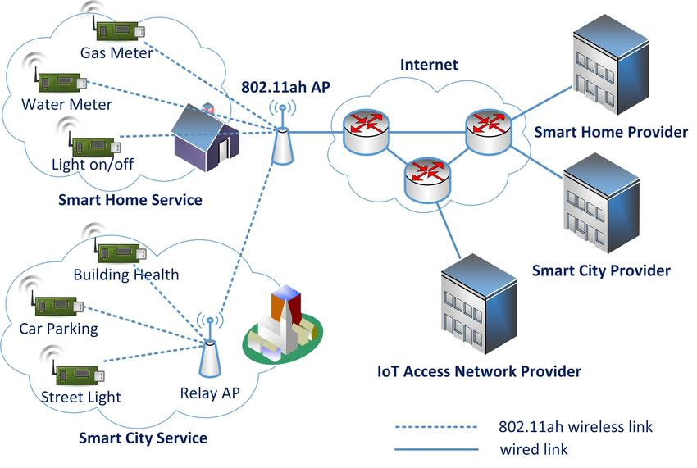
HaLow Network Model

Slide 60
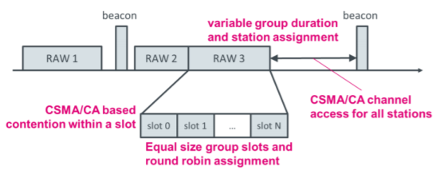
802.11ah architecture
Star topology
  Up to 8191 devices per access point
Devices are assigned to a group
  Groups are scheduled slots with TDMA
  Within a slot CSMA/CA is used for contention among devices
  Devices not in the group can sleep until their slot
  Groups can be assigned by location to avoid hidden-terminal problem
Traditional IP communication on top of that
  And traditional 802.11 security mechanisms (WPA2/TLS)

Slide 61
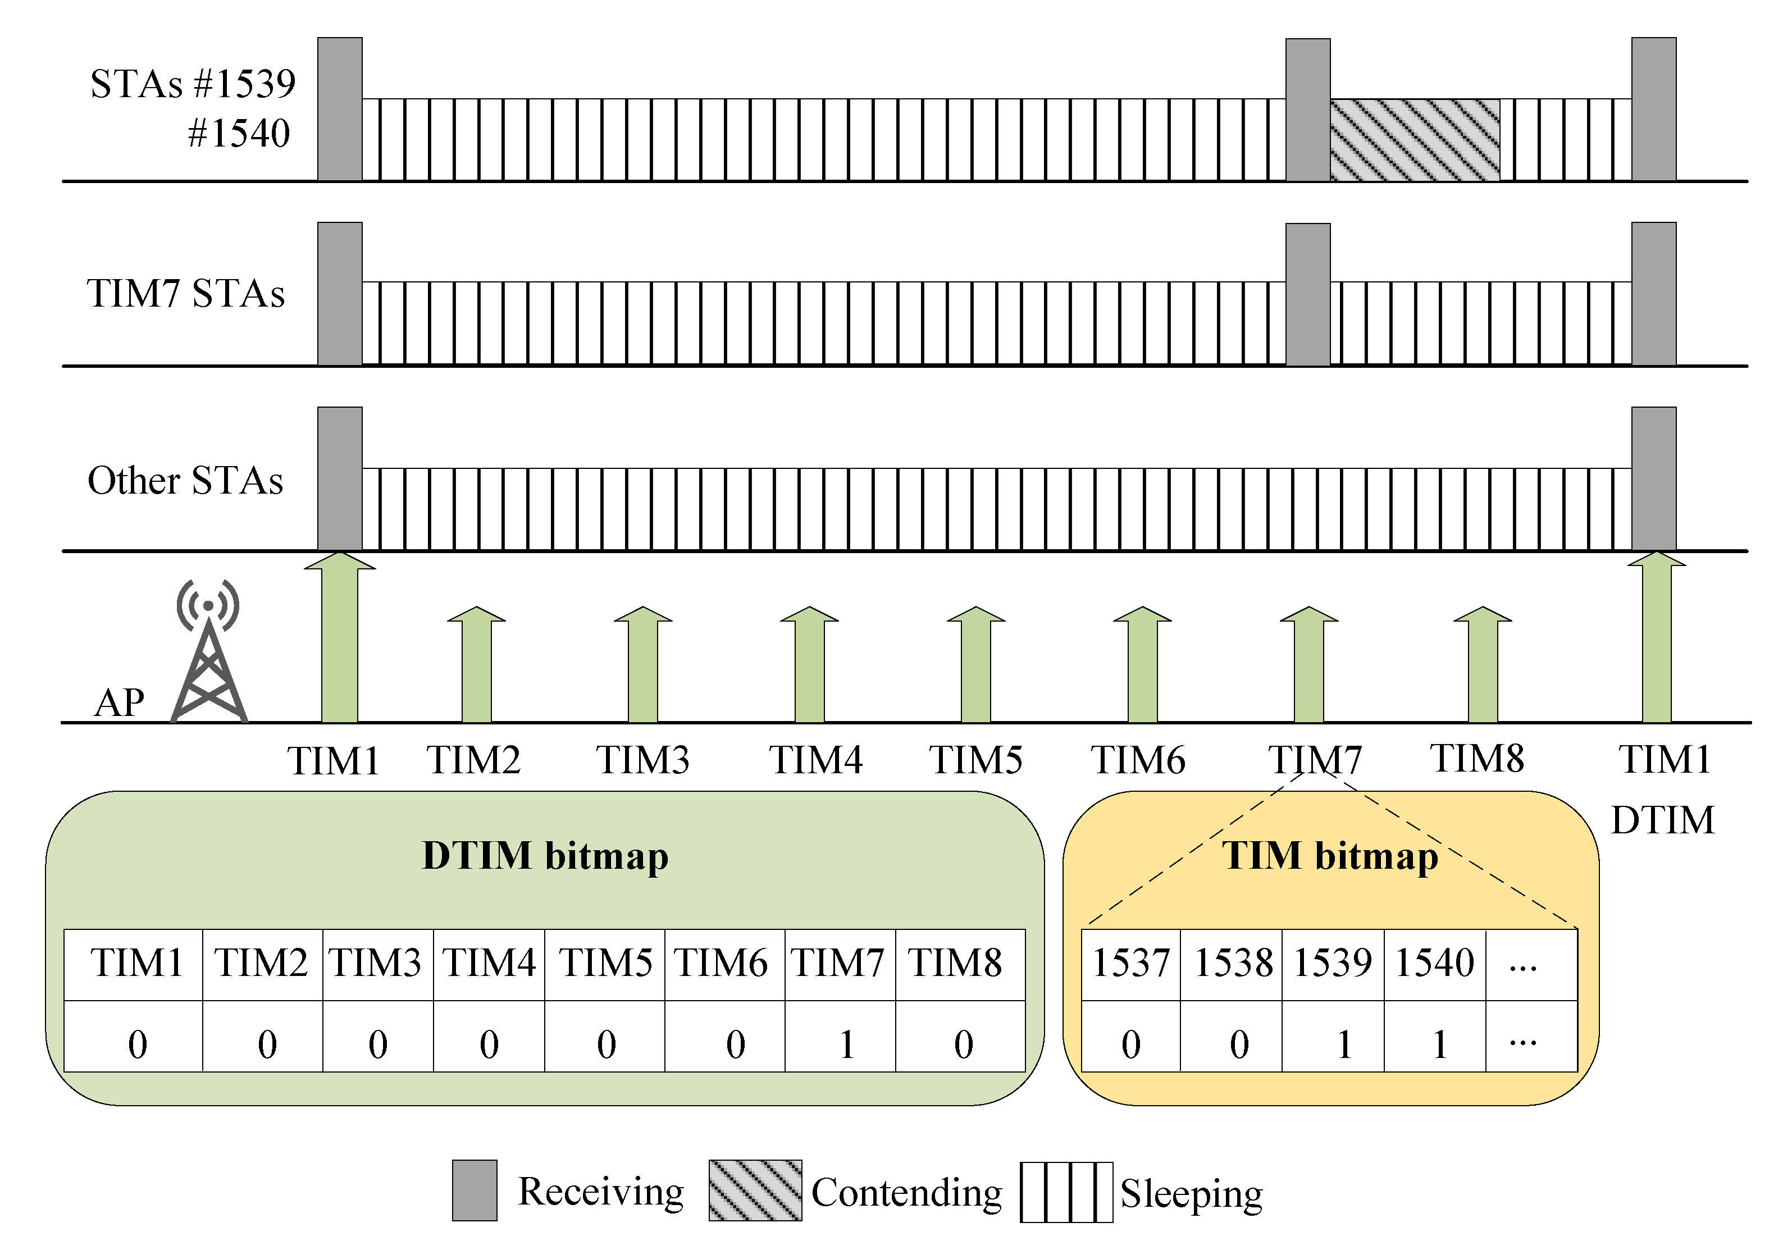
Example group scheduling
For low-power communication, reduce the amount of time devices might need to listen
Hierarchical
  Entire groups are indicated if any traffic exists for any of them
  Then additional indication of which device when that group starts

Slide 62
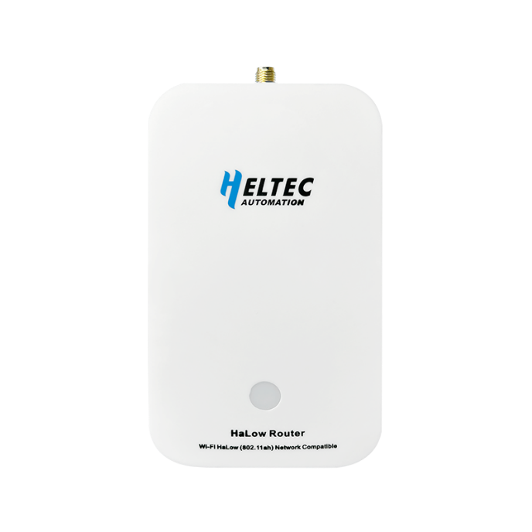
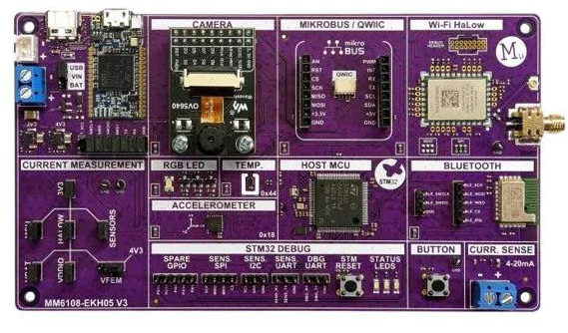
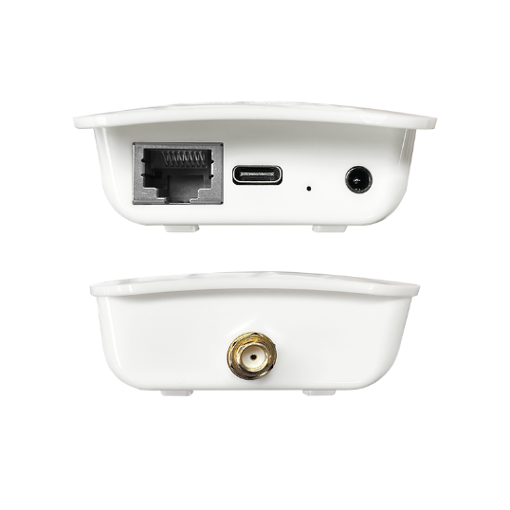
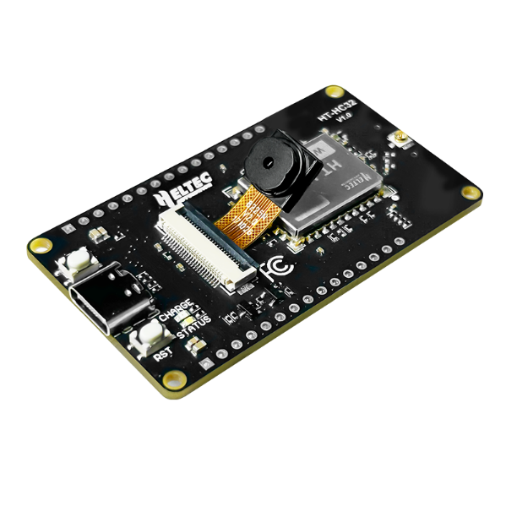
802.11ah hardware
Morse Micro developer of HaLow radio chip
  $30 for the MM6108 soc
  Morse Micro dev board - $150
Heltec sells hardware
  802.11ah access point - $80
  Dev board with ESP32 + HaLow radio - $45
  Radio module - $13
    Built around MM6108
    (not sure how it’s so much cheaper…)

Slide 63
Outline
Wide-Area Network Background
Unlicensed LPWANs
  LoRaWAN
  Sigfox
  802.11ah
  TV Whitespaces

Slide 64
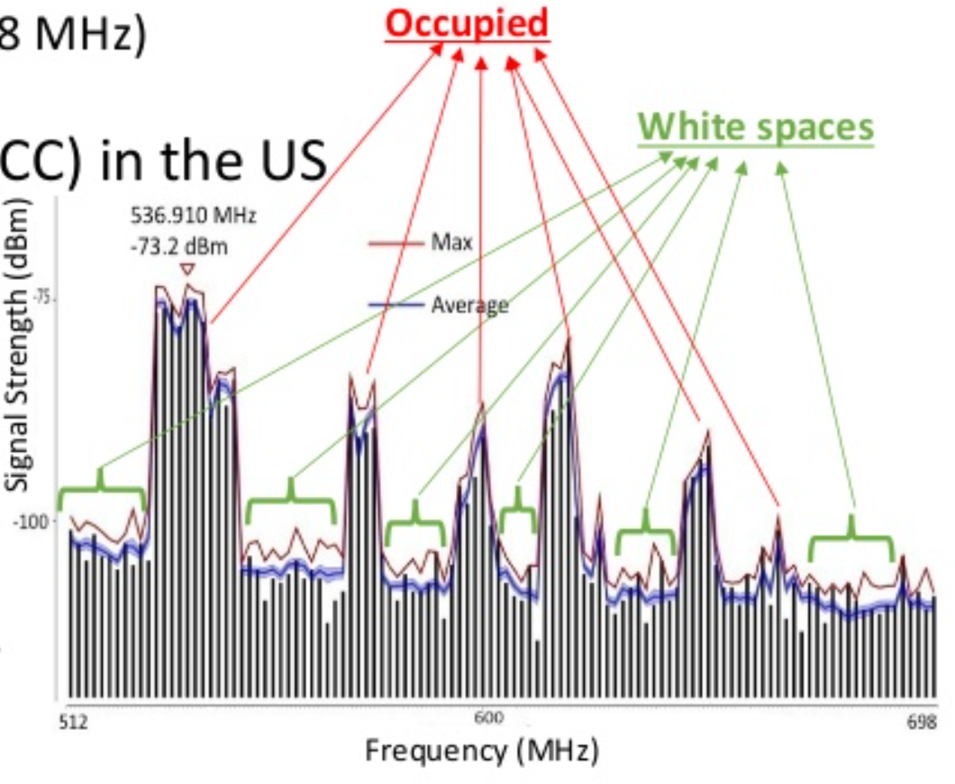
TV whitespaces
Unused TV channels between 54 MHz and 698 MHz
  VHF (54-216 MHz)
  UHF (470-698 MHz)
  6 MHz channel width
Allocated but unused
  FCC allows unlicensed use
  IF you do not interfere with
  primary users

Slide 65
Sensing channel use
Variation in use
  Spatial: Cannot assume same channel will be free everywhere
  Temporal: Cannot assume channel will be free at all times
Cognitive radio approach
  Dynamically identify unused portions of spectrum
Database approach
  Let someone else do the scanning. Consult database based on location and time

Slide 66
802.11af
IEEE standard for whitespaces circa 2014
  Not much (any?) use to date
US/Canada-specific
  Limits general-purpose product appeal
Requires infrastructure about whitespace availability
  People are figuring this out, but not really available yet
  [n.b. very active area of research]

Slide 67
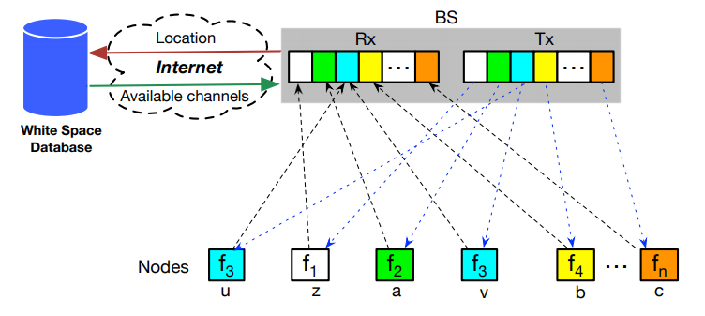
Sensor Networks Over tv Whitespaces (SNOW)
A design for sensor networks over whitespaces
  Base Station manages channel for deployment
  Frequency division for devices. Each uplinks on separate subcarrier
  Downlink is one OFDM transmission. Each device hears its frequency

Slide 68
Outline
Wide-Area Network Background
Unlicensed LPWANs
  LoRaWAN
  Sigfox
  802.11ah
  TV Whitespaces

