Slide 1
Lecture 11
WiFi MAC
CS433 – Wireless Protocols for IoT
Branden Ghena – Spring 2025
Materials in collaboration with
Pat Pannuto (UCSD) and Brad Campbell (UVA)

Slide 2
Administrivia
Hw: Matter due today
Another week on Lab: Thread
Lab: WiFi starts on Friday

Slide 3
Today’s Goals
Introduce MAC layer concepts in 802.11
Understand what exists, what is actually used, and why
Explore two additional areas in 802.11
  Microcontroller use of WiFi
  Future of WiFi

Slide 4
Outline
802.11 Access Control
802.11 Frame format
802.11e Improvements to MAC
Roaming
Microcontrollers and WiFi
MQTT

Slide 5
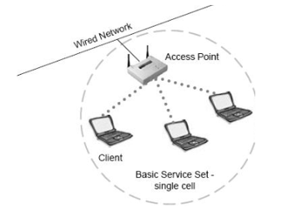
Basic WiFi network
Star topology network
Basic Service Set (BSS)
  Access point(s)
  Multiple connected clients
Service Set ID (SSID)
  Identifies network
  Broadcast by access point in beacons

Slide 6
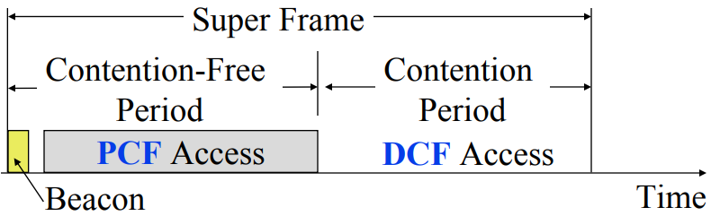
WiFi superframe structure
Beacon followed by contention-free period followed by contention
  Repeats periodically (default ~100 ms)
  802.15.4 adopted a similar superframe
This is more hypothetical than real

Slide 7
Contention-free access
Known as Point Coordination Function (PCF)
  Allocates a contention-free period for specific devices
  Access Point decides when to grant based on requests
Drawbacks
  Latency depends on beacon intervals
  Mechanism for explicit Quality of Service is unclear
PCF is not used in practice
  802.11e adds a revised Quality of Service mechanism
  Especially with the adoption of MU-MIMO and OFDMA techniques, it’s just not necessary

Slide 8
WiFi superframe in practice
Continuous contention access period
  Any device may send at any time
  PCF is unused in practice
Periodic beacons
  Which also use CSMA and therefore may be delayed
Contention
Based Access
Delayed Beacon
Beacon
Time

Slide 9
802.11 beacons
Transmitted periodically (~100 ms by default)
  Enable discovery of network
    Contain capabilities and SSID for the network (802.11b/g/n/ac/ax…)
  Assign contention-free slots if used
  Notify devices of waiting packets
    Traffic Indication Map (TIM) has a bitmap specifying which devices data is for
    Enables devices to sleep, skipping a number of beacons
  Handles broadcast/multicast messages
    Every N beacons includes a notation of available broadcast messages
    Messages are transmitted during next contention access period using normal CSMA
    Defines maximum sleep period for devices (must listen to these beacons)

Slide 10
Contention-based access
Known as Distributed Coordination Function (DCF)
  Base communication method for WiFi (essentially always)
  All packets are immediately ACK’d by receiving device
  Uses CSMA/CA to determine when it can send
    With random backoff
  Problem: packets can be very long (up to 20 milliseconds)
  Solution: Network Allocation Vector (NAV)
    Packets include a notation of their duration
    Sensing the beginning of a packet allows backoff to skip the whole packet duration before continuing

Slide 11
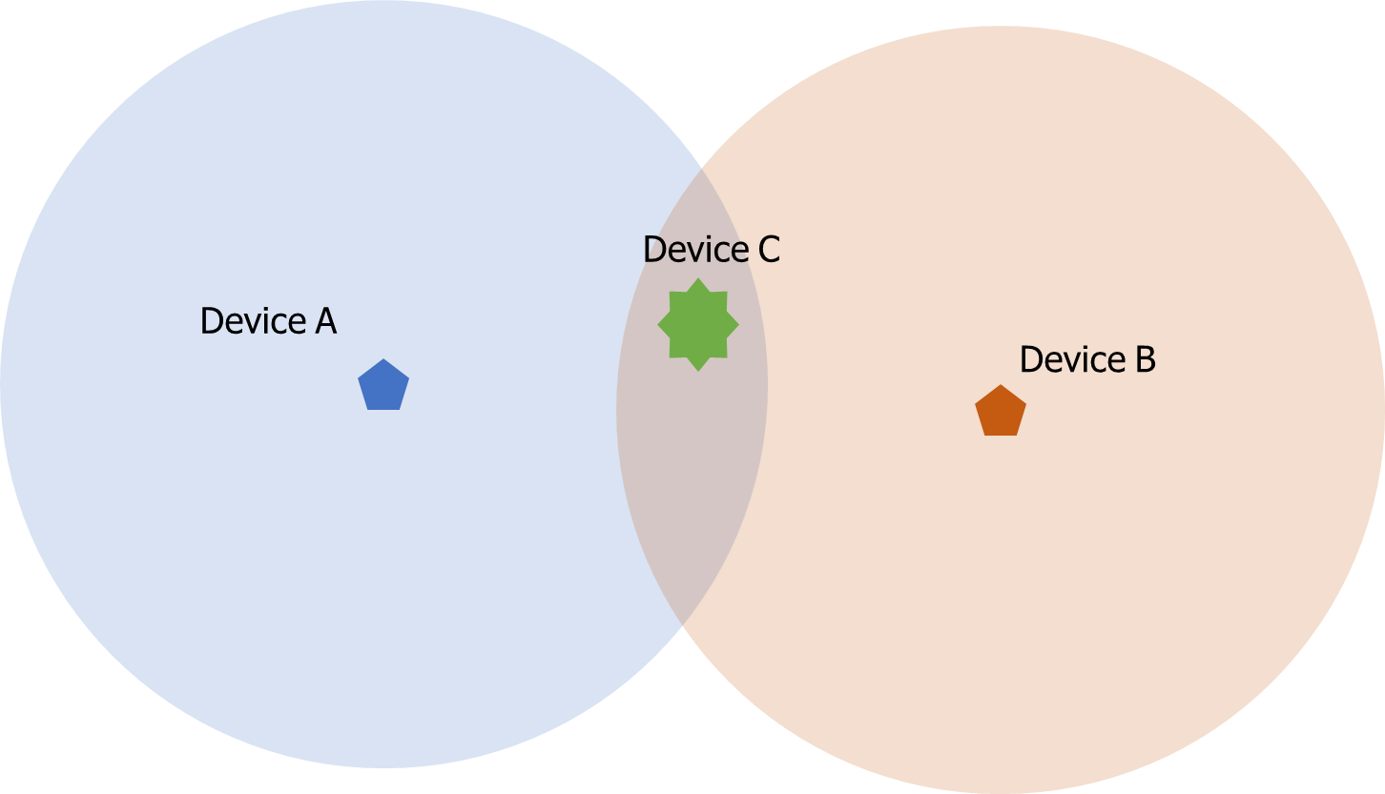
Reminder: hidden terminal problem
Two devices communicating with Access Point may not be able to hear each other
  CSMA fails and Access Point losses both messages
A solution: RTS/CTS (Request/Clear To Send)

Slide 12
Drawbacks of RTS/CTS
Four packets per data (RTS, CTS, Data, Ack)
  Could have just sent data instead of RTS
Significant portion of traffic are application-layer Acks
  Probably better to just have it fail and try again later
RTS/CTS only used for very large packets in practice
  *It’s mentioned still in 802.11n and 802.11ac, so not entirely unused

Slide 13
Backoff in WiFi
Listen for activity
  If free
    Wait for Inter Frame Spacing (IFS)
    If still free, transmit
  If busy
    Randomly select a number of backoff Slots
    Count down slots whenever medium is not busy
    If busy when backoff completes:
      Increase maximum backoff Slots
      Repeat
Slot time: basic time unit for protocol
  Total time of: switch from Rx to Tx, plus processing time, plus propagation delay

Slide 14
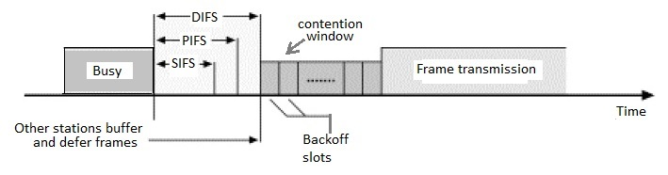
Prioritizing packets with varying IFS
Tiered Contention Multiple Access (TCMA)
  Idea: assign different inter-frame spacing based on traffic class
  Inherently prioritizes communication
Acknowledgements sent with Short IFS (SIFS)
  Will always transmit before new data clears CSMA check
New data sent with longer DCF IFS (DIFS)

Slide 15
Putting backoff together
Two variables
  Contention Window (CW) – maximum backoff amount
  Backoff Count (BO) – current remaining backoff
When attempting to send, if busy Backoff selected in [0, CW]
  Countdown Backoff slots whenever medium is not busy
  At 0, attempt to transmit if not busy
  If busy, double Window and select Backoff again
802.11g values:
  Slot time= 20 us, CWmin= 15 slots (300 us), CWmax= 1023 slots (20 ms)
  SIFS= 10 us, DIFS= 50 us

Slide 16
802.11 backoff example
A and B want to send, but they see that the medium is busy
  Followed by an Acknowledgement after SIFS
Other Traffic
ACK
SIFS
DIFS
A
Arrival A
B
Arrival B
C

Slide 17
802.11 backoff example
Each chooses a random backoff [0, CW] (we’ll say CW is 32)
  Start counting down backoff slots
Other Traffic
ACK
SIFS
DIFS
A
Arrival A
Backoff = 10
B
Arrival B
Backoff = 8
C

Slide 18
802.11 backoff example
C wants to send, waits DIFS, and can send immediately
  No other traffic is going on
  A and B pause backoff for packet duration
Other Traffic
ACK
C Traffic
SIFS
DIFS
DIFS
A
Arrival A
Backoff = 10
B
Arrival B
Backoff = 8
C
Arrival C

Slide 19
802.11 backoff example
A and B used NAV to pause backoff for entire traffic plus ACK
  After DIFS, resume backoff count from its previous value
Other Traffic
ACK
C Traffic
ACK
SIFS
DIFS
DIFS
SIFS
DIFS
A
Arrival A
Backoff = 10
Backoff = 6
B
Arrival B
Backoff = 8
Backoff = 4
C
Arrival C

Slide 20
802.11 backoff example
B reaches zero backoff, finds channel empty, transmits
  A pauses its backoff again for duration plus ACK
Other Traffic
ACK
C Traffic
ACK
B Traffic
SIFS
DIFS
DIFS
SIFS
DIFS
A
Arrival A
Backoff = 10
Backoff = 6
B
Arrival B
Backoff = 8
Backoff = 4
C
Arrival C

Slide 21
Break + Hacking
If you wanted maximum data throughput on a WiFi radio, and you were willing to be non-standards-compliant, what would you do?

Slide 22
Break + Hacking
If you wanted maximum data throughput on a WiFi radio, and you were willing to be non-standards-compliant, what would you do?
  Never backoff at all. Just try during the next open period
    Always be “device C” in our previous example
  Use a shorter SIFS than other devices
    If you start transmitting sooner, you get to keep transmitting!
    Other devices will backoff on your transmission
  Tragedy of the Commons: this utterly fails if many radios follow it

Slide 23
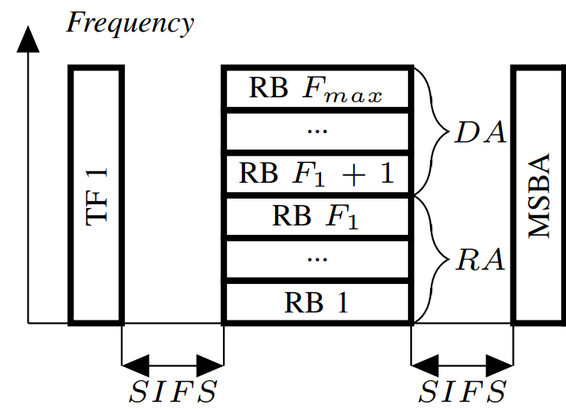
CSMA + OFDMA
For WiFi 6 to be backwards compatible, the OFDMA stuff has to obey the normal CSMA/CA rules as well
Downlink from AP
  The AP wins contention and then transmits various data at various frequencies
Uplink to AP
  The AP wins contention,
  sends a “OFDMA uplink trigger frame”,
  then devices send their responses
https://ieeexplore.ieee.org/document/8422767

Slide 24
Outline
802.11 Access Control
802.11 Frame format
802.11e Improvements to MAC
Roaming
Microcontrollers and WiFi
MQTT

Slide 25

802.11 frame
Frame control (various bits)
  Type of packet (Control, Management, Data)
  Subtype (Association, RTS, CTS, Ack, etc.)
  Indication of to/from “distribution system” (Internet rather than intranet)
Duration
  Specifies on-air time of full packet in microseconds
  Note: no actual length field 😱
Surprising, but smart!
Recall MCS vary — but everyone needs to be able to parse header (for duration, for NAV)
Length can be very large (e.g. in ac: 5.5 ms max duration is 4.5 MB length!); sent at full data rate

Slide 26
802.11 frame
Sequence control
  4-bit fragment number
  12-bit sequence number
Quality of Service control
  Identifies traffic category
High Throughput Control
  Configurations for selecting best data rate
Frame body
  Max size depends on PHY
    ~2000 for lower rates
    ~8000 for 802.11n
    ~11000 for 802.11ac
Frame check sequence
  32-bit CRC

Slide 27
Address field use cases
Source
AP
1
Repeater
Destination
Devices filter on Address 1
 | To DS | From DS | Address 1 | Address 2 | Address3 | Address4 | Use Case
1 | 0 | 0 | Destination Addr | Source Addr | BSS ID | - | Direct communication
2 | 0 | 1 | Destination Addr | BSS ID | Source Addr | - | Traffic from Internet
3 | 1 | 0 | BSS ID | Source Addr | Destination Addr | - | Traffic to Internet
4 | 1 | 1 | Receiver Addr | Transmitter Addr | Destination Addr | Source Addr | Repeater

Slide 28
Address field use cases
Source
AP
2
Repeater
2
Destination
Devices filter on Address 1
 | To DS | From DS | Address 1 | Address 2 | Address3 | Address4 | Use Case
1 | 0 | 0 | Destination Addr | Source Addr | BSS ID | - | Direct communication
2 | 0 | 1 | Destination Addr | BSS ID | Source Addr | - | Traffic from Internet
3 | 1 | 0 | BSS ID | Source Addr | Destination Addr | - | Traffic to Internet
4 | 1 | 1 | Receiver Addr | Transmitter Addr | Destination Addr | Source Addr | Repeater

Slide 29
Address field use cases
3
Source
3
AP
Repeater
Destination
Devices filter on Address 1
 | To DS | From DS | Address 1 | Address 2 | Address3 | Address4 | Use Case
1 | 0 | 0 | Destination Addr | Source Addr | BSS ID | - | Direct communication
2 | 0 | 1 | Destination Addr | BSS ID | Source Addr | - | Traffic from Internet
3 | 1 | 0 | BSS ID | Source Addr | Destination Addr | - | Traffic to Internet
4 | 1 | 1 | Receiver Addr | Transmitter Addr | Destination Addr | Source Addr | Repeater

Slide 30
Address field use cases
Source
4
AP
Repeater
4
Destination
Devices filter on Address 1
 | To DS | From DS | Address 1 | Address 2 | Address3 | Address4 | Use Case
1 | 0 | 0 | Destination Addr | Source Addr | BSS ID | - | Direct communication
2 | 0 | 1 | Destination Addr | BSS ID | Source Addr | - | Traffic from Internet
3 | 1 | 0 | BSS ID | Source Addr | Destination Addr | - | Traffic to Internet
4 | 1 | 1 | Receiver Addr | Transmitter Addr | Destination Addr | Source Addr | Repeater

Slide 31

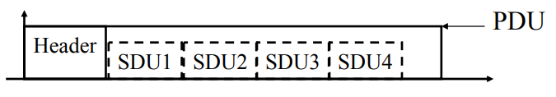
Sending frames in WiFi
Frame bursting (handles one really big packet)
  Transmit multiple frames in a row
Frame fragmentation
  Split service data over multiple frames
Frame aggregation (handles many very small packets)
  Multiple service data in a single frame
  Allows multiple packets to reach Access Point in a single transmission

Slide 32
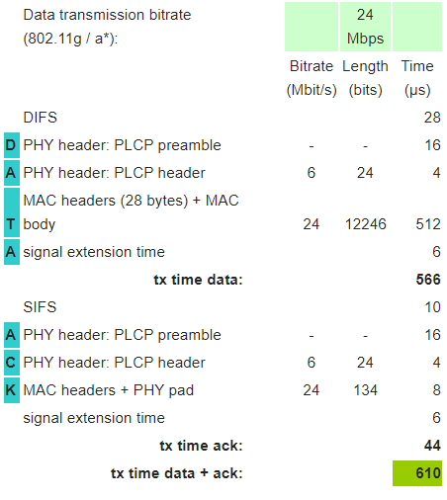
Calculating packet durations
Example duration for a 1500 byte 802.11g packet
  6 Mbps for header
  24 Mbps for payload
  566 μs for total packet
    Plus 10 μs for SIFS
    Plus 34 μs for ACK
https://sarwiki.informatik.hu-berlin.de/Packet_transmission_time_in_802.11

Slide 33
Implementation Drives Specification Sometimes
SIFS nominally defined by processing time
  Aside: Big challenge for SDRs
Convolutional decoders need(ed) 16 µs to finish processing
  For highest-rate MCS (ERP-OFDM)
  SIFS is 10 μs, so extension needed
Processing must finish before next packet starts
  To be able to decode NAV in header
Notes:
https://www.electronics-notes.com/articles/connectivity/wifi-ieee-802-11/802-11g.php

Slide 34
Outline
802.11 Access Control
802.11 Frame format
802.11e Improvements to MAC
Roaming
Microcontrollers and WiFi
MQTT

Slide 35
802.11e improves MAC layer
Hybrid Coordination Function (HCF)
  Modifies contention-free access (still no one uses it)
  Modifies contention-based access: Enhanced Distributed Channel Access (EDCA)
Adapts Quality of Service based on application
  Example of breaking layering for an optimization
  Categories (lowest to highest priority):
    Background
    Best Effort
    Video
    Voice

Slide 36
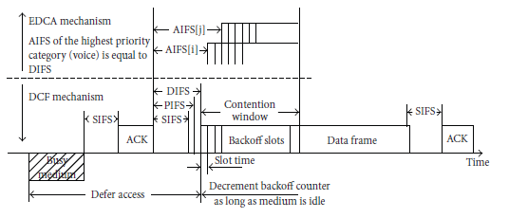
Different priority for different application category
Expand to more IFS lengths for different traffic categories
  Smallest AIFS (equal to DIFS) goes to Voice, Largest to Background
  Contention Window min and max also change for each category
    Selects a probability that most important category goes first

Slide 37
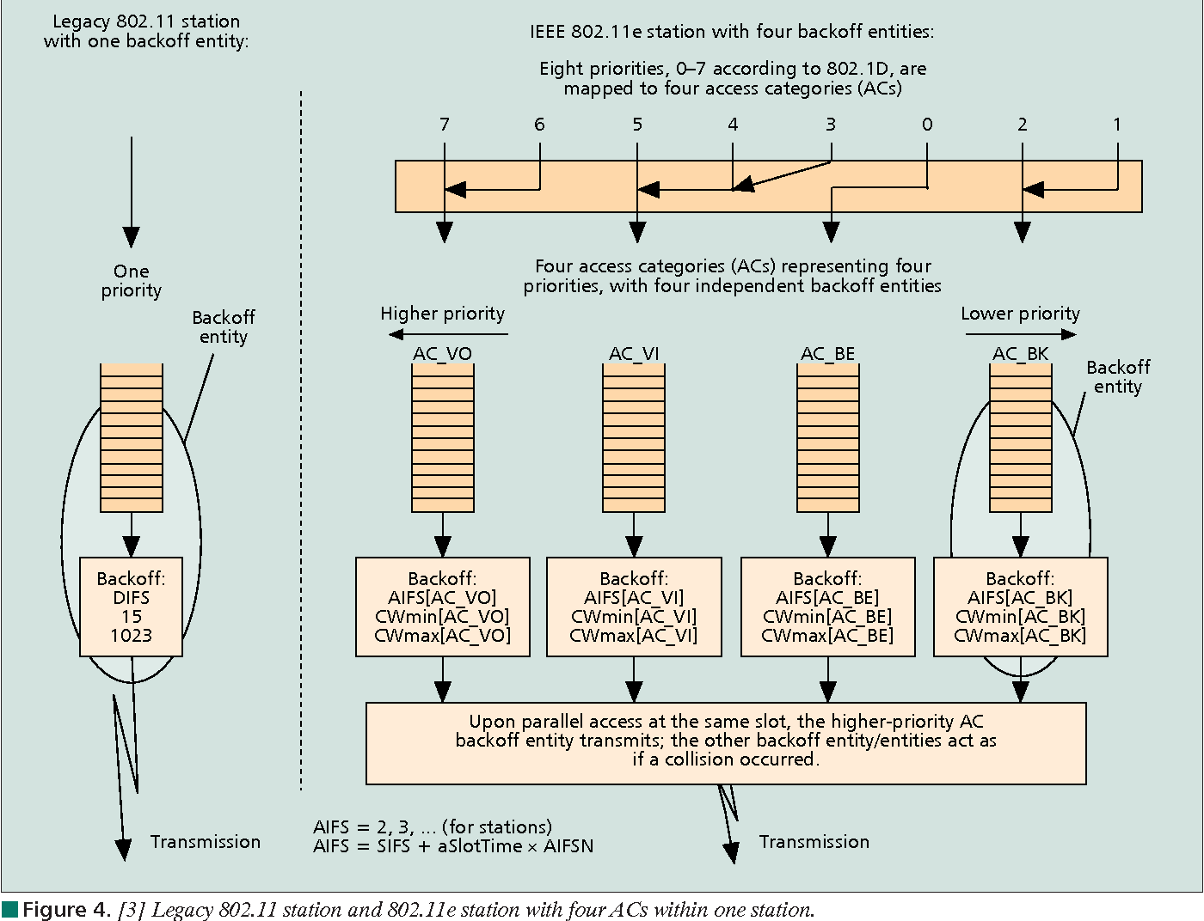
Multiple queues within a single device

Slide 38
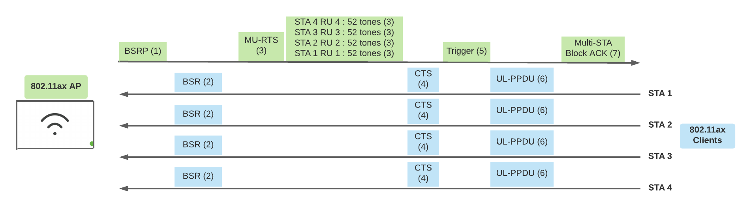
Brief 802.11ax aside
WiFi 6 and beyond use EDCA for their OFDMA scheduling. Steps:
  Access point decides to start an OFDMA communication window
    Mechanism called “Buffer Status Report Poll” asks how much data each device has queued to send
  Access Point wins contention in the normal CSMA method
  Access Point sends a TXOP (Transmit Opportunity) message with schedule
    Some back-and-forth handshakes here
  Devices respond back with uplink messages
    Uses a fast IFS to maintain contention

Slide 39
802.11e also adds maximum durations
802.11e also defines duration a device can transmit for
  Based on PHY in use and Application category
  Background/Best Effort: one frame per contention win
  Example, up to 11 ms for Voice on 802.11ac
    Could be one really big frame at a low data rate
    Could be multiple frames in a row separated by SIFS

Slide 40
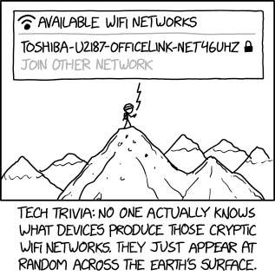
Break + xkcd
https://xkcd.com/2199/

Slide 41
Outline
802.11 Access Control
802.11 Frame format
802.11e Improvements to MAC
Roaming
Microcontrollers and WiFi
MQTT

Slide 42
How do WiFi devices decide to change networks?
WiFi “handoffs” are always initiated by the Client
  It decides to change to a different network
802.11k
  Access Points track information about neighbors
  Clients can request a list of nearby Access Points
802.11v
  Access Points can send messages to Clients with recommendations of which network to connect to
    Which devices may choose to ignore

Slide 43
Apple roaming decision details
Devices look at RSSI of packets from the Access Point
  -70 to -75 dBm triggers roaming
  Looks for Access Points that are 8-12 dBm stronger
Given multiple choices, prefers in this order
  Better version (WiFi 6 > WiFi 5)
  Larger bandwidth (80 MHz > 40 MHz)
Result ends up preferring faster communication
  More reliable
  Higher capabilities
Android has a more complicated “scoring” mechanism
https://support.apple.com/guide/deployment/wi-fi-roaming-support-dep98f116c0f/web

Slide 44
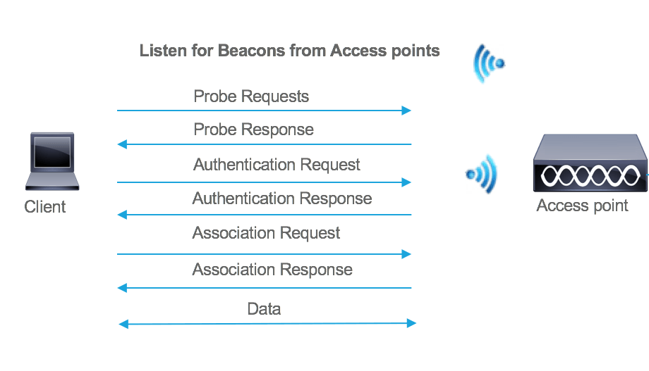
Handling roaming
For a basic WiFi connection, several packets must be sent
  Probe response from all Access Points with details
  Authentication does basic connection to network
  Association shares encryption options and 802.11 capabilities

Slide 45
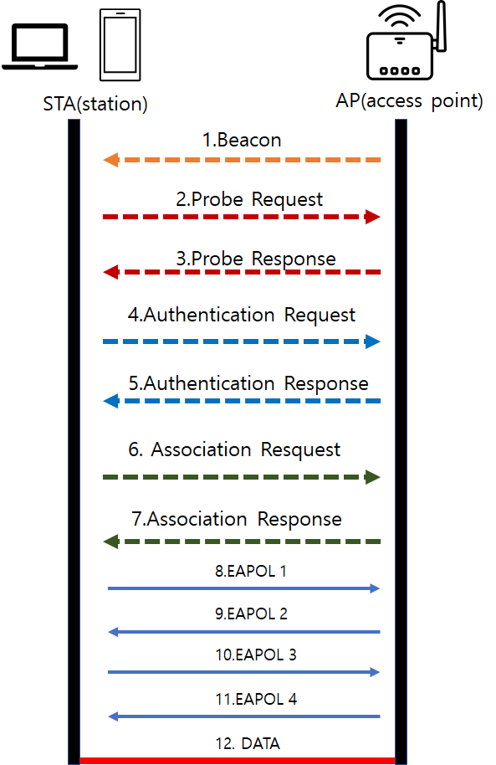
Security has complicated this process
Additional packets need to be sent to verify the device’s identity and exchange keys
802.1x (not 11) is a standard for an authentication server
  Enterprise networks often use this

Slide 46
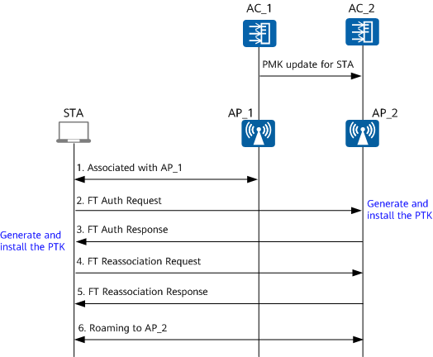
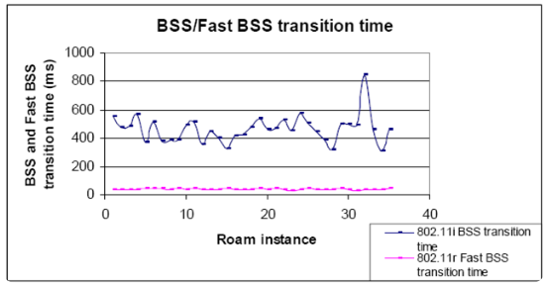
802.11r shares information for faster connections
FT: Fast Transition

Slide 47
Outline
802.11 Access Control
802.11 Frame format
802.11e Improvements to MAC
Roaming
Microcontrollers and WiFi
MQTT

Slide 48
Why, why not, talk WiFi in a wireless for IoT class
Pros
  Ubiquitous
  High-performance
Cons
  Complex configuration
  And security requirements
    Device-Northwestern anyone?
  Expensive in energy and money

Slide 49
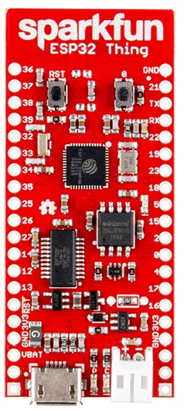
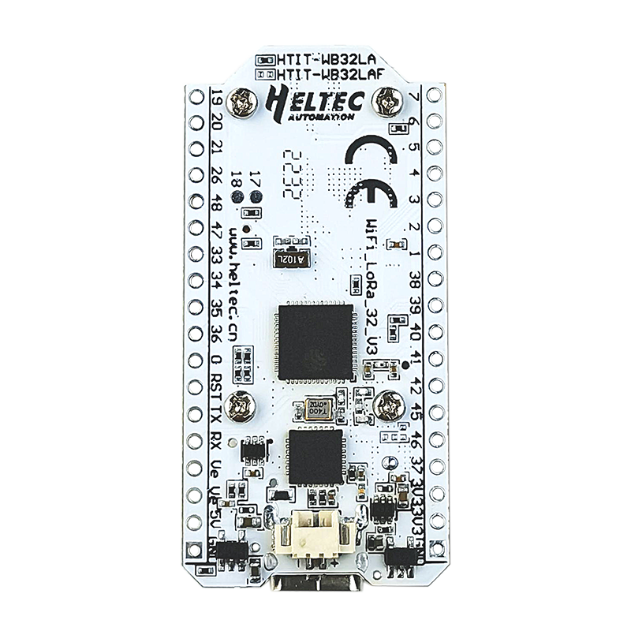
WiFi capability in microcontrollers
ESP32
  Microcontroller plus WiFi radio in single chip
  (Same idea as nRF52840)
Capabilities
  802.11b/g/n 2.4 GHz only
  20 MHz or 40 MHz channels
  Single antenna only (no MIMO)
  MCS0-7
    7 Mbps – 150 Mbps
  Tx power up to 20.5 dBm

Slide 50
Low power WiFi
Question: should a microcontroller stay connected or reconnect?
  Light sleep: stay connected always, only listening to beacons
  Deep sleep: reconnect to network each time data is ready
Answer for ESP32 depends on security and data interval
  Resecuring during connection takes lots of energy
    Crossover point is about 60 seconds
  Insecure transmissions have a crossover of 5-15 seconds
https://blog.voneicken.com/2018/lp-wifi-esp-comparison/#conclusions

Slide 51
Outline
802.11 Access Control
802.11 Frame format
802.11e Improvements to MAC
Roaming
Microcontrollers and WiFi
MQTT

Slide 52
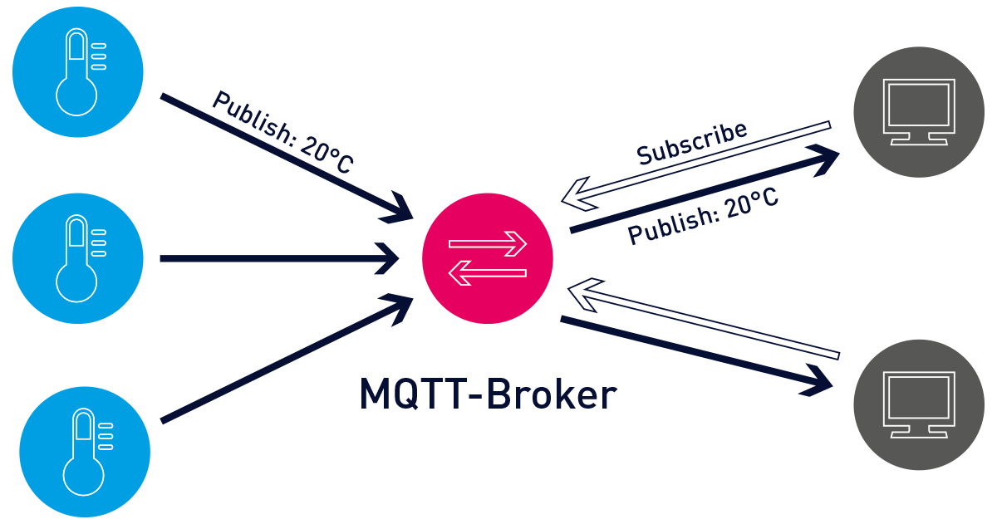
MQTT – an answer to the “where do you send data” question

Slide 53
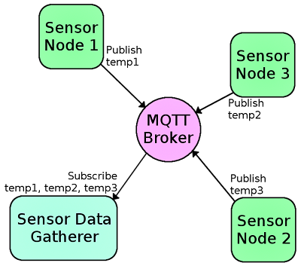
MQTT Roles
MQ Telemetry Transport
  Built for IBM MQ products
Broker
  Server that distributes information
Client
  Any device connected to the Broker

Slide 54
Pub/Sub Architecture
Topic
  String that names the data being sent
Publish
  Sends data with an associated Topic to Broker
Subscribe
  Inform Broker of which Topics you want data from
  ALL subscribed Clients get copies of the data

Slide 55
MQTT Access Control
Nothing is required by default
  Which is its own concern
Can require a password to communicate with Broker
Can make access control lists on a per-topic basis
  Each user with a given password can only access certain topics

Slide 56
Value of MQTT
And that’s pretty much everything there is to MQTT
  MQTT is very simple, and that’s a benefit
  Packets are sent over TCP, so the reliability is already handled sufficiently
    Variants can function over UDP instead
How is data formatted?
  However you want. It’s just bytes attached to a Topic string
  Could be an array of data bytes, JSON blob, image data, whatever
    Up to MB of data in a single payload
  Application-level probably knows how to decode

Slide 57
Outline
802.11 Access Control
802.11 Frame format
802.11e Improvements to MAC
Roaming
Microcontrollers and WiFi
MQTT

