Slide 1
Lecture 10
WiFi PHY
CS433 – Wireless Protocols for IoT
Branden Ghena – Spring 2025
Materials in collaboration with
Pat Pannuto (UCSD) and Brad Campbell (UVA)

Slide 2
Administrivia
Hw: Matter
  Due Thursday
Lab: Thread
  Due next week Thursday
Lab: WiFi
  Overlaps with Lab: Thread unfortunately
  Moving on to WiFi lab this Friday

Slide 3
Today’s Goals
Discuss WiFi physical layers
  Get a feel for what choices are leading to more throughput
  Think a little about what the costs of that are
Explore how WiFi has continuously improved over 30 years

Slide 4
Outline
WiFi Overview
WiFi PHY
  802.11/802.11b
  802.11a/802.11g
  802.11n/802.11ac
  802.11ax
  802.11be and Beyond
  Real-World WiFi

Slide 5
What is WiFi?
Most successful wireless protocol (family)
Small Area (~35m), high performance (up to 9,600 Mbit/s)
~30 years young
  We’ll do some history
  Note the parallels in technology development
    First: Maximize the performance of a single channel
    Now: Improve performance through parallelism
    (more channels working together)

Slide 6


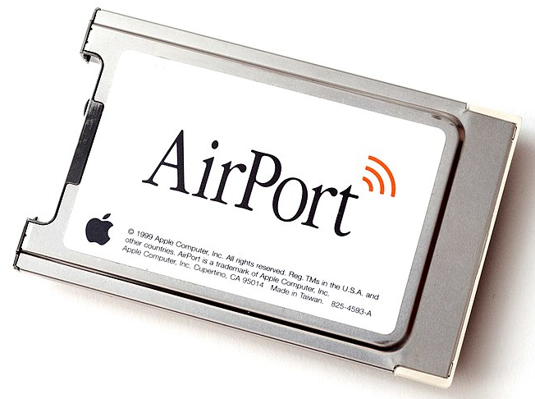
802.11 timeline
1985 – US FCC rules ISM band for unlicensed use
1990s – WaveLAN (NCR Corporation, Netherlands)
  Wireless ethernet for cashier systems
1997 – 802.11 specification
1999 – 802.11b and 802.11a amendments
1999 – WiFi Alliance formed for certification of devices
1999 – Apple iBook is the first consumer WiFi product

Slide 7
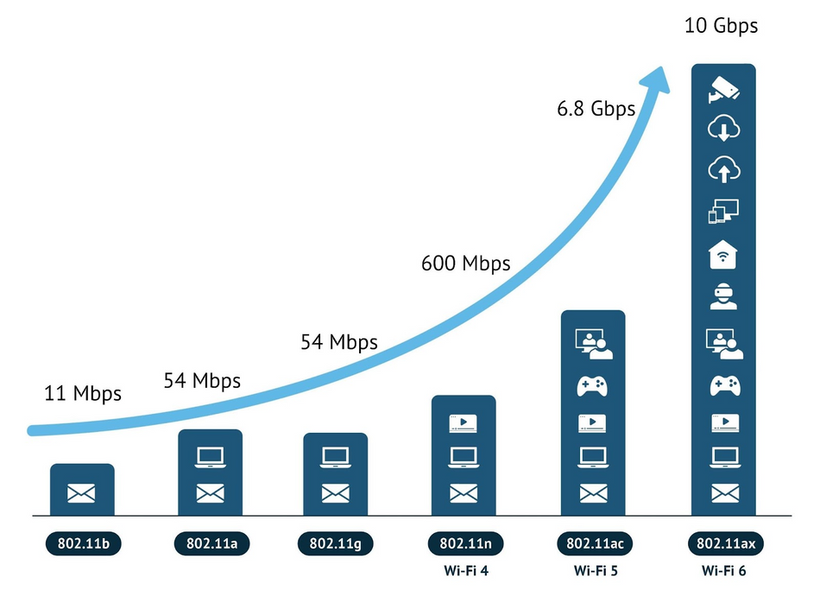
Many different “versions” of WiFi

Slide 8
Major amendments
 | Protocol | Year | Frequency | PHY | Max Rate | Range
- | 802.11 | 1997 | 2.4 GHz | DSSS/FHSS | 2 Mbps | 20 m
1 | 802.11b | 1999 | 2.4 GHz | DSSS | 11 Mbps | 35 m
2 | 802.11a | 1999 | 5 GHz | OFDM | 54 Mbps | 35 m
3 | 802.11g | 2003 | 2.4 GHz | OFDM | 54 Mbps | 38 m
4 | 802.11n | 2009 | 2.4/5 GHz | OFDM + MIMO | 600 Mbps | 70 m
5 | 802.11ac | 2013 | 5 GHz | OFDM + MU-MIMO (downlink only) | 3400 Mbps | 35 m
6 | 802.11ax | 2021 | 2.4/5/[6] GHz | OFDMA + MU-MIMO | 9600 Mbps | 35 m
7 | 802.11be | 2024 | 2.4/5/6 GHz | OFDMA + MU-MIMO | 23000 Mbps | 35 m
802.11b was very popular but is now usually unsupported
802.11a never saw major deployment
WiFi Alliance rebranded 802.11ac as “WiFi 5” and backported scheme

Slide 9
Resources
Peter Steenkiste – Carnegie Mellon University
  https://www.cs.cmu.edu/~prs/wirelessS18/handouts/L11-AdHoc.pdf
  https://www.cs.cmu.edu/~prs/wirelessS18/handouts/L12-LAN.pdf
Raj Jain – Washington University in Saint Louis
  https://www.cse.wustl.edu/~jain/cse574-14/ftp/j_05lan.pdf
  https://www.cse.wustl.edu/~jain/cse574-14/ftp/j_06lan.pdf
Honestly
  https://en.wikipedia.org/wiki/IEEE_802.11

Slide 10
Outline
WiFi Overview
WiFi PHY
  802.11/802.11b
  802.11a/802.11g
  802.11n/802.11ac
  802.11ax
  802.11be and Beyond
  Real-World WiFi

Slide 11
WiFi Physical Layer
Details start to get pretty messy here for multiple reasons:
Different countries/regions have different standards
  Channels look a little different in different areas
WiFi has evolved over the last 30 years
  Different features are designed for different amendments
WiFi is focused on improving throughput
  Solutions that were initially “too complicated” no longer are

Slide 12
Goal: improve throughput
In twenty years, WiFi has gone from 2 Mbps to 9.6 Gbps
How does a network PHY improve its throughput?

Slide 13
Goal: improve throughput
In twenty years, WiFi has gone from 2 Mbps to 9.6 Gbps
How does a network PHY improve its throughput?
More capable modulation and/or bit transmission
  Techniques like OFDM and MIMO
More bandwidth
  Increased channel with at 2.4 Ghz and bigger 5 GHz channels
Better spatial use
  MIMO + beam steering

Slide 14
Walking through PHY changes by amendment
 | Protocol | Year | Frequency | PHY | Max Rate | Range
- | 802.11 | 1997 | 2.4 GHz | DSSS/FHSS | 2 Mbps | 20 m
1 | 802.11b | 1999 | 2.4 GHz | DSSS | 11 Mbps | 35 m
2 | 802.11a | 1999 | 5 GHz | OFDM | 54 Mbps | 35 m
3 | 802.11g | 2003 | 2.4 GHz | OFDM | 54 Mbps | 38 m
4 | 802.11n | 2009 | 2.4/5 GHz | OFDM + MIMO | 600 Mbps | 70 m
5 | 802.11ac | 2013 | 5 GHz | OFDM + MU-MIMO | 3400 Mbps | 35 m
6 | 802.11ax | 2021 | 2.4/5/[6] GHz | OFDMA + MU-MIMO | 9600 Mbps | 35 m
7 | 802.11be | 2024 | 2.4/5/6 GHz | OFDMA + MU-MIMO | 23000 Mbps | 35 m

Slide 15
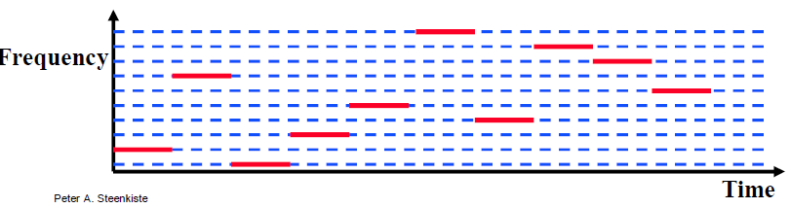
Original WiFi specification (1997)
Legacy WiFi
  Frequency Hopping Spread Spectrum (FHSS)
  GFSK (Gaussian Frequency-Shift Keying)
    Relatively simple radio design
  Frequency hopping over 80 channels (1 MHz each)
  Actually supports an Infrared PHY as well!!

Slide 16
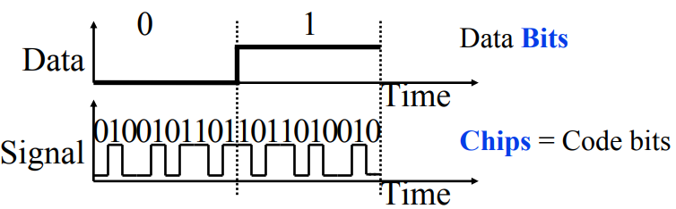
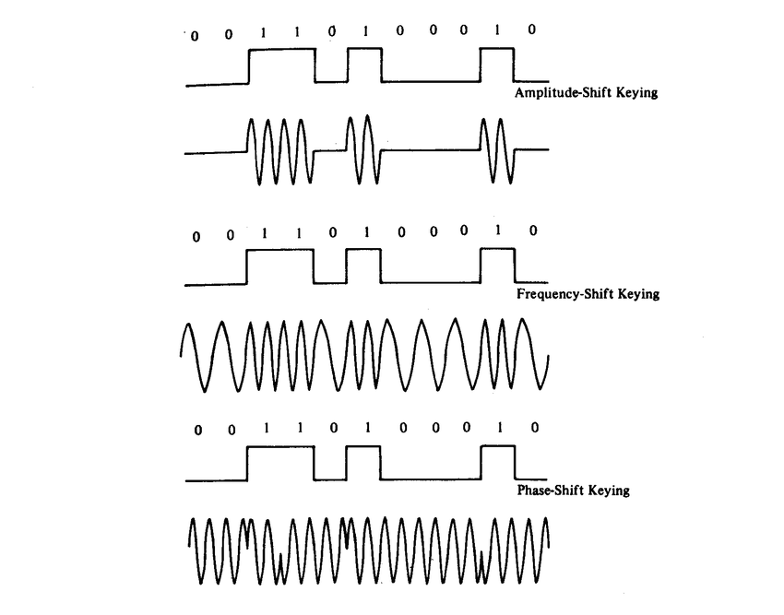
802.11b (1999)
802.11b
  Direct Sequence Spread Spectrum (DSSS)
  DBPSK and DQPSK (Differential Binary/Quadrature Phase-Shift Keying)
Translate data into “codes”
  Each data bit corresponds to several
  code bits (Chips)
  Chips are what is actually modulated
  over the air
  Data can be recovered by knowing
  the code patterns
Modulation
Phase-shift Keying (of the Chips)

Slide 17
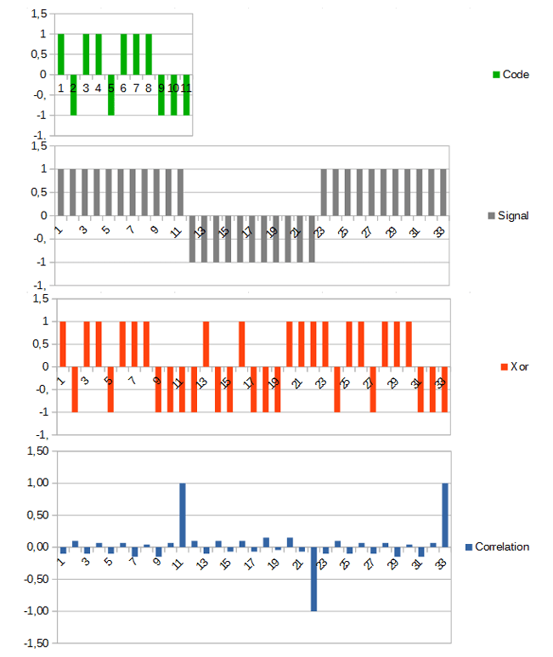
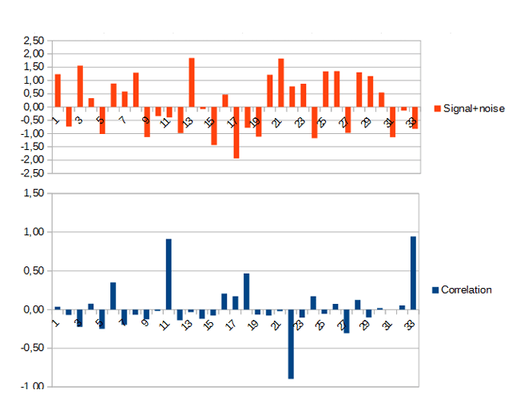
DSSS example from 802.15.4
Data sent is 101
  Code is longer than data, so we replicate bits
  Data is recoverable, even with noise
https://circuitcellar.com/research-design-hub/dsss-in-a-nutshell/

Slide 18
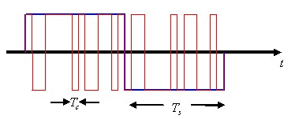
DSSS goals
DSSS increases bandwidth of a signal
  Beyond what is needed for the data
  Energy is smeared across the frequencies
More robust against interference
  Narrowband signals knock out only part
  of the signal
  Data can be recovered from partial code
Cost: using a lot of bandwidth for only a little data

Slide 19
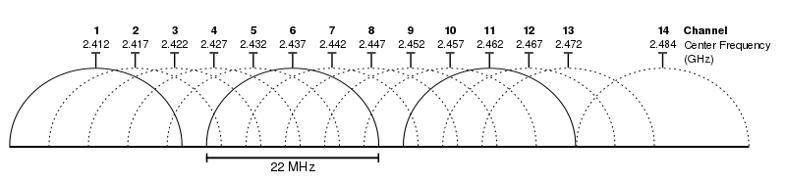
802.11b channels
14 channels total
  1-11 for US
  1-13 for most of the rest of the world
  1-14 for Japan (but 14 only for 802.11b)
22 MHz channels
  5 MHz spacing -> significant channel overlap
  Channels 1, 6, and 11 can be used without overlap

Slide 20
Break + Question
If the majority of channels overlap, why even have them?

Slide 21
Break + Question
If the majority of channels overlap, why even have them?
  Different options for different regions
  Inside US use three channels: 1, 6, 11
  Outside of North America can use four channels: 1, 5, 9, 13
  Historical: avoid other 2.4 GHz users
    If they’re at the low end of the band, you could switch to channel 2 or 3

Slide 22
Walking through PHY changes by amendment
 | Protocol | Year | Frequency | PHY | Max Rate | Range
- | 802.11 | 1997 | 2.4 GHz | DSSS/FHSS | 2 Mbps | 20 m
1 | 802.11b | 1999 | 2.4 GHz | DSSS | 11 Mbps | 35 m
2 | 802.11a | 1999 | 5 GHz | OFDM | 54 Mbps | 35 m
3 | 802.11g | 2003 | 2.4 GHz | OFDM | 54 Mbps | 38 m
4 | 802.11n | 2009 | 2.4/5 GHz | OFDM + MIMO | 600 Mbps | 70 m
5 | 802.11ac | 2013 | 5 GHz | OFDM + MU-MIMO | 3400 Mbps | 35 m
6 | 802.11ax | 2021 | 2.4/5/[6] GHz | OFDMA + MU-MIMO | 9600 Mbps | 35 m
7 | 802.11be | 2024 | 2.4/5/6 GHz | OFDMA + MU-MIMO | 23000 Mbps | 35 m

Slide 23
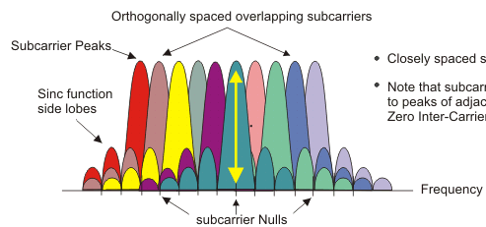
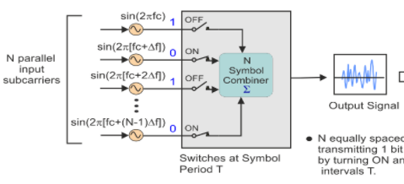
OFDM enables higher throughput
Replace DSSS with
Orthogonal Frequency Division Multiplexing
OFDM idea
  Split band into a number of narrow subcarriers
  Subcarriers are spaced so that they don’t interfere
  Transmit on multiple subcarriers at once to increase throughput
Recall DSSS

Slide 24
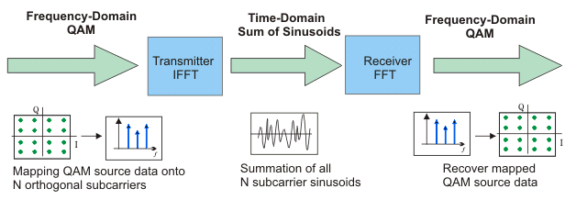
OFDM enables higher throughput at complexity cost
Receivers collect signal from entire channel
  And then can split it apart to gain the data on each subcarrier
Tradeoffs
  Benefits: more throughput, still robust against narrowband interference
  Costs: more complicated and sensitive radio design

Slide 25
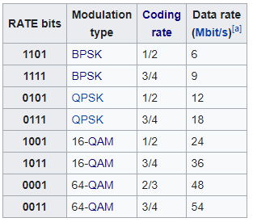
802.11a (1999)
Applied OFDM techniques on the 5 GHz band
  Enabled more data throughput 54 Mbps (compare to 11 Mbps for 802.11b)
Multiple rates available
  BPSK/QPSK/QAM over OFDM
  Quadrature Amplitude Modulation (QAM)
  2, 4, 16, 64 bits per symbol
Never reached widespread adoption
  Regulatory hurdles in some regions
  More complicated hardware delayed it

Slide 26
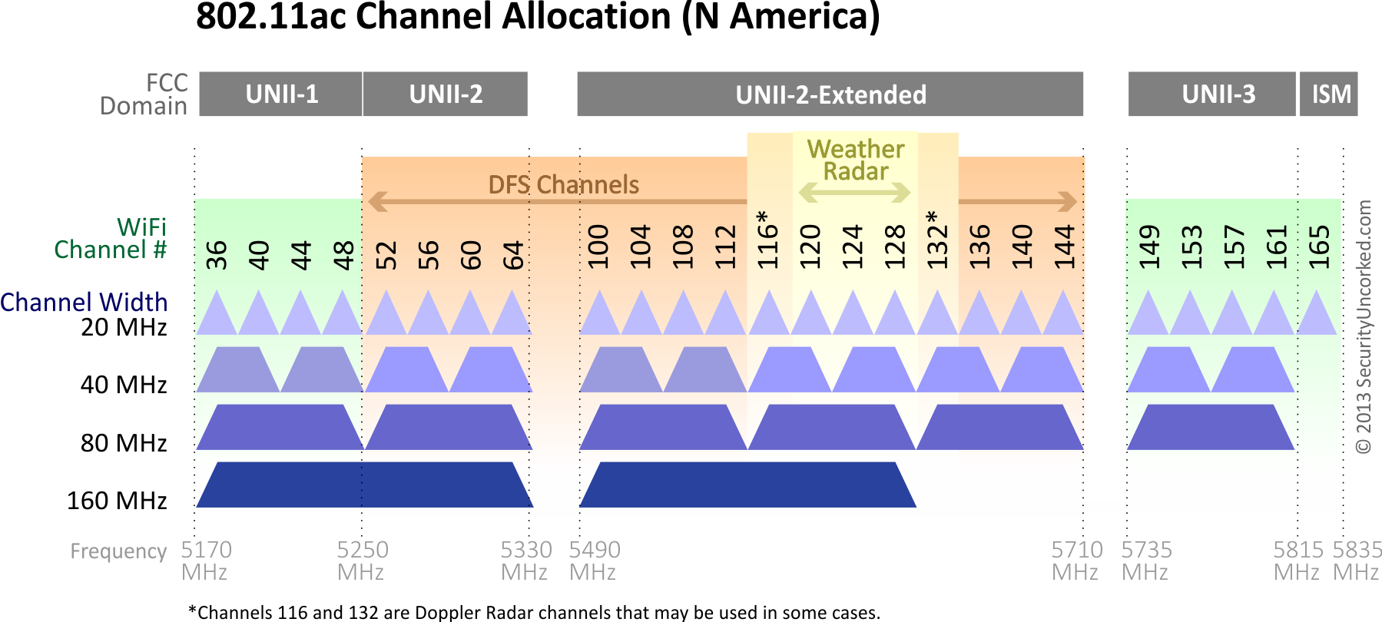
802.11a channels
802.11a did promote the use of 5 GHz band
  Several 20 MHz channels with no overlap (9ish in the US)
    Big increase from “three” channels of 2.4 GHz
  Various regional rules on a number of different channels
    Needs to avoid frequencies in use by existing radar deployments
    Orange channels aren’t usually used in the US at least

Slide 27
Walking through PHY changes by amendment
 | Protocol | Year | Frequency | PHY | Max Rate | Range
- | 802.11 | 1997 | 2.4 GHz | DSSS/FHSS | 2 Mbps | 20 m
1 | 802.11b | 1999 | 2.4 GHz | DSSS | 11 Mbps | 35 m
2 | 802.11a | 1999 | 5 GHz | OFDM | 54 Mbps | 35 m
3 | 802.11g | 2003 | 2.4 GHz | OFDM | 54 Mbps | 38 m
4 | 802.11n | 2009 | 2.4/5 GHz | OFDM + MIMO | 600 Mbps | 70 m
5 | 802.11ac | 2013 | 5 GHz | OFDM + MU-MIMO | 3400 Mbps | 35 m
6 | 802.11ax | 2021 | 2.4/5/[6] GHz | OFDMA + MU-MIMO | 9600 Mbps | 35 m
7 | 802.11be | 2024 | 2.4/5/6 GHz | OFDMA + MU-MIMO | 23000 Mbps | 35 m

Slide 28
802.11g (2003)
Applies OFDM to 2.4 GHz band
  Increases throughput from 11 Mbps to 54 Mbps
  Repeats rate choices of 802.11a but on more support 2.4 GHz band
Same 2.4 GHz channels as 802.11b, but 20 MHz bandwidth
  Still 1, 6, 11 in US
  1, 5, 9, 13 in other regions
Backwards compatible with 802.11b
  Capable of DSSS communication when required

Slide 29

Cost of supporting 802.11b
802.11g uses a completely different PHY layer than 802.11b
  DSSS -> OFDM
  Unintelligible to old receivers creating an interoperability problem
Interoperability mode: send part of message in old format
  DSSS header with OFDM payload
  Adds overhead and slows down the entire network
    Starting with 802.11n, routers don’t support 802.11b by default

Slide 30
Truth or Fiction:
“An 802.11b device slows your whole network to b speed”
Aka, should you have followed all the blogs telling you to do this?:
A: ”Sort of”, and “no”
  When active, b devices slow networks simply because they occupy the channel
  Cutting off your b devices doesn’t cut off your neighbor’s
    Contention [without coordination] is the bigger problem
  On own network, routers are “b-aware”, and can schedule around efficiently
    At cost of “talking b” to everyone a little

Slide 31
Improved WiFi hardware is in high demand
Typically, standards lead hardware by several years
  BLE 5.2 was out while BLE 5.0 was just being adopted in phones
Development of 802.11g hardware started before finalization of standard
  Demand for increased performance was already high in 2003
Phenomena continues in modern WiFi and Cellular protocols
  Hardware supports some features as soon as it’s clear they’ll exist

Slide 32
Walking through PHY changes by amendment
 | Protocol | Year | Frequency | PHY | Max Rate | Range
- | 802.11 | 1997 | 2.4 GHz | DSSS/FHSS | 2 Mbps | 20 m
1 | 802.11b | 1999 | 2.4 GHz | DSSS | 11 Mbps | 35 m
2 | 802.11a | 1999 | 5 GHz | OFDM | 54 Mbps | 35 m
3 | 802.11g | 2003 | 2.4 GHz | OFDM | 54 Mbps | 38 m
4 | 802.11n | 2009 | 2.4/5 GHz | OFDM + MIMO | 600 Mbps | 70 m
5 | 802.11ac | 2013 | 5 GHz | OFDM + MU-MIMO | 3400 Mbps | 35 m
6 | 802.11ax | 2021 | 2.4/5/[6] GHz | OFDMA + MU-MIMO | 9600 Mbps | 35 m
7 | 802.11be | 2024 | 2.4/5/6 GHz | OFDMA + MU-MIMO | 23000 Mbps | 35 m

Slide 33
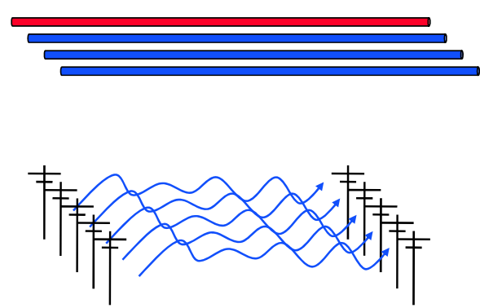
How do we increase throughput?
Wired world
  Add more wires in parallel
Wireless world
  Add more antennas?

Slide 34
How do we increase throughput?
Water world
  Fatter pipes
Wireless world
  Fatter channels
  (with more bandwidth)
802.11.n — Y NOT BOTH?

Slide 35
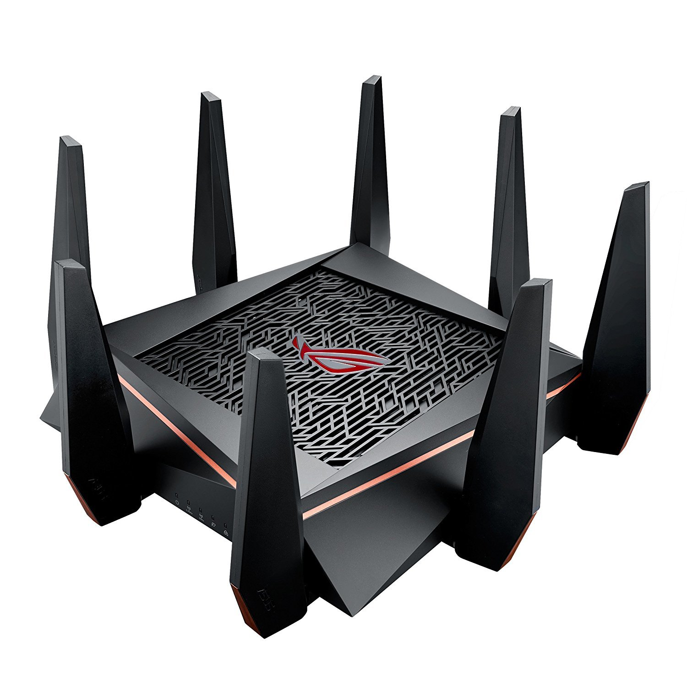
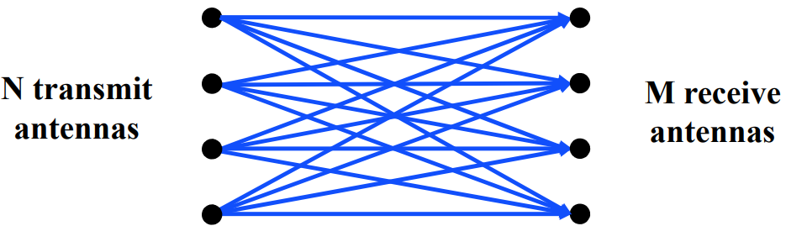
MIMO – Multiple In Multiple Out
N x M subchannels can be used to send data simultaneously
  Huge boost in data throughput
  Antenna diversity adds to reliability as well
The signals may interfere with each other
  But receiving all of them allows the data to be recovered
Beamforming
  Use interactions between array of antennas to focus energy on the receiver
  Way outside of the scope of this class

Slide 36
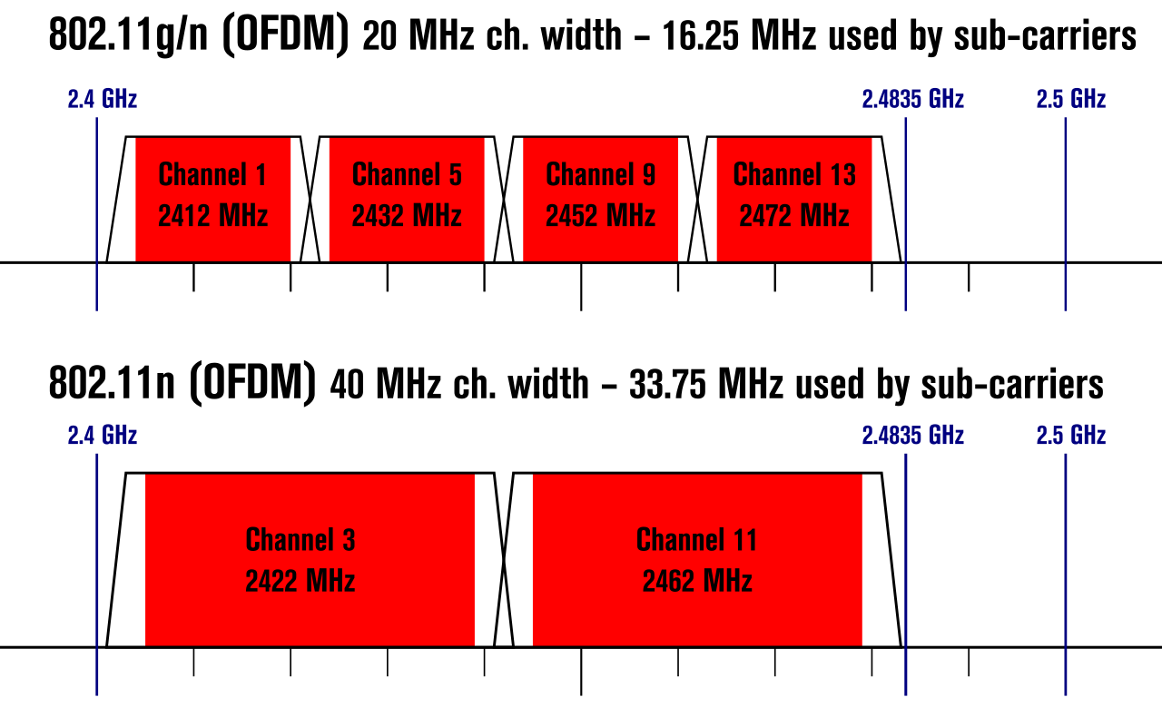
Expandable bandwidth
OFDM allows many subcarriers within a channel to be used at once
  Throughput scales with the amount of bandwidth available
  Allow larger 40 MHz channels to be used

Slide 37
802.11n (2009)
Supports OFDM and MIMO on 2.4 GHz and 5 GHz
Supports 20 MHz and 40 MHz channels
  Easier to create large channels in 5 GHz band
Backwards compatible with 802.11g (tries not to be with 802.11b)
Wildly successful
  Still the 2.4 GHz band protocol (802.11ac is 5 GHz only)
  A little less than half of the networks visible to me are still 802.11n
  My apartment “building WiFi” was still 802.11g…

Slide 38
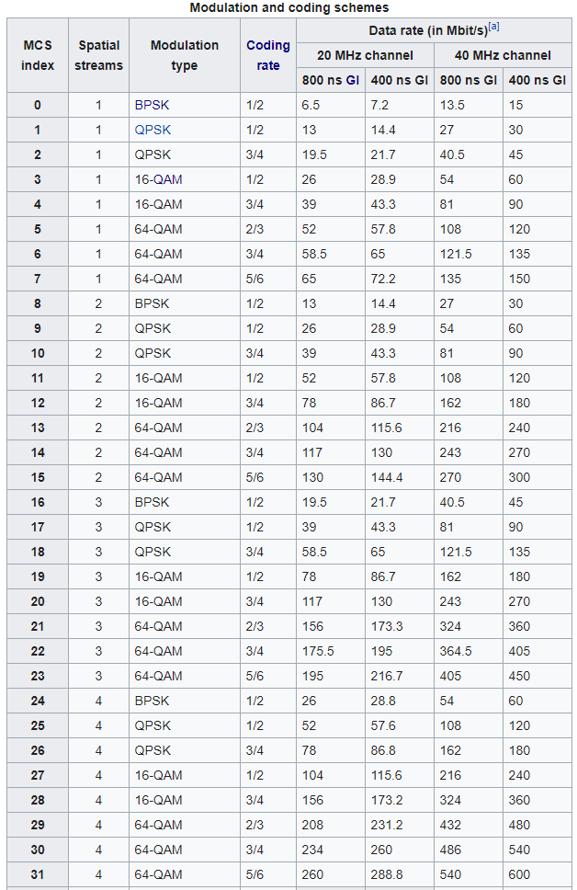
802.11n modulation and coding schemes
MCS – Modulation and Coding Scheme
GI – Guard Interval: delay between transmitted symbols

Slide 39
Break + Open Question
How much bandwidth is acceptable to use?
  Is it okay for a WiFi network to use
  the entire 2.4 GHz spectrum?

Slide 40
Break + Open Question
How much bandwidth is acceptable to use?
  Is it okay for a WiFi network to use
  the entire 2.4 GHz spectrum?
  Maybe. At least the range is pretty short!
    Only next-door neighbor’s network interfere with your network
    Someone further away isn’t affected at all
  Need to share with neighbors nearby though
    Theoretically better to have separate allocations than to overlap and deal with the collisions

Slide 41
Walking through PHY changes by amendment
 | Protocol | Year | Frequency | PHY | Max Rate | Range
- | 802.11 | 1997 | 2.4 GHz | DSSS/FHSS | 2 Mbps | 20 m
1 | 802.11b | 1999 | 2.4 GHz | DSSS | 11 Mbps | 35 m
2 | 802.11a | 1999 | 5 GHz | OFDM | 54 Mbps | 35 m
3 | 802.11g | 2003 | 2.4 GHz | OFDM | 54 Mbps | 38 m
4 | 802.11n | 2009 | 2.4/5 GHz | OFDM + MIMO | 600 Mbps | 70 m
5 | 802.11ac | 2013 | 5 GHz | OFDM + MU-MIMO | 3400 Mbps | 35 m
6 | 802.11ax | 2021 | 2.4/5/[6] GHz | OFDMA + MU-MIMO | 9600 Mbps | 35 m
7 | 802.11be | 2024 | 2.4/5/6 GHz | OFDMA + MU-MIMO | 23000 Mbps | 35 m

Slide 42
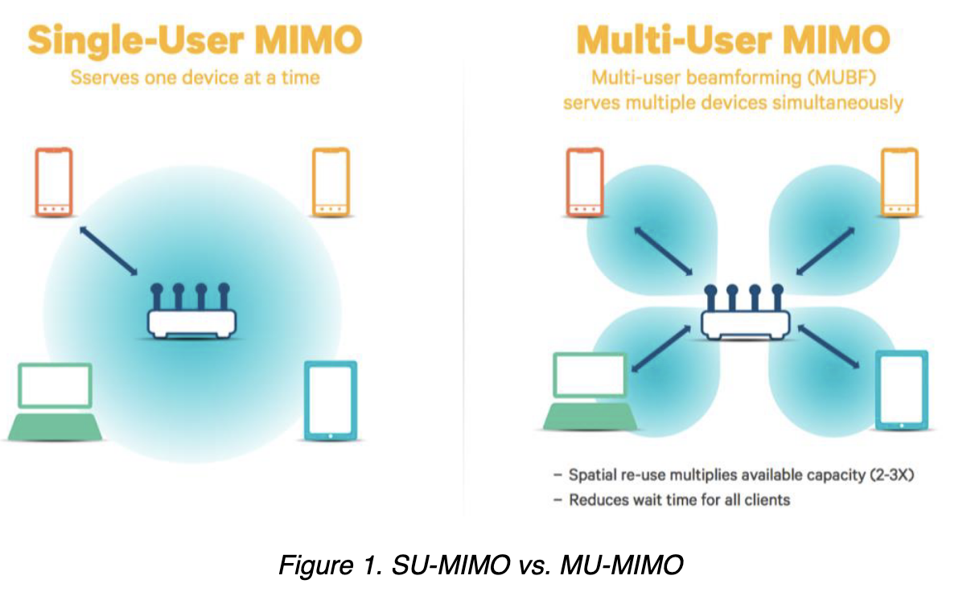
”The MIMO Gap”
Access points have 3-4 [or more now] antennas
Client devices have 1-2 [or more now] antennas
  While absolute numbers keep going up, trend holds
  Asymmetric design pattern again: More complexity in the AP than clients
Original MIMO was one
device at a time
Now expand to be multiple
devices simultaneously

Slide 43
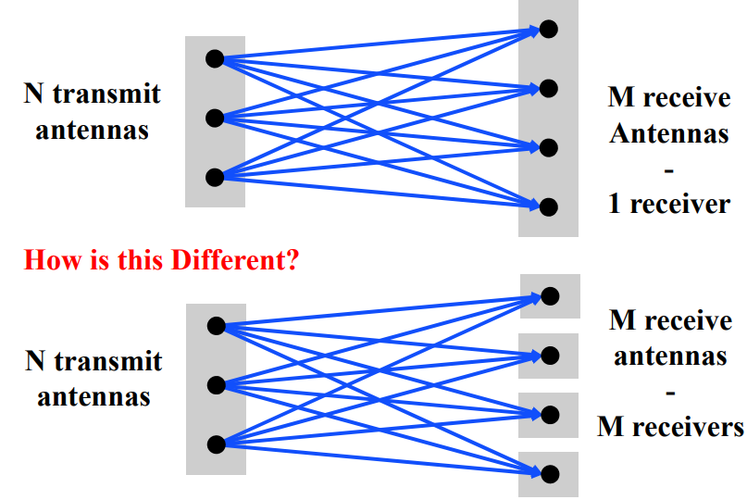
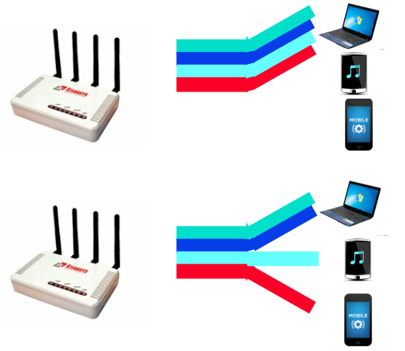
Multi-user Multiple In Multiple Out (MU-MIMO)
Multi-user MIMO uses the same techniques to send in parallel to multiple devices
  Devices cannot cancel out interference anymore
  Send slower, more reliable data streams to overcome this

Slide 44
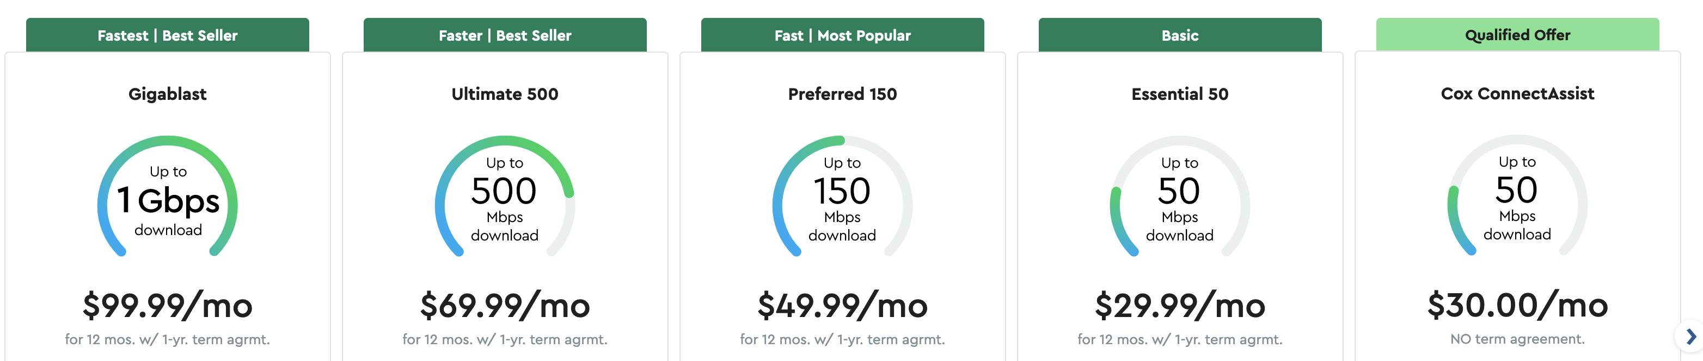
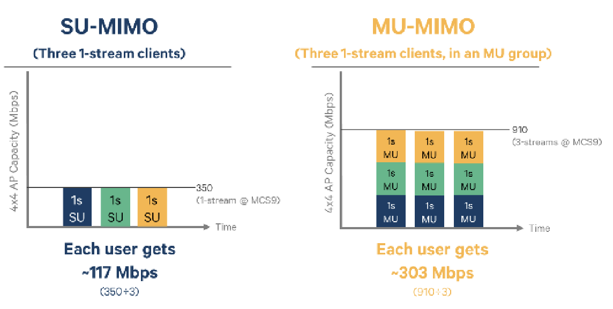
How much data can a single device use?

Slide 45
802.11ac (2013)
Update for 5 GHz band only
  Supports Downlink MU-MIMO (from AP to device)
  Supports channels widths up to 160 MHz
  Engineering updates: up to 256-QAM
Routers apply 802.11ac to 5 GHz and 802.11n to 2.4 GHz
Still in wide use (as of 2024)
  Northwestern WiFi networks are 802.11ac (Eduroam, Device, Guest)

Slide 46
802.11ac channels

Slide 47
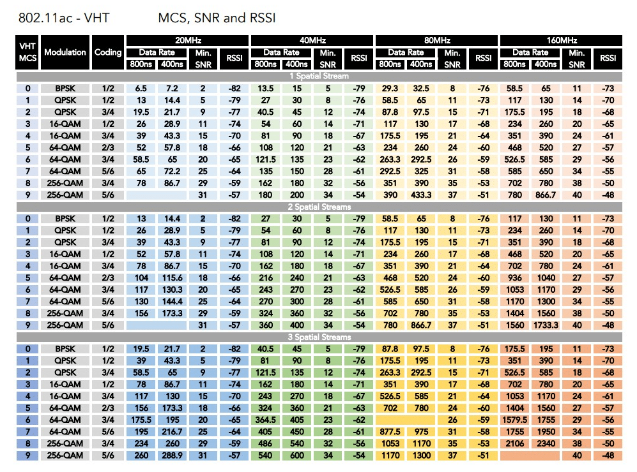
802.11ac modulation and coding schemes
4 spatial streams is also allowed, getting up to 3466 Mbps

Slide 48
Walking through PHY changes by amendment
 | Protocol | Year | Frequency | PHY | Max Rate | Range
- | 802.11 | 1997 | 2.4 GHz | DSSS/FHSS | 2 Mbps | 20 m
1 | 802.11b | 1999 | 2.4 GHz | DSSS | 11 Mbps | 35 m
2 | 802.11a | 1999 | 5 GHz | OFDM | 54 Mbps | 35 m
3 | 802.11g | 2003 | 2.4 GHz | OFDM | 54 Mbps | 38 m
4 | 802.11n | 2009 | 2.4/5 GHz | OFDM + MIMO | 600 Mbps | 70 m
5 | 802.11ac | 2013 | 5 GHz | OFDM + MU-MIMO | 3400 Mbps | 35 m
6 | 802.11ax | 2021 | 2.4/5/[6] GHz | OFDMA + MU-MIMO | 9600 Mbps | 35 m
7 | 802.11be | 2024 | 2.4/5/6 GHz | OFDMA + MU-MIMO | 23000 Mbps | 35 m

Slide 49
New directions in WiFi focus:
Aggregate throughput across all devices
For point-to-point, WiFi is “(more than) fast enough”
Now the problem is the quantity of devices in a single space
  Desktop, laptop, tablet, smartphone, smartwatch, IoT devices, etc.
Insight: Bring established cellular techniques to WiFi

Slide 50
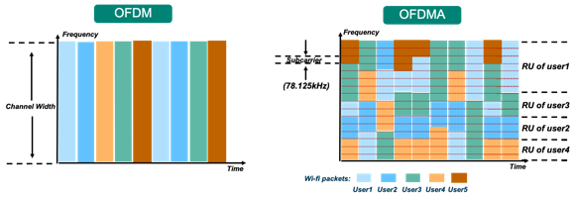
Orthogonal Frequency Division Multiple Access
OFDM: split channel into subcarriers and transmit on those
OFDMA: allocate subcarriers to a device for an amount of time
  Turns OFDM into an access control mechanism (frequency + time)
  Complicated question: which device gets which subcarriers at which time?

Slide 51
OFDM vs OFDMA
Orthogonal Frequency Division Multiplexing vs. Orthogonal Frequency Division Multiple Access
Net spectrum usage ~the same
In same time slot, assign sub-carriers to different users
  Effect: Lower bandwidth per user, but more simultaneous users
This is the same strategy cellular “resource blocks” use
  Called “Resource Units” in WiFi

Slide 52
802.11ax (2021)
Standard approved in February 2021
  First devices started supporting it in 2019 (WiFi 6)
6 GHz band (WiFi 6E)
  1.2 GHz of bandwidth (5.925-7.125 GHz)
  2020: US FCC made band available for unlicensed use!!!
  EU followed by June 2021
OFDMA
  MAC scheduling variant of OFDM
  AP schedules devices based on time and subcarrier allocations

Slide 53
Other 802.11ax improvements
Uplink MU-MIMO
  Multiple devices can transmit to the Access Point simultaneously as long as they use separate frequencies
  Enabled by OFDMA resource unit scheduling
Target Wake Time
  Support for low-power devices (taken from 802.11ah HaLow)
  Station (IoT device) informs Access Point that it will sleep for some duration before checking in
  Access Point saves packets until Station wakes and can even schedule wake times to avoid overlap with other devices (TDMA)

Slide 54
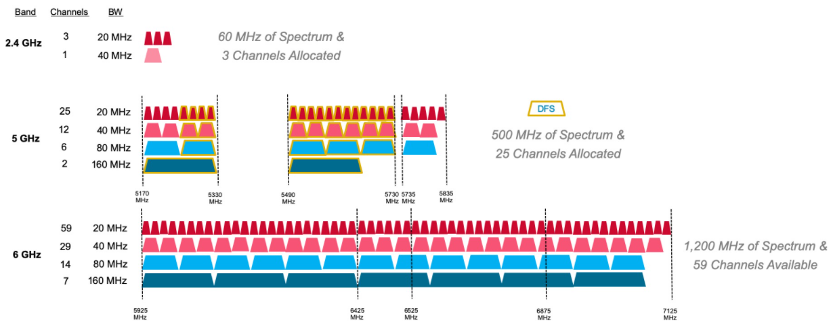
6 GHz band is an enormous amount of bandwidth

Slide 55
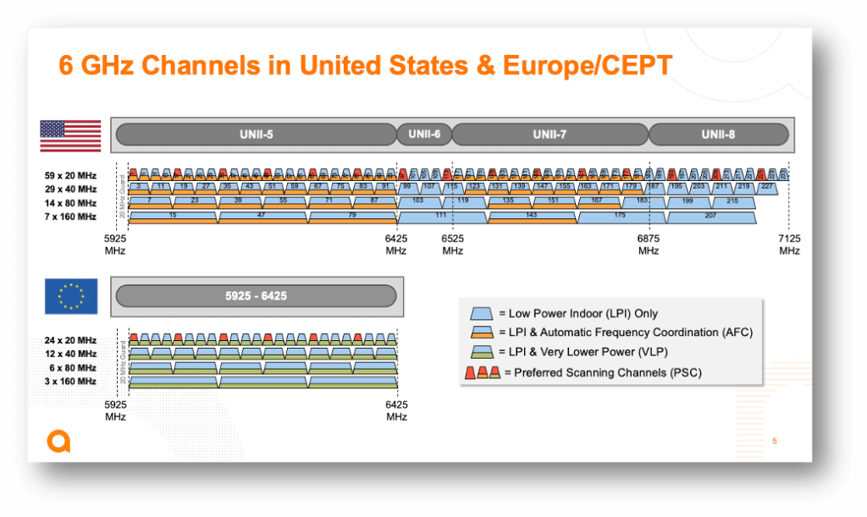
Less bandwidth in the 6 GHz band in Europe

Slide 56
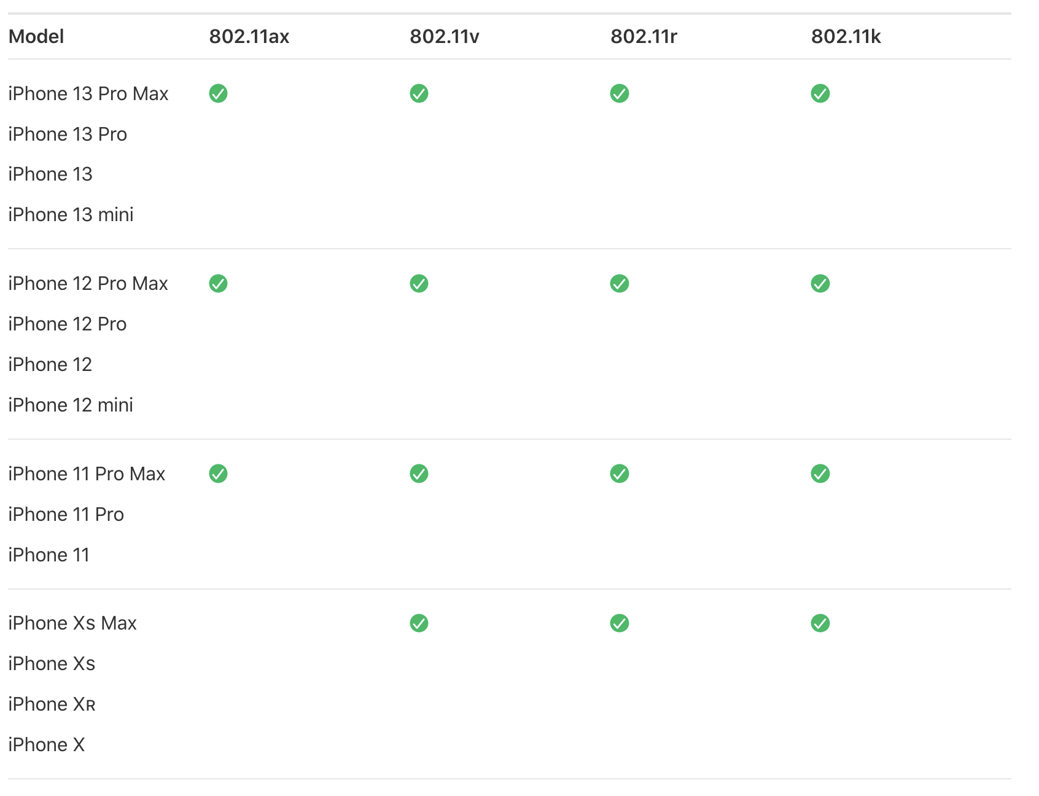
Reminder: WiFi technology (and to some extent cellular) a unicorn – HW support rolls out before specification
Standard Finalized: Sep 2020
Standard Ratified: Feb 2021
Release: Sep 2019 →

Slide 57
WiFi 6 Hardware
Two varieties:
  WiFi 6
    Most of the features, but NOT the new frequencies
  WiFi 6E
    Includes the extra 6 GHz channels
    Basically entirely unused as of 2023
WiFi 6E is the stuff you want for future proofing
  Devices capable of 6E started rolling out in 2022-2023
    iPhone 15 (2023), Macbooks 2023 and newer
    Google Pixel 6 (2022) and newer

Slide 58
Walking through PHY changes by amendment
 | Protocol | Year | Frequency | PHY | Max Rate | Range
- | 802.11 | 1997 | 2.4 GHz | DSSS/FHSS | 2 Mbps | 20 m
1 | 802.11b | 1999 | 2.4 GHz | DSSS | 11 Mbps | 35 m
2 | 802.11a | 1999 | 5 GHz | OFDM | 54 Mbps | 35 m
3 | 802.11g | 2003 | 2.4 GHz | OFDM | 54 Mbps | 38 m
4 | 802.11n | 2009 | 2.4/5 GHz | OFDM + MIMO | 600 Mbps | 70 m
5 | 802.11ac | 2013 | 5 GHz | OFDM + MU-MIMO | 3400 Mbps | 35 m
6 | 802.11ax | 2021 | 2.4/5/[6] GHz | OFDMA + MU-MIMO | 9600 Mbps | 35 m
7 | 802.11be | 2024 | 2.4/5/6 GHz | OFDMA + MU-MIMO | 23000 Mbps | 35 m

Slide 59
802.11be (2024)
“WiFi 7”
  Ratified in September 2024
Essentially: more of everything
  More channel bonding / wider bandwidth: up to 320 MHz
    Including non-contiguous blocks now that we have OFDMA
  Up to 4096-QAM
  Up to 16-stream MIMO
New features
  AP coordination for non-enterprise networks
  Lots of fancy timing estimation stuff (802.1Q)
    Primary focus seems to be AV-streaming Quality-of-Service (QoS)

Slide 60
802.11bn what (might be) coming next?
Target release: 2028
  But lots of pressure from the billion-dollar WiFi industry means that some hardware “support” will certainly arrive early
Almost certainly
  More channel bonding, higher QAM, better MIMO, etc improvements
  mmWave (“60 GHz ISM”) PHY option
    Very high throughput but much shorter range
Lots of other things on the table
  Mostly around network management, fine-timing, latency (XR/VR), scale…
More authoritative details:
  Future Directions for Wi-Fi 8 and Beyond https://ieeexplore.ieee.org/document/9864321
Notes:
It’s really 57–71 GHz, and in total is ~10x the bandwidth of all prior bands combined

Slide 61
Outline
WiFi Overview
WiFi PHY
  802.11/802.11b
  802.11a/802.11g
  802.11n/802.11ac
  802.11ax
  802.11be and Beyond
  Real-World WiFi

Slide 62
Goal: improve throughput
In twenty years, WiFi has gone from 2 Mbps to 9.6 Gbps
How does a network PHY improve its throughput?
More capable modulation and/or bit transmission
  Techniques like OFDM and MIMO
    Original 2 Mbps -> 54 Mbps with OFDM -> 346 Mbps with MIMO (100x)
    Engineering improvements are baked into these steps too
More bandwidth
  Increased channel with at 2.4 Ghz and bigger 5 GHz channels
    346 Mbps with 20 MHz -> 3466 Mbps with 160 MHz (10x)

Slide 63
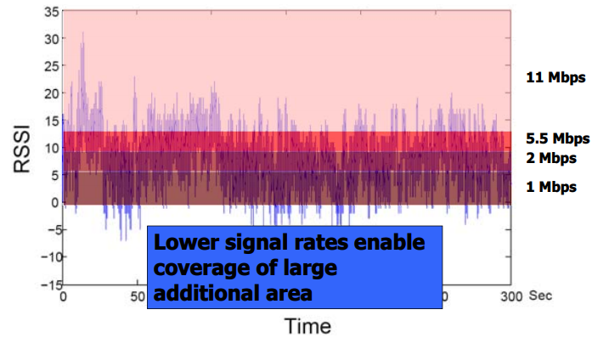
Bit rate adaptation
All modern WiFi standards support multiple bit rates (MCS)
Many factors can influence the choice of bit rate
  Capability of device: not all devices support all bit rates
  Range and packet reliability (interference)

Slide 64
Bit rate adaptation
Selecting the right rate at the right time is a complex problem
  And needs to be decided per-device
  Trial and Error
    Failures -> reduce rate
    Successes -> increase rate
  Signal strength
    Use channel state information to decide
  Context sensitive
    Mobile devices can use lower rates for higher reliability

Slide 65
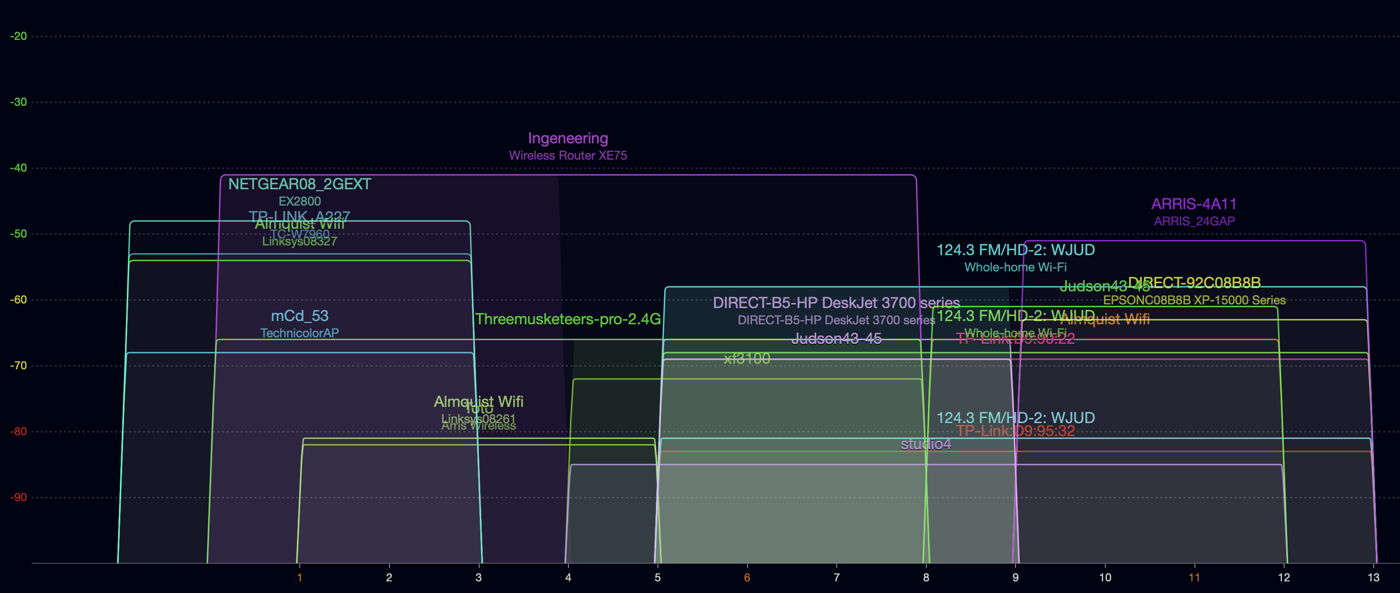
Real-world 802.11 channel use – 2.4 Ghz
Collected from Branden’s prior apartment building in Evanston
Tool: WiFi Explorer (MacOS only, paid)
On Android try “WiFiAnalyzer”
Lots of congestion
  Some devices only use 20 MHz bandwidth (mostly on channel 1 or 11 here)
  Some devices use 40 MHz bandwidth (<1 through 8, or 5-13)

Slide 66
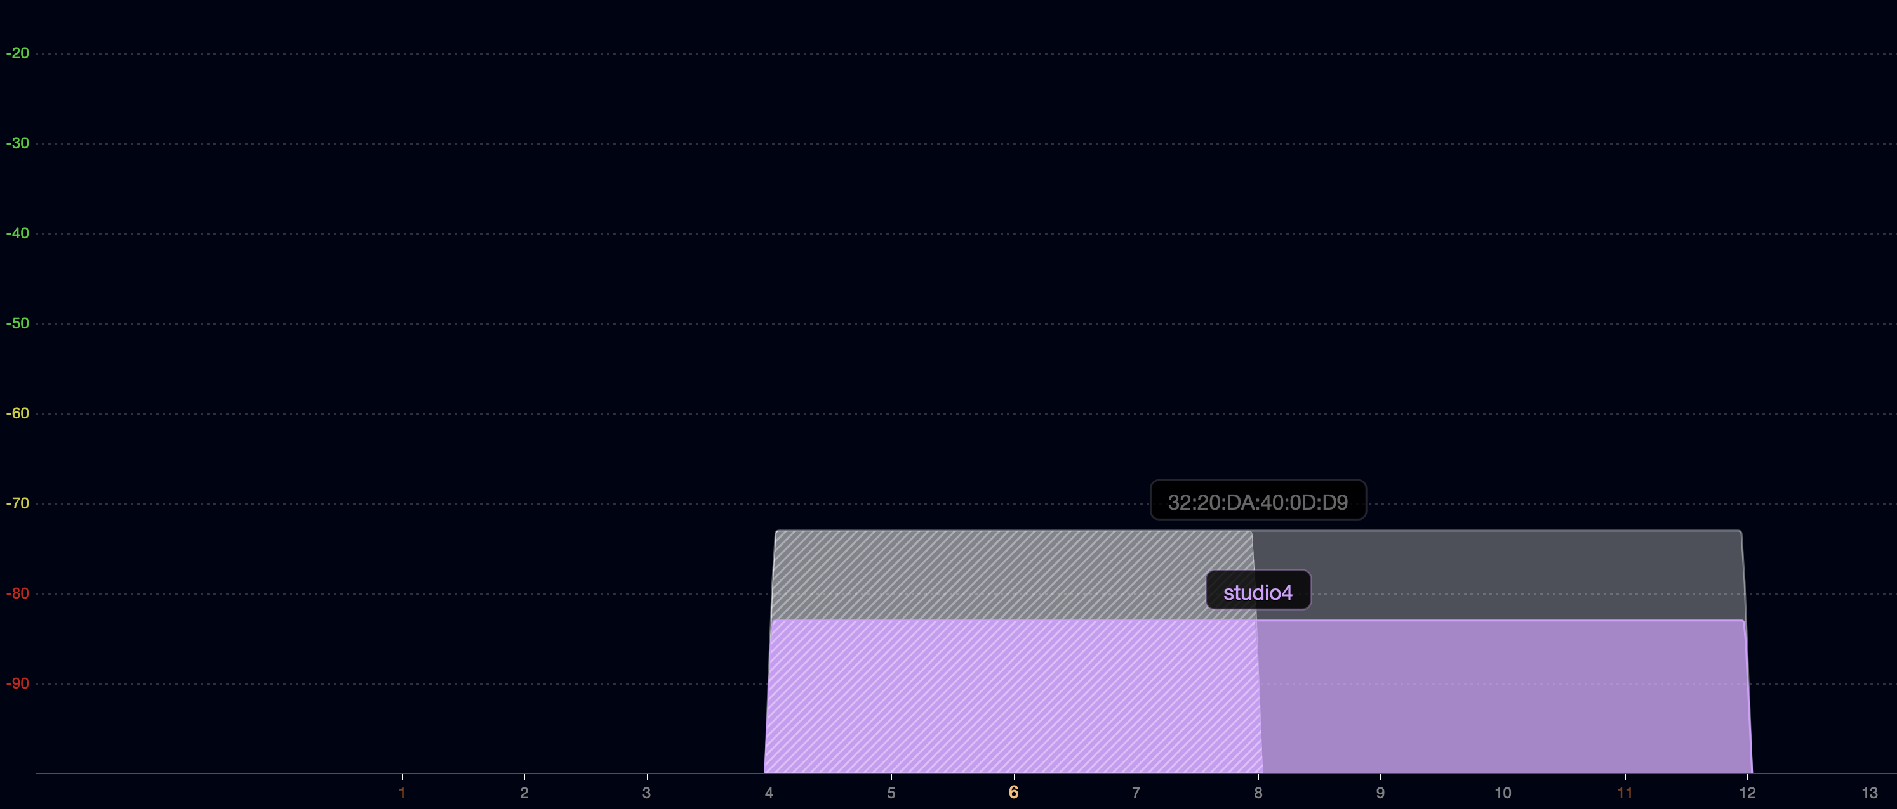
Some real-world devices are weird
Why make a 40 MHz allocation centered on channel 6??
Similarly, some 20 MHz networks use channels 2, 9, or 10

Slide 67
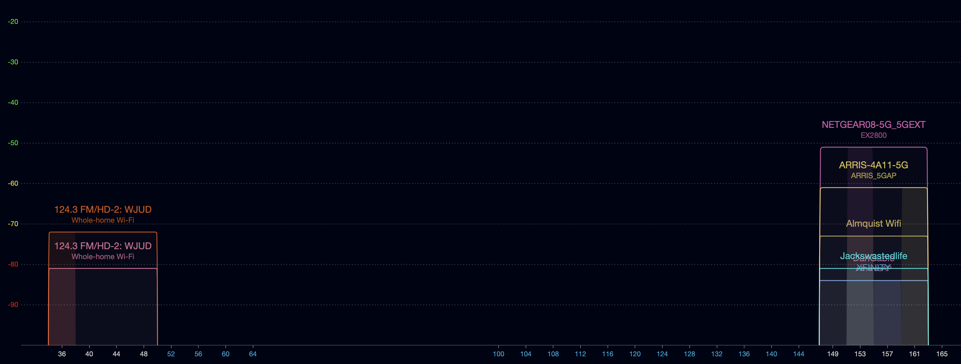
Real-world 802.11 channel use – 5 Ghz
Much less choice
  80 MHz bandwidth on lower channels or upper channels
  Why no use of channel 165?

Slide 68
Real-world 802.11 channel use – 5 Ghz
Much less choice
  80 MHz bandwidth on lower channels or upper channels
  Why no use of channel 165? Only 20 MHz, can’t be 100 MHz in size

Slide 69
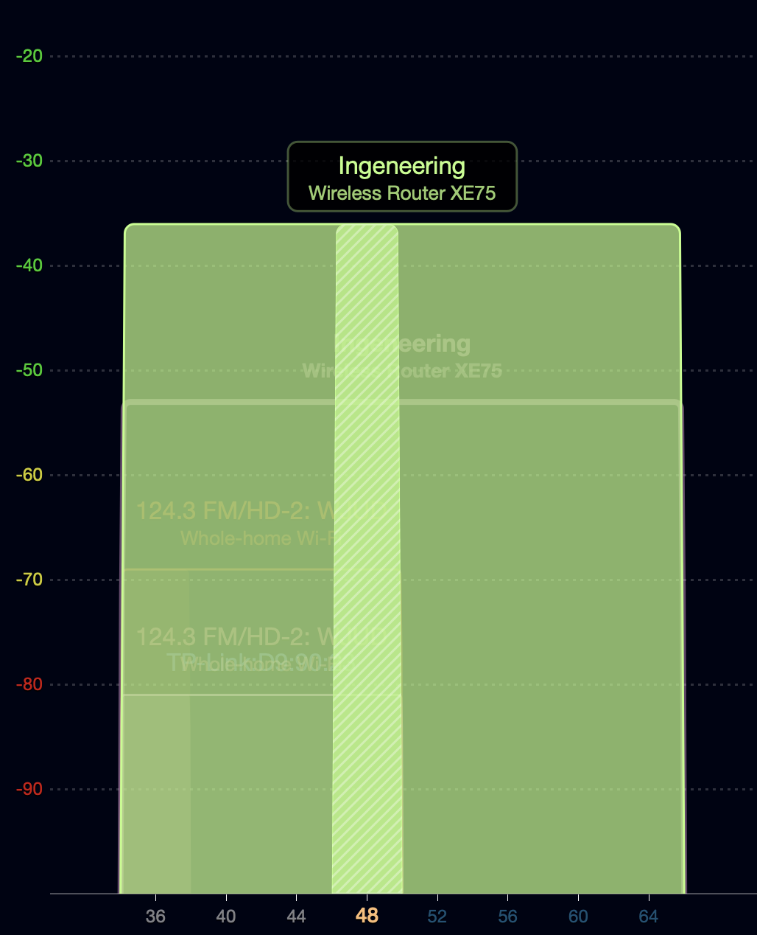
What does a new, (moderately) expensive router get you?
TP-Link Deco XE75
WiFi 6E with Mesh
https://www.tp-link.com/us/deco-mesh-wifi/product-family/deco-xe75/
160 MHz bandwidth channel 💪
Uses channels 52-64 which have special rules
  Must detect radar use and leave channel if it occurs (DFS)
  Must control transmission power between devices (TPC)
Also has a 160 MHz bandwidth allocation on channels 33-61 of the 6 GHz space
  My scans showed no other network in the 6 GHz bands

Slide 70
Outline
WiFi Overview
WiFi PHY
  802.11/802.11b
  802.11a/802.11g
  802.11n/802.11ac
  802.11ax
  802.11be and Beyond
  Real-World WiFi

