Slide 1
Lecture 09
IoT Network Routing
& Low-Power Access Control
CS433 – Wireless Protocols for IoT
Branden Ghena – Spring 2025
With slides from Federico Ferrari (ETH Zurich) and assistance from Andreas Biri (ETH Zurich)
Materials in collaboration with
Pat Pannuto (UCSD) and Brad Campbell (UVA)

Slide 2
Administrivia
Hw: Matter posted
  Due next week Thursday (May 8th)
Lab: BLE due today
  There is a late policy for the class and slip days
  3 total slip days (charged individually to each group member)
Lab: Thread tomorrow
  Starting a new lab
  Relies on prior setup, so it’s not too bad to get started hopefully
Drop deadline
  Next week Friday. I’m not worried about anyone, but reach out if you need

Slide 3
Today’s Goals
Overview of routing for mesh networks
  Walkthrough of one protocol (AODV: what ZigBee uses)
Explore academic research in wireless communication
  Data dissemination
  Low-power access control

Slide 4
Outline
Simple Routing
Mesh Routing
Better Flooding
Low-power Access Control

Slide 5
Routing goals
Have a packet, have a destination, how do we connect them?
We’ll think about a couple of approaches here
  Simple techniques
    Broadcast, tree structures
  Mesh techniques
    Understand the available routes and select a “good” one

Slide 6
Simple routing solutions
Broadcast
  The link-layer solution for everything
Star topology
  Only one location to send to: parent
  Single parent needs to store information about all children
    Addresses, schedules, etc.
Tree topology
  “Star of stars”
  Two choices: send to descendent or send to parent
  Each parent needs to store information about all children beneath it
  Original ZigBee approach (knowledge built into addressing scheme)

Slide 7
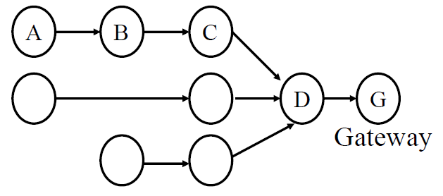
Many-to-one routing (Collection Tree Protocol, CTP)
Tree optimization for sensor networks
  Keep all devices except the “gateway” as simple as possible
Each device only needs to know neighbors and “first hop” to gateway
  If gateway wants to send message back, it must include a full hop path
  Gateway knows full network layout

Slide 8
Outline
Simple Routing
Mesh Routing
Better Flooding
Low-power Access Control

Slide 9
Mesh Routing
Mesh topology makes routing question more complicated
  Multiple hops in a route
  Multiple routes between source and destination
  Becomes a graph theory question based on cost metric
B
C
A
D
F
E

Slide 10
Basic primitive: flooding
Mesh equivalent of broadcast
  Each node sends to each other node
  Eventually packets will reach the desired destination
  Not really routing at all…
Question: how do we make it stop?

Slide 11
Basic primitive: flooding
Mesh equivalent of broadcast
  Each node sends to each other node
  Eventually packets will reach the desired destination
  Not really routing at all…
Question: how do we make it stop?
  Maximum retransmissions counter on each packet
    Decrement at each hop. Drop packet when it hits zero
    Need some guess for how many hops to destination
  Or keep some history of recently flooded packets
    Don’t retransmit a recently sent packet

Slide 12
Routing overview
Use flooding techniques to build up routes
Choice to make: when should knowledge of routes be collected?
  On demand (Reactive Routing) : when we know a packet needs to be sent
    Upside: doesn’t collect routes unless needed, routes are up-to-date
    Downside: delays data transmission
  In advance (Proactive Routing): when a network is created and periodically
    Upside: will already have routes when packet arrives
    Downside: might collect unnecessary routes, periodic updates required

Slide 13
Reactive routing
Build up a map of the routes through a network
  Hopefully the “optimal” routes
Map routes in reaction to a packet arrival
  Sensor devices are slow and limited
  Most likely to resend to same prior address
  Discover a route when it is needed, then cache for next time

Slide 14
Ad-hoc On-demand Distance Vector Routing (AODV)
On-demand: Construct routes only when needed
Modern ZigBee routing approach (for Mesh topology)
Routing table
  Destination node -> Next hop (for all cached destinations)
  Store only next hop instead of full route
    All routers along the path must also have Destination->Next mappings
  Also keep hops-to-destination and last-seen-destination-sequence-number
Route discovery
  Upon demand: check table
  If not cached send Route Request (RREQ) via Flooding
    Route is unknown, so flooding is needed
AODV documentation: https://www.ietf.org/rfc/rfc3561.txt

Slide 15
AODV Route Requests (RREQs)
Request ID | Source Address | Destination Address | Source SeqNo | Destination SeqNo | Hop Count
Request ID identifies this RREQ
  Used to discard duplicates during flooding
  Unless less hops and equally recent, OR more recent
Sequence Numbers are per-device, monotonically increasing
  Used as a notion of “how recently” device has been seen
  Source SeqNo is the source’s most recent sequence number
  Destination SeqNo is the most recently seen from the destination by the source. (Defaults to zero)
Hop Count is the number of hops this request has taken
  Starts at 1 and incremented by each transmitter along the path

Slide 16
Example AODV RREQ (A to F)
Request ID | Source Address | Destination Address | Source SeqNo | Destination SeqNo | Hop Count
A wants to find a route to F, so it sends out an RREQ
B
C
A
D
F
E

Slide 17
Example AODV RREQ (A to F)
Request ID | Source Address | Destination Address | Source SeqNo | Destination SeqNo | Hop Count
1 | A | F | 1 | 0 | 1
B and D also opportunistically add a routing table entry for A
B
C
A
D
F
E

Slide 18
Example AODV RREQ (A to F)
Request ID | Source Address | Destination Address | Source SeqNo | Destination SeqNo | Hop Count
1 | A | F | 1 | 0 | 2
B goes first via some access control protocol (D also in contention)
A and D ignore duplicate Request ID
C opportunistically adds a routing table entry to A
B
C
A
D
F
E

Slide 19
Example AODV RREQ (A to F)
Request ID | Source Address | Destination Address | Source SeqNo | Destination SeqNo | Hop Count
1 | A | F | 1 | 0 | 2
D goes next by some access control protocol (C also in contention)
A, B, and C ignore duplicate Request ID
E and F opportunistically add routing table entries to A
B
C
A
D
F
E

Slide 20
Example AODV RREQ (A to F)
Request ID | Source Address | Destination Address | Source SeqNo | Destination SeqNo | Hop Count
1 | A | F | 1 | 0 | 3
C and E repeat this process with Hop Count 3 (but everyone ignores them because worse)
They go one-at-a-time, but I’m getting tired of drawing these
Actually, they’re in contention with the response from F
B
C
A
D
F
E

Slide 21
AODV Route Response (RREP)
Source Address | Destination Address | Destination SeqNo | Hop Count
Reply is sent unicast back to the source via newly constructed route
  Each node along the way already knows the route back
Includes most recent own sequence number as a sense of recency
  “Destination” from the perspective of the original RREQ
  No need for source sequence number anymore

Slide 22
Example AODV RREP (F to A)
Source Address | Destination Address | Destination SeqNo | Hop Count
F | A | 7 | 2
F sends response back to A via D
D opportunistically adds a routing table entry for F
B
C
A
D
F
E

Slide 23
Break + Practice
C wants to send a packet to E
  What RREQ(s) are sent and what RREP(s) are sent?
B
C
A
D
F
E

Slide 24
Break + Practice
C wants to send a packet to E
  What RREQ(s) are sent and what RREP(s) are sent?
    RREQs:
      C -> (B,D,F)
      (B or D) -> A
      (D or F) -> E
    RREPs:
      E -> (D or F) -> C
  Network could have multiple configurations
B
C
A
D
F
E

Slide 25
RREP optimization
An intermediate node responds with RREP if it already has a path to destination with a more recent Destination sequence number
Source may get multiple RREP responses with different recency and hop counts
  So, some intermediate node could respond “here’s the route I knew of when sequence number was 5”
  Then, destination node could respond “here’s the route right now, I’m actually on sequence number 12”
  Likely want the most recent
    If equally recent, use the least hops

Slide 26
When to update your route
Routing table entries are updated on RREP if:
  Destination sequence number in the RREP is greater the listed one
    More recent
  Sequence numbers are the same, but the route was marked as inactive
    Route exists again
  Sequence numbers are the same, but the hop count is smaller
    Faster route

Slide 27
Route maintenance in AODV
If a link in the routing table breaks, all active neighbors are informed with Route Error (RERR) messages
  After some number of retransmissions and timeouts
  RERR contains destination address that broke
Nodes receiving RERR can start RREQ for destination address
  Which lets them find a new path through the network
  And updates everyone’s cached next-hops

Slide 28
Similar alternative: Dynamic Source Routing (DSR)
Another reactive routing technique
  Similar design as AODV
In DSR, routing tables have full route to destination
  Each packet transmission includes a list of hops to destination
  So the route to an important destination only has to be stored on the source device that cares about it
  Intermediate nodes do not need any route storage for that destination
    Cost is extra bytes used in each packet for route
During discovery, all paths are returned by destination
  So source gets a full list of possible route choices

Slide 29
Tradeoffs for reactive routing
Upside: no transmissions unless there is demand
  Routes might appear, disappear, reappear, but no need to update if no one actually wants to transmit anything
Downside: large, variable delay when actually sending a packet
  Full RREQ/RREP protocol before data can actually be sent
  Route might have broken at some point
    So data will be sent based on cached information
    RERR will occur
    RREQ/RREP will occur
    Then data will be sent again

Slide 30
Proactive routing
Alternative to reactive is to know the routes ahead of time
Periodically query for the possible routes in the network
  Save all routes that are important (maybe just all routes?)
  Also redetermine routes whenever topology changes (nodes join/leave)
Upside: when a packet arrives, route to destination is already known
Downside: requires more memory and effort on part of routers
  Wastes some network bandwidth on checking for route changes

Slide 31
Distance-Vector
Keep routes as “next hops” rather than full routes
  AODV uses this method (DV for Distance Vector)
Can be combined with proactive techniques too
  Each router periodically informs neighbors of its shortest paths to each destination (in terms of hop count)
    Essentially just broadcast your routing table
  Routers choose the best route available
    Either old next-hop it was already aware of
    Or new next-hop through neighbor (with cost of their hops + 1)
  Need to be careful to avoid loops!

Slide 32
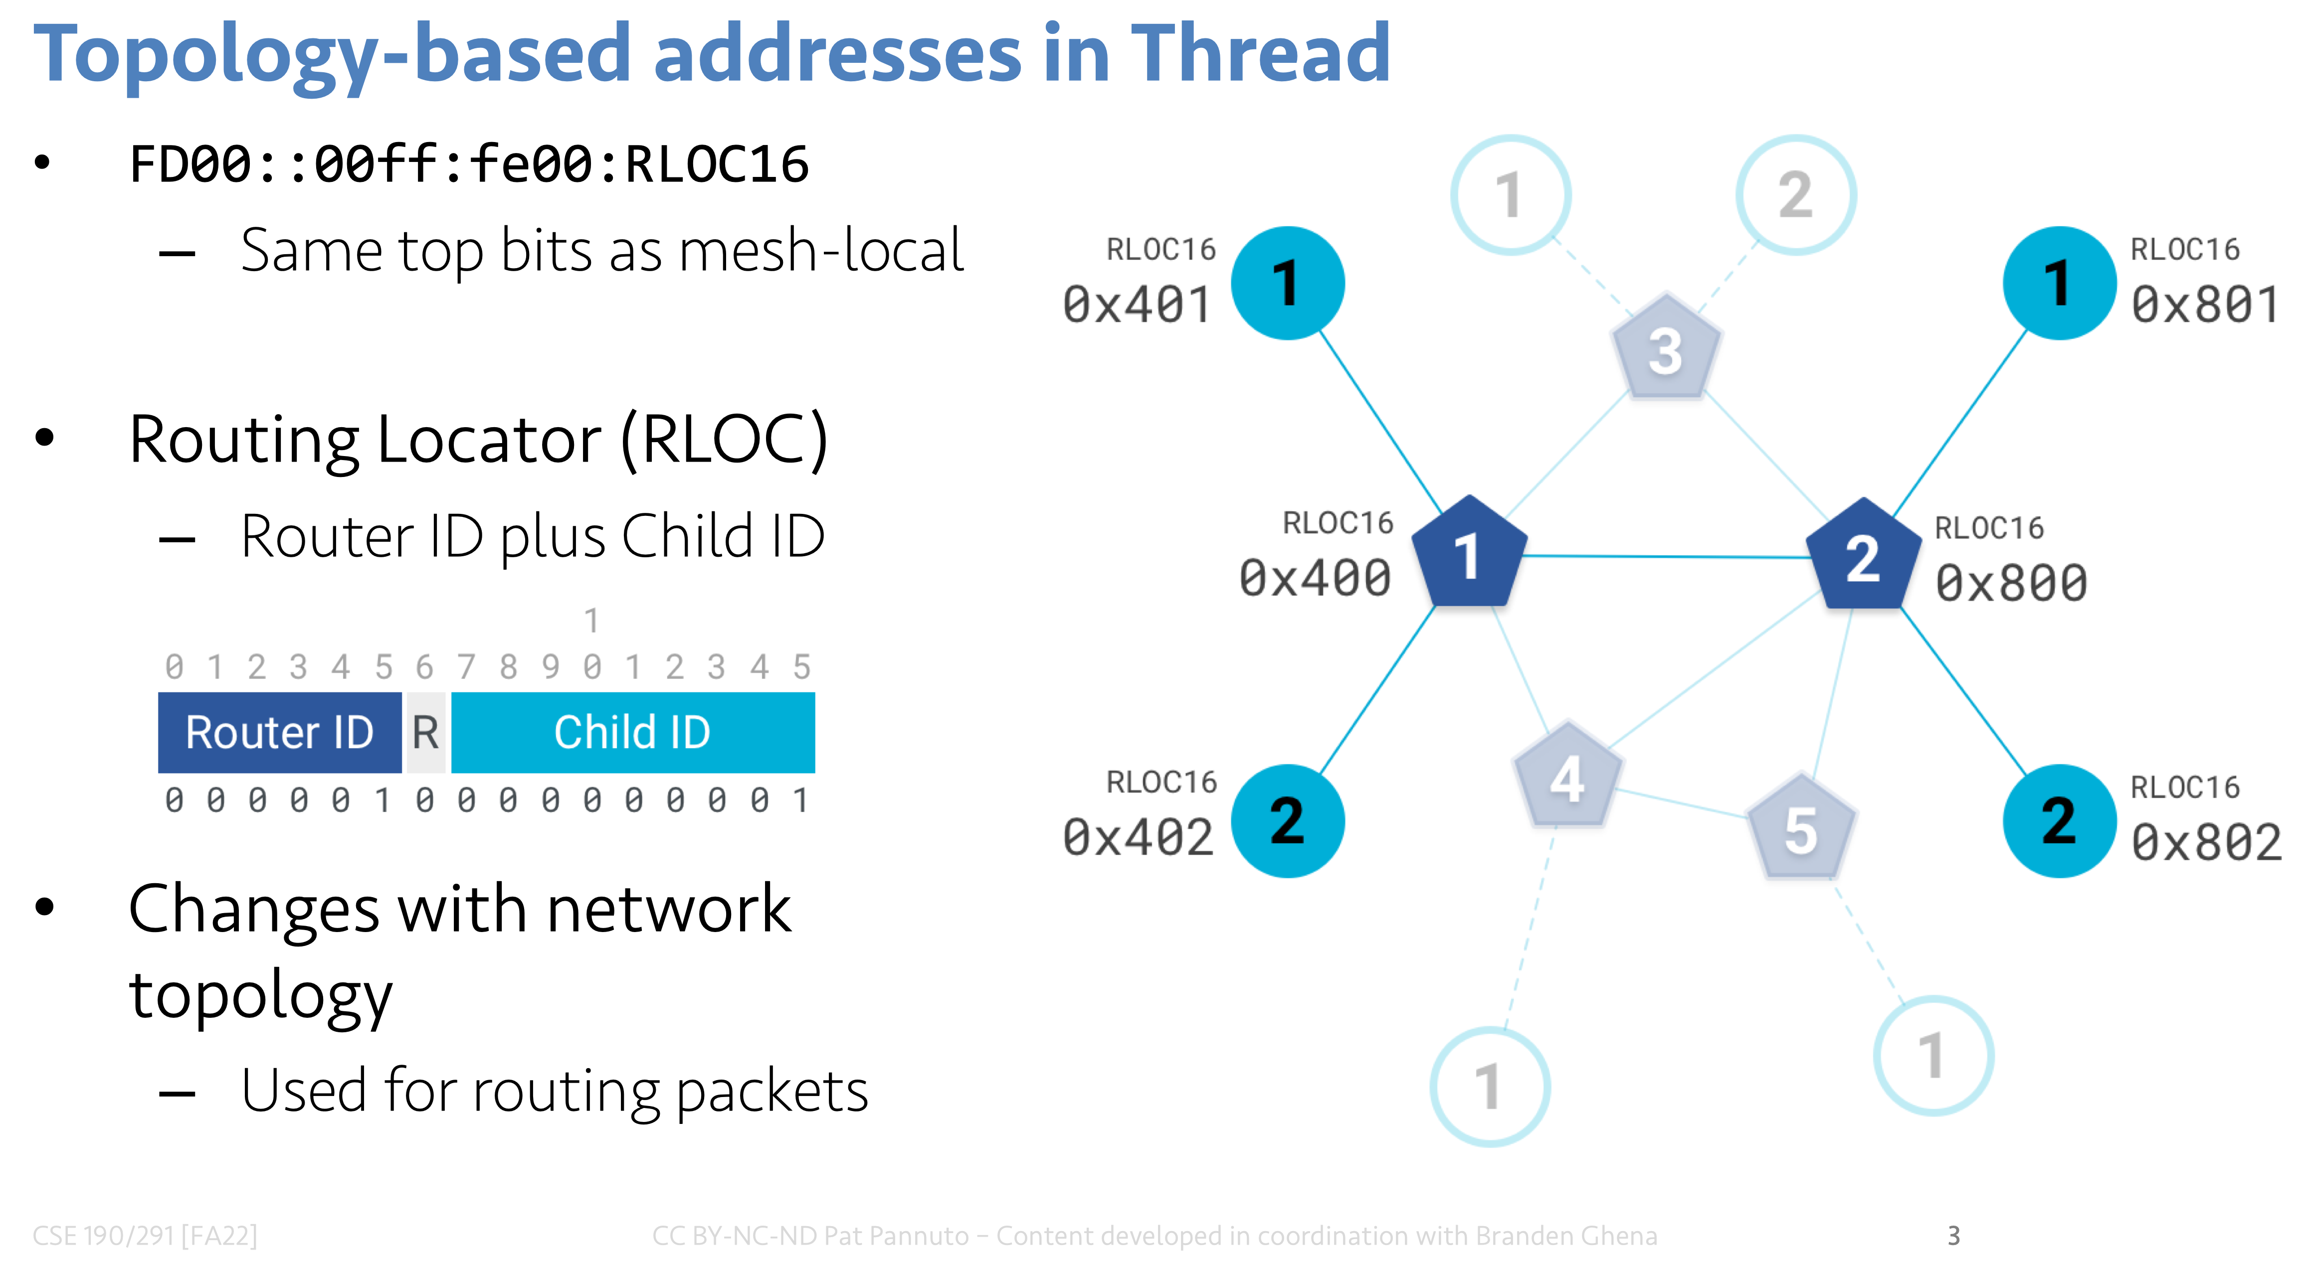
Thread routing
Uses a proactive, distance-vector protocol for unicast routing
If node is a child, send packet to parent router
If node is a router,
  Consult table for address within mesh
    (RLOC helps here!)
  Send to border router for address outside of mesh
Multicast uses a data dissemination protocol (Trickle)
  Or falls back to flooding

Slide 33
Break + Discussion
Hop count is one possible metric for determining routes
What else might be considered?

Slide 34
Reliability as a cost metric
Link quality can very from node to node
  Fewest hops might not be the “fastest” or “most reliable” path
ETX: minimize “expected transmissions”
  Measure link quality over time to determine each link’s reliability
B
C
A
D
F
E

Slide 35
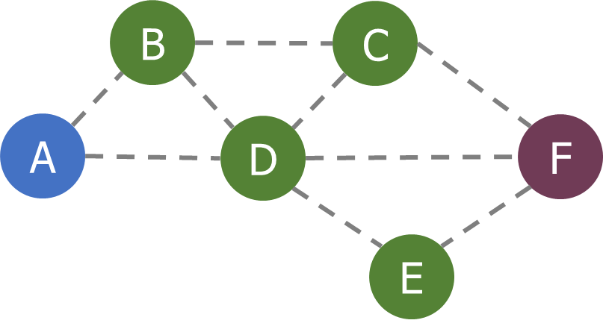
Alternative cost metrics
Spatial reuse
  Prefer transmission on links that do not interfere with each other
  Improves ability to pipeline data through network
  Example: A<->B and E<->F
Energy availability
  Prefer routing through nodes with more remaining
  available energy
  Prefer wall-powered nodes over battery-powered
Arbitrarily complex combinations possible

Slide 36
Outline
Simple Routing
Mesh Routing
Better Flooding
Low-power Access Control

Slide 37
Flooding is a recreation of broadcasts
Goal: get information to all nodes
  This is the problem of “data dissemination”
Problem: difficult in Mesh topologies
  Packet loss, retransmission delays
Really, the desire for data dissemination is just to broadcast to all nodes
  But broadcast transmissions don’t reach far enough to cover entire mesh

Slide 38
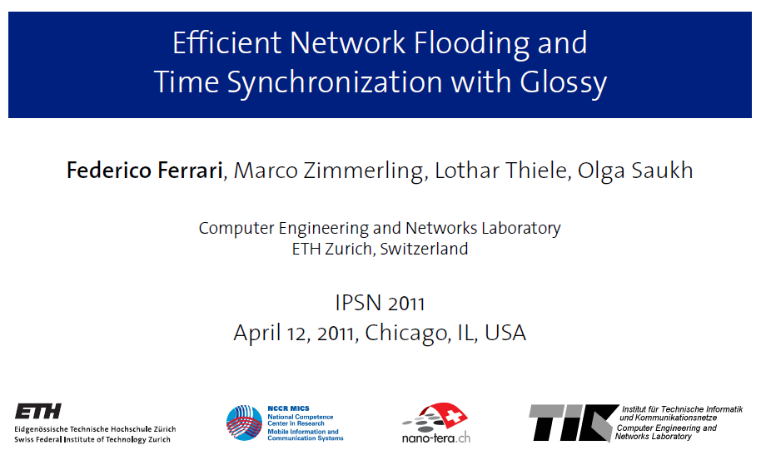
Glossy: what if we expand broadcast range by having multiple nodes participate?

Slide 39
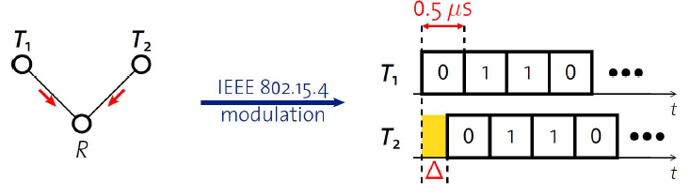
Synchronous transmissions
Multiple nodes transmit same packet at same time
R can receive packet with high probability if Δ is small
  May even improve probability of reception (more energy at receiver)
500 ns is 1/32 of a symbol for 802.15.4 (chip duration)

Slide 40
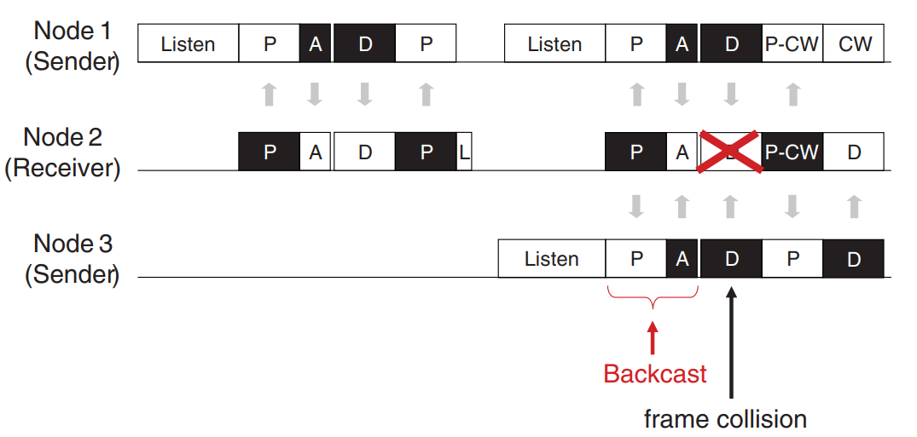
Sidebar: broadcast transmission acknowledgements
P = Probe (data request)
A = Acknowledgement
D = Data transmission
L = Listening period
P-CW =
Probe with Contention Window for response
A-MAC: https://web.eecs.umich.edu/~prabal/pubs/papers/dutta12amac.pdf

Slide 41
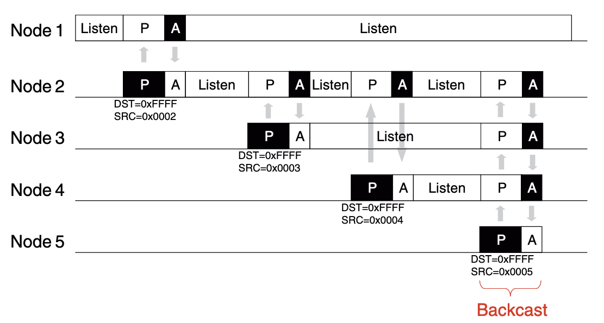
How do we avoid interference?
Fundamental insight:
  “say exactly the same thing at exactly (enough) the same time” leads to coherence instead of interference
In 802.15.4, an ACK is sent exactly 192 µs after receiving
  The ACK packet contains only
  the sequence number being
  ACK’d
  Does not contain source address
  of the ACK-er
  Which is why this works:

Slide 42
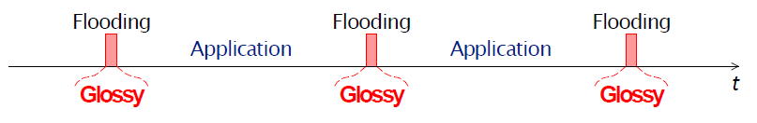
Glossy key techniques
Temporally decouple network flooding from application tasks
Exploit synchronous transmissions for fast network flooding

Slide 43
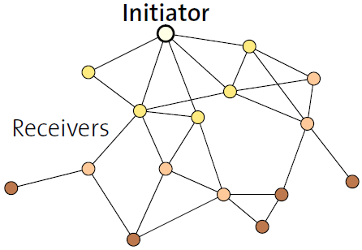
Fast packet propagation in Glossy

Slide 44
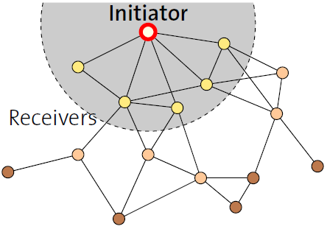
Fast packet propagation in Glossy

Slide 45
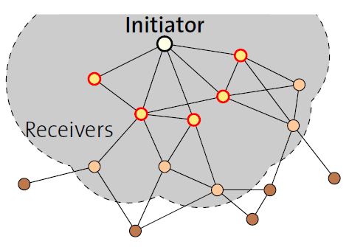
Fast packet propagation in Glossy

Slide 46
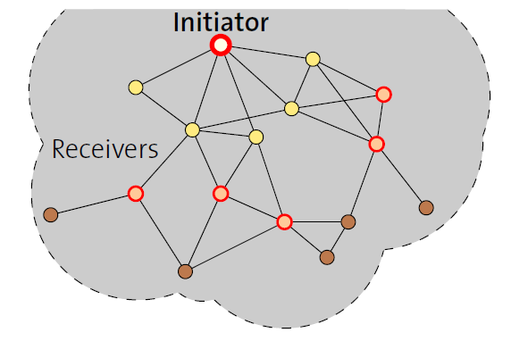
Fast packet propagation in Glossy

Slide 47
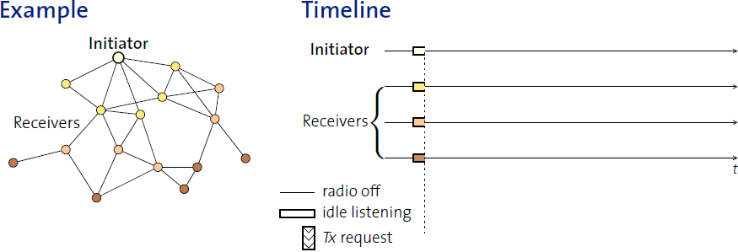
Glossy details
When Glossy starts
  All nodes turn on radios to receive

Slide 48
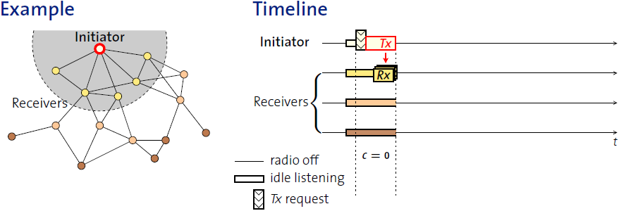
Glossy details
Initiator
  Set relay counter in packet, C = 0
  Broadcast packet

Slide 49
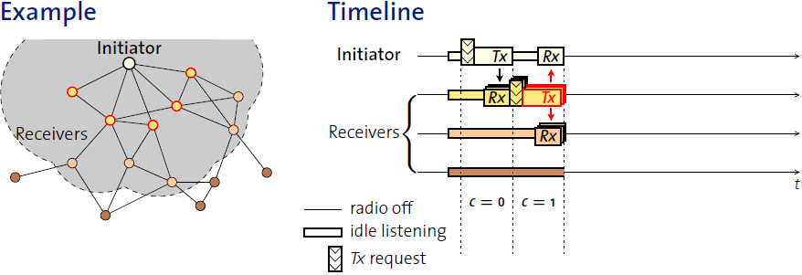
Glossy details
At packet reception:
  Increment relay counter C
  Transmit synchronously (at a fixed period after the reception)

Slide 50
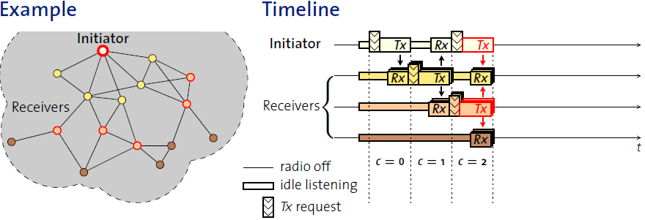
Glossy details
At packet reception:
  Increment relay counter C
  Transmit synchronously (at a fixed period after the reception)

Slide 51
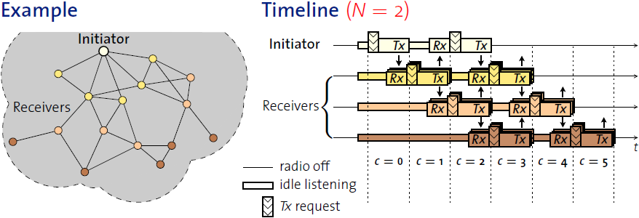
Glossy details
Stop rebroadcasting and turn off radio when
  Already transmitted N times
  Networks pick N for reliability/energy tradeoff

Slide 52
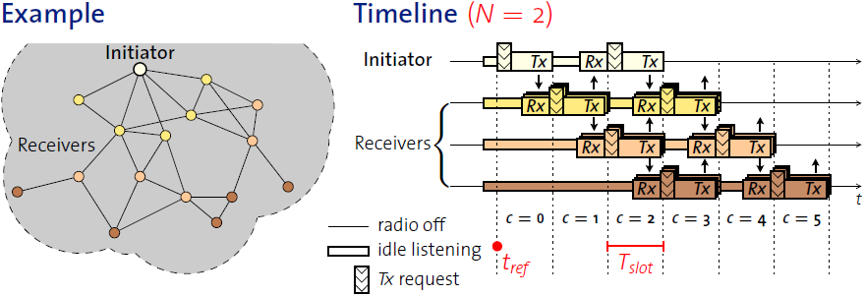
Glossy details
T_{slot} is constant by design
  Needs to be short to make constructive interference work
Beginning of slot (t_{ref}) provides synchronization point
  As a bonus, all nodes are synchronized after flooding event

Slide 53
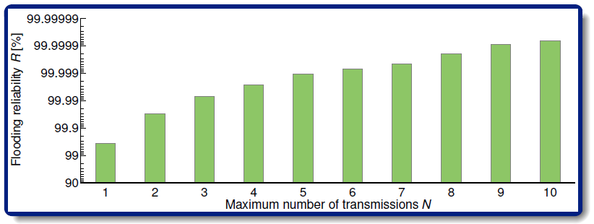
Glossy implementation
Device must be able to have tight time bounds on rx/tx
  500 ns wiggle room maximum
  Includes receive, processing, transmission
    Implies a maximum physical distance for a network
Need to pick an N for reliability

Slide 54
Application of Glossy: avoid routing altogether
Low-Power Wireless Bus (LWB)
  Federico Ferrari, Zimmerling, Mottola, Thiele. SenSys’12
Use Glossy for all device communication
  Make one broadcast domain (a bus) where all nodes communicate
  Avoids all issues of routing, everything is a broadcast
    Works for unicast, multicast, anycast, and broadcast transmissions
General idea: TDMA Glossy floods
  Synchronization is already given to nodes by Glossy
  One coordinator makes the TDMA schedule

Slide 55
Break + Question
What about physical distance in Glossy, does it matter?
  Consider a device receiving the purple (left) and green (right) packets
  How much distance would be acceptable?

Slide 56
Break + Question
What about physical distance in Glossy, does it matter?
  Consider a device receiving the purple (left) and green (right) packets
  How much distance would be acceptable?
500 ns is about 500 feet distance
  Which is probably farther than
  transmission range anyways
500 ns must be sum of clock
inaccuracies plus distance

Slide 57
Outline
Simple Routing
Mesh Routing
Better Flooding
Low-power Access Control

Slide 58
Always-on Radios Simplify Protocols
Many protocols assume a more-powerful device with lots of energy
  BLE: Central
  Thread: Router/Leader
  Zigbee: Router/Coordinator
  WiFi: Router
  LoRa: Gateway
This assumption simplifies the “when to listen” problem
  Powerful device: always listen
  Low-power device: listen-after-talk or synchronized schedule

Slide 59
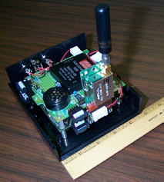

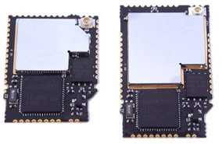
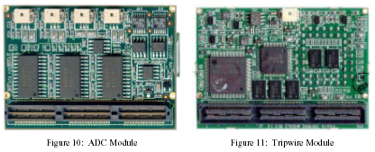
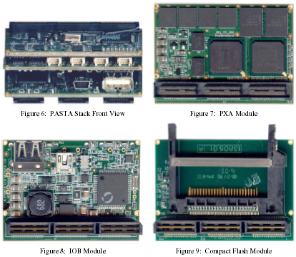
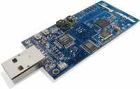
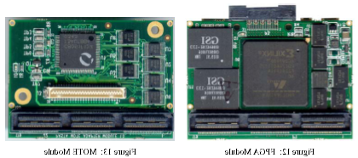
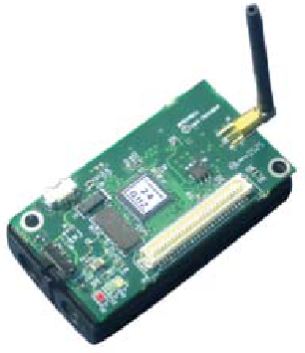
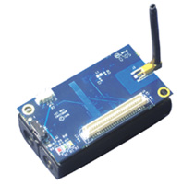
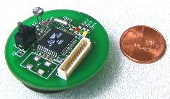
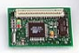
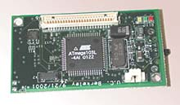
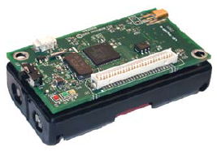
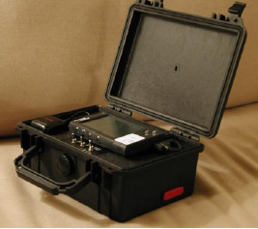
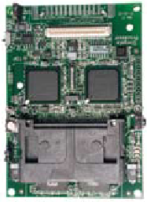
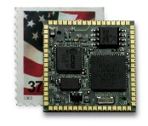
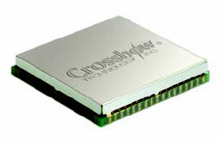
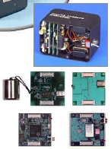

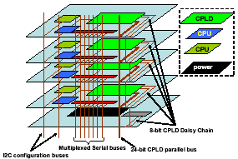
Back to the early days of low power sensor nodes
Tmote Mini
[Sentilla07]
Telos/Tmote
[Polastre05]
PC/104 [Cerpa01]
PASTA [Bajura05]
Mica [Hill01]
Mica2 [Xbow03]
MicaZ [Xbow05]
Iris [Xbow07]
WeC [Hill98]
Rene [Hill99]
MicaZ Stamp
[Xbow06]
Iris OEM
[Xbow07]
WINSng [Pottie00]
Stargate [Intel]
WINS [Rockwell]
mPlatform[Lymberopoulos07]

Slide 60
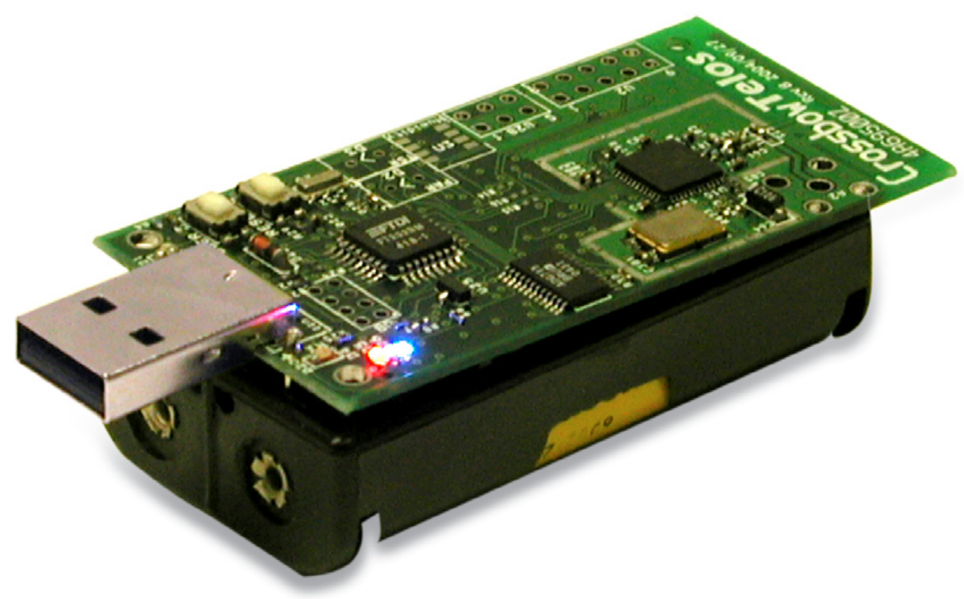
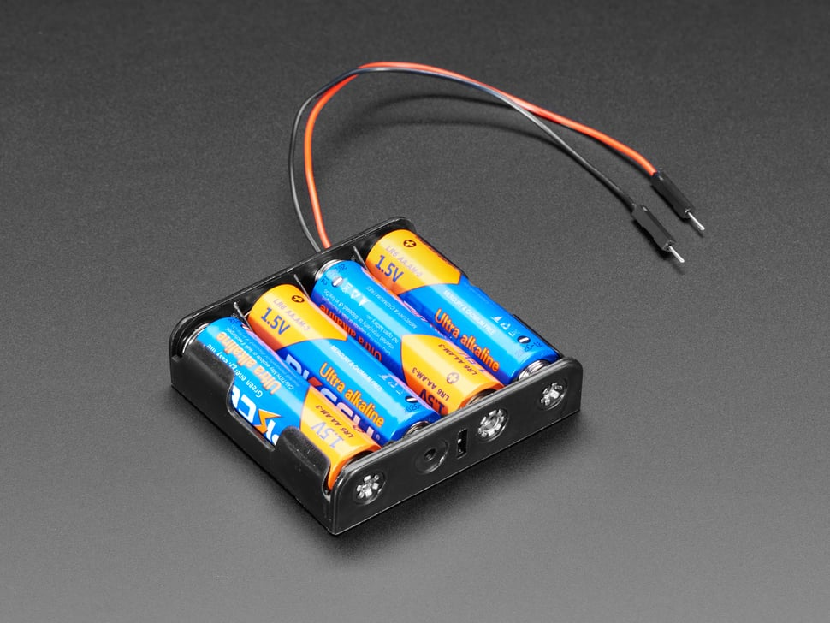
Low power goal: multi-year operation using batteries
Power_{node} = P_{CPU} + P_{TX} + P_{RX} + P_{SLEEP}
Lifetime = Energy_{BATT} / P_{node}
For Lifetime to increase, P_{node} must decrease
  P_{CPU} ≫ P_{SLEEP} (much greater)
  P_{TX} ≫ P_{SLEEP}
  P_{RX} ≫ P_{SLEEP}
  Solution: Minimize Compute, TX, and RX
    Maximize Sleep

Slide 61
Low power MAC principles
Communication is possible if one device is receiving while other is transmitting
Devices can only coordinate using the data communication channel (i.e. no out-of-band communication)
  No global synchronization mechanism
Goal: scheme to schedule TX and RX to permit communication while minimizing energy
Energy is paramount, but additional metrics:
  Latency
  Throughput
  Reliability
  Network scale
A
B

Slide 62
Protocols we’ll discuss
Transmitter Initiated
  B-MAC (initial idea)
  X-MAC (solve problems)
Receiver Initiated
  LPP (initial idea)
  A-MAC (solve problems)

Slide 63
Low Power Listening (LPL) - B-MAC (2004)
CCA
CCA
CCA
RX
TX ACK
CCA
Sleep
Sleep
Sleep
Sleep
Sleep
Receiver
Preamble
TX
RX ACK
Sleep
Sleep
Transmitter
Method:
  Receiver periodically samples the channel
  Transmitter sends a preamble long enough to ensure receiver will detect it
  Upon detection, receiver stays awake to receive transmitted packet
  Receiver ACKs if packet received correctly
Versatile Low Power Media Access for Wireless Sensor Networks. Joseph Polastre, Jason Hill and David Culler. SenSys 2004

Slide 64
LPL performance
Sensor sample period controls the packet rate
CCA check interval
  Too short: energy wasted on idle listening
  Too long: energy wasted on transmissions (long preambles)
In general, it’s better to have larger preambles than to check more often!
  Because messages are sent rarely
  Transmit frequency depends on sensor data collection rate
Time between listening
(checking if the channel is idle)
Versatile Low Power Media Access for Wireless Sensor Networks. Joseph Polastre, Jason Hill and David Culler. SenSys 2004

Slide 65
LPL Drawback
A
CCA
CCA
CCA
RX
TX ACK
CCA
Sleep
Sleep
Sleep
Sleep
Sleep
Receiver
B
Preamble
TX
RX ACK
Sleep
Sleep
Transmitter
C
CCA
CCA
CCA
RX
DROP
CCA
Sleep
Sleep
Sleep
Sleep
Sleep
Receiver
Spend time listening to packets for someone else!
A
C
B
Versatile Low Power Media Access for Wireless Sensor Networks. Joseph Polastre, Jason Hill and David Culler. SenSys 2004

Slide 66
X-MAC: Shorter preambles and destination information
A
RX
RX
TX ACK
RX
TX ACK
RX
Sleep
Sleep
Sleep
Sleep
Receiver
B
TX (DST ID)
TX (DST ID)
TX (DST ID)
RX ACK
TX
RX ACK
Sleep
Sleep
Transmitter
Method
  Transmitter repeatedly sends a short “I have a packet for this address” packet
  Nodes periodically listen, and ACK if the packet is for them
  Upon receiving the ACK, the transmitter sends full packet
  Receiver successfully receives the full packet.
X-MAC: A Short Preamble MAC Protocol for Duty-Cycled Wireless Sensor Networks. Michael Buettner, Gary V. Yee, Eric Anderson, Richard Han. SenSys 2006.

Slide 67
X-MAC: Overhearing node drops out early
A
RX
RX
TX ACK
RX
TX ACK
RX
Sleep
Sleep
Sleep
Sleep
Receiver
B
TX (DST ID)
TX (DST ID)
TX (DST ID)
RX ACK
TX
RX ACK
Sleep
Sleep
Transmitter
C
RX
RX
Sleep
Sleep
Sleep
Overhearer
X-MAC: A Short Preamble MAC Protocol for Duty-Cycled Wireless Sensor Networks. Michael Buettner, Gary V. Yee, Eric Anderson, Richard Han. SenSys 2006.

Slide 68
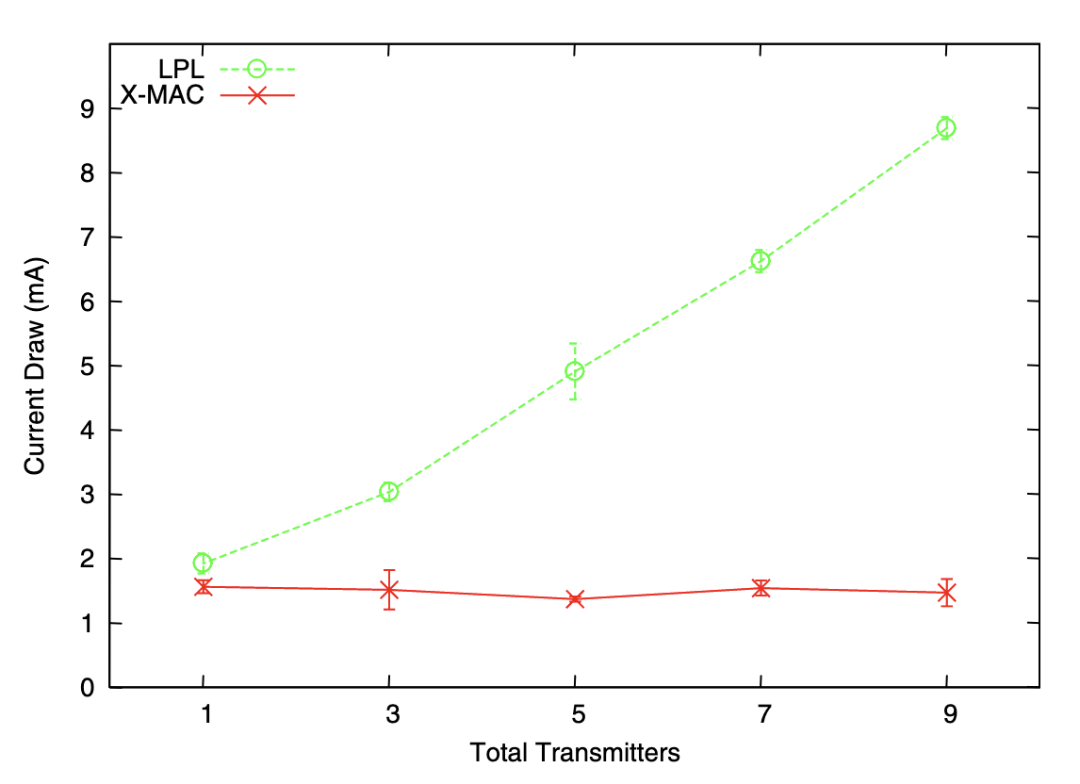
X-MAC: lower power draw than LPL with multiple nearby transmitters
X-MAC: A Short Preamble MAC Protocol for Duty-Cycled Wireless Sensor Networks. Michael Buettner, Gary V. Yee, Eric Anderson, Richard Han. SenSys 2006.

Slide 69
Protocols we’ll discuss
Transmitter Initiated
  B-MAC (initial idea)
  X-MAC (solve problems)
Receiver Initiated
  LPP (initial idea)
  A-MAC (solve problems)

Slide 70
LPL (B-MAC) and X-MAC are transmitter-initiated MAC protocols
Receiving nodes continuously periodically sample the wireless channel
  When they detect a transmission they listen to receive packets
Transmitting nodes are only active when they want to transmit
Receiving nodes prone to unnecessary wakeups
  Have to receive all nearby transmissions to see if the packet happens to be for them
  Unnecessary wakeups lead to increasing receive energy → shorter lifetime
  In general, difficult for receiver to know if it should stay awake or go back to sleep

Slide 71
Low Power Probing (LPP) is receiver initiated
A
TX Probe
RX
TX Probe
RX
TX ACK
TX Probe
RX
Sleep
Sleep
Sleep
Sleep
Receiver
B
RX
TX
RX ACK
Sleep
Sleep
Transmitter
Method
  Receiver periodically transmits a probe, listens afterward
  Transmitter listens for probe packet from intended recipient
  Transmitter sends packet after receiving the correct probe packet
  Works a lot like BLE advertisements!!
RI-MAC: A Receiver-Initiated Asynchronous Duty Cycle MAC Protocol for Dynamic Traffic Loads in Wireless Sensor Networks. Yanjun Sun, Omer Gurewitz, David B. Johnson. SenSys 2008.
Koala: Ultra-Low Power Data Retrieval in Wireless Sensor Networks. Razvan Musaloiu-E., Chieh-Jan Mike Liang, Andreas Terzis. IPSN 2008.

Slide 72
LPP introduces a new challenge for multiple nodes. What happens with multiple transmitters?
RX
TX
Sleep
Sleep
Transmitter
TX Probe
RX
TX Probe
RX
TX Probe
Collision!!
Sleep
Sleep
Sleep
Sleep
Receiver
RX
TX
Sleep
Sleep
Transmitter
If multiple transmitters receive a probe, they both transmit, leading to a collision and a lost packet
Receiver is unsure if there even was a packet at all, or just noise/interference on the channel
RI-MAC: A Receiver-Initiated Asynchronous Duty Cycle MAC Protocol for Dynamic Traffic Loads in Wireless Sensor Networks. Yanjun Sun, Omer Gurewitz, David B. Johnson. SenSys 2008.
Koala: Ultra-Low Power Data Retrieval in Wireless Sensor Networks. Razvan Musaloiu-E., Chieh-Jan Mike Liang, Andreas Terzis. IPSN 2008.

Slide 73
A-MAC resolves this with backcast constructive interference
RX
TX ACK
TX
RX
CCA
CCA
TX
RX ACK
Sleep
Sleep
Sleep
Transmitter
TX Probe
TX Probe
RX ACK
RX
TX Probe
RX
TX ACK
RX
TX ACK
RX
Collision!!
Sleep
Sleep
Sleep
Receiver
RX
TX ACK
TX
RX
CCA
TX
RX ACK
Sleep
Sleep
Transmitter
Method
  Transmitters send an ACK in response to a probe packet
  With multiple transmitters, the ACKs collide, but interfere non-destructively, so the receiver still receives an ACK
  The receiver stays awake to receive a packet, but the packet collides
  The receiver sends a new probe, informing transmitters there was a collision
  Transmitters use CSMA/CA to send packets
Design and Evaluation of a Versatile and Efficient Receiver-Initiated Link Layer for Low-Power Wireless. Prabal Dutta, Stephen Dawson-Haggerty, Yin Chen, Chieh-Jan Mike Liang, and Andreas Terzis. SenSys 2010.

Slide 74
Summary: asynchronous low power MAC protocols
Transmitter initiated protocols
  Receivers periodically sample the channel
  Transmitters transmit sufficiently to ensure recipients heard
  Examples: LPL, X-MAC
  Pros:
    Simple, intuitive
    Can balance TX and RX energy with sample interval
  Cons:
    Receivers prone to false wake-ups
    High idle listening energy costs
Receiver initiated protocols
  Receivers periodically transmit probes
  Transmitters listen for a probe before sending a packet
  Examples: RI-MAC, Koala, A-MAC
  Pros:
    Fixed, small listening energy cost for receivers
  Cons:
    Multiple transmitters leads to collisions

Slide 75
Outline
Simple Routing
Mesh Routing
Better Flooding
Low-power Access Control

