Slide 1
Lecture 08
ZigBee & Interoperability
CS433 – Wireless Protocols for IoT
Branden Ghena – Spring 2025
Materials in collaboration with
Pat Pannuto (UCSD) and Brad Campbell (UVA)

Slide 2
Updates
Lab: BLE
  Due Thursday
  Last part “LED Control Application” is more work than many of the prior parts
Hw: Matter
  Out today or tomorrow

Slide 3
Today’s Goals
Introduce ZigBee as another 802.15.4 implementation
Explore ZigBee application layer
Discuss interoperability designs and the Matter standard

Slide 4
Outline
ZigBee overview
ZigBee PHY and MAC
ZigBee application layer
Interoperability

Slide 5
ZigBee goals
Enable automatic communication between devices
  Low complexity
  Low power
  Focus on home automation and industrial control/monitoring
From our perspective
  802.15.4 PHY and MAC
  Plus well-defined Server/Client interactions
    Similar to BLE (actually, BLE is similar to ZigBee)
  Designed for higher-power devices than Thread or BLE
    Although still relatively low power

Slide 6
ZigBee history
Intertwined with the creation of 802.15.4
  Both are founded around the same time
  ZigBee Alliance involved in the original 802.15.4 specification
    Recently renamed: Connectivity Standards Alliance (CSA)
  Original plan: 802.11/WiFi <-> 802.15.4/ZigBee
Original specification 2004 (following 802.15.4 in 2003)
  Updated 2006, 2007, 2015, (2017?)
  2015 version is also known as ZigBee Pro
  We’ll focus on 2015, but look at previous stuff too
    Application layer stuff hasn’t changed considerably

Slide 7
ZigBee resources
ZigBee Specification (2015)
ZigBee Cluster Library Specification (2016)
Useful resources
  ZigBee overview: https://www.cse.wustl.edu/~jain/cse574-14/ftp/j_13zgb.pdf
  NXP library guides (include overview on ZigBee)
    ZigBee Protocol: https://www.nxp.com/docs/en/user-guide/JN-UG-3113.pdf
    ZigBee Cluster Library: https://www.nxp.com/docs/en/user-guide/JN-UG-3115.pdf
    ZigBee Home Automation: https://www.nxp.com/docs/en/user-guide/JN-UG-3076.pdf

Slide 8
Outline
ZigBee overview
ZigBee PHY and MAC
ZigBee application layer
Interoperability

Slide 9
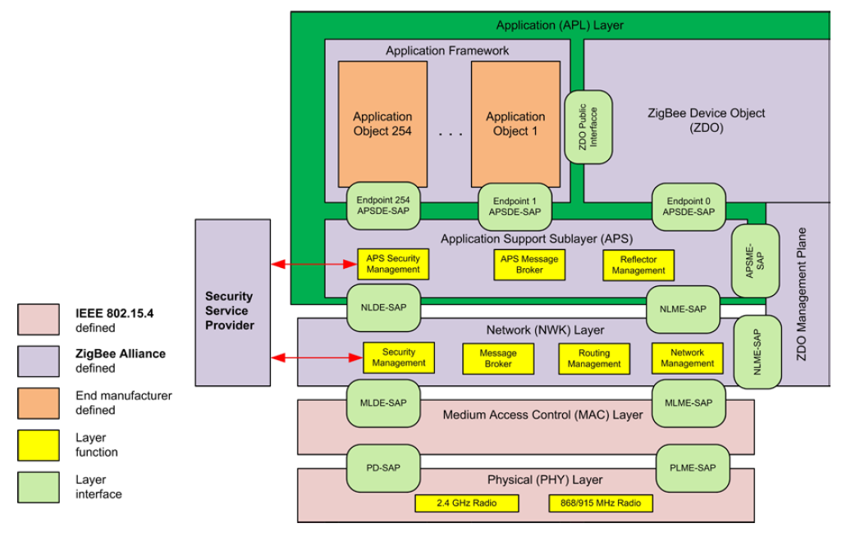
ZigBee stack

Slide 10
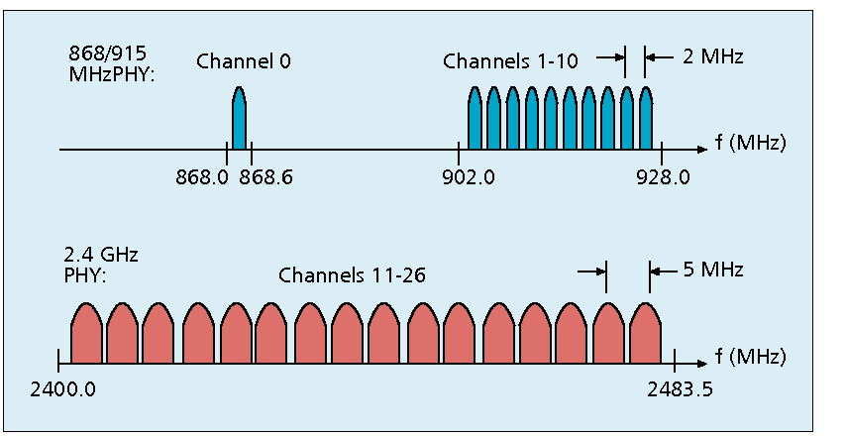
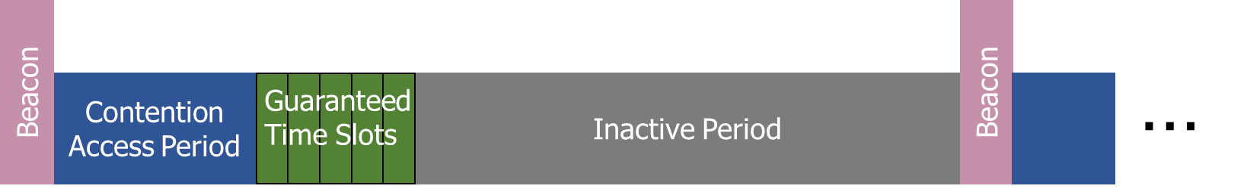
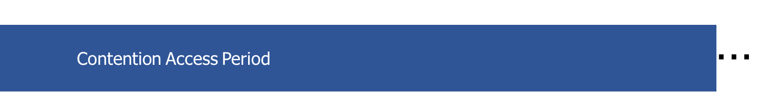
Use of 802.15.4
Basic answer: everything
  Reuse all of PHY (including non-2.4 GHz channels)
  Reuse all of MAC (including beacon-enabled network and GTS)
    Same CSMA/CA mechanism

Slide 11
ZigBee devices (same roles as 802.15.4 defines)
ZigBee Coordinator (ZC)
  Starts the network and decides on key parameters
  Is also a Router
ZigBee Router (ZR)
  Higher-power, more-capable devices
  Radios always on (except during inactive superframe)
  Connect to one or more children
  Connect to one or more routers
ZigBee End Device (ZED)
  Lower-power, less-capable devices
  Always a child of one router

Slide 12
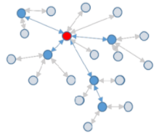
Older ZigBee - tree networks
Original preferred topology
Uses beacon-enabled network
  Synchronization via beacon superframes
  Can reduce power requirements for routers
Some things get simpler
  Address assignment is simple
    If you restrict network size
  Routing is straightforward
    But likely more hops for router-to-router communication

Slide 13
ZigBee tree network complications
Distributed routing scheme limits topologies
  There is a limit on number of routers
  Each router has a maximum number of children
  There is a maximum limit for router depth
  Note: many protocols have limits. Thread has device count limits too!
Needs a beacon scheduling mechanism
  Each parent must both participate in a superframe
  And also send their own superframe beacons
  Need to keep inactive period large if there is significant router depth
  Each beacon includes a TX offset field specifying parent beacon time
    Helps prevent hidden terminal problem

Slide 14
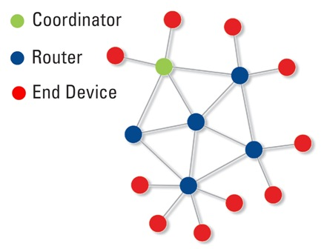
Modern ZigBee – mesh networks
Presently preferred topology
Uses non-beacon-enabled network
  All routers are always-on devices
  Allows arbitrary communication between routers
Some tradeoffs
  Higher power routers
  Routing more complicated (potentially better algorithms though)
  Addressing more complicated
    Assign random addresses to each node
    Include a method for address conflict resolution

Slide 15
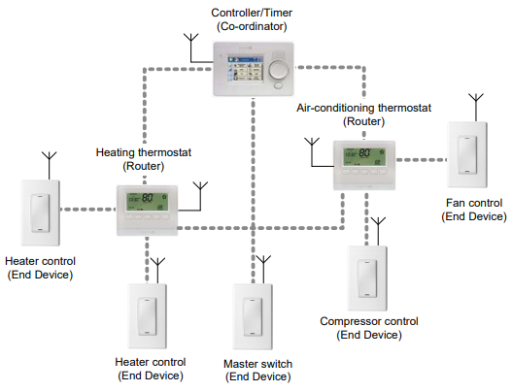
Example ZigBee network

Slide 16
Break + Design Question
How frequently should End Devices communicate?
  Constantly or periodically, and at what period?
Each group:
  Pick an Industrial or Commercial smart device (not a home bulb/switch)
  Consider its energy, latency, and reliability requirements
  Determine communication pattern
  We’ll share around the room

Slide 17
ZigBee End Device polling
Packets are held in ZigBee Routers for up to 7.68 seconds
  Compare to undefined duration for Thread (at least minutes)
  Reduction in “low energy” capability for end devices
  Limiting timeouts makes Router design simpler
ZigBee codifies polling behavior for End Devices
  Long Polling - steady state polling period, example: 7.5 seconds
  Short Polling – polling period while waiting on data, example: 1 second

Slide 18
Outline
ZigBee overview
ZigBee PHY and MAC
ZigBee application layer
Interoperability

Slide 19
Analogies between BLE and ZigBee
BLE Profile
BLE Service
BLE Characteristic
ZigBee Profile + Device Type
ZigBee Cluster
ZigBee Attribute
Also ~ZigBee Commands

Slide 20
ZigBee application-layer terms
Devices act as servers and clients
Profiles – detail application-level features
  Includes network configurations
    For example: security or reliability
  Includes definitions of various Device Types
    Specify a collection mandatory and optional Clusters
    Clusters – collection of Attributes and Commands
      Attributes – information, readable and/or writable
      Commands – control, writable, may elicit a response

Slide 21
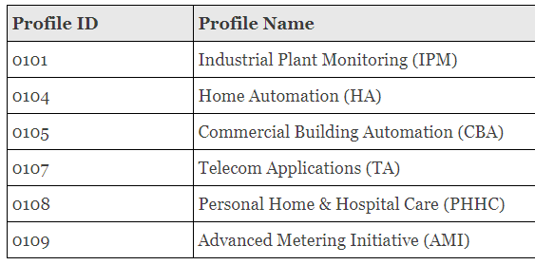
ZigBee profiles
Broad classes of device purposes
  Contains multiple Device Type definitions
Define more features of device than the profiles from BLE
  Pick various optional network/MAC features, like security or commissioning

Slide 22
Example ZigBee profile: Home Automation Device Types
Generic Devices
On/Off Switch
On/Off Output
Remote Control
Door Lock
Door Lock Controller
Simple Sensor
Smart Plug
Intruder Alarm System Devices
IAS Control and Indicating
IAS Ancillary Control
IAS Zone
IAS Warning Device
Lighting
On/Off Light
Dimmable Light
Colour Dimmable Light
On/Off Light Switch
Dimmer Switch
Colour Dimmer Switch
Light Sensor
Occupancy Sensor
HVAC Devices
Thermostat
Each bullet point is a Device Type
Which is a list of mandatory and optional Clusters

Slide 23
ZigBee Device Types
A collection of Clusters
  Some mandatory and some optional
Lists Clusters as Server side or Client Side
  Server side Cluster is an input
  Client side Cluster is an output
Example: light bulbs implement server, switches implement client

Slide 24
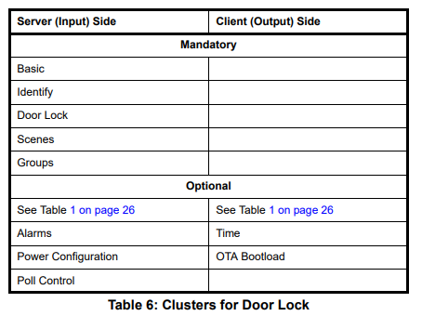
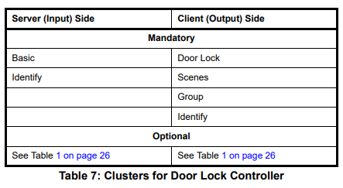
Example Device Types: door lock and door lock controller

Slide 25
ZigBee Clusters
A collection of Attributes and Commands
  Analogous to BLE Services
  Can be optional or mandatory
ZigBee Cluster Library defines standard Clusters
  Lists Attributes and Commands for each
  Attributes
    Type – uint8, enum, bitmap, string, etc.
    Permissions - Read/Write/Report (receive automatic updates)
    How to interpret meaning of value
  Commands
    Field(s), Type of each, Interpretation of each

Slide 26
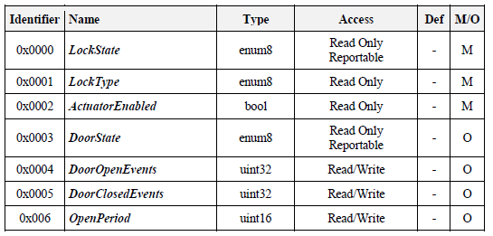
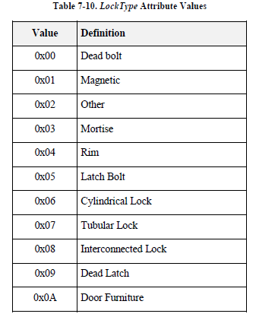
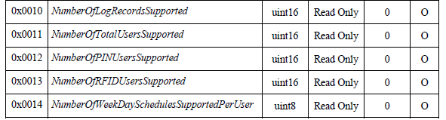
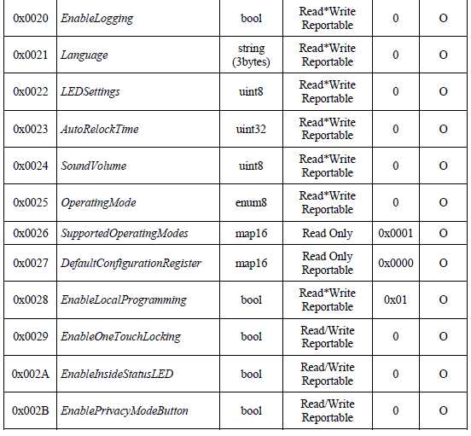
Example Cluster: door lock attributes

Slide 27
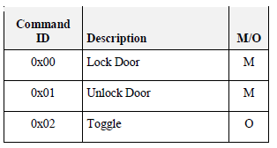
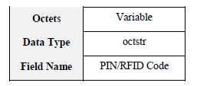
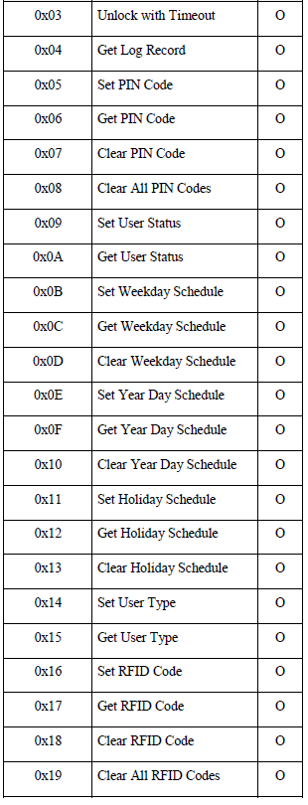
Example Cluster: door lock commands (client side)
Server-side
  Performs actions when it receives these commands
Client-side
  Capable of sending these commands

Slide 28
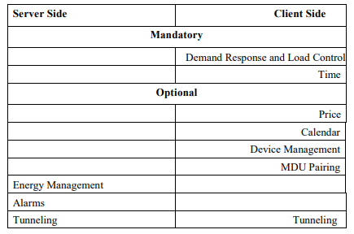
Example ZigBee profile: Smart Energy
Interactions with energy providers for efficiency and cost savings
Devices
  Energy service interface
  Metering device
  Load control device
Clusters
  Demand response
  Metering
  Price
  Key establishment (e.g. security)

Slide 29
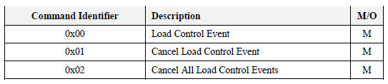
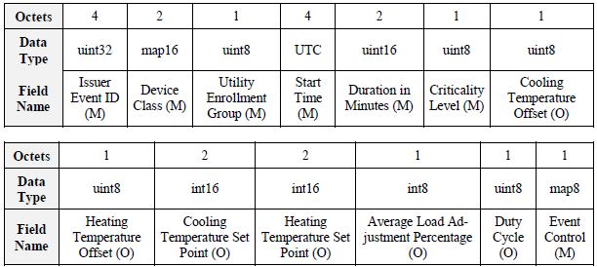
Example: demand response cluster
No attributes, only commands
Load Control Command Payload

Slide 30
Endpoints
Each ZigBee device has a number of Endpoints (up to 240)
  Number by which remote applications can contact it
  Analogous to a Port in TCP/UDP
Each Endpoint has one Device Type attached to it
  Communication refers to the Endpoint number,
    Then the Cluster ID within it,
    Then the Attribute/Command ID within that
  Endpoints can be queried to determine what they provide
Special case: Endpoint 0 – ZigBee Device Object
  All devices must implement the ZigBee Device Object
  Attributes and Commands for controlling a network device
  Network parameters are configured just like a light or door lock

Slide 31
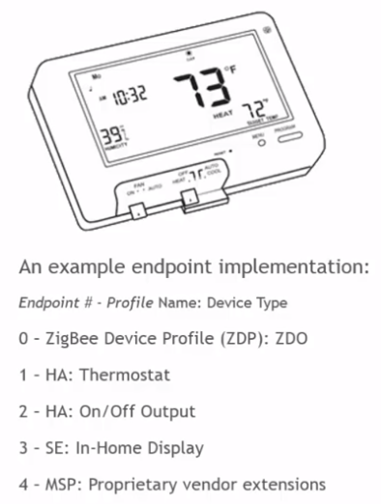
Example Endpoints for a device
Even simple devices hopefully have three endpoints:
  ZigBee Device Object
  <Their functionality>
  Over The Air Bootloader (code updates)

Slide 32
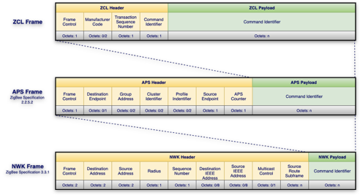
ZigBee application layer packets

Slide 33
Security is still a concern: Phillips Hue Bridge Vulnerability
ZCL data needs to be handled properly
  Phillips Hue Bridge had a buffer overflow when handling long string names
  Allowed attackers to break in through Zigbee to attack the IP network
Steps
  Figure out Zigbee network encryption keys with power analysis
  Upload hacked software via OTA update mechanism
  Buffer overflow bridge with large ZCL payload with attack instructions
  Further gives access to internal IP network to attack other devices
https://nvd.nist.gov/vuln/detail/CVE-2020-6007
https://www.trendmicro.com/vinfo/us/security/news/cybercrime-and-digital-threats/researchers-use-smart-light-bulbs-to-infiltrate-networks

Slide 34
Break + Comparison
ZigBee
  Standardized services
  Low-power end devices
  Higher power routers
  Mesh for extended range and connectivity
  No interface on most consumer hardware
BLE
  Standardized services
  Low-power end devices
  Higher power scanner/centrals
  Star topology for simplicity and focus on single “Central” device
  Compatible with smartphones

Slide 35
Outline
ZigBee overview
ZigBee PHY and MAC
ZigBee application layer
Interoperability

Slide 36
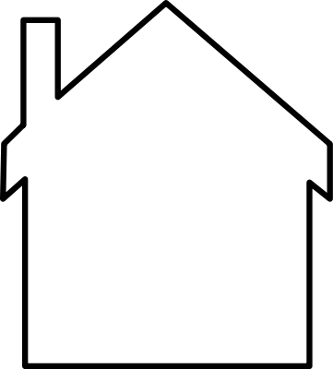
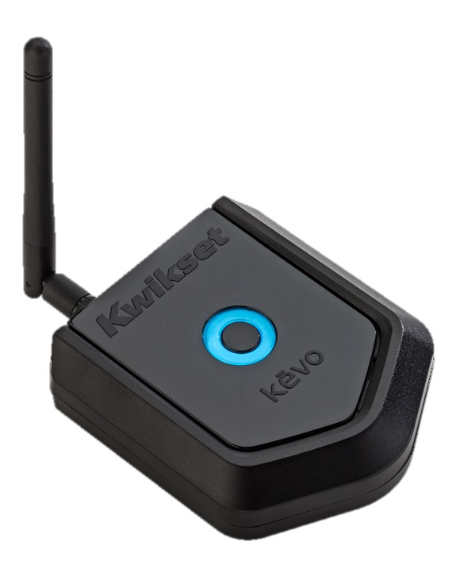
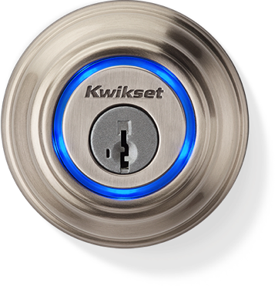
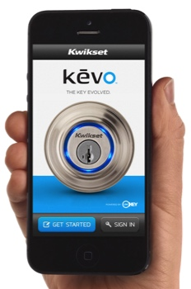
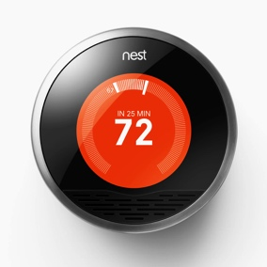
“When I leave, turn down the AC”
Kevo
Nest
Clumsy, and two companies now know that I locked my door.
Slide courtesy of Prabal Dutta
Notes:
Sometimes this makes sense—ASR, for example (Alexa Skills)

Slide 37
“When I leave, turn down the AC”
Kevo
IFTTT
Nest
Clumsy, and two three companies now know that I locked my door.
Slide courtesy of Prabal Dutta
Notes:
Sometimes this makes sense—ASR, for example (Alexa Skills)

Slide 38
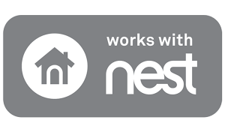








What does it look like without three different clouds?
”Standardization” is the answer? Custom adaptations?
Notes:
MTConnect is read only
OPC UA is so complex that you have to hire consultants to implement it anyway

Slide 39
Reusing ZCL across other networks
Can we use ZigBee Cluster Library to enable device interoperability
  Even if we don’t want to use the ZigBee protocol?
dotdot was a recent effort to spread ZigBee Clusters more widely
  Runs same application-layer on top of various lower layers
  ZigBee, BLE, Thread, WiFi, Ethernet

Slide 40
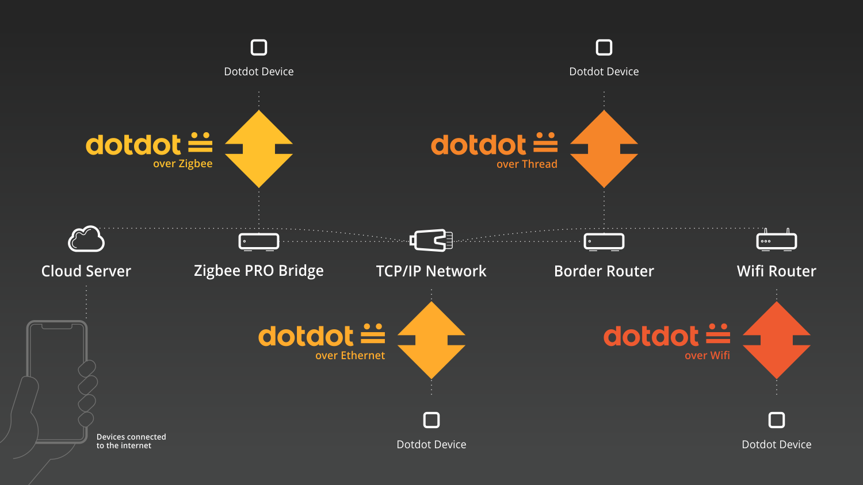
dotdot provides ZigBee-style control over various networks

Slide 41
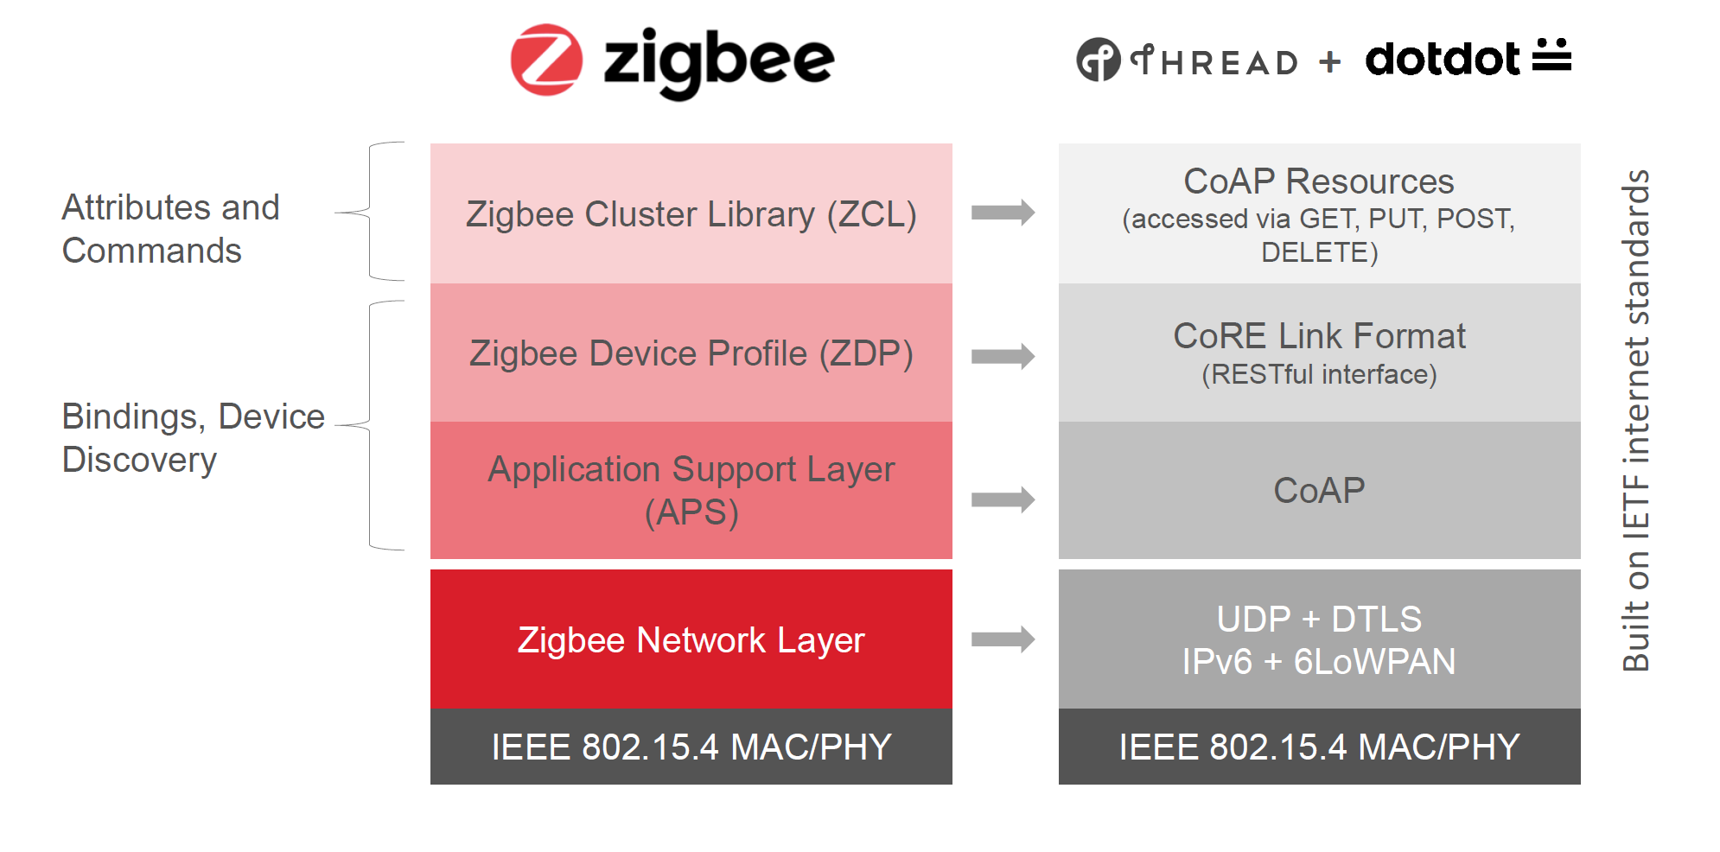
Example dotdot over Thread

Slide 42
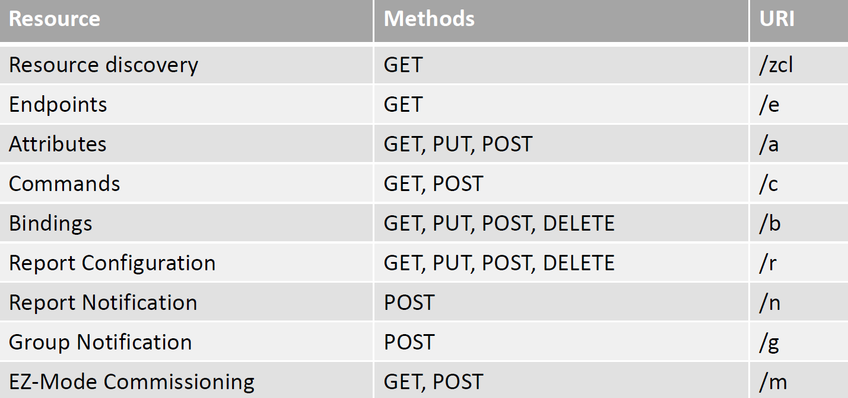
ZCL to CoAP mappings

Slide 43
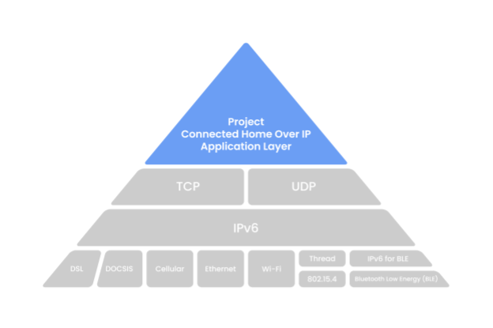
Zigbee Connectivity Standards Alliance today
2021 rebrand
  Zigbee fading in relevance, utility
  Zigbee group created/creating new standard: Matter
    Announced Dec 2019; first products shipped Fall 2022
    Previously known as “Project CHIP”
Setting up as a cross-platform solution
focused on nailing Smart Home
  Commissioning devices
  Security
  Device interactions
Matter

Slide 44
Matter documentation
Specifications
  Version 1.4 (November 2024): https://csa-iot.org/wp-content/uploads/2024/11/24-27349-006_Matter-1.4-Core-Specification.pdf
Nordic has a decent Matter overview with actual technical details: https://developer.nordicsemi.com/nRF_Connect_SDK/doc/latest/nrf/ug_matter_intro_overview.html
Documentation from “Project Chip”: https://project-chip.github.io/connectedhomeip-doc/index.html
Documentation on Matter’s website: https://handbook.buildwithmatter.com/

Slide 45
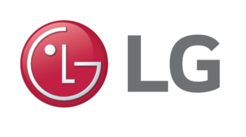















Matter Members

Slide 46
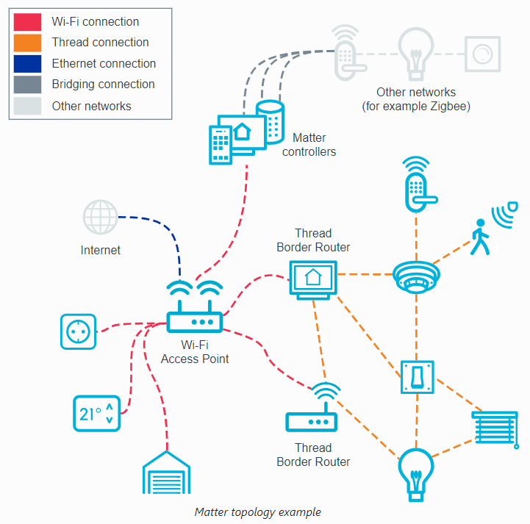
Matter Overview
Assumes networks already exist
How do we communicate with devices over those networks in a way that’s network-agnostic and vendor-agnostic?
Two big parts:
  Devices joining the network
  Communicating information between devices

Slide 47
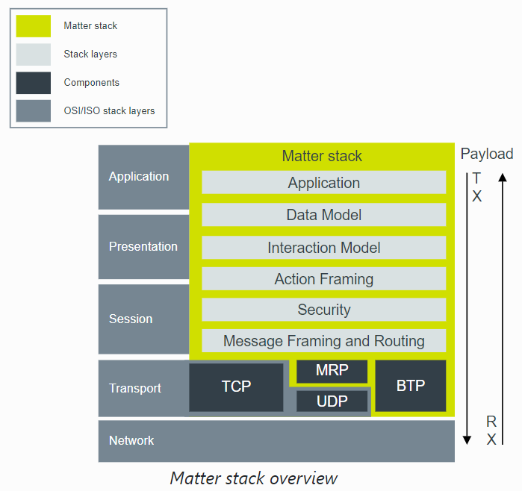
What does matter add?
Application-layer protocol
for how to interact with
devices and understand data
Includes security model for encrypting and authenticating messages
MRP – Message Reliability Protocol
  UDP + Retransmissions
BTP – Bluetooth Transport Protocol
  For device setup

Slide 48
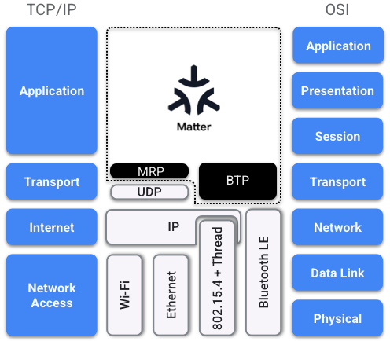
Matter communication architecture
Multiple Phy/Link layers: Ethernet, WiFi, or Thread
IPv6 networking
Multiple transport layers
  TCP, UDP, custom BLE layer for device setup only

Slide 49
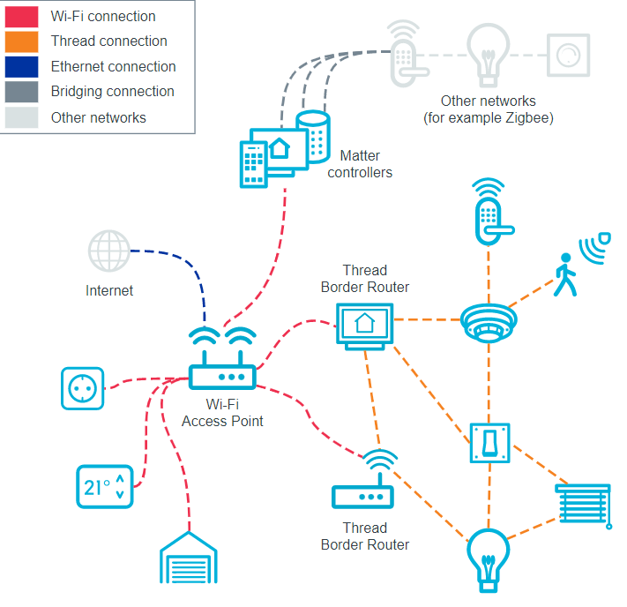
Connecting many devices
Ambitious goals of interoperability
“Fabric”: logical set of devices that share a security domain and can communicate
Devices in Matter can support “multi-fabric”
  This would enable connecting device ecosystems together
  Does have to be implemented though…

Slide 50
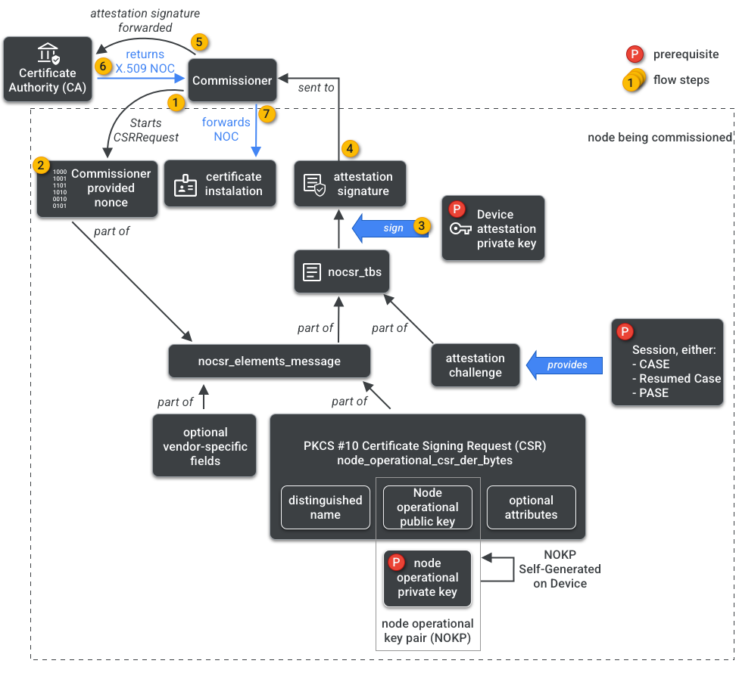
Challenge: credentials for devices joining the fabric
“simple” Matter joining process
Turns into a complicated process
Should this device be allowed to join?
How do we provide credentials for the device for encrypted, authenticated communication within the network?

Slide 51
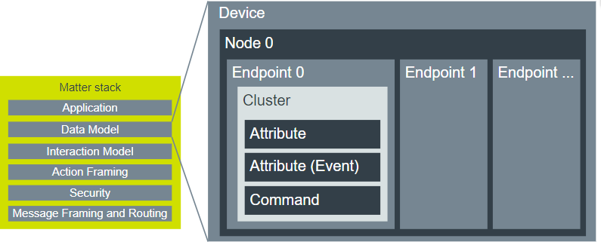
Matter uses ZigBee Cluster Library idea for interactions
“Action Framing” layer converts from raw packet data into device interactions
https://developer.nordicsemi.com/nRF_Connect_SDK/doc/latest/nrf/ug_matter_overview_architecture.html

Slide 52
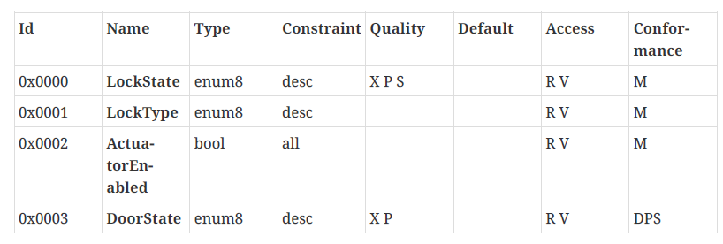
Matter reuses ZCL device attributes
Matter
ZigBee

Slide 53
Currently supported Matter device types
Matter 1.0 (October 2022)
  Lighting
  Smart Plugs/Outlets
  Switches and Controls
  Sensors (contact, light, occupancy, temperature, pressure, etc.)
  Closure (door/window/shades)
  HVAC
Matter 1.2 (October 2023)
  Refrigerators, Dishwashers, Laundry
  Smoke and Carbon Monoxide Alarms, Air Quality Sensors
  Fans, Portable Air Conditioners, Air Purifiers
  Robotics vacuum cleaners

Slide 54
More recent Matter device additions
Matter 1.3 (May 2024)
  Kitchen appliances: microwaves, ovens, cooktops,
  Dryers
  Electric vehicle chargers
  Leak sensors, water valves, rain sensors
Matter 1.4 (November 2024)
  Heat pumps
  Solar panels

Slide 55
What supports matter?
https://www.theverge.com/23568091/matter-compatible-devices-accessories-apple-amazon-google-samsung
  Still an evolving system
  Support is increasingly added to new devices
Needs a Matter Controller and (for thread) Thread border router
  Goal: get those integrated into home WiFi routers
    Version 1.4 adds some specification on how this works
  Current controllers: Apple Homepod, Apple TV, Google TV, Samsung SmartThings Hub, Amazon Echo Hub, and others…
    Mostly NOT Thread border routers though

Slide 56
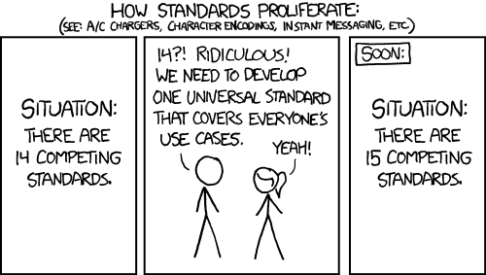
Is ZCL the right standard for device interactions?
Seems better than making something new from scratch
https://xkcd.com/927/

Slide 57
Outline
ZigBee overview
ZigBee PHY and MAC
ZigBee application layer
Interoperability

