Slide 1
Lecture 04
BLE Advertisements
CS433 – Wireless Protocols for IoT
Branden Ghena – Spring 2025
Materials in collaboration with
Pat Pannuto (UCSD) and Brad Campbell (UVA)

Slide 2
Announcements
Wireshark Lab
  Sorry that was not a great lab experience
    We’re going to try again this Friday, but in groups
    I’ll re-evaluate the plan depending on how that goes
  Get checkoffs this week during office hours
    Today 5-6 works
    Last office hours before deadline is 5-7 on Thursday
BLE packets homework will be up later tonight

Slide 3
Today’s Goals
Quick overview of Physical and Link layers for BLE
Describe BLE advertising and scanning roles
Deep dive into advertisements. Questions we might ask as researchers.
  What are the real-world use cases of advertisements?
  How much energy do advertisements take?
  What is the probability of receiving a packet?
    What is the probability of receiving data?

Slide 4
Basics of Bluetooth Low Energy (BLE)
Direct device-to-device communication
  Usually: Computer to Thing
  Smartphone to device, Laptop to device, etc.
Focus on making the “Thing” really low energy
  Push energy-intensive requirements onto “Computer”
Devices (Computer or Thing) are servers with accessible fields
  Not the traditional send-explicit-packets interface you might be expecting
  Lower layers are still exchanging packets to make it work

Slide 5
Bluetooth Classic and BLE co-exist & have different use cases
Bluetooth Classic
(around since 1999)
Continuous data communication
Can afford higher battery power requirements
Bluetooth Low Energy (introduced in 2010)
Small amounts of data transfer
Low power requirements
  “months or years” on small batteries
Ideal for IoT devices
Headphones
Mobile Photo
Printers
Fitness Trackers
Tracking Devices
(eg: Apple AirTag)
Switches
and Sensors
Car BT Audio
Notes:
As mentioned before, devices needing continuous, short-range data and audio streaming use Bluetooth Classic. This version of Bluetooth is standard in wireless printers, keyboards, speakers, and in-car entertainment systems.
Similarly, Bluetooth Low Energy (LE) powers a range of computer peripherals and audio devices. But due to low power usage, it’s ideal for IoT devices like fitness monitors, smart watches, and the like.
smart home, health, sport, and fitness sectors.
Bluetooth latest core specification: v5.3

Slide 6
BLE network topology
Peripheral
Connection
Central & Scanner
Scanner
Connection
Peripheral
Advertisement
Advertisement
Advertisement
Advertisement
Advertiser
Advertiser
Advertiser

Slide 7
Outline
BLE Layers
  Physical Layer
  Link Layer
BLE roles
  Advertising
  Scanning
    Scan Responses
Communicating with advertisements
  Advertisement Use Cases
  Energy Use
  Packet Collisions

Slide 8
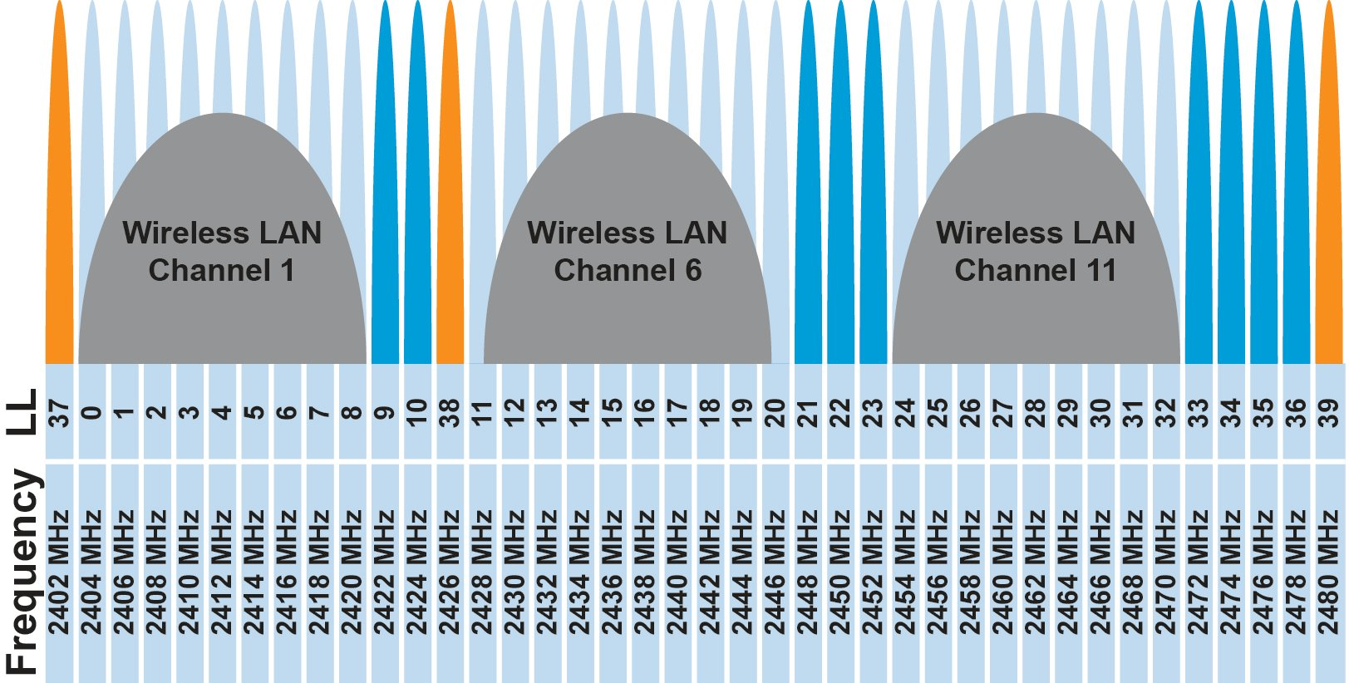
BLE frequency
2.4 GHz carrier, Forty 2-MHz channels, 1 Mbps data rate
  37, 38, 39 for advertising
  0-36 for connection (FHSS)
Why doesn’t BLE avoid WiFi altogether?

Slide 9
BLE frequency
2.4 GHz carrier, Forty 2-MHz channels, 1 Mbps data rate
  37, 38, 39 for advertising
  0-36 for connection (FHSS)
Why doesn’t BLE avoid WiFi altogether?
Can’t on 2.4 GHz
Wants 2.4 GHz for technology improvements

Slide 10
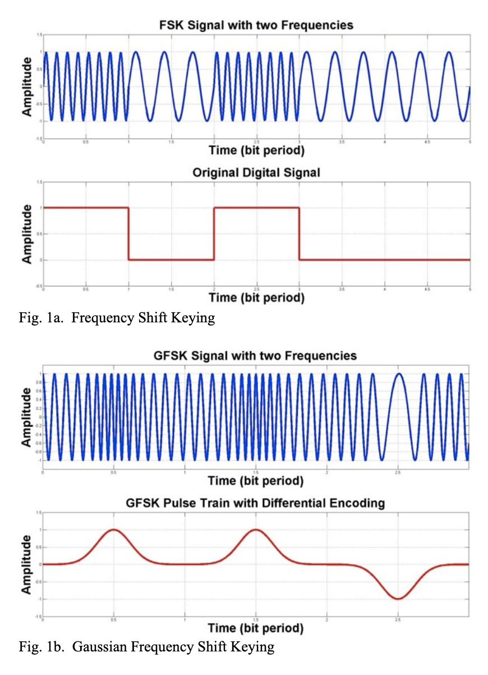
BLE modulation
Gaussian Frequency-Shift Keying (GFSK)
  Improvement on base Frequency-shift Keying
  Smoother transitions between bits -> reduces nearby interference

Slide 11
Why use GFSK?
Gaussian FSK lessens spectral leakage at the expense of some loss in intersymbol discriminability
  Translation: GFSK reduces bandwidth at the cost of bit errors
Notes:
Images from http://j3.rf-explorer.com/40-rfe/article/53-tutorial-how-to-use-rf-explorer-to-monitor-a-rfbee?start=4

Slide 12
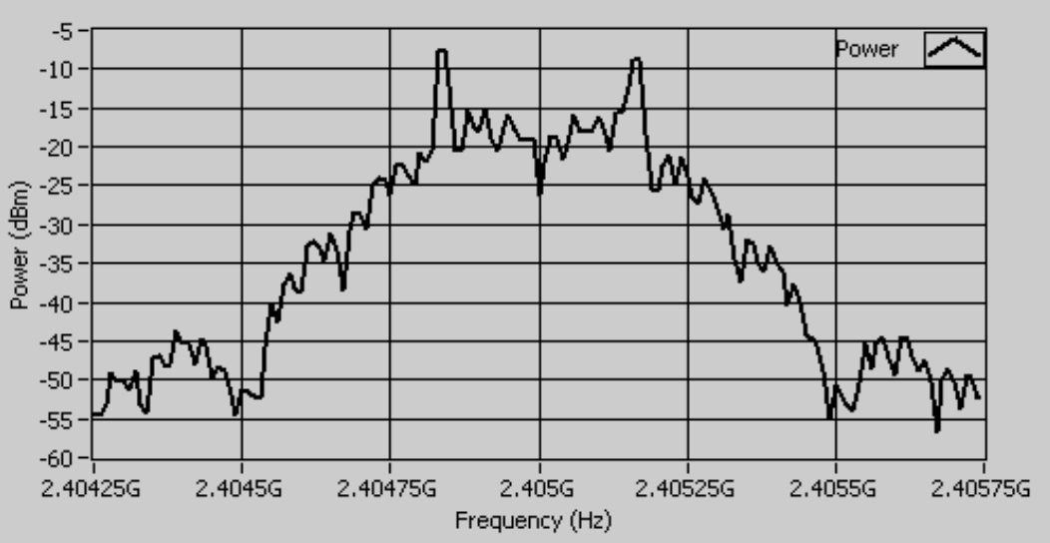
An example from `good case` BLE hardware
2 MHz BLE channels
  Energy focused on +/- 0.55 MHz
  With some much smaller energy near the edges of the channel
Notes:
Fig 8 in https://download.ni.com/evaluation/rf/intro_to_bluetooth_test.pdf

Slide 13
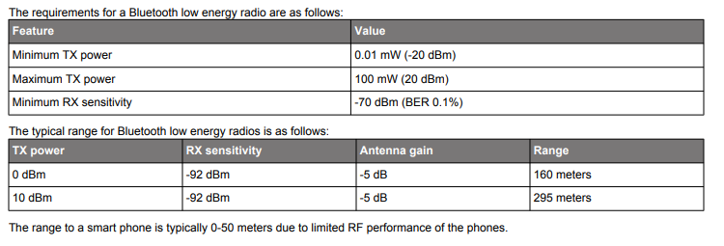
BLE signal strength
Remember nRF52840 capabilities
  Transmit: up to 8 dBm
  Receive sensitivity: -95 dBm

Slide 14
Outline
BLE Layers
  Physical Layer
  Link Layer
BLE roles
  Advertising
  Scanning
    Scan Responses
Communicating with advertisements
  Advertisement Use Cases
  Energy Use
  Packet Collisions

Slide 15
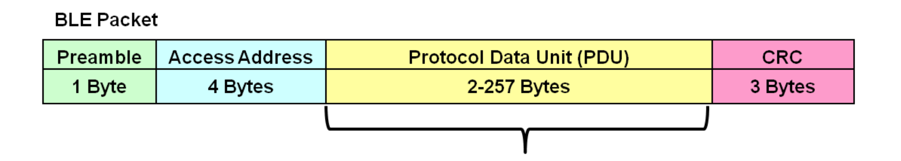
Packet structure
Same packet structure for both advertisements and connections
  Fields are filled in little endian (the opposite of network byte order 😡)
Access address unique for each connection
  Somewhat randomly chosen (spec has rules)
  In Advertising always set to 0x8E89BED6
Data

Slide 16
Device addresses
Public and private address forms
Public
  48 bits: 24-bits of company ID, 24-bits of company assigned number
  Literally the same MAC address scheme as Ethernet and WiFi
Private
  Top two MSbs specify type. Options:
    46 bits of random
    46 bits of hash of an identity key
Why have the two types?

Slide 17
Device addresses
Public and private address forms
Public
  48 bits: 24-bits of company ID, 24-bits of company assigned number
  Literally the same MAC address scheme as Ethernet and WiFi
Private
  Top two MSbs specify type. Options:
    46 bits of random
    46 bits of hash of an identity key
Why have the two types? Privacy

Slide 18
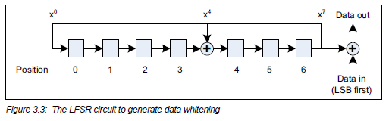
Data whitening
Avoid long series of repetitive bits (all zeros or all ones)
  Would cause RF noise to be more focused in one direction
  Radio hardware desires output to have zero DC-bias (or close to that)
  Great example of the PHY and MAC being interwoven in wireless
I always forget this exists, since hardware usually handles it automatically

Slide 19
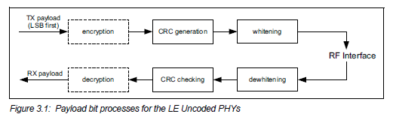
Bit processing pipeline

Slide 20
Break + Question
With enough scanners, could you track BLE devices as they move?

Slide 21
Break + Question
With enough scanners, could you track BLE devices as they move?
  Link Layer
    Depends on how long they use a device address for
    You can do a scan of BLE transmissions to find device addresses
    Scans at multiple locations can detect when a device moves throughout an area
    But if the device re-randomizes between two scanners, you can’t follow it anymore
      Re-randomizing at a scanner could be detectable…
      Or if the user has more than one device with unsynchronized rotation schedules

Slide 22
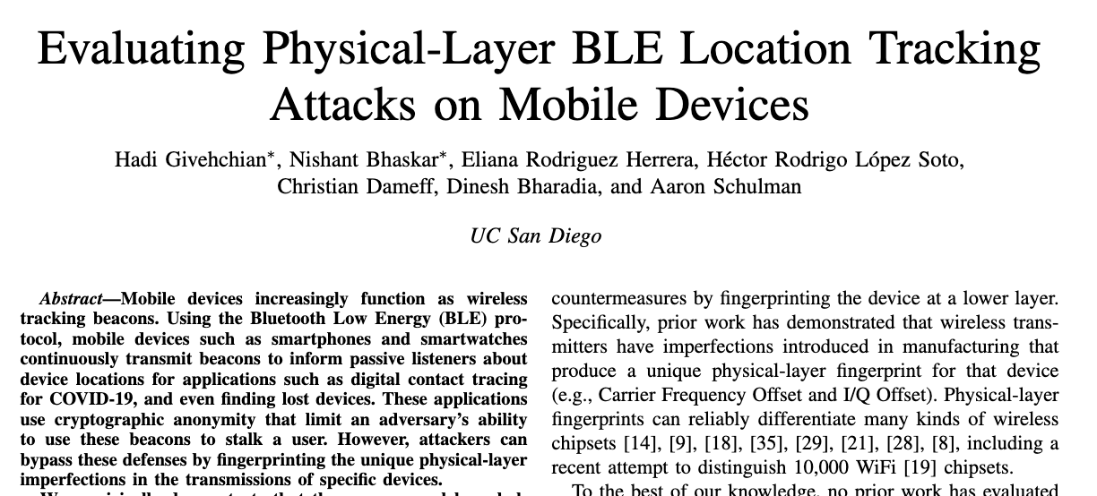
Break + Question
With enough scanners, could you track BLE devices as they move?
  Physical Layer
    Fingerprint unique physical-layer imperfections in signals
    Looking at things like amplitude and timing
    2022 paper out of UCSD explores this

Slide 23
Outline
BLE Layers
  Physical Layer
  Link Layer
BLE roles
  Advertising
  Scanning
    Scan Responses
Communicating with advertisements
  Advertisement Use Cases
  Energy Use
  Packet Collisions

Slide 24
BLE network topology
Peripheral
Connection
Central & Scanner
Scanner
Connection
Peripheral
Advertisement
Advertisement
Advertisement
Advertisement
Advertiser
Advertiser
Advertiser

Slide 25
Advertising
BLE discovery mechanism
  Make nearby devices aware of advertiser’s existence
  Communicate some information from or about advertiser
  Traditional purpose is to enable connections, but this is also useful for general communication
Advertisements
  Periodic broadcast messages with data
Scan Requests/Responses
  Scanner sends responses after getting a request
    Only occurs when scanner is listening
  Almost literally “bonus advertisement data”

Slide 26
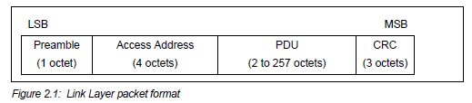
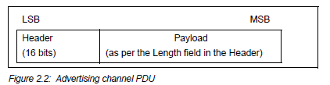
Advertising packet layering

Slide 27
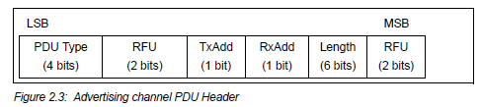
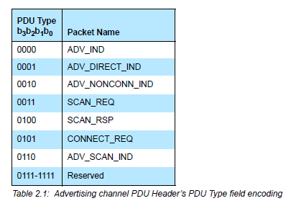
BLE advertising header
ADV_IND
  Advertisement
  Allows connections and scan requests
ADV_NONCONN_IND
  Advertisement
  No connections or scan requests
ADV_SCAN_IND
  Advertisement
  No connections but allows scan requests
SCAN_REQ
  Scan request
SCAN_RSP
  Scan response

Slide 28

Advertisement payloads
AdvA – address of the advertiser
  TxAdd bit from header specifies if this is a “public” or “random” address
Remaining up to 31 bytes are available for use
Putting it all together, up to 47 bytes total:
BLE Packet
Advertising PDU
Preamble 1 Byte | Access Address 4 Bytes | Header 2 Bytes | Advertiser Address 6 Bytes | Advertiser Data (Payload) 0-31 Bytes | CRC 3 Bytes

Slide 29
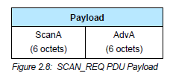
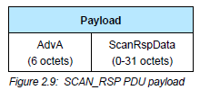
Scan Requests and Responses
Scan request
  Request for additional information
  Just the two addresses: the scanner’s and the advertiser’s
Scan response
  Identical to an advertisement in structure but only occurs after a request
  Usually has additional data not in the advertisement

Slide 30
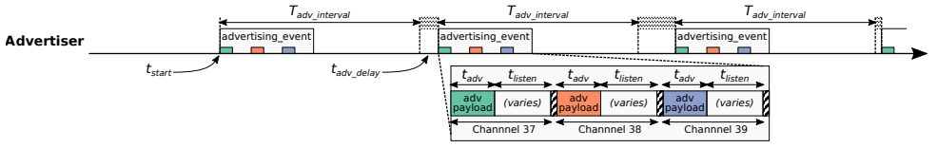
Advertising timing
Advertising Events occur periodically [20ms – 10.24 s] (or longer)
  Plus a random delay after each instance [0-10ms]
  Why?
User picks the rate as a tradeoff of energy and discovery latency

Slide 31
Advertising timing
Advertising Events occur periodically [20ms – 10.24 s] (or longer)
  Plus a random delay after each instance [0-10ms]
  Why? Avoid repeat collisions
User picks the rate as a tradeoff of energy and discovery latency

Slide 32
Advertising event
Three transmissions, one on each advertising channel
  Always in the same order
Transmission, followed by listening window on that same channel
  Requests will be sent >=150 us (Inter-Frame Spacing, IFS) after Tx
  Followed by a retune to the next channel frequency
This short listen window is the magic “low energy” part

Slide 33
Preserving energy in communication
Most energy is spent listening
  This is due primarily to how long listening durations are compared to transmissions
Example: maximum-sized BLE transmission:
  8 bits/byte * 47 bytes = 376 bits at 1 Mbps = 0.376 ms transmitting
  So listening for an entire second is >2500 times longer

Slide 34
Payload of an advertisement
What do you stick in the BLE payload anyways?
  Theoretically whatever you want, but that isn’t very compatible
  Point is to specify capabilities of the advertiser
Desire: specify payloads in such a way that all scanners can interpret what they mean about the device
  This is different from traditional internet packets
  Broadcasts are for _anyone_ to hear, not a specific server/application
Which fields are or aren’t present is device-specific
  A lot more possible fields than will really be used on any device

Slide 35
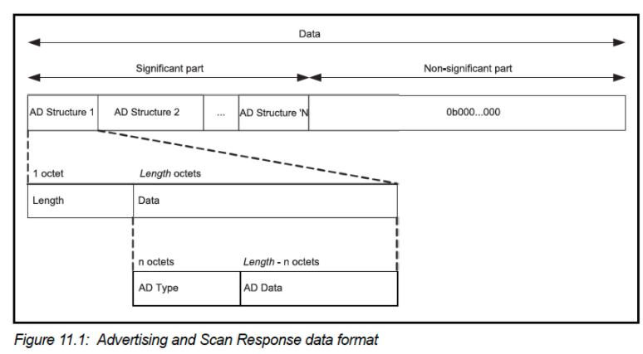
TLV Format
Type – Length – Value (Wikipedia)
  Actually, BLE does the length part first
  Scanner can hop through length/type pairs to find what interests it

Slide 36
Payload types
Listed in the Core Specification Supplement [Supplement v9]
  Each might have their own considerations about AD Data format
Flags (supported modes: BLE and Bluetooth) required by Apple?
Name
Service UUID
TX Power Level
Manufacturer-specific data
And about twenty others

Slide 37
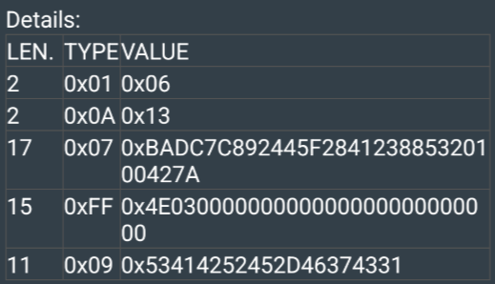
Example: BLE advertisement payload
This particular payload (52 bytes) is a combination of advertisement data and scan response data
Example payload:
  02 01 06 02 0A 13 11 07 BA DC 7C 89 24 45 F2 84
  12 38 85 32 01 00 42 7A 0F FF 4E 03 00 00 00 00
  00 00 00 00 00 00 00 00 0B 09 53 41 42 52 45 2D
  46 37 43 31
Break + Question:
What is the Local Name of this device?
Type 0x09
Bytes in the Local Name type are ASCII values
Bonus: what is this device?

Slide 38
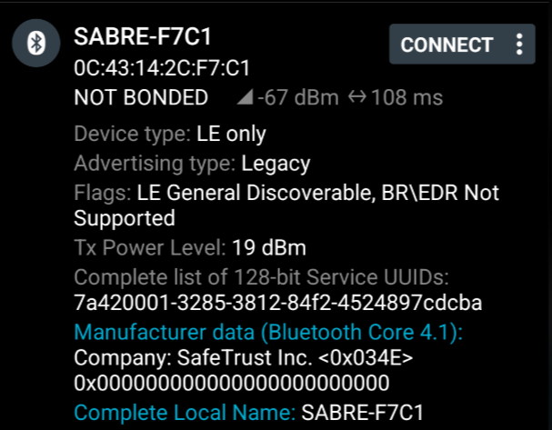
Example: BLE advertisement payload
This particular payload (52 bytes) is a combination of advertisement data and scan response data
Example payload:
  02 01 06 02 0A 13 11 07 BA DC 7C 89 24 45 F2 84
  12 38 85 32 01 00 42 7A 0F FF 4E 03 00 00 00 00
  00 00 00 00 00 00 00 00 0B 09 53 41 42 52 45 2D
  46 37 43 31

Slide 39
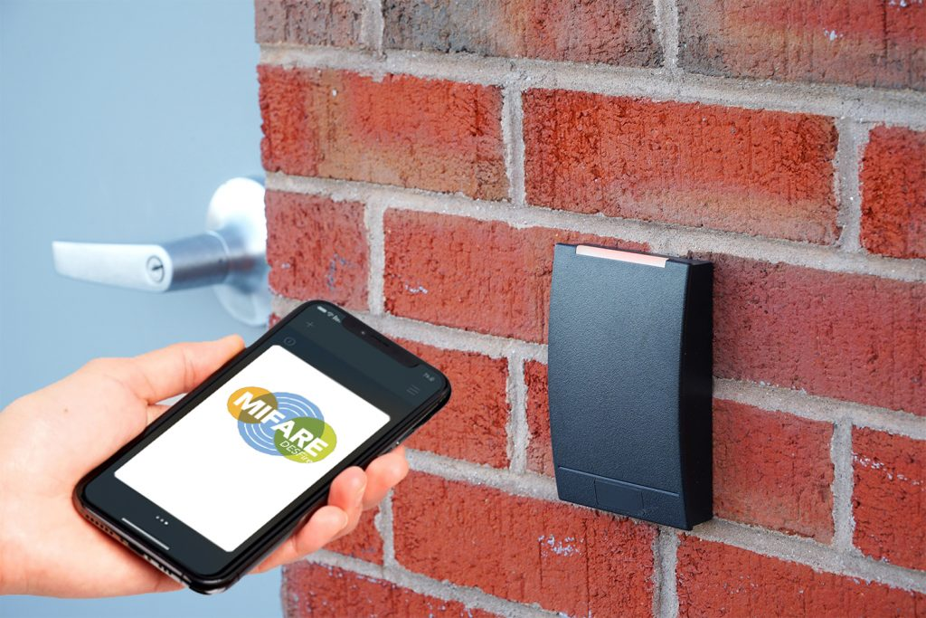
What is this device?
Bluetooth module for door ID scanner

Slide 40
Outline
BLE Layers
  Physical Layer
  Link Layer
BLE roles
  Advertising
  Scanning
    Scan Responses
Communicating with advertisements
  Advertisement Use Cases
  Energy Use
  Packet Collisions

Slide 41
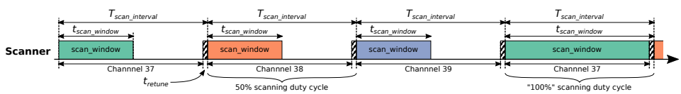
Scanning Pattern
Iterate through channels, listening for advertisements
  T_{scan_interval} controls rate at which channels are changes
  T_{scan_window} controls duty cycle of listening
Why listen at a low duty cycle?

Slide 42
Scanning Pattern
Iterate through channels, listening for advertisements
  T_{scan_interval} controls rate at which channels are changes
  T_{scan_window} controls duty cycle of listening
Why listen at a low duty cycle? Save energy

Slide 43
A warning about scanning expectations
Scanners will NOT receive 100% of packets sent
  Even ignoring range issues
Packets are lost due to (in roughly descending order):
  Duty cycle
  Sharing 2.4 GHz antenna with WiFi
  Retune period after each scanning interval
  Dropped packets in the receive software
  Packet collisions

Slide 44
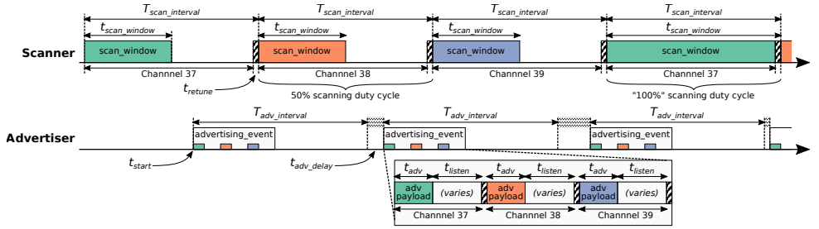
Putting it all together
Advertisements are received when the channel of the scan window and the channel of the advertisement overlap in time (and space)

Slide 45
Outline
BLE Layers
  Physical Layer
  Link Layer
BLE roles
  Advertising
  Scanning
    Scan Responses
Communicating with advertisements
  Advertisement Use Cases
  Energy Use
  Packet Collisions

Slide 46
Scan requests/responses seem intriguing
Why not send most data in scan responses instead of advertisements?
  Theoretically could reduce energy costs
Scan we use scan requests as a form of acknowledgement?
  Could relieve need for redundant transmissions
Problem: scan requests/responses don’t work all that well

Slide 47
Scan Requests and Responses are broken
Goal: provide a little extra advertisement data on demand
Problem: exponential backoff for lost messages
  Scanners backoff if there is a request without a response
    Assumption: collision with another scanner
  But collisions also occur with other devices advertising
    Which shouldn’t require backoff
  Result: scan requests occur less frequently than expected/desired
    Instead, just send additional data in additional advertisements
  Kravets, Robin, Albert F. Harris III, and Roy Want. "Beacon trains: blazing a trail through dense BLE environments." Proceedings of the Eleventh ACM Workshop on Challenged Networks. 2016.

Slide 48
Outline
BLE Layers
  Physical Layer
  Link Layer
BLE roles
  Advertising
  Scanning
    Scan Responses
Communicating with advertisements
  Advertisement Use Cases
  Energy Use
  Packet Collisions

Slide 49
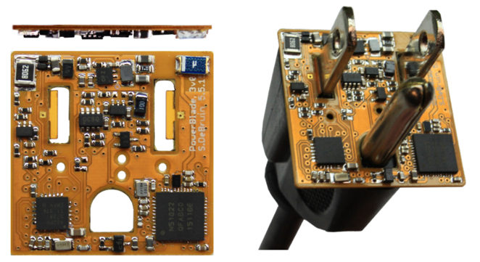
Advertisements are sufficient for some applications
BLE advertisements are uncoordinated, broadcast messages designed for discovery.
Devices are being deployed using advertisements.
  Beacons – iBeacon
  Tracking – Tile
  Local communication – Apple Continuity
  Sensor deployments – PowerBlade
Notes:
PowerBlade is a great example of this.
It’s a plug-load power meter
Initially configured to use advertisements as a simple method for reading measurements with a smartphone
We are interested in household deployments where dozens of PowerBlades will be deployed to measure all the loads in a home
Can we still use BLE advertisements for data transfer in the presence of many other devices?

Slide 50
Beacons
Advertising with advertisements!
Web of Things
  Real-world tags that broadcast virtual-world identifiers
iBeacon and Eddystone
  Formats for sending URLs and device identifiers
  Use existing BLE fields (Service Data and Manufacturer-Specific Data)
Faded in popularity significantly

Slide 51
Tracking
Find devices nearby
  Get a sense of distance to the device
Find my X
  Tile: find my keys
  Apple: find my device (before UWB radios)
Uses TX power level field
  Lists the transmitted power of the device
  Pathloss = TX power – RSSI (all in dBm)

Slide 52
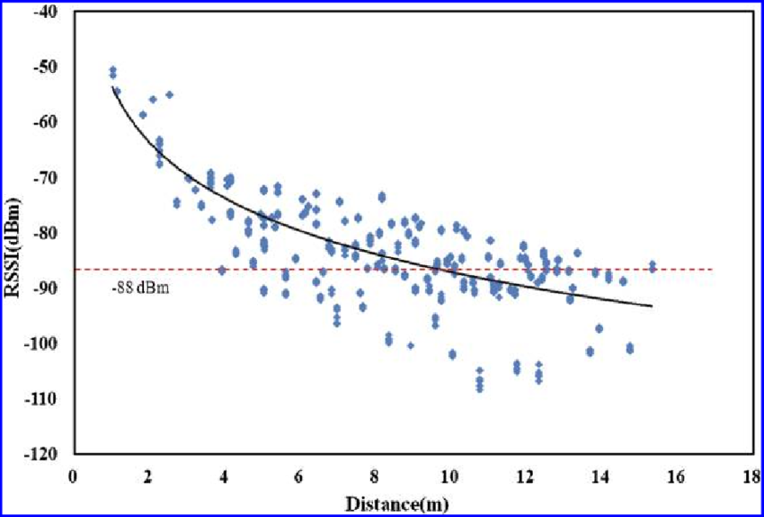
Problem with RSSI-based distance – not accurate
Pathloss is NOT only due to distance
RSSI is way worse at this than you hope it would be
Citation: literally everyone has made this figure at some point

Slide 53
Local communication: Apple “Continuity”
Key part of Apple’s “ecosystem”, including:
Handoff
  Start tasks on one device and continue on another device
Universal Clipboard,
  Copying of data from one Apple device and pasting on another
iPhone Cellular Calls
  Make calls using iPhone’s cellular connection on Mac or iPad

Slide 54
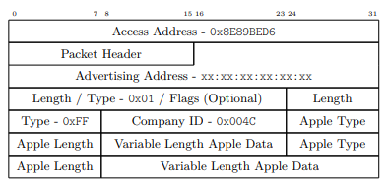
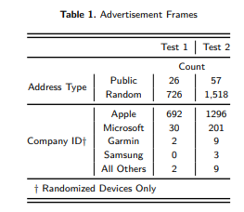
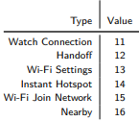
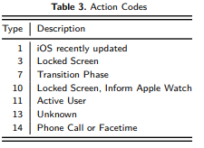
Communication with only nearby devices
Uses BLE “Manufacturer Specific Data” to communicate
Martin, Jeremy, et al. "Handoff all your privacy–a review of apple’s bluetooth low energy continuity protocol." Proceedings on Privacy Enhancing Technologies 2019.4 (2019): 34-53.

Slide 55
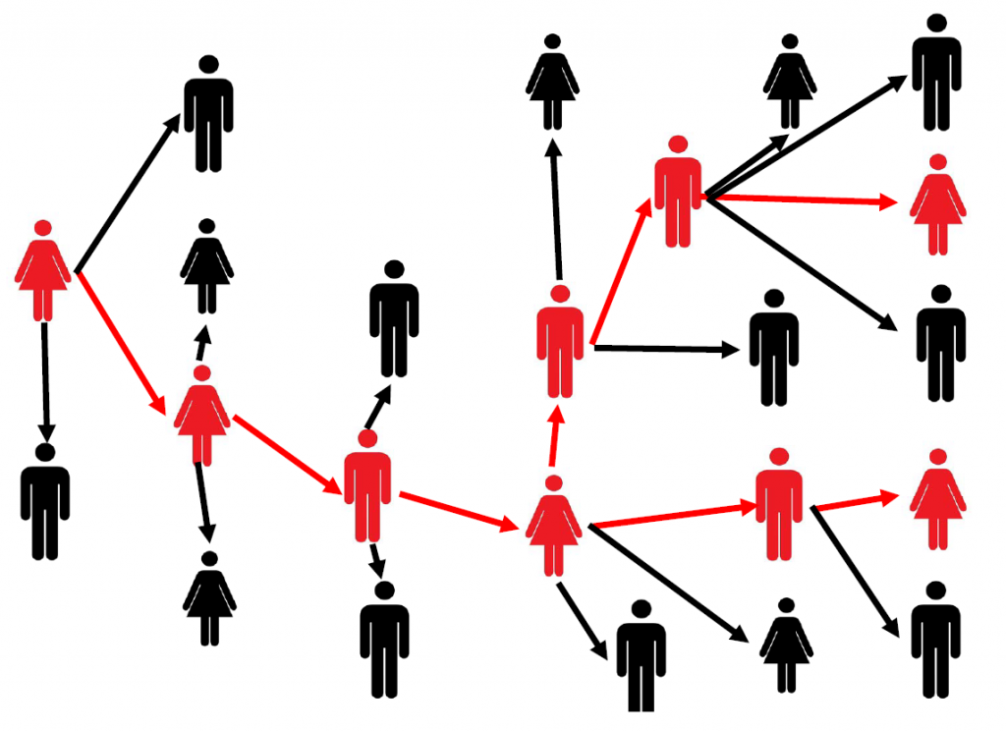
Local Communication: Exposure Notifications
Apple and Google collaboration to use phones for contact tracing
  Smartphone constantly broadcasts identifier.
  Periodically, each smartphone listens for broadcasts around it.
  Check list of identifiers to see if you’ve been around someone who is sick.
Requires government/healthcare
system interactions to determine when
an identifier should be flagged as sick
  24 states (not Illinois) adopted this
Implemented at OS level in background

Slide 56
Sensor deployments
Report data so gateways and users can retrieve it simultaneously
  Easy introspection during a deployment
  Satisfy users’ curiosity
Ignore difficult questions about networking
  Just broadcast the data!
DeBruin, Samuel, et al. "Powerblade: A low-profile, true-power, plug-through energy meter." Proceedings of the 13th ACM Conference on Embedded Networked Sensor Systems. 2015.

Slide 57
Outline
BLE Layers
  Physical Layer
  Link Layer
BLE roles
  Advertising
  Scanning
    Scan Responses
Communicating with advertisements
  Advertisement Use Cases
  Energy Use
  Packet Collisions

Slide 58
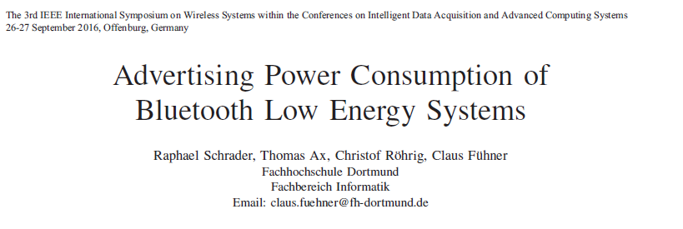
Paper: power measurements of BLE advertisements
Schrader, Raphael, et al. "Advertising power consumption of bluetooth low energy systems." 2016 3rd International Symposium on Wireless Systems within the Conferences on Intelligent Data Acquisition and Advanced Computing Systems (IDAACS-SWS). IEEE, 2016.

Slide 59
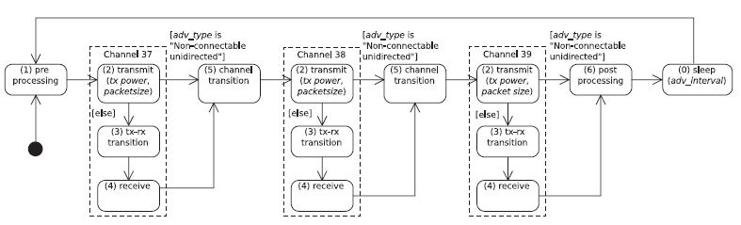
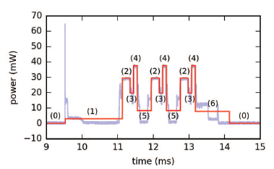
Energy model for BLE advertisements
Creates a set of states and metrics for how much power each uses and for what duration
  power * duration = energy

Slide 60
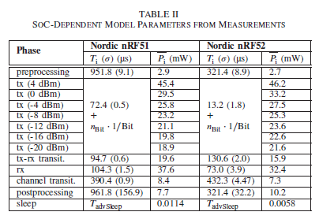
Measurements of Power Use
Power use and duration (energy)
  nRF51 (nRF51822)
  nRF52 (nRF52832)

Slide 61
How much energy does it cost to send data over advertisements?
Configuration
  nRF51822 microcontroller
  Maximum payload size
  +4 dBm transmit power
  Connectable advertisement
  Sleep power 11 µW
One packet per second example:
  110 µW average
  ~270 days on a CR2032
One packet per minute example:
  13 µW average
  ~2250 days on a CR2032

Slide 62
Break + Open Question
How long does the lifetime of a BLE advertiser need to be?

Slide 63
Outline
BLE Layers
  Physical Layer
  Link Layer
BLE roles
  Advertising
  Scanning
    Scan Responses
Communicating with advertisements
  Advertisement Use Cases
  Energy Use
  Packet Collisions

Slide 64
Questions about network capability
What are the odds that a transmitted advertisement will be received?
  Packet reception rate
If M redundant advertisements are sent instead, what are the odds that at least one are received?
  Data reception rate
How do these odds vary with number of devices, advertising interval, and packet size?

Slide 65
What causes transmissions not to be received?
Not within range of the gateway.
  Or various other losses within the gateway itself
Two devices try to send at the same time (packet collision).
X
X
broadcast domain

Slide 66
What is the probability of a packet collision?
time
t_{adv_0}
Packet 0
Jeon, Wha Sook, et al. "Performance analysis of neighbor discovery process in bluetooth low-energy networks." (IEEE Transactions on Vehicular Technology, 2016).
Perez-Diaz de Cerio, David, et al. "Analytical and experimental performance evaluation of BLE neighbor discovery process including non-idealities of real chipsets." (Sensors, 2017).

Slide 67
What is the probability of a packet collision?
time
t_{adv_1}
t_{adv_0}
Packet 0
Packet 1
Packet 1
Packet 1
Packet 1
Packet 1
Jeon, Wha Sook, et al. "Performance analysis of neighbor discovery process in bluetooth low-energy networks." (IEEE Transactions on Vehicular Technology, 2016).
Perez-Diaz de Cerio, David, et al. "Analytical and experimental performance evaluation of BLE neighbor discovery process including non-idealities of real chipsets." (Sensors, 2017).
Notes:
Collisions occur if any part of the two packets overlap
Particularly true for BLE that only has an 8-bit preamble

Slide 68
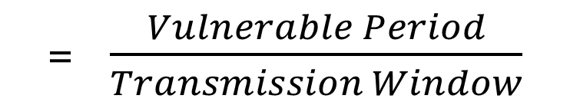
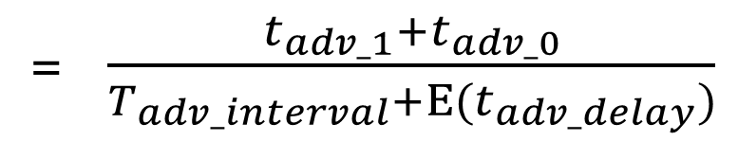
What is the probability of a packet collision?
time
t_{adv_1}
t_{adv_0}
Packet 0
Packet 1
Probability of Collision
= $\frac{Vulnerable Period}{Transmission Window}$
= $\frac{t_{adv_1}+t_{adv_0}}{T_{adv_interval}+Ε(t_{adv_delay})}$
Jeon, Wha Sook, et al. "Performance analysis of neighbor discovery process in bluetooth low-energy networks." (IEEE Transactions on Vehicular Technology, 2016).
Perez-Diaz de Cerio, David, et al. "Analytical and experimental performance evaluation of BLE neighbor discovery process including non-idealities of real chipsets." (Sensors, 2017).
Notes:
The vulnerable period is the sum of the two advertisement durations
While the transmission window is the advertisement interval plus the expected value of the random delay

Slide 69
Determine Probability of Multiple Failures
Given:
  Probability of Collision
Determine:
  Probability of Reception for data sent redundantly across M packets
  i.e., what are the odds that at least one of the packets doesn’t collide
  1 – (Probability of Collision^{M})
    (P_{c})^{M} = Probability that all of them collide
    1-that = Probability that NOT all of them collide

Slide 70
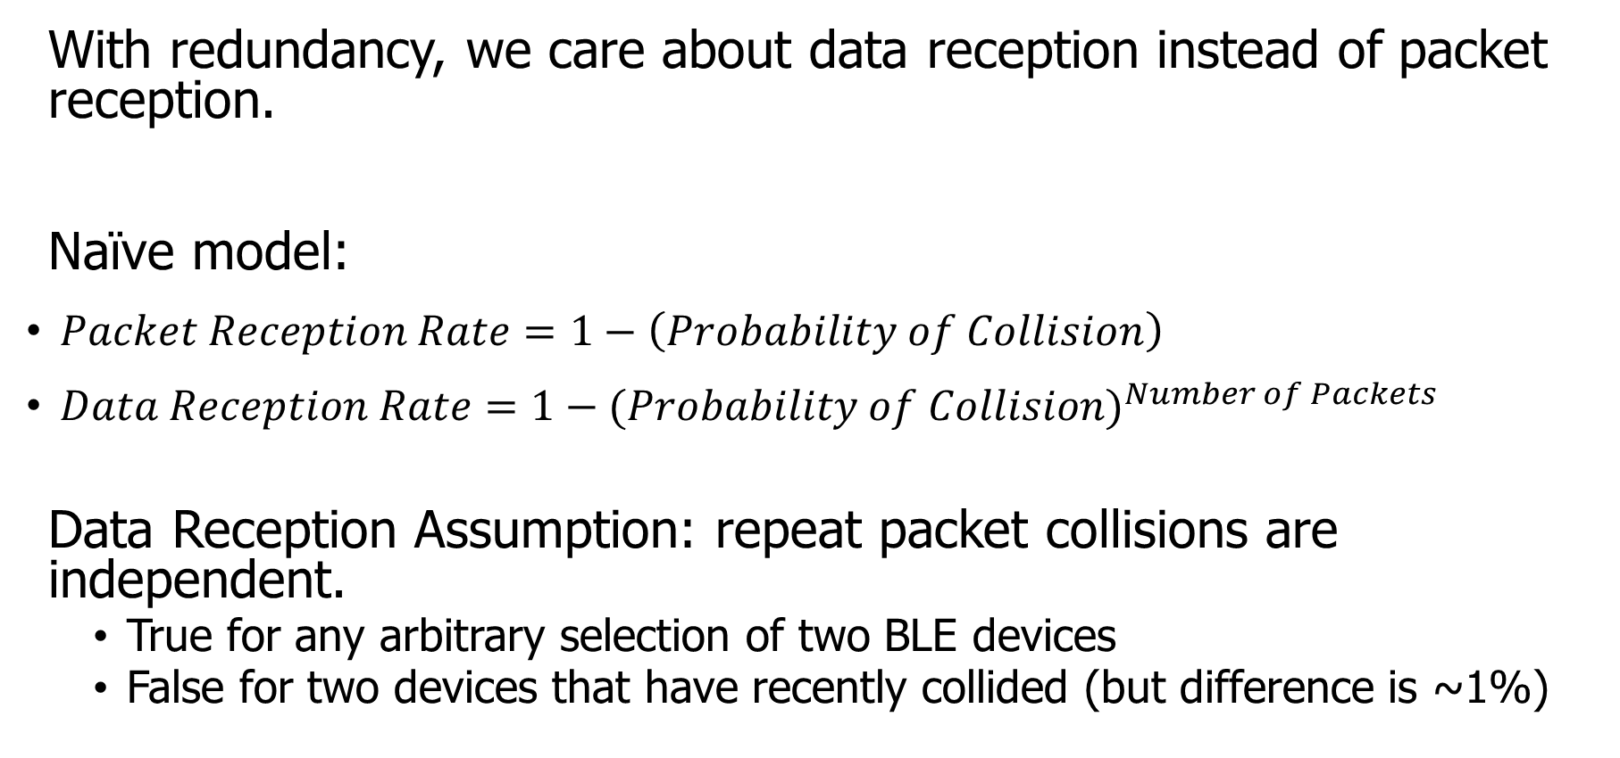
How do we determine reception rate?
With redundancy, we care about data reception instead of packet reception.
Naïve model:
$Packet Reception Rate=1−\left(Probability of Collision\right)$
$Data Reception Rate=1−{(Probability of Collision)}^{Number of Packets}$
Data Reception Assumption: repeat packet collisions are independent.
  True for any arbitrary selection of two BLE devices
  False for two devices that have recently collided (but difference is ~1%)
Notes:
Earlier we demonstrated the probability of collision, which can be used to determine packet reception rates.
Now with redundancy, we don’t care about the reception of any one packet, but the reception rate of the data that is being sent over them.
Naively, we can take the probability of collision and repeat it for any number of redundant packets.
There is an assumption in that model that repeat collisions are independent, which I’ll show you is false.

Slide 71
When are transmissions from two devices independent?
Assumption is true for any BLE device that has been advertising for some time
  Sum of random delays grows the uncertainty of transmission.
  Applied to periodic transmissions, any point in interval becomes equally likely.
    Range of 1x delay, 2x delay, 3x delay, until it wraps
time
T_{adv_interval}
delay
T_{adv_interval}
delay
T_{adv_interval}
delay

Slide 72
When are transmissions from two devices NOT independent?
Independence assumption is false for two BLE devices that have recently collided.
  If T_{adv_interval} is identical, next transmissions with be close in time.
  Collision is determined by difference of random delays.
  Further repeat collisions have the same probability of occurrence.
New time period collisions could occur within
time
T_{adv_interval}
delay
Notes:
If two devices have collided before, and have the same interval, at the next period they will certainly collide again.
BLE has a random delay appended to reduce this possibility.
But we’ve now greatly reduced the transmission window that the a collision could occur in. We can calculate this to determine a distinct probability of repeat collision.
Note that further repeat collisions are bounded by the same difference of random delays, and therefore have the probability of a second repeat collision is the same as the probability of a first repeat collision.

Slide 73





Calculating probability of a repeat collision
Difference of two uniform random delays forms a triangular distribution
probability
t_{adv_1}
t_{adv_0}
Probability of Repeat Collision
difference in transmission time
$$−t_{adv_delay}$$
$$−t_{adv_1}$$
$$0$$
$$t_{adv_0}$$
$$t_{adv_delay}$$

Slide 74
Important lesson: spend time on things that are important
How important was accounting for repeat collisions?
Maximum error is about a 1% change in Data Reception Rate.
This is due to size of delay 10 ms compared to size of transmission ~300 µs.
200 ms interval advertisements

Slide 75
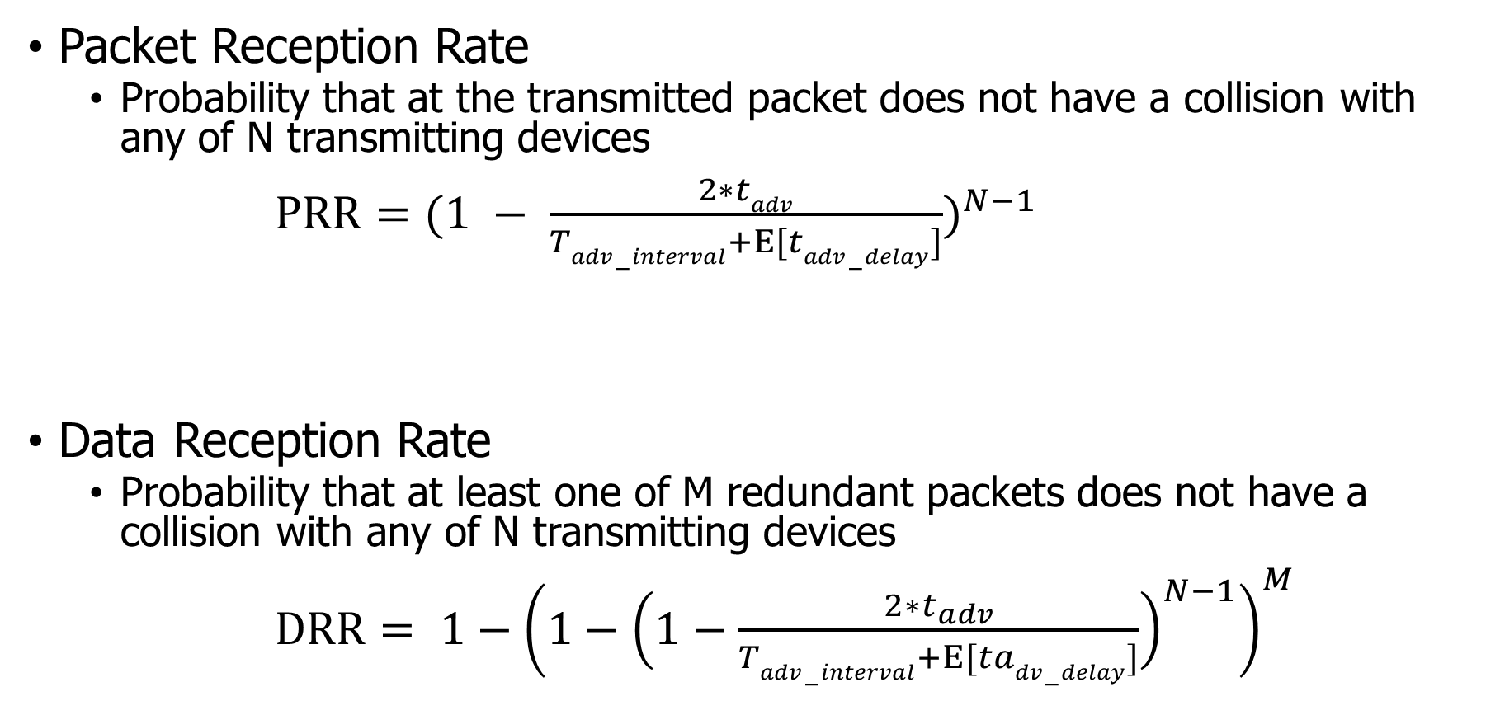
Equations for modeling data transmissions
Packet Reception Rate
  Probability that at the transmitted packet does not have a collision with any of N transmitting devices
$PRR={(1 − \frac{2∗tadv}{Tadv−interval+Ε[tadv−delay]})}^{N−1}$
Data Reception Rate
  Probability that at least one of M redundant packets does not have a collision with any of N transmitting devices
$DRR= {1−\left(1−{\left(1−\frac{2∗t_{adv}}{Tadv−interval+Ε[tadv−delay]}\right)}^{N−1}\right)}^{M}$

Slide 76
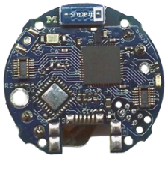
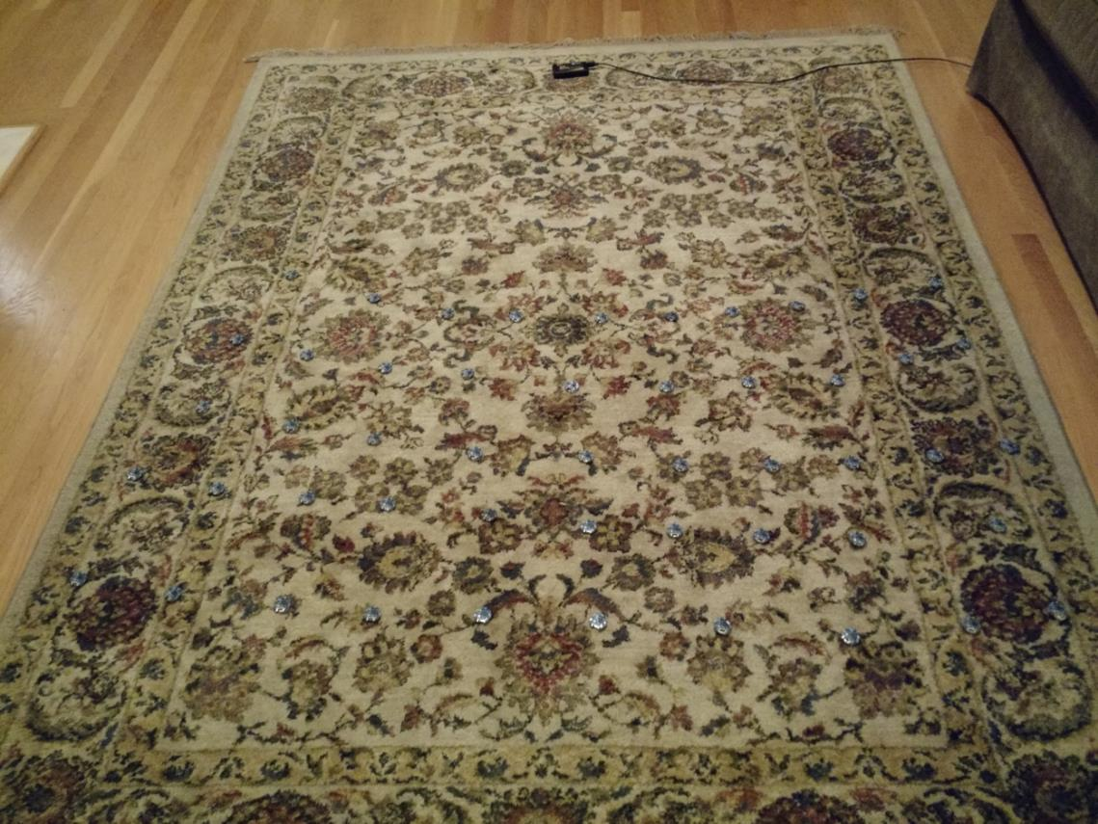
Is the model valid?
Empirical testing setup:
  50 devices
  1 meter from scanner
  5-10 cm apart
Transmit monotonically increasing sequence numbers.
Sweep number of devices and advertising intervals.

Slide 77
Redundancy results in high DRR even with many devices.
In this example, a sensor has new data once per second and sends it in 1-3 packets.
Even without redundancy, data reception rates never fall below 87% even with 200 devices in a deployment, assuming no interference.

Slide 78
Redundancy is (normally) better than less congestion.
Design question:
Send more packets to gain from redundancy?
OR
Send less packets to reduce congestion?
The answer changes, but only with many devices.
Notes:
This plot changes with advertisement rate, and can get as low as 100 devices

Slide 79
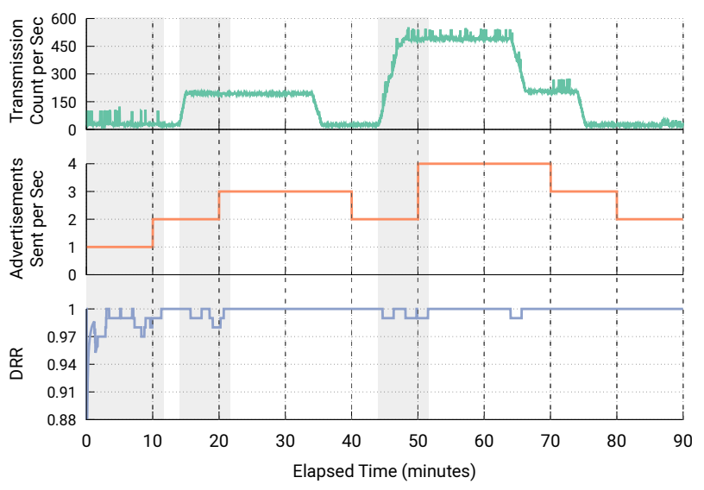
Automatic adaptation to advertising environment
Devices could automatically adjust to the environment for best transmission rate
Scan and count how many unique devices are seen
Estimate DRR based on that traffic environment for redundancy from 1-10 packets per second
Choose the optimal result

Slide 80
Outline
BLE Layers
  Physical Layer
  Link Layer
BLE roles
  Advertising
  Scanning
    Scan Responses
Communicating with advertisements
  Advertisement Use Cases
  Energy Use
  Packet Collisions

