Slide 1
Lecture 02
Network Fundamentals
CS433 – Wireless Protocols for IoT
Branden Ghena – Spring 2025
Materials in collaboration with
Pat Pannuto (UCSD) and Brad Campbell (UVA)
Some slides borrowed from: Peter Steenkiste (CMU),
Christian Poellabauer (Notre Dame)

Slide 2
Administrivia
Let me know if you don’t have access to something
Hw: Background out now
  Due Thursday
First lab this Friday: Wireshark
Group survey will come out soon (will post on Piazza)
  Everyone will be working in groups of three
    If you’re missing one group member, I can find someone
    If you’re missing both group members, you can be found
  If you have a full group, still fill it out so I know

Slide 3
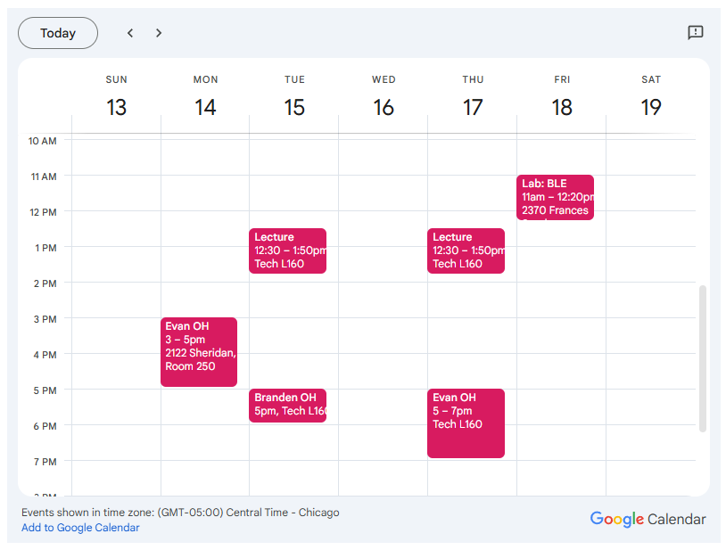
Weekly Schedule
Office hours
  Mondays 3-5
  Tuesdays 5-6 (joint)
  Thursdays 5-7
Lab
  Fridays 11-12:30
  Turns into office hours if there is no scheduled lab

Slide 4
Today’s Goals
Introduce OSI layer model of communication
Provide background on Internet layering
Overview of concerns for the Physical layer
  Speak the “lingo” of wireless communication
  Present technology aspects that we will return to in specific protocols

Slide 5
Outline
OSI Layers
Internet Architecture (Upper Layers)
Physical Layer
  Overview
  Signal Strength
  Signal Frequency and Bandwidth
  Signal Modulation

Slide 6
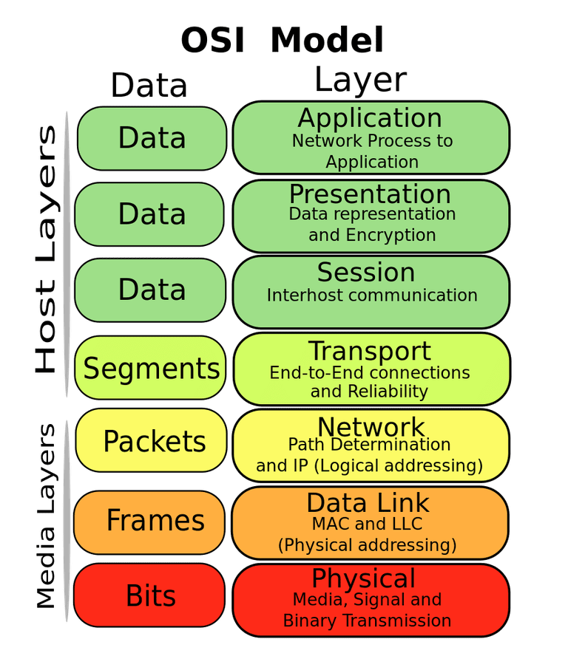
OSI model of communication layers
Open Systems Interconnection (OSI)
Transport
  Sending data between applications
  TCP and UDP
Network
  Sending data between networked computers
  IP
Data Link
  Sending collections of bits
  Ethernet, WiFi
Physical
  Sending individual bits
  Ethernet, WiFi

Slide 7
Where does this class focus?
Transport
  Sending data between applications
  TCP and UDP
Network
  Sending data between networked computers
  IP
Data Link
  Sending collections of bits
  Ethernet, WiFi
Physical
  Sending individual bits
  Ethernet, WiFi
CS domain
CS340, CS440
This course!
EE domain
EE307, EE378, EE380

Slide 8
Protocols are “layered”
Headers for each layer of communication wrap data
  Data is wrapped with header for the network to make a packet
    i.e., bytes are added to the start/end of it
  Packet is wrapped with header for the link to make a frame
Internet Packet
Data
Packet
Header
Frame
Header
Ethernet Frame

Slide 9
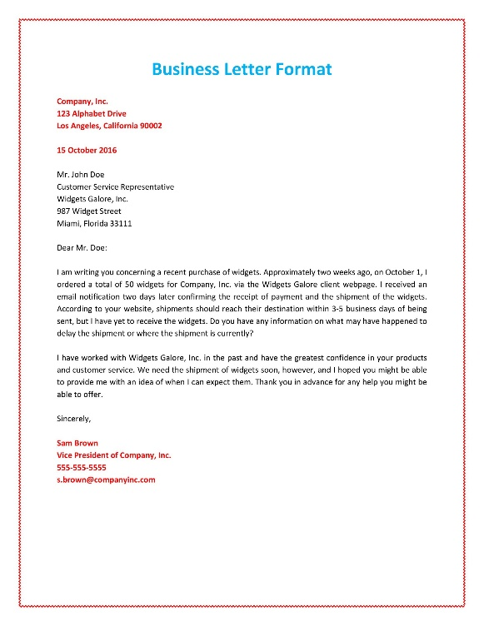

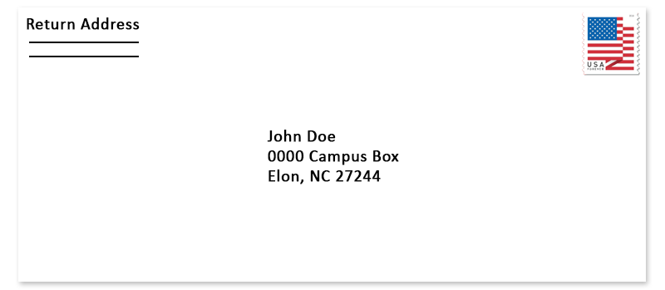

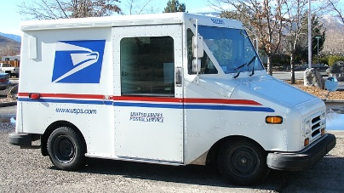


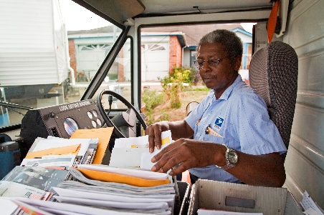
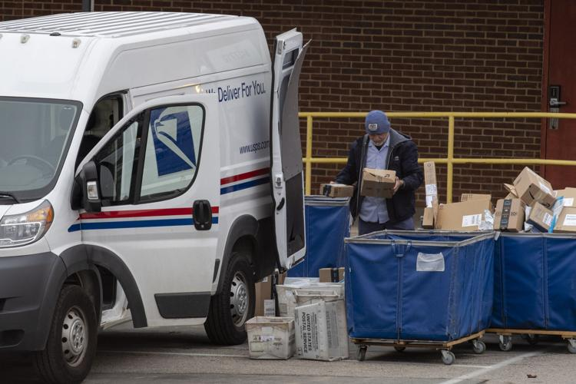
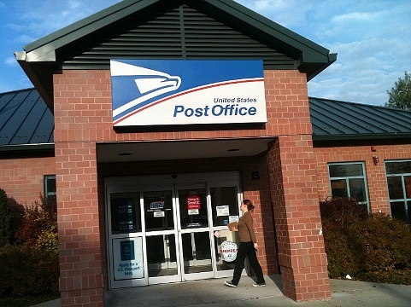
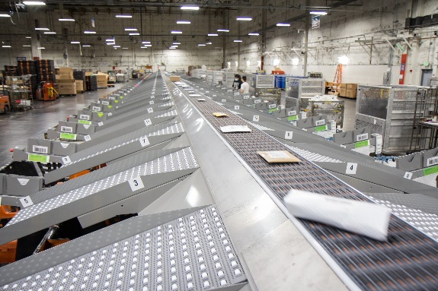
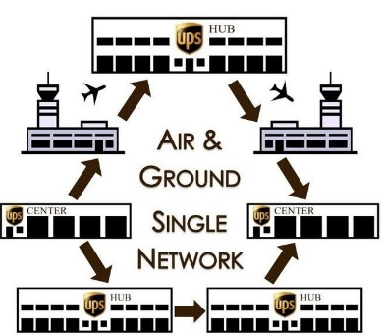
Analogy: Sending a letter
Application:
Purpose/type of letter
Transport:
Carrier service
Network:
Street Address
Link:
Transfer to
post office
Physical:
Moving tangible
object
Courier
Named recipient
Mailing/shipping
infrastructure

Slide 10
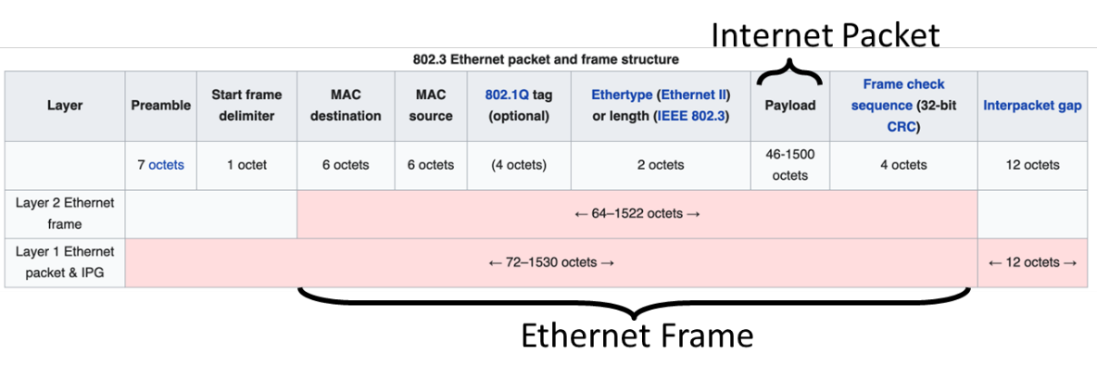
Example of layering for Ethernet and IP
Headers for each layer of communication wrap data
  Data is wrapped with header for network to make a packet
  Packet is wrapped with a header for the link to make a frame

Slide 11
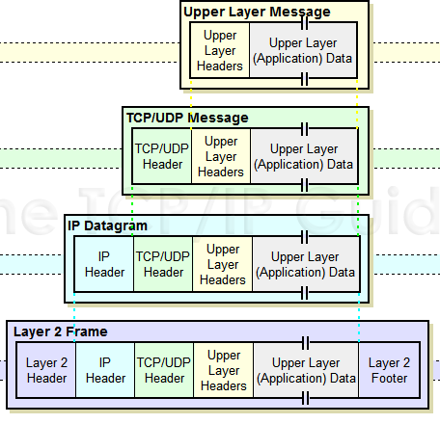
Packet encapsulation
Upper-layer packet is the payload for the lower-layer packet

Slide 12
Transmitting data between networks
LAN1
Host A
Host B
LAN2
client
server
(1)
data
(8)
data
protocol
software
protocol
software
internet packet
(2)
data
PH
(7)
data
PH
LAN1
adapter
LAN2
adapter
LAN1 frame
Router
(3)
data
PH
FH1
(6)
data
PH
FH2
LAN1
adapter
LAN2
adapter
LAN2 frame
(4)
data
PH
FH1
data
PH
FH2
(5)
PH: Internet packet header
FH: LAN frame header
protocol
software

Slide 13
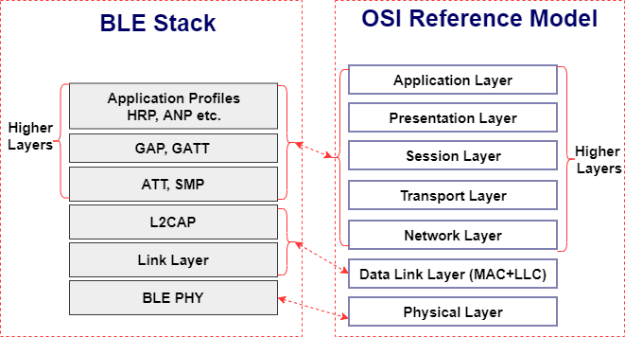
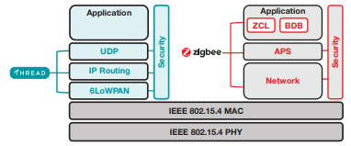
Model does not equal reality
Wireless protocols don’t always split between layers cleanly
  Usually explain parts of physical, data link, and possibly upper layers
Model still helps conceptualize stack-up though
  Layering of some type still occurs

Slide 14
Layering for IoT (joke) (kind of)
MQTT
MQTT is a publish/subscribe message broker

Slide 15
Outline
OSI Layers
Internet Architecture (Upper Layers)
Physical Layer
  Overview
  Signal Strength
  Signal Frequency and Bandwidth
  Signal Modulation

Slide 16
The global Internet
Most famous example of an internet (uppercase to distinguish)
Based on the TCP/IP protocol family
  IP (Internet Protocol)
    Provides a naming scheme and unreliable delivery of packets from host-to-host
  UDP (Unreliable Datagram Protocol)
    Uses IP to provide unreliable data delivery from process-to-process
  TCP (Transmission Control Protocol)
    Uses IP to provide reliable data delivery from process-to-process
Accessed via a mix of Unix file I/O and the sockets interface

Slide 17
Hardware and software organization of an Internet application
Internet client host
Internet server host
Client
User code
Server
Sockets interface
(system calls)
TCP/IP
Kernel code
TCP/IP
Hardware interface
(interrupts)
Network
adapter
Hardware
and firmware
Network
adapter
Global IP Internet

Slide 18
A programmer’s view of the internet
1. Hosts are mapped to a set of 32-bit IP addresses
  129.105.5.212
2. The set of IP addresses is mapped to a set of identifiers called Internet domain names
  129.105.5.212 is mapped to moore.wot.eecs.northwestern.edu
3. A process on one Internet host can communicate with a process on another Internet host over a connection

Slide 19
1. IP addresses
32-bit IP addresses are stored in an IP address struct
  IP addresses are always stored in memory in network byte order (big-endian)
    Remember: most computers use little-endian😭
  True in general for any integer transferred in a packet header from
  one machine to another
    E.g., the port number used to identify an Internet connection
By convention, each byte in a 32-bit IP address is represented by its decimal value and separated by a period
    IP address: 0x816905D4 = 129.105.7.212
/* Internet address structure */
struct in_addr {
uint32_t s_addr; /* network byte order (big-endian) */
};

Slide 20
2. Internet domain names
unnamed root
.net
.edu
.gov
.com
Top-level domain names
mit
northwestern
berkeley
amazon
Second-level domain names
eecs
mccormick
www
54.230.48.28
Third-level domain names
and onwards…
wot
www
165.124.149.20
moore
129.105.5.212
hanlon
129.105.5.211
Note: Northwestern owns 129.105.0.0/16 and 165.124.0.0/16

Slide 21
Domain Naming System (DNS)
The Internet maintains a mapping between IP addresses and domain names in a huge worldwide distributed database
called DNS
Conceptually, programmers can view the DNS database as a collection of millions of host entries
  Each host entry defines the mapping between a set of domain names
  and IP addresses
A special name: localhost
  Refers back to the computer being used (IP address 127.0.0.1)

Slide 22
3. Internet connections
A socket is an endpoint of a connection
  Socket address is an IPaddress:port pair
    IP address identifies the computer
    Port identifies the process on the computer
Clients and servers communicate by sending streams of bytes over connections. Most connections are:
  Point-to-point: connects a pair of processes.
  Full-duplex: data can flow in both directions at the same time,
  [TCP adds] Reliable: stream of bytes sent by the source is eventually received by the destination in the same order it was sent.

Slide 23
Ports are used to identify services to the kernel
Server host 128.2.194.242
Client host
Service request for
128.2.194.242:80
(i.e., the Web server)
Web server
(port 80)
Client
Kernel
Echo server
(port 7)
Service request for
128.2.194.242:7
(i.e., the echo server)
Web server
(port 80)
Client
Kernel
Echo server
(port 7)

Slide 24
How does the Internet handle routing packets?
Network layer (IP)
  Describes computer-to-computer connection
    Packets from my computer <---> Google server
Link layer (Ethernet)
  Describes individual links
    Packets from my computer <---> my router
Routing
  Using link-layer building blocks to get packets from one IP to another

Slide 25
Addressing
How to solve the routing problem?
  I need to know how to get data from me to you
How does the post office work?
  I know where you live (your address)
    Zip Code
    City
    Street
    House Number
    Name

Slide 26
A problem with addressing
Your computer moves all the time
  Home, school, Starbucks...

Slide 27
Assigning and finding IP address ranges
In general, network operators don’t change that often
Solution:
  Tie IP addresses to network operators
  Assign computers IPs as they join networks
Key Point:
  Networks ”own” a block of IP address space
  ”The Internet” is a network of networks

Slide 28

Routing
2.0.0.0/8
1.0.0.0/8
10.0.0.0/8
5.0.0.0/8
4.0.0.0/8

Slide 29
Routing
2.0.0.0/8
  →10.0.0.0/8
1.0.0.0/8
  →2.0.0.0/8
    →10.0.0.0/8
  →4.0.0.0/8
    →5.0.0.0/8
      →10.0.0.0/8
10.0.0.0/8
5.0.0.0/8
  →10.0.0.0/8
4.0.0.0/8
  →5.0.0.0/8
    →10.0.0.0/8

Slide 30
Routing Adaptation
2.0.0.0/8
  →10.0.0.0/8
1.0.0.0/8
  →2.0.0.0/8
    →10.0.0.0/8
  →4.0.0.0/8
    →5.0.0.0/8
      →10.0.0.0/8
10.0.0.0/8
5.0.0.0/8
  →10.0.0.0/8
4.0.0.0/8
  →5.0.0.0/8
    →10.0.0.0/8

Slide 31
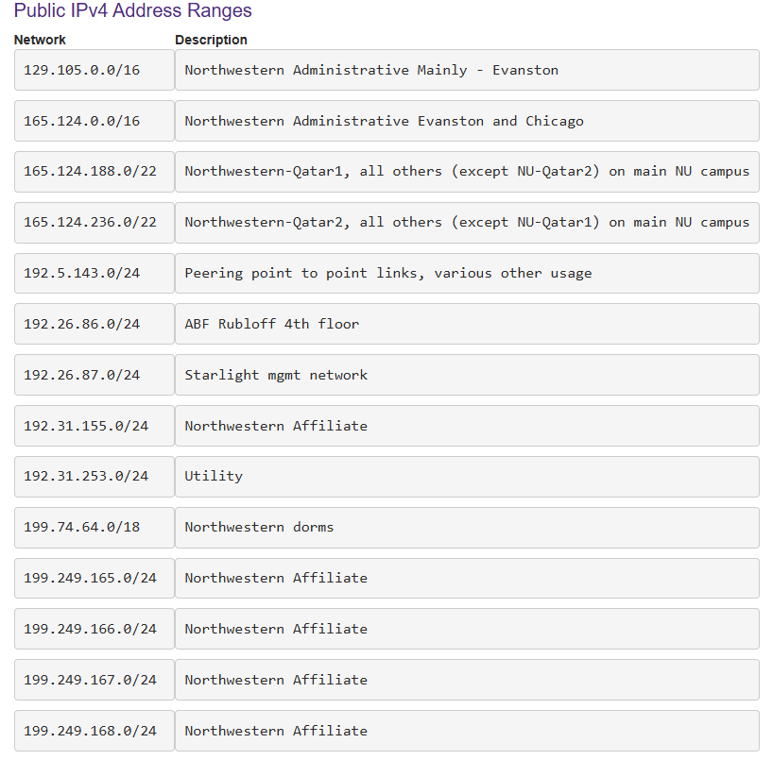
Northwestern IPv4 ranges
Format: ip.addr/NUM
NUM is the number of meaningful bits, from the most-significant bit
  129.105.0.0/16 means the most-significant 16 bits are meaningful
  i.e., 129.105.x.x
  Remaining bits can be used for unique addresses
    2^{(32-NUM)} machines

Slide 32
Identifying your computer?
Every network card has its own MAC address
  IPs are (somewhat) dynamic, ”owned” by local networks
  MACs are hardware and static, ”owned” by specific computers
    Manufacturers own blocks of MACs, ”spend” them each time they make a device
”Connecting” to a network
  Your computer leases an IP from the local network
  Only the local router knows your MAC, everyone else sees your IP
  Actually, with NAT, you probably have a private IP address

Slide 33
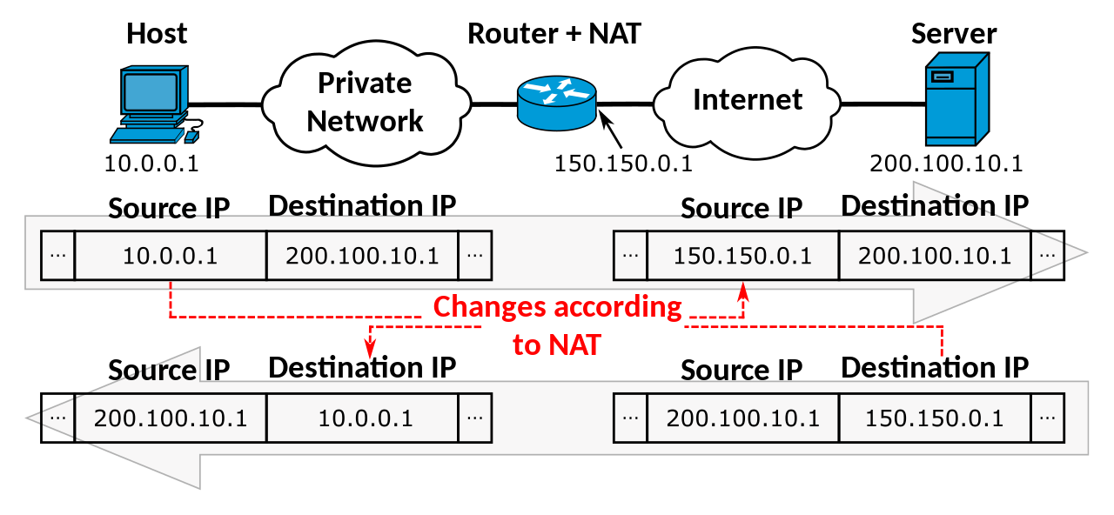
Network Address Translation (NAT)
https://en.wikipedia.org/wiki/Network_address_translation

Slide 34
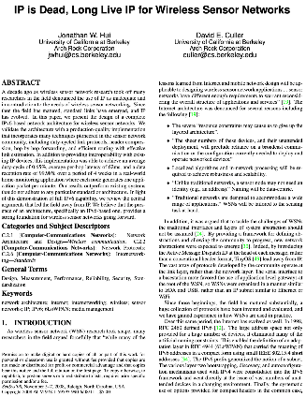
So how does the Internet of Things fit into the Internet?
“IP is the Narrow Waist of the Internet”
  IP is Dead, Long Live IP for Wireless Sensor Networks
A recurring theme in this class:
  How does this actually attach to the Internet
    Physically, direct IP connection
    [hello Hue Hub, Wyze Hub, August Hub, …]
    Logically, through another device
    [are BLE devices really part of the IoT?]

Slide 35
Break + Thinking
What are the steps for viewing a website?

Slide 36
Break + Thinking
What are the steps for viewing a website?
You enter a domain name for the website
Computer looks up domain name to get IP Address
Computer sends request to IP_address:80
Computer gets back data, which it renders into a website

Slide 37
ALL the layers
A ‘famous’ interview question
  “What happens when you type google.com into your browser’s address bar and press enter?”
  https://github.com/alex/what-happens-when
    12 pages worth of material
      Keyboard events
      Parsing URL
      DNS lookup
      Opening socket
      HTTP protocol
      HTML parsing
      GPU rendering

Slide 38
Outline
OSI Layers
Internet Architecture (Upper Layers)
Physical Layer
  Overview
  Signal Strength
  Signal Frequency and Bandwidth
  Signal Modulation

Slide 39
Physical Layer
How bits are transmitted
  Wireless makes this entirely different from wired cases
Important considerations
  Signal strength
  Modulation
  Frequency

Slide 40
Why use wireless?
There are no wires!
No need to install and maintain wires
  Reduces cost
  Simplifies deployment – place devices wherever makes sense
Supports mobile users
  Move around office, campus, city
  Move devices around home

Slide 41
What is hard about wireless?
There are no wires!
Wired networks are constant, reliable, and physically isolated
  Ethernet has the same throughput minute-to-minute
  Bits sent through Ethernet or USB are (usually) received
Wireless networks are variable, error-prone, and shared
  WiFi throughput changes based on location and walls
  Signals from nearby devices interfere with your signals
  Individual bits might flip or never be heard at all

Slide 42
Wireless is a shared medium
Wired communication has signals confined to a conductor
  Copper or fiber
  Guides energy to destination
  Protects signal from interference
Wireless communication is inherently broadcast
  Energy is distributed in space
  Signals must compete with other signals in same frequency band

Slide 43
Increasing network capacity is challenging
Wired networks just add more wires
  Buses are many signals in parallel to send more data
Wireless networks are harder
  Adding more links just increases interference
  Need to expand to different frequencies

Slide 44
Model of RF communication
Energy that radiates spherically from an antenna
Attenuation with distance
  Density of energy reduces over time, distance
  Signal strength is reduced, errors go up
Two key features
  Error rates depend on distance
  Spatial reuse of frequencies

Slide 45
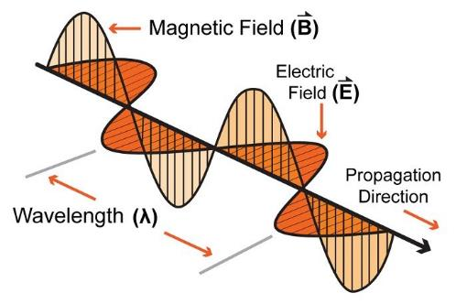
Signal qualities
Signal strength
  The amount of energy transmitted/received
Signal frequency and bandwidth
  Which “channel” the signal is sent on
Signal modulation
  How data is encoded in the signal

Slide 46
Outline
OSI Layers
Internet Architecture (Upper Layers)
Physical Layer
  Overview
  Signal Strength
  Signal Frequency and Bandwidth
  Signal Modulation

Slide 47
Signal qualities
Signal strength
  The amount of energy transmitted/received
Signal frequency and bandwidth
  Which “channel” the signal is sent on
Signal modulation
  How data is encoded in the signal

Slide 48
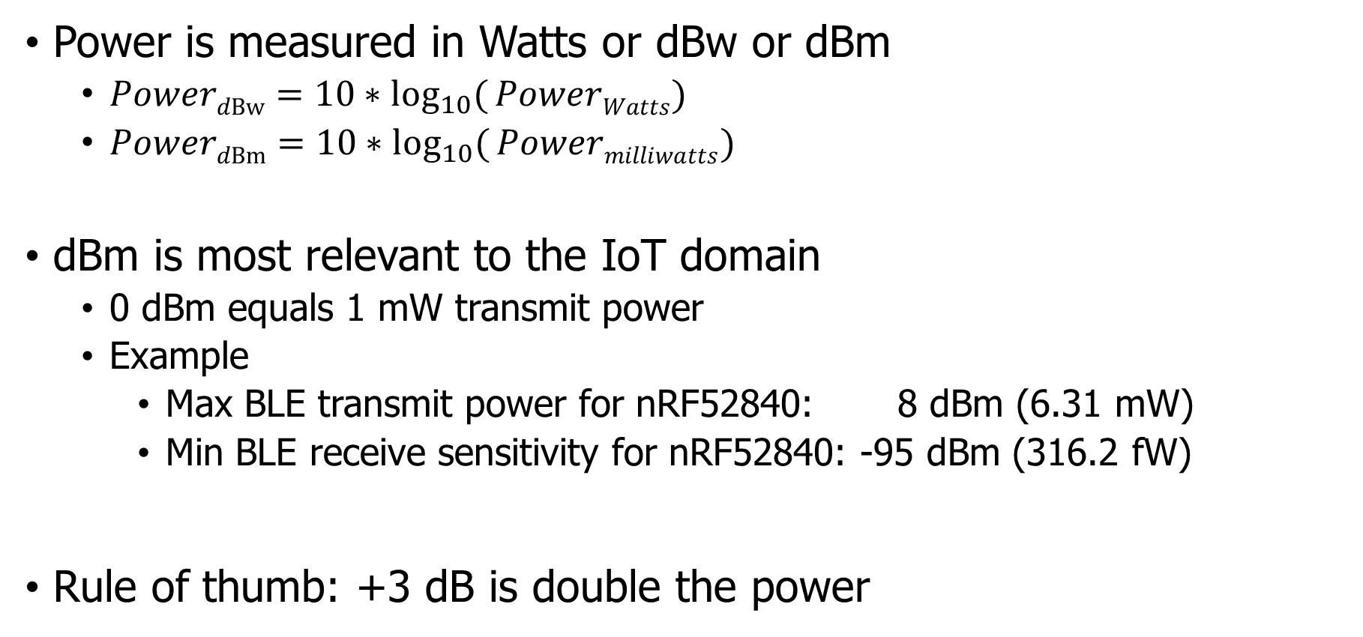
Signal strength is measured in decibels
Power is measured in Watts or dBw or dBm
  ${PowerdBw=10∗log}_{10}({PowerWatts})$
  ${PowerdBm=10∗log}_{10}({Powermilliwatts})$
dBm is most relevant to the IoT domain
  0 dBm equals 1 mW transmit power
  Example
    Max BLE transmit power for nRF52840: 8 dBm (6.31 mW)
    Min BLE receive sensitivity for nRF52840: -95 dBm (316.2 fW)
Rule of thumb: +3 dB is double the power

Slide 49
Signal strength varies significantly across technologies
Bluetooth Low Energy (local area)
  nRF52840 transmit power: 8 dBm (6.31 mW)
  nRF52840 receive sensitivity: -95 dBm (316.2 fW)
LoRa (wide area)
  SX127X LoRa transmit power: 20 dBm (100 mW)
  SX127X LoRa receive sensitivity: -148 dBm (1.6 attoWatt)

Slide 50
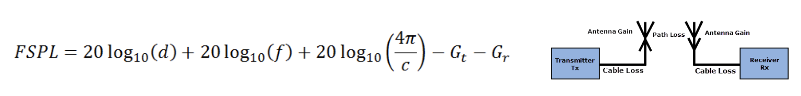
Propagation degrades RF signals
Attenuation in free space
  Signals get weaker as they travel over long distances
  Signal spreads out → Free Space Path Loss (FSPL)

Slide 51

Some intuitions for signal propagation, power, gain, etc
We will use the nrf52840 in lab:
  Max BLE transmit power for nRF52840: 8 dBm (6.31 mW)
  Min BLE receive sensitivity for nRF52840: -95 dBm (316.2 fW)
6.31 mW

Slide 52
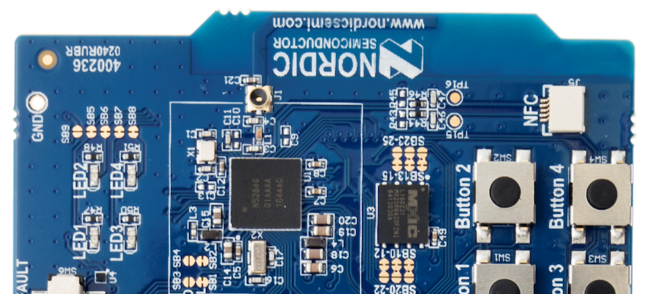
Wait, where is the antenna??
This little strip of metal is the actual antenna
  Receiver only recovers the part of the signal that hits its antenna (“aperture”)

Slide 53
Some Intuitions for Signal Propagation, Power, Gain, etc.
We will use the nrf52840 in lab:
  Max BLE transmit power for nRF52840: 8 dBm (6.31 mW)
  Min BLE receive sensitivity for nRF52840: -95 dBm (316.2 fW)
6.31 mW

Slide 54
Some Intuitions for Signal Propagation, Power, Gain, etc.
We will use the nrf52840 in lab:
  Max BLE transmit power for nRF52840: 8 dBm (6.31 mW)
  Min BLE receive sensitivity for nRF52840: -95 dBm (316.2 fW)
.25 m

Slide 55
Some Intuitions for Signal Propagation, Power, Gain, etc.
We will use the nrf52840 in lab:
  Max BLE transmit power for nRF52840: 8 dBm (6.31 mW)
  Min BLE receive sensitivity for nRF52840: -95 dBm (316.2 fW)
1 m

Slide 56
Some Intuitions for Signal Propagation, Power, Gain, etc.
We will use the nrf52840 in lab:
  Max BLE transmit power for nRF52840: 8 dBm (6.31 mW)
  Min BLE receive sensitivity for nRF52840: -95 dBm (316.2 fW)
2 m

Slide 57
Some Intuitions for Signal Propagation, Power, Gain, etc.
We will use the nrf52840 in lab:
  Max BLE transmit power for nRF52840: 8 dBm (6.31 mW)
  Min BLE receive sensitivity for nRF52840: -95 dBm (316.2 fW)
2 m
46 dB path loss!
0.00016 mW

Slide 58
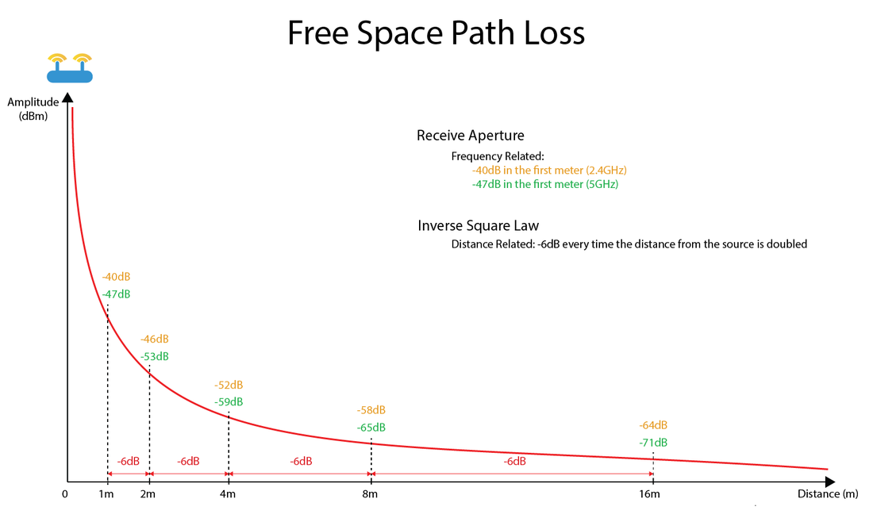
Free-Space Path Loss Model
https://semfionetworks.com/blog/free-space-path-loss-diagrams/

Slide 59
Okay.. So what’s the limit?
We will use the nrf52840 in lab:
  Max BLE transmit power for nRF52840: 8 dBm (6.31 mW)
  Min BLE receive sensitivity for nRF52840: -95 dBm (316.2 fW)
8 dBm – -95 dBm = 103 dB link margin
For FSPL alone for a 2.4 GHz signal, 103 dB is 1,400 m!
Bluetooth does not go 1.4 km…

Slide 60
Propagation is one thing that degrades RF signals
Attenuation in free space
  Signals get weaker as they travel over long distances
  Signal spreads out -> free space path loss
Important: distance is NOT the only signal strength loss
  Free space path loss calculation will not give you accurate range for a signal
Obstacles can weaken signal through absorption or reflection
  Precise quantitative details are in the EE domain
  We’ll use examples to develop qualitative instincts in this class

Slide 61
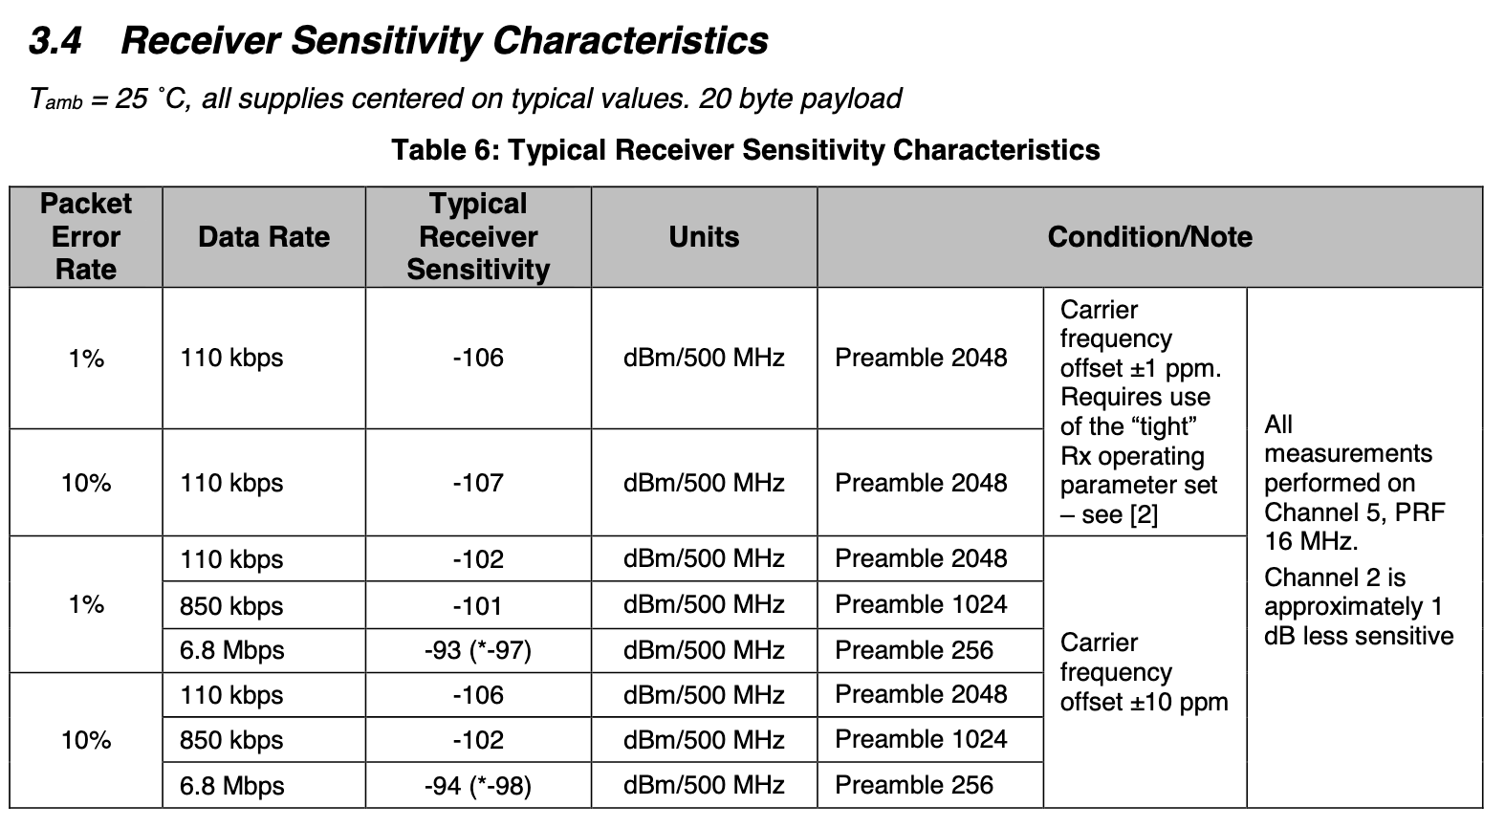
Many factors affect the ability to actually receive data
Here’s some examples, from DW1000 [ultra wideband transceiver]

Slide 62
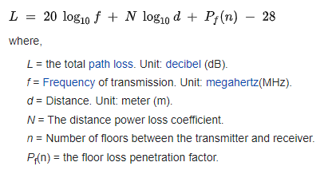
ITU model for Indoor Attenuation
Models like this are more trustworthy less bad than Free-Space Path Loss
  https://en.wikipedia.org/wiki/ITU_model_for_indoor_attenuation

Slide 63
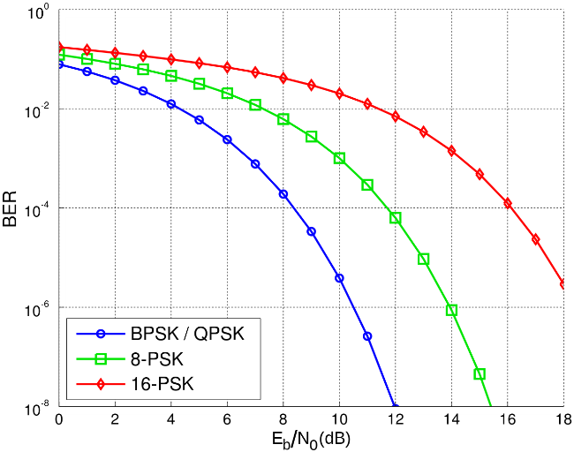
Lower received energy increases error rates
BER:
Bit Error Rate
Odds that a transmitted bit will be received incorrectly
More Errors
Less Errors
Less Energy Received
More Energy Received

Slide 64
Big Idea: many RF factors are interconnected
Energy, Distance, Throughput, and Reliability are all interconnected in communication
Protocols make choices of some and get the results on the others
To get more distance, choose one or more:
  Increase energy
  Communicate slower
  Accept a higher error rate

Slide 65
Break + Say hi to your neighbors
Things to share
  Name
  Major
  One of the following
    Favorite Candy
    Favorite Pokemon
    Favorite Emoji

Slide 66
Break + Say hi to your neighbors
Things to share
  Name -Branden
  Major -EE, CE, and CS
  One of the following
    Favorite Candy - Twix
    Favorite Pokemon - Eevee
    Favorite Emoji - 🍢

Slide 67
Outline
OSI Layers
Internet Architecture (Upper Layers)
Physical Layer
  Overview
  Signal Strength
  Signal Frequency and Bandwidth
  Signal Modulation

Slide 68
Signal qualities
Signal strength
  The amount of energy transmitted/received
Signal frequency and bandwidth
  Which “channel” the signal is sent on
Signal modulation
  How data is encoded in the signal

Slide 69
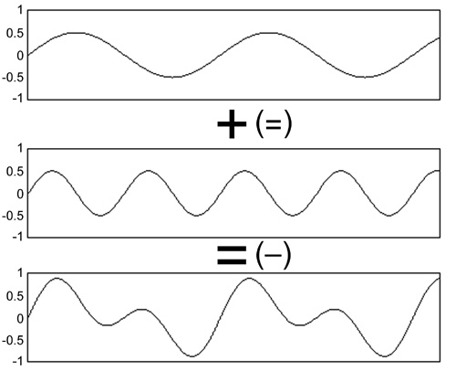
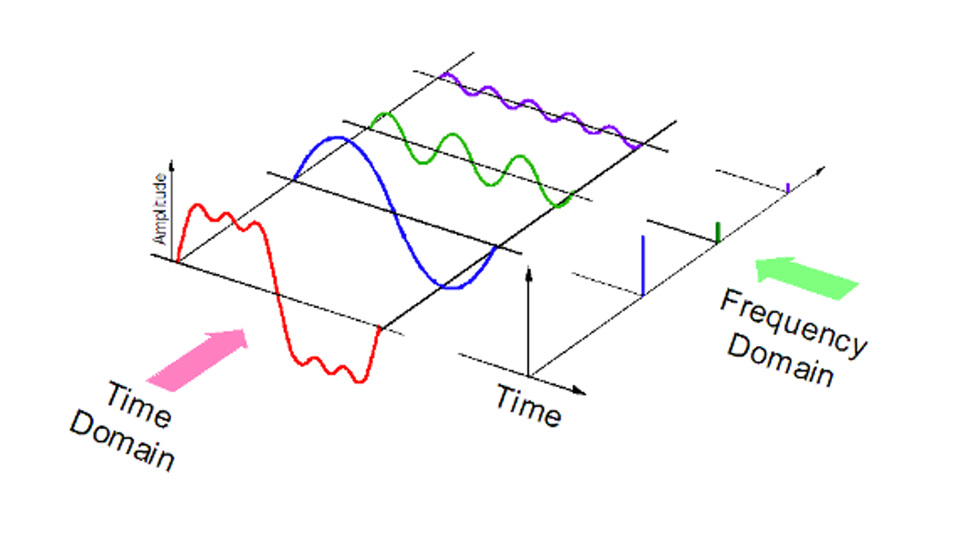
Sum of sinusoids can be reversed
RF signals are fundamentally sinusoids of electromagnetic energy
Sinusoids at different frequencies can be combined and pulled apart again later
  Particularly, it’s relatively easy for hardware to determine if there’s energy present on a given frequency
  Although very close frequencies might be difficult to disentangle

Slide 70
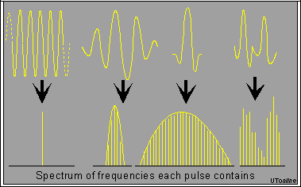
Complex waveforms have a center frequency and a width
A pure sinusoid is energy at exactly one frequency
A messy sinusoid with data layered on top of it has nearby energy
  There’s a center of the signal energy
  Plus some amount of width, which depends on how complicated the data layered on top is

Slide 71
How do radio stations work?
FM radio in cars is a good example of frequencies
  All of FM radio has an allocation of 87.5 to 108.0 MHz
  Each station takes has up to ~200 kHz of bandwidth
First station is 87.7 MHz +/- 100 kHz
  Ranges from 87.6 to 87.8
Second station is 87.9 MHz +/- 100 kHz
  Ranges from 87.8 to 88.0
What if they overlapped? They interfere with each other
  You’d possibly hear both. Or get junk data that’s neither.

Slide 72
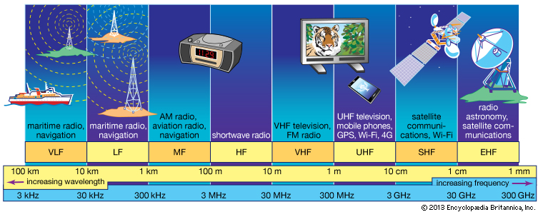
RF communication frequencies
IoT focus

Slide 73
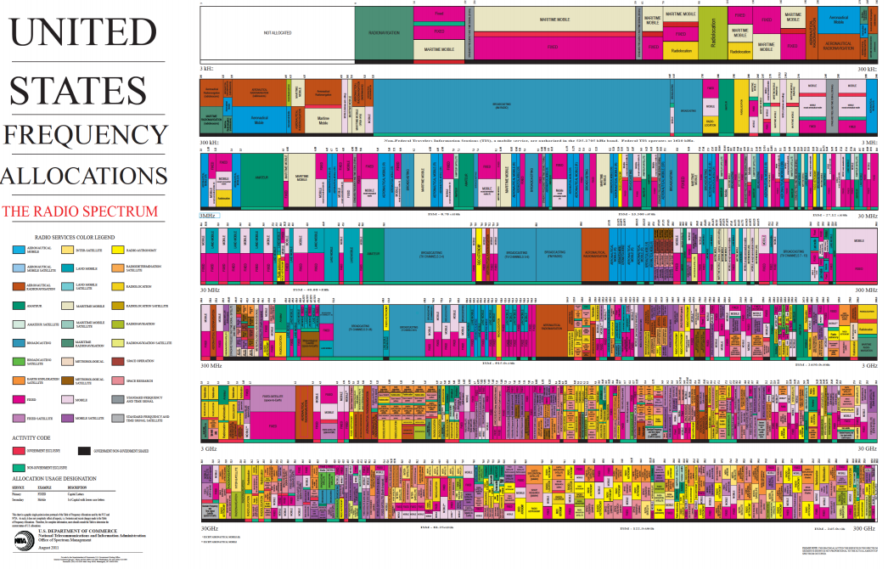
Wireless spectrum is allocated to specific uses

Slide 74
433 MHz Band
Amateur radio (ham radio) was provided with specific frequencies to use
  There are quite a few: https://en.wikipedia.org/wiki/Amateur_radio_frequency_allocations
433 MHz is within one of these bands in the US but globally is set aside as its own thing
  Designated for low-power devices
  Unlicensed use
  Vehicle key-less entry devices, garage door openers, weather stations
    Some IoT protocols use it as well! LoRa for example

Slide 75
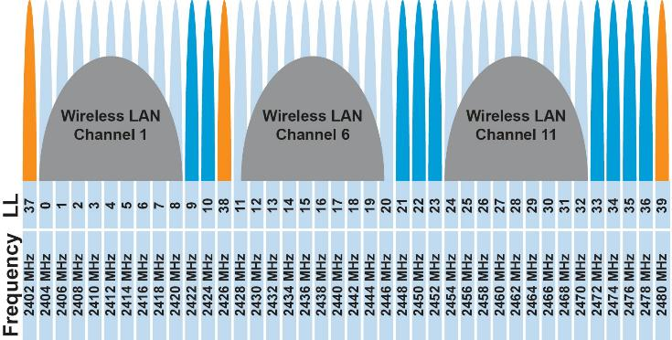
Unlicensed bands are where IoT thrives
902 MHz – 928 MHz
  LPWANs
2.4 GHz to 2.5 GHz
  WiFi, BLE, Thread
5 GHz
  Faster WiFi

Slide 76
Unlicensed bands are where IoT thrives
902 MHz – 928 MHz
  LPWANs
2.4 GHz to 2.5 GHz
  WiFi, BLE, Thread
5 GHz
  Faster WiFi
Cellular uses licensed bands at great cost
  Why?

Slide 77
Unlicensed bands are where IoT thrives
902 MHz – 928 MHz
  LPWANs
2.4 GHz to 2.5 GHz
  WiFi, BLE, Thread
5 GHz
  Faster WiFi
Cellular uses licensed bands at great cost
  Why? No interference from other users

Slide 78
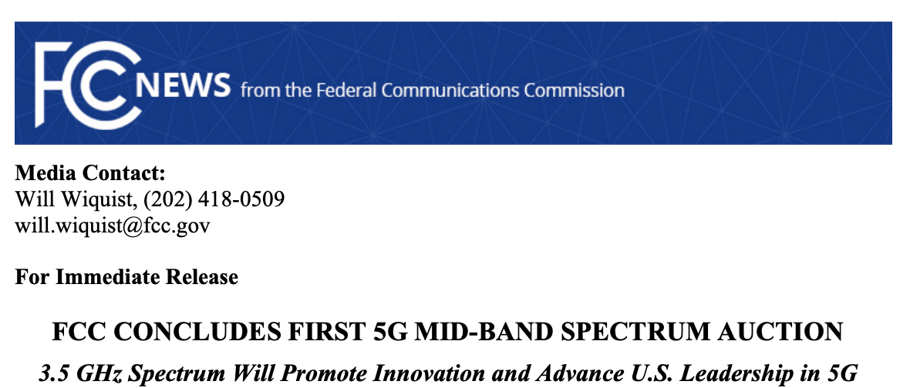
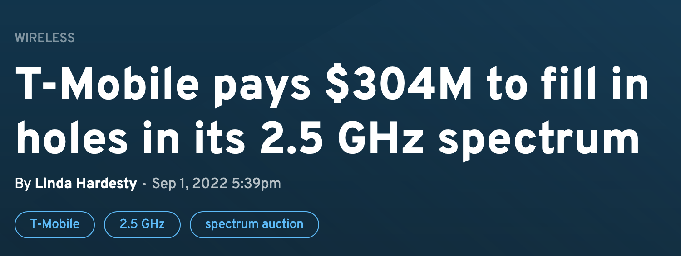
Wireless spectrum is limited...and valuable
FCC auctioned off 3.5 GHz spectrum in August 2020
  70 MHz
  $4.6 billion
FCC auctioned off 2.5 GHz spectrum in 2022
  $427 million
https://www.fiercewireless.com/wireless/t-mobile-pays-304m-fill-holes-its-25-ghz-spectrum

Slide 79

Different technologies use spectrum in different ways
How spectrum is used affects: cost ($), robustness, throughput…
  We will talk about how each technology uses spectrum, and implications
This graphic shows how BLE and WiFi interoperate; more on this next week

Slide 80
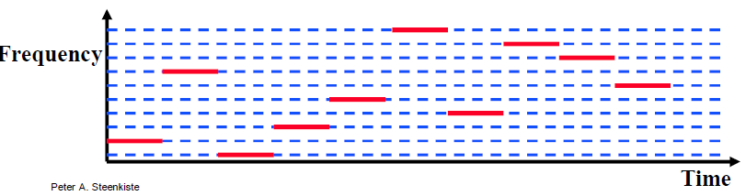
Frequency Hopping Spread Spectrum
Transmitter hops through a sequence of transmit channels
  Spend some “dwell time” on each channel before hopping again
  Receiver must know the hopping pattern
Avoid causing or receiving prolonged interference

Slide 81
Sidebar: inventor of FHSS – Hedy Lamarr
Actress, inventor, and all-around badass
  Designed FHSS with George Antheil during WWII based on music ideas
  Idea: torpedo control can’t be easily jammed if it jumps around
https://en.wikipedia.org/wiki/Hedy_Lamarr#Inventing_career

Slide 82
Outline
OSI Layers
Internet Architecture (Upper Layers)
Physical Layer
  Overview
  Signal Strength
  Signal Frequency and Bandwidth
  Signal Modulation

Slide 83
Signal qualities
Signal strength
  The amount of energy transmitted/received
Signal frequency and bandwidth
  Which “channel” the signal is sent on
Signal modulation
  How data is encoded in the signal

Slide 84
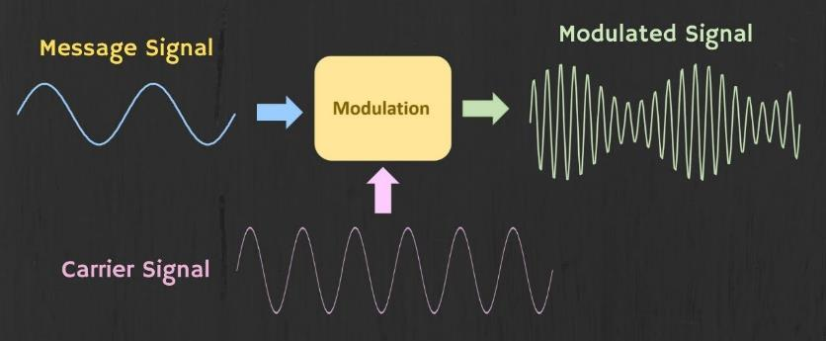
Modulation
Encoding signal data in an analog “carrier” signal
  Carrier signal defines the frequency
  Modulation scheme + data define bandwidth required

Slide 85
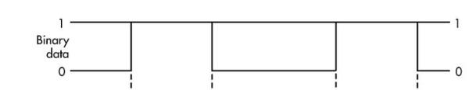
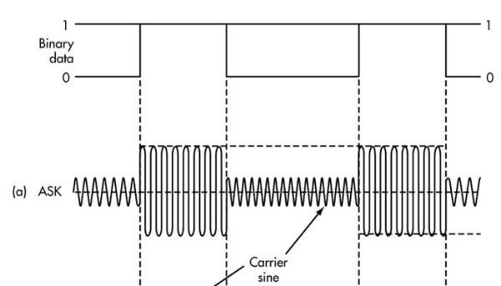
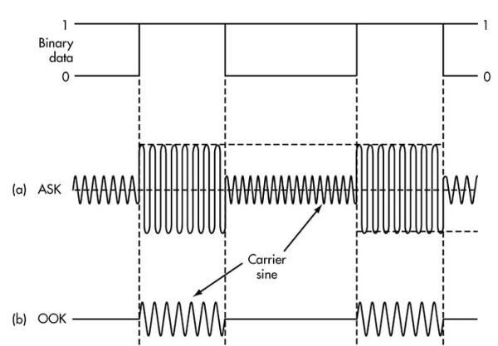
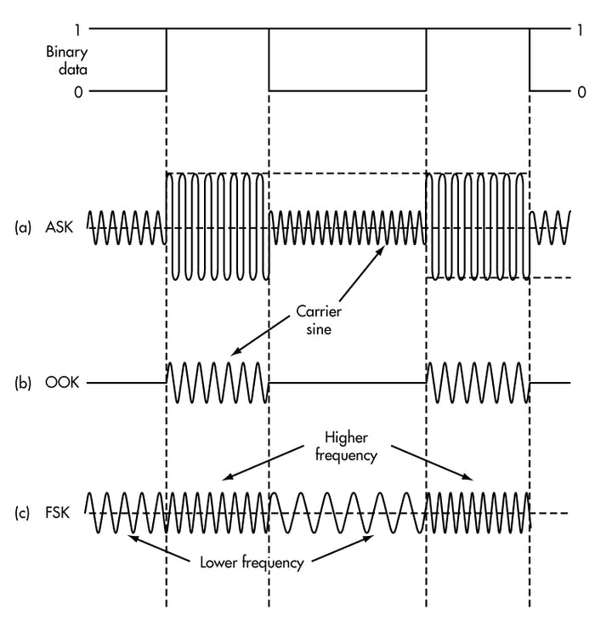
Modulation types
Encoding binary data on a signal
Amplitude-shift Keying (ASK)
  Modify amplitude of carrier signal
  On-Off Keying (OOK) is an extreme example
Frequency-shift Keying (FSK)
  Modify frequency of carrier signal

Slide 86
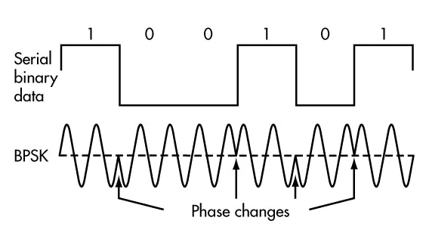
Modulation types
Phase-shift keying (PSK)
  Modify phase of carrier signal
  Usually differential:
  the change signifies data
More complicated possibilities exist
  QAM (Quadrature Amplitude Modulation) combines amplitude and phase shift keying
    Allows for more than one bit per “symbol”

Slide 87
Modulation tradeoffs
Various tradeoffs between different modulation schemes
  Bandwidth requirements, transceiver hardware, immunity to noise, etc.
ASK (amplitude) is simple but susceptible to noise
  Noise exists in the real world
FSK (frequency) is relatively simple and robust to noise, but uses more bandwidth
  Bandwidth is limited, but still commonly used
PSK (phase) energy efficient and robust, but more complex hardware
  More expensive hardware, but very commonly used

Slide 88
Outline
OSI Layers
Internet Architecture (Upper Layers)
Physical Layer
  Overview
  Signal Strength
  Signal Frequency and Bandwidth
  Signal Modulation

