Slide 1
Lecture 15
LPWANs Challenges
CS397/497 – Wireless Protocols for IoT
Branden Ghena – Spring 2024
With images from Swarun Kumar (CMU) and Dinesh Bharadia (UCSD)
Materials in collaboration with
Pat Pannuto (UCSD) and Brad Campbell (UVA)

Slide 2
Administrivia
All remaining assignments are posted
Hw: Cellular
  Due Thursday next week (May 23rd)
Lab: LoRa
  Due Wednesday of last week of classes (May 29th)
  Definitely the biggest lab, so account for that
Final Design Project
  Due Tuesday of exam week (June 4th)

Slide 3
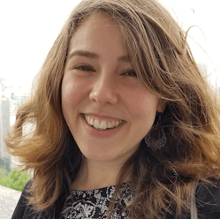
Guest Lecture: May 23rd (next week Thursday)
Dr. Meghan Clark
  Research areas
    Smart buildings
    Network monitoring
  PhD UC Berkeley (2021)
  IoT Systems Research Scientist at Resideo
    Smart home company
  Talk is going to include more details on Matter and Smart Home IoT communication architectures

Slide 4
Today’s Goals
Consider LPWAN use cases,
looking at a particular automotive study
Explore academic research improving LoRaWAN capabilities
Deep-dive into challenges LPWANs face

Slide 5
Outline
LPWAN Use Cases
LPWAN Challenges
Improving LoRaWAN

Slide 6
Project Background
Research project with automotive company (circa 2019)
LPWAN protocols are potentially interesting for automotive uses
New design points allow trading bandwidth, range, power, and cost.
Could these enable new valuable applications?

Slide 7
Problem Statement
Is there an opportunity to complement existing high-bandwidth low-latency networks, with emerging low-cost long-range networks for certain automotive use cases?
What new uses cases can be realized by the addition of these new communications capabilities?
How would future vehicle architectures change to support these networks?

Slide 8
Low-Power Applications
Now
(could be realized today)
Asset Tracking
Parked Status
Near
(could be realized soon)
Vehicle Security
Far
(longer-term ideas)
Distributed Data Collection

Slide 9
Asset Tracking Application (Now)
Track the vehicle’s location in real time from factory to point-of-sale.
Envision a web application that can label each vehicle on a dealer’s lot.
Could be useful to owner as well for theft-tracking purposes.
Would utilize:
  GPS
  Accelerometers (detect if vehicle is in motion)

Slide 10
Parked Status Application (Now)
Alert the user of flat tires, dead batteries, or other issues that can occur while the vehicle is parked and off.
Envision a smartphone app that could send owners a notification if something goes wrong.
Would utilize:
  Tire pressure sensors
  Battery status sensors
  Door, trunk, window, and roof opened/closed sensors
  Fuel level sensor
  Accelerometers (collision detection)

Slide 11
Vehicle Security Application (Near Term)
Detect suspicious activity around the vehicle and send notifications to the owner.
Envision a smartphone app that notifies the owner with a picture of the nearby activity.
Would be enabled by sensors already in place for vehicle autonomy purposes.
Would utilize:
  Cameras
  Motion sensors
  Door, trunk, window, and roof opened/closed sensors
  Accelerometers

Slide 12
Distributed Data Collection Application (Far Term)
Collect and collate various sensor data from cars parked throughout a region.
Parked vehicles can be used as a city-scale sensor network to determine various phenomena.
  Track weather down to local levels.
  Measure air quality throughout a city.
  Sense and report nearby traffic congestion.
This is a little further-term than other applications, but cities and researchers could benefit greatly from available data.

Slide 13
Break + Analysis
How well does LoRaWAN meet these application needs?
What about LTE-M / NB-IoT?
Now
(could be realized today)
Asset Tracking
Parked Status
Near
(could be realized soon)
Vehicle Security
Far
(longer-term ideas)
Distributed Data Collection

Slide 14
Project Takeaways
Unlicensed LPWANs seem limited in applicability to vehicles
Coverage areas and bandwidth capabilities are too limited
Cellular LPWANs can enable inactive vehicle applications
Applications have long lifetimes, even using a backup battery
Architecture changes to support low-power communications appear feasible
Low-power, inactive-vehicle applications are worth further investigation
Asset tracking and parked vehicle status are realizable in near-term
What would the costs of realizing these applications be?
How much value would they add for customers and company

Slide 15
Outline
LPWAN Use Cases
LPWAN Challenges
Improving LoRaWAN

Slide 16
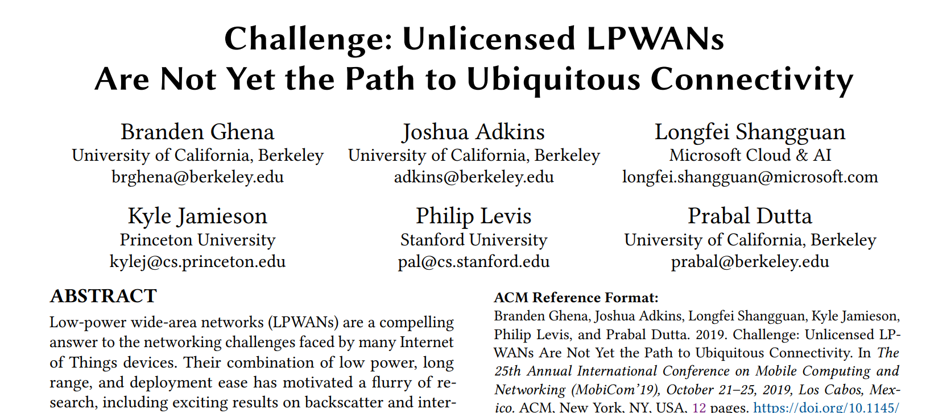
Challenge for Unlicensed LPWANs Paper
MobiCom 2019

Slide 17
Two major categories of low-power, wide-area network protocols
Unlicensed LPWANs
  Sigfox, LoRaWAN, etc.
  Unlicensed band, 915 MHz (US)
  Managed or user deployable
Cellular IoT
  LTE-M and NB-IoT
  Licensed cellular bands
  Managed networks
  Rolled out US-wide
Notes:
Cellular IoT includes the new machine-to-machine focused cellular protocols, LTE-M and NarrowBand-IoT
These operate in the standard licensed cellular bands in managed networks
On the right you can see
Each of these networks have range on the order of kilometers
Throughput focuses on uplink, with rates of ten to several thousand kbps
We also have 2G plotted as an example of the kinds of networks we’re evolving from
LPWANs have lower throughput, but increased range over the 2G protocol

Slide 18
Do novel networks meet application needs?
How do we compare varied requirements and capabilities?
  Networks have throughput per gateway and range of gateway.
  Applications have throughput per device and deployment area.
Each gateway must support throughput for all devices in its coverage area.
  Deployment areas are often wider than a single gateway’s range.
Solution: compare the density of communication.
  Data communication rate per unit area.

Slide 19
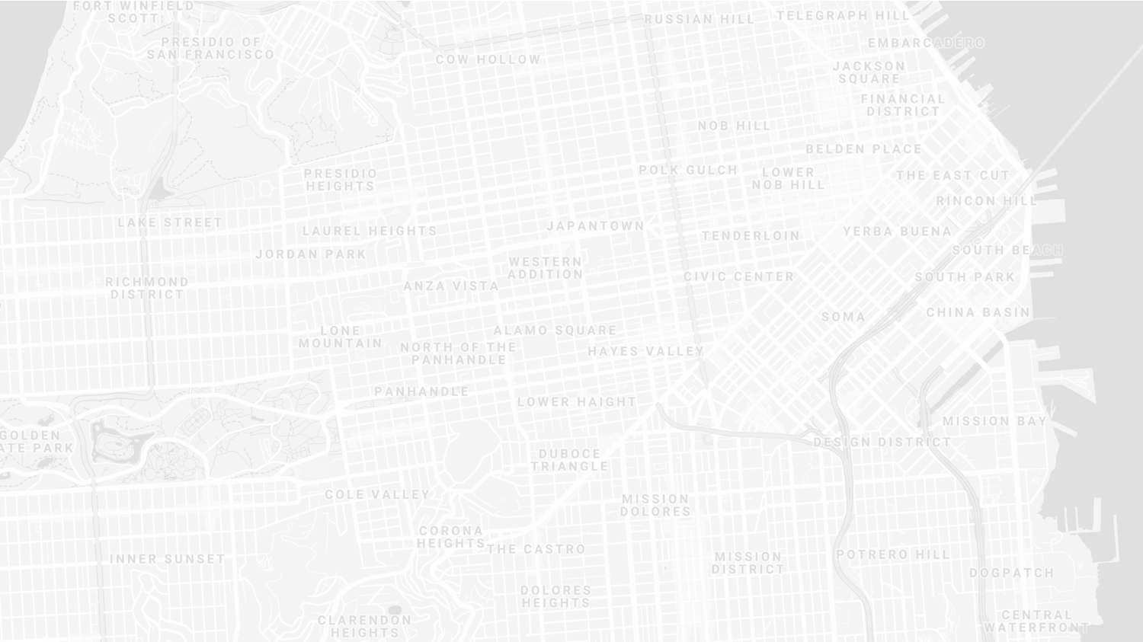
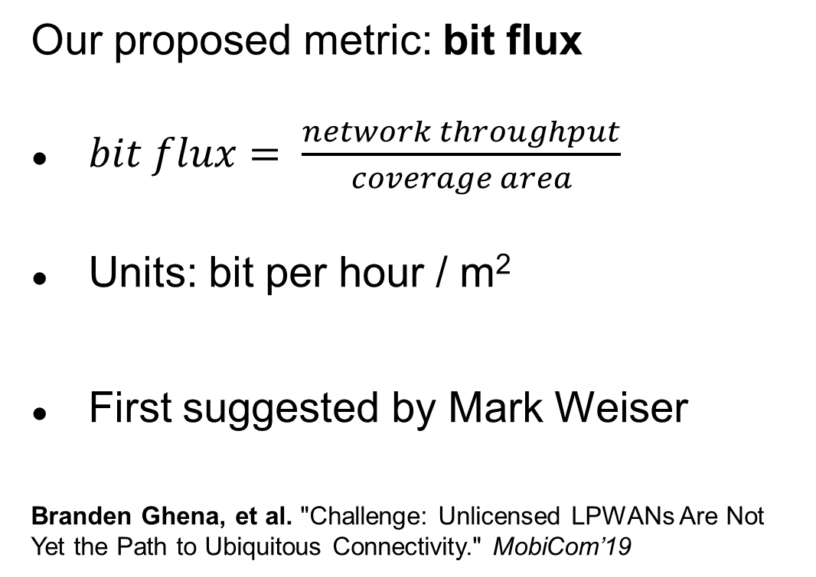
New metric for wide-area communication.
Our proposed metric: bit flux
$bit flux= \frac{network throughput}{coverage area}$
Units: bit per hour / m²
First suggested by Mark Weiser
Branden Ghena, et al. "Challenge: Unlicensed LPWANs Are Not Yet the Path to Ubiquitous Connectivity." MobiCom’19
Notes:
bit flux is our metric for data density
throughput divided by coverage area
As with many ideas, this was first suggested by Mark Weiser

Slide 20
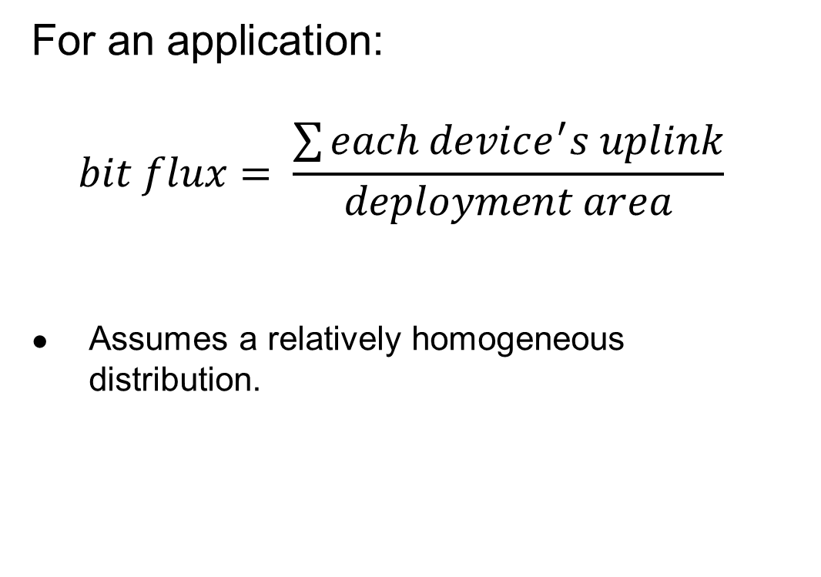
Bit flux can measure application needs.
For an application:
$$bit flux= \frac{\sum{each device^{′}s uplink}}{deployment area}$$
Assumes a relatively homogeneous distribution.
Notes:
For applications, bit flux sums the data needs for each device in the deployment
And divides by the total deployment area
To determine the application uplink density

Slide 21
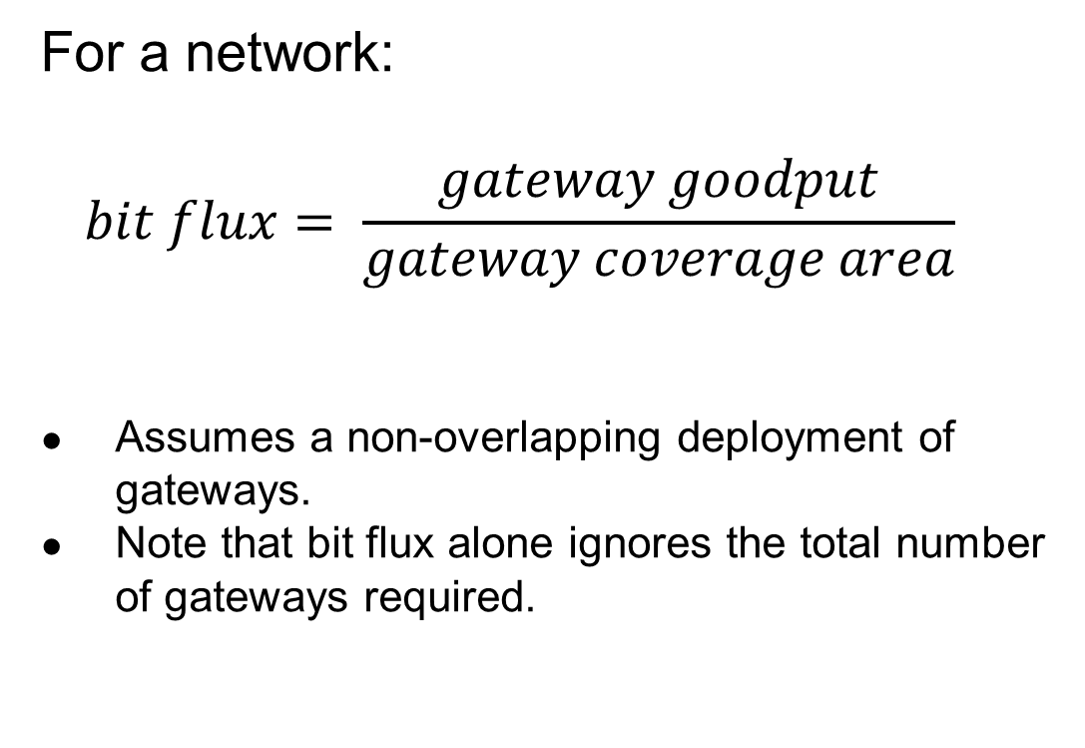
Bit flux can measure network capabilities.
For a network:
$$bit flux= \frac{gateway goodput}{gateway coverage area}$$
Assumes a non-overlapping deployment of gateways.
Note that bit flux alone ignores the total number of gateways required.
Notes:
For networks, we divide the goodput of a network
By the coverage area of a single gateway
This gives us a number that represents the data density that a network can support, at any width of deployment

Slide 22

Bit flux accounts for spatial reuse.
Reducing coverage area and deploying additional gateways improves capacity.
$bit flux↑ = \frac{gateway goodput}{coverage area↓}$
Notes:
Bit flux also accounts for spatial reuse in networks
Reducing range (and deploying more gateways), reduces the coverage area for each gateway, increasing the network bit flux

Slide 23
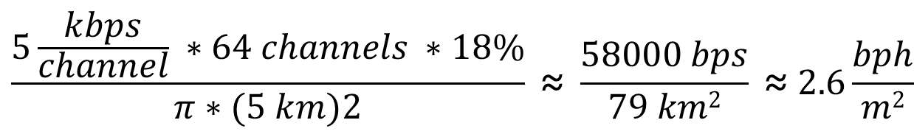
Bit flux measurement for LoRaWAN.
ALOHA access control
$$\frac{5\frac{kbps}{channel} ∗64 channels ∗18\%}{π∗(5 km)2} \text{≈} \frac{58000 bps}{79 km2} \text{≈} 2.6\frac{bph}{m2}$$
Hata model
Notes:
Here is the bit flux measurement for a LoRaWAN network
In the US, LoRaWAN has 64 channels for uplink
But it relies on an ALOHA access control mechanism, so packet collisions reduce throughput significantly

Slide 24
Networks differ in capability by orders of magnitude.
Notes:
We can calculate bit flux for each of the networks we’re interested in
We note that there are several orders of magnitude difference in the throughput capability of each network
Particularly between cellular communication and unlicensed LPWANs

Slide 25
Range reduction results in a bit flux curve for each network.
Notes:
These points are at the maximum range for each network, but they have the ability to perform power control and reduce range
This creates a curve for each network, where we can reduce range (and install more gateways) in order to increase network capability

Slide 26
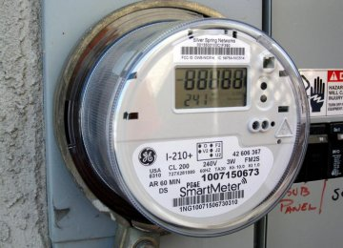
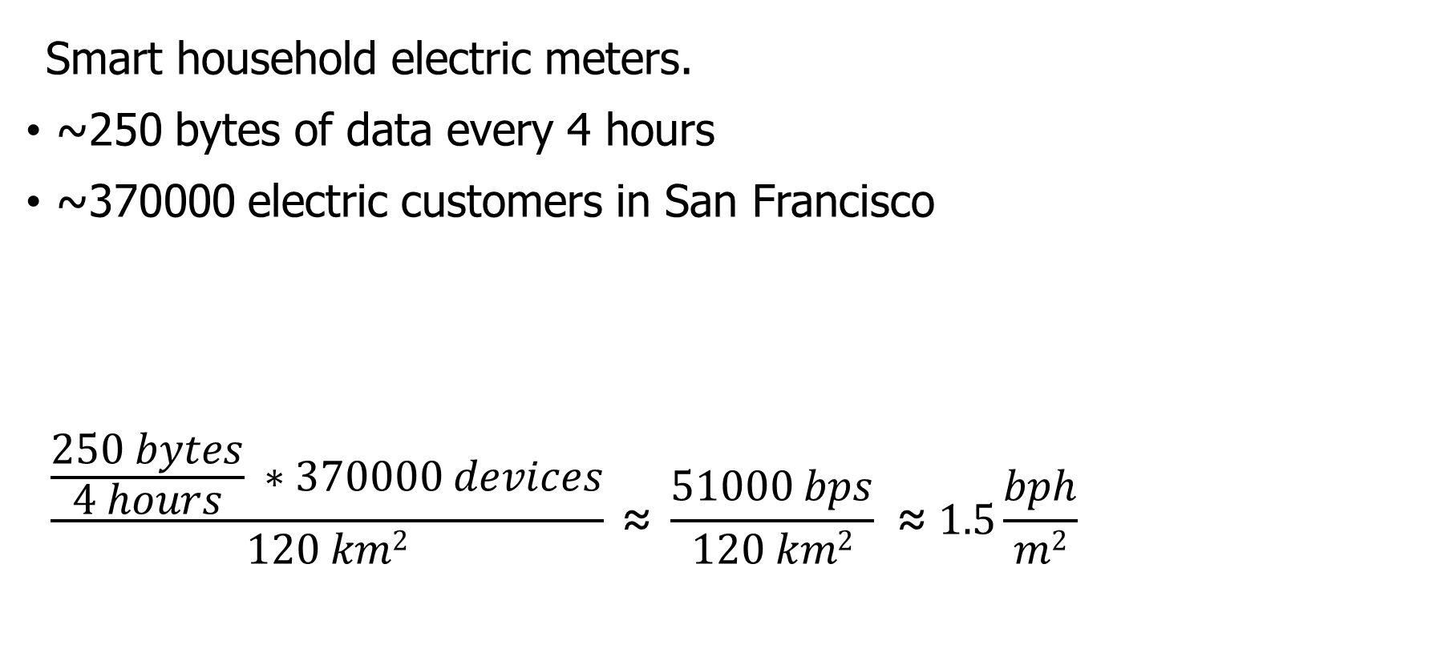
Let’s compare network capabilities to a real-world application.
Smart household electric meters.
~250 bytes of data every 4 hours
~370000 electric customers in San Francisco
$$\frac{\frac{250 bytes}{4 hours} ∗370000 devices}{120 km2} \text{≈} \frac{51000 bps}{120 km2} \text{≈} 1.5\frac{bph}{m2}$$
Notes:
Now that we can measure the capability of each network, lets compare that to the needs of an application
The example I’ll be talking through is Electricity Metering, there are about a dozen others in the paper
PG&E smart meters send about 250 bytes every 4 hours
This isn’t a lot of data, but smart meters are densely deployed, with three hundred thousand across San Francisco

Slide 27
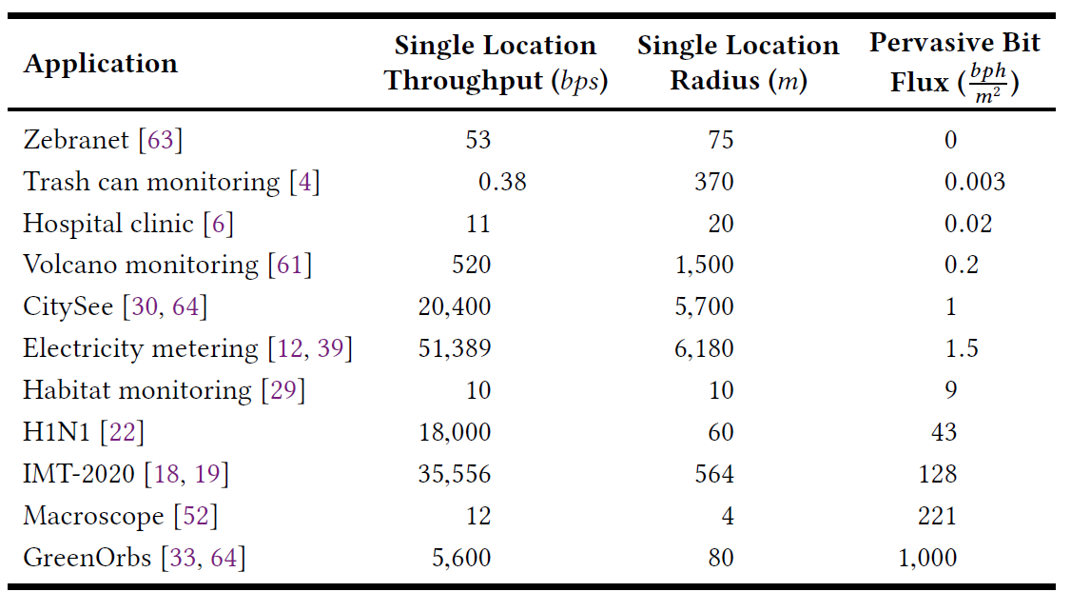
Bitflux for various applications
See paper for full details on each application
Creates a comparison point between applications and networks!
https://brandenghena.com/projects/lpwan/ghena19lpwans.pdf

Slide 28
All networks are capable of meeting the data needs of electricity metering.
Electricity Metering Application
Notes:
We can plot the need of the Electricity Metering application as a line on our bit flux figure
Any network above this line is capable of serving the application’s needs
Sigfox needs range reduction, but all networks are capable of serving this application’s needs
So, great! Networks can serve ubiquitous applications. Problem solved, right?

Slide 29
Unlicensed LPWANs lag behind Cellular IoT in ability to support applications.
2G < 0.03% utilized
Notes:
Let’s visualize this instead as the number of gateways deployed and the proportion of network utilized.
Again, because of power control, there is a tradeoff here. We could deploy a single gateway for everything, or many gateways with reduced range to increase capacity.
Cellular networks have no problem with this application
With a single gateway, LTE-M could spend 1% of its capacity to service this app.
Unlicensed LPWANs, however, have choices to make on how many gateways they deploy and how much capacity they are willing to spend on this one application

Slide 30
Sigfox requires range reduction to meet application needs.
Capacity Problem
Throughput capability of Sigfox is insufficient to support application needs
It can only support the application with reduced range and additional gateways
Notes:
There are two particular problems we can see with the unlicensed LPWANs
The first is a capacity issue:
Sigfox can’t satisfy the application at all without power control.
Range is sufficient for a single gateway to cover the city, but it wouldn’t be able to keep up with the data.

Slide 31
Capacity solutions are relatively straightforward.
Better access control mechanisms. Explore CSMA?
Recover simultaneous transmissions (Choir and Charm).
Increase bandwidth (TV white spaces).
All likely come at the cost of increased energy usage…
  Results in a protocol that looks pretty similar to cellular…
Adwait Dongare, et al. "Charm: exploiting geographical diversity through coherent combining in low-power wide-area networks.“ IPSN’18
Rashad Eletreby, et al. "Empowering low-power wide area networks in urban settings." SIGCOMM’17
Abusayeed Saifullah, et al. "SNOW: Sensor network over white spaces." SenSys’16
Notes:
Solving these capacity problems is relatively straightforward
And a lot of research from our community has begun that path
One solution would be better access control mechanisms than the ALOHA
We could also significantly increase the available bandwidth through the use of TV white spaces

Slide 32
LoRaWAN devotes most of its network capacity to a single application.
Coexistence Problem
LoRaWAN can meet application needs
But only by using 50% of the 915 MHz unlicensed-band spectrum
Notes:
But there is a second problem, that of coexistence
LoRaWAN could handle the application with only 2 or 3 gateways
Remember, that we are calculating bit flux for LoRaWAN using all available channels
As long as you are willing to commit 50% of the 915 MHz spectrum to electricity metering

Slide 33
Coexistence is inevitable in urban areas.
Urban environments and long range lead to many overlapping deployed networks.
Capacity problems worsen coexistence by devoting more bandwidth to one application.
It’s not just electricity metering…
Notes:
You might try to say it’s fine to dedicate so much of a network to a single application. I dedicate 50% of my home WiFi to Netflix all the time…
But coexistence cannot be ignored in urban areas
There won’t just be one network, but two, or three, or more
And they all have to share the same bandwidth for all deployed applications

Slide 34
Coexistence in unlicensed bands is a more difficult problem.
No methods for inter-network negotiation so far.
Without buy-in from most deployments, all access control becomes uncoordinated.
Cellular IoT does not have this problem
Notes:
Solving these coexistence problems are more difficult
We need methods for coordination and negotiation between deployed networks
And without buy-in from all networks, collisions are inevitable
It doesn’t matter that you are using a wonderful scheduling TDMA algorithm to send data without collisions if your neighbor is transmitting whenever they want
And a really important point is that cellular IoT doesn’t face this problem

Slide 35
Cellular may dominate future deployments.
LTE-M and NB-IoT are now deployed in the US (and worldwide).
Licensed bandwidth avoids the coexistence problem.
Cellular may solve many applications but is not a perfect solution.
  Still has higher energy and monetary costs for use.
  Also limited to where service is already available.
Notes:
Occupying licensed bands means LTE-M and NB-IoT don’t have multiple overlapping networks to coordinate with
So coexistence isn’t a concern
And they already have more capacity than the unlicensed protocols
Without solutions for unlicensed LPWANs, deployments will move to cellular networks
And when the applications leave, research will leave as well
Without real solutions to the problems they face, we’re in danger of losing an exciting research domain
We pose this as a challenge to the community to develop coexistence and capacity solutions for unlicensed LPWANs

Slide 36
Unlicensed LPWANs are still useful for some scenarios.
Controlled or unoccupied regions have reduced coexistence concerns.
  Industrial factories, farms, parks and forests.
Unlicensed networks are very exciting for research.
  Anyone can deploy a network wherever they want.
  Much easier to explore protocol modifications and new technologies.
Research suffers without real-world applications.
  Problem areas are strong recommendations for new research.
  New research is only useful if they will have real-world impacts.

Slide 37
Implications – Low-Power Wide-Area Networks.
Existing unlicensed LPWANs face significant challenges in supporting urban applications.
  Best suited for industrial or agricultural uses in controlled environments.
Research directions for unlicensed LPWANs:
  improve network capacity,
  and enable coexistence.
Cellular IoT networks (LTE-M and NB-IoT) are positioned to solve the needs of city-scale sensing.
  If the money and energy costs are there.

Slide 38
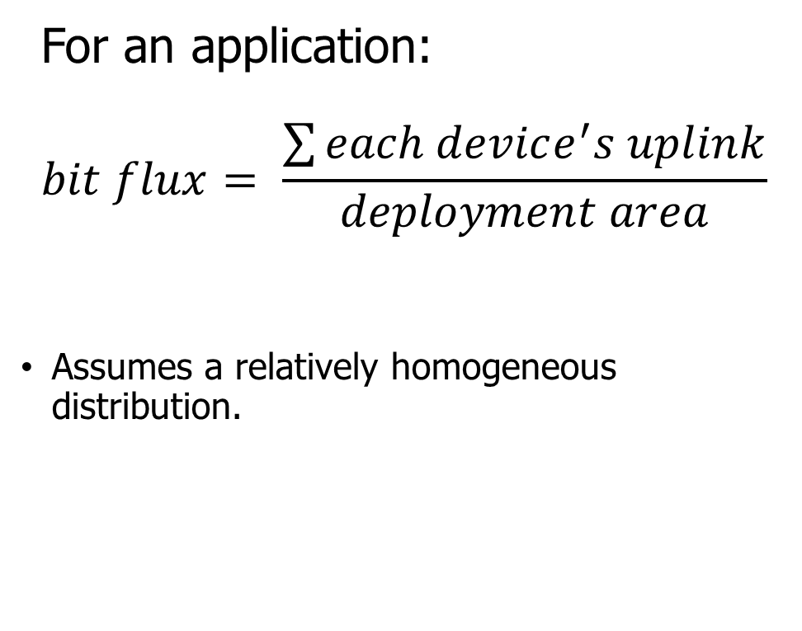
Break + Question
How important is a homogenous distribution?
Can you come up with a scenario where this breaks?
For an application:
$$bit flux= \frac{\sum{each device^{′}s uplink}}{deployment area}$$
Assumes a relatively homogeneous distribution.

Slide 39
Break + Question
How important is a homogenous distribution?
Can you come up with a scenario where this breaks?
Consider densely populated pockets of transmission over wide areas
  Deployment area needs to correspond to pockets, not to entire range
For an application:
$$bit flux= \frac{\sum{each device^{′}s uplink}}{deployment area}$$
Assumes a relatively homogeneous distribution.

Slide 40
Outline
LPWAN Use Cases
LPWAN Challenges
Improving LoRaWAN

Slide 41
Resources
Swarun Kumar (CMU) - https://swarunkumar.com/lpwan.html
Choir
  https://swarunkumar.com/papers/choir-sigcomm2017.pdf
  https://swarunkumar.com/slides/choir-sigcomm2017.pdf
Charm
  https://swarunkumar.com/papers/charm-ipsn2018.pdf
Opportunistic Packet Recovery
  https://swarunkumar.com/papers/opr-mobisys2020.pdf
BSMA
  https://github.com/ucsdwcsng/bsma_lora/blob/09b998355498d6268ab0c1e940b395ec62a026a0/docs/full_paper_3495243.3560544.pdf

Slide 42
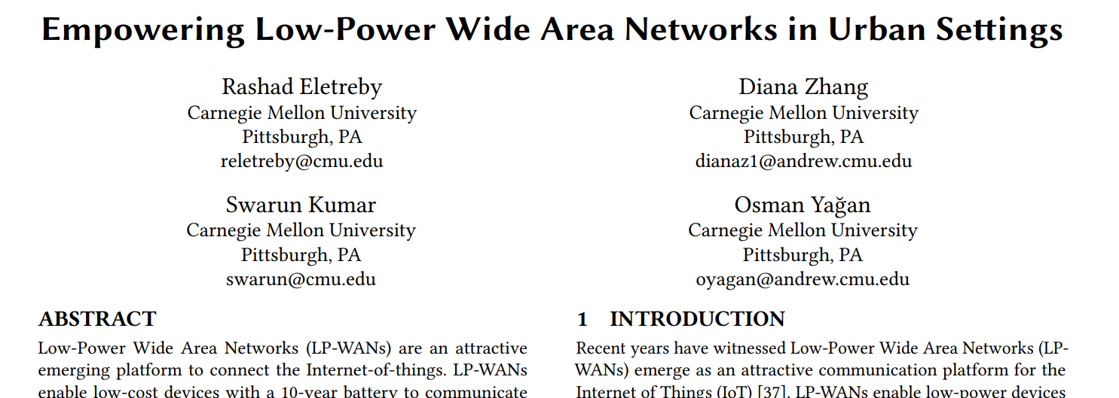
Choir Paper
SIGCOMM 2017

Slide 43
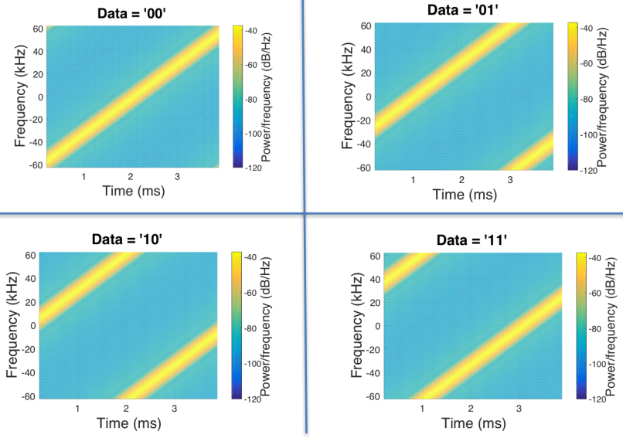
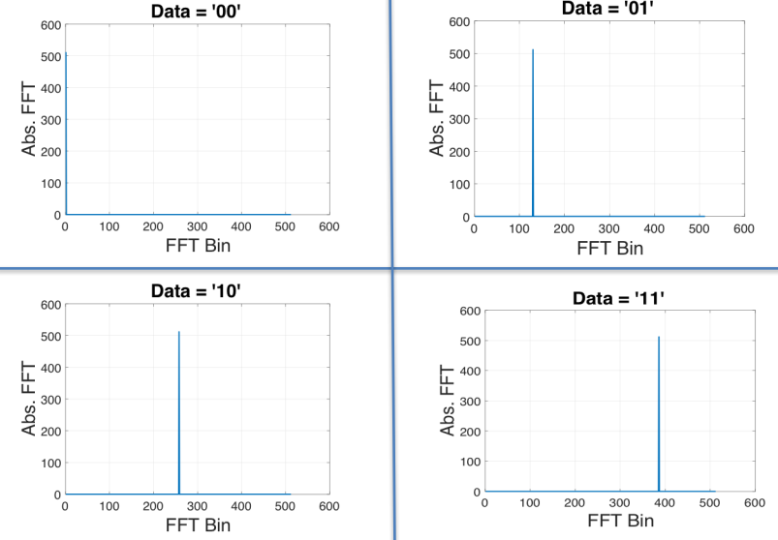
Choir concept
Can we distinguish data from LoRa chirps that have collided?
  Yes! By applying signal processing to the problem
Data in time domain
Data in frequency domain

Slide 44
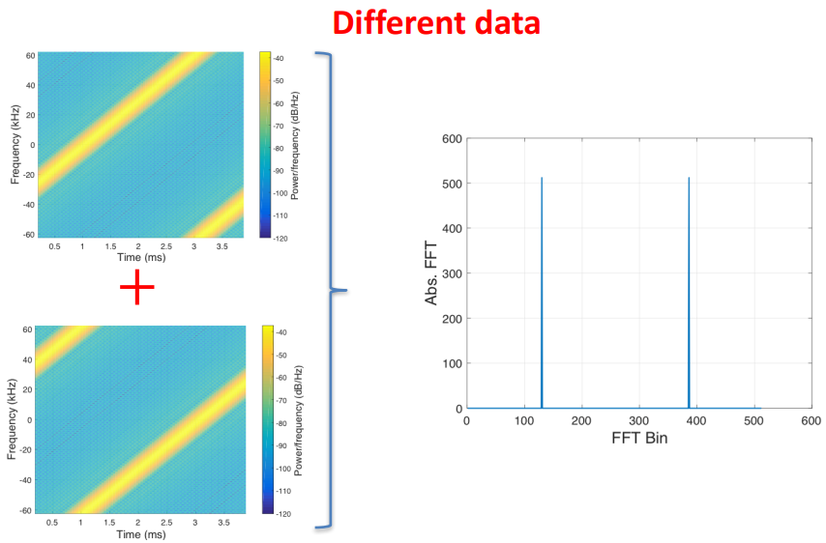
What happens when LoRa chirps collide?

Slide 45
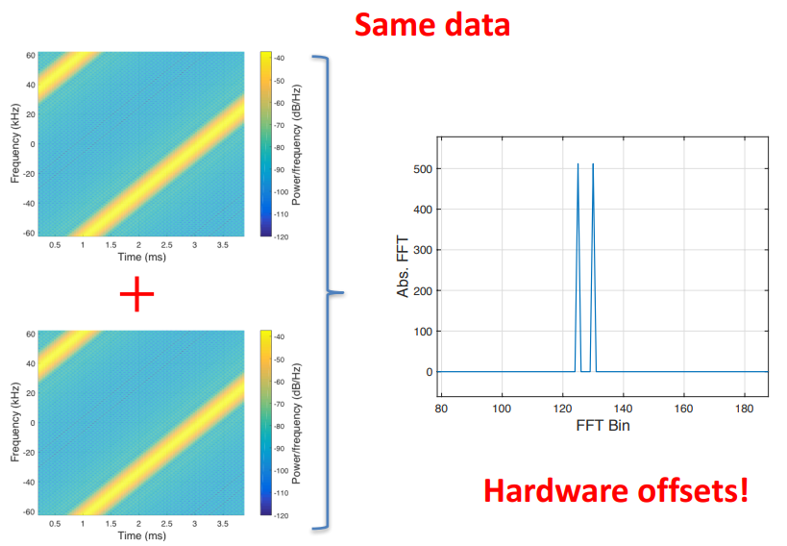
What happens when LoRa chirps collide?

Slide 46
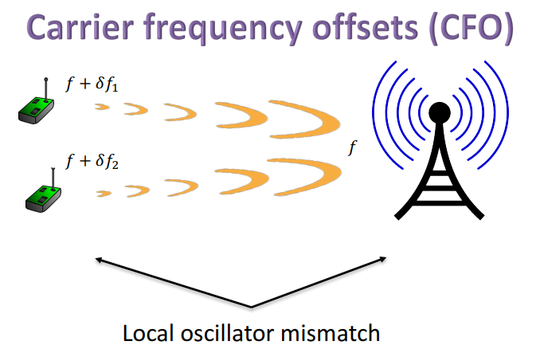
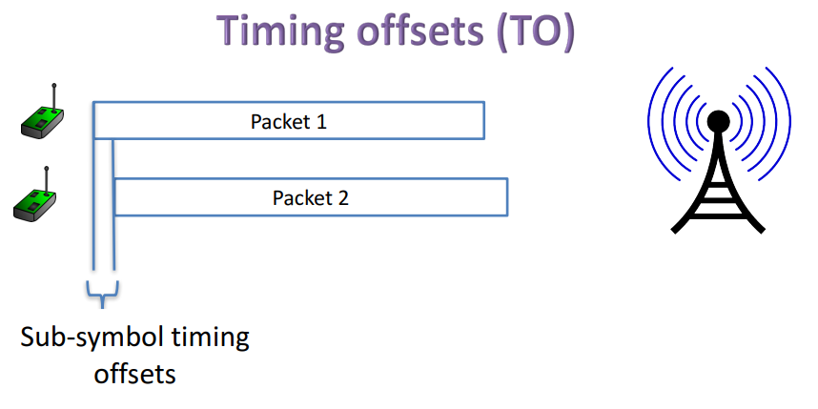
Imperfections in hardware create offsets

Slide 47
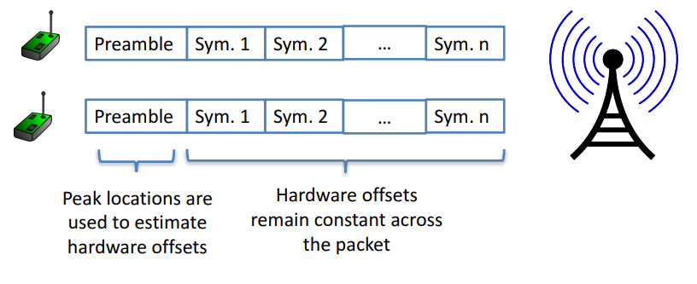
Decoding colliding packets

Slide 48
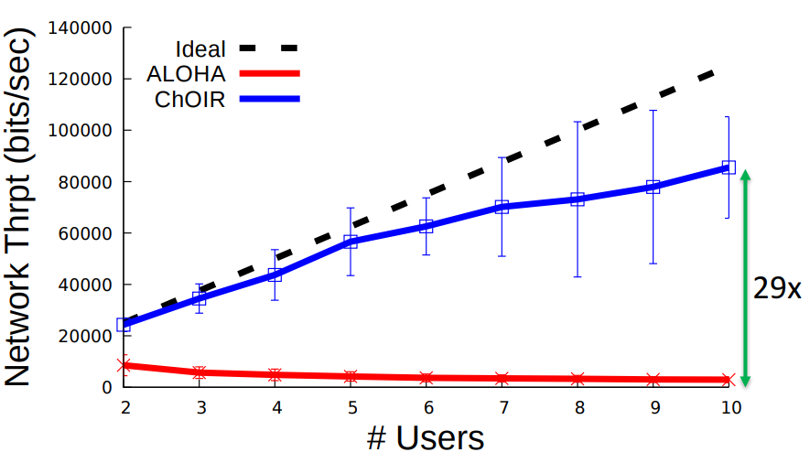
Choir results
Recovering collided packets resolves losses due to Aloha transmission!
Increases maximum throughput on the network considerably!
Requires hardware modifications on gateways

Slide 49
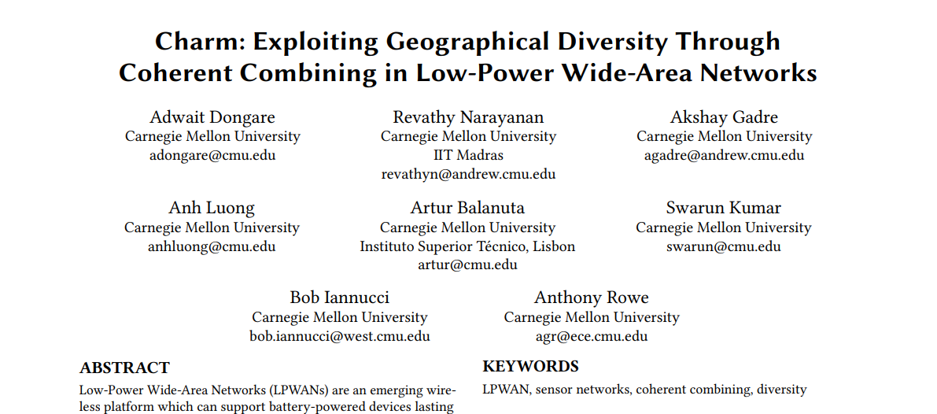
Charm Paper
IPSN 2018

Slide 50
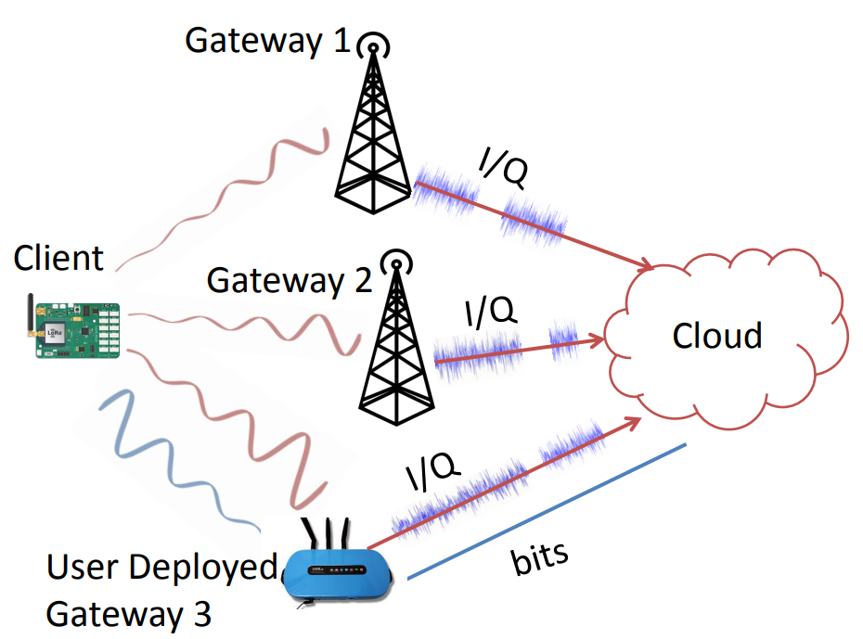
Charm
Take advantage of multiple gateways in range of a device
Combine signals received at each gateway to recover packets that weren’t received cleanly
Particularly useful at decoding weak signals

Slide 51
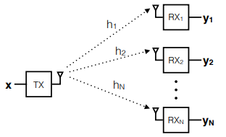
Coherent combining
Signal received at each receiver is a combination of
  Signal
  Wireless channel
  Random noise
Signal and wireless channel are similar
at all receivers
Noise is different though!
Possibly independent?
When combined, signals are coherent (build in strength)
whereas noise is incoherent (spreads out)

Slide 52
Charm uses coherent combining across gateways
Gateways send signal data to the cloud
The cloud can perform combining on the data and recover signals
Challenges
  Only send the data when it’s needed
  Tight time synchronization on the data
  Gateway hardware changes

Slide 53
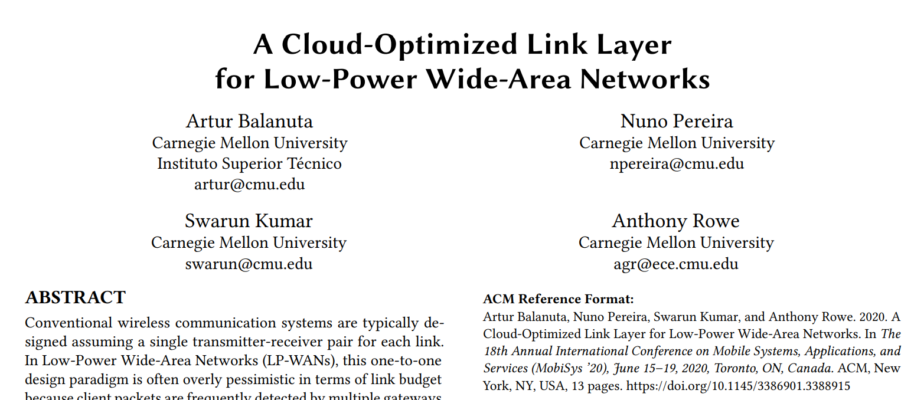
Opportunistic Packet Recovery Paper
MobiSys 2020

Slide 54
Opportunistic Packet Recovery (OPR)
Can we recover packets that have bad CRCs?
  What if we have some information about where the interference might have occurred during the signal transmission?
  OPR demonstrates that we can recover packets!
Process
  Receive bits even for bad packets
  Measure RSSI for each bit along the way
  Look for changes in RSSI that signals interference
  Try different values for the effected bits until the CRC succeeds!

Slide 55
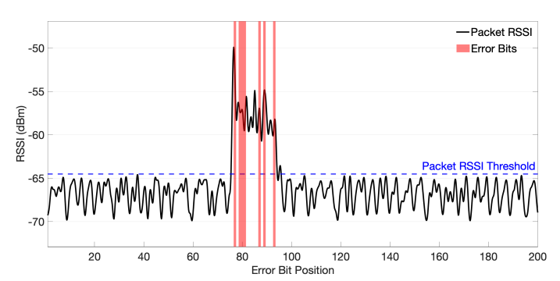
Detecting error bits in transmitted packets
Correctly identifies 83% of the corrupted bits with 17% false positives

Slide 56
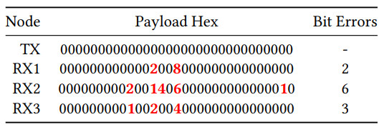
Multiple gateways do even better
If multiple gateways receive the packet, they can compare their received data
Common bits are likely correct, while differences are likely interference

Slide 57
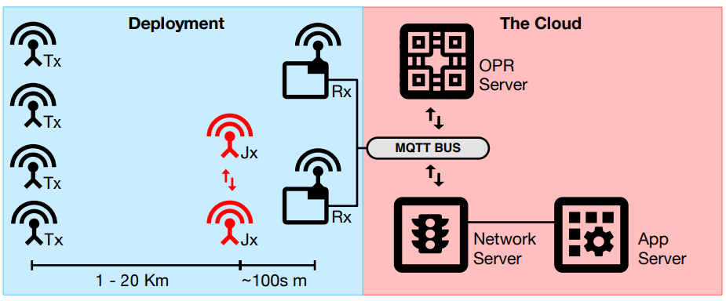
OPR total design
Bad packets are sent to
the OPR Server for
handling along with
RSSI data
OPR server attempts to
reconstruct the packet
In practice, system can correct up to 72% of CRC errors!
  Also completes correction in time for the ACK response (within 1 second)

Slide 58
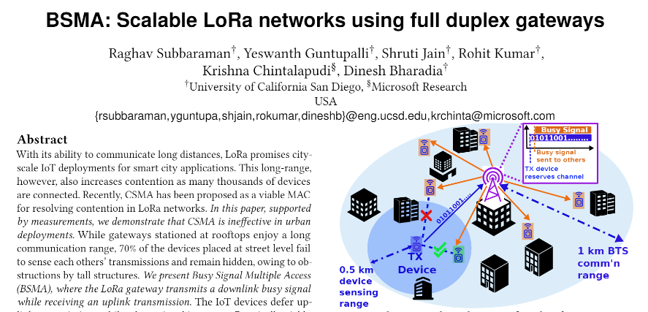
Busy-Signal Multiple Access (BSMA) Paper
MobiCom 2022

Slide 59
CSMA provides better throughput than Aloha
Current LoRaWAN uses Aloha for uplink communication
  So there’s nothing stopping devices from colliding
Switching to CSMA could provide significantly more throughput
  Reduces time and energy wasted on packet collisions
Concern: does CSMA for LoRa actually work in the real world?

Slide 60
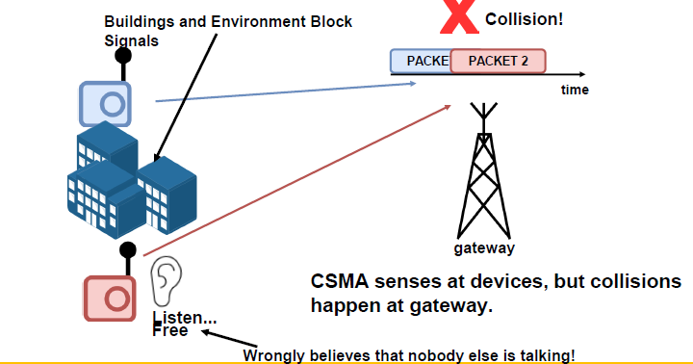
Obstructions cause hidden terminal problem
Hidden terminal problem is a concern here
  Devices may not be able to hear each other
Measured reality: devices fail to detect simultaneous transmissions 70% of the time!!

Slide 61
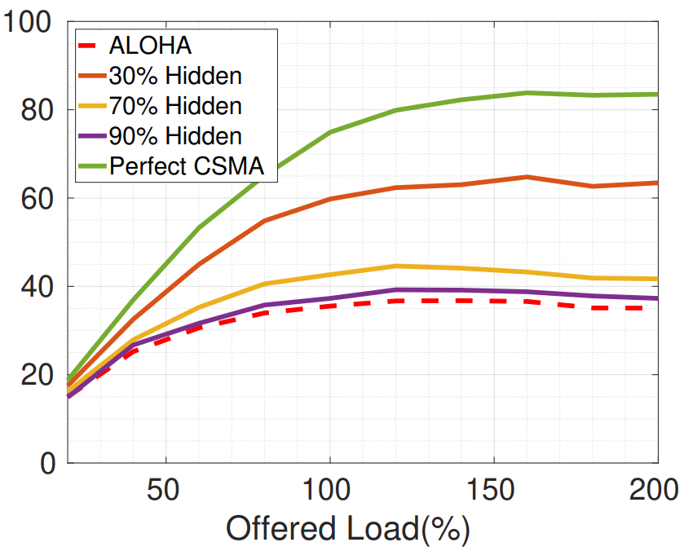
Hidden terminals greatly reduce CSMA throughput
Perfect CSMA could provide twice the throughput of Aloha
But, at 70% failure for CSMA, it’s not really an improvement over Aloha

Slide 62
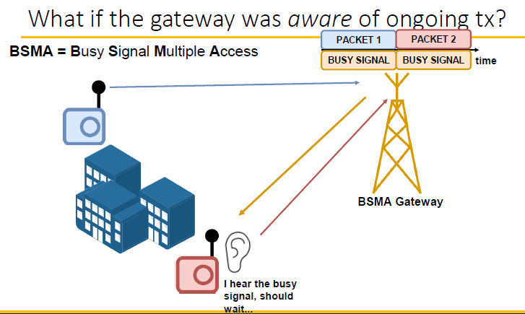
Busy-signal can alleviate this problem!
Idea: have the Gateway transmit a “busy signal” on one of the downlink channels while an uplink is in progress
Other devices can hear the gateway, even if they can’t hear each other

Slide 63
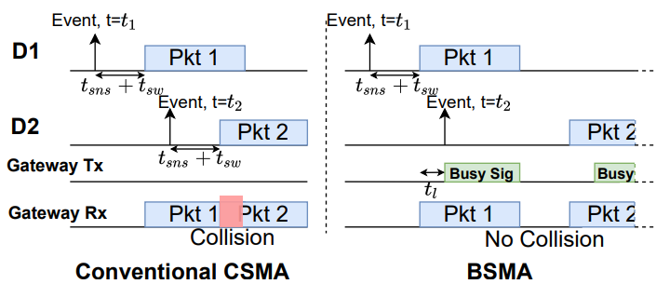
BSMA design
End devices do not attempt to transmit while a busy signal is present
  Instead, they defer transmission for a random duration, and go back to sleep
  When waking up, they sense for a busy signal again before transmitting

Slide 64
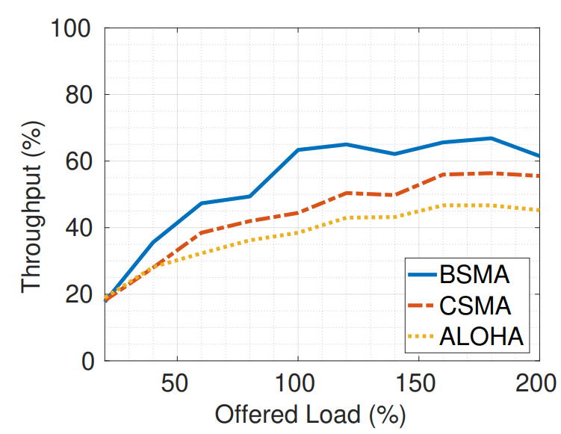
Real-world improvements from BSMA application
50% improvement over Aloha when network is under load
  Still some packets are lost due to collisions
Could be combined with other approaches to still recover collided data
  Maybe even intentionally send busy signal based on number of acceptable collisions
Greatly reduced energy per packet as well
  Since they’re more likely to be received, and sensing doesn’t cost too much

Slide 65
Translating research into the real world
What are the challenges in translating this research into real-world use?
  Improve gateway hardware: how do people buy/make it?
    Needs a manufacturer to be interested
  Multiple gateways are necessary
    Not applicable to very small deployments
    Network operators (TTN or Helium) would be good targets
    They also have backend stuff running anyways, so adding OPR should be possible!

Slide 66
Outline
LPWAN Use Cases
LPWAN Challenges
Improving LoRaWAN

