Slide 1
Lecture 13 Cellular IoT & LPWAN Intro
CS397/497 – Wireless Protocols for IoT
Branden Ghena – Spring 2024
Materials in collaboration with Pat Pannuto (UCSD) and Brad Campbell (UVA)

Slide 2
Today’s Goals
Understand how modern “Cellular for IoT” fit into the existing cellular infrastructure, and what they do at a technical level to suit IoT needs
Apply knowledge from the course to understand LPWAN design
Overview of unlicensed-band LPWANs
LoRaWAN

Slide 3
Outline
Cellular IoT
LPWAN Design
LoRaWAN

Slide 4
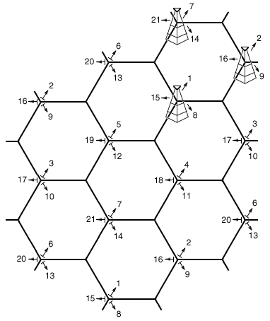
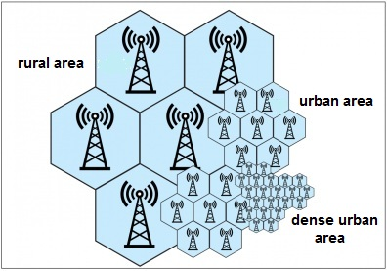
Reminder: the cell in cellular technologies
Place towers at corners of cells
Directional antennas send three different frequency bands, one per cell
Each cell gets three tower and three bands
Density of cells varies based on expected number of users
Change cell size using Power Control

Slide 5
3GPP (aka: the actual answer for what stuff is really doing)
3rd Generation Partnership Project (3GPP)
Industry alliance for development of telecoms standards
Established around 1998
Makes “Releases” which are roughly analogous to IEEE standards/versions
Release 8 (2008) LTE ~4G
Release 15 (2018) NR (New Radio) ~5G
Focused on the practical
ITU post-hoc defined “4G”, 3GPP defined LTE

Slide 6
Mapping ”4G”, “LTE”, “LTE Advanced”, etc onto actual technologies
This Qualcomm presentation is great: https://www.qualcomm.com/media/documents/files/demystifying-3gpp-and-the-essential-role-of-qualcomm-in-leading-the-expansion-of-the-mobile-ecosystem.pdf

Slide 7
LTE Categories
Different equipment supports different “categories” of LTE
Maximum MCS index supported
Examples
iPhone 6 (2015): Cat 4
Pixel 3 (2018): Cat 16
Notes:
MCS = Modulation Coding Scheme
https://mcsindex.com/ looks like all the tables for WiFi; not clear whether this is the same for cell

Slide 8
Additional low-end categories for IoT
LTE Cat 0
Traditional LTE, but focused on the really low end
1 Mbps for uplink and downlink
LTE-M (LTE Cat M1)
375 kbps uplink, 300 kbps downlink (for the commonly implemented mode)
Reduced power and maximum bandwidth
Increased range
NB-IoT (LTE Cat NB1)
65 kbps uplink, 26 kbps downlink
Reduced power and greatly reduced bandwidth
Greatly increased range

Slide 9
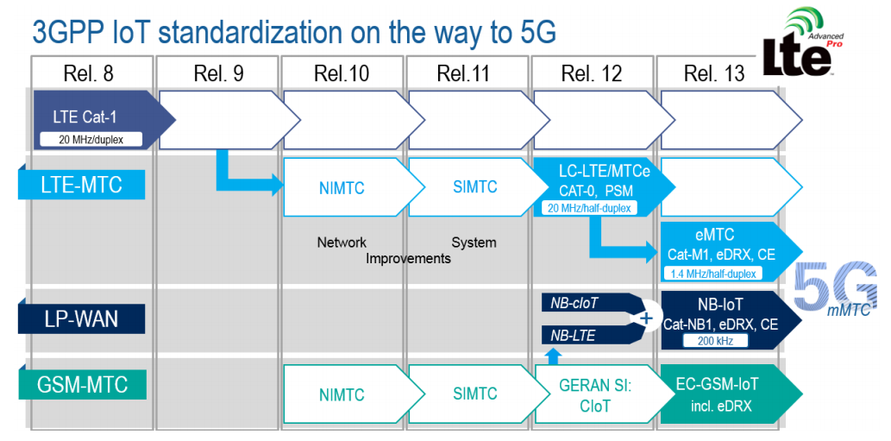
LTE-M and NB-IoT were developed in parallel

Slide 10
Why do we need “special categories” for IoT on cell?
We can treat IoT devices differently than human-centric devices
Pragmatic for the end device
Lower power
Allow for long-off periods
Pragmatic for network operators
Allows for scale– network no longer needs to assume that devices could always be on in each cell or that they all possibly need a lot of throughput

Slide 11
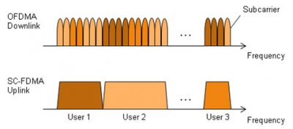
LTE-M and NB-IoT downlink and uplink
OFDMA downlink
Put the more complicated hardware in the cell tower [simple FFT demodulator]
SC-FDMA (single carrier FDMA) uplink
Blocks of subchannels combined into one signal
Essentially just send a single signal, with increased bandwidth.
Simpler for end devices to implement

Slide 12
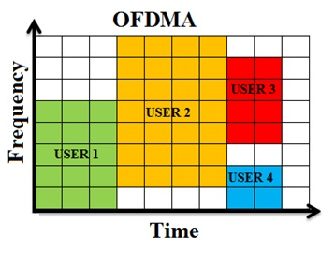
LTE resource allocation
Cellular uses OFDMA to schedule
Time + Frequency -> “2D Scheduling”
Cellular uses single channels up to 20 MHz
Further divides these into 100 Resource Blocks
Resource Block
12 subcarriers for OFDM in frequency (15 kHz each)
7 symbols in time (0.5 ms)
Devices are allocated frequency and time based on what they are sending
Allocated in units of Resource Blocks
One “Resource Block”

Slide 13
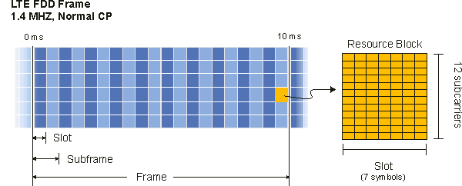
Resources used by LTE-M and NB-IoT
LTE-M uses up to 6 resource blocks
1.4 MHz of bandwidth (1.080 MHz)
Can co-exist with other normal LTE traffic, scheduled by cell tower
Limited to only some capability of LTE (much less throughput)

Slide 14
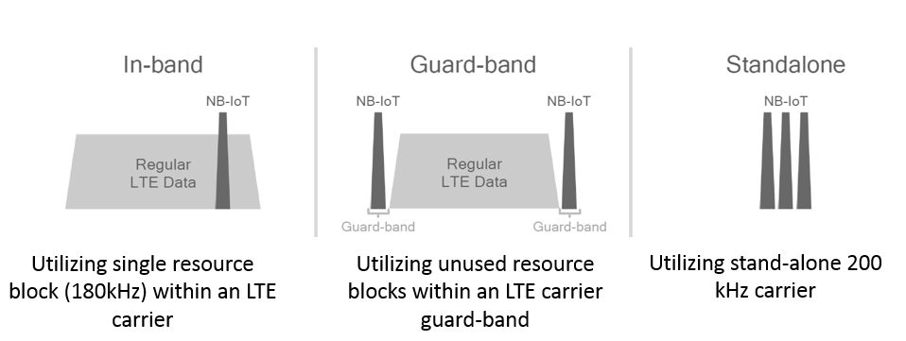
Resources used by LTE-M and NB-IoT
NB-IoT uses up to 1 resource block
200 kHz of bandwidth (180 kHz)
Multiple deployment options
In-band or Guard-band very common in practice

Slide 15
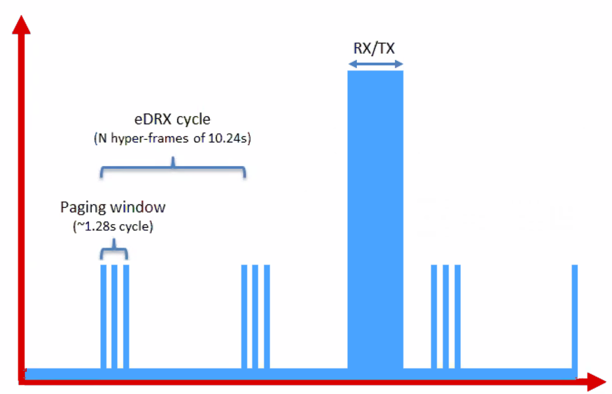
Reducing energy use for IoT devices
Reduce max Tx power to 20 dBm
Increased receive sensitivity at tower will cover it
Extended Discontinuous Reception (eDRX)
Allow devices to reduce paging period and still stay on network
Cell tower will hold messages
What does this get to?
“For a LTE-M1 device that transmits data once per day, and wakes up every 60 hyper frames to check for commands (this would be about every 10 minutes), a life of 4.7 years is achievable on 2 AA batteries.”
Graphics, quote from https://www.link-labs.com/blog/lte-e-drx-psm-explained-for-lte-m1

Slide 16
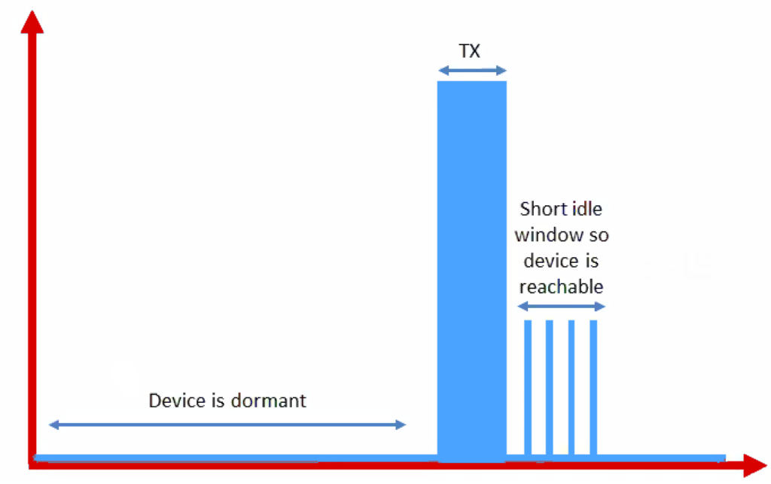
Further power reduction for simple devices
Power Saving Mode (PSM)
For very simple, uplink-focused devices, allow them to turn off entirely but stay connected
Minutes to days in duration
Notify tower before sleeping, listen for packets after each transmission
Graphics from https://www.link-labs.com/blog/lte-e-drx-psm-explained-for-lte-m1

Slide 17
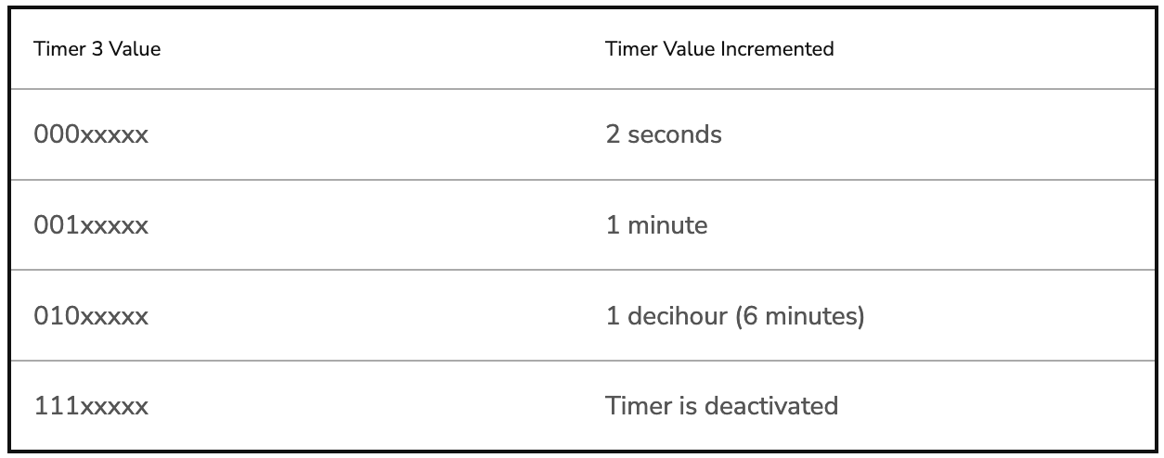
Some numbers from an actual telecom: Aeris [n.b. Aeris has been a leader in cellular M2M since the 90’s]
PSM has two timers, devices request values, tower chooses actual:
Extended Timer (“sleep” timer)
3GPP max is 35,712,00s [413.33 days]
Aeris timer range: Min 240m [4h]; Max 413 days
“Aeris Fusion” timer range: Max: 12.9 days
Active Timer (how long will the device stay in idle after communication?)
Seconds or minutes
Numbers from https://aeriscom.zendesk.com/hc/en-us/articles/360049848254-Understanding-LTE-M-Power-Management-Modes
Notes:
Really hard to tell difference between Aeris and Aeris Fusion. I think Aeris Fusion is a new product that allows devices (same SIM?) to dynamically switch between an IoT profile and a full-fledge voice / high-bw data profile. My guess then is that Aeris network is all their own owned infra, and Fusion is them acting as an MVNO [thus limited to others for wakeup range]

Slide 18
Improved range for LTE-M and NB-IoT
LTE defines a Maximum Coupling Loss (MCL) a.k.a Link Budget
Traditional cellular: 144 dB (~2.5 km)
LTE-M: 160 dB (~5 km)
NB-IoT: 164 dB (~10 km)
Sigfox: ~155 dB
LoRaWAN: ~143 dB
Note that many cellular bands are often on higher frequencies
Example: 1900 GHz
Coarsely, lower frequency is longer range, but it’s complicated

Slide 19
Coarsely, lower frequency -> longer range
This was the picture circa 2019
Why else might T-Mobile have really wanted to buy Sprint…

Slide 20
Cellular deployments
Originally unclear which would be dominant
Verizon and AT&T focused on LTE-M
T-Mobile focused on NB-IoT
All rolled out services nationwide in the 2018-2019 timeframe
Networks expanded provide both capabilities
LTE-M: AT&T, T-Mobile, Verizon, US Cellular
NB-IoT: AT&T, T-Mobile, Verizon
Pricing models still very uncertain
NB-IoT example: $5 per device per year up to 12 MB, 10 packets per hour
Future adoption will greatly depend on these

Slide 21
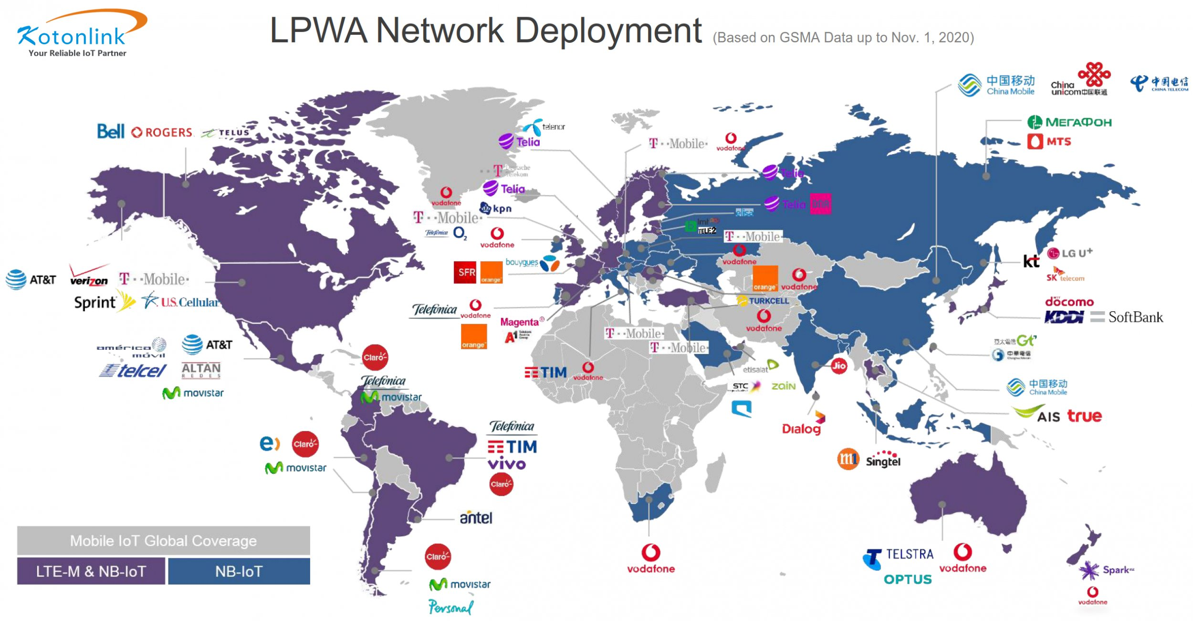

Slide 22
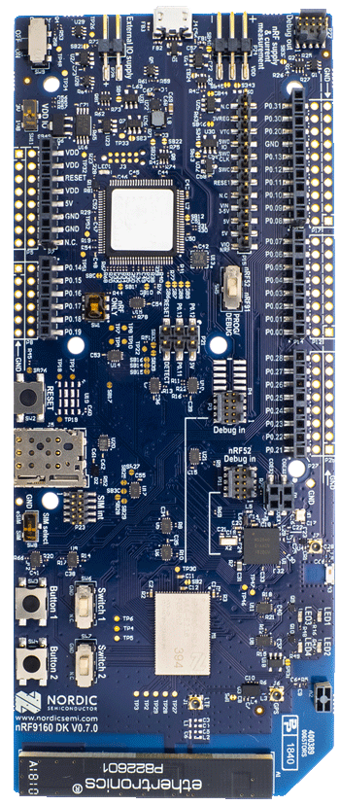
Microcontroller support
Devices need to be certified
Hardware and software
Tend to be modules or dual-core systems
Add a SIM card to connect to network

Slide 23
What about 5G?
NB-IoT and LTE-M are the low-power, wide-area 5G solutions
Intent is to coexist with 5G solutions for human-centric devices
Even if 4G sunset occurs, LTE-M and NB-IoT will still be around
https://www.ericsson.com/en/reports-and-papers/nb-iot-and-lte-m-in-the-context-of-5g-industry-white-paper

Slide 24
Break + Open Question
Cellular hardware almost always requires certified radio modules where you can’t change the code at all. Why?

Slide 25
Break + Open Question
Cellular hardware almost always requires certified radio modules where you can’t change the code at all. Why?
Otherwise you could cheat at the protocols!!
Or just generally not follow them fairly.
Avoids “tragedy of the commons” by allowing specific trusted devices only

Slide 26
Outline
Cellular IoT
LPWAN Design
LoRaWAN

Slide 27
LTE-M and NB-IoT design constrained by fitting within existing cellular ecosystem
What might a fresh design look like?
Caveat: In ISM bands!
So it’s an unlicensed, shared communication band

Slide 28
Design a wide-area network (ignore low-power for now)
What PHY choices would you make?

Slide 29
Design a wide-area network (ignore low-power for now)
What PHY choices would you make?
Modulation
Tx Power
Carrier Frequency Band
Data Throughput
Channel Bandwidth

Slide 30
Design a wide-area network (ignore low-power for now)
What PHY choices would you make?
Modulation
Unclear. Can’t be too crazy for cheap devices but there’s a bit of leeway there.
Tx Power
High (much higher than 0 dBm)
Carrier Frequency Band
Low (something lower than 2.4 GHz, 915 MHz or lower?)
Data Throughput
Low (much lower than 1 Mbps. Reduce )
Channel Bandwidth
Unclear. Likely less bandwidth available on lower frequency carrier.
Higher bandwidth gives longer range (by increasing reliability)
Lower bandwidth gives more simultaneous devices (for a fixed allocation)

Slide 31
Design a low-power wide-area network
Any particular MAC choices for lower power?
Device Roles
When do devices listen?
Access Control Mechanism

Slide 32
Design a low-power wide-area network
Any particular MAC choices for lower power?
Device Roles
Diversity of devices in network
High power gateway, low power devices in star topology
When do devices listen?
Devices should be off whenever possible
Listen-after send for downlink
Access Control Mechanism
No TDMA access control if it can be avoided
Removes requirement for synchronization
CSMA is problematic due to hidden terminal problem
What’s left: Aloha, FDMA, CDMA, ???

Slide 33
Long-range CSMA is problematic
Long-range makes everything more challenging
Kilometers of range mean kilometers between devices
Detection of channel use is less reliable
Active research in clear channel assessment for LPWANs
Hidden terminal problem has a wider range
Might make RTS/CTS more important
Result: CSMA doesn’t dominate LPWANs like it does WLANs

Slide 34
LPWANs overview (common qualities)
Unlicensed 915 MHz band (902-928 MHz)
Higher power transmissions: ~20 dBm (100 mW)
Low data rate 100 kbps or less
Range on the order of multiple kilometers
Simple Aloha access control

Slide 35
Outline
Cellular IoT
LPWAN Design
LoRaWAN

Slide 36
LoRaWAN
Open communication standard built with proprietary LoRa PHY
Low rate (1-20 kbps) and long range (~5 km)
Shorter range than Sigfox but much higher bit rate
Most popular LPWAN protocol
Target of academic research
Industry involvement in hardware and deployments

Slide 37
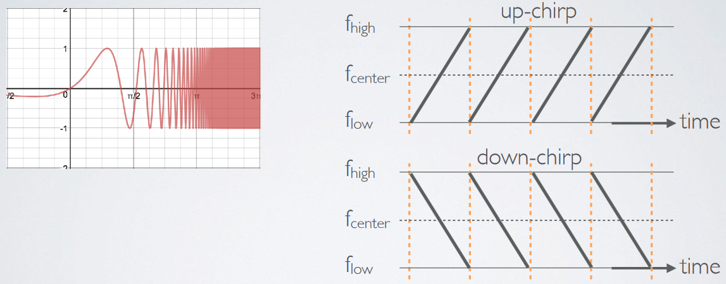
LoRa PHY uses a different modulation
Chirp Spread Spectrum (CSS)
Modulation technique where frequency is varied linearly from lowest to highest within a channel

Slide 38
Chirp Spread Spectrum
Data is modulated in the starting and ending points of chirp
Frequency increases linearly, modulo bounds of the channel

Slide 39
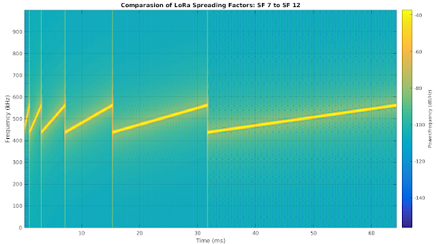
CSS has a Spreading Factor which determines bit rate
Spreading Factor is essentially the rate-of-change of frequency
Slope of the line
Lower values of spreading factor (steeper slope) are faster data rate
Important: different spreading factors are (mostly) orthogonal!
Two can overlap in time, space, and channel without a collision

Slide 40
LoRaWAN channels
Sixty-four, 125 kHz uplink channels
Frequency Hopping over the 64 uplink channels
Plus eight, 500 kHz overlapping uplink channels (not well used in practice)
Eight, 500 kHz downlink channels

Slide 41
LoRaWAN gateways
No synchronization with end devices
Instead listen to entire bandwidth simultaneously
Only 12 MHz total
Recognize preambles and allocate a hardware to decode packet
Normal gateways: 8 decoders
Good gateways: 64 decoders

Slide 42
LoRaWAN data rates
Data Rate Index | Spreading Factor | Bit Rate
125 kHz Uplink Rates
0 | SF10, 125 kHz | 980 bps
1 | SF9, 125 kHz | 1760 bps
2 | SF8, 125 kHz | 3125 bps
3 | SF7, 125 kHz | 5470 bps
500 kHz Uplink Rates
4 | SF8, 500 kHz | 12500 bps
500 kHz Downlink Rates
8 | SF12, 500 kHz | 980 bps
9 | SF11, 500 kHz | 1760 bps
10 | SF10, 500 kHz | 3900 bps
11 | SF9, 500 kHz | 7000 bps
12 | SF8, 500 kHz | 12500 bps
13 | SF7, 500 kHz | 21900 bps
Data rate options depend on channel in use
Unbalanced uplink and downlink
64-channel uplink
1-5 kbps data rate
Allowable rates based on dwell time restriction (400 ms)

Slide 43
LoRaWAN link budget
Typical TX power 20 dBm
Up to 30 dBm for 64-channel hopping
Up to 26 dBm for 8-channel hopping
Receive sensitivity -119 dBm
Compare to -100 dBm for 802.15.4 and -95 dBm for BLE
Resulting range is about a kilometer in urban environments

Slide 44
LoRaWAN MAC
Uplink: Aloha - transmit whenever
Randomly split across 64 uplink channels (reduced odds of collision)
Devices a different spreading factors also do not collide
Packets are very long though: up to 400 ms in duration
Downlink: listen-after-send (class A device)
Two windows for RX on different channels

Slide 45
Optional downlink mechanisms
Periodic listening (class B device)
Synchronized with periodic beacons
TX still unsynchronized Aloha
Mostly unused
Continuous listening (class C device)
Always-on receivers

Slide 46
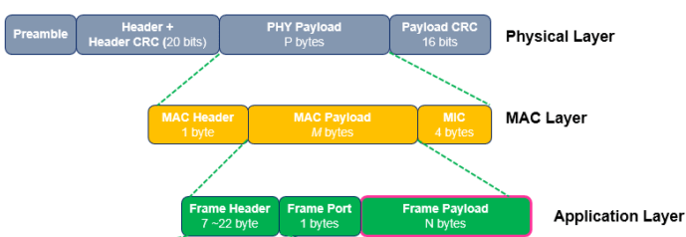
LoRaWAN packet format
Frame header includes device address
MAC Payload maximum size depends on data rate
Again based on dwell time in the US
Data Rate Index | MAC Payload Size
0 | 19 bytes
1 | 61 bytes
2 | 133 bytes
3 | 250 bytes
4 | 250 bytes

Slide 47
LoRaWAN network details

Slide 48
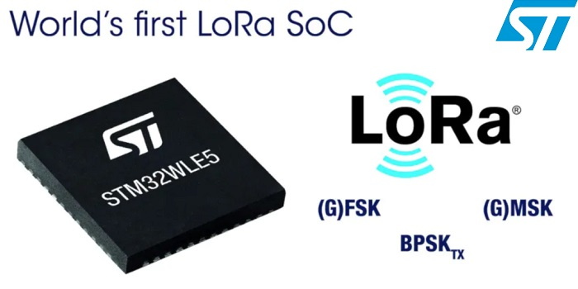
LoRaWAN hardware
Numerous hardware modules and development kits
Almost all use Semtech radio chips (Semtech owns LoRa PHY)
Recent addition: STM32WLE5 LoRa SoC
Cortex-M4 + LoRa radio (analogous to nRF52840)

Slide 49
LoRaWAN network providers
Somewhat-managed network providers
The Things Network (predominantly in Europe)
But available in the US too!
Helium
Any can buy and install their own gateway, which serves everyone
Microtransactions to pay for communication

Slide 50
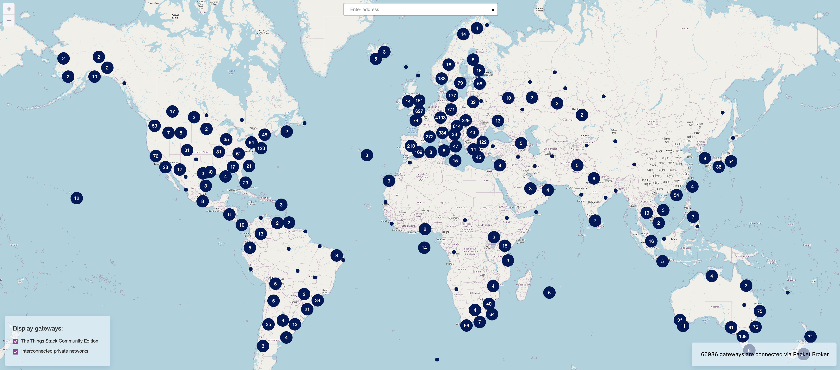
TTN Scale [Jan 2022]

Slide 51
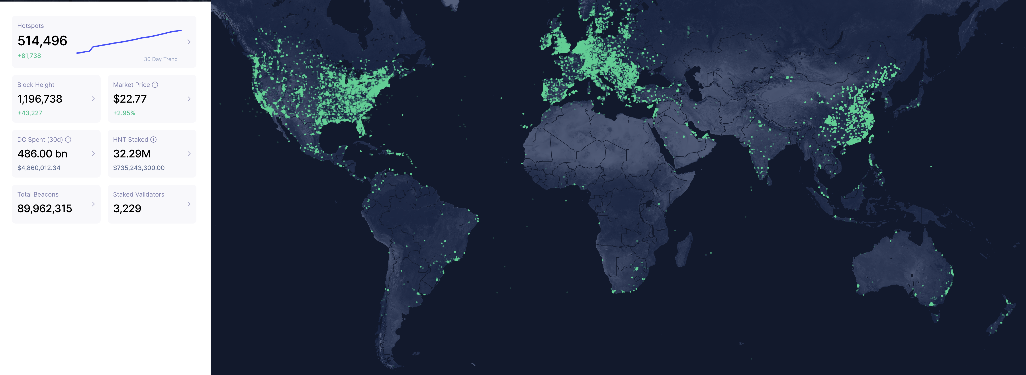
Helium Scale [Jan 2022]
May 2022: 800,000 hotspots, with +80K in last 30 days

Slide 52
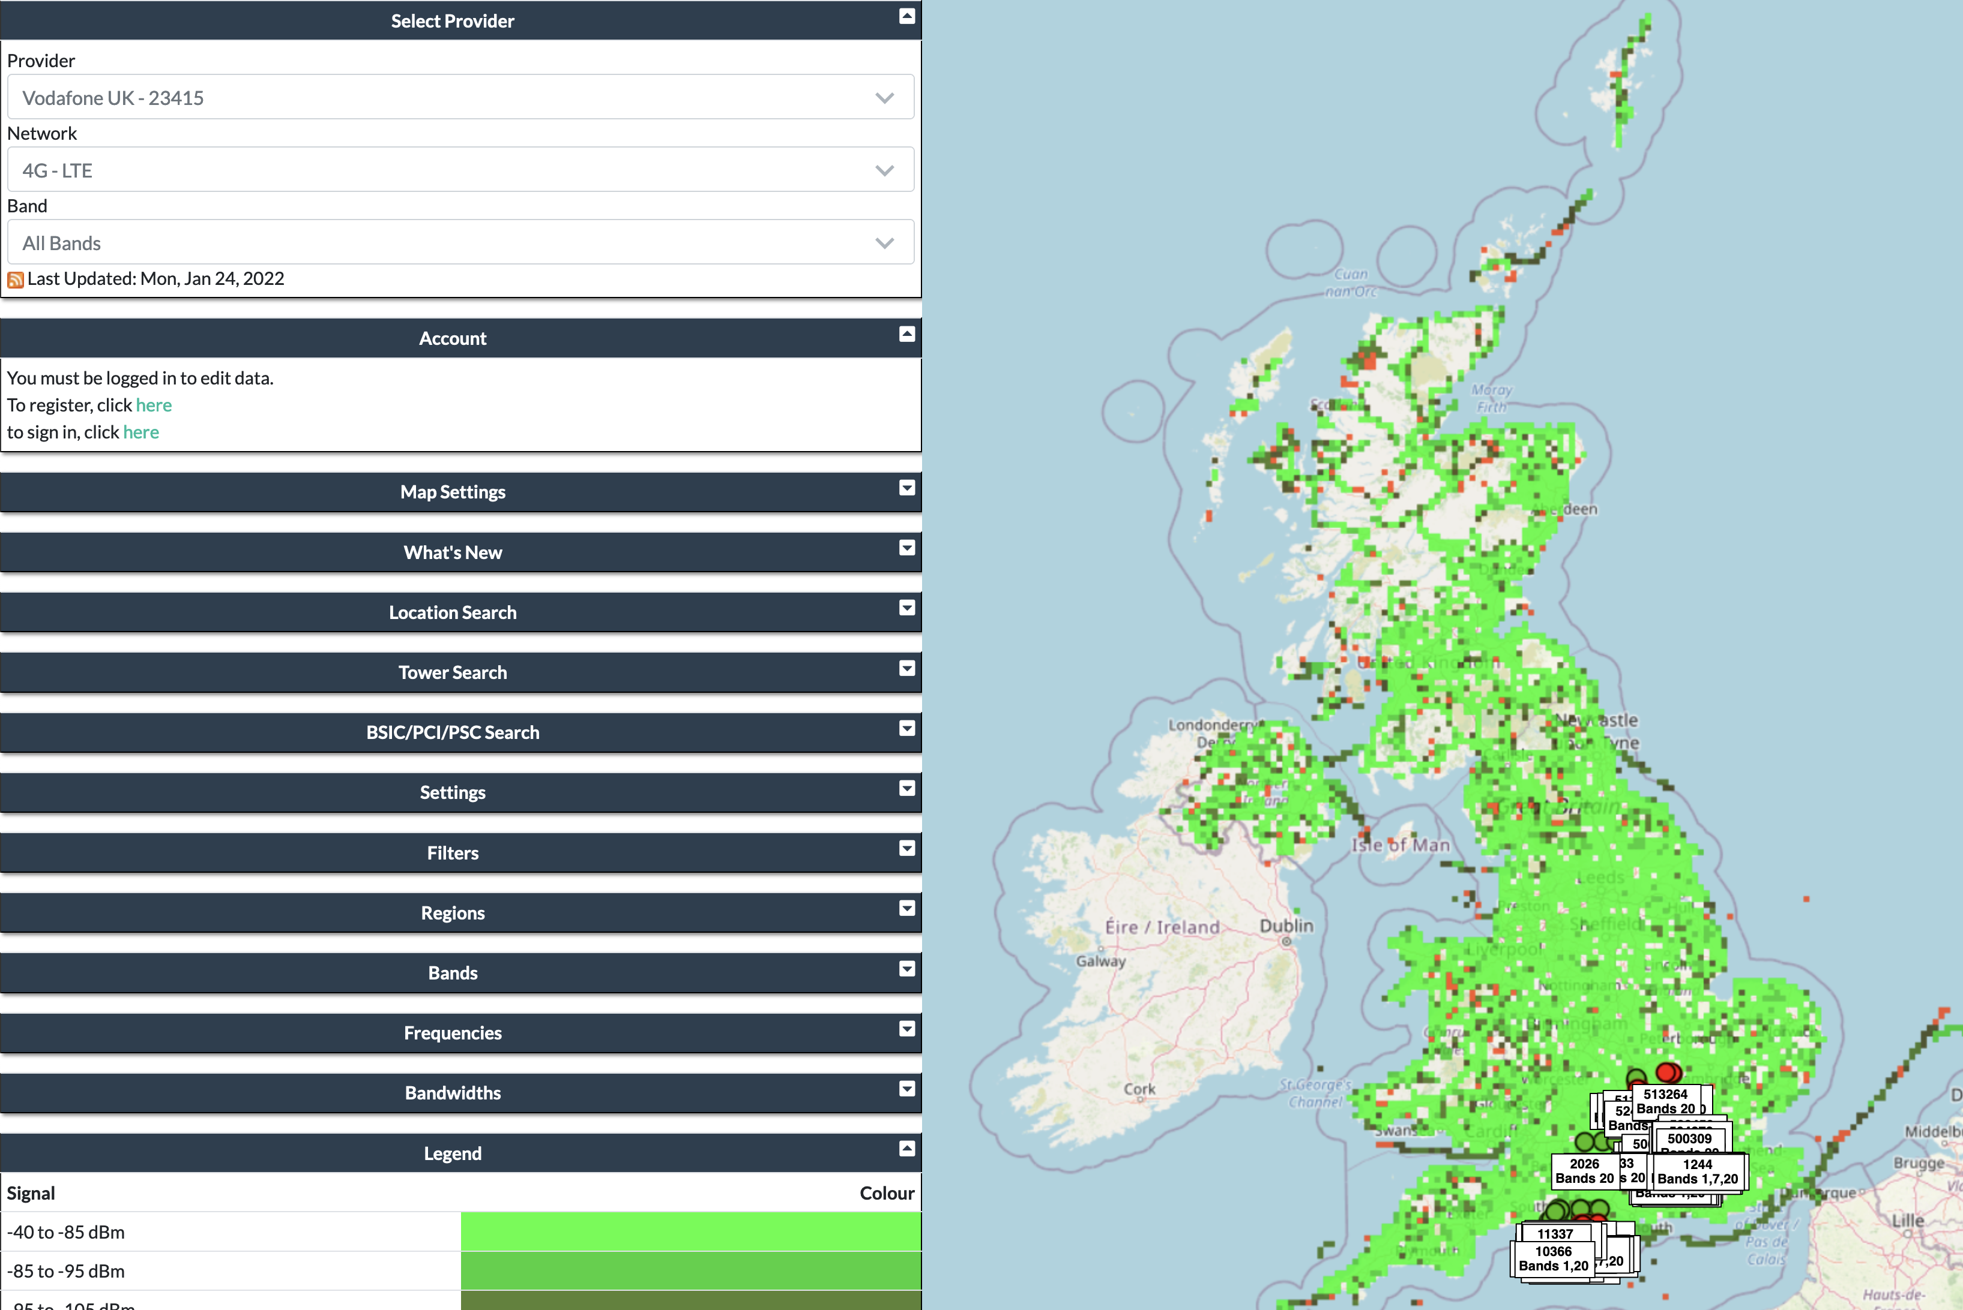
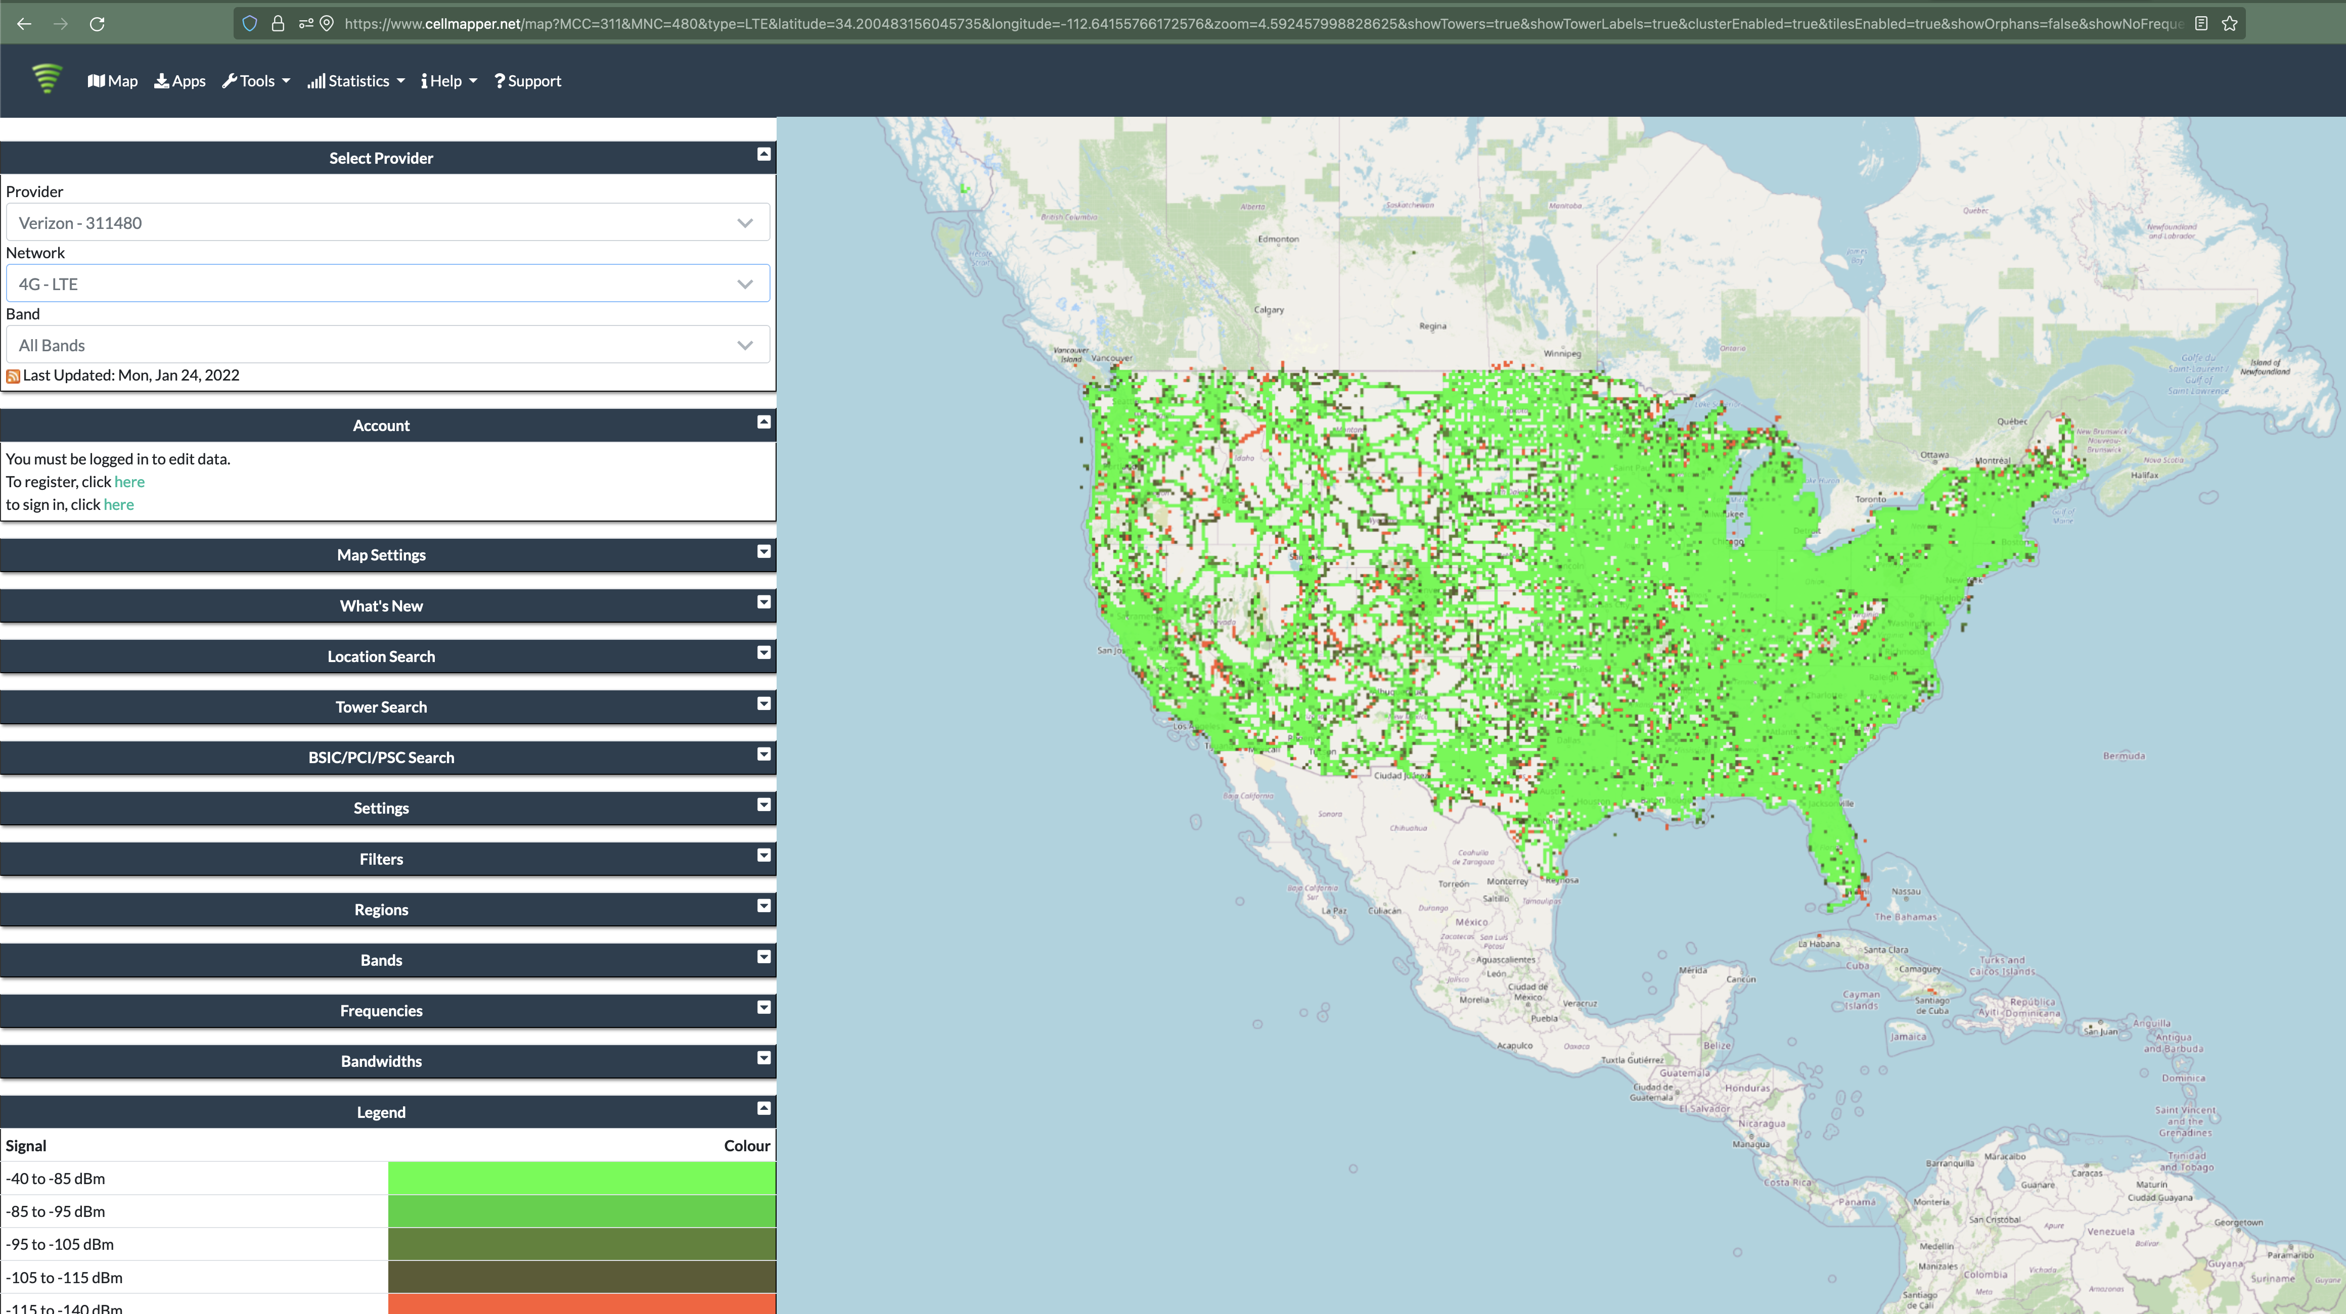
Quick reality check: Verizon?
And this is just crowd-sourced data…

Slide 53
LoRaWAN interested parties
MachineQ is a subsidiary of Comcast providing LoRaWAN networks
Long-term goal
Indoor-to-outdoor LoRaWAN gateways combined with WiFi/Cellular
Tune down power for 100-200 meter range
Current focus: IoT Platform-as-a-service
Devices, network, analytics

Slide 54
Outline
Cellular IoT
LPWAN Design
LoRaWAN

