Slide 1
Lecture 12
Evolution of Cellular
CS397/497 – Wireless Protocols for IoT
Branden Ghena – Spring 2024
Materials in collaboration with
Pat Pannuto (UCSD) and Brad Campbell (UVA)

Slide 2
Administrivia
Lab: Thread due Wednesday
Lab: WiFi due next week Wednesday
  Get going on this!
Hardware swap
  I have more Heltec boards to hand out
  I will also collect Nordic boards today

Slide 3
Today’s Goals
Introduction to the Wide-area communication space
Understand fundamentals of cellular technology
Learn how “older” cellular technology works
  And why it is relevant to the IoT today

Slide 4
Outline
Wide-Area Network Background
Cellular Network Technologies
  1G
  2G
  3G/4G and beyond

Slide 5
Wide area networks
Communication at the region/city scale rather than the building/residence scale
  Throughout cities
  Agricultural deployments
  Industrial facilities
City-scale sensing is one very popular domain
  What might we want to sense throughout a city?

Slide 6
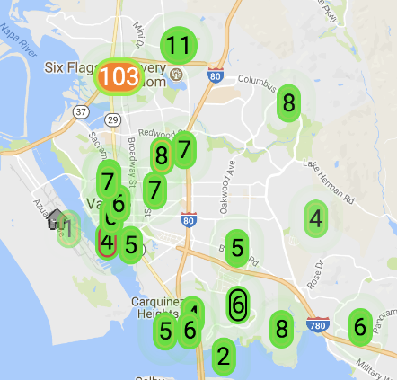
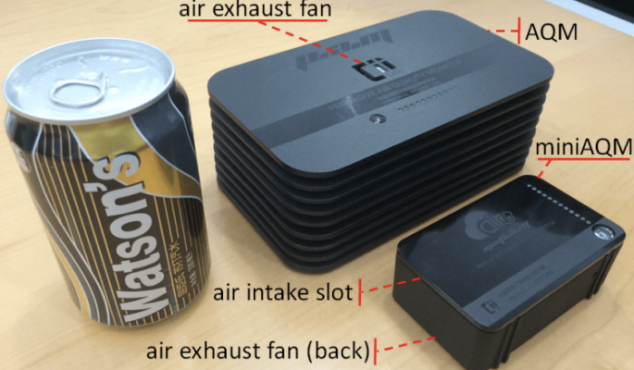
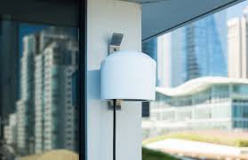
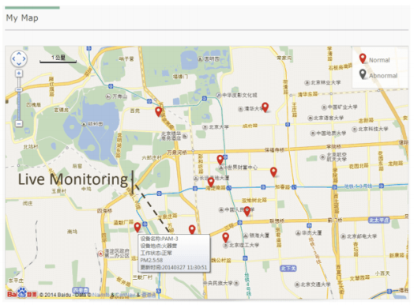
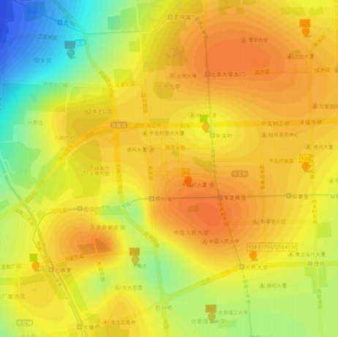
Air quality monitoring
[2]
[2]
[1]
[1]
[1] Cheng et al. AirCloud: a cloud-based air-quality monitoring system for everyone. 2014. [2] Purple Air. 2018.

Slide 7
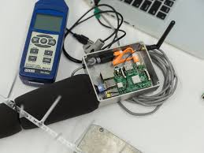
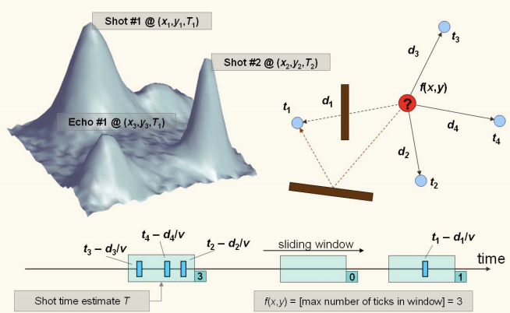
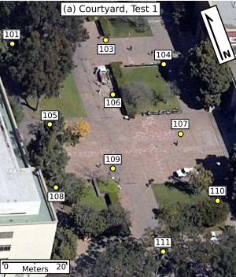
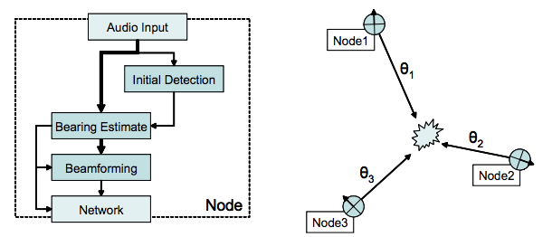
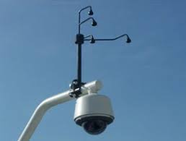
Audio detection, classification, and localization
[3]
[2]
[1]
[1]
[1] Girod et al. The Design and Implementation of a Self-Calibrating Distributed Acoustic Sensing Platform. 2006. [2] Lédeczi et al. Multiple Simultaneous Acoustic Source Localization in Urban Terrain. 2005. [3] Sounds of New York City. 2016.

Slide 8
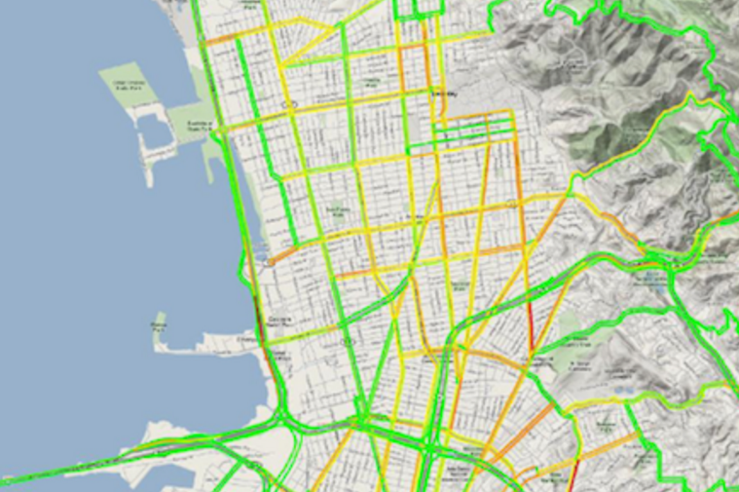
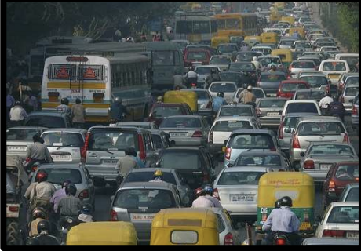
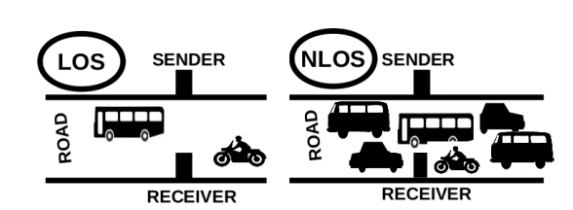
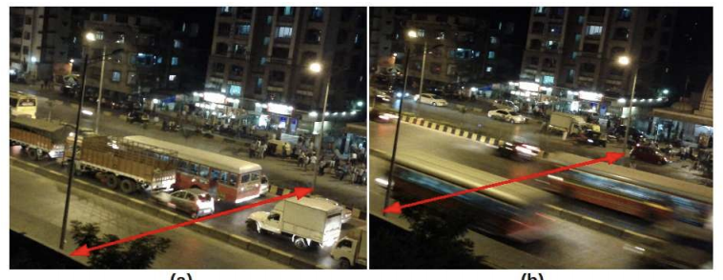
Traffic queue sensing and congestion control
[1]
[1]
[1]
[1] Sen et al. Kyun Queue: A Sensor Network System To Monitor Road Traffic Queues, 2012

Slide 9
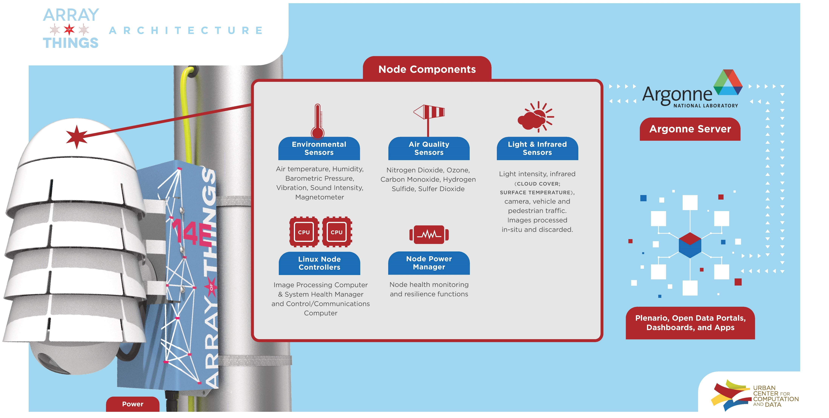
Array of Things project - Chicago

Slide 10
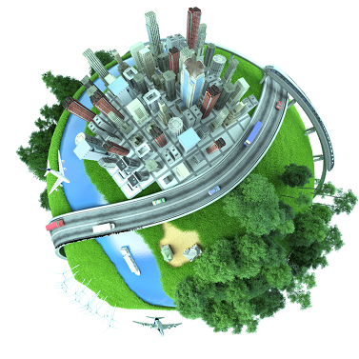








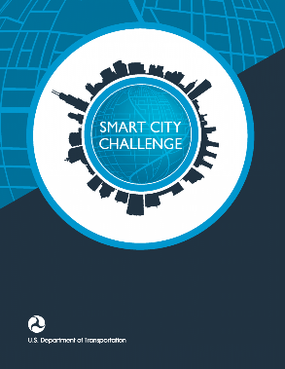



Slide 11
Considering wide-area networks
WiFi
Data
Throughput
Range

Slide 12
Considering wide-area networks
WiFi
Data
Throughput
Bluetooth
BLE
Zigbee
Range

Slide 13
Considering wide-area networks
WiFi
Higher Power
& Higher Cost
Data
Throughput
Bluetooth
BLE
Zigbee
Lower Power
& Lower Cost
Range

Slide 14
Considering wide-area networks
WiFi
4G
Higher Power
& Higher Cost
3G
Data
Throughput
Bluetooth
2G
BLE
Zigbee
Lower Power
& Lower Cost
Range

Slide 15
Takeaway: Cellular provides the IoT the only reliable global coverage available today
If the goal is deploy-today + work-anywhere, cell is the only option
  (Or arguably satellite)
That’s not to say cell actually works everywhere!
  Just the best-available

Slide 16
Outline
Wide-Area Network Background
Cellular Network Technologies
  1G
  2G
  3G/4G and beyond

Slide 17
Poll: What decade was the first commercial mobile phone?
1910-1920
1920-1930
1930-1940
1940-1950
1950-1960
1960-1970
1970-1980
1980-1990
1990-2000
2000-2010

Slide 18
The first commercial mobile phone was in 1946!
By 1948, 5000 users placing around 30,000 calls weekly
  “The equipment, of course employing vacuum tubes, weighed eighty pounds, filled much of a vehicle’s trunk and drew so much power that it would cause the headlights to dim. Service cost $15 per month, plus thirty to forty cents per local call, equivalent to $175 2012 dollars, plus $3.50 to $4.65 per call. “
https://ethw.org/The_Foundations_of_Mobile_and_Cellular_Telephony
https://www.smithsonianmag.com/innovation/first-mobile-phone-call-was-made-75-years-ago-180978003/

Slide 19
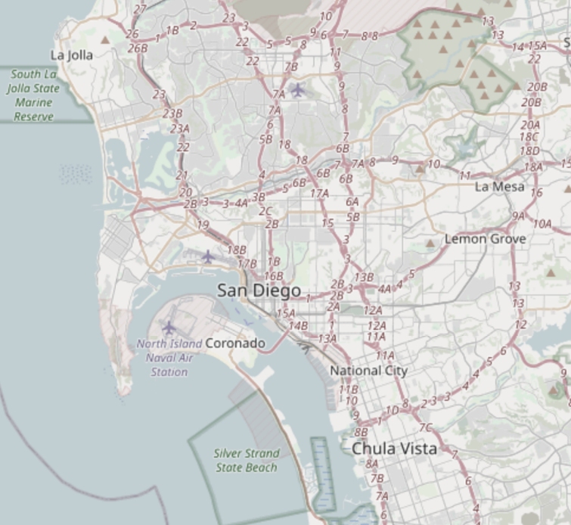
The first `mobile` network architecture
Single transmitter tower, multiple receiver towers
  Why?
Notes:
A single transmitter on a central tower provided a handful of channels for an entire metropolitan area. Between one and eight receiver towers handled the call return signals. At most, three subscribers could make calls at one time in any city using the single transmitter and the tiny amount of spectrum allocated by the Federal Communications Commission to this service. It was in effect a massive party line, where a tightly controlled number of subscribers had to listen first for someone else on the line, and, if finding the line free, signal an operator, who would place the call. During the call, the user depressed a button on the handset to talk and released it to listen.

Slide 20
The first `mobile` network architecture
Single transmitter tower, multiple receiver towers
  Why? Transmission energy of phone!
Medium Access Control?
  Push-to-talk [half-duplex]
  City-wide “party line”
  Maximum of three concurrent callers
Notes:
A single transmitter on a central tower provided a handful of channels for an entire metropolitan area. Between one and eight receiver towers handled the call return signals. At most, three subscribers could make calls at one time in any city using the single transmitter and the tiny amount of spectrum allocated by the Federal Communications Commission to this service. It was in effect a massive party line, where a tightly controlled number of subscribers had to listen first for someone else on the line, and, if finding the line free, signal an operator, who would place the call. During the call, the user depressed a button on the handset to talk and released it to listen.

Slide 21
1965: The Improved Mobile Telephone Service
“More spectrum”
  Bell: VHF Low (35-44 MHz, 9 channels),
  VHF High (152-158 MHz, 11 channels),
  UHF (454-460 MHz, 12 channels)
  7 channels at VHF, and 12 channels at UHF for
  "RCCs" (Radio Common Carriers)
    These will end up becoming pagers, mostly
“Full Duplex”
  Implemented as channel pairs (two half-duplex)
Increased spectrum is still not enough
  Limited to 40,000 total subscribers
  E.g. NYC had 2,000 people on 12 channels with a typical wait of 30 minutes to place a call
Phones fit in a briefcase now
Notes:
Also now full duplex, and no more operators

Slide 22
Quick review: How can we share spectrum?
Frequency division
  Already doing that
Time division
  Already doing that
Code division
  Won’t come to [US…] mobile networks until the 80’s
Spatial division!!

Slide 23
What’s wrong inefficient with this picture?
Early mobile networks handled the mobility challenge with wide-area coverage
The active user could be anywhere in the 40~60 mile range of the transmit tower
  So they had exclusive access to that whole area!
12 frequency channels → 12 users

Slide 24
The “cell” in cellular networks
Cells use spatial division
  Reduce transmit power, smaller area
Now…
  12 / 3 = 4 channels per cell
  * 6 cells in area
  = 24 users of same spectrum!
And we can choose the cell size based on our expected needs

Slide 25
Spatial division tradeoffs
?
Need more infrastructure (more towers)
Need logic to support handoff
  Cellular concept in Bell labs at 1947 [one year after first mobile], but no handoff solution yet

Slide 26
How often does handoff need to happen anyway?
Really a question of “how big are cells”
A back-of-envelope answer for “Handoffs per 3-minute call”:
 | Speed (mph) | Speed (kph) | Cell Radius (km) | Handoffs
Freeway, rural | 65 | 104 | 16 | 0.33
Freeway, urban | 65 | 104 | 1.6 | 3.25
Surface streets, urban | 30 | 48 | 1 | 2.4
Pedestrian, urban | 1.5 | 2.4 | 1 | 0.12
Pedestrian, microcell | 1.5 | 2.4 | 0.1 | 1.2
Table data from Arthur H. M. Ross, PhD: http://www.cdg.org/technology/cdma_technology/a_ross/handoff.asp

Slide 27
Introducing 1G! (First Generation)
AMPS — Advanced Mobile Phone Service (circa 1983)
  Other 1G’s:
    Nordic Mobile Telephone (NMT) — Nordics, Eastern Europe, Russia
    Total Access Communications System (TACS) — UK, West Germany, Portugal South Africa
    Radiocom 2000 — France
1G is defined by:
  Analog voice channels
  Established by digital control channel ← handoffs

Slide 28
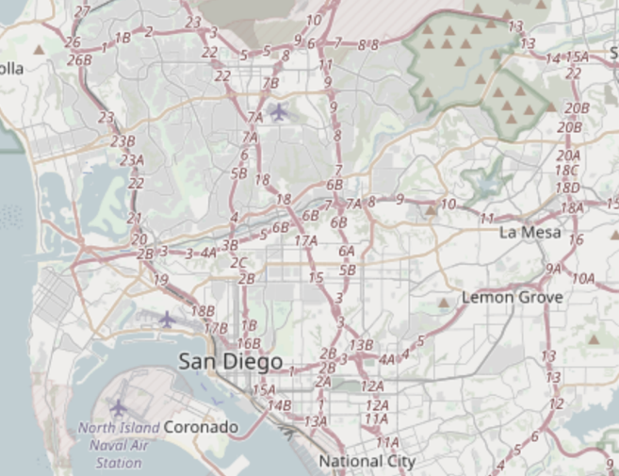
Break + Discussion: How to implement handoff?
<brainstorm>

Slide 29
How does AMPS implement handoff?
Base station detects weak signal
Base station tells mobile about new, better tower
Base station sends cutover trigger
Lots bad about this:
  No `make before break` — many drops!
  Mobile has better estimates than base station

Slide 30
Spatial division in practice
Directional antennas at tessellation corners provide redundant coverage [robustness!]

Slide 31
Spatial division in practice
Directional isolation is imperfect, requires many bands in practice
  ~5-7 cells are within conflict range, so we need to divide channels by ~7

Slide 32
Over time, AMPS did also get more frequencies
AMPS in the US:
  850 MHz band
  Divided into “A” block and “B” block
    Granted to local phone company and “wireless company” respectively
  Each block had 21 control, 395 voice channels
    Divide by 7 to get voice channels per cell: ~56
    So ~56 users per cell, rather than 12 for the entire city
Several expansions of this frequency block
  Most interesting: in 1989 UHF TV channels 70-83 added 666 more channels

Slide 33
The first “sunset”
Single-user analog channels is not very efficient
Wireless carriers want to replace 1G
  Key Takeaway: Spectrum allocation is the most scarce resource, therefore want to maximize efficiency of its use
  [efficiency: number of paying customers / spectrum?]
But many things in the built environment rely on AMPS
  Because when they were built, AMPS was the most reliable
    OnStar
    ADT home alarms [got sued!]
  Some systems made adapters, others just stopped working
FCC required network support until early 2008 (dropped soon after)
Notes:
Options: SOL mostly. People sold adapter kits to replace transmit modules where possible [see 2G OnStar example for this happening now later in slides]. ADT got sued class-action for selling products that were ‘destined to fail’ (suit failed).

Slide 34
Aside: Super cool hackaday projects
Building your own 1G network!
  https://hackaday.com/tag/amps/
  https://github.com/unsynchronized/gr-amps
  ⚠ ⚠ ⚠ This uses spectrum you do not own ⚠ ⚠ ⚠
    “The FCC can levy fines of up to $11,000, per transmitter, per day, with up to six months in federal prison, for violations of the Code of Federal Regulations.”
    Could deploy with wired connections though…

Slide 35
Outline
Wide-Area Network Background
Cellular Network Technologies
  1G
  2G
  3G/4G and beyond

Slide 36
IS-54 aka 2G aka TDMA aka D-AMPS (Digital AMPS)
Deployed ~1993
Used TDMA to share AMPS channels
  Each AMPS analog channel-pair was 30 kHz
  Digital compression allowed for 3 time slots per channel — tripled capacity!
    Later iterations would compress further, 6 time slots per channel
    Without additional bandwidth: 6*56 = 336 simultaneous devices per cell
Beat out competing FDMA analog solution from Motorola
  Narrowband AMPS, “N-AMPS”, compressed calls to fit in 10 kHz channels
Also encrypted [poorly: CMEA broken publicly in 1997]

Slide 37
GSM aka 2G aka TDMA
Wait, didn’t the last slide say 2G was something else?
What is “2G” then?
  Exactly.
  “2G” isn’t one technology, it’s a collection of “second generation” protocols
  This is true for later generations too

Slide 38
CDMA in 2G
todo, ran out of time

Slide 39
The first 2G sunset happened in 2008
D-AMPS was sunset when AMPS was sunset
Modern “2G” is all GSM
And if you think this is confusing, it only gets worse
  Anecdata: Pat as a Qualcomm intern in 2010 asked everyone I met there “what actually is 4G,” and every engineer just laughed at me

Slide 40
GSM
So can we just call modern 2G “GSM”?
“Global System for Mobile Communications”
  It is a standard [the dominant 2G]
  GSM meant “phone” for a while in parts of Europe
    (and apparently still in Belgium?)
  GSMA is the GSM Association; which a lot of people just call GSM
    Because GSM made [a] 3G and LTE [which is a 4g?] and 5g [ish! more next time]
  Yay.

Slide 41
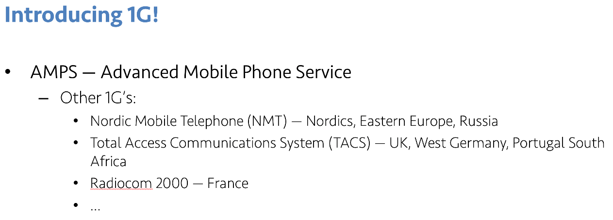
Origins of GSM
An incredible sweet spot of timing, technology need, and politics?
1987: 13 European countries sign accord to use one wireless standard
  10 months later: GSM standard ratified
  Insight: Not a ton new in GSM by ‘87, just a lot of arbitrary design decisions
Not a very `mobile` mobile network…
Notes:
Lot of patting-on-back for co-operation history, but it seems somewhat genuine; plus 4 dudes who just plowed through their standard
— Insight: GSM

Slide 42
The real innovation of GSM was the indirection and interoperability it enabled
Europe hit this problem before the US because the US is large
  (and US telecoms owned/operated subsidiaries in Canada)
Coincided with major growth in global mobility
  Mobile devices needed to be able to use other carriers infrastructure
Early GSM isn’t anything fancy in modulation, data, etc
  It’s all about the control channels

Slide 43
https://en.wikipedia.org/wiki/File:Gsm_structures.svg

Slide 44
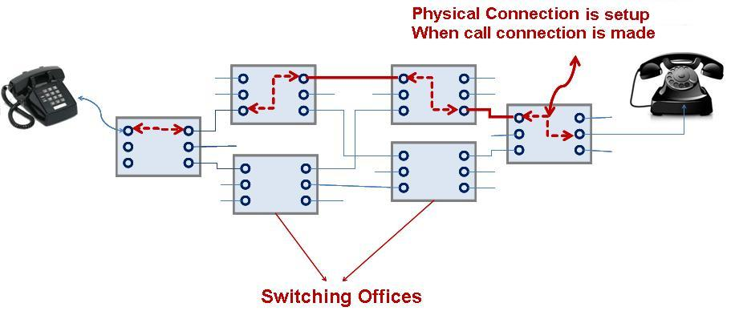
Circuit switching

Slide 45
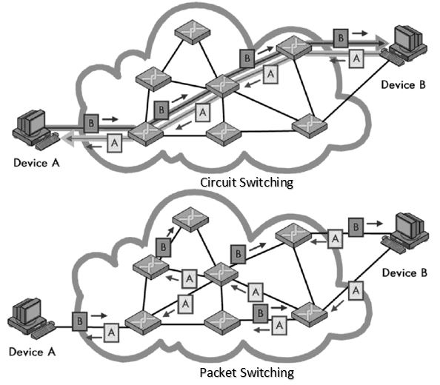
Comparing circuits vs packets
Circuit switching
  Virtual electrical connections between two devices
  Full capacity is dedicated to only those two devices
Packet switching
  Chunks of data get routed between devices
  Overhead to figure out where they go

Slide 46
GSM evolved over time to add data
GSM was voice-only at first
Then overlaid data on the voice channel
  Circuit Switched Data (CSD)
    9.6 — 14.4 kb/s
    Previous hacks were literally cell phone calling a modem (~3.5 kb/s); same concept
Then added actual packetized data [“2.5G”]
  General Packet Radio Service (GPRS)
    Throughput 9.2 – 21.55 kbit/s/timeslot [goodput 8-20 kbit/s/timeslot]
  Enhanced Data Rates for GSM Evolution (EDGE)

Slide 47
So why does the IoT care about 2G?
It’s easy to implement
  2G == GMSK, 3G = QPSK [requires linear PA], 4G = …
It’s cheap
  Relative to other cellular plans, anyways
It’s low power*
  *For select IoT workloads
  Energy-per-bit of continuous stream improves each generation
  Energy-per-event of infrequent event is more tricky though

Slide 48
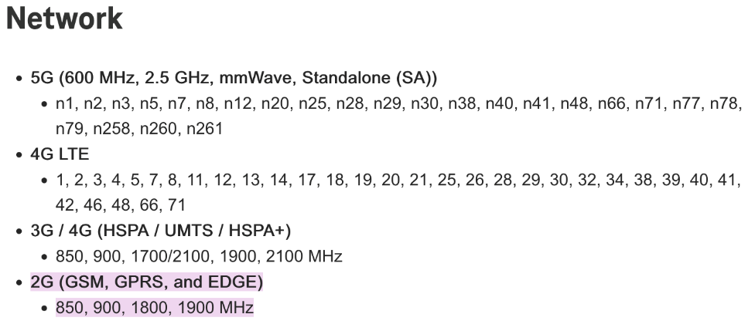
Why might 2G continue to survive [globally]?
More coverage for lower costs
  2G has longer range than 3G
It fills the legacy niche
  High performance HW includes fallbacks
    2G/3G radios, then 2G/3G/4G radios, now 2G/3G/4G/5G radios
    Consider the iPhone 13 Pro (2021):
  Brick phones still popular!

Slide 49
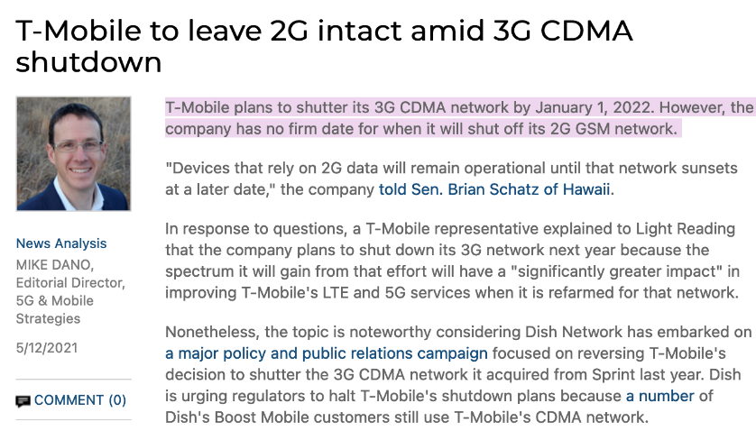
2G in the US… [Plans]
AT&T stopped servicing 2G networks in 2016
Verizon Wireless also phased out its 2G CDMA network at the end of 2020
Sprint will shut down their 2G CDMA network in April 2022
  Unclear if this happened or not
T-Mobile plans on 2023
April 2024
No firm date at this time

Slide 50
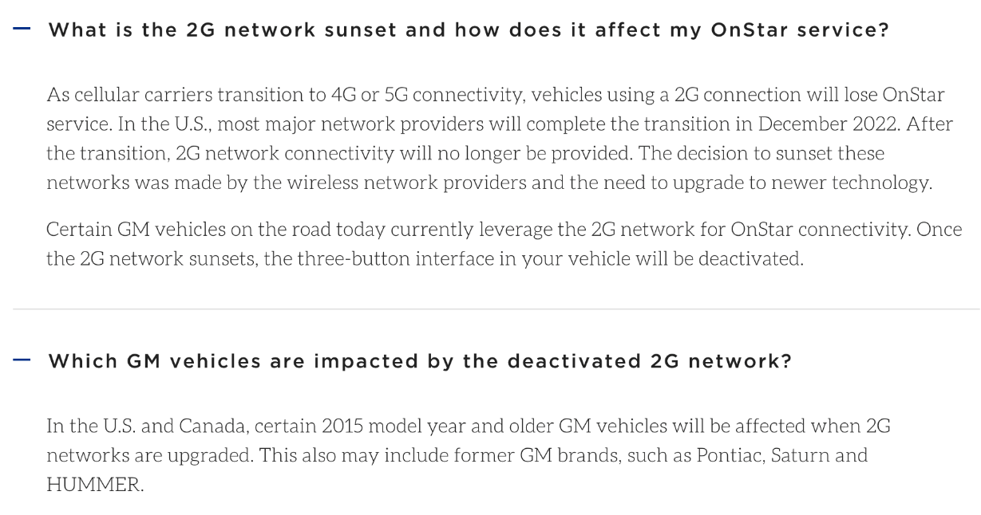
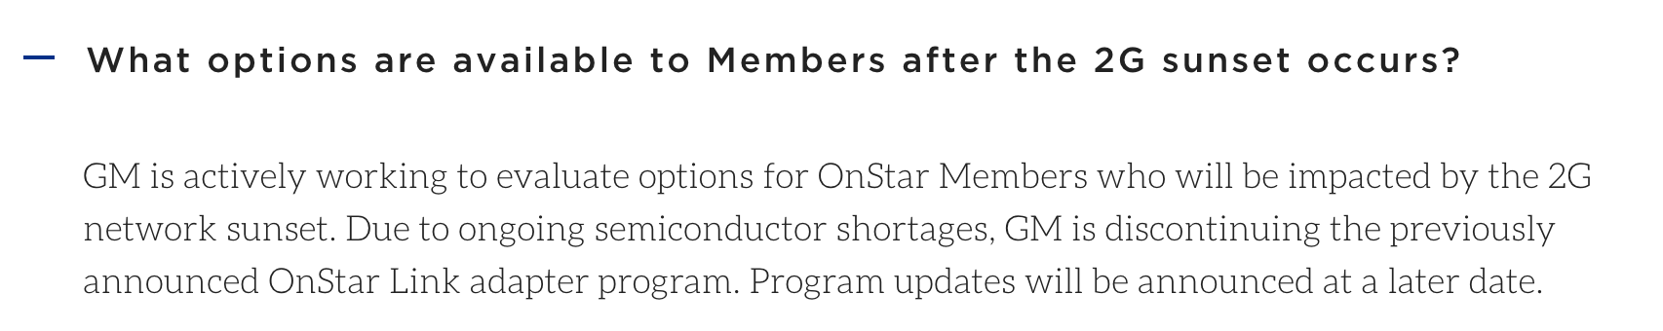
Does GM ever learn?
[Could they have?]
What would you put in cars if you were the PM of OnStar today?

Slide 51
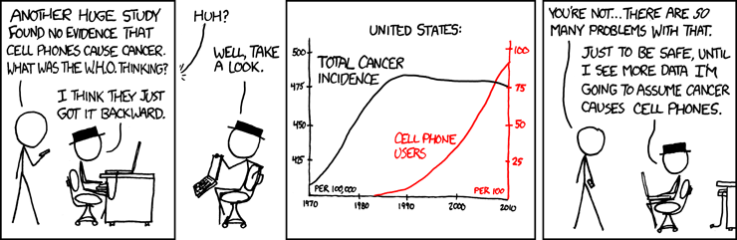
Break + xkcd
https://xkcd.com/925/

Slide 52
Outline
Wide-Area Network Background
Cellular Network Technologies
  1G
  2G
  3G/4G and beyond

Slide 53
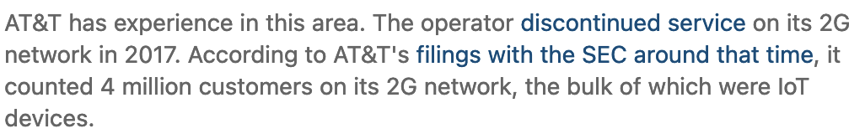
Starting with the end: the 3G sunset
[As of Oct, 2021] announced retirements:
  Verizon: Dec 2022
  AT&T: Feb 2022
  T-Mobile: Finally got there in July 2022 (after months of delays)
2G reminder
  Verizon and AT&T
  actually did sunset 2G
  T-Mobile plans on ???
AT&T: 2.7% of customers will be affected by 3G shutdown

Slide 54
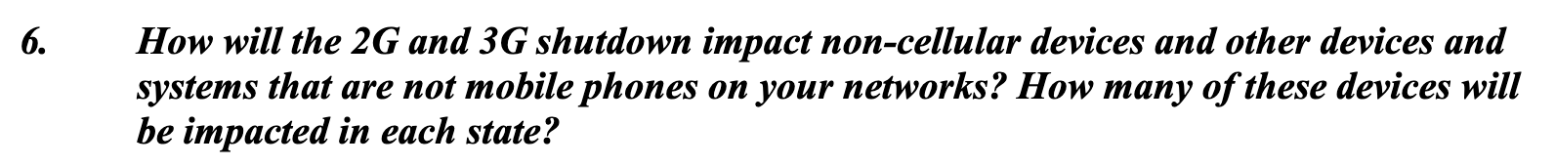
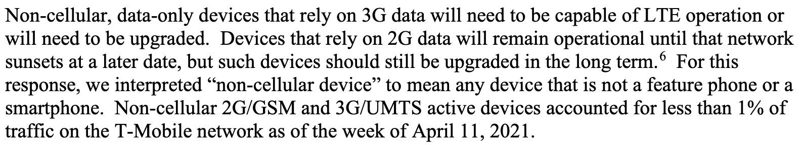
Why does 2G have staying power that 3G doesn’t?
T-Mobile’s letter to Congress on 2g/3g sunset
  n.b. Senator Schatz seems to get this stuff
Notes:
Pat’s personal guess: There are critical infrastructure bits that are/will-be effectively 2G only that will take a long time to replace. One band of 2G will live on for years. These are less frequent M2M, so one band is plenty and hit the pragmatic long-tail of legacy devices; also fixes 3g sunset. Reading between the lines, T-Mobile [which is really Deutsche-Telekom, which is really a global conglomerate, which can’t sunset 2g globally for a long time and so will have internal infra anyway] will provide 2g services for everything left; can do MVNO-like takeover of devices that need to run on sunset networks [assuming they can roam to the one band that’s left]

Slide 55
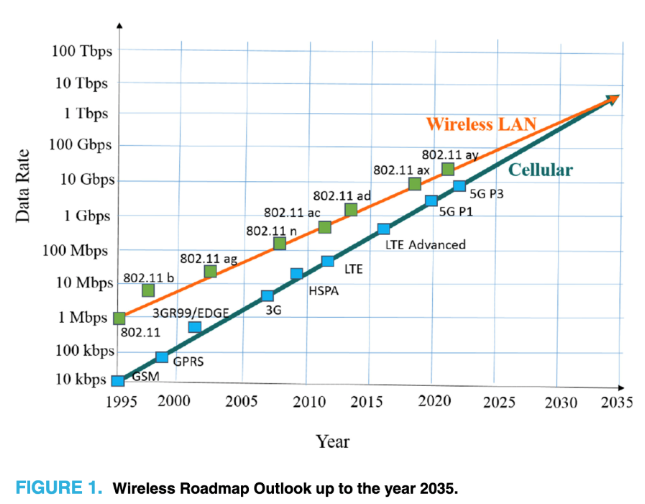
So what did [*]G provide over 2G anyway?
Biggest thing is throughput
And a spectrum land-grab
  Wireless providers advocated [successfully] for [global] release of additional spectrum to support new, faster wireless
  Lots of [initial] 4G rollout also on new spectrum
    But no more coming — sunsets only way to get more 4G spectrum
  5G is [mostly] on much higher bands, not suited for 4G
Terahertz Band: The Last Piece of RF Spectrum Puzzle for Communication Systems (preprint; Elayan et al.)

Slide 56
Aside: Eventually, the naming thing got annoying, so an international standards body fixed* it
*Yeah, you know how this story will end
The International Telecommunications Union (ITU) is a UN branch
  ITU-R set standards for what can be considered “a 4G technology”
”Generations” are now defined by speed
  E.g. to qualify as “a 4G technology”: 100 Mb/s+ (mobile), 1 Gb/s+ (stationary)
  Fun game: How fast is LTE?
    LTE spec maxes out at 300 MB/s down and 75 MB/s up
    It seems LTE has been retroactively classified as 3.95G
      [By everyone except the wireless carriers?]

Slide 57
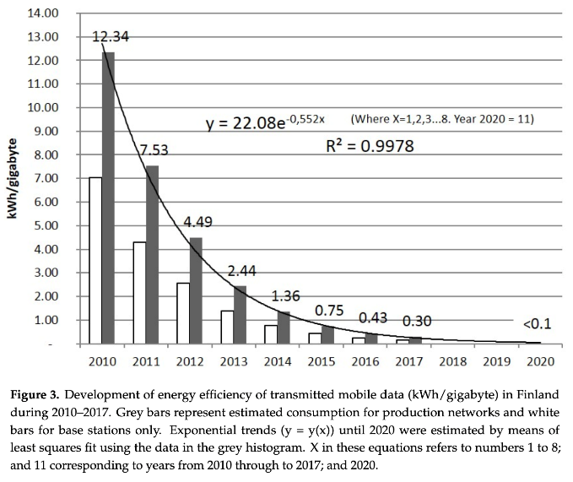
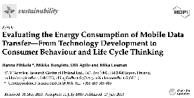
Corollary to improved throughput is improved energy performance
Same philosophy as high-performance architecture, etc
  There is always baseline load, which going faster amortizes
Notes:
Pic as citation pretty lazy Pat… :D

Slide 58
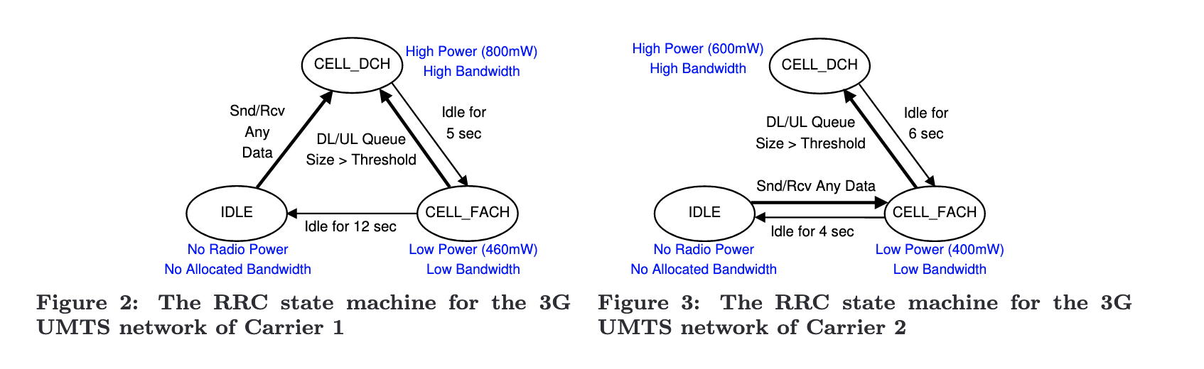
But energy per transaction is complex
Radios, cellular protocols, and cellular providers have state machines
  Hard to predict a priori and globally ☹
Characterizing radio resource allocation for 3G networks; Feng Qian, Zhaoguang Wang, Alexandre Gerber, Zhuoqing Morley Mao, Subhabrata Sen, Oliver Spatscheck; SIGCOMM’10

Slide 59
So what is 5G doing differently?
Largely, 5G is a small(er)-cell technology
  “Urban optimized”
  Unlikely to roll out to all geographic areas quickly
  (because of infrastructure cost)
This does also allow for higher performance

Slide 60
Outline
Wide-Area Network Background
Cellular Network Technologies
  1G
  2G
  3G/4G and beyond

Slide 61
Outline
Wide-Area Network Background
Cellular Network Technologies
  1G
  2G
  3G/4G and beyond
Bonus: IoT on Global Cellular
  Story by Pat Pannuto & nLine

Slide 62
Sizing networks is hard
Sometimes you just lose performance…

Slide 63
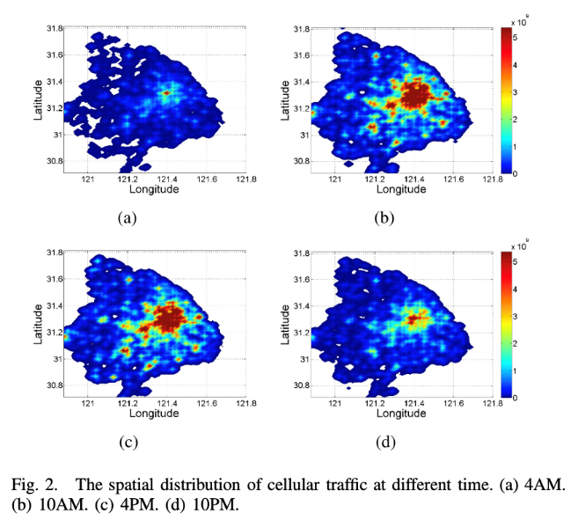
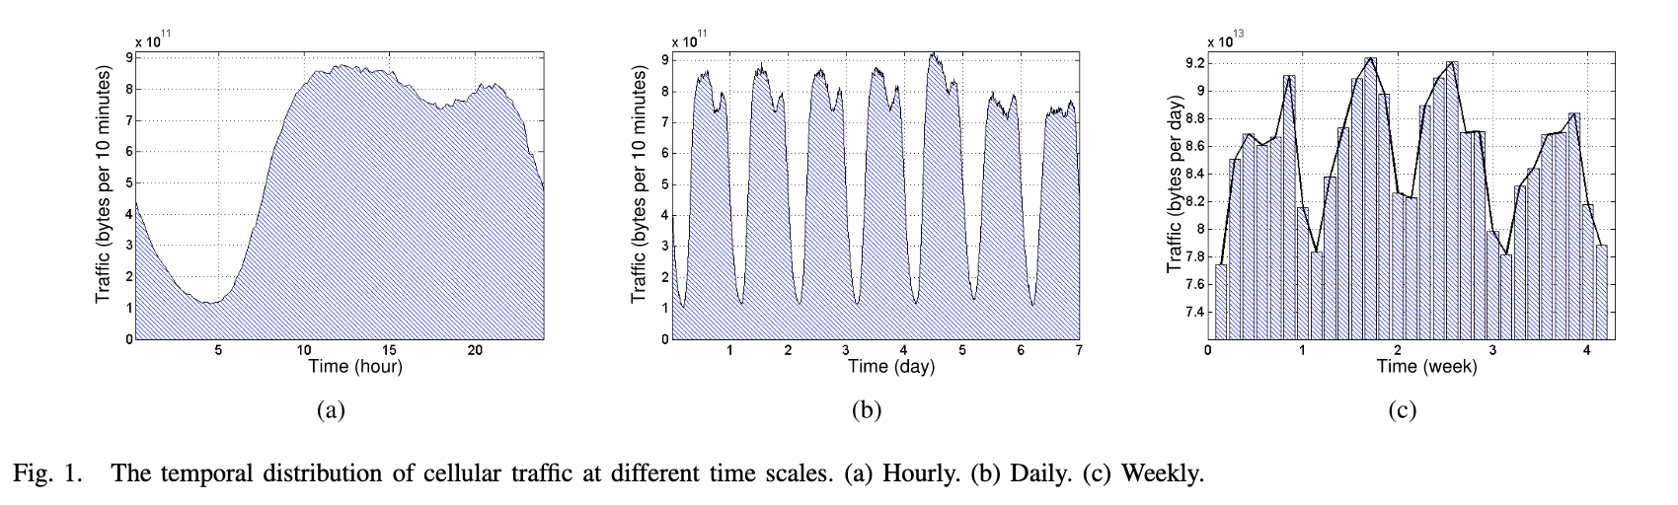
Traffic fluctuates in all networks, for cellular it becomes a function of both when and where you are
Understanding Mobile Traffic Patterns of Large Scale Cellular Towers in Urban Environment; Xu, Li, Wang, Zhang, Jin; IEEE ToN

Slide 64
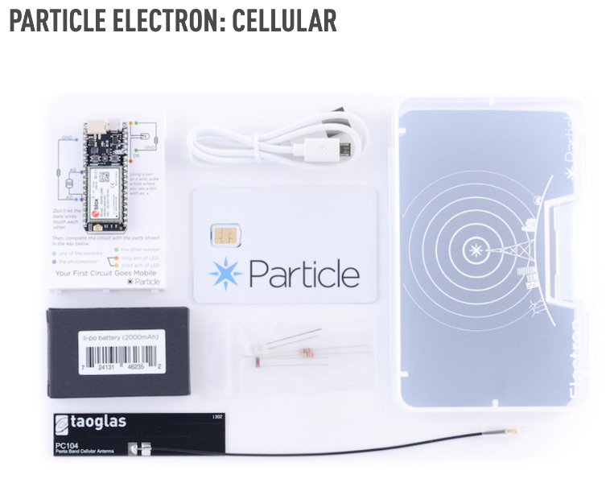
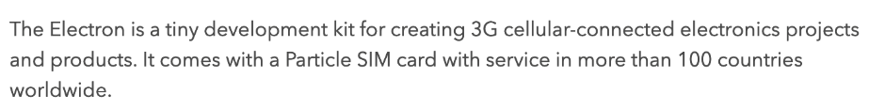
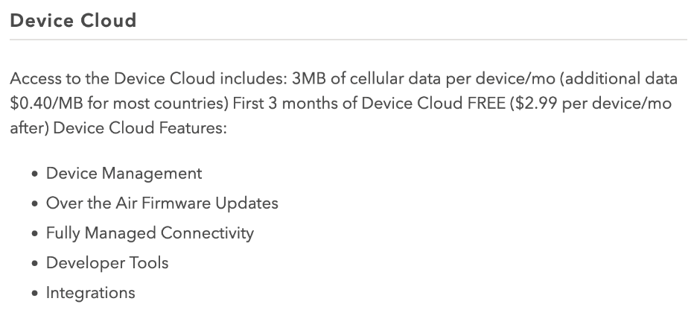
Why does this matter for IoT Deployments?
Say you’re building a power grid sensor you want to deploy globally…

Slide 65
What is a MVNO
“Mobile Virtual Network Operator”
Decoupling the builders of infrastructure from the sellers
Not a new concept, but seeing aggressive growth
  MetroPCS; Cricket; Boost Mobile; etc
  GoogleFi; Xfinity Cellular

Slide 66
So how does Particle, a small IoT platform startup, provide global cellular coverage?
We deployed some Electrons in Accra, Ghana sending a message once per minute 24/7 for a few weeks
  PRR [POST Reception Rate] changes over time
  Almost zero PRR from ~7-9am and ~4-7pm daily
Introducing traffic priority
  Call Particle: “What gives?”
    Particle buys from T-Mobile
    T-Mobile buys from Deutsche-Telekom [didn’t own them yet]
    DT buys from Vodafone
    Vodafone buys from MTN
    MTN has 5 tiers of traffic priority on their network [guess which tier we were in?]

Slide 67
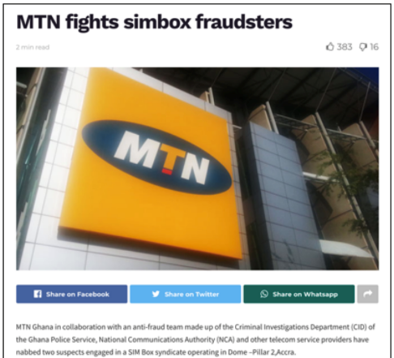
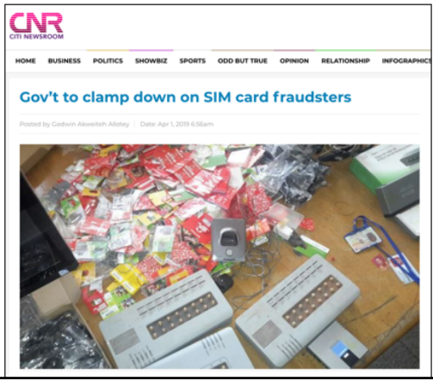
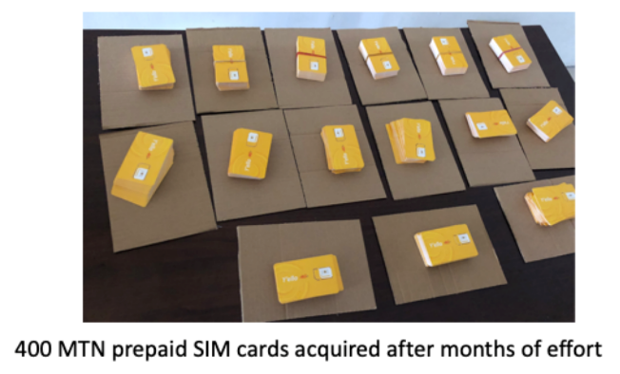
So how do you get higher on the priority list?
You buy from MTN
… also not easy
  Limit of 3 SIMs / person due to fraud
    Particularly important due to prevalence of SIM-based mobile money

Slide 68
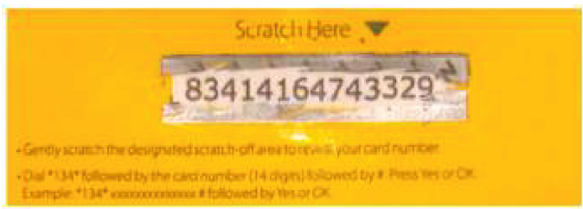
So how do you deploy in Tanzania?
Not limited in SIMs, but limited in payment plans
Post-paid plans not an option
  Need to purchase ‘airtime recharges’
  Which you use by texting from that phone to an SMS shortcode
    So now you must have in-country staff!

Slide 69
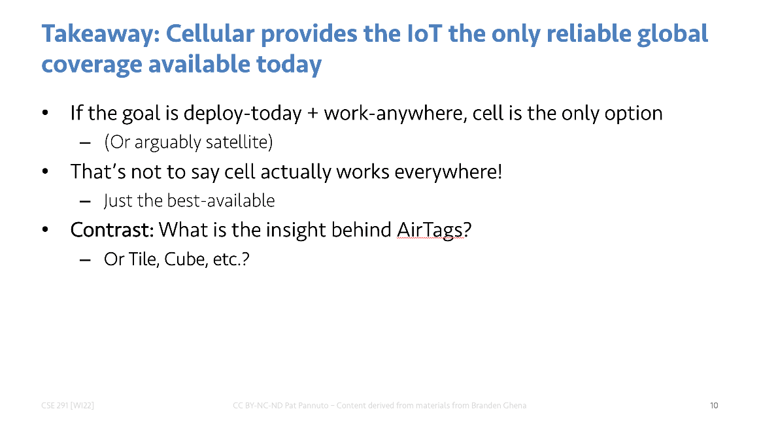
So how do you actually realize this claim?
Good. Question.

