Slide 1
Lecture 07
Thread
CS397/497 – Wireless Protocols for IoT
Branden Ghena – Spring 2024
Materials in collaboration with
Pat Pannuto (UCSD) and Brad Campbell (UVA)
With some advice from Neal Jackson (UC Berkeley)

Slide 2
Administrivia
Hw: BLE Packets due today
  Do it. It’s good for you. Much like eating spinach.
Lab: BLE due on Tuesday
  If you haven’t started, do so ASAP
  Some people had various hardware/software issues getting started
    Once you’ve gotten to “blink an LED”, everything should be good from there

Slide 3
Today’s Goals
Explore 802.15.4 packet structure
Describe goals and capabilities of Thread networks
Understand addressing in Thread networks
Describe runtime behaviors like network joining

Slide 4
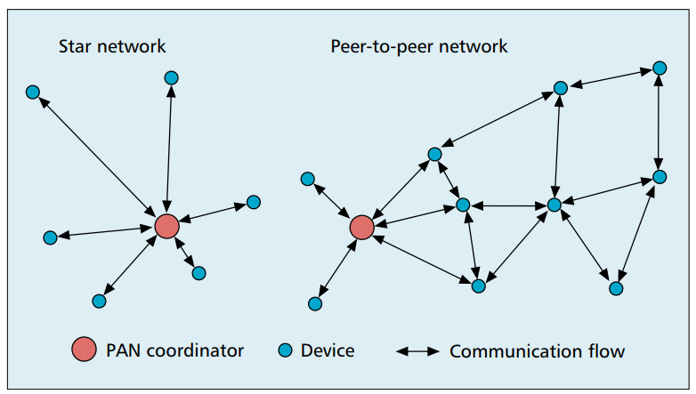
802.15.4 network topologies
Only specifies PHY and MAC, but has use cases in mind

Slide 5
Modes of operation
Beacon-enabled PAN
  Slotted CSMA/CA
  Structured communication patterns
  Optionally with some TDMA scheduled slots
Non-beacon-enabled PAN
  Unslotted CSMA/CA
  No particular structure for communication
    Could be defined by other specifications, like Thread or Zigbee

Slide 6
Beacon-enabled superframe structure
Beacon
Beacon
…
Contention Access Period
Inactive Period
Beacons occur periodically [15 ms – 245 seconds]
  Devices must listen to each beacon
Contention Access Period
  Slotted CSMA/CA synchronized by beacon start time
Inactive Period
  No communication occurring. Assumes sleepy devices

Slide 7
Non-beacon-enabled PAN
…
Contention Access Period
Same idea, just no beacons
  Which removes synchronization benefit (and slotted CSMA/CA)
  Also removes beacon listening cost
    Devices only need to check for activity before transmitting
  Still need an algorithm to determine when it should receive data
    All the time is a huge energy drain
    Algorithms can get complicated here
    Could BLE mechanism of listen-after-send apply?
      Only if sending to a high-power device, not among equals

Slide 8
802.15.4 specification versions
2011
  Four PHY options (UWB)
  MAC capability to support ranging (distance measurements)
2015
  Six PHY options (RFID, Smart Utility, TV White Space)
  Time Slotted Channel Hopping (TSCH) access control (TDMA+FDMA)
2020
  Several new PHY options (China medical band, alternate modulations)

Slide 9
Major 802.15.4 uses
Zigbee & Thread
Both build upon the 15.4 PHY and Link primitives
  Using most but discarding some
Both consider higher-level application considerations
  Building a network
  Communicating between devices
  Application logic

Slide 10
Outline
Thread Overview
Thread Addressing
Runtime Behavior
Using IP

Slide 11
What’s the need for Thread?
Born from Google’s Nest team
Requirements:
  IP-based: interoperate with rest of the Internet
  Scalable: hundreds of devices in a network
  Low power: years of operation on batteries
  Secure: authenticated and encrypted communication
  Reliability – mesh networking without single point of failure
2014: Thread Group alliance formed
  Goal: develop, maintain and drive adoption of Thread as an industry networking standard for IoT
Source: openthread.io, threadgroup.org

Slide 12
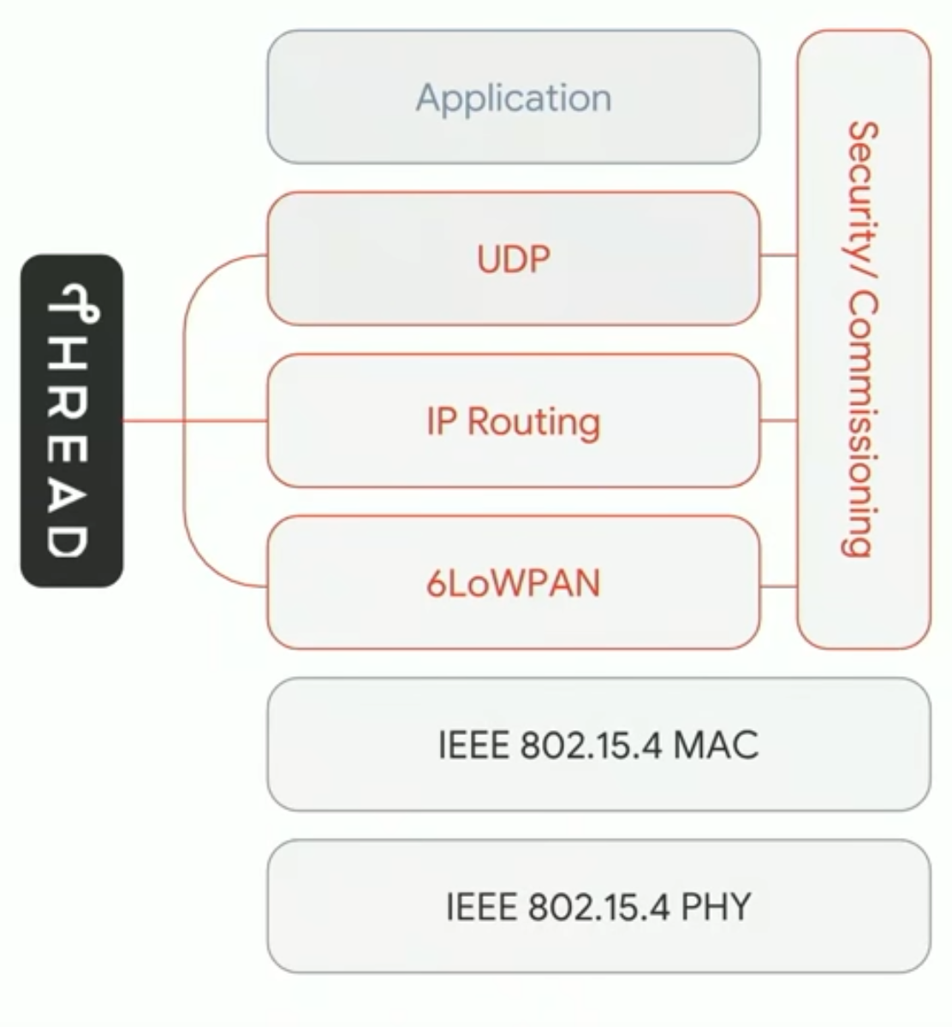
Thread overview
Build a networking layer on top of 15.4
  Reuses most of PHY and MAC
  Adds IP communication
  Handles addressing and mesh maintenance
Industry-focused, but based in academic research

Slide 13
References on Thread
Request for specification: https://www.threadgroup.org/ThreadSpec
  Frustratingly locked down 😡
Overview on capabilities: https://openthread.io/guides/thread-primer
  Excellent overview
  Lifting heavily for these slides
Good overview on Thread Networking:
  https://www.threadgroup.org/support#Whitepapers
  See the “Thread Network Fundamentals” whitepaper

Slide 14
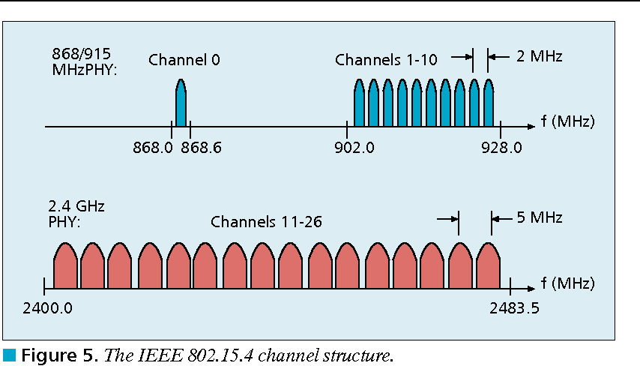
Changes to Physical Layer
Remove all non-2.4 GHz PHY options
Otherwise the same
  O-QPSK
  16 channels, 5 MHz spacing
  Typical TX power 0 dBm
  Typical RX sensitivity -100 dBm

Slide 15
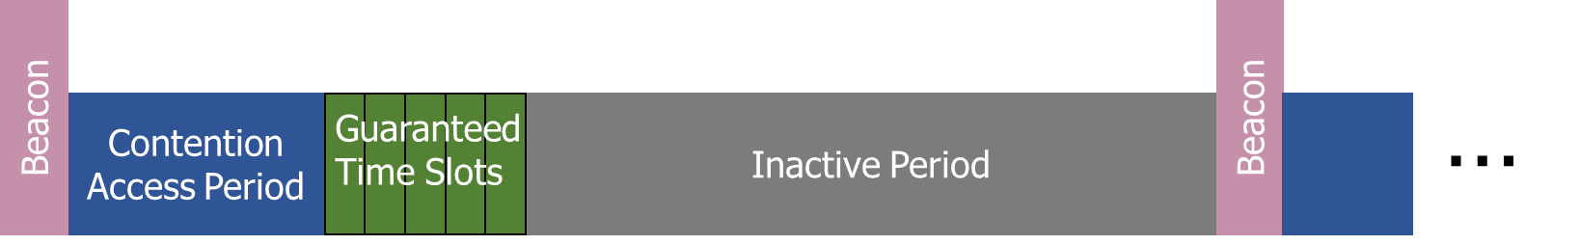
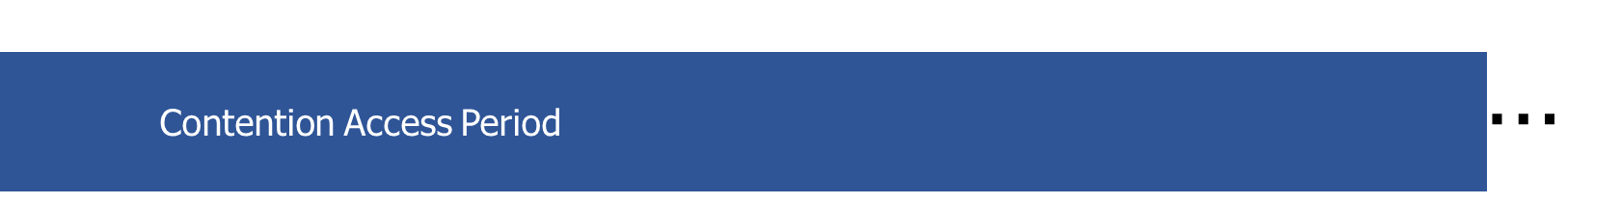
Changes to Link Layer and MAC
Non-beacon-enabled PAN only
  No superframe structure
  No periodic beacons
  No Guaranteed Time Slots
Throw out most existing MAC Commands
  Network joining will be handled at a higher layer
    Remove network joining/leaving
    Remove changing coordinators
    Remove Guaranteed Time Slot request

Slide 16
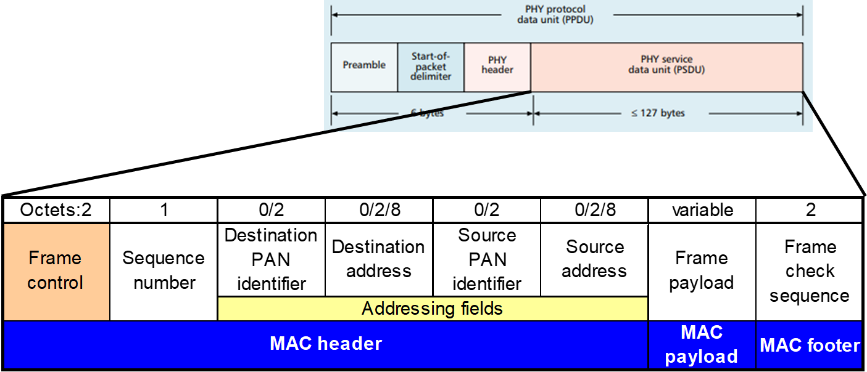
Changes to Link Layer and MAC
Keep unslotted CSMA/CA algorithm
Keep packet structure
Keep Frame Types
  Beacon
  MAC Command
    Beacon Request
    Data Request
  Data
  Acknowledgement

Slide 17
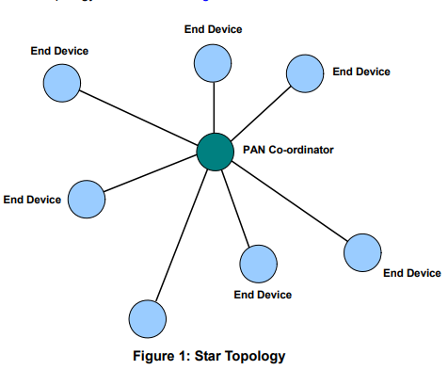
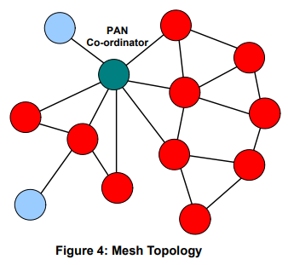
Thread networks use a mix of star and mesh topologies
Central PAN coordinator in charge of network
  Single point of failure
End Devices can be less complicated
PAN Coordinator still in charge
But mid-level Routers add route redundancy
And End Devices didn’t have to change at all
Notes:
What are some issues with these topologies?
Central point of failure
Some nodes have to spend more energy communicating

Slide 18
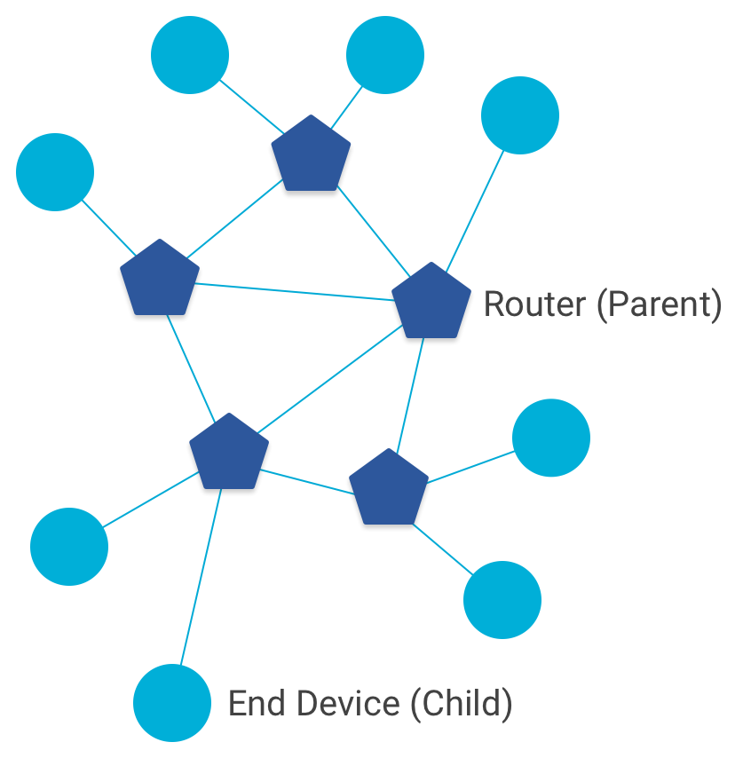
Combination of star and mesh topology
Routers (parent)
  Mesh communication with other routers
  Radio always on
  Forwards packets for network devices
  Enables other devices to join network
  Up to 32 routers per network
End devices (child)
  Communicates with one parent (router)
  Does not forward packets
  Can disable transceiver to save power
    Send packets periodically to avoid timeout
  Up to 511 end devices per router (~16k total)

Slide 19
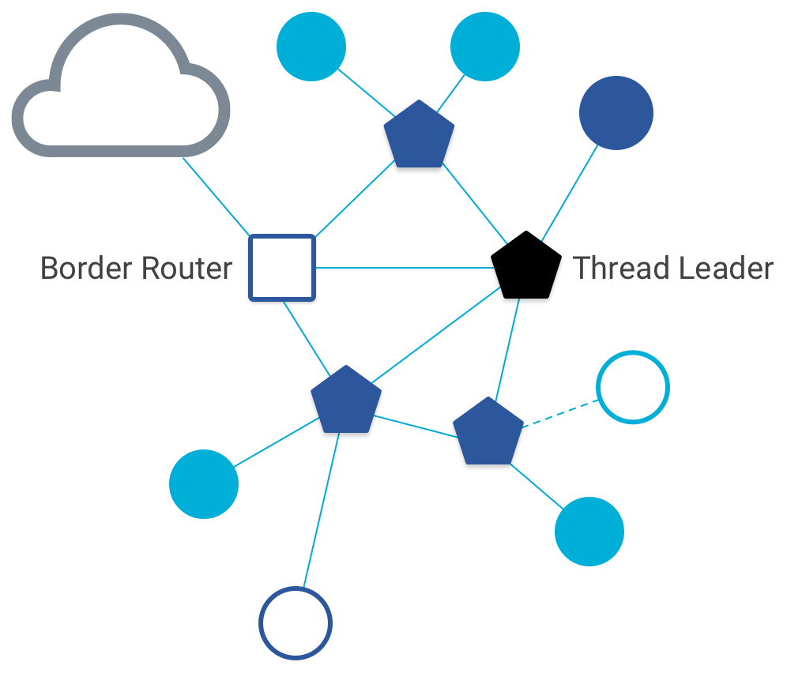
Other special roles
Thread leader
  Device in charge of making decisions
    Addresses, Joining details
  Automatically selected from routers
    One leader at any given time
    Additional leader is selected if the network partitions
Border router
  Router that also has connectivity to another network
    Commonly WiFi or Ethernet
  Provides external connectivity
  Multiple border routers may exist at once

Slide 20
Why use Thread instead of basic 802.15.4?
Full specification of upper layers
  Clarifies how data is transmitted between devices on a network
    Not just one single hop away
  Cleans up a lot of things otherwise left implementation-dependent
Interaction with the world outside of the sensor network!
  Gateway can be a dumb forwarder of packets
  Devices can directly talk to NTP servers or POST data to a website!

Slide 21
Break + Question
What kinds of IoT devices are likely to have each thread role?
End Device
Router
Border Router

Slide 22
Break + Question
What kinds of IoT devices are likely to have each thread role?
End Device
  Battery-powered sensor
  Nest Temperature Sensor
Router
  Wall-powered device
  Nest Thermostat
Border Router
  Must have Internet connectivity
  Custom gateway of some type?

Slide 23
Outline
Thread Overview
Thread Addressing
Runtime Behavior
Using IP

Slide 24
Thread uses IPv6 for communication
Why IP?
  If Wireless Sensor Networks represent a future of billions of connected devices distributed throughout the physical world
    Shouldn’t they run standard protocols wherever possible?
  Why IPv6?
    Clean redesign of IPv4 makes it easier to use to support sensor networks
    Address structure makes device addresses more compressible
Benefits
  Interoperability with normal computers and networks
  Reuse state of the art developed standards instead of remaking them
    Security, Naming, Discovery, Services
Costs
  Packet overhead can be high (will fix)
  Complexity for supporting protocols
Hui and Culler, “IP is Dead, Long Live IP for Wireless Sensor Networks”. 2008

Slide 25
Background: IPv6
Replacement to Internet Protocol v4
  (Something unrelated used version number 5)
Extended addressing for devices
  32-bits for IPv4 addresses -> 128-bits for IPv6 addresses
  340 trillion, trillion, trillion addresses
    (> 100 times number of atoms on the surface of the Earth)
  Example: a39b:239e:ffff:29a2:0021:20f1:aaa2:2112
Supports multiple transmit models
  Broadcast: one-to-all
  Multicast: one-to-many
  Unicast: one-to-one
Various other improvements

Slide 26
Background: IPv6 address notation rules
Groups of zeros can be replaced with “::”
  Can only use “::” in one place in the address
Leading zeros in a 16-bit group can be omitted
  0000:0000:0000:0000:0000:0000:0000:0001 → ::1
  2345:1001:0023:1003:0000:0000:0000:0000 → 2345:1001:23:1003::
  aecb:0222:0000:0000:0000:0000:0000:0010 → aecb:222::10
Special addresses
  Localhost - ::1 (IPv4 version is 127.0.0.1)
  Link-Local Network - fe80:: (bottom 64-bits are ~device MAC address)
  Local Network – fc00:: and fd00::
  Global Addresses – 2000:: (various methods for allocating bottom bits)

Slide 27
Background: IPv6 datagram format
Header starts with various data for the router
Priority: like “type of service” in IPv4.
Flow label: marks packets that are part of a transaction for routers
Next header: TCP, UDP, ICMP, etc.
Hop limit: hops to live
version
priority
flow label
payload length
next header
hop limit
source address
(128 bits)
destination address
(128 bits)
data
(variable length, typically a TCP or UDP segment)
32 bits

Slide 28
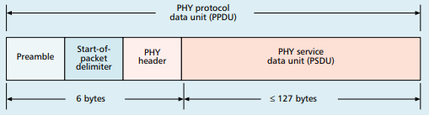
Fitting an IPv6 datagram in an 802.15.4 frame
version
priority
flow label
payload length
next header
hop limit
source address
(128 bits)
destination address
(128 bits)
data
(variable length, typically a TCP or UDP segment)
32 bits
How many bytes for the IPv6 header?
How much for the MAC header + footer?
How much room do we get for payload?

Slide 29
Fitting an IPv6 datagram in an 802.15.4 frame
version
priority
flow label
payload length
next header
hop limit
source address
(128 bits)
destination address
(128 bits)
data
(variable length, typically a TCP or UDP segment)
32 bits
How many bytes for the IPv6 header?
How much for the MAC header + footer?
How much room do we get for payload?
- 8+16+16 = 40 bytes
- 5 to 25 bytes depending on options
- 127-40-N = 82 to 62 bytes

Slide 30
IPv6 tricky to use directly with 802.15.4
Header overhead very high
  around half of bytes in PSDU, even more when security enabled
IP packets may be large, compared to 802.15.4 max frame size
  IPv6 requires all links support 1280 byte packets [RFC 2460]
Need some way to compress and fragment!

Slide 31
6LoWPAN
Method for running IPv6 over 802.15.4 links
  IPv6 over Low-Power Wireless Personal Area Networks
  IETF Standard (RFC4944 + updates in RFC6282)
Directly out of the research world (Jonathan Hui + David Culler)
  Research Paper: IP is Dead, Long Live IP for Wireless Sensor Networks
  Thesis of work: sensor networks can and should use IPv6
Important goals
  Compress IPv6 headers
  Handle fragmentation of packets
  Enable sending packets through mesh

Slide 32
6LoWPAN header compression
40 bytes of IPv6 header are a lot for a 127-byte payload
Most important goals
  Communication with devices inside the 15.4 network should be low-overhead
  Communication outside of the 15.4 network must be possible
    Still minimize overhead where possible, but might be larger
Assume a bunch of common parameters to save space
  A bunch of options are set to default values
  Payload length can be re-determined from packet length
  Source/Destination addresses can often be reassembled from link layer data
    Plus information about network address assignment known by routers
Border router “inflates” the packet before sending externally

Slide 33
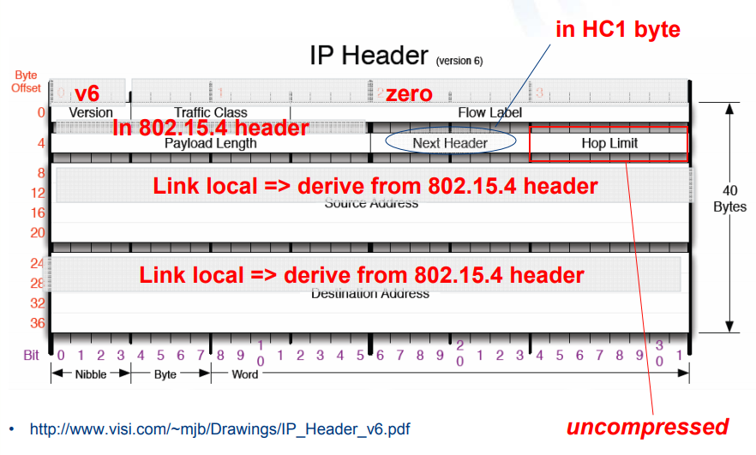
Example of compression
Example of HC1 header compression
  Note: Thread actually uses IPHC from rfc6282 (not HC1), but similar idea
  Good overview: https://www.youtube.com/watch?v=wRdrCsgJekM

Slide 34
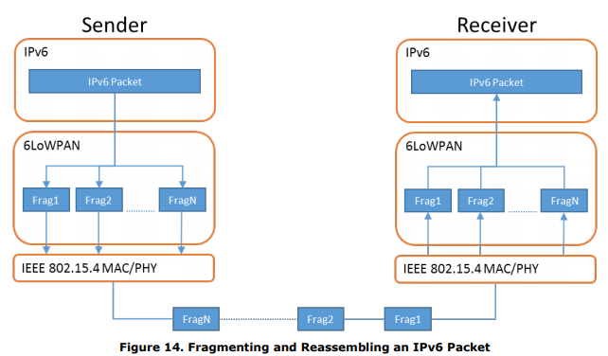
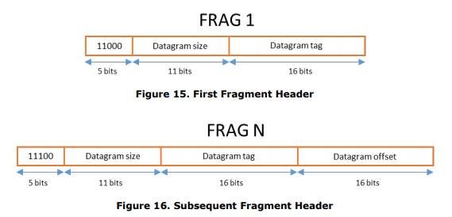
6LoWPAN fragmentation
Only the first packet of the fragments will hold the IPv6 header
  Tag, offset, and size are used to reconstruct

Slide 35

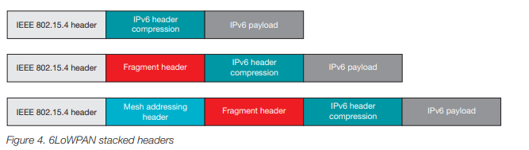
6LoWPAN mesh forwarding
Additional header with originator and final addresses
Which of these headers are used depends on the packet

Slide 36
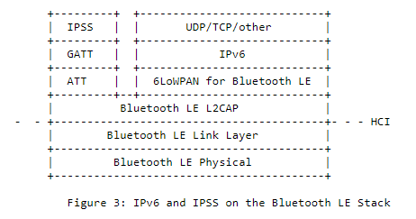
Sidebar: IPv6 over BLE
RFC7668 defines 6LoWPAN techniques for BLE connections

Slide 37
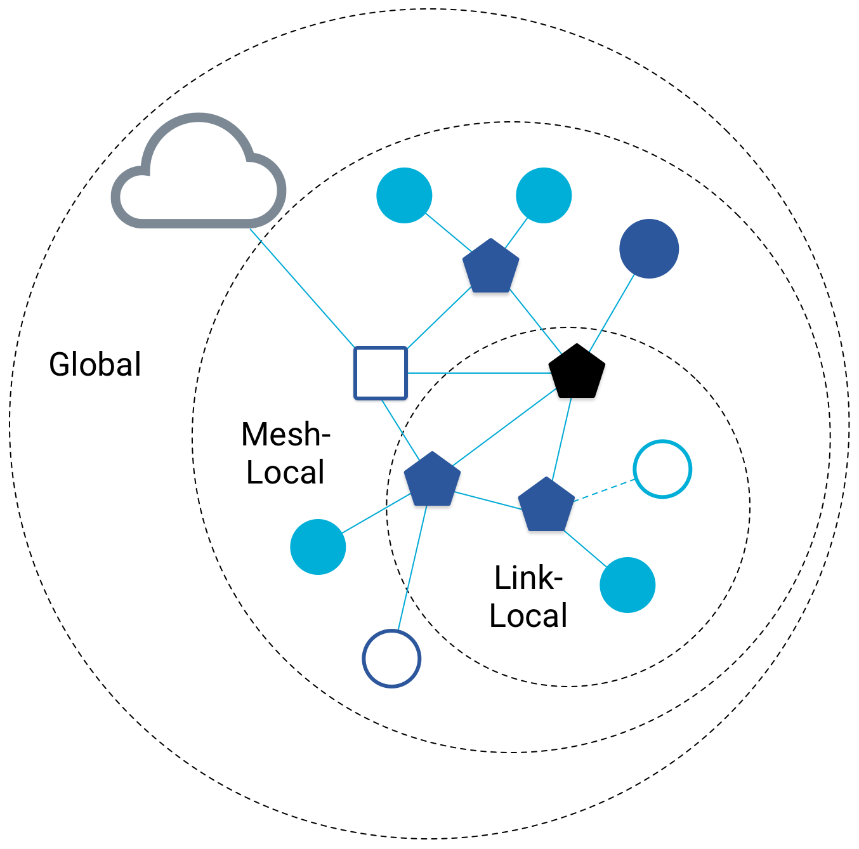
Benefit to IPv6: multiple address spaces per Thread device
Each device gets an IPv6 address for each way to contact it
  Global IP address
  Mesh-local IP address
  Link-local IP address
  Topology-based IP address
    Send to parent
    Send to child
  Role-based IP address(es)
    Send to all Routers
    Send to Border Router

Slide 38
Traditional addresses in Thread
Link-Local Addresses
  FE80::/16
  Bottommost 64-bits are EUI-64 (MAC address with 0xFFFE in the middle)
  Permanent for a given device (no matter the network)
  Used for low-layer interactions with neighbors (discovery, routing info)
Mesh-Local Addresses
  FD00::/8 (FD00:: and FC00:: are for local networks in IPv6)
  Remaining bits are randomly chosen as part of joining the network
  Permanent while connection is maintained to a network
  Used for application-layer interactions
Global Addresses
  2000::/3 (2000:: are for global, unicast IP addresses in IPv6)
  Public address for communicating with broader internet through Border Router
  Various methods for allocation (SLAAC, DHCP, Manual)

Slide 39
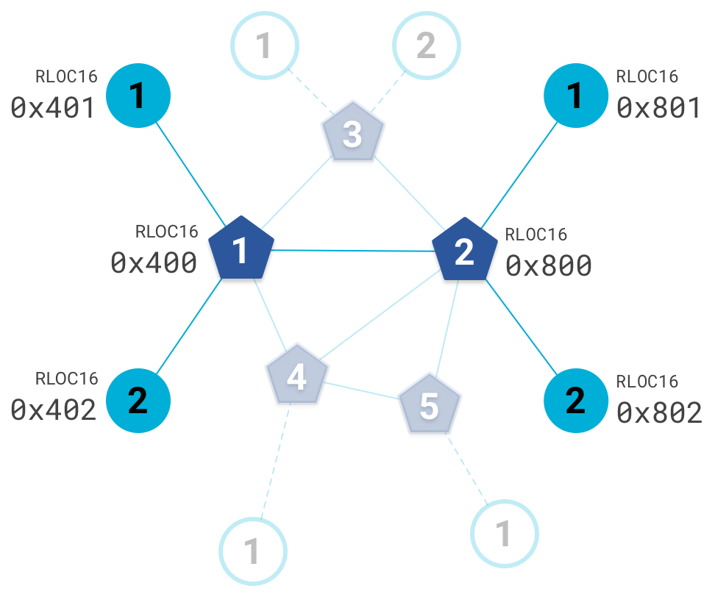
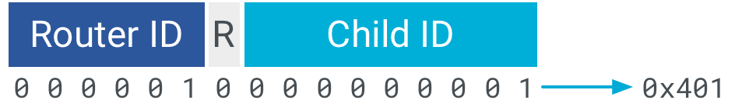
Topology-based addresses in Thread
FD00::00FF:FE00:RLOC16
  Same top bits as mesh-local
Routing Locator (RLOC)
  Router ID concatenated
  with Child ID
Changes with network topology
  Used for routing packets

Slide 40
Role-based addresses in Thread
Multicast
  FF02::1 – link-local, all listening devices
  FF02::2 – link-local, all routers/router-eligible
  FF03::1 – mesh-local, all listening devices
  FF03::2 – mesh-local, all routers/router-eligible
Anycast
  FD00::00FF:FE00:FCxx
    00 – Thread Leader
    01-0F – DHCPv6 Agent
    30-37 – Commissioner
    etc.

Slide 41
Break + Question
Which type of address(es) could you use for communication?
  Global
  Mesh-local
  Link-local
  Topology
  Role-based
Communicate with each circled target
4
3
Your Node
1
2

Slide 42
Break + Question
  Options
  Global
  Mesh-local
  Link-local
  Topology
  Role-based
Green node
  Mesh-local
  Topology (parent)
  Link-local
Blue node
  Mesh-local
  Topology (other child of parent)
  Maybe link-local
Orange node
  Mesh-local
  Role-based
Purple “cloud”
  Global
4
3
Your Node
1
2

Slide 43
Outline
Thread Overview
Thread Addressing
Runtime Behavior
Using IP

Slide 44
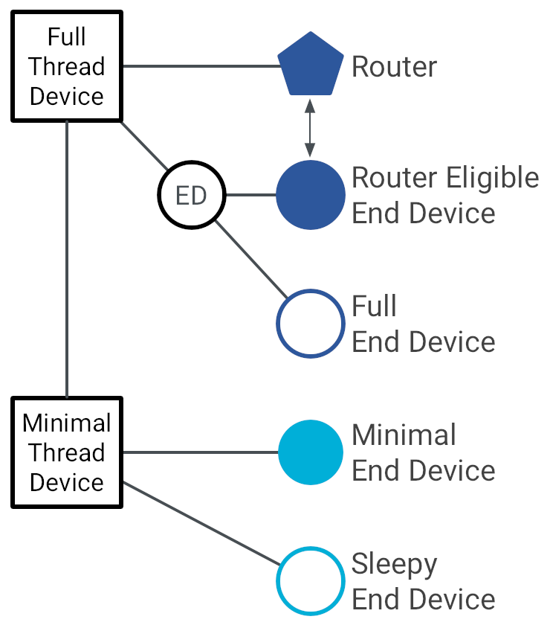
Thread device types
Full Thread Devices
  MAC: Always-on
  Participate in routing
  Examples:
    Routers
    Thread Leader
    Border Router
    Router-Eligible End Device (REED)

Slide 45
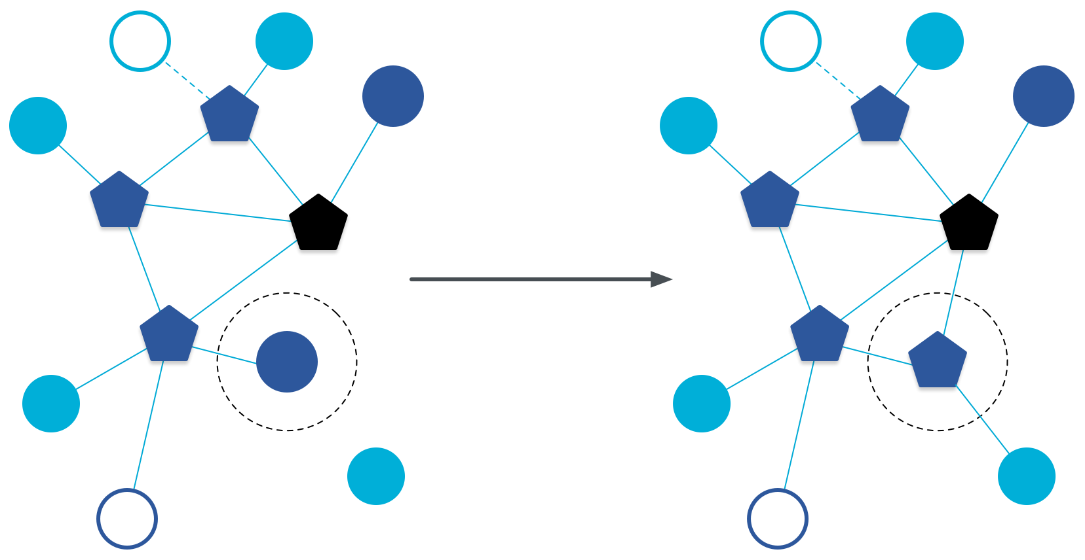
Router promotion
Router Eligible End Device (REED)
  A router without any children
  Can operate as an end device with one connection (lower power)
  Promotes to a router when a joining end device relies on it
    If there is room for an additional router (max 32, typical 16-23)

Slide 46
Thread device types
Full Thread Devices
  MAC: Always-on
  Participate in routing
  Examples:
    Routers
    Thread Leader
    Border Router
    Router-Eligible End Device (REED)
Minimal Thread Devices
  MAC: Can be low power
  Only send/receive to/from parent
  Examples:
    Minimal End Device (MED)
    Sleepy End Device (SED)
    Synchronized Sleepy End Device (SSED)

Slide 47
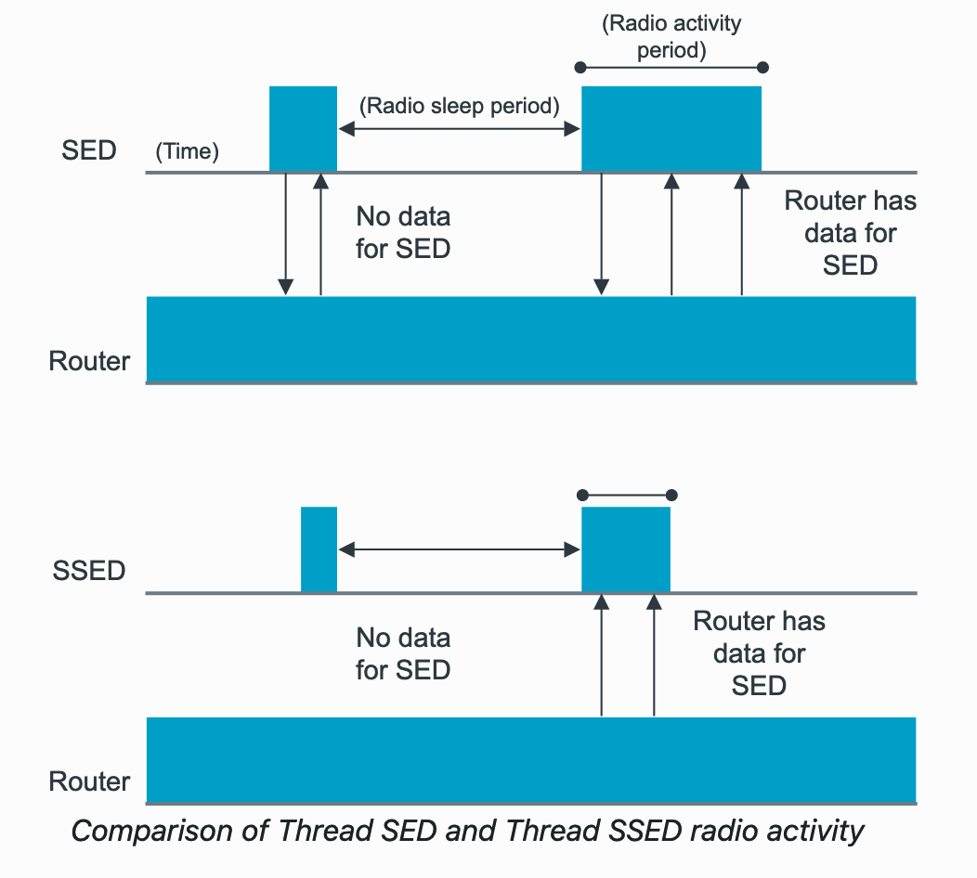
Sleepy End Devices
These are the low power devices
Periodically must exchange messages with Router
Sleepy End Device (SED)
  MAC:
    TX: Router always-on, so send as needed (ALOHA)
    RX: Periodically check in with router if new data pending
Synchronized Sleep End Device (SSED)
  MAC:
    TX: ALOHA
    RX: Listen during pre-configured windows
https://developer.nordicsemi.com/nRF_Connect_SDK/doc/latest/nrf/protocols/thread/sed_ssed.html

Slide 48
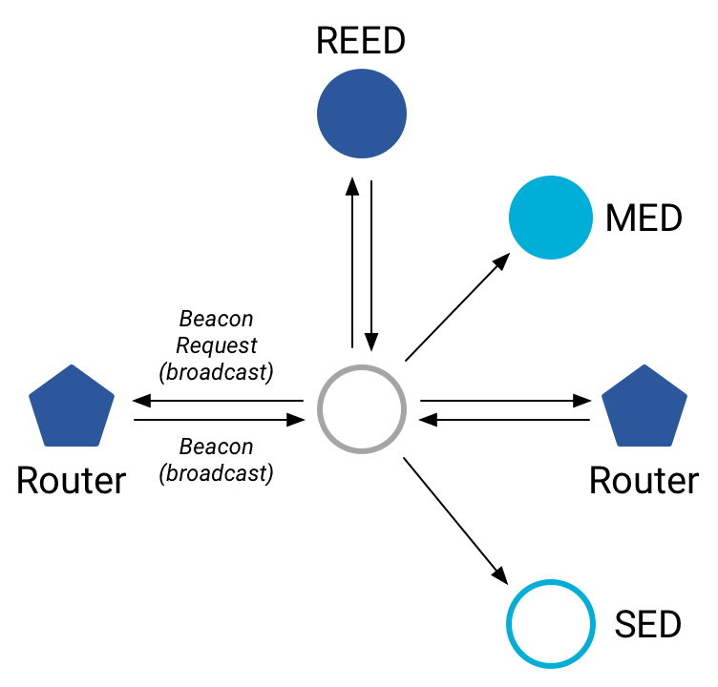
Discovering Thread networks
“Beacon Request” MAC command
  Routers/Router-eligible devices respond
  Payload contains information about network
Thread network specification
  PAN ID – 16-bit ID
  XPAN ID – extended 64-bit ID
  Network Name – human-readable
Active scanning across channels can
quickly find all existing nearby networks

Slide 49
Creating a new network
Select a channel (possibly by scanning for availability)
Become a router
  Elect yourself as Thread Leader
  Respond to Beacon Requests from other devices
Further organization occurs through Mesh-Level Establishment protocol

Slide 50
Mesh-Level Establishment (MLE)
Creating and configuring mesh links
  Payloads placed in UDP packets within IPv6 payloads
Commands for mesh
  Establish link
  Advertise link quality
  Connect to parent
TLVs (Type-Length-Value)
  Various data types that may be helpful within those packets
  Addresses, Link Quality, Routing Data, Timestamps
0 | Command Type | TLV | … | TLV
OR (secure version)
255 | Aux Header | Command Type | TLV | … | TLV | MIC

Slide 51
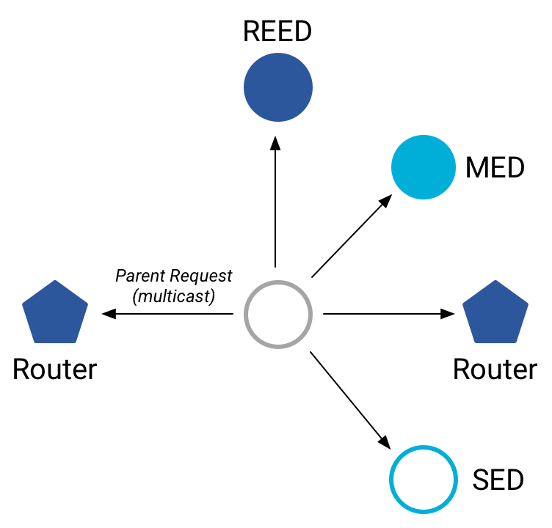
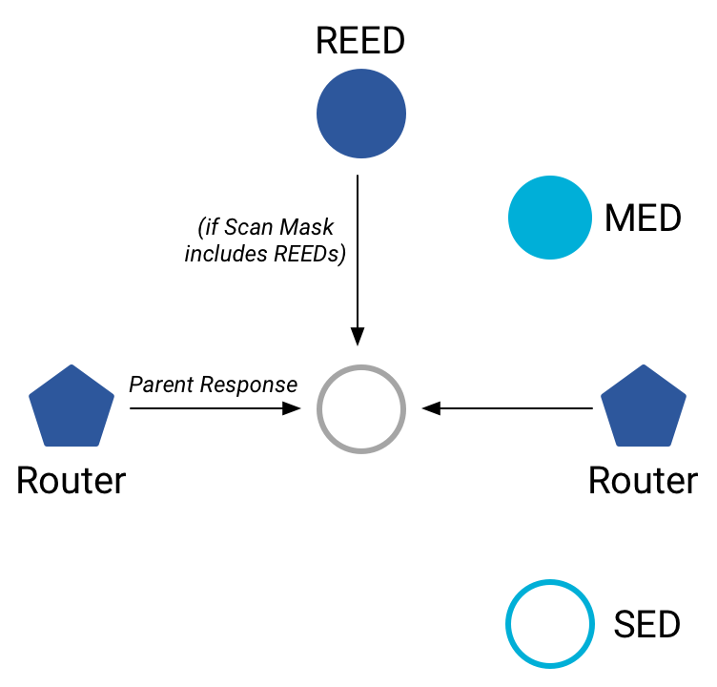
Joining an existing network
All devices join as a child of some existing router
Send a Parent Request (to all routers/router-eligible)
  Using the multicast, link-local address
Receive a Parent Response (from all routers/router-eligible separately)
  Contains information on link quality
Send a Child ID Request (to router with best link)
  Contains parameters about the new child device
Receive a Child ID Response (from that router)
  Contains address configurations

Slide 52
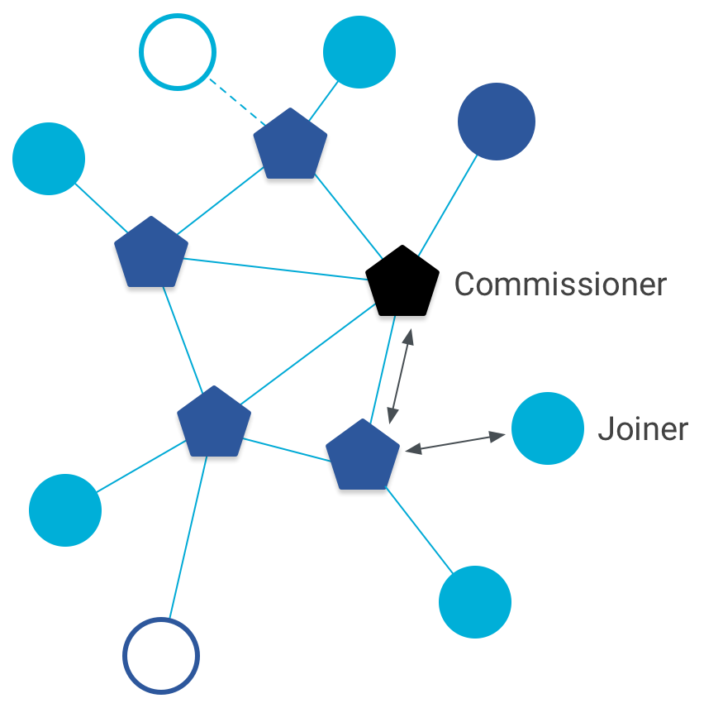
Thread Commissioning
As part of joining a network, a thread device is also “commissioned”
Bonus step in the joining process for real-world networks
Authenticates the joining device allowing it to join and encrypt communications
https://www.threadgroup.org/Portals/0/documents/support/CommissioningWhitePaper_658_2.pdf

Slide 53
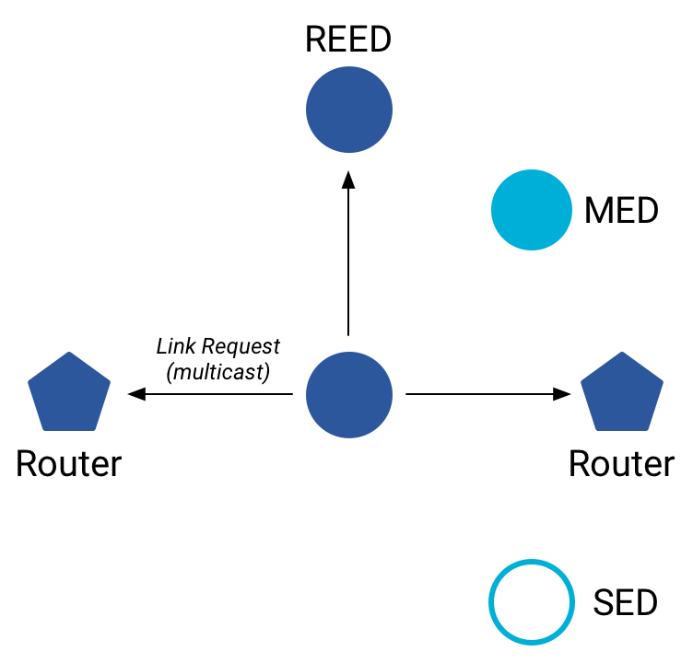
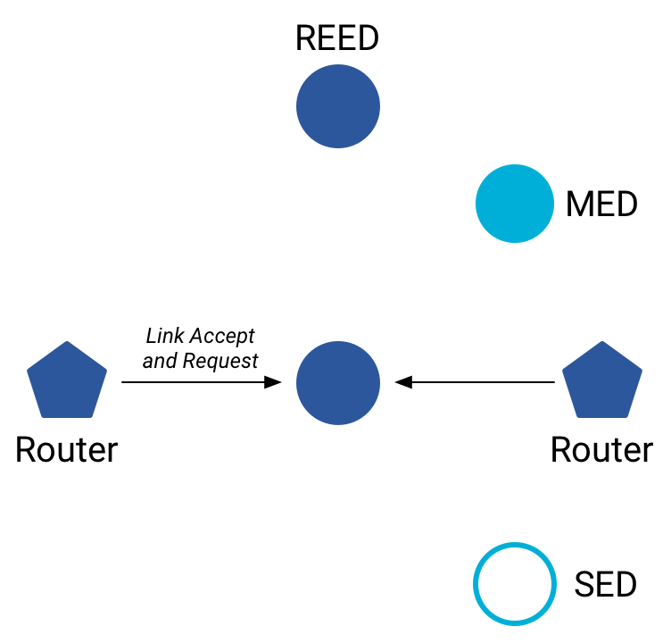
Becoming a router
Thread tries to maintain 16-23 routers (max 32)
  Goals: path diversity, extend connectivity
Send a Link Request (to all routers/router-eligible)
  Using the multicast, link-local address
Receive Link Accept and Request (from each router separately)
  Forms bi-directional link
Send a Link Accept (to each router individually)

Slide 54
Thread Routing
Uses Distance-vector routing
Routers periodically advertise routing costs to all other Routers and quality of one-hop links to neighbors
  Uses MLE messages
Cost to destination is the minimum of what all neighbors advertise to that destination plus your cost to that neighbor
Rate at which advertisements are sent is determined by an instance of the Trickle algorithm
Source: section 5.9 in spec

Slide 55
Each router stores neighbor and routing information
Each router stores a routing database which consists of:
  Router ID Set
    set of current valid router IDs
  Link Set
    Information about Routers that are/were recently neighbors
    <router_id, link_margin, incoming_quality, outgoing_quality, age>
  Route Set
    records route cost and next hop about other Routers that are, or recently were, reachable (had a finite routing cost) from this router
    <destination, next_hop, route_cost>

Slide 56
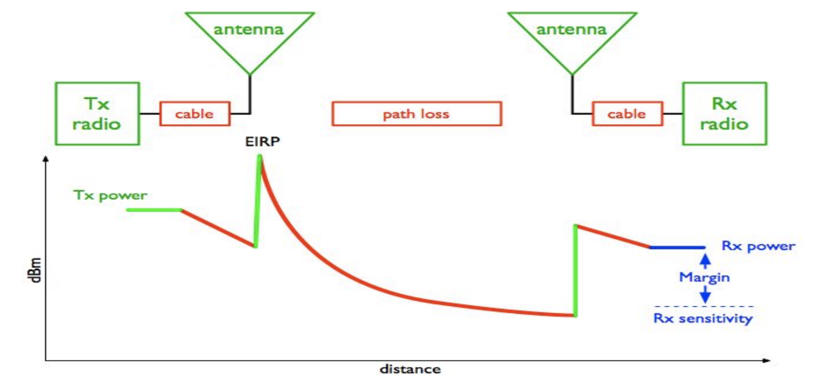
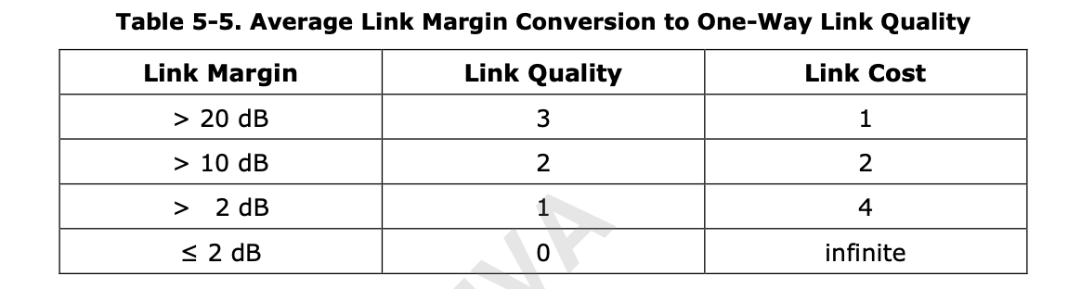
Routers use average link margin to compute Link Cost
Link Margin gives an indication about the quality of the link
Source: https://www.cdt21.com/design_guide/link-budget/

Slide 57
Routing Example
For Router 1
Router ID Set = {2, 3, 4, 5}
Link Set:
Router Id | RLOC16 | Quality In | Quality Out | Age
2 | 0x800 | 2 | 3 | 0
3 | .. | 3 | 3 | 14
4 | .. | 3 | 2 | 0
Route Set:
Destination | Next Hop | Route Cost
1 | 1 | 0
2 | 2 | 2
3 | 3 | 3
4 | 4 | 1
5 | 2 | 3

Slide 58
Updates to Thread specification
Thread version 1.2
  Simpler, lower-power end devices
    Any packet sent is enough to keep the device attached to network
    All acknowledgements identify if packets are available for it
  Power control
    Reduce transmission power to minimum needed for “good connection”
    Reduces potential for “hidden terminal problem”
Thread version 1.3
  Better IPv6 support
    Coordinate address selection with IP network boarder router connects to
    Shuttle DNS Service Discovery messages between networks
  Support for TCP

Slide 59
Outline
Thread Overview
Thread Addressing
Runtime Behavior
Using IP

Slide 60
Communicating with IP
Any communication that layers on top of IP is now possible
  If there is a library to support it
Common choices
  UDP
    DNS – translate hostnames into IP addresses
    SNTP – get real-world time, accuracy better than 1 second
    CoAP – send and receive data

Slide 61
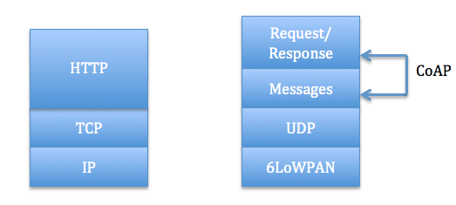
Constrained Application Protocol - CoAP
HTTP, but over UDP targeting less-capable devices
  Same REST architecture
  Adds capability for automatic retransmissions
CoAP Requests
  Have a type: GET, POST, PUT, DELETE
  Have a URL: /file/etc
  Have data up to 65 KB

Slide 62
Sensor networks don’t use TCP (yet?)
Uncommon choice: TCP
  Concerns: Too large, too slow, poorly suited to lossy networks
  Also concerning: We’re just replicating TCP poorly
  Active research:
    Sam Kumar, Michael Anderson, Hyung-Sin Kim, David Culler.
    “Performant TCP for Low-Power Wireless Networks”. 2020.
    The debate is still very much open
2023 update: Thread now supports TCP!!
  Primarily for large data payloads, like firmware updates

Slide 63
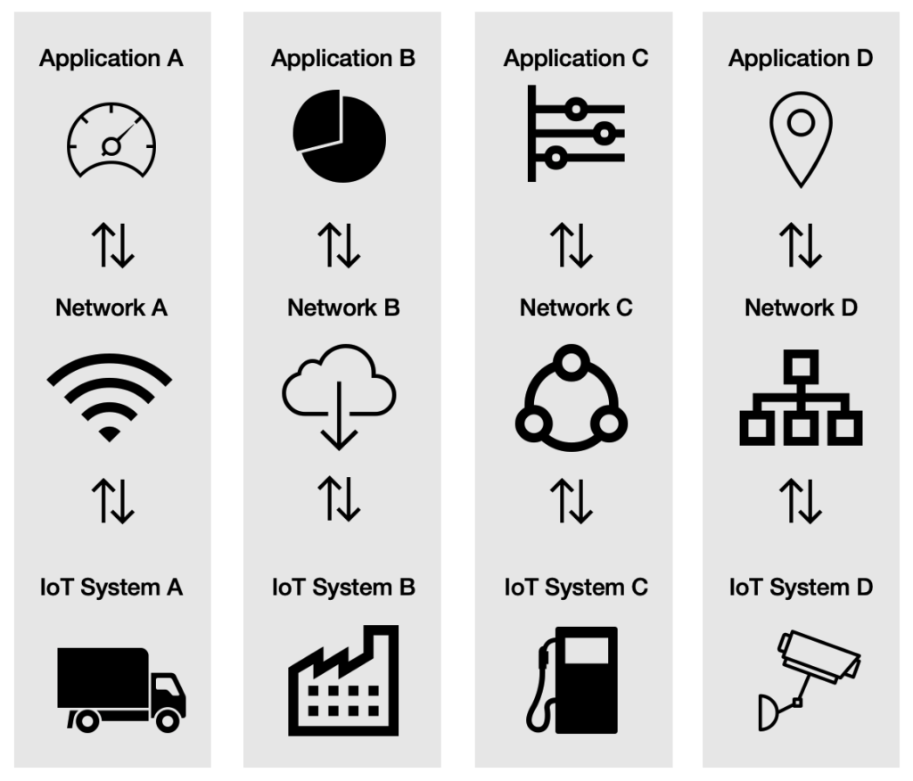
A problem: the siloed internet of things
Problem: companies are more interested in selling you the whole stack
  Which then makes it harder for devices to be interoperable
This is not Thread or IP-specific, but a problem all IoT devices are facing
Concerns
  What IP address do you send data to?
  Manufacturer’s server is an obvious choice
We’ll talk about the Matter standard as an approach to this issue

Slide 64
Outline
Thread Overview
Thread Addressing
Runtime Behavior
Using IP

