Slide 1
Lecture 01
Introduction
CS397/497 – Wireless Protocols for IoT
Branden Ghena – Spring 2024
Materials in collaboration with Pat Pannuto (UCSD) and Brad Campbell (UVA)

Slide 2
Welcome to CS397/497!
Goal: get a feel for wireless communication and protocols
  How are they used?
  Why are they different and in what ways?
  Which applications are they most useful for?
39 students (34 undergrad, 5 grad)
  Lots of different backgrounds and interests
  (CS, ECE, Robotics, Data Science, Music, Neuroscience)
This course is based on discussion and questions
  Expect to attend classes, ask questions, and interact with others
  You’re hopefully here because you want to be and want to learn

Slide 3
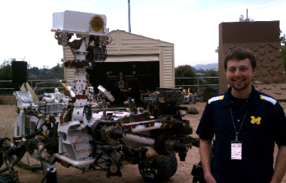
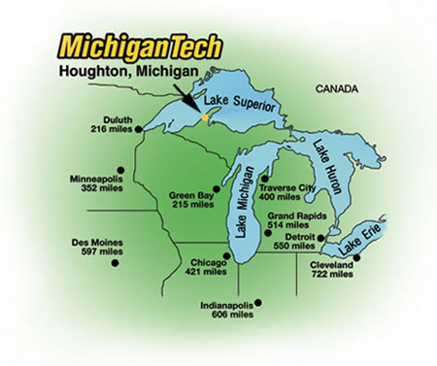
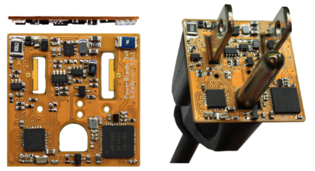

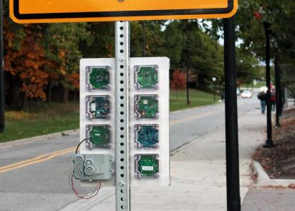




Branden Ghena (he/him)
Assistant Faculty of Instruction
Education
  Undergrad: Michigan Tech
  Master’s: University of Michigan
  PhD: University of California, Berkeley
Research
  Resource-constrained sensing systems
  Low-energy wireless networks
  Embedded operating systems
Teaching
  Computer Systems
    CS211: Fundamentals of Programming II
    CS213: Intro to Computer Systems
    CS343: Operating Systems
    CE346: Microprocessor System Design
    CS397: Wireless Protocols for the IoT
Things I love

Slide 4
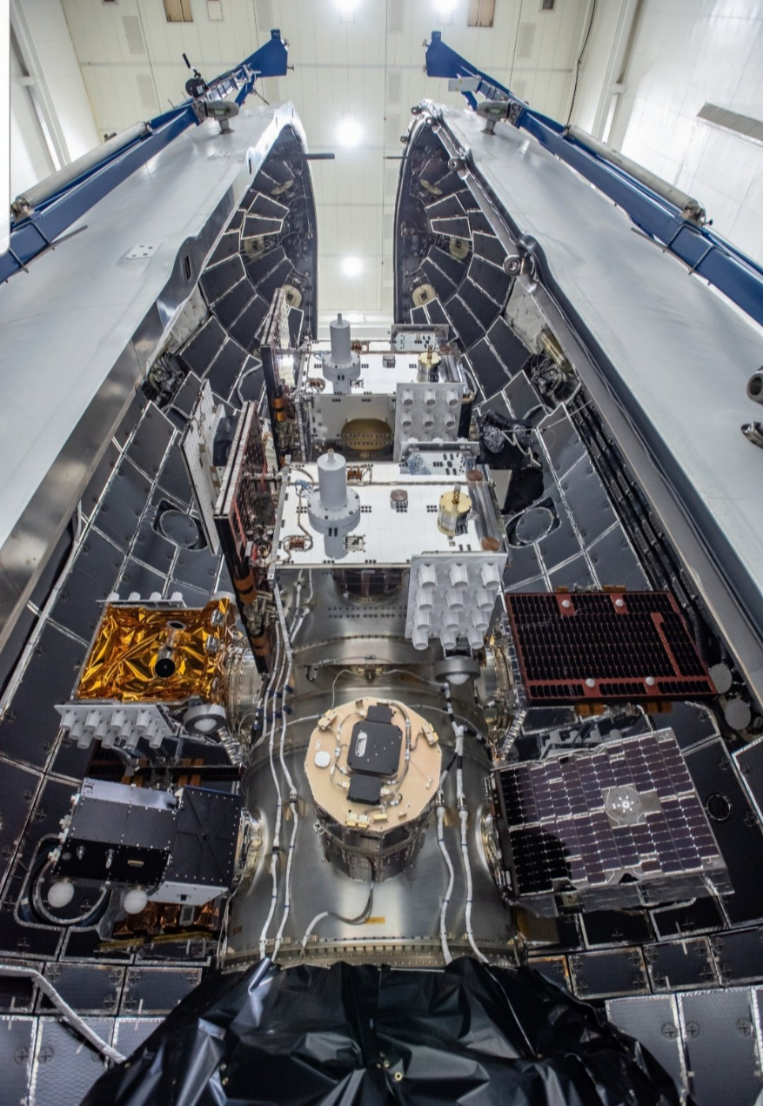
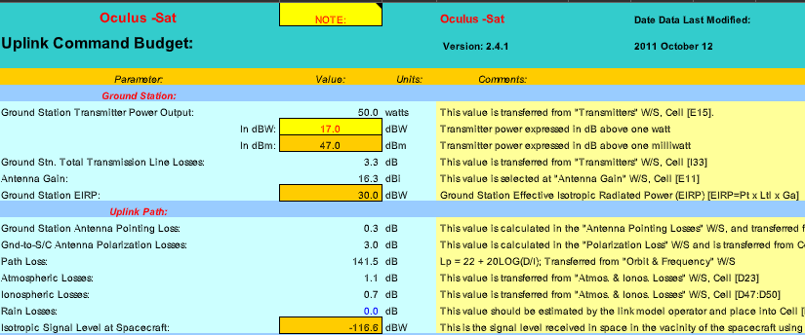
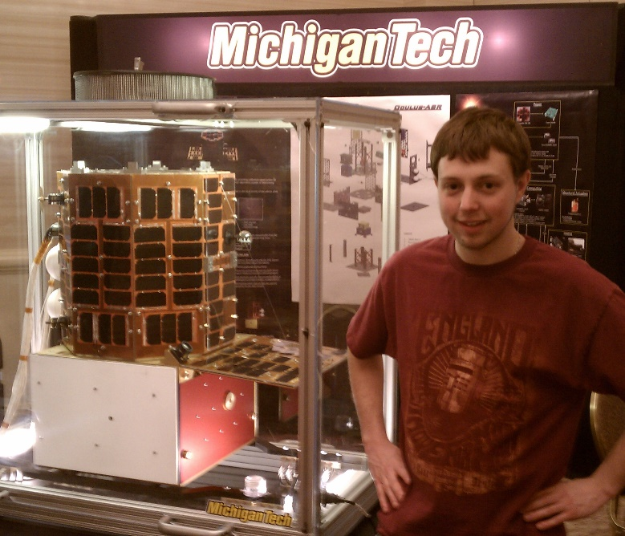
Undergraduate: satellite radios and computers
How the heck are you supposed to learn this stuff?

Slide 5

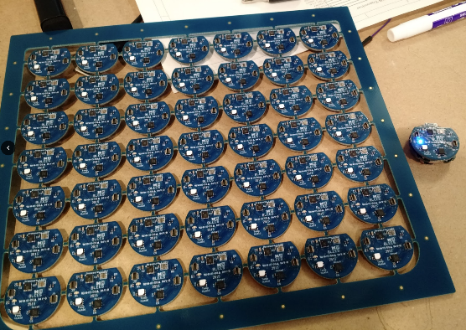
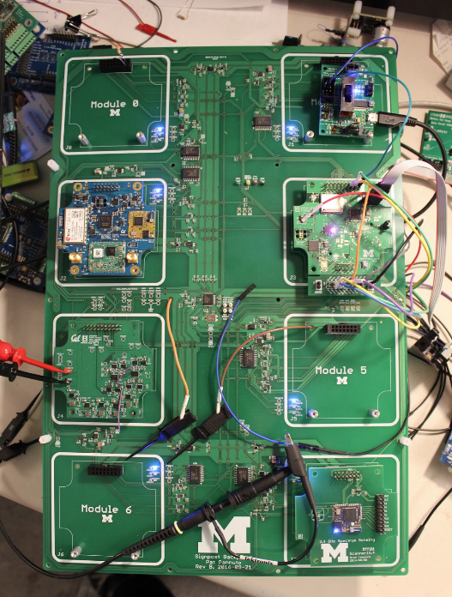
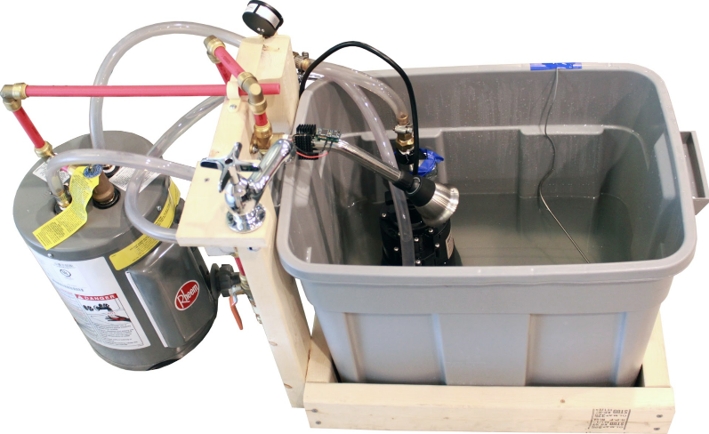
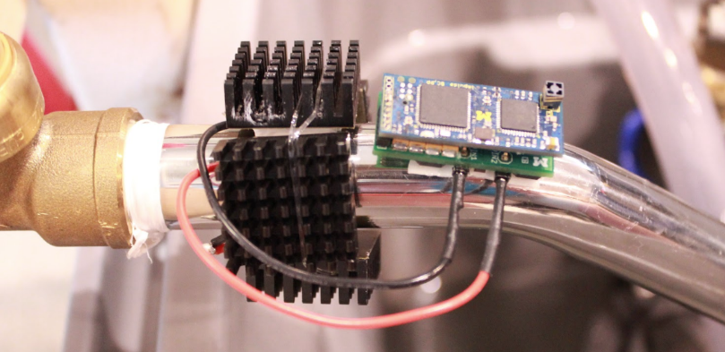
Grad school: resource-constrained embedded systems
Most interesting to me: the interfaces
  Hardware and software
  Applications and OS
  Communication
Again: learn by doing
  With significant assistance from my peers

Slide 6
Faculty: now I can choose what to teach!
Goal: provide classes that teach more advanced embedded systems topics
  Overlaps strongly with CS and ECE, but hopefully useful to other engineering and sciences domains too
Result: this course!
  Course goals: make students familiar with a number of different wireless protocols and their tradeoffs
    Practical hands-on experience with as many networks as possible
    Open-ended design for final, chance to delve deeply into materials

Slide 7
Today’s Goals
Introduction to the Internet of Things and Embedded Systems
Overview of the course
Introduction to wireless communication

Slide 8
Outline
Who and Why
Internet of Things
Embedded Systems
Course Overview
Overview of wireless networks

Slide 9
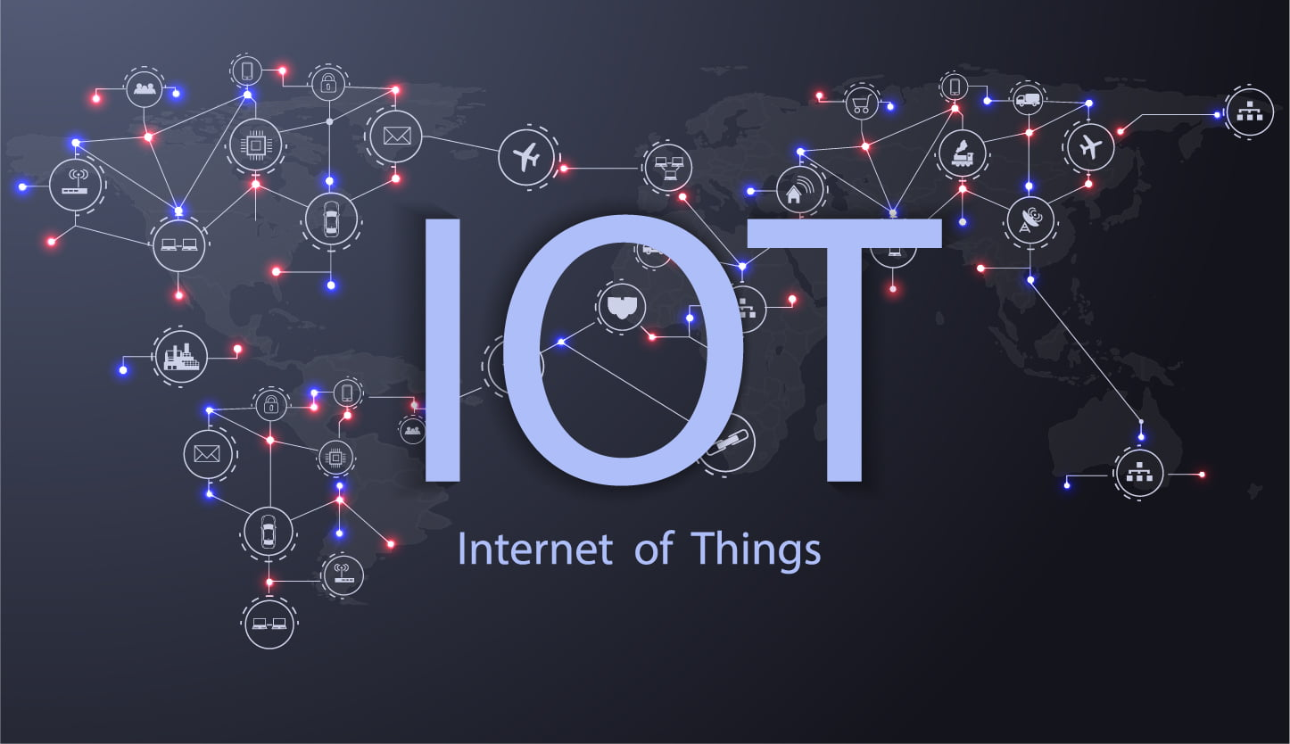
Perspective of this course
This class is about wireless protocols
  For a specific domain: the Internet of Things
So we’ll spend some amount of time discussing
the Internet of Things and embedded systems

Slide 10
Discussion: what is the Internet of Things?
Name a few Internet of Things devices
What are the qualities that designate those devices at “IoT”?

Slide 11
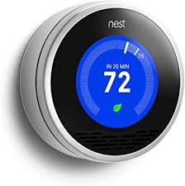
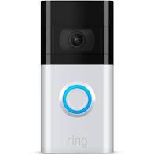


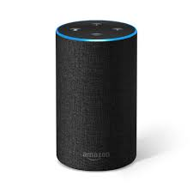
Discussion: what is the Internet of Things?
Name a few Internet of Things devices
What are the qualities that designate those devices at “IoT”?

Slide 12
Thought experiment: headphones
What about battery powered wireless headphones?
Would that still count as IoT?

Slide 13
Thought experiment: headphones
What about battery powered wireless headphones?
Would that still count as IoT?
  Feels to me like a personal device rather than infrastructure
  Something important about having many users

Slide 14
Thought experiment: desktop IoT
What if the Nest thermostat was powered by an entire desktop?
  8-core x86-64 processor, 32 GB RAM, 1 TB SSD
Would that still count as IoT?
Why don’t we see that in practice?

Slide 15
Thought experiment: desktop IoT
What if the Nest thermostat was powered by an entire desktop?
  8-core x86-64 processor, 32 GB RAM, 1 TB SSD
Would that still count as IoT?
Why don’t we see that in practice?
Cost

Slide 16
Focus on energy needs
The origins of IoT are battery-powered sensing systems
  And energy-harvesting devices
Why do we put so much focus on systems with batteries?
  Why do they need batteries?

Slide 17
Focus on energy needs
The origins of IoT are battery-powered sensing systems
  And energy-harvesting devices
Why do we put so much focus on systems with batteries?
  Why do they need batteries?
Deployability

Slide 18
Largest IoT challenges: power and communication
This class is about wireless technologies
  For resource-constrained systems, such as the IoT
We will focus on the tradeoffs between technologies
  How they balance differing constraints
    Power, spectrum, complexity, etc.
  And the technical foundations of these designs and differences

Slide 19
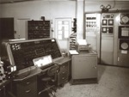
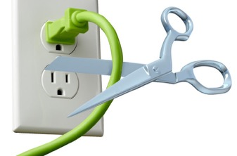
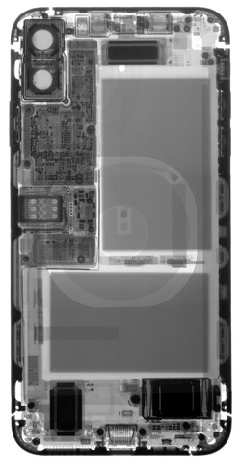
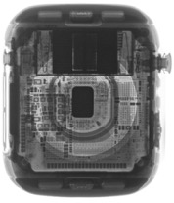
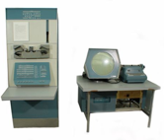


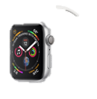

Energy is the defining constraint of emerging technologies
Mainframe
Computer
Workstation
By volume, the emerging computing classes are mostly energy storage
Volume is shrinking cubically
Laptop
Mini Computer
Battery
IoT/Wearable
Personal Computer
Smartphone
Notes:
Defining feature of modern computing classes is the amount of energy storage required to allow their operation
Clip art: http://www.ctecsolar.com/cut-cord-electric-company/
X-rays: iFixit teardowns

Slide 20
Branden’s take on the Internet of Things
Key features
  Computation
    Local to the device
    With some capability for arbitrary compute and storage
  Connectivity
    Almost certainly wireless
    Likely Internet, possibly local
  Interaction
    Sensing or Actuation
Secondary features
  Low energy
  (Relatively) Low cost

Slide 21
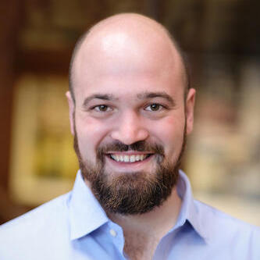
Pat Pannuto’s take on the Internet of Things
His early grad school essays described the “last inch” problem
  Now he often says “expanding the reach of digital world”
For him, it is about ‘networked’ ‘things’
  Which implicitly adds some computational capacity
Assistant Professor, UC San Diego
https://patpannuto.com/
He teaches a version of this course there, and we share materials back-and-forth!

Slide 22
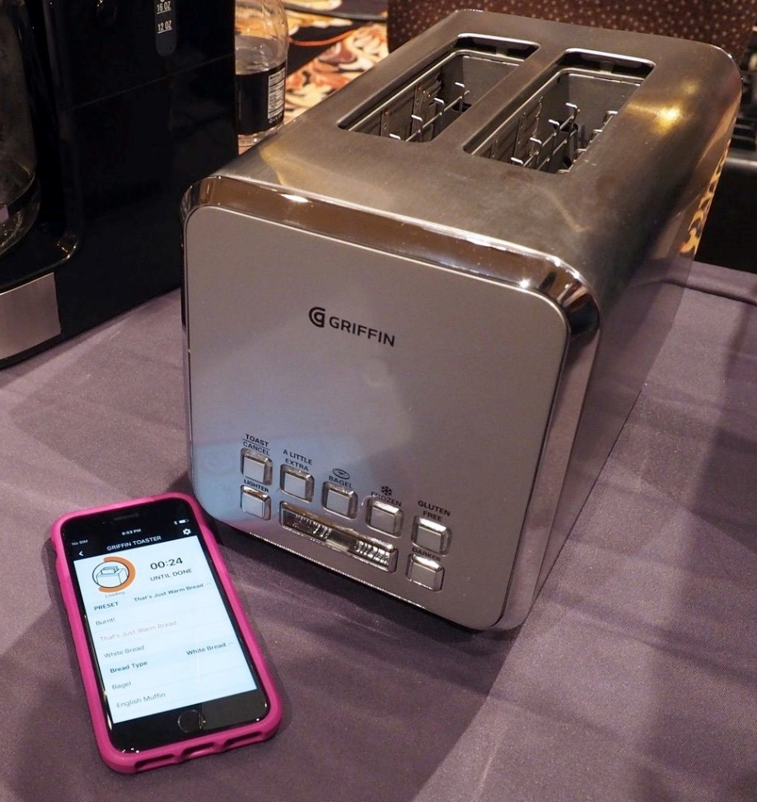
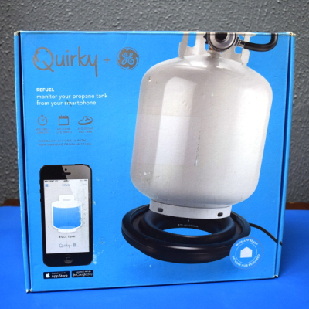
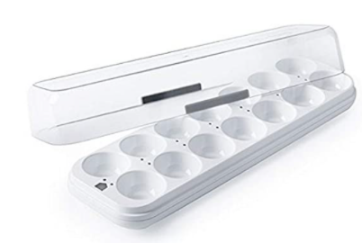
Warning: Internet of Crap

Slide 23
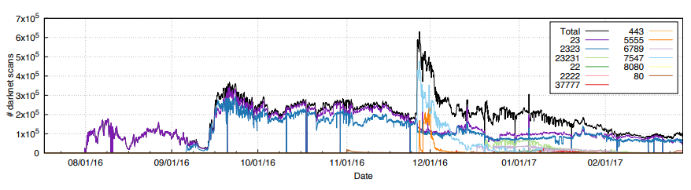
Internet of Insecure Crap
Mirai botnet (2016)
Takes control of up to 600,000 insecure connected devices
  IP-attached cameras, DVRs, routers, printers
Used to DoS websites

Slide 24
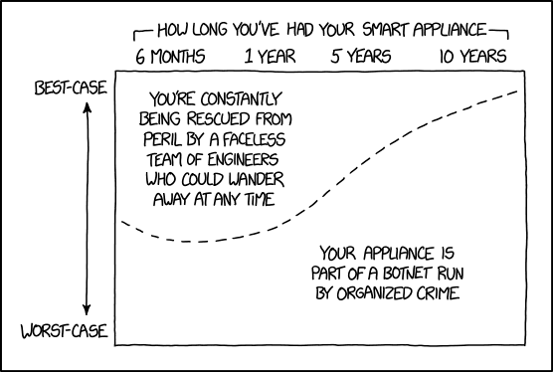
Break + xkcd
https://xkcd.com/1966/

Slide 25
Outline
Who and Why
Internet of Things
Embedded Systems
Course Overview
Overview of wireless networks

Slide 26
What are embedded systems
Embedded systems are devices containing computers that are used as a device rather than as a computer
  Computers are embedded into the device
Internet of Things devices are embedded devices
But there are embedded systems that are not IoT
  Smart vehicles and Robotics
  Personal devices
  Security or management chips inside other devices (like laptops/smartphones)
Example: USB-C power brick has more compute than Apollo 11 did
https://forrestheller.com/Apollo-11-Computer-vs-USB-C-chargers.html

Slide 27
Microcontrollers drive most embedded systems
Microcontroller: entire computer in a single chip
  Processor
  Working memory: SRAM (like RAM)
  Nonvolatile memory: Flash (like SSD)
  Peripherals
    I/O pins
    Analog Inputs and Outputs
    Timers
    Wireless radios
    Cryptography accelerators
  Power management
    Buses
      UART
      I2C
      SPI
      USB

Slide 28
How is a microcontroller different?
A very constrained computer
  Simple processor
    16 or 32 bits (usually 32-bit these days)
    Processor speed in MHz
    Single core, pipelined processor
    No cache, or maybe a very small instruction cache
  Memory measured in kB
    Code executes right from read-only Flash (which is part of the address space)
  Sometimes no OS support at all
    “bare-metal” programming

Slide 29
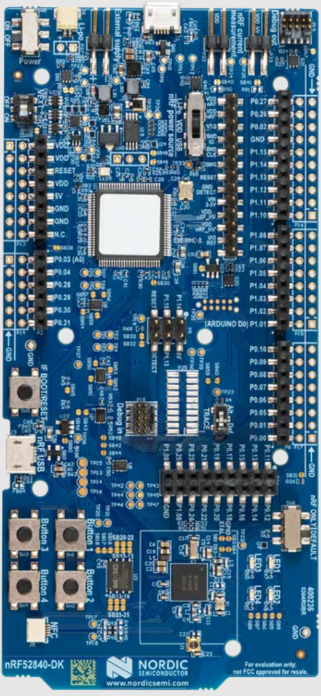
Nordic nRF52840DK - BLE & Thread
nRF52840 microcontroller dev kit
  Microcontroller is the bottom chip
  Everything else is just to program it, measure power, and connect to external things
nRF52840
  64 MHz, 32-bit ARM Cortex-M4F
  1 MB Flash, 256 KB RAM
  A bunch of peripherals
  Bluetooth Low Energy and 802.15.4 communication

Slide 30
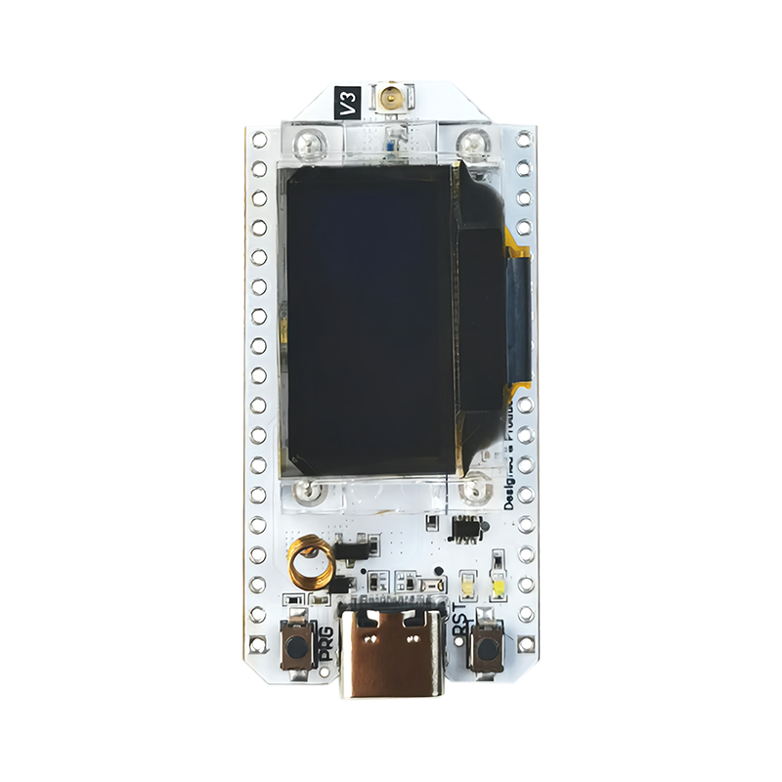
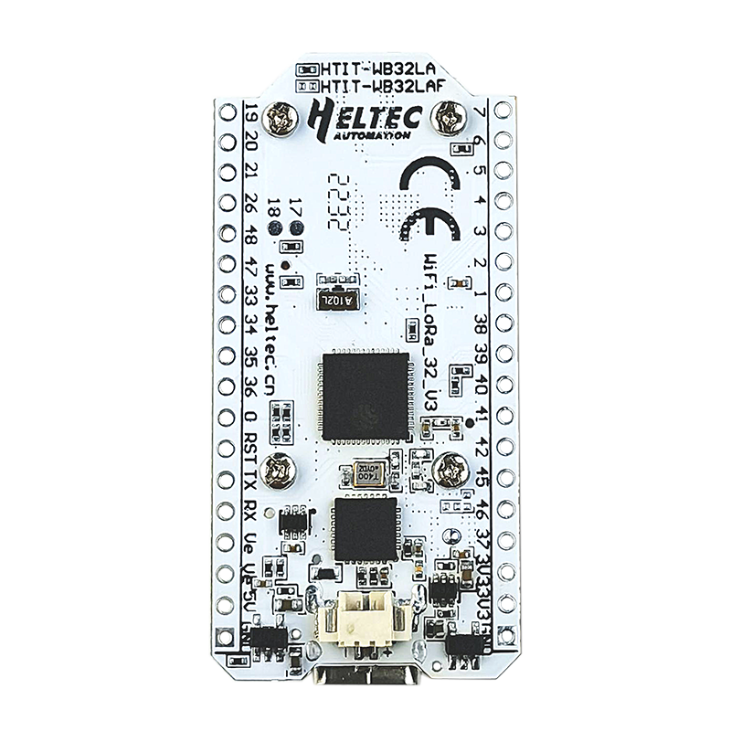
Heltec WiFi LoRa 32 v3 - WiFi & LoRa
ESP32 microcontroller
  240 MHz, 32-bit custom architecture
  384 kB Flash, 512 kB RAM
  A bunch of peripherals
  WiFi and Bluetooth Low Energy communication
SX1262
  LoRa transceiver (connected over SPI)
OLED display

Slide 31
Embedded systems are programmed in C
C++ also used
  Occasionally assembly or other things (Rust, Lua, Python)
But even the few things C gives you aren’t necessarily available
  Heap space possibly nonexistent
    You have to choose some space in RAM to save as a heap
    And then include the algorithm for allocating that memory
  Printf may be nonexistent too
    There’s no STDIN/STDOUT/STDERR because there is no shell
    Might be able to do serial output though

Slide 32
Embedded software
There are a multitude of embedded software systems
  Every microcontroller vendor has their own
  Popular platforms like Arduino
Embedded OSes
  Contiki, Riot, Zephyr, Mynewt, FreeRTOS, Tock
nRF52840DK has support across all of these
WiFi LoRa 32 v3 should work with some
  Best support likely in Arduino

Slide 33
Outline
Who and Why
Internet of Things
Embedded Systems
Course Overview
Overview of wireless networks

Slide 34
Course Staff
Instructor: Me!
PM: Liam Patterson
  Took the class last year
  Deep systems experience
We’ll have weekly office hours to support you all
  Schedule posted soon
  Plan: big chunk on Fridays as a pseudo-lab session (1-5pm tentatively)

Slide 35
Asking questions
Class and office hours are always an option!
  Office hours by demand. I promise to meet!!
Piazza: (similar to Campuswire)
  Post questions
  Answer each other’s questions
  Find lab partners
  Information from the course staff
  Post private info just to course staff
Please do not email me! Post to Piazza instead!
  Let me know if you don’t have access

Slide 36
Grading
50% Lab projects - hands-on semi-guided activities
  Likely 5 of these, divided equally
  Small groups of three students (except for the first one)
25% Homeworks - pencil-on-paper practice
  Likely 4 of these, with the last worth double
  Individual work
25% Final design project - paper writeup
  One of these due during exam week
  Individual work

Slide 37
Labs
Practice interacting with and considering networks
Group work (teams of three)
Should all include real hardware and real wireless communication
  Wireshark
  Bluetooth
  Thread
  WiFi
  LoRaWAN

Slide 38
Homeworks
Analysis, designing, calculating
  Background
  BLE packets
  Matter
  Cellular (worth double)
Usually take the form of some details on paper and you looking stuff up on your own
  Looking through wireless specifications and searching on the internet

Slide 39
Final design project
Design a communication plan for an application of your choice
Explain application and determine what its constraints are
  Cost, power, scale, data, reliability
Actually think through how it will work, citing real-world capabilities
  Research and cite data you find
  Explain and consider tradeoffs
This is the “final project” for the course
  Design rather than real hardware

Slide 40
On upper-level, special-topics courses
Something this class does not include is exams or quizzes
The point is to be here because you’re actually interested in the material
  Come to lecture and discuss ideas with us
  You don’t have to take notes, just focus on actually understanding stuff
You can help guide the course
  It’s okay to derail lecture (sometimes) with interesting tangents
  I’m happy to add material on other topics if you ask

Slide 41
What to expect
Very curated and structured
(e.g. CS111)
Real world project at a job
Computing course structure and guidance
autograder
online documentation
detailed programming assignments
defining requirements and milestones
course-specific libraries
multiple solutions
full provided documentation
real-world software stacks
Figure stuff out on your own! (or with a group)
Goal is to help prepare you to engineer projects in the real world

Slide 42
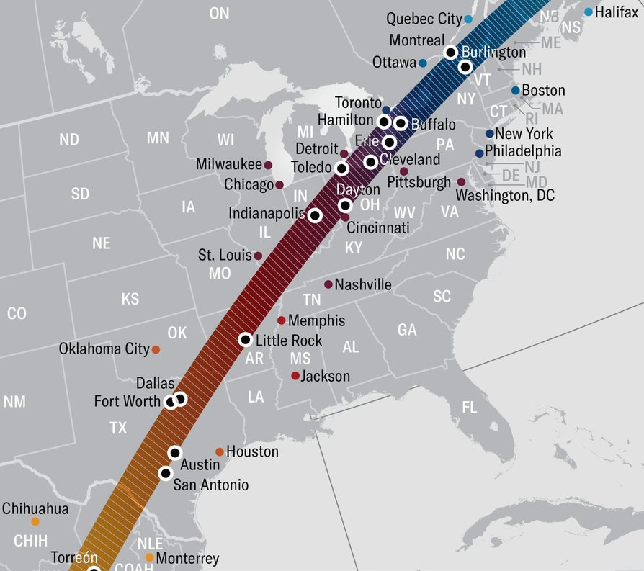
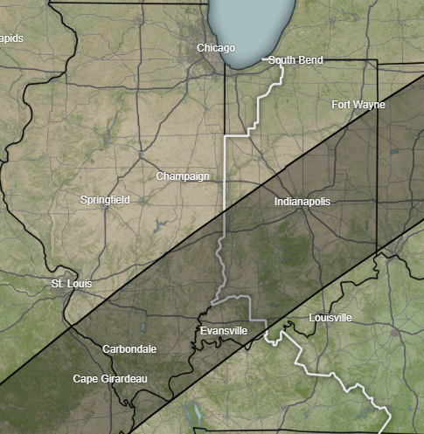
Great American Total Solar Eclipse
Roughly 2:00 pm Central in
southern Illinois/Indiana
  3.5 minutes of total solar eclipse
Get yourself to 100% eclipse
  99% was “oh that’s kind of neat”
  100% was “the coolest thing I’ve
  ever seen in my entire life”
Skip class, find a car, go see it (4-5 hour drive)
  Next opportunity is 2044
https://science.nasa.gov/eclipses/future-eclipses/eclipse-2024/where-when/

Slide 43
Architecture of a lecture
Full
Administrivia
+ stretch break
Open
Question
Summary
+ Bonus
Attention
0
20
25
50
53
78
80
Time (minutes)

Slide 44
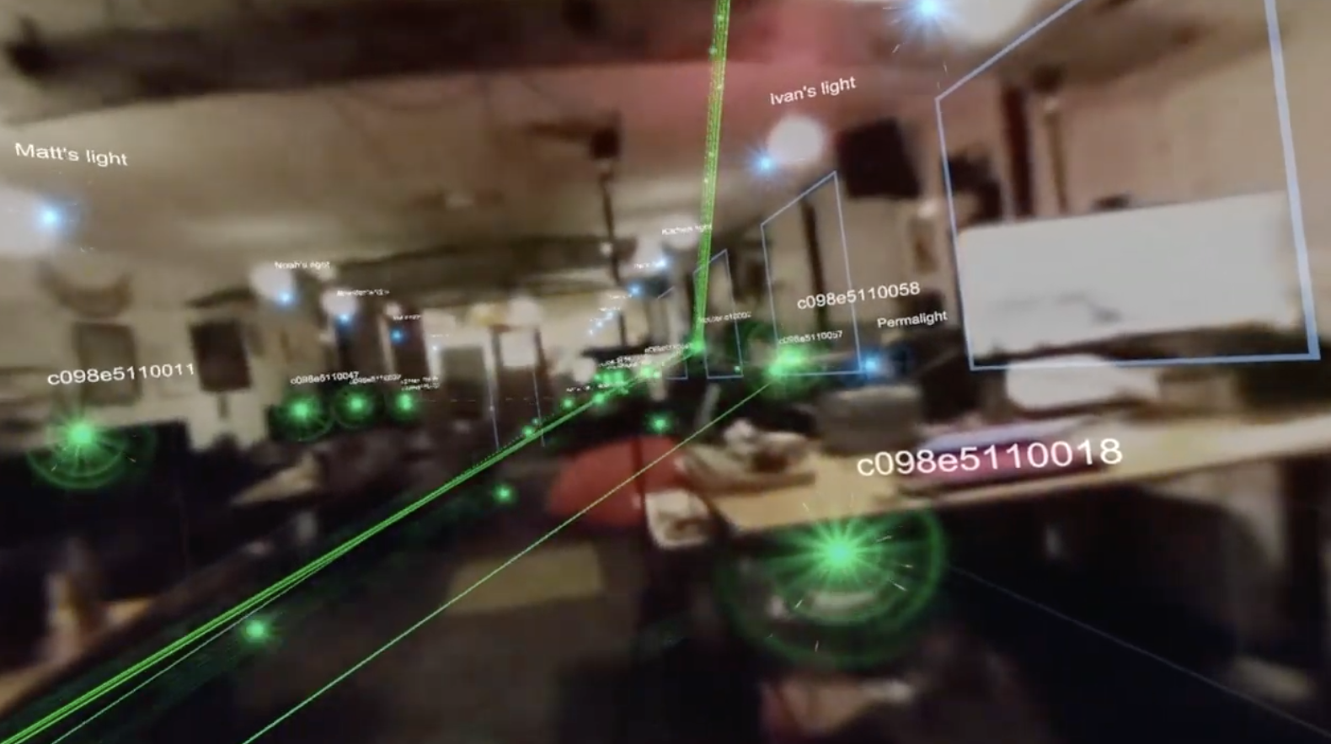
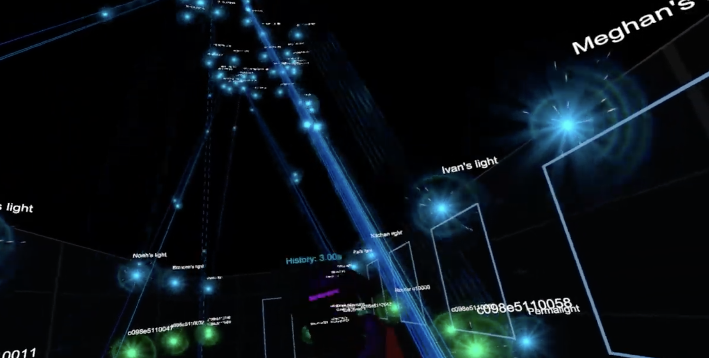
Break+Video
Wireless Network Visualization (Dr. Meghan Clark – UC Berkeley)
https://www.youtube.com/watch?v=KLOdp54_qJ4

Slide 45
Outline
Who and Why
Internet of Things
Embedded Systems
Course Overview
Overview of wireless networks

Slide 46
Bluetooth Low Energy (BLE)
Bluetooth Classic was good for enabling device to device communication
  But not particularly low energy
  And very bad at short-term, one-time connections
Bluetooth Low Energy was developed to improve this
  Focuses on low-energy interactions
  Much lower throughput that Bluetooth
Supported by hardware devices already in smartphones
  Humans can interact directly with nearby devices!!

Slide 47
802.15.4 & Thread
802.15.4 is a low-energy physical layer
  Radio chips have been widely available for 15-20 years
Significant amounts of sensor network research have focused on building layers on top of 802.15.4
  Access control layers
  Network layers
Thread is a selection of these possibilities to make a network
  Uses IPv6 networking!!
  Basis for modern smart-home standards: Matter

Slide 48
WiFi (802.11)
Ubiquitous wireless communication
  High energy requirements for high throughput communication
Now accessible through relatively low power radios
  ESP32 is dominant here
  Still significantly more effort than BLE or Thread
IoT devices can use the same WiFi that’s already available
  No need for additional infrastructure!!

Slide 49
LPWANs (Low-Power Wide-Area Networks)
How do we collect data from city-scale deployments?
  There’s an unmet need for long-range, but low-throughput networks
  Existing cellular technologies focus on human requirements
Still a brand new space (relatively)
  Unlicensed-band technologies in last 10 years: Sigfox and LoRaWAN
  Cellular technologies in last 4 years: LTE-M and NB-IoT
Focus on long-range, low-energy, low-throughput
  One gateway can cover an entire city!!

Slide 50
Extra topics
Backscatter
  Insanely low-energy communication
  Enables energy-harvesting indoor devices
Localization
  How do we find all this stuff?
  And how do devices determine where they are relative to each other?
Satellite Communication
  Growing use-case
Other topics are possible if desired! (seriously!)
  Reach out and tell me what you want to learn about (that’s clearly a class topic)

Slide 51
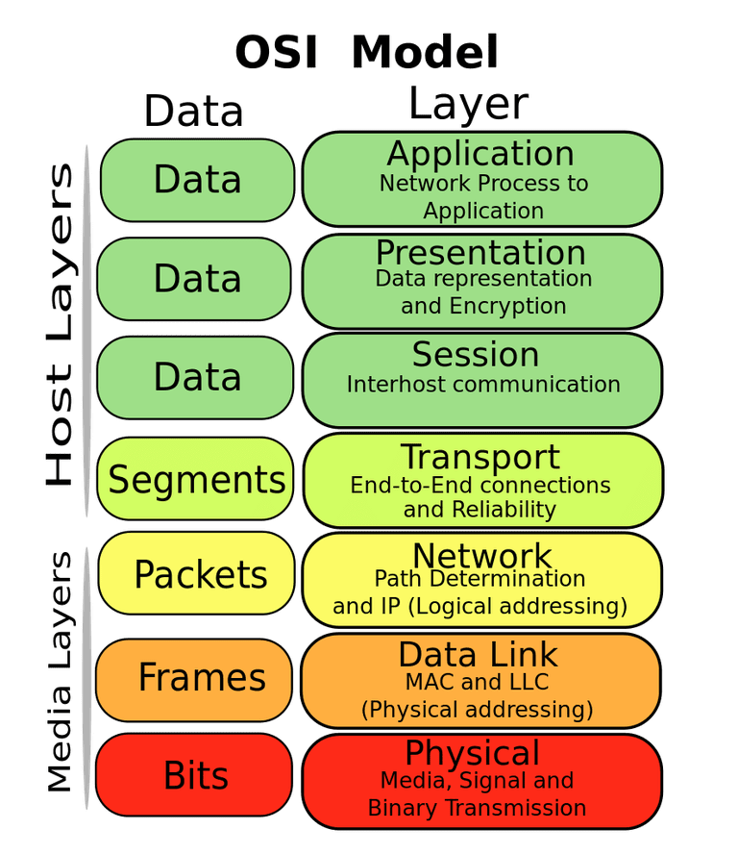
OSI model of communication layers
Transport
  Sending data between applications
  TCP and UDP
Network
  Sending data between networked computers
  IP
Data Link
  Sending collections of bits
  Ethernet, WiFi
Physical
  Sending individual bits
  Ethernet, WiFi

Slide 52
Where does this class focus?
Transport
  Sending data between applications
  TCP and UDP
Network
  Sending data between networked computers
  IP
Data Link
  Sending collections of bits
  Ethernet, WiFi
Physical
  Sending individual bits
  Ethernet, WiFi
CS domain
CS340, CS440
This course!
EE domain
EE307, EE378, EE380

Slide 53
Outline
Who and Why
Internet of Things
Embedded Systems
Course Overview
Overview of wireless networks

