Slide 1
Lecture 02 Network Fundamentals
CS397/497 – Wireless Protocols for IoT
Branden Ghena – Spring 2022
Some slides borrowed from: Peter Steenkiste (CMU), Christian Poellabauer (Notre Dame)
Materials in collaboration with Pat Pannuto (UCSD)

Slide 2
Administrivia
Campuswire
Everyone should have access to it
If you don’t, this is the exception when you should email me
Canvas
Most important information is on the Canvas homepage
I’m posting slides there too

Slide 3
Today’s Goals
Introduce OSI layer model of communication
Provide background on Internet layering
Overview of concerns for the Physical and Data link layers
Speak the “lingo” of wireless communication
Present technology aspects that we will return to in specific protocols
Describe Medium Access Control mechanisms

Slide 4
Outline
OSI Layers
Internet Architecture (Upper Layers)
Physical Layer
Data Link Layer

Slide 5
Communication layers
Application
Presentation
Session
Transport
Network
Data Link
Physical
What goes on at each of these?

Slide 6
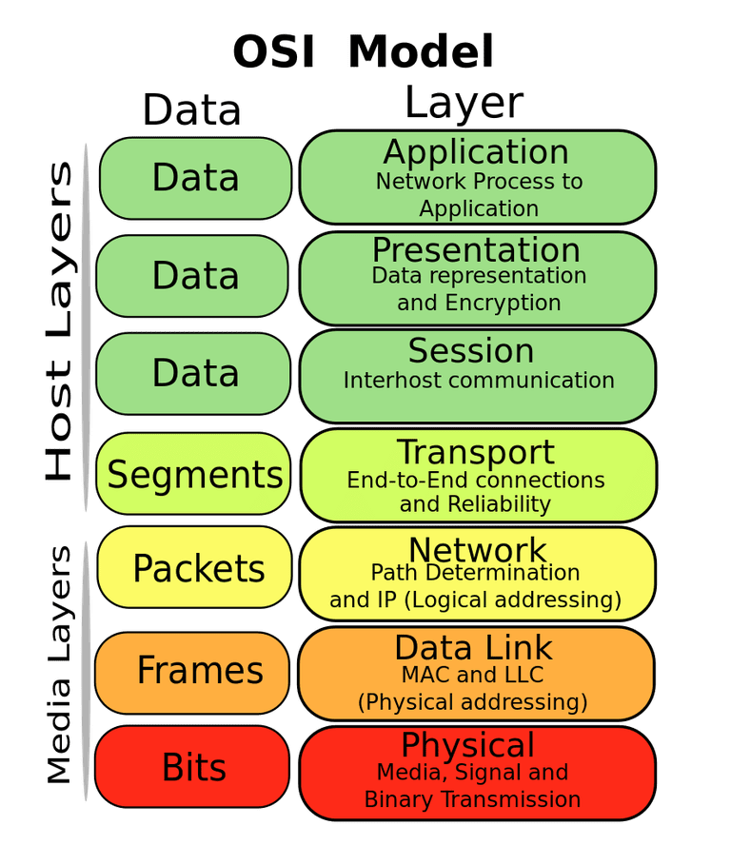
OSI model of communication layers
Transport
How to form connections between computers
TCP and UDP
CS domain: CS340
Network
How to send packets between networks
IP
CS domain: CS340
Data Link
How to send frames of data
Ethernet, WiFi
Our primary focus (but we go up & down)
Physical
How to send individual bits
Ethernet, WiFi
EE domain: EE307, EE380, EE395

Slide 7
Protocols are “layered”
Headers for each layer of communication wrap data
Data is wrapped with header for the network to make a packet
Packet is wrapped with header for the link to make a frame
Internet Packet
Data
Packet Header
Frame Header
Ethernet Frame

Slide 8
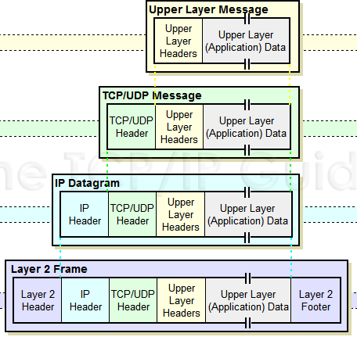
Packet encapsulation
Upper-layer packet is the payload for the lower-layer packet

Slide 9
Transmitting data between networks
LAN1
Host A
Host B
LAN2
client
server
(1)
data
(8)
data
protocol
software
protocol
software
internet packet
(2)
data
PH
(7)
data
PH
LAN1
adapter
LAN2
adapter
LAN1 frame
Router
(3)
data
PH
FH1
(6)
data
PH
FH2
LAN1
adapter
LAN2
adapter
LAN2 frame
(4)
data
PH
FH1
data
PH
FH2
(5)
PH: Internet packet header
FH: LAN frame header
protocol
software

Slide 10
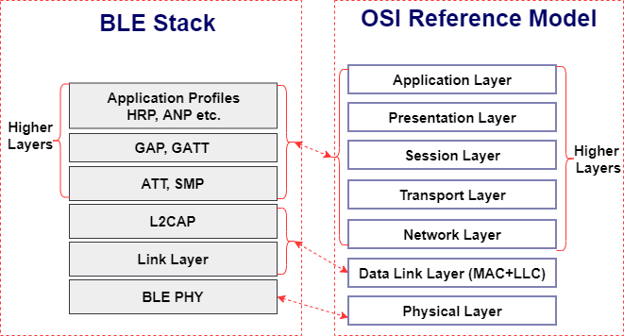
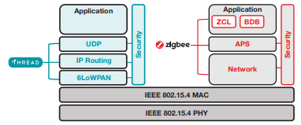
Model does not equal reality
Wireless protocols don’t always split between layers cleanly
Usually explain parts of physical, data link, and possibly upper layers
Model still helps conceptualize stack-up though
Layering of some type still occurs

Slide 11
Layering for IoT (joke) (kind of)
MQTT
MQTT is a publish/subscribe message broker

Slide 12
Outline
OSI Layers
Internet Architecture (Upper Layers)
Physical Layer
Data Link Layer

Slide 13
The global Internet
Most famous example of an internet (uppercase to distinguish)
Based on the TCP/IP protocol family
IP (Internet Protocol)
Provides a naming scheme and unreliable delivery of packets from host-to-host
UDP (Unreliable Datagram Protocol)
Uses IP to provide unreliable data delivery from process-to-process
TCP (Transmission Control Protocol)
Uses IP to provide reliable data delivery from process-to-process
Accessed via a mix of Unix file I/O and the sockets interface

Slide 14
Hardware and software organization of an Internet application
Internet client host
Internet server host
Client
User code
Server
Sockets interface
(system calls)
TCP/IP
Kernel code
TCP/IP
Hardware interface
(interrupts)
Network
adapter
Hardware
and firmware
Network
adapter
Global IP Internet

Slide 15
A programmer’s view of the internet
1. Hosts are mapped to a set of 32-bit IP addresses
129.105.7.30
2. The set of IP addresses is mapped to a set of identifiers called Internet domain names
129.105.7.30 is mapped to moore.wot.eecs.northwestern.edu
3. A process on one Internet host can communicate with a process on another Internet host over a connection

Slide 16
1. IP addresses
32-bit IP addresses are stored in an IP address struct
IP addresses are always stored in memory in network byte order (big-endian)
Remember: most computers use little-endian😭
True in general for any integer transferred in a packet header from one machine to another
E.g., the port number used to identify an Internet connection
By convention, each byte in a 32-bit IP address is represented by its decimal value and separated by a period
IP address: 0x8169071E = 129.105.7.30
/* Internet address structure */
struct in_addr {
uint32_t s_addr; /* network byte order (big-endian) */
};

Slide 17
2. Internet domain names
unnamed root
.net
.edu
.gov
.com
Top-level domain names
mit
northwestern
berkeley
amazon
Second-level domain names
eecs
mccormick
www
54.230.48.28
Third-level domain names
and onwards…
wot
www
129.105.1.129
Note: Northwestern owns 129.105.x.x
moore
129.105.7.30
hanlon
129.105.7.27

Slide 18
Domain Naming System (DNS)
The Internet maintains a mapping between IP addresses and domain names in a huge worldwide distributed database called DNS
Conceptually, programmers can view the DNS database as a collection of millions of host entries
Each host entry defines the mapping between a set of domain names and IP addresses
A special name: localhost
Refers back to the computer being used (IP address 127.0.0.1)

Slide 19
3. Internet connections
Clients and servers communicate by sending streams of bytes over TCP connections. Each connection is:
Point-to-point: connects a pair of processes.
Full-duplex: data can flow in both directions at the same time,
Reliable: stream of bytes sent by the source is eventually received by the destination in the same order it was sent.
A socket is an endpoint of a connection
Socket address is an IPaddress:port pair
IP address identifies the computer
Port identifies the process on the computer

Slide 20
Ports are used to identify services to the kernel
Server host 128.2.194.242
Client host
Service request for
128.2.194.242:80
(i.e., the Web server)
Web server
(port 80)
Client
Kernel
Echo server
(port 7)
Service request for
128.2.194.242:7
(i.e., the echo server)
Web server
(port 80)
Client
Kernel
Echo server
(port 7)

Slide 21
How does the Internet handle routing packets?
IP layer
Describes the overall goal
Packets from my computer <---> Google
Link layer (Ethernet)
Describes individual links
Packets from my computer <---> my router
Routing
Using link-layer building blocks to get packets from one IP to another

Slide 22
Assigning and finding IP address ranges
In general, network operators don’t change that often
Solution:
Tie IP addresses to network operators
Assign computers IPs as they join networks
Key Point:
Networks ”own” a block of IP address space
”The Internet” is a network of networks

Slide 23
Routing
2.0.0.0/8
1.0.0.0/8
10.0.0.0/8
5.0.0.0/8
4.0.0.0/8

Slide 24
Routing
2.0.0.0/8
10.0.0.0/8
1.0.0.0/8
2.0.0.0/8
10.0.0.0/8
4.0.0.0/8
5.0.0.0/8
10.0.0.0/8
10.0.0.0/8
5.0.0.0/8
10.0.0.0/8
4.0.0.0/8
5.0.0.0/8
10.0.0.0/8

Slide 25
Routing – ”Adaptive”
2.0.0.0/8
10.0.0.0/8
1.0.0.0/8
2.0.0.0/8
10.0.0.0/8
4.0.0.0/8
5.0.0.0/8
10.0.0.0/8
10.0.0.0/8
5.0.0.0/8
10.0.0.0/8
4.0.0.0/8
5.0.0.0/8
10.0.0.0/8

Slide 26
Identifying your computer?
Every network card has its own MAC address
IPs are (somewhat) dynamic, ”owned” by local networks
MACs are hardware and static, ”owned” by specific computers
Manufacturers own blocks of MACs, ”spend” them each time they make a device
”Connecting” to a network
Your computer leases an IP from the local network
Only the local router knows your MAC, everyone else sees your IP
Note: this overview ignores NATs, which are commonplace today

Slide 27
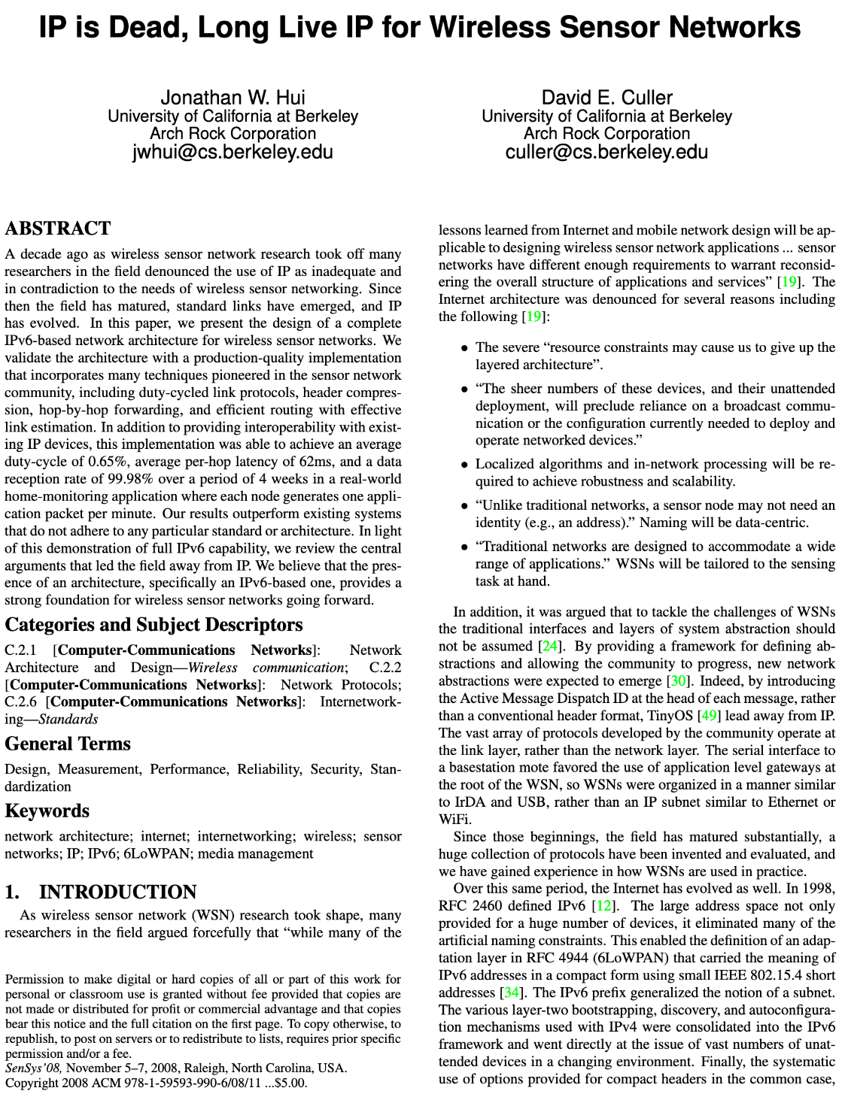
So how does the Internet of Things fit into the Internet?
“IP is the Narrow Waist of the Internet”
IP is Dead, Long Live IP for Wireless Sensor Networks
A recurring theme in this class:
How does this actually attach to the Internet
Physically [hello Hue Hub, Wyze Hub, August Hub, …]
Logically [are BLE devices really part of the IoT?]

Slide 28
Break + Thinking
What are the steps for viewing a website?

Slide 29
Break + Thinking
What are the steps for viewing a website?
You enter a domain name for the website
Computer looks up domain name to get IP Address
Computer sends request to IP_address:80
Computer gets back data, which it renders into a website

Slide 30
ALL the layers
A ‘famous’ interview question
“What happens when you type google.com into your browser’s address bar and press enter?”
https://github.com/alex/what-happens-when (11 pages!)
Keyboard events
Parsing URL
DNS lookup
Opening socket
HTTP protocol
HTML parsing
GPU rendering

Slide 31
Outline
OSI Layers
Internet Architecture (Upper Layers)
Physical Layer
Data Link Layer

Slide 32
Physical Layer
How bits are transmitted
Wireless makes this entirely different from wired cases
Important considerations
Signal strength
Modulation
Frequency

Slide 33
Why use wireless?
There are no wires!
No need to install and maintain wires
Reduces cost
Simplifies deployment – place devices wherever makes sense
Supports mobile users
Move around office, campus, city
Move devices around home

Slide 34
What is hard about wireless?
There are no wires!
Wired networks are constant, reliable, and physically isolated
Ethernet has the same throughput minute-to-minute
Bits sent through Ethernet or USB are (usually) received
Wireless networks are variable, error-prone, and shared
WiFi throughput changes based on location and walls
Signals from nearby devices interfere with your signals
Individual bits might flip or never be heard at all

Slide 35
Wireless is a shared medium
Wired communication has signals confined to a conductor
Copper or fiber
Guides energy to destination
Protects signal from interference
Wireless communication is inherently broadcast
Energy is distributed in space
Signals must compete with other signals in same frequency band

Slide 36
Increasing network capacity is challenging
Wired networks just add more wires
Buses are many signals in parallel to send more data
Wireless networks are harder
Adding more links just increases interference
Need to expand to different frequencies

Slide 37
Model of RF communication
Energy that radiates spherically from an antenna
Attenuation with distance
Density of energy reduces over time, distance
Signal strength is reduced, errors go up
Two key features
Error rates depend on distance
Spatial reuse of frequencies

Slide 38
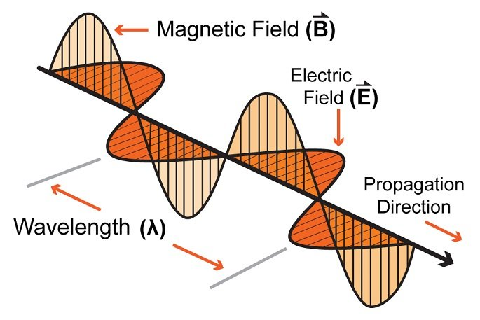
Signal qualities
Signal strength
The amount of energy transmitted/received
Signal frequency and bandwidth
Which “channel” the signal is sent on
Signal modulation
How data is encoded in the signal

Slide 39
Signal qualities
Signal strength
The amount of energy transmitted/received
Signal frequency and bandwidth
Which “channel” the signal is sent on
Signal modulation
How data is encoded in the signal

Slide 40
Signal strength is measured in decibels
Power is measured in Watts or dBw or dBm
${PowerdBw=10∗log}_{10}({PowerWatts})$
${PowerdBm=10∗log}_{10}({Powermilliwatts})$
dBm is most relevant to the IoT domain
0 dBm equals 1 mW transmit power
Example
Max BLE transmit power for nRF52840: 8 dBm (6.31 mW)
Min BLE receive sensitivity for nRF52840: -95 dBm (316.2 fW)
Rule of thumb: +3 dB is double the power

Slide 41
Signal strength varies significantly across technologies
Bluetooth Low Energy (local area)
nRF52840 transmit power: 8 dBm (6.31 mW)
nRF52840 receive sensitivity: -95 dBm (316.2 fW)
LoRa (wide area)
SX127X LoRa transmit power: 20 dBm (100 mW)
SX127X LoRa receive sensitivity: -148 dBm (1.6 attoWatt)

Slide 42
Propagation degrades RF signals
Attenuation in free space
Signals get weaker as they travel over long distances
Signal spreads out -> free space path loss
Obstacles can weaken signal through absorption or reflection
Important: distance is NOT the only signal strength loss
Free space path loss calculation will not give you accurate range for a signal

Slide 43
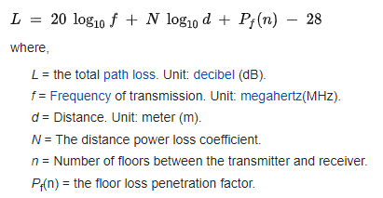
ITU model for Indoor Attenuation
Models like this are less bad than Free-Space Path Loss
https://en.wikipedia.org/wiki/ITU_model_for_indoor_attenuation

Slide 44
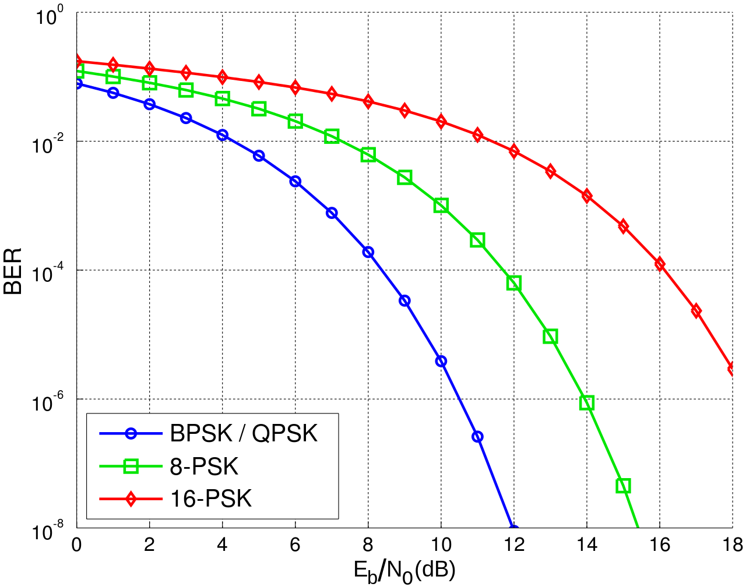
Lower received energy increases error rates
BER: Bit Error Rate
Odds that a transmitted bit will be received incorrectly
More Errors
Less Errors
Less Energy Received
More Energy Received

Slide 45
Signal qualities
Signal strength
The amount of energy transmitted/received
Signal frequency and bandwidth
Which “channel” the signal is sent on
Signal modulation
How data is encoded in the signal

Slide 46
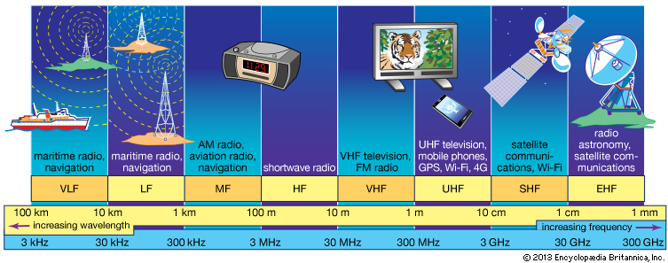
RF communication frequencies
IoT focus

Slide 47
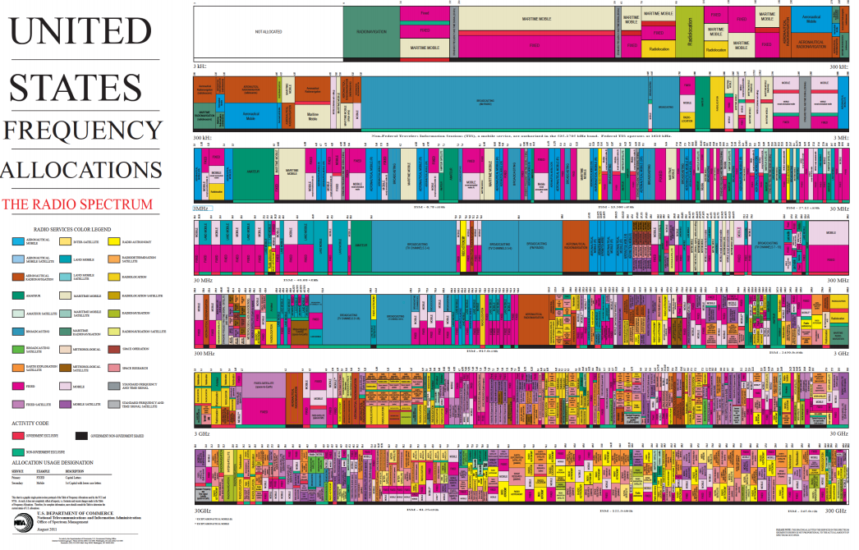
Wireless spectrum is allocated to specific uses

Slide 48
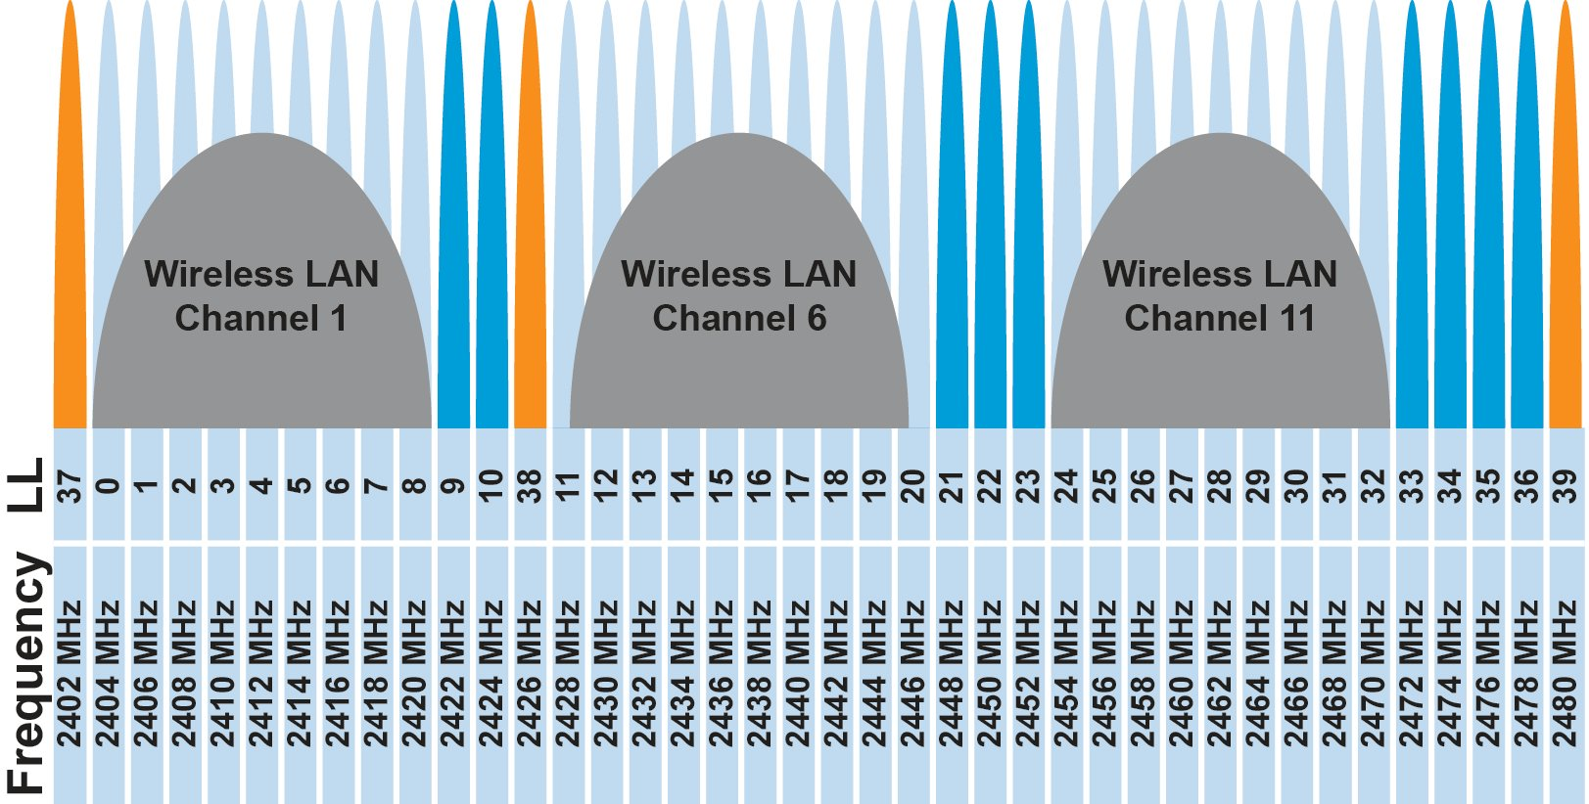
Unlicensed bands are where IoT thrives
902 MHz – 928 MHz
LPWANs
2.4 GHz to 2.5 GHz
WiFi, BLE, Thread
5 GHz
Faster WiFi
Cellular uses licensed bands at great cost
Why?

Slide 49
Unlicensed bands are where IoT thrives
902 MHz – 928 MHz
LPWANs
2.4 GHz to 2.5 GHz
WiFi, BLE, Thread
5 GHz
Faster WiFi
Cellular uses licensed bands at great cost
Why? No interference from other users

Slide 50
Frequency Hopping Spread Spectrum
Transmitter hops through a sequence of transmit channels
Spend some “dwell time” on each channel before hopping again
Receiver must know the hopping pattern
Avoid causing or receiving prolonged interference

Slide 51
Sidebar: inventor of FHSS – Hedy Lamarr
Actress and Inventor
Designed FHSS with George Antheil during WWII
Idea: torpedo control can’t be easily jammed if it jumps around
https://en.wikipedia.org/wiki/Hedy_Lamarr#Inventor

Slide 52
Signal qualities
Signal strength
The amount of energy transmitted/received
Signal frequency and bandwidth
Which “channel” the signal is sent on
Signal modulation
How data is encoded in the signal

Slide 53
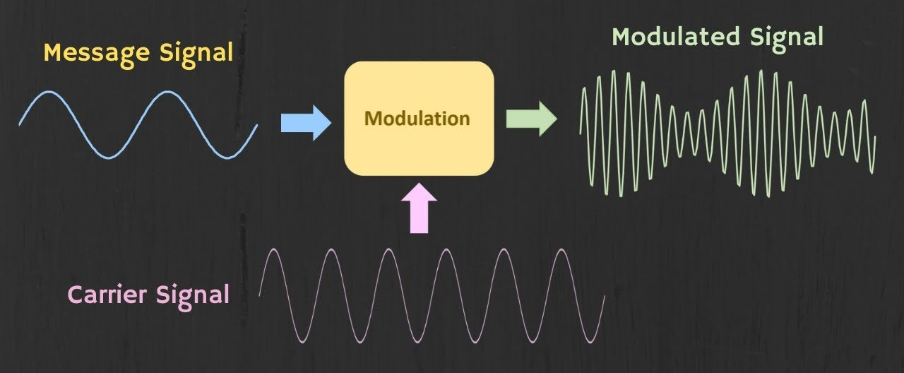
Modulation
Encoding signal data in an analog “carrier” signal
Carrier signal defines the frequency
Modulation scheme + data define bandwidth required

Slide 54
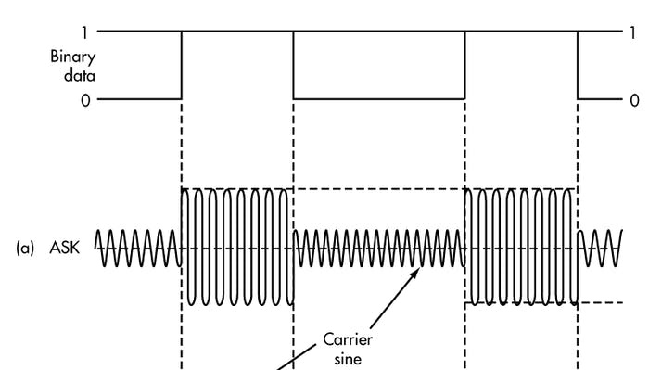
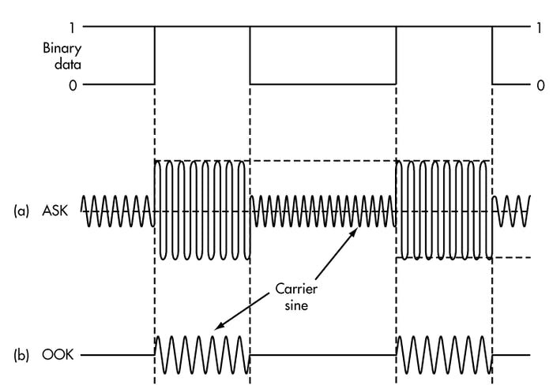
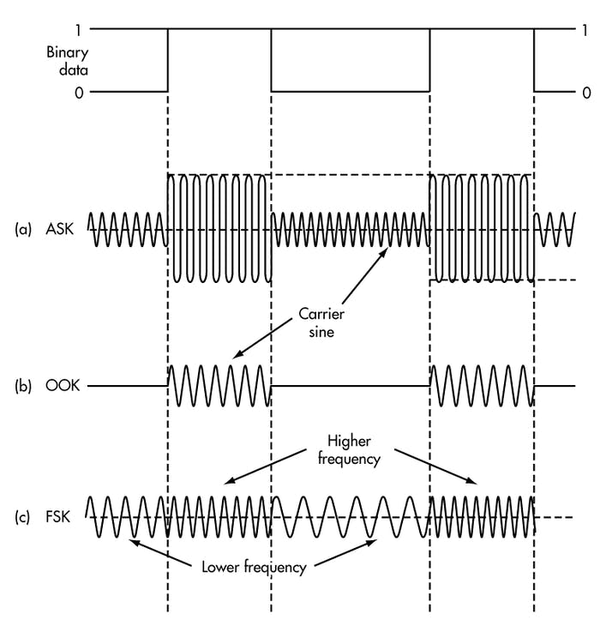
Modulation types
Encoding binary data on a signal
Amplitude-shift Keying (ASK)
Modify amplitude of carrier signal
On-Off Keying (OOK) is an extreme example
Frequency-shift Keying (FSK)
Modify frequency of carrier signal

Slide 55
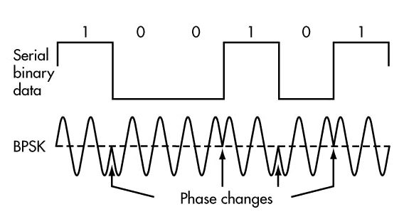
Modulation types
Phase-shift keying (PSK)
Modify phase of carrier signal
Usually differential: the change signifies data
More complicated possibilities exist
QAM (Quadrature Amplitude Modulation) combines amplitude and phase shift keying
Allows for more than one bit per “symbol”

Slide 56
Modulation tradeoffs
Various tradeoffs between different modulation schemes
Bandwidth requirements, transceiver hardware, immunity to noise, etc.
ASK (amplitude) is simple but susceptible to noise
Noise exists in the real world
FSK (frequency) is relatively simple and robust to noise, but uses more bandwidth
Bandwidth is limited, but still commonly used
PSK (phase) energy efficient and robust, but more complex hardware
More expensive hardware, but very commonly used

Slide 57
Break + Say hi to your neighbors
Things to share
Name
Major
One of the following
Favorite Candy
Favorite Pokemon
Favorite Emoji

Slide 58
Break + Say hi to your neighbors
Things to share
Name -Branden
Major -EE, CE, and CS
One of the following
Favorite Candy - Twix
Favorite Pokemon - Eevee
Favorite Emoji - 🍢

Slide 59
Outline
OSI Layers
Internet Architecture (Upper Layers)
Physical Layer
Data Link Layer

Slide 60
Data Link Layer
Framing
Combine arbitrary bits into a “packet” of data
Logical link control
Manage transfer between transmitter and receiver
Error detection and correction
Media access
Controlling which device gets to transmit next
Inherently coupled to PHY and its decisions

Slide 61
Framing
Typical packet structure
Preamble - Existence of packet and synchronization of clocks
Header - Addresses, Type, Length
Data - Payload plus higher layer headers (e.g. IP packet)
Trailer - Padding, CRC
Wireless considerations
Control information for Physical Layer
Ensure robustness for header
Explicit multi-hop routing
Possibly different data rates for different parts of packet
Preamble | Destination Address | Source Address | Type and Length | Data | CRC

Slide 62
Error control: detection and recovery
Detection: only detect errors
Make sure corrupted packets get discarded
Cyclical Redundancy Checks
Detect single bit errors
Detect “burst” errors of several contiguous bits
Recovery: also try to recover from small bit errors
Forward error correction
Retransmissions
Far more important for wireless because the cost of transmission is higher

Slide 63
Medium Access Control
How does a network determine which transmitter gets to transmit?
Remember: the wireless medium is inherently broadcast
Two simultaneous transmitters may lose both packets

Slide 64
Analogy: wireless medium as acoustic
How do we determine who gets to speak?
Two simultaneous speakers also lose both “transmissions”

Slide 65
Analogy: wireless medium as acoustic
How do we determine who gets to speak?
Two simultaneous speakers also lose both “transmissions”
Eye contact (or raise hand) -> out-of-band communication
Wait until it’s quiet for some time -> carrier sense multiple access
Strict turn order -> time division multiple access
Just speak and hope it works -> ALOHA
Everybody sing at different tones -> frequency division multiple access (stretching the metaphor)
Others?

Slide 66
MAC protocol categorization
Medium Access Control Protocols
Contention-Based Protocols
Contention-Free Protocols
ALOHA
CSMA
FDMA
TDMA
Also, CDMA

Slide 67
ALOHA
ALOHAnet (1971)
University of Hawaii – Norman Abramson
First demonstration of wireless packet network
Rules
If you have data to send, send it
Two (or more) simultaneous transmissions will collide and be lost
Wait a duration of time for an acknowledgement
If transmission was lost, try sending again “later”
Want some kind of exponential backoff scheme here

Slide 68
Packet collisions
Each packet transmission has a window of vulnerability
Twice the on-air duration of a packet
Transmissions during the packet are bad
Transmissions before packet can also be bad
My transmission
Other transmission
My transmission
Other transmission

Slide 69
Slotted ALOHA
Split time into synchronized “slots”
Any device can transmit whenever it has data
But it must transmit at the start of a slot
And its transmission cannot be longer than a slot
Removes half of the possibilities for collisions!
At the cost of some synchronization method
My transmission
My transmission
Other transmission
Other transmission
time

Slide 70
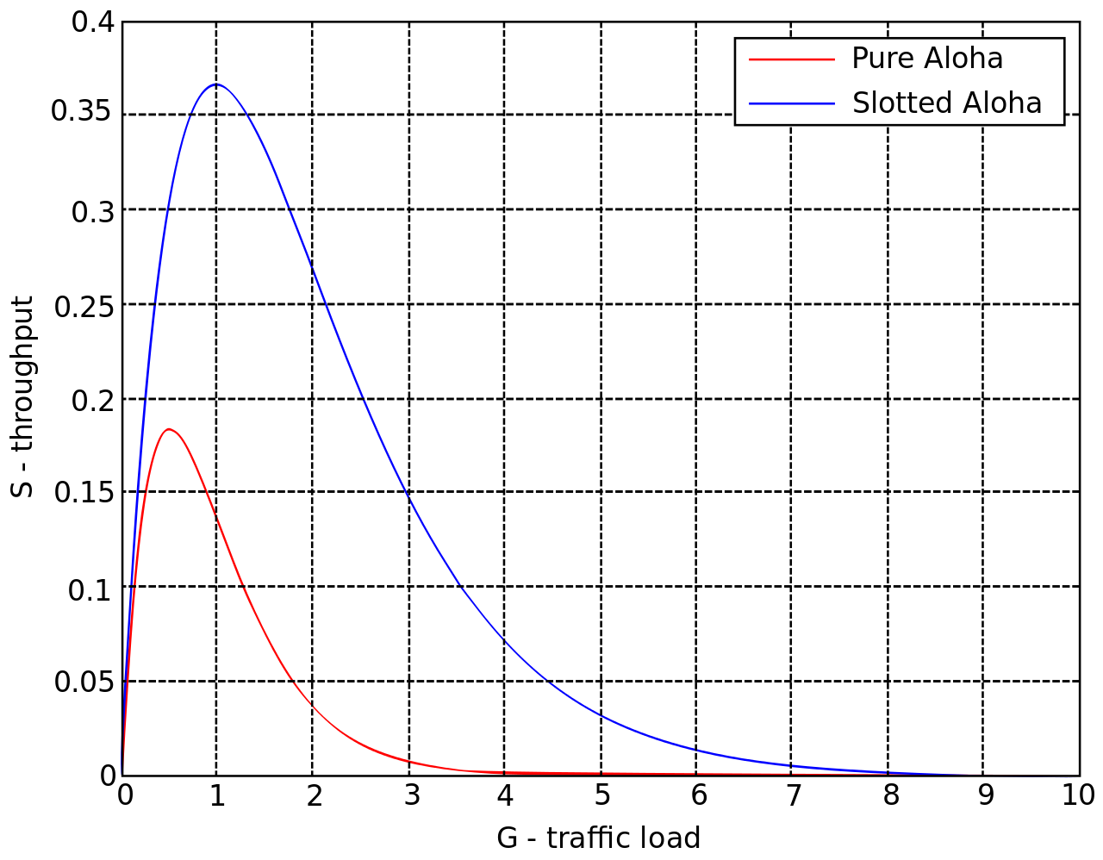
ALOHA throughput
It can be shown that traffic maxes out at
ALOHA: 18.4%
Slotted ALOHA: 36.8%
Assuming Poisson distribution of transmission attempts
Slotted throughput is double because the “before” collisions can no longer occur

Slide 71
Capture effect
Actually, two packets at once isn’t always a total loss
The louder packet can still sometimes be heard if loud enough
How much louder?
Ballpark 12-14 dB
When does this work?
Depends on the radio hardware
Louder packet first almost always works
Louder packet second sometimes works

Slide 72
MAC protocol categorization
Medium Access Control Protocols
Contention-Based Protocols
Contention-Free Protocols
ALOHA
CSMA
FDMA
TDMA
Also, CDMA

Slide 73
CSMA/CA – Carrier Sense Multiple Access with Collision Avoidance
First listen for a duration and determine if anyone is transmitting
If idle, you can transmit
If busy, wait and try again later
“listen before send”
Can be combined with notion of slotting
If current slot is idle, transmit in next slot
If current slot is busy, follow some algorithm to try again later

Slide 74
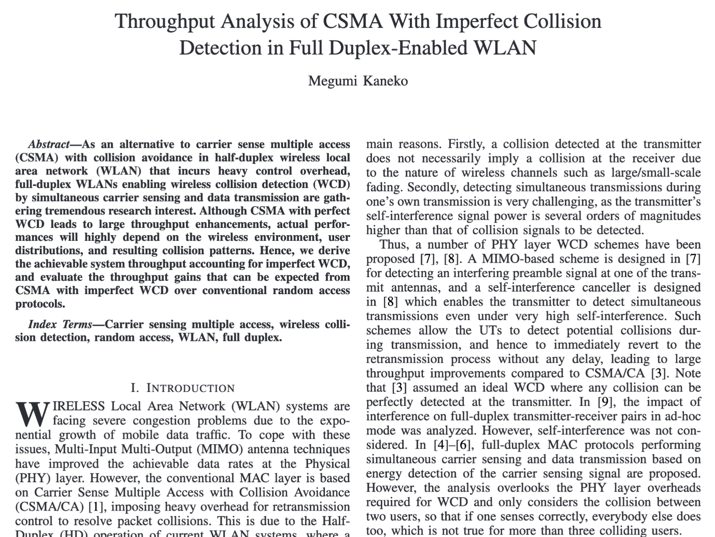
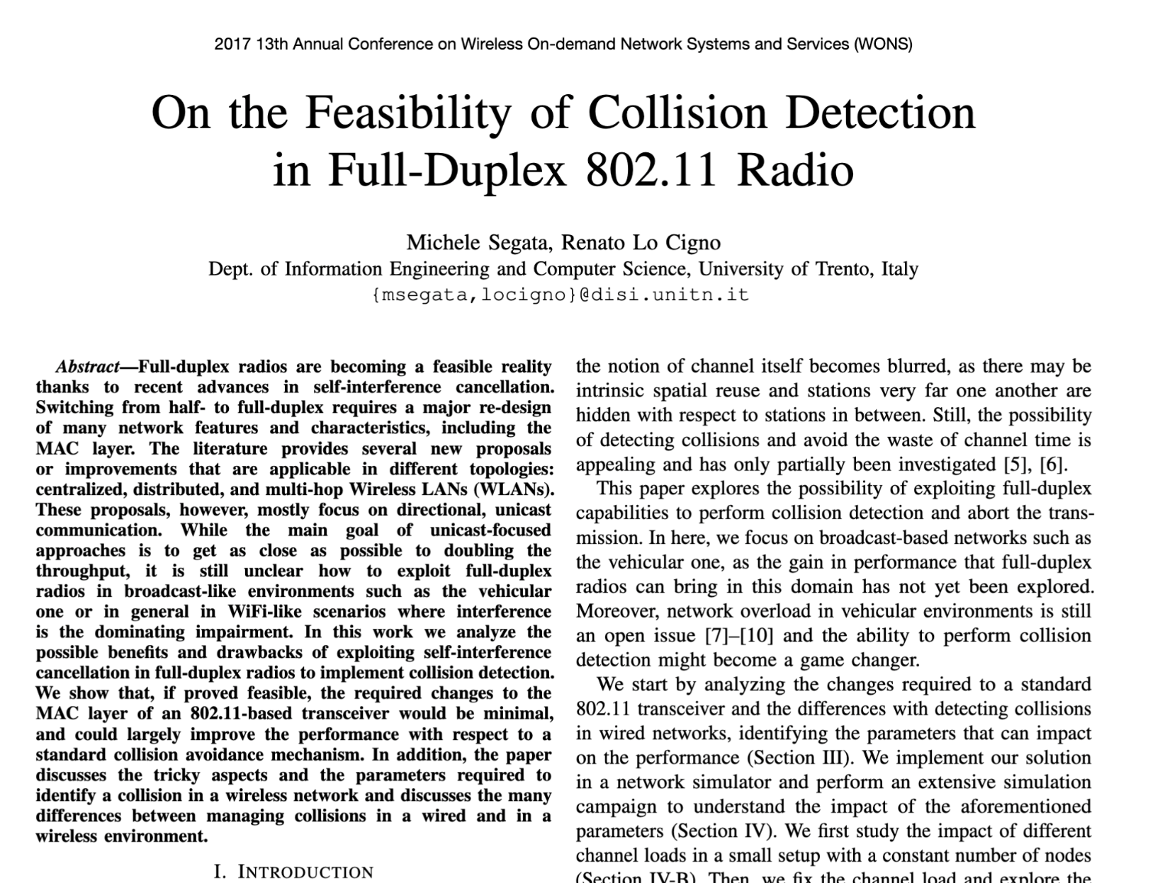
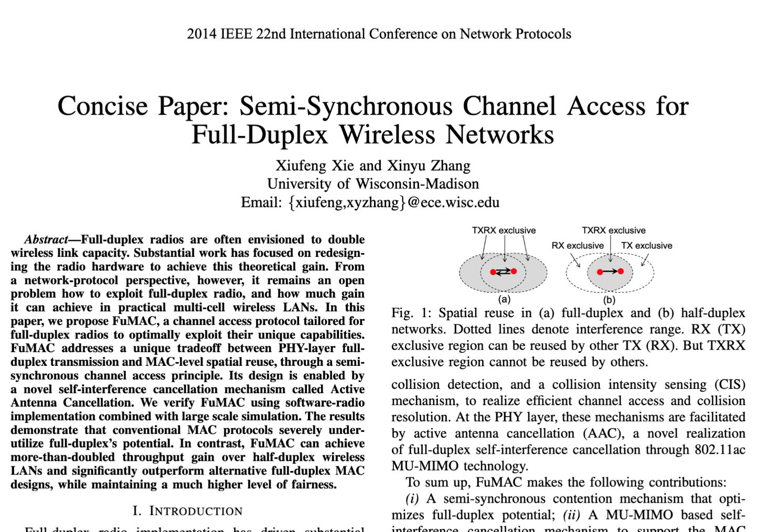
CSMA/CD – CSMA with Collision Detection
Detect collisions during your own transmission
Works great on wired mediums (Ethernet, I2C)
Very challenging for wireless systems
Transmit and receive are usually the same antenna
Receiving while transmitting would be drowned out by transmission
Remember: TX at 8 dBm and RX at -95 dBm
Area of active research!

Slide 75
Hidden terminal problem
Device C
Device A
Device B

Slide 76
CSMA with RTS/CTS
Hidden terminal problem means that two transmitters might never be able to detect each other’s transmissions
A partial solution
When channel is idle, transmitter sends a short Request To Send (RTS)
Receiver will send a Clear To Send (CTS) to only one node at a time
RTS collisions are faster and less wasteful than hidden terminal collisions
Downside: overhead is high for waiting for CTS when contention is low

Slide 77
MAC protocol categorization
Medium Access Control Protocols
Contention-Based Protocols
Contention-Free Protocols
ALOHA
CSMA
FDMA
TDMA
Also, CDMA

Slide 78
Contention-free access control protocols
Goal: split up communication such that devices will not conflict
Can be predetermined or reservation-based
Devices might request to join the schedule and be given a slot
Devices lose their slot if it goes unused for some amount of time
Reservations often occur during a dedicated CSMA contention slot
Assignment of schedules can be complicated
Really efficient at creating a high-throughput network
Assuming they are all following the same protocol
Otherwise, interference can be very problematic

Slide 79
FDMA – Frequency Division Multiple Access
Split transmissions in frequency
Different carrier frequencies are independent
Fundamentally how RF spectrum is split
Technically, each device uses a separate, fixed frequency
Walkie-talkies
Conceptually, how RF channels work
WiFi networks pick different bands
802.15.4 picks a channel to communicate on

Slide 80
TDMA – Time Division Multiple Access
Split transmissions in time
Devices share the same channel
Splits time into fixed-length windows
Each device is assigned one or more windows
Can build a priority system here with uneven split among devices
Requires synchronization between devices
Often devices must listen periodically to resynchronize
Less efficient use of slots reduce synchronization
Large guard windows. E.g. 1.5 second slot for a 1 second transmission

Slide 81
Real-world protocol access control
ALOHA
BLE advertisements
Unlicensed LPWANs: Sigfox, LoRaWAN
CSMA
WiFi (slotted, CSMA/CA)
TDMA
BLE connections
Cellular LPWANs: LTE-M and NB-IoT

Slide 82
Outline
OSI Layers
Internet Architecture (Upper Layers)
Physical Layer
Data Link Layer

