Slide 1
Lecture 01
Introduction
CS397/497 – Wireless Protocols for IoT
Branden Ghena – Spring 2022
Materials in collaboration with Pat Pannuto (UCSD)

Slide 2
COVID Update - Spring 2022 Edition
Masks in class are no longer mandatory
  You’re still welcome to wear one if you want, but I won’t make you
  I’ll still be wearing one
If you are sick, do not come to class
  We will be flexible with deadlines as necessary
  Lectures are being recorded automatically

Slide 3
Welcome to CS397/497!
~37 students (25 undergrad, 12 grad)
  Lots of different backgrounds and interests
This is going to be like a graduate course
  No exams!
  Occasional paper reading
  Majority of your grade is the final project
This course is based on discussion and questions
  Expect to attend classes, ask questions, and interact with others
  You’re hopefully here because you want to be and want to learn

Slide 4
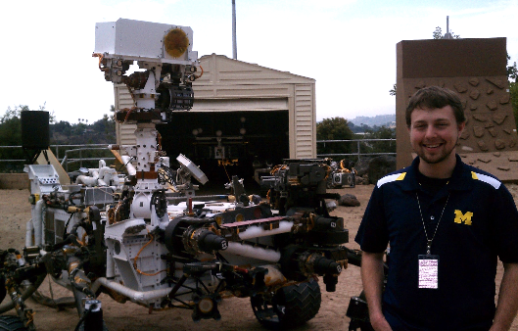
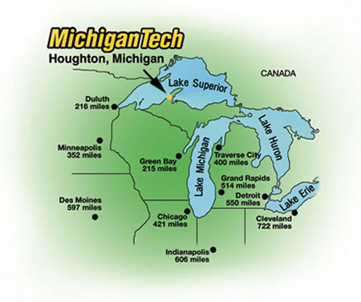
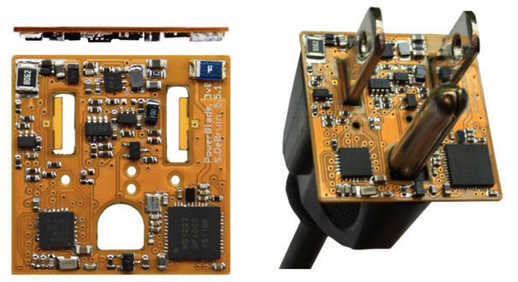
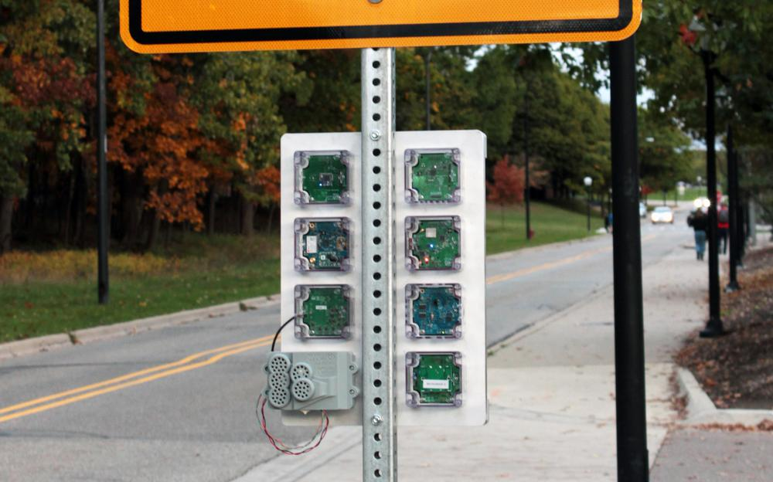



Branden Ghena (he/him)
Assistant Faculty of Instruction
Education
  Undergrad: Michigan Tech
  Master’s: University of Michigan
  PhD: University of California, Berkeley
Research
  Resource-constrained sensing systems
  Low-energy wireless networks
  Embedded operating systems
Teaching
  Computer Systems
    CS211: Fundamentals of Programming II
    CS213: Intro to Computer Systems
    CS343: Operating Systems
    CE346: Microprocessor System Design
    CS397: Wireless Protocols for the IoT
Things I love

Slide 5
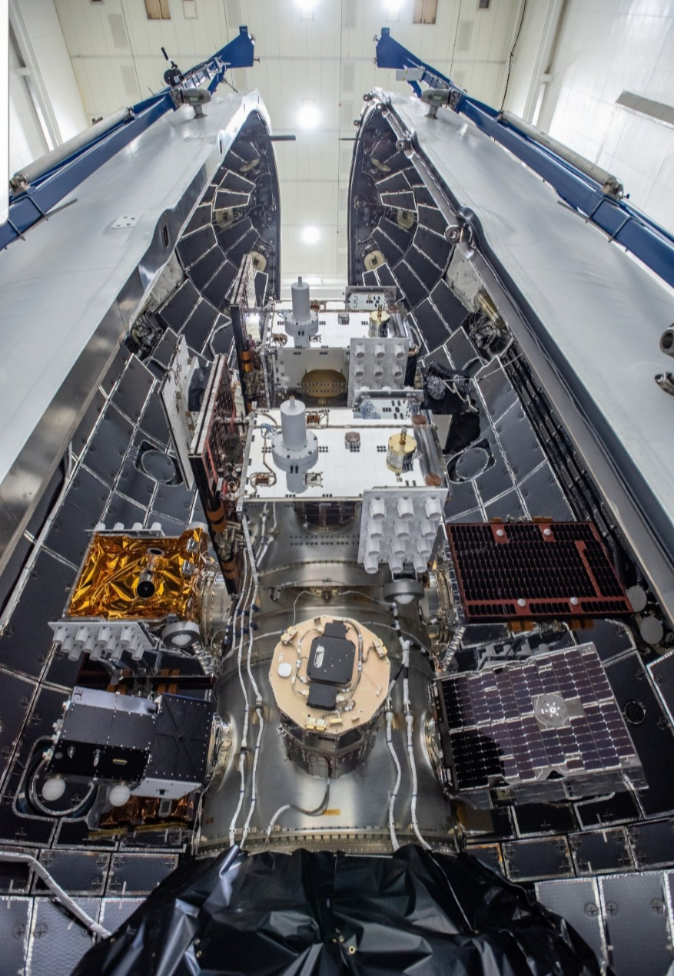
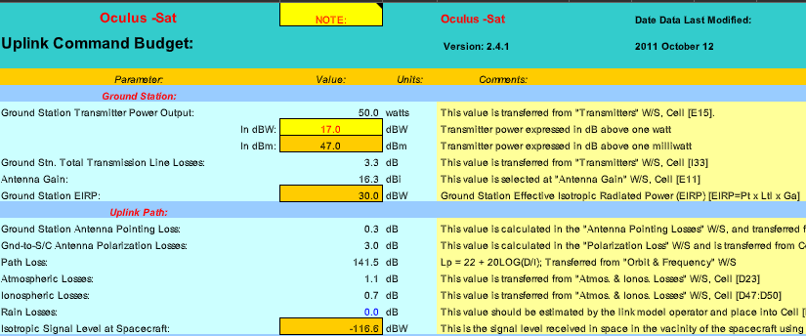
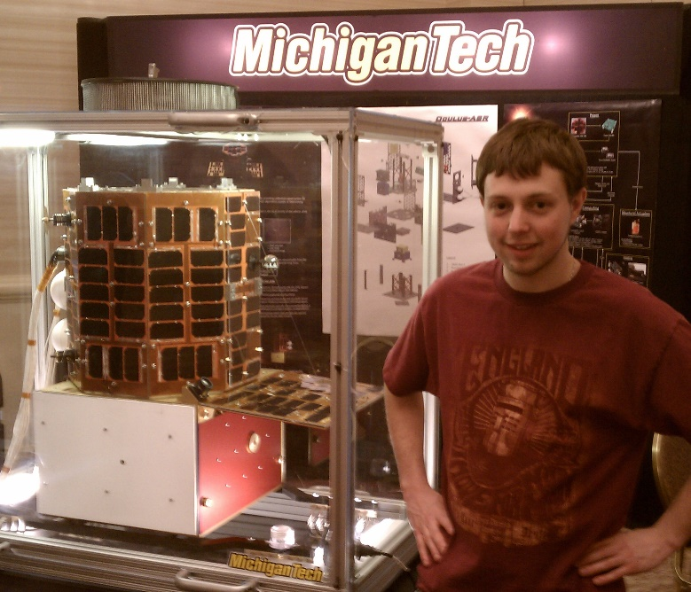
Undergraduate: satellite radios and computers
How the heck are you supposed to learn this stuff?

Slide 6

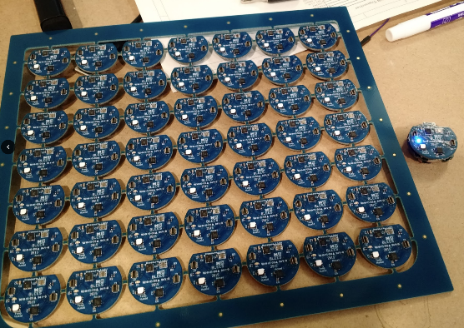
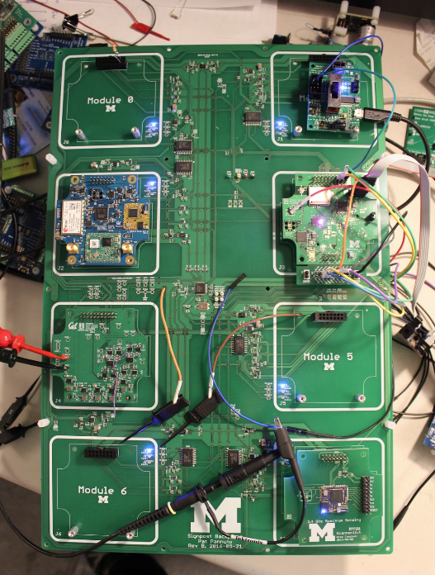
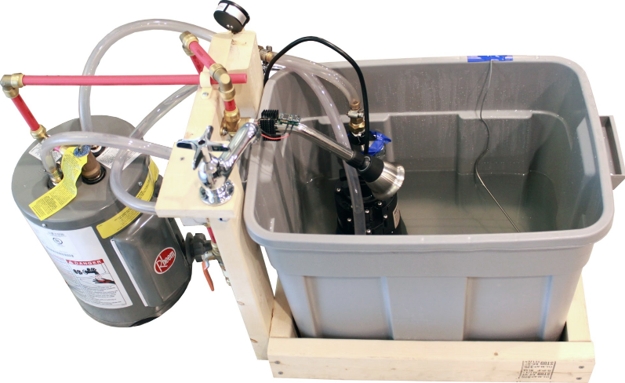
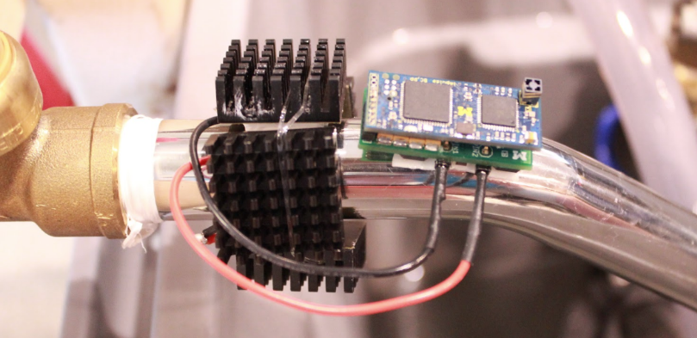
Grad school: resource-constrained embedded systems
Most interesting to me: the interfaces
  Hardware and software
  Applications and OS
  Communication
Again: learn by doing
  With significant assistance from my peers

Slide 7
Faculty: now I can choose what to teach!
Goal: provide classes that teach more advanced embedded systems topics
  Hopefully, generally useful to other nearby domains of CS and ECE too!
Result: this course!
  Course goals: make students familiar with a number of different wireless protocols and their tradeoffs
    Practical hands-on experience with some networks
    Open-ended project where students can choose their specific focus

Slide 8
Today’s Goals
Overview of the course
Introduction to the Internet of Things
Introduction to wireless communication

Slide 9
Outline
Who and Why
Internet of Things
Course Overview
Overview of wireless networks

Slide 10
Perspective of this course
This class is about wireless protocols
  For a specific domain: the Internet of Things
So we’ll spend some amount of time discussing the Internet of Things and embedded systems

Slide 11
Discussion: what is the Internet of Things?
Name a few Internet of Things devices
What are the qualities that designate those devices at “IoT”?

Slide 12
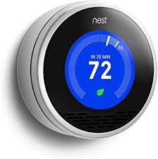
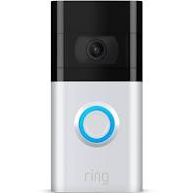


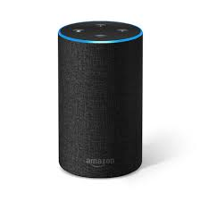
Discussion: what is the Internet of Things?
Name a few Internet of Things devices
What are the qualities that designate those devices at “IoT”?

Slide 13
Thought experiment on capabilities
What if the Nest thermostat was powered by an entire desktop?
  8-core x86-64 processor, 32 GB RAM, 1 TB SSD
Would that still count as IoT?
Why don’t we see that in practice?

Slide 14
Thought experiment on capabilities
What if the Nest thermostat was powered by an entire desktop?
  8-core x86-64 processor, 32 GB RAM, 1 TB SSD
Would that still count as IoT?
Why don’t we see that in practice?
Cost

Slide 15
Thought experiment on energy
IoT devices include a mix of batteries, wall power, (and energy-harvesting)
Why do we put so much focus on systems with batteries?
  Why do they need batteries?

Slide 16
Thought experiment on energy
IoT devices include a mix of batteries, wall power, (and energy-harvesting)
Why do we put so much focus on systems with batteries?
  Why do they need batteries?
Deployability

Slide 17
Largest IoT challenges: power and communication
This class is about wireless technologies
  For resource-constrained systems, such as the IoT
We will focus on the tradeoffs between technologies
  How they balance differing constraints
    Power, spectrum, complexity, etc.
  And the technical foundations of these designs and differences

Slide 18
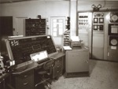
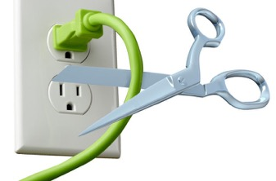
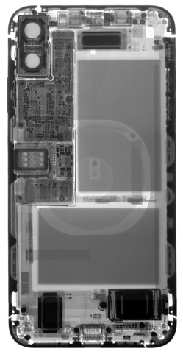
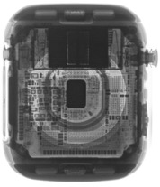
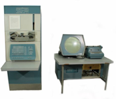


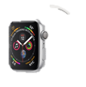

Energy is the defining constraint of emerging technologies
Mainframe
Computer
Workstation
By volume, the emerging computing classes are mostly energy storage
Volume is shrinking cubically
Laptop
Mini Computer
Battery
IoT/Wearable
Personal Computer
Smartphone
Notes:
Defining feature of modern computing classes is the amount of energy storage required to allow their operation
Clip art: http://www.ctecsolar.com/cut-cord-electric-company/
X-rays: iFixit teardowns

Slide 19
Branden’s take on the Internet of Things
Key features
  Computation
    Local to the device
    With some capability for arbitrary compute and storage
  Connectivity
    Almost certainly wireless
    Likely Internet, possibly local
  Interaction
    Sensing or Actuation
Secondary features
  Low energy
  (Relatively) Low cost

Slide 20
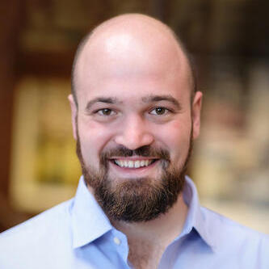
Pat Pannuto’s take on the Internet of Things
His early grad school essays described the “last inch” problem
  Now he often says “expanding the reach of digital world”
For him, it is about ‘networked’ ‘things’
  Which implicitly adds some computational capacity
    [Though not always? Backscatter sensors break this definition…]
Assistant Professor, UC San Diego
https://patpannuto.com/

Slide 21
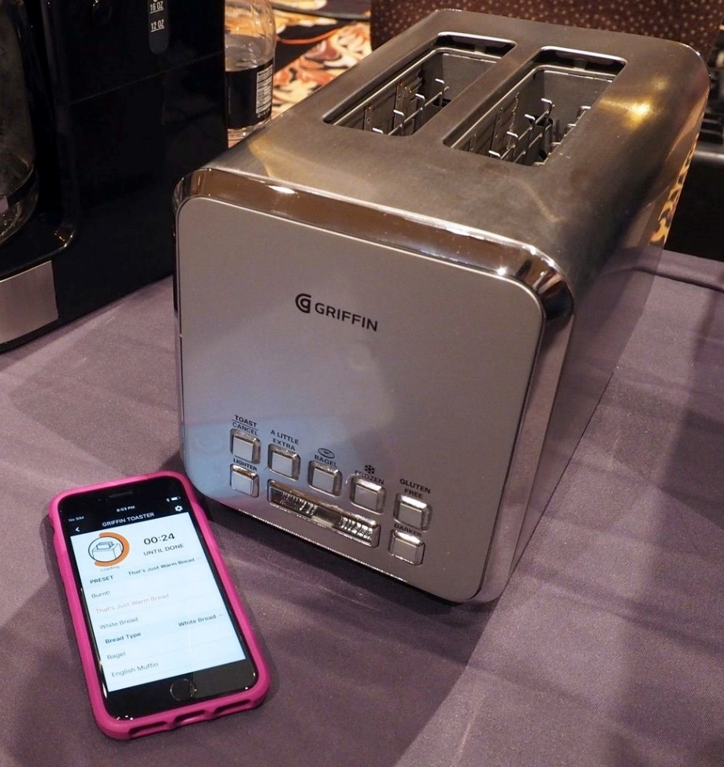

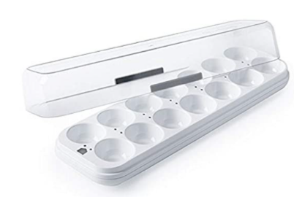
Warning: Internet of Crap

Slide 22
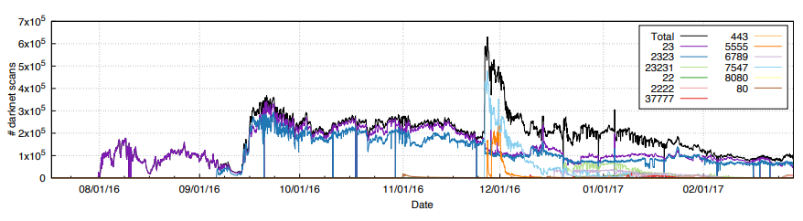
Internet of Insecure Crap
Mirai botnet (2016)
Takes control of up to 600,000 insecure connected devices
  IP-attached cameras, DVRs, routers, printers
Used to DoS websites

Slide 23
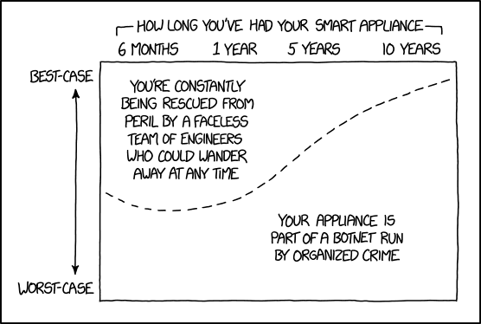
Break + xkcd
https://xkcd.com/1966/

Slide 24
Outline
Who and Why
Internet of Things
Course Overview
Overview of wireless networks

Slide 25
Asking questions
Class and office hours are always an option!
  Office hours by demand. I promise to meet!!
Campuswire: (similar to piazza)
  Post questions
  Answer each other’s questions
  Find lab partners
  Information from the course staff
  Post private info just to course staff
Please do not email me! Post to Campuswire instead!
  I’ll be updating roster again a few times

Slide 26
Grading
Seriously, no exams or homework or participation points
  The point of in-class material is to teach you and prepare you for projects
  Come because you want to learn it
35% Lab projects
  Likely 7 of these, divided equally
65% Final project
  10% Proposal
  05% Update Meeting
  10% Presentation
  10% Paper
  30% Project Quality

Slide 27
Grading
Seriously, no exams or homework or participation points
  The point of in-class material is to teach you and prepare you for projects
  Come because you want to learn it
35% Lab projects
  Likely 7 of these, divided equally
65% Final project
  10% Proposal
  05% Update Meeting
  10% Presentation
  10% Paper
  30% Project Quality

Slide 28
Labs
Practice interacting with and considering networks
Sometimes getting real hardware working
  BLE Scanning/Advertising, BLE Connections, OpenThread Lab
Sometimes analysis and designing
  Wireshark, WiFi Analysis, Cellular Cost, Sensor Network Design
Might be able to start these in-class, but likely will be done outside of class
  Can definitely be done in small groups (up to three students)
  Some will require it (due to hardware availability)

Slide 29
Lab grading
Around one page submission on canvas
  “Prove to me that you did this lab”
  Point me at public Github code. Include pictures of debug output/network visualization. Discuss what did/didn’t work.
  Possibly answer some questions and write up thoughts.
  NOT a formal lab writeup
Playing this pretty loose since it’s a small, experimental class
  There’s always a chance something in labs won’t work

Slide 30
Grading
Seriously, no exams or homework or participation points
  The point of in-class material is to teach you and prepare you for projects
  Come because you want to learn it
35% Lab projects
  Likely 7 of these, divided equally
65% Final project
  10% Proposal
  05% Update Meeting
  10% Presentation
  10% Paper
  30% Project Quality

Slide 31
Project
Classic grad school “do a project”
Come up with something you’re interested in exploring that is linked to the topics of class
  Definitely acceptable to overlap with research or other classes
  Work in small groups of 2-4 students
This is your chance to decide what you’re actually interested in and to guide your own learning
  Expectation is that you’ll do a serious deep dive into it

Slide 32
Project proposals
Proposals due Friday, April 22nd
  Three weeks from tomorrow
  Want to provide plenty of time to work on the project
  And also to order hardware if necessary
Start thinking about project ideas and finding partners now
  Preferably two-four people. One or Five+ would need justification.
I am very happy to talk about ideas during office hours
  Goal is that we’ll have talked about it at some point before you submit the proposal

Slide 33
Project ideas
Analyze and optimize a deployed network
  Measure throughput, packet loss, or latency, etc.
  Determine how to improve network for an application use case
Implement and evaluate a modified network protocol
  Change something about the specification of an existing protocol
  Measure the effect that it has on a deployment
Implement software library for a protocol
  Especially for anyone that took CE346
  Implement BLE Advertisements or 802.15.4 on top of Microbit

Slide 34
Project ideas
Simulate a wireless network
  Accurately predict throughput, energy, latency, etc.
  Could be done in any language or platform (e.g. NS-3)
Visualize network performance
  Provide tools for understanding and debugging performance
  Real-time or historical snapshot
Many other possibilities. Don’t feel limited by these!

Slide 35
Hardware for projects
Talk to me about your needs, and I might have ideas or things to lend out that will help
  I’ve got lots of random stuff on hand, as does Josiah Hester
We have some budget for ordering project hardware
  Talk to me about what your project needs would be
  Make sure that hardware is actually purchasable

Slide 36
Project presentations and report
Presentations will be the last week of classes
  During lecture Tuesday and Thursday
  (may revise this based on the number of groups)
Reports will be due during exam week
  Up to 6 page “workshop paper” writeup

Slide 37

Break+Video
Wireless Network Visualization (Dr. Meghan Clark – UC Berkeley)
https://www.youtube.com/watch?v=KLOdp54_qJ4

Slide 38
Outline
Who and Why
Internet of Things
Course Overview
Overview of wireless networks

Slide 39
Bluetooth Low Energy
Bluetooth Classic was good for enabling device to device communication
  But not particularly fast or low energy
Bluetooth Low Energy was developed to improve this
  Focuses on low-energy interactions
  Much lower throughput that Bluetooth
Supported by hardware devices already in smartphones
  Humans can interact directly with nearby devices!!

Slide 40
802.15.4 & Thread
802.15.4 is a low-energy physical layer
  Radio chips have been widely available for 15-20 years
Significant amounts of sensor network research have focused on building layers on top of 802.15.4
  Access control layers
  Network layers
Thread is a selection of these possibilities to make a network
  Uses IPv6 networking!!

Slide 41
WiFi (802.11)
Ubiquitous wireless communication
  High energy requirements for high throughput communication
Now accessible through relatively low power radios
  ESP32, Electric Imp, and company
  Still significantly more effort than BLE or Thread
IoT devices can use the same WiFi that’s already available
  No need for additional infrastructure!!

Slide 42
LPWANs (Low-Power Wide-Area Networks)
How do we collect data from city-scale deployments?
  There’s an unmet need for long-range, but low-throughput networks
  Existing cellular technologies focus on human requirements
Still a brand new space (relatively)
  Unlicensed-band technologies in last 5 years: Sigfox and LoRaWAN
  Cellular technologies in last 2 years: LTE-M and NB-IoT
Focus on long-range, low-energy, low-throughput
  One gateway can cover an entire city!!

Slide 43
Extras
This space is very much still an area of active research
Backscatter
  Insanely low-energy communication
  Enables energy-harvesting indoor devices
Localization
  How do we find all this stuff?
  And how do devices determine where they are relative to each other?
Other topics are possible if desired!
  Reach out and tell me what you want to learn about

Slide 44
Why use wireless?
There are no wires!
No need to install and maintain wires
  Reduces cost
  Simplifies deployment – place devices wherever makes sense
Supports mobile users
  Move around office, campus, city
  Move devices around home

Slide 45
What is hard about wireless?
There are no wires!
Wired networks are constant, reliable, and physically isolated
  Ethernet has the same throughput minute-to-minute
  Bits sent through Ethernet or USB are (usually) received
Wireless networks are variable, error-prone, and shared
  WiFi throughput changes based on location and walls
  Signals from nearby devices interfere with your signals
  Individual bits might flip or never be heard at all

Slide 46
Wireless is a shared medium
Wired communication has signals confined to a conductor
  Copper or fiber
  Guides energy to destination
  Protects signal from interference
Wireless communication is inherently broadcast
  Energy is distributed in space
  Signals must compete with other signals in same frequency band

Slide 47
Increasing network capacity is challenging
Wired networks just add more wires
  Buses are many signals in parallel to send more data
Wireless networks are harder
  Adding more links just increases interference
  Need to expand to different frequencies

Slide 48
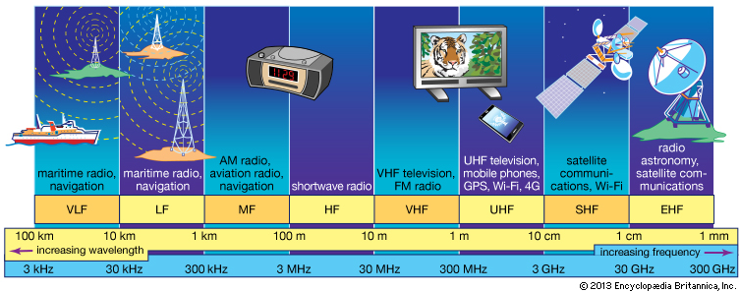
RF communication
IoT focus

Slide 49
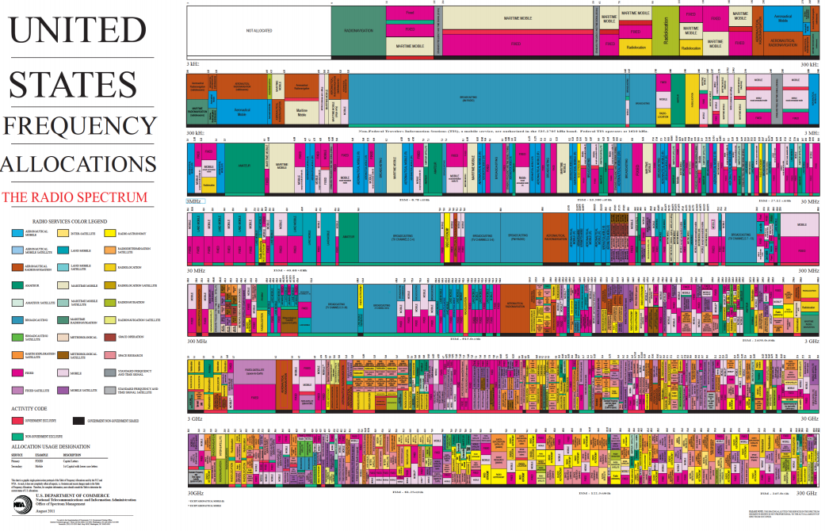
Wireless spectrum is allocated to specific uses

Slide 50
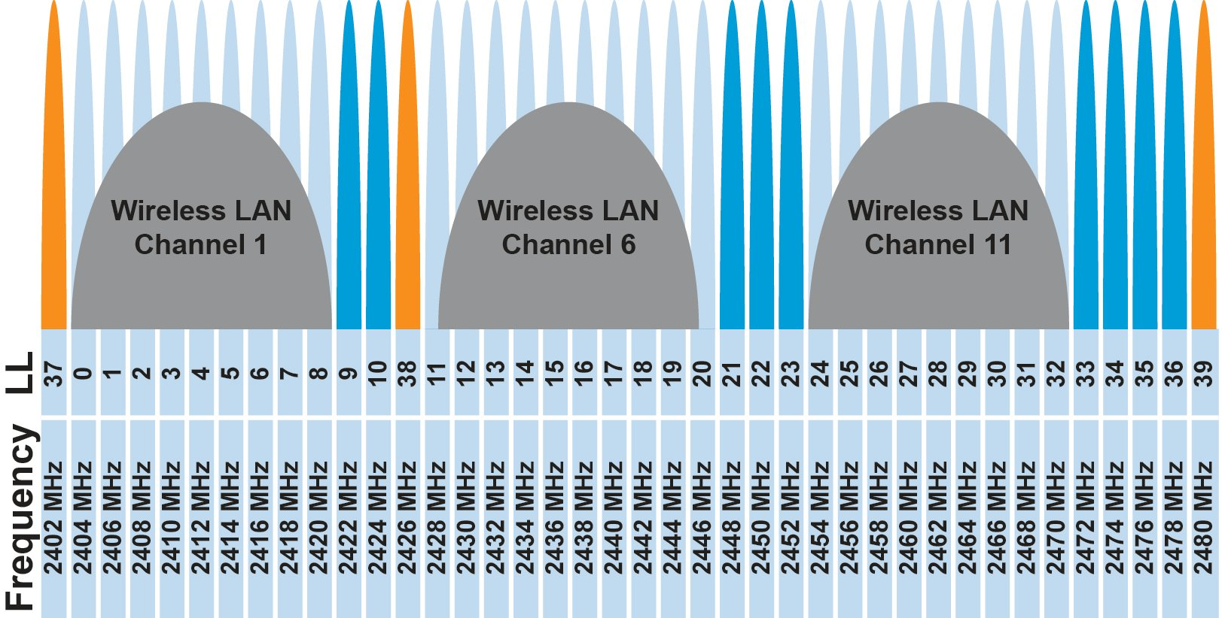
Unlicensed bands are where IoT thrives
902 MHz – 928 MHz
  LPWANs
2.4 GHz to 2.5 GHz
  WiFi, BLE, Thread
5 GHz
  Faster WiFi
Cellular uses licensed bands

Slide 51
Model of RF communication
Energy that radiates spherically from an antenna
Attenuation with distance
  Density of energy reduces over time, distance
  Signal strength reduced, errors go up
Two key features
  Error rates depend on distance
  Spatial reuse of frequencies

Slide 52
Outline
Who and Why
Internet of Things
Course Overview
Overview of wireless networks

