Slide 1
Lecture 13 Introduction to LPWANs
CS397/497 – Wireless Protocols for IoT
Branden Ghena – Winter 2021

Slide 2
Today’s Goals
Introduction to the Wide-area communication space
Apply knowledge from the course to understand LPWAN design
Overview of unlicensed-band LPWANs
LoRaWAN

Slide 3
Resources
Sigfox
Sigfox Technical Overview
IETF Descriptions
https://www.ietf.org/proceedings/97/slides/slides-97-lpwan-25-sigfox-system-description-00.pdf
https://tools.ietf.org/html/draft-zuniga-lpwan-sigfox-system-description-04
LoRaWAN
LoRaWAN Specification version 1.1
LoRaWAN Regional Parameters version 1.0.2

Slide 4
Outline
Wide-Area Network Background
Design an LPWAN
Unlicensed LPWANs
LoRaWAN

Slide 5
Wide area networks
Communication at the region/city scale rather than the building/residence scale
Throughout cities
Agricultural deployments
Industrial facilities
City-scale sensing is one very popular domain
What might we want to sense throughout a city?

Slide 6
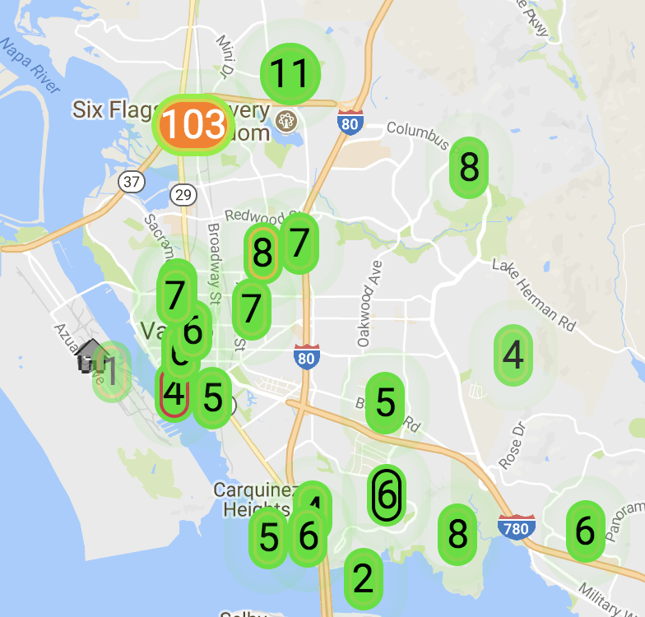
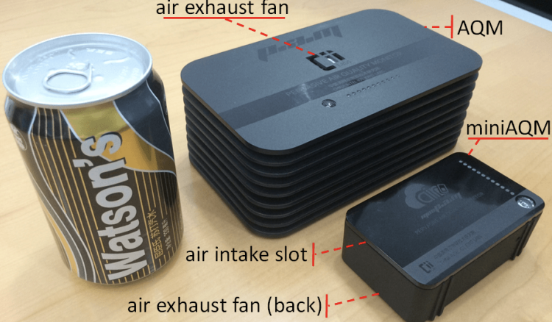
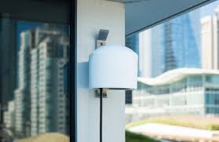
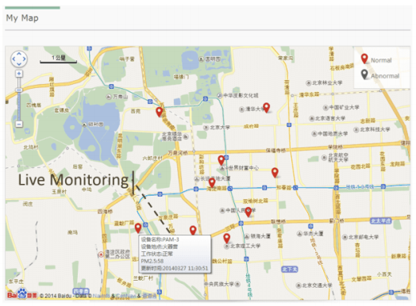
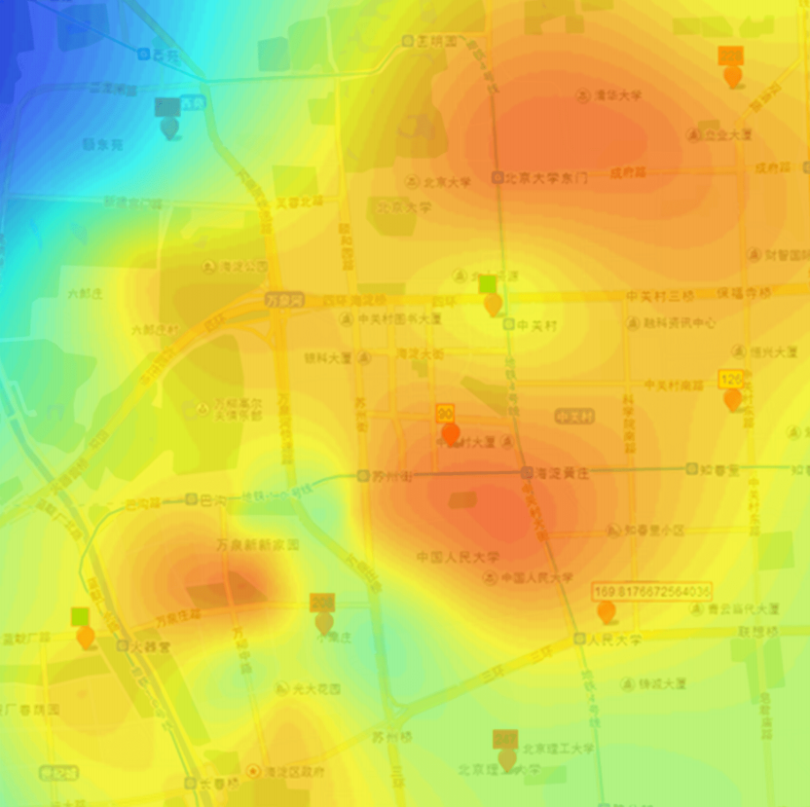
Air quality monitoring
[2]
[2]
[1]
[1]
[1] Cheng et al. AirCloud: a cloud-based air-quality monitoring system for everyone. 2014. [2] Purple Air. 2018.

Slide 7
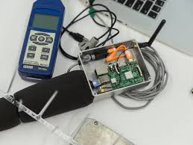
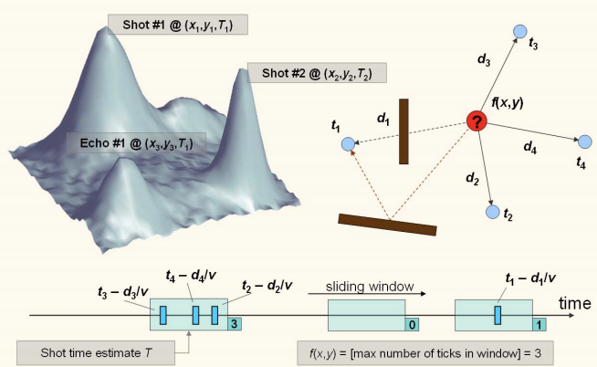
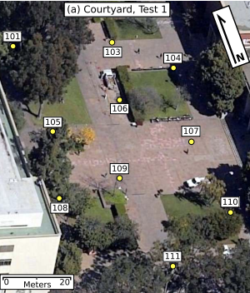
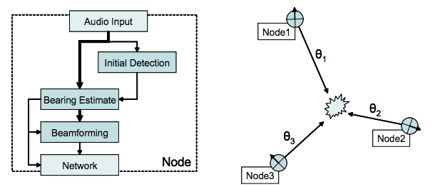
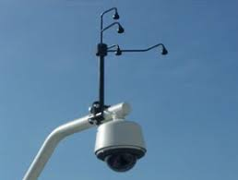
Audio detection, classification, and localization
[3]
[2]
[1]
[1]
[1] Girod et al. The Design and Implementation of a Self-Calibrating Distributed Acoustic Sensing Platform. 2006. [2] Lédeczi et al. Multiple Simultaneous Acoustic Source Localization in Urban Terrain. 2005. [3] Sounds of New York City. 2016.

Slide 8
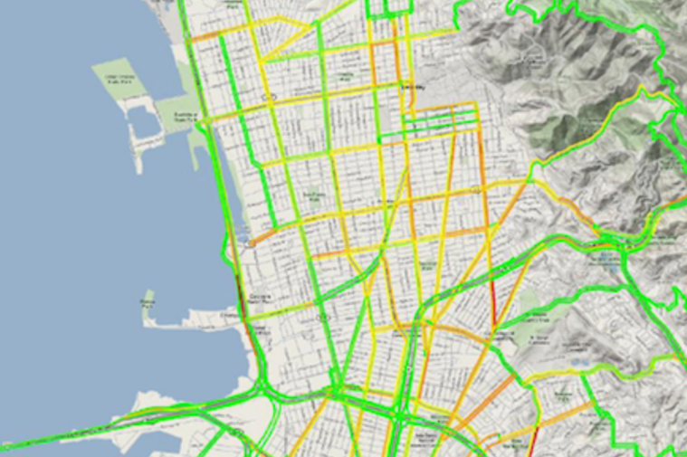
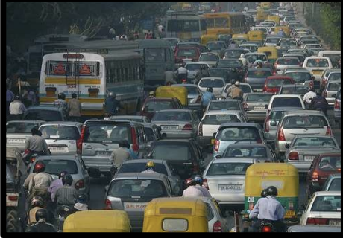
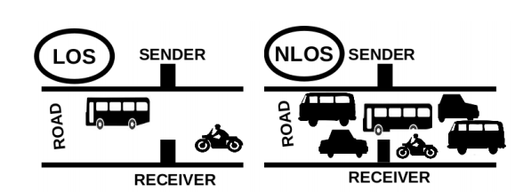
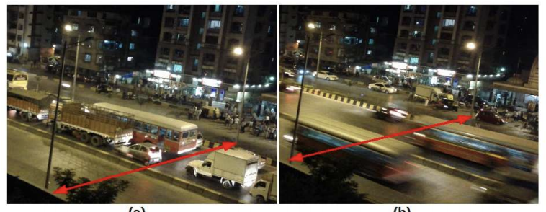
Traffic queue sensing and congestion control
[1]
[1]
[1]
[1] Sen et al. Kyun Queue: A Sensor Network System To Monitor Road Traffic Queues, 2012

Slide 9
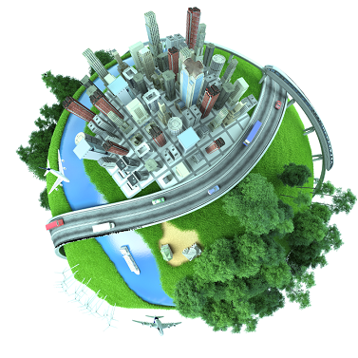

Slide 10
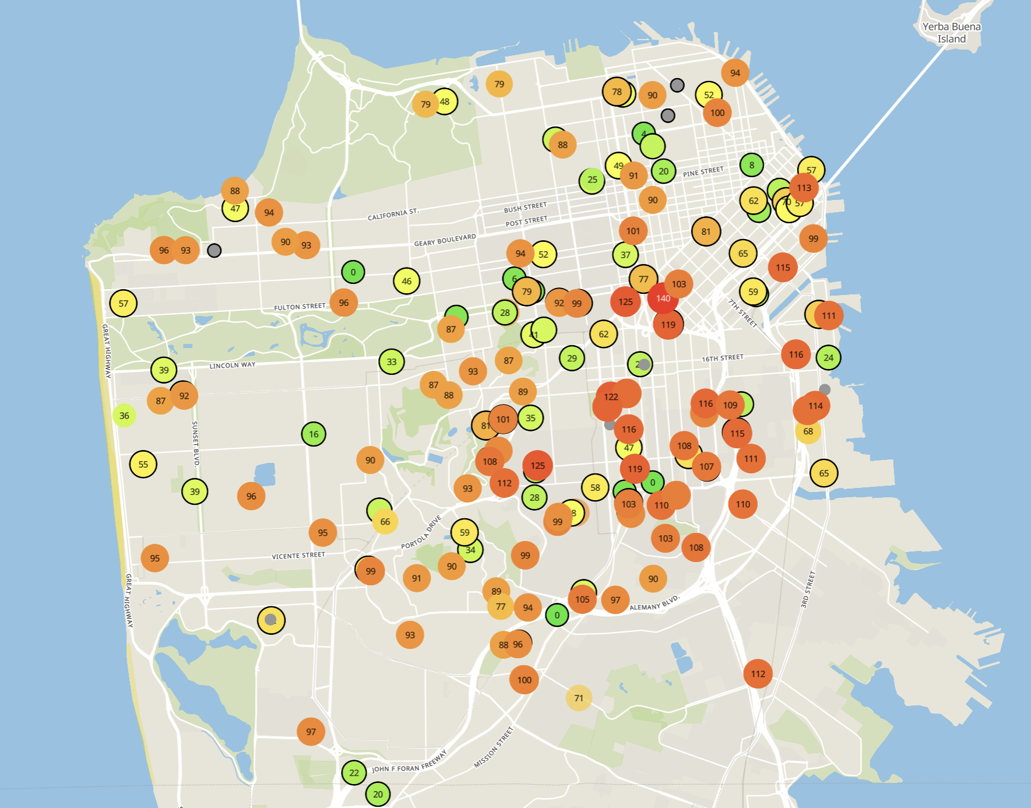
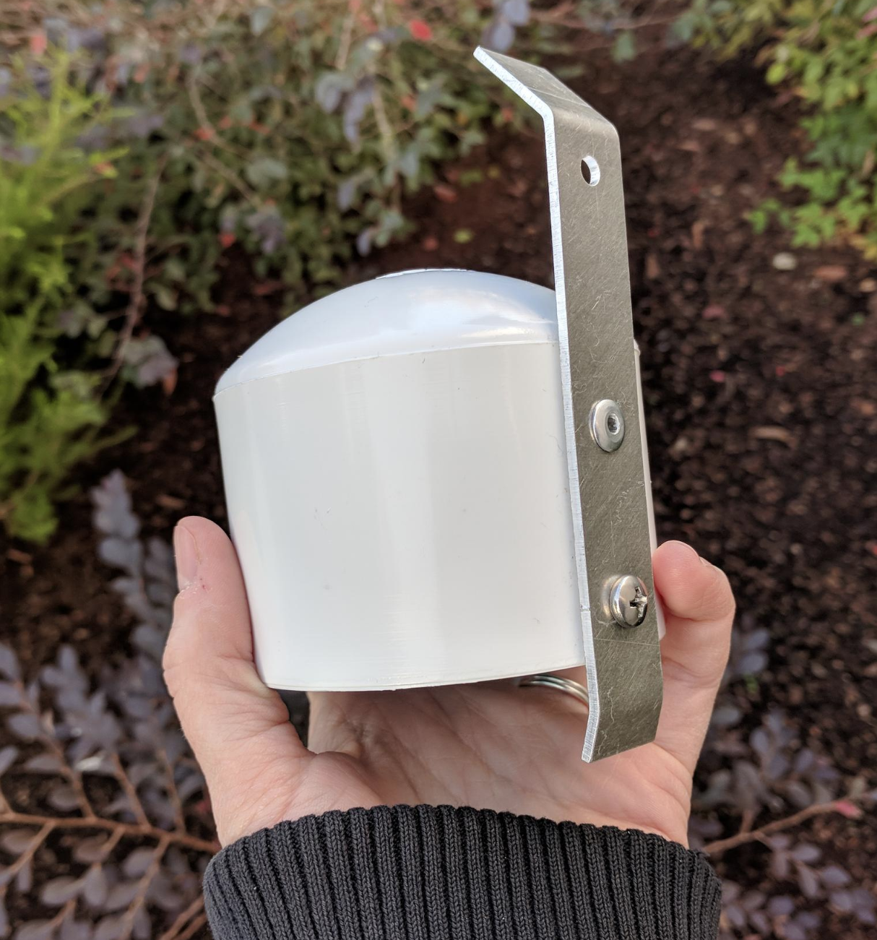
Example application: air quality monitoring
[1]
[2]
[2]
[1] Cheng et al. AirCloud: a cloud-based air-quality monitoring system for everyone. 2014. [2] Purple Air. 2019.

Slide 11
How do we collect data from a sensor?
Manually collect measurements
Too much work
Connect it to WiFi (or Ethernet)
Too many separate networks
Pay for cellular access
Too expensive for many devices

Slide 12
How do we collect data from MANY sensors?
Manually collect measurements
Too much work
Connect it to WiFi (or Ethernet)
Too many separate networks
Pay for cellular access
Too expensive for many devices

Slide 13
We need another network option
Requirements:
Wide area of coverage
Deploy fewer gateways
Low power
So we can deploy on batteries
Doesn’t need high throughput
Sensor data is relatively small

Slide 14
Long-range, low-data needs haven’t historically been met
WiFi
Data
Throughput
Range

Slide 15
Long-range, low-data needs haven’t historically been met
WiFi
Data
Throughput
Bluetooth
BLE
Zigbee
Range

Slide 16
Long-range, low-data needs haven’t historically been met
WiFi
Higher Power & Higher Cost
Data
Throughput
Bluetooth
BLE
Zigbee
Lower Power & Lower Cost
Range

Slide 17
Long-range, low-data needs haven’t historically been met
WiFi
4G
Higher Power & Higher Cost
3G
Data
Throughput
2G
Bluetooth
2G
BLE
Zigbee
Lower Power & Lower Cost
Range

Slide 18
Long-range, low-data needs haven’t historically been met
WiFi
4G
Higher Power & Higher Cost
3G
Data
Throughput
Bluetooth
2G
Low-Power Wide-Area Networks
BLE
Zigbee
Lower Power & Lower Cost
Range

Slide 19
Outline
Wide-Area Network Background
Design an LPWAN
Unlicensed LPWANs
LoRaWAN

Slide 20
Design a wide-area network (ignore low-power for now)
What PHY choices would you make?

Slide 21
Design a wide-area network (ignore low-power for now)
What PHY choices would you make?
Modulation
Tx Power
Carrier Frequency Band
Data Throughput
Channel Bandwidth

Slide 22
Design a wide-area network (ignore low-power for now)
What PHY choices would you make?
Modulation
Unclear. Can’t be too crazy for cheap devices.
Tx Power
High (much higher than 0 dBm)
Carrier Frequency Band
Low (something lower than 2.4 GHz, 915 MHz or lower?)
Data Throughput
Low (much lower than 1 Mbps)
Channel Bandwidth
Unclear. Likely smaller for lower frequency carrier.

Slide 23
Design a low-power wide-area network
Any particular MAC choices for lower power?

Slide 24
Design a low-power wide-area network
Any particular MAC choices for lower power?
Diversity of devices in network
High power gateway, low power devices in star topology
Devices should be off whenever possible
Listen-after send for downlink
Remove requirements for synchronization
No TDMA access control if it can be avoided
Aloha, CSMA

Slide 25
Long-range CSMA is problematic
Long-range makes everything more challenging
Kilometers of range mean kilometers between devices
Detection of channel use is less reliable
Active research in clear channel assessment for LPWANs
Hidden terminal problem has a wider range
Might make RTS/CTS more important
Result: CSMA doesn’t dominate LPWANs like it does WLANs

Slide 26
LPWANs overview (common qualities)
Unlicensed 915 MHz band (902-928 MHz)
Higher power transmissions: ~20 dBm (100 mW)
Low data rate 100 kbps or less
Range on the order of multiple kilometers
Simple Aloha access control

Slide 27
Outline
Wide-Area Network Background
Design an LPWAN
Unlicensed LPWANs
LoRaWAN

Slide 28
LoRaWAN
Open communication standard built with proprietary LoRa PHY
Low rate (1-20 kbps) and long range (~5 km)
Shorter range than Sigfox but much higher bit rate
Most popular LPWAN protocol
Target of academic research
Industry involvement in hardware and deployments

Slide 29
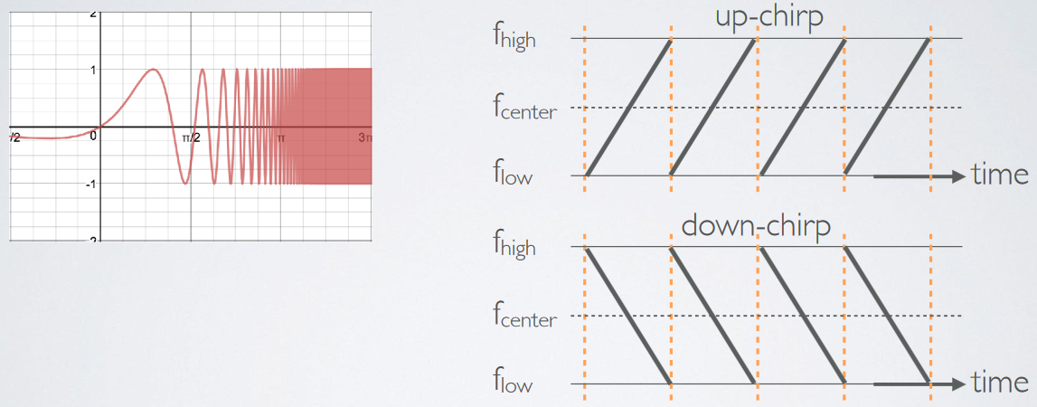
LoRa PHY uses a different modulation
Chirp Spread Spectrum (CSS)
Modulation technique where frequency is varied linearly from lowest to highest within a channel

Slide 30
Chirp Spread Spectrum
Data is modulated in the starting and ending points of chirp
Frequency increases linearly, modulo bounds of the channel

Slide 31
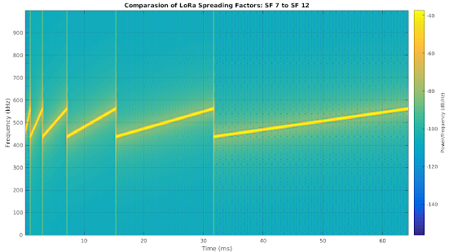
CSS has a Spreading Factor which determines bit rate
Spreading Factor is essentially the rate-of-change of frequency
Slope of the line
Lower values of spreading factor (steeper slope) are faster data rate
Important: different spreading factors are (mostly) orthogonal!
Two can overlap in time, space, and channel without a collision

Slide 32
LoRaWAN channels
Sixty-four, 125 kHz uplink channels
Frequency Hopping over the 64 uplink channels
Plus eight, 500 kHz overlapping uplink channels (not well used in practice)
Eight, 500 kHz downlink channels

Slide 33
LoRaWAN gateways
No synchronization with end devices
Instead listen to entire bandwidth simultaneously
Only 12 MHz total
Recognize preambles and allocate a hardware to decode packet
Normal gateways: 8 decoders
Good gateways: 64 decoders

Slide 34
LoRaWAN data rates
Data Rate Index | Spreading Factor | Bit Rate
125 kHz Uplink Rates
0 | SF10, 125 kHz | 980 bps
1 | SF9, 125 kHz | 1760 bps
2 | SF8, 125 kHz | 3125 bps
3 | SF7, 125 kHz | 5470 bps
500 kHz Uplink Rates
4 | SF8, 500 kHz | 12500 bps
500 kHz Downlink Rates
8 | SF12, 500 kHz | 980 bps
9 | SF11, 500 kHz | 1760 bps
10 | SF10, 500 kHz | 3900 bps
11 | SF9, 500 kHz | 7000 bps
12 | SF8, 500 kHz | 12500 bps
13 | SF7, 500 kHz | 21900 bps
Data rate options depend on channel in use
Unbalanced uplink and downlink
64-channel uplink
1-5 kbps data rate
Allowable rates based on dwell time restriction (400 ms)

Slide 35
LoRaWAN link budget
Typical TX power 20 dBm
Up to 30 dBm for 64-channel hopping
Up to 26 dBm for 8-channel hopping
Receive sensitivity -119 dBm
Compare to -100 dBm for 802.15.4 and -95 dBm for BLE
Resulting range is about a kilometer in urban environments

Slide 36
LoRaWAN MAC
Uplink: Aloha - transmit whenever
Randomly split across 64 uplink channels (reduced odds of collision)
Devices a different spreading factors also do not collide
Packets are very long though: up to 400 ms in duration
Downlink: listen-after-send (class A device)
Two windows for RX on different channels

Slide 37
Optional downlink mechanisms
Periodic listening (class B device)
Synchronized with periodic beacons
TX still unsynchronized Aloha
Mostly unused
Continuous listening (class C device)
Always-on receivers

Slide 38
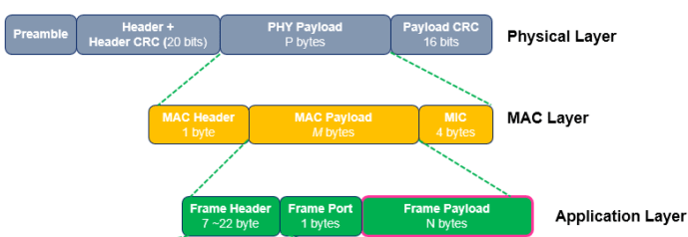
LoRaWAN packet format
Frame header includes device address
MAC Payload maximum size depends on data rate
Again based on dwell time in the US
Data Rate Index | MAC Payload Size
0 | 19 bytes
1 | 61 bytes
2 | 133 bytes
3 | 250 bytes
4 | 250 bytes

Slide 39
LoRaWAN network details

Slide 40
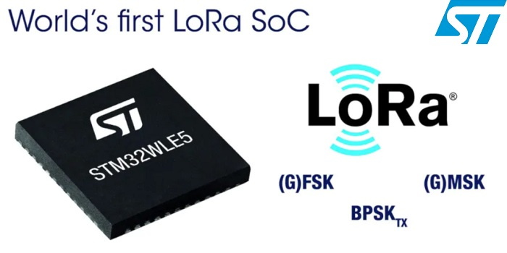
LoRaWAN hardware
Numerous hardware modules and development kits
Almost all use Semtech radio chips (Semtech owns LoRa PHY)
Recent addition: STM32WLE5 LoRa SoC
Cortex-M4 + LoRa radio (analogous to nRF52840)

Slide 41
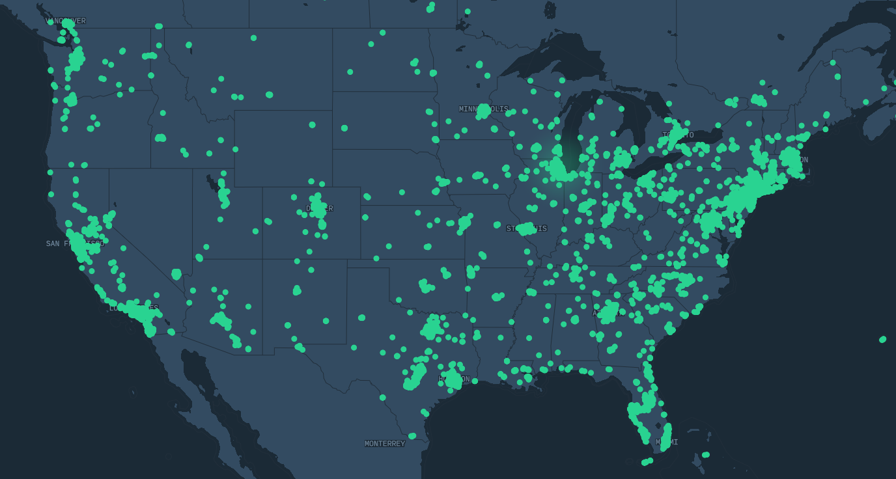
LoRaWAN network providers
Somewhat-managed network providers
The Things Network (predominantly in Europe)
Helium
Any can buy and install their own gateway, which serves everyone
Microtransactions to pay for communication

Slide 42
LoRaWAN interested parties
MachineQ is a subsidiary of Comcast providing LoRaWAN networks
Long-term goal
Indoor-to-outdoor LoRaWAN gateways combined with WiFi
Tune down power for 100-200 meter range

Slide 43
Outline
Wide-Area Network Background
Design an LPWAN
Unlicensed LPWANs
LoRaWAN

