Slide 1
Lecture 17:
Virtualization
CS343 – Operating Systems
Branden Ghena – Spring 2024
Some slides borrowed from:
Jaswinder Pal Singh (Princeton), Harsha V. Madhyastha (Michigan), and UC Berkeley CS162

Slide 2
Administrivia
Midterm exam 2
  Wednesday, June 5th from 9:00-10:20pm in the lecture hall
    Normal 80-minute exam
  Expect a similar format to the previous exam
    Covers Device I/O through Virtualization
      Lectures 9 through 18
      Does NOT cover scheduling or concurrency
  Practice materials on Canvas homepage
  May bring: one 8.5x11” sheet with notes on front and back

Slide 3
Today’s Goals
Explore notion of a “virtual machine” and how to virtualize computers.
Understand challenges and tradeoffs for several approaches
  Emulation
  Hypervisors
  Containers

Slide 4
Outline
Virtualization
Approaches
  Emulation
  Hypervisors
  Containers

Slide 5
Virtualization
Virtual (fake) versions of real resources are often provided to users
  Memory – virtual memory
  CPU – processes and scheduler
  Disk – files
OS provides these abstractions to simplify applications
  And provide security!

Slide 6
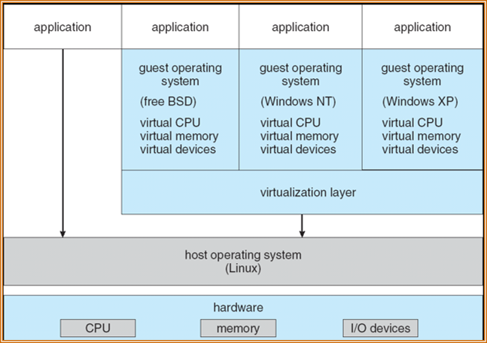
Virtual Machines (VMs)
What about virtualizing the whole computer?
  Provide interfaces that look like a normal computer
  But actually interact with software that manages and multiplexes access
Run an entire OS within an OS

Slide 7
Original motivation: support more applications
1960s IBM mainframes had many different OSes
  Some applications only written for certain OSes though
Virtualization allowed multiple OSes to run on a single mainframe
  Which let one powerful computer serve varied needs of many people
Still applies today to some degree
  Windows + Ubuntu VM
    Want PowerPoint and also terminal environment (vim/make/gcc)
  MacOS + Windows VM
    Various Windows-only programs
    Often dual boot rather than VM

Slide 8
Modern motivation: package and isolate applications
High-performance applications aren’t really stand-alone
  Assumptions about OS
  Assumptions about libraries and services
  Multiple processes working together
A virtual machine is a method to encapsulate “entire stack”
  Even down to expectations of hardware
Cloud computing platforms run many applications together
  Need isolation from each other in a strongly controllable way
    Exactly 2 GB of RAM go to this
    Exactly two processor cores go to that

Slide 9
Virtualization approaches
Simulate everything in the computer completely
  Emulation
Simulate parts of the computer, but not all of it (actually use CPU)
  Hypervisor
Simulate the operating system (software environment)
  Containers

Slide 10
Outline
Virtualization
Approaches
  Emulation
  Hypervisors
  Containers

Slide 11
Software emulation
User software emulates the behavior of every single instruction
  Data structures for Processor, Memory, I/O, etc.
  Code for Instruction Cycle:
    Fetch next instruction
    Decode
    Perform operation
    Update state
Example: Gameboy emulator
  Simulates every behavior as-if it were actually Gameboy hardware

Slide 12
Emulation example: QEMU
We have been using QEMU for lab to simulate an x86-64 computer
  2 CPU cores
  2 GB of RAM
  VirtIO GPU
  PS/2 mouse and keyboard
  2 PCI IDE interfaces with hard disk and CD-ROM support
    nautilus.iso connected to CD-ROM
  Serial and parallel ports
    stdio connected to serial port
    file parport.out connected to parallel port
  Other stuff
    Floppy disk
    PCI and ISA network adapters
    Intel HD Audio Controller and HDA codec
    PCI UHCI, OHCI, EHCI or XHCI USB controller and a virtual USB-1.1 hub

Slide 13
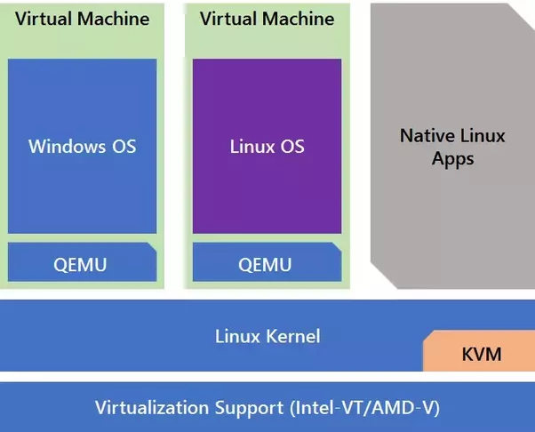
Emulation tradeoffs
Upsides
  Any hardware you want
  Entirely in userspace
Downside
  Accurate behavior is difficult to provide
  Software runs slower than the hardware would
  (But modern hardware might run software faster than old hardware)

Slide 14
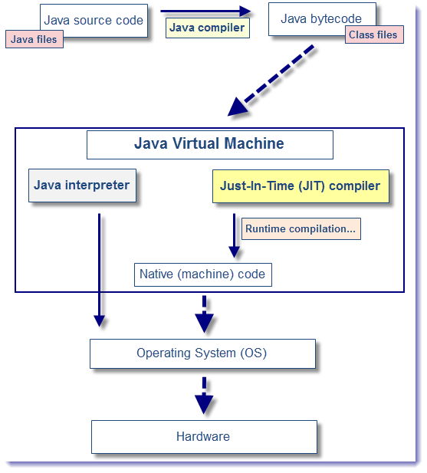
Simple emulators: interpreted languages
Create a simple environment for code to execute within
Interpret code instructions (bytecode or lines of code) and perform actions
  Example: fakes a machine that executes Java bytecode
Still ties in to many parts of the real machine
  Filesystem
  Devices

Slide 15
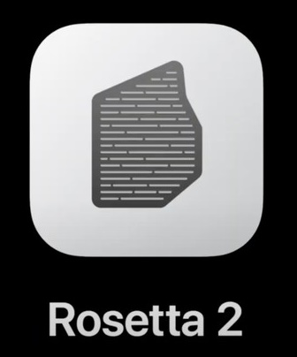
Not-quite-emulation: binary translation
MacOS on ARM (M1)
  Uses ARM processor with ARM instruction set
  Old programs were compiled for x86-64 instruction set
Solution: translate assembly instructions
  Can be translated in advance
  Or just-in-time (JIT)
  Works fine for applications that are I/O bound
Simulates a different CPU, but leaves the remainder of the computer the same

Slide 16
Break + Open Question
What are the best use cases for full hardware emulation?

Slide 17
Break + Open Question
What are the best use cases for full hardware emulation?
  Non-standard, slow machines (example: old gaming consoles)
    Where people do not have access to the original hardware
    The original hardware was slower than modern hardware
    And there are existing application binaries that they want to run
  Application-level simulation/testing (example: Nautilus!)
    Still hopefully for the above (for performance)
    Entirely controlled environment: makes debugging easier

Slide 18
Outline
Virtualization
Approaches
  Emulation
  Hypervisors
  Containers

Slide 19
How do we speed up virtual machines?
“Efficiency … demands that a statistically dominant subset of the virtual processor’s instructions be executed directly by the real processor, with no software intervention…”
—Popek and Goldberg, 1974
Need to use some parts of the computer for real while simulating other parts

Slide 20
Virtual Machine Monitor (VMM)
Also known as hypervisors
  OS kernel is the system “supervisor” and manages the computer
  Hypervisor manages supervisors
Creates the illusion that the OS has full control over the hardware
  And even gives real (limited) access to hardware whenever possible
  But may actually be sharing full computer resources among several OSes
Probably what you had in mind as virtual machines
  VirtualBox, VMWare, Parallels

Slide 21
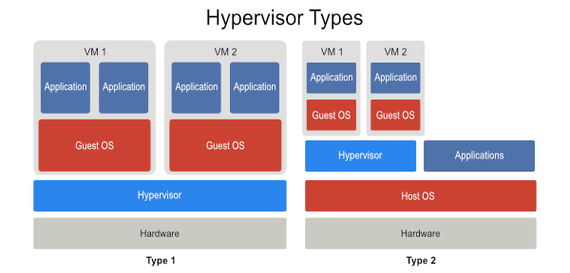
Hypervisor layering: directly on hardware
Hypervisor manages hardware directly
Guest OSes run on top of it
  “Guest OS” as in it isn’t actually in charge of the computer
“Bare Metal” Hypervisor
Hosted Hypervisor

Slide 22
Hypervisor layering: on top of Host OS
Normal operating system runs on hardware
  Known as “Host OS”
Hypervisor runs on top of host and coordinates with it to enable interactions with hardware
  Some coordination may be within the kernel itself
“Bare Metal” Hypervisor
Hosted Hypervisor

Slide 23
Hypervisor layering: comparison
“Bare Metal” Hypervisor
Hosted Hypervisor

Slide 24
Abstraction choices for hypervisor
Fully virtualizing hypervisor
  Virtual machine looks exactly like a physical machine
    Though not necessarily the exact same machine it’s actually running on
  Guest OS does not need to be modified in any way
  Guest may not even be aware it’s running virtually
Para-virtualizing hypervisor
  Guest OS has extensions to cooperate with hypervisor
  Sacrifice transparency for better performance
    Same abstraction-breaking ideal from previous lectures
  Might include an API to interact with hypervisor
  Guest OS likely can skip some stuff the hypervisor handles instead

Slide 25
Arbitrary combinations of these are possible
Bare Metal Hypervisor
Hosted Hypervisor
 | VMWare ESXi, Microsoft Hyper-V | VMware Workstation, VMware Fusion, Parallels, VirtualBox
 | Xen | User Mode Linux
Fully
Virtualized
Para
Virtualized

Slide 26
Arbitrary combinations of these are possible
“Normal” VMs
Bare Metal Hypervisor
Hosted Hypervisor
 | VMWare ESXi, Microsoft Hyper-V | VMware Workstation, VMware Fusion, Parallels, VirtualBox
 | Xen | User Mode Linux
Fully
Virtualized
Para
Virtualized

Slide 27
Arbitrary combinations of these are possible
Cloud/Server stuff
Bare Metal Hypervisor
Hosted Hypervisor
 | VMWare ESXi, Microsoft Hyper-V | VMware Workstation, VMware Fusion, Parallels, VirtualBox
 | Xen | User Mode Linux
Fully
Virtualized
Para
Virtualized

Slide 28
Arbitrary combinations of these are possible
Bare Metal Hypervisor
Hosted Hypervisor
 | VMWare ESXi, Microsoft Hyper-V | VMware Workstation, VMware Fusion, Parallels, VirtualBox
 | Xen | User Mode Linux
Fully
Virtualized
Para
Virtualized
Run Linux as an application

Slide 29
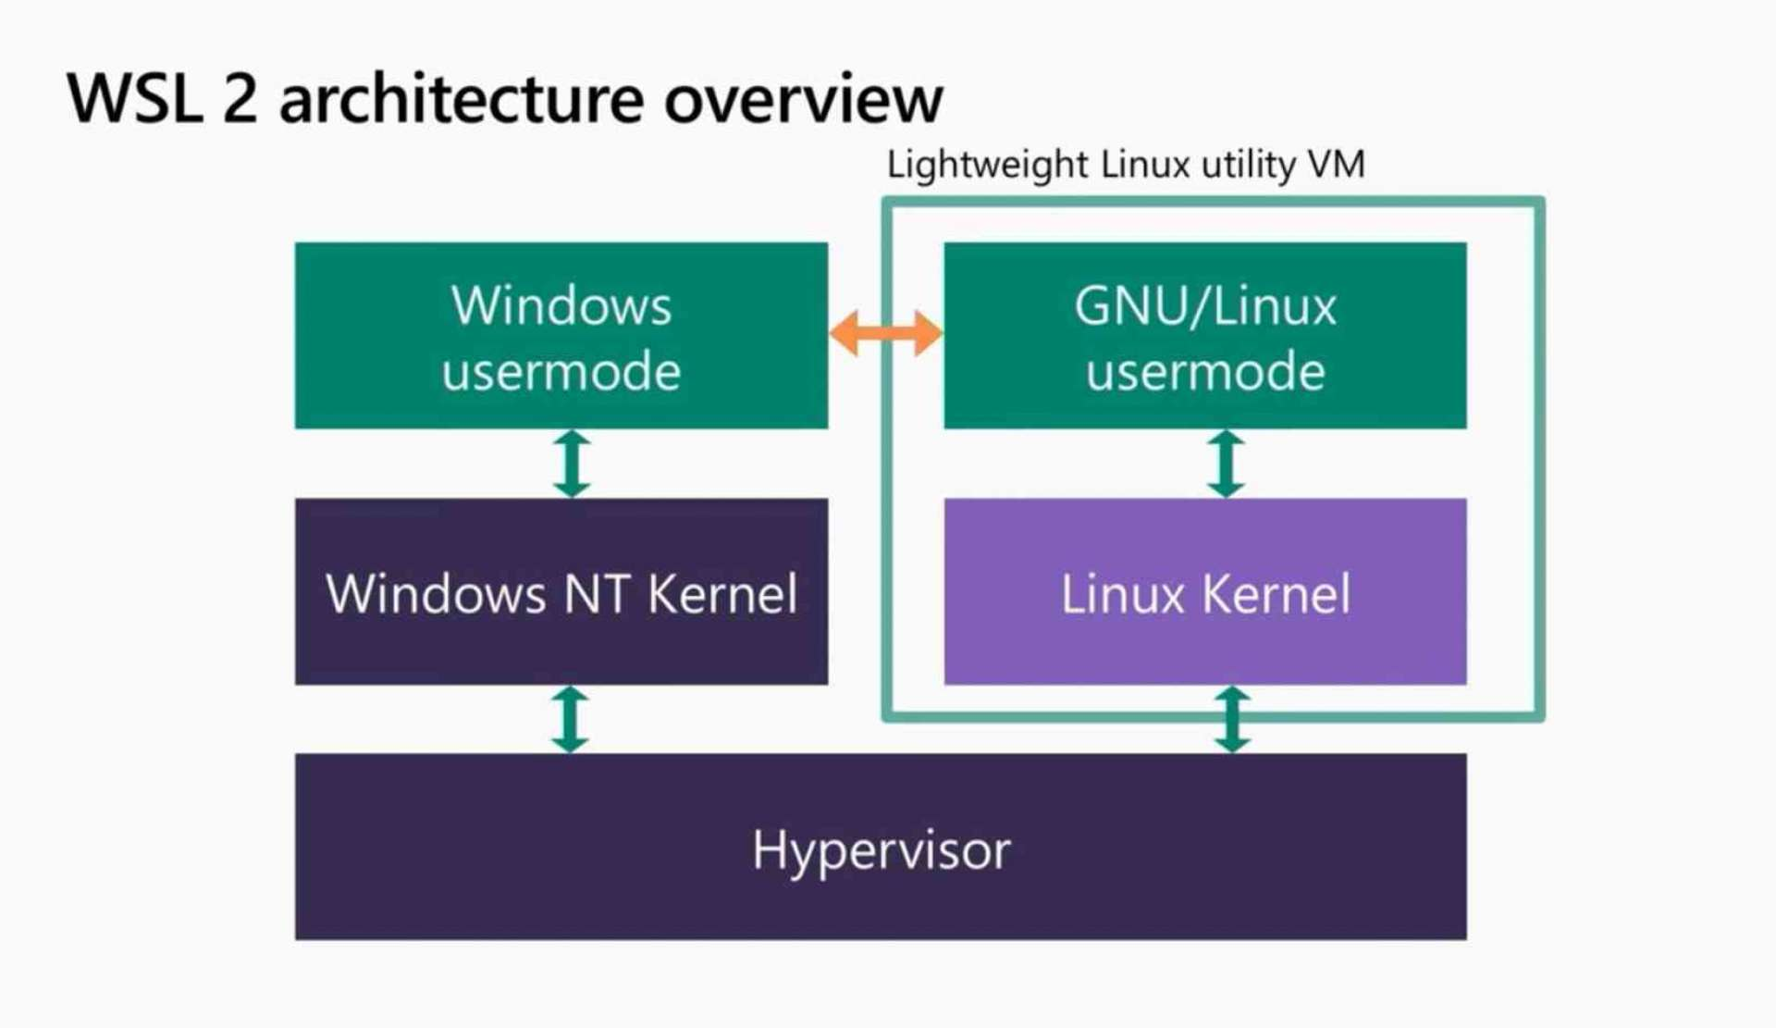
Windows Subsystem for Linux (WSL 2)
Provides Linux environment
on a Windows computer
Windows Hyper-V provides a
fully-virtualized system
  Windows and Linux both run
  on top of it
Differences:
  WSL2 also enables communication between userspaces rather than fully isolating the two
    They can both share access to the file system, for example
  Windows is a “privileged” guest with full control of the system

Slide 30
Hypervisor example: system call
Process
1. System call: trap to OS
5. Resume execution
Guest OS
3. OS trap handler: Decode trap and execute syscall. When done issue
return-from-trap
Hypervisor
2. Receive trap. Call guest OS trap handler
4. OS tried to return from trap. Do real return-from-trap

Slide 31
Hypervisor challenges: privileged instructions
The guest OS is going to run privileged instructions
  Scheduling threads, editing page tables, modifying interrupt state
Cannot let it have full control over the hardware
  Otherwise it really isn’t a “guest” and host might never regain control
Solution: trap into hypervisor
  Bare metal: Illegal instruction fault goes directly to hypervisor
  Hosted: Illegal instruction fault in Host OS passed to hypervisor
    Which can actually do something to handle it!!

Slide 32
Problem: x86 doesn’t virtualize very well
CPU architecture is virtualizable only if sensitive instructions always trap if run in user mode
Historically, x86 does not guarantee this
  Some instructions behave differently in user mode
  For example: some instructions have no effect when run in user mode
One solution: binary translation
  Find all unacceptable instructions in the OS binary (possibly at runtime)
  Replace with different instructions that trap to hypervisor
    Which will perform the originally desired operations

Slide 33
Virtualization extensions to x86
Intel VT and AMD-V
  Extensions to instruction set architecture to enable virtualization
  Fix virtualization problems
  Also speed up virtualization performance by requiring less trapping
VM Entry/Exit
  Swap out Virtual Machine Control Structure (VMCS) that specifies OS state
    Registers, Address Space, Executing Threads
  Example optimization: Virtual Processor ID in TLB entries
    Allows Guest OS and Host OS to share a TLB

Slide 34
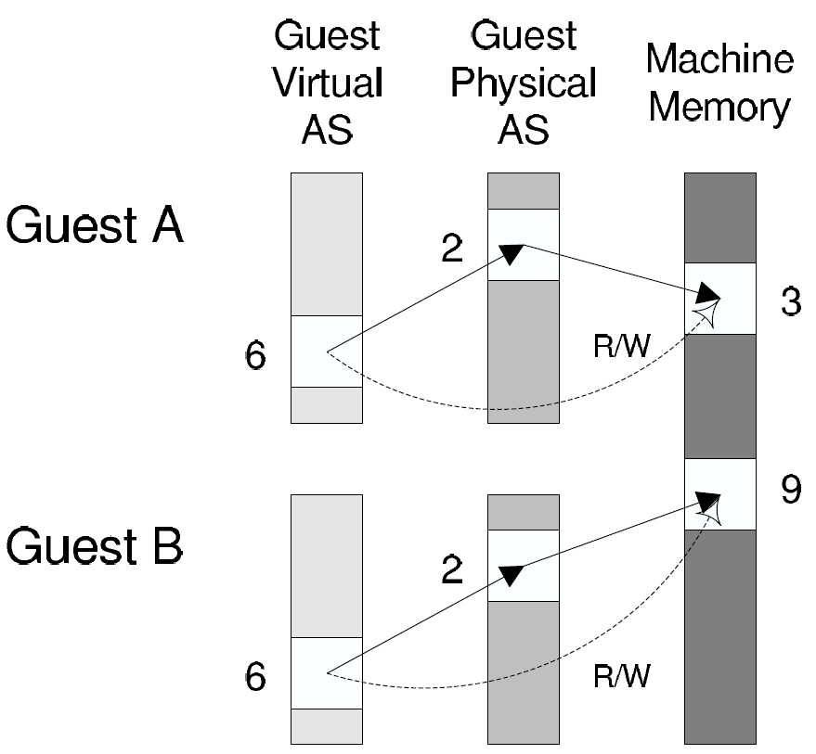
Hypervisor challenges: Memory virtualization
Guest OS maintains its own page tables, mapping virtual to physical memory
  But the guest itself is running in virtual memory
Hypervisor maintains “shadow page tables” that map Guest memory pages to actual memory pages
  Guest modifications to page tables trap to hypervisor that modifies its own tables accordingly
Virtual extensions can do this double-translation in hardware

Slide 35
Hypervisor challenge: I/O devices
Difficult to replicate all the different drivers that can exist in a kernel in the hypervisor
One solution: leverage host OS drivers
  Present virtual I/O devices to guest OS
  Guest interacts with virtual I/O through its own device driver
  Calls get sent to hypervisor, which makes appropriate calls to host drivers

Slide 36
Break + Questions – VirtualBox on ARM Mac
Will VirtualBox work on the new ARM Macs?
  Will the program run as-is?
  What architecture will the guest OS need to be?
  Could students run CS213 labs in it?

Slide 37
Break + Questions – VirtualBox on ARM Mac
Will VirtualBox work on the new ARM Macs?
  Will the program run as-is?
    No. Currently compiled for x86-64. Needs to be recompiled. But it probably has a bunch of hardware-specific code that needs to be rewritten too… (support exists as of October 2022!)
  What architecture will the guest OS need to be?
    ARM. VirtualBox is a hypervisor that runs code on the actual processor.
    Windows and Linux do have some ARM support…
  Could students run CS213 labs in it?
    Not really… Any x86-64 specific stuff won’t work.

Slide 38
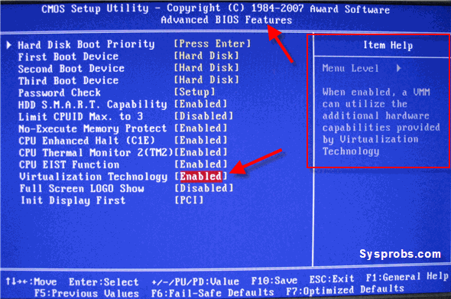
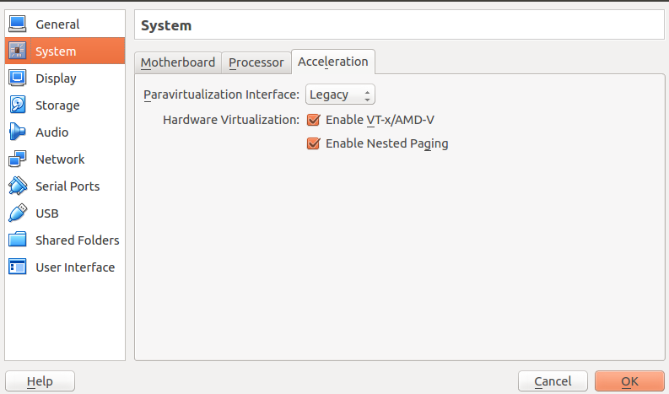
Sidebar: virtualization extensions often disabled by default
Most users will never have a need for them
  And developers can probably figure out BIOS settings

Slide 39
Outline
Virtualization
Approaches
  Emulation
  Hypervisors
  Containers

Slide 40
Not-quite-containers: Compatibility layer
To allow software to run on another OS, provide an interface that can translate system calls
  Essentially emulating an OS, rather than computer hardware
Wine
  Provides dynamic libraries that mirror those that exist in Windows
    But new implementations make Linux system calls
WSL (1.0)
  Translates Linux system calls into Windows system calls

Slide 41
Cloud platform requirements
May want to provide multiple OSes, but can do so with multiple physical machines
Really want encapsulation and isolation
  Encapsulation
    Include particular shared libraries that application needs
    Without interfering with other applications on system
  Isolation
    Guarantee certain processing and memory allocations to each application
    Limit visibility into the filesystem (without overhead of partition per app)

Slide 42
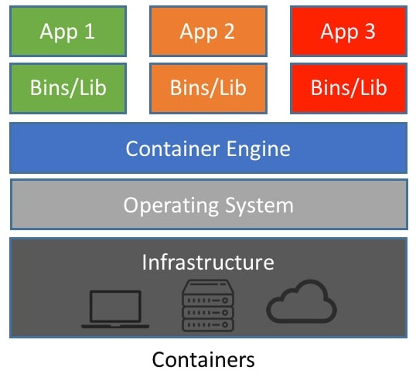
Containers
Provide each application with illusion of its own dedicated OS
  Isolated resources:
  processor and memory
  Isolated namespace:
  PIDs, network, filesystem
  Includes only the binaries and libraries it needs

Slide 43
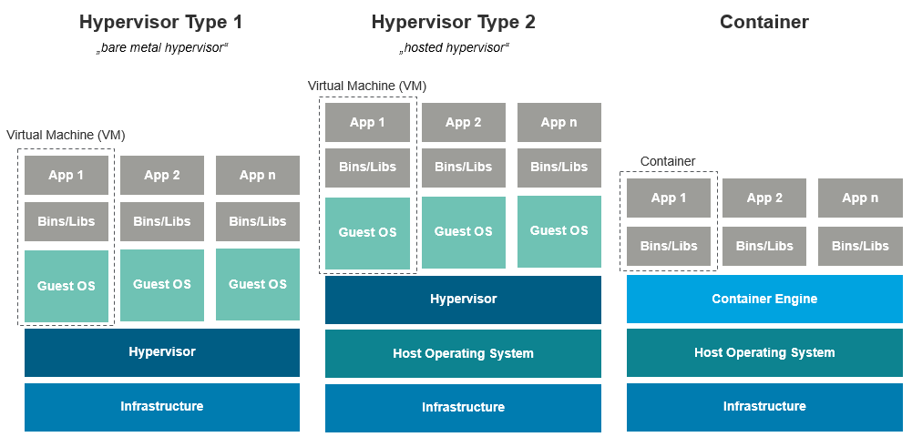
Visual comparison of Hypervisors and Containers

Slide 44
How to implement containers
Needs the ability to isolate one process from the effects of another
  More strongly than a normal OS does anyways
On Linux, there is a related idea which is the basis for containers
  cgroups

Slide 45
Linux cgroups (control groups)
Collection of processes treated as a group for resource allocation
Provider greater performance isolation between cgroups than between processes
  Firm limits per group
Example:
“production”
“testing”
“dev”
User Software
syscall handlers
scheduler
syscall tbl
subsystems
System Software
intr tbl
intrpt handlers
Page Tables
Drivers
Processor
Memory
Net BW
Files
Hardware

Slide 46
Linux cgroups (control groups)
Collection of processes treated as a group for resource allocation
Provider greater performance isolation between cgroups than between processes
  Firm limits per group
Example:
“production”
“testing”
“dev”
User Software
syscall handlers
scheduler
syscall tbl
subsystems
System Software
intr tbl
intrpt handlers
Page Tables
Drivers
Processor
Memory
Net BW
Files
Hardware

Slide 47
cgroups can be used to build containers
Devices can be connected or denied to a cgroup
  cgroup processes will not be able to detect device at all
Accounting can be done on cgroup usage
  Memory, CPU, disk I/O

Slide 48
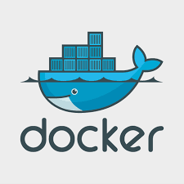
Docker
Container packaging, distribution, and execution
  Also created open standard for container runtimes
Images
  Describes starting state of a Docker container
  Like a snapshot of the system
Union file system
  Image describes file system as a sequence of layers
    Each layer includes some files
  Overall file system is the union of all the layers
  Layers can be reused in different images

Slide 49
Docker use cases
Environments are hard to set up
  Often the hardest part of starting software development
  Containerized applications encapsulate requirements
  Can be run on any system that has the same kernel it was built for
Packages an application and its requirements into a container
  Can be used by an individual to more easily run an application
  Can be deployed to a cloud server to run
Example: could use Docker for QEMU + Nautilus
  Need a very specific version of QEMU, with all the proper libraries

Slide 50
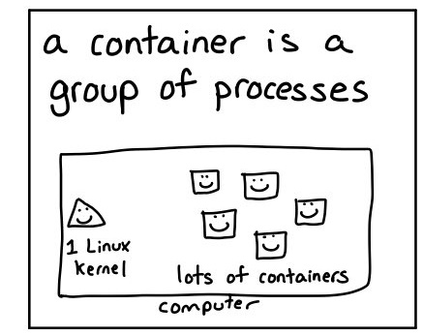
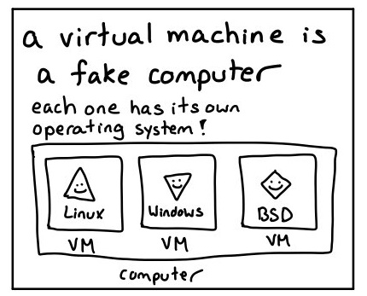
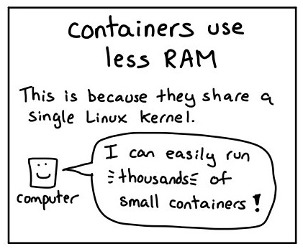
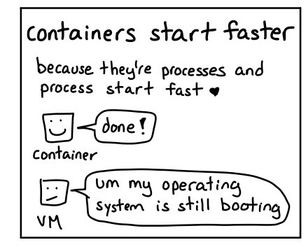
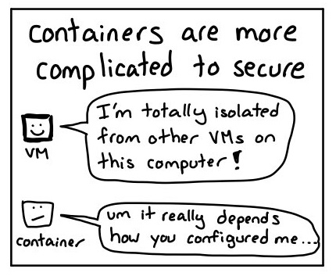
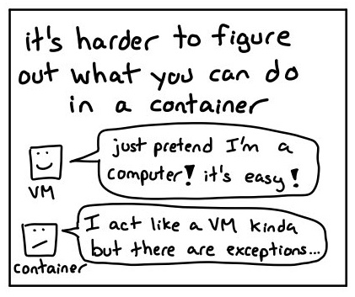
Bonus explanation
https://twitter.com/b0rk/status/1237744128450072578

Slide 51
Outline
Virtualization
Approaches
  Emulation
  Hypervisors
  Containers

