Slide 1
Lecture 10:
Device Drivers
CS343 – Operating Systems
Branden Ghena – Spring 2024
Some slides borrowed from:
Stephen Tarzia (Northwestern), Jaswinder Pal Singh (Princeton), and UC Berkeley CS162

Slide 2
Administrivia
PC Lab due tonight
  There was a bugfix for the starter code posted to Piazza
    Not required that you use it. We’ll apply it when grading your code
Driver Lab will be up tonight or maybe tomorrow

Slide 3
Today’s Goals
Explore how software for device I/O is architected.
Discuss OS considerations at multiple software layers.
Investigate example device drivers
  One in Nautilus
  One in Linux and Tock

Slide 4
Outline
Abstractions
Device I/O layers
  Application Layer
  Kernel I/O Subsystem
  Device Driver
  Interrupt Handler
Example Driver: Nautilus Character Device
Example Driver: Temperature Sensor

Slide 5
Writing software to manage devices
Kernel software for managing a device is a device driver
  70% of Linux code is device drivers
  15.3 Million lines of source code
Big challenge for device drivers
  How do we enable interactions with so many varied devices?
    Need abstractions to allow software to interact with them easily
    Need mechanisms to reuse a lot of code for commonalities

Slide 6
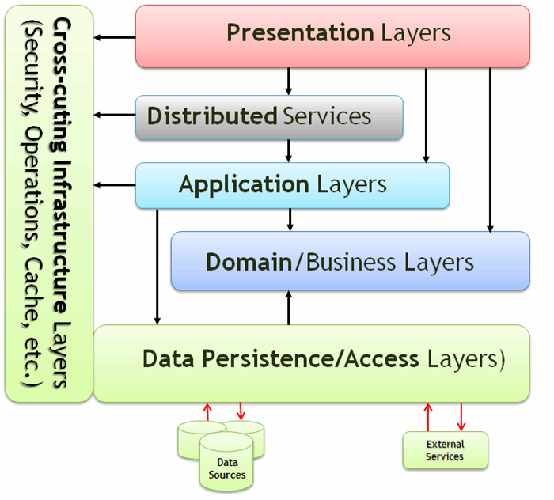
General software abstractions
When building large software projects, we like to define layers of code
  Makes it clear what is handled where
  Enables swapping out implementations when desired

Slide 7
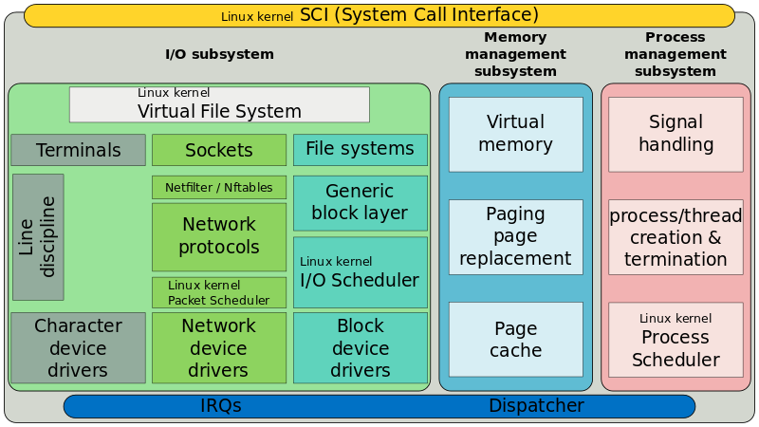
Linux Kernel Layering

Slide 8
Linux Kernel Layering

Slide 9
Linux Kernel Layering

Slide 10
Linux Kernel Layering

Slide 11
Linux Kernel Layering

Slide 12
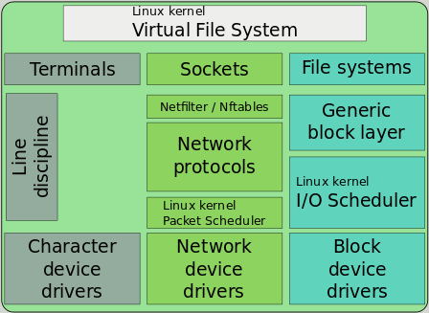
Abstraction: everything is a file!
Hardware: treat devices like memory
  They can be read and written at addresses
Software: treat devices like files
  They can be read and written
  They may be created or destroyed (plugged/unplugged)
  They can be created in hierarchies. Example:
    SATA devices
      SSD
    USB devices
      Webcam
      Microphone

Slide 13
Linux device classes
Character devices
  Accessed as a stream of bytes (like a file)
  Example: Webcam, Keyboard, Headphones
  We will focus on these
Block devices
  Accessed in blocks of data (like a disk)
  Can hold entire filesystems
  Example: Disks, Flash drives
Network interfaces
  See CS340 (Computer Networking)
  Accessed through transfer of data packets
dev
char
block
net
Serial
Parallel
SATA
SCSI
Ethernet
WiFi
video
2D
3D

Slide 14
System layers when interacting with devices
User applications
  Do useful things
I/O subsystem
  Receive syscalls, route to device drivers
Device drivers
  Translate application requests into device interactions
Interrupt Handler
  Receive events from hardware
Hardware
  Do useful things
User Applications
I/O Subsystem
Device Drivers
Interrupt Handler
Hardware

Slide 15
Outline
Abstractions
Device I/O layers
  Application Layer
  Kernel I/O Subsystem
  Device Driver
  Interrupt Handler
Example Driver: Nautilus Character Device
Example Driver: Temperature Sensor

Slide 16
Where we are at in the system
Processes
User Applications
I/O Subsystem
Device Drivers
Interrupt Handler
Hardware

Slide 17
Communication with devices
Interactions occur through system calls
  Open/Close
  Read/Write
  Seek, Flush
  Ioctl
  And various others

Slide 18
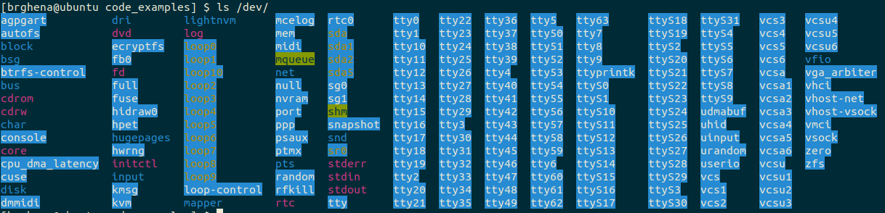
Accessing devices
Open/Close
  Inform device that something is using it (or not)
  Argument is path to device (like path to file)
  Get a file descriptor that the other operations act on
“/dev” directory is populated with devices

Slide 19
Interacting with devices
Same read/write commands you’ve likely seen before
  These are actually syscalls!
Read
  ssize_t read(int fd, void *buf, size_t count);
Write
  ssize_t write(int fd, const void *buf, size_t count);

Slide 20
Arbitrary device interactions
ioctl – I/O Control
  int ioctl(int fd, unsigned long request, ...);
Request number followed by an arbitrary list of arguments
  “request” may be broken in fields: command, size, direction, etc.
Catch-all for device operations that don’t fit into file I/O model
  Combine with “magic numbers” to form some special action
  Reset device, Start action, Change setting, etc.
  Read the device documentation to find these

Slide 21
Asynchronous I/O operations
Previous examples were all synchronous I/O calls
  Read/Write will block process until complete
  Easy to use, but not always most efficient method
Asynchronous I/O calls also exist
  POSIX AIO library
    aio_read/aio_write – enqueue read/write request
    aio_error – check status of an I/O request
    aio_return – get result of a completed I/O request

Slide 22
Synchronous blocking read example
Process
Kernel
Device
Read
Context Switch
Driver sets up request
DMA Request
Block Process
DMA Read
Driver handles response
Interrupt
Unblock Process
Continue Process
Context Switch

Slide 23
Asynchronous read example
Process
Kernel
Device
aio_read
Context Switch
Driver sets up request
DMA Request
Do other work
DMA Read
Driver handles response
aio_error
aio_return
Interrupt
Ready
Continue Process
Context Switch

Slide 24
Asynchronous read example with early request
Process
Kernel
Device
aio_read
Context Switch
Driver sets up request
DMA Request
Do other work
aio_error
DMA Read
Not Ready
Do other work
Driver handles response
aio_error
aio_return
Interrupt
Ready
Continue Process
Context Switch

Slide 25
Break + Open Question
Could you re-create the asynchronous I/O interface using threads?

Slide 26
Break + Open Question
Could you re-create the asynchronous I/O interface using threads?
  aio_read creates a new thread, which does the actual blocking read
    Thread will essentially block immediately
  aio_error / aio_return get data from that worker thread
    Synchronized with locks
    Thread exits after aio_return occurs
  This is basically the underlying implementation for glibc POSIX AIO

Slide 27
Outline
Abstractions
Device I/O layers
  Application Layer
  Kernel I/O Subsystem
  Device Driver
  Interrupt Handler
Example Driver: Nautilus Character Device
Example Driver: Temperature Sensor

Slide 28
Where we are at in the system
Processes
User Applications
I/O Subsystem
Device Drivers
Interrupt Handler
Hardware

Slide 29
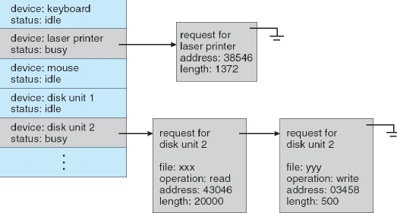
Kernel I/O subsystem
The OS kernel does various things for devices that are not specific to the individual device
  Manages permissions
  Routes call to appropriate driver
  Schedules requests to drivers

Slide 30
Kernel needs to handle process memory
Address translation
  All the data user processes give to the kernel comes with virtual addresses
  Pointers are either going to have to be translated
  Or memory is going to need to be copied
Buffering
  Kernel may need to hold on to a copy of data
    Especially in asynchronous case
  When copies are done and how many times is a big kernel efficiency question

Slide 31
Outline
Abstractions
Device I/O layers
  Application Layer
  Kernel I/O Subsystem
  Device Driver
  Interrupt Handler
Example Driver: Nautilus Character Device
Example Driver: Temperature Sensor

Slide 32
Where we are at in the system
Processes
User Applications
I/O Subsystem
Device Drivers
Interrupt Handler
Hardware

Slide 33
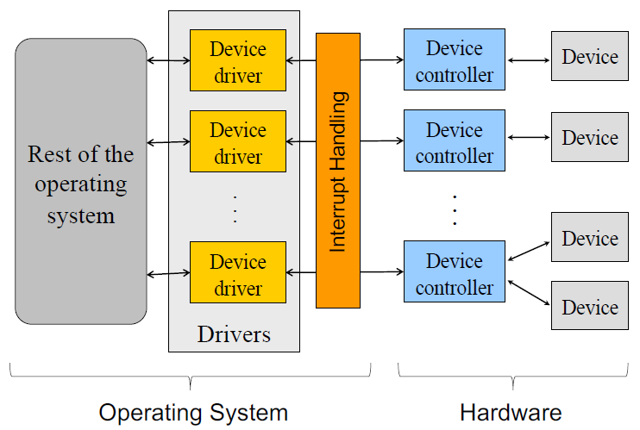
Device drivers
Device-specific code for communicating with device
  Supports some interfaces above and below
    Possibly file syscalls above and memory-mapped I/O below
    Possibly internal API above and below..
Examples
  Specific disk drivers are
  layered on top of SATA driver
  Keyboard driver is layered
  on top of USB driver
  Ethernet driver has various
  network interfaces layered
  above it

Slide 34
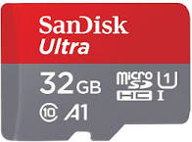
Example: possible driver layers for an SD card
Block device interface
Various filesystems
Generic SD Card Driver
microSDHC UHS-I Driver
Generic SPI Interface Driver
Intel SPI Controller Driver
Memory-Mapped I/O

Slide 35
Device I/O is handled by device drivers
Communication is up to the hardware
  Port-mapped I/O or memory-mapped I/O
  Or function calls to a lower-level driver
Interaction design is up to the driver (and OS)
  Programed I/O
    Synchronous or with interrupts
  Direct Memory Access
    Needs hardware support
    With interrupts

Slide 36
Device drivers are often designed with two “halves”
Top half
  Interrupt handler
    Continues next transaction
    Or signals for bottom half to continue (often with shared variable)
Bottom half
  Implements interface that higher layers require
  Performs logic to start device requests
  Wait for I/O to be completed
    Synchronously (blocking) or asynchronously (return to kernel)
  Handle responses from the device when complete

Slide 37
Virtualizing one device for many users
Some devices need to be virtualized
  Software that emulates unique devices for each higher level user even though only a single hardware resource actually exists
Process 1
Process 2
Kernel
Virtualized Disk
Disk Driver

Slide 38
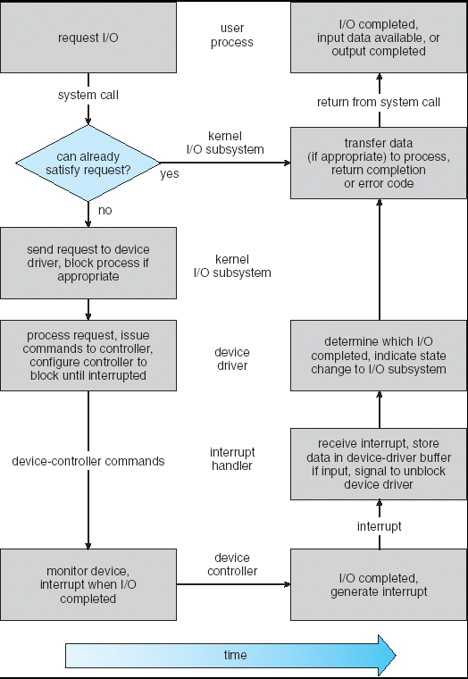
Life cycle of an I/O request
User
Program
Kernel I/O
Subsystem
Device Driver
Bottom Half
Device Driver
Top Half
Device
Hardware

Slide 39
How are devices found anyways?
At boot, the OS kernel searches for devices attached to it
  Action is usually called “probe”
  Starts up drivers for each device it finds
  A significant amount of time is spent in device discovery
Run “dmesg” on linux to see printouts from this process
  Live demo!

Slide 40
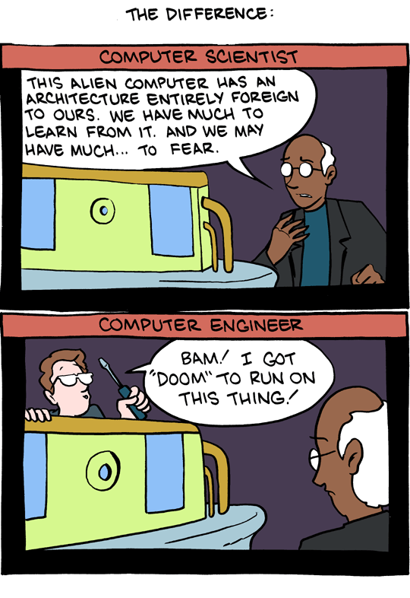
Break + SMBC webcomic
Not really relevant to class, just amuses me
Take a break and reset your brains for a minute
https://www.smbc-comics.com/comic/2011-02-18

Slide 41
Outline
Abstractions
Device I/O layers
  Application Layer
  Kernel I/O Subsystem
  Device Driver
  Interrupt Handler
Example Driver: Nautilus Character Device
Example Driver: Temperature Sensor

Slide 42
Nautilus kernel
http://cs.iit.edu/~khale/nautilus/
Small, light-weight kernel for research use
  All the basic features for getting an x86-64 computer to boot
  And just about nothing else
Created by Kyle Hale (Illinois Institute of Technology)
and Peter Dinda (Northwestern)
Example use case: experiment with virtual memory strategies

Slide 43
Nautilus character device abstraction
Character device: a device that can read/write arbitrary characters
  (as compared to Block devices that must read/write in chunks)
Nautilus says every character device must have the following:
  get_characteristics() – every device has this, none particularly for chardev
  read() – single byte
  write() – single byte
  status() – determine if device is readable or writeable or both

Slide 44
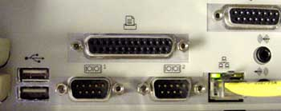
Layering in Nautilus
Virtual Console Driver
Character Device Driver
Serial Port
Parallel Port

Slide 45
Layering in Nautilus
Virtual Console Driver
Character Device Driver
Serial Port
Parallel Port

Slide 46
Virtual console
Allows keyboard input and text output for a user
  Generally, the basic terminal that you have open
  Could be implemented in all kinds of ways though
    Example: keyboard input plus printer output
  Any device that can read/write individual characters could act as a console
  So the virtual console just contains a nk_char_dev
    Passed into the virtual console at initialization
    Could be implemented with any hardware

Slide 47
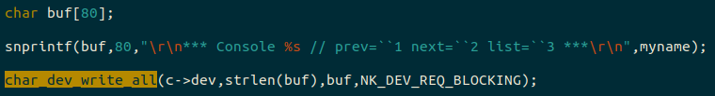
Virtual console reads and writes to generic char_dev
Tries to write an entire string in blocking mode
  Should not return until the entire string is displayed

Slide 48
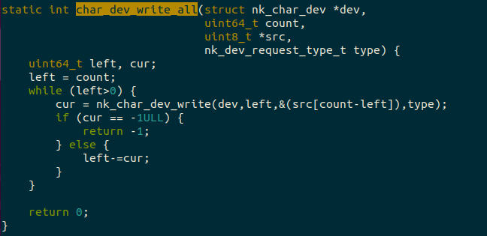
Virtual Console implements by calling into nk_char_dev

Slide 49
Layering in Nautilus
Virtual Console Driver
Character Device Driver
Serial Port
Parallel Port

Slide 50
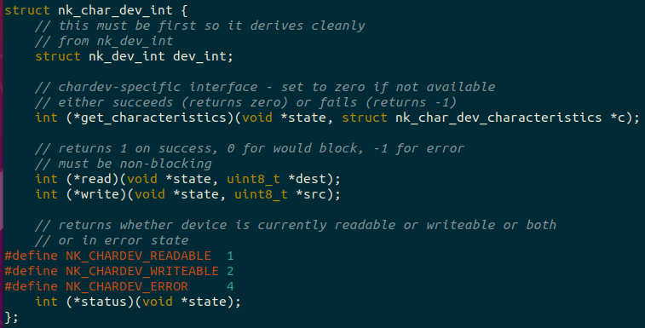
Each nk_char_dev holds an interface of function pointers

Slide 51
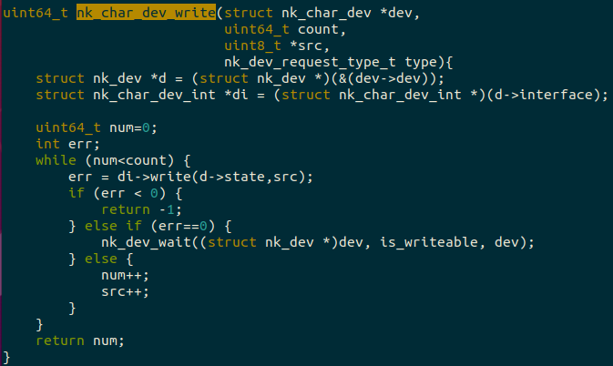
Simplified nk_char_dev_write: calls write() operation

Slide 52
Layering in Nautilus
Virtual Console Driver
Character Device Driver
Serial Port
Parallel Port

Slide 53
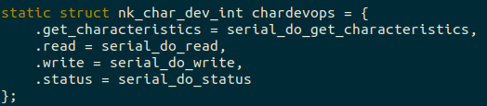
A serial device implements the nk_char_dev operations
Serial device implements all of those operations
When you create a serial device, you actually make an nk_char_dev and initialize it with a chardevops
  All of the generic device operations call into the actual serial device

Slide 54
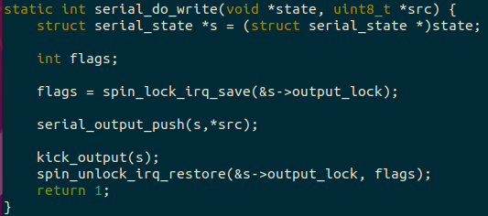
Simplified Serial device: pushes data into a queue

Slide 55
Serial queue operation
Whenever a write comes in, we push data byte into a queue
  Serial output goes slowly, so many bytes could be queued up
Then we enable interrupts and write the first byte to the MMIO register
Then when an interrupt comes in, we pop the next byte from the queue and write it to the MMIO register
  Repeats until the queue is empty

Slide 56
Layering in Nautilus
Virtual Console Driver
Character Device Driver
Serial Port
Parallel Port

Slide 57
Parallel port will be implemented by you!
A little simpler than the serial port version
  Never queues bytes and instead only writes one at a time
  Reject additional bytes while the system is in operation
  Whenever an interrupt comes in, that byte is complete so you’re ready for the next one
Same idea though, parallel port supports all the basic operations of an nk_char_dev
  When initialized, creates an nk_char_dev connected to its operations

Slide 58
Outline
Abstractions
Device I/O layers
  Application Layer
  Kernel I/O Subsystem
  Device Driver
  Interrupt Handler
Example Driver: Nautilus Character Device
Example Driver: Temperature Sensor

Slide 59
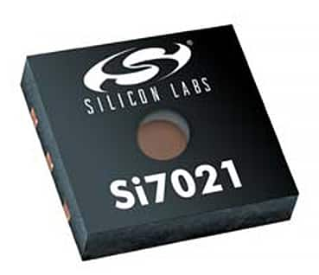
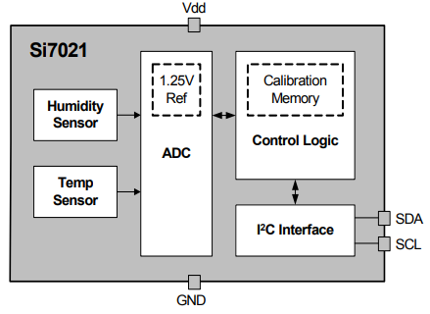
Si7021 temperature and humidity sensor
Popular on embedded devices
  Also has a Linux driver!
Connects to computer over I²C bus
  Two-wire, 100 Kbps low-power bus
  Like any other bus
    Takes an address
    Whether it’s a read or write transaction
    And an amount of data
https://www.silabs.com/documents/public/data-sheets/Si7021-A20.pdf

Slide 60
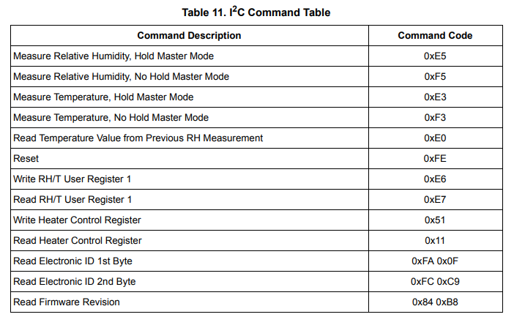
How do we make it do anything?
Typically with I²C devices, you write a 1-2 byte command
  Then you read the data in the next transaction
  Commands are found in the datasheet

Slide 61

What will the driver look like?
Layer below it will be I²C controller (function calls)
In the Temperature driver we need to
  See what the request from the layer above is
  Perform an I²C write transaction with a command byte (0xE3)
  Wait until data is ready
  Perform an I²C read transaction to get the data
  Translate the data into meaningful units

Slide 62
What are the driver layers going to be?
In Linux, some sensors are connected through the Industrial I/O subsystem (IIO)
  Handles sensor data generically
    Get raw sample
    Get scaling value
    Get offset value
Lower layers could change and
everything would still work
  USB->I2C converter for example
  Or a totally different sensor
Character Device
IIO Core
Si7021
Generic I2C Interface
Computer-Specific I2C Driver
Memory-Mapped I/O

Slide 63
Demo: Linux device driver code for Si7021
https://github.com/torvalds/linux/blob/master/drivers/iio/humidity/si7020.c
  Linux source code is all on Github!
But if you want to explore Linux code, a better link is:
https://elixir.bootlin.com/linux/latest/source/drivers/iio/humidity/si7020.c
  Creates linked databases for function calls and variable types
    Lists where it is defined
    Lists where it is used
  Makes it easy to hop up and down layers

Slide 64
OSes can make design choices about drivers
Interface does not have to be like a file
  For example: could have a set of unique syscalls for each device
Asynchronous model could be enforced
  Must register callback handlers with lower layer to get response
Tock embedded operating system does both of these
  https://www.tockos.org/

Slide 65
Demo: Tock device driver code for Si7021
https://github.com/tock/tock/blob/master/capsules/extra/src/si7021.rs

Slide 66
Outline
Abstractions
Device I/O layers
  Application Layer
  Kernel I/O Subsystem
  Device Driver
  Interrupt Handler
Example Driver: Nautilus Character Device
Example Driver: Temperature Sensor

