Slide 1
Lecture 07:
Condvars and Semaphores
CS343 – Operating Systems
Branden Ghena – Spring 2024
Some slides borrowed from:
Stephen Tarzia (Northwestern), and Shivaram Venkataraman (Wisconsin)

Slide 2
Administrivia
Scheduler lab due by end-of-day today
  Remember that slip days are automatic, no need to ask
Get started on PCLab right away as midterm practice

Slide 3
Midterm Exam 1
Exam Details
  In class, Thursday April 25. Starts at 12:30 sharp. 80-minute exam
  Covers all lectures through next week Tuesday
    (1. Introduction through 8. Synchronization Bugs)
  You may bring ONE 8.5”x11” sheet of paper with notes on front and back
    Handwritten, typeset, whatever you want
  No calculators or other notes
Review materials
  Posted to Canvas homepage: practice problems + prior exams
  Review session: Monday 5-6 pm in Annenberg G21
    Will practice some problems from those materials

Slide 4
Today’s Goals
Understand how we can apply locks to gain correctness and maintain performance
  Counter
  Data Structures (bonus, if time is available)
Signaling between threads to enforce ordering
  Condition Variables
  Semaphores
Consider types of synchronization issues that can occur

Slide 5
Review: Locks/Mutexes
Simple mutual exclusion primitive
Init(), Acquire()/Lock(), Release()/Unlock()
Implementations trade complexity, fairness, and performance
  Spinlocks
  Ticket locks
  Yielding locks
  Queueing locks

Slide 6
Outline
Applying Locks
Ordering with Condition Variables
Semaphores
Synchronization Bugs

Slide 7
Review: Need to enforce mutual exclusion on critical sections
#include <stdio.h>
#include <pthread.h>
static volatile int counter = 0;
static const int LOOPS = 1e9;
void* mythread(void* arg) {
printf("%s: begin\n", (char*)arg);
for (int i=0; i<LOOPS; i++) {
counter++;
}
printf("%s: done\n", (char*)arg);
return NULL;
}
int main(int argc, char* argv[]) {
pthread_t p1, p2;
printf("main: begin (counter = %d)\n", counter);
pthread_create(&p1, NULL, mythread, "A");
pthread_create(&p2, NULL, mythread, "B");
// wait for threads to finish
pthread_join(p1, NULL);
pthread_join(p2, NULL);
printf("main: done with both (counter = %d, goal was %d)\n", counter, 2*LOOPS);
return 0;
}

Slide 8
Naively locked counter example
static volatile int counter = 0;
static const int LOOPS = 1e9;
static pthread_mutex_t lock;
void* mythread(void* arg) {
printf("%s: begin\n", (char*)arg);
for (int i=0; i<LOOPS; i++) {
pthread_mutex_lock(&lock);
counter++;
pthread_mutex_unlock(&lock);
}
printf("%s: done\n", (char*)arg);
return NULL;
}
int main(int argc, char* argv[]) {
pthread_t p1, p2;
pthread_mutex_init(&lock, 0);
printf("main: begin (counter = %d)\n", counter);
pthread_create(&p1, NULL, mythread, "A");
pthread_create(&p2, NULL, mythread, "B");
// wait for threads to finish
pthread_join(p1, NULL);
pthread_join(p2, NULL);
printf("main: done with both (counter = %d, goal was %d)\n", counter, 2*LOOPS);
return 0;
}

Slide 9
Problem: locking overhead decreases performance
Single-threaded counter: | 3.850 seconds
Multithreaded no-lock counter: | 4.700 seconds (Broken!)
Naïve-locked counter: | 80.000 seconds (Correct…)
When iterating one billion times:
Formerly loop contained 3 instructions (mov, add, mov)
Now it has
  Two function calls
  Multiple instructions inside of those
  Possibly even interaction with the OS…
  3 instructions -> 60 instructions

Slide 10
Simple mutual exclusion: one big lock
Simple solution “one big lock”
  Find all the function calls that interact with shared memory
  Lock at the start of each function call and unlock at the end
Essentially, no concurrent access
  Correct but poor performance
  If you’ve forgotten all of this years from now, “one big lock” will still work

Slide 11
Counter example with big lock technique
code posted with last lecture on canvas
static volatile int counter = 0;
static const int LOOPS = 1e9;
static pthread_mutex_t lock;
void* mythread(void* arg) {
pthread_mutex_lock(&lock);
printf("%s: begin\n", (char*)arg);
for (int i=0; i<LOOPS; i++) {
counter++;
}
printf("%s: done\n", (char*)arg);
pthread_mutex_unlock(&lock);
return NULL;
}
int main(int argc, char* argv[]) {
pthread_t p1, p2;
pthread_mutex_init(&lock, 0);
printf("main: begin (counter = %d)\n", counter);
pthread_create(&p1, NULL, mythread, "A");
pthread_create(&p2, NULL, mythread, "B");
// wait for threads to finish
pthread_join(p1, NULL);
pthread_join(p2, NULL);
printf("main: done with both (counter = %d, goal was %d)\n", counter, 2*LOOPS);
return 0;
}

Slide 12
Problem: locking decreases performance
Single-threaded counter: | 3.850 seconds
Multithreaded no-lock counter: | 4.700 seconds (Broken!)
Naïve-locked counter: | 80.000 seconds
Big lock counter: | 3.895 seconds
Big lock technique basically returned us to single-threaded execution time (and single-threaded implementation)
Why is the no-lock multithreaded version so slow?
  Not 100% certain
  Likely something to do with hardware memory/cache consistency

Slide 13
Reducing lock overhead
We want to enable parallelism, but deal with less lock overhead
  Need to increase the amount of work done when not locked
  Goal: lots of parallel work per lock/unlock event
“Sloppy” updates to global state
  Keep local state that is operated on
  Occasionally synchronize global state with current local state
Counter example
  Keep a local counter for each thread (not shared memory)
  Add local counter to global counter periodically

Slide 14
Sloppy counter example
code posted with last lecture on canvas
static volatile int counter = 0;
static const int LOOPS = 1e9;
static pthread_mutex_t lock;
void* mythread(void* arg) {
int sloppy_count = 0;
printf("%s: begin\n", (char*)arg);
for (int i=0; i<LOOPS; i++) {
sloppy_count++;
if (i%1000 == 0) {
pthread_mutex_lock(&lock);
counter += sloppy_count;
pthread_mutex_unlock(&lock);
sloppy_count = 0;
}
}
int main(int argc, char* argv[]) {
pthread_t p1, p2;
pthread_mutex_init(&lock, 0);
printf("main: begin (counter = %d)\n", counter);
pthread_create(&p1, NULL, mythread, "A");
pthread_create(&p2, NULL, mythread, "B");
// wait for threads to finish
pthread_join(p1, NULL);
pthread_join(p2, NULL);
printf("main: done with both (counter = %d, goal was %d)\n", counter, 2*LOOPS);
return 0;
}
Offscreen Tail condition: don’t forget to update “counter” again when the for loop is complete!

Slide 15
Problem: locking decreases performance
Single-threaded counter: | 3.850 seconds
Multi-threaded no-lock counter: | 4.700 seconds (Broken!)
Naïve-locked counter: | 80.000 seconds
Big lock counter: | 3.895 seconds
Sloppy lock (synchronize every 100): | 2.150 seconds
Sloppy lock (synchronize every 10000): | 1.472 seconds
Sloppy lock (synchronize every 1000000): Sloppy lock (synchronize every 1000000000): | 1.478 seconds 1.500 seconds
Optimal for this counter example will be synchronizing once, when entirely finished with the local sum

Slide 16
Break + Open Question
Avoiding data races is challenging
Synchronization means we’re running some code in parallel anyways
Is concurrency worth it? What kinds of problems work best?

Slide 17
Break + Open Question
Avoiding data races is challenging
Synchronization means we’re running some code in parallel anyways
Is concurrency worth it? What kinds of problems work best?
  Problems that do not share data will still be HUGE wins!
    No (or few) data races. Big concurrency performance gains.
    Such problems are termed: embarrassingly parallel
      https://en.wikipedia.org/wiki/Embarrassingly_parallel#Examples

Slide 18
Outline
Applying Locks
Ordering with Condition Variables
Semaphores
Synchronization Bugs

Slide 19
Requirements for sensible concurrency
Mutual exclusion
  Prevents corruption of data manipulated in critical sections
  Atomic instructions → Locks → Concurrent data structures
Ordering (B runs after A)
  By default, concurrency leads to a lack of control over ordering
  We can use mutex’d variables to control ordering, but it’s inefficient:
    while(!myTurn) sleep(1);
  We would like cooperating threads to be able to signal each other.
    Park/unpark and futex could be used solve this problem
    But we want a higher-level abstraction

Slide 20
Barriers for all-or-nothing synchronization
Barriers create synchronization points in the program
  All threads must reach barrier before any thread continues
pthread_barrier_init(barrier_t)
pthread_barrier_wait(barrier_t)
Use case: neural network processing
  Spawn a pool of threads
  Each thread handles a portion of the input data
  Collect results from all threads at the end of the layer
  Distribute results to appropriate threads for next layer

Slide 21
Basic Signaling with Condition Variable (condvar)
Queue of waiting threads
  Combine with a flag and a mutex to synchronize threads
wait(condvar_t, lock_t)
  Lock must be held when wait() is called
  Puts the caller to sleep AND releases lock (atomically)
  When awoken, reacquires lock before returning
signal(condvar_t)
  Wake a single waiting thread (if any are waiting)
  Do nothing if there are no waiting threads
  Called while holding the lock; action occurs after lock is released

Slide 22
Waiting for a thread to finish
pthread_t p1, p2;
// create child threads
pthread_create(&p1, NULL, mythread, "A");
pthread_create(&p2, NULL, mythread, "B");
...
// join waits for the child threads to finish
thr_join(p1, NULL);
thr_join(p2, NULL);
return 0;
How to implement join?

Slide 23
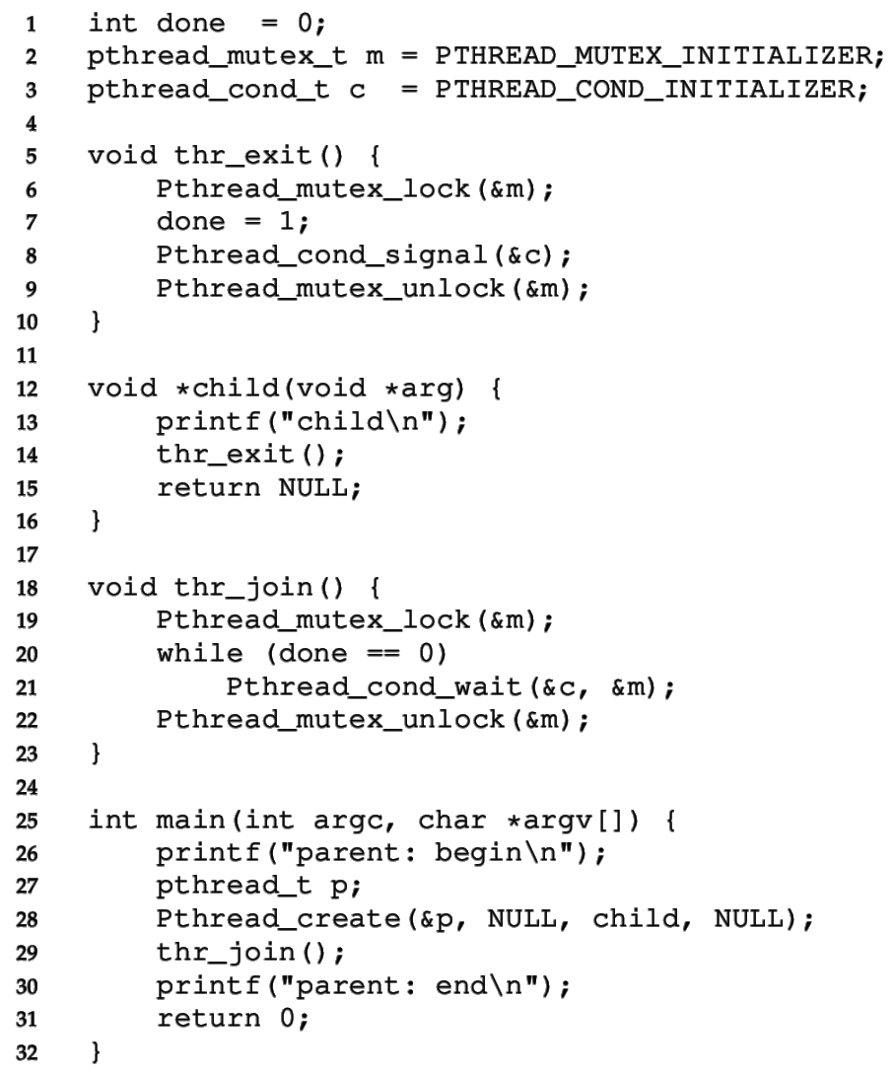
CV for child wait
Must use mutex to protect “done” flag and condvar
  Done flag tracks the event
  Condvar is used for ordering
  Mutex protects both!

Slide 24
CV for child wait
Must use mutex to protect “done” flag and condvar
Parent calls thr_join()
  wait()’s until done==1

Slide 25
CV for child wait
Must use mutex to protect “done” flag and condvar
Parent calls thr_join()
  wait()’s until done==1
Child calls thr_exit()
  sets done to 1
  calls signal()
  unlocks mutex

Slide 26
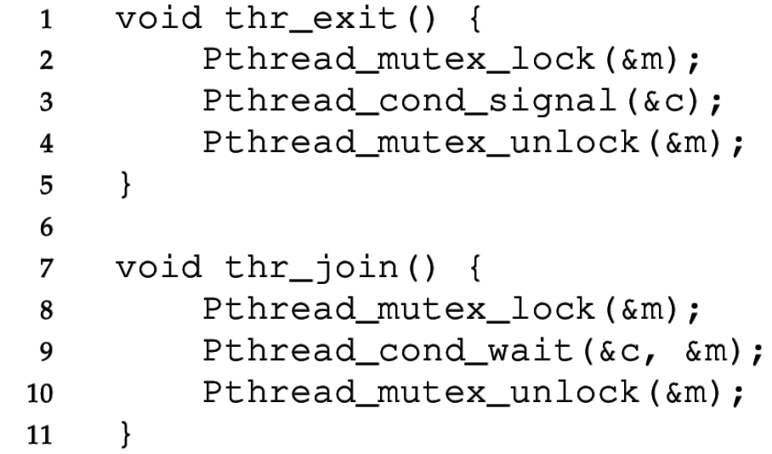
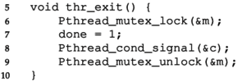
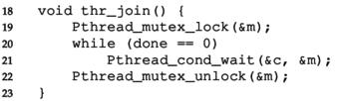
Check your understanding: why doesn’t this work?
Incorrect Code
Correct Code
Parent Child
Consider if an ordering exists that would lead to incorrect behavior
  Lock means that only one critical section will run at a time

Slide 27
Buggy attempts to wait for a child, no flag
Incorrect Code
Correct Code
Parent Child
Without done variable:
  The child could run first and signal
  Before the parent starts waiting for the child
  Parent waits forever…

Slide 28
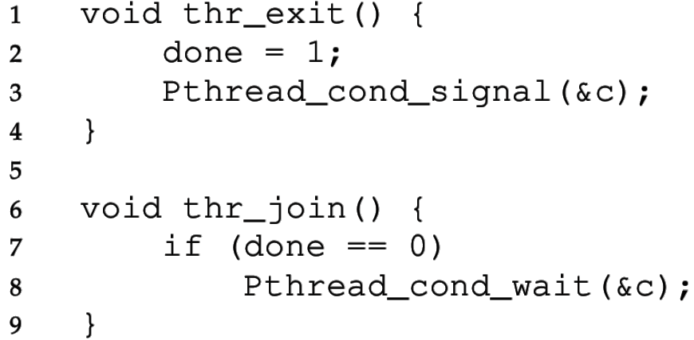
Check your understanding: is a lock necessary?
Incorrect Code
Correct Code
Parent Child
What could go wrong?
  Without the lock, these lines could be interleaved in any way

Slide 29
Buggy attempts to wait for a child, no mutex
Incorrect Code
Correct Code
Parent Child
Without the lock:
  Parent could see done == 0 and enter the if statement
  Child could then exit, setting done to 1 and signaling
  Parent then calls wait (missed the signal) and waits forever

Slide 30
Always use a loop to check the flag variable
It’s possible for the thread
to wake up from a wait, but
the resource is not available!
Maybe another thread took the resource first
  Another thread could run and claim it before the woken thread is scheduled
Maybe a spurious wakeup occurred
  Often other sources can cause wakeups to occur
    Signals or Interrupts usually
  Makes the implementation of condvar simpler, and we need to double-check the flag anyways, so it doesn’t matter

Slide 31
Must check condition within a loop
Thread 1 is working on the resource (claimed the lock already)
Thread 2 calls condvar_wait()
Thread 1 does some work, calls condvar_signal()
Before Thread 2 is scheduled, Thread 3 executes and skips the wait because the resource is ready!
Now Thread 2 will run, but the resource will not be ready
There is no guarantee that the condition you’ve been waiting for is true when you are awoken
So, we must also use a “predicate loop.” (while, not if)

Slide 32
Spurious (fake) wakeups
Pthreads allows wakeup to return not just when a signaled, but also when a timer expires or for no reason at all!
Spurious wakeups were included in the specification because they may allow some implementations be more efficient.
Should be safe since we have to wait with a while loop anyways

Slide 33
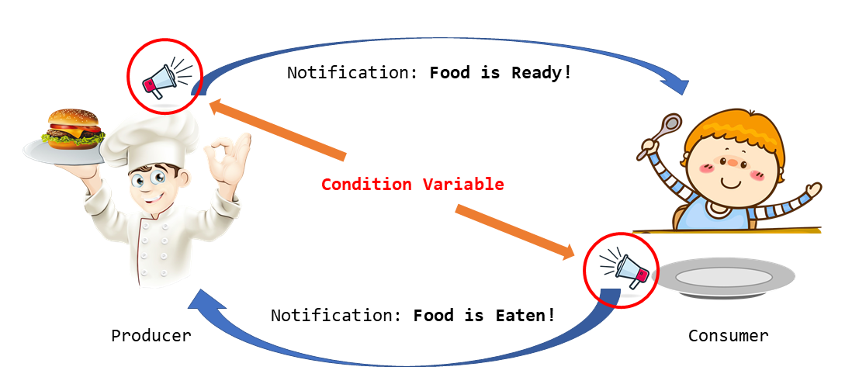
Classical concurrency problem: Producer-Consumer

Slide 34
Produce/Consumer Example Details
We have multiple producers and multiple consumers that communicate with a shared queue (FIFO buffer).
  Concurrent queue allows work to happen asynchronously.
  Buffer has finite size (does not dynamically expand)
Two operations:
  Put, which should block (wait) if the buffer is full.
  Get, which should block (wait) if the buffer is empty.
This is more complex than a (linked-list-based) concurrent queue because of the finite size and waiting.
Example scenario: request queue in a multi-threaded web server.

Slide 35
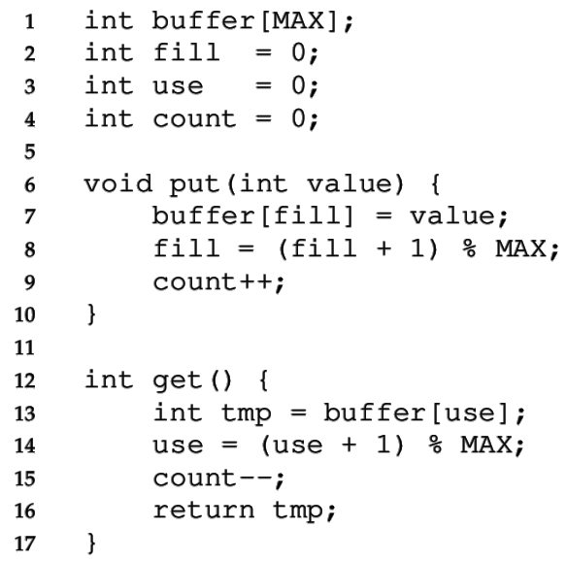
Managing the buffer
A simple implementation of a circular buffer that stores data in a fixed-size array.
fill is the index of the tail
use is the index of the head
count is the number of items
This simple implementation assumes:
Concurrency is managed elsewhere
It will overwrite data if we try to put more than MAX elements.
35

Slide 36
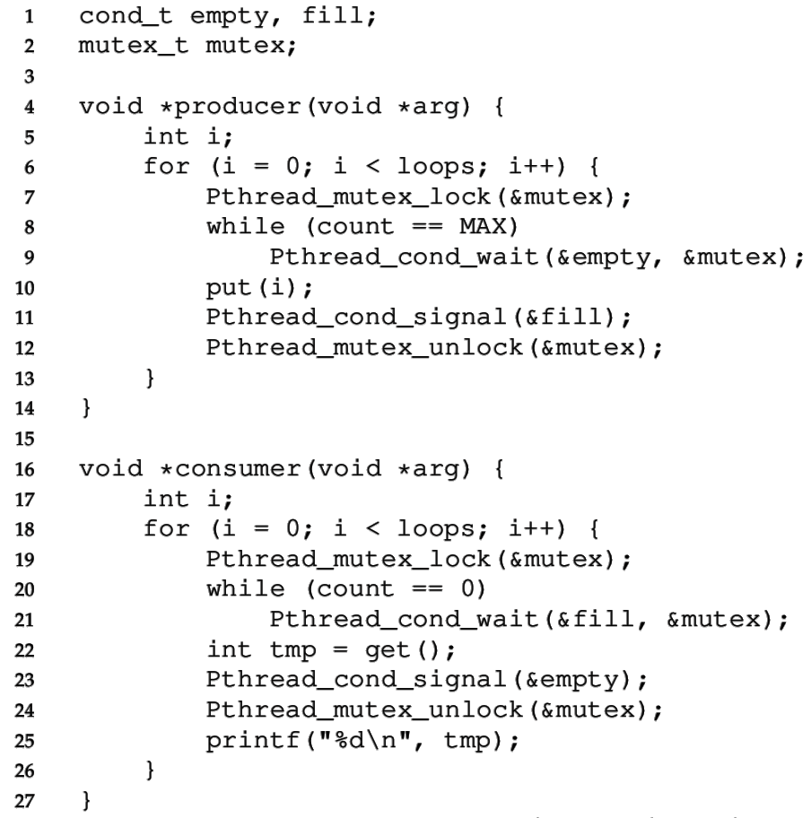
Managing the concurrency
Always acquire mutex
  Must use same mutex in both functions
Use two condvars
36

Slide 37
Managing the concurrency
Always acquire mutex
  Must use same mutex in both functions
Use two condvars
Producer waits on empty while the buffer is full
  Producer signals fill after put
37

Slide 38
Managing the concurrency
Always acquire mutex
  Must use same mutex in both functions
Use two condvars
Producer waits on empty while the buffer is full
  Producer signals fill after put
Consumer waits on fill while the buffer is empty
  Consumer signals empty after get
38

Slide 39
Managing the concurrency
Always acquire mutex
  Must use same mutex in both functions
Use two condvars
Producer waits on empty while the buffer is full
  Producer signals fill after put
Consumer waits on fill while the buffer is empty
  Consumer signals empty after get
Loops re-check count condition after breaking out of wait, to check that there really is a resource
39

Slide 40
Broadcast makes more complex conditions possible
Recall that signal wakes one waiting thread (FIFO)
  But there are times when threads are not all equivalent
  The signal may not be serviceable by any of the threads
For example, consider memory allocation/free requests
  An allocation can only be serviced by free of >= size
pthread_cond_broadcast wakes all threads
  This approach may be inefficient, but it may be necessary to ensure progress

Slide 41
Condition Variable: rules of thumb
Shared state determines if condition is true or not
  Check the state in a while loop before waiting on condvar
Use a mutex to protect:
  The shared state on which condition is based, and
  Operations on the condvar itself
Use different condvars for different conditions
  Sometimes, cond_broadcast() helps if you can’t find an elegant solution using cond_signal()

Slide 42
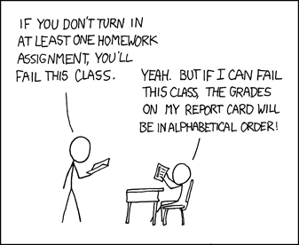
Break + xkcd (not relevant, just funny)
https://xkcd.com/336/

Slide 43
Outline
Applying Locks
Ordering with Condition Variables
Semaphores
Synchronization Bugs

Slide 44
Generalizing Synchronization
Condvars have no state or lock, just a waiting queue
  The rest is handled by the programmer
Semaphores are a generalization of condvars and locks
  Includes internal (locked) state
  A little harder to understand and use, but can do everything

Slide 45

Semaphores (by Edsger Dijkstra, 1965)
Keeps an internal integer value that determines
what happens to a calling thread
Init(val)
  Set the initial internal value
  Value cannot otherwise be directly modified
Up/Signal/Post/V() (from Dutch verhogen “increase”)
  Increase the value. If there is a waiting thread, wake one.
Down/Wait/Test/P() (from Dutch proberen “to try”)
  Decrease the value. Wait if the value is negative.
Dijkstra invented Dijkstra’s Algorithm!
Also Semaphores and the entire field of Concurrent Programming
https://en.wikipedia.org/wiki/Edsger_W._Dijkstra

Slide 46
Semaphores vs Condition Variables
Semaphores
Condition Variables
Up/Post: increase value and wake one waiting thread
Down/Wait: decrease value and wait if it’s negative
Signal: wake one waiting thread
Wait: wait
Compared to CVs, Semaphores add an integer value that controls when waiting is necessary
  Value counts the quantity of a shared resource currently available
  Up makes a resource available, down reserves a resource
  Negative value -X means that X threads are waiting for the resource

Slide 47
Check your understanding: build a mutex
How would we build a mutex out of a semaphore?
  typdef struct {
  sem_t sem;
  } lock_t;
  init(lock_t* lock){
  }
  acquire(lock_t* lock) {
  }
  release(lock_t* lock) {
  }
sem_init(sem_t*, int initial)
sem_wait(sem_t*): Decrement, wait until
value >= 0
sem_post(sem_t*): Increment value then
wake a single waiter

Slide 48
Check your understanding: build a mutex
How would we build a mutex out of a semaphore?
  typdef struct {
  sem_t sem;
  } lock_t;
  init(lock_t* lock){
  sem_init(&(lock->sem), 1);
  }
  acquire(lock_t* lock) {
  sem_wait(&(lock->sem));
  }
  release(lock_t* lock) {
  sem_post(&(lock->sem));
  }
sem_init(sem_t*, int initial)
sem_wait(sem_t*): Decrement, wait until
value >= 0
sem_post(sem_t*): Increment value then
wake a single waiter

Slide 49
Explanation of semaphore mutex implementation
  typdef struct {
  sem_t sem;
  } lock_t;
  init(lock_t* lock){
  sem_init(&(lock->sem), 1);
  }
  acquire(lock_t* lock) {
  sem_wait(&(lock->sem));
  }
  release(lock_t* lock) {
  sem_post(&(lock->sem));
  }
The semaphore value represents the number of resources available
  For a lock, there is 1 available initially
Acquiring the lock might give it to you immediately
  Or it might wait
  Multiple threads could be waiting
Releasing the lock only occurs after acquiring and resets it to 1

Slide 50
Semaphores reduce effort for numerical conditions
Condition Variable
Semaphore
void thr_exit() {
sem_post(&s);
}
void thr_join() {
sem_wait(&s);
}
// somewhere before all of this
sem_init(&s, 0);
Parent Child
Want parent to wait immediately so initialize to 0
If child thread finishes first, semaphore increments to 1
Resource: number of threads completed

Slide 51
Readers-Writers Problem
Some resources don’t need strict mutual exclusion, especially if they have many read-only accesses. (eg., a linked list)
Any number of readers can be active simultaneously, but
Writes must be mutually exclusive AND cannot happen during read
API:
  acquire_read_lock(), release_read_lock()
  acquire_write_lock(), release_write_lock()

Slide 52
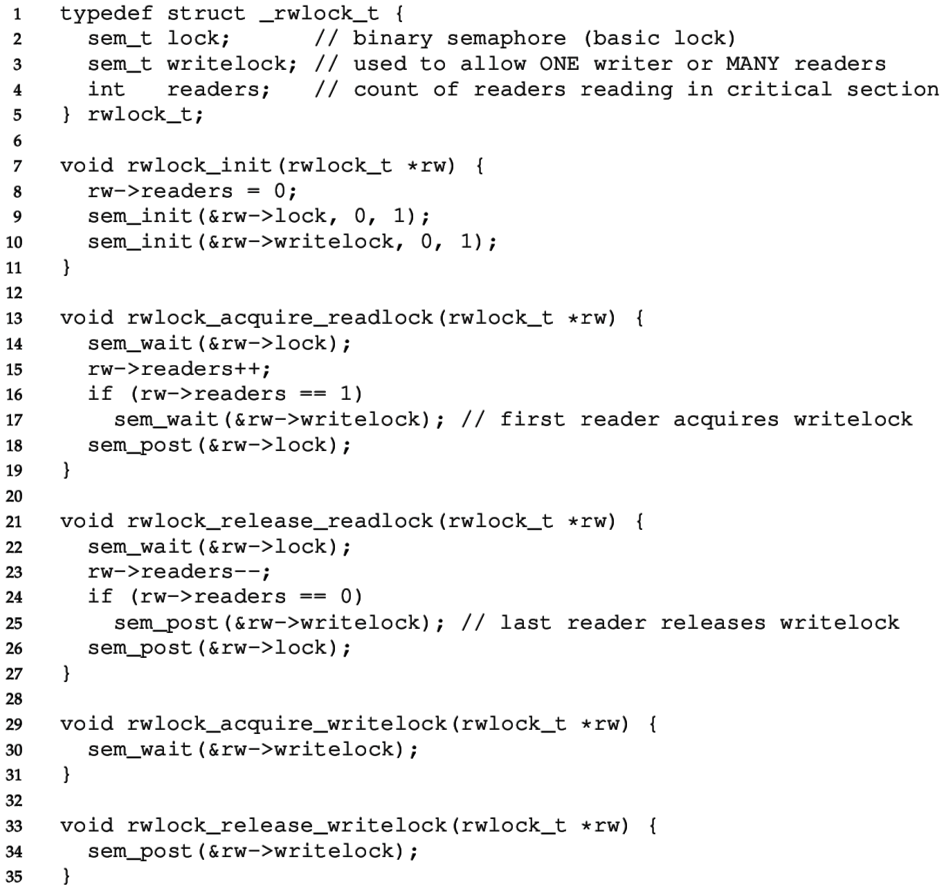
Reader-writer Lock
“lock” semaphore used as a mutex

Slide 53
Reader-writer Lock
“writelock” must be held during read to block writes or during write to block reads.
During reads
  Number of active readers is counted.
  First/last reader handles acquiring/releasing writelock.

Slide 54
Classical concurrency problems
Note that this particular solution could starve writers
  There might always be readers in the critical section
Full solution to readers-writers problem with progress guarantee
  https://en.wikipedia.org/wiki/Readers%E2%80%93writers_problem
Generally: try to map your problem to one of these solved problems
  Producers/Consumers or Readers/Writers
  There are MANY solutions to these problems available online

Slide 55
Outline
Applying Locks
Ordering with Condition Variables
Semaphores
Synchronization Bugs

Slide 56
Common synchronization bugs
Atomicity violation
  Critical section is violated (due to missing lock)
Order violation
  Something happens sooner (or later) than expected
Deadlock
  Two threads wait indefinitely on each other
Livelock (not that common in practice)
  Two threads repeatedly block each other from proceeding and retry

Slide 57
Atomicity violation
It’s not too bad to find and protect critical sections,
  But often we forget to add locks around other uses of the shared data.
Obvious critical section is here:
  Two threads should not enter this at once
But, we also have to make sure that file
is not modified elsewhere.
Even if this one-line close was atomic we
have to make sure it doesn’t run during
the above critical section.
Main Thread
lock(lck);
if (file == NULL) {
file = open("~/myfile.txt");
}
write(file, "hello file");
unlock(lck);
…
Some Other Thread
close(file); // whoops!!

Slide 58
Order violation
Code often requires a certain ordering of operations, especially:
  Objects must be initialized before they’re used
  Objects cannot be freed while they are still in use
Parent
file = open("file.dat");
thread_create(child_fcn);
// do some work
…
close(file);
Child Thread
child_fcn() {
write(file, "hello");
}
Close must happen after write, but code does not enforce this ordering.

Slide 59
Why is this difficult?
It seems like we can just add lots of locks and semaphores to be safe, right?
  Still tricky! Too many locks can cause deadlock – indefinite waiting.
How about just one big lock?
  (+) Cannot deadlock with one lock (unless there are interrupts)
  (–) However, this would limit concurrency
    If every task requires the same lock, then unrelated tasks cannot proceed in parallel.
Concurrent code is always difficult to write ☹
  Although somewhat easier with some higher-level languages

Slide 60
Deadlock
A concurrency bug arising when:
  Two threads are each waiting for the other to release a resource.
  While waiting, the threads cannot release the resource already held.
    Or at least do not release it
  So the two threads wait forever.
Can arise when multiple shared resources are used.
  For example, acquiring two or more locks.

Slide 61
Deadlock versus starvation
Honk!
Each segment of road can be viewed as a resource
  Car must own the segment under them
  Must acquire segment that they are moving into
Deadlock: Two cars in opposite directions meet in middle
Starvation (not deadlock): Eastbound traffic doesn’t stop for westbound traffic

Slide 62
Locking granularity
Coarse grained lock:
  Use one (or a few) locks to protect all (or large chunks of) shared state
  Linux kernel < version 2.6.39 used one “Big Kernel Lock”
  Essentially only one thread could run kernel code
  It’s simple but there is much contention for this lock, and concurrency is limited
Fine grained locks:
  Use many locks, each protecting small chunks of related shared state
  Leads to more concurrency and better performance
  However, there is greater risk of deadlock

Slide 63
Outline
Applying Locks
Ordering with Condition Variables
Semaphores
Synchronization Bugs

