Slide 1
Lecture 05: Concurrency Sources and Challenges
CS343 – Operating Systems
Branden Ghena – Spring 2024
Some slides borrowed from: Stephen Tarzia (Northwestern), and UC Berkeley CS61C and CS162

Slide 2
Administrivia
Get started on Scheduling Lab right away!
Getting Started lab was NOT an accurate representation of workload
Don’t plan on being able to get schedulers working at the last minute
Scheduling Lab debugging tip:
Make your own workloads, do the math on their metrics, then test on them
That’s the only way to know for sure that your scheduler is right
We will test on many workloads that have not been provided to you

Slide 3
Today’s Goals
Describe where and why concurrency and parallelism are involved in computing.
Be disappointed by performance limits on concurrency.
Introduce concept of data races as a concurrency problem.

Slide 4
Outline
Real Time Operating Systems
Earliest Deadline First scheduling
Rate Monotonic scheduling
Modern Operating Systems
Linux O(1) scheduler
Lottery and Stride scheduling
Linux Completely Fair Scheduler

Slide 5
Proportional-share scheduling is impossible instantaneously
Goal: each process gets an equal share of processor
N threads “simultaneously” execute on 1/N^{th} of processor
Doesn’t work in the real world
Jobs block on I/O
OS needs to give out timeslices
At any time t we want to observe:
CPU Time
t/N
T₁
T₂
T₃

Slide 6
Linux Completely Fair Scheduler (CFS) (2007-2023)
What if we make shares proportional over a longer period?
Track processor time given to job so far
Scheduling decision
Choose thread with minimum processor time to schedule
“Repairs” illusion of fairness
Update processor time when the scheduling occurs again
Timeslice expiration is a big update
Blocking I/O results in maintaining small processor time
T₁
CPU Time
t/N
T₃
T₂

Slide 7
Modern scheduling is not easy
Getting scheduling right on multicore can be difficult
No way to know whether a process will be more I/O or CPU bound in the future
Want to keep threads on the same core, but also not waste cores
In 2016, researchers found issues in Linux scheduler implementation that lead to 13%+ slowdown in jobs
https://blog.acolyer.org/2016/04/26/the-linux-scheduler-a-decade-of-wasted-cores/

Slide 8
Modern scheduling challenges
Fair sharing of CPU time is insufficient
Maximize cache usage
Maximize processor affinity
Reduce energy consumption
Hybrid systems with heterogeneous processing capabilities
Particular focus: latency requirements
Some processes need to respond quickly to new data
They don’t need more processing time. They need the time more quickly
Heuristic shortcuts were added to CFS to allow some jobs to jump the queue

Slide 9
Earliest Eligible Virtual Deadline First (EEVDF) (2023-Present)
Algorithm first described in a 1995 research paper
Run job with earliest “virtual deadline”
TLDR: share processor time proportionally, but schedule within that based on latency
Still divides processor time equally between jobs, like CFS
Biased by priority of the job. Higher priority means larger share
Calculate “lag” for each job
Measurement of how far it’s behind a fair share of processor time
Negative lag means a job has run more than its fair share already
Job won’t be eligible to run until lag >= 0
Lag increases automatically as other jobs run. So time until lag >= 0 can be calculated
Virtual deadline for job: time until lag >= 0, plus duration it should run for
Now + timeslice for any jobs below fair share of processor time
Future + timeslice for any jobs above fair share of processor time
Where timeslices vary by priority of the job
https://lwn.net/Articles/925371/

Slide 10
Multicore scheduling
Affinity scheduling: once a thread is scheduled on a CPU, OS tries to reschedule it on the same CPU
Cache reuse
Grouping threads could help or hurt…
Soft affinity: make this a goal of the system
Not always achieved
Hard affinity: allow some jobs to demand guaranteed affinity
Process/Thread can tell the kernel which core it should be run on

Slide 11
Single queue multicore scheduling
Simplest approach to multicore scheduling
Keep one global queue of all jobs to be run
Whenever a processor becomes idle, grab the next job from the queue
Essentially, exactly the single-core strategy, but with more cores
Downsides
Odds are that a job will run on a different core next time
So state for the job won’t be in the per-core cache
Only one core can modify the queue at a time
See data race issues we’ll talk about today

Slide 12
Multi-queue multicore scheduling
Keep one queue of jobs for each core
Ensures that jobs stay on a single core when running
Need to balance work among cores somehow
Might have one core with many jobs and another that’s idle
Work stealing: when a processor is idle, look at other processor’s queues and take a job from them
Still undermines affinity goals, but hopefully worth it?
Complicated to scale out to many cores

Slide 13
Summary on schedulers
If You care About: | Then Choose:
CPU Throughput | First-In-First-Out
Average Turnaround Time | Shortest Remaining Processing Time
Average Response Time | Round Robin
Favoring Important Tasks | Priority
Fair CPU Time Usage | Linux CFS or EEVDF
Meeting Deadlines | EDF or RMS

Slide 14
Outline
Threads Review
Need for Parallelism
Processor Concurrency
Concurrency Challenges
Amdahl’s Law
Data Races

Slide 15
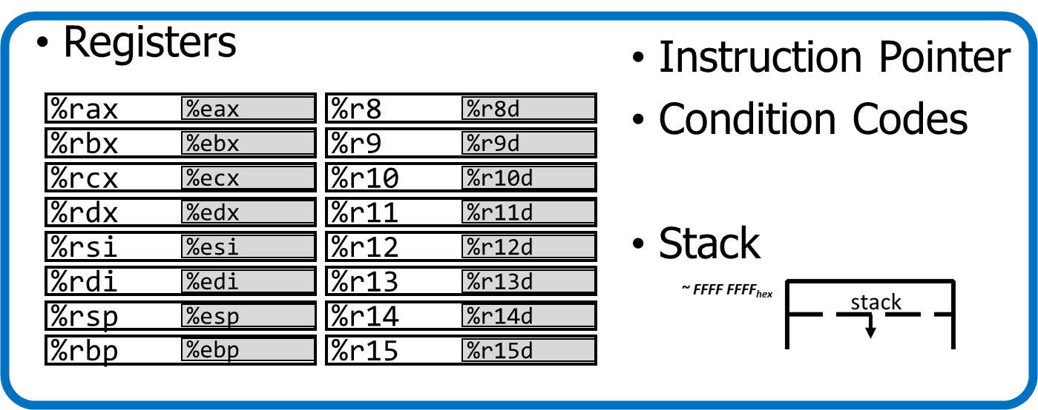
Processes and threads
A process could have multiple threads
Each with its own registers and stack
Threads have separate:
Instruction Pointer
Registers
Stack Memory
Condition Codes
Threads share:
Code
Global variables
Code and Data

Slide 16
Thread use case: web server
Example: Web server
Receives multiple simultaneous requests
Reads web pages from disk to satisfy each request

Slide 17
Web server option 3: multi-threaded web server
One thread per request. Thread handles only that request.
Easy to program (maybe), and fast!
State is stored in the stacks of each thread and the thread scheduler
Simple to program if they are independent…
Main Thread
Request 1 arrives
Create thread
Request 2 arrives
Create thread
Thread 1
Read in request 1
Start disk I/O
Disk I/O finishes
Respond to request 1
Exit
Thread 2
Read in request 2
Start disk I/O
time

Slide 18
Models for thread libraries: User Threads
Thread scheduling is implemented within the process
OS only knows about the process, not the threads
Upsides
Works on any hardware or OS
Performance is better when creating and switching
Downsides
A system call in any thread blocks all threads
Processes
Thread Library
OS Kernel
Scheduler

Slide 19
Models for thread libraries: Kernel Threads
Thread scheduling is implemented by the operating system
OS manages the threads within each process
Upsides
Other threads can continue while one blocks on I/O
No additional scheduler
Downsides
Higher overhead
This is what we’ll focus on in CS343
Processes
OS Kernel
Scheduler

Slide 20
POSIX Threads Library: pthreads
https://man7.org/linux/man-pages/man7/pthreads.7.html
int pthread_create(pthread_t *thread, const pthread_attr_t *attr, void *(*start_routine)(void*), void *arg);
thread is created executing start_routine with arg as its sole argument.
return is implicit call to pthread_exit
void pthread_exit(void *value_ptr);
terminates the thread and makes value_ptr available to any successful join
int pthread_join(pthread_t thread, void **value_ptr);
suspends execution of the calling thread until the target thread terminates.
On return with a non-NULL value_ptr the value passed to pthread_exit() by the terminating thread is made available in the location referenced by value_ptr.

Slide 21
Pthread system call example
What happens when pthread_create() is called in a process?
Library:
int pthread_create(…) {
Do some work like a normal function
Put syscall number into register
Put args into registers Special trap instruction
clone (56) syscall on Linux
Kernel:
Get args from regs
Do the work to spawn the new thread
Store return value in %eax
Get return values from regs
Do some more work like a normal function
};

Slide 22
Threads versus Processes
Threads
pthread_create()
Creates a thread
Shares all memory with all threads of the process.
Scheduled independently of parent
pthread_join()
Waits for a particular thread to finish
Can communicate by reading/writing (shared) global variables.
Processes
fork()
Creates a single-threaded process
Copies all memory from parent
Can be quick using copy-on-write
Scheduled independently of parent
waitpid()
Waits for a particular child process to finish
Can communicate by setting up shared memory, pipes, reading/writing files, or using sockets (network).

Slide 23
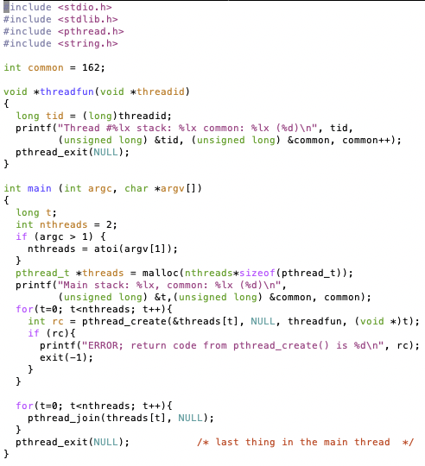
Threads Example

Slide 24
Threads Example
Reads N from process arguments
Creates N threads
Each one prints a number, then increments it, then exits
Main process waits for all of the threads to finish

Slide 25
Threads Example

Slide 26
Threads Example
Left: Every thread has its own stack
Right: Every thread shares global memory

Slide 27
Break + Check your understanding
How many threads are in this program?
Does the main thread join with the threads in the same order that they were created?
Do the threads exit in the same order they were created?
If we run the program again, could the result change?

Slide 28
Break + Check your understanding
How many threads are in this program? Five
Does the main thread join with the threads in the same order that they were created? Yes
Do the threads exit in the same order they were created? Maybe??
If we run the program again, could the result change? Possibly!

Slide 29
Outline
Threads
Need for Parallelism
Processor Concurrency
Concurrency Challenges
Amdahl’s Law
Data Races

Slide 30
It’s the mid 1990s and you work at Microsoft.
You need to double the speed of Excel in two years.
What do you do?

Slide 31
It’s the mid 1990s and you work at Microsoft.
You need to double the speed of Excel in two years.
What do you do? Take a vacation

Slide 32
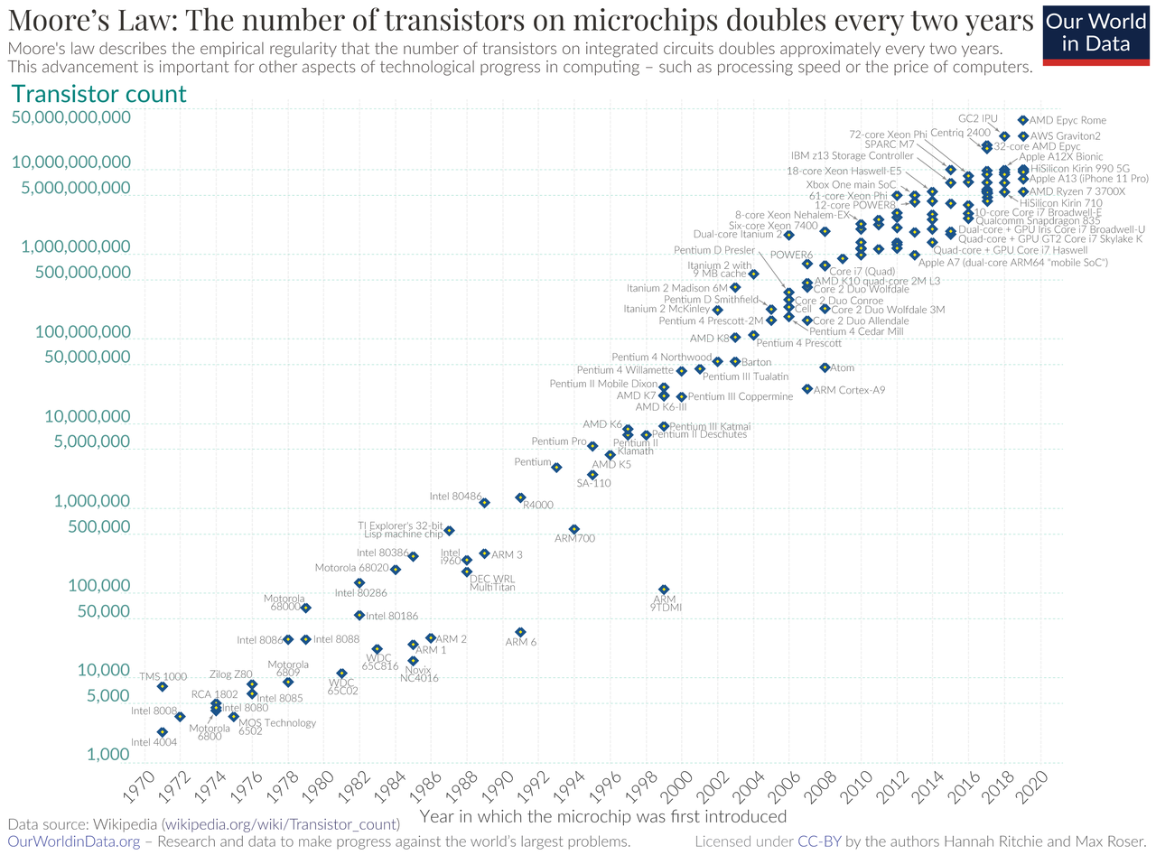
Moore’s Law – CPU transistors counts
“Number of transistors in a chip doubles every 18 months”
How? Transistors are getting exponentially smaller!
How small? Today: <7nm! (maybe smaller, kind of complicated)
< ½ the size of most viruses!
Notes:
Gordon Moore – first version of the law – ’65: double every year; restated in ‘75: double every two years
Was simplified to “every 18 months”

Slide 33
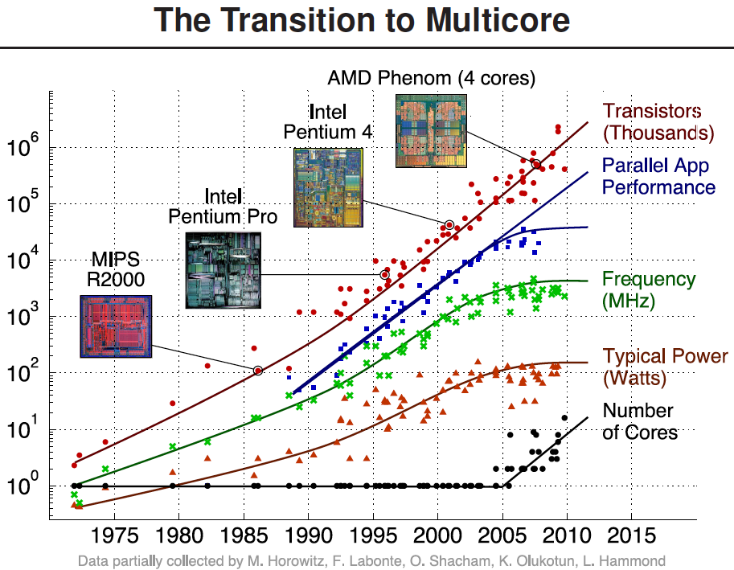
Processors kept getting faster too

Slide 34
Power is a major limiting factor on speed
We could make processors go very fast
But doing so uses more and more power
More power means more heat generated
And chips typically work up to around 100°C
Hotter than that and things stop working
We add heat sinks and fans and water coolers to keep chips cool
But it’s hard to remove heat quickly enough from chips
So, power consumption ends up limiting processor speed

Slide 35
Denard Scaling
Moore’s Law corollary: Denar Scaling
As transistors get smaller, the power density stays the same
Which is to say that the power-per-transistor decreases!
Making the processor clock speed faster uses more power
But the two balance out for roughly net even power
So not only do we get more transistors, but chip speed can be faster too
From our Excel example:
In two years, new hardware would run the existing software twice as fast

Slide 36
Then they stopped getting faster
~2006: Leakage current becomes significant
Now smaller transistors doesn’t mean lower power

Slide 37
So… now what?
In summary:
Making transistors smaller doesn’t make them lower power,
so if we were to make them faster, they would take more power,
which will eventually lead to our processors melting…
and because of that, we can’t reliably make performance better by waiting for clock speeds to increase.
How do we continue to get better computation performance?

Slide 38
Exploit parallelism!

Slide 39
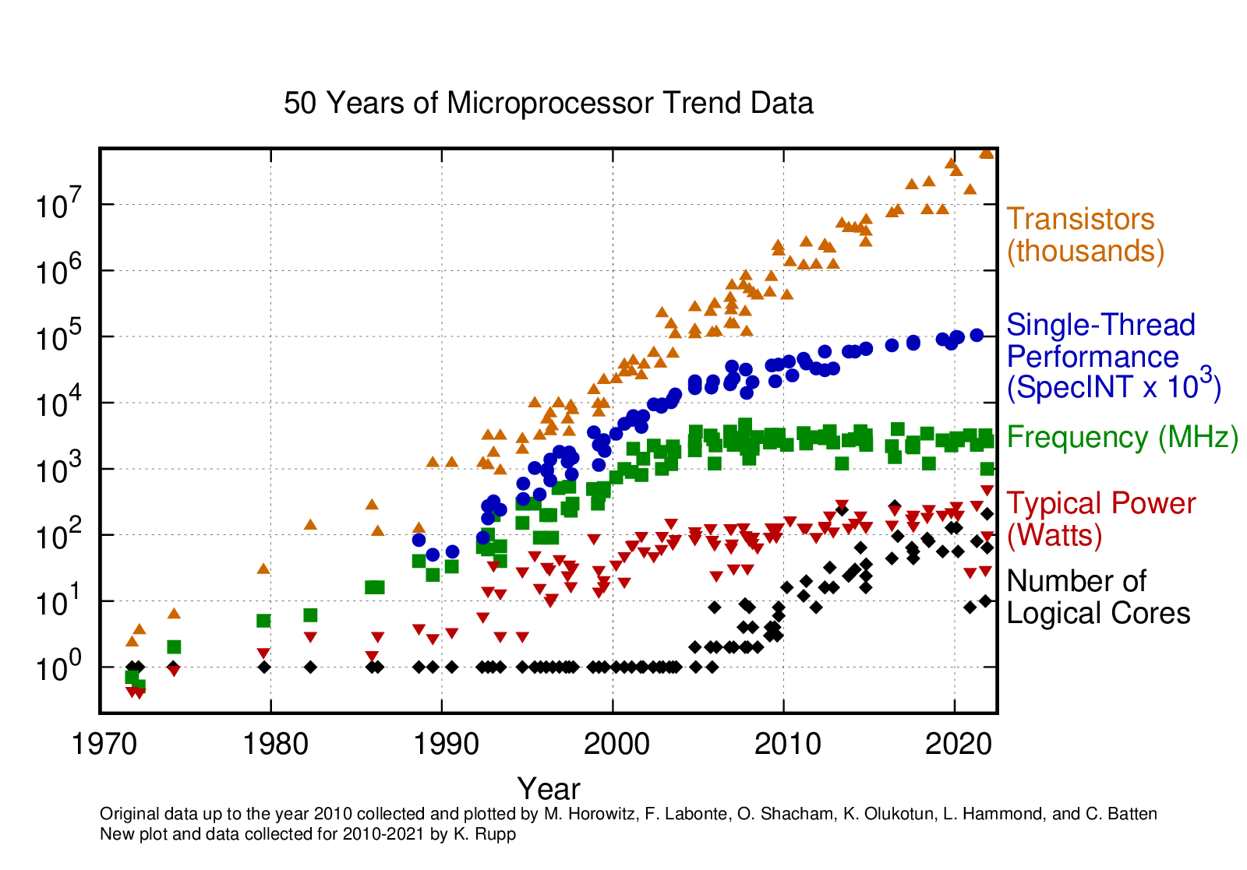
Update: 2010-2021
Still growing!
Small improvement
Stable
Stable
Still growing for servers

Slide 40
Key question: how do we use all these cores?

Slide 41
Break + Parallelism Analogy
I want to peel 100 potatoes as fast as possible:
I can learn to peel potatoes faster
OR
I can get 99 friends to help me
Whenever one result doesn’t depend on another, doing the task in parallel can be a big win!

Slide 42
Outline
Threads
Need for Parallelism
Processor Concurrency
Concurrency Challenges
Amdahl’s Law
Data Races

Slide 43
Parallelism versus Concurrency
Two processes A and B
A
B
time
Serial execution
Parallel execution
Concurrent execution
A
B
time
A
B
time
time
A
OR
B

Slide 44
Parallelism versus Concurrency
Parallelism
Two things happen strictly simultaneously
Concurrency
More general term
Two things happen in the same time window
Could be simultaneous, could be interleaved
Concurrent execution occurs whenever two processes are both active
time
time
time
A
OR
B
OR

Slide 45
Hardware sources of concurrency
Instruction-level parallelism
Task parallelism
Multiple processes
Multiple threads

Slide 46
Hardware sources of concurrency
Instruction-level parallelism
Task parallelism
Multiple processes
Multiple threads

Slide 47
Model of a processor
CPU
Updated
Registers and
Memory
Instructions,
Registers,
Memory
CPU
Instruction Fetch
Instruction Decode
Execute
Memory
Writeback

Slide 48
But instructions don’t always have to be executed in order
movq (%rdi), %rax movq (%rsi), %rdx movq %rdx, (%rdi) movq %rax, (%rsi) addq %rcx, %rbx
We can apply the multiprogramming approach of executing this addq while the movq is waiting on memory.
Doesn’t have to go after the movq instructions because it uses different registers

Slide 49
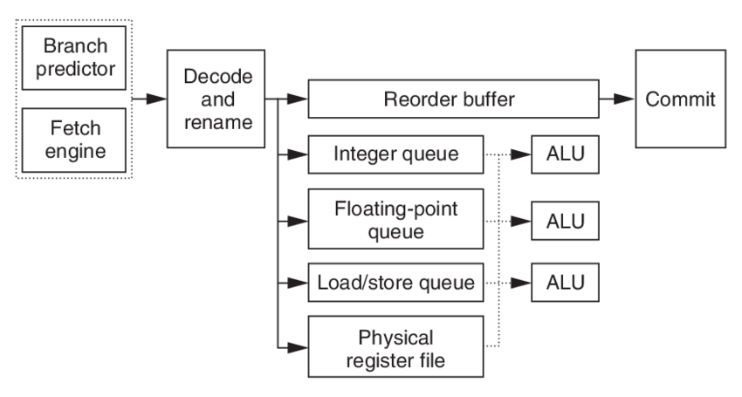
Out-of-order processors
Reorder instructions to make best use of CPU
Commit, or “write back” data to memory and regfile in the order the programmer expects
Fetch many instructions at once!
Read register file, handle data dependencies with register renaming
Generally: looks for independent instructions it can execute early

Slide 50
Out-of-order processors obey normal execution results
Initial thoughts on out-of-order execution
😱
The processor could be executing my program in order it feels like?!!
How do I possibly reason about anything?
Answer: the processor promises to have the same results as if things were done in the normal order.
CPU
Updated
Registers and
Memory
Instructions,
Registers,
Memory

Slide 51
Multiple threads might rely on memory ordering
The processor can’t account for multiple threads though
If memory results are shared by two threads, the processor might mess something up for you.
What will Thread 1 print?
f = 0;
x = 0;
// split into threads
Thread 1
Thread 2
while (f == 0);
printf(“%d\n”, x);
x = 42;
f = 1;

Slide 52
Multiple threads might rely on memory ordering
The processor can’t account for multiple threads though
If memory results are shared by two threads, the processor might mess something up for you.
What will Thread 1 print? Could be 42. Could be 0.
f = 0;
x = 0;
// split into threads
Thread 1
Thread 2
while (f == 0);
printf(“%d\n”, x);
x = 42;
f = 1;
This can be addressed with memory barriers

Slide 53
Hardware sources of concurrency
Instruction-level parallelism
Task parallelism
Multiple processes
Multiple threads

Slide 54
Task parallelism use case
Run Chrome and Spotify simultaneously
Each are separate programs
Each has a different memory space
Each can run on a separate core
Don’t even need to communicate...
Note: OS can fake this by interleaving processes, but hardware can make it actually simultaneous

Slide 55
Multicore Systems (in pictures)
Core 0
Memory
Processor 0 Memory Accesses
Control
Datapath
RIP
Bytes
Registers
(ALU)
Core 1
Control
Processor 1 Memory Accesses
Datapath
RIP
Registers
(ALU)
Actually parallel!

Slide 56
Multicore Systems (in words)
A computer system with at least 2 processor cores
Each core has its own registers
Each core executes independent instruction streams
Cores share the same system memory
But usually use different parts of it
Communication possible through memory accesses
Deliver high throughput for independent jobs via task-level parallelism

Slide 57
Hardware sources of concurrency
Instruction-level parallelism
Task parallelism
Multiple processes
Multiple threads

Slide 58
Multithreading processors
Basic idea: Processor resources are expensive and should not be left idle
Long memory latency to memory on cache miss?
Hardware switches threads to bring in other useful work while waiting for cache miss
Cost of thread context switch must be much less than cache miss latency
Switching threads is less expensive than processes because they share memory
Cache is still valid
Page Table for virtual memory doesn’t have to change

Slide 59
Multithreading processor
Processor
Control
Memory
Datapath
RIP 0
RIP 1
Registers 0
Registers 1
(ALU)
Bytes
Two copies of RIP and Registers inside processor hardware
Looks like two processors to software (hardware thread 0, hardware thread 1)
Control logic decides which thread to execute an instruction from next (concurrent, but NOT parallel)
59

Slide 60
Multithreading versus Multicore
Multithreading => Better utilization
≈5% more hardware for ≈1.3x better performance?
Gets to share ALUs, caches, memory controller
Multicore => Duplicate cores
≈50% more hardware for ≈2x better performance?
Share some caches (L2 cache, L3 cache), memory controller
Modern processors might do both!
Multiple cores with multiple threads per core
Not all do though, some focus on better single-thread performance

Slide 61
Multithreading, multicore processors
Combine capabilities of both designs
Run two processes each with two threads
Or run one process with four threads
Processor
Memory
Control
Processor 0 Memory Accesses
Datapath
RIP 0
RIP 1
Registers 0
Registers 1
Bytes
(ALU)
Processor
Control
Processor 1 Memory Accesses
Datapath
RIP 0
RIP 1
Registers 0
Registers 1
(ALU)

Slide 62
Clearing up vocabulary
Core: computation unit within the CPU
ALU, Registers, etc.
Capable of running one or more threads
CPU (processor): the chip that goes in your computer
Contains one or more cores
Computers could have multiple CPU chips as well
Sometimes people equate processors and cores, which is confusing
I’ll definitely do it by mistake at some point if I haven’t already. Sorry!

Slide 63
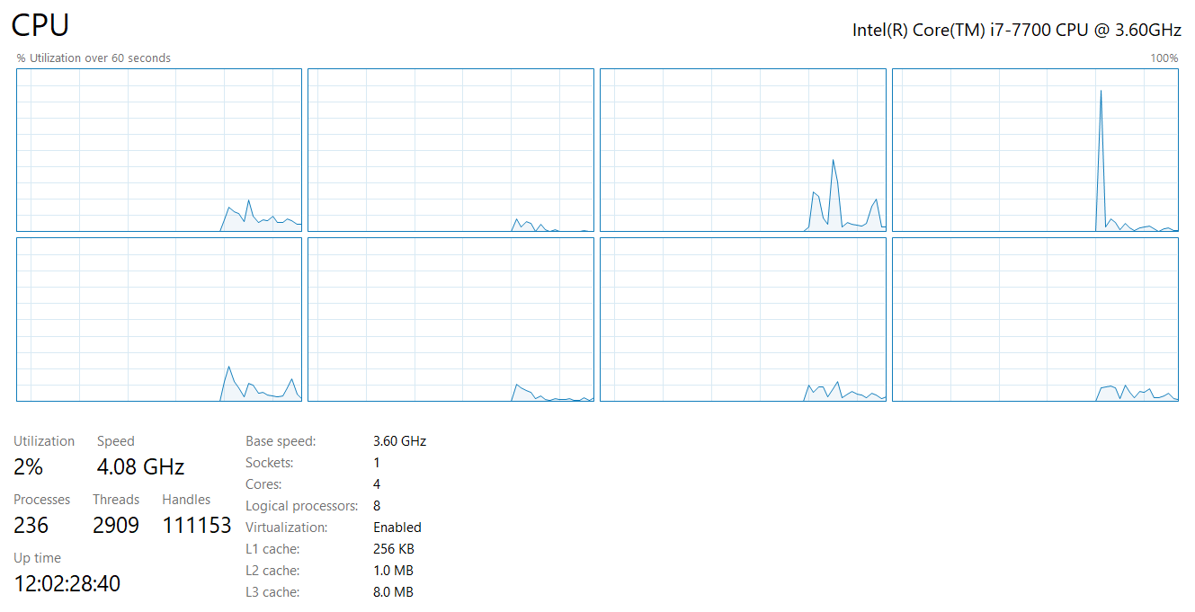
My desktop computer
4 total cores
Each capable of 2 threads
≈ 8 jobs at once

Slide 64
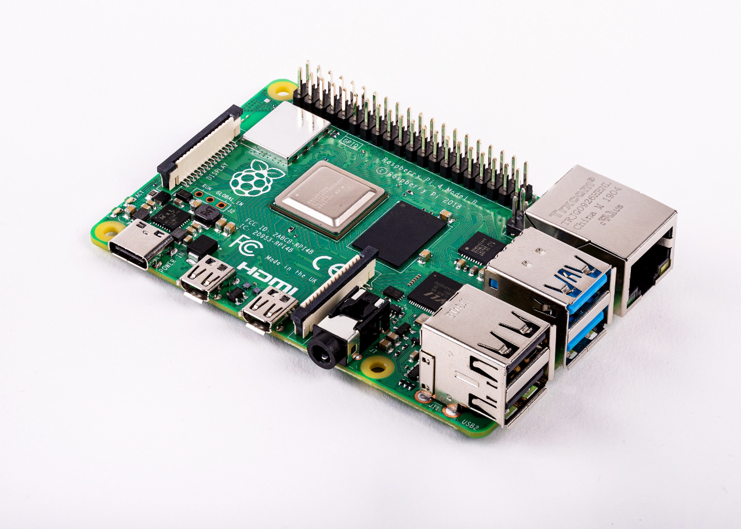
Raspberry Pi 4
Quad core processor
One thread per core
3-way superscalar pipeline
L1 Cache
32 KiB 2-way set associative data cache
48 KiB 3-way set associative instruction cache
Per core
L2 Cache
512 KiB to 4 MiB (shared)
RAM 1-4 GB
$35
Literally all computers are doing parallelism these days

Slide 65
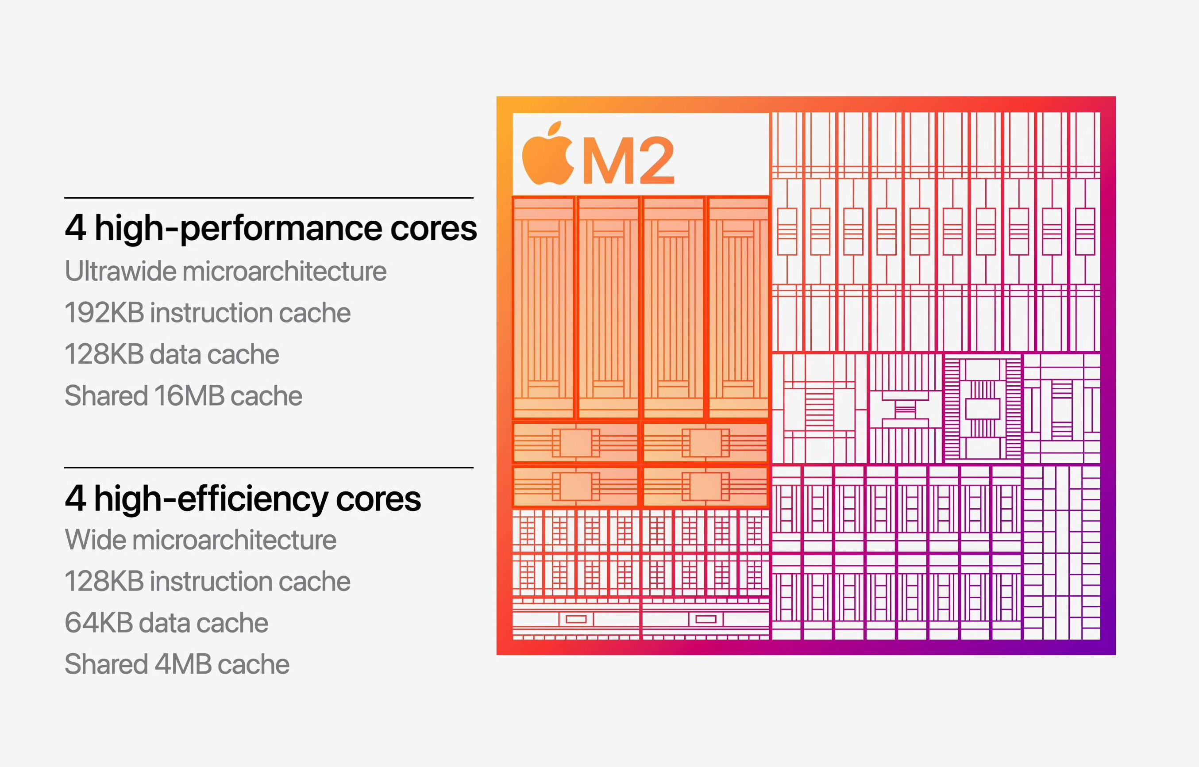
Other modern multicore designs
Heterogeneous multicore
Not all cores are necessarily identical
Enables scheduler to make complicated choices of performance or energy savings
At the cost of a complicated scheduler…

Slide 66
Back up to the OS perspective
Modern operating systems must manage concurrency
Both parallel operation and interleaving operations
Concurrency is valuable
Performance gains are the reason

Slide 67
Break + Real-world Connection
How many cores/threads does your processor support?
Windows: Task Manager -> Performance -> CPU
MacOS: About this Mac -> System Report -> Hardware
Apple ARM M processors only do 1 thread per core
Linux: In terminal: lscpu
Android/iOS: You’ll need to google it

Slide 68
Outline
Threads
Need for Parallelism
Processor Concurrency
Concurrency Challenges
Amdahl’s Law
Data Races

Slide 69
Challenges to concurrency
Concurrency is great! We can do so many things!!
But what’s the downside…?
How much speedup can we get from it?
How hard is it to write parallel programs?

Slide 70
Challenges to concurrency
Concurrency is great! We can do so many things!!
But what’s the downside…?
How much speedup can we get from it?
How hard is it to write parallel programs?

Slide 71
Speedup Example
95 s | 5 s
Imagine a program that takes 100 seconds to run
95 seconds in the blue part
5 seconds in the green part

Slide 72
Speedup from improvements
Speedup with Improvement | = | Execution time without improvement
 |  | Execution time with improvement
95 s | 5 s
5 s -> 2.5 s: Speedup = 100/97.5 = 1.026
5 s -> 1 s: Speedup = 100/96 = 1.042
5 s -> 0.001s: Speedup = 100/95.001 = 1.053
The impact of a performance improvement is relative to the importance of the part being improved!

Slide 73
Amdahl’s Law
Equivalent to prior equation
1
Speedup =
F = Fraction of execution time speed up S = Scale of improvement
(1 - F) + F
Not improved part
S
Improved part
Example: 2x improvement to 25% of the program
1
1
=
=
1.14
0.75 + 0.25
0.75 + 0.125
2

Slide 74
Parallel speedup example
Speedup with improvement | $$= \frac{1}{\left(1−F\right)+(F/S)}$$
Consider an improvement which runs 20 times faster but is only usable 15% of the time
Speedup with improvement | $$= \frac{1}{\left(0.85\right)+(0.15/20)}$$
= 1.166
Nowhere near 20x speedup!
What if it’s usable 25% of the time?
Speedup with improvement | $$= \frac{1}{\left(0.75\right)+(0.25/20)}$$
= 1.311

Slide 75
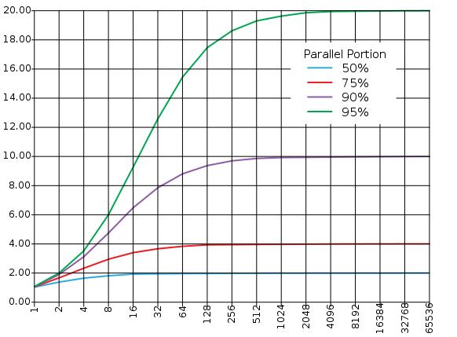
Amdahl’s (heartbreaking) Law (in pictures)
The amount of speedup that can be achieved through parallelism is limited by the non-parallel portion of your program!
And every program has at least some non-parallel parts
Time
Speedup
Parallel
portion
Serial
portion
1
2
3
4
5
Number of Processors
Number of Processors

Slide 76
Amdahl’s (heartbreaking) Law (in words)
Amdahl’s Law tells us that to achieve linear speedup with more processors:
none of the original computation can be serial (non-parallelizable)
To get a speedup of 90 from 100 processors, the percentage of the original program that could be scalar would have to be 0.1% or less
Speedup = 1/(.001 + .999/100) = 90.99

Slide 77
Break + Question
Speedup with improvement | $$= \frac{1}{\left(1−F\right)+(F/S)}$$
50% | 50%
Suppose a program spends 50% of its time in a square root routine.
How much must you speed up square root to make the program run 2x faster?
(A)
10
(B)
20
(C)
100
(D)
None of the above

Slide 78
Break + Question
Speedup with improvement | $$= \frac{1}{\left(1−F\right)+(F/S)}$$
50% | 50%
Suppose a program spends 50% of its time in a square root routine.
How much must you speed up square root to make the program run 2x faster?
Speedup = 1 / [ (1 - F) + (F/S) ]
2 = 1 / [ (1 - 0.5) + (0.5/S)]
S = 0.5 / ((1/2) – 0.5) = ∞
(A)
10
(B)
20
(C)
100
The square root would need to decrease to nothing before you got 2x speedup
(D)
None of the above

Slide 79
Outline
Threads
Need for Parallelism
Processor Concurrency
Concurrency Challenges
Amdahl’s Law
Data Races

Slide 80
Challenges to concurrency
Concurrency is great! We can do so many things!!
But what’s the downside…?
How much speedup can we get from it?
How hard is it to write parallel programs?

Slide 81
Concurrency problem: data races
Consider two threads with a shared global variable: int count = 0
count could end up with a final value of 1 or 2. How?
Thread 1:
void main(){
count += 1;
}
Thread 2:
void main(){
count += 1;
}

Slide 82
Concurrency problem: data races
Consider two threads with a shared global variable: int count = 0
count could end up with a final value of 1 or 2. How?
These instructions could be interleaved in any way.
Assuming “count” is in memory location 0x8049a1c
Thread 1:
void thread_fn(){
mov $0x8049a1c, %edi
mov (%edi), %eax
add $0x1, %eax
mov %eax, (%edi)
}
Thread 2:
void thread_fn(){
mov $0x8049a1c, %edi
mov (%edi), %eax
add $0x1, %eax
mov %eax, (%edi)
}

Slide 83
Data race example – Count = 2
Before this code starts
Thread 1
Register | Value
%eax | ???
Thread 2
Register | Value
%eax | ???
Time
Thread 1 | Thread 2
mov (%edi), %eax
add $0x1, %eax
mov %eax, ($edi)
 | mov (%edi), %eax
 | add $0x1, %eax
 | mov %eax, (%edi)
Memory
Variable | Value
count | 0
Assuming “count” is in memory location pointed to by %edi

Slide 84
Data race example – Count = 2
Thread 1
Register | Value
%eax | 0
Thread 2
Register | Value
%eax | ???
Time
Thread 1 | Thread 2
mov (%edi), %eax
add $0x1, %eax
mov %eax, ($edi)
 | mov (%edi), %eax
 | add $0x1, %eax
 | mov %eax, (%edi)
Memory
Variable | Value
count | 0
Assuming “count” is in memory location pointed to by %edi

Slide 85
Data race example – Count = 2
Thread 1
Register | Value
%eax | 1
Thread 2
Register | Value
%eax | ???
Time
Thread 1 | Thread 2
mov (%edi), %eax
add $0x1, %eax
mov %eax, ($edi)
 | mov (%edi), %eax
 | add $0x1, %eax
 | mov %eax, (%edi)
Memory
Variable | Value
count | 0
Assuming “count” is in memory location pointed to by %edi

Slide 86
Data race example – Count = 2
Thread 1
Register | Value
%eax | 1
Thread 2
Register | Value
%eax | ???
Time
Thread 1 | Thread 2
mov (%edi), %eax
add $0x1, %eax
mov %eax, ($edi)
 | mov (%edi), %eax
 | add $0x1, %eax
 | mov %eax, (%edi)
Memory
Variable | Value
count | 1
Assuming “count” is in memory location pointed to by %edi

Slide 87
Data race example – Count = 2
Thread 1
Register | Value
%eax | 1
Thread 2
Register | Value
%eax | 1
Time
Thread 1 | Thread 2
mov (%edi), %eax
add $0x1, %eax
mov %eax, ($edi)
 | mov (%edi), %eax
 | add $0x1, %eax
 | mov %eax, (%edi)
Memory
Variable | Value
count | 1
Assuming “count” is in memory location pointed to by %edi

Slide 88
Data race example – Count = 2
Thread 1
Register | Value
%eax | 1
Thread 2
Register | Value
%eax | 2
Time
Thread 1 | Thread 2
mov (%edi), %eax
add $0x1, %eax
mov %eax, ($edi)
 | mov (%edi), %eax
 | add $0x1, %eax
 | mov %eax, (%edi)
Memory
Variable | Value
count | 1
Assuming “count” is in memory location pointed to by %edi

Slide 89
Data race example – Count = 2
Thread 1
Register | Value
%eax | 1
Thread 2
Register | Value
%eax | 2
Time
Thread 1 | Thread 2
mov (%edi), %eax
add $0x1, %eax
mov %eax, ($edi)
 | mov (%edi), %eax
 | add $0x1, %eax
 | mov %eax, (%edi)
Memory
Variable | Value
count | 2
Assuming “count” is in memory location pointed to by %edi

Slide 90
Theads do not have guaranteed ordering
BUT, there’s no guarantee that the instructions occur in that order!
Since the two threads are running in parallel, the instructions could be interleaved in any way (both threads are really running simultaneously)

Slide 91
Data race example – Count = 1
Remember, each thread has its own separate registers!
Before this code starts
Thread 1
Register | Value
%eax | ???
Thread 2
Register | Value
%eax | ???
Time
Thread 1 | Thread 2
mov (%edi), %eax
 | mov (%edi), %eax
 | add $0x1, %eax
 | mov %eax, (%edi)
add $0x1, %eax
mov %eax, (%edi)
Memory
Variable | Value
count | 0
Assuming “count” is in memory location pointed to by %edi

Slide 92
Data race example – Count = 1
Thread 1
Register | Value
%eax | 0
Thread 2
Register | Value
%eax | ???
Time
Thread 1 | Thread 2
mov (%edi), %eax
 | mov (%edi), %eax
 | add $0x1, %eax
 | mov %eax, (%edi)
add $0x1, %eax
mov %eax, (%edi)
Memory
Variable | Value
count | 0
Assuming “count” is in memory location pointed to by %edi

Slide 93
Data race example – Count = 1
Thread 1
Register | Value
%eax | 0
Thread 2
Register | Value
%eax | 0
Time
Thread 1 | Thread 2
mov (%edi), %eax
 | mov (%edi), %eax
 | add $0x1, %eax
 | mov %eax, (%edi)
add $0x1, %eax
mov %eax, (%edi)
Memory
Variable | Value
count | 0
Assuming “count” is in memory location pointed to by %edi

Slide 94
Data race example – Count = 1
Thread 1
Register | Value
%eax | 0
Thread 2
Register | Value
%eax | 1
Time
Thread 1 | Thread 2
mov (%edi), %eax
 | mov (%edi), %eax
 | add $0x1, %eax
 | mov %eax, (%edi)
add $0x1, %eax
mov %eax, (%edi)
Memory
Variable | Value
count | 0
Assuming “count” is in memory location pointed to by %edi

Slide 95
Data race example – Count = 1
Thread 1
Register | Value
%eax | 0
Thread 2
Register | Value
%eax | 1
Time
Thread 1 | Thread 2
mov (%edi), %eax
 | mov (%edi), %eax
 | add $0x1, %eax
 | mov %eax, (%edi)
add $0x1, %eax
mov %eax, (%edi)
Memory
Variable | Value
count | 1
Assuming “count” is in memory location pointed to by %edi

Slide 96
Data race example – Count = 1
Thread 1
Register | Value
%eax | 1
Thread 2
Register | Value
%eax | 1
Time
Thread 1 | Thread 2
mov (%edi), %eax
 | mov (%edi), %eax
 | add $0x1, %eax
 | mov %eax, (%edi)
add $0x1, %eax
mov %eax, (%edi)
Memory
Variable | Value
count | 1
Assuming “count” is in memory location pointed to by %edi

Slide 97
Data race example – Count = 1
Thread 1
Register | Value
%eax | 1
Thread 2
Register | Value
%eax | 1
Time
Thread 1 | Thread 2
mov (%edi), %eax
 | mov (%edi), %eax
 | add $0x1, %eax
 | mov %eax, (%edi)
add $0x1, %eax
mov %eax, (%edi)
Memory
Variable | Value
count | 1
Assuming “count” is in memory location pointed to by %edi

Slide 98
Data race comparison
Assuming “count” is in memory location pointed to by %edi
Thread 1 | Thread 2
mov (%edi), %eax
add $0x1, %eax
mov %eax, ($edi)
 | mov (%edi), %eax
 | add $0x1, %eax
 | mov %eax, (%edi)
Thread 1 | Thread 2
mov (%edi), %eax
 | mov (%edi), %eax
 | add $0x1, %eax
 | mov %eax, (%edi)
add $0x1, %eax
mov %eax, (%edi)
Time
Final value of count: 2
Final value of count: 1

Slide 99
Data race explanation
Thread scheduling is non-deterministic
There is no guarantee that any thread will go first or last or not be interrupted at any point
If different threads write to the same variable
The final value of the variable is also non-deterministic
This is a data race

Slide 100
Check your understanding: data races with multiple threads
Consider three threads with a shared global variable: int count = 0
What are the possible values of count?
Thread 1:
void main(){
count += 2;
}
Thread 2:
void main(){
count -= 2;
}
Thread 3:
void main(){
count += 3;
}

Slide 101
Check your understanding: data races with multiple threads
Consider three threads with a shared global variable: int count = 0
What are the possible values of count? -2, 0, 1, 2, 3, 5
How are you supposed to reason about this?! Need mechanisms for sharing memory.
Thread 1:
void main(){
count += 2;
}
Thread 2:
void main(){
count -= 2;
}
Thread 3:
void main(){
count += 3;
}

Slide 102
Outline
Threads
Need for Parallelism
Processor Concurrency
Concurrency Challenges
Amdahl’s Law
Data Races

