Slide 1
Lecture 15:
Filesystem Principles
CS343 – Operating Systems
Branden Ghena – Fall 2024
Some slides borrowed from:
Stephen Tarzia (Northwestern), Shivaram Venkataraman (Wisconsin), and UC Berkeley CS162

Slide 2
Today’s Goals
Introduce the general concerns of filesystems.
Revisit application-level view of filesystems.
Explore tradeoffs in how filesystems track which blocks are available and which blocks are in use by which files.
Generally, understand the “design space” of filesystems.
  Implementations will be selections of these.

Slide 3
Outline
Introduction to filesystems
Application view
Parts of a file system
  Managing disk
  Handling file data
  Tracking files
Whole filesystem example

Slide 4
Introducing file systems
I/O API and
syscalls
Variable-Size Buffer
Memory Address
Logical Index,
Typically 4 KB
File System
Block
Flash Trans. Layer
Hardware Devices
Sector(s)
Sector(s)
Sector(s)
Phys. Block
Phys Index., 4KB
Physical Index,
512B or 4KB
Erasure Page
HDD
SSD

Slide 5

Translation from user to system view
File
(Bytes)
File
System
What happens if user says: “give me bytes 2 – 12?”
  Fetch block corresponding to those bytes
  Return just the correct portion of the block
What about writing bytes 2 – 12?
  Fetch block, modify relevant portion, write out block
Everything inside file system is in terms of whole-size blocks
  Actual disk I/O happens in blocks
  read/write smaller than block size needs to translate and buffer

Slide 6
Classic OS situation
Take limited hardware interface (array of blocks) and provide a more convenient/useful interface with:
  Naming: Find file by name, not block numbers
  Translation: Map files to blocks
  Organization: Tree-based directory structure which holds all files
  Protection: Enforce access restrictions
  Reliability: Keep files intact despite crashes, hardware failures, etc.
We combine all of this to create a filesystem
  Many different approaches and tradeoffs
  FAT32, NTFS, ext4, ZFS, etc.

Slide 7
Filesystem challenges
Disk performance
  Sequential access is fast; random access is slow (for HDDs)
Persistence of data
  Needs to tolerate sudden power loss without corruption
Free space management
  Files are created and deleted
  Files grow and shrink in size

Slide 8
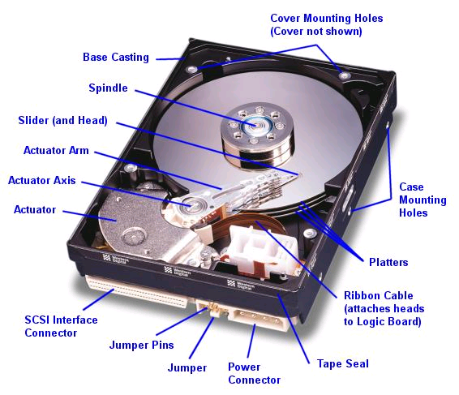
Hard drive disk (HDD) reminder
Western Digital Drive
http://www.storagereview.com/guide/

Slide 9
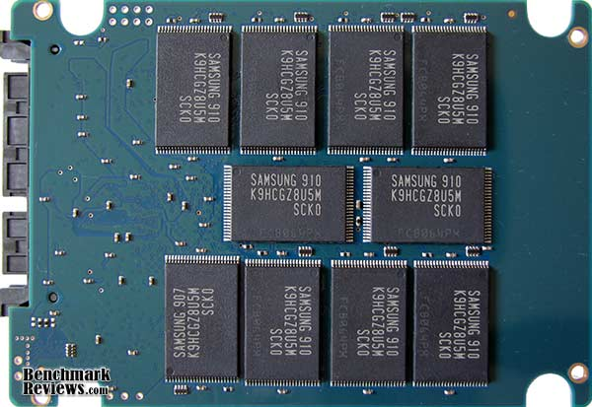
Solid state drive (SSD) reminder
NAND
NAND
NAND
NAND
NAND
NAND
NAND
NAND
Host
Buffer
Manager
(software
Queue)
Flash
Memory
Controller
NAND
NAND
NAND
NAND
NAND
NAND
NAND
NAND
SATA
Flash memory
No issues with
random access speed
Writes are a concern though!
  Writes 10x slower than reads
  Limited write lifetime (~1-10k writes per page)
NAND
NAND
NAND
NAND
NAND
NAND
NAND
NAND
DRAM
NAND
NAND
NAND
NAND
NAND
NAND
NAND
NAND

Slide 10
Outline
Introduction to filesystems
Application view
Parts of a file system
  Managing disk
  Handling file data
  Tracking files
Whole filesystem example

Slide 11
Application view of file system
Directories
  Which are just a file where the data is pointers to other files
Regular Files
  A handle with associated data
  “Type” of the file comes down to the data within it
    Reminder: “File extensions” in name of file are a convention, not a necessity
Special files
  Character and block devices!!

Slide 12
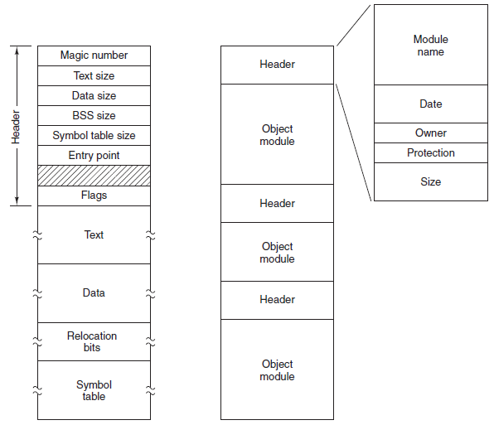
Binary file examples
Executable
File
Archive
(tar)

Slide 13
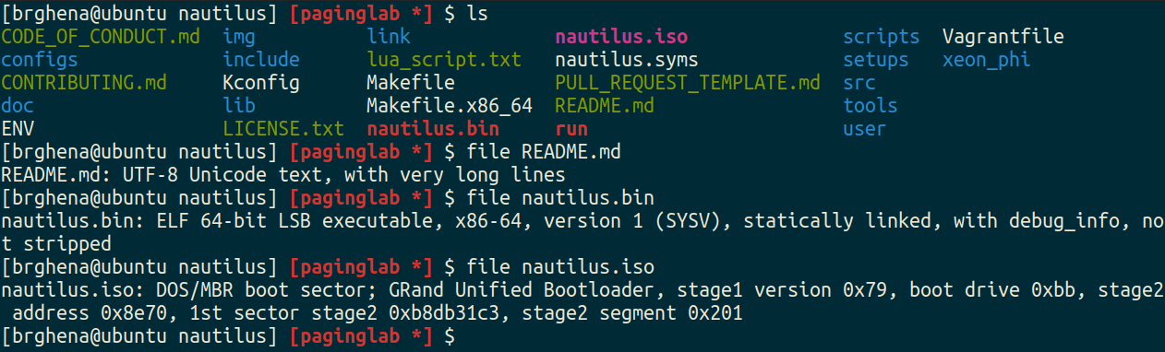
File command
file in Linux command line can determine the type of a file
  https://github.com/file/file

Slide 14
Syscalls to interact with files
open (or create) a file with a given path (directories & name) and set the file pointer to the beginning of the file
read up to a certain number of bytes from an open file, and move the file pointer for the next read.
write an array of bytes to an open file (and move the pointer)
close an open file
lseek to move the file pointer to a certain index in the file
fsync to push changes to disk immediately (flush dirty data)

Slide 15
Additional file syscalls
stat/fstat gets file metadata (data about the data)
rename to move a file
unlink to remove a file
mkdir to make a directory
Linux:
  getdents to list the contents of a directory
    “get directory entries”
    Because “read” would be filesystem-specific to interpret

Slide 16
File/directory metadata
Files also have attributes: readable, writeable, access time, etc.
struct stat {
dev_t st_dev; /* ID of device containing file */
ino_t st_ino; /* Inode number (low-level name) */
mode_t st_mode; /* File type and mode (permissions) */
nlink_t st_nlink; /* Number of hard links */
uid_t st_uid; /* User ID of owner */
gid_t st_gid; /* Group ID of owner */
dev_t st_rdev; /* Device ID (if special file) */
off_t st_size; /* Total size, in bytes */
blksize_t st_blksize; /* Block size for filesystem I/O */
blkcnt_t st_blocks; /* Number of 512B blocks allocated */
struct timespec st_atim; /* Time of last access */
struct timespec st_mtim; /* Time of last modification */
struct timespec st_ctim; /* Time of last status change */
};

Slide 17
Filesystem links
ln unix command creates a link to a file – like a pointer.
  Allows a file to exist in multiple paths without wasting space
Hard link creates another entry in a directory referring to the same disk address (inode number).
Symbolic/Soft link is a special file whose contents is just the string path of another file.
  Symlinks are much more common in modern practice (ln -s)
  Allow referring to file in other filesystems
  But may lead to a dangling reference – the referred-to file may be deleted

Slide 18

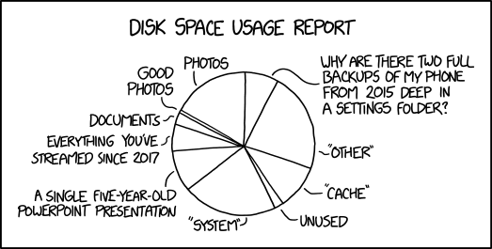
Break + double xkcd
https://xkcd.com/2143/
https://xkcd.com/2531/

Slide 19
Outline
Introduction to filesystems
Application view
Parts of a file system
  Managing disk
  Handling file data
  Tracking files
Whole filesystem example

Slide 20
Data structures on disk
A bit different than data structures in memory
Access must be in units of blocks at a time
  Can’t efficiently read/write a single word
  Instead must read/write entire block containing it
  Ideally want sequential access patterns (sequential accesses are fast)
Durability
  File system hopefully should be in a meaningful state upon shutdown
  But, shutdown could happen at any moment so that guarantee is tricky!

Slide 21
Disk partitions
Disk A
Most computers have one physical disk,
  But they may require multiple filesystems.
A disk partition is a contiguous chunk of the disk that can be formatted to store a filesystem.
At left, we have:
  Three different Linux partitions: /boot, swap, /
  A Windows partition.
  Each of the partitions may be formatted differently.
At bootup, initial boot code will present user with a menu to choose Windows or Linux boot.
Initial Boot Code
Partition Table
Partition 1: /boot
Partition 2: /
Partition 3: swap
Partition 4: Windows C:\
(not drawn to scale)

Slide 22
What does the filesystem need to track?
Track free disk blocks (within partition)
  Need to know which are available for new data
Track blocks containing data for files
  Need to know where to read a file from
Track files in a directory
  Need to be able to walk the directory hierarchy to find files
All this needs to be maintained in data structures on the disk itself

Slide 23
What goes within a partition?
Partition
Generic view of any filesystem
  We’ll talk about specifics next lecture
Header
Free Space Tracking
File Tracking
File Data
Header
Free Space Tracking
File Tracking
File Data

Slide 24
What goes within a partition?
Partition
Generic view of any filesystem
  We’ll talk about specifics next lecture
Header (Superblock)
  Details about which filesystem this is
  Metadata about the filesystem
Header
Free Space Tracking
File Tracking
File Data

Slide 25
Tracking available blocks on a disk
Partition
Free Space Tracking
  Track which blocks in “File Data” are in use
List of block addresses would make sense…
  Assume block address is 32-bits and 4 KB block
  1 TB disk -> 250,000,000 blocks
  1 GB of block addresses
  More complex but space-efficient data structures are possible
    Space-efficient is nice because we really want to limit reads to disk
Header
Free Space Tracking
File Tracking
File Data

Slide 26
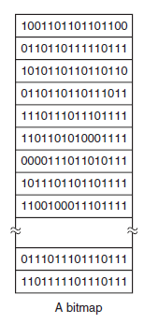
Bitmaps are a more space efficient tracking option
Each block on disk is represented by a single bit
  1 means free and 0 means used (or vice versa)
  Every block is listed in order
1 TB disk -> 250 million blocks -> 250 million bits -> 30 MB
Bitmaps for tracking free blocks are a constant size for a disk
  Upside: easy to work with
  Downside: more complex data structures could compress runs of free/used blocks
    Depends whether disk is expected to be fragmented or not
Bitmaps are typically used in practice

Slide 27
Outline
Introduction to filesystems
Application view
Parts of a file system
  Managing disk
  Handling file data
  Tracking files
Whole filesystem example

Slide 28
What goes in the file data?
Partition
Regular file data
  Just the file’s contents directly
  Attributes already handled in inode
Directory data
  Structure listing files within this directory
    File name, permissions, first data block
    OR File name, inode
  Obvious implementation leads to a fixed maximum file name size
    8 characters in MS-DOS plus 3 for extension
    14 characters in Unix v7
    This is the route of much evil abbreviation
Header
Free Space Tracking
File Tracking
File Data

Slide 29
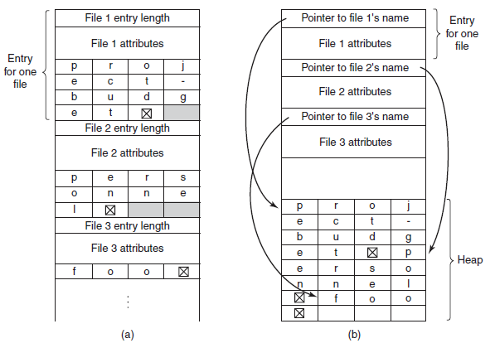
Directory data structures
(a) uses variable-length structures for each file
(b) contains an extra heap section for holding filenames
File attributes could also go here instead of in the inode

Slide 30
Outline
Introduction to filesystems
Application view
Parts of a file system
  Managing disk
  Handling file data
  Tracking files
Whole filesystem example

Slide 31
Tracking available blocks on a disk
Partition
File Tracking
  File attributes
  Ordered blocks where the file data is located
Two common implementations
  Allocation Table
    FAT32
  Index Nodes (inodes)
    Unix File System, Fast File System,
    ext3/ext4, NTFS
Header
Free Space Tracking
File Tracking
File Data

Slide 32
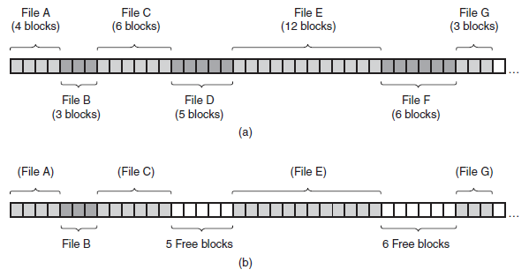
Requiring contiguous blocks won’t work
Need ability to map random blocks to file
  Files in contiguous blocks is definitely nice
    Sequential reads are fast
  But requiring it leads to lots of fragmentation (unusable gaps in disk)

Slide 33
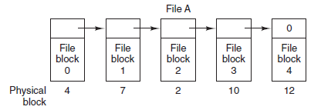
Forcing sequential access to file data also won’t work
Partition
Linked list in File Data is undesirable too
  Must read each data block to get next pointer
  No random access to file
    Appending requires reading through all of the file’s blocks first
Header
Free Space Tracking
File Tracking
File Data

Slide 34
Allocation table – an example file tracking solution
Build a linked list of data blocks for each file
  But distribute that linked list across an array
Treat “File Tracking” block as an array of block pointers
  Index into this array is the block number
  Read tracking block first to determine which data blocks for the file
    Then you can only read the actual data blocks you want
Next Block
Example: File “A” starts at Block 4
Block Number
0 | -1
1 | -1
2 | 10
3 | 11
4 | 7
5 | -1
6 | 3
7 | 2
8 | -1
9 | -1
10 | 12
11 | 14
12 | -1
13 | -1
14 | -1
15 | -1

Slide 35
Allocation table
Build a linked list of data blocks for each file
  But distribute that linked list across an array
Treat “File Tracking” block as an array of block pointers
  Index into this array is the block number
  Read tracking block first to determine which data blocks for the file
    Then you can only read the actual data blocks you want
Next Block
Example: File “A” starts at Block 4
Block Number
0 | -1
1 | -1
2 | 10
3 | 11
4 | 7
5 | -1
6 | 3
7 | 2
8 | -1
9 | -1
10 | 12
11 | 14
12 | -1
13 | -1
14 | -1
15 | -1

Slide 36
Allocation table
Build a linked list of data blocks for each file
  But distribute that linked list across an array
Treat “File Tracking” block as an array of block pointers
  Index into this array is the block number
  Read tracking block first to determine which data blocks for the file
    Then you can only read the actual data blocks you want
Next Block
Example: File “A” starts at Block 4
Block Number
0 | -1
1 | -1
2 | 10
3 | 11
4 | 7
5 | -1
6 | 3
7 | 2
8 | -1
9 | -1
10 | 12
11 | 14
12 | -1
13 | -1
14 | -1
15 | -1

Slide 37
Allocation table
Build a linked list of data blocks for each file
  But distribute that linked list across an array
Treat “File Tracking” block as an array of block pointers
  Index into this array is the block number
  Read tracking block first to determine which data blocks for the file
    Then you can only read the actual data blocks you want
Next Block
Example: File “A” starts at Block 4
Block Number
0 | -1
1 | -1
2 | 10
3 | 11
4 | 7
5 | -1
6 | 3
7 | 2
8 | -1
9 | -1
10 | 12
11 | 14
12 | -1
13 | -1
14 | -1
15 | -1

Slide 38
Allocation table
Build a linked list of data blocks for each file
  But distribute that linked list across an array
Treat “File Tracking” block as an array of block pointers
  Index into this array is the block number
  Read tracking block first to determine which data blocks for the file
    Then you can only read the actual data blocks you want
Next Block
Example: File “A” starts at Block 4
Block Number
0 | -1
1 | -1
2 | 10
3 | 11
4 | 7
5 | -1
6 | 3
7 | 2
8 | -1
9 | -1
10 | 12
11 | 14
12 | -1
13 | -1
14 | -1
15 | -1
5 total blocks
{4, 7, 2, 10, 12}

Slide 39
allocation-table-based system breakdown
The allocation table tracks next pointers for each data block
  Contains one entry for each data block
Each directory has zero or more data blocks
  The data blocks contain (filename, permissions, first data block) tuples for each file it contains
Each file has zero or more data blocks
  The data blocks contain the actual file data

Slide 40
Break + Check your understanding – Allocation table size
If each block address is 32 bits, and blocks are 4 kB in size, how big is the Allocation Table for a 2 TB drive?

Slide 41
Break + Check your understanding – Allocation table size
If each block address is 32 bits, and blocks are 4 kB in size, how big is the Allocation Table for a 2 TB drive?
2 TB / 4 KB = 500,000,000 blocks * 4 bytes = 2 GB

Slide 42
Problem 1: we really want the allocation table to fit in RAM
Accessing the allocation table on disk would slow us down
  File blocks are not necessarily sequential
  You might end up having to load in multiple blocks worth of File Tracking
Instead, at boot, load allocation table into RAM
  File accesses will require scanning the linked list in RAM,
  but only a single disk access
  Writes should be sent back to disk occasionally for safety
But 2 GB is a bit big to leave in RAM all the time…

Slide 43
Problem 2: file attributes should be more accessible
Unclear where attributes should go for a file with allocation table
  Either in the first block of the file
  Or in the directory data
Separation of attributes from block pointers is undesirable
  Would be nice to have both of them in a single disk read
  Or less than one read if they’re already in RAM

Slide 44
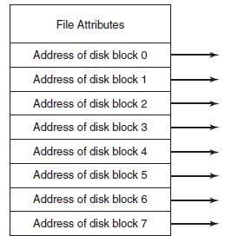
Index node (inode) – alternative file tracking solution
inode
Treat “File Tracking” as an array of inodes
  Each inode corresponds to a single file
  More files means more inodes
inode contents
  File attributes
  Ordered list of pointers to data blocks for the file
Many improvements have sprung up
  Optimization: coalesce contiguous blocks
  Optimization: for very small files, put data right in the inode!

Slide 45
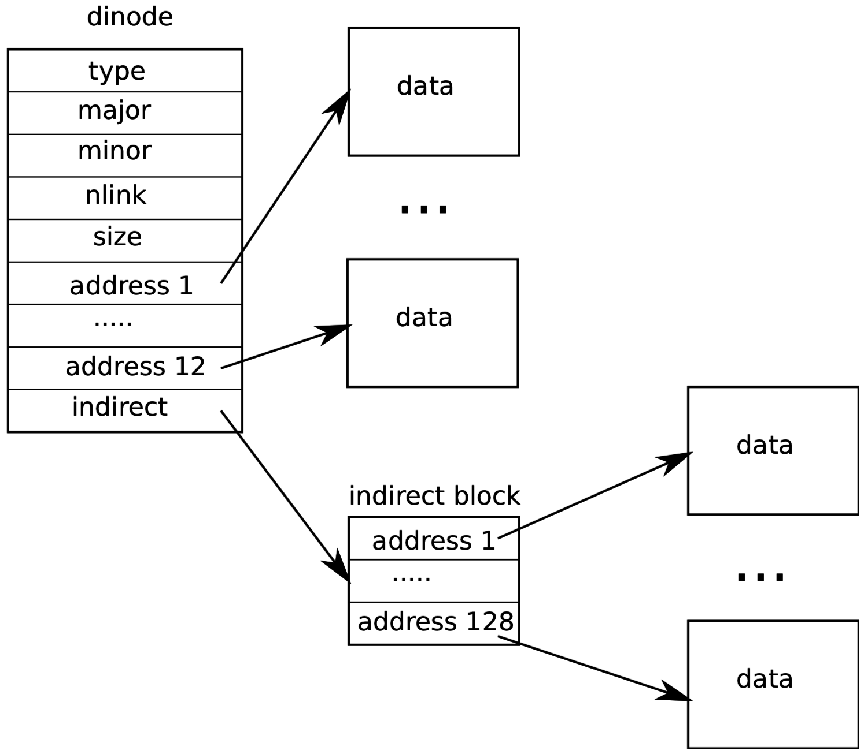
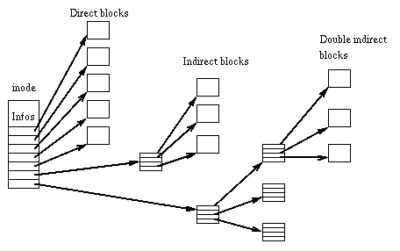
Hierarchical inodes allow for larger file sizes
Each inode is ≤ one block in size
  So there would be a limit to how many blocks a file can have
  Apply tree structure to block pointers to solve this

Slide 46
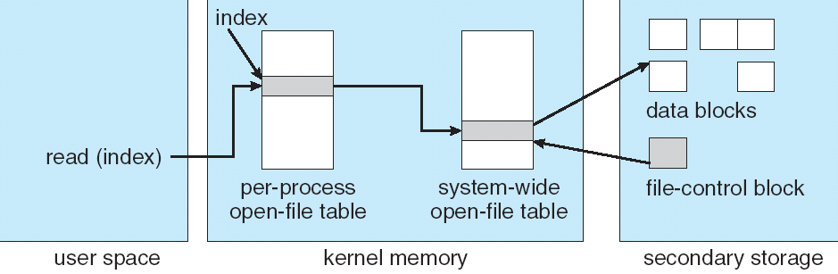
File system access with inodes
Open syscall: find inode and load it into memory
Read/write syscalls: reference inode by file descriptor
fd
(fd)
inode

Slide 47
inode-based system breakdown
Each file (regular file or directory) has one inode
  The inode has permissions and pointers to data blocks
  If the file is really big, the inode points to indirect blocks (which contain additional data block pointers)
Each directory has zero or more data blocks
  The data blocks contain (filename, inode) pairs for each file it contains
Each file has zero or more data blocks
  The data blocks contain the actual file data

Slide 48
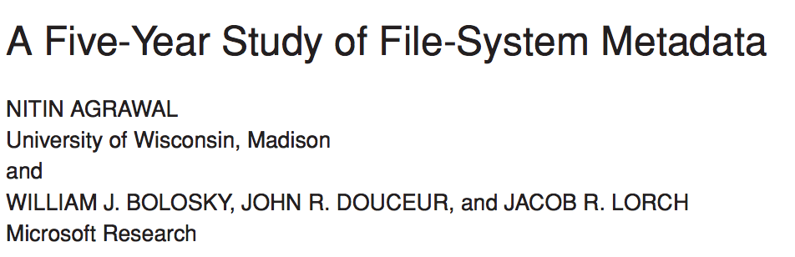
What can we observe about real-world file systems?
2007

Slide 49
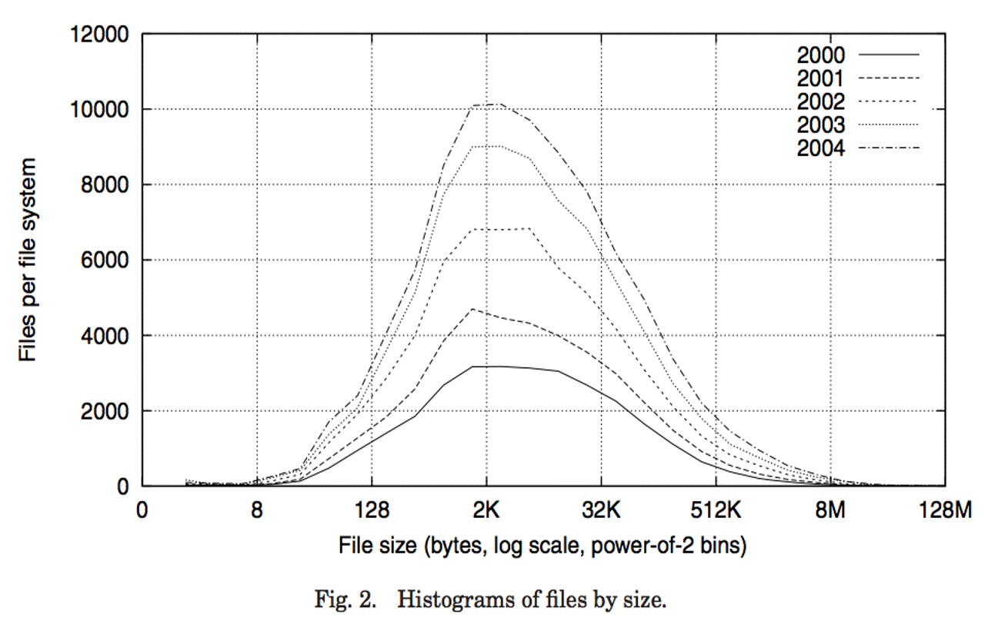
1. Most files are small

Slide 50
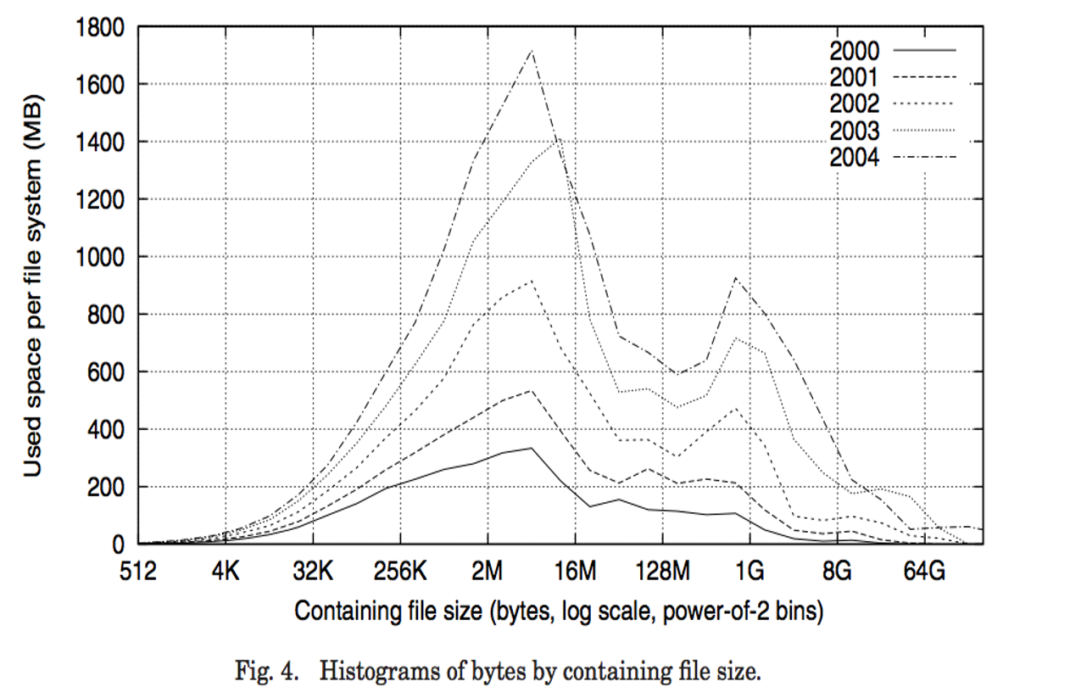
2. Most bytes are spent on a few large files

Slide 51
Break + Broader Thinking
Study was on 60,000 Windows PC file systems in a large corporation from 2000-2004 (over twenty years ago)
  Does this still apply today? Why or why not?
  Can you think of systems where it especially might not apply?

Slide 52
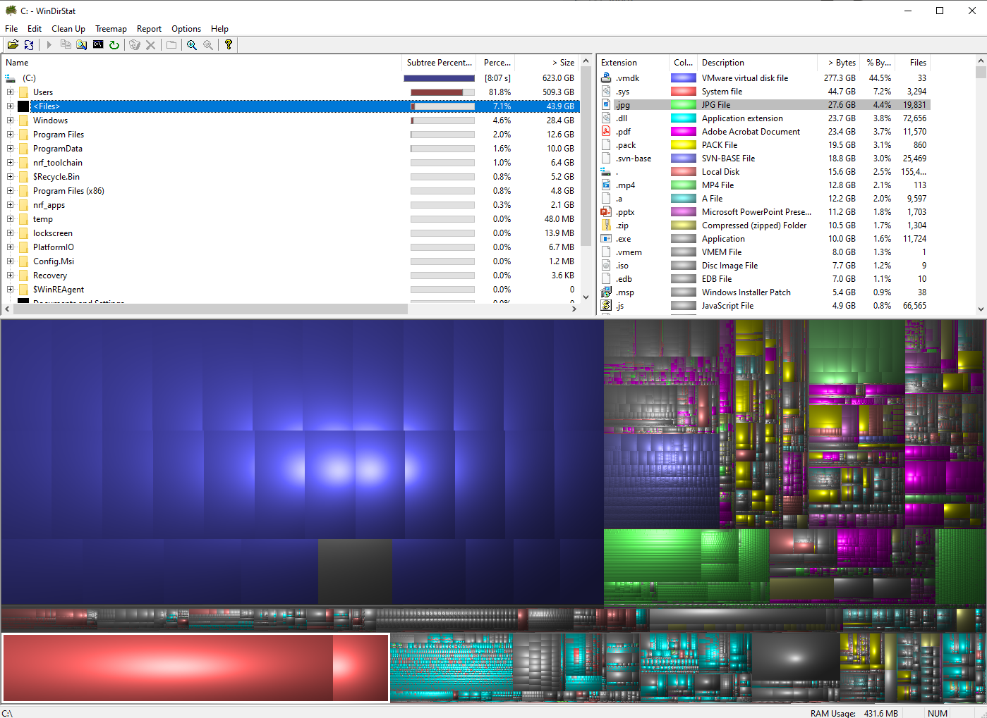
Storage trace of my work desktop
4% JPGs
  19,000 total
  Roughly 1.5 MB per image
4% PDFs
2% MP4s
2% PPTX
2% Zips
45% for a VM
(which is really just a partition in disguise)

Slide 53
Outline
Introduction to filesystems
Application view
Parts of a file system
  Managing disk
  Handling file data
  Tracking files
Whole filesystem example

Slide 54
A trace through the filesystem
Now we have enough knowledge to walk through an entire filesystem access
Here we assume
  Bitmap for marking free data blocks
  Bitmap for marking free inode blocks
  Inode for each file/directory
  One or more data blocks for each file/directory
Exact ordering of some of these steps are up for debate
  Different implementations may swap ordering of some parts

Slide 55
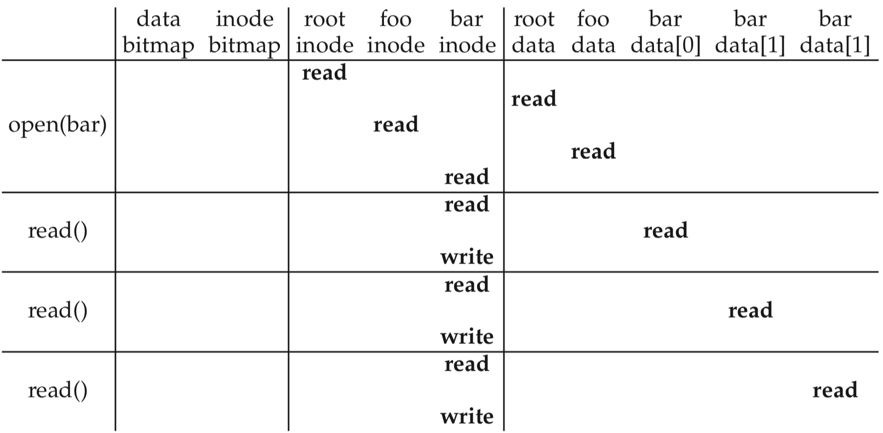
Open and read example
open("/foo/bar")
time
find file inode

Slide 56
Open and read example
open("/foo/bar")
time
update attributes

Slide 57
Open and read example
open("/foo/bar")
time
inode reads/writes from here occur in memory rather than disk

Slide 58
Open and read example
open("/foo/bar")
time
read next file block

Slide 59
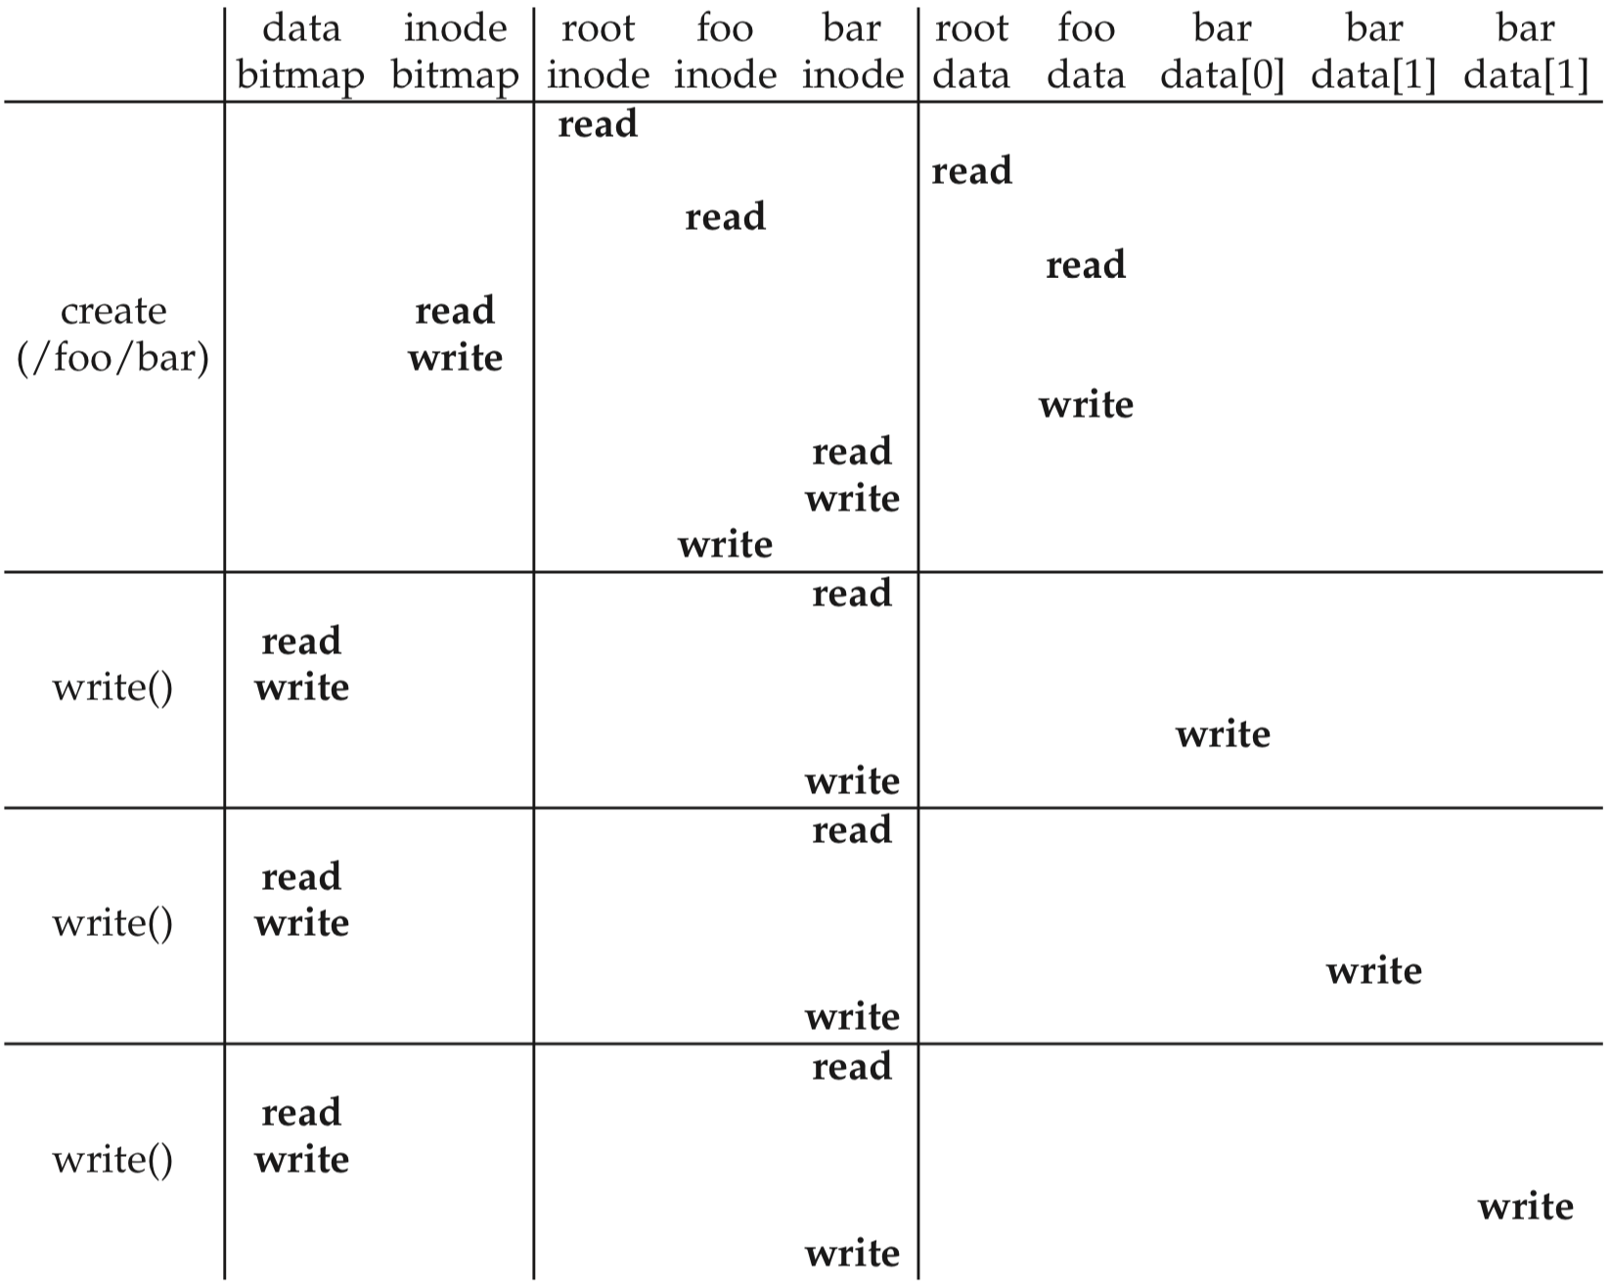
Create and write a file
Create:
First, read the parent directory to ensure that name is not already used.
Find & claim a free inode.
Add <“bar”, inode#> to parent directory.
Fill-in file metadata.
1
2
3
4

Slide 60
Create and write a file
Create:
First, read the parent directory to ensure that name is not already used.
Find & claim a free inode.
Add <“bar”, inode#> to parent directory.
Fill-in file metadata.
Write:
Look for remaining space in existing blocks first.
Find & claim a new data block.
Write data to new block
Point to it in inode
1
2
3
4
1
2
3
4

Slide 61
Outline
Introduction to filesystems
Application view
Parts of a file system
  Managing disk
  Tracking files
  Handling file data
Whole filesystem example

