Slide 1
Lecture 11:
Virtual Memory
CS343 – Operating Systems
Branden Ghena – Fall 2024
Some slides borrowed from:
Stephen Tarzia (Northwestern), Shivaram Venkataraman (Wisconsin), and UC Berkeley CS61C and CS162

Slide 2
Resources the OS manages
Processor
  Scheduling
Devices
  Device Drivers
Memory
  Virtual Memory
Files
  File systems

Slide 3
Today’s Goals
Discuss OS management of process memory with virtual memory
Understand two virtual memory mechanisms:
segmentation and paging
Explore optimizations to memory paging

Slide 4
Outline
Address Spaces
Methods of address translation
  Segmentation
  Paging

Slide 5
The reality of memory in a computer
DISK
Process A
Process B
Process A
RAM
Process C
CPU
Process B
Process C

Slide 6
A process’s view of the memory
The Address Space of the process
The illusion:
  Processes run alone on the computer
  They have full access to every memory address
    2⁶⁴ bytes of memory available to them
The reality:
  There are many processes
  There is only so much RAM available
~ FFFF FFFF_{hex}
stack
heap
static data
code
~ 0_{hex}

Slide 7
Virtual memory enables this illusion
Virtual Addresses
Physical Addresses
~ FFFF FFFF_{hex}
stack
~ FFFF FFFF_{hex}
Process A
Address Space
RAM
Process B
heap
static data
code
OS
~ 0_{hex}
~ 0_{hex}

Slide 8
Why is this illusion important?
We want to compile our programs at set addresses
  There are alternatives to this, such as Position Independent code
  But those alternatives often have performance costs
But we can’t know which addresses will be available
  How would developers know which addresses Chrome could use safely or which addresses Powerpoint intended to use?
Plus, the amount of RAM on systems varies widely
  Old laptop with 512 MB, Desktop with 16 GB, Server with 256 GB
  If they run x86-64 Linux, the same program will work on all of them
  Specialized systems, like embedded, might not need this requirement

Slide 9
Goals of virtual memory
Independence from other programs running
Independence from machine hardware
Security
  Applications shouldn’t be able to even read other memory much less write
Efficiency
  Allow reuse of some parts of memory
    Code sections for threads, duplicate processes, or shared libraries
  Don’t slow down the system too much by enabling the above

Slide 10
Virtual memory is how the OS controls memory accesses
I/O operations are controlled by system calls
CPU usage is controlled by the scheduler (and interrupts)
How can the OS control memory accesses?
  Context switch for each memory read/write is too high of a cost
  Hardware needs to automatically handle most requests

Slide 11
Memory Management Unit (MMU) supports virtual memory
Translation: hardware support for common case reads/writes
  Configured by the OS
Faults: trap to OS to handle uncommon errors
Virtual
Addresses
RAM
Physical
Addresses
CPU
Translation and Faults
Memory Management Unit

Slide 12
Short Break + Question
Which is bigger in practice: virtual memory or physical memory?

Slide 13
Short Break + Question
Which is bigger in practice: virtual memory or physical memory?
  2⁶⁴ bytes worth of addresses in both
  Both could hold up to 18 Exabytes (~18000 Petabytes, ~18000000 Terabytes)
  Virtual memory: practically there isn’t a limit
  Physical memory: practically limited to amount of RAM installed
    So, likely measured in Gigabytes
  On almost any real system: Virtual Memory is MUCH larger

Slide 14
Outline
Address Spaces
Methods of address translation
  Segmentation
  Paging

Slide 15
Share memory by splitting between whole processes
Virtual Addresses
Physical Addresses
~ FFFF FFFF_{hex}
stack
~ FFFF FFFF_{hex}
Process A
MMU
Address Space
RAM
Process B
heap
static data
code
OS
~ 0_{hex}
~ 0_{hex}

Slide 16
Address translation with a base register
Divide RAM into segments, each with a separate “base” address
  Processes each get their own individual segment
  Takes advantage of processes usually being smaller than RAM
To get a physical address from a virtual one, add to base value
Memory Management Unit
mode == user?
Virtual Address
No
Physical Address
Yes
+
base

Slide 17
Adding protection creates “Base and Bound” translation
Add a “bound” register with maximum value of the segment
  Memory accesses greater than bound trigger a fault
  No need to worry about lower bound, since minimum address is 0+base
Memory Management Unit
mode == user?
Virtual Address
No
Physical Address
Yes
>
bound?
No
+
base
Fault
Yes

Slide 18
Base and bounds evaluation
Advantages
  Provides protection between address spaces
  Supports dynamic relocation of processes (even at runtime)
  Simple, inexpensive hardware implementation
Disadvantages
  Process must be allocated contiguous physical memory
    Including memory between sections that might never be used
    Large allocations end up wasting a lot of space through fragmentation
  No partial sharing of memory

Slide 19
Memory fragmentation example
Process A
Process B
Process A
RAM
Process C
Process B
CPU
Process C

Slide 20
Memory fragmentation example
Process A
Process A
RAM
Process C
CPU
Process C

Slide 21
Memory fragmentation example
Process A
Process A
RAM
Process C
Process D
Process D
CPU
Hmm… There’s enough space, but not all together!
Process C

Slide 22
Check your understanding – base and bound
What are the results of the following memory reads? (16-bit)
  Base: 0xC000 Bound: 0x1FFF
  Read 0x0010
  Read 0x1400
  Read 0xD000

Slide 23
Check your understanding – base and bound
What are the results of the following memory reads? (16-bit)
  Base: 0xC000 Bound: 0x1FFF
  Read 0x0010 -> 0xC010
  Read 0x1400 -> 0xD400
  Read 0xD000 -> Fault (translates to 0x19000)

Slide 24
What if we split the code into multiple base/bound segments?
Physical Addresses
stack
~ FFFF FFFF_{hex}
code
MMU
stack
Address Space
RAM
heap
heap
static data
static data
code
OS
~ 0_{hex}
~ 0_{hex}

Slide 25
Segmentation design
Select some number of “segments” that processes may have
  Separate base and bound register for each one
Need to distinguish which accesses correspond to which segment
  Solution: use top few bits of the virtual address, log₂(number of segments)
    00 -> segment 0
    01 -> segment 1
    etc.
  Only add remaining lower bits to the base register

Slide 26
Memory Management Unit for segmentation
Similar comparison and addition hardware as before
New segment table to select correct base and bounds
  Bits from virtual address decide on the correct segment
  Segment decides the proper base and bound selection
  Can also apply permissions to individual segments
Segment | Base | Bound | Permissions
0 | 0x2000 | 0x06FF | Read/Execute
1 | 0x0000 | 0x04FF | Read/Write
2 | 0x3000 | 0x0FFF | Read/Write
3 | 0x0000 | 0x0000 | None
Example
Code
Stack
Data
Unused

Slide 27
OS management of processes with segmentation
On context switch
  Hardware changes to kernel mode and deactivates the MMU
  Save process’s segment table with the rest of the process data
  Load new process’s segment table into the MMU
  Change to user mode and jump to new process
x86 example
  No table, but rather registers for each segment
    Stack Segment, Code Segment, Data Segment
    Extra Segment, F Segment, G Segment

Slide 28
Segmentation evaluation
Advantages
  Sparse allocation of address space (most of it goes in no segment at all)
  Stack and heap segments can grow
  Different protection for different segments
    Only execute or write where it makes sense to
  Still possible to do dynamic relocation and hardware still relatively simple
Disadvantages
  Still results in fragmentation of memory
    Entire section must fit
    But sections are irregularly sized

Slide 29
Quick question – segmentation (16-bit address space)
How many bits are used for the segment?
Segment | Base | Bound | Permissions
0 | 0x0000 | 0x06FF | Read/Execute
1 | 0x0700 | 0x02FF | Read/Write
2 | 0x3C00 | 0x01FF | Read/Write
3 | 0x1800 | 0x01FF | Read/Execute
4 | 0x4200 | 0x0400 | Read/Execute
5 | 0x0000 | 0x0000 | None
6 | 0x0000 | 0x0000 | None
7 | 0x0000 | 0x0000 | None

Slide 30
Quick question – segmentation (16-bit address space)
How many bits are used for the segment?
Three bits (8 choices)
Placed as most significant bits
Lower 13 bits are added to base
Segment | Base | Bound | Permissions
0 | 0x0000 | 0x06FF | Read/Execute
1 | 0x0700 | 0x02FF | Read/Write
2 | 0x3C00 | 0x01FF | Read/Write
3 | 0x1800 | 0x01FF | Read/Execute
4 | 0x4200 | 0x0400 | Read/Execute
5 | 0x0000 | 0x0000 | None
6 | 0x0000 | 0x0000 | None
7 | 0x0000 | 0x0000 | None

Slide 31
Break + Practice – segmentation (16-bit address space)
Which segment is each?
Read 0x0200
Read 0x0500
Write 0x0410
Read 0x4004
Write 0x5004
Segment | Base | Bound | Permissions
0 | 0x0000 | 0x06FF | Read/Execute
1 | 0x0700 | 0x02FF | Read/Write
2 | 0x3C00 | 0x01FF | Read/Write
3 | 0x1800 | 0x01FF | Read/Execute
4 | 0x4200 | 0x0400 | Read/Execute
5 | 0x0000 | 0x0000 | None
6 | 0x0000 | 0x0000 | None
7 | 0x0000 | 0x0000 | None
Upper 3 bits of address are the segment
Lower 13 bits of address are appended to Base

Slide 32
Break + Practice – segmentation (16-bit address space)
Which segment is each?
Read 0x0200
Read 0x0500
Write 0x0410
Read 0x4004
Write 0x5004
Segment | Base | Bound | Permissions
0 | 0x0000 | 0x06FF | Read/Execute
1 | 0x0700 | 0x02FF | Read/Write
2 | 0x3C00 | 0x01FF | Read/Write
3 | 0x1800 | 0x01FF | Read/Execute
4 | 0x4200 | 0x0400 | Read/Execute
5 | 0x0000 | 0x0000 | None
6 | 0x0000 | 0x0000 | None
7 | 0x0000 | 0x0000 | None
Segment 0
Segment 2
Upper 3 bits of address are the segment
Lower 13 bits of address are appended to Base

Slide 33
Break + Practice – segmentation (16-bit address space)
Do full translation
Read 0x0200
Read 0x0500
Write 0x0410
Read 0x4004
Write 0x5004
Segment | Base | Bound | Permissions
0 | 0x0000 | 0x06FF | Read/Execute
1 | 0x0700 | 0x02FF | Read/Write
2 | 0x3C00 | 0x01FF | Read/Write
3 | 0x1800 | 0x01FF | Read/Execute
4 | 0x4200 | 0x0400 | Read/Execute
5 | 0x0000 | 0x0000 | None
6 | 0x0000 | 0x0000 | None
7 | 0x0000 | 0x0000 | None
Segment 0
Segment 2
Upper 3 bits of address are the segment
Lower 13 bits of address are appended to Base

Slide 34
Break + Practice – segmentation (16-bit address space)
Do full translation
Read 0x0200 -> 0x0200
Read 0x0500 -> 0x0500
Write 0x0410 -> Fault
(Permission)
Read 0x4004
Write 0x5004
Segment | Base | Bound | Permissions
0 | 0x0000 | 0x06FF | Read/Execute
1 | 0x0700 | 0x02FF | Read/Write
2 | 0x3C00 | 0x01FF | Read/Write
3 | 0x1800 | 0x01FF | Read/Execute
4 | 0x4200 | 0x0400 | Read/Execute
5 | 0x0000 | 0x0000 | None
6 | 0x0000 | 0x0000 | None
7 | 0x0000 | 0x0000 | None
Segment 0
Segment 2
Upper 3 bits of address are the segment
Lower 13 bits of address are appended to Base

Slide 35
Break + Practice – segmentation (16-bit address space)
Do full translation
Read 0x0200 -> 0x0200
Read 0x0500 -> 0x0500
Write 0x0410 -> Fault
(Permission)
Read 0x4004 -> 0x3C04
Write 0x5004 -> Fault (Bound) [0x1004 > 0x01FF]
Segment | Base | Bound | Permissions
0 | 0x0000 | 0x06FF | Read/Execute
1 | 0x0700 | 0x02FF | Read/Write
2 | 0x3C00 | 0x01FF | Read/Write
3 | 0x1800 | 0x01FF | Read/Execute
4 | 0x4200 | 0x0400 | Read/Execute
5 | 0x0000 | 0x0000 | None
6 | 0x0000 | 0x0000 | None
7 | 0x0000 | 0x0000 | None
Segment 0
Segment 2
Upper 3 bits of address are the segment
Lower 13 bits of address are appended to Base

Slide 36
Outline
Address Spaces
Methods of address translation
  Segmentation
  Paging

Slide 37
Improving upon segmentation
Segmentation had some good features
  Address space does not need to be contiguous
  Segments can grow when needed
But irregularly-sized segments lead to fragmentation
RAM
Many processes created
Some processes complete
New process doesn’t fit!
RAM is available, but only in fragments.

Slide 38
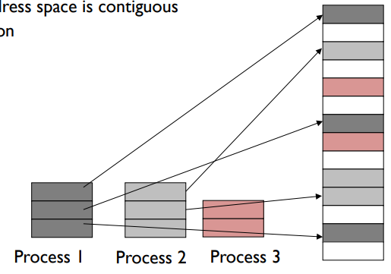
Solution to fragmentation: pages of memory
Divide memory into small, fixed-sized pages
Pages of virtual memory map to pages
of physical memory
  Like segments were mapped,
  but many more pages than segments
Processes and their sections
can be mapped to any
place in memory

Slide 39
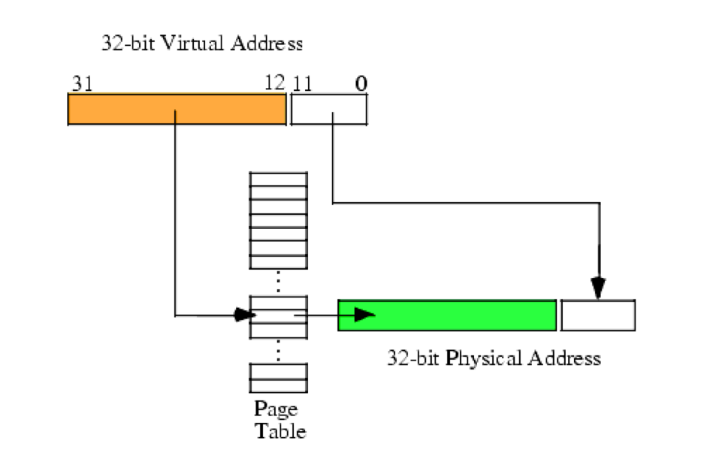
Page table translates virtual addresses to physical addresses
Use topmost bits of virtual address to select page table entry
  One page table entry per each virtual page
Combine address at page table entry with bottommost bits
  Actually just concatenate the two
Just like segment tables, there will be a different page table for each process

Slide 40
Paging versus segmentation
Every page of virtual memory maps to a page of physical memory
  No need for a bound anymore
  Above a bound would just be within the bounds of some other page
We don’t pick the number of pages, we pick page size
  Number of pages = Size of memory / Size of Page
Result: Way more pages than there were segments
  4 kB pages with 4 GB of RAM -> ~1 million pages
  Need to keep page table in memory rather than hardware registers
    Hardware register points at the base of the page table

Slide 41
Virtual Memory
(Process B Only!)
Process A
Process B
0
1
2
3
4
5
6
7
8
Process B
Process B Page Table
VPN | PPN | Valid?
0
1
2
3
4
5
6
7
8
Process B
CPU
Process B

Slide 42
Virtual Memory
(Process B Only!)
Process A
Physical Memory (RAM)
Shared
Process B
0
1
2
3
4
5
6
7
8
Process A
0
1
2
3
4
5
6
Process B
Process A
Process B Page Table
Process B
VPN | PPN | Valid?
0 | 2 | 1
1
2
3 | 6 | 1
4
5
6
7 | 4 | 1
8
Process B
CPU
Process A
Process B
Process A
Process B
Process B

Slide 43
Virtual Memory
(Process B Only!)
Process A
Physical Memory (RAM)
Shared
Process B
0
1
2
3
4
5
6
7
8
Process A
0
1
2
3
4
5
6
Process B
Process A
Process B Page Table
Process B
VPN | PPN | Valid?
0 | 2 | 1
1 | X | 0
2 | X | 0
3 | 6 | 1
4 | X | 0
5 | X | 0
6 | X | 0
7 | 4 | 1
8 | X | 0
Process B
CPU
Process A
Process B
Process A
Process B
Process B

Slide 44
Check your understanding – virtual address translation
Virtual Address
Do we need to translate the lower bits of a virtual address?
Virtual Page Number
Offset
Page table lookup!
?
Physical Page Number
Offset
Physical Address

Slide 45
Check your understanding – virtual address translation
Virtual Address
Do we need to translate the lower bits of a virtual address?
No. Those are used to determine word/byte within the page.
Virtual Page Number
Offset
Page table lookup!
Physical Page Number
Offset
Physical Address

Slide 46
Steps to translating virtual addresses with paging
Virtual Address:
VPN
offset
Page Table
3) Combine PPN and offset
V | AR | PPN
X | XX
. . .
+
1) Index into PT using VPN
2) Check Valid and Access Rights bits
Physical
Address
4) Use PA to access memory
Important:
This is all done in hardware!! OS is not involved unless it faults

Slide 47
Break + Virtual Memory Practice
Assume `a` starts at 0x3000 (virtual)
Ignore instruction fetches and
access to `i` and `sum` (they’re in registers)
Virtual Address
Accesses
load 0x3000
load 0x3004
load 0x3008
load 0x300C
Physical Address
Accesses
load 0x100C
load 0x7000
load 0x100C
load 0x7004
load 0x100C
load 0x7008
load 0x100C
load 0x700C
Code
int sum = 0;
for(int i=0; i<N; i++){
sum += a[i];
}
Which physical address is within the page table?
At what physical address does `a` start?

Slide 48
Break + Virtual Memory Practice
Assume `a` starts at 0x3000 (virtual)
Ignore instruction fetches and
access to `i` and `sum` (they’re in registers)
Virtual Address
Accesses
load 0x3000
load 0x3004
load 0x3008
load 0x300C
Physical Address
Accesses
load 0x100C
load 0x7000
load 0x100C
load 0x7004
load 0x100C
load 0x7008
load 0x100C
load 0x700C
Code
int sum = 0;
for(int i=0; i<N; i++){
sum += a[i];
}
Which physical address is within the page table? 0x100C
  All accesses are within the same Page
At what physical address does `a` start? 0x7000
  Accesses to the array step by 4 byte increments

Slide 49
How the OS deals with memory in a paging system
How do the OS and program agree on addresses?
  Each program can use any virtual addresses it wants
    Some default for compiler/OS pairing
  OS controls physical memory layout in RAM and maps the two
How does the OS move memory around without messing up programs?
  Just update the record in the page table
  Process doesn’t know the difference
How to protect OS and process memory from other processes?
  Ensure that virtual pages from a process never map to physical pages for another
  But we can share physical pages for threads or shared libraries if we want!

Slide 50
Dealing with processes bigger than memory
Paging allows the OS to support processes larger than RAM
  Just leave the virtual pages unmapped
  When a load occurs to the unmapped page, a fault triggers the OS
  Which can then load the needed page into RAM from disk
    (and push some other page onto disk)

Slide 51
Virtual Memory
(Process B Only!)
Physical Memory (RAM)
Shared
Process B
0
1
2
3
4
5
6
7
8
Process A
Process B
0
1
2
3
4
5
6
Process B
Process B
Process B
Process B
Process B
Process B
DISK
CPU
Process B
Process B
Process B
Process B
Process B
Process B
Process B

Slide 52
OS management of processes with paging
When loading a process
  OS places actual memory into physical pages in RAM
  OS creates page table for the process
    OS decides access permissions to different pages
    OS connects to shared libraries already in RAM
When a context switch occurs
  OS changes which page table is in use (%CR3 register in x86)
When a fault occurs
  OS decides how to handle it. (Invalid access or missing page?)

Slide 53
Paging evaluation
Advantages
  Still sparse allocation of address space and growing segments as needed
  Still different protection for different segments
    Only execute or write where it makes sense to
  Still possible to do dynamic relocation and hardware still relatively simple
  No fragmentation of main memory
    Pages can fit anywhere they need to
  Can load processes bigger than main memory!

Slide 54
Paging evaluation (continued)
Disadvantages
  More work on the part of the OS to set up a process
    Only a problem if we create processes frequently
  Page tables are slow to access
    Page tables need to be stored in memory due to size
    MMU only holds the base address of the page table and reads from it
    Two memory loads per load!!!
    Going to have to fix this…
  Page tables require a lot of storage space
    Mapping must exist for each virtual page, even if unused
    Becomes a serious issue on 64-bit systems

Slide 55
Outline
Address Spaces
Methods of address translation
  Segmentation
  Paging

