Slide 1
Lecture 09:
Device Input and Output
CS343 – Operating Systems
Branden Ghena – Fall 2024
Some slides borrowed from:
Stephen Tarzia (Northwestern), Shivaram Venkataraman (Wisconsin), Jaswinder Pal Singh (Princeton), and UC Berkeley CS61C and CS162

Slide 2
Administrivia
Grading in progress
  Midterm grades: almost definitely Wednesday
  PC Lab grades: planned for Thursday
Drop deadline is this week on Friday
  I’m happy to meet with you if you’re concerned
Scheduling Lab due Thursday!
  You might try to get it done early rather than working all evening on Halloween…

Slide 3
Today’s Goals
Discuss I/O devices and how a computer connects to them.
Understand two different methods of reading/writing device data.
Explore patterns for device interaction:
  Synchronous versus Asynchronous
  Programmed I/O versus Direct Memory Access

Slide 4
Outline
Overview of Device I/O
Connecting to devices
  Buses on a computer
Talking to devices
  Port-Mapped I/O and Memory-Mapped I/O
Device interactions
  Synchronous versus Asynchronous Events
  Programmed I/O versus Direct Memory Access

Slide 5
Devices are the point of modern computers
Computation was sufficient for batch systems
  Even then, tape or disk was the input and output mechanism
But interactive systems need to receive input from users and output responses
  Keyboard/mouse
  Disk
  Network
  Graphics
  Audio
  Various USB devices
Computer
Processor
Memory
Devices
Control
Input
Datapath
Output

Slide 6
Devices are core to useful general-purpose computing
Input
Output
Mouse
Monitor
Computer
Keyboard
Headphones
Ethernet
Ethernet
Bluetooth
Bluetooth

Slide 7
Devices are essential to cyber-physical systems too
Input
Output
Lidar
Throttle Control
Computer
Inertial Measurement Unit
Brake Control
Camera
Wheel Rotation
CAN
CAN

Slide 8
Device access rates vary by many orders of magnitude
Rates in bit/sec
System must be able to handle each of these
  Sometimes needs low overhead
  Sometimes needs to not wait around
Device | Behavior | Partner | Data Rate (Kb/s)
Keyboard | Input | Human | 0.2
Mouse | Input | Human | 0.4
Microphone | Output | Human | 700.0
Bluetooth | Input or Output | Machine | 20,000.0
Hard disk drive | Storage | Machine | 100,000.0
Wireless network | Input or Output | Machine | 300,000.0
Solid state drive | Storage | Machine | 500,000.0
Wired LAN network | Input or Output | Machine | 1,000,000.0
Graphics display | Output | Human | 3,000,000.0

Slide 9
Handling devices appropriately
OS concerns
  Communicating with devices needs to be fast and efficient
  Devices are shared resources that need to be access controlled and shared
  Devices are wildly variable and need some common interfaces for application software
General solution pattern
  Access I/O devices similarly to memory
  Read device state and write commands to it
    With interrupts to inform kernel of events

Slide 10
Outline
Overview of Device I/O
Connecting to devices
  Buses on a computer
Talking to devices
  Port-Mapped I/O and Memory-Mapped I/O
Device interactions
  Synchronous versus Asynchronous Events
  Programmed I/O versus Direct Memory Access

Slide 11
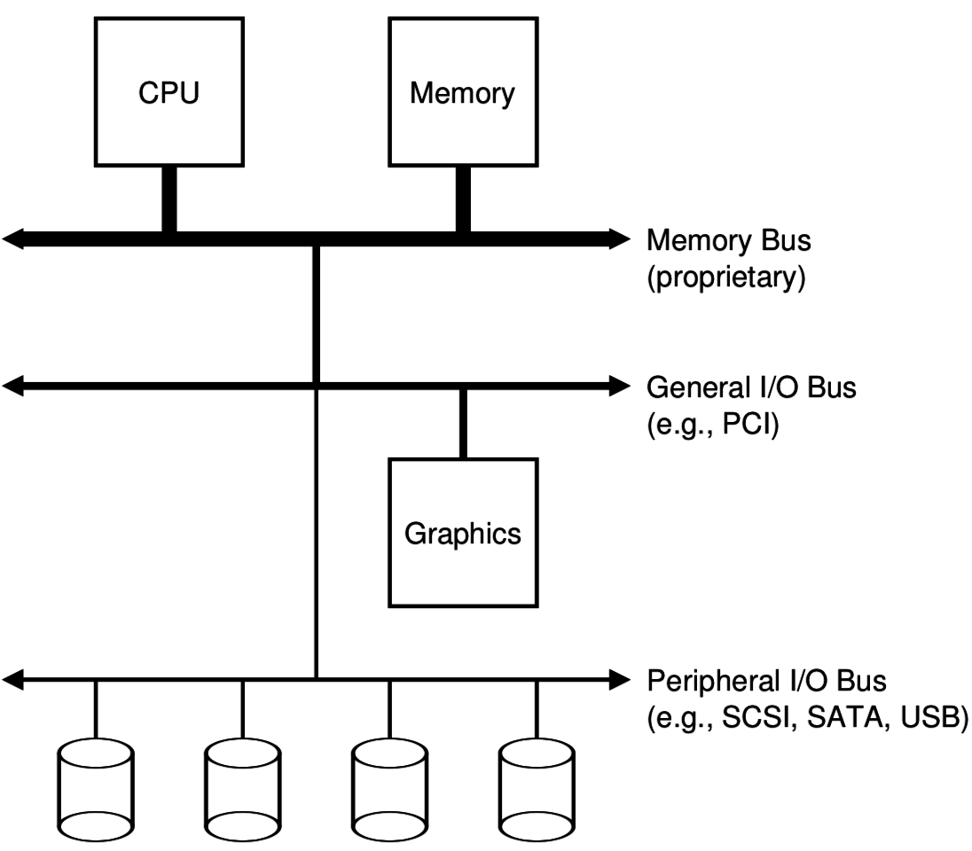
Devices connect to buses on the computer
I/O Hierarchy
  Close to the CPU are very fast connections
  Farther from CPU are slower but more flexible protocols
Fast connections are literally physically close to the CPU
  Electrical signals are limited by speed of light
  1 nanosecond ~= 1 foot

Slide 12
What is a bus anyways?
Common set of wires for communication between two or more components
  Lets one set of wires connect to N devices
Standardized buses have a specific set of wires and protocol for communicating over them (DMI, PCI, SATA, USB)
  Example wires: 64 address wires, 64 data wires, ~10 control wires
Concerns
  How many wires in the bus?
  Single controller or multiple with arbitration?
  Half-duplex (one direction of communication at a time) or full-duplex?

Slide 13
Computer networks also run over buses
Ethernet is a bus too!
Network protocols specify how two computers communicate, very similarly to these buses
Compared to networks, internal computer busses are:
  Higher speed
  Very high reliability
  Accessed cooperatively (often with only one controller: the CPU)

Slide 14
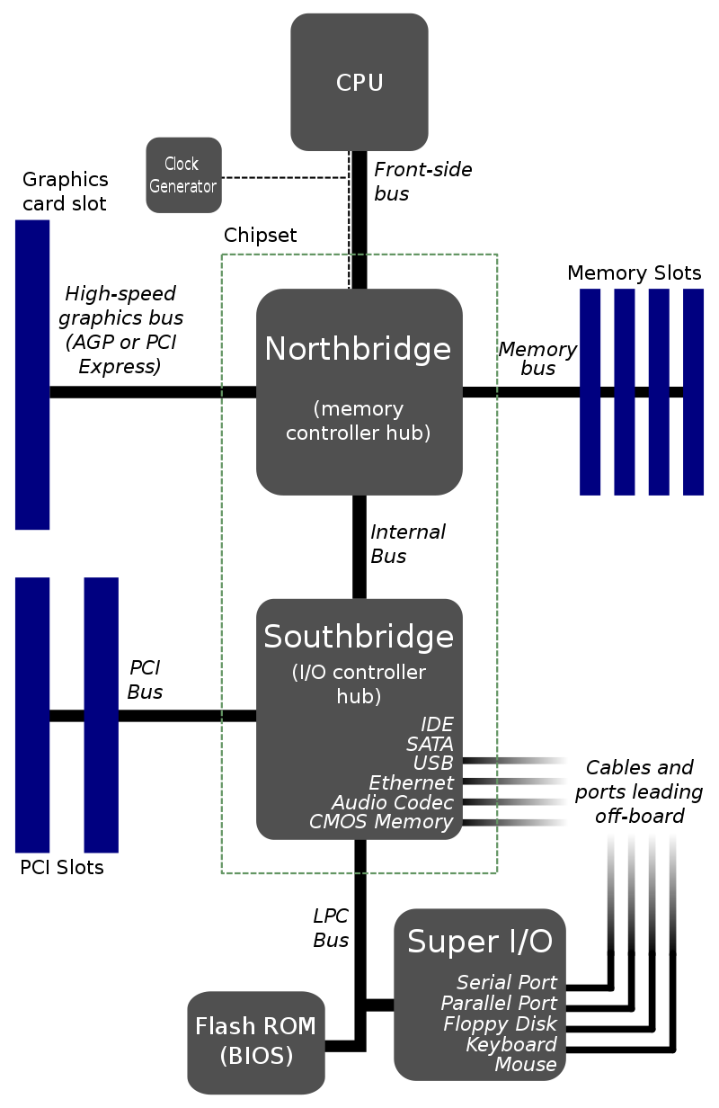
Old version of I/O hierarchy
Hub architecture
Northbridge
  High speed memory control
  RAM + Graphics
Southbridge
  Low speed peripherals
  Disk, Network, USB

Slide 15
Check your understanding – physical layout
Which is going to be physically closer to the CPU?
  Northbridge or Southbridge
Why?

Slide 16
Check your understanding – physical layout
Which is going to be physically closer to the CPU?
  Northbridge or Southbridge
Why?
  Need accesses to be fast
  Electrical signals are limited by speed of light
    1 nanosecond ~= 1 foot

Slide 17
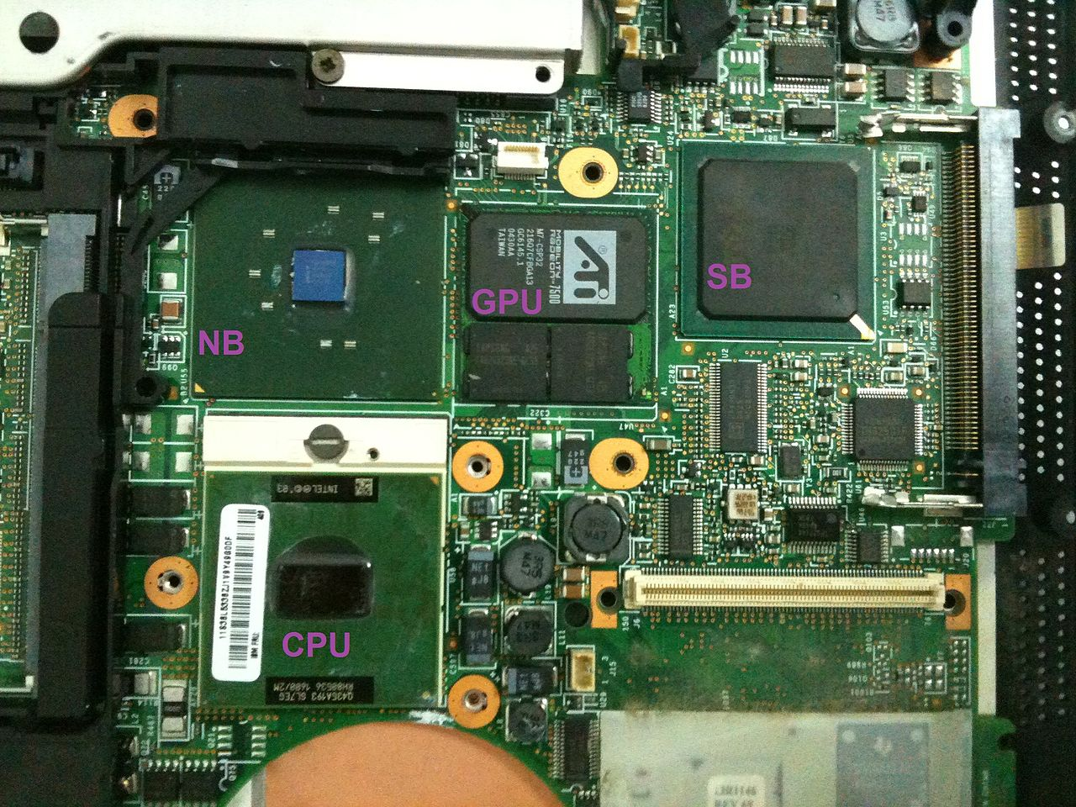
Physical layout of an old motherboard
Note physical distance from CPU

Slide 18
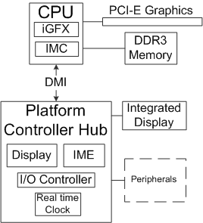
Platform Controller Hub (PCH) architecture
Enables faster communication high-throughput peripherals
  Memory and Graphics

Slide 19
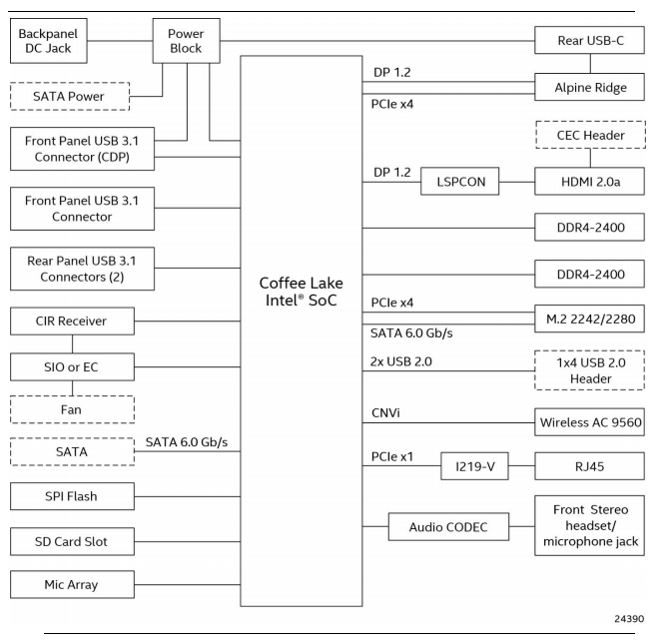
My office “desktop”
Small form factor desktop
  Intel NUC 8
CPU includes I/O Controller and GPU in single package
CPU implements many connections directly
  USB
  SATA
  Some have hardware controllers
    Ethernet (RJ45)
    Thunderbolt (Rear USB-C)
    3.5mm Audio (Front stereo headset…)

Slide 20
Some important buses
Legacy
  Parallel Port
  Serial Port
USB
SATA
PCIe
Device driver software usually talks to bus controller
  Which sends appropriate signals to device

Slide 21
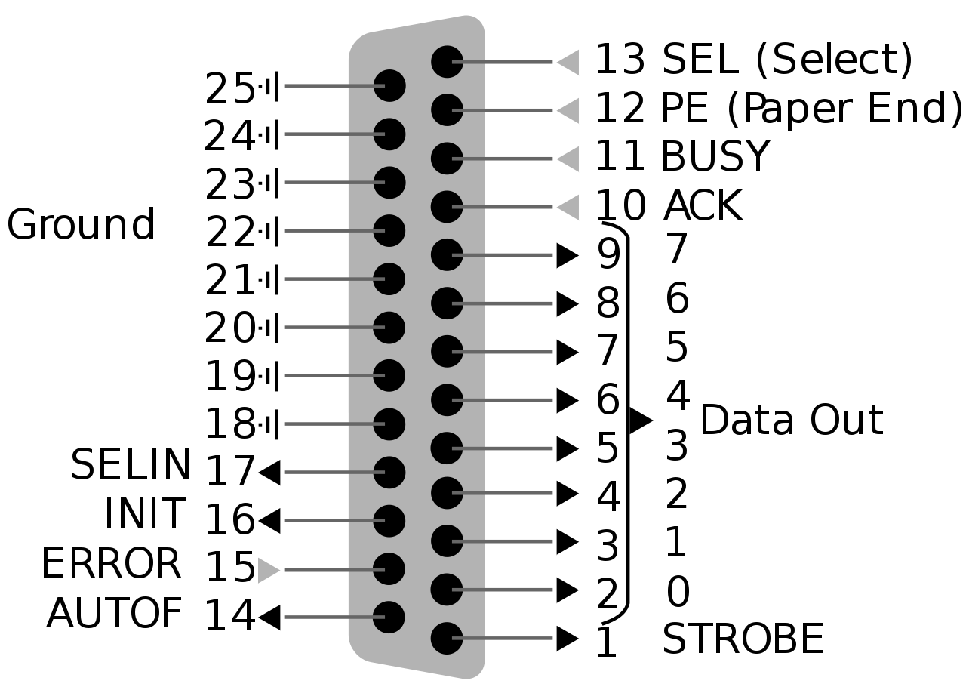
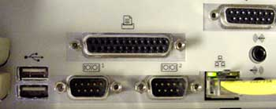
Parallel Port – “Printer Port” or Centronics Port
“That big long one you might have seen once”
8 data bits plus control signals
  Up to 2.5 Mbps!!
Very simple to implement
  Write 8 bits of data
  Set STROBE low
    BUSY goes low in response
  When BUSY goes high
    Set STROBE high
  Repeat

Slide 22
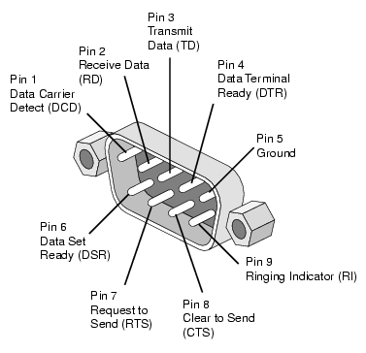
Serial Port – RS-232
“That one we used to use before USB”
RS-232 serial protocol
  One wire for Transmit, one wire for receive
  Bits go one after another at a certain speed (“baudrate”)
    Up to 256 Kbps
Used to connect modems
  Still occasionally used for
  old devices (via a USB to
  RS-232 converter)

Slide 23

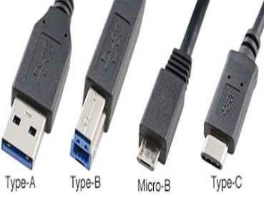
USB – Universal Serial Bus
“That one you are familiar with already”
Connect and power external devices
Comes in multiple form-factors and versions
  USB 3.x and type C connectors are the fast ones
Speed has increased greatly
  1.5 Mbps
  12 Mbps
  480 Mbps
  5 Gbps
  10 Gbps
  40 Gbps

Slide 24
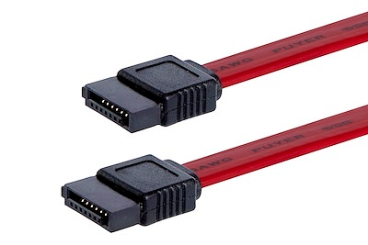
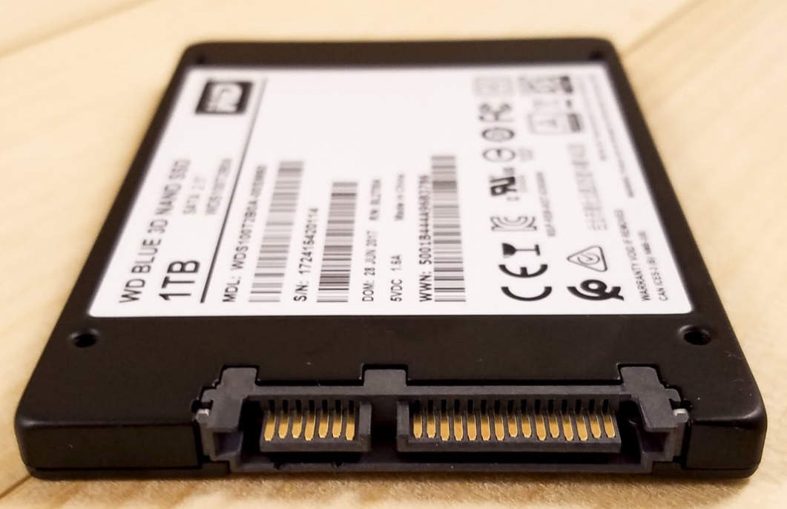
SATA – Serial ATA – AT Attachment – “Advanced Technology”
“That cable you plug an SSD/HDD in with”
Long evolution as you might have
guessed from the name
6 Gbps
  One transmit and one receive single
    Two wires for each in twisted pair
  Short connection length for high speed
SATA
Power

Slide 25
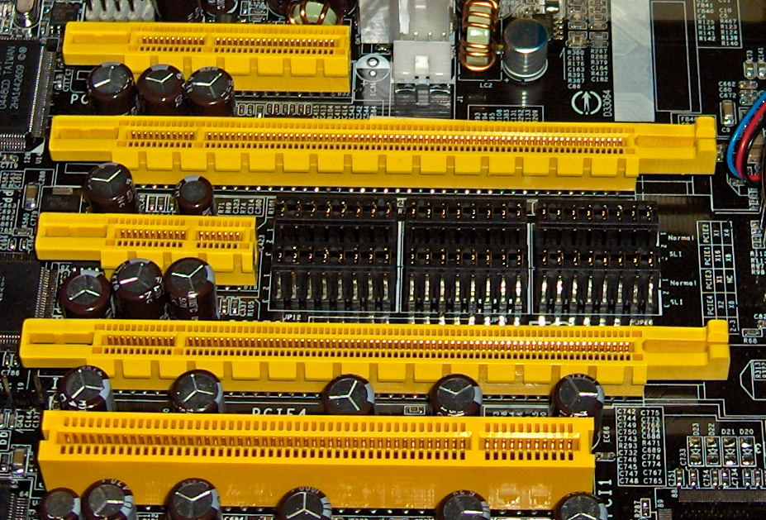
PCIe – Peripheral Component Interconnect Express
“That slot you put a graphics card into”
  Or WiFi card, or some SSDs
Collection of point-to-point
connections
  Motherboard and CPU support
  N “lanes” in various configurations
Different sizes for different
number of bits in parallel
  Order 10s Gbps

Slide 26
Live Demo: List devices on a Linux computer
lsusb
  List USB devices
lspci
  List PCI devices
Combine with –s flag to select a single device
Combine with -v flag for verbose mode with more information

Slide 27
Break + Question
Why do we need all of these busses?
  Isn’t USB enough for everything?

Slide 28
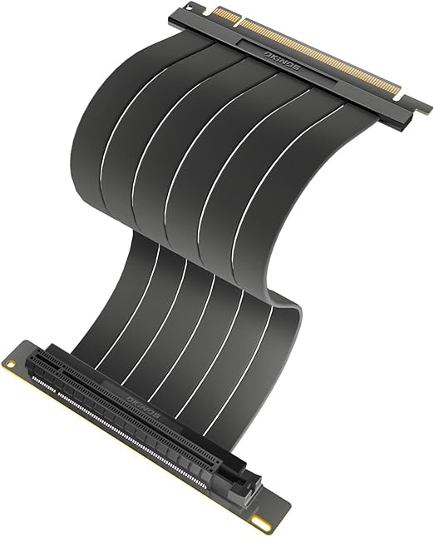
Break + Question
Why do we need all of these busses?
  Isn’t USB enough for everything?
Different tools for different purposes!
  USB is more general-purpose, short range, powers devices
  PCIe is for LOTS of data, but very short range and cables would be crazy
  Ethernet is for long-range, lots of data, no power
https://www.reddit.com/r/explainlikeimfive/comments/uf4efj/comment/i6rmv15

Slide 29
Outline
Overview of Device I/O
Connecting to devices
  Buses on a computer
Talking to devices
  Port-Mapped I/O and Memory-Mapped I/O
Device interactions
  Synchronous versus Asynchronous Events
  Programmed I/O versus Direct Memory Access

Slide 30
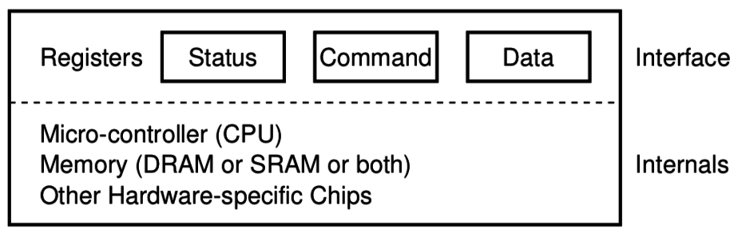
How does an OS talk with I/O devices?
A device is really a miniature computer-within-the-computer
  Has its own processing, memory, software
We can mostly ignore that and deal with its interface
  Called registers (similar to processor registers in that they hold data)
  Read/Write like they’re data
How do we read/write them?
  Special assembly instructions
  Treat like normal memory

Slide 31
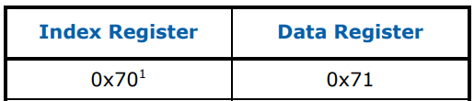
Example powered device: Real Time Clock
Battery-backed up clock on computer motherboard
Keeps sense of time when computer is off
Resynchronized when the computer is awake
Index | Contents | Range
0x00 | Seconds | 0-59
0x02 | Minutes | 0-59
0x04 | Hours | 0-23 in 24-hour mode, 1-12 in 12-hour mode, highest bit set if PM
0x06 | Weekday | 1-7, Sunday =1
0x07 | Day of Month | 1-31
0x08 | Month | 1-12
0x09 | Year | 0-99
https://www.singlix.com/trdos/archive/pdf_archive/real-time-clock-nmi-enable-paper.pdf

Slide 32
Port-Mapped I/O (PMIO): special assembly instructions
x86 IN and OUT instructions
  Privileged instructions (kernel mode only)
  Two arguments: destination and data register
Each device is mapped to some port address
  IN and OUT instructions interact with interface
  IN <PORT NUMBER>, <REGISTER>
  OUT <REGISTER>, <PORT NUMBER>

Slide 33
Example powered device: Real Time Clock
Example: read current value from real-time clock
// read seconds
mov $0, %al
out %al, $0x70
in $0x71, %al
Index | Contents | Range
0x00 | Seconds | 0-59
0x02 | Minutes | 0-59
0x04 | Hours | 0-23 in 24-hour mode, 1-12 in 12-hour mode, highest bit set if PM
0x06 | Weekday | 1-7, Sunday =1
0x07 | Day of Month | 1-31
0x08 | Month | 1-12
0x09 | Year | 0-99
Port Address
https://www.singlix.com/trdos/archive/pdf_archive/real-time-clock-nmi-enable-paper.pdf

Slide 34
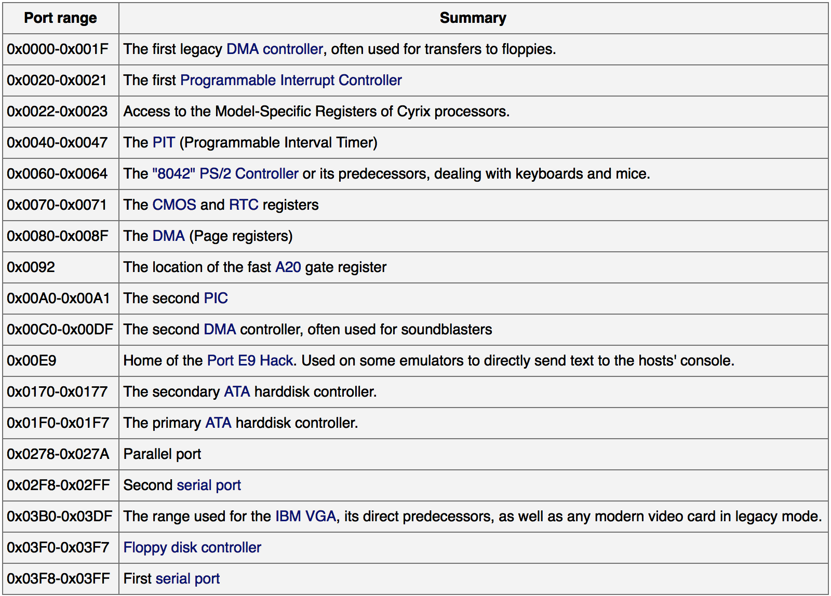
Example I/O
port map
This isn’t
standardized,
but these are
some typical
values.
https://wiki.osdev.org/Can_I_have_a_list_of_IO_Ports

Slide 35
Check your understanding – PMIO in C
How would you access PMIO from a C program?

Slide 36
Check your understanding – PMIO in C
How would you access PMIO from a C program?
  Need to use assembly!
  Hopefully with C function wrapper, like System Calls

Slide 37
Annoying parts of Port-Mapped I/O
Special assembly instructions are hard to write in C
  Need some wrapper function that actually calls them
  Not really that big of an issue, but a little weird
Feels sort of like memory read/write, but isn’t
  Why not?
  Can we just put the “port address space” somewhere in memory?
    Could be a problem if we don’t have enough memory
    But today we have tons of extra physical address space laying around

Slide 38

Memory-mapped I/O (MMIO): treat devices like normal memory
Certain physical addresses do not actually go to RAM
Instead, they correspond to I/O devices
  And any instruction that accesses memory can access them too!
x86 being the historical
amalgamation that it is,
uses both PMIO or MMIO
depending on the device
Address
0xFFFFFFFF
0xFFFF0000
control reg.
data reg.
0x00000000

Slide 39
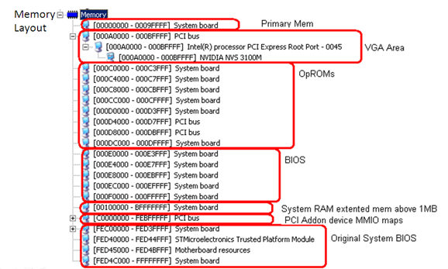
Example memory map (from an old 32-bit computer)
PCI devices are mapped here

Slide 40
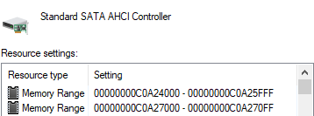
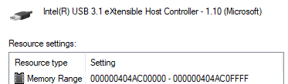
Example devices on my windows computer
SATA controller is mapped into memory at two places
USB controller is mapped into a much higher memory region
Regions are large because they contain multiple control/data “registers”

Slide 41
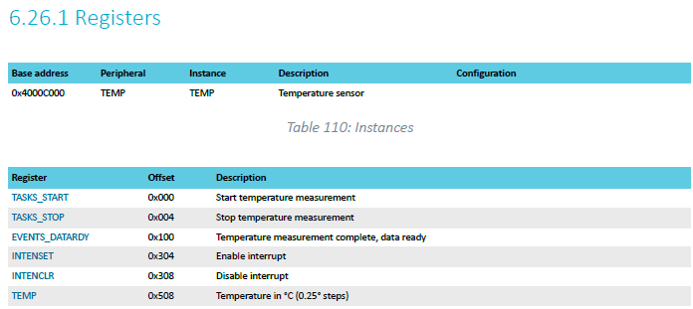
Microcontroller example: reading temperature
Internal temperature sensor
  0.25° C resolution
  Range equivalent to microcontroller IC (-40° to 105° C)
  Various configurations for the temperature conversion (ignoring)
nRF52833

Slide 42
MMIO addresses for TEMP device
What addresses do we need? (ignore interrupts for now)
  0x4000C000 – TASKS_START
  0x4000C100 – EVENTS_DATARDY
  0x4000C508 - TEMP
nRF52833

Slide 43
Accessing addresses in C
What does this C code do?
*(uint32_t*)(0x4000C000) = 1;

Slide 44
Accessing addresses in C
What does this C code do?
*(uint32_t*)(0x4000C000) = 1;
  0x4000C000 is cast to a uint32_t*
  Then dereferenced
  And we write 1 to it
  “There are 32-bits of memory at 0x4000C000. Write a 1 there.”

Slide 45
Other details about MMIO
Devices are mapped into physical memory
  Usually only accessible by the kernel
  But could be directly placed in virtual memory for a process in very special cases
Devices are NOT memory though
  Need to be careful not to cache them
    Values being read could change, or reading could have an effect
  Cannot let compiler mess with our reads/writes either
    volatile keyword in C
Conceptually not really very different from PMIO
  Both just read/write to specific addresses the device is mapped to

Slide 46
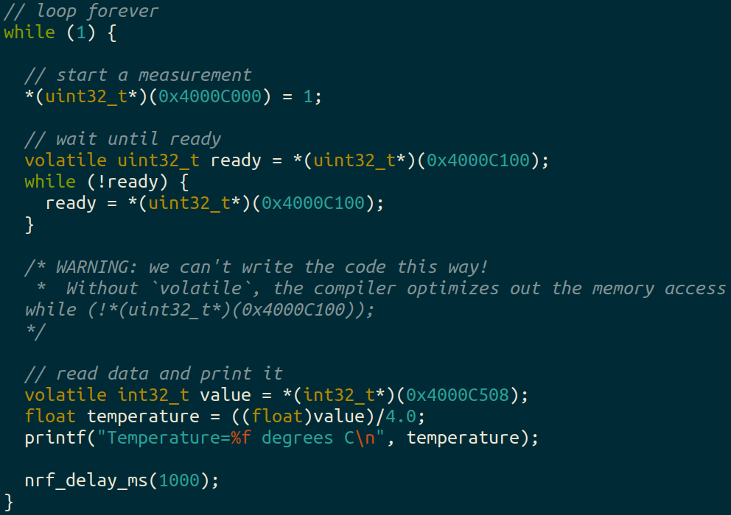
Break + example code to read and print temperature value

Slide 47
Outline
Overview of Device I/O
Connecting to devices
  Buses on a computer
Talking to devices
  Port-Mapped I/O and Memory-Mapped I/O
Device interactions
  Synchronous versus Asynchronous Events
  Programmed I/O versus Direct Memory Access

Slide 48
What do interactions with devices look like?
while STATUS==BUSY; Wait
  (Need to make sure device is ready for a command)
Write value(s) to DATA
Write command(s) to COMMAND
while STATUS==BUSY; Wait
  (Need to make sure device has completed the request)
Read value(s) from Data
This is the “polling” model of I/O.
“Poll” the peripheral in software repeatedly to see if it’s ready yet.

Slide 49
Waiting can be a waste of CPU time
    while STATUS==BUSY; Wait
      (Need to make sure device is ready for a command)
    Write value(s) to DATA
    Write command(s) to COMMAND
    while STATUS==BUSY; Wait
      (Need to make sure device has completed the request)
    Read value(s) from Data
Imagine a keyboard device
  CPU could be waiting for minutes before data arrives
  Need a way to notify CPU when an event occurs
    Interrupts!

Slide 50
Interrupts, visually
Some code
that’s executing
Could be kernel code or some application
Interrupt triggers!
Interrupt handler
code
Continue
original code

Slide 51
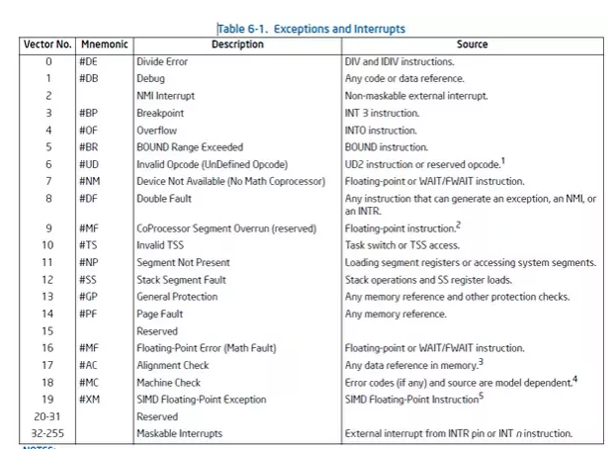
Hardware devices can generate interrupts
Each device maps to some number of hardware interrupts
Done at system boot time
  Discover devices
  Map devices into address space
  Map interrupts for devices

Slide 52
Interrupts allow waiting to happen asynchronously
Prior code example was synchronous
  Nothing else continued on the processor until access was complete
  Good for very fast devices (like the real-time clock, that just returns data)
  We call this “Polling”
    Might make sense in applications which can Block
With interrupts, device handling is now asynchronous
  Access occurs in the background and processor can do something else
  Good for very slow devices (Disk)
  Comes with all the downsides of concurrency though…

Slide 53
Microcontroller TEMP device supports interrupts!
Can either wait on the EVENTS_DATARDY register
Or could enable an interrupt from the device
  And only bother reading data when it is ready

Slide 54
Driver implementation types
Blocking
  Driver function doesn’t return until the action is complete
  Kernel ends up waiting, either in a loop or on something like a condvar
    Probably only makes sense if the kernel can have multiple threads
Non-blocking
  Driver function returns as soon as it starts the action
  Kernel can do other work for a while
  Interrupt signals that the action is complete

Slide 55
Device driver interrupt pattern: non-blocking
Kernel requests driver to perform some action
  Driver writes to the hardware device
  Sets the status of the driver to be busy
Function returns so the kernel can keep running
  Likely returns to Scheduler and runs a process/thread
Interrupt occurs when action is completed
  Change the status of the driver to be ready
Kernel can now make a new request whenever it wants to

Slide 56
Device driver interrupt pattern: blocking
Kernel requests driver to perform some action
  Driver writes to the hardware device
  Sets the status of the driver to be busy
Function returns so the kernel can keep running
  Kernel waits on a signal that the device is ready
Interrupt occurs when action is completed
  Change the status of the driver to be ready
  Signal that the device is ready
Kernel can now make a new request whenever it wants to

Slide 57
Outline
Overview of Device I/O
Connecting to devices
  Buses on a computer
Talking to devices
  Port-Mapped I/O and Memory-Mapped I/O
Device interactions
  Synchronous versus Asynchronous Events
  Programmed I/O versus Direct Memory Access

Slide 58
Programmed I/O (PIO)
    while STATUS==BUSY; Wait (possibly on interrupt)
      (Need to make sure device is ready for a command)
    Write value(s) to DATA
    Write command(s) to COMMAND
    while STATUS==BUSY; Wait (possibly on interrupt)
      (Need to make sure device has completed the request)
    Read value(s) from Data
How do we read and write those values? (could be a lot)
  With normal CPU memory accesses: Programmed I/O
  Literally: you write a program to do the input and output

Slide 59
Check your understanding – writing to GPU
Let’s say that a GPU has MMIO registers for an entire 4 KB page
  Takes 100 ns to write each word (8 bytes) of memory
Assuming that we’re just writing all zeros (ignore reading from memory), how long does it take to write a page to MMIO?

Slide 60
Check your understanding – writing to GPU
Let’s say that a GPU has MMIO registers for an entire 4 KB page
  Takes 100 ns to write each word (8 bytes) of memory
Assuming that we’re just writing all zeros (ignore reading from memory), how long does it take to write a page to MMIO?
  4 KB / 8 B = 500 writes * 100 ns / write = 50 µs
    (For a 3 GHz processor, that’s ~150,000 cycles)

Slide 61
Direct Memory Access (DMA)
Even with interrupts, just providing data to the peripheral is time consuming
  The processor is involved in writing/reading each byte
DMA is an alternative method that uses hardware to do the memory transfers for the processor
  Software writes address of the data and the size to the peripheral
  Device reads data directly from memory
  Processor can go do other things while read/write is occurring

Slide 62
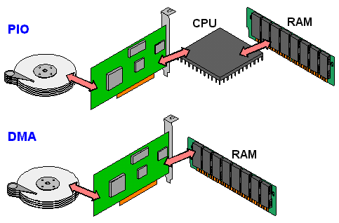
Programmed I/O versus Direct Memory Access
SATA Controller
Disk
SATA Controller
Disk

Slide 63
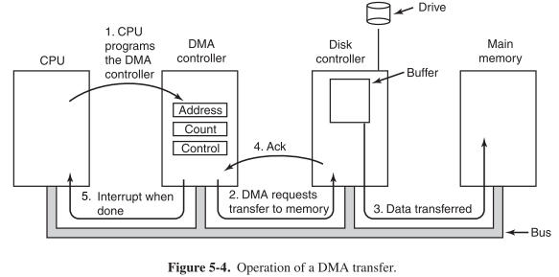
Disk access with DMA

Slide 64
DMA considerations
Need to be careful about letting devices access arbitrary memory
  Should devices be trusted?
  This random flash drive that’s plugged in shouldn’t be able to read all of RAM
Often a hardware “DMA controller” does the transfer for the device
  IOMMU can even set up virtual memory spaces for devices

Slide 65
Interaction pattern with Interrupts and DMA
Configure the peripheral
Enable peripheral interrupts
Set up peripheral DMA transfer
Start peripheral
Continue on to other code
Interrupt occurs, signaling DMA transfer complete
Set up next DMA transfer
Continue on to other code, and repeat
Kernel is in charge of keeping a queue of hardware requests

Slide 66
Returning to the variety of devices
Interrupts support high-latency devices and time-sensitive devices
DMA supports high-throughput devices
Device | Behavior | Partner | Data Rate (Kb/s)
Keyboard | Input | Human | 0.2
Mouse | Input | Human | 0.4
Microphone | Output | Human | 700.0
Bluetooth | Input or Output | Machine | 20,000.0
Hard disk drive | Storage | Machine | 100,000.0
Wireless network | Input or Output | Machine | 300,000.0
Solid state drive | Storage | Machine | 500,000.0
Wired LAN network | Input or Output | Machine | 1,000,000.0
Graphics display | Output | Human | 3,000,000.0

Slide 67
Outline
Overview of Device I/O
Connecting to devices
  Buses on a computer
Talking to devices
  Port-Mapped I/O and Memory-Mapped I/O
Device interactions
  Synchronous versus Asynchronous Events
  Programmed I/O versus Direct Memory Access

