Slide 1
Lecture 02:
Processes and Threads
CS343 – Operating Systems
Branden Ghena – Fall 2024
Some slides borrowed from:
Stephen Tarzia (Northwestern), Jaswinder Pal Singh (Princeton), Harsha Madhyastha (Michigan), and UC Berkeley CS61C and CS162

Slide 2
Administrivia
Getting Started Lab
  Will be released today. Sometime this evening likely
  Purpose is to make sure that you’ve got everything set up right
    SSH login for EECS servers (if this fails, IT turnaround is ~24 hours)
    Github account and Git SSH access
    Ability to build the Nautilus Kernel
  Individual assignment
    Everyone needs their own setup working to collaborate
  Let us know if you’re having problems with this!
    Should not take long to complete

Slide 3
Today’s Goals
Understand the operating system’s view of a process.
Explore the context switches and exceptional control flow.
Understand the basics of system calls and signals.
What are threads and why are they useful?

Slide 4
Outline
Processes
Context Switching
  Running a Process
  Exceptions
  Running the Kernel
System Calls
Signals
Threads

Slide 5
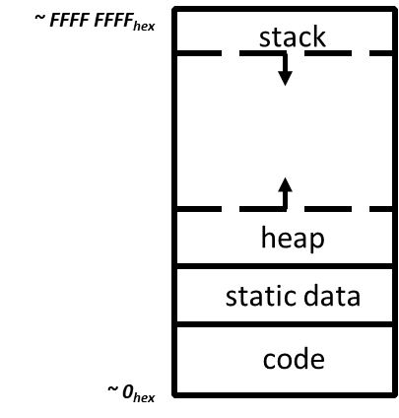
View of a process
Process: program that is being executed
Contains code, data, and a thread
  Thread contains registers, instruction pointer, and stack
Code and Data
Registers
Instruction Pointer
Condition Codes
Stack
%rax
%r8
%eax
%r8d
%rbx
%r9
%ebx
%r9d
%rcx
%r10
%ecx
%r10d
%rdx
%r11
%edx
%r11d
%rsi
%r12
%esi
%r12d
%rdi
%r13
%edi
%r13d
%rsp
%r14
%esp
%r14d
%rbp
%r15
%ebp
%r15d

Slide 6
POSIX processes also have file descriptors
Integers specifying a file the process is interacting with
  Process contains a table linking integers to files (and permissions)
Default file descriptors
  0 - Standard input (stdin)
  1 - Standard output (stdout)
  2 - Standard error (stderr)
Function calls to interact with files
  int open (const char *path, int oflag, ... );
  ssize_t read (int fildes, void *buf, size_t nbyte);
  ssize_t write (int fildes, const void *buf, size_t nbyte);

Slide 7
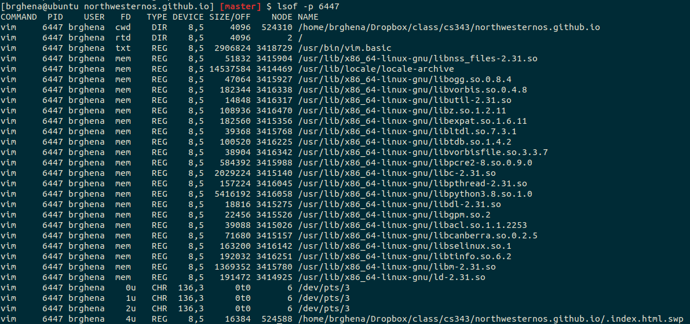
Example file descriptors

Slide 8
Also the code files mapped to the address space

Slide 9
Additional process contents
Whatever else the OS thinks is useful
  Process ID
  Priority
  Time Used
  Process State
Different OSes will attach different things to the
“process abstraction”

Slide 10
Processes are an abstraction provided by the OS
The machine itself usually doesn’t support processes
  Just has a processor and a set of registers
  Memory is just arbitrary memory
OS provides the abstraction
  Multiple processes can run at the “same time”
  Each has its own registers
  Each has its own isolated memory
Processes enable
  Multiple functionalities on a computer
  Multiprogramming of a system

Slide 11
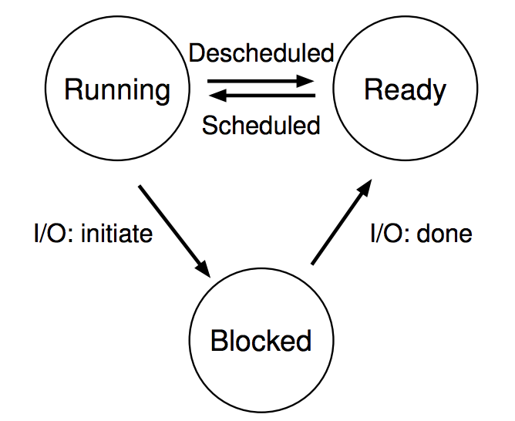
Processes don’t run all the time
The three basic process states:
OS schedules processes
  Decides which of many competing processes to run.
A blocked process is not ready to run.
I/O means input/output – anything other than computing.
  For example, reading/writing disk, sending network packet, waiting for keystroke, updating display.
  While waiting for results, the process often cannot do anything, so it blocks, and the OS schedules a different process to run.

Slide 12
Multiprogramming processes
The three basic process states:
When one process is Blocked, OS can schedule a different process that is Ready
Even with a single processor, the OS can provide the illusion of many processes running simultaneously
OS usually sets a maximum runtime before switching limit for processes (timeslice)

Slide 13
What about the kernel itself?
The kernel is NOT a process
It does have features of a normal C program though
  Kernel has its own stack, code, and heap memory regions
It’s instead the default code that the machine runs whenever it needs to handle some special operation
  Examples:
    when a process becomes blocked
    when a process does something wrong like accessing invalid memory
    when a hardware device has data to be read

Slide 14
Key difference between kernel and processes: privilege
Processes have limited access to the computer
  Hardware supports different “modes” of execution (kernel and user)
  Kernel mode has access to physical memory and special instructions
They run when the OS lets them
They have access to the memory the OS gives them
They cannot access many things directly
  Must ask the OS to do so for them

Slide 15
Break + Question
Is it safe for two processes to have the same code section?

Slide 16
Break + Question
Is it safe for two processes to have the same code section?
Usually yes!
The OS can mark the code section as read-only
Example: multiple instances of a shell share the same code
Self-modifying code would be a problem…

Slide 17
Outline
Processes
Context Switching
  Running a Process
  Exceptions
  Running the Kernel
System Calls
Signals
Threads

Slide 18

Context: Tock Operating System
Usually we’ll use Nautilus as an example (last two labs are in it)
  But Nautilus doesn’t have a userspace!! (usually)
  (also I honestly understand it less well than Tock)
Tock OS
  Embedded operating system
    Targets resource-constrained embedded systems
  Written in Rust
    Reliability and Security are key goals
  Multi-programming traditional OS environment
    One core, with as many processes as you want
https://tockos.org/ - https://github.com/tock/tock

Slide 19
Switch to Process
When a kernel decides to start running a process it does a context switch into the process
  This includes starting a process for the first time
  Or continuing running a process after it was stopped
    Blocked for I/O or just timesliced off the processor
High-level steps for switching into a process
  Scheduler decides which process should be running
  Save kernel register values to kernel stack
  Restore process register values (usually from a data structure)
  Switch to process mode instead of kernel mode
  Jump to next instruction in process

Slide 20
Tock ARM implementation: Switch to Process
Tock ARM-v7m implementation
  Save kernel register values to kernel stack
    https://github.com/tock/tock/blob/048f67396faad06954195e025723ff04f8b3c3bc/arch/cortex-v7m/src/lib.rs#L234
  Restore process register values (usually from a data structure)
    https://github.com/tock/tock/blob/048f67396faad06954195e025723ff04f8b3c3bc/arch/cortex-v7m/src/lib.rs#L248
  Bonus: enter exception handler
  Switch to process mode instead of kernel mode
    https://github.com/tock/tock/blob/048f67396faad06954195e025723ff04f8b3c3bc/arch/cortex-v7m/src/lib.rs#L91
  Jump to next instruction in process
    https://github.com/tock/tock/blob/048f67396faad06954195e025723ff04f8b3c3bc/arch/cortex-v7m/src/lib.rs#L101

Slide 21
Tock RISC-V implementation: Switch to Process
Tock rv32i implementation
  Save kernel register values to kernel stack
    https://github.com/tock/tock/blob/048f67396faad06954195e025723ff04f8b3c3bc/arch/rv32i/src/syscall.rs#L276
  Bonus: pause exceptions
    https://github.com/tock/tock/blob/048f67396faad06954195e025723ff04f8b3c3bc/arch/rv32i/src/syscall.rs#L311
  Restore process register values (usually from a data structure)
    https://github.com/tock/tock/blob/048f67396faad06954195e025723ff04f8b3c3bc/arch/rv32i/src/syscall.rs#L349
  Switch to process mode instead of kernel mode
  AND jump to next instruction in process
  AND enable exceptions again
    https://github.com/tock/tock/blob/048f67396faad06954195e025723ff04f8b3c3bc/arch/rv32i/src/syscall.rs#L384

Slide 22
Outline
Processes
Context Switching
  Running a Process
  Exceptions
  Running the Kernel
System Calls
Signals
Threads

Slide 23
Control flow
Processors do only one thing:
  From startup to shutdown, a CPU simply reads and executes (interprets) a sequence of instructions, one at a time
  This sequence is the CPU’s control flow (or flow of control)
Physical control flow
<startup>
inst₁
inst₂
inst₃
…
inst_{n}
<shutdown>
Time

Slide 24
Altering control flow
Instructions that change control flow allow software to react changes in program state
  Jumps/branches
  Call/return
Also need to react to changes in system state
  Data arrives at network adapter
  Instruction divides by zero
  User hits Ctrl-C on the keyboard
  System timer expires
These mechanisms are known as “exceptional control flow”

Slide 25
Exceptional control flow
Mechanisms that could cause exceptional control flow
  Exceptions: events cause execution to jump to OS handler
  System calls: request from process causes execution to jump to OS
  Signals: OS causes process to jump to process handler
Running process
Other code (usually OS)
Event
I_current
Exception
I_next
Exception processing
by exception handler
Return to I_next

Slide 26
Exceptions
Hardware detects an event that OS software needs to resolve immediately
Could be an error
  Invalid memory access
  Invalid instruction
Could just be something the OS should handle (known as interrupts)
  Page fault
  USB device detected
OS has a table of “exception handlers”, which are functions that handle each exception class (also known as interrupt handlers)
  Hardware jumps execution to the proper handler

Slide 27
Tock exception vector
Array of functions for each exception type
  In Tock, most are “unhandled” which just crashes the system
  Some are device interrupts (which don’t matter for today’s lecture
Interrupt “vector”
  https://github.com/tock/tock/blob/226f48da7d9299eaab8ea2d9ae81ecbfc6b6653b/chips/nrf52/src/crt1.rs#L31
SVC is a “service call” instruction
  It’s used by processes to request an action from the OS
  SVC_Handler is a function to handle those requests
    https://github.com/tock/tock/blob/048f67396faad06954195e025723ff04f8b3c3bc/arch/cortex-v7m/src/lib.rs#L73

Slide 28
Processes run until an exception occurs
While the process is running, the OS is NOT running
  In a single-core environment at least
So, when does the OS kernel get to run again?
  Whenever an exception occurs
Hardware can be a source of this
  Random device event occurring
  Timer expiring (source of the process timeslice)
Software can also cause this
  System calls

Slide 29
Outline
Processes
Context Switching
  Running a Process
  Exceptions
  Running the Kernel
System Calls
Signals
Threads

Slide 30
How does a process ask the OS to do something?
Certain things can only be accessed from kernel mode
  All of memory, I/O devices, etc.
  Kernel: the portion of the OS that is running and in memory
Bad Idea to allow processes to just enter kernel mode
  We do NOT trust processes
  So there shouldn’t be any instruction that switches to kernel mode unless that instruction also switches to kernel code
Requirements
  Switch execution to the kernel
  Change into kernel mode
  Inform the kernel what you want it to do

Slide 31
Hardware can save us!
Solution: trigger an exception to run an OS handler
  Hardware instruction: trap
When instruction runs:
  Mode is changed to kernel mode
  AND
  Instruction Pointer is moved to a known location in the kernel
Same mechanism is used for other exceptions
  Division by zero, invalid memory access
  Also very similar to hardware interrupts

Slide 32
System call example
System call: making a request of the OS from a process
  Uses exceptional control flow to enter OS kernel
  Returns back to process when complete
    Instruction after the system call
Kernel code
User code
Exception
syscall
next instruction
Do the thing
Returns

Slide 33
Switch to Kernel
Assume the process wants to switch to the kernel, what occurs?
High-level steps for switching to the kernel
  Process executes a system call
  Processor enters kernel mode and runs an exception handler
  Save process registers
  Restore kernel registers
  Figure out why a context switch occurred

Slide 34
Tock ARM Implementation: Switch to Kernel
Tock ARM-v7m implementation
  Process executes a system call
    https://github.com/tock/libtock-c/blob/3b19582f09c2f8d085122f6d69cb641765b4354c/libtock/tock.c#L298
  Processor enters kernel mode and runs an exception handler
    https://github.com/tock/tock/blob/048f67396faad06954195e025723ff04f8b3c3bc/arch/cortex-v7m/src/lib.rs#L73
  Bonus: return to switch_to_user implementation
    https://github.com/tock/tock/blob/048f67396faad06954195e025723ff04f8b3c3bc/arch/cortex-v7m/src/lib.rs#L132
  Save process registers
    https://github.com/tock/tock/blob/048f67396faad06954195e025723ff04f8b3c3bc/arch/cortex-v7m/src/lib.rs#L261
  Restore kernel registers
    https://github.com/tock/tock/blob/048f67396faad06954195e025723ff04f8b3c3bc/arch/cortex-v7m/src/lib.rs#L269
  Figure out why a context switch occurred
    https://github.com/tock/tock/blob/3a3c84b5da9b4f5f7d14f218b83144ebeffb2d5a/arch/cortex-m/src/syscall.rs#L262

Slide 35
Tock RISC-V Implementation: Switch to Kernel
Tock rv32i implementation
  Process executes a system call
    https://github.com/tock/libtock-c/blob/3b19582f09c2f8d085122f6d69cb641765b4354c/libtock/tock.c#L298
  Processor enters kernel mode and runs an exception handler
    https://github.com/tock/tock/blob/048f67396faad06954195e025723ff04f8b3c3bc/arch/rv32i/src/syscall.rs#L393
  Save process registers
    https://github.com/tock/tock/blob/048f67396faad06954195e025723ff04f8b3c3bc/arch/rv32i/src/syscall.rs#L422
  Bonus: return to switch_to_process implementation
    https://github.com/tock/tock/blob/048f67396faad06954195e025723ff04f8b3c3bc/arch/rv32i/src/syscall.rs#L572
  Restore kernel registers
    https://github.com/tock/tock/blob/048f67396faad06954195e025723ff04f8b3c3bc/arch/rv32i/src/syscall.rs#L587
  Figure out why a context switch occurred
    https://github.com/tock/tock/blob/3a3c84b5da9b4f5f7d14f218b83144ebeffb2d5a/arch/cortex-m/src/syscall.rs#L262

Slide 36
Handling the system call
Now the kernel is running again AND it knows why it was running
If a fault occurred crash the process or something
If a syscall occurred, read why from the process’s registers
  Which are saved in some data structure somewhere
  Then figure out what to do about that request

Slide 37
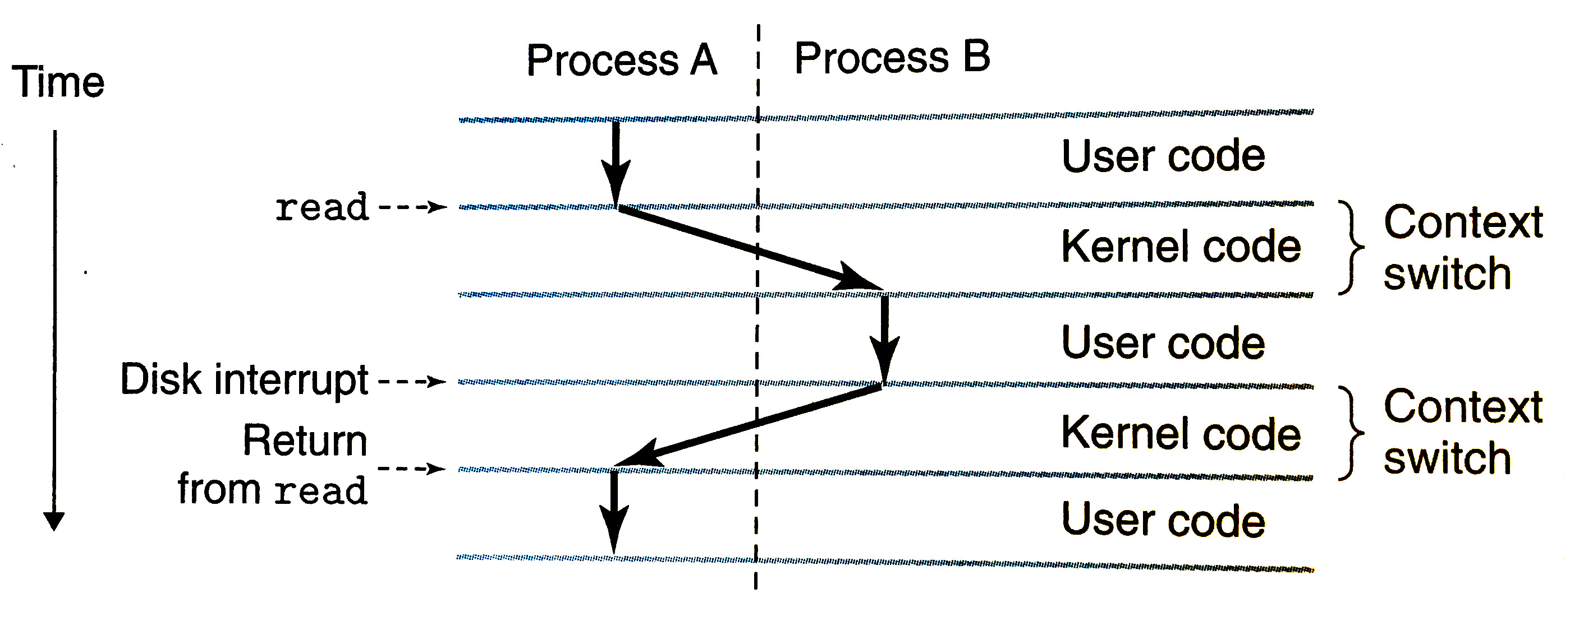
Switching between process and kernel is a context switch
Context switch: switching from process to kernel or kernel to process
  Vague term. Sometimes refer to there-and-back as a context switch
Diagram from Bryant & O’Hallaron book

Slide 38
Break + Question
Context switches are expensive
  Lots of context switches lead to poor performance
  Why?

Slide 39
Break + Question
Context switches are expensive
  Lots of context switches lead to poor performance
  Why?
  Lots of memory manipulation
    Saving and restoring registers
    All cached data is almost certainly invalid
  Triggering an exception isn’t exactly quick
    Processor needs to stop everything and jump somewhere
  OS needs to figure out what’s going on and respond to it
    The figuring it out part can be a lot of code

Slide 40
Outline
Processes
Context Switching
  Running a Process
  Exceptions
  Running the Kernel
System Calls
Signals
Threads

Slide 41
Things a program cannot do itself
Print “hello world”
  because the display is a shared resource.
Download a web page
  because the network card is a shared resource.
Save or read a file
  because the filesystem is a shared resource, and the OS wants to check file permissions first.
Launch another program
  because processes are managed by the OS
Send data to another program
  because each program runs in isolation, one at a time

Slide 42
Linux system calls
Example system calls
  https://man7.org/linux/man-pages/man2/syscalls.2.html
Number | Name | Description
0 | read | Read file
1 | write | Write file
2 | open | Open file
3 | close | Close file
4 | stat | Get info about file
57 | fork | Create process
59 | execve | Execute a program
60 | _exit | Terminate process
62 | kill | Send signal to process

Slide 43
Many other system calls
POSIX contains many others, for example time()
  And especially lots of old ones
Windows or other operating systems will have entirely different system calls
  Same basic idea for how they function though

Slide 44
Example system call usage
Create new processes with system calls
From process view:
  Just look like regular C functions
  Take arguments, return values
Underneath:
  Function uses special assembly instruction to trigger exception

Slide 45
Process system calls
pid_t fork(void);
  Create a new process that is a copy of the current one
  Returns either PID of child process (parent) or 0 (child)
void _exit(int status);
  Exit the current process (exit(), the library call cleans things up first)
pid_t waitpid(pid_t pid, int *status, int options);
  Suspends the current process until a child (pid) terminates
int execve(const char *filename, char *const argv[], char *const envp[]);
  Execute a new program, replacing the existing one

Slide 46
Creating a new process
  #include <stdio.h>
  #include <unistd.h>
  int main(){
  if(fork() == 0) {
  printf("Child!\n");
  } else {
  printf("Parent!\n");
  }
  printf("Both!\n");
  return 0;
  }

Slide 47
Creating a new process
  #include <stdio.h>
  #include <unistd.h>
  int main(){
  if(fork() == 0) {
  printf("Child!\n");
  } else {
  printf("Parent!\n");
  }
  printf("Both!\n");
  return 0;
  }
Existential crisis

Slide 48
Executing a new program
  #include <stdio.h>
  #include <unistd.h>
  int main(){
  if(fork() == 0) {
  execve("/bin/python3", ...);
  } else {
  printf("Parent!\n");
  }
  printf("Only parent!\n");
  return 0;
  }

Slide 49
Creating your own shell
https://danishpraka.sh/2018/01/15/write-a-shell.html
  void execute(char** args) {
  if (strcmp(args[0], "exit") == 0) {
  exit(); // exit the shell when requested
  }
  pid_t cpid = fork();
  if (cpid == 0) {
  if (execvp(args[0], args) < 0) { // child, execute new process
  printf("command not found: %s\n", args[0]);
  }
  } else {
  waitpid(cpid, & status, WUNTRACED); // parent, wait for process to be complete
  }}
  int main(){
  char** args;
  while(1){
  printf("> ");
  args = parse_incoming_text(); // complicated in C unfortunately
  execute(args);
  }}

Slide 50
Creating your own shell
https://danishpraka.sh/2018/01/15/write-a-shell.html
  void execute(char** args) {
  if (strcmp(args[0], "exit") == 0) {
  exit(); // exit the shell when requested
  }
  pid_t cpid = fork();
  if (cpid == 0) {
  if (execvp(args[0], args) < 0) { // child, execute new process
  printf("command not found: %s\n", args[0]);
  }
  } else {
  waitpid(cpid, & status, WUNTRACED); // parent, wait for process to be complete
  }}
  int main(){
  char** args;
  while(1){
  printf("> ");
  args = parse_incoming_text(); // complicated in C unfortunately
  execute(args);
  }}

Slide 51
Break + Question
What does the following code do?
#include <stdio.h>
#include <sys/types.h>
int main() {
while(1){
fork();
}
return 0;
}

Slide 52
Break + Question
What does the following code do?
#include <stdio.h>
#include <sys/types.h>
int main() {
while(1){
fork();
}
return 0;
}
Creates a new process
  Then each process creates a new process
  Then each of those creates a new process…
Known as a Fork bomb!
  Machine eventually runs out of memory and processing power and will stop working
Defense: limit number of processes per user

Slide 53
Fork bombs in various languages
Python fork bomb
  import os
  while 1:
  os.fork()
Rust fork bomb
  #[allow(unconditional_recursion)]
  fn main() {
  std::thread::spawn(main);
  main();
  }
Bash fork bomb
  :(){ :|:& };:
Bash with spacing and a clearer function name
  fork() {
  fork | fork &
  }
  fork

Slide 54
Outline
Processes
Context Switching
  Running a Process
  Exceptions
  Running the Kernel
System Calls
Signals
Threads

Slide 55
Alerting processes of events
How do we let a process know there was an event?
  Errors
  Termination
  User commands (like CTRL-C or CTRL-\)
Events could happen whenever
  Need to interrupt process control flow and run an event handler
  Linux mechanism to do so is called “signals”

Slide 56
Signals are asynchronous messages to processes
Sometimes the OS wants to send something like an interrupt to a process
  Your child process completed
  You tried to use an illegal instruction
  You accessed invalid memory
  You are terminating now
In POSIX systems, this idea is called “Signals”
1) SIGHUP 2) SIGINT 3) SIGQUIT 4) SIGILL 5) SIGTRAP
6) SIGABRT 7) SIGBUS 8) SIGFPE 9) SIGKILL 10) SIGUSR1
11) SIGSEGV 12) SIGUSR2 13) SIGPIPE 14) SIGALRM 15) SIGTERM
16) SIGSTKFLT 17) SIGCHLD 18) SIGCONT 19) SIGSTOP 20) SIGTSTP
21) SIGTTIN 22) SIGTTOU 23) SIGURG 24) SIGXCPU 25) SIGXFSZ
26) SIGVTALRM 27) SIGPROF 28) SIGWINCH 29) SIGIO 30) SIGPWR
31) SIGSYS ...

Slide 57
Signals are asynchronous messages to processes
Sometimes the OS wants to send something like an interrupt to a process
  Your child process completed
  You tried to use an illegal instruction
  You accessed invalid memory
  You are terminating now
In POSIX systems, this idea is called “Signals”
1) SIGHUP 2) SIGINT 3) SIGQUIT 4) SIGILL 5) SIGTRAP
6) SIGABRT 7) SIGBUS 8) SIGFPE 9) SIGKILL 10) SIGUSR1
11) SIGSEGV 12) SIGUSR2 13) SIGPIPE 14) SIGALRM 15) SIGTERM
16) SIGSTKFLT 17) SIGCHLD 18) SIGCONT 19) SIGSTOP 20) SIGTSTP
21) SIGTTIN 22) SIGTTOU 23) SIGURG 24) SIGXCPU 25) SIGXFSZ
26) SIGVTALRM 27) SIGPROF 28) SIGWINCH 29) SIGIO 30) SIGPWR
31) SIGSYS ...
Process Errors

Slide 58
Signals are asynchronous messages to processes
Sometimes the OS wants to send something like an interrupt to a process
  Your child process completed
  You tried to use an illegal instruction
  You accessed invalid memory
  You are terminating now
In POSIX systems, this idea is called “Signals”
1) SIGHUP 2) SIGINT 3) SIGQUIT 4) SIGILL 5) SIGTRAP
6) SIGABRT 7) SIGBUS 8) SIGFPE 9) SIGKILL 10) SIGUSR1
11) SIGSEGV 12) SIGUSR2 13) SIGPIPE 14) SIGALRM 15) SIGTERM
16) SIGSTKFLT 17) SIGCHLD 18) SIGCONT 19) SIGSTOP 20) SIGTSTP
21) SIGTTIN 22) SIGTTOU 23) SIGURG 24) SIGXCPU 25) SIGXFSZ
26) SIGVTALRM 27) SIGPROF 28) SIGWINCH 29) SIGIO 30) SIGPWR
31) SIGSYS ...
Process Termination

Slide 59
Sending signals
OS sends signals when it needs to
Processes can ask the OS send signals with a system call
  int kill(pid_t pid, int sig);
Users send signals through OS from command line or keyboard
  Shell command: kill -9 pid (SIGKILL)
  CTRL-C (SIGINT)

Slide 60
Handling signals
Programs can register a function to handle individual signals
  signal(int sig, sighandler_t handler);
OS keeps track of signal handlers for each signal
  Calls that function when a signal occurs
What is the process supposed to do about it?
  Do some quick processing to handle it
    That needs to be “reentrant” safe
  Reset the process and try again
  Quit the process (default handler)

Slide 61
Example: catching a signal
#include <stdbool.h>
#include <stdlib.h>
#include <stdio.h>
#include <unistd.h>
#include <signal.h>
void sighandler (int signum) {
printf("HA HA You can't kill me!\n");
}
int main (void) {
signal(SIGINT, sighandler);
printf("Starting\n");
while(true) {
printf("Going to sleep for a second...\n");
sleep(1);
}
return 0;
}

Slide 62
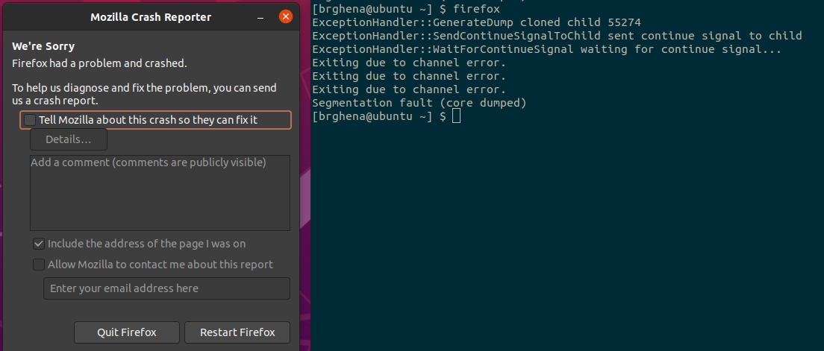
Examples: sending a signal
> kill -11 pid (11 is SIGSEGV – a.k.a segfault)

Slide 63
Outline
Processes
Context Switching
  Running a Process
  Exceptions
  Running the Kernel
System Calls
Signals
Threads

Slide 64
Software Tasks: Threads
Unit of execution within a process
Processes discussed so far have a single thread
They “have a single thread of execution”
They “are single-threaded”
But a single process could have multiple threads

Slide 65
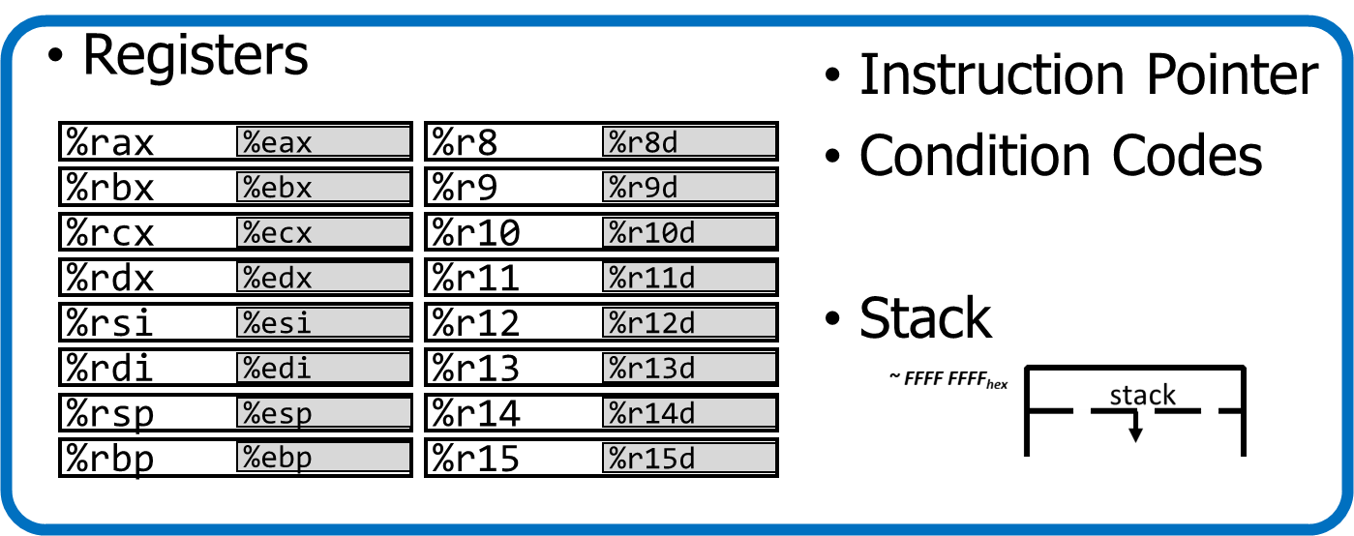
Alternate view of a process
A process could have multiple threads
  Each with its own registers and stack
Threads have separate:
  Instruction Pointer
  Registers
  Stack Memory
  Condition Codes
Threads share:
  Code
  Global variables
Code and Data

Slide 66
Process address space with threads
Stack (T1)
Thread 1
Thread 2
Stack (T2)
Stack (T3)
Thread 3
Data
Segment
Heap
Static Data
%RIP (T3)
%RIP (T2)
Code
%RIP (T1)

Slide 67
Thread use case: web browser
Let’s say you’re implementing a web browser:
You want a tab for each web page you open:
The same code loads each website (shared code section)
The same global settings are shared by each tab (shared data section)
Each tab does have separate state (separate stack and registers)
Disclaimer: Actually, modern browsers use separate processes for each tab for a variety of reasons including performance and security. But they used to use threads.

Slide 68
Thread use case: user interfaces
Even if there is only a single processor core, threads are useful
Single-threaded User Interface
  While processing actions, the UI is frozen
  main() {
  while(true) {
  check_for_UI_interactions();
  process_UI_actions(); // UI freezes while processing
  }
  }

Slide 69


Thread use case: web server
Example: Web server
  Receives multiple simultaneous requests
  Reads web pages from disk to satisfy each request

Slide 70
Web server option 1: handle one request at a time
  Request 1 arrives
  Server reads in request 1
  Server starts disk I/O for request 1
  Request 2 arrives
  Disk I/O for request 1 finishes
  Server responds to request 1
  Server reads in request 2
Easy to program, but slow
  Can’t overlap disk requests with computation
  Can’t overlap either with network sends and receives
time

Slide 71
Web server option 1: event-driven model
Issue I/Os, but don’t wait for them to complete
  Request 1 arrives
  Server reads in request 1
  Server starts disk I/O for request 1
  Request 2 arrives
  Server reads in request 2
  Server starts disk I/O for request 2
  Disk I/O for request 1 completes
  Server responds to request 1
Fast, but hard to program
  Must remember which requests are in flight and which I/O goes where
  Lots of extra state
time

Slide 72
Web server option 3: multi-threaded web server
One thread per request. Thread handles only that request.
Easy to program (maybe), and fast!
  State is stored in the stacks of each thread and the thread scheduler
  Simple to program if they are independent…
Main Thread
Request 1 arrives
Create thread
Request 2 arrives
Create thread
Thread 1
Read in request 1
Start disk I/O
Disk I/O finishes
Respond to request 1
Exit
Thread 2
Read in request 2
Start disk I/O
time

Slide 73
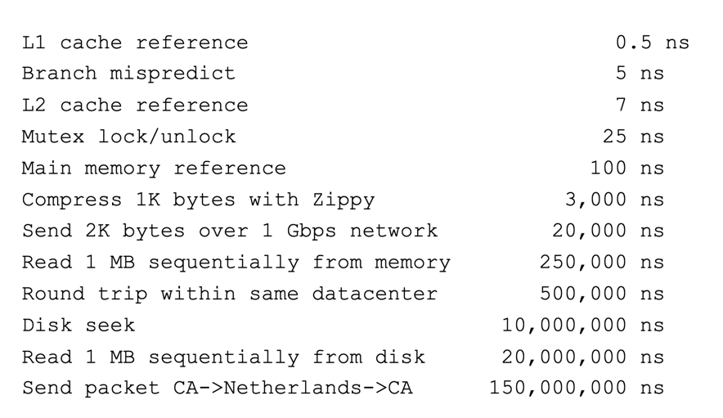
More Practical Motivation
Back to Jeff Dean’s “Numbers Everyone Should Know”
Handle I/O in separate thread, avoid blocking other progress

Slide 74
Outline
Processes
Context Switching
  Running a Process
  Exceptions
  Running the Kernel
System Calls
Signals
Threads

Slide 75
Bonus: Thread example

Slide 76
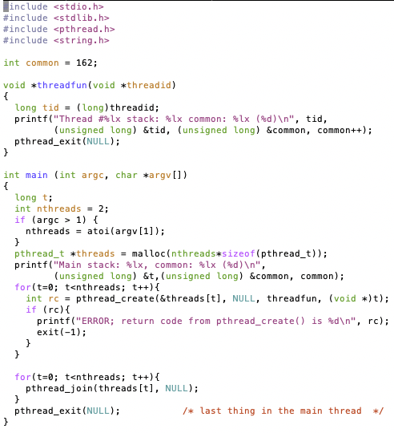
Threads Example

Slide 77
Threads Example
Reads N from process arguments
Creates N threads
Each one prints a number, then increments it, then exits
Main process waits for all of the threads to finish

Slide 78

Threads Example

Slide 79
Check your understanding
How many threads are in this program?
Does the main thread join with the threads in the same order that they were created?
Do the threads exit in the same order they were created?
If we run the program again, would the result change?

Slide 80
Check your understanding
How many threads are in this program? Five
Does the main thread join with the threads in the same order that they were created? Yes
Do the threads exit in the same order they were created? Maybe??
If we run the program again, would the result change?
Possibly!

