Slide 1
Lecture 01:
Introduction
CS343 – Operating Systems
Branden Ghena – Fall 2024
Some slides borrowed from:
Stephen Tarzia (Northwestern), Jaswinder Pal Singh (Princeton), and UC Berkeley CS162

Slide 2
Welcome to CS343!
In brief: how does the operating system work and why?
Role of the Operating System
  Manages hardware resources
  Provides abstractions to support processes
Major topics
  Scheduling
  Concurrency
  Devices
  Virtual Memory
  File Systems

Slide 3
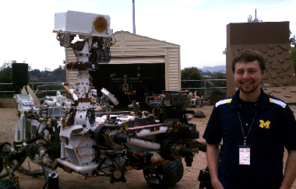
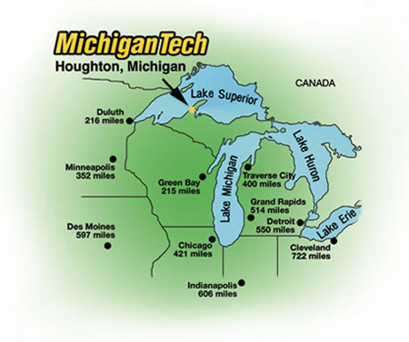
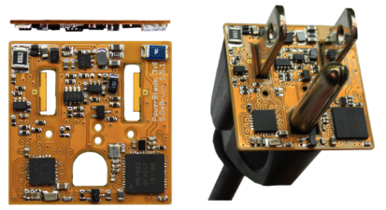

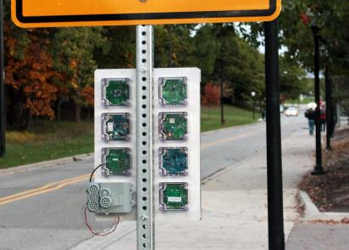




Branden Ghena (he/him)
Assistant Faculty of Instruction
Education
  Undergrad: Michigan Tech
  Master’s: University of Michigan
  PhD: University of California, Berkeley
Research
  Resource-constrained sensing systems
  Low-energy wireless networks
  Embedded operating systems
Teaching
  Computer Systems
    CS211: Fundamentals of Programming II
    CS213: Intro to Computer Systems
    CS343: Operating Systems
    CE346: Microcontroller System Design
    CS397: Wireless Protocols for the IoT
Things I love

Slide 4
Today’s Goals
Discuss the role of an Operating System
Introduce theme and goals of the course
Describe how this class is going to function
Explore trends in OS history

Slide 5
Outline
What is an OS?
Logistics
Operating Systems History
CS343 Focus

Slide 6
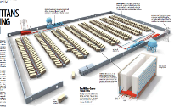
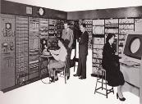
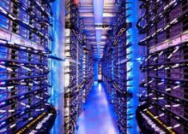
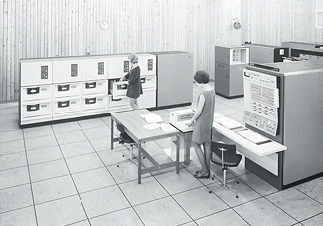
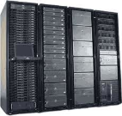

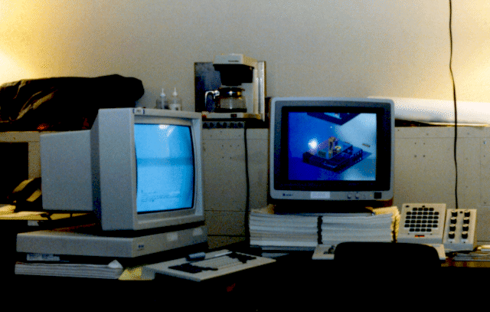



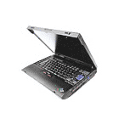




Computers come in incredible diversity
Ratio of Computers to People
Number crunching, Data Storage, Massive Internet Services,
ML, …
1:10⁶
Mainframe
Bell’s Law:
New computer class every 10 years
Mini
1:10³
Workstation
Productivity,
Interactive
PC
Laptop
1:1
PDA
Cell
Streaming from/to the physical world
10³:1
Motes
years

Slide 7
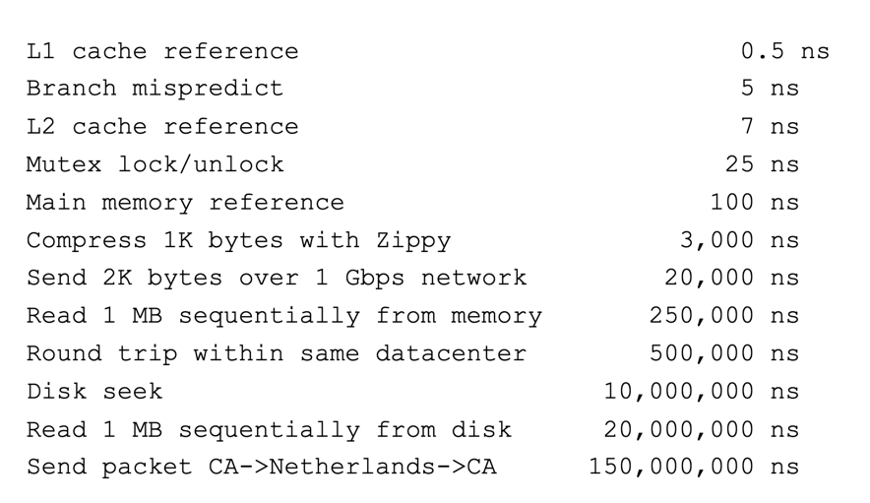
Computing timescales are increasingly large
Jeff Dean
(Google AI):
“Numbers Everyone Should Know”

Slide 8
Operating systems are at the heart of these challenges
OSes make advancing technology available to rapidly evolving applications. They do so with two major goals:
  Provide abstractions to applications to enable hardware compatibility
    Why: allow reuse of common features, avoid low-level details
    Challenges: What are the correct abstractions?
  Manage sharing of resources across many applications
    Why: protect applications, enforce fair access
    Challenges: What are the mechanisms and what are the policies?
Good operating systems do these quickly, efficiently, and securely

Slide 9
What is an operating system?
User processes
Spotify
Powerpoint
Steam
Chrome
QEMU
Physical computer
Hardware

Slide 10
What is an operating system?
User processes
Spotify
Powerpoint
Steam
Chrome
QEMU
Operating System
Physical computer
Hardware

Slide 11
What is an operating system?
User processes
Spotify
Powerpoint
Steam
Chrome
QEMU
File
System
Virtual
Memory
Process
Manager
Network
Operating System
Device Drivers
Interrupt Handlers
Boot and Init
Physical computer
Hardware

Slide 12
What is an operating system?
User processes
Spotify
Powerpoint
Steam
Chrome
QEMU
Application Interface
File
System
Virtual
Memory
Process
Manager
Network
Operating System
Device Drivers
Interrupt Handlers
Boot and Init
Hardware Abstraction Layer
Physical computer
Hardware

Slide 13
What’s part of the OS?
OS kernel – the part of the OS code that has full control of the system
Process scheduling
(who uses CPU)
Memory allocation
(who uses RAM)
Accesses hardware devices
  Outputs graphics
  Reads/writes to network
  Read/write to disks
  Handles boot-up and power-down
OS distribution – the kernel + lots of other useful stuff
GUI / Window manager
Command shell
Software package manager
  “app store”, yum, apt, brew
Common software libraries
Useful apps:
  Text editor, compilers, web browser, web server, SSH, anti-virus, file-sharing, media libraries,

Slide 14
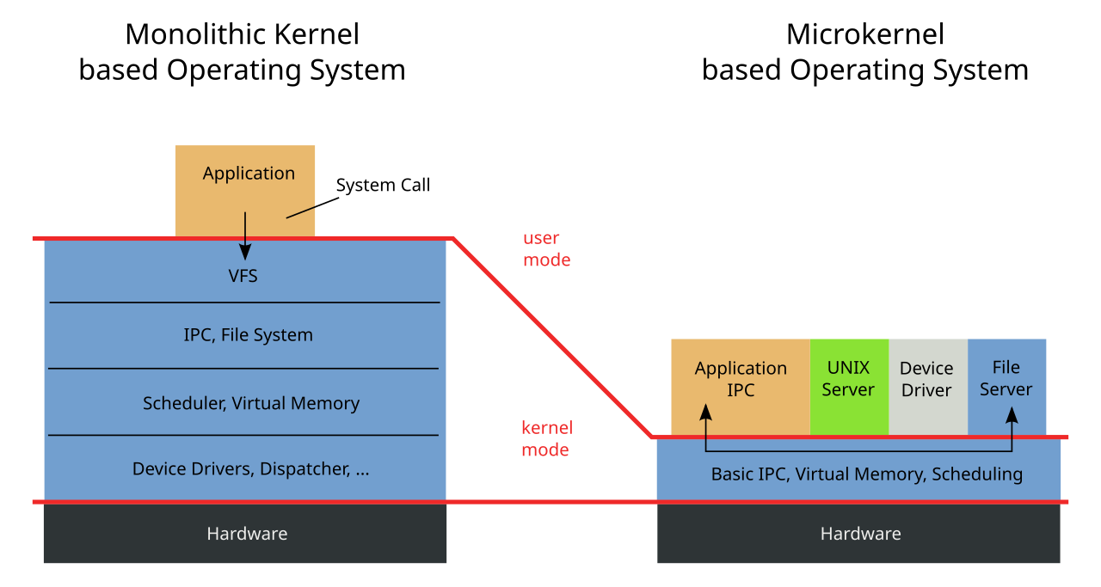
Kernel design choices can vary
We usually focus on Monolithic kernel design in this course

Slide 15
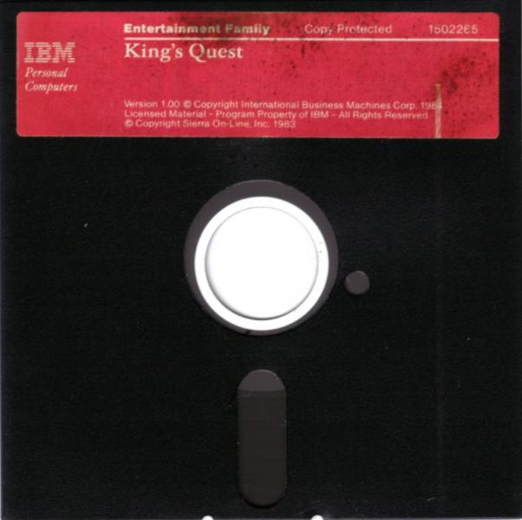
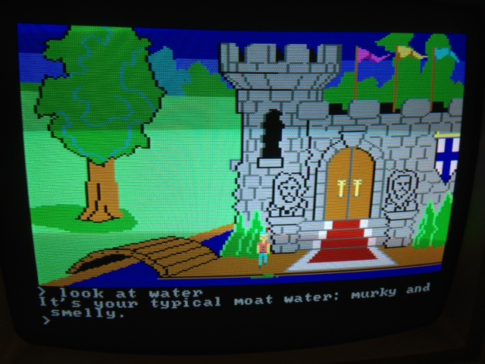
Before operating systems
User could only run one program at a time.
Had to insert the program disk before booting the machine.
Program had to control the hardware directly
  This is a nuisance because hardware is complicated
  Program will only be compatible with one set of hardware
An example (at right): 1983 “King’s Quest” game for IBM PC Jr.

Slide 16
Embedded systems often still run without operating systems
“Bare-metal” embedded systems
  Many downsides:
  Application must handle things for themselves
    Boot and initialization
    All hardware it wants to interact with
  Applications are not portable
    Rewrite, mostly from scratch, for new microcontroller
  No malloc, no segfaults
    Instead invalid memory accesses likely crash the whole system
    Imagine if each CS211 segfault resulted in the EECS server rebooting…
Upside: can be a VERY highly efficient system

Slide 17
Operating Systems are middle-management
Applications we care about
Spotify
Powerpoint
Steam
Chrome
QEMU
Operating System
Overhead
Hardware to run things
Hardware

Slide 18



Roles of an Operating System give the overhead value
Referee
  Manage protection, isolation, and sharing of resources
  Resource allocation and communication
Illusionist
  Provide clean, easy-to-use abstractions of physical resources
    Infinite memory, dedicated machine
    Higher level objects: files, users, messages
    Masking limitations, virtualization
Glue
  Common services
    Storage, Window system, Networking
  Sharing, Authorization
  Look and feel

Slide 19
Example: File Systems
Referee
  Prevent users from accessing other’s files without permission
Illusionist
  Files can grow infinitely large
  Where a file exists in memory or disk isn’t important!
Glue
  Default file system types, named directories, file explorer

Slide 20
Architecture of a lecture
Full
Practice Questions
Open
Question
Wrapup
+ Bonus
Attention
0
20
25
50
53
78
80
Time (minutes)

Slide 21
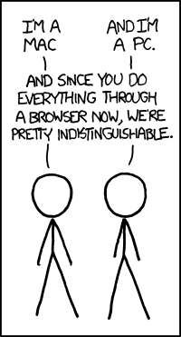
Break + xkcd
Open question:
Are modern web browsers basically operating systems?
https://xkcd.com/934/

Slide 22
Outline
What is an OS?
Logistics
Operating Systems History
CS343 Focus

Slide 23
Course staff
Teaching Assistant
  Connor Selna
    PhD student in systems
Peer Mentors (8)
  Blake Hu
  Emily Wei
  Ethan Havemann
  Jason Lu
Their role: support student questions via office hours and Piazza
We’ll have lots of weekly office hours blocks for you to get help from them
Kevin Hayes
Max Glass
Natalie Hill
Robert Pritchard

Slide 24
Course Details – how to learn stuff
Lectures: here Tuesdays and Thursdays
  Provides background on materials
  Attend and ask questions!
  Panopto tab on Canvas should have best-effort recordings (a few hours later)
  I also post the slides right before class to the Canvas homepage
Textbook:
  Modern Operating Systems (4th Edition), Tanenbaum and Bos
  Very useful reference. Lecture will be relatively in sync with it
  Other references are in the syllabus
Office Hours: will start next week

Slide 25
Asking questions
Class and office hours are always an option!
  I usually have time after class to answer a bunch of questions
  Right after a break is a great time for questions too
Piazza: (similar to Campuswire)
  Post questions
  Answer each other’s questions
  Find lab partners
  Information from the course staff
  Post private info just to course staff
Please do not email me! Post to Piazza instead!
  Let me know if you don’t have access. I’ll update the roster

Slide 26
Course grade
20% Midterm (first half of the course)
20% Final (second half of the course)
60% Labs
  05% Getting Started Lab (individual)
  15% Queuing/Scheduling Lab
  10% Producer-Consumer Lab
  15% Device Driver Lab
  15% Paging Lab
Exact number to letter mapping is a little flexible
  But this course is NOT curved
  Only flexible in your favor

Slide 27
Midterm exams
Test on your knowledge of course material (like a 213 exam)
  In-person, on paper
  I’ll allow a notes sheet
Not cumulative. Two midterms on two halves of the class
First midterm will be during class time: October 22nd (Tuesday)
  Week before the drop deadline
Second midterm, exam week: December 11th (Wednesday)
  Make sure you can be here in-person for it!

Slide 28
Labs
These are a significant amount of the learning in this class
  Hands-on experience with the topics we’re talking about
  Labs primarily involve written code in C
  Can be quite a bit of work
Work on these in groups of up to three students
  Preferably two or three
  Goal: collaboration, not splitting labs
    If you don’t work on it, you’re not going to learn from it
    Pair programming more often results in code written right the first time

Slide 29
Lab logistics
Getting Started Lab
  Learn how everything works
Producer-Consumer Lab
  Concurrency and locks
Queuing/Scheduling Lab
  OS application scheduling
Device Driver Lab
  Driver for a GPU
Paging Lab
  Memory management
Getting started lab is special
  One week deadline (due 10/03)
  Must do alone
  All-or-nothing grading
  (Doesn’t take very long usually)
Normally teams of 2 or 3 students
  Find partners now!
  We’ll put out a survey soon for those who don’t know anyone

Slide 30
Late policy
You can submit labs late
20% penalty to maximum grade per day late
  Example: three days late means maximum grade is 40%
We will be flexible with deadlines for problems outside of your control
  Sick, family emergency, broken computer
  Contact me! (via Piazza)

Slide 31
Slip days
Slip days let you turn in a homework late and receive no penalty
Each student gets 3 slip days
  Apply to labs
  You don’t need to tell us you’re using them, we’ll just automatically apply them at the end of the year
  Be sure to coordinate about them on partner assignments
Examples:
  Turn in Scheduling Lab three days late
  Turn in Scheduling Lab two days late and Paging lab one day late
  Turn in Paging Lab five days late with only a two-day penalty

Slide 32
Academic integrity
This is something I take very seriously
Collaboration good; plagiarism bad
  You should know where that line is, and be nowhere near it
  When in doubt, ask the instructor before you do something you’re not sure about
At no point should you see someone else’s solutions
  Not your colleagues’, not your friends’, not your cousin’s, not something you found online, not something you asked AI to create
I report everything suspicious to the dean

Slide 33
Expectations
Give yourself time to complete labs
  Dealing with C code
  Handling a large code base
  Dealing with concurrency!!
  You’ll learn a lot through the challenge
Don’t fall behind on lecture materials
  Material builds on itself, like in CS213
Use course staff to help you out
  Office hours & Piazza are for your benefit

Slide 34
Break + First Tasks
Find partner(s) for assignments
  We’ll put out a form in the next few days if you don’t know people in the class
Take a break, chat with your neighbors, look at your phone, reset your brain for a minute
Getting Started Lab should be up on Thursday

Slide 35
Outline
What is an OS?
Logistics
Operating Systems History
CS343 Focus

Slide 36
Computer History
Check out the textbook!
  In-depth history
  Entertaining writing with just the right amount of sarcasm
This isn’t a computer history course
  But there is a good reason to understand the lineage of the techniques we explore in this course

Slide 37
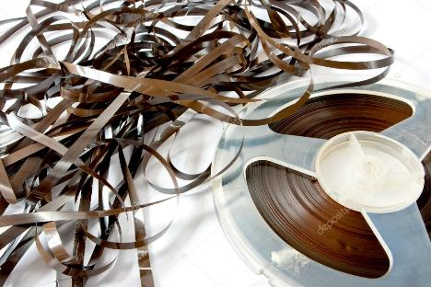
Early evolution of computing systems – Batch
1955: Batch systems
  Collect a bunch of program punch cards and write them all one magnetic tape.
  Run the tape through the mainframe to execute all the jobs in sequence.
OS responsibility
  Libraries for managing Input/Output (I/O)
Problems
  I/O is VERY slow. 80-90% of total time just waiting.

Slide 38
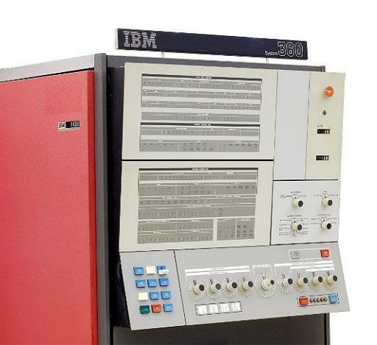
Early evolution of computing systems – Multiprogramming
1960s: Multiprogramming (IBM OS/360)
  Keep multiple runnable jobs in memory at once.
  Allows overlap I/O of one job with computing of another.
    Uses asynchronous I/O and interrupts or polling to detect I/O completion
OS responsibility
  Schedule jobs
  Monitor I/O
Problems
  Still need to submit all jobs in advance

Slide 39
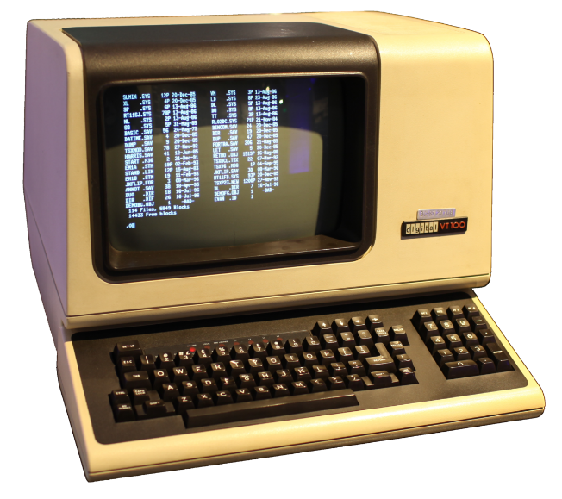
Early evolution of computing systems – Timesharing
1960s-70s: Timesharing (MULTICS, Unix)
  Multiple user terminals connected to one machine
  Allows interactive use of machine to be efficient (because another user’s job can run while you’re thinking).
OS responsibility
  Multiple users (with permissions!)
  Scheduling processes
  Application interface
  Shell tools

Slide 40
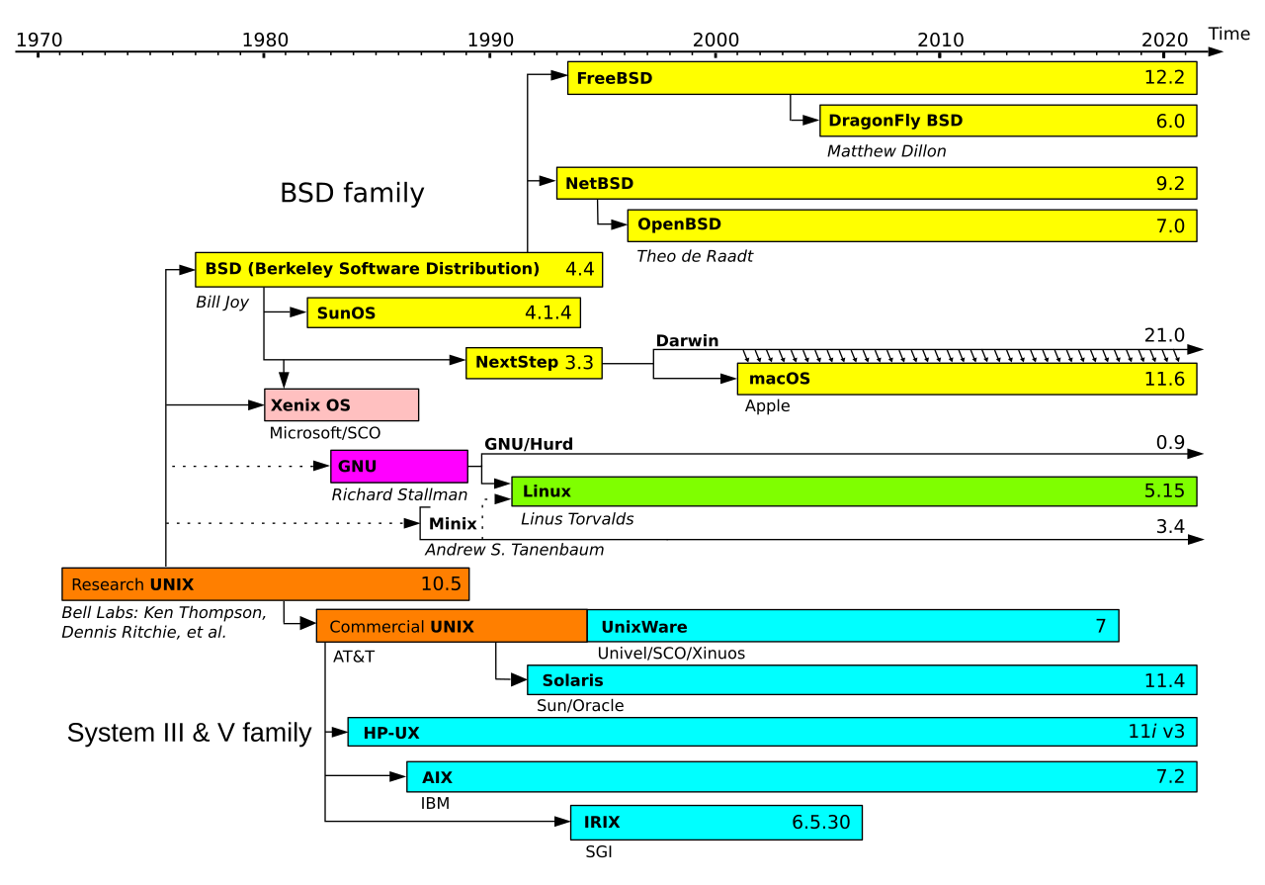
Simplified History of Unix-like Operating Systems
Operating systems are very interconnected

Slide 41
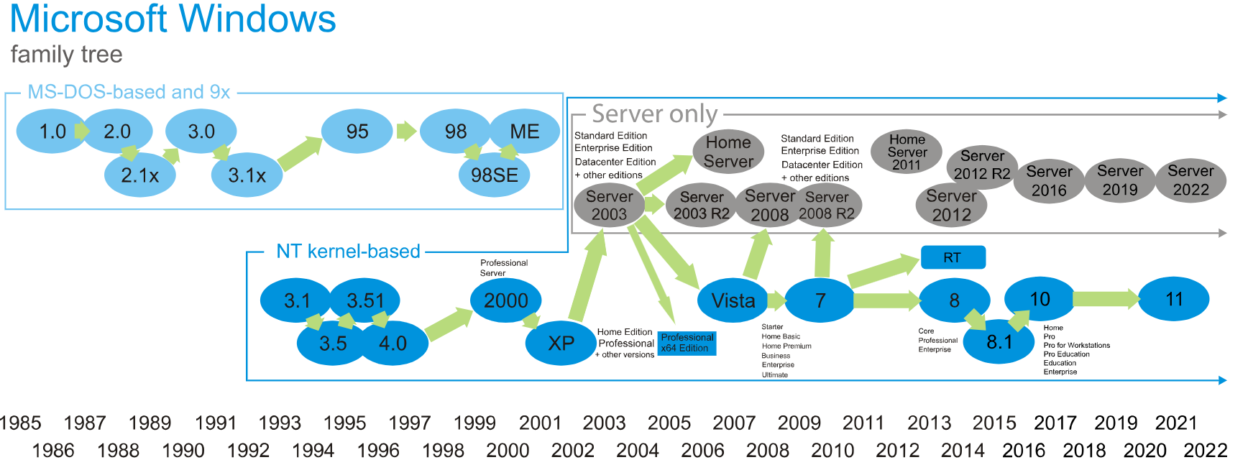
Legacy of Windows
Entirely separate from Unix family tree
DOS was the original kernel, followed by NT
  Server has a separate OS, based on NT with some updates from it

Slide 42
Later evolution of computer systems – PC
1980s-00s: Personal Computers (IBM PC, Macintosh)
  Graphical user interfaces were developed
  Mainframe OS concepts (like networking) were applied to PCs
  Magnetic disk (hard drive) capacity becomes huge, but still slow
OS responsibility
  Look and feel of a system, particularly for non-experts
  Tools that were distributed with the OS had significant business results
    Computers are bought for Excel or for Lotus 1-2-3

Slide 43
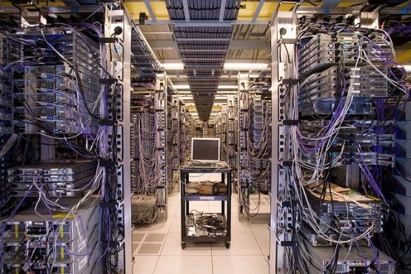
Later evolution of computer systems – Mobile and Cloud
2000s-20s: Mobile and pervasive computing, Cloud Computing
  Slow hardware is once again common (phones & wearables)
  OS manages sensitive information like location and internet behavior
  Fast flash storage is common.
  Server hardware is shared by many different cloud computing customers
OS responsibility
  Diverse hardware drivers
  Security
  Massive parallelism

Slide 44
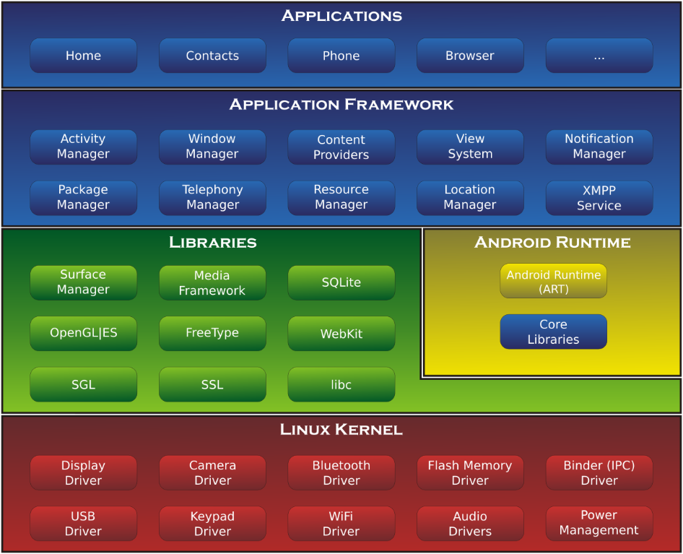
An example: Android Operating System
Kernel - Linux
  With modifications particularly in power management
  And additional drivers
Distribution
  Look and feel of “Android”
  App framework
  Some of this changes per vendor (Samsung vs Google)

Slide 45
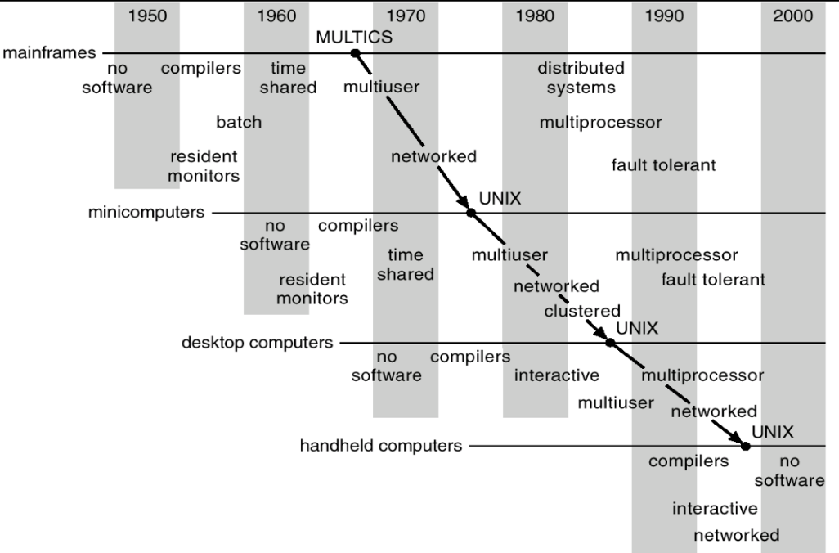
Operating systems have evolved with hardware in a cycle
Sophisticated operating systems first arose on mainframes.
OS ideas migrated to smaller machines as those machines became more powerful.
In 2024, a smart watch has
1 GB RAM, 32 GB SSD storage,
two CPU cores, and a real OS.

Slide 46
Some future OS directions
Manage increasingly specialized hardware
  Post-Moore’s law, general-purpose CPUs loose out to special-purpose chips
  OS must maintain abstractions while enabling capabilities
Energy as another resource
  Already considered in laptop/smartphone worlds
  Increasingly important to data center operations as well
Very small-scale, ubiquitous devices
  Computers are becoming part of everything around us
  How do we develop applications for those devices and coordinate them?

Slide 47
Outline
What is an OS?
Logistics
Operating Systems History
CS343 Focus

Slide 48
Schedule for first half of the course
Concurrency
  Dealing with the realities of modern-day computing
  Sources, Control, Challenges
Scheduling
  Managing CPU utilization
  Workload, Queuing, Real-time

Slide 49
Schedule for second half of the course
Device Drivers
  Management and abstraction of devices
  Interrupts, DMA, Abstractions
Virtual Memory
  Management and abstraction of memory
  Paging, Allocation, Security
File Systems
  Management and abstraction of data
  Principles, Examples

Slide 50
Why do we care about OS?
Performance
  Speed is influenced by
    Parallelism, resource contention, memory management
    Generally OS overhead
Security
  Process and data isolation when actually all running together
  The biggest security vulnerabilities break abstractions
    Meltdown and Spectre
Systems Design and Implementation
  Maybe you won’t ever build an OS (maybe you will!)
  But you might work on other large, backend systems that will deal with similar concerns. This is good practice!

Slide 51
Outline
What is an OS?
Logistics
Operating Systems History
CS343 Focus

