Slide 1
Lecture 12:
Virtual Memory Optimizations
CS343 – Operating Systems
Branden Ghena – Fall 2022
Some slides borrowed from:
Stephen Tarzia (Northwestern), Shivaram Venkataraman (Wisconsin), and UC Berkeley CS162

Slide 2
Administrivia
Driver Lab is due next week Tuesday!
  There’s quite a lot of work for this one
  You need to write your own tests for the GPU
    There are lots of edge cases where students commonly lose points
  Get started ASAP
Reminder: office hours are available
  14 hours across Monday-Thursday
  Come ask questions about the class, labs, debugging, etc.
  Chronically underutilized this quarter

Slide 3
Today’s Goals
Explore optimizations to memory paging.
Insight into how virtual memory is used and what it looks like in today’s systems.
Review of the memory hierarchy and how the OS interacts with each level.
Introduce swapping as a mechanism for enabling more virtual memory than physical memory.
Explore several page replacement policies that control swapping.

Slide 4
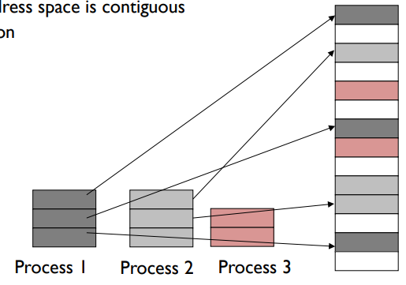
Memory paging
Divide memory into small, fixed-sized pages
Pages of virtual memory map to pages
of physical memory
  Like segments were mapped,
  but many more pages than segments
Processes and their sections
can be mapped to any
place in memory

Slide 5
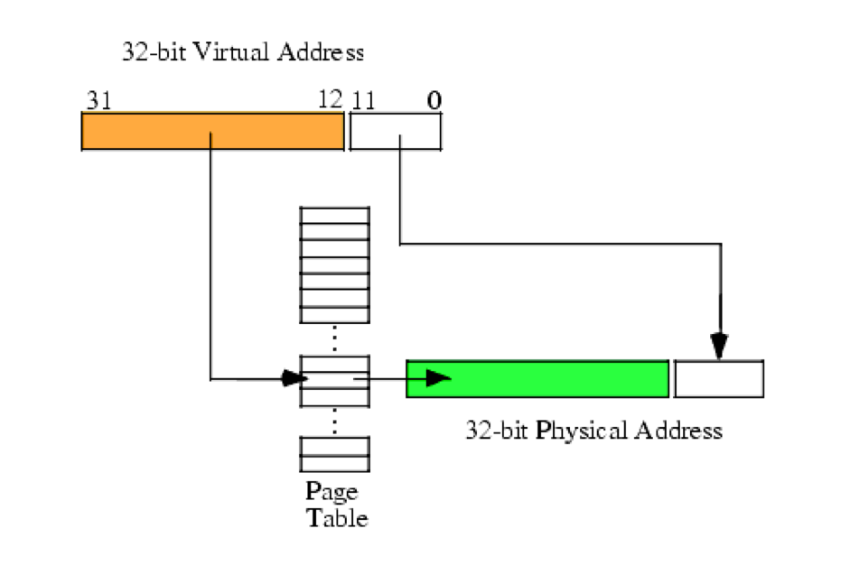
Page table translates virtual addresses to physical addresses
Use topmost bits of virtual address to select page table entry
  One page table entry per each virtual page
Add address at page table entry to bottommost bits
  Actually just concatenate the two
Just like segment tables, there will be a different page table for each process

Slide 6
Virtual Memory
(Process B Only!)
Process A
Physical Memory (RAM)
Shared
Process B
0
1
2
3
4
5
6
7
8
Process A
0
1
2
3
4
5
6
Process B
Process A
Process B Page Table
Process B
VPN | PPN | Valid?
0 | 2 | 1
1 | X | 0
2 | X | 0
3 | 6 | 1
4 | X | 0
5 | X | 0
6 | X | 0
7 | 4 | 1
8 | X | 0
Process B
CPU
Process A
Process B
Process A
Process B
Process B

Slide 7
Paging challenges
Page tables are slow to access
  Page tables need to be stored in memory due to size
  MMU only holds the base address of the page table and reads from it
  Two memory loads per load!!!
  Going to have to fix this…
Page tables require a lot of storage space
  Mapping must exist for each virtual page, even if unused
  Becomes a serious issue on 64-bit systems

Slide 8
Outline
Paging improvements
  Improving translation speed
  Improving table storage size
OS Paging Implementation
Memory Hierarchy

Slide 9
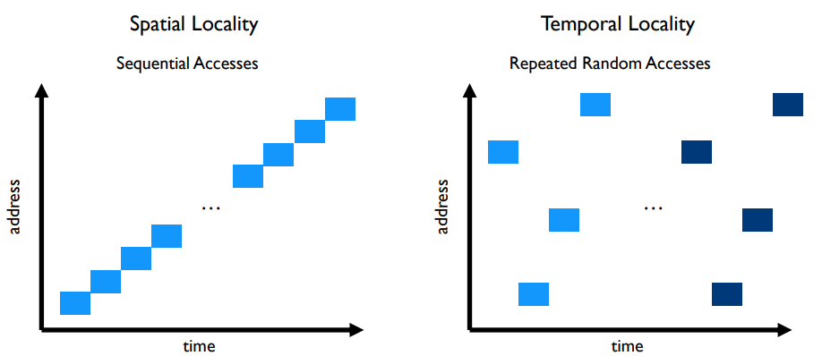
Caching can speed up page table access
How do we make page table access faster?
  How do we make memory access faster?
  Cache it!
Code and Stack have very high spatial locality

Slide 10
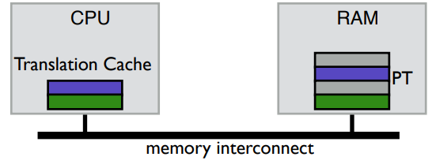
TLB caches page table entries
Translation Lookaside Buffer
  Fully-associative cache (only compulsory misses)
  Holds a subset of the page table (VPN->PPN mapping and permissions)
On a TLB miss, go check the real page table (done in hardware)

Slide 11
Address translation with TLB
Virtual Address
hardware
hardware or software
software
TLB
Lookup
TLB Miss
TLB Hit
Page Table
“Walk”
Protection
Check
Page not
in Mem
Page
in Mem
Access
Denied
Access
Permitted
Page Fault
(OS loads page)
Update
TLB
Protection
Fault
Physical
Address
Find in Disk
Find in Mem
SEGFAULT
Check cache

Slide 12
Context switches with a TLB
A process must only access its own page table entries in the TLB!
  Otherwise, the mapping is wrong, and it accesses another process…
  OS needs to manage the TLB
Option 1: Flush TLB on each context switch
  Costly to lose recently cached translations
Option 2: Track with process each entry corresponds to
  x86-64 Process Context Identifiers (12-bit -> 4096 different processes)
    Extra state for the OS to manage if it has more processes than that

Slide 13
Software controlled TLBs
Some RISC CPUs have a software-managed TLB
  TLB still used for translation, but a miss causes a fault for OS to handle
    OS looks in page table for proper entry
    OS evicts an existing entry from TLB
    OS inserts correct entry into TLB
  Special instruction allows OS to write to TLB
  Hardware is simpler and OS has control over the TLB functionality
    Can prefetch page table entries it thinks might be important
    Can flush entries relevant to other processes
  TLB misses take longer to complete, however

Slide 14
Outline
Paging improvements
  Improving translation speed
  Improving table storage size
OS Paging Implementation
Memory Hierarchy

Slide 15
Paging disadvantages
Page tables are slow to access
  Memory access for page table before any other memory access
  TLB can speed this up considerably for common execution
Page tables require a lot of storage space
  Mapping must exist for each virtual page, even if unused
  Becomes a serious issue on 64-bit systems

Slide 16
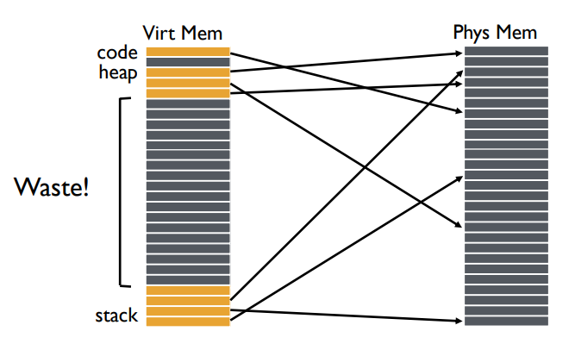
Why do page tables take so much storage space?
For every virtual page,
there must exist an entry
in the page table
  Even though most virtual
  addresses aren’t used!
32-bit address space with 4 kB pages -> 1 million entries
  At least 8 MB of storage
  64-bit address space would require 36 exabytes of page table storage…

Slide 17
Create multiple page tables, each with useful mappings only
How do we eliminate extraneous entries from the page tables?
Virtual Page Number | Valid? | Physical Page Number
0 | 1 | 2
1 | 1 | 3
2 | 0
3 | 0
4 | 0
5 | 1 | 7
6 | 0
7 | 0

Slide 18
Create multiple page tables, each with useful mappings only
Collect groups of page table entries
(call them “page table entry pages”?)
Virtual Page Number | Valid? | Physical Page Number
0 | 1 | 2
1 | 1 | 3
2 | 0
3 | 0
4 | 0
5 | 1 | 7
6 | 0
7 | 0

Slide 19
Create multiple page tables, each with useful mappings only
Collect groups of page table entries
Only keep groups that have valid mappings in them
Virtual Page Number | Valid? | Physical Page Number
0 | 1 | 2
1 | 1 | 3
4 | 0
5 | 1 | 7

Slide 20
Create multiple page tables, each with useful mappings only
Collect groups of page table entries
Only keep groups that have valid mappings in them
Remaining groups are now separate tables
Virtual Page Number | Valid? | Physical Page Number
0 | 1 | 2
1 | 1 | 3
Virtual Page Number | Valid? | Physical Page Number
4 | 0
5 | 1 | 7

Slide 21
Create multiple page tables, each with useful mappings only
Collect groups of page table entries
Only keep groups that have valid mappings in them
Remaining groups are now separate tables
Create a directory of page tables to collect existing page tables
Virtual Page Number | Valid? | Physical Page Number
0 | 1 | 2
1 | 1 | 3
Virtual Page Number | Valid? | Physical Page Number
4 | 0
5 | 1 | 7
Virtual Page Number Range | Valid? | Page Table Address
0-1 | 1
2-3 | 0
4-5 | 1
6-7 | 0

Slide 22
Multilevel page tables
Virtual Address
31
22
21
12
11
0
p1 p2 offset
10-bit
L1 index
10-bit
L2 index
Root of the Current
L1 Page Table
(Hardware register)
offset
Physical Memory
p2
p1
Valid page table
Level 1
Page Table
(Directory)
Invalid page table
Valid page
Level 2
Page Tables
Invalid page
Unused RAM
Valid data in RAM
Data Pages

Slide 23
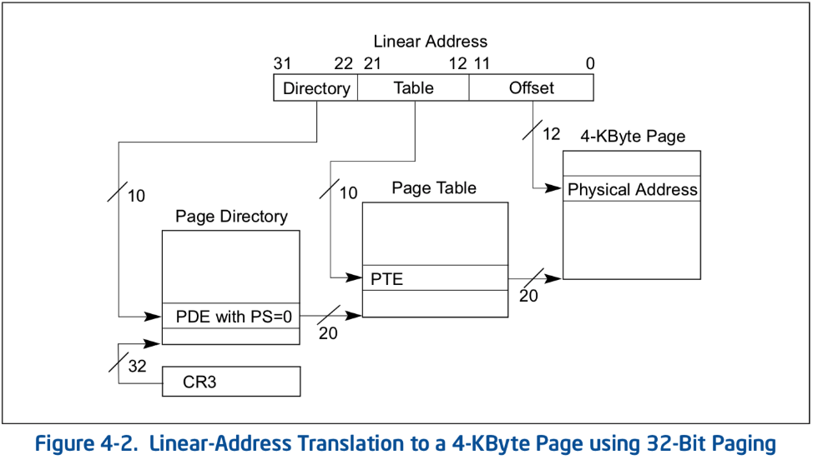
Multilevel page table logistics
Virtual address is broken down into three or more parts
  Highest bits index into highest-level page table
A missing entry at any level triggers a page fault
Size of tables in memory
proportional to number of
pages of virtual memory used
  Small processes can
  have proportionally small
  page tables

Slide 24
Multilevel page tables can keep nesting
Even page table directory is often sparse, so break it up too
x86-64
  Four levels of page table
  48-bit addresses
  (256 TB RAM ought to be enough for everyone right?)
9 bits
9 bits
9 bits
9 bits
12 bits
48-bit Virtual
Address:
Virtual
P1 index
Virtual
P2 index
Virtual
P3 index
Virtual
P4 index
Offset
PageTablePtr
8 bytes
4096-byte pages (12 bit offset)
Page tables also 4k bytes (pageable)
Physical
Address:
(40-50 bits)
Physical Page #
12bit Offset

Slide 25
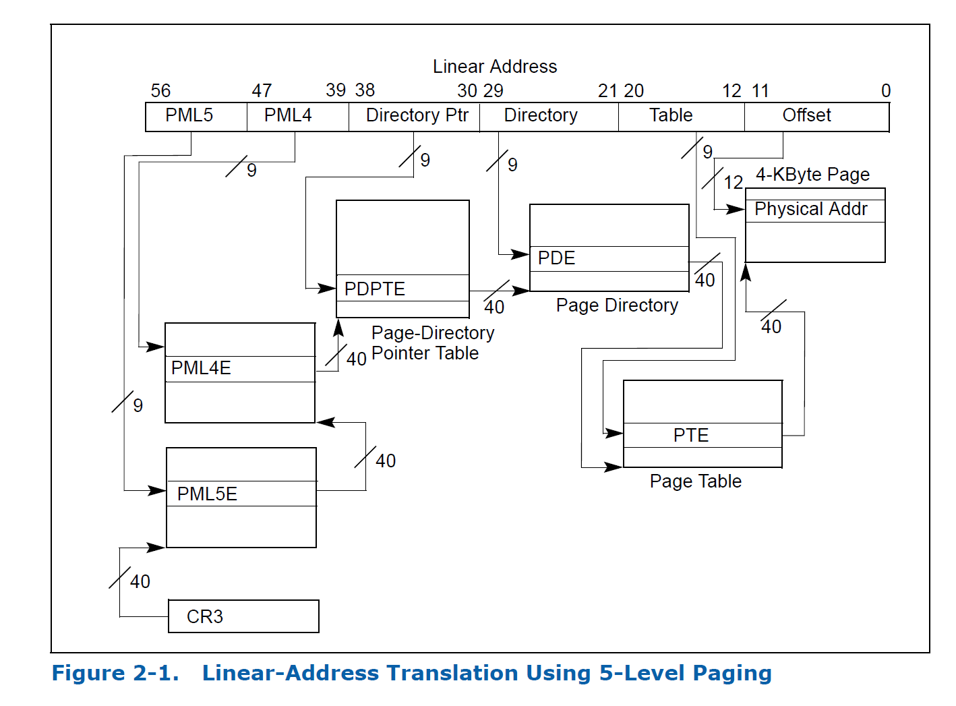
Intel Ice Lake (2019): 5 layers!!

Slide 26
Check your understanding – multilevel page table
How many memory loads per read are there now?

Slide 27
Check your understanding – multilevel page table
How many memory loads per read are there now?
  6
  As in each memory access takes six times as long
TLB is extremely important

Slide 28
Additional optimization: large pages
Always using large pages results in wasted memory
  Example: 1 MB page where only 1 KB is used
Always using small pages results in unnecessary page table entries
  Example: 250 entries in a row to represent 1 MB of memory
Can we mix in larger pages opportunistically?
  Small pages normally
  Large pages occasionally
  Huge pages rarely

Slide 29
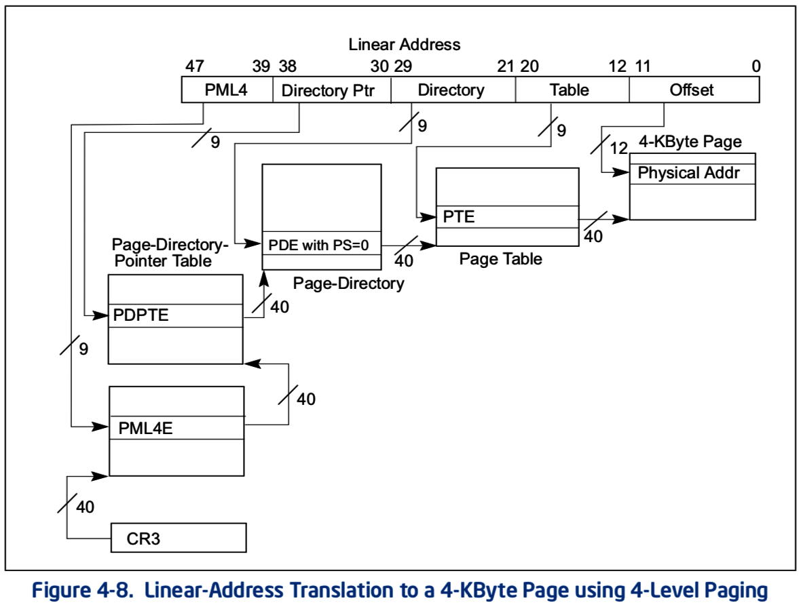
x86-64 allows multiple-sized pages: 4 KB
Normal x86-64 paging

Slide 30
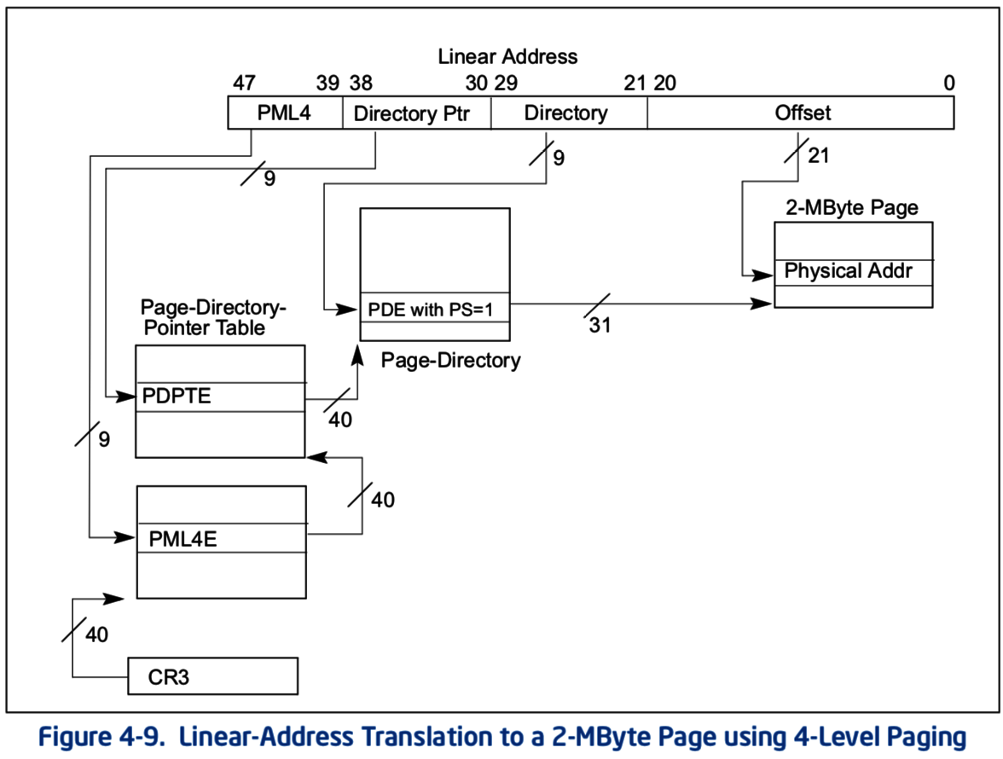
x86-64 allows multiple-sized pages: 2 MB
Page Size bit triggers walk to skip next table and go straight to
2 MB page in memory
Remaining address bits are used as offset into larger page

Slide 31
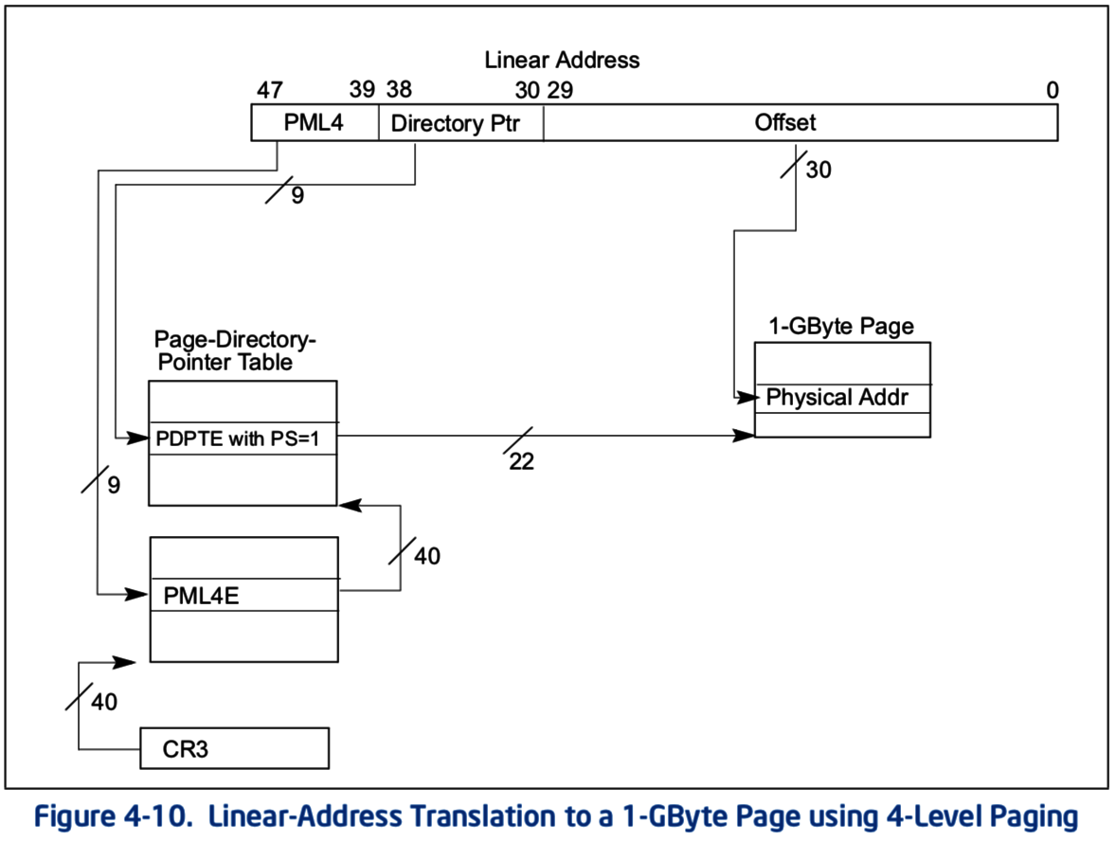
x86-64 allows multiple-sized pages: 1 GB
Can also skip straight to 1 GB pages
With a bit of extra hardware, TLB can hold large page entries
  Occupies a single TLB entry for 1 GB of data
  (250000 normal entries)

Slide 32
Other data structures for paging
If hardware handles TLB misses
  Need a regular structure it can “walk” to find page table entry
  x86-64 needs to use multilevel page tables
If software handles TLB misses
  OS can use whatever data structure it pleases
  Example: inverted page tables
    Only store entries for virtual pages with valid physical mappings
    Use hash of VPN+PCID to find the entry you need

Slide 33
Break + Question
If every page of virtual memory was used, would a multi-level page table take more or less space than a “flat” page table?
How often is every page of virtual memory used?

Slide 34
Break + Question
If every page of virtual memory was used, would a multi-level page table take more or less space than a “flat” page table?
  More! Still need an entry for every “used” page
  Now would have to add tree structure as well
How often is every page of virtual memory used?
  Never! That would be 18 exabytes of storage in one process
  For refence: ~44000 exabytes is all of human digital storage (2022)

Slide 35
Outline
Paging improvements
  Improving translation speed
  Improving table storage size
OS Paging Implementation
Memory Hierarchy

Slide 36
OS tracks regions rather than pages
A Region is a collection of one or more pages for a process
  An Address Space is a collection of regions for a process
The OS will keep a data structure of regions for each process
  Includes starting page/address and size
  Protection fields
  Additional bookkeeping information
    Is it a kernel region or an application?
    Is it a “pinned” region, i.e. a region we should never remove?
    Is the region in RAM or on disk?
    Is the region listed in the TLB yet?
    Has the region been modified?

Slide 37
Operations on regions
Add
  Create a new region
  Accesses to virtual addresses in that range should now succeed
Remove
  Remove the region entirely
  Accesses to virtual addresses in that range should now fault
Move
  Change physical addresses associated with the region
Protect
  Change protection status of region
  Could change from read-only to read-and-write

Slide 38
Considerations when adding new regions
The new region goes in the OS data structure immediately
However, we don’t necessarily need to allocate space in RAM immediately or update the Page Table
  Those actions are a lot of work
  But maybe the process is never going to actually use most pages
  We could instead wait to see if the process uses pages
    And fix them up individually when exceptions occur

Slide 39
Page faults enable lazy allocation and lazy loading
Paging is not just translation and overflow
  Paging provides an opportunity to be lazy about loading requested data
Trick: don’t load data upfront, do it later when it’s first needed!
  This is an important performance optimization,
  reducing program start time

Slide 40
Lazy loading in practice
If a process requests a huge chunk of memory, maybe it will not use all that memory immediately (or ever!).
  Programmers and compilers are sometimes greedy in their requests
  We can virtually allocate memory, but mark most of the pages “not present”
  Let the CPU raise an exception when the memory is really used
  Then really allocate the demanded page
Lazy allocation minimizes latency of fulfilling the request and it prevents OS from allocating memory that will not be used.

Slide 41
Extra features of lazy loading
Lazy loading also works for large code binaries
  Delay loading a page of instructions until it’s needed
OS must also write zeros to newly assigned physical frames
  Program does not necessarily expect the new memory to contain zeros,
  But we clear the memory for security, so that other process’ data is not leaked.
  OS can keep one read-only physical page filled with zeros and just give a reference to this at first.
    After the first page fault (due to writing a read-only page), allocate a real page.

Slide 42
Lazy allocation via copy-on-write with Fork
Recall that fork + exec is the only way to create a child process in unix
Fork clones the entire process, including all virtual memory
  This can be very slow and inefficient, especially if the memory will just be overwritten by a call to exec.

Slide 43
Lazy allocation via copy-on-write with Fork
Copy on write is a performance optimization:
  Don’t copy the parent’s pages, share them
    Make the child process’ page table point to the parent’s physical pages
    Mark all the pages as “read only” in the PTEs (temporarily)
  If parent or child writes to a shared page, a page fault exception will occur
  OS handles the page fault by:
    Copying parent’s page to the child & marking both copies as writeable
    When the faulting process is resumed, it retries the memory write.

Slide 44
Back to adding regions
Adding a Lazy Region
  Just add the region to the process data structure
  Later, when an exception occurs you can load data update the Page Table as necessary
Adding an Eager Region
  Do everything right away
    Add to data structure, load into RAM, update Page Table
  Example: a process’s code might be eagerly loaded along with the first couple pages of the stack

Slide 45
Removing, moving, and protecting pages
Modify the region in the data structure
Also update the Page Table immediately
  Can’t do this lazily, as future accesses to pages MUST change
But what if page table data is already in the TLB?!! Two options:
  Flush the entire TLB (remove all entries in it)
  Invalidate particular pages (removes individual entry from TLB if it exists)
  For performance, which to do depends on how many pages you’re updating.
  Answer depends on the processor hardware, threshold is: 2-1000

Slide 46
OS management of processes with paging
When loading a process
  Add regions to data structure
    For eager regions, also allocate RAM pages and update Page Table
    For lazy regions (most), don’t do anything now
  Some regions might connect to shared libraries already in RAM
When a context switch occurs
  OS changes which page table is in use (%CR3 register in x86)
When a fault occurs
  OS handles it by checking the region data structure and the page table
    Might be an invalid access (based on address or permissions)
    Might be a page that’s on disk or was lazily allocated

Slide 47
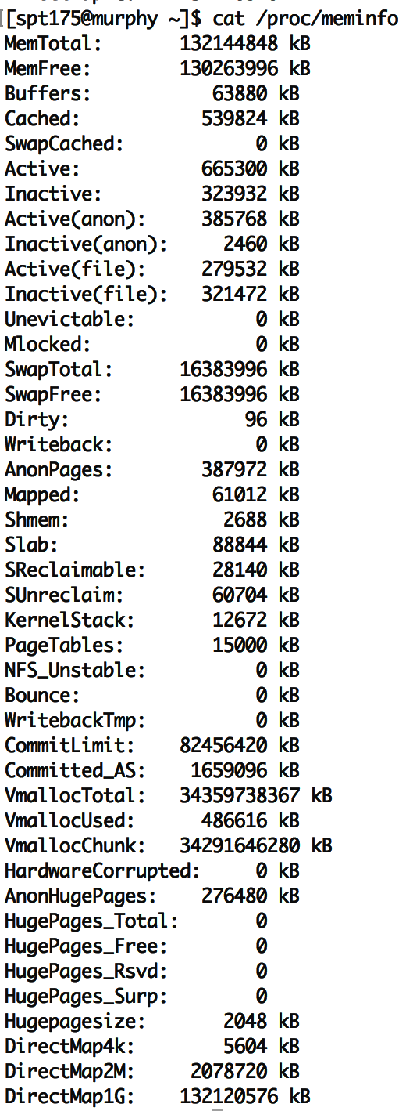
To see virtual memory info on Linux
cat /proc/meminfo
vmstat
pmap
top
Try these commands yourself sometime!

Slide 48
Virtual memory in practice
On Linux, the pmap command shows a process’ VM mapping.
We see:
  OS tracks which file code is loaded from, so it can be lazily loaded
  The main process binary and libraries are lazy loaded, not fully in memory
  Libraries have read-only sections that can be shared with other processes
cat /proc/<pid>/smaps shows even more detail
References:
https://unix.stackexchange.com/a/116332
https://www.akkadia.org/drepper/dsohowto.pdf

Slide 49
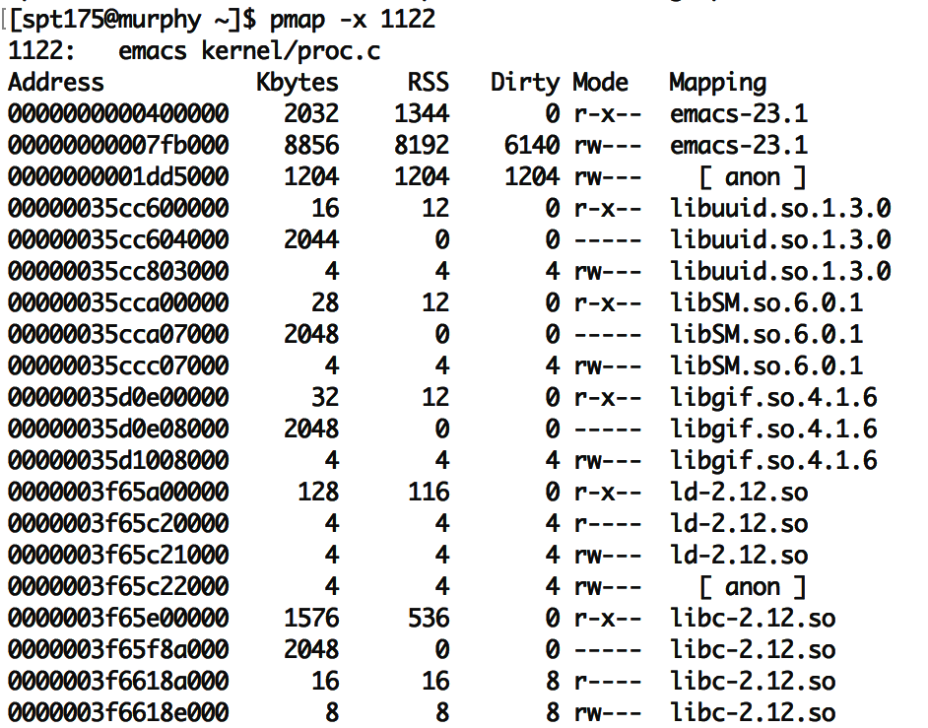
pmap on emacs
“Mapping” shows source of the section, more code can be loaded from here later.
  “anon” are regular program data,
  requested by sbrk or mmap.
  (In other words, heap data.)
Each library has several sections:
  “r-x--” for code can be shared
  “r----” for constants
  “rw---” for global data
  “-----” for guard pages:
    (not mapped to anything, just reserved to generate page faults)
RSS means resident in physical mem.
Dirty pages have been written and therefore cannot be shared with others

Slide 50
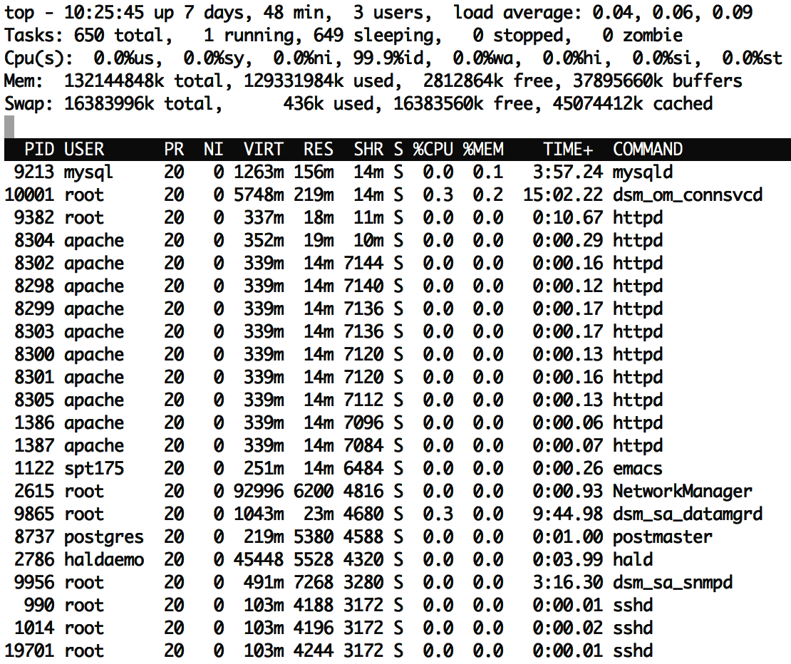
top has a column showing shared memory
The duplicate processes are using a lot of shared memory:
  ~50% of resident memory for httpd is shared
  ~75% of resident memory for sshd is shared
Even if there is just one instance of emacs running, it may share many libraries with other running programs.
Total virtual memory is ~10x larger than resident memory
  Processes only use a small fraction of their VM!
  Due to sharing and lazy loading.

Slide 51
Process side: requesting memory from the OS – brk()
System call to change data segment size (the program “break”)
  Either set a new virtual address pointer for top of data segment
  Or increment the size of the data segment by N bytes
These are the old system calls to dynamically change program memory
  How malloc creates space
“sbrk() and brk() are considered legacy even by 1997 standards”
  Removed from POSIX in 2001
  Still exists in some form in lots of OSes (including Nautilus)

Slide 52
Process side: modern requesting memory from the OS – mmap()
Map (or unmap) files or devices into memory
Given a file, places the file in the process’s virtual address space
  Process can request an address to place it at, which OS might follow
Given flag MAP_ANONYMOUS, creates empty memory
  Initialized to zero and accessible from process
  Malloc implementation uses this
Many other options
  Create huge page, create memory for a stack, shared memory

Slide 53
Break + Consideration
Why use mmap() to put a file in your address space, when you could just read()/write() it instead?

Slide 54
Break + Consideration
Why use mmap() to put a file in your address space, when you could just read()/write() it instead?
  Speed! No longer need to make system calls for each file access
  A downside: now you need to handle file interactions yourself
    Track offset for reading and writing
    Make sure you don’t go past the end of the file

Slide 55
Outline
Paging improvements
  Improving translation speed
  Improving table storage size
OS Paging Implementation
Memory Hierarchy

Slide 56
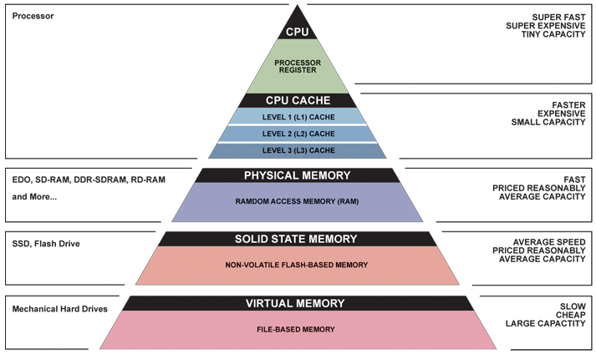
Memory Hierarchy

Slide 57
The OS view on registers
Illusion: separate set for each process
Reality: separate set for each core (or each thread in a core)
OS needs to save and update registers whenever the currently running process changes
Process and hardware handle moving memory into registers

Slide 58
The OS view on caches
Mostly ignore them, handled by the hardware automatically
Occasionally might need to clear them for security purposes
Addresses in the caches are either entirely physical addresses
Or are virtually indexed, physically tagged
  Cache lookup and TLB lookup happen in parallel
  TLB result is used as Tag for cache to determine if there was a hit

Slide 59
The OS view on memory
Managed through virtual memory translation
  Paging (or Segmentation) that we talked about last time
OS chooses which portions of processes go in RAM
  Other portions of memory get “swapped” to disk
  Writeable memory regions (stack, heap, global data) must be preserved
  Read-only memory regions (code) can be reloaded from original location

Slide 60
The OS view on disk
Non-volatile memory store
  Everything else on the system disappears when power is removed
  (and cannot be trusted across reboots)
Backing store for lots of information
  Boot information: via “Master Boot Record” on disk
  Filesystem, which the OS manages access to through system calls
  Swap space, which the OS moves extra pages in and out of
    Disk is significantly bigger than RAM, so this will work
Disk is a device that the OS manages and reads in “blocks”
  Compare to memory, which is directly addressed by processes

Slide 61
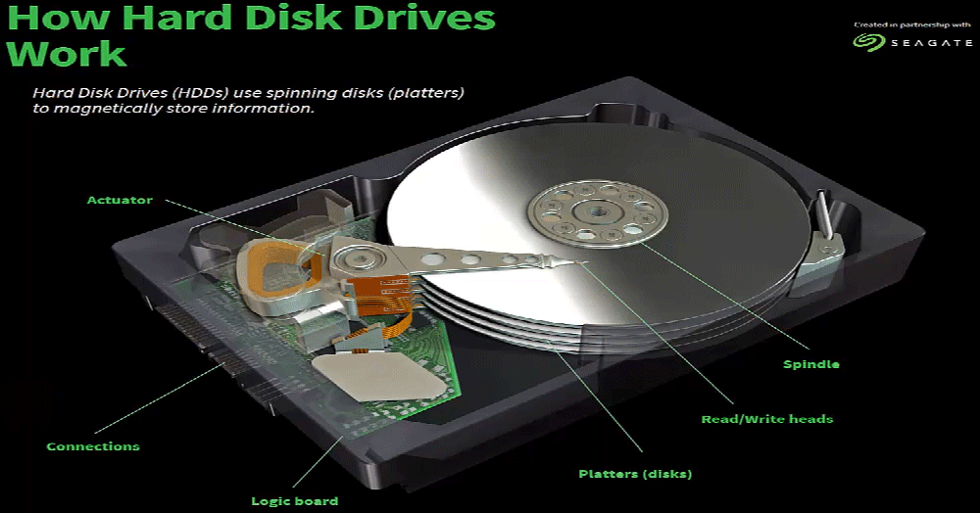
Traditional hard disk drives (HDDs) use magnetic regions

Slide 62
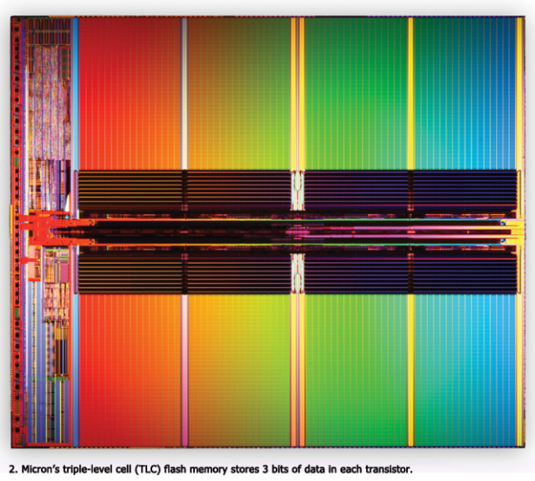
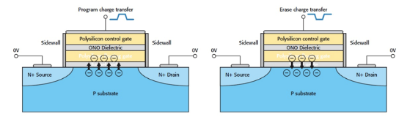
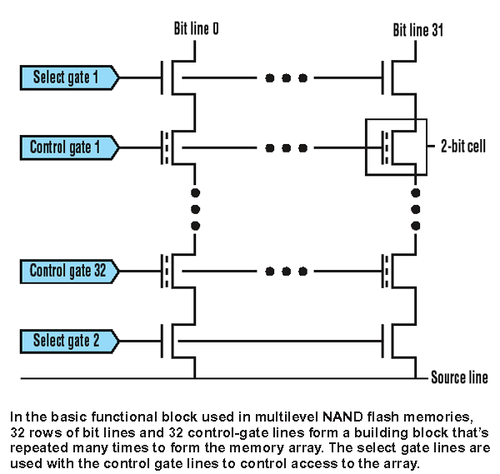
Solid state drives (SSDs) use flash memory
Still non-volatile
Significantly faster
  0.1 ms to access
  (10 ms for disk)
More limited lifetime than disk
  Limited writes
NMOS transistor with an additional conductor between gate and source/drain which “traps” electrons. The presence/absence is a 1 or 0

Slide 63
Outline
Paging improvements
  Improving translation speed
  Improving table storage size
OS Paging Implementation
Memory Hierarchy

