Slide 1
Lecture 06:
Data Races & Mutexes
CS343 – Operating Systems
Branden Ghena – Fall 2022
Some slides borrowed from:
Stephen Tarzia (Northwestern), Shivaram Venkataraman (Wisconsin), and UC Berkeley CS61C and CS162

Slide 2
Reminder: Scheduling Lab due Tuesday
Two thirds of the class has made serious progress on it
  So about one third hasn’t really started yet…
You do have slip days to let you submit late with no penalty
  Four total slip days across the quarter
  Not recommended to spend them all on this first real lab

Slide 3
Today’s Goals
Explore problems with concurrently shared memory.
Introduce locks as a simple solution for correctness.
  Design of locks
  Implementation of locks
Optimize locks to enforce fairness and increase performance.

Slide 4
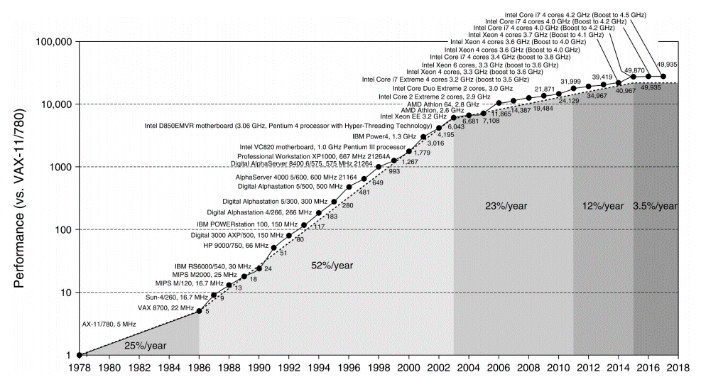
Reminder on performance (SPEC benchmark)
Copyright Elsevier Inc. 2019

Slide 5
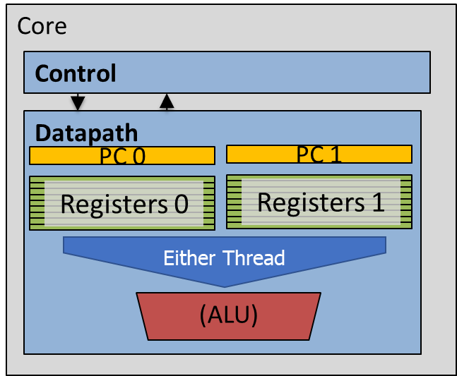
Review: modern hardware capabilities
Processor (also known as CPU)
L1 Cache
L1 Cache
L1 Cache
L1 Cache
L2 Cache
L2 Cache
L2 Cache
L2 Cache
L3 Cache

Slide 6
Outline
Race Conditions
Lock Design
Basic Lock Implementation
Lock Optimizations

Slide 7
Better understanding race conditions
We demonstrated the idea last lecture
Now let’s explore it with real code!

Slide 8
Concurrency example: initialization code
int main(int argc, char* argv[]) {
pthread_t p1, p2;
printf("main: begin (counter = %d)\n", counter);
pthread_create(&p1, NULL, mythread, "A");
pthread_create(&p2, NULL, mythread, "B");
// wait for threads to finish
pthread_join(p1, NULL);
pthread_join(p2, NULL);
printf("main: done with both (counter = %d, goal was %d)\n",
counter, 2*LOOPS);
return 0;
}
Start two threads
Wait until done

Slide 9
Concurrency example: threaded code
#include <stdio.h>
#include <pthread.h>
static volatile int counter = 0;
static const int LOOPS = 1e7;
void* mythread(void* arg) {
printf("%s: begin\n", (char*)arg);
for (int i=0; i<LOOPS; i++) {
counter++;
}
printf("%s: done\n", (char*)arg);
return NULL;
}
Each thread runs this function
Add to global variable

Slide 10
Concurrency example: threaded code
#include <stdio.h>
#include <pthread.h>
static volatile int counter = 0;
static const int LOOPS = 1e7;
void* mythread(void* arg) {
printf("%s: begin\n", (char*)arg);
for (int i=0; i<LOOPS; i++) {
counter++;
}
printf("%s: done\n", (char*)arg);
return NULL;
}
volatile marks memory that the compiler shouldn’t try to optimize
i.e., something tricky is going on here!

Slide 11
Live example – data race
zip with code linked on Canvas
Compile with “gcc -pthread -o race data_race.c”
  [brghena@ubuntu race_condition] $ ./race
  main: begin (counter = 0)
  B: begin
  A: begin
  A: done
  B: done
  main: done with both (counter = 12161815, goal was 20000000)
Different results each time you run it

Slide 12
What’s the problem?
Which thread runs at a given time is unpredictable
  Might even be both simultaneously
  But is this a problem?
  Why does it matter who
  increments the counter first?
  The net result should be
  20,000,000 regardless, right?
  Actually, there is a serious bug
  It will yield a different result every time!
To understand, we need to break the abstraction of C
  Think about the assembly instructions
  In short, the “counter++” operation is not atomic.
$ ./race
main: begin (counter = 0)
A: begin
B: begin
A: done
B: done
main: done with both
(counter = 10416197, goal was 20000000)

Slide 13
Incrementing a number in assembly
“counter++” has to:
  Copy from the memory location of the counter variable to a register
  Increment the register’s value
  Copy from the register back to memory
Assuming that “counter” is in memory location 0x8049a1c:
  mov 0x8049a1c, %eax
  add $0x1, %eax
  mov %eax, 0x8049a1c
The scheduler can interrupt the thread before or after the “add”
  This would cause both threads to read the same value, increment it to the same value, and thus they would repeat work.

Slide 14
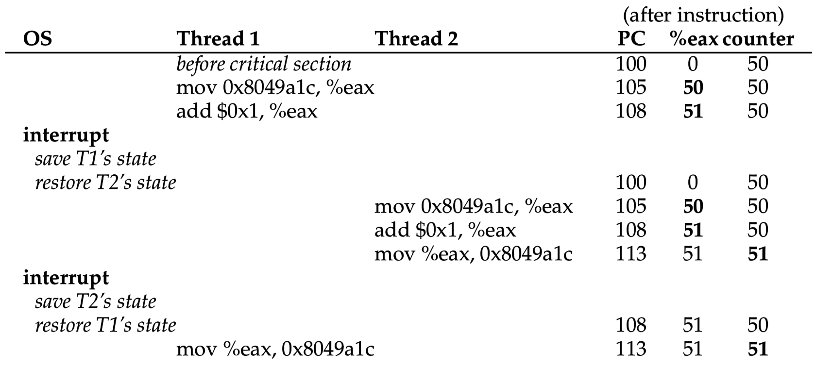

The increment failure in detail: 50 + 1 + 1 = 51!
Remember: each thread has its own unique registers
%RIP

Slide 15
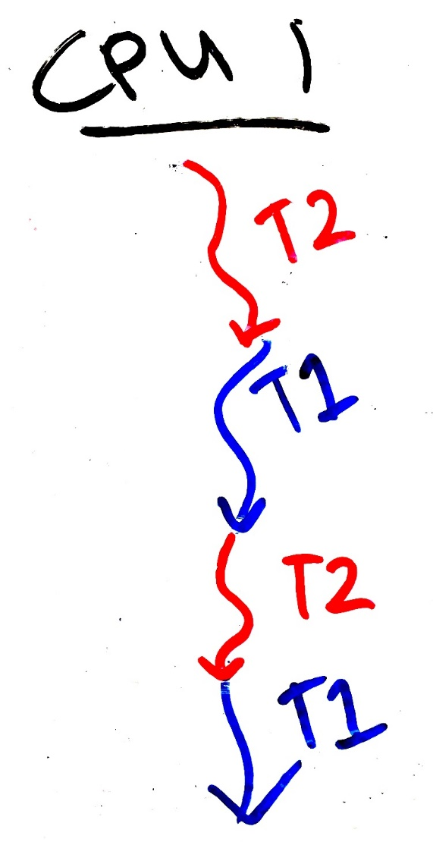
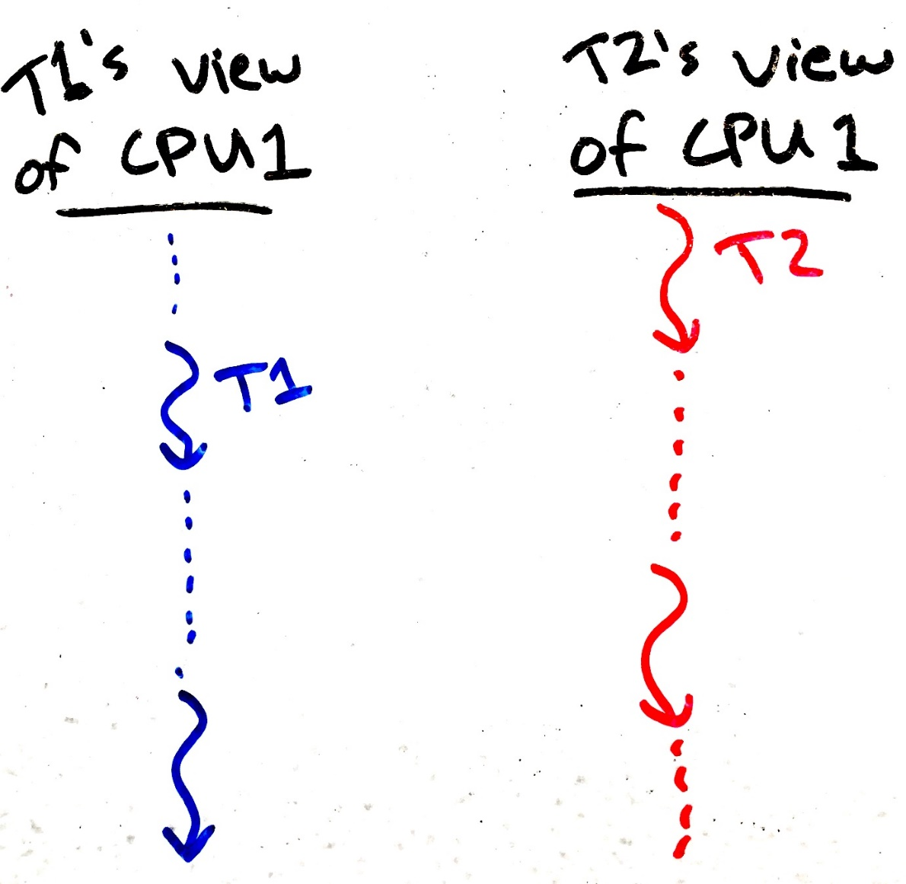
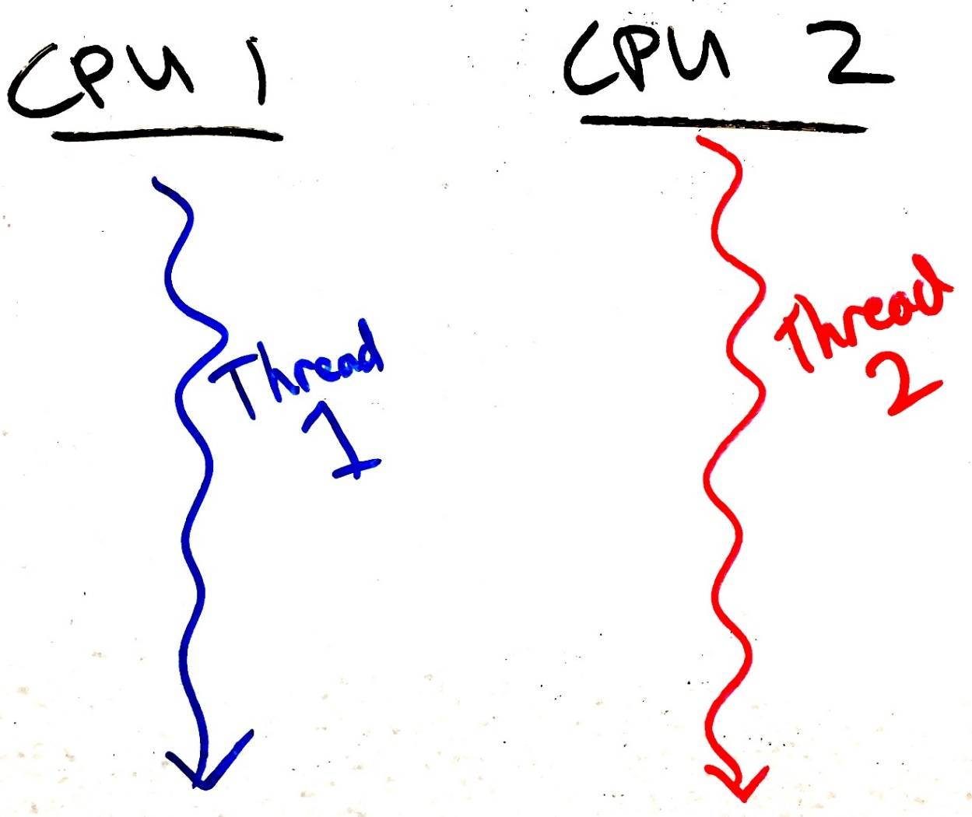
The process scheduler creates concurrency
Even if only one CPU is present, threads operate “concurrently” because they are taking turns using the CPU.
Each process thinks it has its own CPU that is sometimes very, very slow…
Obvious concurrency on two CPU cores:
Simulated concurrency on one CPU core:
Slow
Is like
Slow time
Slow time
Slow time

Slide 16

Assume the scheduler is evil
Remember that processes have no control over the scheduler.
So, to protect against concurrency bugs, we must assume that the scheduler can interrupt us at any time and schedule any other process.
In other words, assume that the scheduler is adversarial, and will do the worst possible scheduling.
To prevent weird and rare concurrency bugs,
your code must work correctly even when
faced with an evil scheduler.

Slide 17
Live example – data races when executing for less time
What happens if we modify the loop duration?
  [brghena@ubuntu race_condition] $ ./race
  main: begin (counter = 0)
  B: begin
  B: done
  A: begin
  A: done
  main: done with both (counter = 200, goal was 200)
Thread is now completing its work before being re-scheduled
  The problem is not solved, it will just occur rarely (and be harder to debug)

Slide 18
Race Condition
Two or more things are happening at the same time
It’s not clear which will run when
The result will be different depending on execution order
Result becomes indeterminate (non-deterministic)
Data race:
  Two or more threads access shared memory at the same time
  and at least one modifies it
  (Race Conditions are more broad)

Slide 19
Critical Section
Code that interacts with a shared resource must not be executed concurrently
The code that accesses a shared resource is a Critical Section
  In other words, code that would lead to a data race
  May be multiple, unrelated critical sections for multiple shared resources
Critical sections need to be addressed for correctness
  Races can be avoided by never overlapping multiple critical sections
  We must execute critical sections “atomically” (all or none)

Slide 20
Critical section occurs when shared memory is accessed
static volatile int counter = 0;
static const int LOOPS = 1e7;
void* mythread(void* arg) {
printf("%s: begin\n“,(char*)arg);
for (int i=0; i<LOOPS; i++) {
counter++;
}
printf("%s: done\n", (char*)arg);
return NULL;
}
Initialization code
int main(int argc, char* argv[]) {
pthread_t p1, p2;
printf("main: begin (counter = %d)\n", counter);
pthread_create(&p1, NULL, mythread, "A");
pthread_create(&p2, NULL, mythread, "B");
// wait for threads to finish
pthread_join(p1, NULL);
pthread_join(p2, NULL);
printf("main: done with both (counter = %d, goal was %d)\n", counter, 2*LOOPS);
return 0;
}

Slide 21
When do critical sections occur?
Critical sections often involve modification of multiple related data
  While the modifications are happening there is some inconsistency
  The inconsistency is eventually resolved before leaving the critical section
For example:
  Inserting an element in the middle of a linked list
    Two pointers must change. List is broken if just one is changed.
  Reading a value and then modifying it
Don’t have to worry about critical sections if:
  Program is single-threaded, OR
  The particular data is not shared among threads and modified, OR
  Operation is just one assembly instruction (CPU executes these atomically)

Slide 22
Check your understanding. Where is the critical section?
static volatile char* person1;
static volatile char* person2;
static const int LOOPS = 1e4;
void* mythread(void* arg) {
printf("%s: begin\n", (char*)arg);
int i;
for (i=0; i<LOOPS; i++) {
// swap
volatile char* tmp = person1;
person1 = person2;
person2 = tmp;
}
printf("%s: done\n", (char*)arg);
return NULL;
}
Initialization code
int main(int argc, char* argv[]) {
pthread_t p1, p2;
person1 = "Jack";
person2 = "Jill";
printf("main: begin (%s, %s)\n",
person1, person2);
pthread_create(&p1,NULL,mythread,"A");
pthread_create(&p2,NULL,mythread,"B");
// wait for threads to finish pthread_join(p1, NULL);
pthread_join(p2, NULL);
printf("main: end (%s, %s)\n",
person1, person2);
}
22

Slide 23
Buggy concurrent swap. What can go wrong?
static volatile char* person1;
static volatile char* person2;
static const int LOOPS = 1e4;
void* mythread(void* arg) {
printf("%s: begin\n", (char*)arg);
int i;
for (i=0; i<LOOPS; i++) {
// swap
volatile char* tmp = person1;
person1 = person2;
person2 = tmp;
}
printf("%s: done\n", (char*)arg);
return NULL;
}
Initialization code
int main(int argc, char* argv[]) {
pthread_t p1, p2;
person1 = "Jack";
person2 = "Jill";
printf("main: begin (%s, %s)\n",
person1, person2);
pthread_create(&p1,NULL,mythread,"A");
pthread_create(&p2,NULL,mythread,"B");
// wait for threads to finish pthread_join(p1, NULL);
pthread_join(p2, NULL);
printf("main: end (%s, %s)\n",
person1, person2);
}
23

Slide 24
Buggy concurrent swap. What can go wrong?
static volatile char* person1;
static volatile char* person2;
static const int LOOPS = 1e4;
void* mythread(void* arg) {
printf("%s: begin\n", (char*)arg);
int i;
for (i=0; i<LOOPS; i++) {
// swap
volatile char* tmp = person1;
person1 = person2;
person2 = tmp;
}
printf("%s: done\n", (char*)arg);
return NULL;
}
Initialization code
int main(int argc, char* argv[]) {
pthread_t p1, p2;
person1 = "Jack";
person2 = "Jill";
printf("main: begin (%s, %s)\n",
person1, person2);
pthread_create(&p1,NULL,mythread,"A");
pthread_create(&p2,NULL,mythread,"B");
// wait for threads to finish pthread_join(p1, NULL);
pthread_join(p2, NULL);
printf("main: end (%s, %s)\n",
person1, person2);
}
For a brief period in time:
person1: “Jill”
person2: “Jill”
24

Slide 25
Check your understanding. Is there a problem here?
static volatile int sum_amount = 2;
static const int LOOPS = 1e7;
void* mythread(void* arg) {
int counter = 0;
printf("%s: begin\n", (char*)arg);
for (int i=0; i<LOOPS; i++) {
counter += sum_amount;
}
printf("%s: done %d\n",(char*)arg,
counter);
return NULL;
}
Initialization code
int main(int argc, char* argv[]) {
pthread_t p1, p2;
printf("main: begin\n");
pthread_create(&p1, NULL, mythread, "A");
pthread_create(&p2, NULL, mythread, "B");
// wait for threads to finish
pthread_join(p1, NULL);
pthread_join(p2, NULL);
printf("main: done\n");
return 0;
}

Slide 26
Check your understanding. Is there a problem here?
static volatile int sum_amount = 2;
static const int LOOPS = 1e7;
void* mythread(void* arg) {
int counter = 0;
printf("%s: begin\n", (char*)arg);
for (int i=0; i<LOOPS; i++) {
counter += sum_amount;
}
printf("%s: done %d\n",(char*)arg,
counter);
return NULL;
}
This code will work!
All threads only read from shared memory.
If at least one wrote to shared memory, it would be a problem.
Initialization code
int main(int argc, char* argv[]) {
pthread_t p1, p2;
printf("main: begin\n");
pthread_create(&p1, NULL, mythread, "A");
pthread_create(&p2, NULL, mythread, "B");
// wait for threads to finish
pthread_join(p1, NULL);
pthread_join(p2, NULL);
printf("main: done\n");
return 0;
}

Slide 27
Outline
Race Conditions
Lock Design
Basic Lock Implementation
Lock Optimizations

Slide 28
Solution Requirements
We MUST stop data races from occurring in our programs.
No two threads may simultaneously be in their critical sections.
Threads outside of critical sections should have no impact.
No assumptions should be made about number of cores, speed of cores, or scheduler choices.

Slide 29
Locks (also known as a mutex)
Locks are the simplest mutual exclusion primitive
  Represent a resource that can be reserved and freed
Acquire/lock:
  Used before a critical section to reserve the resource
  If the lock is free (unlocked), then lock it and proceed.
  If the lock is already taken (someone else called acquire/lock),
  then wait until it’s free before proceeding.
Release/unlock:
  Used at the end of a critical section to free the resource
  Only the thread holding the lock can release it
  Allows one waiting (or future) thread to acquire the lock

Slide 30


Two different metaphors & etymology
Lock
Think about locking a bathroom door
Our virtual lock works as follows:
  Anyone can lock or unlock
  (there is no “key”).
  Trying to enter (lock) if the lock is already-locked will cause you to wait until it’s unlocked.
Token
Holding the token gives
you permission to do something.
There is only one token.
Thus, you:
  Try to acquire the token (“lock”). You have to wait your turn if someone else is holding it.
  When done, release the token/lock.
The token represents exclusive access to a shared resource or a critical section.

Slide 31
Locks prevent data races
static volatile int counter = 0;
static const int LOOPS = 1e7;
static pthread_mutex_t lock;
void* mythread(void* arg) {
printf("%s: begin\n", (char*)arg);
for (int i=0; i<LOOPS; i++) {
pthread_mutex_lock(&lock);
counter++;
pthread_mutex_unlock(&lock);
}
printf("%s: done\n", (char*)arg);
return NULL;
}
int main(int argc, char* argv[]) {
pthread_t p1, p2;
pthread_mutex_init(&lock, 0);
printf("main: begin (counter = %d)\n", counter);
pthread_create(&p1, NULL, mythread, "A");
pthread_create(&p2, NULL, mythread, "B");
// wait for threads to finish
pthread_join(p1, NULL);
pthread_join(p2, NULL);
printf("main: done with both (counter = %d, goal was %d)\n", counter, 2*LOOPS);
return 0;
}

Slide 32
Live example – locking critical sections
Compile with “gcc -pthread -o locked locked_data_race.c”
  [brghena@ubuntu race_condition] $ ./locked
  main: begin (counter = 0)
  B: begin
  A: begin
  A: done
  B: done
  main: done with both (counter = 20000000, goal was 20000000)
Correct result every time! (code does go a bit slower though…)

Slide 33
Guidelines for implementing locks
Requirements for correctness
Mutual Exclusion:
  Only one thread in critical section at a time
Progress (deadlock-free):
  If several simultaneous requests, must allow one to proceed
Bounded Wait (starvation-free):
  Must eventually allow every waiting thread to proceed
Additional goals
Fairness – each thread waits for the same amount of time
Performance – do the above in minimal execution time

Slide 34
Outline
Race Conditions
Lock Design
Basic Lock Implementation
Lock Optimizations

Slide 35
Algorithmic approach: Peterson’s Solution
There are indeed several algorithmic approaches to create a lock!
See textbook (or other sources) for Peterson’s Solution for two threads
Advantages:
  Algorithm, so it works on any platform no matter the hardware
Disadvantages:
  Solution for N threads gets complicated
  Performance is slow

Slide 36
Hardware approach: atomic instructions
Atomic instructions perform operations on memory in one uninterruptable instruction
  Guarantees that all parts of the instruction occur before the next instruction
  In multicore, guarantees that entire access to memory is serialized
Commonly read, modify, and write in a single instruction

Slide 37
Atomic Instruction: Exchange
Example atomic_exchange
  int atomic_exchange(int* pointer, int new_value) {
  int old_value = *pointer; // fetch old value from memory
  *pointer = new_value; // write new value to memory
  return old_value; // return old value
  }
atomic_exchange(destptr, newval)
  Write a new value to memory, and return the old one
  Also known as test-and-set when operating on boolean data
  x86-64 instruction: lock; xchg
pseudocode for the instruction: remember, this is actually in hardware NOT C

Slide 38
Atomic Instruction: Compare And Swap
Example atomic_compare_and_swap (remember, this is pseudocode for hardware)
bool atomic_compare_and_swap(int* pointer, int expected_value, int new_value) {
int actual_value = *pointer;
if (actual_value == expected_value) {
*pointer = new_value;
return true;
}
return false;
}
atomic_compare_and_swap(destptr, oldval, newval)
  x86-64 instruction: lock; cmpxchg
  Generalization of exchange

Slide 39
Other atomics: sequential memory consistency
Memory barrier
  Guarantees that all load/stores before this line of code are completed
  before any load/stores after this line of code are started
  Comes in software (compiler orders things) and hardware (processor orders things) forms
    Both are necessary for correct execution!
  C wrappers for atomics allow you to specify a memory barrier
Atomic Load/Store C-wrappers
  Guarantee sequential consistency (will happen in order)
  Remember:
    Normally, accesses could be reordered by compiler or processor!

Slide 40
Approaches
Disable interrupts
Peterson’s Algorithm
Spinlocks (with atomic instructions)
  The simple solution we were looking for

Slide 41
Spinlock implementation
typedef struct {
int flag; // 0 indicates that mutex is available, 1 that it is held
} lock_t;
void mutex_init(lock_t* mutex) {
mutex->flag = 0; // lock starts available
}
void mutex_acquire(lock_t* mutex) {
while (atomic_exchange(&(mutex->flag), 1) == 1); // spin-wait until available
}
void mutex_release(lock_t* mutex) {
atomic_store(&(mutex->flag), 0); // make lock available
}

Slide 42
Break + Question: did we need atomics?
Initialization: bool lock = false;
  // wait for lock released
  while (lock != 0);
  // lock == 0 now (unlocked)
  // set lock
  lock = 1;
  // access shared resource ...
  // release lock
  lock = 0;
Is this code sufficient?

Slide 43
Break + Question: did we need atomics?
Initialization: bool lock = false;
  // wait for lock released
  while (lock != 0);
  // lock == 0 now (unlocked)
  // set lock
  lock = 1;
  // access shared resource ...
  // release lock
  lock = 0;
Is this code sufficient?
No! lock is a shared resource and reading then writing it is not atomic

Slide 44
Outline
Race Conditions
Lock Design
Basic Lock Implementation
Lock Optimizations

Slide 45
Evaluating a lock
Requirements for correctness
Mutual Exclusion:
  Only one thread in critical section at a time
Progress (deadlock-free):
  If several simultaneous requests, must allow one to proceed
Bounded Wait (starvation-free):
  Must eventually allow every waiting thread to proceed
Additional goals
Fairness – each thread waits for the same amount of time
Performance – do the above in minimal execution time

Slide 46
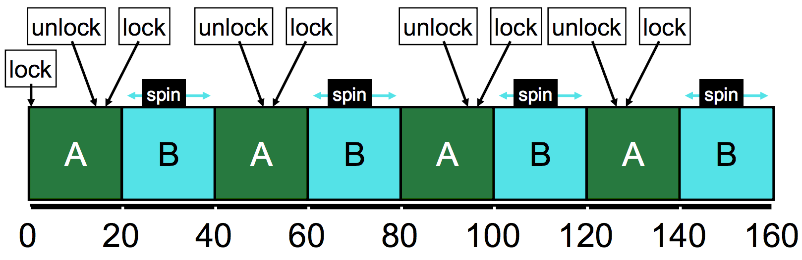
Spinlock evaluation - Correctness
Mutual Exclusion and Progress Yes
Bounded Wait No
  No guarantee that a thread will eventually get its turn (assume an infinite system)

Slide 47
Spinlock evaluation – Goals
Fairness
  Doesn’t even guarantee no starvation
  No control at all over whether each thread waits an even amount
Performance (uniprocessor)
  Process “spins”, repeatedly checking a variable that will not change
  Timeslice must expire before another thread is given a chance to unlock
  If N threads want the lock, then N timeslices are wasted spinning
Performance (multiprocessor)
  Doesn’t waste entire timeslice anymore
  No calls to OS means process gets the lock as soon as it is free. So fast!

Slide 48
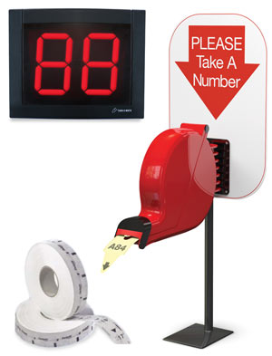
Addressing the bounded wait problem
Need some way to track “whose turn it is” to take the lock
You can have the lock when not held AND it’s no one else’s turn
Idea: hand out numbered tickets

Slide 49
Atomic Instruction: Fetch and Add
Example atomic_fetch_and_add (remember, in hardware not C)
  int atomic_fetch_and_add(int* pointer, int increment) {
  int old_value = *pointer;
  *pointer = old_value + increment;
  return old_value;
  }
atomic_fetch_and_add(destptr, incr)
  Add a new value to the current value in memory, and return the old one
  x86-64 instruction: lock; xadd
List of C wrappers available here:
https://gcc.gnu.org/onlinedocs/gcc/_005f_005fatomic-Builtins.html

Slide 50
Ticket lock implementation
Each thread atomically reserves its turn
Unique turn numbers prevent a data race
  Fails with 2^32 threads!
When finished, set to next turn
typedef struct {
unsigned int ticket; // current available ticket
unsigned int turn; // which ticket gets to proceed
} lock_t;
void mutex_init(lock_t* mutex) {
mutex->ticket = 0; mutex->turn = 0;
}
void mutex_lock(lock_t* mutex) {
int myturn = atomic_fetch_and_add(&(mutex->ticket), 1); // take a ticket
while (mutex->turn != myturn); // spin-wait until available
}
void mutex_unlock(lock_t* mutex) {
atomic_fetch_and_add(&(mutex->turn), 1); // next turn
}
Prevents starvation with FIFO ordering of access!

Slide 51
Ticket Lock Example
A lock(): Ticket 0, Turn 0 // enter critical section!
B lock(): Ticket 1, Turn 0 // wait
C lock(): Ticket 2, Turn 0 // wait

Slide 52
Ticket Lock Example
A lock(): Ticket 0, Turn 0
B lock(): Ticket 1, Turn 0
C lock(): Ticket 2, Turn 0
A unlock(): Turn 1 // B gets to go

Slide 53
Ticket Lock Example
A lock(): Ticket 0, Turn 0
B lock(): Ticket 1, Turn 0
C lock(): Ticket 2, Turn 0
A unlock(): Turn 1
A lock(): Ticket 3, Turn 1
B unlock(): Turn 2 // C gets to go

Slide 54
Ticket Lock Example
A lock(): Ticket 0, Turn 0
B lock(): Ticket 1, Turn 0
C lock(): Ticket 2, Turn 0
A unlock(): Turn 1
A lock(): Ticket 3, Turn 1
B unlock(): Turn 2
C unlock(): Turn 3 // A gets to go again
A unlock(): Turn 4 // Available ticket is turn 4 too, so next request goes immediately

Slide 55
Ticket Lock Evaluation
Correctness: Mutual Exclusion, Progress, Bounded Wait Yes
Goals
Fairness Yes
  FIFO ordering of threads
Performance
  Similar positives and negatives as original spinlock
  One downside: on a release() all threads must check if it is their turn

Slide 56
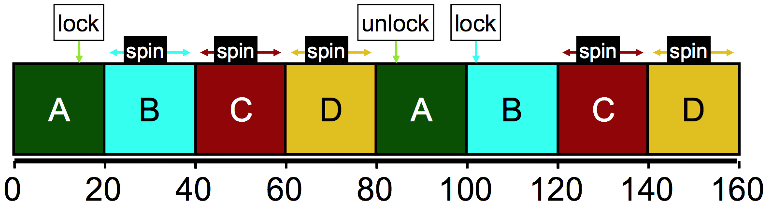
Ticket lock still wastes time spinning
B, C, and D are “busy waiting”
  Might be occupying an entire core in multicore
Scheduler is fairly scheduling all threads, but ignorant of locks
Idea: can we skip threads that are waiting on a lock?

Slide 57
Yield timeslice when not yet ready
Yield syscall unschedules the current thread
  sched_yield() in POSIX API
  Gives the user process just a little control over the scheduler
In acquire(), yield after checking condition
Might delay thread response time in multicore scenario
void mutex_lock(lock_t* mutex) {
int myturn = atomic_fetch_and_add(&(mutex->ticket), 1); // take a ticket
while (mutex->turn != myturn) {
sched_yield(); // not ready yet
}
}

Slide 58
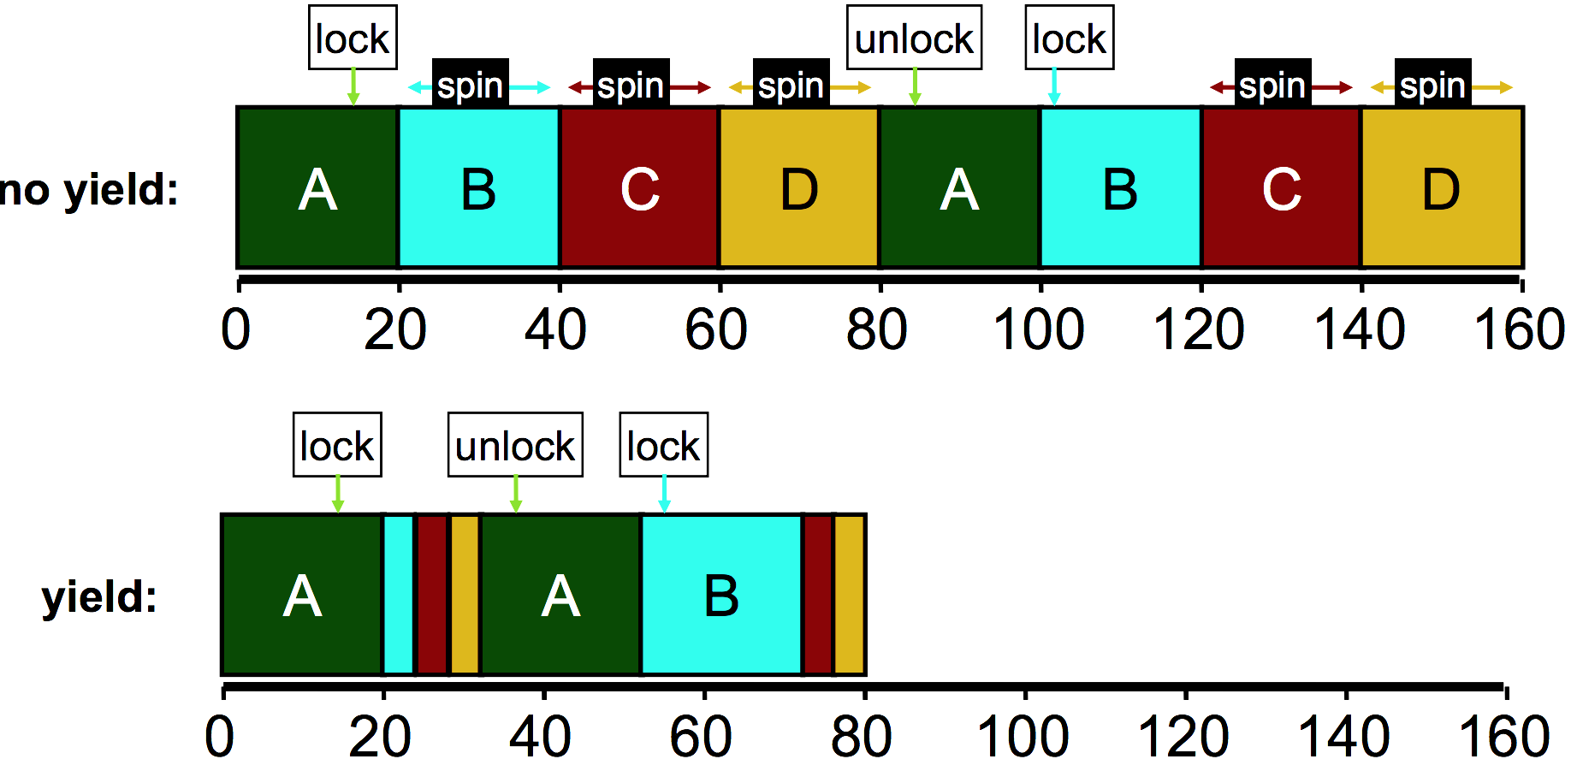
Yielding reduces busy-waiting

Slide 59
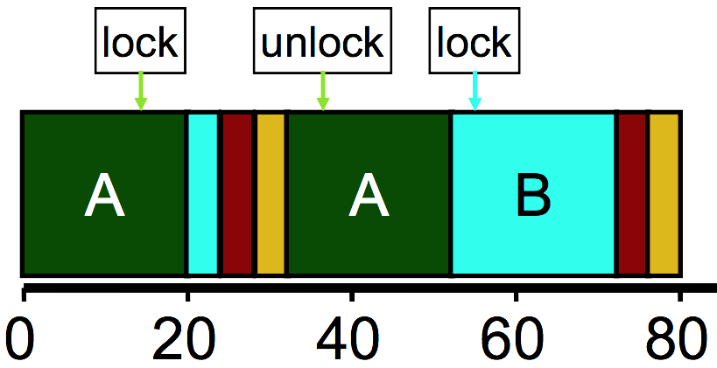
How much does yielding improve things?
Performance better with yield(), but still doing a lot of unnecessary context switches
Wasted CPU cycles
  Without yield(): O(threads*timeslice)
  With yield(): O(threads*context_switch)
  Timeslice ~1 ms, Context switch: ~1 µs
Still expensive if we expect many threads to be contending over the lock

Slide 60
Building a blocking lock
A more performant solution requires cooperation between thread’s locks and the OS scheduler to block threads
Some OSes (Solaris) have system calls to do so
  park() – blocks the current thread
  unpark(thread_id) – unblocks another thread, specified by thread ID
Building locks on park/unpark
  If lock acquire fails, add own thread ID to waiting thread queue and park()
  Release dequeues the next waiting thread ID and calls unpark() on it
  Fairness: unlocking thread effectively decides which thread goes next

Slide 61
Linux Futex (fast userspace mutex) syscalls
Similar to park/unpark, but the queue is in the kernel
Key idea: only makes the kernel calls when you actually need to wait or wake a sleeping thread
futex_wait(int* pointer, int expected)
  Put thread to sleep if the value at address equals “expected”
  Used to build acquire()
futex_wake(int* pointer)
  Unblock one thread waiting on “pointer”
  Used to build release()
See https://eli.thegreenplace.net/2018/basics-of-futexes/

Slide 62
Spinning versus Blocking
Each approach is better under different circumstances
Single core systems
  If waiting process is scheduled, then process holding lock is not
  Waiting process should always yield its time
Multicore systems
  If waiting process is scheduled, then process holding lock could also be
  Spin or block depends how long until the lock is released
    If the lock is released quickly, spin wait
    If the lock is released slowly, block
    Where quick and slow are relative to context-switch cost

Slide 63
Two-phase waiting
Problem: we can’t always know how long the wait will be
  Programmer might know…
  Library definitely can’t know
Idea:
  Spin lock for a little while, and then give up and block
  Example: Linux Native POSIX Thread Library (NPTL)
    Check the lock at least three times before blocking with Futex

Slide 64
Summary on lock implementations
Spinlocks
Ticket locks
Yielding locks
Queueing locks
  Futex on Linux
Sophisticated locks are more fair and do not waste processor time “busy waiting”
But also have unnecessary context-switch overhead if the lock is only briefly and rarely held

Slide 65
Outline
Race Conditions
Lock Design
Basic Lock Implementation
Lock Optimizations

Slide 66
Outline
Bonus: Interrupts

Slide 67
Where else does concurrency come from?
Processors introduce it for performance reasons by running multiple processes and threads
Interactions with the outside world introduce it because events occur whenever they feel like it
  Network request arriving
  User presses a key
  Motion sensor triggers
Also, we need some way to deal with errors the occur when executing instructions
  No pathway for returning an error from an instruction

Slide 68
Interrupts
A way for the CPU to be, well, interrupted.
CPU hardware switches to privileged mode
  Now any instruction can be executed, including privileged ones.
Execution jumps to a predefined location
  Handler specified in the CPU’s interrupt vector table
  Lets the kernel deal with whatever the event was
Used to support asynchronous I/O
  Lets a hardware device tell the CPU that some data is ready
  Remember that a disk operation is millions of times slower than an add.
CPU has electrical pin(s) for hardware interrupts.
There is also an instruction for software interrupts (like traps!)

Slide 69
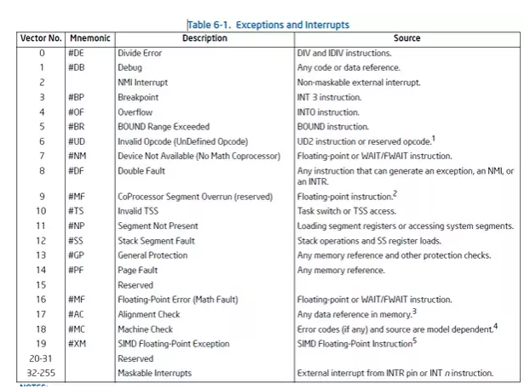
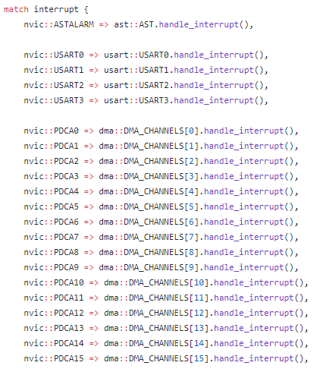
Interrupt Vector Table
Table actually lives in memory somewhere, with function pointers for each vector number
Example from Tock for SAM4L chip (in Rust)

Slide 70
Interrupt Vector Table
Table actually lives in memory somewhere, with function pointers for each vector number
Example from Tock for SAM4L chip (in Rust)

Slide 71
Differences from traps
When we performed a system call:
  We knew it was about to happen.
  Set up our registers in advance.
  Performed what looked sort of like a function call.
Interrupts can happen whenever.
  This can get extremely complicated on modern systems with out-of-order execution, multiple cores and threads, and caches

Slide 72
Interrupt handlers
Interrupt context
  Can’t just enter the kernel like we did with system calls
  Interrupt could have occurred while we were in the kernel
Handler code
  Execute some quick processing to deal with the interrupt
  Return so the hardware can bring us back to our normal operation
  Cannot pause to wait for something else to finish first because the entire core jumped to handling this interrupt
Handled by the operating system
  Processes are interrupted, but otherwise not normally involved

Slide 73
Why are interrupts important to the kernel?
Interrupts are a case where the kernel could have a data race with itself!!
  Imagine being in the middle of an operation on a device
  When an interrupt comes in for that same device
  Data structures for the device could end up messed up
Takeaway: concurrency isn’t just about processes and threads
  Many different software designs need to deal with it

Slide 74
Data race fix for single-core machines: disable interrupts
void lock() {
disable_interrupts();
}
void unlock() {
enable_interrupts();
}
Disable interrupts to prevent preemption during critical section
  Scheduler can’t run if the OS never takes control
  Also stops data races in interrupt handlers
Problems
  Doesn’t work on multicore machines
  Bad Idea™ to let processes disable the OS
    Process could freeze the entire computer
  Might screw up timing for interrupt handling

