Slide 1
Lecture 14: Device Input and Output
CS343 – Operating Systems
Branden Ghena – Fall 2020
Some slides borrowed from: Stephen Tarzia (Northwestern), Shivaram Venkataraman (Wisconsin), Jaswinder Pal Singh (Princeton), and UC Berkeley CS61C and CS162

Slide 2
Today’s Goals
Discuss I/O devices and how a computer connects to them.
Understand two different methods of reading/writing device data.
Explore patterns for device interaction:
Synchronous versus Asynchronous
Programmed I/O versus Direct Memory Access

Slide 3
Outline
Overview of Device I/O
Connecting to devices
Buses on a computer
Talking to devices
Port-Mapped I/O and Memory-Mapped I/O
Device interactions
Synchronous versus Asynchronous Events
Programmed I/O versus Direct Memory Access

Slide 4
Devices are the point of modern computers
Computation was sufficient for batch systems
Even then, tape was the input and output mechanism
But interactive systems need to receive input from users and output responses
Keyboard/mouse
Disk
Network
Graphics
Audio
Various USB devices
Computer
Processor
Memory
Devices
Control
Input
Datapath
Output

Slide 5
Devices are core to useful general-purpose computing
Input
Output
Mouse
Monitor
Computer
Keyboard
Headphones
Ethernet
Ethernet
Bluetooth
Bluetooth

Slide 6
Devices are essential to cyber-physical systems too
Input
Output
Lidar
Throttle Control
Computer
Inertial Measurement Unit
Brake Control
Camera
Wheel Rotation
CAN
CAN

Slide 7
Device access rates vary by many orders of magnitude
Rates in bit/sec
System must be able to handle each of these
Sometimes needs low overhead
Sometimes needs to not wait around
Device | Behavior | Partner | Data Rate (Kb/s)
Keyboard | Input | Human | 0.2
Mouse | Input | Human | 0.4
Microphone | Output | Human | 700.0
Bluetooth | Input or Output | Machine | 20,000.0
Hard disk drive | Storage | Machine | 100,000.0
Wireless network | Input or Output | Machine | 300,000.0
Solid state drive | Storage | Machine | 500,000.0
Wired LAN network | Input or Output | Machine | 1,000,000.0
Graphics display | Output | Human | 3,000,000.0

Slide 8
Handling devices appropriately
OS concerns
Communicating with devices needs to be fast and efficient
Devices are shared resources that need to be access controlled and shared
Devices are wildly variable and need some common interfaces for application software
General theme
Access I/O devices similarly to memory
Read device state and write commands to it
With interrupts to inform kernel of events

Slide 9
Outline
Overview of Device I/O
Connecting to devices
Buses on a computer
Talking to devices
Port-Mapped I/O and Memory-Mapped I/O
Device interactions
Synchronous versus Asynchronous Events
Programmed I/O versus Direct Memory Access

Slide 10
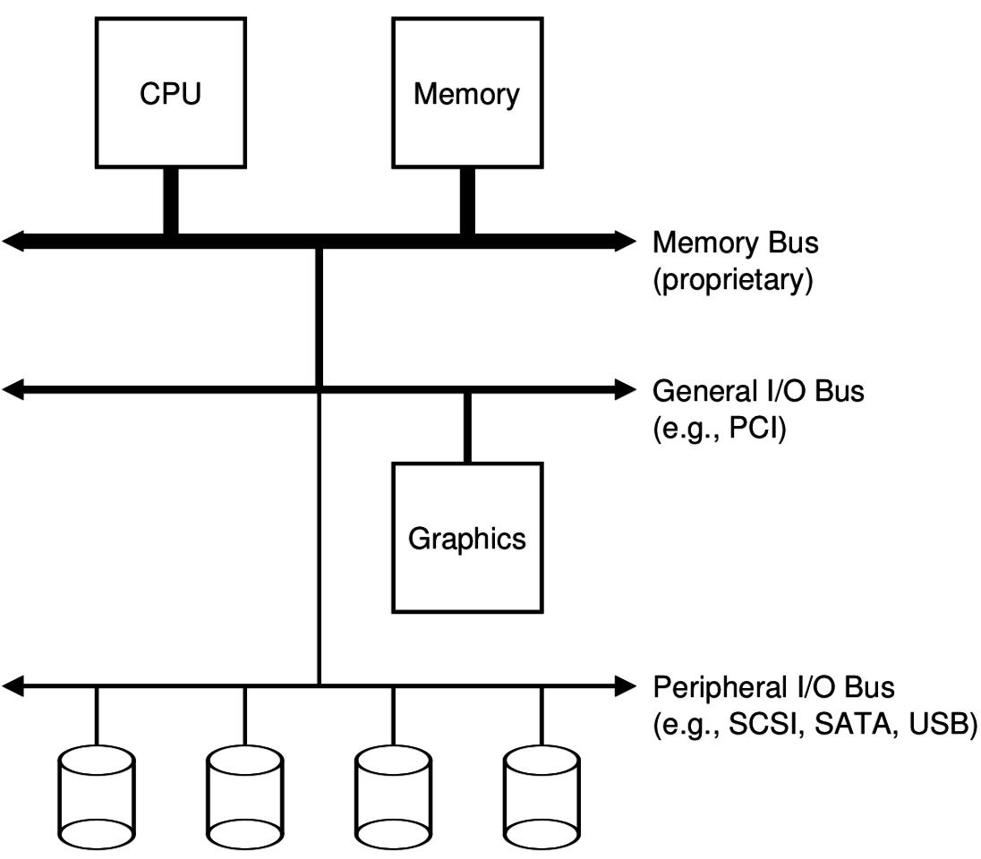
Devices connect to buses on the computer
I/O Hierarchy
Close to the CPU are very fast connections
Farther from CPU are slower but more flexible protocols

Slide 11
What is a bus anyways?
Common set of wires for communication between two or more components
Lets one set of wires connect to N devices
Standardized buses have a specific set of wires and protocol for communicating over them (DMI, PCI, SATA, USB)
Example wires: 64 address wires, 64 data wires, ~10 control wires
Concerns
How many wires in the bus?
Single controller or multiple with arbitration?
Half-duplex (one direction of communication at a time) or full-duplex?

Slide 12
Computer networks also run over buses
Ethernet is a bus too!
Network protocols specify how two computers communicate, very similarly to these buses
Internal computer buses differences from general networks
Higher speed
Very high reliability
Accessed cooperatively (often with only one controller: CPU)

Slide 13
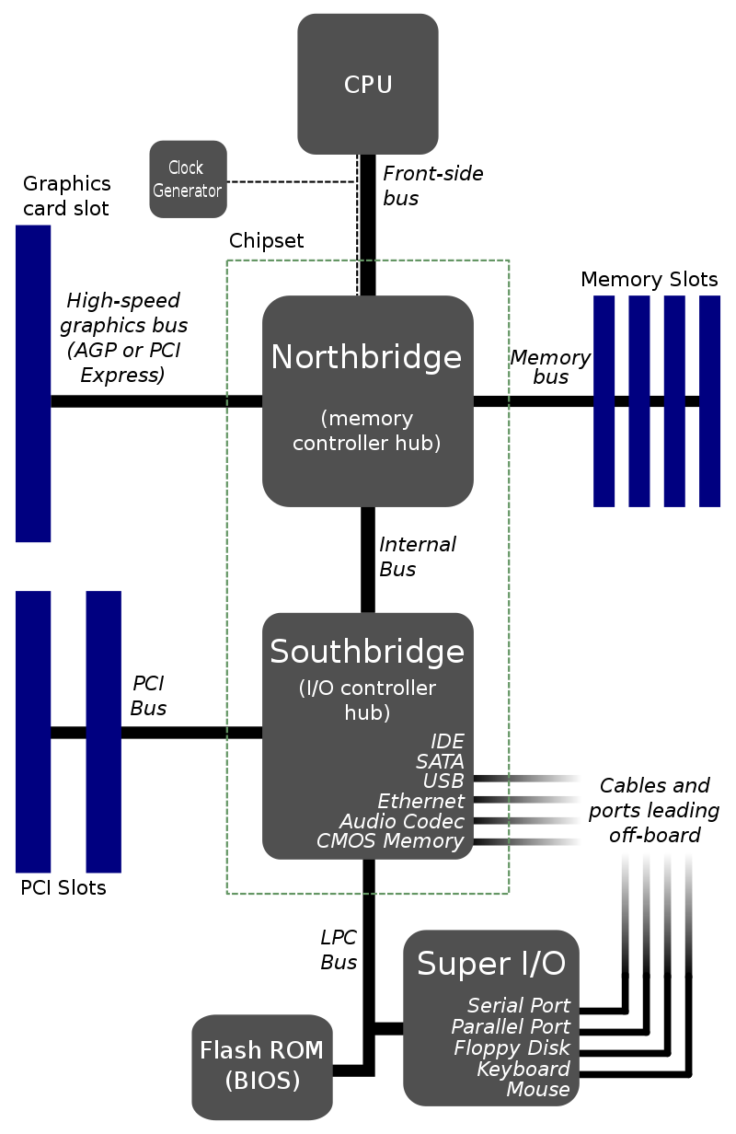
Old version of I/O hierarchy
Hub architecture
Northbridge
High speed memory control
RAM + Graphics
Southbridge
Low speed peripherals
Disk, Network, USB

Slide 14
Check your understanding – physical layout
Which is going to be physically closer to the CPU?
Northbridge or Southbridge
Why?

Slide 15
Check your understanding – physical layout
Which is going to be physically closer to the CPU?
Northbridge or Southbridge
Why?
Need accesses to be fast
Electrical signals are limited by speed of light
1 nanosecond ~= 1 foot

Slide 16
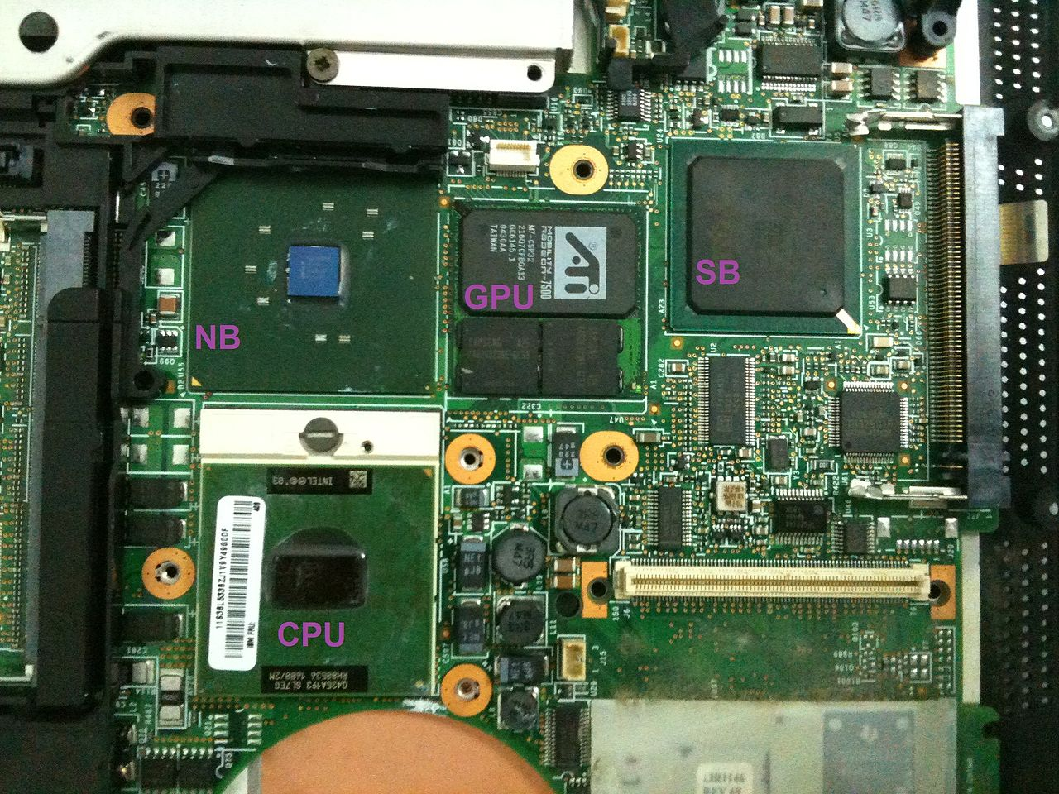
Physical layout of an old motherboard
Note physical distance from CPU

Slide 17
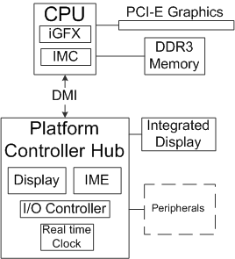
Platform Controller Hub (PCH) architecture
Enables faster communication high-throughput peripherals
Memory and Graphics

Slide 18
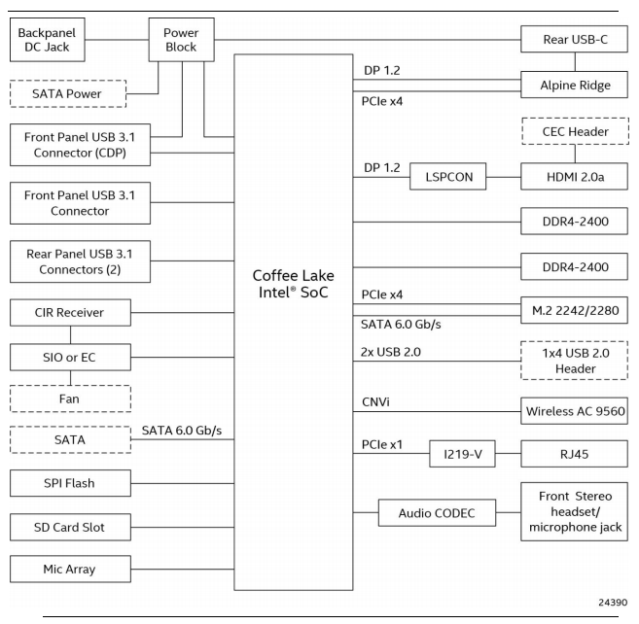
Intel NUC 8
Small form factor desktop
CPU includes PCH and GPU in single package
CPU implements many connections directly
USB
SATA
Some have hardware controllers
Ethernet (RJ45)
Thunderbolt (Rear USB-C)
3.5mm Audio (Front stereo headset…)

Slide 19
Some important buses
Legacy
Parallel Port
Serial Port
USB
SATA
PCIe
Device driver sometimes talks to bus controller
Which sends appropriate signals to device

Slide 20
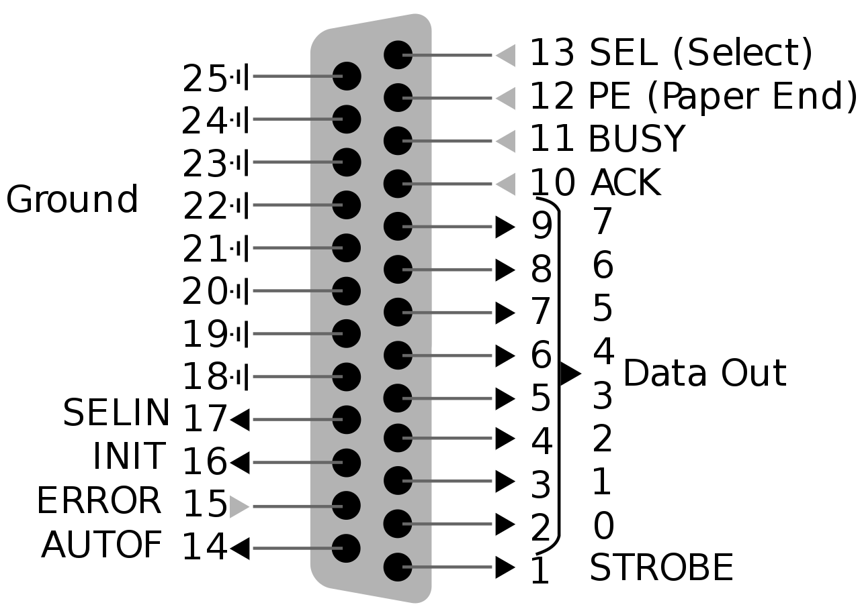
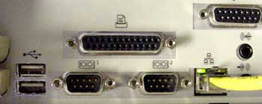
Parallel Port – “Printer Port” or Centronics Port
“That big long one you might have seen once”
8 data bits plus control signals
Up to 2.5 Mbps!!
Very simple to implement
Write 8 bits of data
Set STROBE low
BUSY goes low in response
When BUSY goes high
Set STROBE high
Repeat

Slide 21
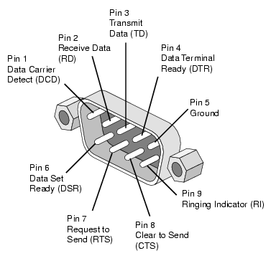
Serial Port – RS-232
“That one we used to use before USB”
RS-232 serial protocol
One wire for Transmit, one wire for receive
Bits go one after another at a certain speed (“baudrate”)
Up to 256 Kbps
Used to connect modems
Still occasionally used for old devices (via a USB to RS-232 converter)

Slide 22
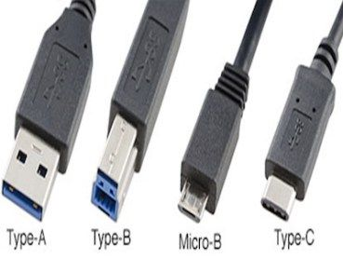
USB – Universal Serial Bus
“That one you are familiar with already”
Comes in multiple form-factors and versions
USB 3.x and type C connectors are the fast ones
Speed has increased greatly
1.5 Mbps
12 Mbps
480 Mbps
5 Gbps
10 Gbps
40 Gbps

Slide 23
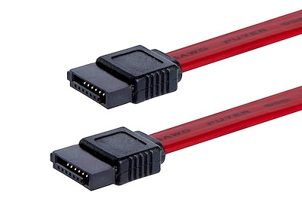
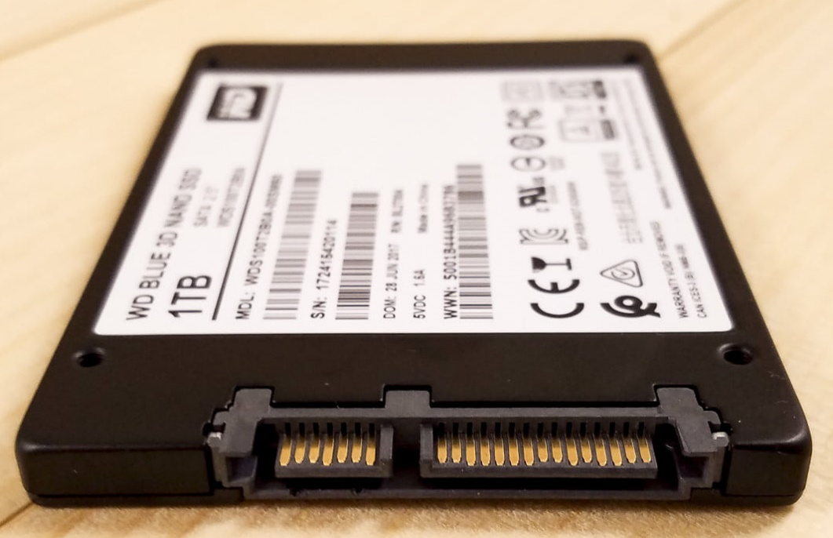
SATA – Serial ATA – AT Attachment – “Advanced Technology”
“That cable you plug a drive in with”
Long evolution as you might have guessed from the name
6 Gbps
One transmit and one receive single
Two wires for each in twisted pair
Short connection length for high speed
SATA
Power

Slide 24
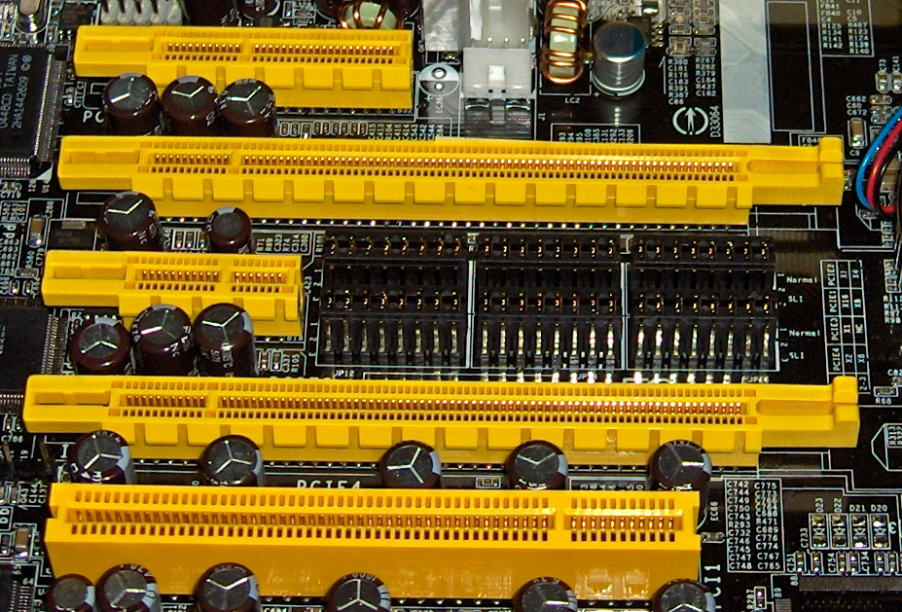
PCIe – Peripheral Component Interconnect Express
“That slot you put a graphics card into”
Or WiFi card, or some SSDs
Collection of point-to-point connections
Motherboard and CPU support N “lanes” in various configurations
Different sizes for different number of bits in parallel
Order 10s Gbps

Slide 25
Outline
Overview of Device I/O
Connecting to devices
Buses on a computer
Talking to devices
Port-Mapped I/O and Memory-Mapped I/O
Device interactions
Synchronous versus Asynchronous Events
Programmed I/O versus Direct Memory Access

Slide 26
How does an OS talk with I/O devices?
A device is really a miniature computer-within-the-computer
Has its own processing, memory, software
We can mostly ignore that and deal with its interface
Called registers (actually are from EE perspective, but you can’t use them)
Read/Write like they’re data
How do we read/write them?
Special assembly instructions
Treat like normal memory

Slide 27
Port-Mapped I/O (PMIO): special assembly instructions
x86 IN and OUT instructions
Privileged instructions (kernel mode only)
Two arguments: destination and data register
Each device is mapped to some port address
IN and OUT instructions interact with interface
Example: read current value from real-time clock
mov $0, %al out %al, $0x70 /* Select output of seconds */ in $0x71, %al /* AL register contains 0-59 */

Slide 28
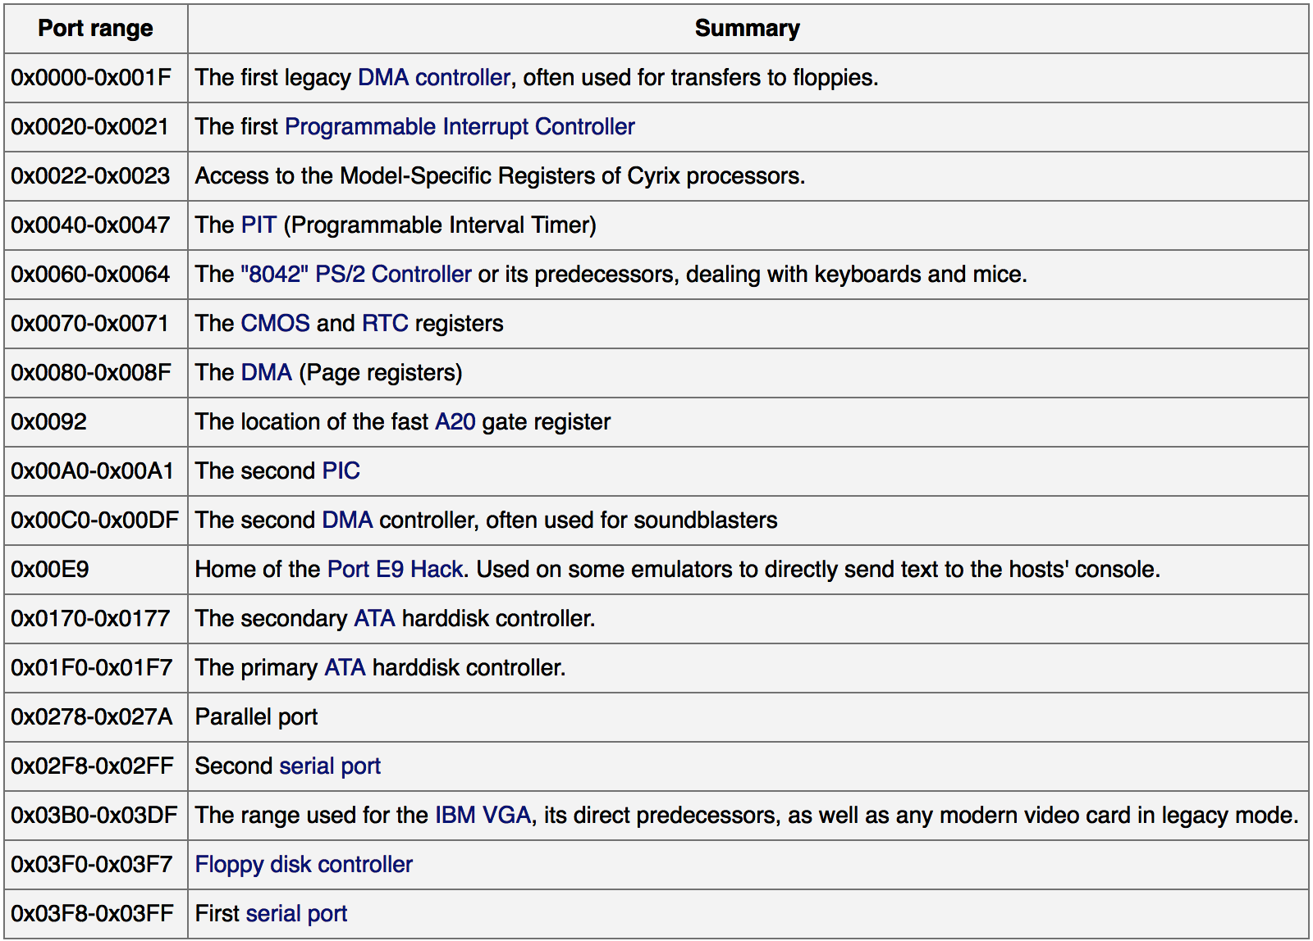
Example I/O port map
This isn’t standardized, but these are some typical values.
https://wiki.osdev.org/Can_I_have_a_list_of_IO_Ports

Slide 29
Check your understanding – PMIO in C
How would you access PMIO with C instructions?

Slide 30
Check your understanding – PMIO in C
How would you access PMIO with C instructions?
Can’t! Need to use assembly (hopefully with C function wrapper)

Slide 31
Annoying parts of Port-Mapped I/O
Special assembly instructions are hard to write in C
Need some wrapper function that actually calls them
Feels sort of like memory read/write, but isn’t
Why not?
Can we just put the “port address space” somewhere in memory?
Used to be a problem for 16-bit computers
But today we have tons of extra physical address space laying around

Slide 32
Memory-mapped I/O (MMIO): treat devices like normal memory
Certain physical addresses do not actually go to RAM
Instead they correspond to I/O devices
And any instruction that accesses memory can access them too!
x86 being the historical amalgamation that it is, uses either PMIO or MMIO depending on the device
Address
0xFFFFFFFF
0xFFFF0000
control reg.
data reg.
0x00000000

Slide 33
LED blinking code in C using MMIO (on 32-bit nRF52832)
void main(void) { const uint32_t LED_NUM = 1; // set LED pin to be an output *((volatile uint32_t*)0x50000700 + 4*LED_NUM) = 0x00000003;
while (true) { volatile int i;
// LED on
*((volatile uint32_t*)0x50000504) |= (1 << LED_NUM); for (i=0; i<400000; i++); // wait a second
// LED off *((volatile uint32_t*)0x50000504) &= ~(1 << LED_NUM); for (i=0; i<400000; i++); // wait a second
}
}

Slide 34
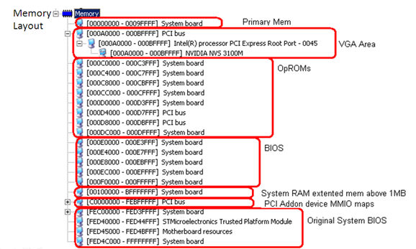
Example memory map (from an old 32-bit computer)
PCI devices are mapped here

Slide 35
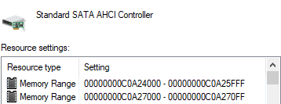
Example devices on my windows computer
SATA controller is mapped into memory at two places
USB controller is mapped into a much higher memory region
Regions are large because they contain multiple control/data “registers”

Slide 36
Other details about MMIO
Devices are mapped into physical memory
Usually only accessible by the kernel
But could be directly placed in virtual memory for a process in very special cases
Devices are NOT memory though
Need to be careful not to cache them
Cannot let compiler mess with our reads/writes either
volatile keyword in C
Conceptually not really very different from PMIO
Both just read/write to specific addresses the device is mapped to

Slide 37
Outline
Overview of Device I/O
Connecting to devices
Buses on a computer
Talking to devices
Port-Mapped I/O and Memory-Mapped I/O
Device interactions
Synchronous versus Asynchronous Events
Programmed I/O versus Direct Memory Access

Slide 38
What do interactions with devices look like?
while STATUS==BUSY; Wait
(Need to make sure device is ready for a command)
Write value(s) to DATA
Write command(s) to COMMAND
while STATUS==BUSY; Wait
(Need to make sure device has completed the request)
Read value(s) from Data

Slide 39
Waiting can be a waste of CPU time
while STATUS==BUSY; Wait
(Need to make sure device is ready for a command)
Write value(s) to DATA
Write command(s) to COMMAND
while STATUS==BUSY; Wait
(Need to make sure device has completed the request)
Read value(s) from Data
Imagine a keyboard device
CPU could be waiting for minutes before data arrives
Need a way to notify CPU when an event occurs
Interrupts!

Slide 40
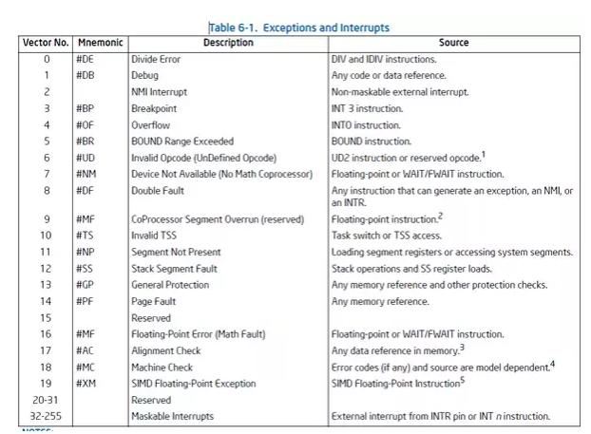
Hardware devices can generate interrupts
Each device maps to some number of hardware interrupts
Done at system boot time
Discover devices
Map devices into address space
Map interrupts for devices

Slide 41
Interrupts allow waiting to happen asynchronously
Prior code example was synchronous
Nothing else continued on the processor until access was complete
Good for very fast devices (GPU)
We call this “Polling”
With interrupts, device handling is now asynchronous
Access occurs in the background and processor can do something else
Good for very slow devices (Disk)
Comes with all the downsides of concurrency though…

Slide 42
Programmed I/O (PIO)
while STATUS==BUSY; Wait (possibly on interrupt)
(Need to make sure device is ready for a command)
Write value(s) to DATA
Write command(s) to COMMAND
while STATUS==BUSY; Wait
(Need to make sure device has completed the request)
Read value(s) from Data
How do we read and write those values? (could be a lot)
With normal CPU memory accesses: Programmed I/O
Literally: you write a program to do the input and output

Slide 43
Check your understanding – writing to disk
Let’s say that disk has MMIO registers for an entire 4 KB page
Takes 100 ns to write each word (8 bytes) of memory
Assuming that we’re just writing all zeros (ignore reading from memory), how long does it take to write a page to MMIO?

Slide 44
Check your understanding – writing to disk
Let’s say that disk has MMIO registers for an entire 4 KB page
Takes 100 ns to write each word (8 bytes) of memory
Assuming that we’re just writing all zeros (ignore reading from memory), how long does it take to write a page to MMIO?
4 KB / 8 B = 500 writes * 100 ns / write = 50 µs
(For a 3 GHz processor, that’s 150,000 cycles)

Slide 45
Direct Memory Access (DMA)
Alternative method that uses hardware to do memory transfers
OS writes address of the data and the size
Device reads data directly from memory
CPU can go do other things while read/write is occurring
Notes
Need to be careful about letting devices access arbitrary memory
Are devices part of the trusted compute base?
Often a hardware “DMA controller” does the transfer for the device
IOMMU can even set up virtual memory spaces for devices

Slide 46
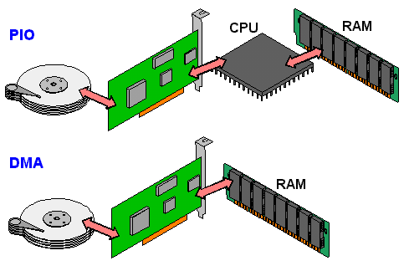
Programmed I/O versus Direct Memory Access
SATA Controller
Disk
SATA Controller
Disk

Slide 47
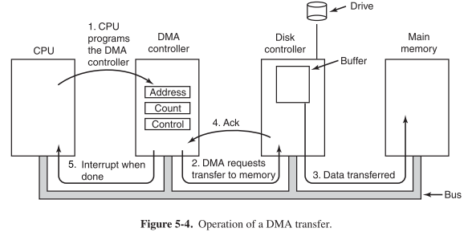
Disk access with DMA

Slide 48
Interaction pattern with Interrupts and DMA
Interrupt from disk: IDLE (!BUSY)
Set up DMA controller
Device is disk
Select Read or Write
Specify memory address and size
Start DMA transfer
Continue until interrupt again
OS ends up keeping a queue of transfers to be sent to disk that needs to be accessed asynchronously from several places
Producer/Consumer Problem!

Slide 49
Outline
Overview of Device I/O
Connecting to devices
Buses on a computer
Talking to devices
Port-Mapped I/O and Memory-Mapped I/O
Device interactions
Synchronous versus Asynchronous Events
Programmed I/O versus Direct Memory Access

