Slide 1
Lecture 17
Processes
CS213 – Intro to Computer Systems
Branden Ghena – Winter 2025
Slides adapted from:
St-Amour, Hardavellas, Bustamente (Northwestern), Bryant, O’Hallaron (CMU), Garcia, Weaver (UC Berkeley)

Slide 2
Today’s Goals
Introduce the role of an operating system
Explore various mechanisms by which OS and processes interact
  System calls and signals
Discuss operations on files as example system calls
Introduce the idea of “scheduling” processes

Slide 3
Outline
Intro to Operating Systems
Process Control Flow
System Calls
File I/O
  Standard I/O
Signals
Scheduling Processes

Slide 4
What is an operating system?
User processes
Spotify
Powerpoint
Steam
Chrome
QEMU
Physical computer
Hardware

Slide 5
What is an operating system?
User processes
Spotify
Powerpoint
Steam
Chrome
QEMU
Operating System
Physical computer
Hardware

Slide 6
What is an operating system?
User processes
Spotify
Powerpoint
Steam
Chrome
QEMU
File
System
Virtual
Memory
Process
Manager
Network
Operating System
Device Drivers
Interrupt Handlers
Boot and Init
Physical computer
Hardware

Slide 7
What is an operating system?
User processes
Spotify
Powerpoint
Steam
Chrome
QEMU
Application Interface
File
System
Virtual
Memory
Process
Manager
Network
Operating System
Device Drivers
Interrupt Handlers
Boot and Init
Hardware Abstraction Layer
Physical computer
Hardware

Slide 8
What’s part of the OS?
OS kernel – the part of the OS code that has full control of the system
Process scheduling
(who uses CPU)
Memory allocation
(who uses RAM)
Accesses hardware devices
  Outputs graphics
  Reads/writes to network
  Read/write to disks
  Handles boot-up and power-down
OS distribution – the kernel + lots of other useful stuff
GUI / Window manager
Command shell
Software package manager
  “app store”, yum, apt, brew
Common software libraries
Useful apps:
  Text editor, compilers, web browser, web server, SSH, anti-virus, file-sharing, media libraries,

Slide 9
Major goals of an Operating System
OSes make advancing technology available to rapidly evolving applications. They do so with two major goals:
  Provide abstractions to applications to enable hardware compatibility
    Why: allow reuse of common features, avoid low-level details
    Challenges: What are the correct abstractions?
  Manage sharing of resources across many applications
    Why: protect applications, enforce fair access
    Challenges: What are the mechanisms and what are the policies?
Good operating systems do these quickly, efficiently, and securely

Slide 10
Processes are an abstraction provided by the OS
The machine itself usually doesn’t support processes
  Just has a processor and a set of registers
  Memory is just arbitrary memory
OS provides the abstraction
  Multiple processes can run at the “same time”
  Each has its own registers
  Each has its own isolated memory
Processes enable
  Multiple functionalities on a computer
  Multiprogramming of a system

Slide 11
Outline
Intro to Operating Systems
Process Control Flow
System Calls
File I/O
  Standard I/O
Signals
Scheduling Processes

Slide 12
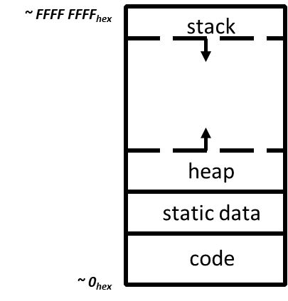
Reminder: view of a process
Process: program that is being executed
Contains code, data, and a thread
  Thread contains registers, instruction pointer, and stack
Code and Data
Registers
Instruction Pointer
Condition Codes
Stack
%rax
%r8
%eax
%r8d
%rbx
%r9
%ebx
%r9d
%rcx
%r10
%ecx
%r10d
%rdx
%r11
%edx
%r11d
%rsi
%r12
%esi
%r12d
%rdi
%r13
%edi
%r13d
%rsp
%r14
%esp
%r14d
%rbp
%r15
%ebp
%r15d

Slide 13
Questions remaining about processes
Interaction mechanisms with OS
  How do processes make requests of the OS?
  How does the OS inform processes of various events?
Both answered by the same basic mechanism:
exceptional control flow

Slide 14
Control flow
Processors do only one thing:
  From startup to shutdown, a CPU simply reads and executes (interprets) a sequence of instructions, one at a time
  This sequence is the CPU’s control flow (or flow of control)
Physical control flow
<startup>
inst₁
inst₂
inst₃
…
inst_{n}
<shutdown>
Time

Slide 15
Altering control flow
Instructions that change control flow allow software to react changes in program state
  Jumps/branches
  Call/return
But comptuers also need to react to changes in system state
  Data arrives at network adapter
  Instruction divides by zero
  User hits Ctrl-C on the keyboard
  System timer expires
These mechanisms are known as “exceptional control flow”

Slide 16
Exceptional control flow
Mechanisms that could cause exceptional control flow
  Exceptions: events cause execution to jump to OS handler
  Context switch: request or timeout causes execution to jump to OS
  Signals: event plus OS causes execution to jump to process handler
Running process
Other code (usually OS)
Event
I_current
Exception
I_next
Exception processing
by exception handler
Return to I_next

Slide 17
Exceptions
Hardware detects an event that OS software needs to resolve immediately
Could be an error
  Invalid memory access
  Invalid instruction
Could just be something the OS should handle
  Page fault
  USB device detected
OS has a table of “exception handlers”, which are functions that handle each exception class (also known as interrupt handlers)
  Hardware jumps execution to the proper handler

Slide 18
Outline
Intro to Operating Systems
Process Control Flow
System Calls
File I/O
  Standard I/O
Signals
Scheduling Processes

Slide 19
Things a program cannot do itself
Print “hello world”
  because the display is a shared resource.
Download a web page
  because the network card is a shared resource.
Save or read a file
  because the filesystem is a shared resource, and the OS wants to check file permissions first.
Launch another program
  because processes are managed by the OS
Send data to another program
  because each program runs in isolation, one at a time

Slide 20
How does a process ask the OS to do something?
Certain things can only be accessed from kernel mode
  All of memory, I/O devices, etc.
  Kernel: the portion of the OS that is running and in memory
Bad Idea to allow processes to just enter kernel mode
  We do NOT trust processes
  So there shouldn’t be any instruction that switches to kernel mode unless that instruction also switches to kernel code
Requirements
  Switch execution to the kernel
  Change into kernel mode
  Inform the kernel what you want it to do

Slide 21
Hardware can save us!
Solution: trigger an exception to run an OS handler
  Hardware instruction: trap
When instruction runs:
  Mode is changed to kernel mode
  AND
  Instruction Pointer is moved to a known location in the kernel
Same mechanism is used for other exceptions
  Division by zero, invalid memory access
  Also very similar to hardware interrupts

Slide 22
System call example
System call: making a request of the OS from a process
  Uses exceptional control flow to enter OS kernel
  Returns back to process when complete
    Returns to instruction after the system call
Kernel code
User code
Exception
syscall
next instruction
Do the thing
Returns

Slide 23
System call steps (simplification)
Process loads parameters into registers (just like a function call)
Process executes trap instruction (int, syscall, svc, etc.)
Hardware moves %rip to “handler” and switches to kernel mode
OS checks what the process wants to do from registers
OS decides whether the process is allowed to do so

Slide 24
Returning from a system call (simplification)
After OS finishes whatever operation it was asked to do
  And when the process is scheduled to run again
OS places return result in a register (just like a function call)
OS changes mode to user mode (and sets virtual memory stuff)
OS sets %rip to instruction after the system call
Process continues and can use results of system call

Slide 25
Linux system calls
Example system calls
  https://man7.org/linux/man-pages/man2/syscalls.2.html
Number | Name | Description
0 | read | Read file
1 | write | Write file
2 | open | Open file
3 | close | Close file
4 | stat | Get info about file
57 | fork | Create process
59 | execve | Execute a program
60 | _exit | Terminate process
62 | kill | Send signal to process

Slide 26
Example using system calls
Let’s create new processes with system calls
From process view:
  Just look like regular C functions
  Take arguments, return values
Underneath:
  Function uses special assembly instruction to trigger exception

Slide 27
The C function for syscalls just performs the correct assembly
Example system call: fork
  C code:
    fork();
  x86-64 assembly implementation:
  fork:
    movq $57, %rdi
    syscall
    retq
Number | Name | Description
57 | fork | Create process

Slide 28
Process management system calls
pid_t fork(void);
  Create a new process that is a copy of the current one
  Returns either PID of child process (parent) or 0 (child)
void _exit(int status);
  Exit the current process (exit(), the library call cleans things up first)
pid_t waitpid(pid_t pid, int *status, int options);
  Suspends the current process until a child (pid) terminates
int execve(const char *filename, char *const argv[], char *const envp[]);
  Execute a new program, replacing the existing one
  Replaces code and data, clears registers, sets %rip to start again

Slide 29
Creating a new process
  #include <stdio.h>
  #include <unistd.h>
  int main(){
  if(fork() == 0) {
  printf("Child!\n");
  } else {
  printf("Parent!\n");
  }
  printf("Both!\n");
  return 0;
  }

Slide 30
Creating a new process
  #include <stdio.h>
  #include <unistd.h>
  int main(){
  if(fork() == 0) {
  printf("Child!\n");
  } else {
  printf("Parent!\n");
  }
  printf("Both!\n");
  return 0;
  }
Existential crisis

Slide 31
Executing a new program
  #include <stdio.h>
  #include <unistd.h>
  int main(){
  if(fork() == 0) {
  execve("/bin/python3", ...);
  } else {
  printf("Parent!\n");
  }
  printf("Only parent!\n");
  return 0;
  }

Slide 32
Break + Question
What does the following code do?
#include <stdio.h>
#include <sys/types.h>
int main() {
while(1){
fork();
}
return 0;
}

Slide 33
Break + Question
What does the following code do?
#include <stdio.h>
#include <sys/types.h>
int main() {
while(1){
fork();
}
return 0;
}
Creates a new process
  Then each process creates a new process
  Then each of those creates a new process…
Known as a Fork bomb!
  Machine eventually runs out of memory and processing power and will stop working
Defense: limit number of processes per user

Slide 34
Fork bombs in various languages
Python fork bomb
  import os
  while 1:
  os.fork()
Rust fork bomb
  #[allow(unconditional_recursion)]
  fn main() {
  std::thread::spawn(main);
  main();
  }
Bash fork bomb
  :(){ :|:& };:
Bash with spacing and a clearer function name
  fork() {
  fork | fork &
  }
  fork

Slide 35
Outline
Intro to Operating Systems
Process Control Flow
System Calls
File I/O
  Standard I/O
Signals
Scheduling Processes

Slide 36
Another example OS abstraction: File Systems
OS manages file systems to restrict and abstract them
Restrictions
  Prevent users from accessing other’s files without permission
Abstractions
  Files can grow infinitely large
  Where a file exists in memory or disk isn’t important!
  Default file system types, named directories, file explorer

Slide 37
Files
Collections of data
  Usually in permanent storage on your computer
  Interactions managed by the OS
Types of files
  Regular files
    Arbitrary data
    Think of as a big array of bytes
  Directories
    Collections of regular files
  Special files
    Links, pipes, devices (see CS343)

Slide 38
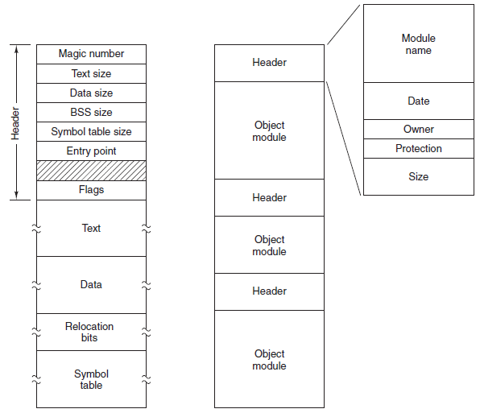
Sidebar: what about types of regular files?
Text files versus Executables versus Tar files
  All just differing patterns of bytes!
  It really is just all data. The meaning is in how you interpret it.
Executable
File
Archive
(tar)

Slide 39
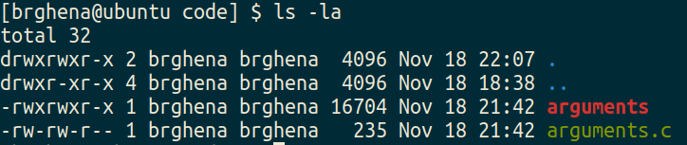
File permissions
Files have owners and permissions associated with them

Slide 40
File permissions
Files have owners and permissions associated with them
Permissions for the owner and name of the owner
  Read, Write, eXecute
    Cannot execute `arguments.c`
  For directories: Read contents, Write new contents, Traverse directory

Slide 41
File permissions
Files have owners and permissions associated with them
Permissions for the group and name of the group
  Example: I could make a CS213 group, add you all to it, and only give that group access to some folder or file

Slide 42
File permissions
Files have owners and permissions associated with them
Permissions for everyone else on the computer
  Not the owner and not in the group
  For my personal machine, not particularly relevant
  For Moore, probably don’t want to let others read your files…

Slide 43
How does a process access files?
This is an example use case for system calls
Files are a shared and managed resource on the computer
  Need to follow permissions settings
  Handle if multiple processes try to edit a file simultaneously
Also need to simplify what the interface looks like
  Files are actually structures in filesystem likely on disk
  But the process shouldn’t need to care about the details of that

Slide 44
How do we interact with files?
Analogy: think of a file as a book
  Big array of characters (bytes)
Open the book, starting at the first page
Read from the book
Write to the book
Change pages (without reading everything in between)
Close the book when finished

Slide 45
System calls for interacting with files
Open the book, starting at the first page
  open()
Read from the book
  read()
Write to the book
  write()
Change pages (without reading everything in between)
  lseek()
Close the book when finished
  close()

Slide 46
Higher-level methods of file interaction
Here, we’re talking about system calls to the OS
C standard library also defines file interactions
  fopen, fread, fwrite, fseek, fclose
  All are wrappers on top of the actual syscalls
  Buffers your interactions to make them more efficient
    Reads/Writes large chunks of data at a time
    Might collect multiple fwrite’s before doing a single real write
    fflush() guarantees that the buffer is written now

Slide 47
Opening files
int open(const char *pathname, int flags);
pathname is the string path for the file
  “/home/brghena/class/cs213/s21/code/arguments.c”
  “./arguments.c”
  “arguments.c”
flags include access permission requests
  Read only, Write only, Read and Write (O_RDONLY, O_WRONLY, O_RDWR)
  Also can choose to append to a file (O_APPEND)
  Or to create the file if it does not exist (O_CREAT)

Slide 48
Open returns a “file descriptor”
int open(const char *pathname, int flags);
OS keeps track of opened files for each process
  File descriptor is just a number referring to the opened file
  Non-negative number. Always the lowest unused, starting at zero
    A “handle” to the file
File descriptor is used in other calls to reference the file
  That way the OS doesn’t have to look up pathname every time
Negative number instead specifies an error (for all of these calls)

Slide 49
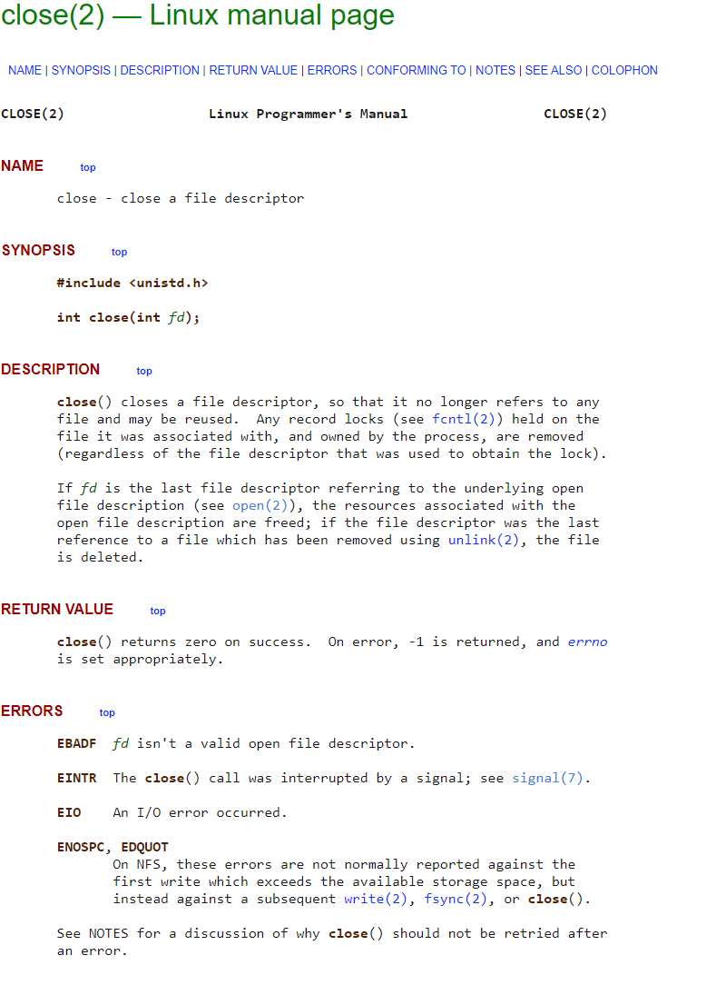
Sidebar: how do you figure out how these calls work?
Manual pages
Online: https://man7.org/linux/man-pages/man2/close.2.html

Slide 50
Example: read a file and print it to terminal
int main(int argc, char *argv[]) {
// check argument count
if (argc != 2) {
printf("Usage: ./kitten FILE\n");
return -1;
}
// try opening file
int fd = open(argv[1], O_RDONLY);
if (fd < 0) {
printf("Error opening file!\n");
return -1;
}
// array to hold read data
uint8_t read_size = 10;
uint8_t read_data[read_size];
while(true) {
// read from file
ssize_t read_length = read(fd, read_data, read_size);
if (read_length < 0) {
printf("Error reading file!\n");
return -1;
}
if (read_length == 0) {
break;
}
// print out data
for (int i=0; i<read_length; i++) {
printf("%c", read_data[i]);
}
}
return 0;
}

Slide 51
Outline
Intro to Operating Systems
Process Control Flow
System Calls
File I/O
  Standard I/O
Signals
Scheduling Processes

Slide 52
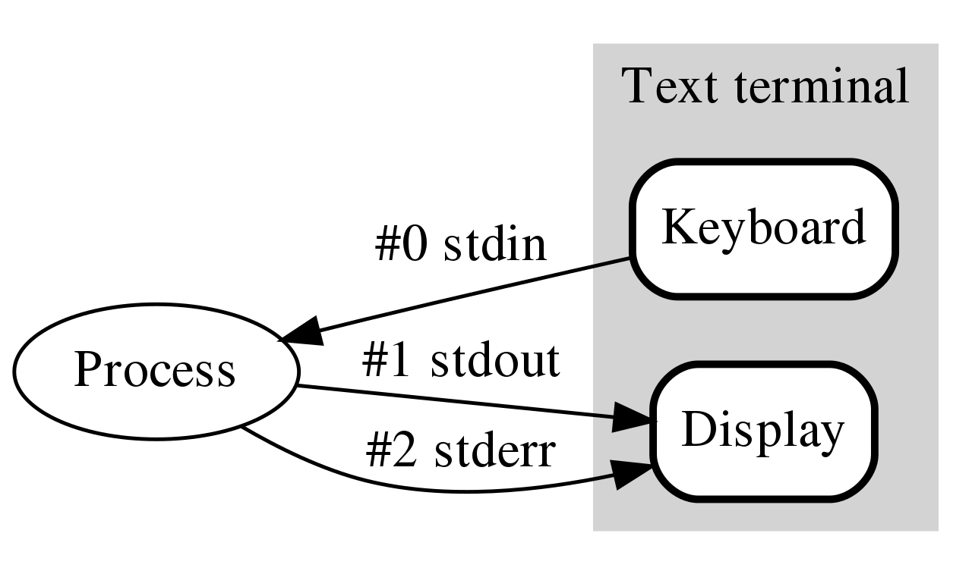
How do programs talk to users?
We often gloss over this in CS211
  printf()
  gets()
Work through the same file mechanism
  Three special files created for each program
  stdin – standard input (file descriptor 0)
  stdout – standard output (file descriptor 1)
  stderr – standard error (file descriptor 2)
printf(…) -> fprintf(1, …) -> handle arguments then write(1, …)

Slide 53
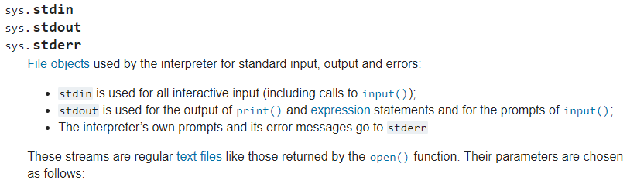
Standard I/O is a process thing, not a C thing
You can access them in Python, for instance
  https://docs.python.org/3/library/sys.html#sys.stdin

Slide 54
Example: printing to terminal with a write call
int main(int argc, char *argv[]) {
// check argument count
if (argc != 2) {
printf("Usage: ./kitten FILE\n");
return -1;
}
// try opening file
int fd = open(argv[1], O_RDONLY);
if (fd < 0) {
printf("Error opening file!\n");
return -1;
}
// array to hold read data
uint8_t read_size = 10;
uint8_t read_data[read_size];
while(true) {
// read from file
ssize_t read_length = read(fd, read_data, read_size);
if (read_length < 0) {
printf("Error reading file!\n");
return -1;
}
if (read_length == 0) {
break;
}
// print out data
ssize_t write_length = write(STDOUT_FILENO,
read_data, read_length);
}
return 0;
}

Slide 55
Example: trace system calls for commands
strace -o syscalls.txt COMMAND
  Tracks every system call made by the command
  Outputs to a file: syscalls.txt
Try on
  cat
  parallel-sum-ex

Slide 56
Break + Open Question
How does printf() work?

Slide 57
Break + Open Question
How does printf() work?
  Read in arguments and determine what it needs to format
  Create a new string buffer and write formatted values into it
  Call write() on STDOUT with the string

Slide 58
Outline
Intro to Operating Systems
Process Control Flow
System Calls
File I/O
  Standard I/O
Signals
Scheduling Processes

Slide 59
Alerting processes of events
How do we let a process know there was an event?
  Errors
  Termination
  User commands (like CTRL-C or CTRL-\)
Events could happen whenever
  Need to interrupt process control flow and run an event handler
  Linux mechanism to do so is called “signals”

Slide 60
Signals are a different version of exceptional control flow
Signal is generated by the OS
Interrupts user code and jumps to a signal handler
  Then returns back to user code afterwards
  Unless the signal handler ends the program (this is the default handler)
User code
User code
Signal
some instruction
next instruction
Handle Signal
Returns

Slide 61
Signals are asynchronous messages to processes
Sometimes the OS wants to send something like an interrupt to a process
  Your child process completed
  You tried to use an illegal instruction
  You accessed invalid memory
  You are terminating now
In POSIX systems, this idea is called “Signals”
1) SIGHUP 2) SIGINT 3) SIGQUIT 4) SIGILL 5) SIGTRAP
6) SIGABRT 7) SIGBUS 8) SIGFPE 9) SIGKILL 10) SIGUSR1
11) SIGSEGV 12) SIGUSR2 13) SIGPIPE 14) SIGALRM 15) SIGTERM
16) SIGSTKFLT 17) SIGCHLD 18) SIGCONT 19) SIGSTOP 20) SIGTSTP
21) SIGTTIN 22) SIGTTOU 23) SIGURG 24) SIGXCPU 25) SIGXFSZ
26) SIGVTALRM 27) SIGPROF 28) SIGWINCH 29) SIGIO 30) SIGPWR
31) SIGSYS ...

Slide 62
Signals are asynchronous messages to processes
Sometimes the OS wants to send something like an interrupt to a process
  Your child process completed
  You tried to use an illegal instruction
  You accessed invalid memory
  You are terminating now
In POSIX systems, this idea is called “Signals”
1) SIGHUP 2) SIGINT 3) SIGQUIT 4) SIGILL 5) SIGTRAP
6) SIGABRT 7) SIGBUS 8) SIGFPE 9) SIGKILL 10) SIGUSR1
11) SIGSEGV 12) SIGUSR2 13) SIGPIPE 14) SIGALRM 15) SIGTERM
16) SIGSTKFLT 17) SIGCHLD 18) SIGCONT 19) SIGSTOP 20) SIGTSTP
21) SIGTTIN 22) SIGTTOU 23) SIGURG 24) SIGXCPU 25) SIGXFSZ
26) SIGVTALRM 27) SIGPROF 28) SIGWINCH 29) SIGIO 30) SIGPWR
31) SIGSYS ...
Process Errors

Slide 63
Signals are asynchronous messages to processes
Sometimes the OS wants to send something like an interrupt to a process
  Your child process completed
  You tried to use an illegal instruction
  You accessed invalid memory
  You are terminating now
In POSIX systems, this idea is called “Signals”
1) SIGHUP 2) SIGINT 3) SIGQUIT 4) SIGILL 5) SIGTRAP
6) SIGABRT 7) SIGBUS 8) SIGFPE 9) SIGKILL 10) SIGUSR1
11) SIGSEGV 12) SIGUSR2 13) SIGPIPE 14) SIGALRM 15) SIGTERM
16) SIGSTKFLT 17) SIGCHLD 18) SIGCONT 19) SIGSTOP 20) SIGTSTP
21) SIGTTIN 22) SIGTTOU 23) SIGURG 24) SIGXCPU 25) SIGXFSZ
26) SIGVTALRM 27) SIGPROF 28) SIGWINCH 29) SIGIO 30) SIGPWR
31) SIGSYS ...
Process Termination

Slide 64
Sending signals
OS sends signals when it needs to
Processes can ask the OS send signals with a system call
  int kill(pid_t pid, int sig);
Users send signals through OS from command line or keyboard
  Shell command: kill -9 pid (SIGKILL)
  CTRL-C (SIGINT)

Slide 65
Handling signals
Programs can register a function to handle individual signals
  signal(int sig, sighandler_t handler);
What are you supposed to do about it?
  Do some quick processing to handle it
    That needs to be “reentrant” safe
  Reset the process and try again
  Quit the process (default handler)

Slide 66
Example: catching a signal
#include <stdbool.h>
#include <stdlib.h>
#include <stdio.h>
#include <unistd.h>
#include <signal.h>
void sighandler (int signum) {
printf("HA HA You can't kill me!\n");
}
int main (void) {
signal(SIGINT, sighandler);
printf("Starting\n");
while(true) {
printf("Going to sleep for a second...\n");
sleep(1);
}
return 0;
}

Slide 67
Example: catching a segfault
#include <stdbool.h>
#include <stdlib.h>
#include <stdio.h>
#include <unistd.h>
#include <signal.h>
int* pointer = 0x00000000;
void sighandler (int signum) {
printf("Oops, that pointer wasn't valid. Try again!\n");
sleep(1);
}
int main (void) {
signal(SIGSEGV, sighandler);
printf("About to read from pointer 0x%08lX\n", (long)pointer);
int test = *pointer;
return(0);
}

Slide 68
Examples: sending a signal
> kill -11 pid (11 is SIGSEGV – a.k.a segfault)

Slide 69
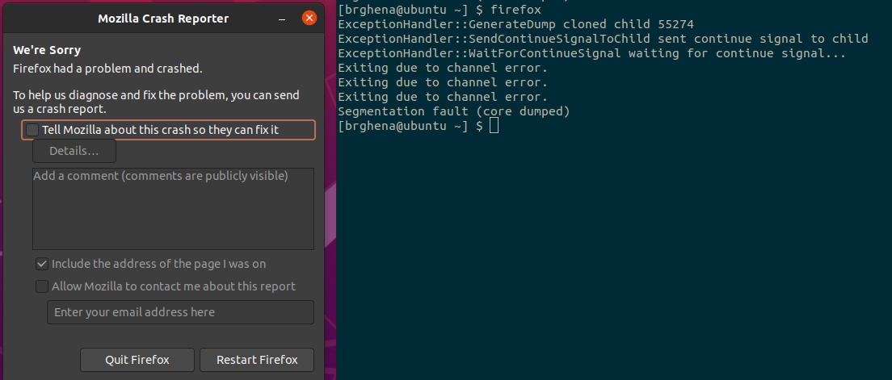
Examples: sending a signal
> kill -11 pid (11 is SIGSEGV – a.k.a segfault)

Slide 70
Outline
Intro to Operating Systems
Process Control Flow
System Calls
File I/O
  Standard I/O
Signals
Scheduling Processes

Slide 71
Lies your operating system always told you
“Every process on your computer gets to run at the same time!”
  This is an illusion
My desktop at home (running Windows)
  Current load: 250 processes with 2987 threads
So how does the magic work?

Slide 72
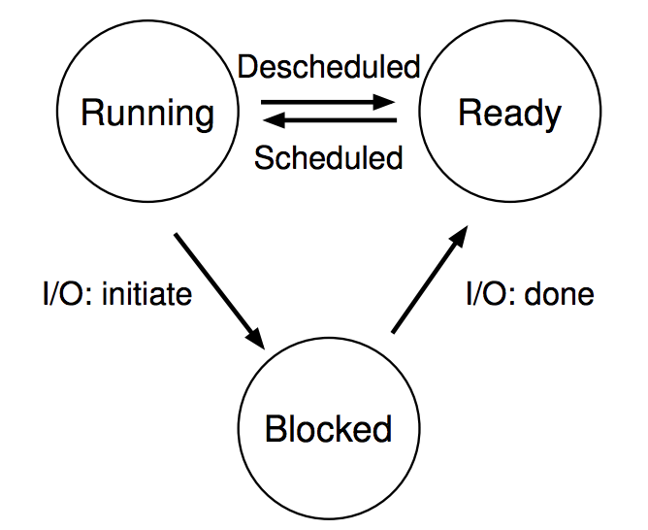
Processes don’t run all the time
The three basic process states:
OS schedules processes
  Decides which of many competing processes to run.
A blocked process is not ready to run and is waiting on I/O
I/O means input/output – anything other than computing.
  For example, reading/writing disk, sending network packet, waiting for keystroke
  While waiting for results, the OS blocks the process, waiting to do more computation until the result is ready

Slide 73
Multiprogramming processes
The three basic process states:
Even with a single processor, the OS can provide the illusion of many processes running simultaneously
  And also use this opportunity to get more useful work done
When one process is Blocked, OS can schedule a different process that is Ready
OS can also swap between various Ready processes so they all make progress

Slide 74
Scheduling
We know that multiple processes will be sharing the CPU
  Possibly multiple threads in each process
  Possibly multiple cores in the CPU
Scheduling is creating a policy for sharing the CPU
  Which process/thread is chosen to run, and when?
  When (if ever) does the OS change which process is running?

Slide 75
When can the OS make scheduling decisions?
Whenever the OS is actually running
  i.e. after a context switch
Possible triggers
  System calls
    Process/Thread creation/termination
    I/O requests
  Hardware events (interrupts)
    I/O complete
    Timer triggers

Slide 76
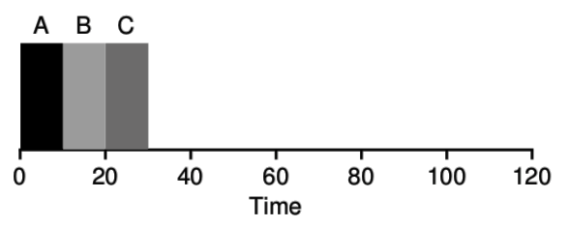
Example scheduler: FIFO Scheduling
First In, First Out (FIFO)
  also known as First Come First Served (FCFS)
Policy
  First job to arrive gets scheduled first
  Let a job continue until it is complete
  Then schedule next remaining job with earliest arrival

Slide 77
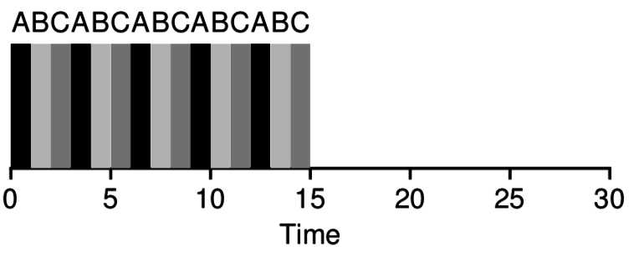
Example scheduler: Round Robin Scheduling
Round Robin scheduling runs a job for a small timeslice (quanta), then schedules the next job
Over time each job makes growing amounts of progress
If we switch fast enough, it seems to the user that all jobs are running in parallel

Slide 78
CS343 – Operating Systems
213 topics in more depth: Concurrency, Processes, Virtual Memory
  Deal with data races directly
  Implement virtual memory system
Also, totally new topics: File Systems and Devices
Focus: “how does the Operating System make the computer work”?

Slide 79
Outline
Intro to Operating Systems
Process Control Flow
System Calls
File I/O
  Standard I/O
Signals
Scheduling Processes

