Slide 1
Lecture 11
Memory Hierarchy
CS213 – Intro to Computer Systems
Branden Ghena – Winter 2025
Slides adapted from:
St-Amour, Hardavellas, Bustamente (Northwestern), Bryant, O’Hallaron (CMU), Garcia, Weaver (UC Berkeley)

Slide 2
Administrivia
Business as usual
  Bomb Lab due today
  Homework 3 releases later today (maybe tomorrow)
  Attack Lab is out now
Reminder on Attack Lab partnership survey if you want a partner!
Topics remaining in class
  Memory System (Hierarchy, Caches, Virtual Memory)
  Applications (Concurrency, Virtual Memory, Processes)
  Other Systems Introductions (Compilers, Networks)

Slide 3
Changing the focus of CS213
So far in class we’ve focused on how computers do things
  Represent data
  Run instructions
Now we’re focusing on how to improve those things
  Secure (last lecture plus some stuff in two weeks)
  Efficient (today and next week)
As we’ll show today, the most important thing to speed up is memory
  It is possible and hardware does so already
  Software can be designed to take advantage of this

Slide 4
Today’s Goals
Hardware day!!
Describe what’s going on inside a processor
  Assembly-to-transistors deep-dive
Explore the memory systems available in modern computers
  Understand capabilities and limitations of each
Discuss the memory hierarchy
  How it improves performance through caching

Slide 5
Outline
What’s in a processor? Assembly-to-Transistors
Memory Technologies
Memory Hierarchy
Caching Concept

Slide 6
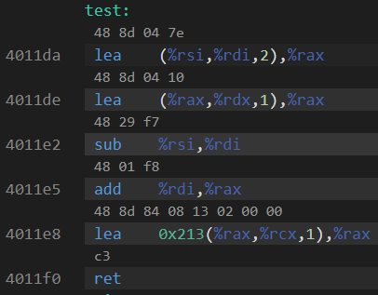
Assembly into machine code
Machine code are the numerical versions of each instruction
Number breaks down into parts
  Operation
  Source
  Destination
Immediates are stored in the instruction encoding

Slide 7
Representing instructions as numbers
Why represent instructions as numbers?
Everything in memory is “just a number”
  And instructions go in memory
Hardware can “decode” number to figure out what to do
  Break number apart into bits (just like floating point)
  Some bits pick operation
  Some bits pick register or specify immediate

Slide 8
Machine code ideas
Example:
  ADD $0x4351FF23, %rax
  ADD with destination %rax translates into 0x05
  Immediate is appended on to that
  Machine code: 0x0523FF5143
Number of bytes for each instruction is variable
  1-15 bytes depending on instruction and operands
  So the processor reads it byte-by-byte to figure out the meaning
Translation is tedious
  We’re not going to do it by hand, although Attack Lab touches it a bit

Slide 9
Computer Processor (in five easy steps)
Reads instruction from memory
Decodes it into an Operation plus Configurations
  Immediates, Registers, Memory, etc.
Reads from source (based on configuration)
Executes that operation
Writes to destination (based on configuration)

Slide 10
These steps are relatively easy (we’ll skip them)
Reads instruction from memory
Decodes it into an Operation plus Configurations
  Immediates, Registers, Memory, etc.
Reads from source (based on configuration)
Executes that operation
Writes to destination (based on configuration)

Slide 11
This is extremely complicated for x86-64 (skip it too)
Reads instruction from memory
Decodes it into an Operation plus Configurations
  Immediates, Registers, Memory, etc.
Reads from source (based on configuration)
Executes that operation
Writes to destination (based on configuration)

Slide 12
We can talk about what execution means though!
Reads instruction from memory
Decodes it into an Operation plus Configurations
  Immediates, Registers, Memory, etc.
Reads from source (based on configuration)
Executes that operation
Writes to destination (based on configuration)

Slide 13
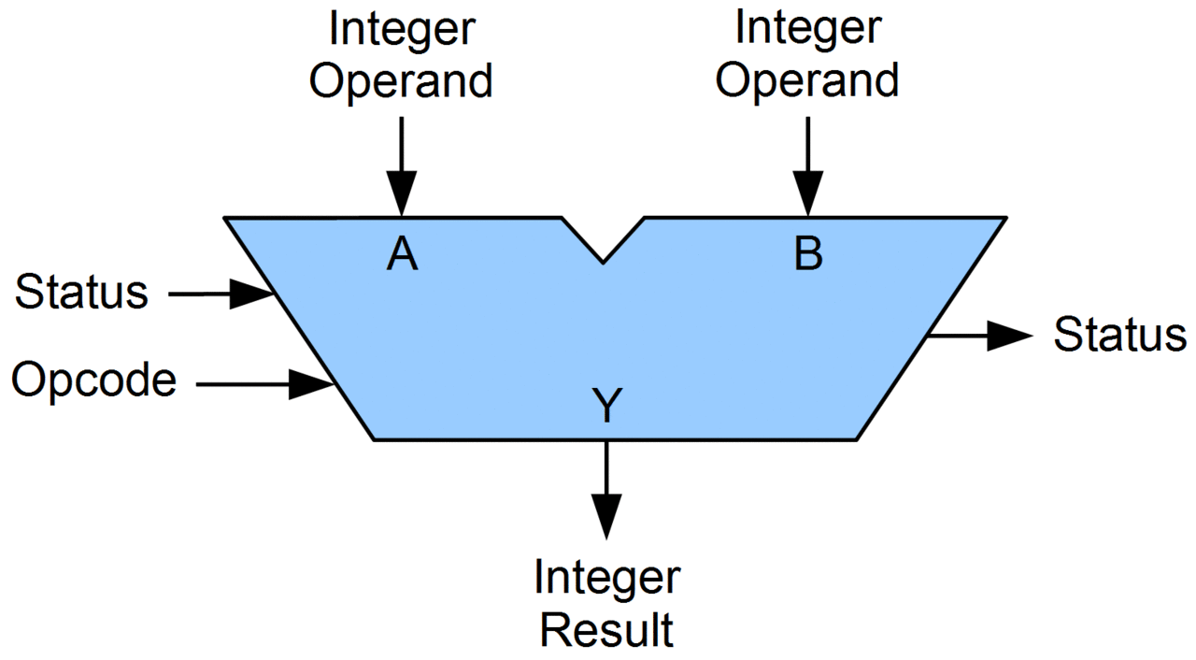
Arithmetic Logic Unit (ALU)
Piece of hardware
Takes in two operands
  Source and Destination values
Takes in an Opcode
  Which operation to run
Performs operation and outputs result

Slide 14
What can an ALU do?
All the basic arithmetic operations
  Add
  Subtract
  Bitwise And
  Bitwise Or
  Bitwise Xor
  Arithmetic Shift Right
  Logical Shift Right
  Logical Shift Left
Complex operations are separate hardware
  Multiply, Divide, Anything floating point

Slide 15
Let’s zoom in

Slide 16
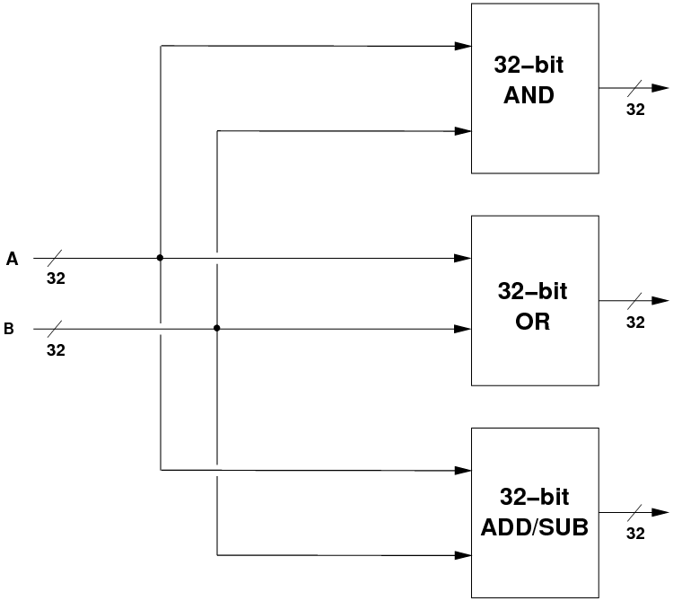
Inside an ALU
Input values go into separate hardware blocks for each operation
Every operation occurs in parallel, simultaneously
  We are in hardware so this doesn’t take any additional time
64-bit
AND
64
ALU Inputs
64
64-bit
OR
64
64
64-bit
ADD/SUB
64

Slide 17
Inside an ALU – selecting the correct output
64-bit
AND
64
ALU Inputs
Selector
ALU Output
64
64-bit
OR
64
64
Selects ALU output based on Opcode
64-bit
ADD/SUB
Opcode
64

Slide 18
Let’s zoom in

Slide 19
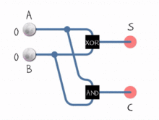
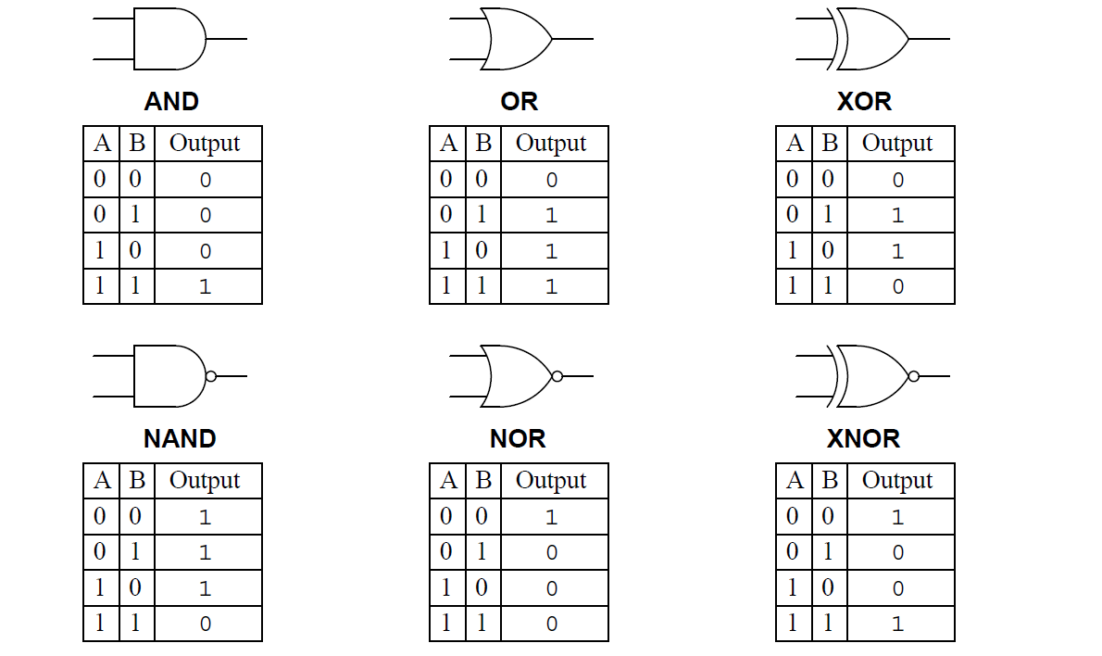
How is an ALU made?
All of those arithmetic operations can be broken down into a series of 1-bit Boolean operations
  Add is XOR for result + AND for carry
  Subtract is Flip bits (NOT), Add one (XOR + AND), then Add (XOR + AND)
  And/Or/Xor are just their respective operations
  Shifts are just move the bits around (simple in hardware, just move wires)

Slide 20
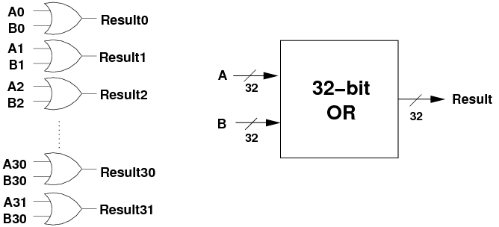
64-bit OR operation
Perform OR operation on each individual bit
  Pictured is a series of 1-bit OR gates
64
64-bit
OR
64
64
A62
B62
A63
B63
Result62
Result63

Slide 21
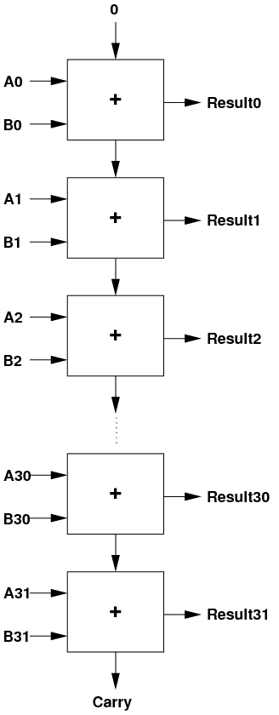
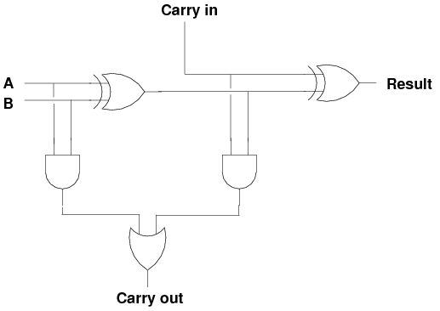
64-bit ADD operation
Below is the 1-bit version with carry-in/out
  Two 1-bit AND, two 1-bit XOR, one 1-bit OR
  Repeat 64 times, connecting carries together
A62
B62
Result62
A63
B63
Result63

Slide 22
Let’s zoom in

Slide 23
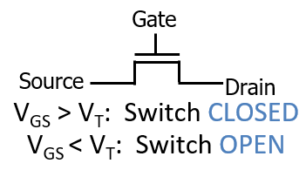
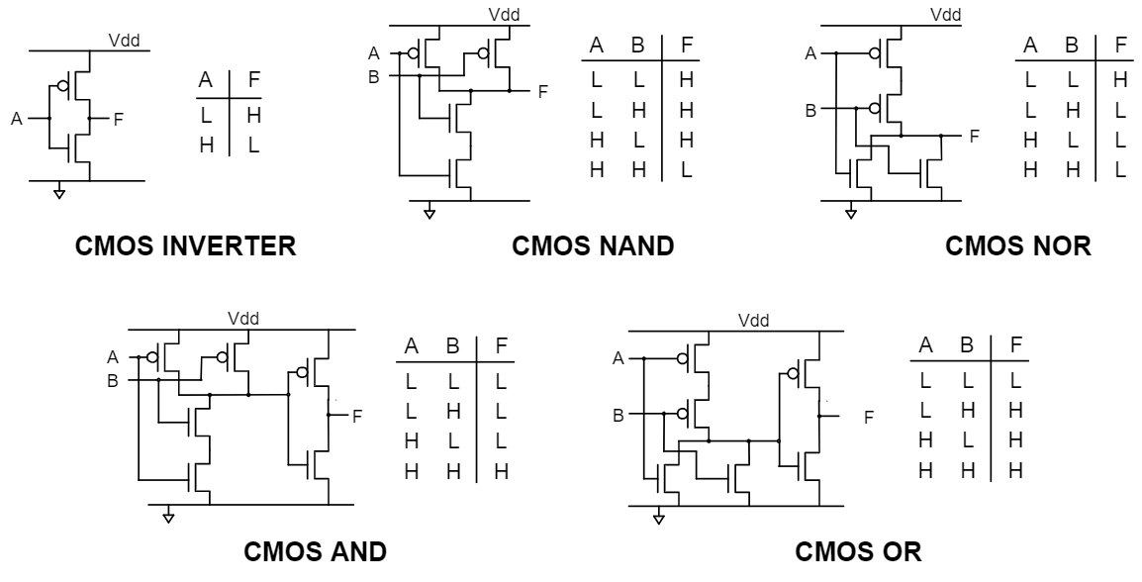
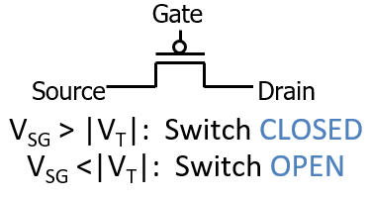
Logic gates can be created with transistors
Transistors are just on/off switches
CMOS implementation of logic gates
  Complementary Metal-Oxide Semiconductor

Slide 24
Let’s zoom in

Slide 25
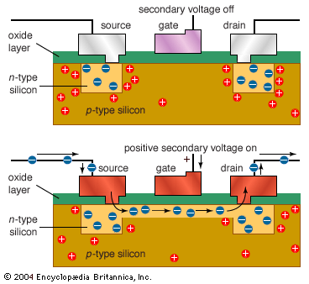
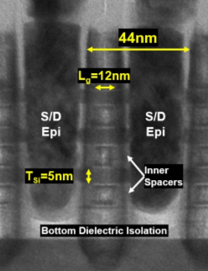
Transistors are made out of silicon and other materials
Turning gate on/off causes source and drain to connect or disconnect
  Acts as a switch
We can make
very small
transistors
  Handfuls of
  nanometers
  in size

Slide 26
That’s the bottom

Slide 27
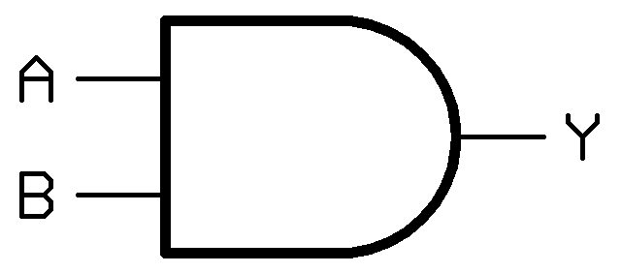
Zooming out again
~6 transistors
Transistors make logic gates
F
1-bit AND gate

Slide 28
Zooming out again
~30 transistors
Logic gates make operations
1-bit AND gate
1-bit ADD operation

Slide 29

Zooming out again
~1000 transistors
1-bit operations make 64-bit operations
A62
B62
Result62
A63
B63
Result63
1-bit ADD operation

Slide 30
Zooming out again
~20K transistors
Operations make an ALU
64-bit
AND
64
ALU Inputs
Selector
64-bit
OR
ALU Output
64
64
64
A62
B62
Result62
A63
B63
Opcode
Result63
64

Slide 31
ALU allows us to execute operations
Reads instruction from memory
Decodes it into an Operation plus Configurations
  Immediates, Registers, Memory, etc.
Reads from source (based on configuration)
Executes that operation
Writes to destination (based on configuration)

Slide 32
All the way back to software
Machine code specifies what should be executed
Assembly translates into machine code
C compiles into assembly

Slide 33
Break + Open Question
We hit roughly 20 thousand transistors for an ALU, but a modern processor has more than 1 billion transistors.
Where are all the rest going?

Slide 34
Break + Open Question
We hit roughly 20 thousand transistors for an ALU, but a modern processor has more than 1 billion transistors.
Where are all the rest going?
  Decoding instructions
  Multiple processor cores (each with multiple ALUs and decoders)
  Graphics
  Other peripheral devices
    USB, HDMI, Ethernet, etc.
  Memory!
    Registers and Caches (especially caches)

Slide 35
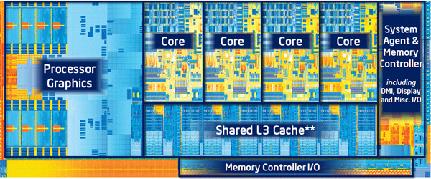
A processor is just a lot of transistors connected very carefully
ALU plus other operations make up a Core
  Decode logic, floating point, registers, etc.
Multiple cores plus caches make up a Processor
  And other stuff these days like graphics

Slide 36
Outline
What’s in a processor? Assembly-to-Transistors
Memory Technologies
Memory Hierarchy
Caching Concept

Slide 37
Reminder: metric unit prefixes
Going to talk about nanometers and nano/micro/milliseconds today
Also we do frequently mention bytes, kilobytes, megabytes, gigabytes, etc.
For perspective
  1 Megasecond ≈ 11 days
  1 Gigasecond ≈ 31 years
Prefix | Symbol | Power | Decimal Value
Peta | P | 10¹⁵ | 1 000 000 000 000 000
Tera | T | 10¹² | 1 000 000 000 000
Giga | G | 10⁹ | 1 000 000 000
Mega | M | 10⁶ | 1 000 000
Kilo | k | 10³ | 1 000
- |  | 10⁰ | 1
milli | m | 10⁻³ | 0.001
micro | μ | 10⁻⁶ | 0.000 001
nano | n | 10⁻⁹ | 0.000 000 001
pico | p | 10⁻¹² | 0.000 000 000 001

Slide 38
Storage in a Computer System
Data can be stored in different places
  Registers, caches, memory, disk, etc.
Hugely different characteristics
  Storage size
    x86-64: 16 registers. 128 B total (not including FP registers, etc.)
    Memory is measured in GB, disks in TB
  Latency (i.e., time to access data)
    Registers are really fast, memory less so, disk is incredibly slow
  Cost per byte
    Registers are really expensive, disks are really cheap, memory somewhere in the middle
Each serves a different purpose in a system
  Can design systems to get the best of all worlds (in most cases)

Slide 39
Tour of computer memory
System bus
Memory bus
Processor
Main
memory
I/O
bridge
I/O bus
USB
controller
Graphics
adapter
Disk
controller
Mouse
Keyboard
Display
Disk

Slide 40
Tour of computer memory
Registers and Caches
System bus
Memory bus
Processor
Main
memory
I/O
bridge
I/O bus
USB
controller
Graphics
adapter
Disk
controller
Mouse
Keyboard
Display
Disk

Slide 41
Register storage
x86-64
  16 registers (general-purpose) with 8 bytes each
  32 registers (special-purpose) with up to 64 bytes each
  Plus some other odds and ends (%rip, flags, segments, etc.)
128 bytes for general purpose registers
Order 2-3 kB for everything
Accesses are very fast. Within a single processor cycle
  Usually, 0.25-4 cycles per instruction

Slide 42
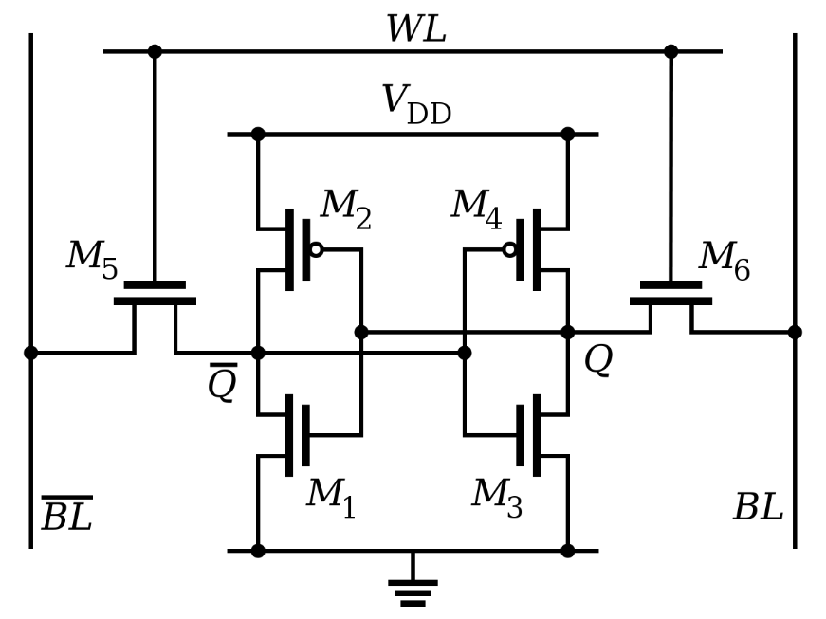
Register technology: SRAM
Static RAM (SRAM)
  Each cell stores a bit in a bi-stable circuit,
  typically a six-transistor circuit
  Static – no need for periodic refreshing;
  keeps data while powered
  Relatively insensitive to disturbances such as electrical noise
    Energetic particles (alpha particles, cosmic rays) can flip stored bits
Fastest memory on computer
  Also most expensive and takes up most space per bit
  Typically used for registers and cache memories

Slide 43
Cache memories (a.k.a. caches)
Memory in the processor that duplicates portions of main memory
  Goal: speed up accesses to frequently used data
  Complicated part: what’s in the cache at any given moment
    Many configurations to try to improve the “hit rate” on data
Not general-purpose memory
  Can’t be directly accessed and doesn’t have memory addresses
  Hardware automatically chooses what’s in the cache
Cache sizes
  Kilobytes to Megabytes of storage: ~1-100 MB total in modern processors

Slide 44
Tour of computer memory
RAM
System bus
Memory bus
Processor
Main
memory
I/O
bridge
I/O bus
USB
controller
Graphics
adapter
Disk
controller
Mouse
Keyboard
Display
Disk

Slide 45
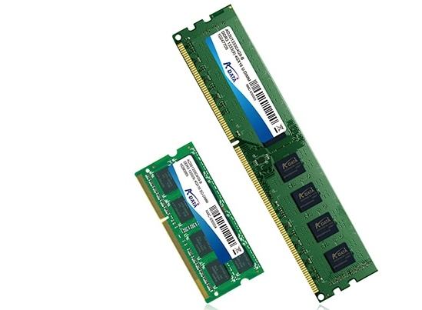
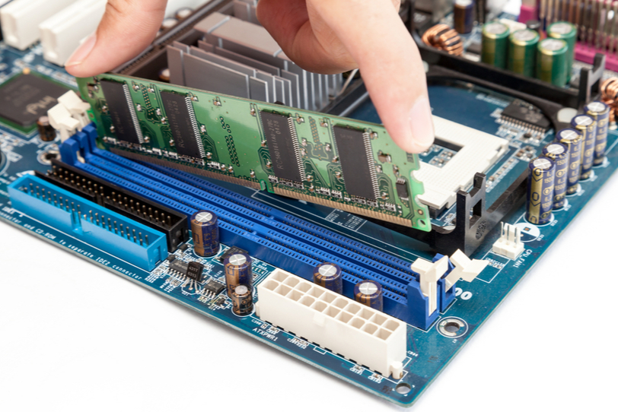
Main memory
The “RAM” in your computer
  Random Access Memory
  Can access any byte you want in “random” order
Typically measured in GB
  1-128 GB
  Some special purpose systems may have MUCH less or more
This is the “array of bytes” we’ve been using in assembly
  Program memory lives in RAM

Slide 46
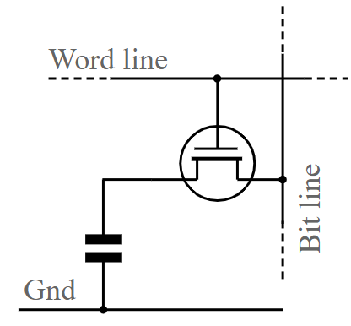
Main memory technology: DRAM
Dynamic RAM (DRAM)
  Each cell stores a bit as a charge in a capacitor
  Capacitors lose charge; each cell must be refreshed every 10-100 ms
  More sensitive to disturbances (EMI, radiation, …) than SRAM
Slower than SRAM, but cheaper and denser
  ~100x slower than registers
Typically used for main memory

Slide 47
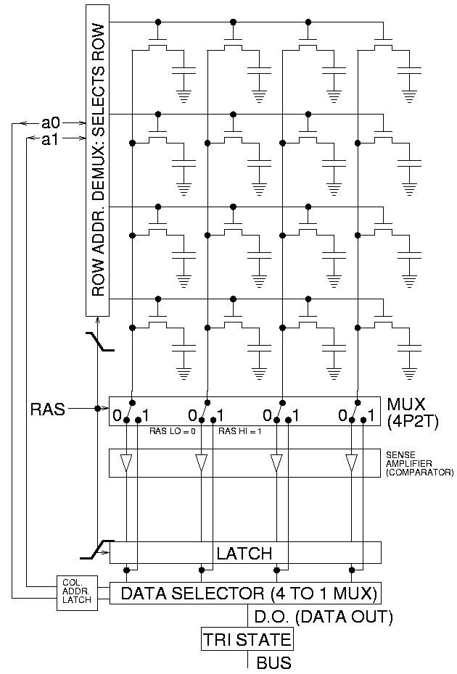
Accessing DRAM
Read entire row of data at a time
  Large in practice, kilobytes
Select actual bytes that are wanted
  Possibly modifying those bits
Write row back to memory
  Must always happen!
  Reading is destructive

Slide 48
Connecting main memory and the processor
Data flows between main memory and processor over “buses”
  A collection of parallel wires that carry address, data, and control signals
  Typically shared by multiple devices
movl A, %eax (load)
Processor writes address A to the bus
Memory writes data to the bus
Processor reads data from the bus
CPU chip
register file
movl %eax, A (store)
Processor writes address A to the bus
Processor writes data to the bus
Memory reads data from the bus
ALU
Includes memory
controller
main
memory
bus interface
system bus
I/O
bridge
memory bus

Slide 49
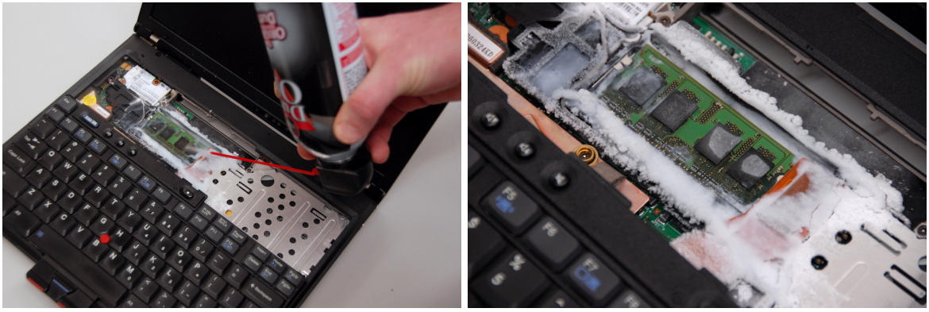
Sidebar: memory security is important
Data in RAM disappears without power
  But the rate depends on temperature, minutes to decay if frozen
  Cold Boot Attack: freeze RAM to remove from computer and steal contents

Slide 50
Tour of computer memory
System bus
Memory bus
Processor
Main
memory
I/O
bridge
I/O bus
USB
controller
Graphics
adapter
Disk
controller
Mouse
Keyboard
Display
Disk
Disk:
Hard drive or SSD

Slide 51
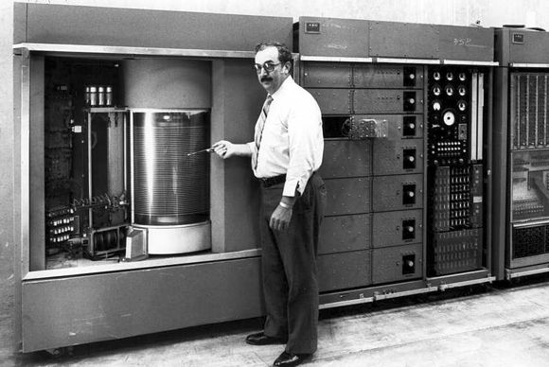
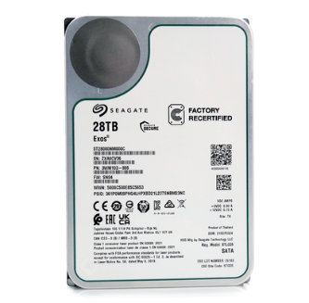
Disk storage
IBM 350 Disk Storage Unit
First disk drive, 1956
Storage?
5MB! (these slides are 8 MB)
Workhorse storage devices
  Terabytes in size in modern computers
  Milliseconds to read
    100,000x longer than reading from RAM
    10,000,000x longer than reading from registers
Used for filesystem storage
  Running programs do not
  directly use disk except
  when interacting with files
Seagate 24TB HDD, 2025
5.75 inches
(146 mm)
Basic mechanisms the same!
4 inches
(102 mm)

Slide 52
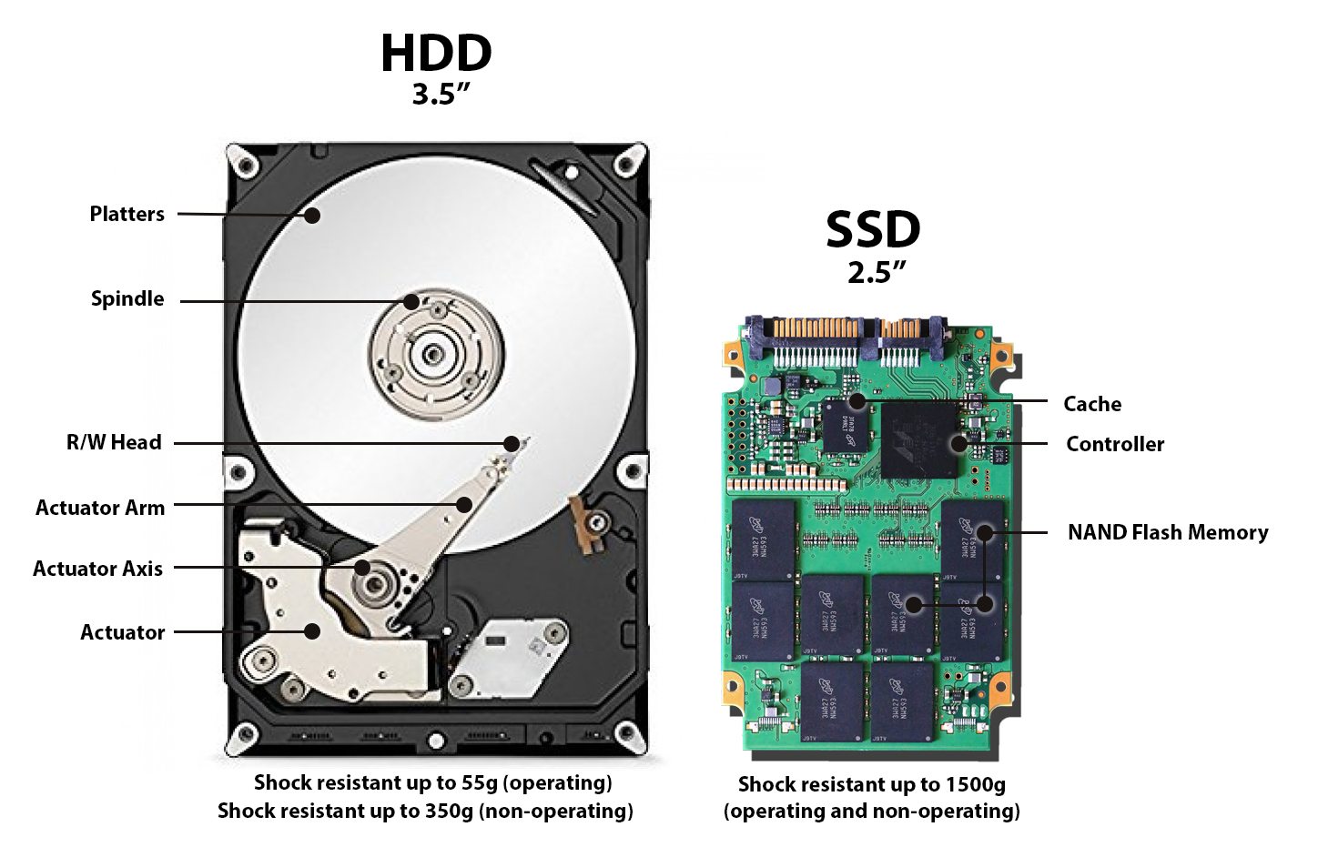
Disk types

Slide 53
Hard disk drive operation
The disk surface
spins at a fixed
rotational rate
(5400-15000 RPM)
The read/write head
is attached to the end
of the arm and flies over
the disk surface on
a thin cushion of air.
spindle
spindle
spindle
spindle
spindle
By moving radially, the arm can position the read/write head over any track.
arm
read/write heads
move in unison
from cylinder to cylinder
spindle

Slide 54
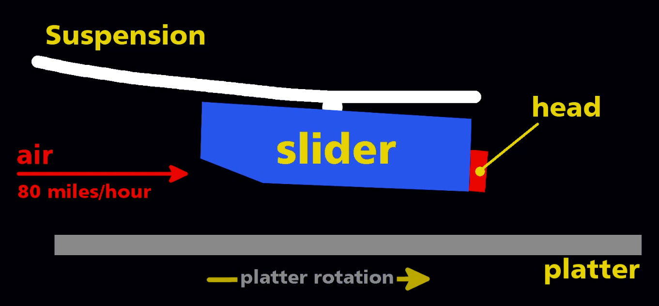
Disk heads read/write data to the platters

Slide 55
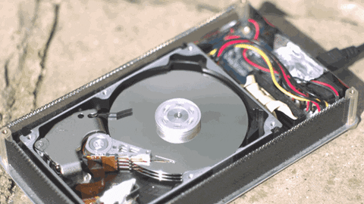
Animation of Disk Access

Slide 56
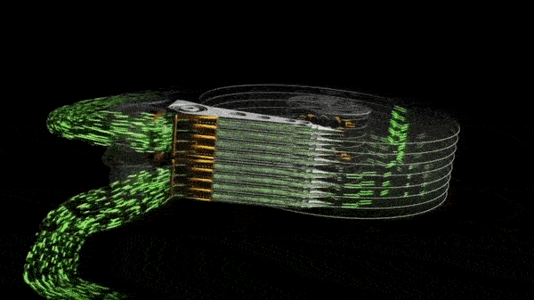
Writing bits to the platters
Note: most disks can only move the entire set of arms, not two sets of them

Slide 57
Accessing data on disk
Three-step process
  Read head needs to move to the right cylinder: seek time
  Platter turns until start of sector under the read head: rotational latency
  Sector passes under read head and data is read: transfer time
Time cost dominated by seek time and rotational latency
  Consequence: reading first bit of a sector is expensive
  But reading the rest of the sector is basically free!
When using disks, best to favor large sequential reads/writes
  Terrible for random access! (reading a little bit here, a little bit there)
  Fits file access well (read/write in order)
    But overall still really slow compared to main memory or registers

Slide 58
Disk types

Slide 59
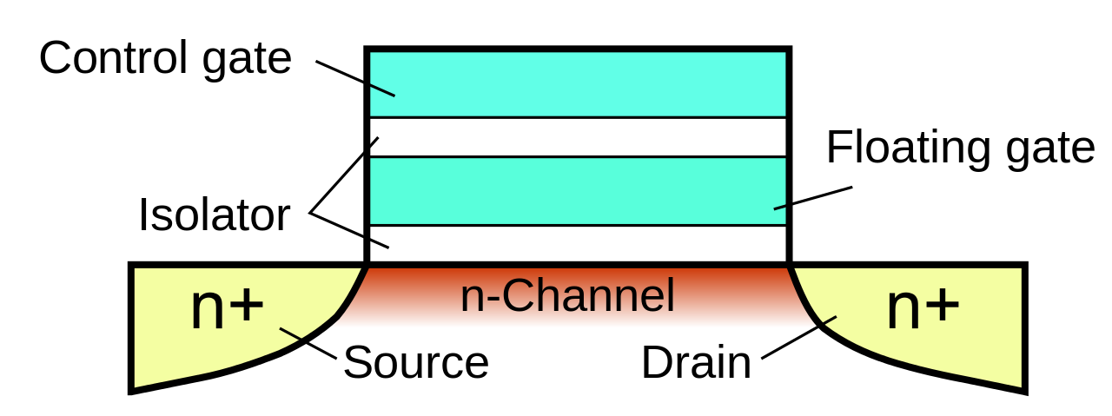
Floating-gate transistors
Concept behind transistor-based non-volatile memory
  EPROM, EEPROM, and Flash
  High voltage on control gate creates charge on floating gate
  Charge on floating gate activates/deactivates transistor
High voltage degrades
structure, leading it to
eventually fail after
enough writes

Slide 60
Solid State Drives (SSDs)
I/O bus
Flash memory
  Just like Flash Drives
Pages: 2KB to 512KB, Blocks: 32 to 128 pages
Data read/written in units of pages
Page can be written only after its block has been erased
  Need to copy rest of the data to not lose it. Expensive!
A block wears out after repeated writes (10k – 100k writes) and can no longer be used
Requests to read and
write logical disk blocks
Solid State Disk (SSD)
Flash
translation layer
Flash memory
Block 0
Block B-1
…
…
…
Page 0
Page 1
Page P-1
Page 0
Page 1
Page P-1
Notes:
SSD based on flash memory (non-volatile memory based on EEPROM – electrically erasable programmable ROM)
Plugs into a standard disk slot – typically USB or SATA
Made of a few chips and a flash translation layer, a hw/firmware piece similar to a disk controller

Slide 61
SSDs vs Rotating Disks
Advantages
  No moving parts → faster, less power, more rugged
Disadvantages
  Have the potential to wear out
    Mitigated by “wear leveling logic” in flash translation layer
    Order petabyte (10¹⁵ bytes) of random writes before they wear out
  More expensive per byte (but getting cheaper)
    2025: HDD $0.012 per GB, SSD $0.042 per GB (about 4x the cost)
Applications
  Portable electronics (phones, tablets, etc.)
  Began to appear in desktops and servers circa 2007
  Now common on laptops as well
Biggest speed improvement to your computer:
Get an SSD

Slide 62
Reading memory from disk
CPU chip
register file
Data from disk is always read into Main Memory
Direct Memory Access (DMA)
  Processor starts a read and then returns to programs
  Disk performs the read, transfers data, then notifies processor when done
ALU
main
memory
bus interface
I/O bus
USB
controller
graphics
adapter
disk
controller
mouse
keyboard
monitor
disk

Slide 63
Tour of computer memory
Registers and Caches
RAM
System bus
Memory bus
Processor
Main
memory
I/O
bridge
I/O bus
USB
controller
Graphics
adapter
Disk
controller
Mouse
Keyboard
Display
Disk
Disk:
Hard drive or SSD

Slide 64
Break + Question
How do you make an SSD with a longer lifetime (more writes)?
  Without changing any of the physics of how it works

Slide 65
Break + Question
How do you make an SSD with a longer lifetime (more writes)?
  Without changing any of the physics of how it works
  Secretly make it larger than it claims to be
    e.g. 200 GB when it claims to be 100 GB
  Behind the scenes move around memory as necessary so the device can still hold 100 GB even if half of the flash is
    Maintain a mapping of which data is located where

Slide 66
Outline
What’s in a processor? Assembly-to-Transistors
Memory Technologies
Memory Hierarchy
Caching Concept

Slide 67
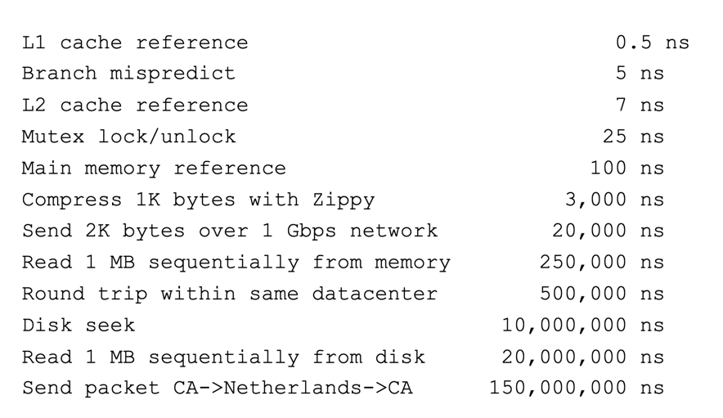
Computing timescales
Assuming 4 GHz processor, Instruction (with registers): 0.25 ns
Jeff Dean
(Google AI):
“Numbers Everyone Should Know”
Reminder:
1,000,000,000 ns per second

Slide 68

Jim Gray’s storage latency analogy
How “far” is data for the CPU, converted to human scale
Storage
Distance
Time
Jim Gray
Turing Award 1998
Registers
In my apartment
~1 minute
On-chip cache
Across the street
2-4 minutes
On-board cache
A few blocks away
10 minutes
Main memory
In Milwaukee
1.5 hours
Disk
On Mars
2 years
Tape
On Kepler-76b
2000 years
(at speed of light)

Slide 69
The CPU-Memory gap
Disk
Increasing gap between DRAM, disk, and CPU speeds.
SSD
DRAM, disk and CPU
performance gap widening
DRAM
SRAM roughly
keeping up
SRAM
CPU
Split reflects the
introduction of multicores
Notes:
In early 21st century computer manufacturers discover they couldn’t keep increasing CPU clock freq. because chips would consume too much power; answer was multicore – there you see the cycle times getting slower but effective cycle times keeping about the same improvement rate

Slide 70
The CPU-Memory Gap
CPUs outspeed memory
  But they can’t compute on data they don’t have!
  If the CPU has to wait for data to reach it, it just sits idle!
    All that engineering effort, just sitting around waiting…
Challenge: get data to the CPU despite “slow” memory
  So the CPU can work at full speed, without waiting for data
Two-pronged strategy
  Memory hierarchy: keep data we need closer to the CPU
  Locality of reference: predict which data we’re likely to need

Slide 71
Memory hierarchy
Some fundamental and enduring properties of systems
  The faster the storage, the more expensive ($) it is
  The faster the storage, the smaller (capacity) it is
  The gap between processor and main memory speed is widening
Key idea: keep the data you need the most in fast memory!
  Data you only need from time to time can be in slow memory, no big deal
  Most used data goes in registers
  Least used data goes to disk
Analogy: kitchen ingredients I use
  Salt, all the time: it sits out on the counter
  Oregano, frequently: front of the cabinet
  Onion powder, occasionally: back of the cabinet
  Brown sugar, sometimes: somewhere in the pantry
  Saffron, never: I can go buy some if I do need it

Slide 72
Memory hierarchy
Smaller,
faster,
and
costlier
(per byte)
storage
devices
CPU registers hold words retrieved from L1 cache.
L0:
registers
on-chip L1
cache (SRAM)
L1 cache holds cache lines retrieved from the L2 cache memory.
L1:
L2:
off-chip L2
cache (SRAM)
L2 cache holds cache lines retrieved from main memory.
Main memory holds disk
blocks retrieved from local
disks.
L3:
main memory
(DRAM)
Larger,
slower,
and
cheaper
(per byte)
storage
devices
Local disks hold files retrieved from disks on remote network servers.
L4:
local secondary storage
(local disks)
L5:
remote secondary storage
(distributed file systems, Web servers)

Slide 73
Outline
What’s in a processor? Assembly-to-Transistors
Memory Technologies
Memory Hierarchy
Caching Concept

Slide 74
Caching, general principle
Cache: A smaller, faster storage device that acts as a staging area for a subset of the data in a larger, slower device
  Data lives in both places (typically)
  When the consumer (e.g., CPU) reads the data, it gets it from the smaller, faster storage
  If the data we want is not in the cache, we pay the full cost of bringing it over from the larger, slower storage into the smaller, faster storage
    The hope: we don’t need to do it too often
Fundamental idea in systems. Shows up all over!
  Memory hierarchies
  Content delivery networks (CDNs) on the Internet (Akamai, Cloudflare, etc.)

Slide 75
Caching in a memory hierarchy
Fundamental idea of a memory hierarchy
  For each k, the faster, smaller device at level k serves as a cache for the larger, slower device at level k+1
    L2 cache memory as a cache for main memory
    Main memory as a cache for disk, etc.
  Each level stores some of the most frequently accessed data
  The closer the cache is to the processor, the “hotter” the cached data

Slide 76
Memory hierarchies make memory fast and large
Why do memory hierarchies work?
  Programs tend to access the data at level k more often than they access the data at level k+1
  Thus, the storage at level k+1 can be slower, and thus larger and cheaper per bit
Net effect:
  A large pool of memory that costs as little as the cheap storage near the bottom, but that serves data to programs at the rate of the fast storage near the top
  Best of both worlds!

Slide 77
Caching in a memory hierarchy
Smaller, faster, more expensive
device at level k caches a
subset of the blocks from level k+1
Level k:
8
9
14
3
Data is copied between
levels in block-sized transfer units
0
1
2
3
4
5
6
7
Larger, slower, cheaper storage
device at level k+1 is partitioned
into blocks.
Level k+1:
8
9
10
11
12
13
14
15
Blocks cannot be stored in an arbitrary location!
They can only live at one of a fixed set of locations.
In this example: they must be in the same “column” for both levels.

Slide 78
General caching concepts
Program needs object d, which is stored in some block b
Cache hit
  Program finds b in the cache at level k
  e.g., block 14
14
Request
14
Level
k:
9
14
3
4*
14
0
1
2
3
Level
k+1:
4
5
6
7
8
9
10
11
12
13
14
15

Slide 79
General caching concepts
Program needs object d, which is stored in some block b
Cache hit
  Program finds b in the cache at level k
  e.g., block 14
Cache miss
  b is not at level k, so the level k cache must fetch it from level k+1,
  e.g., block 12
  If the level-k cache is full, then some current block must be replaced (evicted). Which one is the “victim”?
    Here, we pick 4; same column as 12
    4 is “dirty”, need to write back to k+1
    More on this next lecture
12
Request
12
Level
k:
4*
9
14
3
4*
12
12
Request
12
0
1
2
3
Level
k+1:
4
5
6
7
4*
8
9
10
11
12
13
14
15
12
“ * ” means the block is dirty (i.e., it has been modified)

Slide 80
What causes a cache miss?
Cold (compulsory) miss
  Cold misses occur when a block is accessed for the first time
  No one ever accessed it, so there wasn’t any reason to bring it into cache
Capacity miss
  Occurs when the set of active cache blocks (working set) is larger than the cache
  There’s no way the working set can all fit in the cache, so there will be misses
Conflict miss
  In most caches, blocks cannot be stored in any available slot
  If two blocks need to go in the same slot, need to evict the old one to store the new!
  If after that, we need to access the old block, conflict miss!
    We had a conflict, evicted a block, and now we miss trying to access that block
  Note: can happen even when there is “room” elsewhere in the cache!
  We’ll show examples of this next lecture

Slide 81
Break + Question
Miss types: Cold, Capacity, Conflict
When you first start up a program, it runs really slowly for a few seconds. What kind of cache misses are occurring?
When you have too many browser tabs open and active, all of the tabs run more slowly. What kind of cache misses are occurring?

Slide 82
Break + Question
Miss types: Cold, Capacity, Conflict
When you first start up a program, it runs really slowly for a few seconds. What kind of cache misses are occurring?
  Cold (aka Compulsory) misses. The data has never been loaded before!
When you have too many browser tabs open and active, all of the tabs run more slowly. What kind of cache misses are occurring?
  Capacity misses. You have too much data to fit it all in the cache
    Could be Conflict misses as well, but probably not

Slide 83
Outline
What’s in a processor? Assembly-to-Transistors
Memory Technologies
Memory Hierarchy
Caching Concept

