Slide 1
Lecture 14
Concurrency
CS213 – Intro to Computer Systems
Branden Ghena – Winter 2024
Slides adapted from:
St-Amour, Hardavellas, Bustamente (Northwestern), Bryant, O’Hallaron (CMU), Garcia, Weaver (UC Berkeley)

Slide 2
Administrivia
Attack Lab due Today
Homework 4 is out now
  Due next week Thursday, only covers cache materials
SETI Lab releases soon
  Today’s lecture has 90%+ of the information you need for it
    And everything you need to get started
  Tuesday’s lecture will add a few more details about optimization
  Due last Thursday of class

Slide 3
Today’s Goals
Discuss goals of concurrency and how it is achieved in software
Understand the challenges of writing parallel software
Explore how to practically use parallelism for simple examples

Slide 4
Outline
Need for Parallelism
Processes and Threads
Concurrency Challenges
Using Threads

Slide 5
It’s the mid 1990s and you work at Microsoft.
You need to double the speed of Excel in two years.
What do you do?

Slide 6
It’s the mid 1990s and you work at Microsoft.
You need to double the speed of Excel in two years.
What do you do? Take a vacation

Slide 7
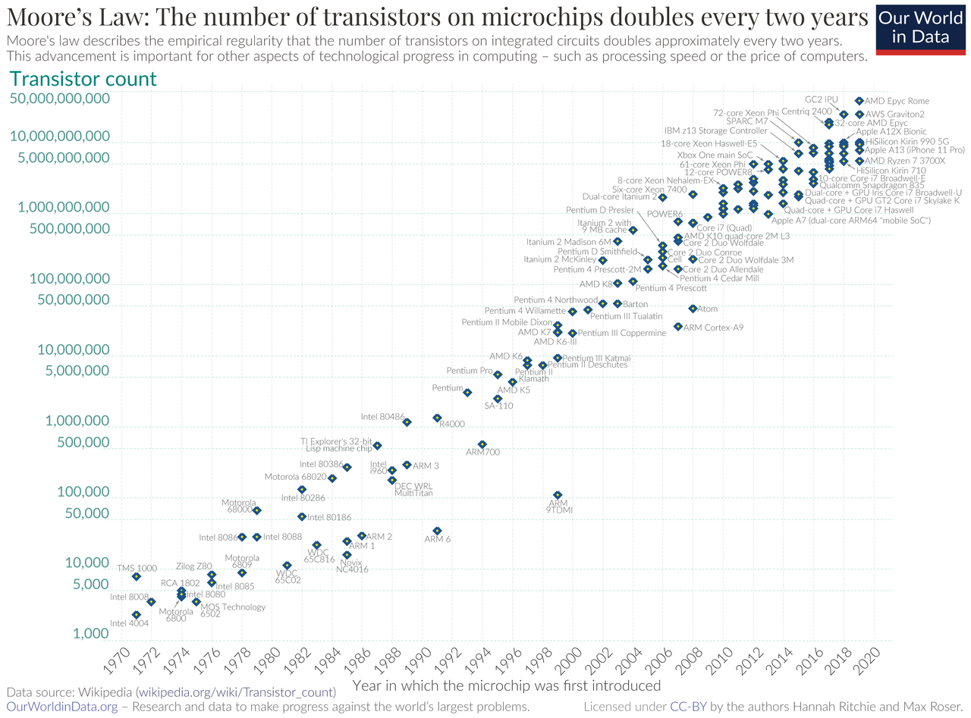
Moore’s Law – CPU transistors counts
“Number of transistors in a chip doubles every 18 months”
Transistors are getting exponentially smaller!
How small? Today: 7nm!
< ½ the size of most viruses!
Notes:
Gordon Moore – first version of the law – ’65: double every year; restated in ‘75: double every two years
Was simplified to “every 18 months”

Slide 8
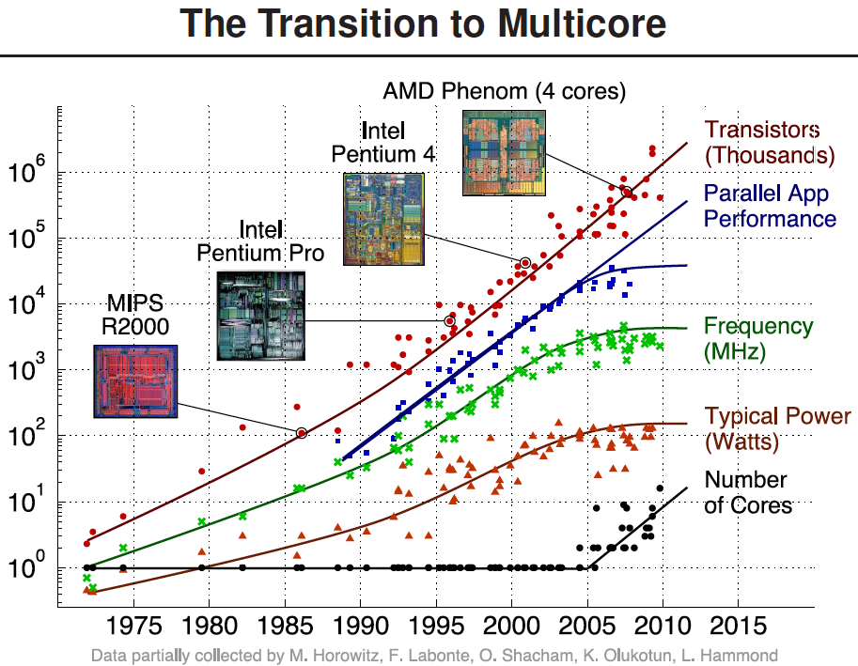
Processors kept getting faster too

Slide 9
Power is a major limiting factor on speed
We could make processors go very fast
  But doing so uses more and more power
More power means more heat generated
  And chips typically work up to around 100°C
  Hotter than that and things stop working
We add heat sinks and fans and water coolers to keep chips cool
  But it’s hard to remove heat quickly enough from chips
So, power consumption ends up limiting processor speed

Slide 10
Denard Scaling
Moore’s Law corollary: Denar Scaling
  As transistors get smaller, the power density stays the same
  Which is to say that the power-per-transistor decreases!
Making the processor clock speed faster uses more power
  But the two balance out for roughly net even power
  So not only do we get more transistors, but chip speed can be faster too
From our Excel example:
  In two years, new hardware would run the existing software twice as fast

Slide 11
Then they stopped getting faster
~2006: Leakage current becomes significant
Now smaller transistors doesn’t mean lower power

Slide 12
So… now what?
In summary:
Making transistors smaller doesn’t make them lower power,
so if we were to make them faster, they would take more power,
which will eventually lead to our processors melting…
and because of that, we can’t reliably make performance better by waiting for clock speeds to increase.
How do we continue to get better computation performance?

Slide 13
Exploit parallelism!

Slide 14
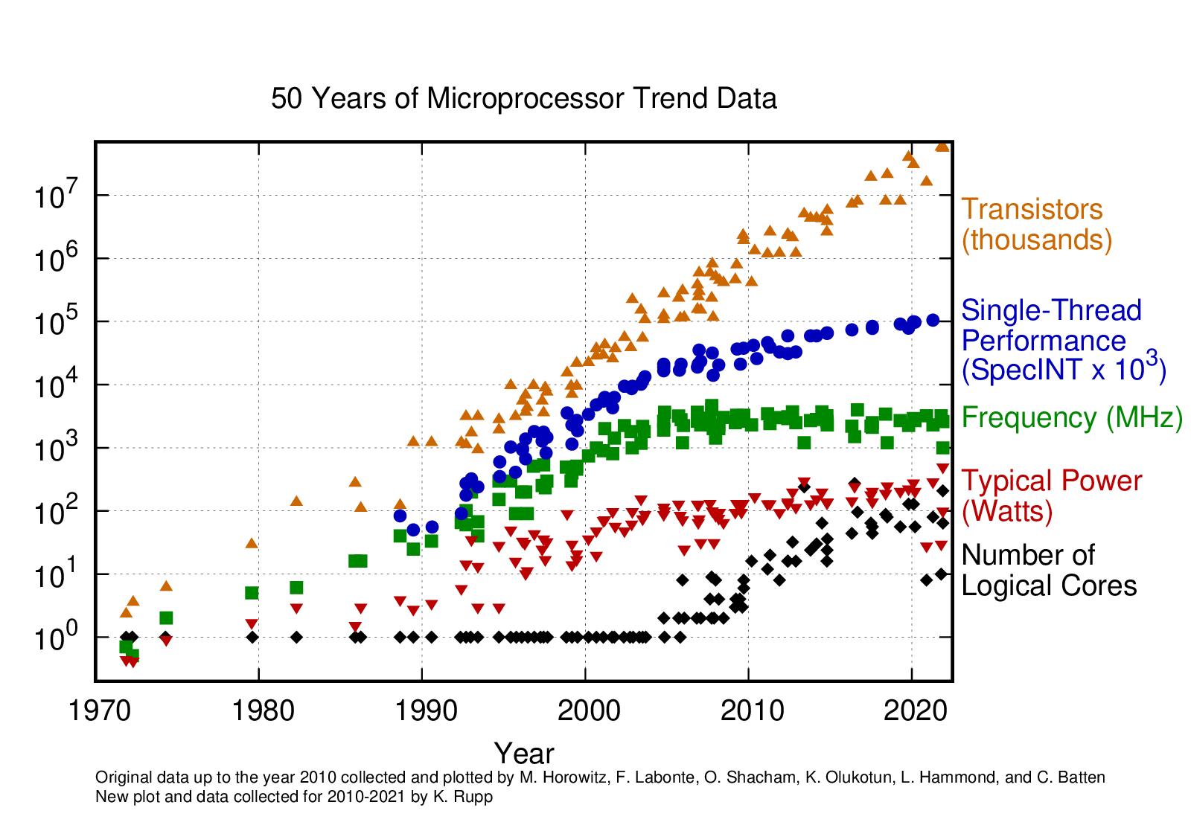
Update: 2010-2021
Still growing!
Small improvement
Stable
Stable
Still growing for servers

Slide 15
Parallelism Analogy
I want to peel 100 potatoes as fast as possible:
  I can learn to peel potatoes faster
  OR
  I can get 99 friends to help me
Whenever one result doesn’t depend on another,
doing the task in parallel can be a big win!

Slide 16
Parallelism versus Concurrency
Two processes A and B
A
B
time
Serial execution
Parallel execution
Concurrent execution
A
B
time
A
B
time
time
A
OR
B

Slide 17
Parallelism versus Concurrency
Parallelism
  Two things happen strictly simultaneously
Concurrency
  More general term
  Two things happen in the same time window
    Could be simultaneous, could be interleaved
  Concurrent execution occurs whenever two processes are both active
time
time
time
A
OR
B
OR

Slide 18
Outline
Need for Parallelism
Processes and Threads
Concurrency Challenges
Using Threads

Slide 19
How do we apply parallelism to software?
Goal: make computer faster by performing multiple tasks
Need multiple different software tasks
Two particular ways of creating a software task
  Processes
  Threads

Slide 20
View of a process
Process: a program that is currently being run
Contents:
Address Space
Registers
~ FFFF FFFF_{hex}
stack
%rax
%r8
%eax
%r8d
Instruction Pointer
Condition Codes
Etc.
%rbx
%r9
%ebx
%r9d
%rcx
%r10
%ecx
%r10d
%rdx
%r11
%edx
%r11d
%rsi
%r12
heap
%esi
%r12d
%rdi
%r13
static data
%edi
%r13d
%rsp
%r14
%esp
%r14d
code
%rbp
%r15
%ebp
%r15d
~ 0_{hex}

Slide 21
Process use case: separate programs
Right now I am running:
  Powerpoint
  Chrome
  Notion
Each is a separate process
  Have their own memory
  Have their own registers
  Operating System manages them
No need for communication between them

Slide 22
Multiprocessor Systems (in pictures)
Core 0
Memory
Processor 0 Memory Accesses
Control
Datapath
RIP
Bytes
Registers
(ALU)
Core 1
Control
Processor 1 Memory Accesses
Datapath
RIP
Registers
(ALU)
Actually parallel!

Slide 23
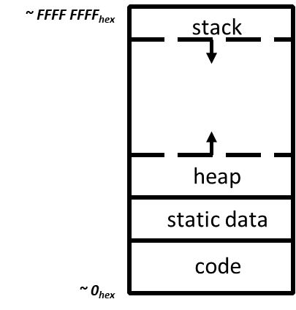
Alternate view of a process
Process: code and data, plus a thread
Thread: execution state
  Each process has at least one thread
Code and Data
Registers
Instruction Pointer
Condition Codes
Stack
%rax
%r8
%eax
%r8d
%rbx
%r9
%ebx
%r9d
%rcx
%r10
%ecx
%r10d
%rdx
%r11
%edx
%r11d
%rsi
%r12
%esi
%r12d
%rdi
%r13
%edi
%r13d
%rsp
%r14
%esp
%r14d
%rbp
%r15
%ebp
%r15d

Slide 24
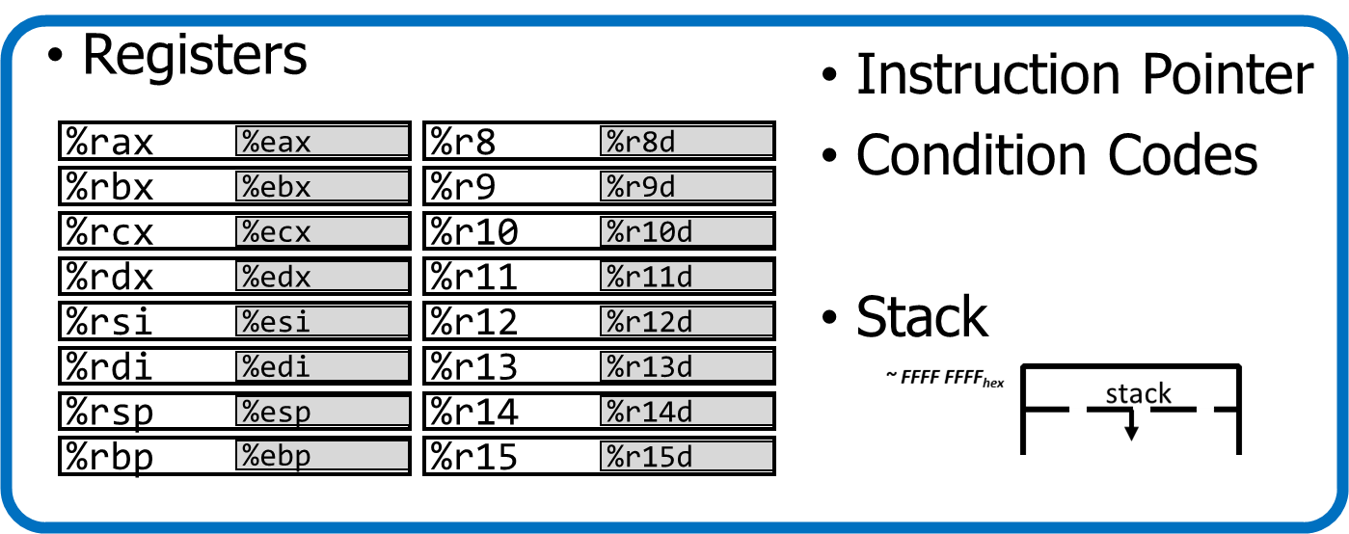
Alternate view of a process
A process could have multiple threads
  Each with its own registers and stack
Threads have separate:
  Instruction Pointer
  Registers
  Stack Memory
  Condition Codes
Threads share:
  Code
  Global variables
Code and Data

Slide 25
Thread use case: web browser
Let’s say you’re implementing a web browser:
You want a tab for each web page you open:
Each tab is its own thread
The same code loads each website (shared code section)
The same global settings are shared by each tab (shared data section)
Each tab does have separate state (separate stack and registers)
Disclaimer: Actually, modern browsers use separate processes for each tab for a variety of reasons including performance and security. But they used to use threads.

Slide 26
Process address space with multiple threads
Stack (T1)
Thread 1
Thread 2
Stack (T2)
Stack (T3)
Thread 3
Data
Segment
Heap
Static Data
%RIP (Thread 3)
%RIP (Thread 2)
Code
%RIP (Thread 1)

Slide 27
Multithreading processors
Basic idea: Processor resources are expensive and should not be left idle
Long memory latency to memory on cache miss?
  Hardware switches threads to bring in other useful work while waiting for cache miss
  Swapping between threads in a process takes less time than waiting for memory, so we get back to work sooner!

Slide 28
Multithreading processor
Processor
Control
Memory
Datapath
RIP 0
RIP 1
Registers 0
Registers 1
(ALU)
Bytes
Two copies of RIP and Registers inside processor hardware
Looks like two processors to software
(hardware thread 0, hardware thread 1)
Control logic decides which thread to execute an instruction
from next (concurrent, but NOT parallel)
28

Slide 29
Multithreading, multicore processors
Combine capabilities of both designs
Run two processes each with two threads
Or run one process with four threads
Processor
Memory
Control
Processor 0 Memory Accesses
Datapath
RIP 0
RIP 1
Registers 0
Registers 1
Bytes
(ALU)
Processor
Control
Processor 1 Memory Accesses
Datapath
RIP 0
RIP 1
Registers 0
Registers 1
(ALU)

Slide 30
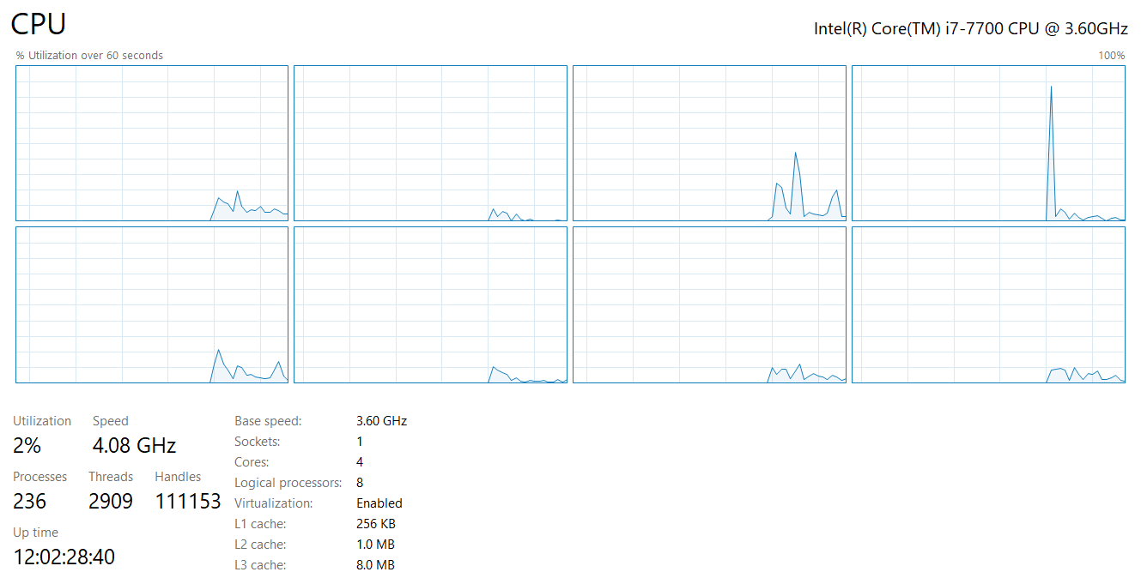
Example: i7 processor
4 total cores
Each capable of 2 threads
≈ 8 processors

Slide 31
Break + Open Question
How many “cores” does a computer need?

Slide 32
Break + Open Question
How many “cores” does a computer need?
  Depends on the workload
  Personal computer
    ~2-10 processes running at once in the foreground
    Plus ~100 in the background
  Server
    Could be serving thousands of requests simultaneously
    Moore: 48 cores, Hanlon: 40 cores

Slide 33
Outline
Need for Parallelism
Processes and Threads
Concurrency Challenges
Using Threads

Slide 34
Challenges to concurrency
Concurrency is great! We can do so many things!!
But what’s the downside…?
How much speedup can we get from it?
How hard is it to write parallel programs?

Slide 35
Challenges to concurrency
Concurrency is great! We can do so many things!!
But what’s the downside…?
How much speedup can we get from it?
How hard is it to write parallel programs?

Slide 36
Speedup Example
95 s | 5 s
Imagine a program that takes 100 seconds to run
95 seconds in the blue part
5 seconds in the green part
We’re going to speed up the green part and take a look at the net result

Slide 37
Speedup from improvements
Speedup with Improvement | = | Execution time without improvement
 |  | Execution time with improvement
95 s | 5 s
5 s -> 2.5 s: Speedup = 100/97.5 = 1.026
5 s -> 1 s: Speedup = 100/96 = 1.042
5 s -> 0.001s: Speedup = 100/95.001 = 1.053
The impact of a performance improvement is relative to the importance of the part being improved!

Slide 38
Amdahl’s Law
Equivalent to prior equation
1
Speedup =
F = Fraction of execution time speed up
S = Scale of improvement
(1 - F) + F
Non-speed-up part
S
Speed-up part
Example: 2x improvement to 25% of the program
1
1
=
=
1.14
0.75 + 0.25
0.75 + 0.125
2

Slide 39
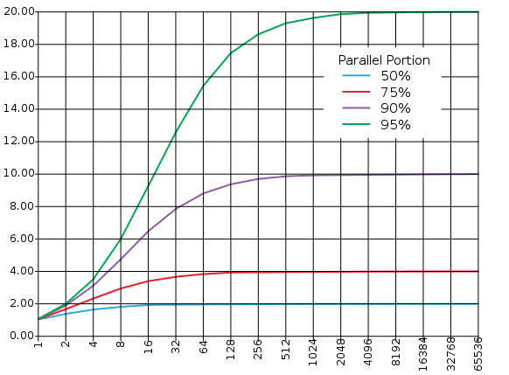
Amdahl’s Law (in pictures)
The amount of speedup that can be achieved through parallelism is limited by the non-parallel portion of your program! 😭
  And every program has at least some non-parallel parts
Time
Speedup
Parallel
portion
Serial
portion
1
2
3
4
5
Number of Processors
Number of Processors

Slide 40
Challenges to concurrency
Concurrency is great! We can do so many things!!
But what’s the downside…?
How much speedup can we get from it?
How hard is it to write parallel programs?

Slide 41
Concurrency problem: data races
Consider two threads with a shared global variable: int count = 0
count could end up with a final value of 1 or 2. How?
Thread 1:
void thread_fn(){
count += 1;
}
Thread 2:
void thread_fn(){
count += 1;
}

Slide 42
Concurrency problem: data races
Consider two threads with a shared global variable: int count = 0
count could end up with a final value of 1 or 2. How?
These instructions could be interleaved in any way.
Assuming “count” is in memory location 0x8049a1c
Thread 1:
void thread_fn(){
mov $0x8049a1c, %edi
mov (%edi), %eax
add $0x1, %eax
mov %eax, (%edi)
}
Thread 2:
void thread_fn(){
mov $0x8049a1c, %edi
mov (%edi), %eax
add $0x1, %eax
mov %eax, (%edi)
}

Slide 43
Data race example – Count = 2
Before this code starts
Thread 1
Register | Value
%eax | ???
Thread 2
Register | Value
%eax | ???
Time
Thread 1 | Thread 2
mov (%edi), %eax
add $0x1, %eax
mov %eax, ($edi)
 | mov (%edi), %eax
 | add $0x1, %eax
 | mov %eax, (%edi)
Memory
Variable | Value
count | 0
Assuming “count” is in memory location pointed to by %edi

Slide 44
Data race example – Count = 2
Thread 1
Register | Value
%eax | 0
Thread 2
Register | Value
%eax | ???
Time
Thread 1 | Thread 2
mov (%edi), %eax
add $0x1, %eax
mov %eax, ($edi)
 | mov (%edi), %eax
 | add $0x1, %eax
 | mov %eax, (%edi)
Memory
Variable | Value
count | 0
Assuming “count” is in memory location pointed to by %edi

Slide 45
Data race example – Count = 2
Thread 1
Register | Value
%eax | 1
Thread 2
Register | Value
%eax | ???
Time
Thread 1 | Thread 2
mov (%edi), %eax
add $0x1, %eax
mov %eax, ($edi)
 | mov (%edi), %eax
 | add $0x1, %eax
 | mov %eax, (%edi)
Memory
Variable | Value
count | 0
Assuming “count” is in memory location pointed to by %edi

Slide 46
Data race example – Count = 2
Thread 1
Register | Value
%eax | 1
Thread 2
Register | Value
%eax | ???
Time
Thread 1 | Thread 2
mov (%edi), %eax
add $0x1, %eax
mov %eax, ($edi)
 | mov (%edi), %eax
 | add $0x1, %eax
 | mov %eax, (%edi)
Memory
Variable | Value
count | 1
Assuming “count” is in memory location pointed to by %edi

Slide 47
Data race example – Count = 2
Thread 1
Register | Value
%eax | 1
Thread 2
Register | Value
%eax | 1
Time
Thread 1 | Thread 2
mov (%edi), %eax
add $0x1, %eax
mov %eax, ($edi)
 | mov (%edi), %eax
 | add $0x1, %eax
 | mov %eax, (%edi)
Memory
Variable | Value
count | 1
Assuming “count” is in memory location pointed to by %edi

Slide 48
Data race example – Count = 2
Thread 1
Register | Value
%eax | 1
Thread 2
Register | Value
%eax | 2
Time
Thread 1 | Thread 2
mov (%edi), %eax
add $0x1, %eax
mov %eax, ($edi)
 | mov (%edi), %eax
 | add $0x1, %eax
 | mov %eax, (%edi)
Memory
Variable | Value
count | 1
Assuming “count” is in memory location pointed to by %edi

Slide 49
Data race example – Count = 2
Thread 1
Register | Value
%eax | 1
Thread 2
Register | Value
%eax | 2
Time
Thread 1 | Thread 2
mov (%edi), %eax
add $0x1, %eax
mov %eax, ($edi)
 | mov (%edi), %eax
 | add $0x1, %eax
 | mov %eax, (%edi)
Memory
Variable | Value
count | 2
Assuming “count” is in memory location pointed to by %edi

Slide 50
Theads do not have guaranteed ordering
BUT, there’s no guarantee that the instructions occur in that order!
Since the two threads are running in parallel, the instructions could be interleaved in any way
(both threads are really running simultaneously)

Slide 51
Data race example – Count = 1
Remember, each thread has its own separate registers!
Before this code starts
Thread 1
Register | Value
%eax | ???
Thread 2
Register | Value
%eax | ???
Time
Thread 1 | Thread 2
mov (%edi), %eax
 | mov (%edi), %eax
 | add $0x1, %eax
 | mov %eax, (%edi)
add $0x1, %eax
mov %eax, (%edi)
Memory
Variable | Value
count | 0
Assuming “count” is in memory location pointed to by %edi

Slide 52
Data race example – Count = 1
Thread 1
Register | Value
%eax | 0
Thread 2
Register | Value
%eax | ???
Time
Thread 1 | Thread 2
mov (%edi), %eax
 | mov (%edi), %eax
 | add $0x1, %eax
 | mov %eax, (%edi)
add $0x1, %eax
mov %eax, (%edi)
Memory
Variable | Value
count | 0
Assuming “count” is in memory location pointed to by %edi

Slide 53
Data race example – Count = 1
Thread 1
Register | Value
%eax | 0
Thread 2
Register | Value
%eax | 0
Time
Thread 1 | Thread 2
mov (%edi), %eax
 | mov (%edi), %eax
 | add $0x1, %eax
 | mov %eax, (%edi)
add $0x1, %eax
mov %eax, (%edi)
Memory
Variable | Value
count | 0
Assuming “count” is in memory location pointed to by %edi

Slide 54
Data race example – Count = 1
Thread 1
Register | Value
%eax | 0
Thread 2
Register | Value
%eax | 1
Time
Thread 1 | Thread 2
mov (%edi), %eax
 | mov (%edi), %eax
 | add $0x1, %eax
 | mov %eax, (%edi)
add $0x1, %eax
mov %eax, (%edi)
Memory
Variable | Value
count | 0
Assuming “count” is in memory location pointed to by %edi

Slide 55
Data race example – Count = 1
Thread 1
Register | Value
%eax | 0
Thread 2
Register | Value
%eax | 1
Time
Thread 1 | Thread 2
mov (%edi), %eax
 | mov (%edi), %eax
 | add $0x1, %eax
 | mov %eax, (%edi)
add $0x1, %eax
mov %eax, (%edi)
Memory
Variable | Value
count | 1
Assuming “count” is in memory location pointed to by %edi

Slide 56
Data race example – Count = 1
Thread 1
Register | Value
%eax | 1
Thread 2
Register | Value
%eax | 1
Time
Thread 1 | Thread 2
mov (%edi), %eax
 | mov (%edi), %eax
 | add $0x1, %eax
 | mov %eax, (%edi)
add $0x1, %eax
mov %eax, (%edi)
Memory
Variable | Value
count | 1
Assuming “count” is in memory location pointed to by %edi

Slide 57
Data race example – Count = 1
Thread 1
Register | Value
%eax | 1
Thread 2
Register | Value
%eax | 1
Time
Thread 1 | Thread 2
mov (%edi), %eax
 | mov (%edi), %eax
 | add $0x1, %eax
 | mov %eax, (%edi)
add $0x1, %eax
mov %eax, (%edi)
Memory
Variable | Value
count | 1
Assuming “count” is in memory location pointed to by %edi

Slide 58
Data race comparison
Assuming “count” is in memory location pointed to by %edi
Thread 1 | Thread 2
mov (%edi), %eax
add $0x1, %eax
mov %eax, ($edi)
 | mov (%edi), %eax
 | add $0x1, %eax
 | mov %eax, (%edi)
Thread 1 | Thread 2
mov (%edi), %eax
 | mov (%edi), %eax
 | add $0x1, %eax
 | mov %eax, (%edi)
add $0x1, %eax
mov %eax, (%edi)
Time
Final value of count: 2
Final value of count: 1

Slide 59
Data race explanation
Thread scheduling is non-deterministic
  There is no guarantee that any thread will go first or last or not be interrupted at any point
If different threads write to the same variable
  The final value of the variable is also non-deterministic
  This is a data race
Avoid incorrect results by:
  Not writing to the same memory address!!
  OR
  Synchronizing reading and writing to get deterministic behavior

Slide 60
Data race explanation
Thread scheduling is non-deterministic
  There is no guarantee that any thread will go first or last or not be interrupted at any point
If different threads write to the same variable
  The final value of the variable is also non-deterministic
  This is a data race
Avoid incorrect results by:
  Not writing to the same memory address!!
  OR
  Synchronizing reading and writing to get deterministic behavior
We’ll pick this one for CS213
CS343 explores this in depth

Slide 61
Avoiding shared memory data races
Ensure that no two threads write to the same memory address
Multiple threads reading from the same memory address is fine
  As long as no thread writes to that memory
Where do you put results then? Simple solution:
  Make an array with a slot for each thread
  Each thread only writes to their own slot in the array
  After all threads are done, main thread iterates the array and determines the final result

Slide 62
Question + Break
Consider three threads with a shared global variable: int count = 0
What are the possible values of count?
Thread 1:
void main(){
count += 1;
}
Thread 2:
void main(){
count -= 1;
}
Thread 3:
void main(){
count += 2;
}

Slide 63
Question + Break
Consider three threads with a shared global variable: int count = 0
What are the possible values of count? -1, 0, 1, 2, 3
How are you supposed to reason about this?!
Need mechanisms for sharing memory.
Thread 1:
void main(){
count += 1;
}
Thread 2:
void main(){
count -= 1;
}
Thread 3:
void main(){
count += 2;
}

Slide 64
Outline
Need for Parallelism
Processes and Threads
Concurrency Challenges
Using Threads

Slide 65
Thread operations
Create threads
  Shares all memory with all threads of the process.
  Scheduled independently of parent
Join thread
  Waits for a particular thread to finish
  Can’t continue computation until all threads finish
That’s it! Don’t really need anything else (for this class)
  Library also includes synchronization primitives to solve data races
Can communicate between threads by reading/writing (shared) global variables
  But we’re only going to read from shared variables for safety
  We’ll write to separate memory locations

Slide 66
POSIX Threads Library: pthreads
https://man7.org/linux/man-pages/man7/pthreads.7.html
int pthread_create(pthread_t* thread, const pthread_attr_t* attr,
void* (*start_routine)(void*), void* arg);
  Thread is created executing start_routine with arg as its sole argument.
  Returning from the start routine exits the thread
void pthread_exit(void* value_ptr);
  Terminates the thread and makes value_ptr available to any successful join
int pthread_join(pthread_t thread, void** value_ptr);
  Suspends execution of the calling thread until the target thread terminates.
  On return with a non-NULL value_ptr the value passed to pthread_exit() by the terminating thread is made available in the location referenced by value_ptr.

Slide 67
Basic thread example
Main thread
call Pthread_create()
Peer thread
call Pthread_join()
printf()
Main thread waits for
peer thread to terminate
return NULL;
Peer thread
terminates
Pthread_join() returns
exit()
Terminates
main thread and
any peer threads

Slide 68
Example: parallel sum of array
double array[LEN] = {1, 2, 3, …, LEN};
// determine result sequentially
double sequential_sum = 0;
for (int i=0; i<LEN; i++) {
sequential_sum += array[i];
}

Slide 69
Example: parallel sum of array
double array[LEN] = {1, 2, 3, …, LEN};
Parallelization Plan
Create num_threads different threads
Threads create “partial” sums for their portion of the work
  Each thread does (LEN/num_threads) work
  Create an array for results with one slot per thread
Wait until done, then sum the partial results
  Main thread calls join() to wait for each thread to complete
  Main thread adds up results

Slide 70
Example: parallel sum of array
Create num_threads different threads
pthread_t tid[num_threads];
for (long i=0; i<num_threads; i++) {
pthread_create(&(tid[i]), NULL, worker, (void*)i);
}
Arguments to pthread_create
  thread_handle, attributes, thread_function, function_argument
Main Thread

Slide 71
Example: parallel sum of array
2. Threads create “partial” sums for their portion of the work
void* worker(void* arg) {
long i = (long)arg;
int mystart = i * (LEN/num_threads);
int myend = (i+1) * (LEN/num_threads);
partial_sum[i] = 0;
for (int j=mystart; j<myend; j++) {
partial_sum[i] += array[j];
}
pthread_exit(NULL); // Thread work is complete
}
Decide which portion of work this thread should do
Worker Threads

Slide 72
Example: parallel sum of array
2. Threads create “partial” sums for their portion of the work
void* worker(void* arg) {
long i = (long)arg;
int mystart = i * (LEN/num_threads);
int myend = (i+1) * (LEN/num_threads);
partial_sum[i] = 0;
for (int j=mystart; j<myend; j++) {
partial_sum[i] += array[j];
}
pthread_exit(NULL); // Thread work is complete
}
Do the work
Puts result in its own slot in the partial_sum array (avoids data races)
Worker Threads

Slide 73
Example: parallel sum of array
3. Wait until done, then sum the partial results
for (int j=0; j<num_threads; j++) {
pthread_join(tid[j], NULL); // second argument is return result
}
double parallel_sum = 0;
for (int k=0; k<num_threads; k++) {
parallel_sum += partial_sum[k];
}
Main Thread

Slide 74
Trying this out for yourself
See SETI Lab for example code you can run yourself
We just went through a slightly simplified version of
parallel-sum-ex.c

Slide 75
Running the parallel sum application
Array of 200 million length
No threads created
Only the sequential version is run. Takes about ~878 million cycles to run
$ ./parallel-sum-ex 0 1 200000000
Sequential sum: 19999999900000000 ( 878576632 cycles)
Parallel sum: 0 (44 cycles)

Slide 76
Running the parallel sum application
Array of 200 million length
1 to thread created. No parallelism for a speedup. Actually, it takes LONGER to run.
Starting threads takes time! Need to make sure they’re doing enough work to be worth it.
$ ./parallel-sum-ex 0 1 200000000
Sequential sum: 19999999900000000 ( 878576632 cycles)
Parallel sum: 0 (44 cycles)
$ ./parallel-sum-ex 1 1 200000000
Sequential sum: 19999999900000000 ( 902438479 cycles)
Parallel sum: 19999999900000000 (1169222739 cycles)

Slide 77
Running the parallel sum application
Array of 200 million length
8 threads actually has some parallelism
Starts doing better than one thread but needs more parallelism for a big win.
$ ./parallel-sum-ex 0 1 200000000
Sequential sum: 19999999900000000 ( 878576632 cycles)
Parallel sum: 0 (44 cycles)
$ ./parallel-sum-ex 1 1 200000000
Sequential sum: 19999999900000000 ( 902438479 cycles)
Parallel sum: 19999999900000000 (1169222739 cycles)
$ ./parallel-sum-ex 8 8 200000000
Sequential sum: 19999999900000000 ( 888810917 cycles)
Parallel sum: 19999999900000000 (1033659530 cycles)

Slide 78
Running the parallel sum application
Array of 200 million length
16 threads starts to win!
I don’t actually have that many cores, but the system is swapping threads whenever memory reads stall to improve performance
$ ./parallel-sum-ex 0 1 200000000
Sequential sum: 19999999900000000 ( 878576632 cycles)
Parallel sum: 0 (44 cycles)
$ ./parallel-sum-ex 1 1 200000000
Sequential sum: 19999999900000000 ( 902438479 cycles)
Parallel sum: 19999999900000000 (1169222739 cycles)
$ ./parallel-sum-ex 8 8 200000000
Sequential sum: 19999999900000000 ( 888810917 cycles)
Parallel sum: 19999999900000000 (1033659530 cycles)
$ ./parallel-sum-ex 16 16 200000000
Sequential sum: 19999999900000000 ( 895258209 cycles)
Parallel sum: 19999999900000000 ( 693511997 cycles)

Slide 79
Running the parallel sum application
Array of 200 million length
32 and 64 threads are really cruising
Down to half the time for the computation
$ ./parallel-sum-ex 0 1 200000000
Sequential sum: 19999999900000000 ( 878576632 cycles)
Parallel sum: 0 (44 cycles)
$ ./parallel-sum-ex 1 1 200000000
Sequential sum: 19999999900000000 ( 902438479 cycles)
Parallel sum: 19999999900000000 (1169222739 cycles)
$ ./parallel-sum-ex 8 8 200000000
Sequential sum: 19999999900000000 ( 888810917 cycles)
Parallel sum: 19999999900000000 (1033659530 cycles)
$ ./parallel-sum-ex 16 16 200000000
Sequential sum: 19999999900000000 ( 895258209 cycles)
Parallel sum: 19999999900000000 ( 693511997 cycles)
$ ./parallel-sum-ex 32 32 200000000
Sequential sum: 19999999900000000 ( 886174224 cycles)
Parallel sum: 19999999900000000 ( 609774231 cycles)
$ ./parallel-sum-ex 64 64 200000000
Sequential sum: 19999999900000000 ( 898098616 cycles)
Parallel sum: 19999999900000000 ( 426420305 cycles)

Slide 80
Running the parallel sum application
Array of 200 million length
128 threads is basically the same as 64 threads
Further parallelism isn’t helping very much. (technically worse than 64, but it’s within error bounds on timing)
$ ./parallel-sum-ex 0 1 200000000
Sequential sum: 19999999900000000 ( 878576632 cycles)
Parallel sum: 0 (44 cycles)
$ ./parallel-sum-ex 1 1 200000000
Sequential sum: 19999999900000000 ( 902438479 cycles)
Parallel sum: 19999999900000000 (1169222739 cycles)
$ ./parallel-sum-ex 8 8 200000000
Sequential sum: 19999999900000000 ( 888810917 cycles)
Parallel sum: 19999999900000000 (1033659530 cycles)
$ ./parallel-sum-ex 16 16 200000000
Sequential sum: 19999999900000000 ( 895258209 cycles)
Parallel sum: 19999999900000000 ( 693511997 cycles)
$ ./parallel-sum-ex 32 32 200000000
Sequential sum: 19999999900000000 ( 886174224 cycles)
Parallel sum: 19999999900000000 ( 609774231 cycles)
$ ./parallel-sum-ex 64 64 200000000
Sequential sum: 19999999900000000 ( 898098616 cycles)
Parallel sum: 19999999900000000 ( 426420305 cycles)
$ ./parallel-sum-ex 128 128 200000000
Sequential sum: 19999999900000000 ( 891919128 cycles)
Parallel sum: 19999999900000000 ( 493951974 cycles)

Slide 81
Outline
Need for Parallelism
Processes and Threads
Concurrency Challenges
Using Threads

Slide 82
Outline
Bonus: SIMD Instructions

Slide 83
SIMD Architectures
Data-Level Parallelism (DLP): Executing one operation on multiple data streams
  SIMD: Single Instruction Multiple Data
Example: Multiplying a coefficient vector by a data vector (e.g. in filtering)
y[i] := c[i] × x[i], 0≤i<n
Sources of performance improvement:
  One instruction is fetched & decoded for entire operation
  Multiplications are known to be independent
  Pipelining/concurrency in memory access as well

Slide 84
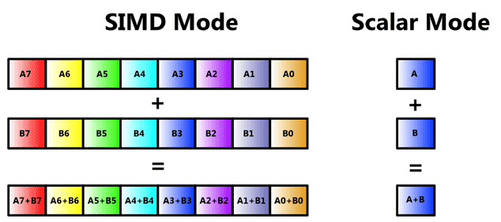

Slide 85
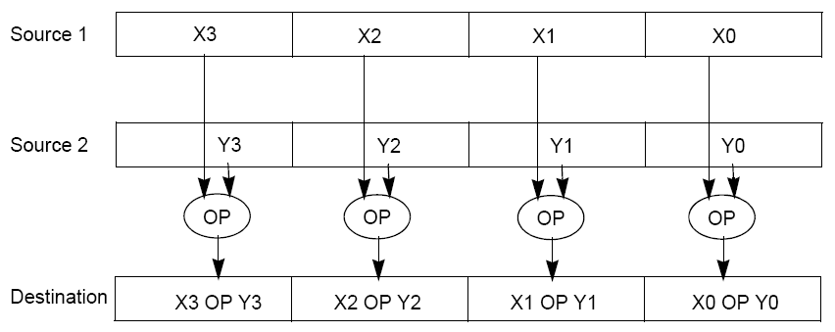
Example SIMD Instructions
To improve performance, Intel’s SIMD instructions
  Fetch one instruction, do the work of multiple instructions
  MMX (MultiMedia eXtension, Pentium II processor family)
  SSE (Streaming SIMD Extension, Pentium III and beyond)
Notes:
hardware/assembly language solution

Slide 86
Example: SIMD Array Processing
for each f in array
f = sqrt(f)
pseudocode
for each f in array {
load f to the floating-point register
calculate the square root
write the result from the register to memory
}
SISD
for each 4 members in array {
load 4 members to the SSE register
calculate 4 square roots in one operation
write the result from the register to memory
}
SIMD

Slide 87
SIMD in the Real World
Today’s compilers can generate SIMD code!
  But in some cases we get better results by hand
Intel’s x86 implements many SIMD instructions
  Which have the benefit of being usable on lab machines
  (and most of our own personal computers)

Slide 88
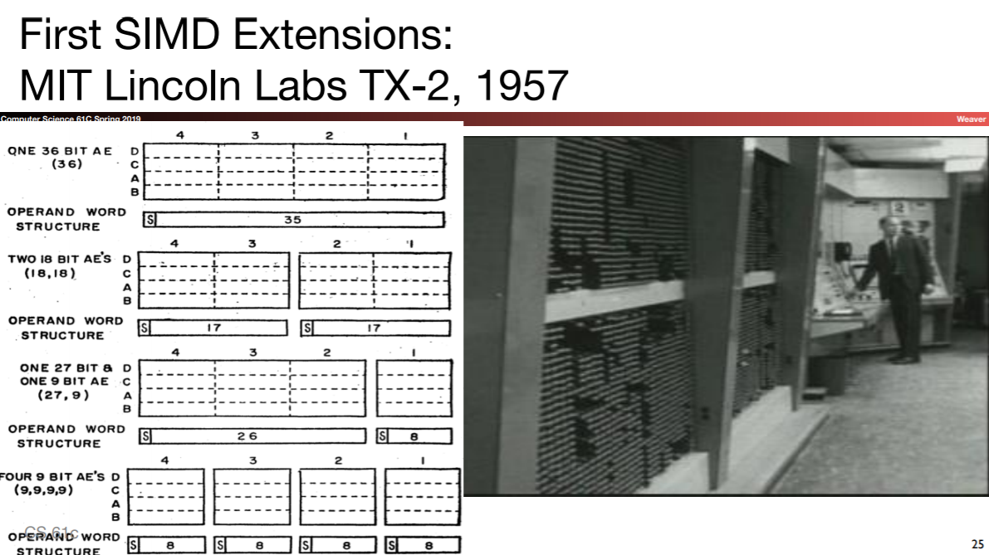

Slide 89
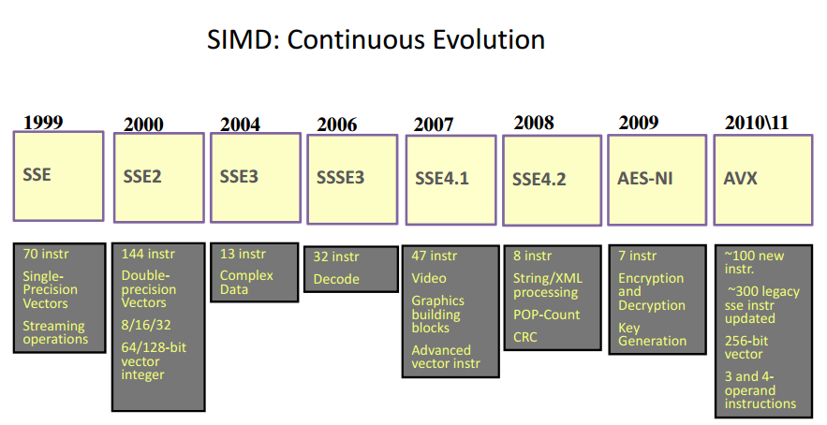
Intel SIMD has been continuously extended

Slide 90
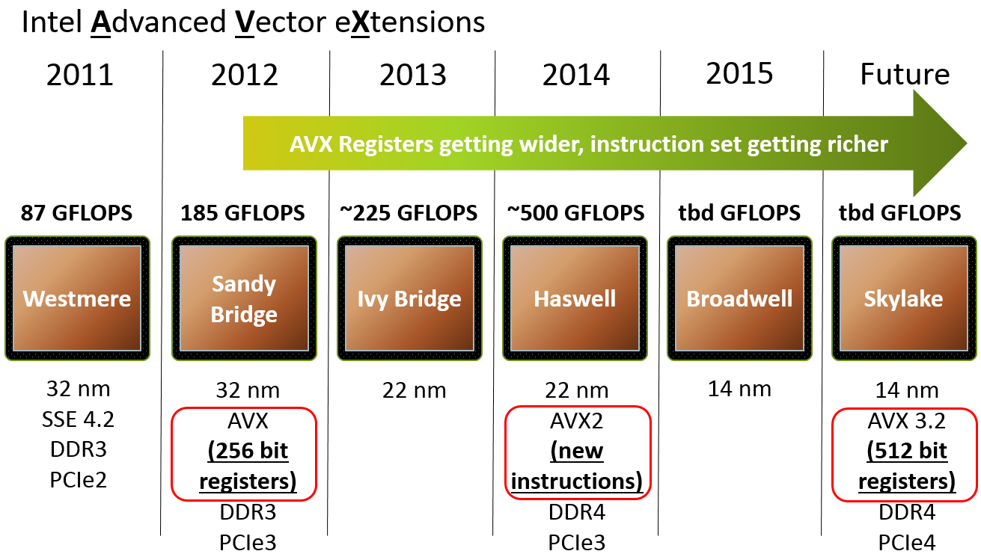
And it has increased in size a lot

Slide 91
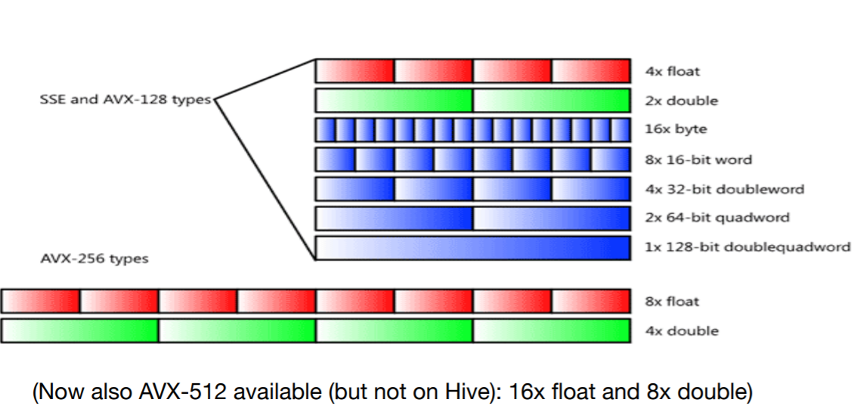
Intel SIMD Data Types

Slide 92
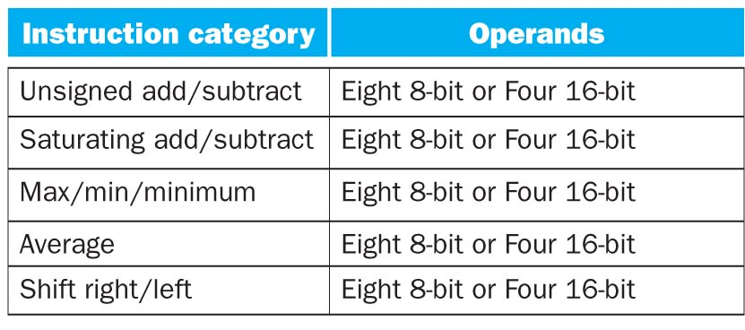
SSE Instruction Categories for Multimedia Support
SSE-2+ supports wider data types to allow
16 × 8-bit and 8 × 16-bit operands
Notes:
64 bits operated on simultaneously!

Slide 93
How do we use these SIMD instructions?
Intrinsics:
  “function calls” that actually just execute an assembly instruction
Example:
_mm_add_epi32(first_values, second_values);
WHAT????

Slide 94
_mm_add_epi32(first_values, second_values)
Arguments are
Extended Packed Integers,
each 32-bits in size
(signed)
MultiMedia extension
(They all start with this)
first_values
second_values
+

Slide 95
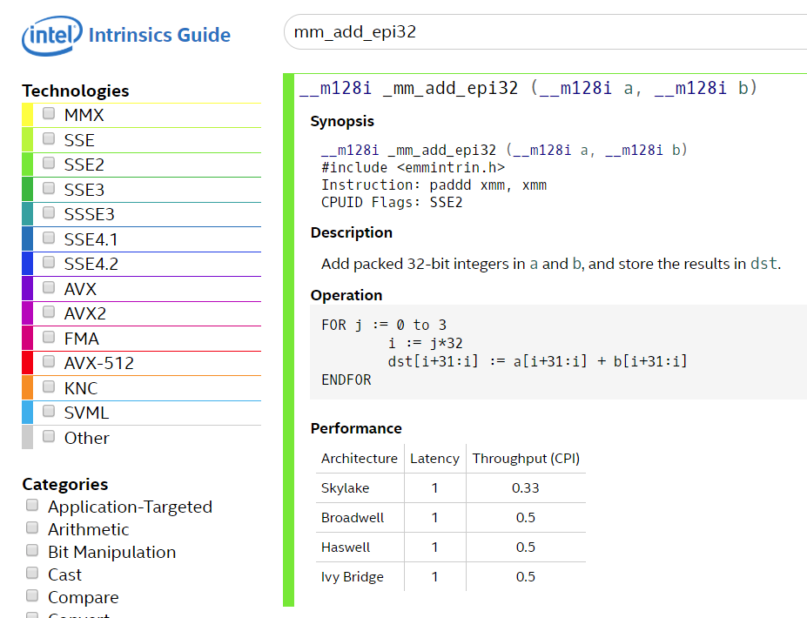
Sooooooo fast

Slide 96
int add_no_SSE(int size, int *first_array, int *second_array) {
for (int i = 0; i < size; ++i) {
first_array[i] += second_array[i];
}
}
int add_SSE(int size, int *first_array, int *second_array) {
for (int i=0; i + 4 <= size; i+=4) { // only works if (size%4) == 0
// load 128-bit chunks of each array
__m128i first_values = _mm_loadu_si128((__m128i*) &first_array[i]);
__m128i second_values = _mm_loadu_si128((__m128i*) &second_array[i]);
// add each pair of 32-bit integers in the 128-bit chunks
first_values = _mm_add_epi32(first_values, second_values);
// store 128-bit chunk to first array
_mm_storeu_si128((__m128i*) &first_array[i], first_values);
}
...
}
https://www.cs.virginia.edu/~cr4bd/3330/F2017/simdref.html

Slide 97
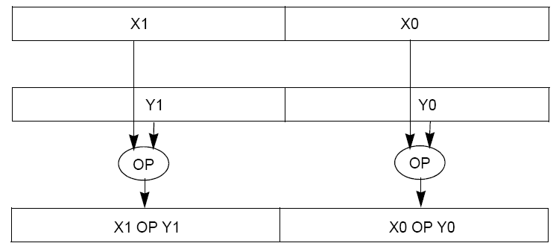
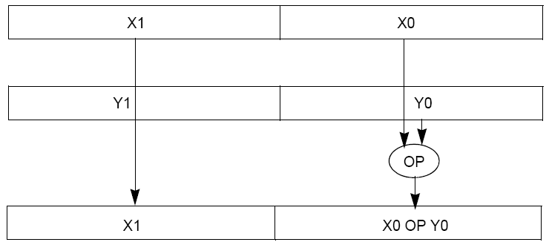
You can do this with floating point numbers too!
Packed
Double
(PD)
Scalar
Double
(SD)

Slide 98
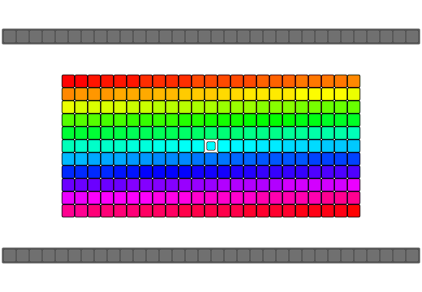
Example: Reversing an array in 7 steps
(animated)

