Slide 1
Lecture 05
Intro to x86-64 Assembly
CS213 – Intro to Computer Systems
Branden Ghena – Winter 2024
Slides adapted from:
St-Amour, Hardavellas, Bustamente (Northwestern), Bryant, O’Hallaron (CMU), Garcia, Weaver (UC Berkeley)

Slide 2
Administrivia
Pack Lab
  Due in one week from today (Thursday, January 25)
  If you haven’t yet, get started right away!
    Lots of conceptually difficult parts to understand
    Lots of C code to write, which you may have forgotten
  Especially, make sure you don’t have issues logging into Moore
    Takes ~24 hours to fix and we won’t be giving extensions for it
  This assignment is 12.5% of your overall course grade, and takes at least that much effort
    Not an “easier first assignment”

Slide 3
Administrivia
Homework 2
  Releases later today
  Ready to be worked on (except the last question for Thursday’s lecture)
  Due in 1.5 weeks (Tuesday, January 30th)
Midterm exam
  Exactly two weeks from today (February 1st)
  Taken here in the classroom
  Details next week

Slide 4
Today’s Goals
Introduce assembly and the x86-64 Instruction Set Architecture
  Discuss background of the factors that affected its evolution
Understand registers: the analogy to variables in assembly
Explore our first assembly instruction: mov

Slide 5
Outline
Assembly Languages
Registers
x86-64 Assembly
  Introduction
  Move Instruction
  Memory Addressing Modes

Slide 6
Assembly (Also known as: Assembly Language, ASM)
Purpose of a CPU: execute instructions
High-level programs (like in C) are split into many small instructions
Assembly is a low-level programming language where the program instructions match a particular architecture’s operations
  Assembly is a human-readable text representation of machine code
  Each assembly instruction is one machine instruction (usually)

Slide 7
Programs can be written in assembly or machine instructions
C Program (source code)
a = (b+c)–(d+e);
    Assembly Program
      addq %rdi, %rsi
      addq %rdx, %rcx
      subq %rcx, %rsi
      movq %rsi, %rax
Machine Instructions
0x4889D3
0x488903
0x53
0x5B

Slide 8
There are many assembly languages
Instruction Set Architecture: All programmer-visible components of a processor needed to write software for it
  Operations the processor can execute
  The system’s state (registers, memory, program counter)
  The effect operations have on system state
Each assembly language has instructions that match a particular processor’s Instruction Set Architecture (ISA)
Assembly is not portable to other architectures (like C is)

Slide 9
Which instructions should an assembly include?
Each assembly language has its own operations
There are some obviously useful instructions:
Add, subtract, and bit shift
Read and write memory
But what about:
Only run the next instruction if these two values are equal
Perform four pairwise multiplications simultaneously
Add two ascii numbers together (‘2’ + ‘3’ = 5)
Notes:
Add two ascii numbers is a real x86 instruction. No joke

Slide 10
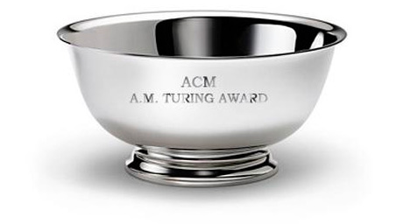
Instruction Set Philosophies
Early trend: add more instructions to do elaborate operations
Complex Instruction Set Computing (CISC)
  Handle many different types of operations
  More options for the compiler
  Complicated hardware runs more slowly
Opposite philosophy later began to dominate:
Reduced Instruction Set Computing (RISC)
  Simpler (and smaller) instruction set makes it easier to build fast hardware
  Let software do the complicated operations by composing simpler ones
Modern reality is somewhere between these two

Slide 11



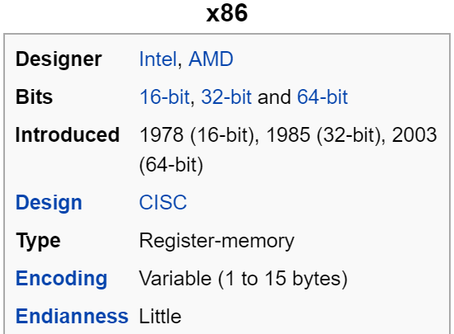
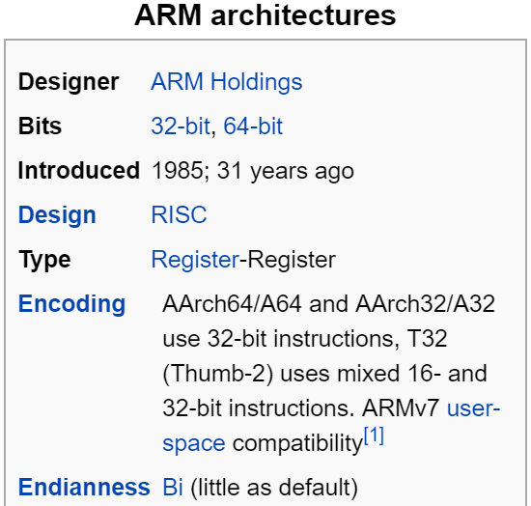
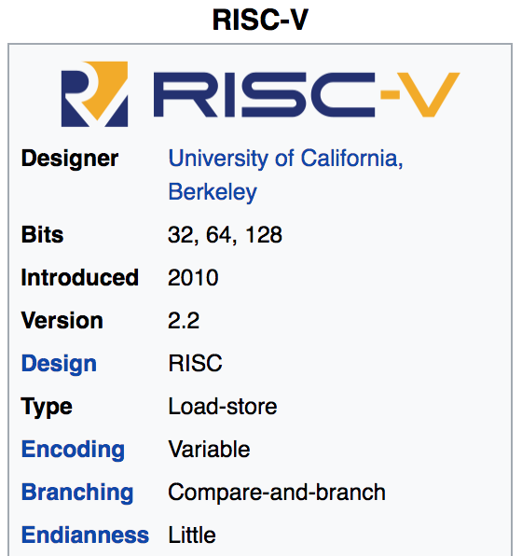
Mainstream Instruction Set Architectures
Macbooks & PCs
(Core i3, i5, i7, M)
x86 Instruction Set
Smartphones (iPhone, Android), Apple Hardware, Raspberry Pi, Embedded systems
ARM Instruction Set
Open-source
Relatively new, designed for cloud computing, embedded systems, academic use
RISCV Instruction Set

Slide 12
Instruction Set Architecture sits at software/hardware interface
Source code
Compiler
Architecture
Hardware
Different applications
or algorithms
Perform optimizations,
generate instructions
Instruction set
Different implementations
Intel Pentium 4
C Language
x86-64
Program A
Intel Core i7
GCC
AMD Ryzen
Program B
Clang
ARMv8 (AArch64/A64)
ARM Cortex-A53
Apple M1

Slide 13
Intel x86 Processors
Dominate laptop/desktop/server market
  No longer completely dominant in laptops though
Complex instruction set computer (CISC)
  Many different instructions with many different formats
  But, only small subset encountered by normal programs
Design evolved over time
  Backwards compatible up until 8086, introduced in 1978
  Added more features as time goes on
  Historical legacy has large impact on architecture

Slide 14
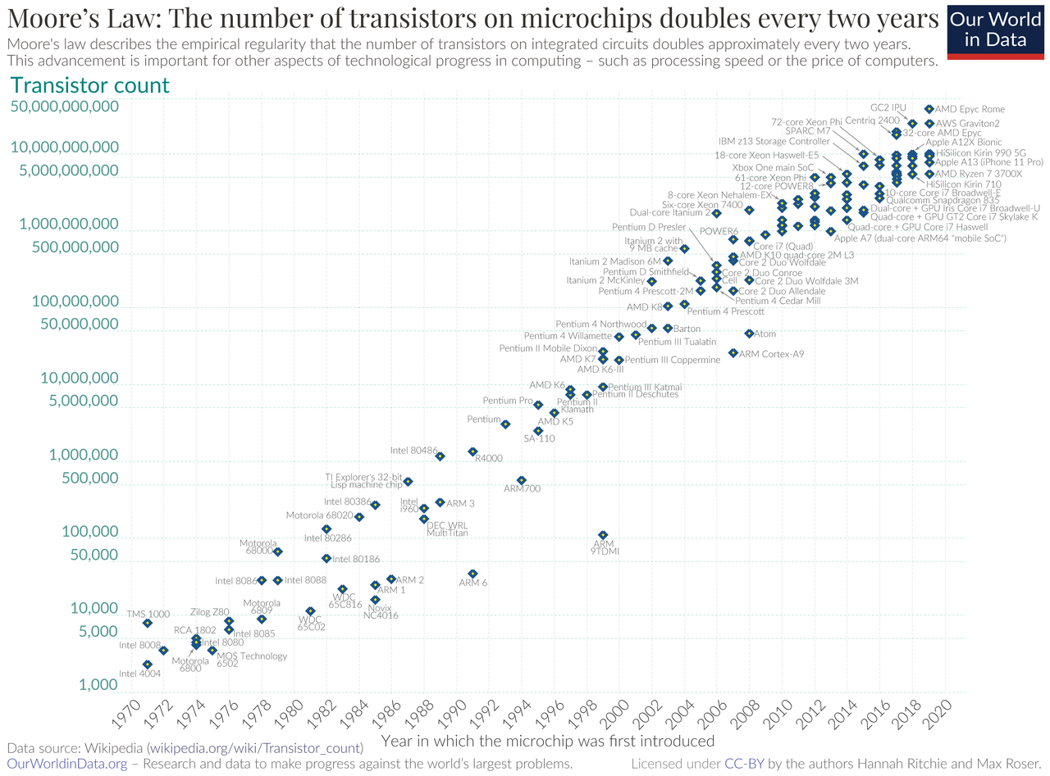
Moore’s Law – CPU transistors counts
“Number of transistors in a chip doubles every 18 months”
Transistors are getting exponentially smaller!
How small? Today: 3nm!
< ½ the size of most viruses!
Notes:
Gordon Moore – first version of the law – ’65: double every year; restated in ‘75: double every two years
Was simplified to “every 18 months”

Slide 15
Evolution of x86 ISA
Name | Date | Transistors | Comments
8086 | 1978 | 29k | 16b processor, basis for IBM PC & DOS; 1MB address space
80286 | 1982 | 134K | Elaborate (!useful) addressing; basis for IBM PC and Windows
386 | 1985 | 275K | Extended to 32b, added “flat addressing” that Linux/gcc uses
486 | 1989 | 1.9M | Improved performance; integrated FP unit into chip
Pentium | 1993 | 3.1M | Improved performance
PentiumPro | 1995 | 6.5M | Conditional move instructions; big change in microarch. (P6)
Pentium II | 1997 | 7M | Merged Pentium/MMZ + PentiumPro, MMX instructions within P6
Pentium III | 1999 | 8.2M | Integer and floating point vector instructions (SSE); Level2 cache
Pentium 4 | 2001 | 42M | 8B ints and floating point formats to vector instructions
Pentium 4E | 2004 | 125M | Hyperthreading (able to run 2 programs simultaneously), 64b
Core 2 | 2006 | 291M | P6-like, multicore, no hyperthreading
Core i7 (Nehalem) | 2008 | 781M | Hyperthreading + multicore, TurboBoost (run fewer cores faster)
Core i3 (Nehalem) | 2010 | 383M+177M | GPU on second silicon die within package (at 2010 version)
Core i3, i5, i7 (Sandy Bridge) | 2011 | 997M (i7 – 4 cores) | Cores and GPU within the same processor die
Core i3, i5, i7 (Ivy Bridge) | 2012 | 1400M (i7 – 4 cores) | Tri-gate transistors, much lower power consumption
Xeon E7 8800 V4 (Broadwell-EX) | 2016 | >5690M (22 cores) | 14nm technology
Notes:
The x86 processor line has a long evolutionary development; started with a 16b microprocessor …
This is a list of some notable models, dates and a few key features
386 – first 32b, added flat addressing for Linux
Pentium 4E – hyperthreading and 64b
Core 2 – first multicore from Intel
Each successive processor has been designed to be backward compatible – able to run code from previous version; many strange artifacts result from this

Slide 16
Backwards Compatibility The cause of, and solution to, all of life’s problems.
Programs that worked on one x86 processor should keep working on the next one
  Old programs work on new processors, which makes upgrading possible
  Even today’s x86-64 processors boot thinking they are 8086s!
Adding powerful new features while keeping backwards compatibility is a careful balancing act
  Backwards compatibility introduces a lot of constraints
  May rule out “cleaner” designs that would break existing programs
  The cause of some “surprising” aspects of the design of x86-64
  “The x86 really isn't all that complex—it just doesn't make a lot of sense.”
  — Mike Johnson (AMD's x86 architect), 1994
Not just a hardware thing!

Slide 17
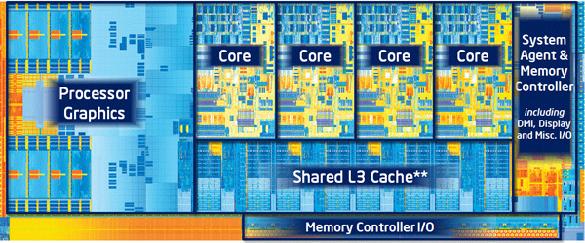
In this class
x86-64/EMT64: the current standard
  Some asides on IA32: The traditional x86
Presentation
  Book covers x86-64; web aside on IA32
  Labs will be based on x86-64

Slide 18
Outline
Assembly Languages
Registers
x86-64 Assembly
  Introduction
  Move Instruction
  Memory Addressing Modes

Slide 19
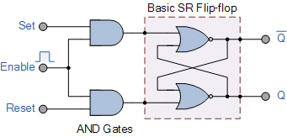
Hardware uses registers for variables
Unlike C, assembly doesn’t have variables as you know them
Instead, assembly uses registers to store values
Registers are:
  Small memory chunks of a fixed size
  Can be read or written
  Limited in number
  Very fast and low power to access
  Don’t have types (just bits)
    The operation performed
    determines how contents are treated

Slide 20
How many registers?
Tradeoff between speed and availability
  More registers can hold more variables
  Simultaneously; all registers are slower
  Also registers take physical space within the chip
x86-64 has 16 registers (for integer operations)
  Historically only 8 registers 😱
  Added 8 more with 64-bit extensions

Slide 21
How big should each register be?
Registers are usually the size of a word
  The natural unit of data for a processor
  Width of the data type that a CPU can process in one instruction
    Likely the size of its registers
  Imprecise term that will inevitably slip into explanations
x86 processors started with 16-bit words
IA32 upgraded to 32-bit “double word” registers
x86-64 upgraded again 64-bit “quad word” registers

Slide 22
x86-64 Integer Registers
64-bit names
%rax
%r8
%eax
%r8d
%rbx
%r9
%ebx
%r9d
%rcx
%r10
%ecx
%r10d
%rdx
%r11
%edx
%r11d
%rsi
%r12
%esi
%r12d
%rdi
%r13
%edi
%r13d
%rsp
%r14
%esp
%r14d
%rbp
%r15
%ebp
%r15d
32-bit names

Slide 23
Historical Register Purposes
Name Origin (mostly obsolete)
%rax
%eax
Accumulate
Base
Counter
Data
Source Index
Destination Index
Stack Pointer (still important)
Base Pointer
%rbx
%ebx
%rcx
%ecx
%rdx
%edx
%rsi
%esi
%rdi
%edi
%rsp
%esp
%rbp
%ebp

Slide 24
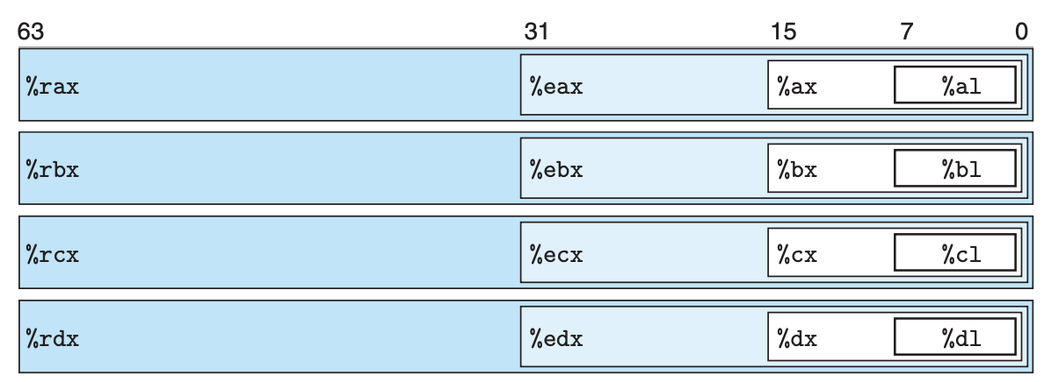
x86-64 Register Access Options
Registers can be accessed by any of these names to work with
8-byte, 4-byte, 2-byte, or 1-byte data

Slide 25
x86-64 Register Access Options
The same data can be accessed under different names and widths
Example: store 64-bit value 0x0000000000010A0B in %rax
  %rax: 0x0000000000010A0B (64-bit)
  %eax: 0x00010A0B (32-bit)
  %ax: 0x0A0B (16-bit)
  %al: 0x0B (8-bit)

Slide 26
x86-64 full register naming
16-bit registers
8-bit
8-bit
%rax
%eax
%ax
%ah
%al
%rbx
%ebx
%bx
%bh
%bl
%rcx
%ecx
%cx
%ch
%cl
%rdx
%edx
%dx
%dh
%dl
%rsi
%esi
%si
%sil
%rdi
%edi
%di
%dil
%rbp
%ebp
%bp
%bpl
%rsp
%esp
%sp
%spl
%r8
%r8d
%r8w
%r8b
…
…
…
%r15b
%r15
%r15d
%r15w
32-bit registers
64-bit registers

Slide 27
Registers versus Memory
What if more variables than registers?
  Keep most frequently used in registers and move the rest to memory (called spilling to memory)
Why not all variables in memory?
  Smaller is faster: registers 100-500 times faster
  Memory Hierarchy
    Registers: 16 registers * 64 bits = 128 Bytes
    RAM: 4-32 GB
    SSD: 100-1000 GB

Slide 28
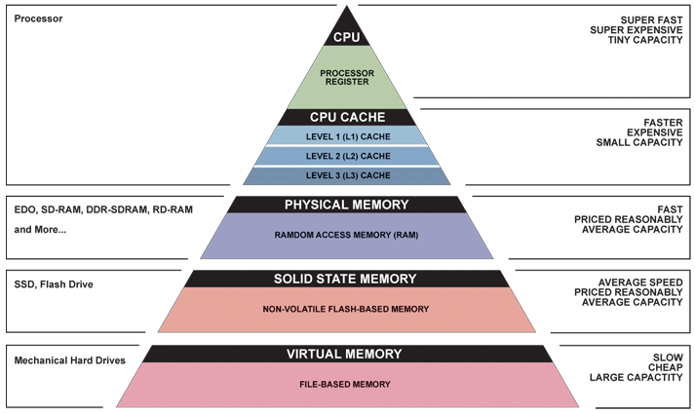
Memory Hierarchy
Registers
Memory

Slide 29
Special-purpose register: Instruction Pointer
Instruction Pointer: %rip
  Contains the address of the currently executing instruction
  Actually special-purpose, only used for this one thing
Processor hardware uses %rip when loading instructions
  Load instruction from memory pointed to by %rip
  Advance %rip to the next instruction
  Repeat
  Note: hardware does this automatically, you don’t (usually) interact with this at all

Slide 30
Assembly Programmer’s View of System State
CPU
Memory
Registers
Addresses
PC
Code
Data
Stack
Data
Condition
Codes
Instructions
Programmer-visible state
  Named registers
    Together in “register file”
    Heavily used program data
  The Instruction Pointer (%rip in x86-64)
    Address of next instruction
  Condition codes
    Store status information about most recent arithmetic operation
    Used for conditional branching
  Memory
    Byte-addressable array
    Code and user data
    Includes the Stack
    (for supporting procedures and variables)
Notes:
Preview for the coming lectures

Slide 31
Break + Question
Which of these is FALSE?
  [A] Registers are faster to access than memory
  [B] Registers do not have a type
  [C] Registers can have special purposes
  [D] Registers are dynamically created as needed

Slide 32
Break + Question
Which of these is FALSE?
  [A] Registers are faster to access than memory
  [B] Registers do not have a type
  [C] Registers can have special purposes
  [D] Registers are dynamically created as needed
  There are a fixed number of registers for a given architecture

Slide 33
Outline
Assembly Languages
Registers
x86-64 Assembly
  Introduction
  Move Instruction
  Memory Addressing Modes

Slide 34
Writing Assembly Code? In 2024???
Chances are, you’ll never write a program in assembly, but understanding assembly is the key to the machine-level execution model:
  Behavior of programs in the presence of bugs
    When high-level language model breaks down
  Tuning program performance
    Understanding compiler optimizations and sources of program inefficiency
  Implementing systems software
    What are the “states” of processes that the OS must manage
    Using special units (timers, I/O co-processors, etc.) inside processor!
  Fighting malicious software
    Distributed software is in binary form
Notes:
Compilers are much better and more patient than you are
I hope that you are never writing a program in assembly
Not even to eke the very last bit of performance out
Because compilers are much better at it
Understanding assembly will help you
Like how C will help you better appreciate the magic that Java does for you
Similarly, understanding assembly will help you understand what the machine is doing for you
Sometimes you actually do have to poke around with GDB in the assembly (this is what gets shipped to you!)

Slide 35
Example x86-64 Assembly
.text
.globl multstore
.type multstore, @function
# multiply and store to memory
multstore:
  pushq %rbx # save to stack
  movq %rdx, %rbx
  call mult2
  movq %rax, (%rbx)
  popq # restore from stack
  ret

Slide 36
Example x86-64 Assembly
.text
.globl multstore
.type multstore, @function
# multiply and store to memory
multstore:
  pushq %rbx # save to stack
  movq %rdx, %rbx
  call mult2
  movq %rax, (%rbx)
  popq # restore from stack
  ret
Various assembly instructions

Slide 37
Example x86-64 Assembly
.text
.globl multstore
.type multstore, @function
# multiply and store to memory
multstore:
  pushq %rbx # save to stack
  movq %rdx, %rbx
  call mult2
  movq %rax, (%rbx)
  popq # restore from stack
  ret
Comments use the
# symbol

Slide 38
Example x86-64 Assembly
.text
.globl multstore
.type multstore, @function
# multiply and store to memory
multstore:
  pushq %rbx # save to stack
  movq %rdx, %rbx
  call mult2
  movq %rax, (%rbx)
  popq # restore from stack
  ret
Labels are arbitrary names that mark a section of code
We’ll get back to these later

Slide 39
Example x86-64 Assembly
.text
.globl multstore
.type multstore, @function
# multiply and store to memory
multstore:
  pushq %rbx # save to stack
  movq %rdx, %rbx
  call mult2
  movq %rax, (%rbx)
  popq # restore from stack
  ret
Assembler directives
(mostly ignore these)
Can be used to specify data versus code regions, make functions linkable with other code, and many other tasks.

Slide 40
x86-64 Instructions
General Instruction Syntax:
op src, dst
  1 operator, 2 operands
    op = operation name (“operator”)
    src1 = source location (“source”)
    dst = destination location (“destination”)
Keep hardware simple via regularity

Slide 41
Careful! Two Syntaxes for Assembly
Intel/Microsoft Format
ATT Format
lea eax,[ecx+ecx*2]
sub esp,8
cmp dword ptr [ebp-8],0
mov eax,dword ptr [eax*4+100h]
leal (%ecx,%ecx,2),%eax
subl $8,%esp
cmpl $0,-8(%ebp)
movl $0x100(,%eax,4),%eax
Intel/Microsoft mnemonics vs. ATT
  Operands listed in opposite order: mov Dest, Src vs. movl Src, Dest
  Constants not preceded by ‘$’, Denote hex with ‘h’ at end: 100h vs. $0x100
  Operand size indicated by operands rather than operator suffix: sub vs. subq
  Addressing format shows effective address computation: [eax*4+100h] vs. $0x100(,%rax,4)
gcc (gas), gdb, objdump work on the ATT format
  We will always use the ATT format as well
Notes:
ATT named after AT&T who used to operate Bell Labs many years ago; ATT is what gcc, objdump, etc consider

Slide 42
Short Break + Example x86-64 Assembly
.text
.globl multstore
.type multstore, @function
# multiply and store to memory
multstore:
  pushq %rbx # save to stack
  movq %rdx, %rbx
  call mult2
  movq %rax, (%rbx)
  popq # restore from stack
  ret
What might this instruction do?
(op src, dst)

Slide 43
Outline
Assembly Languages
Registers
x86-64 Assembly
  Introduction
  Move Instruction
  Memory Addressing Modes

Slide 44
Three Basic Kinds of Instructions
Transfer data between memory and register
  Load data from memory into register
    %reg = Mem[address]
  Store register data into memory
    Mem[address] = %reg
Perform arithmetic operation on register or memory data
  c = a + b; z = x << y; i = h & g;
Control flow: what instruction to execute next
  Unconditional jumps to/from procedures
  Conditional branches
    Remember: Memory is indexed just like an array of bytes!

Slide 45
Moving Data
General form: mov_ source, destination
  Missing letter _ specifies size of operands
  Reminder: backwards compatibility means “word” = 16 bits
  Lots of these in typical code
movb src, dst
  Move 1-byte “byte”
movw src, dst
  Move 2-byte “word”
movl src, dst
  Move 4-byte “long word”
movq src, dst
  Move 8-byte “quad word”
  Native size for x86-64
Note: Instructions must be used with properly-sized register names

Slide 46
Operand Types (src and dst)
%rax
%rcx
Immediate: Constant integer data
  Examples: $0x400, $-533
  Like C literal, but prefixed with ‘$’
  Encoded with 1, 2, 4, or 8 bytes depending on the instruction
Register: 1 of 16 integer registers
  Examples: %rax, %r13
  But %rsp reserved for special use
  Others have special uses for particular instructions
Memory: Consecutive bytes of memory at a computed address
  Simplest example: (%rax) treats value of %rax as an address → access memory
  Various other “address modes” we’ll talk about later
%rdx
%rbx
%rsi
%rdi
%rsp
%rbp
%rN (r8-r15)

Slide 47
MOV Operand Combinations
 | Source | Dest | Src, Dest | C Analog
movq | Imm | Reg | movq $0x4, %rax
 |  | Mem | movq $-147, (%rax)
 | Reg | Reg | movq %rax, %rdx
 |  | Mem | movq %rax, (%rdx)
 | Mem | Reg | movq (%rax), %rdx
var_a = 0x4;
*p_a = -147;
var_d = var_a;
*p_d = var_a;
var_d = *p_a;
Cannot do memory-memory transfer with a single instruction
  How would you do it?
Notes:
Mem -> Reg
Reg -> Mem
movq (%rax), %rdx
movq %rdx, (%rbx)

Slide 48
MOV Operand Combinations
 | Source | Dest | Src, Dest | C Analog
movq | Imm | Reg | movq $0x4, %rax
 |  | Mem | movq $-147, (%rax)
 | Reg | Reg | movq %rax, %rdx
 |  | Mem | movq %rax, (%rdx)
 | Mem | Reg | movq (%rax), %rdx
var_a = 0x4;
*p_a = -147;
var_d = var_a;
*p_d = var_a;
var_d = *p_a;
Cannot do memory-memory transfer with a single instruction
  How would you do it? 1) Mem->Reg, 2) Reg->Mem
Notes:
Mem -> Reg
Reg -> Mem
movq (%rax), %rdx
movq %rdx, (%rbx)

Slide 49
Example of Move Instructions: swap()
void swap(long* xp, long* yp)
{
long t0 = *xp;
long t1 = *yp;
*xp = t1;
*yp = t0;
}
Register Variable
%rdi ⇔ xp
%rsi ⇔ yp
%rax ⇔ t0
%rdx ⇔ t1
Registers
Memory
swap:
movq (%rdi), %rax
movq (%rsi), %rdx
movq %rdx, (%rdi)
movq %rax, (%rsi)
ret
%rdi
%rsi
%rax
%rdx

Slide 50
Example of Move Instructions: swap()
Registers
Memory
Word
Address
%rdi
0x120
123
123
0x120
%rsi
0x100
0x118
0x110
%rax
0x108
%rdx
456
0x100
swap:
movq (%rdi), %rax # t0 = *xp
movq (%rsi), %rdx # t1 = *yp
movq %rdx, (%rdi) # *xp = t1
movq %rax, (%rsi) # *yp = t0
ret
Notes:
But actually, pointers are just addresses!
Showing here 8-byte words of memory, addresses jump by 8

Slide 51
Example of Move Instructions: swap()
Registers
Memory
Word
Address
%rdi
0x120
123
123
0x120
%rsi
0x100
0x118
0x110
%rax
123
0x108
%rdx
456
0x100
swap:
movq (%rdi), %rax # t0 = *xp
movq (%rsi), %rdx # t1 = *yp
movq %rdx, (%rdi) # *xp = t1
movq %rax, (%rsi) # *yp = t0
ret

Slide 52
Example of Move Instructions: swap()
Registers
Memory
Word
Address
%rdi
0x120
123
123
0x120
%rsi
0x100
0x118
0x110
%rax
123
0x108
%rdx
456
456
0x100
swap:
movq (%rdi), %rax # t0 = *xp
movq (%rsi), %rdx # t1 = *yp
movq %rdx, (%rdi) # *xp = t1
movq %rax, (%rsi) # *yp = t0
ret

Slide 53
Example of Move Instructions: swap()
Registers
Memory
Word
Address
%rdi
0x120
456
123
0x120
%rsi
0x100
0x118
0x110
%rax
123
0x108
%rdx
456
456
0x100
swap:
movq (%rdi), %rax # t0 = *xp
movq (%rsi), %rdx # t1 = *yp
movq %rdx, (%rdi) # *xp = t1
movq %rax, (%rsi) # *yp = t0
ret

Slide 54
Example of Move Instructions: swap()
Registers
Memory
Word
Address
Note: these did not change
%rdi
0x120
456
123
0x120
%rsi
0x100
0x118
0x110
%rax
123
0x108
%rdx
456
123
0x100
swap:
movq (%rdi), %rax # t0 = *xp
movq (%rsi), %rdx # t1 = *yp
movq %rdx, (%rdi) # *xp = t1
movq %rax, (%rsi) # *yp = t0
ret

Slide 55
Break + Open Question
How does the number of available registers affect a system?
  What if x86-64 only had two registers?
  What if x86-64 instead had 512 registers?

Slide 56
Break + Open Question
How does the number of available registers affect a system?
  What if x86-64 only had two registers?
    “Register Pressure” becomes a problem
    Accessing 3+ things at once requires memory
    Way more memory reads/writes
  What if x86-64 instead had 512 registers?
    Most of the registers would never be used
      For any realistic program
    Could have spent that silicon on something more important

Slide 57
Outline
Assembly Languages
Registers
x86-64 Assembly
  Introduction
  Move Instruction
  Memory Addressing Modes

Slide 58
Memory Addressing Modes: Basic
Common need: interact with memory
  Exact address might be made of multiple parts
Indirect: (R) Mem[Reg[R]]
  Data in register R specifies the memory address
  Like pointer dereference in C
  Example: movq (%rcx), %rax
Displacement: D(R) Mem[Reg[R]+D]
  Data in register R specifies the start of some memory region
  Constant displacement D specifies the offset from that address
  Example: movq 8(%rbp), %rdx

Slide 59
Complete Memory Addressing Modes
General:
  D(Rb,Ri,S) Mem[Reg[Rb]+Reg[Ri]*S+D]
    Rb: Base register (any register)
    Ri: Index register (any register except %rsp)
    S: Scale factor (1, 2, 4, 8) – why these numbers?
    D: Constant displacement value (a.k.a. immediate)
Special cases (see textbook Figure 3.3 or next slide)
  D(Rb,Ri) Mem[Reg[Rb]+Reg[Ri]+D] (S=1)
  (Rb,Ri,S) Mem[Reg[Rb]+Reg[Ri]*S] (D=0)
  (Rb,Ri) Mem[Reg[Rb]+Reg[Ri]] (S=1,D=0)
  (,Ri,S) Mem[Reg[Ri]*S] (Rb=0,D=0)
Sizes of common C types!
Notes:
Syntax for memory operands can be more complex
Designed to do things that are common with pointers
D: displacement, add a constant
Rb: base pointer
Ri: index into array
S: scale the index (pointer arithmetic needs to scale by the size of the pointer target)
compiler keeps track of what the pointer points to and scales accordingly
int x[] x[i]
ith element of an array of ints: Ri=i, S=4 (bytes)
See figure 3.3 in 3e textbook

Slide 60
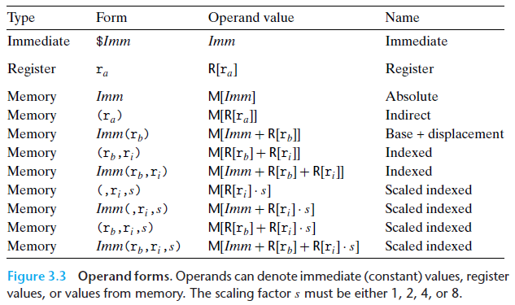
Full list of addressing mode forms

Slide 61
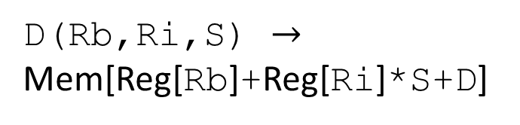
Address Computation Examples
%rdx
0xf000
D(Rb,Ri,S) $→$
Mem[Reg[Rb]+Reg[Ri]*S+D]
%rcx
0x0100
Expression | Address Computation | Address
0x8(%rdx)
(%rdx,%rcx)
(%rdx,%rcx,4)
0x80(,%rdx,2)

Slide 62
Address Computation Examples
%rdx
0xf000
D(Rb,Ri,S) $→$
Mem[Reg[Rb]+Reg[Ri]*S+D]
%rcx
0x0100
Expression | Address Computation | Address
0x8(%rdx) | %rdx + 0x8 | 0xf008
(%rdx,%rcx)
(%rdx,%rcx,4)
0x80(,%rdx,2)

Slide 63
Address Computation Examples
%rdx
0xf000
D(Rb,Ri,S) $→$
Mem[Reg[Rb]+Reg[Ri]*S+D]
%rcx
0x0100
Expression | Address Computation | Address
0x8(%rdx) | %rdx + 0x8 | 0xf008
(%rdx,%rcx) | %rdx + %rcx*1 | 0xf100
(%rdx,%rcx,4)
0x80(,%rdx,2)

Slide 64
Address Computation Examples
%rdx
0xf000
D(Rb,Ri,S) $→$
Mem[Reg[Rb]+Reg[Ri]*S+D]
%rcx
0x0100
Expression | Address Computation | Address
0x8(%rdx) | %rdx + 0x8 | 0xf008
(%rdx,%rcx) | %rdx + %rcx*1 | 0xf100
(%rdx,%rcx,4) | %rdx + %rcx*4 | 0xf400
0x80(,%rdx,2)

Slide 65
Address Computation Examples
%rdx
0xf000
D(Rb,Ri,S) $→$
Mem[Reg[Rb]+Reg[Ri]*S+D]
%rcx
0x0100
Expression | Address Computation | Address
0x8(%rdx) | %rdx + 0x8 | 0xf008
(%rdx,%rcx) | %rdx + %rcx*1 | 0xf100
(%rdx,%rcx,4) | %rdx + %rcx*4 | 0xf400
0x80(,%rdx,2) | %rdx*2 + 0x80 | 0x1e080

Slide 66
Outline
Assembly Languages
Registers
x86-64 Assembly
  Introduction
  Move Instruction
  Memory Addressing Modes

