Slide 1
Lecture 02
Data Representations
CS213 – Intro to Computer Systems
Branden Ghena – Winter 2024
Slides adapted from:
St-Amour, Hardavellas, Bustamente (Northwestern), Bryant, O’Hallaron (CMU), Garcia, Weaver (UC Berkeley)

Slide 2
Announcements
Homework 1 will be posted sometime later today
  Practice problems on binary-to-hex-to-decimal conversion, integer encodings, and memory
  Today’s lecture will finish the content you need for it
  Due Tuesday January 16th
  You’ll submit to Gradescope, which I’ll add you all too as well

Slide 3
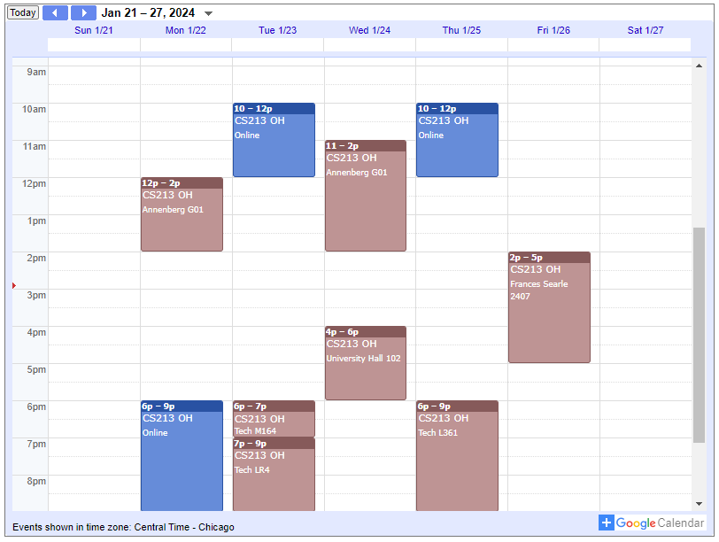
Office Hours
Start on Wednesday of this week
Variety of times, with most in-person but some online
Depending on slot,
2-6 staff members available to help people
Help queue signup and status on Canvas homepage

Slide 4
Today’s Goals
Review of binary and hexadecimal
Discuss data representation in memory
Explore data representations
  Integers, signed and unsigned
  Different bit widths
  Translating between encoding schemes
  Other encodings besides integers

Slide 5
Outline
Binary and Hex
Memory
Encoding
Integer Encodings
  Signed Integers
  Converting Sign
  Converting Length
Other encodings

Slide 6
Positional Numbering Systems
The position of a numeral (e.g., digit) determines its contribution to the overall number
  Makes arithmetic simple (compared to, say, roman numerals)
  Any number has one canonical representation
Example: base 10
  10456₁₀ = 1*10⁴ + 0*10³ + 4*10² + 5*10¹ + 6*10⁰
  Usually, we leave out the zeros:
    1*10⁴ + 4*10² + 5*10¹ + 6*10⁰

Slide 7
Practice: Base 2
Translate 0b10111 to decimal (0b means binary)
  1*16 + 0*8 + 1*4 + 1*2 + 1*1
  16 + 4 + 2 + 1
  23
Translate decimal 40 to binary
  32 + 8
  1*32 + 0*16 + 1*8 + 0*4 + 0*2 + 0*1
  0b101000

Slide 8
Base 16: Hexadecimal
Hex | Decimal | Binary
0 | 0 | 0000
1 | 1 | 0001
2 | 2 | 0010
3 | 3 | 0011
4 | 4 | 0100
5 | 5 | 0101
6 | 6 | 0110
7 | 7 | 0111
8 | 8 | 1000
9 | 9 | 1001
A | 10 | 1010
B | 11 | 1011
C | 12 | 1100
D | 13 | 1101
E | 14 | 1110
F | 15 | 1111
Writing long sequences of 0s and 1s is tedious and error-prone
  And takes up a lot of space on a page!
So we’ll often use base 16 (also called hexadecimal)
Base 2 = 2 symbols (0, 1)
Base 10 = 10 symbols (0-9)
Base 16, need 16 symbols
  Use letters A-F once we run out of decimal digits
Example: 0x3A (0x means hexadecimal)

Slide 9
Hex example
Hex | Decimal | Binary
0 | 0 | 0000
1 | 1 | 0001
2 | 2 | 0010
3 | 3 | 0011
4 | 4 | 0100
5 | 5 | 0101
6 | 6 | 0110
7 | 7 | 0111
8 | 8 | 1000
9 | 9 | 1001
A | 10 | 1010
B | 11 | 1011
C | 12 | 1100
D | 13 | 1101
E | 14 | 1110
F | 15 | 1111
Convert decimal 165 to hex (first convert to binary)
Decimal to binary
  165
  128 + 32 + 4 + 1
  1*128 + 0*64 + 1*32 + 0*16 + 0*8 + 1*4 + 0*2 + 1*1
  0b10100101
Binary to hex
  0b1010 0101
  0xA5

Slide 10
Specific bit widths
Since computers are hardware, cannot have arbitrary bit lengths
  Must be some specific number of bits
  We’ll say “this is a 16-bit number” or this is a “9-bit number”
What if the number of bits isn’t divisible by four, can it still be hex?
  Yes! All non-existent bits MUST be zero
Example: translate 0x35 to a 6-bit binary number
  0b0011 0101 -> 0b11 0101
  If it had been 0x75 (0b111 0101) writing as a 6-bit binary number would be impossible (converting could happen, but we’d have overflow)

Slide 11
More bit-width examples
Convert 0b11 to hexadecimal
  0x3
How many bits is 0x3?
  MUST be at least 2 bits
  Could be more though: 4-bit, or 64-bit, or as many zeros as you want

Slide 12
Outline
Binary and Hex
Memory
Encoding
Integer Encodings
  Signed Integers
  Converting Sign
  Converting Length
Other encodings

Slide 13
Bytes
A single bit doesn’t hold much information
  Only two possible values: 0 and 1
  So we’ll typically work with larger groups of bits
For convenience, we’ll refer to groups of 8 bits as bytes
  And usually work with multiples of 8 bits at a time
  Conveniently, 8 bits = 2 hexits
Some examples
  1 byte: 0b01100111 = 0x67
  2 bytes: 11000100 00101111₂ = 0xC42F
“0b” prefix = it’s in binary
“0x” prefix = it’s in hex

Slide 14
Byte-oriented memory organization
We’ve seen how sequences of bits can express numbers
  And how we usually work with groups of 8 bits (bytes) for convenience
  Variables are almost always some multiple number of bytes (1 byte, 2 bytes, 8 bytes, etc.)
In a computer system, bytes can be stored in memory
  Conceptually, memory is a very large array of bytes
  Each byte has its own address (≈ pointer)
Compiler + run-time system control allocation
  Where different program objects should be stored
  Multiple mechanisms, each with its own region: static, stack, and heap
00•••0
FF•••F
• • •

Slide 15
Most/least significant bits/bytes
When working with sequences of bits (or sequences of bytes), need to be able to talk about specific bits (bytes)
  Most Significant bit (MSb) and Most Significant Byte (MSB)
    Have the largest possible contribution to numeric value
    Leftmost when writing out the binary sequence
  Least Significant bit (LSb) and Least Significant Byte (LSB)
    Have the smallest possible contribution to numeric value
    Rightmost when writing out the binary sequence
10110110 01101010 10101010 01111100
Most significant byte
Least significant byte
Most significant bit
Least significant bit

Slide 16
Addressing and byte ordering
For data that spans multiple bytes, need to agree on two things
  1. What should be the address of the object? (each byte has its own!)
    And by extension, given an address, how do we find the relevant bytes
    (same question!)
  2. How should we order the bytes in memory?
    Do we put the most or least significant byte at the first address?

Slide 17
There isn’t always one correct answer
Different systems can pick different answers! (mostly for 2nd Q)
  Very nice illustration of two overarching principles in systems:
  You need to know the specifics of the system you’re using!
    Many questions don’t really have right or wrong answers!
    Instead, they have tradeoffs. What the “right” answer is depends on context!
  Different answers across systems is perfectly fine
    But all the parts of a given system must agree with each other!

Slide 18
1. Addressing data in memory
Addr.
Bytes
32-bit
64-bit
All addresses refer to one or more bytes
  Never bits
For multi-byte objects, the lowest address refers to the entire object
  Addresses of successive objects differ by
  4 (32-bit) or 8 (64-bit)
Systems pretty much universally
use the address of the first byte as
the address for the whole object
  I’m not aware of any system that does
  otherwise
  But there could be some weirdo systems
  out there (or historically)
0000
0001
Addr
=
??
0002
0000
0003
Addr
=
??
0004
0000
0005
Addr
=
??
0006
0004
0007
0008
0009
Addr
=
??
0010
0008
Addr
=
??
0011
0012
0008
0013
Addr
=
??
0014
0012
0015
Notes:
For objects that span multiple bytes we need to agree on two things
- what would be the address of the object?
- how would we order the bytes in memory?

Slide 19
2. Byte ordering
How to order bytes within a multi-byte object in memory
  Only relevant when working with data larger than a byte!
Conventions
  Big Endian: Computer Networks, various historical computer systems
    Most significant byte has lowest address (comes first)
  Little Endian: Intel (x86, x86-64), ARM, other modern computer systems
    Least significant byte has lowest address (comes first)
Example
  4-byte piece of data: 0x01234567
  Address of that data is 0x100
Increasing memory addresses
Big Endian
0x100
0x101
0x102
0x103
01
01
23
23
45
45
67
67
Little Endian
0x100
0x101
0x102
0x103
67
67
45
45
23
23
01
01
Notes:
most significant comes first -> big endian
Little and big endian comes from Jonathan Swifts’ Guilliver’s Travels where two groups couldn’t agree as to how a soft-boiled egg should be opened (big or little end first)
Anecdote: little endian was developed by intel to keep backwards compatibility with cashier’s machines that were streaming data in the proper order for computation (LSB in first).
The CTC Datapoint 2200 was designed using simpler bit-serial logic in which little-endian address and data formats facilitate carry propagation. When Intel implemented the 8008 for Datapoint, they kept the little-endian architecture. However, Datapoint never used the 8008 chip, using an MSI equivalent implementation as Intel was unable to deliver the 8008 in time. After renegotiation, CTC kept its money and Intel kept the rights to 8008. That was the beginning of the x86 architecture.

Slide 20
Practice: reading memory
Address | Value
0x2010 | 0x37
0x2011 | 0x1A
0x2012 | 0xBE
0x2013 | 0x98
0x2014 | 0x0C
0x2015 | 0x80
0x2016 | 0x42
Assume memory is Little Endian
  So the Least Significant Byte comes first
What is the four-byte value at 0x2010?
What is the two-byte value at 0x2014?
What is the one-byte value at 0x2016?

Slide 21
Practice: reading memory
Address | Value
0x2010 | 0x37
0x2011 | 0x1A
0x2012 | 0xBE
0x2013 | 0x98
0x2014 | 0x0C
0x2015 | 0x80
0x2016 | 0x42
Assume memory is Little Endian
  So the Least Significant Byte comes first
What is the four-byte value at 0x2010?
What is the two-byte value at 0x2014?
What is the one-byte value at 0x2016?
0x98BE1A37
0x800C
0x42

Slide 22
Practice: reading memory
Address | Value
0x2010 | 0x37
0x2011 | 0x1A
0x2012 | 0xBE
0x2013 | 0x98
0x2014 | 0x0C
0x2015 | 0x80
0x2016 | 0x42
Assume memory is Little Endian
  So the Least Significant Byte comes first
What is the four-byte value at 0x2010?
What is the two-byte value at 0x2014?
What is the one-byte value at 0x2016?
0x98BE1A37
0x800C
0x42

Slide 23
Practice: reading memory
Address | Value
0x2010 | 0x37
0x2011 | 0x1A
0x2012 | 0xBE
0x2013 | 0x98
0x2014 | 0x0C
0x2015 | 0x80
0x2016 | 0x42
Change: assume memory is Big Endian
  So the Most Significant Byte comes first
What is the four-byte value at 0x2010?
What is the two-byte value at 0x2014?
What is the one-byte value at 0x2016?
0x371ABE98
0x0C80
0x42
Note: endianness doesn’t affect one-byte values!

Slide 24
Tables of memory
Address | 0 | 1 | 2 | 3 | 4 | 5 | 6 | 7
0x1040 | 2E | E2 | BD | 62 | EF | A0 | CD | 93
0x1048 | A4 | 75 | 61 | 2F | 0F | DB | 64 | A4
0x1050 | 54 | 7A | F2 | 60 | 6E | 47 | B0 | 92
0x1058 | DA | 72 | 8F | A8 | E5 | 15 | 18 | CE
0x1060 | 86 | BF | 6A | 6A | 92 | 99 | CF | 6C
Method of displaying large chunks of memory
  8 bytes per row (in this example)
  Data values in hexadecimal
Memory addresses labeled on the left and byte offset on the top
  Also in hexadecimal

Slide 25
Tables of memory
Address | 0 | 1 | 2 | 3 | 4 | 5 | 6 | 7
0x1040 | 2E | E2 | BD | 62 | EF | A0 | CD | 93
0x1048 | A4 | 75 | 61 | 2F | 0F | DB | 64 | A4
0x1050 | 54 | 7A | F2 | 60 | 6E | 47 | B0 | 92
0x1058 | DA | 72 | 8F | A8 | E5 | 15 | 18 | CE
0x1060 | 86 | BF | 6A | 6A | 92 | 99 | CF | 6C
To find an address: deconstruct into:
  base address (left) + offset (top)
Remember: addresses are in hexadecimal!
  0x1048+2 = 0x104A

Slide 26
Practice: Tables of memory
Address | 0 | 1 | 2 | 3 | 4 | 5 | 6 | 7
0x1040 | 2E | E2 | BD | 62 | EF | A0 | CD | 93
0x1048 | A4 | 75 | 61 | 2F | 0F | DB | 64 | A4
0x1050 | 54 | 7A | F2 | 60 | 6E | 47 | B0 | 92
0x1058 | DA | 72 | 8F | A8 | E5 | 15 | 18 | CE
0x1060 | 86 | BF | 6A | 6A | 92 | 99 | CF | 6C
What value is at address 0x1050?
  0x54 (0x1050 + 0)
What value is at address 0x105F?
  0xCE (0x1058 + 7)

Slide 27
Outline
Binary and Hex
Memory
Encoding
Integer Encodings
  Signed Integers
  Converting Sign
  Converting Length
Other encodings

Slide 28
Big Idea: What do bits and bytes mean in a system?
The answer is: it depends!
Depending on the context, the bits 11000011 could mean
  The number 195
  The number -61
  The number -19/16
  The character ‘├’
  The ret x86 instruction
You have to know the context to make sense of any bits you have!
  Looking at the same bits in different contexts can lead to interesting results
  Information = bits + context!
An encoding is a set of rules that gives meaning to bits

Slide 29
An example encoding: ASCII characters
ASCII = American Standard Code for Information Interchange
  Standard dating from the 60s
Maps 8-bit* bit patterns to characters
  (* the standard is actually 7-bit, leaving the 8th bit unused)
  We already know how to go from sequences of bits (base 2) to integers
  Need to take one more step, and interpret these integers as characters
Examples
  0100 0001₂ = 0x41 = 65₁₀ = ‘A’
  0100 0010₂ = 0x42 = 66₁₀ = ‘B’
  0011 0000₂ = 0x30 = 48₁₀ = ‘0’
  0011 0001₂ = 0x31 = 49₁₀ = ‘1’
Reference: https://www.asciitable.com/

Slide 30
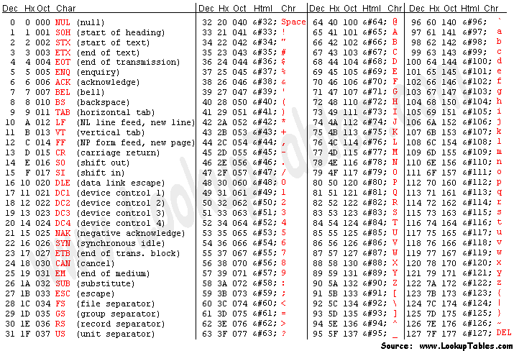
Full ASCII table
Values listed in:
Decimal
Hexadecimal
Octal
HTML
Character

Slide 31
Encodings are just determined by people
There’s no inherent truth in the design of an encoding
  Although some encodings are nice or annoying for various reasons
  Example: it’s nice in ASCII that letters are in alphabetical order
You could come up with an entirely new way of encoding characters
  The hard part would be getting everyone else to agree to use it

Slide 32
Open Question + Break
What things might we want to encode?

Slide 33
Open Question + Break
What things might we want to encode?
  Numbers
    Signed and unsigned integers
    Real numbers
    Mathematical symbols: ∞ 𝛑
  Language
    Characters in various different languages ΩͶݽ서北
    Emoji 😱😡😁😭🤷🦃🎶🎂✨🐱‍🏍🍢
  Colors, Playing Cards, User Actions, anything!

Slide 34
Outline
Binary and Hex
Memory
Encoding
Integer Encodings
  Signed Integers
  Converting Sign
  Converting Length
Other encodings

Slide 35
Integer types in C
C type provides both size and encoding rules
Integer types in C come in two flavors
  Signed: short, signed short, int, long, …
  Unsigned: unsigned char, unsigned short, unsigned int, ...
And in multiple different sizes
  1 byte: signed char, unsigned char
  2 bytes: short, unsigned short
  4 bytes: int, unsigned int
  Etc.

Slide 36
Sizes of C types are system dependent
Portability
  Some programmers assume an int can be used to store a pointer
  OK for most 32-bit machines, but fails for 64-bit machines!
How I program
  Use fixed width integer types from <stdint.h>
  int8_t, int16_t, int32_t
  uint8_t, uint16_t, uint32_t
C Data Type | Intel IA32 | x86-64 | C Standard* (C99)
char | 1 | 1 | ≥1
short | 2 | 2 | ≥2
int | 4 | 4 | ≥2
long | 4 | 8 | ≥4
long long | 8 | 8 | ≥8
float | 4 | 4
double | 8 | 8
pointer | 4 | 8 | Widths for data, code pointers may differ!
CS213 uses this
Notes:
Note that short int use 2-bytes, unqualified int is 4B and long int uses the full word size (4 or 8)
Also note two different floating-point formats – single and double precision
There are differences among same architectures of different width, different archs of same width, and the standard is in lala land

Slide 37
Expressing C types in bits
Two families of encodings to express integers using bits
  Unsigned encoding for unsigned integers
  Two’s complement encoding for signed integers
Each encoding will use a fixed size (# of bits)
  For a given machine
  Size + encoding family determine which C type we’re representing
    Reverse is also true: a C type specifies both size and encoding
  Fixed size is because computers are finite!

Slide 38
Unsigned integer encoding
Just write out the number in binary
  Works for 0 and all positive integers
Example: encode 104₁₀ as an unsigned 8-bit integer
  104₁₀ = 0×2⁷ + 1×2⁶ + 1×2⁵ + 0×2⁴ + 1×2³ + 0×2² + 0×2¹ + 0×2⁰
⇒ 01101000
⇒ 0x68
(Binary To Unsigned)

Slide 39
Bounds of unsigned integers
For a fixed width w, a limited range of integers can be expressed
  Smallest value (we will call UMin):
    all 0s bit pattern: 000…0, value of 0
  Largest value (we will call UMax):
    all 1s bit pattern: 111...1, value of 2^{w} – 1
    2^{w} – 1 = 1×2^{w-1} + 1×2^{w-2} + ... + 1×2¹ + 1×2⁰ = 11111...
Maximum 8-bit number = 2⁸-1 = 256-1 = 255

Slide 40
Outline
Binary and Hex
Memory
Encoding
Integer Encodings
  Signed Integers
  Converting Sign
  Converting Length
Other encodings

Slide 41
Encoding signed integers
What’s different about representing a signed number?
  It can be negative!
So, we’re going to have to somehow represent values that are negative and positive
There are actually many different encodings capable of doing this
  This is when that “nice encoding” versus “annoying encoding” matters

Slide 42
Doesn’t work: attempting signed encoding
Goal: encode integers that can be positive or negative
First attempt: we can use the most significant bit for sign
  “Sign-and-magnitude” encoding
  In 8-bits:
    +4 = 00000100
    -4 = 10000100
+127 = 01111111
-127 = 11111111
+0 = 00000000
-0 = 10000000
Annoying problem: we have two representations of zero!
Also annoying: hardware to do math with signed and unsigned numbers gets complicated…

Slide 43
Does work: Two’s complement encoding
Bad news: need to make the encoding more complicated
Good news: it will actually work
Plan:
  Start with unsigned encoding, but make ONLY the largest power negative
  Example: for 8 bits, most significant bit is worth -2⁷ not +2⁷ (other bits are still positive)
To encode a negative integer
  First, set the most significant bit to 1 to start with a big negative number
  Then, add positive powers of 2 (the other bits) to “get back” to number we want
Example: encode -6 as a 4-bit two’s complement integer
  -6₁₀ =
1 × -2³
+ 0 × 2² + 1 × 2¹ + 0 × 2¹
⇒ 0b1010
⇒ 0xa

Slide 44
Two’s complement examples
Encode -100 as an 8-bit two’s complement number
  -100₁₀ =
1 × -2⁷
-128
+ 0 × 2⁶
+ 0
+ 0 × 2⁵
+ 0
+ 1 × 2⁴
+ 16
+ 1 × 2³
+ 8
+ 1 × 2² + 0 × 2¹ + 0 × 2⁰
+4 +0 +0
Problem becomes:
encode +28 as a 7-bit unsigned number
-100₁₀ = 0b10011100 = 0x9C
Shortcut: determine positive version of number, flip all the bits, and add one
  100₁₀ = 0b01100100
  Flipped = 0b10011011
  Plus 1 = 0b10011100 = 0x9C We’ll talk about binary addition next lecture

Slide 45
Interpreting binary signed values
Converting binary to signed:
Note: most significant bit still tells us sign!! 1-> negative
  Checking if a number is negative is just checking that top bit
Zero problem is solved too
  0b00000000 = 0 0b10000000 = -128
-1: 0b111…1 = -1 (regardless of number of bits!)
Sign bit

Slide 46
Bounds of two’s complement integers
For a fixed width w, a limited range of integers can be expressed
  Smallest value, most negative (we will call TMin):
    1 followed by all 0s bit pattern: 100…0 = -2^{w-1}
  Largest value, most positive (we will call TMax):
    0 followed by all 1s bit pattern: 01...1, value of 2^{w-1} – 1
Beware the asymmetry! Bigger negative number than positive

Slide 47
Ranges for different bit amounts
Observations
  |TMin | = TMax + 1
    Asymmetric range
  UMax = 2 * TMax + 1
C Programming
  #include <limits.h>
  Declares constants, e.g.,
    ULONG_MAX
    LONG_MAX
    LONG_MIN
  Values are platform specific
Notes:
Note the asymmetry on the 2’s-complement range, a source of bugs; why the asymmetry? 0 is nonnegative which means it can represent one less positive number
Note also that UMax is just over 2 TMax (Umax = 2*Tmax+1)

Slide 48
Unsigned & Signed Numeric Values
X
B2U(X)
B2T(X)
Equivalence
  Same encodings for non-negative values
Uniqueness
  Every bit pattern represents unique integer value
  Each representable integer has unique bit encoding
⇒ Can Invert Mappings
  Can go from bits to number and back, and vice versa
  U2B(x) = B2U⁻¹(x)
    Bit pattern for unsigned integer
  T2B(x) = B2T⁻¹(x)
    Bit pattern for two’s complement integer
0000
0
0
0001
1
1
0010
2
2
0011
3
3
0100
4
4
0101
5
5
0110
6
6
0111
7
7
1000
8
–8
1001
9
–7
1010
10
–6
1011
11
–5
1100
12
–4
1101
13
–3
1110
14
–2
1111
15
–1

Slide 49
Practice + Break
What range of integers can be represented with
5-bit two’s complement?
    A -31 to +31
    B -15 to +15
    C 0 to +31
    D -16 to +15
    E -32 to +31

Slide 50
Practice + Break
What range of integers can be represented with
5-bit two’s complement?
    A -31 to +31 No asymmetry and 6-bits
    B -15 to +15 No asymmetry
    C 0 to +31 Unsigned
    D -16 to +15 Correct
    E -32 to +31 6-bits

Slide 51
Outline
Binary and Hex
Memory
Encoding
Integer Encodings
  Signed Integers
  Converting Sign
  Converting Length
Other encodings

Slide 52
Casting signed to unsigned
C allows conversions from signed to unsigned (and vice versa)
Resulting value
  Not based on current decimal value: instead keep the bits and reinterpret them!
  Non-negative values unchanged
    ux = 15213
  Negative values change into (large) positive values (and vice versa)
    uy = 50323
Warning: Casts can be implicit in assignments or function calls!
  More on that in a few slides
short int x = 15213;
unsigned short int ux = (unsigned short) x;
short int y = -15213;
unsigned short int uy = y; /* implicit cast! */

Slide 53
Mapping Signed ↔ Unsigned (4 bits)
Bits
0000
0001
0010
0011
0100
0101
0110
0111
1000
1001
1010
1011
1100
1101
1110
1111
Signed
0
1
2
3
4
5
6
7
-8
-7
-6
-5
-4
-3
-2
-1
Unsigned
0
1
2
3
4
5
6
7
8
9
10
11
12
13
14
15
=
Large negative
value becomes
large positive!
+ 16 (i.e., 2⁴)
- 16 (i.e., 2⁴)

Slide 54
Signed vs Unsigned in C
Constants
  By default constants are considered to be signed integers
  Unsigned with “U/u” as suffix: 0U, 4294967259U
Expression evaluation
  If there is a mix of unsigned and signed in a single expression,
  signed values are converted to unsigned
  Including comparison operations!! <, >, ==, <=, >=
Can lead to surprising behavior!
  -1 < 0U ⇒ false!
  -1 gets converted to unsigned
  All 1s bit pattern ⇒ UMax! Definitely not less than 0!

Slide 55
Example
Convert signed 8-bit number -120 into an unsigned number
Convert -120 into binary
Convert binary back into unsigned decimal

Slide 56
Example
Convert signed 8-bit number -120 into an unsigned number
Convert -120 into binary
-120 = -128 + 8 =
Convert binary back into unsigned decimal

Slide 57
Example
Convert signed 8-bit number -120 into an unsigned number
Convert -120 into binary
-120 = -128 + 8 =
1x(-128) + 0x64 + 0x32 + 0x16 + 1x8 + 0x4 + 0x2 + 0x1
0b 1000 1000
Convert binary back into unsigned decimal

Slide 58
Example
Convert signed 8-bit number -120 into an unsigned number
Convert -120 into binary
-120 = -128 + 8 =
1x(-128) + 0x64 + 0x32 + 0x16 + 1x8 + 0x4 + 0x2 + 0x1
0b 1000 1000
Convert binary back into unsigned decimal
  1x128 + 0x64 + 0x32 + 0x16 + 1x8 + 0x4 + 0x2 + 0x1
  128 + 8 = 136

Slide 59
Code Security Example
/* Kernel memory region holding user-accessible data */
#define KSIZE 1024
char kbuf[KSIZE];
/* Copy at most maxlen bytes from kernel region to user buffer */
int copy_from_kernel(void *user_dest, int maxlen) {
/* Byte count len is minimum of buffer size and maxlen */
int len = KSIZE < maxlen ? KSIZE : maxlen;
memcpy(user_dest, kbuf, len);
return len;
}
Simplified example of code found in FreeBSD’s implementation of getpeername
There are legions of experts trying to find vulnerabilities in programs, not all with good intentions

Slide 60
Typical Usage
/* Kernel memory region holding user-accessible data */
#define KSIZE 1024
char kbuf[KSIZE];
/* Copy at most maxlen bytes from kernel region to user buffer */
int copy_from_kernel(void *user_dest, int maxlen) {
/* Byte count len is minimum of buffer size and maxlen */
int len = KSIZE < maxlen ? KSIZE : maxlen;
memcpy(user_dest, kbuf, len);
return len;
}
#define MSIZE 528
void getstuff() {
char mybuf[MSIZE];
copy_from_kernel(mybuf, MSIZE);
printf(“%s\n”, mybuf);
}

Slide 61
Malicious Usage
/* Declaration of library function memcpy */
void *memcpy(void *dest, void *src, size_t n);
/* Kernel memory region holding user-accessible data */
#define KSIZE 1024
char kbuf[KSIZE];
/* Copy at most maxlen bytes from kernel region to user buffer */
int copy_from_kernel(void *user_dest, int maxlen) {
/* Byte count len is minimum of buffer size and maxlen */
int len = KSIZE < maxlen ? KSIZE : maxlen;
memcpy(user_dest, kbuf, len);
return len;
}
#define MSIZE 528
void getstuff() {
char mybuf[MSIZE];
copy_from_kernel(mybuf, -MSIZE);
. . .
}
size_t is unsigned!

Slide 62
Outline
Binary and Hex
Memory
Encoding
Integer Encodings
  Signed Integers
  Converting Sign
  Converting Length
Other encodings

Slide 63
Truncation
May want to convert between numeric types of different sizes
Going from a larger to a smaller number of bits is easy
  Truncation: drop bits from the most significant side until we fit
    Values that can be represented by both types are preserved!
      Including negative values!
    Values that can’t be represented by the smaller type are mapped to some that can (modular (= modulo) behavior)
Example
  16 bits → 8 bits: 10110010 01001000 →
  Unsigned: 45640₁₀ → 72₁₀
    72₁₀ = 45640₁₀ modulo 2⁸
  Signed: -52664₁₀ → 72₁₀
    72₁₀ = -52664₁₀ modulo 2⁸
01001000

Slide 64
Extension
Going from smaller to larger: what to do with the “new” bits?
  These “new” bits go on the most significant side
Unsigned: easy, pad with 0s!
  Always safe to add 0s on the most significant end: 15213₁₀ = 00015213₁₀
  Example: 8 bits → 16 bits: 01001000 →
    72₁₀ = 72₁₀
  Value is preserved!
00000000
01001000

Slide 65
Sign Extension
Extending signed encodings takes more effort to preserve the value
Duplicate the Most significant bit when extending
  If it’s a zero, extend with zeros. If it’s a one, extend with ones.
w
X
• • •
• • •
X’
• • •
• • •
k
w

Slide 66
Example sign extension
Extend -128 from an 8-bit to bigger versions
8-bit version:
  -128 + 0 = 1x(-128) + all zeros = 0b1000 0000
9-bit version:
  -256 + 128 = 1x(-256) + 1x128 + all zeros = 0b1 1000 0000
10-bit version:
  -512 + 256 + 128 = 0b11 1000 0000

Slide 67
Sign Extension Examples
signed short x = 15213;
signed int ix = (int) x;
signed short y = -15213;
signed int iy = (int) y;
Decimal
Hex
Binary
x
15213
3B 6D
00111011 01101101
ix
15213
00 00 3B 6D
00000000 00000000 00111011 01101101
y
-15213
C4 93
11000100 10010011
iy
-15213
FF FF C4 93
11111111 11111111 11000100 10010011
Converting from smaller to larger integer data type
C automatically performs sign extension for signed types
  If cast changes both sign and size, extends based on source signedness
  But less confusing to write code that makes the types (and casts) explicit

Slide 68
Justification for sign extension
Prove correctness by induction on k
  Induction Step: extending by single bit maintains value
Look at weight of high-order bits:
  X: -2^{w–1} x_{w–1}
  X’: -2^{w} x_{w–1} + 2^{w–1} x_{w–1} = (-2^{w-1+1})x_{w–1} + 2^{w–1} x_{w–1} = (-2×2^{w-1} + 2^{w-1} )x_{w–1} = -2^{w–1} x_{w–1}
w
X
-
• • •
extending
truncating
X’
-
+
• • •
w+1
Notes:
Truncating from a w-bit number to a k-bit one – drop the high-order w-k bits; clearly can alter its value

Slide 69
Break + Practice
Hex | Decimal | Binary
0 | 0 | 0000
1 | 1 | 0001
2 | 2 | 0010
3 | 3 | 0011
4 | 4 | 0100
5 | 5 | 0101
6 | 6 | 0110
7 | 7 | 0111
8 | 8 | 1000
9 | 9 | 1001
A | 10 | 1010
B | 11 | 1011
C | 12 | 1100
D | 13 | 1101
E | 14 | 1110
F | 15 | 1111
Convert 16-bit 0x3427 to an 8-bit signed integer
Convert 8-bit 0xF0 to a 16-bit signed integer

Slide 70
Break + Practice
Hex | Decimal | Binary
0 | 0 | 0000
1 | 1 | 0001
2 | 2 | 0010
3 | 3 | 0011
4 | 4 | 0100
5 | 5 | 0101
6 | 6 | 0110
7 | 7 | 0111
8 | 8 | 1000
9 | 9 | 1001
A | 10 | 1010
B | 11 | 1011
C | 12 | 1100
D | 13 | 1101
E | 14 | 1110
F | 15 | 1111
Convert 16-bit 0x3427 to an 8-bit signed integer
  Process: truncate extra bits
  Answer is 0x27
Convert 8-bit 0xF0 to a 16-bit signed integer

Slide 71
Break + Practice
Hex | Decimal | Binary
0 | 0 | 0000
1 | 1 | 0001
2 | 2 | 0010
3 | 3 | 0011
4 | 4 | 0100
5 | 5 | 0101
6 | 6 | 0110
7 | 7 | 0111
8 | 8 | 1000
9 | 9 | 1001
A | 10 | 1010
B | 11 | 1011
C | 12 | 1100
D | 13 | 1101
E | 14 | 1110
F | 15 | 1111
Convert 16-bit 0x3427 to an 8-bit signed integer
  Process: truncate extra bits
  Answer is 0x27
Convert 8-bit 0xF0 to a 16-bit signed integer
  Process: sign extend. Is the most-significant bit one? Yes!
  Answer is 0xFFF0

Slide 72
Outline
Binary and Hex
Memory
Encoding
Integer Encodings
  Signed Integers
  Converting Sign
  Converting Length
Other encodings

Slide 73
Encoding strings (The C way)
Represented by array of characters
  Each character encoded in ASCII format
  NULL character (code 0) to mark the end
Compatibility
  Byte ordering not an issue (data all single-byte!)
  ASCII text files generally platform independent
    Except for different conventions of line termination
    character(s)!
char S[6] = "18243";
Big-Endian
Little-Endian
0x31
0x38
0x32
0x34
0x33
0x00
0x31
0x38
0x32
0x34
0x33
0x00

Slide 74
Encoding color
RGB colors
  3-byte values
  First byte is Red, then Green, then Blue
Usually specified in hexadecimal
  #FF0000 -> maximum red, zero green or blue
  #4E2A84 -> 1/4 red, 1/8 blue, 1/2 green (Northwestern Purple)
2²⁴ possible colors = 16777216 colors

Slide 75
Interpreting file contents
Collections of data
  Usually in permanent storage on your computer
Regular files
  Arbitrary data
  Think of as a big array of bytes
Non-regular files would be directories, symbolic links, or other less used things

Slide 76
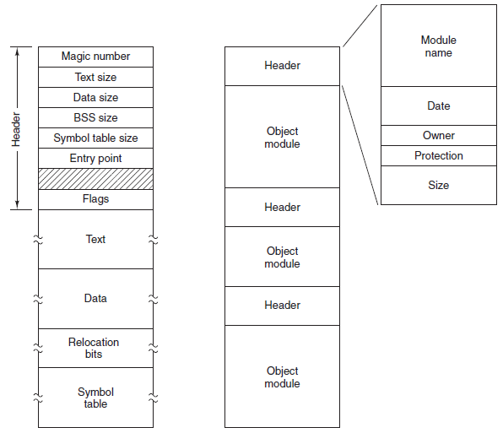
What about different types of regular files?
Text files versus Executables versus Tar files
  All just differing patterns of bytes!
  It really is just all data. The meaning is in how you interpret it.
Executable
File
Archive
(tar)

Slide 77
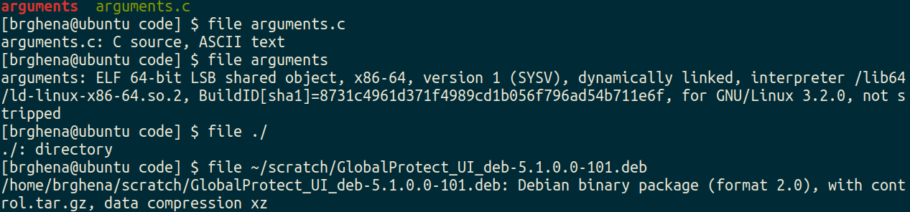
Identifying regular files
file in Linux command line can help determine the type of a file
  https://github.com/file/file

Slide 78
Encoding time
Unix time:
  32-bit signed integer counting seconds elapsed since initial time
  Initial time was January 1st at midnight UTC, 1970
Current Unix time (as of last editing this slide): 1672850392
  Negative numbers would mean times before 1970
Problem: when does Unix time hit the maximum value?
  2147483647 seconds from January 1st 1970
  Result: January 19th, 2038
  This is the “Year 2038 Problem”

Slide 79
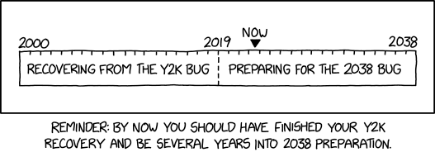
Bonus xkcd comic
https://xkcd.com/2697/

Slide 80
Outline
Binary and Hex
Memory
Encoding
Integer Encodings
  Signed Integers
  Converting Sign
  Converting Length
Other encodings

