Slide 1
Lecture 18 Input/Output Devices
CS213 – Intro to Computer Systems
Branden Ghena – Fall 2023
Slides adapted from: Hester, Tarzia (Northwestern), Bryant, O’Hallaron (CMU), Dutta, Garcia, Weaver (UC Berkeley), Venkataraman (Wisconsin), Singh (Princeton)

Slide 2
Administrivia
Homework 4 due today!
Don’t forget about it
Good practice for midterm 2
SETI Lab due on Thursday!
Beware, it’ll take quite a while to get feedback close to the deadline
Run seti-eval as sparingly as possible
It will give you very similar results to seti-perf

Slide 3
Common SETI Lab Errors
Straight line performance
Often better than 1.02x right away and graph does not have a curve shape
Doesn’t vary thread count per the program argument
Stuck at 0.3x
Usually didn’t optimize
Or maybe just optimized p_band_scan.c but not anything it relies on
No Carrier Match
Your code output didn’t match the original band_scan
No Alien Match
You didn’t correctly determine which of your generated signals is alien

Slide 4
Administrivia
Midterm 2 next week Wednesday
12:00-1:20 pm in this classroom (Tech Auditorium)
Allowed two sheets of standard paper, front and back, for notes
You may reuse your notes from last time as the first sheet if you want or you can make entirely new notes sheets
Material from weeks 5 and onwards
x86-64 Assembly Procedures through I/O & Networks (Thursday)
Homeworks 3 and 4
Bomb Lab, Attack Lab, and SETI Lab

Slide 5
Today’s Goals
Introduce Input and Output (I/O) in computer systems
Consider application-level I/O details
Explore OS / microcontroller approaches to I/O
How to talk to devices
Interaction patterns with devices
Device drivers

Slide 6
Outline
Input/Output Motivation
Application-Level Input/Output
Talking to Devices
MMIO Example
Device Interaction Patterns
Device Drivers

Slide 7
Devices are the point of computers
Traditional systems need to receive input from users and output responses
Keyboard/mouse
Disk
Network
Graphics
Audio
Various USB devices
Embedded systems have the same requirement, just more types of IO
Computer
Processor
Memory
Devices
Control
Input
Datapath
Output

Slide 8
Devices are core to useful general-purpose computing
Input
Output
Mouse
Monitor
Computer
Keyboard
Headphones
Ethernet
Ethernet
Bluetooth
Bluetooth

Slide 9
Devices are essential to cyber-physical systems too
Input
Output
Lidar
Throttle Control
Computer
Inertial Measurement Unit
Brake Control
Camera
Wheel Rotation
CAN
CAN

Slide 10
Device access rates vary by many orders of magnitude
Rates in bit/sec
System must be able to handle each of these
Sometimes needs low overhead
Sometimes needs to not wait around
Device | Behavior | Partner | Data Rate (Kb/s)
Keyboard | Input | Human | 0.2
Mouse | Input | Human | 0.4
Microphone | Output | Human | 700.0
Bluetooth | Input or Output | Machine | 20,000.0
Hard disk drive | Storage | Machine | 100,000.0
Wireless network | Input or Output | Machine | 300,000.0
Solid state drive | Storage | Machine | 500,000.0
Wired LAN network | Input or Output | Machine | 1,000,000.0
Graphics display | Output | Human | 3,000,000.0

Slide 11
Outline
Input/Output Motivation
Application-Level Input/Output
Talking to Devices
MMIO Example
Device Interaction Patterns
Device Drivers

Slide 12
Linux abstraction: everything is a file!
Application-level: treat devices like files
They can be read and written
They may be created or destroyed (plugged/unplugged)
They can be created in hierarchies. Example:
SATA devices
SSD
USB devices
Webcam
Microphone

Slide 13
Linux device classes
Character devices
Accessed as a stream of bytes (like a file)
Example: Webcam, Keyboard, Headphones
Block devices
Accessed in blocks of data (like a disk)
Can hold entire filesystems
Example: Disks, Flash drives
Network interfaces
See CS340 (Computer Networking)
Accessed through transfer of data packets
dev
char
block
net
Serial
Parallel
SATA
SCSI
Ethernet
WiFi
video
2D
3D

Slide 14
Communication with devices
Must ask the OS to communicate with the device for us
This is a job for system calls!
Which system calls? File I/O ones!
Open/Close
Read/Write
Seek, Flush
Ioctl
And various others

Slide 15
Accessing devices
Open/Close
Inform device that something is using it (or not)
Argument is path to device (like path to file)
Get a file descriptor that the other operations act on
“/dev” directory is populated with devices

Slide 16
Interacting with devices
Same read/write system calls you’ve seen before
Read
ssize_t read(int fd, void *buf, size_t count);
Write
ssize_t write(int fd, const void *buf, size_t count);
Seek doesn’t really make sense for most devices…

Slide 17
Arbitrary device interactions
ioctl – I/O Control
int ioctl(int fd, unsigned long request, ...);
Request number followed by an arbitrary list of arguments
“request” may be broken in fields: command, size, direction, etc.
Catch-all for device operations that don’t fit into file I/O model
Combine with “magic numbers” to form some special action
Reset device, Start action, Change setting, etc.
Read the device documentation to find these

Slide 18
ioctl example - sounds through console
void play_beep(unsigned int repeats, float frequency) {
/* try to snag the console */
int console_fd = open("/dev/console", O_WRONLY);
for (unsigned int i=0; i<repeats; i++) { /* start beep */
if(ioctl(console_fd, KIOCSOUND, (int)(CLOCK_TICK_RATE/frequency)) < 0) {
perror("ioctl");
}
usleep(1000); /* wait... */
ioctl(console_fd, KIOCSOUND, 0); /* stop beep */
usleep(1000); /* wait... */
}
close(console_fd);
}
Simplified from: http://www.johnath.com/beep/beep.c

Slide 19
Break + Open Question
What are some downsides of “everything is a file”?

Slide 20
Break + Open Question
What are some downsides of “everything is a file”?
Doesn’t allow devices to send data to us. Data needs to be requested
Slow turnaround time for detecting some action by a device
Like a mouse click
Not all devices map to files well
Microphone/Webcam work okay, just chunks of data to be read
Input devices not so much: keyboard, mouse, touchscreen
These are often handled directly by the OS instead

Slide 21
Outline
Input/Output Motivation
Application-Level Input/Output
Talking to Devices
MMIO Example
Device Interaction Patterns
Device Drivers

Slide 22
Going deeper: how to talk to devices
What if you are writing the OS? How does it talk to devices?
Or what if you don’t have an OS at all and want to control devices directly?
Example: embedded systems

Slide 23
How to interact with I/O devices
A device is really a miniature computer-within-the-computer
Has its own processing, memory, software
We can mostly ignore that and deal with its interface
Called registers (actually are from EE perspective, but you can’t use them)
Read/Write like they’re data

Slide 24
Example powered device: Real Time Clock
Battery-backed up clock on computer motherboard
Keeps sense of time when computer is off
Resynchronized when the computer is awake
Index | Contents | Range
0x00 | Seconds | 0-59
0x02 | Minutes | 0-59
0x04 | Hours | 0-23 in 24-hour mode, 1-12 in 12-hour mode, highest bit set if PM
0x06 | Weekday | 1-7, Sunday =1
0x07 | Day of Month | 1-31
0x08 | Month | 1-12
0x09 | Year | 0-99
Registers:
https://www.singlix.com/trdos/archive/pdf_archive/real-time-clock-nmi-enable-paper.pdf

Slide 25
Two options for reading/writing device registers
Special assembly instructions
Treat like normal memory

Slide 26
Two options for reading/writing device registers
Special assembly instructions
Treat like normal memory

Slide 27
Port-Mapped I/O (PMIO): special assembly instructions
x86 IN and OUT instructions
Privileged instructions (kernel mode only)
Two arguments: destination and data register
Each device is mapped to some port address
IN and OUT instructions interact with interface
IN <PORT NUMBER>, <REGISTER>
OUT <REGISTER>, <PORT NUMBER>

Slide 28
Example powered device: Real Time Clock
Example: read current value from real-time clock
// read seconds
mov $0, %al out %al, $0x70 in $0x71, %al
Index | Contents | Range
0x00 | Seconds | 0-59
0x02 | Minutes | 0-59
0x04 | Hours | 0-23 in 24-hour mode, 1-12 in 12-hour mode, highest bit set if PM
0x06 | Weekday | 1-7, Sunday =1
0x07 | Day of Month | 1-31
0x08 | Month | 1-12
0x09 | Year | 0-99
Port Address
https://www.singlix.com/trdos/archive/pdf_archive/real-time-clock-nmi-enable-paper.pdf

Slide 29
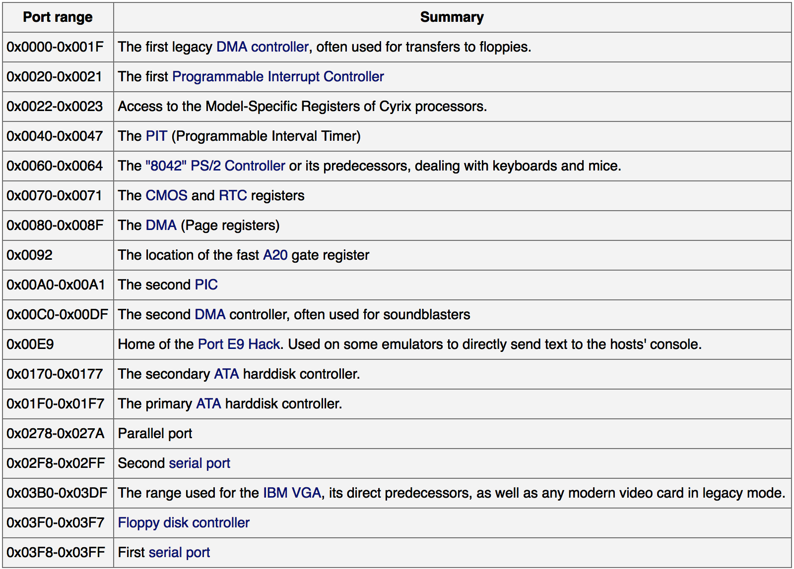
Example I/O port map
This isn’t standardized, but these are some typical values.
https://wiki.osdev.org/Can_I_have_a_list_of_IO_Ports

Slide 30
Check your understanding – PMIO in C
How would you access PMIO from a C program?

Slide 31
Check your understanding – PMIO in C
How would you access PMIO from a C program?
Need to use assembly!
Hopefully with C function wrapper, like System Calls

Slide 32
Annoying parts of Port-Mapped I/O
Special assembly instructions are hard to write in C
Need some wrapper function that actually calls them
Not really that big of an issue, but a little weird
Feels sort of like memory read/write, but isn’t
Why not?
Can we just put the “port address space” somewhere in memory?
Could be a problem if we don’t have enough memory
But today we have tons of extra physical address space laying around

Slide 33
Two options for reading/writing device registers
Special assembly instructions
Treat like normal memory

Slide 34
Memory-mapped I/O (MMIO): treat devices like normal memory
Certain physical addresses do not actually go to RAM
Instead, they correspond to I/O devices
And any instruction that accesses memory can access them too!
x86-64 being the historical amalgamation that it is, uses both PMIO or MMIO depending on the device
Address
0xFFFFFFFF
0xFFFF0000
control reg.
data reg.
0x00000000

Slide 35
Other details about MMIO
Devices are mapped into physical memory
Usually only accessible by the operating system
But could be directly placed in virtual memory for a process in very special cases
Devices are NOT memory though
Need to be careful not to cache them
Values being read could change, or reading could have an effect
Cannot let compiler mess with our reads/writes either
volatile keyword in C
Conceptually not really very different from PMIO
Both just read/write to specific addresses the device is mapped to

Slide 36
Outline
Input/Output Motivation
Application-Level Input/Output
Talking to Devices
MMIO Example
Device Interaction Patterns
Device Drivers

Slide 37
Simpler Memory-Mapped IO example: a microcontroller
A microcontroller is a single chip with a processor and memory
Used for simple devices such as embedded systems
Example use case: a Fitbit
Fitbit flex (circa 2013)
Features
Counts your steps
Reports via Bluetooth Low Energy
Lights up some LEDs based on your goals
Vibrates when its battery is low

Slide 38
Fitbit teardown
https://www.ifixit.com/Teardown/Fitbit+Flex+Teardown/16050
Notes:
Fitbit, Wearables, microcontrolles

Slide 39
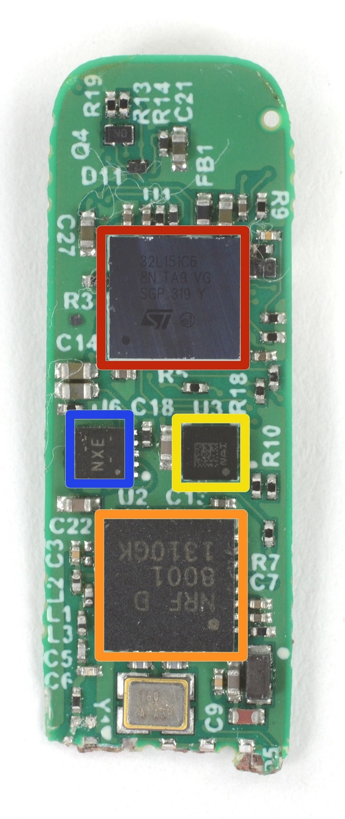
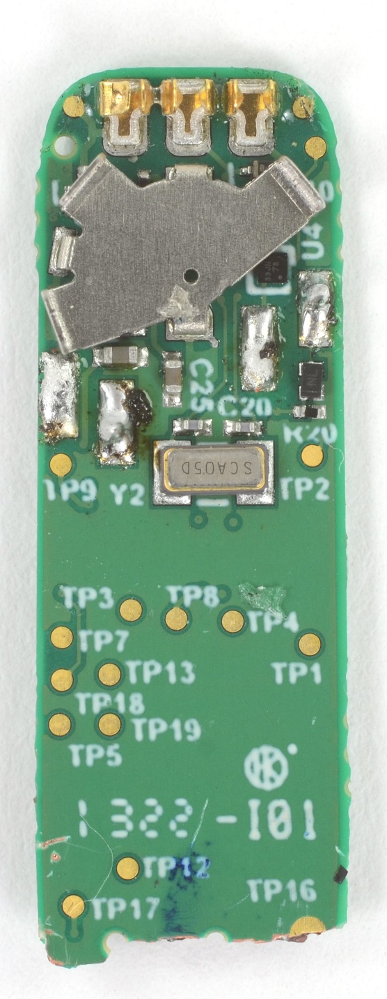
Fitbit circuit board front
The back is uninteresting
Red (top)
STMicro 32L151C6 Microcontroller
Blue (left)
TI BQ24040 Battery Charger
Yellow (right)
STMicro LIS2DH Accelerometer
Orange (bottom)
Nordic nRF8001 Bluetooth Low Energy Radio

Slide 40
Fitbit as a computer
Computers usually need
Processor
Memory (RAM)
Storage (Flash/SSD)
External communication
USB, Thunderbolt, SATA, HDMI, WiFi
Power management
Maybe batteries and charging
Something to connect it all: motherboard
Microcontroller
Bluetooth radio
Vibratory motor
Battery and power management
Circuit board

Slide 41
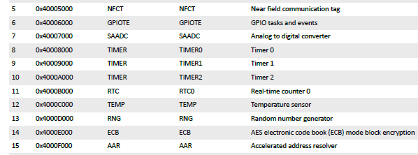
Example microcontroller memory map
0x1000 bytes is plenty of space for each device (a.k.a. peripheral)
1024 registers, each 32 bits
No reason to pack them tighter than that
nRF52833 microcontroller

Slide 42
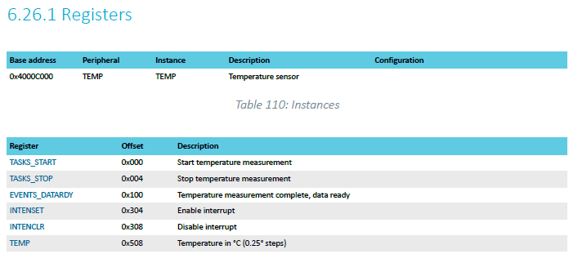
Example: TEMP device on nRF52833 microcontroller
Internal temperature sensor
0.25° C resolution
Range equivalent to microcontroller chip (-40° to 105° C)
Various configurations for the temperature conversion (ignoring)

Slide 43
MMIO addresses for TEMP
What addresses do we need? (ignore interrupts for now)
0x4000C000 – TASKS_START
0x4000C100 – EVENTS_DATARDY
0x4000C508 - TEMP

Slide 44
Accessing addresses in C
What does this C code do?
*(uint32_t*)(0x4000C000) = 1;

Slide 45
Accessing addresses in C
What does this C code do?
*(uint32_t*)(0x4000C000) = 1;
0x4000C000 is cast to an uint32_t* (a 32-bit unsigned integer pointer)
Then dereferenced
And we write 1 to it
“There are 32-bits of memory at 0x4000C000. Write a 1 there.”

Slide 46
Example code
To the terminal!
Let’s write it from scratch

Slide 47
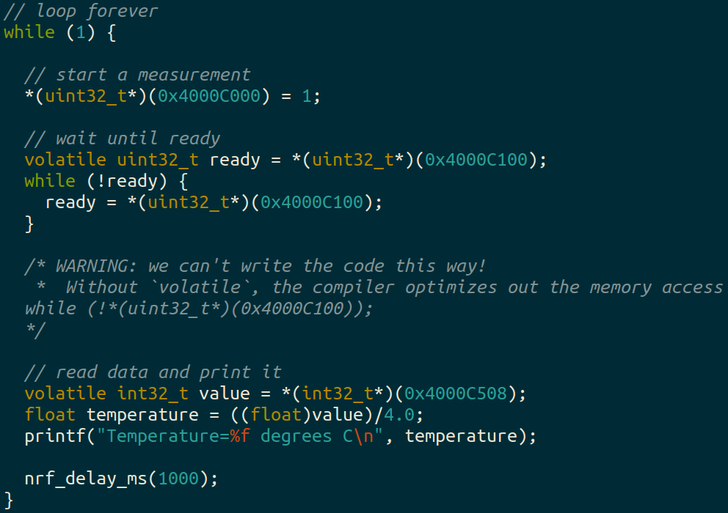
Example code (temp_mmio app)

Slide 48
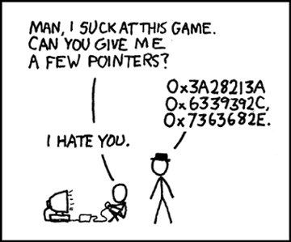
Break + relevant xkcd
https://xkcd.com/138/

Slide 49
Outline
Input/Output Motivation
Application-Level Input/Output
Talking to Devices
MMIO Example
Device Interaction Patterns
Device Drivers

Slide 50
What do interactions with devices look like?
while STATUS==BUSY; Wait
(Need to make sure device is ready for a command)
Write value(s) to DATA
Write command(s) to COMMAND
while STATUS==BUSY; Wait
(Need to make sure device has completed the request)
Read value(s) from Data
This is the “polling” model of I/O.
“Poll” the peripheral in software repeatedly to see if it’s ready yet.

Slide 51
Waiting can be a waste of CPU time
while STATUS==BUSY; Wait
(Need to make sure device is ready for a command)
Write value(s) to DATA
Write command(s) to COMMAND
while STATUS==BUSY; Wait
(Need to make sure device has completed the request)
Read value(s) from Data
Imagine a keyboard device
CPU could be waiting for minutes before data arrives
Need a way to notify CPU when an event occurs
Interrupts!

Slide 52
Interrupts
What is an interrupt?
Some event which causes the processor to stop normal execution
The processor instead jumps to a software “handler” for that event
Then returns back to what it was doing afterwards
What causes interrupts?
Hardware exceptions
Divide by zero, Undefined Instruction, Memory bus error
Software
Syscall, Software Interrupt (SWI)
External hardware
Input pin, Timer, various “Data Ready”

Slide 53
Interrupts, visually
Some code that’s executing

Slide 54
Interrupts, visually
Some code that’s executing
Interrupt triggers!
Interrupt handler code

Slide 55
Interrupts, visually
Some code that’s executing
Interrupt triggers!
Interrupt handler code
Continue original code
Interrupts are a form of exceptional control flow

Slide 56
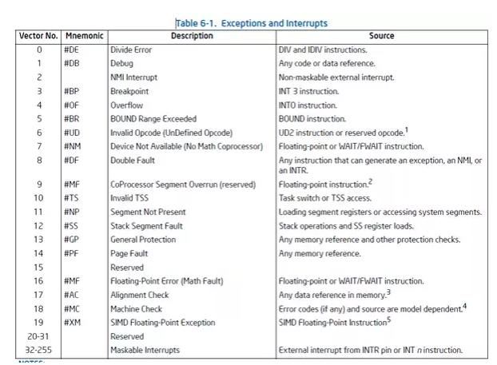
Hardware devices can generate interrupts
Each device maps to some number of hardware interrupts
Done at system boot time for x86-64
Discover devices
Map devices into address space
Map interrupts for devices
Hardcoded into hardware for microcontrollers

Slide 57
Interrupts allow waiting to happen asynchronously
Prior code example was synchronous
Nothing else continued on the processor until access was complete
Good for very fast devices (like the real-time clock, that just returns data)
We call this “Polling”
With interrupts, device handling is now asynchronous
Access occurs in the background and processor can do something else
Good for very slow devices (Disk)
Comes with all the downsides of concurrency though…

Slide 58
Microcontroller TEMP device supports interrupts!
Can either loop while checking the EVENTS_DATARDY register
Or could enable an interrupt from the device
And only bother reading data when it is ready

Slide 59
When should a system use polling versus interrupts?
Polling
Great if the device is going to respond immediately (like 1 cycle)
Important if we need to respond very quick (less than a microsecond)
Interrupts
Great if we’ll need to wait a long time for status to change
Still responds pretty quickly, but not immediately
Needs to context switch from running code to interrupt handler

Slide 60
Check your understanding – writing to GPU
Let’s say that a GPU has MMIO registers for an entire 4 KB page
Takes 100 ns to write each word (8 bytes) of memory
Assuming that we’re just writing all zeros (ignore reading from memory), how long does it take to write a page to MMIO?

Slide 61
Check your understanding – writing to GPU
Let’s say that a GPU has MMIO registers for an entire 4 KB page
Takes 100 ns to write each word (8 bytes) of memory
Assuming that we’re just writing all zeros (ignore reading from memory), how long does it take to write a page to MMIO?
4 KB / 8 B = 512 writes * 100 ns / write = 51 µs
(For a 3 GHz processor, that’s ~150,000 cycles)

Slide 62
Direct Memory Access (DMA)
Even with interrupts, providing data to the peripheral is time consuming for transferring lots of data
Need to be interrupted every byte, to copy the next byte over
DMA is an alternative method that uses hardware to do the memory transfers for the processor
Software writes address of the data and the size to the peripheral
Peripheral reads data directly from memory
Processor can go do other things while read/write is occurring

Slide 63
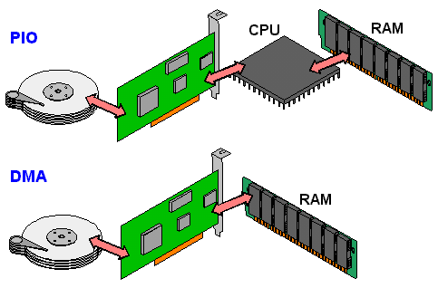
Programmed I/O versus Direct Memory Access
SATA Controller
Disk
SATA Controller
Disk

Slide 64
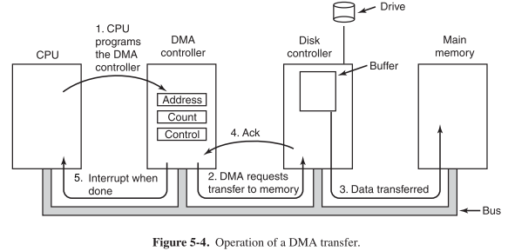
General-purpose DMA

Slide 65
Full peripheral interaction pattern
Configure the peripheral
Enable peripheral interrupts
Set up peripheral DMA transfer
Start peripheral
Continue on to other code
Interrupt occurs, signaling DMA transfer complete
Set up next DMA transfer
Continue on to other code, and repeat

Slide 66
Break + Open Question
What kinds of peripherals/devices should you use the DMA for?

Slide 67
Break + Open Question
What kinds of peripherals/devices should you use the DMA for?
Anything where there is a lot of data coming in over a period of time
Either a big buffer of lots of data, like a radio message
Or a bunch of individual samples, coming in quickly
Devices
Canonical example from general computing: disks (HDD/SSD)
Messages to/from other devices (radios, wired busses)
Sensor readings (if read quickly)

Slide 68
Outline
Input/Output Motivation
Application-Level Input/Output
Talking to Devices
MMIO Example
Device Interaction Patterns
Device Drivers

Slide 69
What is a device driver?
A device driver is the software in the Operating System that manages a specific device
Modern computers come with MANY of these pre-installed
And have the ability to automatically find many others if needed
Can be generic “keyboard driver” or very specific “Ricoh IM C3000 printer driver”
Source of many bugs in the in Operating System
Due to amount and variety of them

Slide 70
How should we write driver software?
There are various knobs available to us from hardware
Polling, Interrupts, DMA
There are also various software interface design
Synchronous
Asynchronous Callbacks

Slide 71
Synchronous device drivers
Synchronous functions
Function call issues a command
Does not return until action is complete and result is ready
Example: most functions we’re used to
sqrt() for example
printf() also usually works this way (with some exceptions)
For microcontrollers: Arduino interfaces are usually like this!
Easy to get started with and understand

Slide 72
Downside of synchronous code: the waiting
How long will it take until the function returns?
Immediately, seconds, minutes?
What if there’s an error and the device never responds?
More advanced interface could include a timeout option
Synchronous designs require other synchronous designs
We can build synchronous interfaces from asynchronous ones
But we can’t go the other way

Slide 73
Asynchronous drivers
Goal: let the hardware run on its own and have the code get back to it later
Challenge: programmers don’t think that way
Other challenge: how do we “get back to it later”?
One solution: Callbacks

Slide 74
Callbacks
Callbacks reuse a similar idea to interrupts
When the event occurs, call this function
General pattern
Call driver function with one argument being a function pointer
Driver sets up interaction and returns immediately
Later the event happens and the driver calls the function pointer

Slide 75
Callback functions
uint32_t timer_start( uint32_t microseconds, void (*callback_fn)(void*), void* context );
timer_start(duration, my_timer_handler, context);
“Context” is often provided as well (void*)
Ability for caller to pass an argument for the callback function
Often a pointer to a position in a structure or a shared variable to modify
Similar to idea of closures in other languages

Slide 76
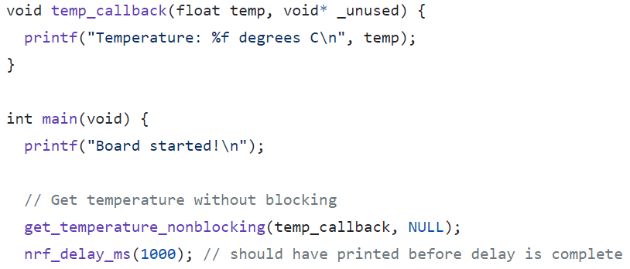
Example with callbacks (could be temp driver)
…

Slide 77
CE346 – Microprocessor System Design
Embedded Systems
How does hardware work?
How do we write drivers to interact with hardware from software?
Sensing and sensors
Big open-ended project: anything with inputs and outputs
Project demos: Tuesday of exam week (12/5) from 11-5 in Mudd 3514
Public! Anyone is welcome to stop in
Not formal presentations, just demos you can play with

Slide 78
Outline
Input/Output Motivation
Application-Level Input/Output
Talking to Devices
MMIO Example
Device Interaction Patterns
Device Drivers

