Slide 1
Lecture 15
Compiler Optimizations
CS213 – Intro to Computer Systems
Branden Ghena – Fall 2023
Slides adapted from:
Bryant, O’Hallaron (CMU), Garcia, Weaver (UC Berkeley)

Slide 2
Administrivia
Attack Lab due today!
  Most of you are finished with it though ❤
SETI Lab is out and ready to be worked on
  Today is the last of the material that will be helpful towards it
  Be careful with this one:
    Lots of C code to understand and write
    Spans Thanksgiving, so you have less time to work on it than you think
Homework 4 should be out later today
Reminder: midterm 2 on Wednesday of exam week
  Covers material from the second half of class

Slide 3
Today’s Goals
Discuss the role of a compiler
Explore basic optimizations at both the local and global levels
Understand limitations of optimizations
Describe how GCC can be configured to use these optimizations

Slide 4
Outline
Compilers and Optimizations
Local Optimizations
Global Optimizations
Obstacles to Optimization
GNU C Compiler (GCC)

Slide 5
How do we get code to run on a machine?
CPU only understands “machine code”
  All other languages must either be interpreted or compiled
The very bad old days: write hexadecimal instructions by hand
  This was back in the 1940s and the days of vacuum tubes
  Hook up wires and switches to form data input

Slide 6

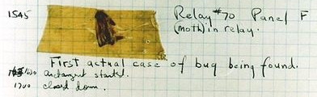
Rear Admiral Grace Hopper
Popularized term “debugging”
  After finding a literal moth in their computer
Invented first compiler in 1951
  “I decided data processors ought to be able to write their programs in English, and the computers would translate them into machine code”

Slide 7


Other Compilers Champions
John Backus
  Developed FORTRAN in 1957
“Much of my work has come from being lazy. I didn't like writing programs, and so, when I was working on the IBM 701, I started work on a programming system to make it easier to write programs”
Fran Allen
  Pioneer of compiler optimization techniques
  Wrote a 1966 paper introducing control flow graphs, which are central to compiler theory
First woman to win the Turing Award

Slide 8
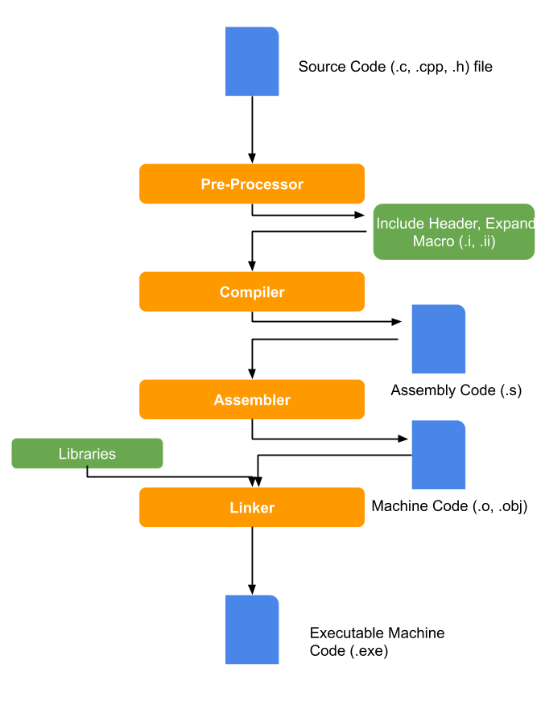
C compilation steps
Pre-processor
  Text insertion of macros and #includes
Compiler
  Transform C source into assembly
  Also perform optimizations along the way
Assembler
  Transform assembly into machine code
Linker
  Place code at real addresses and fixup

Slide 9
Optimizations
An optimization is a code transformation with the goal of making a program faster
  Can be done manually, by a programmer
  Or can be done automatically, by a compiler
  MUST maintain correctness
Some optimizations are processor-dependent
  They take advantage of unique processor capabilities
  Example: right shift instead of divide by powers of two
Some optimizations are processor-independent
  They make programs faster regardless of processor
  Example: removing redundant code

Slide 10
General goals of compiler optimization
Minimize number of instructions
  Don’t do calculations more than once
  Don’t do unnecessary calculations at all
  Avoid slow instructions
Avoid waiting for memory
  Keep everything in registers whenever possible
  Access memory in cache-friendly patterns
Avoid branching
  Branches are slow for all modern processor architectures
  Don’t make unnecessary decisions
  Make it easier for the CPU to predict branches whenever possible

Slide 11
Compilation is a pipeline
Preprocessing
Compilation
Assembling
Fold constants
Eliminate common subexpressions
Inline functions
Reduce operation strength
Select instructions
Schedule instructions
Allocate registers
Emit assembly language
Reduce control flow to gotos
Move code out of loops
Eliminate dead code
Restructure loops
Hundreds! Many repeated.

Slide 12
Two categories of optimizations
entry
Local optimizations
  Work within a single basic block
  (chunks of code with no gotos or labels)
  Examples: combining constants, eliminating dead code
Global optimizations
  Work across the “control flow graph” of an entire function
  Examples: loop transformations
Optimizations are often limited to function boundaries
setup
Easy?
easy
complex
loop
Done?
exit

Slide 13
Outline
Compilers and Optimizations
Local Optimizations
Global Optimizations
Obstacles to Optimization
GNU C Compiler (GCC)

Slide 14
Constant Folding
Do arithmetic in the compiler
long mask = 0xFF << 8; → long mask = 0xFF00;
Any expression with constant inputs can be folded
  Might even be able to remove library calls…
  size_t namelen = strlen("Harry Bovik");
  → size_t namelen = 11;
Notes:
Probably the most obvious local optimization there is: if you can have the compiler do some math, instead of doing it when the program is run, that’s a win. For example, you remember all those wacky expressions you had to write in data lab to get big constants? If you go back and disassemble your solutions you’ll probably see hex FF00 instead of hex FF shift left 8, and so on.
Really clever compilers might be able to fold through C library functions with constant arguments.

Slide 15
Strength reduction
Replace expensive operations with cheaper ones
long a = b * 5;
→ long a = (b << 2) + b;
Multiplication and division are the usual targets
Multiplication is often hiding in memory access expressions
  Example: array indexing
Notes:
Another easy, reliable local optimization is to replace expensive machine instructions with cheap ones. This is the optimizer that likes to turn mul into lea.

Slide 16
Dead code elimination
Don’t emit code that will never be executed
if (0) { puts("Kilroy was here"); }
if (1) { puts("Only bozos on this bus"); }
Don’t emit code whose result is overwritten
x = 23;
x = 42;
These may look silly, but...
  Can be produced by other optimizations
  Assignments to x might be far apart
Notes:
If code is never going to be executed, don’t write it out! And don’t do any calculations that would only be used by code that’s never executed, or that has its result overwritten before it’s used.
You might be thinking “why would anyone write that in the first place?” but other optimizations often make code be dead. Maybe that “if zero” was “if some arithmetic that the constant folder evaluated to zero” in the source code.
This is arguably a global optimization – it changes the control flow graph -- but it’s so easy and reliable it usually gets lumped with the local ones.

Slide 17
Common Subexpression Elimination
Factor out repeated calculations or memory accesses
  Only do them once
  Makes code closer to the assembly representation too
  norm[i] = v[i].x*v[i].x + v[i].y*v[i].y;
  →
  elt = &v[i];
  x = elt->x;
  y = elt->y;
  norm[i] = x*x + y*y;
Notes:
If you’ve got to do a calculation, only do it once, and remember the result. This complex expression reads from memory four times, but we can calculate the address of v[i] just once…
… and we can load dot x and dot y from memory once each
… and finally we can do all the arithmetic in registers.
This can be a local or a global optimization and there are at least five different algorithms for it.

Slide 18
Break + Question
int a = 5;
int x = 2*a;
int y = x+6;
int t = x * y;
if (t < 0) {
printf(“Message 1\n”);
} else {
printf(“Message 2\n”);
}
Optimize the code snippet as much as possible

Slide 19
Break + Question
int a = 5;
int x = 2*a;
int y = x+6;
int t = x * y;
if (t < 0) {
printf(“Message 1\n”);
} else {
printf(“Message 2\n”);
}
Optimize the code snippet as much as possible
Result:
printf(“Message 2\n”);
t is always 160
  Fold constants
160 is never less than 0
  Remove dead code

Slide 20
Outline
Compilers and Optimizations
Local Optimizations
Global Optimizations
Obstacles to Optimization
GNU C Compiler (GCC)

Slide 21
Inlining
Copy body of a function into its caller(s)
  Can create opportunities for many other optimizations
  Can make code much bigger and therefore slower (if larger than cache!)
int pred(int x) {
if (x == 0)
return 0;
else
return x - 1;
}
int func(int y) {
return pred(y)
+ pred(0)
+ pred(y+1);
}
int func(int y) {
int tmp;
if (y == 0) tmp = 0; else tmp = y - 1;
if (0 == 0) tmp += 0; else tmp += 0 - 1;
if (y+1 == 0) tmp += 0; else tmp += (y + 1) - 1;
return tmp;
}
Notes:
One of the most important global optimizations is inlining. Take a short function and copy its body in place of all calls to it. Obviously this cuts out the function call overhead, but it also gets around that one-function-at-a-time restriction and gives the compiler opportunities to do more other optimizations. Here we have two simple functions and there’s not much to do to either one by itself, but if we combine them…

Slide 22
Inlining
Copy body of a function into its caller(s)
  Can create opportunities for many other optimizations
  Can make code much bigger and therefore slower (if larger than cache!)
int pred(int x) {
if (x == 0)
return 0;
else
return x - 1;
}
int func(int y) {
return pred(y)
+ pred(0)
+ pred(y+1);
}
int func(int y) {
int tmp;
if (y == 0) tmp = 0; else tmp = y - 1;
if (0 == 0) tmp += 0; else tmp += 0 - 1;
if (y+1 == 0) tmp += 0; else tmp += (y + 1) - 1;
return tmp;
}
Always true
Does nothing
Can constant fold
Notes:
Now each of the function calls is an expression that we can optimize based on the value of x at each call site.

Slide 23
Inlining
Copy body of a function into its caller(s)
  Can create opportunities for many other optimizations
  Can make code much bigger and therefore slower (if larger than cache!)
int func(int y) {
int tmp;
if (y == 0) tmp = 0; else tmp = y - 1;
if (0 == 0) tmp += 0; else tmp += 0 - 1;
if (y+1 == 0) tmp += 0; else tmp += (y + 1) - 1;
return tmp;
}
int func(int y) {
int tmp = 0;
if (y != 0) tmp = y - 1;
if (y != -1) tmp += y;
return tmp;
}
End result is MUCH simpler!
Notes:
And so inlining plus local optimizations produces this much simpler function.
This kind of opportunity to simplify the code after inlining, comes up a whole lot in C++ with template functions. If you ever wondered why almost the entire implementation of std::string and std::map is in the header files? It’s so the compiler can inline all of it and then simplify it down to the cases that matter for the actual program.
The catch to inlining is that if you do it too much, the program can become really big. Too big for the instruction cache. That makes it slow no matter what.

Slide 24
Code Motion
Move calculations out of a loop
  Only valid if every iteration would produce same result
  long j;
  for (j = 0; j < n; j++) {
  a[n*i+j] = b[j];
  }
  →
long j;
int ni = n*i;
for (j = 0; j < n; j++) {
a[ni+j] = b[j];
}
Notes:
Sometimes a program computes the same value over and over because the expression is inside a loop. If every iteration of the loop computes the same result, we say the calculation is a ‘loop invariant’ and we move it to above the loop. It’s CSE in time instead of space. In the example, n times I is invariant so we make a temp variable for it.

Slide 25
Loop Transformations
Rearrange entire loop nests for maximum efficiency
/* Two stages of some calculation */
void compute(double *a, double *b, long n) {
for (long i = 0; i < n; i++)
for (long j = 0, j < n; j++)
a[j*n + i] = atan2(i, j);
for (long i = 0; i < n; i++)
for (long j = 0, j < n; j++)
b[i*n + j] = a[i*n + j] + (i >= 1 && j >= 1)
? a[(i-1)*n + (j-1)]
: 0;
}
Notes:
Also called “loop nest optimization.”
Here’s a messy calculation with two stages, each of which is a two-deep loop nest. Compilers put scary amounts of algebra into making this kind of code go fast because guess what: most of a computer’s CPU time is spent in loops.

Slide 26
Loop Transformations
Loop interchange: do iterations in cache-friendly order
/* Two stages of some calculation */
void compute(double *a, double *b, long n) {
for (long i = 0; i < n; i++)
for (long j = 0, j < n; j++)
a[i*n + j] = atan2(j, i);
for (long i = 0; i < n; i++)
for (long j = 0, j < n; j++)
b[i*n + j] = a[i*n + j] + (i >= 1 && j >= 1)
? a[(i-1)*n + (j-1)]
: 0;
}
Notes:
It doesn’t matter what order the first loop nest is done in, so – assuming the compiler knows that, which it probably does for atan2 – it can swap the roles of I and J so that the A matrix is written in cache-friendly order. This is called loop interchange because it’s logically the same as swapping the two loops. I wrote it this way because …

Slide 27
Loop Transformations
Loop fusion: combine adjacent loops with the same limits
/* Two stages of some calculation */
void compute(double *a, double *b, long n) {
for (long i = 0; i < n; i++) {
for (long j = 0, j < n; j++) {
a[i*n + j] = atan2(j, i);
for (long i = 0; i < n; i++)
for (long j = 0, j < n; j++)
b[i*n + j] = a[i*n + j] + (i >= 1 && j >= 1)
? a[(i-1)*n + (j-1)]
: 0;
}
}
}
Notes:
… the next optimization, loop fusion, is going to notice that the two loop nests have the exact same limits and no conflicting side effects, and so we can do them at the same time. This reduces the amount of branching and bookkeeping and also makes better use of memory cache – now we are using a[i*n+j] right after we set it.

Slide 28
Loop Transformations
Induction variable elimination: replace loop indices with algebra
/* Two stages of some calculation */
void compute(double *a, double *b, long n) {
for (long i = 0; i < n*n; i++) {
for (long j = 0, j < n; j++) {
a[i] = atan2(i%n, i/n);
b[i] = a[i] + (i >= n && i%n >= 1)
? a[i – n - 1]
: 0;
}
}
}
Notes:
The inner loop always runs from zero to N-1, and we’re always working with array element i*n+j, and that means we can combine the inner and outer loops and get rid of j by doing math on I instead.
This is mainly valuable if it frees up registers that we need for something else. It also means fewer, more predictable branches.
The compiler might not do it in this case because it introduces a division, yuck, slow. Of course, we’re calling a trig function on every iteration, that’s even slower.

Slide 29
Loop Transformations
/* Two stages of some calculation */
void compute(double *a, double *b, long n) {
for (long i = 0; i < n; i++)
for (long j = 0, j < n; j++)
a[j*n + i] = atan2(i, j);
for (long i = 0; i < n; i++)
for (long j = 0, j < n; j++)
b[i*n + j] = a[i*n + j] + (i >= 1 && j >= 1)
? a[(i-1)*n + (j-1)] : 0;
}
Top is the original code
Bottom is the transformed version
Note: still O(n²) complexity!
But the constant factor is much smaller than before
/* Two stages of some calculation */
void compute(double *a, double *b, long n) {
for (long i = 0; i < n*n; i++) {
a[i] = atan2(i%n, i/n);
b[i] = a[i] + (i >= n && i%n >= 1)
? a[i – n - 1] : 0;
}
}
Notes:
The inner loop always runs from zero to N-1, and we’re always working with array element i*n+j, and that means we can combine the inner and outer loops and get rid of j by doing math on I instead.
This is mainly valuable if it frees up registers that we need for something else. It also means fewer, more predictable branches.
The compiler might not do it in this case because it introduces a division, yuck, slow. Of course, we’re calling a trig function on every iteration, that’s even slower.

Slide 30
Break + Quiz
Optimize the following code: (hint: could be MUCH smaller)
  long multi_loop(long orig_value) {
  long new_value = 0;
  for (int i=0; i<4; i++) {
  for (int j=0; j<8; j++) {
  new_value += 1;
  }
  new_value += orig_value;
  }
  return new_value;
  }

Slide 31
Break + Quiz
Optimize the following code: (hint: could be MUCH smaller)
  long multi_loop(long orig_value) {
  long new_value = 0;
  for (int i=0; i<4; i++) {
  for (int j=0; j<8; j++) {
  new_value += 1;
  }
  new_value += orig_value;
  }
  return new_value;
  }
  long multi_loop(long orig_value) {
  return 4*orig_value + 32;
  }

Slide 32
Outline
Compilers and Optimizations
Local Optimizations
Global Optimizations
Obstacles to Optimization
GNU C Compiler (GCC)

Slide 33
Limits to compiler optimization
Generally cannot improve algorithmic complexity
  Only constant factors, but those can be worth 10x or more…
MUST NOT cause any change in program behavior
  Programmer may not care about “edge case” behavior, but compiler does not know that
  Exception: language may declare some changes acceptable (UNDEFINED BEHAVIOR)
Often only analyze one function at a time
  Whole-program analysis (“LTO”) expensive but gaining popularity
  Exception: inlining merges many functions into one
Tricky to anticipate run-time inputs
  Profile-guided optimization can help with common case, but…
  “Worst case” performance can be just as important as “normal”
Notes:
Compilers aren’t magic and they aren’t creative. This means they can’t do everything for you.
In most cases they can’t make your algorithm better. They can edit all the unnecessary instructions out of your bubble sort, but it will still be bubble sort, not quicksort.
They don’t know what’s in or out of scope of your design, so they can’t change any behavior, not even edge-case behavior you never cared about… unless the language says it’s OK. A language spec might allow its compilers to apply the associative law to floating-point calculations even though floating point arithmetic isn’t associative.
They usually only look at one function at a time, just to keep compilation time down—except that inlining merges many functions into one.
And they typically have no information about what will happen when the program is run.

Slide 34
Optimization Challenges
Memory aliasing
Function calls
Non-associative arithmetic
Larger cache optimizations

Slide 35
Memory Aliasing
Code updates b[i] on every iteration
/* Sum rows of n X n matrix a and store in vector b. */
void sum_rows1(double *a, double *b, long n) {
long i, j;
for (i = 0; i < n; i++) {
b[i] = 0;
for (j = 0; j < n; j++)
b[i] += a[i*n + j];
}
}
b[i] should just be placed in a register and only a single memory write should occur
Notes:
A is N-by-N square matrix and we want to sum up the values in each row and put the sums in another array B.
The compiler loads b[i] from memory, adds a[i][j], and writes it back, on each cycle. Why?

Slide 36
Memory Aliasing
Code updates b[i] on every iteration
  Why couldn’t compiler optimize this away?
/* Sum rows of n X n matrix a and store in vector b. */
void sum_rows1(double *a, double *b, long n) {
long i, j;
for (i = 0; i < n; i++) {
b[i] = 0;
for (j = 0; j < n; j++)
b[i] += a[i*n + j];
}
}
# sum_rows1 inner loop
.L4:
movsd (%rsi,%rax,8), %xmm0 # FP load
addsd (%rdi), %xmm0 # FP add
movsd %xmm0, (%rsi,%rax,8) # FP store
addq $8, %rdi
cmpq %rcx, %rdi
jne .L4
Notes:
A is N-by-N square matrix and we want to sum up the values in each row and put the sums in another array B.
The compiler loads b[i] from memory, adds a[i][j], and writes it back, on each cycle. Why?

Slide 37
Memory Aliasing
/* Sum rows of n X n matrix a and store in vector b. */
void sum_rows1(double *a, double *b, long n) {
long i, j;
for (i = 0; i < n; i++) {
b[i] = 0;
for (j = 0; j < n; j++)
b[i] += a[i*n + j];
}
}
Compiler MUST consider that memory aliasing could occur
Unless it can prove it is impossible
Value of B:
A and B overlap in memory?
init: [4, 8, 16]
double A[9] =
{ 0, 1, 2,
4, 8, 16,
32, 64, 128};
sum_rows1(A, &(A[3]), 3);
double A[9] =
{ 0, 1, 2,
0, 8, 16,
32, 64, 128};
double A[9] =
{ 0, 1, 2,
0, 8, 16,
32, 64, 128};
double A[9] =
{ 0, 1, 2,
1, 8, 16,
32, 64, 128};
double A[9] =
{ 0, 1, 2,
3, 8, 16,
32, 64, 128};
double A[9] =
{ 0, 1, 2,
3, 0, 16,
32, 64, 128};
double A[9] =
{ 0, 1, 2,
3, 3, 16,
32, 64, 128};
double A[9] =
{ 0, 1, 2,
3, 6, 16,
32, 64, 128};
double A[9] =
{ 0, 1, 2,
3, 22, 16,
32, 64, 128};
double A[9] =
{ 0, 1, 2,
3, 22, 0,
32, 64, 128};
double A[9] =
{ 0, 1, 2,
3, 22, 32,
32, 64, 128};
double A[9] =
{ 0, 1, 2,
3, 22, 96,
32, 64, 128};
double A[9] =
{ 0, 1, 2,
3, 22, 224,
32, 64, 128};
i = 0: [3, 8, 16]
i = 1: [3, 22, 16]
i = 2: [3, 22, 224]
Notes:
Well, what if B is inside A? Then, every time we modify B, we change the values in A and that might change what the next addition produces. Watch what happens to the values in A as I step through the loop.
Remember I said the compiler can’t change any program behavior? That it doesn’t know what the programmer wanted? This could have been what the programmer wanted, even though what you get in B is not the sum of each row in A as it was before the call.
This is called pointer aliasing, or memory aliasing.

Slide 38
Avoiding aliasing penalties: with local variable
Use a local variable for intermediate results
/* Sum rows of n X n matrix a and store in vector b. */
void sum_rows2(double *a, double *b, long n) {
long i, j;
for (i = 0; i < n; i++) {
double val = 0;
for (j = 0; j < n; j++)
val += a[i*n + j];
b[i] = val;
}
}
# sum_rows2 inner loop
.Loop:
addsd (%rdi), %xmm0 # FP load + add
addq $8, %rdi
cmpq %rax, %rdi
jne .Loop

Slide 39
Avoiding aliasing penalties: aliasing still occurs
Still changes A if aliased because that’s what the code specifies
/* Sum rows of n X n matrix a and store in vector b. */
void sum_rows2(double *a, double *b, long n) {
long i, j;
for (i = 0; i < n; i++) {
double val = 0;
for (j = 0; j < n; j++)
val += a[i*n + j];
b[i] = val;
}
}
Value of B:
double A[9] =
{ 0, 1, 2,
4, 8, 16,
32, 64, 128};
sum_rows1(A, &(A[3]), 3);
init: [4, 8, 16]
double A[9] =
{ 0, 1, 2,
4, 8, 16,
32, 64, 128};
double A[9] =
{ 0, 1, 2,
4, 8, 16,
32, 64, 128};
double A[9] =
{ 0, 1, 2,
4, 8, 16,
32, 64, 128};
double A[9] =
{ 0, 1, 2,
3, 8, 16,
32, 64, 128};
double A[9] =
{ 0, 1, 2,
3, 8, 16,
32, 64, 128};
double A[9] =
{ 0, 1, 2,
3, 8, 16,
32, 64, 128};
double A[9] =
{ 0, 1, 2,
3, 8, 16,
32, 64, 128};
double A[9] =
{ 0, 1, 2,
3, 27, 16,
32, 64, 128};
double A[9] =
{ 0, 1, 2,
3, 27, 16,
32, 64, 128};
double A[9] =
{ 0, 1, 2,
3, 27, 16,
32, 64, 128};
double A[9] =
{ 0, 1, 2,
3, 27, 16,
32, 64, 128};
double A[9] =
{ 0, 1, 2,
3, 27, 224,
32, 64, 128};
i = 0: [3, 8, 16]
i = 1: [3, 27, 16]
i = 2: [3, 27, 224]

Slide 40
Avoiding aliasing penalties: with restrict keyword
Use restrict keyword to tell compiler that a and b cannot alias
/* Sum rows of n X n matrix a and store in vector b. */
void sum_rows3(double *restrict a, double *restrict b, long n) {
long i, j;
for (i = 0; i < n; i++) {
b[i] = 0;
for (j = 0; j < n; j++)
b[i] += a[i*n + j];
}
}
# sum_rows2 inner loop
.Loop:
addsd (%rdi), %xmm0 # FP load + add
addq $8, %rdi
cmpq %rax, %rdi
jne .Loop

Slide 41
Avoiding aliasing penalties: with different language
Use a different language altogether
  For example, in Fortran array arguments are assumed not to alias
subroutine sum_rows4(a, b, n)
implicit none
integer, parameter :: dp = kind(1.d0)
real(kind=dp), dimension(:), intent(in) :: a
real(kind=dp), dimension(:), intent(out) :: b
integer, intent(in) :: n
integer :: i, j
do i = 1,n
b(i) = 0
do j = 1,n
b(i) = b(i) + a(i*n + j)
end
end
end
# sum_rows2 inner loop
.Loop:
addsd (%rdi), %xmm0 # FP load + add
addq $8, %rdi
cmpq %rax, %rdi
jne .Loop

Slide 42
Optimization Challenges
Memory aliasing
Function calls
Non-associative arithmetic
Larger cache optimizations

Slide 43
Function calls are opaque
size_t strlen(const char *s) {
size_t len = 0;
while (*s++ != '\0') {
len++;
}
return len;
}
O(n) execution time
Return value depends on:
  value of s
  contents of memory at address s
    Only cares about whether individual bytes are zero
    Does not modify memory
Compiler might know some of that (but probably not)
Compiler examines one function at a time
  Some exceptions for code in a single file
Must assume a function call could do anything
Cannot usually
  Move function calls
  Change number of times a function is called
  Cache data from memory in registers across function calls
Notes:
Another big blocker for optimization is function calls.
The compiler only looks at one function at a time – there are exceptions, like inlining, but even then usually only within a single file – and it mostly doesn’t know what any other function does while it’s working on each one. It has to assume function calls could do almost anything.
That means it can’t optimize function calls very much. It can’t move them around, it can’t change the number of times a function is called, and it can’t assume data it loaded from memory before a function call is unchanged afterward.
For example, here’s strlen from the standard library. It loops over every character in the string, so it has order-of-N execution time. It doesn’t modify memory, and the return value only depends on the argument and the data in memory pointed to by the argument. It’s a standard library function so the compiler might know some of that, but probably not.

Slide 44
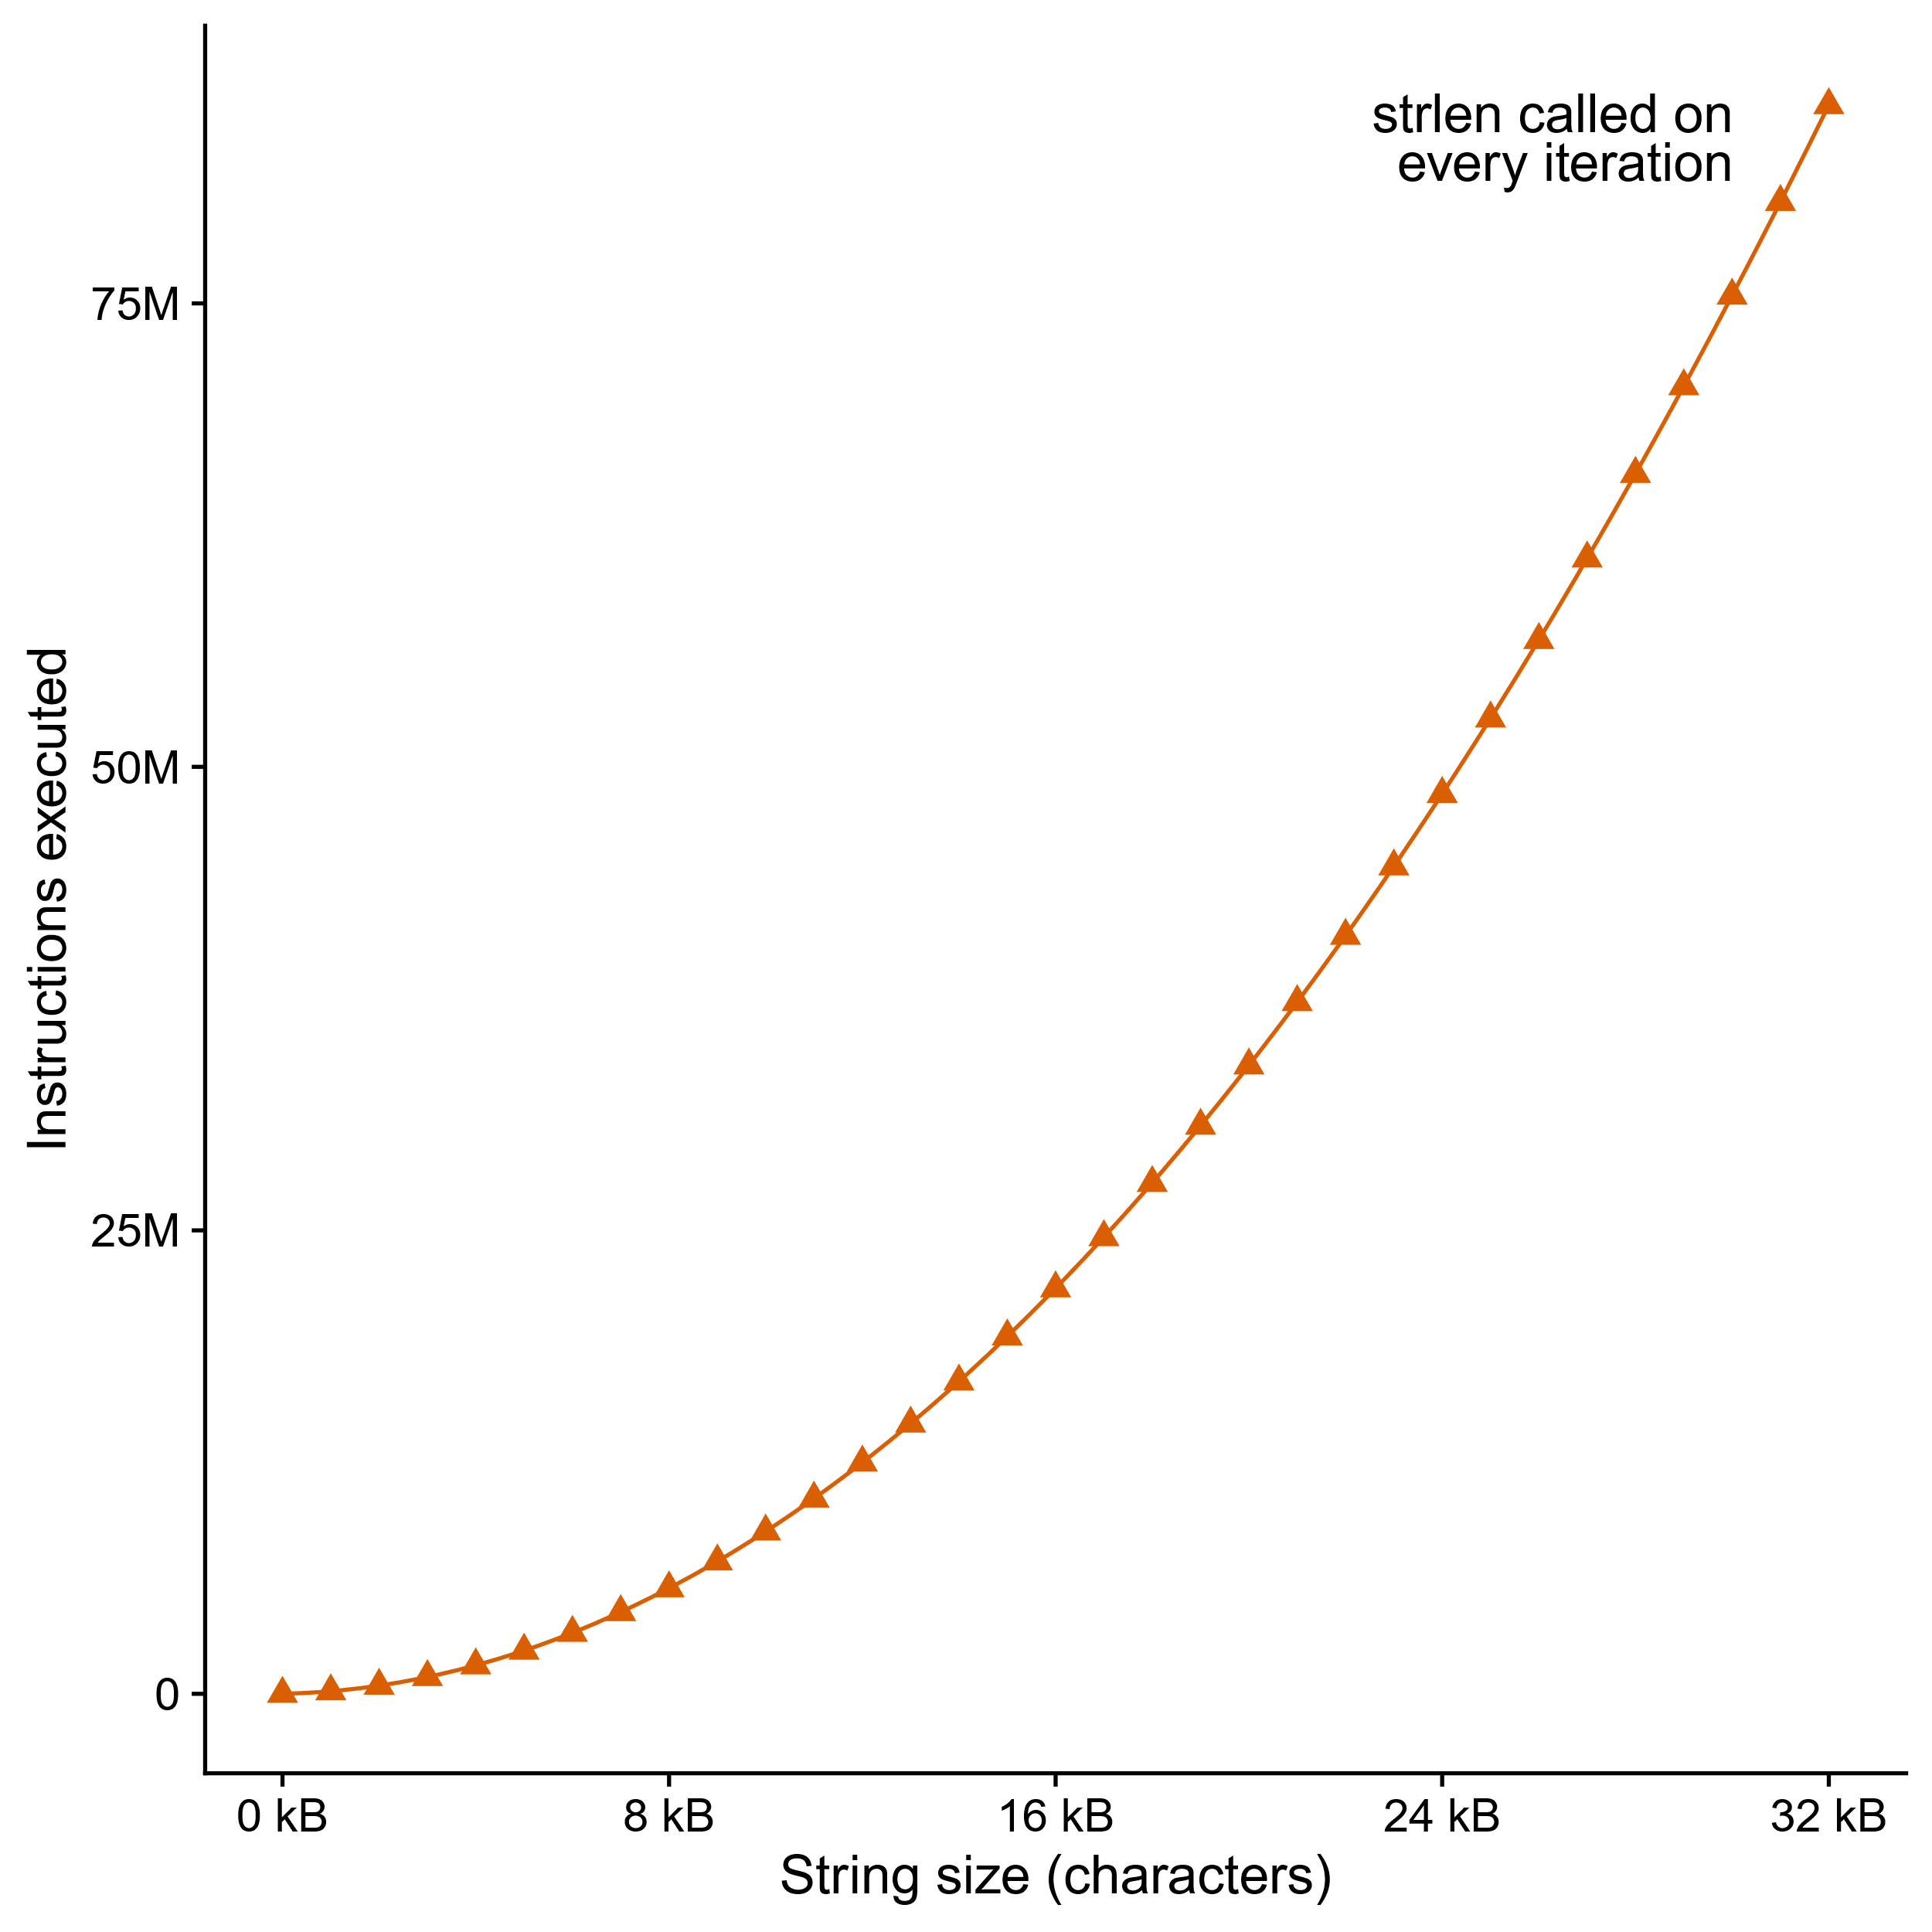
Can’t move functions out of loops
void lower_quadratic(char *s) {
size_t i;
for (i = 0; i < strlen(s); i++)
if (s[i] >= 'A' && s[i] <= 'Z')
s[i] += 'a' - 'A';
}

Slide 45
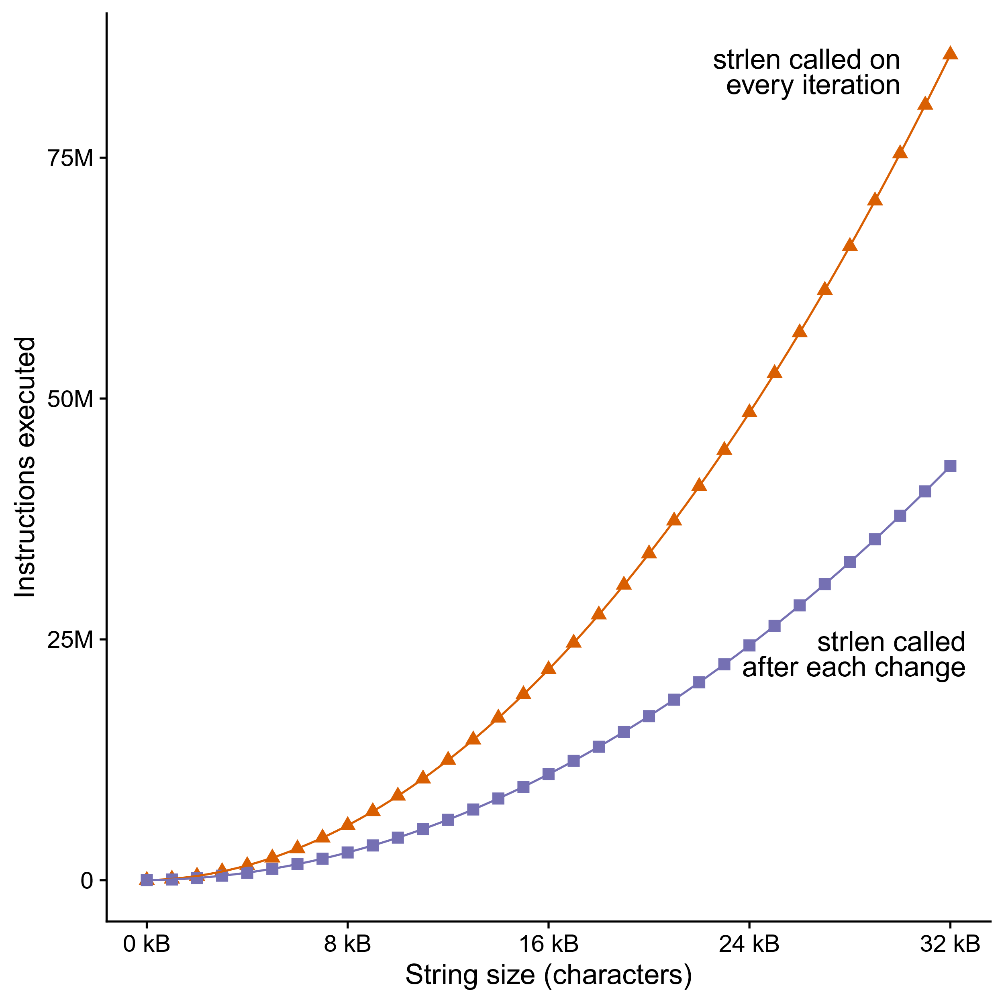
Can’t move functions out of loops
void lower_still_quadratic(char *s) {
size_t i, n = strlen(s);
for (i = 0; i < n; i++)
if (s[i] >= 'A' && s[i] <= 'Z') {
s[i] += 'a' - 'A’;
n = strlen(s);
}
}

Slide 46
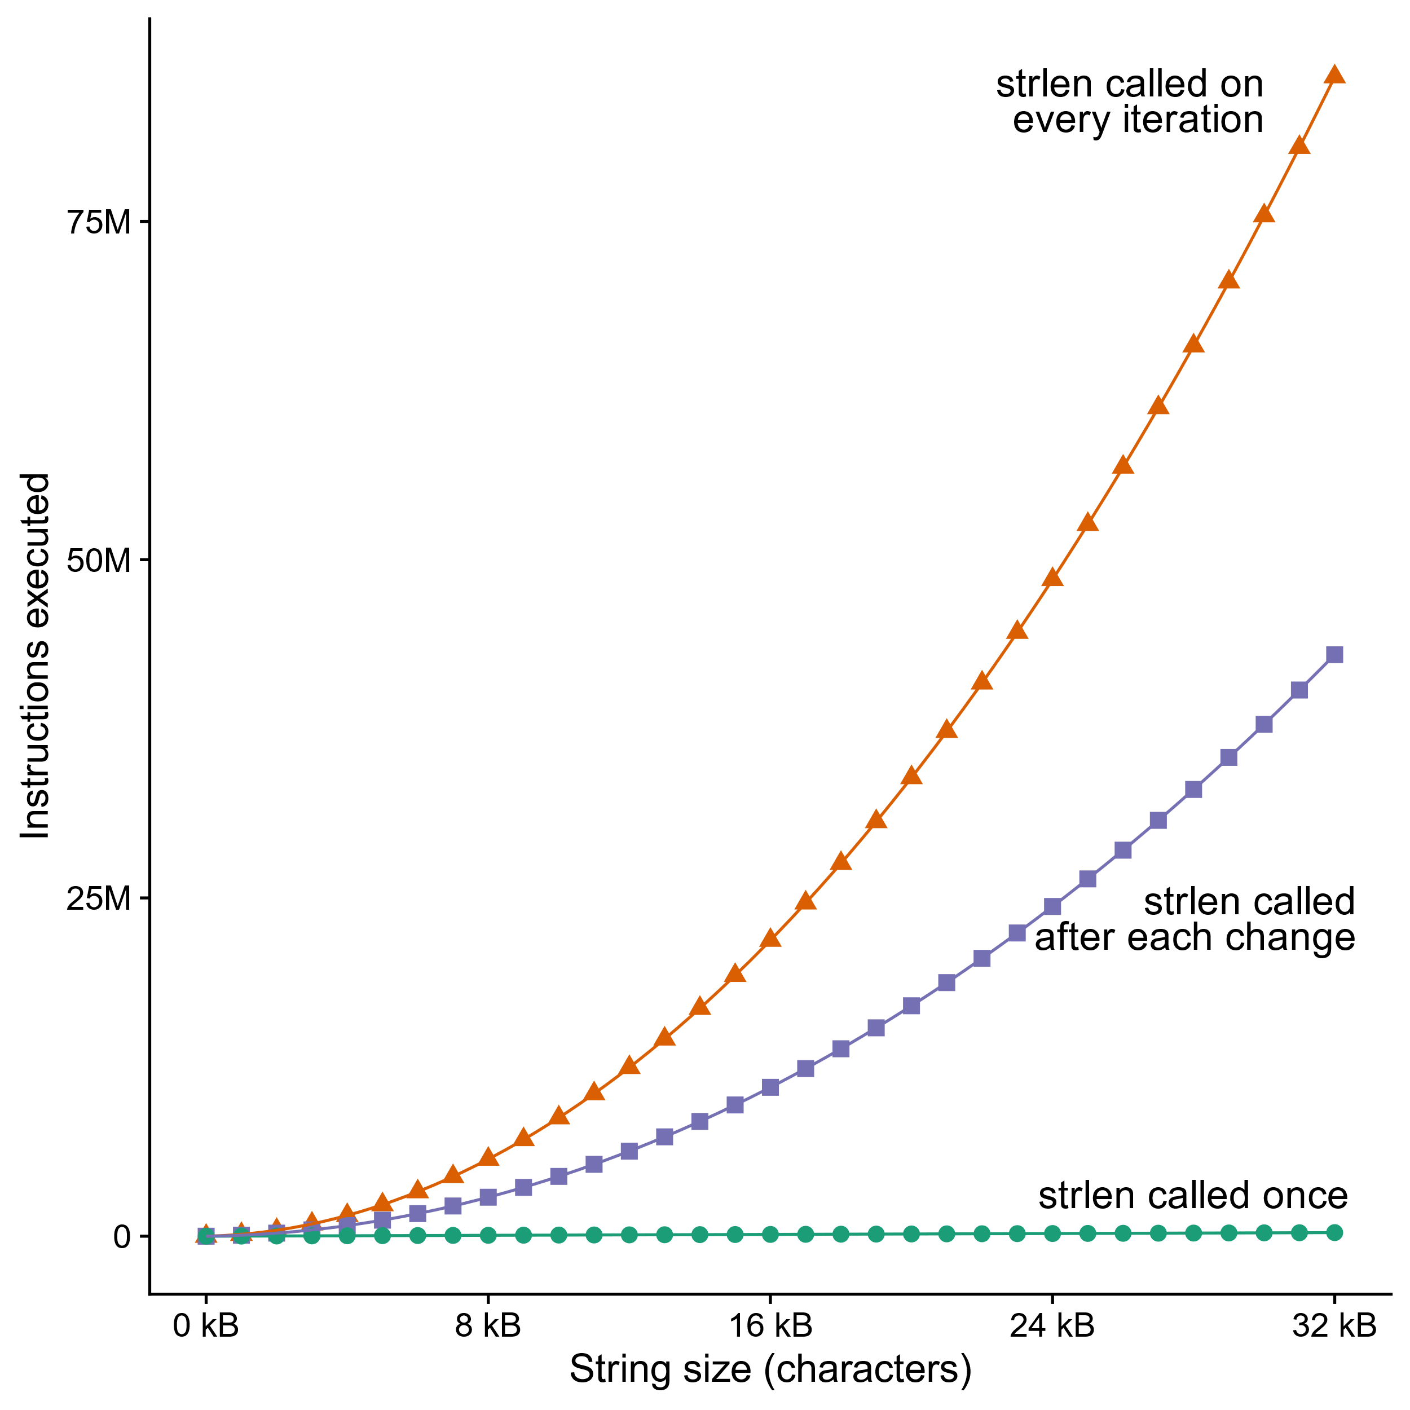
Can’t move functions out of loops
void lower_linear(char *s) {
size_t i, n = strlen(s);
for (i = 0; i < n; i++)
if (s[i] >= 'A' && s[i] <= 'Z')
s[i] += 'a' - 'A';
}

Slide 47
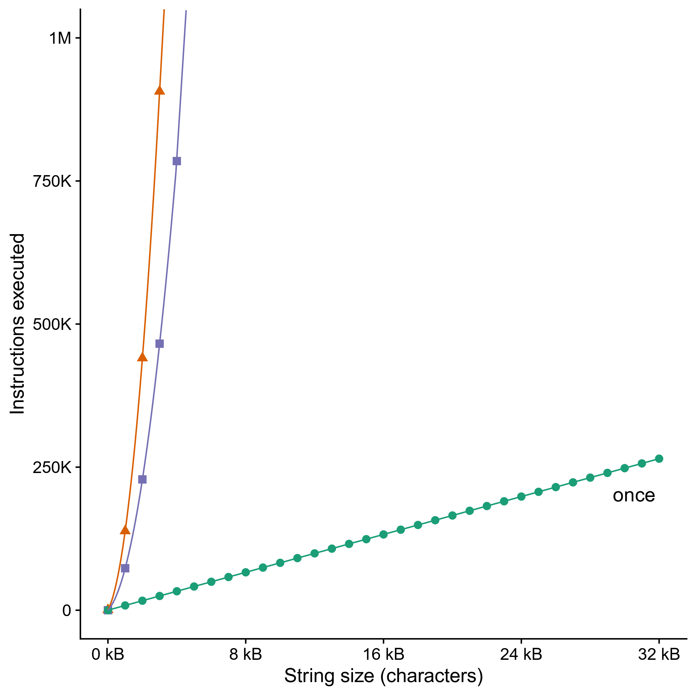
Can’t move functions out of loops
Even calling strlen() once is a linear function, it’s just that the others are terrible
  Zoom in here shows that
Putting strlen() in the loop is a super common CS211 mistake
  Although we let it slide

Slide 48
Optimization Challenges
Memory aliasing
Function calls
Non-associative arithmetic
Larger cache optimizations

Slide 49
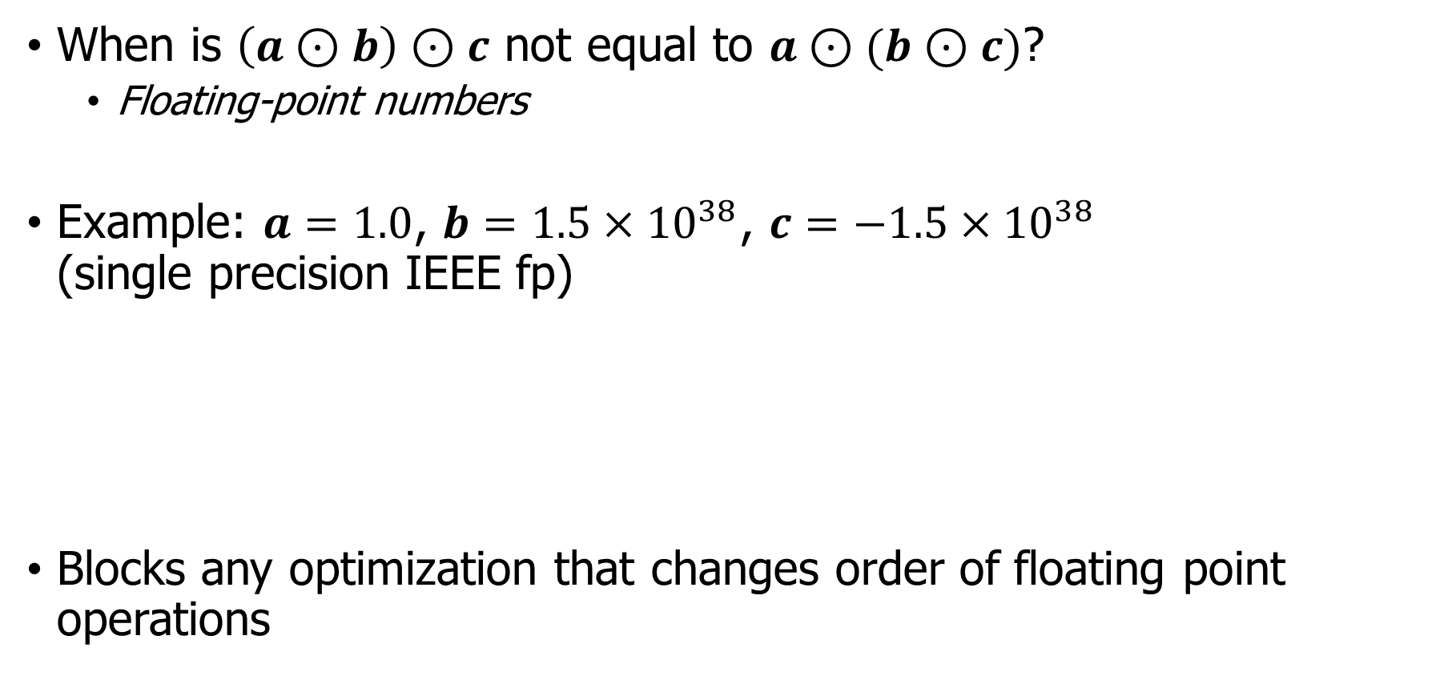
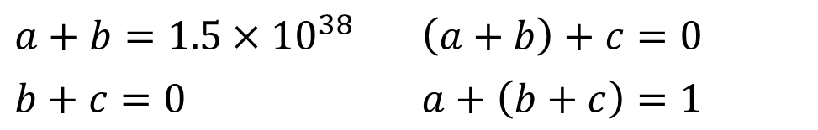
Non-associative arithmetic
When is $\left(a⊙b\right)⊙c$ not equal to $a⊙(b⊙c)$?
  Floating-point numbers
Example: $a=1.0$, $b=1.5×{10}^{38}$, $c=−1.5×{10}^{38}$
(single precision IEEE fp)
Blocks any optimization that changes order of floating point operations
$$a+b=1.5×{10}^{38}$$ | $$\left(a+b\right)+c=0$$
$$b+c=0$$ | $$a+\left(b+c\right)=1$$
Notes:
Who can think of a mathematical operator – like addition, or matrix product, or whatever – that isn’t associative? Paren A op B, close paren, op C is not the same as A op paren B op C, close paren? [Demand at least two examples from class, then reveal next part of slide.]
These are my top three examples: octonions, which are like complex numbers, but with eight dimensions instead of two; vector cross product (unlike vector exterior product); and … floating point numbers.
[reveal] Floating point numbers aren’t associative because of rounding error. If you add 1.0 to 1.5x10^38 in single precision IEEE float, it gets rounded back to 1.5x10^38, so if you then subtract 1.5x10^38 again you get zero. But if you do it in the other order, 1.5x10^38 minus 1.5x10^38 is zero, plus one is one.
[reveal] In C the compiler is only allowed to change order of operations if it gives the same result, so it has to be very cautious about reordering floating point math.

Slide 50
Optimization Challenges
Memory aliasing
Function calls
Non-associative arithmetic
Larger cache optimizations

Slide 51
Larger cache optimizations
void mmm(double *a, double *b,
double *c, int n) {
memset(c, 0, n*n*sizeof(double));
int i, j, k, i1, j1, k1;
for (i = 0; i < n; i+=B)
for (j = 0; j < n; j+=B)
for (k = 0; k < n; k+=B)
for (i1 = i; i1 < i+B; i1++)
for (j1 = j; j1 < j+B; j1++)
for (k1 = k; k1 < k+B; k1++)
c[i1*n+j1] += a[i1*n + k1]
* b[k1*n + j1];
}
void mmm(double *a, double *b,
double *c, int n) {
memset(c, 0, n*n*sizeof(double));
int i, j, k;
for (i = 0; i < n; i++)
for (j = 0; j < n; j++)
for (k = 0; k < n; k++)
c[i*n + j] += a[i*n + k]
* b[k*n + j];
}
j
j1
c
a
b
c
a
b
=
x
=
x
i
i1
Block size B x B
Compiler cannot do this transformation automatically
Notes:
For example, remember last week we talked about how much matrix multiply speeds up if you do it in blocks for better cache use?
The compiler can’t do that transformation for you.
Unless maybe there’s a special option, like GCC’s –ffast-math, to tell it not to worry about getting the numbers right.

Slide 52
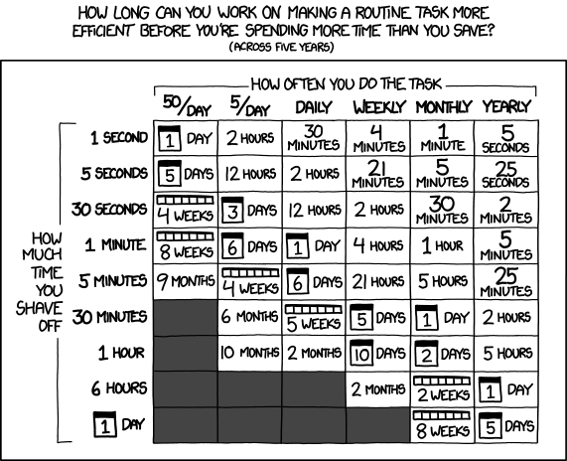
Break + Relevant xkcd
https://xkcd.com/1205/

Slide 53
Outline
Compilers and Optimizations
Local Optimizations
Global Optimizations
Obstacles to Optimization
GNU C Compiler (GCC)

Slide 54
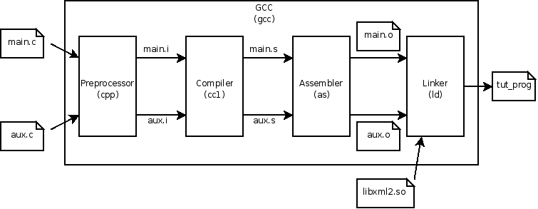
GNU C Compiler (GCC)
Very widely used compiler
  Created in 1987
  Originally just supported C, but now supports several languages
    C, C++, Objective-C, Fortran, Ada, D, Go
Collection of tools that perform the compilation steps

Slide 55
Enabling optimizations
Flag given to gcc chooses optimization levels
  -O# where # is one of {0, 1, 2, 3, s} (and a few custom others)
  (that flag is a capital Oh for Optimization, not a zero)
-O0 is the default (oh zero)
  Almost all optimizations are disabled
  Code compiles more quickly!
  Code does what you expect

Slide 56
More advanced optimizations
Each level up from there is just a collection of optimizations
-O1
-fauto-inc-dec
-fbranch-count-reg
-fcombine-stack-adjustments
-fcompare-elim
-fcprop-registers
-fdce
-fdefer-pop
-fdelayed-branch
-fdse
-fforward-propagate
-fguess-branch-probability
...
Explanation of optimizations:
https://gcc.gnu.org/onlinedocs/gcc/Optimize-Options.html

Slide 57
Optimizations examples in godbolt
Go to Godbolt!

Slide 58
Code examples for Godbolt
long square(long num) {
return num*num;
}
long multi_loop(long orig_value){
long new_value = 0;
for (int i=0; i<4; i++) {
for (int j=0; j<8; j++) {
new_value += 1;
}
new_value += orig_value;
}
return new_value;
}
long complex(long a, long b) {
if (a > b) {
b *= 2;
} else {
a += 10;
}
return a+b;
}

Slide 59
Architecture-dependent optimizations
By default, GCC knows which ISA you are compiling for
  x86-64
GCC does not know the specific processor you’re compiling for
  So it can make architecture-dependent choices
  But it cannot make processor-dependent optimizations
-march=cpu-type
  Informs GCC of the specific processor you’re on
  Make sure you tell it the correct processor!
    The wrong one might lead to code that crashes

Slide 60
Optimizations in SETI Lab
Enable optimizations to start with
  This should be enough to get you to 100%
  Assuming you’ve got the concurrency part correct
To achieve extra credit
  Look into more advanced flags and what they do
  Consider what optimizations you could perform on the code that the compiler cannot
    Note: must focus these on the loops that are doing the most work

Slide 61
Be sure to apply optimizations to everything!
Common SETI Lab bug: only apply optimizations to p_band_scan.c
  In reality, much of the work is performed in the functions it calls to do signal processing
Be sure to make clean and then recompile everything after enabling or changing optimizations

Slide 62
Compilers courses
Is this lecture content interesting to you?
  There is a LOT more depth here
  Certainly more advanced optimizations
  Also the idea of how does a compiler parse and understand your code
Courses to consider:
  CS322 – Compiler Construction
  CS323 – Code Analysis and Transformation

Slide 63
Outline
Compilers and Optimizations
Local Optimizations
Global Optimizations
Obstacles to Optimization
GNU C Compiler (GCC)

