Slide 1
Lecture 10
Buffer Overflows
CS213 – Intro to Computer Systems
Branden Ghena – Fall 2023
Slides adapted from:
St-Amour, Hardavellas, Bustamente (Northwestern), Bryant, O’Hallaron (CMU), Garcia, Weaver (UC Berkeley)

Slide 2
Administrivia
Continue work on Bomb Lab
Homework 3 releases late tonight or early tomorrow
  Due on Tuesday, November 7th
Attack Lab is out after class
  Due on Wednesday, February 22nd

Slide 3
Today’s Goals
Introduce the domain of Computer Security
Understand buffer overflows and return-oriented programming
  What enables them
  How they are used
  How to protect against them

Slide 4

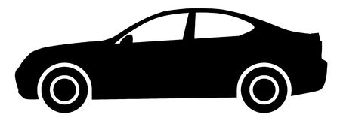
Why is computer security so important?
Most public security happens at least in some portion on the honor system
  Pretty easy to break a window
  Keyed locks are easy to pick
  Master keys can be determined and manufactured (Matt Blaze attack)
  Laws apply after you’ve done it

Slide 5
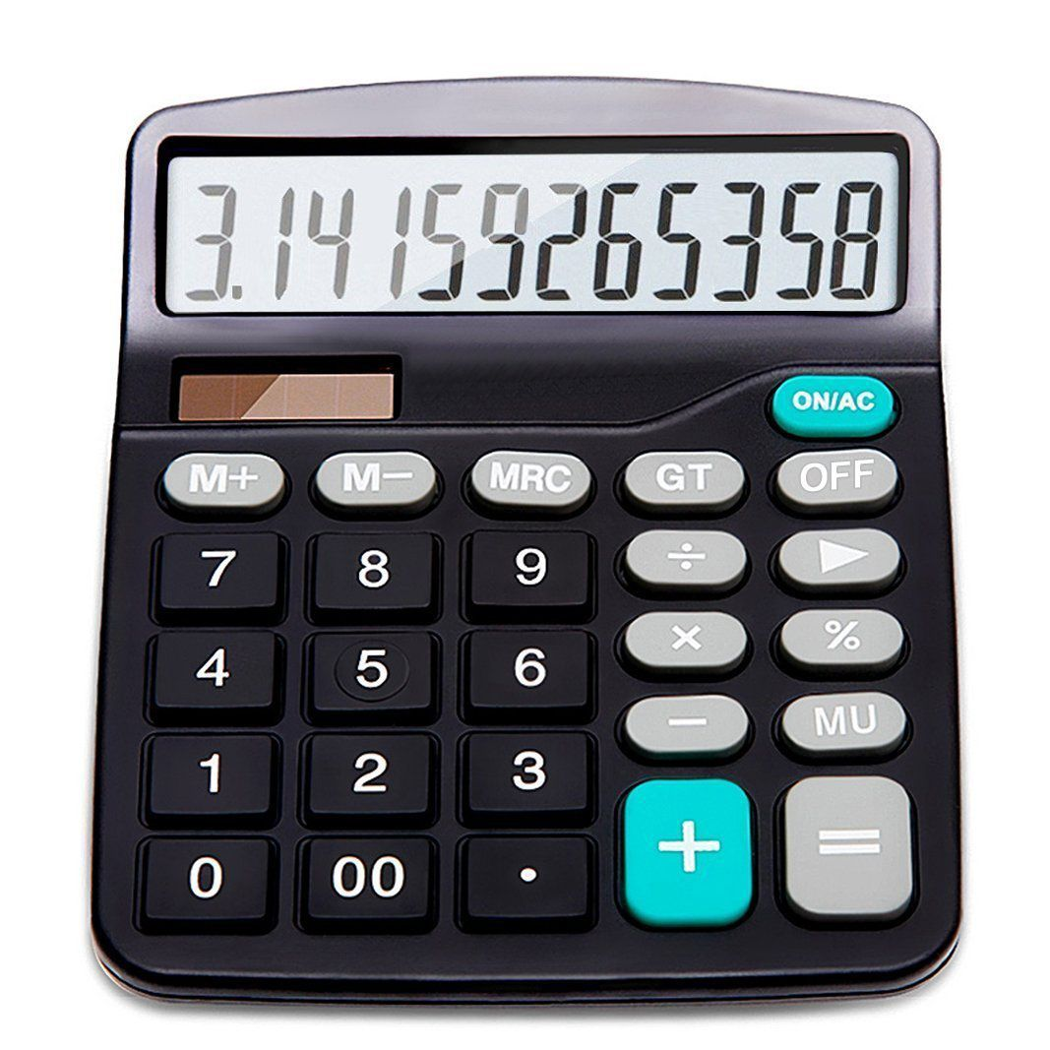
Early computers didn’t have any security either
Simple machines for doing computation do not have private files or contention
Sometimes there were multiple users, but all were employees of the same company
  Permissions needed to be as secure as a file in a locked drawer on a desk
“The act of breaking into a computer system has to have the same social stigma as breaking into a neighbor's house. It should not matter that the neighbor's door is unlocked.”
- Ken Thompson, Turing Award Lecture, 1984

Slide 6
Connectivity of computers makes security a top concern
Security of physical items is dependent on the fact that only one person can possess a thing at a time
  And it’s usually obvious when theft occurs
  Not the case for private information on a computer!
The internet makes security incredibly important
  Usually not people breaking into computers manually, one at a time
  Instead, it is computers breaking into computers by means of scripting
  And you can access a computer from anywhere on Earth
Breaking into or controlling one car is a crime
  Controlling 100,000 cars remotely is a problem for the manufacturer

Slide 7
Outline
Buffer Overflows
Protecting Against Buffer Overflows
Return-Oriented Programming
Protecting Against Return-Oriented Programming

Slide 8
Memory Referencing Bug Example
typedef struct {
int a[2];
double d;
} struct_t;
double fun(int i) {
volatile struct_t s; // volatile ≈ don’t optimize this away
s.d = 3.14;
s.a[i] = 1073741824; // Possibly out of bounds
return s.d;
}
fun(0) ➙ 3.14
fun(1) ➙ 3.14
fun(2) ➙ 3.1399998664856
fun(3) ➙ 2.00000061035156
fun(4) ➙ 3.14
fun(5) ➙ 3.14
fun(6) ➙ Segmentation fault (core dumped)
Abuses undefined behavior
Result is system specific

Slide 9
Memory Referencing Bug Example
typedef struct {
int a[2];
double d;
} struct_t;
fun(0) ➙ 3.14
fun(1) ➙ 3.14
fun(2) ➙ 3.1399998664856
fun(3) ➙ 2.00000061035156
fun(4) ➙ 3.14
fun(5) ➙ 3.14
fun(6) ➙ Segmentation fault
Explanation:
Return Addr | 6
? | 5
? | 4
d4 ... d7 | 3
d0 ... d3 | 2
a[1] | 1
a[0] | 0
Location accessed by fun(i)
struct_t

Slide 10
Such problems are a BIG deal
Generally called a “buffer overflow”
  Going past end of memory allocated for an array (AKA buffer)
Why is it a big deal?
  #1 technical cause of security vulnerabilities
    (#1 overall cause is social engineering)
Most common form:
  Unchecked lengths on string inputs
  Particularly with character arrays on the stack
    Sometimes referred to as “stack smashing”

Slide 11
String library code
Implementation of Unix function gets
  No way to specify limit on number of characters to read
Similar problems with other Unix functions
  strcpy, strcat: Copies string of arbitrary length
  scanf, fscanf, sscanf, when given %s specifier
/* Get string from stdin */
char *gets(char *dest)
{
int c = getchar();
char *p = dest;
while (c != EOF && c != '\n') {
*p++ = c;
c = getchar();
}
*p = '\0';
return dest;
}
No bounds checking!

Slide 12
Vulnerable buffer code
int main(){
printf("Type a string:");
call_echo();
return 0;
}
unix>./bufdemo-nsp
Type a string:012
012
unix>./bufdemo-nsp
Type a string: 00001111222233334444555
00001111222233334444555
void call_echo() {
echo();
}
Much more than 4 characters!
/* Prints whatever is read */
void echo(){
char buf[4]; /* Way too small! */
gets(buf);
puts(buf);
}
unix>./bufdemo-nsp
Type a string: 0000111122223333444455556
Segmentation Fault

Slide 13
Buffer Overflow Disassembly
echo:
00000000004006cf <echo>:
4006cf: 48 83 ec 18 sub $24,%rsp
4006d3: 48 89 e7 mov %rsp,%rdi
4006d6: e8 a5 ff ff ff callq 400680 <gets>
4006db: 48 89 e7 mov %rsp,%rdi
4006de: e8 3d fe ff ff callq 400520 <puts@plt>
4006e3: 48 83 c4 18 add $24,%rsp
4006e7: c3 retq
Sidebar: the compiler is optimizing here to use 8-byte alignment instead of 16-byte.
It knows no function this calls needs 16-byte alignment.
call_echo:
00000000004006e8 <call_echo>:
4006e8: 48 83 ec 08 sub $8,%rsp
4006ec: b8 00 00 00 00 mov $0,%eax
4006f1: e8 d9 ff ff ff callq 4006cf <echo>
4006f6: 48 83 c4 08 add $8,%rsp
4006fa: c3 retq

Slide 14
Buffer Overflow Stack
After call to gets
Offsets from %rsp in hex
void echo()
{
char buf[4];
gets(buf);
. . .
}
echo:
subq $24, %rsp
movq %rsp, %rdi
call gets
. . .
 | 0 | 1 | 2 | 3 | 4 | 5 | 6 | 7
… | Stack frame for call_echo
28
20
18 | Return Address (8 bytes)
10 | 20 bytes unused
08
00 | ?? | ?? | ?? | ??
return
address
call_echo:
. . .
4006f1: callq 4006cf <echo>
4006f6: add $8,%rsp
. . .
Stack grows down
%rsp
buf[0]
buf[1]
buf[3]

Slide 15
Buffer Overflow Stack Example
After call to gets
Offsets from %rsp in hex
void echo()
{
char buf[4];
gets(buf);
. . .
}
echo:
subq $24, %rsp
movq %rsp, %rdi
call gets
. . .
 | 0 | 1 | 2 | 3 | 4 | 5 | 6 | 7
… | Stack frame for call_echo
28
20
18 | F6 | 06 | 40 | 00 | 00 | 00 | 00 | 00
10 | 20 bytes unused
08
00 | ?? | ?? | ?? | ??
return
address
call_echo:
. . .
4006f1: callq 4006cf <echo>
4006f6: add $8,%rsp
. . .
Stack grows down
%rsp
buf[0]
buf[1]
buf[3]

Slide 16
Buffer Overflow Stack Example #1
After call to gets
Offsets from %rsp in hex
void echo()
{
char buf[4];
gets(buf);
. . .
}
echo:
subq $24, %rsp
movq %rsp, %rdi
call gets
. . .
 | 0 | 1 | 2 | 3 | 4 | 5 | 6 | 7
… | Stack frame for call_echo
28
20
18 | F6 | 06 | 40 | 00 | 00 | 00 | 00 | 00
10 | 34 | 34 | 34 | 34 | 35 | 35 | 35 | 00
08 | 32 | 32 | 32 | 32 | 33 | 33 | 33 | 33
00 | 30 | 30 | 30 | 30 | 31 | 31 | 31 | 31
return
address
call_echo:
. . .
4006f1: callq 4006cf <echo>
4006f6: add $8,%rsp
. . .
Stack grows down
%rsp
buf[0]
buf[1]
buf[3]
buf[7]
unix>./bufdemo-nsp
Type a string: 00001111222233334444555
00001111222233334444555
Overflowed buffer, but did not corrupt state

Slide 17
Buffer Overflow Stack Example #2
After call to gets
Offsets from %rsp in hex
void echo()
{
char buf[4];
gets(buf);
. . .
}
echo:
subq $24, %rsp
movq %rsp, %rdi
call gets
. . .
 | 0 | 1 | 2 | 3 | 4 | 5 | 6 | 7
… | Stack frame for call_echo
28
20
18 | 36 | 00 | 40 | 00 | 00 | 00 | 00 | 00
10 | 34 | 34 | 34 | 34 | 35 | 35 | 35 | 35
08 | 32 | 32 | 32 | 32 | 33 | 33 | 33 | 33
00 | 30 | 30 | 30 | 30 | 31 | 31 | 31 | 31
return
address
call_echo:
. . .
4006f1: callq 4006cf <echo>
4006f6: add $8,%rsp
. . .
Stack grows down
%rsp
buf[0]
buf[1]
buf[3]
buf[7]
Is it a string?
Is it an address?
Depends on context!
unix>./bufdemo-nsp
Type a string: 0000111122223333444455556
Segmentation Fault
Overflowed buffer and corrupted return address. Could point to unmapped memory, etc.

Slide 18
Buffer Overflow Stack Example #3
After call to gets
Offsets from %rsp in hex
void echo()
{
char buf[4];
gets(buf);
. . .
}
echo:
subq $24, %rsp
movq %rsp, %rdi
call gets
. . .
 | 0 | 1 | 2 | 3 | 4 | 5 | 6 | 7
… | Stack frame for call_echo
28
20
18 | 00 | 06 | 40 | 00 | 00 | 00 | 00 | 00
10 | 34 | 34 | 34 | 34 | 35 | 35 | 35 | 35
08 | 32 | 32 | 32 | 32 | 33 | 33 | 33 | 33
00 | 30 | 30 | 30 | 30 | 31 | 31 | 31 | 31
return
address
call_echo:
. . .
4006f1: callq 4006cf <echo>
4006f6: add $8,%rsp
. . .
Stack grows down
%rsp
buf[0]
buf[1]
buf[3]
buf[7]
unix>./bufdemo-nsp
Type a string: 000011112222333344445555
000011112222333344445555
Overflowed buffer, corrupted return address, but program seems to work! Latent bug!

Slide 19
Buffer Overflow Stack Example #3 Explained
After call to gets
Offsets from %rsp in hex
register_tm_clones:
. . .
400600: mov %rsp,%rbp
400603: mov %rax,%rdx
400606: shr $0x3f,%rdx
40060a: add %rdx,%rax
40060d: sar %rax
400610: jne 400614
400612: pop %rbp
400613: retq
 | 0 | 1 | 2 | 3 | 4 | 5 | 6 | 7
… | Stack frame for call_echo
28
20
18 | 00 | 06 | 40 | 00 | 00 | 00 | 00 | 00
10 | 34 | 34 | 34 | 34 | 35 | 35 | 35 | 35
08 | 32 | 32 | 32 | 32 | 33 | 33 | 33 | 33
00 | 30 | 30 | 30 | 30 | 31 | 31 | 31 | 31
return
address
Stack grows down
%rsp
buf[0]
buf[1]
buf[3]
buf[7]
“Returns” to unrelated code
Lots of things happen, without modifying critical state
Eventually executes retq back to main as if nothing happened...

Slide 20
Break + Question
After call to gets
Offsets from %rsp in hex
 | 0 | 1 | 2 | 3 | 4 | 5 | 6 | 7
… | Stack frame for call_echo
28
20
18 | Return Address (8 bytes)
10 | 20 bytes unused
08
00 | ?? | ?? | ?? | ??
Generally: How many bytes must be written to corrupt the return address? (assume char buf[4];)
Is the answer the same for all programs?
Is it the same each time the code runs?
return
address
Stack grows down
%rsp
buf[0]
buf[1]
buf[3]

Slide 21
Break + Question
After call to gets
Offsets from %rsp in hex
 | 0 | 1 | 2 | 3 | 4 | 5 | 6 | 7
… | Stack frame for call_echo
28
20
18 | Return Address (8 bytes)
10 | 20 bytes unused
08
00 | ?? | ?? | ?? | ??
Generally: How many bytes must be written to corrupt the return address? (assume char buf[4];) -> 25 bytes
Is the answer the same for all programs?
  No! Depends how much stack space the function uses
Is it the same each time the code runs?
  Almost certainly yes. Functions usually use the same amount of stack space each time
return
address
Stack grows down
%rsp
buf[0]
buf[1]
buf[3]

Slide 22
Malicious use of buffer overflow
Max Memory Address
…
void foo(){
bar();
...
}
void bar() {
char buf[64];
gets(buf);
...
}
return
address
A
foo stack frame
A
B
08048444 <malicious_code>:
8048444: 55 push %ebp
8048445: 89 e5 mov %esp,%ebp
8048447: 53 push %ebx
8048448: 83 ec 24 sub $0x24,%esp
804844b: 8d 5d f4 lea -0xc(%ebp),%ebx
804844e: 89 1c 24 mov %ebx,(%esp)
8048451: e8 fa fe ff ff call 8048350
8048456: 89 1c 24 mov %ebx,(%esp)
data
written
by
gets()
pad
bar stack frame
exploit
code
buf
B
…
Input string contains binary representation of executable code
Overwrite return address with address of buffer
When bar() returns, where do we go?
  Into the beginning of malicious_code on the stack! 😱
Memory Address 0

Slide 23
Exploits based on buffer overflows
Buffer overflow bugs can allow remote machines to execute arbitrary code on victim machines
Distressingly common in real programs
  Programmers keep making the same mistakes 😭
  Recent measures make these attacks much more difficult
Examples across the decades
  Original “Internet worm” (1988)
    Attacked fingerd server, replicated itself across the internet
  Stuxnet (2010)
    Attack on Iran nuclear program, malicious code destroyed centrifuges
  … and many, many more
You will learn some of these tricks with the attack lab
  Hopefully convincing you to never leave such holes in your programs!

Slide 24
Example: The original Internet worm (1988)
Internet worm
  Early versions of the finger server (fingerd) used gets() to read the argument sent by the client:
    finger branden@northwestern.edu
  Worm attacked fingerd server by sending phony argument:
    finger “exploit-code padding new-return-address”
    Exploit code: execute a root shell on the victim machine with a direct TCP connection to the attacker
Once on a machine, scanned for other machines to attack
  Invaded ~6000 computers in hours (10% of the Internet ☺ )
    See June 1989 article in Communications of the ACM
  The young author of the worm was prosecuted…

Slide 25
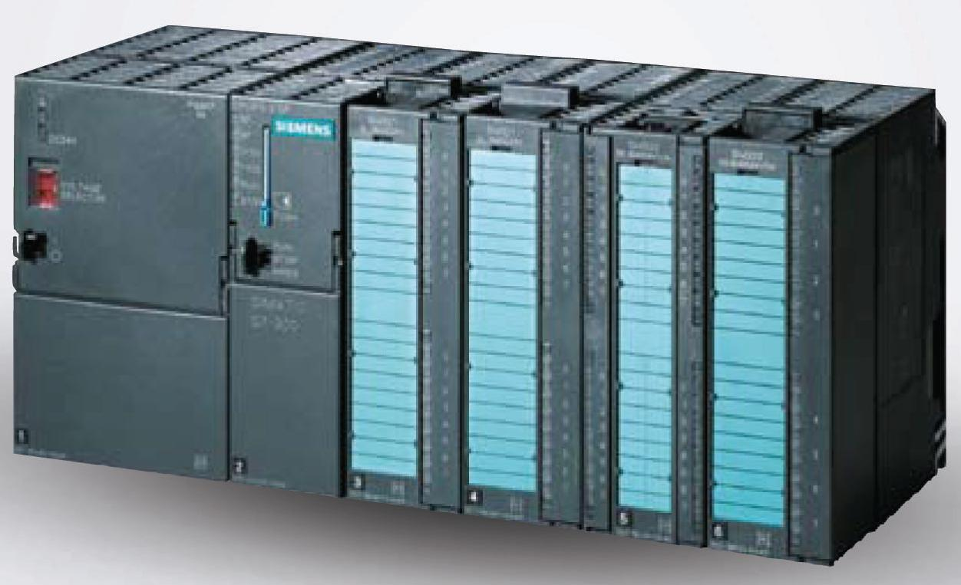
Example: Attack on Nuclear Plants (2010)
Stuxnet
  Spread through buffer overflow
  Disrupted Iran’s nuclear program
    Damage uranium enrichment plants
    Malicious code destroys centrifuges
  At the time, likely the most sophisticated malware ever
  Targets only specific Siemens SCADA systems, plants with Natanz-like centrifuge cascade setups
    Centrifuge rotor frequency: 1064 Hz
    Stuxnet speeds rotors up to 1410 Hz
    Spinning so fast destroys the rotors
  Was somewhat effective: may have destroyed 1,000 centrifuges, reduced output, sowed chaos

Slide 26
Outline
Buffer Overflows
Protecting Against Buffer Overflows
Return-Oriented Programming
Protecting Against Return-Oriented Programming

Slide 27
1. Avoiding Buffer Overflow Vulnerability
/* Echo Line */
void echo()
{
char buf[4]; /* Way too small! */
fgets(buf, 4, stdin); /* length limit! */
puts(buf);
}
Use safe library routines that limit string lengths
  fgets instead of gets
  strncpy instead of strcpy
  Don’t use scanf with %s conversion specification
    Use fgets to read the string
    Or use format specifier %ns where n is a suitable integer
Also: don’t write your programs in C, when possible
  Fundamental design of C is to be fast, not to be secure

Slide 28
2. System-Level Protection: Randomized Stack
Stack base
Buffer overflow attack requires knowing
the absolute address of the buffer
  To overwrite return address to that
At start of program, allocate a random
amount of space on stack
  Different every time the program runs
Shifts stack addresses for entire program
  Program still runs fine
  Legitimate accesses to the stack are relative to %rsp
But absolute addresses get randomly shifted
  Don’t know what return address should be!
  Still not impossible to overcome (NOP sled)
Random
allocation
main
Application
Code
B?
pad
exploit
code
B?

Slide 29
3. System-Level Protection: Explicit Execute Page Permissions
Non-executable stack
  On x86-64, can mark a region of memory as “non-executable”
  Trying to execute something in that region → crash
  More about page permissions in the virtual memory lecture (later in class)
OpenBSD goes further: W^X
  A region of memory can be writeable or executable, but not both (xor!)
  Causes trouble for JITs
Stack after call to gets()
P stack frame
B
pad
data written
by gets()
exploit
code
Q stack frame
B
Any attempt to execute this code will fail

Slide 30
Break + Open Question
Why is a buffer overflow in a web browser so bad?

Slide 31
Break + Open Question
Why is a buffer overflow in a web browser so bad?
  The buffer overflow will exist in at least all instances of the same version of the web browser installed on the same OS and architecture
    Possibly many other versions too
  If it can be triggered from a website, then you could run malicious code on computers without any manual effort
    Any website could be suspect
  Scale is enormous: Chrome has roughly 3 billion users

Slide 32
Outline
Buffer Overflows
Protecting Against Buffer Overflows
Return-Oriented Programming
Protecting Against Return-Oriented Programming

Slide 33
How else are buffer overflows dangerous?
Without the ability to write malicious code, our computers are safe, right??
Some computers won’t fix it: legacy hardware, forgot, etc.
Buffer overflows are definitely still happening
  Can we take advantage of that in some way?

Slide 34
Finding a new way to abuse a vulnerability
Buffer overflows can still write values to the stack
Even if they can’t place malicious code directly on the stack, they can always modify return addresses
We can use that idea to build an attack from pieces of already existing program code that we reuse for malicious purposes
  This is one of those ideas that sounds impossible to pull off in the real world
  But actually, it totally works AND we’ll have you do it in Attack Lab!

Slide 35
Return-Oriented Programming (ROP)
Challenge (for would-be hackers)
  Stack randomization → predicting buffer location is hard
    So it’s hard to know where to jump and start executing
  Making stack non-executable → injecting code doesn’t work
    We can inject anything we want, but we can’t run it
Alternative strategy: Don’t inject your own code!
  Use code that’s already in the program!
  It’s in a predictable location!
    Otherwise, don’t know where to call/jump
  It’s executable
    Otherwise, the program wouldn’t run at all…

Slide 36
Return-Oriented Programming (ROP)
But wait, the code I want to run isn’t in the program!
  Unlikely that, e.g., a mail client includes code to, e.g., launch missiles
Key idea: construct the code you want to run from pieces that you find in the program!
  We’ll call these pieces gadgets
Strategy: find machine code fragments that do one small step of the malicious program you want to run, then return
  Then we’ll put these small steps together to get the whole program
  These return instructions will be the glue that tie them together
“The program” includes the standard library!
  Things like printf, scanf, etc.
  That’s a lot of code! So, lots of gadgets to choose from

Slide 37
Gadget Examples
Use the end of existing functions
Repurpose parts of instructions
long ab_plus_c
(long a, long b, long c){
return a*b + c;
}
00000000004004d0 <ab_plus_c>:
4004d0: 48 0f af fe imul %rsi,%rdi
4004d4: 48 8d 04 17 lea (%rdi,%rdx,1),%rax
4004d8: c3 ret
Gadget: rax ← rdi + rdx
Address: 0x4004d4
void setval
(unsigned *p) {
*p = 3347663060u;
}
00000000004004d9 <setval>:
4004d9: c7 07 d4 48 89 c7 movl $0xc78948d4,(%rdi)
4004df: c3 ret
Encodes: movq %rax, %rdi
Gadget: rdi ← rax
Address: 0x4004dc

Slide 38
Combining Gadgets
Let’s say our malicious program is this:
%rax = (%rbx * %rcx) + %rdi
And let’s say we found the following gadgets in the standard library
Combine gadgets by adding pointers to them to the stack
  Arrange on the stack by overflowing a buffer, like before
0000000000400474 <g1>:
400474: 48 0f af cb imul %rbx,%rcx
400478: c3 retq
Given a large enough
standard library, can
find gadgets that do
pretty much anything
we want! Plenty of
code to pick from.
0000000000400479 <g2>:
400479: 48 01 cf add %rcx,%rdi
40047c: c3 retq
000000000040047d <g3>:
40047d: 48 89 f8 mov %rdi,%rax
400480: c3 retq
40047d
400479
400474
%rsp
…
…
buf

Slide 39
Gadget Execution
Step 1: we overflowed the buffer, like before
  We set up the stack with the gadget addresses, as on last slide
  Now we’re about to return from the vulnerable function (echo)
00000000004006cf <echo>:
...
4006d6: e8 a5 ff ff ff callq 400680 <gets>
...
4006e7: c3 retq
0000000000400474 <g1>:
400474: 48 0f af cb imul %rbx,%rcx
400478: c3 retq
%rip = 4006e7
…
0000000000400479 <g2>:
400479: 48 01 cf add %rcx,%rdi
40047c: c3 retq
40047d
400479
400474
%rsp
000000000040047d <g3>:
40047d: 48 89 f8 mov %rdi,%rax
400480: c3 retq
…
…
buf

Slide 40
Gadget Execution
Step 2: return from echo
  Get the return address from %rsp
  Oh, that’s the address of the first gadget!
00000000004006cf <echo>:
...
4006d6: e8 a5 ff ff ff callq 400680 <gets>
...
4006e7: c3 retq
0000000000400474 <g1>:
400474: 48 0f af cb imul %rbx,%rcx
400478: c3 retq
%rip = 400474
…
0000000000400479 <g2>:
400479: 48 01 cf add %rcx,%rdi
40047c: c3 retq
40047d
400479
400474
%rsp
000000000040047d <g3>:
40047d: 48 89 f8 mov %rdi,%rax
400480: c3 retq

Slide 41
Gadget Execution
Step 3: run the first gadget
  %rcx = %rbx × %rcx
00000000004006cf <echo>:
...
4006d6: e8 a5 ff ff ff callq 400680 <gets>
...
4006e7: c3 retq
0000000000400474 <g1>:
400474: 48 0f af cb imul %rbx,%rcx
400478: c3 retq
%rip = 400474
…
0000000000400479 <g2>:
400479: 48 01 cf add %rcx,%rdi
40047c: c3 retq
40047d
400479
%rsp
000000000040047d <g3>:
40047d: 48 89 f8 mov %rdi,%rax
400480: c3 retq

Slide 42
Gadget Execution
Step 4: return from the first gadget
  Get the return address from %rsp
  QUIZ: where do we go next?
400479, that’s gadget 2!
00000000004006cf <echo>:
...
4006d6: e8 a5 ff ff ff callq 400680 <gets>
...
4006e7: c3 retq
0000000000400474 <g1>:
400474: 48 0f af cb imul %rbx,%rcx
400478: c3 retq
%rip = 400478
…
0000000000400479 <g2>:
400479: 48 01 cf add %rcx,%rdi
40047c: c3 retq
40047d
400479
%rsp
000000000040047d <g3>:
40047d: 48 89 f8 mov %rdi,%rax
400480: c3 retq

Slide 43
Gadget Execution
Step 5: run the second gadget
  %rdi = (%rbx × %rcx) + %rdi
00000000004006cf <echo>:
...
4006d6: e8 a5 ff ff ff callq 400680 <gets>
...
4006e7: c3 retq
0000000000400474 <g1>:
400474: 48 0f af cb imul %rbx,%rcx
400478: c3 retq
%rip = 400479
…
0000000000400479 <g2>:
400479: 48 01 cf add %rcx,%rdi
40047c: c3 retq
40047d
%rsp
000000000040047d <g3>:
40047d: 48 89 f8 mov %rdi,%rax
400480: c3 retq

Slide 44
Gadget Execution
Step 6: return from the second gadget
  Get the return address from %rsp
  Oh, that’s the address of the third gadget!
00000000004006cf <echo>:
...
4006d6: e8 a5 ff ff ff callq 400680 <gets>
...
4006e7: c3 retq
0000000000400474 <g1>:
400474: 48 0f af cb imul %rbx,%rcx
400478: c3 retq
%rip = 40047d
…
0000000000400479 <g2>:
400479: 48 01 cf add %rcx,%rdi
40047c: c3 retq
40047d
%rsp
000000000040047d <g3>:
40047d: 48 89 f8 mov %rdi,%rax
400480: c3 retq

Slide 45
Gadget Execution
Step 7: run the third gadget
  %rax = (%rbx × %rcx) + %rdi
  We’ve run the program we wanted to run. Our job is done.
00000000004006cf <echo>:
...
4006d6: e8 a5 ff ff ff callq 400680 <gets>
...
4006e7: c3 retq
0000000000400474 <g1>:
400474: 48 0f af cb imul %rbx,%rcx
400478: c3 retq
%rip = 40047d
…
%rsp
0000000000400479 <g2>:
400479: 48 01 cf add %rcx,%rdi
40047c: c3 retq
000000000040047d <g3>:
40047d: 48 89 f8 mov %rdi,%rax
400480: c3 retq

Slide 46
Gadget Execution
Step 8: Return from the third gadget
  At this point, return to whatever address we find on the stack.
  That’s past the data we put there ourselves, so it’s whatever was there before.
  Maybe not meant to be an address! Could be anything!
But we don’t care about what the program does anymore!
  We’ve run the code we wanted to run, nothing else matters!
  (Maybe we stole from bank accounts, launched missiles, etc.)
0000000000400474 <g1>:
400474: 48 0f af cb imul %rbx,%rcx
400478: c3 retq
%rip = ???
…
%rsp
0000000000400479 <g2>:
400479: 48 01 cf add %rcx,%rdi
40047c: c3 retq
000000000040047d <g3>:
40047d: 48 89 f8 mov %rdi,%rax
400480: c3 retq

Slide 47
Return-Oriented Programming Execution
Trigger with ret instruction in the current function
“Returns” to gadget 1, instead of to its caller
Gadget 1 does its thing, then returns to gadget 2, etc.
  Repeat as necessary
Complete! You’ve “run” the “function” you wanted to run!
Gadget n code
c3
...
...
...
Gadget 2 code
c3
Gadget 1 code
c3
%rsp

Slide 48
Outline
Buffer Overflows
Protecting Against Buffer Overflows
Return-Oriented Programming
Protecting Against Return-Oriented Programming

Slide 49
1. Avoiding buffer overflow vulnerabilities
Write better code please
Return-oriented programming starts with a buffer overflow
  To set up gadget addresses on the stack
No buffer overflow, no return-oriented programming!

Slide 50
2. Stack Canaries
Idea
  Place special value (“canary”) on stack just beyond buffer
  Check for corruption before exiting function
  So we can detect buffer overflows before we run malicious code
    Then just crash the program instead of doing bad things
  Analogy: canary in a coal mine
GCC Implementation
  -fstack-protector
  Now the default for potentially
  vulnerable functions
    (disabled in attack lab to show the vulnerability)
unix>./bufdemo-sp
Type a string:0123456
0123456
unix>./bufdemo-sp
Type a string:01234567
*** stack smashing detected ***

Slide 51
2. Stack Canaries - Disassembly
echo:
40072f: sub $0x18,%rsp
400733: mov %fs:0x28,%rax
40073c: mov %rax,0x8(%rsp)
400741: xor %eax,%eax
400743: mov %rsp,%rdi
400746: callq 4006e0 <gets>
40074b: mov %rsp,%rdi
40074e: callq 400570 <puts@plt>
400753: mov 0x8(%rsp),%rax
400758: xor %fs:0x28,%rax
400761: je 400768 <echo+0x39>
400763: callq 400580 <__stack_chk_fail@plt>
400768: add $0x18,%rsp
40076c: retq
Read value from a special, read-only segment in memory
Store it on the stack at offset 8 from %rsp
Check the canary is fine using xorl (0 if the two values are identical)
Notes:
“canary” from the history use of these birds to detect the presence of dangerous gases in mines
%gs:20 is segmented addressing, from the 80286, store as read-only.

Slide 52
2. Stack Canaries - Setting up canary
After call to gets
/* Echo Line */
void echo()
{
char buf[4]; /* Way too small! */
gets(buf);
puts(buf);
}
Offsets from %rsp in hex
 | 0 | 1 | 2 | 3 | 4 | 5 | 6 | 7
… | Stack frame for call_echo
28
20
18 | Return Address (8 bytes)
10 | Canary (8 bytes)
08 | 12 bytes unused
00 | ?? | ?? | ?? | ??
return
address
Stack grows down
echo:
. . .
movq %fs:40, %rax # Get canary
movq %rax, 8(%rsp) # Place on stack
xorl %eax, %eax # Erase canary
. . .
%rsp
buf[0]
buf[1]
buf[3]

Slide 53
2. Stack Canaries - Setting up canary
After call to gets
/* Echo Line */
void echo()
{
char buf[4]; /* Way too small! */
gets(buf);
puts(buf);
}
Offsets from %rsp in hex
 | 0 | 1 | 2 | 3 | 4 | 5 | 6 | 7
… | Stack frame for call_echo
28
20
18 | Return Address (8 bytes)
10 | 00 | Canary (overwritten)
08 | 32 | 32 | 32 | 32 | 33 | 33 | 33 | 33
00 | 30 | 30 | 30 | 30 | 31 | 31 | 31 | 31
return
address
echo:
. . .
movq 8(%rsp), %rax # Retrieve from stack
xorq %fs:40, %rax # Compare to canary
je .L6 # If same, OK
call __stack_chk_fail # FAIL
.L6: . . .
Stack grows down
%rsp
buf[0]
buf[1]
buf[3]
Input: 000111122223333
Code crashes due to canary mismatch

Slide 54
3. Address space layout randomization (ASLR)
Like stack randomization, generalized to all of memory
  Especially: executable code
Code, stack, heap all start in random locations
  Determined when program starts up
  You know the gadget you want is at the end of ab_plus_c
  But if you don’t know where ab_plus_c is, that’s no use!
Can be circumvented by clever side-channel attacks
  But really hard! Much harder than ROP
code
heap
heap
stack
code
stack
???? <ab_plus_c>:
????: 48 0f af fe
????: 48 8d 04 17
????: c3

Slide 55
Security is an arms race
There is no single fix for system security
  New attacks are constantly being discovered
  New solutions are constantly being applied
Find a vulnerability and how it can be exploited
Fix vulnerability
Go back to 1
A good goal is to at least avoid all the simple known attacks
Designing with security in mind can make vulnerabilities harder to find in the first place

Slide 56
Outline
Buffer Overflows
Protecting Against Buffer Overflows
Return-Oriented Programming
Protecting Against Return-Oriented Programming

