Slide 1
Lecture 04
Floating Point
CS213 – Intro to Computer Systems
Branden Ghena – Fall 2023
Slides adapted from:
St-Amour, Hardavellas, Bustamente (Northwestern), Bryant, O’Hallaron (CMU), Garcia, Weaver (UC Berkeley)

Slide 2
Administrivia
Homework 1 due today! (11:59 pm Central)
  Submit on Gradescope
  About 60% of the class has submitted so far 🧡
Pack Lab is due next week Tuesday
  Reminder: work collaboratively with your partner, not separately
Reminder: small office hours changes
  Monday 11-12 was removed. Monday 2-3 was added
  Wednesday 10-12 (with me) moved rooms
  Make use of office hours!

Slide 3
Today’s Goals
Explore representing real (decimal) numbers with binary
Understand IEEE754 encoding
Discuss encoding impacts on floating-point arithmetic

Slide 4
What is hard about floating point?
LOTS OF RULES
  No, more than that
Homework 2 will give you a chance to practice
Plus on exams you’ll have a notes sheet to write down rules on

Slide 5
Outline
Fractional Binary Numbers
Representing Floating Point
Smaller Floating Point
Floating Point Arithmetic

Slide 6
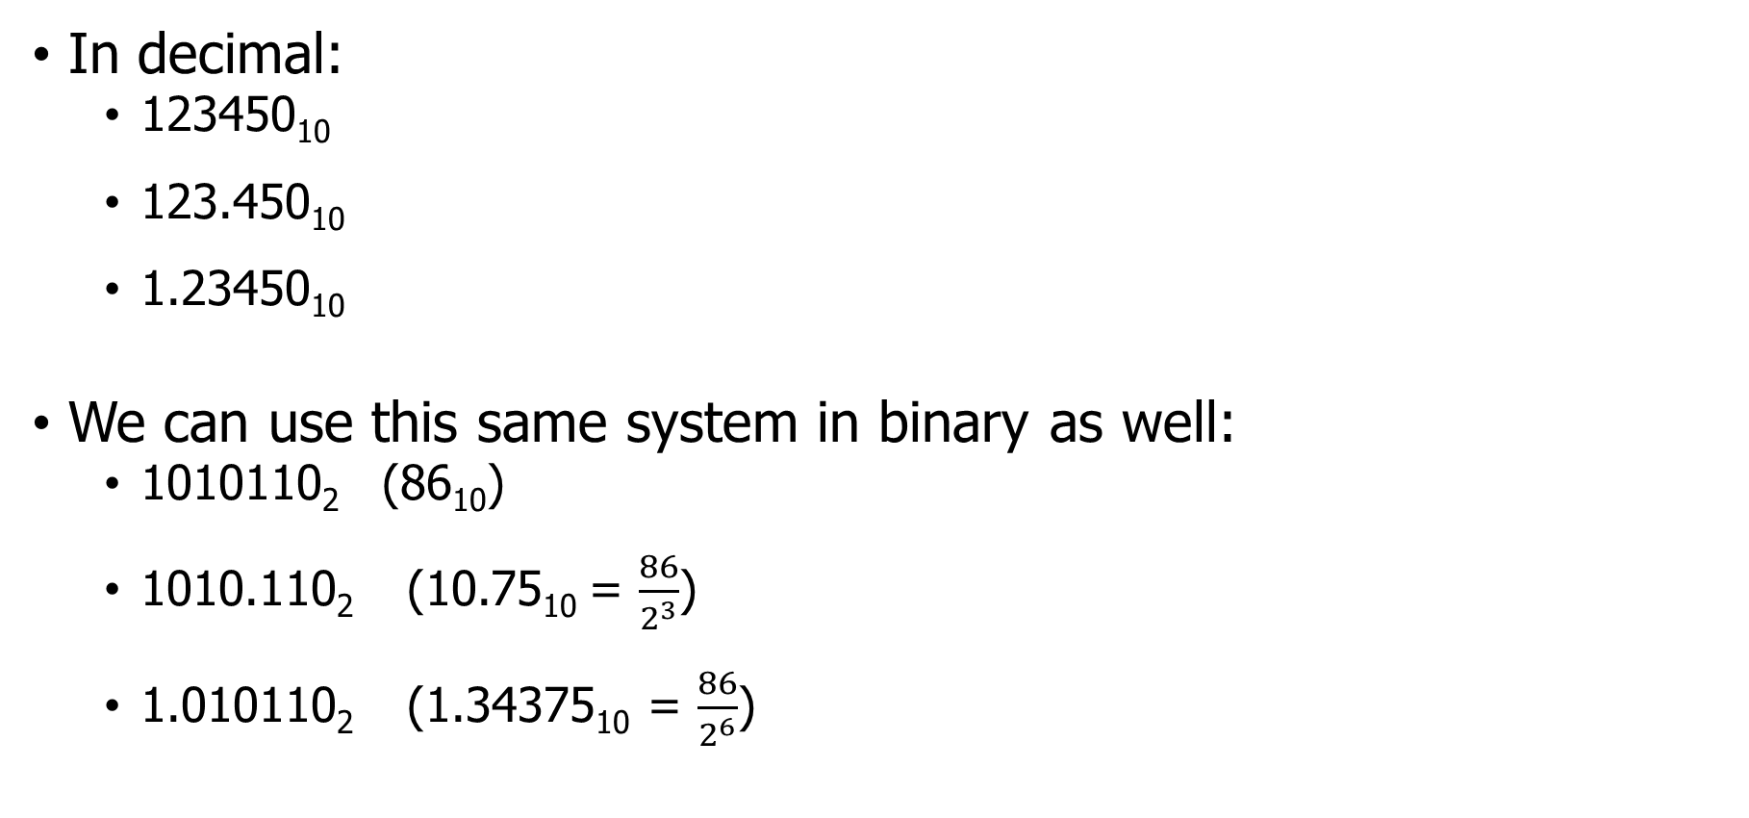
Floating point numbers
In decimal:
  123450₁₀
  123.450₁₀
  1.23450₁₀
We can use this same system in binary as well:
  1010110₂ (86₁₀)
  1010.110₂ (10.75₁₀ = $\frac{86}{2^{3}}$)
  1.010110₂ (1.34375₁₀ = $\frac{86}{2^{6}}$)

Slide 7
Fractional Binary Numbers
Representation
  Bits to right of “binary point” represent fractional powers of 2
  Represents rational number:
2^{i}
2^{i–1}
2² = 4
• • •
2¹ = 2
2⁰ = 1
b_{i}
b_{i–1}
• • •
b₂
b₁
b₀
.
b_{–1}
b_{–2}
b_{–3}
• • •
b_{–j}
1/2 = 2⁻¹
1/4 = 2⁻²
• • •
1/8 = 2⁻³
2^{–j}
Notes:
First step is to understand how fractional numbers are represented in binary
As with decimal representation, the weighting of the digits is defined relative to the decimal point symbol;
For binary, the weighting of the binary digit is defined relative to the binary point symbol

Slide 8
Example binary conversion
1010.110
Before the binary point:
1*2³ + 0*2² + 1*2¹ +0*2⁰
= 1*2³ + 1*2¹ = 8+2 = 10
After the binary point:
1*2⁻¹ + 1*2⁻² + 0*2⁻³
= 1*2⁻¹ + 1*2⁻² = ½ + ¼ = ¾ = 0.75

Slide 9
Fractional Binary Number Examples
101.
Note:
This the number 3!
This is the number 7!
This is the number 63!
11
  5+3/4 = 0b
  2+7/8 = 0b
  63/64 = 0b
10.111
0.111111
Notes:
Shifting the binary point right, multiplies by 2, shifting left divides by 2

Slide 10
Binary point is part of the solution, but not an entire encoding
Some problems remain:
Computers are finite, but real numbers are not
  Need to choose how many bits to use
  Many decimal numbers would take infinite binary bits to represent perfectly
    3.14₁₀ = 11.0010001111010111₂ (we could keep going)
We also need to represent where the “binary point” is located
  We’ll use some of our bits to do so
Should do signed numbers while we’re at it

Slide 11
Outline
Fractional Binary Numbers
Representing Floating Point
Smaller Floating Point
Floating Point Arithmetic

Slide 12
Floating Point Standard – IEEE754
Floating point representations
  Encodes rational numbers of the form V = m × 2e
  Base 2 scientific notation!
IEEE Standard 754 (IEEE floating point)
  Established in 1985 as uniform standard for floating point arithmetic
    Before that, many idiosyncratic formats
  Headed by William Kahan, CS prof. at UC Berkeley (later won Turing Award)
  Supported by all major CPUs
Driven by numerical concerns and numerical analysts
  Nice standards for rounding, overflow, underflow
  Had to be implementable in fast hardware as well and support many languages

Slide 13
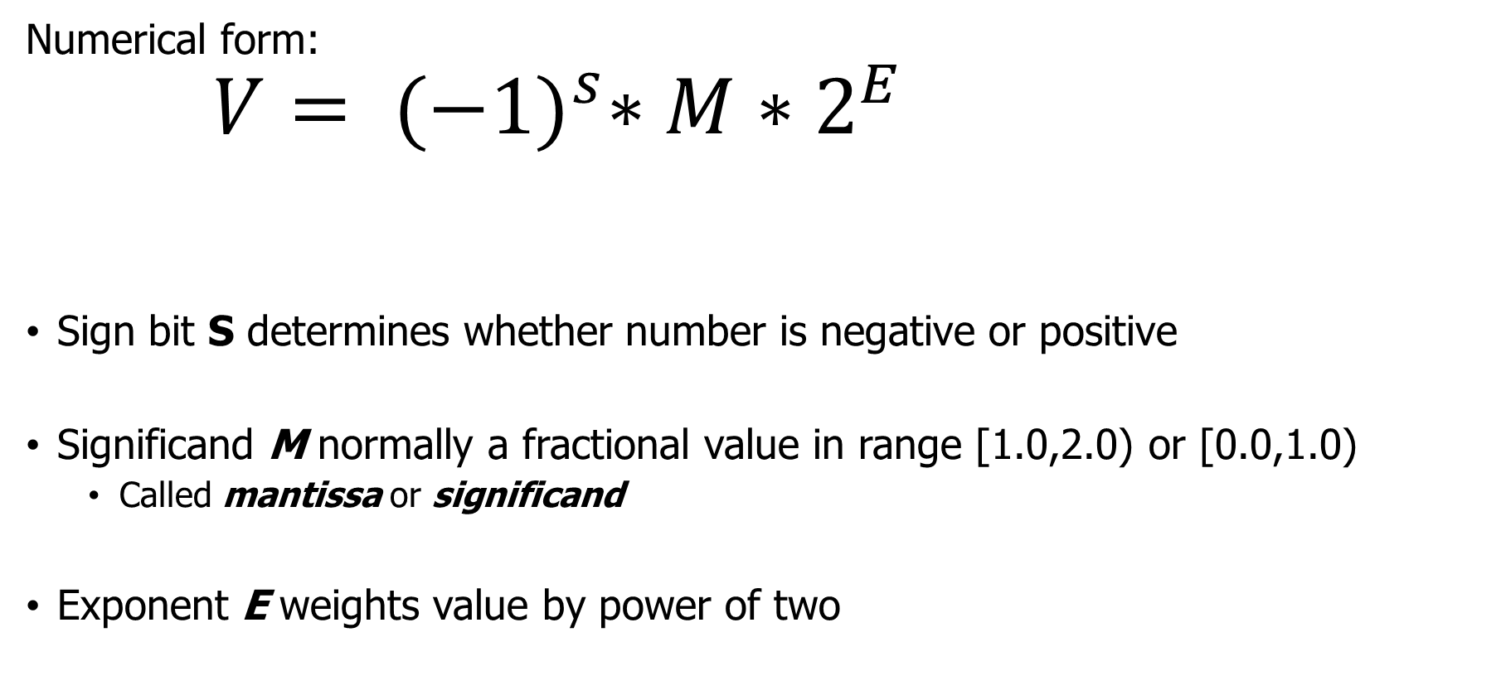
Floating Point Representation
Exponent
Numerical form:
      $$V= {(−1)}^{s}∗M∗2^{E}$$
Sign bit S determines whether number is negative or positive
Significand M normally a fractional value in range [1.0,2.0) or [0.0,1.0)
  Called mantissa or significand
Exponent E weights value by power of two
Sign bit
Significand (Mantissa)
Notes:
Instead, we would like to represent numbers like x * 2^y by using x and y

Slide 14
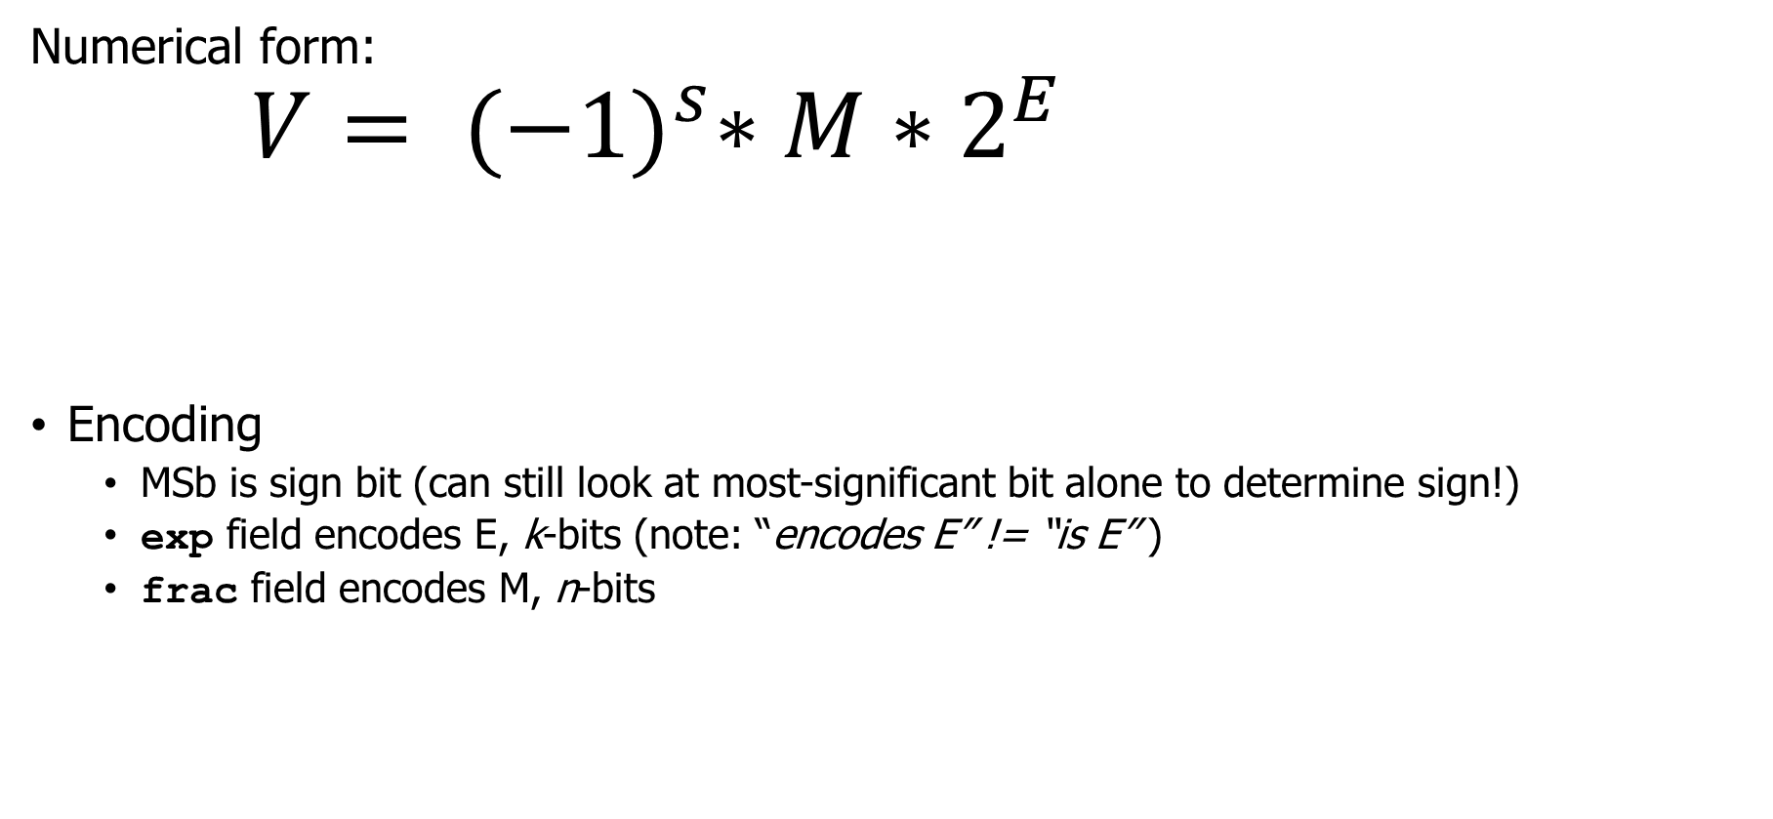
Floating Point Encoding
Exponent
Numerical form:
      $$V= {(−1)}^{s}∗M∗2^{E}$$
Encoding
  MSb is sign bit (can still look at most-significant bit alone to determine sign!)
  exp field encodes E, k-bits (note: “encodes E” != “is E” )
  frac field encodes M, n-bits
Sign bit
Significand (Mantissa)
s
exp
frac
Notes:
Instead, we would like to represent numbers like x * 2^y by using x and y

Slide 15
Floating Point Precision
Sizes
  Single precision: k = 8 exp bits, n= 23 frac bits (32b total). float in C
  Double precision: k = 11 exp bits, n = 52 frac bits (64b total). double in C
31
30
23
22
0
s
exp
frac
63
62
52
51
32
s
exp
frac
31
0
frac
Notes:
Extended precision, btw is what the Intel processors will use when operating on numbers loaded on the floating point registers (and converted back and forth as you move in and out of memory)
The 1 wasted bit is there for backwards compatibility to 8087/80287 which were generating “unnormal” FP numbers and explicitly encoded the integer part for faster computation.

Slide 16
Categories for Encoded Values
Value encoded – three cases, depending on value of exp
  Normalized, the most common
  Denormalized (very small values)
  Special values – infinity and NaN
s
≠ 0 && not all 1s
frac
s
00000000
frac
Infinity
s
11111111
00000000000000000000000
NaN
s
11111111
≠0
Notes:
Neither all zeroes nor all ones -> normalized, the most common case
All zero for denormalized, to represent zero and very small numbers close to it;
# So what’s the representation of 0 in FP? How many zeros are there?

Slide 17
Categories for Encoded Values
Value encoded – three cases, depending on value of exp
  Normalized, the most common
  Denormalized (very small values)
  Special values – infinity and NaN
s
≠ 0 && not all 1s
frac
s
00000000
frac
Infinity
s
11111111
00000000000000000000000
NaN
s
11111111
≠0
Notes:
Neither all zeroes nor all ones -> normalized, the most common case
All zero for denormalized, to represent zero and very small numbers close to it;
# So what’s the representation of 0 in FP? How many zeros are there?

Slide 18

Normalized, Signifcand
$$V= {(−1)}^{s}∗M∗2^{E}$$
Condition: not a special exponent (all zeros or ones)
Significand is encoded with implied leading 1
  M = 1.xxx…x₂ (1+f where f = 0.xxx₂)
    xxx…x: bits of frac used directly
Idea: every normalized number is 1.xxxx
  So we’re not going to include the leading 1 in the frac
  We’ll just know it’s there when we convert to decimal
  Saves one extra bit in the encoding!
s
exp
frac
Notes:
Exponent field is represented as a signed integer in biased form – E = Exp – bias
The bias for 32b single precision yields exponents ranging from -126 to +127
The implied leading 1 is just a trick to get an additional bit of pecision

Slide 19
Normalized, Exponent
$$V= {(−1)}^{s}∗M∗2^{E}$$
Condition: not a special exponent (all zeros or ones)
Exponent coded as a biased value
  E = Exp – Bias
    Exp : unsigned value denoted by exp
    Bias : Bias value = 2^{k-1} - 1, k is number of exponent bits
      Single precision (8-bit exp): 127 (Exp: 1…254, E: -126…127)
      Double precision (11-bit exp): 1023 (Exp: 1…2046, E: -1022…1023)
Exponent really just pushes the binary point around
  1.11 * 2^2 = 11.1 * 2^1 = 111.0 * 2^0 = 111
  111 * 2^-2 = 11.1 * 2^-1 = 1.11 * 2^0 = 1.11
s
exp
frac
Notes:
Exponent field is represented as a signed integer in biased form – E = Exp – bias
The bias for 32b single precision yields exponents ranging from -126 to +127
The implied leading 1 is just a trick to get an additional bit of pecision

Slide 20

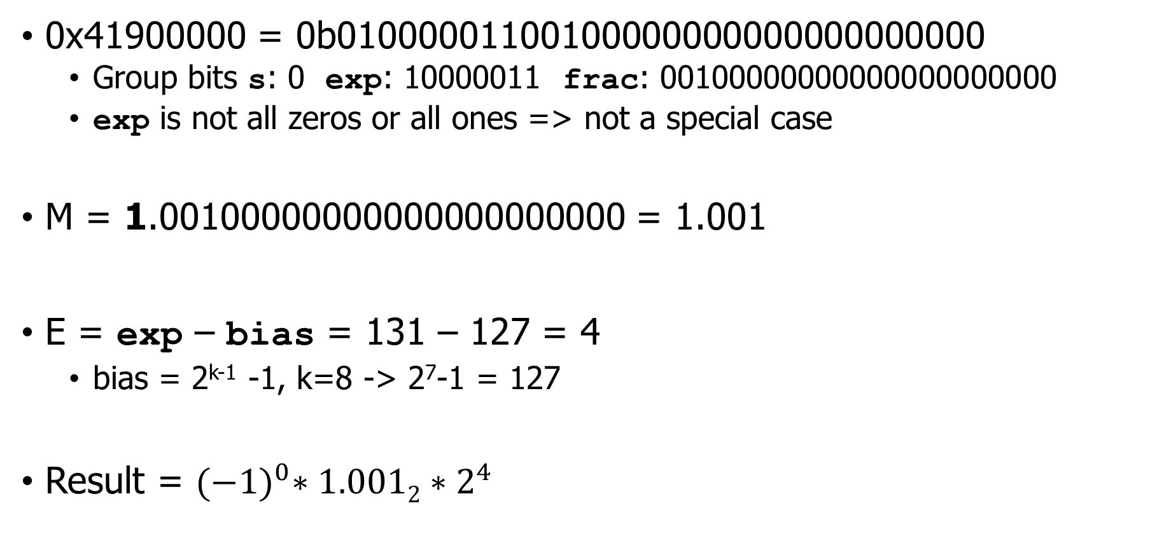
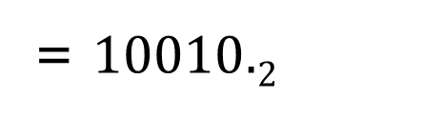
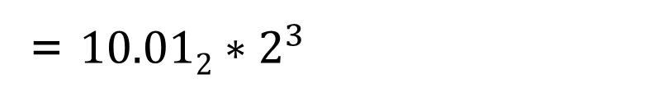
Decoding example for normalized floating point (32-bit)
0x41900000 = 0b01000001100100000000000000000000
  Group bits s: 0 exp: 10000011 frac: 00100000000000000000000
  exp is not all zeros or all ones => not a special case
M = 1.00100000000000000000000 = 1.001
E = exp – bias = 131 – 127 = 4
  bias = 2^{k-1} -1, k=8 -> 2⁷-1 = 127
Result = ${(−1)}^{0}∗1.0012∗2^{4}$
= $10.012∗2^{3}$
= $10010.2$
= 18
$$V= {(−1)}^{s}∗M∗2^{E}$$
s
exp
frac

Slide 21
Normalized Encoding Example
Value
  float F = 15213.0; // single precision: 8 exp bits, 23 frac bits
  15213₁₀ = 11101101101101₂ = 1.1101101101101₂ × 2¹³
Significand
  M = 1.1101101101101₂
  frac = 11011011011010000000000 pad with 0s on the right. (example: 1.5 = 1.500)
Exponent
  E = 13
  Bias = 127
  exp = E + Bias = 140 =10001100₂
More examples and practice in the
bonus slides after the end
Floating Point Representation:
Hex: 4 6 6 D B 4 0 0
Binary: 0100 0110 0110 1101 1011 0100 0000 0000
exp: 100 0110 0
frac: 110 1101 1011 0100 0000 0000

Slide 22
Normalized Numbers: Why These Choices?
Significand coded with implied leading 1
  Any non-zero integer will start with a 1 bit somewhere
  Leading 1 carries no information, so don’t need to store it!
  Can express mantissas between:
    1.0 when frac is all 0s
    2.0 (nearly) when frac is all 1s
      Want smaller? Use a smaller exponent!
Exponent coded as biased value
  E = Exp – Bias
  Alternative to using two’s complement to represent signed integers
  Reasons are a bit tricky
    Floating point binary values increase in the same order as unsigned = share comparisons!
    Bias provides a more useful range (when considering denormalized)

Slide 23
Question + Break
0x3F800000 = 0b00111111100000000000000000000000
  Group bits s: 0 exp: 01111111 frac: 00000000000000000000000
  exp is not 0…0 or 1…1 => not a special case
M =
E = exp – bias =
  bias = 2^{k-1} -1, k=8 -> 2⁷-1 = 127
$$V= {(−1)}^{s}∗M∗2^{E}$$
s
exp
frac

Slide 24
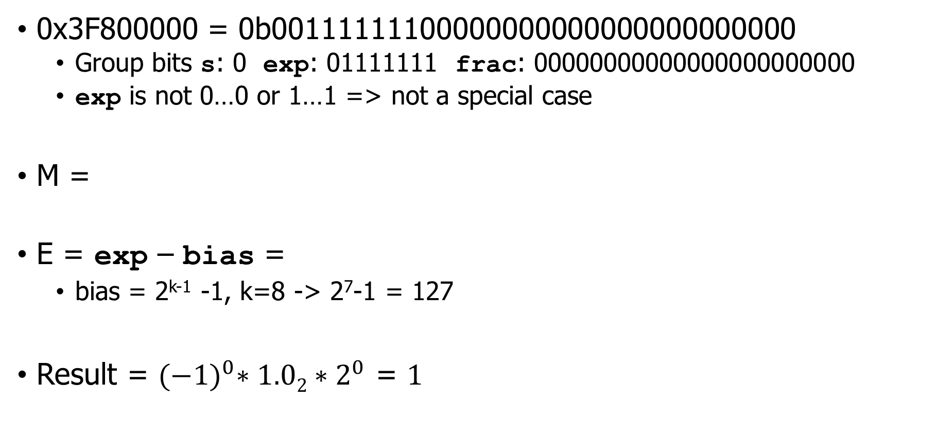
Question + Break
0x3F800000 = 0b00111111100000000000000000000000
  Group bits s: 0 exp: 01111111 frac: 00000000000000000000000
  exp is not 0…0 or 1…1 => not a special case
M =
E = exp – bias =
  bias = 2^{k-1} -1, k=8 -> 2⁷-1 = 127
Result = ${(−1)}^{0}∗1.02∗2^{0}$ = $1$
1.00000000000000000000000 = 1.0
127 – 127 = 0
$$V= {(−1)}^{s}∗M∗2^{E}$$
s
exp
frac

Slide 25
Live Practice – pick a hex number
0xXXXX0000 =
$$V= {(−1)}^{s}∗M∗2^{E}$$
31
30
23
22
0
s
exp
frac

Slide 26
Categories for Encoded Values
Value encoded – three cases, depending on value of exp
  Normalized, the most common
  Denormalized (very small values)
  Special values – infinity and NaN
s
≠ 0 && not all 1s
frac
s
00000000
frac
Infinity
s
11111111
00000000000000000000000
NaN
s
11111111
≠0
Notes:
Neither all zeroes nor all ones -> normalized, the most common case
All zero for denormalized, to represent zero and very small numbers close to it;
# So what’s the representation of 0 in FP? How many zeros are there?

Slide 27
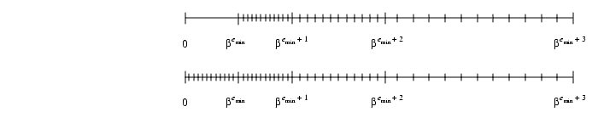
Normalized floating point leaves a gap around zero
Gap is the size of 1.0000 * 2^{Min Exponent} (due to leading 1 bit)
  And how do we encode “zero” anyways?
Solution: fill in numbers between 0 and 1 * 2^{Min Exponent}
  Using same spacing as the previous range, in the form 0.XXXXX
0
Spacing:
2⁻¹²⁴
2⁻¹²⁵
2⁻¹²⁶
0
Spacing:
2⁻¹²⁴
2⁻¹²⁵
2⁻¹²⁶
2⁻¹²⁶

Slide 28


Denormalized Values
$$V= {(−1)}^{s}∗M∗2^{E}$$
Purpose: gracefully represent numbers approaching ±0
Condition: exp = 000…0₂
Value
  Exponent value E = 1 - Bias
    Note: not simply E = 0 - Bias as it would be if we followed the previous rules
    This means we’re re-using the spacing from smallest normalized numbers
  Significand value M = 0.xxx…x₂ (0.frac)
    xxx…x: bits of frac. Leading 0 instead of leading 1
Cases
  exp = 000…0, frac = 000…0 => Represents value 0
    Note that we have distinct values +0 and –0
  exp = 000…0, frac ≠ 000…0 => Numbers very close to 0.0

Slide 29
Categories for Encoded Values
Value encoded – three cases, depending on value of exp
  Normalized, the most common
  Denormalized (very small values)
  Special values – infinity and NaN
s
≠ 0 && not all 1s
frac
s
00000000
frac
Infinity
s
11111111
00000000000000000000000
NaN
s
11111111
≠0
Notes:
Neither all zeroes nor all ones -> normalized, the most common case
All zero for denormalized, to represent zero and very small numbers close to it;
# So what’s the representation of 0 in FP? How many zeros are there?

Slide 30
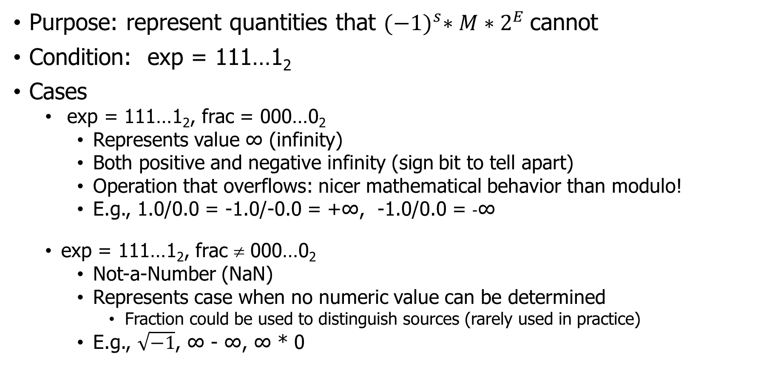
Special Values
Purpose: represent quantities that ${(−1)}^{s}∗M∗2^{E}$cannot
Condition: exp = 111…1₂
Cases
  exp = 111…1₂, frac = 000…0₂
    Represents value ∞ (infinity)
    Both positive and negative infinity (sign bit to tell apart)
    Operation that overflows: nicer mathematical behavior than modulo!
    E.g., 1.0/0.0 = -1.0/-0.0 = +∞, -1.0/0.0 = -∞
  exp = 111…1₂, frac ≠ 000…0₂
    Not-a-Number (NaN)
    Represents case when no numeric value can be determined
      Fraction could be used to distinguish sources (rarely used in practice)
    E.g., $\sqrt{−1}$, ∞ - ∞, ∞ * 0

Slide 31
Floating Point in C
C guarantees two levels
  float single precision
  double double precision
Conversions
  int → float
    maybe rounded
    less bits for actual value (32 → 23)
  int or float → double
    exact value preserved
    double has greater range and higher precision (52 bits for frac)
  double → float
    may overflow, underflow (too small to represent), or be rounded (IEEE 754)
    C99 standard says undefined if value out of range
  double or float → int
    rounded toward zero (-1.999 → -1)
    C99 standard says undefined if value out of range
Notes:
“inexact” exception may also be raised for significant loss of precision, but that appears to be implementation-dependent

Slide 32

Break + Summary of FP Real Number Encodings
-∞
+∞
NaN
-Normalized
-Denorm
+Denorm
+Normalized
NaN
−0
+0
  $$V= {(−1)}^{s}∗M∗2^{E}$$
 | Normalized | Denormalized
s | 0/1 means +/- | 0/1 means +/-
exp | exp ≠ 000…0₂ and exp ≠ 111…1₂ | exp = 000…0₂
frac | x₁x₂x₃…x_{j} | x₁x₂x₃…x_{j}
Bias= | 2^{(k-1)} – 1, for k exponent bits | 2^{(k-1)} – 1, for k exponent bits
E= | exp – Bias | 1 – Bias
M= | 1. x₁x₂x₃…x_{j} a.k.a. 1.frac | 0. x₁x₂x₃…x_{j} a.k.a. 0.frac
V= | (–1)^{s} × (1.frac) × 2^{(exp – Bias)} | (–1)^{s} × (0.frac) × 2^{(1 – Bias)}
Notes:
The set of values that can be represented
- The two infinites are at the extremes
- the denormalized numbers are clustered around zero
- the representable numbers are not uniformly distributed (denser nearer the origin)

Slide 33
Outline
Fractional Binary Numbers
Representing Floating Point
Smaller Floating Point
Floating Point Arithmetic

Slide 34
Floating point examples
We’ll often do floating point in custom bit widths
  Rather than 32-bit (float) or 64-bit (double)
Reasons
  64 is just too many bits to write out and think about
  Make sure you understand the concepts of floating point
    Smaller versions still demonstrate concepts! (e.g., 8-bit)

Slide 35
Example: Tiny Floating Point
8-bit Floating Point Representation
  Sign bit is in the most significant bit.
  Next four (k) bits are exp, with a bias of 7 (2^{k-1}-1)
  Last three (n) bits are frac
Same general form as IEEE 754 format
  normalized, denormalized numbers
  representation of 0, NaN, infinity
Sidebar: increasingly useful for Machine Learning use!
  Models often don’t need 32-bits of precision
7
6
3
2
0
s
exp
frac
Notes:
Consider a simple 8b FP representation (so that we can enumerate the space)

Slide 36
Denormalized encoding example
0
7
6
3
2
s
exp
frac
Convert 5/512 to 8-bit tiny float
  5/512 = 0b101 * 2⁻⁹ = 10.1 * 2⁻⁸ = 1.01 * 2⁻⁷
E = exp - bias -> -7 = exp – (2⁽⁴⁻¹⁾-1) -> -7 = exp – 7
  exp = 0 ???
  But exp can’t be less than 1 (or we’re denormalized)
  So, the answer must be a denormalized number. Reset the problem!

Slide 37
Denormalized encoding example
0
7
6
3
2
s
exp
frac
Convert 5/512 to 8-bit tiny float
  5/512 = 0b101 * 2⁻⁹ = 10.1 * 2⁻⁸ = 1.01 * 2⁻⁷
E = 1 – bias = 1 – 7 = -6
0.xxx * 2⁻⁶ = 1.01 * 2⁻⁷ -> 0.101 * 2⁻⁶
S: 0 (positive) exp: 0000(denorm) frac: 101
0b0 0000 101 -> 0x05

Slide 38
Exponents for 8-bit tiny floats
Bias = 2⁴⁻¹ - 1 = 7
(4-bit exp)
Denormalized
E = 1 - Bias
exp exp E 2E
0 0000 -6 1/64 (denorms)
1 0001 -6 1/64
2 0010 -5 1/32
3 0011 -4 1/16
4 0100 -3 1/8
5 0101 -2 1/4
6 0110 -1 1/2
7 0111 0 1
8 1000 +1 2
9 1001 +2 4
10 1010 +3 8
11 1011 +4 16
12 1100 +5 32
13 1101 +6 64
14 1110 +7 128
15 1111 n/a (inf, NaN)
Normalized
E = exp – Bias
Special

Slide 39
Dynamic Range of 8-bit tiny float
s exp frac E Value
s exp frac E Value
0 0000 000 -6 0
0 0000 001 -6 1/8*1/64(2⁻⁶)= 1/512
0 0000 010 -6 2/8*1/64 = 2/512
...
0 0000 110 -6 6/8*1/64 = 6/512
0 0001 001 -6 9/8*1/64 = 9/512
...
0 0110 110 -1 14/8*1/2 = 14/16
0 0110 111 -1 15/8*1/2 = 15/16
0 0111 000 0 8/8*1 = 1
0 0111 001 0 9/8*1 = 9/8
0 0111 010 0 10/8*1 = 10/8
...
0 1110 110 7 14/8*128 = 224
0 1110 111 7 15/8*128 = 240
0 1111 000 n/a inf
0 1111 001 n/a NaN
...
0 1111 111 n/a NaN
0 0000
111
-6
7/8*1/64 = 7/512
0 0001
000
-6
8/8*1/64 = 8/512
Notes:
One interesting property of this representation – if you look at the numbers as unsigned integers, they occur in ascending order as do the values they represent in floating point -> no accident, this mean you can sort them using an integer sort routine. Minor issue is with negative numbers since they have a leading one and occur in descending order – but you can handle that (check if both are zero, then check the sign bits and compare the numbers as unsigned).

Slide 40
Dynamic Range of 8-bit tiny float
s exp frac E Value
s exp frac E Value
0 0000 000 -6 0
0 0000 001 -6 1/8*1/64(2⁻⁶)= 1/512
0 0000 010 -6 2/8*1/64 = 2/512
...
0 0000 110 -6 6/8*1/64 = 6/512
0 0001 001 -6 9/8*1/64 = 9/512
...
0 0110 110 -1 14/8*1/2 = 14/16
0 0110 111 -1 15/8*1/2 = 15/16
0 0111 000 0 8/8*1 = 1
0 0111 001 0 9/8*1 = 9/8
0 0111 010 0 10/8*1 = 10/8
...
0 1110 110 7 14/8*128 = 224
0 1110 111 7 15/8*128 = 240
0 1111 000 n/a inf
0 1111 001 n/a NaN
...
0 1111 111 n/a NaN
0 0000
111
-6
7/8*1/64 = 7/512
0 0001
000
-6
8/8*1/64 = 8/512
Notes:
One interesting property of this representation – if you look at the numbers as unsigned integers, they occur in ascending order as do the values they represent in floating point -> no accident, this mean you can sort them using an integer sort routine. Minor issue is with negative numbers since they have a leading one and occur in descending order – but you can handle that (check if both are zero, then check the sign bits and compare the numbers as unsigned).

Slide 41
Dynamic Range of 8-bit tiny float
Bias = 7
V= (–1)^{s}
× (0.frac)
× 2^{(1 – Bias)}
Denormalized
numbers
s exp frac E Value
s exp frac E Value
0 0000 000 -6 0
0 0000 001 -6 1/8*1/64(2⁻⁶)= 1/512
0 0000 010 -6 2/8*1/64 = 2/512
...
0 0000 110 -6 6/8*1/64 = 6/512
0 0001 001 -6 9/8*1/64 = 9/512
...
0 0110 110 -1 14/8*1/2 = 14/16
0 0110 111 -1 15/8*1/2 = 15/16
0 0111 000 0 8/8*1 = 1
0 0111 001 0 9/8*1 = 9/8
0 0111 010 0 10/8*1 = 10/8
...
0 1110 110 7 14/8*128 = 224
0 1110 111 7 15/8*128 = 240
0 1111 000 n/a inf
0 1111 001 n/a NaN
...
0 1111 111 n/a NaN
0 0000
111
-6
7/8*1/64 = 7/512
0 0001
000
-6
8/8*1/64 = 8/512
Normalized
numbers
V= (–1)^{s}
× (1.frac)
× 2^{(exp – Bias)}
Special
values
Notes:
One interesting property of this representation – if you look at the numbers as unsigned integers, they occur in ascending order as do the values they represent in floating point -> no accident, this mean you can sort them using an integer sort routine. Minor issue is with negative numbers since they have a leading one and occur in descending order – but you can handle that (check if both are zero, then check the sign bits and compare the numbers as unsigned).

Slide 42
Dynamic Range of 8-bit tiny float
Bias = 7
V= (–1)^{s}
× (0.frac)
× 2^{(1 – Bias)}
Denormalized
numbers
s exp frac E Value
s exp frac E Value
0 0000 000 -6 0
0 0000 001 -6 1/8*1/64(2⁻⁶)= 1/512
0 0000 010 -6 2/8*1/64 = 2/512
...
0 0000 110 -6 6/8*1/64 = 6/512
0 0001 001 -6 9/8*1/64 = 9/512
...
0 0110 110 -1 14/8*1/2 = 14/16
0 0110 111 -1 15/8*1/2 = 15/16
0 0111 000 0 8/8*1 = 1
0 0111 001 0 9/8*1 = 9/8
0 0111 010 0 10/8*1 = 10/8
...
0 1110 110 7 14/8*128 = 224
0 1110 111 7 15/8*128 = 240
0 1111 000 n/a inf
0 1111 001 n/a NaN
...
0 1111 111 n/a NaN
0 0000
111
-6
7/8*1/64 = 7/512
0 0001
000
-6
8/8*1/64 = 8/512
Normalized
numbers
V= (–1)^{s}
× (1.frac)
× 2^{(exp – Bias)}
Special
values
Notes:
One interesting property of this representation – if you look at the numbers as unsigned integers, they occur in ascending order as do the values they represent in floating point -> no accident, this mean you can sort them using an integer sort routine. Minor issue is with negative numbers since they have a leading one and occur in descending order – but you can handle that (check if both are zero, then check the sign bits and compare the numbers as unsigned).

Slide 43
Dynamic Range of 8-bit tiny float
Bias = 7
V= (–1)^{s}
× (0.frac)
× 2^{(1 – Bias)}
Denormalized
numbers
s exp frac E Value
s exp frac E Value Notes of Interest
0 0000 000 -6 0
0 0000 001 -6 1/8*1/64(2⁻⁶)= 1/512
0 0000 010 -6 2/8*1/64 = 2/512
...
0 0000 110 -6 6/8*1/64 = 6/512
0 0001 001 -6 9/8*1/64 = 9/512
...
0 0110 110 -1 14/8*1/2 = 14/16
0 0110 111 -1 15/8*1/2 = 15/16
0 0111 000 0 8/8*1 = 1
0 0111 001 0 9/8*1 = 9/8
0 0111 010 0 10/8*1 = 10/8
...
0 1110 110 7 14/8*128 = 224
0 1110 111 7 15/8*128 = 240
0 1111 000 n/a inf
0 1111 001 n/a NaN
...
0 1111 111 n/a NaN
closest to zero
0 0000
111
-6
7/8*1/64 = 7/512
largest denorm
0 0001
000
-6
8/8*1/64 = 8/512
smallest norm > 0
Normalized
numbers
V= (–1)^{s}
× (1.frac)
× 2^{(exp – Bias)}
closest to 1 below
closest to 1 above
largest norm
Special
values
Notes:
One interesting property of this representation – if you look at the numbers as unsigned integers, they occur in ascending order as do the values they represent in floating point -> no accident, this mean you can sort them using an integer sort routine. Minor issue is with negative numbers since they have a leading one and occur in descending order – but you can handle that (check if both are zero, then check the sign bits and compare the numbers as unsigned).

Slide 44
Distribution of Values
6-bit IEEE-like format
  exp = 3 exponent bits
  frac = 2 fraction bits
  Bias is 3 (2³⁻¹-1)
Notice how the distribution gets denser toward zero.
-∞
+∞
Notes:
All representable numbers; two infinites at the end

Slide 45
Distribution of Values (Close-up View)
6-bit IEEE-like format
  exp = 3 exponent bits
  frac = 2 fraction bits
  Bias is 3 (2³⁻¹-1)
Smooth transition between normalized and de-normalized numbers due to definition E = 1 - Bias for denormalized values
  Zeros are denormalized numbers too! (+0 and -0)
5
4
2
1
0
s
exp
frac

Slide 46
Outline
Fractional Binary Numbers
Representing Floating Point
Smaller Floating Point
Floating Point Arithmetic

Slide 47
Floating Point Operations
Conceptual view
  x +_{float} y = Fit(x +_{math} y)
  x *_{float} y = Fit(x *_{math} y)
First compute exact, mathematical result
  As a human: convert to decimal first, do math in decimal
Then make it fit into desired precision
  Step 1: Determine frac, exp
    Frac must be of the form 1.xxxx (0.xxx if denormalized)
    Change exp if needed to get frac to that form (e.g., result is 101.xxx)
  Step 2: Possibly overflow if exponent too is large
    Unlike integer overflow, result is mathematically reasonable: infinity
  Step 3: Possibly round to fit into frac if we have too many mantissa bits

Slide 48
Rounding
Default rounding mode for IEEE floating point is Round-to-even
  Other methods are statistically biased (round up, round down, round-to-zero)
    Sum of set of positive numbers will consistently be over- or under- estimated
  Round to nearest number
    If exactly in between, round to nearest even number
Round-to-even example
  Illustrated with rounding of money
$1.40 $1.60
  Rounded $1 $2
Notes:
Rounds nearest even is not arbitrary, it looks to avoid biases on results by rounding up ~50% of the time and down the rest

Slide 49
Rounding
Default rounding mode for IEEE floating point is Round-to-even
  Other methods are statistically biased (round up, round down, round-to-zero)
    Sum of set of positive numbers will consistently be over- or under- estimated
  Round to nearest number
    If exactly in between, round to nearest even number
Round-to-even example
  Illustrated with rounding of money
$1.40 $1.60 $1.50 $2.50 –$1.50
  Rounded $1 $2
Notes:
Rounds nearest even is not arbitrary, it looks to avoid biases on results by rounding up ~50% of the time and down the rest

Slide 50
Rounding
Default rounding mode for IEEE floating point is Round-to-even
  Other methods are statistically biased (round up, round down, round-to-zero)
    Sum of set of positive numbers will consistently be over- or under- estimated
  Round to nearest number
    If exactly in between, round to nearest even number
Round-to-even example
  Illustrated with rounding of money
$1.40 $1.60 $1.50 $2.50 –$1.50
  Rounded $1 $2 $2 $2 –$2
Notes:
Rounds nearest even is not arbitrary, it looks to avoid biases on results by rounding up ~50% of the time and down the rest

Slide 51
Closer Look at Round-to-even
Rounding to other decimal places than the decimal point
  When exactly halfway between two possible values
    Round so that least significant digit is even
  E.g., round to nearest hundredth (i.e., 2 decimal digits in fractional part)
    1.2349999 => 1.23 (Less than half way)
    1.2350001 => 1.24 (Greater than half way)
    1.2350000 => 1.24 (Half way—round to even)
    1.2450000 => 1.24 (Half way—round to even)

Slide 52
Rounding Binary Numbers
Binary fractional numbers
  Are “even” when least significant bit is 0
  Are half-way when bits to right of rounding position = 100…0₂
  General form XX…X.YY…Y100…0₂
  last Y is the position to which we want to round
Examples
  Round to nearest 1/4 (2 bits right of binary point)
  Value Binary Rounded Action Rounded Value
  2+3/32 10.00011₂ 10.00₂ (<1/2—down) 2
  2+3/16 10.00110₂ 10.01₂ (>1/2—up) 2+1/4
  2+3/8 10.01100₂ 10.10₂ (1/2—up to even) 2+1/2
  2+5/8 10.10100₂ 10.10₂ (1/2—down to even) 2+1/2
  2+7/8 10.11100₂ 11.00₂ (1/2—up to even) 3
Notes:
Note the first two are not half way (not of the format XX..X.YY..Y100)
Note the last two are and the resulting rounded number has the least significant bit = 0

Slide 53
Important: remember how rounding works
Only two options when rounding
  Leave the number alone
  Or add one to the number
1010.000010010000
  Part to remove is 10…0, so we need to round
  Options are:
    1010.00001000 (leave it alone)
    1010.00001001 (add one)
  Pick the one that ends in zero: 1010.00001000

Slide 54
Mathematical Properties of FP Arithmetic
Mathematical properties of FP Addition
  Addition is Associative? NO
    (x + y) + z = x + (y + z)
    Possibility of overflow and inexactness of rounding
      (3.14 + 1e10) - 1e10 = 0 (rounding)
      3.14 + (1e10 - 1e10) = 3.14
Mathematical properties of FP Multiplication
  Multiplication is Associative? NO
    (x × y) × z = x × (y × z)
    Possibility of overflow, inexactness of rounding
  Multiplication distributes over addition? NO
    x × (y + z) = (x × y) + (x × z)
    Possibility of overflow, inexactness of rounding
More in bonus slides

Slide 55
Floating Point Summary
IEEE Floating point (IEEE 754) has clear mathematical properties
  But not always the ones you may expect!
Represents numbers of form (-1)^{S} × M × 2E
One can reason about operations independent of implementation
  As if computed with perfect precision and then rounded
Not the same as arithmetic on real numbers
  Violates associativity/distributivity
  Makes life difficult for compilers & serious numerical applications programmers

Slide 56
Outline
Fractional Binary Numbers
Representing Floating Point
Smaller Floating Point
Floating Point Arithmetic

Slide 57
Outline
Bonus slides
  Use these for additional practice
  And if you’re interested in additional topics

Slide 58
Interesting Numbers for float/double
Description exp frac Numeric Value^{{single prec., double prec.}}
Zero 00…00 00…00 0.0
Smallest Pos. Denorm. 00…00 00…01 2^{– {23,52}} X 2^{– {126,1022}}
  Single ~ 1.4 X 10^{–45}
  Double ~ 4.9 X 10^{–324}
Largest Denormalized 00…00 11…11 (1.0 – ε) X 2^{– {126,1022}}
  Single ~ 1.18 X 10^{–38}
  Double ~ 2.2 X 10^{–308}
Smallest Pos. Normalized 00…01 00…00 1.0 X 2^{– {126,1022}}
  Just slightly larger than
  largest denormalized
One 01…11 00…00 1.0
Largest Normalized 11…10 11…11 (2.0 – ε) X 2 ^{{127,1023}}
  Single ~ 3.4 X 10³⁸
  Double ~ 1.8 X 10³⁰⁸
Notes:
Smallest denormalized – 1 bit in the least significant position

Slide 59
Normalized Encoding Example
Value
  float F = 12345.0; // single precision: k=8, n=23
  12345₁₀ = 11000000111001₂ = 1.1000000111001₂ X 2¹³
Significand
  M = 1.1000000111001₂
  frac = 10000001110010000000000
  (drop leading 1, add 10 zeros)
Exponent
  E = 13
  Bias = 127
  E = exp – Bias → exp = E + Bias = 140 =10001100₂
Floating Point Representation:
Hex: 4 6 4 0 E 4 0 0
Binary: 0100 0110 0100 0000 1110 0100 0000 0000
Notes:
The blue box shows the common part between the bit-level representation of the 12345 integer and the floating point (all the same but for the leading 1 dropped)

Slide 60
Creating a Floating Point Number
Carnegie Mellon
s | exp | frac
1 | 4-bits | 3-bits
Steps
  Is the number within the range (-2^{1-Bias}, +2^{1-Bias})?
    If yes, “denormalize” to have a leading 0
    otherwise, normalize to have leading 1
  Round to fit within fraction
  Postnormalize to deal with effects of rounding
QUIZ in next three slides
  Convert 8-bit unsigned numbers to tiny floating point format

Slide 61
Step 1: Normalize
Carnegie Mellon
s | exp | frac
1 | 4-bits | 3-bits
Requirement
  Set binary point so that numbers of form 1.xxxxx
  Adjust all to have leading one
    Decrement exponent as shift left
  Value Binary Fraction Exponent
  128
  13
  17
  19
  138
  63
10000000
00001101
00010001
00010011
10001010
00111111
1.0000000
1.1010000
1.0001000
1.0011000
1.0001010
1.1111100
7
3
4
4
7
5

Slide 62
Step 2: Rounding
1.BBGRXXX
Guard bit: LSB of result
Sticky bit: OR of remaining bits
Round bit: 1st bit removed
Round up conditions
  round up if <Guard, Round, Sticky> = <x11> because >0.5
  round up if <Guard, Round, Sticky> = <110> as per round to even rules
  Value Fraction GRS Incr? Rounded
  128
  13
  17
  19
  138
  63
  1.0000000
  1.1010000
  1.0001000
  1.0011000
  1.0001010
  1.1111100
  000
  100
  010
  110
  011
  111
  N
  N
  N
  Y
  Y
  Y
  1.000
  1.101
  1.000
  1.010
  1.001
  10.000

Slide 63
Step 3: Postnormalize
Carnegie Mellon
Issue
  Rounding may have caused overflow
  Handle by shifting right once & incrementing exponent
  Value Rounded Exp Adjusted Result
  128 1.000 7 128
  13 1.101 3 13
  17 1.000 4 16
  19 1.010 4 20
  138 1.001 7 144
  63 10.000 5
M=1.000 exp=6 64

Slide 64
Floating Point Puzzles
For each of the following C expressions, either:
  Argue that it is true for all argument values
  Explain why not true
x == (int)(double) x
x == (int)(float) x
d == (double)(float) d
f == (float)(double) f
f == -(-f);
1.0/2 == 1/2.0
d*d >= 0.0
(f+d)-f == d
int x = …;
float f = …;
double d = …;
Assume neither
d nor f is NaN
Notes:
Tmax = 01111..111 (32 bits) → 1.1111..1 (31 bits) * 2^30 → 1.11..1 (23 bits) * 2^30 = Tmax - 256

Slide 65
Floating Point Puzzles
For each of the following C expressions, either:
  Argue that it is true for all argument values
  Explain why not true
x == (int)(double) x
x == (int)(float) x
d == (double)(float) d
f == (float)(double) f
f == -(-f);
1.0/2 == 1/2.0
d*d >= 0.0
(f+d)-f == d
Yes
No (x = TMax)
No (d = 1e40)
Yes
Yes
Yes
Yes
No (f = 1.0e20,
d = 1.0;
f+d rounded to
1.0e20
int x = …;
float f = …;
double d = …;
Assume neither
d nor f is NaN
Notes:
Tmax = 01111..111 (32 bits) → 1.1111..1 (31 bits) * 2^30 → 1.11..1 (23 bits) * 2^30 = Tmax - 256

Slide 66
Floating-Point Multiplication, Directly
For cases where you can’t work with exact results
  E.g., when doing it in hardware
Operands
  (–1)^{s1} M1 2^{E1} * (–1)^{s2} M2 2^{E2}
Exact result
  (–1)^{s} M 2E
  Sign s: s1 ^ s2
  Significand M: M1 * M2
  Exponent E: E1 + E2
Fixing
  If M ≥ 2, shift M right, increment E
  If E out of range, overflow
  Round M to fit frac precision
Implementation
  Biggest chore is multiplying significands
E1=3 M1=1.11010010
E2=5 M2=1.11001110
--------------------------------------------
E=8 M=11.01001000111111
E=8+1 M=1.101001000111111
E=9 M=1.1010010010

Slide 67
Floating-Point Addition, Directly
E1 – E2
Operands
  (–1)^{s1} M1 2^{E1}
  (–1)^{s2} M2 2^{E2}
  Assume E¹ > E²
Exact Result
  (–1)^{s} M 2E
  Sign s, significand M: Result of signed align & add
  Exponent E: E¹
Fixing
  If M ≥ 2, shift M right, increment E
  if M < 1, shift M left k places,
  decrement E by k
  Overflow if E out of range
  Round M to fit frac precision
  (–1)^{s1} M1
+
  (–1)^{s2} M2
  (–1)^{s} M
E1=5 M1=1.11010010
E2=2 M2=1.11001110
E2=2 M2=0001.11001110
-----------------------------------
E1=5 M1=1.11010010
E2=5 M2=0.00111001110
------------------------------------
E =5 M =10.00001011110
E =6 M =1.000001011110

Slide 68
Mathematical Properties of FP Add
Compare to those of Abelian Group
  Closed under addition? YES
    But may generate infinity or NaN
  Commutative? YES
  Associative? NO
    Overflow and inexactness of rounding
      (3.14+1e10)-1e10=0 (rounding)
      3.14+(1e10-1e10)=3.14
  0 is additive identity? YES
  Every element has additive inverse? ALMOST
    Except for infinities & NaNs
Monotonicity
  a ≥ b ⇒ a+c ≥ b+c? ALMOST
    Except for NaNs
Notes:
For the mathematically inclined; skip

Slide 69
Mathematical Properties of FP Multiplication
Compare to commutative ring
  Closed under multiplication? YES
    But may generate infinity or NaN
  Multiplication Commutative? YES
  Multiplication is Associative? NO
    Possibility of overflow, inexactness of rounding
  1 is multiplicative identity? YES
  Multiplication distributes over addition? NO
    Possibility of overflow, inexactness of rounding
Monotonicity
  a ≥ b & c ≥ 0 ⇒ a *c ≥ b *c? ALMOST
    Except for NaNs
Notes:
For the mathematically inclined; skip

