Slide 1
Lecture 01
Introduction & C
CS211 – Fundamentals of Computer Programming II
Branden Ghena – Spring 2023
Slides adapted from:
Jesse Tov, Sruti Bhagavatula, Joe Hummel

Slide 2
Welcome to CS211
Course Goal: become a better and broader programmer
First half
  C programming
  Unix shell
Second half
  C++ programming
Introduces students to industry-standard languages and tools
Builds foundational software design skills at a medium scale

Slide 3
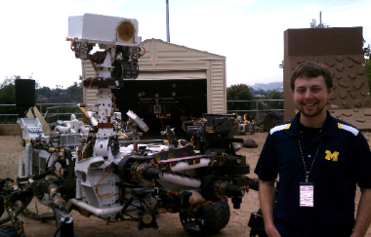
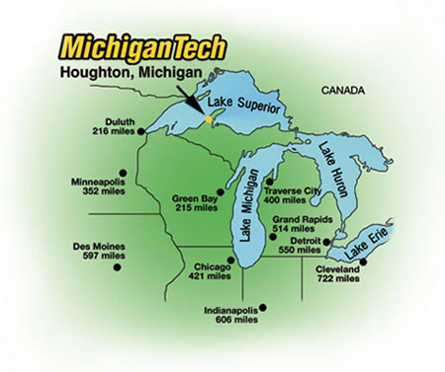
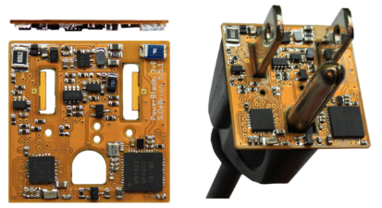
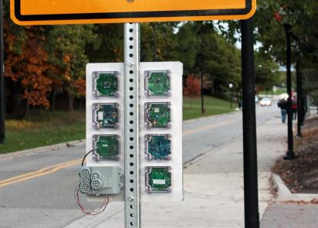





Branden Ghena (he/him)
Assistant Faculty of Instruction
Education
  Undergrad: Michigan Tech
  Master’s: University of Michigan
  PhD: University of California, Berkeley
Research
  Resource-constrained sensing systems
  Low-energy wireless networks
  Embedded operating systems
Teaching
  Computer Systems
    CS211: Fundamentals of Programming II
    CS213: Intro to Computer Systems
    CS343: Operating Systems
    CE346: Microprocessor System Design
    CS397: Wireless Protocols for the IoT
Things I love

Slide 4
Questions in class
Please ask questions!!!
  It’s not just you who doesn’t understand something.
You can always ask questions verbally during class
  Raise hand whenever
  I’ll stop for questions too
Other options
  Ask me after class
  Ask on Piazza

Slide 5
Today’s Goals
Discuss why we teach (and require) this class
Describe how this class is going to function
Introduction to C programming

Slide 6
Outline
Why?
Course Overview
Intro to C
  Hello World
  Variables
  Computing Fibonacci

Slide 7
What does CS211 teach?
C and C++ Programming
Unix Shell

Slide 8
C - the most important programming language
Old (1972), but nowhere near the first programming language
  FORTRAN, LISP, ALGOL, COBOL, Basic, B, and many others came first
Right time, right place, right capability
  Enables both low-level control and (relatively) high level thinking
  Fast, efficient, and highly portable
Inspired everything that has come since
  C syntax is copied partially or completely in MANY other languages
  Lessons learned from using C inspired improvements to make programming easier

Slide 9
C++ - an evolutionary addition to C
Additional features on top of C
  Most important: classes to support Object Oriented Programming
  Also includes a significant amount of libraries that C does not
Enables more complicated software design
  Manages which part of code can access which things at which times
  Manages how things are named and referred to
  Manages errors to help software respond to them

Slide 10
Things written in C/C++
All major modern operating systems are partially or entirely C
  Windows, Linux, MacOS, Android, iOS
Scientific computing (mix of C and C++)
  Mathematica, MATLAB, various scientific libraries
Video game engines (often C++)
  Unreal Engine, Unity, CryEngine
Embedded control systems (usually C, occasionally C++)
  Cars, Airplanes, Satellites and Rovers, Thermostats, Webcams, …

Slide 11
Upsides to C and C++
You are in charge of everything
  You can do anything you want without constraints
Capable of directly interacting with hardware (“systems language”)
  Grab exactly as much memory as you need and manage it yourself
  Makes it incredibly fast (~100x faster than Python)
  Makes it incredibly efficient (no memory is wasted)
These lead to the languages being very widely used
  Top five programming languages for decades include C and C++

Slide 12
Downsides to C and C++
You are in charge of everything
  And nothing is taken care of for you
Things you “can’t” do are often UNDEFINED BEHAVIOR
  To enable portability, the languages just straight-up don’t say what happens if you violate the rules
  The computer could do anything
Backwards compatibility means features are only ever added
  You’ll see this especially in C++, C just has less features total
  C++ feels like a bunch of things stapled together
    And there’s an amazing programming language hiding in there

Slide 13
Analogies for programming languages
Racket
  Generic beginner’s car that gets you places
Python
  Great car you can drive without a license
  Unless you want to go really fast or on bad terrain, might be good enough
C
  A racing car that goes incredibly fast but breaks down every fifty miles
C++
  A souped-up version of the C racing car with dozens of extra features that only breaks down every 250 miles
  But when it breaks down, nobody can figure out what went wrong
http://users.cms.caltech.edu/~mvanier/hacking/rants/cars.html

Slide 14
So why teach C and C++?
You’ll learn a lot more about programming
  Syntax and ideas from C inspired a lot of other languages
  Feels very different from Racket or Python
You’ll become a better programmer
  You’re going to run into a lot of errors and problems in this class
  Hopefully they teach you to better design and plan your code
Prepare you to dig deeper into computer systems
  A “systems language” is needed to interact directly with hardware
  Major options: Pascal, C, C++, Ada, Rust

Slide 15
What does CS211 teach?
C and C++ Programming
Unix Shell

Slide 16
Unix
A wildly popular operating system in the 1970s and 80s
Today refers to the family of operating systems inspired or grown from Unix
  Particular design style for “everything is a file”
  Various tools the OS is expected to provide
  Command line interface, also known as a “shell”
Unix
Linux
Android
BSD
MacOS
iOS

Slide 17
C and Unix were born together
Operating systems used to be written in assembly
  Basic instructions specific to a certain processor family (see CS213)
  So supporting a new computer type meant rewriting all of your software
Unix development (1969) by Ken Thompson and Dennis Ritchie
  Developed at Bell Labs, which was a computing research powerhouse
C language (1972) by Dennis Ritchie to write Unix programs
  And they quickly rewrote the whole OS in C as well
  This made the OS simpler to modify and easier to port to new systems
  Unix became enormously popular due in part to its portability

Slide 18
Unix shell
Text-based interface to a computer
  Compare to graphical interfaces that need a mouse
Necessary for remote interactions with many computers
  Cloud servers
  Specialized “headless” hardware
Can be incredibly efficient and powerful
  Find all JPEG files in this folder and convert into PNGs
  mogrify –format png *.jpg
  Replace all instances of CS150 with CS211 across all Markdown files
  sed –i ‘s/CS150/CS211/g’ *.md

Slide 19

So why teach Unix shell?
Many future classes are going to require you to work on a specialized computer that is shared by the class
  More resources, specific capabilities, etc.
Add another basic computing tool to your skillset
  You might not use shell every day
  But maybe you might
You get to feel like a “hacker”
  Using shell isn’t the only way to be a
  programmer, but is a stereotypical way

Slide 20
So, why CS211?
It’s going to make you a much better programmer
It’s going to teach you a bunch of new skills
It’s going to enable you to succeed in future classes

Slide 21
Architecture of a lecture
Full
Administrivia
+ stretch break
Open
Question
Summary
+ Bonus
Attention
0
20
25
50
53
78
80
Time (minutes)

Slide 22
Break + Question
Why might some software use C instead of Python?

Slide 23
Break + Question
Why might some software use C instead of Python?
  Performance!!
    C is MUCH faster than Python
  Tricky low-level “systems” behavior
    Directly manipulating memory and hardware devices
    E.g., an Operating System or a Game Engine
  Legacy code
    C is older than Python is, and is supported on more systems
    An old Palm Pilot from the 90s: Python won’t work on it but C will

Slide 24
Outline
Why?
Course Overview
Intro to C
  Hello World
  Variables
  Computing Fibonacci

Slide 25
Course Staff
TA (1)
  Sherwin Shen - PhD student in Computer Science
PMs (14)
  Sofia Melendez Ethan McAlpin
  Natalie Hill John Sanchez
  Chisara Ojiako Matt Saperstein
  Mercy Omwoyo Jackie Lin
  Eli Barlow Ben Geduld
  Antonio Rocha Liz Yumbla
  Inessa Verbitsky Emily Wei
Their role: support student questions via office hours and Piazza

Slide 26
How to learn stuff
Lectures: here in class on Tuesdays and Thursdays
  Please attend and ask questions!
  Panopto tab on Canvas will have recordings (a few hours later)
Textbook
  Zybooks “Programming in C” and “Programming in C++”
  Interactive materials covering the basics of C and C++
Office hours (starting next week)
  Planning a mix of in-person and online
  More info will be posted to Piazza when the schedule is ready

Slide 27
Asking questions
Class and office hours are always an option!
  I’ve got time to hang out after lectures and answer questions
Piazza: (similar to Campuswire)
  Post questions
  Answer each other’s questions
  Find posts from the course staff
  Post private info just to course staff
Please do not email me! Post to Piazza instead!
  I’m terrible at email and won’t respond when I get busy
  Exception: email me if you can’t access Piazza.
  I’ll be updating roster again a few times

Slide 28
Exercises
Practice labs in the zyBooks textbook
  Small snippets of code you’ll need to write to match some expected output
  Usually, 1-20 lines of code
Immediate feedback, infinite retries, graded on completion
  Can work with others on them if that’s helpful
Provides practice programming in C/C++
  If you’re already comfortable, should be easy
  If you’re uncomfortable, these should help!

Slide 29
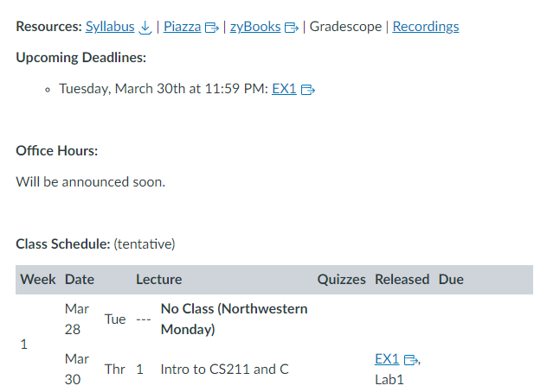
Bad news: first assignment is already out
The first set of exercises (“EX1”) is due next week Tuesday
Posted on Canvas
homepage
Lecture slides are also
posted to Canvas right
before class

Slide 30
Labs
Small, guided practice sessions to set up a new environment
  Setup for SSH access to lab machines (C programming)
  CLion IDE setup with game engine (C++)
These are super important, because without them you won’t be able to work on your homework!
  First lab will be out tonight or tomorrow
These are not formal assignments or quizzes
  You may work with others on them
  Goal is to make sure your setup works before the homework starts

Slide 31
Homeworks
Medium-sized individual programming assignments
  Around 200-1000 lines of code (50-200 is your solution)
  About a week to complete them
First three are C, last two are C++
These are serious work, but also where the most learning will happen
  Individual, may NOT work with other students on them

Slide 32
Final Project
A bigger homework, where you get to choose what you want to do
  Done with a partner of your choosing
Make an “interactive program” (usually a game)
  Examples: Pacman, Tetris, Two-dots, MS Paint, Checkers, Desert Bus
This is your chance to do something interesting and fun!
Can be a significant amount of work though

Slide 33
Quizzes
Multiple quizzes instead of a big exam
  Should be four total
  Each is roughly 15-20 minutes
Quizzes cover mainly material from the last two weeks
  But build upon knowledge from the entire course
Only 10% of your grade total (2.5% each)
  Focus is really on making sure you’re caught up on class material
  Hopefully shouldn’t be too stressful
First quiz isn’t until Tuesday of Week 3

Slide 34
Grade composition
Category | Count | Total Value
Exercises | 6 | 5%
Labs | 2 | 5%
Homework | 5 | 55%
Final project | 1 | 25%
Quizzes | 4 | 10%
Standard letter grade scale
  93%+ A
  90%+ A-
  87%+ B+
  etc.

Slide 35
Relative homework difficulties
Homework | Difficulty
HW1 | 5
HW2 | 7
HW3 | 11
HW4 | 6
HW5 | 9
Final Project | 10ish*
HW3 is the last in C
It’s a two-part assignment spread over two weeks
* But really it’s up to you

Slide 36
Late Policy
You can submit homeworks late
  Quizzes, exercises, and labs cannot be submitted late
10% penalty to maximum grade per day late
  Example: three days late means maximum grade is 70%
Final project has a sliding scale
  90% for up to 24-hours late
  60% and 30% for the two days after that

Slide 37
We will support you if possible and equitable
We can be flexible with deadlines for problems outside of your control
  Sick, family emergency, broken computer
  Contact me (via Piazza) and I’ll provide additional extensions
Also, we support expected accessibility needs
  Make sure to submit ANU requests if you have any
  Let me know about anything else you need and we can discuss it

Slide 38
Slip Days
Slip days let you turn in a homework late and receive no penalty
Each student gets 4 slip days
  Apply to homeworks only (not final project, exercises, or labs)
  You don’t need to tell us you’re using them, we’ll just automatically apply them at the end of the year
Examples:
  Turn in HW1 three days late
  Turn in HW4 two days late and HW5 one day late
  Turn in HW2 four days late with only a one-day penalty

Slide 39
Getting Help – Office Hours
Office hours are mostly hosted by the PMs and TA
  I will have some too! Especially for higher-level questions
Schedule
  We’re going to host a TON of office hours
  With some in-person and some online
  Details to follow, schedule on Canvas homepage
Reminder: office hours are meant to augment the class
  Attend them when you need to!

Slide 40
Getting Help – Request a Meeting
Lecture is my side gig
My main job is helping students succeed
If you are struggling, reach out and I will meet with you
  Course material
  Homework
  Other stuff going on in your life

Slide 41
Advice
Submit assignments early and often!
If you find this course difficult, that’s because it is difficult.
However, nobody fails unless they give up.
You belong here and can succeed here.
Be kind to each other.

Slide 42
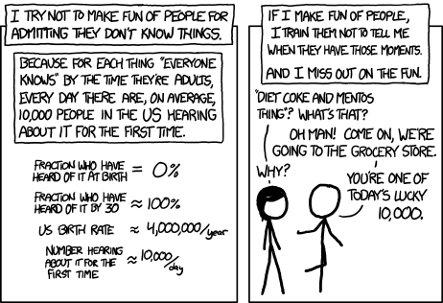
Break + relevant xkcd
https://xkcd.com/1053/

Slide 43
Collaboration in CS211, three levels:
Partner Collaboration
  Your code and the other student’s code are identical because you share it and work on it together
  ONLY for registered partners on final project
Close Collaboration
  You communicate about code however you see fit
  ONLY acceptable for labs and exercises
Arms-Length Collaboration
  You discuss problems and solutions at a high level
  MAY NOT read, write, look at, record, or transcribe code
  MAY NOT have the code up on screen during collaboration
  MUST cite your sources, both arms-length collaborators and other resources
Refer to syllabus for the official version of this policy

Slide 44
Academic Honesty
In CS211, we take cheating very seriously
Cheating is when you:
  Engage in an inappropriate level of collaboration
    Such as look at another student’s code
  Enable another student, present or future, to cheat
    Such as letting a CS211 student read your code next year
  Fail to cite your sources (friend, Stack Overflow, etc.)
    Such as you get a big hint and don’t acknowledge where it came from in a code comment

Slide 45
Academic Honesty
Please do not cheat in CS211
If you don’t write code, you won’t learn!
Cheating on code is super easy to catch!!
  No, like really really easy
  All suspected cheating is reported to the relevant dean for investigation
  Last time I taught CS211, eight different students were reported
If you are unsure about a situation, ask the staff on Piazza

Slide 46
Outline
Why?
Course Overview
Intro to C
  Hello World
  Variables
  Computing Fibonacci

Slide 47
Hello world C program
hello.c
#include <stdio.h>
int main(void) {
printf("Hello, CS 211!\n");
return 0;
}

Slide 48
Hello world C program
hello.c
#include <stdio.h>
int main(void) {
printf("Hello, CS 211!\n");
return 0;
}
This is the code file where you can find this code!
Usually, I’ll provide students source code for any in-class examples

Slide 49
Hello world C program
hello.c
#include <stdio.h>
int main(void) {
printf("Hello, CS 211!\n");
return 0;
}
A function named main()

Slide 50
Hello world C program
hello.c
#include <stdio.h>
int main(void) {
printf("Hello, CS 211!\n");
return 0;
}
A function named main()
No Arguments (void)
Returns an integer

Slide 51
Hello world C program
hello.c
#include <stdio.h>
int main(void) {
printf("Hello, CS 211!\n");
return 0;
}
Call to the printf() function
One argument to the function, the string “Hello, CS211\n”

Slide 52
Hello world C program
hello.c
The printf() function is a part of the standard input/output library, included here
#include <stdio.h>
int main(void) {
printf("Hello, CS 211!\n");
return 0;
}
Call to the printf() function
One argument to the function, the string “Hello, CS211\n”

Slide 53
Hello world C program
hello.c
#include <stdio.h>
int main(void) {
printf("Hello, CS 211!\n");
return 0;
}
Returns a value, 0
(which is of type int)

Slide 54
Hello world C program
hello.c
Two special things going on here:
main() is a special function name that is called when the program runs
#include <stdio.h>
int main(void) {
printf("Hello, CS 211!\n");
return 0;
}

Slide 55
Hello world C program
hello.c
Two special things going on here:
main() is a special function name that is called when the program runs
main() returns a number that specifies whether the program succeeded or failed and how
  0 means success
  non-zero means failure
  specific numbers mean different things to different programs
#include <stdio.h>
int main(void) {
printf("Hello, CS 211!\n");
return 0;
}

Slide 56
Outline
Why?
Course Overview
Intro to C
  Hello World
  Variables
  Computing Fibonacci

Slide 57
Program state is preserved in variables
C is an Imperative programming language
  List of step-by-step statements that modify the program’s state
State is information from prior steps that influences future steps
  Example: TV volume Up/Down apply to prior setting
In programs, we explicitly keep state in variables
int z = 5;

Slide 58
Values, objects, and variables
Values are the actual information we want to work with
  Numbers, Strings, Images, etc.
  Example: 5 is an int value while ‘a’ is a char value
An object is a chunk of memory that can hold a value of a particular type.
  Example: function f takes an argument int x
    Each time f is called, a “fresh” object that can hold an int is “created”
A variable is the name of an object
Assigning to a variable changes the value stored in the object named by the variable

Slide 59
Example of definition and assignment
  int z = 5;
  z = 7;
  z = z + 4;
What happens?

Slide 60
Example of definition and assignment
  int z = 5;
  z = 7;
  z = z + 4;
What happens?
  The first statement is a definition.
  It creates an int object,
  names it z,
  and initializes it to the value 5
z: | 5

Slide 61
Example of definition and assignment
  int z = 5;
  z = 7;
  z = z + 4;
What happens?
  The second statement is an assignment.
  It replaces the value 5
  stored in the object named by z
  with the value 7.
z: | 7

Slide 62
Example of definition and assignment
  int z = 5;
  z = 7;
  z = z + 4;
What happens?
  The third statement is also an assignment.
  It retrieves the current value of z (which is 7),
  then adds 4 to it,
  and then stores the result back in the object named by z.
z: | 11

Slide 63
C: Typed imperative programming
Imperative programming
  Each line is a statement that changes the program’s state
  Usually, the values within a variable
Type System
  Variables have a type associated with them
  The type determines qualities of the object
    Example: how much memory it takes up
  The type specifies what kind of value the variable holds
    Example: integers, decimal numbers, strings, etc.

Slide 64
Some types in C
Hold an integer number (like 5 or 0 or -3)
  char, short, int, long, size_t, int8_t, int16_t, int32_t, etc.
  These can also specify signedness
    unsigned: only 0 and greater
    signed: negative, 0, or positive
Hold a decimal number (like 6.238 or 0.00001 or -32566.5)
  float, double
  These are always negative, 0, or positive
Difference between types: how big of a value they can hold
  short: 0 to 65536 OR signed short: -32768 to 32767
  int: 0 to 4294967296 OR signed int: -2147483648 to 2147483647
  We’ll have a whole future lecture on why the types are like this

Slide 65
Signed vs unsigned variables
All “integer” types in C can be signed or unsigned
  char, short, int, long, etc.
  Unsigned: only zero or positive
  Signed: negative, zero, or positive
Signed is the default! If it doesn’t say, it’s usually signed
  An exception is size_t which is unsigned
Comparing signed and unsigned numbers generates a warning
  Should make sure they’re the same before comparing

Slide 66
Temporarily changing types while comparing
You can cast a variable to another type during an expression
  To cast, put a type in parentheses before the variable name
Example
  int i = 0; //int is signed by default
  size_t length = 5; //size_t is unsigned
  if (i > length) { // warning here!
  printf(“Too big!\n”);
  }

Slide 67
Temporarily changing types while comparing
You can cast a variable to another type during an expression
  To cast, put a type in parentheses before the variable name
Example
  int i = 0; //int is signed by default
  size_t length = 5; //size_t is unsigned
  if (i > (int)length) { // no warning anymore!
  printf(“Too big!\n”);
  }

Slide 68
typedef can be used to make new C type names
Typedef creates a new type name that is a copy of an existing type
Typedef keyword is followed by two types
  First type: the original type name
  Second type: the new type name
Example:
  typedef int x_coordinate_t;
  x_coordinate_t my_variable = 5;

Slide 69
More complicated example
  int prev;
  int curr = 5;
  int next = 8;
  prev = curr;
  curr = next;
  next = prev + curr;
  prev = curr;
  curr = next;
  next = prev + curr;
  prev = curr;
  curr = next;
  next = prev + curr;

Slide 70
More complicated example
prev: | 🐝
  int prev;
  int curr = 5;
  int next = 8;
  prev = curr;
  curr = next;
  next = prev + curr;
  prev = curr;
  curr = next;
  next = prev + curr;
  prev = curr;
  curr = next;
  next = prev + curr;

Slide 71
More complicated example
prev: | 🐝
curr: | 5
  int prev;
  int curr = 5;
  int next = 8;
  prev = curr;
  curr = next;
  next = prev + curr;
  prev = curr;
  curr = next;
  next = prev + curr;
  prev = curr;
  curr = next;
  next = prev + curr;

Slide 72
More complicated example
prev: | 🐝
curr: | 5
next: | 8
  int prev;
  int curr = 5;
  int next = 8;
  prev = curr;
  curr = next;
  next = prev + curr;
  prev = curr;
  curr = next;
  next = prev + curr;
  prev = curr;
  curr = next;
  next = prev + curr;

Slide 73
More complicated example
prev: | 5
curr: | 5
next: | 8
  int prev;
  int curr = 5;
  int next = 8;
  prev = curr;
  curr = next;
  next = prev + curr;
  prev = curr;
  curr = next;
  next = prev + curr;
  prev = curr;
  curr = next;
  next = prev + curr;

Slide 74
More complicated example
prev: | 5
curr: | 8
next: | 8
  int prev;
  int curr = 5;
  int next = 8;
  prev = curr;
  curr = next;
  next = prev + curr;
  prev = curr;
  curr = next;
  next = prev + curr;
  prev = curr;
  curr = next;
  next = prev + curr;

Slide 75
More complicated example
prev: | 5
curr: | 8
next: | 13
  int prev;
  int curr = 5;
  int next = 8;
  prev = curr;
  curr = next;
  next = prev + curr;
  prev = curr;
  curr = next;
  next = prev + curr;
  prev = curr;
  curr = next;
  next = prev + curr;

Slide 76
More complicated example
prev: | 8
curr: | 8
next: | 13
  int prev;
  int curr = 5;
  int next = 8;
  prev = curr;
  curr = next;
  next = prev + curr;
  prev = curr;
  curr = next;
  next = prev + curr;
  prev = curr;
  curr = next;
  next = prev + curr;

Slide 77
More complicated example
prev: | 8
curr: | 13
next: | 13
  int prev;
  int curr = 5;
  int next = 8;
  prev = curr;
  curr = next;
  next = prev + curr;
  prev = curr;
  curr = next;
  next = prev + curr;
  prev = curr;
  curr = next;
  next = prev + curr;

Slide 78
More complicated example
prev: | 8
curr: | 13
next: | 21
  int prev;
  int curr = 5;
  int next = 8;
  prev = curr;
  curr = next;
  next = prev + curr;
  prev = curr;
  curr = next;
  next = prev + curr;
  prev = curr;
  curr = next;
  next = prev + curr;

Slide 79
More complicated example
prev: | 13
curr: | 13
next: | 21
  int prev;
  int curr = 5;
  int next = 8;
  prev = curr;
  curr = next;
  next = prev + curr;
  prev = curr;
  curr = next;
  next = prev + curr;
  prev = curr;
  curr = next;
  next = prev + curr;

Slide 80
More complicated example
prev: | 13
curr: | 21
next: | 21
  int prev;
  int curr = 5;
  int next = 8;
  prev = curr;
  curr = next;
  next = prev + curr;
  prev = curr;
  curr = next;
  next = prev + curr;
  prev = curr;
  curr = next;
  next = prev + curr;

Slide 81
More complicated example
prev: | 13
curr: | 21
next: | 34
  int prev;
  int curr = 5;
  int next = 8;
  prev = curr;
  curr = next;
  next = prev + curr;
  prev = curr;
  curr = next;
  next = prev + curr;
  prev = curr;
  curr = next;
  next = prev + curr;

Slide 82
Outline
Why?
Course Overview
Intro to C
  Hello World
  Variables
  Computing Fibonacci

Slide 83
Definition of Fibonacci Function
$fib\left(n\right)= \left\{\begin{aligned}n, if n<2; \\ fib\left(n−2\right)+fib\left(n−1\right), otherwise\end{aligned}\right.$
n | fib(n)
0 | 0
1 | 1
2 | 1
3 | 2
4 | 3
5 | 5
6 | 8
7 | 13
8 | 21

Slide 84
Implementing Fibonacci in C
fib.c
long fib(int n){
if (n < 2) {
return n;
} else {
return fib(n ‑ 2) + fib(n ‑ 1);
}
}
$$fib\left(n\right)= \left\{\begin{aligned}n, if n<2; \\ fib\left(n−2\right)+fib\left(n−1\right), otherwise\end{aligned}\right.$$
Recursion works in C!

Slide 85
Implementing Fibonacci in C
fib.c
long fib(int n){
if (n < 2) {
return n;
} else {
return fib(n ‑ 2) + fib(n ‑ 1);
}
}
$$fib\left(n\right)= \left\{\begin{aligned}n, if n<2; \\ fib\left(n−2\right)+fib\left(n−1\right), otherwise\end{aligned}\right.$$
if (⟨test-expr⟩) { // evaluate ⟨test-expr⟩; then…
⟨then-stms⟩ // do these if ⟨test-expr⟩ was true
} else {
⟨else-stms⟩ // do these if ⟨test-expr⟩ was false
}

Slide 86
Any statements can be nested in C
if (⟨first-test-expr⟩) {
if (⟨second-test-expr⟩) {
⟨A-stms⟩
} else {
⟨B-stms⟩
}
} else {
if (⟨third-test-expr⟩) {
⟨C-stms⟩
} else {
⟨D-stms⟩
}
}

Slide 87
C ignores most whitespace
$$fib\left(n\right)= \left\{\begin{aligned}n, if n<2; \\ fib\left(n−2\right)+fib\left(n−1\right), otherwise\end{aligned}\right.$$
long fib(int n){
if (n < 2) {
return n;
} else {
return fib(n ‑ 2) + fib(n ‑ 1);
}
}

Slide 88
C ignores most whitespace
$$fib\left(n\right)= \left\{\begin{aligned}n, if n<2; \\ fib\left(n−2\right)+fib\left(n−1\right), otherwise\end{aligned}\right.$$
long fib(int n){
if (n < 2) {
return n;
} else {
return fib(n ‑ 2) +
fib(n ‑ 1);
}
}
C doesn’t care about whitespace

Slide 89
C ignores most whitespace
$$fib\left(n\right)= \left\{\begin{aligned}n, if n<2; \\ fib\left(n−2\right)+fib\left(n−1\right), otherwise\end{aligned}\right.$$
long fib(int n){if(n<2){return n;}else{return fib(n‑2)+fib(n‑1);}}
C really doesn’t care about whitespace

Slide 90
C ignores most whitespace
$$fib\left(n\right)= \left\{\begin{aligned}n, if n<2; \\ fib\left(n−2\right)+fib\left(n−1\right), otherwise\end{aligned}\right.$$
long fib(int n){if(n<2){return n;}else{return fib(n‑2)+fib(n‑1);}}
C really doesn’t care about whitespace
But humans do!
So don’t write your code this way!!!!!!!!!!

Slide 91
A note on style
A lot of things are possible in C, but bad ideas
  They can make things hard to read
  They can be a source of bugs in code
We try to provide you with what we think of as “good” C code
We have a guide to how you should write your C code
  This is a (small) portion of your grade on each homework!
  https://nu-cs211.github.io/cs211-files/cstyle.html

Slide 92
Outline
Why?
Course Overview
Intro to C
  Hello World
  Variables
  Computing Fibonacci

