Slide 1
Lecture 12
Other Protocols
CE346 – Microcontroller System Design
Branden Ghena – Spring 2025
Some slides borrowed from:
Josiah Hester (Northwestern), Prabal Dutta (UC Berkeley)

Slide 2
Final Project Details
A bunch of little posts on Piazza with details
  Some might apply to your project
  Details on grading that you might be interested in
  Link so you can make a private repo for your code
Two big notes
  You MUST cite work you use
  Don’t use Lab1 (MMIO GPIO) or Lab2 (Virtual Timers) in your final project

Slide 3
Other final project stuff
I’ll do one more round of ordering later this week
  After that the purchases will slow down
Lab this Friday will be office hours instead!
  You are not required to attend
  But I’ll be there to answer project questions if you have any
  You’re welcome to just come and work too
Next week Friday will be project check-ins
  More details to come

Slide 4
Administrivia
Lecture schedule for the rest of the quarter
  Thursday (05/22) – Wireless Communication
  Tuesday (05/27) – Nonvolatile Memory & Energy Management
    Also the final quiz
  Thursday (05/29) – Microprocessors + Wrapup
  Tuesday (06/03) & Thursday (06/05) – Project Office Hours

Slide 5
Today’s Goals
Discuss more advanced wired communication protocols
  With a little less detail
  Just give a taste of what they are like
Think about higher-layer concerns like data routing, interpretation, and reliability

Slide 6
Outline
USB
CAN
Bit-banging
  1-wire
  Neopixel LED strips
Video Protocols
  VGA
  HDMI

Slide 7
USB references
USB in a NutShell
  https://www.beyondlogic.org/usbnutshell
Other stuff I found useful
  https://www.usbmadesimple.co.uk/
  http://kofa.mmto.arizona.edu/stm32all/blue_pill/usb/an57294.pdf
  https://en.wikipedia.org/wiki/USB

Slide 8
Universal Serial Bus (USB)
Pervasive wired communication protocol
  Universal accurately applies!
  Targets predominantly external devices over a plug/cable
Good combination of simple and capable
  Base version for simple devices does not require too much
  in terms of pins or resources
  More complex versions can transfer a significant amount of data
    These grew organically over time though
Great support for interoperability
  Generic device profiles that allowed for plug-and-play
  Supported by OS initiatives to include driver software

Slide 9
USB is a layered protocol
USB protocol describes how to:
  Electrically send bits
  Send frames of multiple bytes
  Communicate data between two devices
  Communicate specific application data (through device classes)
Much more complicated, compared to others
  SPI: only how to electrically send bits
  UART and I2C: how to send frames of bytes

Slide 10
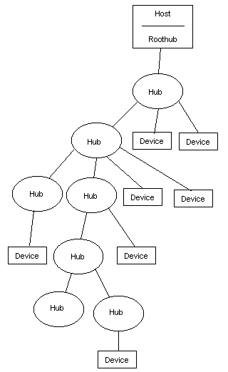
Roles and topology
Hosts and Devices
  USB On-The-Go allows host negotiation
    Added later. Supports devices like smartphones
Host is in charge of communication (“Upstream”)
Devices provide various capabilities Host can
interact with (“Downstream”)
Tiered star topology
  Host connects to hubs, which connect to devices
  Up to 127 devices per hub. Up to 5 layers of hubs

Slide 11
USB Outline
Low-layer details
  How are bits sent
  How are packets (collections of bits) sent
Higher-layer details
  How do we interact with devices
  How do we determine what devices are and how they work

Slide 12
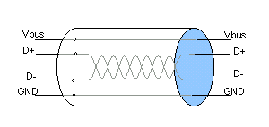
USB signals
Four signals
  Vbus (5 volts, can power devices)
  D+
  D-
  Ground
D+/D- are a differential pair
  Signals are inverses of each other
    Usually, occasionally act separately to signal special conditions
    Increases voltage difference between states (5 - -5 = 10 volts)
  Wires are twisted to avoid interference

Slide 13
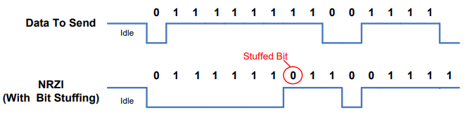
Synchronizing data
No clock signal!! How is USB so fast?
  Partially EE magics: better receivers, matched wire impedance
  Partially easier to distinguish signal states
  Also guaranteed transitions, which allow resynchronization
Transitions are used to denote data (non-return-to-zero inverted)
  With guaranteed transition in within every 8 bits (bit stuffing)
  Allows clocks on the two devices to synchronize

Slide 14
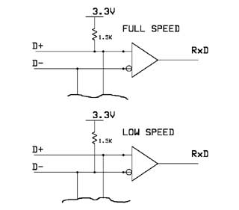
USB speeds
USB 1.0
  Low Speed: 1.5 Mbps
    Not clear if this is used anymore
  Full Speed: 12 Mbps
    Microcontrollers tend to support Full Speed
    We’re focusing on details from it
USB 2.0
  High Speed: 480 Mbps
USB 3.0+
  Super Speed: 5-20 Gbps
  Adds multiple parallel data connections
Pull-up resistors allow for detection of a plugged device
Also identify speed

Slide 15
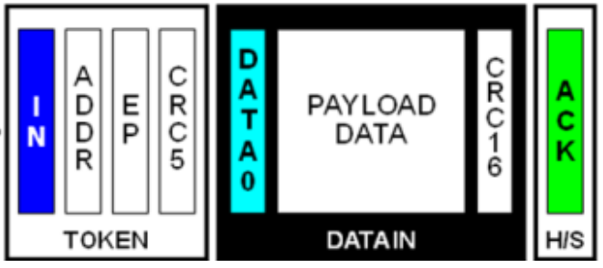
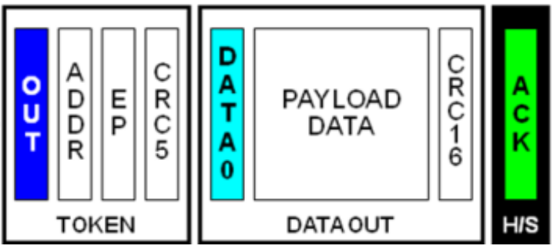
USB interactions
Reading data from Device
General transaction format
  Host sends a Token packet: identifies transfer direction and device
  Host or Device send data depending on direction
  Other side acknowledges receipt of data
Like a maxed-out version of the I2C transaction pattern
  Host always initiates communication
Writing data to Device

Slide 16
USB token packets
Packet fields
  Sync field, allows transmitter and receiver clocks to synchronize
  Packet ID, determines what type of packet is being sent
    Token type: Setup device, Read from device, or Write to device
  Address+Endpoint to identify Device
  CRC, (Cyclical Redundancy Check) to detect bit errors
    5-bit CRC

Slide 17
USB data packets
Packet fields
  Sync field, allows transmitter and receiver clocks to synchronize
  Packet ID, determines what type of packet is being sent
    Data: application data
  Data, up to 1023 bytes (full speed, often capped at 64 for microcontrollers, probably bigger for modern USB versions)
  CRC, (Cyclical Redundancy Check) to detect bit errors
    16-bit CRC

Slide 18
Cyclic Redundancy Check (CRC)
Determines if the data received matches the data sent
  CRC value is calculated on original data and appended to message
  CRC value is recalculated on the received data
  Value appended to message and value recalculated MUST match
Essentially some kind of hash operation
  Turns many bits into some smaller number of bits that are unique-ish
CRC algorithms are:
  Particularly good at single bit errors AND contiguous bit errors
  Relatively simple to calculate
  Very widely used in communication

Slide 19
Break + Question
Reading data from Device
Why have two CRC values?
Writing data to Device

Slide 20
Break + Question
Reading data from Device
Why have two CRC values?
  Devices that aren’t addressed want to be able to determine that right away without reading all of the data
  For reading, data is sent by two different devices, so it needs two CRCs
    Keep writes the same for symmetry
Writing data to Device

Slide 21
USB Outline
Low-layer details
  How are bits sent
  How are packets (collections of bits) sent
Higher-layer details
  How do we interact with devices
  How do we determine what devices are and how they work

Slide 22
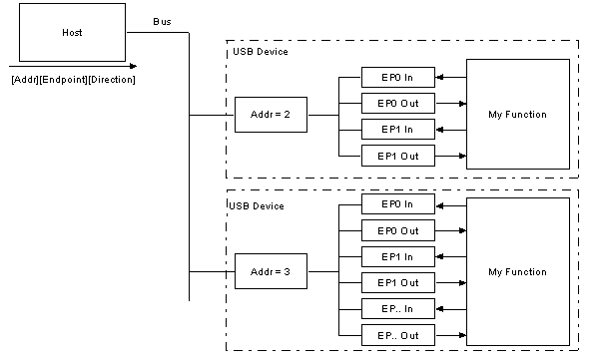
Interacting with USB devices
Each Device is given a separate address on the bus
Each Device also has a number of Endpoints
  Logical communication channels
  Direct data and guide communication patterns

Slide 23
USB endpoint types
Interrupt transfers
  Guaranteed latency, small amounts of data
  Important sensor data (mice and keyboards)
  Polled frequently by Host
Bulk transfers
  Sporadic large transfers, reliable communication
  General reading/writing of data (flash drives and USB serial)
  Polled by Host whenever there is available bandwidth
Isochronous transfers
  Guaranteed data rate, unreliable communication
  Continuous data streaming (audio and webcams)
  Polled frequently by host

Slide 24
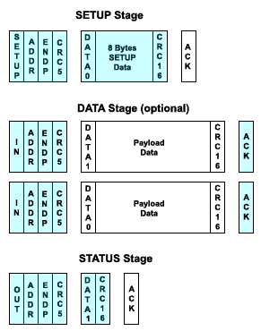
USB control endpoint
Every USB Device has a special Control endpoint as well
Used for setting up the USB Device
driver on the Host
Initializing a Device
  Host sends SETUP transaction requesting
  device descriptor
  Host performs IN transaction to read
  device descriptor
  Host performs OUT transaction to write
  device status

Slide 25
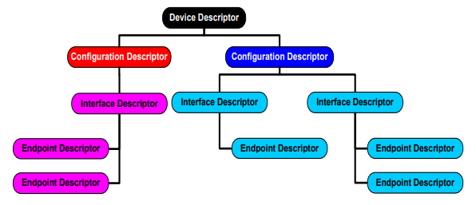
USB device descriptors
Tree structure describing the device
  Interfaces it provides
  Endpoints associated with each interface
  Transmitted as an array of bytes

Slide 26
Example Microbit
Interface: Communications, Abstract (modem), CDC
  Endpoint: 3, IN, Interrupt
Interface: CDC Data, CDC DATA interface
  Endpoint: 1, IN, Bulk
  Endpoint: 2, OUT, Bulk
Interface: Vendor Specific Class, Subclass, Protocol
  Endpoint: 5, IN, Bulk
  Endpoint: 4, OUT, Bulk
Interface: Mass Storage, SCSI, MSD interface
  Endpoint: 7, IN, Bulk
  Endpoint: 6, OUT, Bulk
Virtual serial device
SEGGER JTAG interface
USB external filesystem

Slide 27
lsusb output
lsusb
  List USB devices
Combine with –s flag to select a single device
Combine with -v flag for verbose mode with more information

Slide 28
Minimal virtual serial USB Device
Virtual Serial Device
  Endpoint 0: Control, IN/OUT
    Respond to IN requests by setting up OUT with a buffer of descriptor data of the correct size
  Endpoint 1: Interrupt, IN
    Needed for serial modem controls, just ignore it
  Endpoint 2: Bulk, OUT
    Connect to buffer from _write() (just takes raw characters)
  Endpoint 3: Bulk, IN
    Connect buffer to _read() (just provides raw characters)

Slide 29

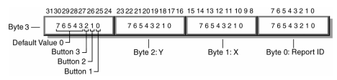
HID USB Device (Human Interface Device)
Used for human interaction devices, like keyboard/mouse
“Report” structure is provided over Interrupt IN endpoint
  Or on demand via Control IN endpoint
Example mouse with x,y and three buttons

Slide 30
USB summary
Specification for fast data communication
Specification for interacting with abstract device types
  Connects correct driver to interpret and send data
Pros
  Very fast
  Very interoperable
Cons
  Hardware and software are way more complex than simple protocols like UART, SPI, and I2C
  Not very energy efficient

Slide 31
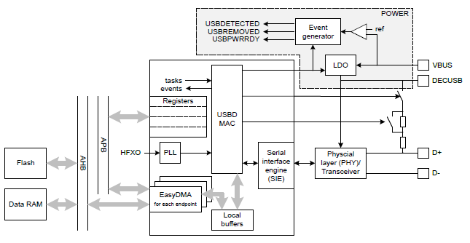
nRF52 USBD
Implements USB Device (not Host)
  Control endpoint
  14 bulk/interrupt (7 IN, 7 OUT)
    64-byte transfers
  2 isochronous (1 IN, 1 OUT)
    1023-byte transfers
Full-speed USB
  With 5 volt signals

Slide 32
Break + Question
What are the ramifications of many USB devices sharing a bus?
  Consider: throughput and latency
What if I really had 127 USB mice on a single USB hub?
  What if it was microphones instead?

Slide 33
Break + Question
What are the ramifications of many USB devices sharing a bus?
  Consider: throughput and latency
    Devices need to share bandwidth
    Also devices are “polled” one-at-a-time
What if I really had 127 USB mice on a single USB hub?
  What if it was microphones instead?
    Certainly latency would be really bad
    You might saturate the data throughput capabilities!

Slide 34
Outline
USB
CAN
Bit-banging
  1-wire
  Neopixel LED strips
Video Protocols
  VGA
  HDMI

Slide 35
Controller Area Network (CAN bus)
Designed for highly reliable interactions within a vehicle
Multi-master with arbitration
  Similar to I2C
Mechanism for sending messages with “identifiers”
  Identifies the data in the message, not the device its for
  Lower value identifiers have high priority
  All messages are received by all CAN nodes
    Which can decide at higher levels which identifiers they care about

Slide 36
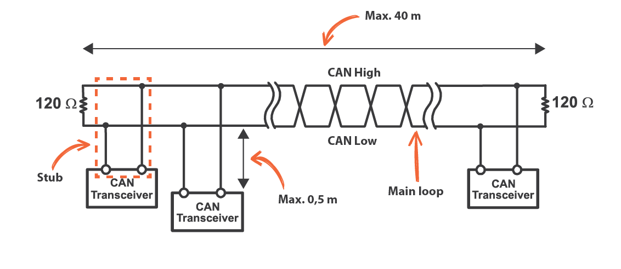
CAN physical connections
Two differential, wired-AND signal lines
  Transitions are used to transmit bits (non-return-to-zero) with bit-stuffing
  Combines aspects of USB and I2C
  125 kHz – 5 Mbps speeds

Slide 37

CAN packet format
11-bit identifier
  Check bits as they are sent to see if you win arbitration
Up to 8 bytes (64 bits) of data
  Very small messages!
CRC for bit error detection
Acknowledgement
  Like I2C, let the line float and see if another device responds
  If not, explicitly retransmit!

Slide 38
CAN message types
Data frame
  Transmission of data for a certain identifier
Remote frame
  Requests data transmission of a certain identifier
Error frame
  Transmitted when an error is detected with the previous message
Overload frame
  Transmitted by a node that is too busy to respond right now

Slide 39
CAN reliability design – detecting errors
Check for errors everywhere and appropriately handle
  Bit error
    If the value found on the bus differs from the one sent
  Stuff error
    If 6 consecutive bits of the same type are found
  CRC error
    If CRC does not match
  Form error
    Format field has unexpected values
  Acknowledgement error
    No ACK received
Devices detecting an error broadcast a message signifying it!
  Multiple devices sending the same message works without arbitration loss
  Previous message is then retransmitted

Slide 40
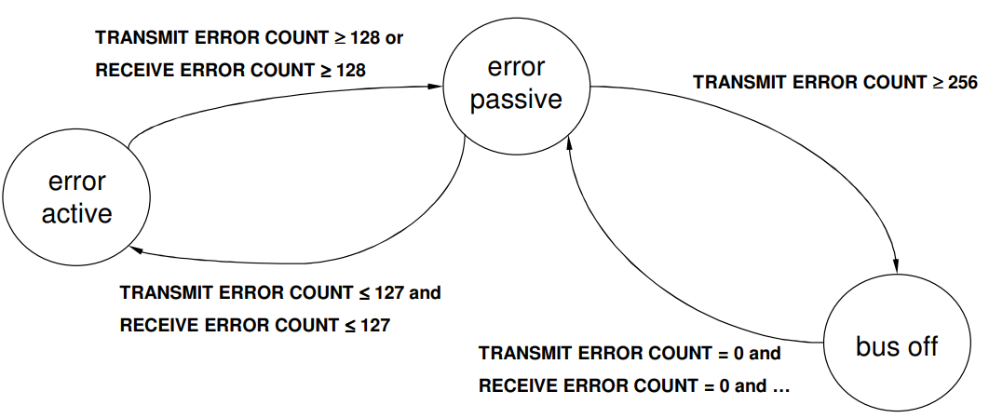
CAN reliability design – handling errors
Each node accepts the possibility that maybe it is the faulty one
Track errors and successes and change device state
  Passive: limited error signaling and transmissions
  Bus off: does not transmit in any way
Idea is that the CAN
controller hardware can
be faulty but still detect
it in some cases

Slide 41
CAN summary
Designed for reliable vehicular communication
Multi-master bus with serial communication
Pros
  Highly reliable
  Extensible to many devices
Cons
  Special-purpose design. Whole system has to agree on identifiers
  Relatively slower throughput

Slide 42
Break + Open Question
Why is CAN a good choice for vehicles (historically)?
What problems is CAN facing today?

Slide 43
Break + Open Question
Why is CAN a good choice for vehicles (historically)?
  High reliability
  A few low-data-rate sensors scattered throughout the car
What problems is CAN facing today?
  Camera data doesn’t fit in 8-byte packets…

Slide 44
Outline
USB
CAN
Bit-banging
  1-wire
  Neopixel LED strips
Video Protocols
  VGA
  HDMI

Slide 45
Controlling a protocol without a peripheral
If your microcontroller doesn’t have a hardware peripheral to control a certain protocol, you could still emulate it
  Known as bit-banging
Example: use GPIO to create a UART
  Set high/low values with certain timings to make start, data, and stop bits
    Probably based on an interrupt if microcontroller is fast enough
    Or maybe is hard-coded with delays
  For reading the UART, instead read bits from the bus at a given rate
    Expect start/stop bits, but ignore them

Slide 46
Two bit-banging examples
1-Wire Protocol
Neopixel LED strip

Slide 47
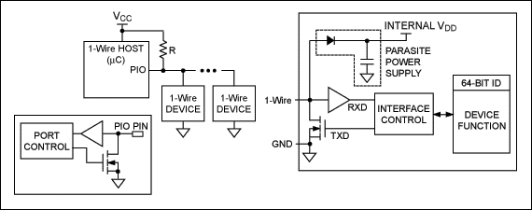
1-Wire Protocol
Similar to I2C, but without a clock line
Devices can optionally power themselves off the data line

Slide 48
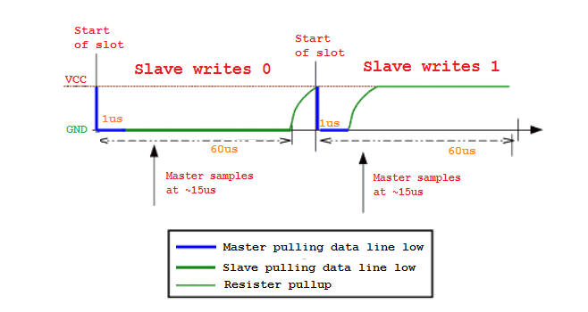
1-wire read operations
Controller drives line low then releases, and samples 15 μs later
  Falling edge wakes up peripheral devices
  Peripheral device either drives low for a 0 or also releases for a 1
Peripheral writes 0
Peripheral writes 1
Controller samples at ~15 μs
Controller samples at ~15 μs
Controller pulling data line low
Peripheral pulling data line low
Resistor pullup

Slide 49
Controlling 1-wire with a UART
1-wire is not supported by most microcontrollers
  Instead, it must be emulated either with GPIO or with another protocol
Example: UART plus an external transistor can emulate 1-wire
  Run UART way faster than 1-wire: each UART byte is one 1-wire bit
  Connect TX to a transistor which can connect to Ground or disconnect
  Connect RX to the data line
  To read, write data 0xFF
    Start bit pulls line low to trigger peripheral device
    8 data bits do not affect data line (disconnected)
    RX line will match 0xFF for reading a 1, or will be anything else for a 0

Slide 50
Two bit-banging examples
1-Wire Protocol
Neopixel LED strip

Slide 51
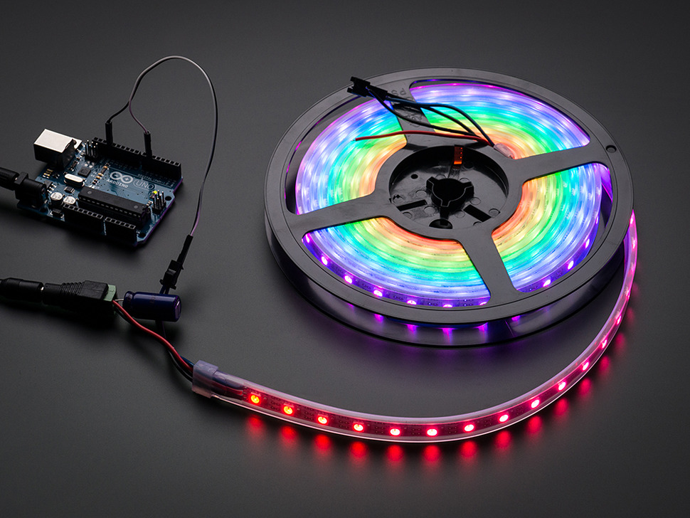
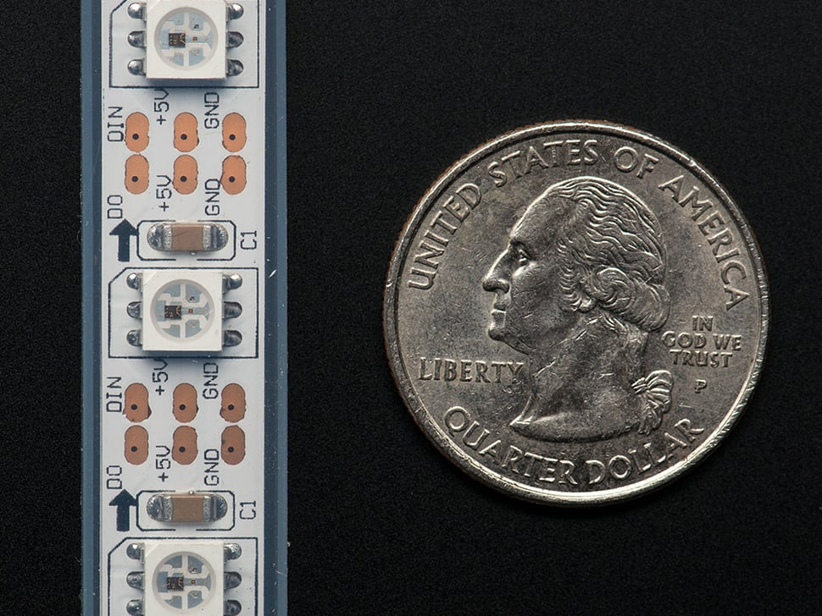
Neopixel LED strips
LEDs on a long strip connected in series
  Often capable of RGB control
Custom protocol for driving them

Slide 52
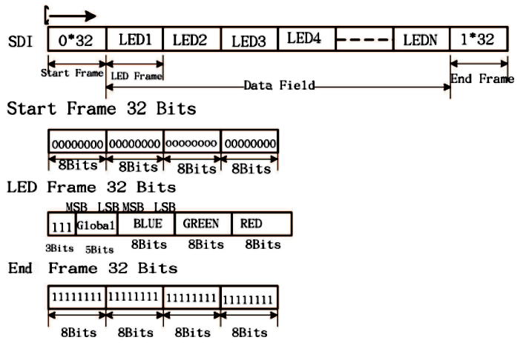
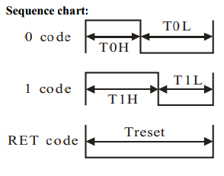
Neopixel protocol
32 bits for each LED
  After the first LED gets its data, all the next bits are forwarded down the chain
Each bit is represented by an amount of time high and low

Slide 53
Emulating Neopixel protocol with SPI
Idea: configure SPI speed so N bits line up with the period of the bit
  For example, 8 bits per period
To send a 0 bit: 0xE0 (0b11100000)
To send a 1 bit: 0xF8 (0b11111000)
From the Neopixel perspective, that data is just the square wave it wanted
Warning: I don’t promise the actual numbers here are correct. Just the overall idea. Recalculate the numbers yourself based on timing requirements

Slide 54
Emulating Neopixel protocol with PWM
Idea: these are just differing duty-cycle square waves i.e., PWM
  Set PWM period to equal the period for sending a bit
  Needs to be a left-aligned PWM signal
To send a 0 bit: 30% duty cycle
To send a 1 bit: 70% duty cycle
Driver translates colors into a byte array, then bits in the array into duty cycles,
then just plays the duty cycles
Warning: I don’t promise the actual numbers here are correct. Just the overall idea. Recalculate the numbers yourself based on timing requirements

Slide 55
Details on NeoPixels
Datasheets:
  https://cdn-shop.adafruit.com/product-files/2757/p2757_SK6812RGBW_REV01.pdf
  https://cdn-shop.adafruit.com/datasheets/WS2812B.pdf
Good writeups on using NeoPixels:
  https://github.com/japaric/ws2812b/blob/master/firmware/README.md
  https://wp.josh.com/2014/05/13/ws2812-neopixels-are-not-so-finicky-once-you-get-to-know-them/

Slide 56
Outline
USB
CAN
Bit-banging
  1-wire
  Neopixel LED strips
Video Protocols
  VGA
  HDMI

Slide 57
Controlling video output
Not very common for embedded systems
  Either directly connected to a screen over SPI/I2C, or not at all
Very common for traditional computing though
  And while we’re talking about protocols, let’s look at them!
Reminder: memory is a huge embedded systems concern here
  640 x 480 pixels @ 18-bit color = 675 kB
  nRF52833 RAM: 128 kB, Flash: 512 kB

Slide 58
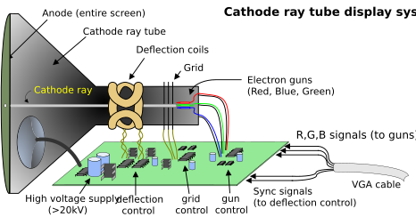
Old-school VGA display design
Screen lights up when hit with electrons
  Separate Red, Green, and Blue activation areas
System directs electrons at each pixel of the screen on a loop

Slide 59
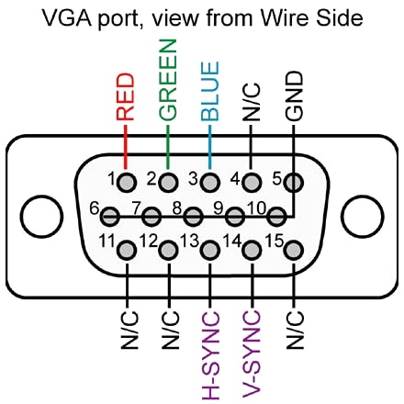
VGA connector
All data goes to the display (write-only)
Horizontal and Vertical sync lines
  Timing control
  Horizontal: when each row restarts
  Vertical: when the entire screen restarts
Red/Green/Blue lines
  Analog voltage for intensity: 0-0.7 volts
  Requires a high-speed DAC (RAMDAC)
Ground pins
  To connect ground between devices

Slide 60
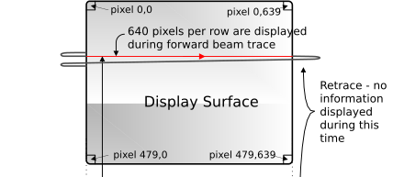
Example display: 640x480 at 60 Hz
Send each pixel in a row at
20 MHz (40 ns per pixel)
  25 μs for the entire 640 pixel row
6.35 μs pause before next row
After all 480 rows, 1.43 ms pause before next frame
High resolution devices would have to go faster
  Possibly MUCH faster
https://digilent.com/reference/learn/programmable-logic/tutorials/vga-display-congroller/start

Slide 61
More modern VGA devices
Protocol doesn’t really make any sense for a digital device
  But it already existed and was very popular
  So LCD monitors implemented it too
ADC reads in analog voltages for Red, Green, and Blue into a memory
Data from the memory is displayed on the screen
Bits -> DAC -> Wire -> ADC -> Bits
  That’s a lot of unnecessary work

Slide 62
VGA Extension - Display Data Channel (DDC)
Uses extra wires in the VGA connector
  Originally “4-bit monitor ID”, but rarely used in practice
  Instead uses two pins as I2C data and clock lines
Monitor is always a peripheral device at address 0x50
Provides a “Extended Display Identification Data” payload
  128-256 bytes of data
  “Descriptor” for the display, like USB descriptors
  Identifies manufacturer, resolution(s), refresh rate(s), timing requirements

Slide 63
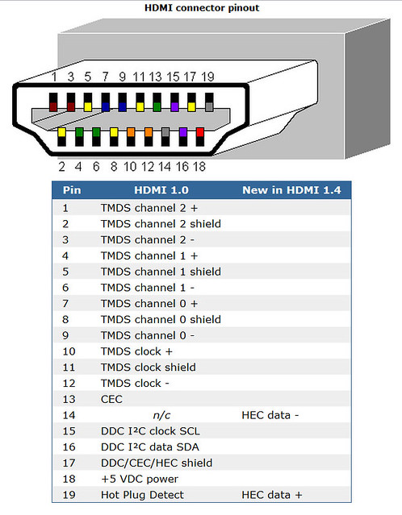
HDMI
Clock plus three data “channels”
  Transition-Minimized Differential Signaling (TMDS)
  Similar to USB with twisted pair wiring
  Send data packets to display
I2C data and clock for Display Data Channel (DDC)
  Adapted from VGA
Consumer Electronics Control (CEC) enables control of devices
  Only uses 1-wire to reduce pin count

Slide 64
Outline
USB
CAN
Bit-banging
  1-wire
  Neopixel LED strips
Video Protocols
  VGA
  HDMI

